Slide 1

The AGATA campaign at LNL
Jose Javier Valiente Dobón
LNL (INFN), Italy

Slide 2
Overview
AGATA configurations for physics
  PRISMA-like
  Zero degrees-like
Status of the experiments performed
Some preliminary physics results
  Intruder states around N=20
  Fusion-fission to study N=50
  Lifetiems measurements around N=126
Summary

Slide 3
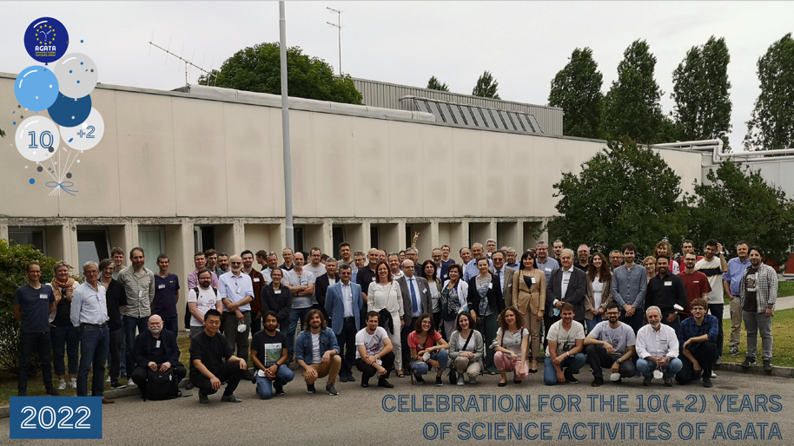
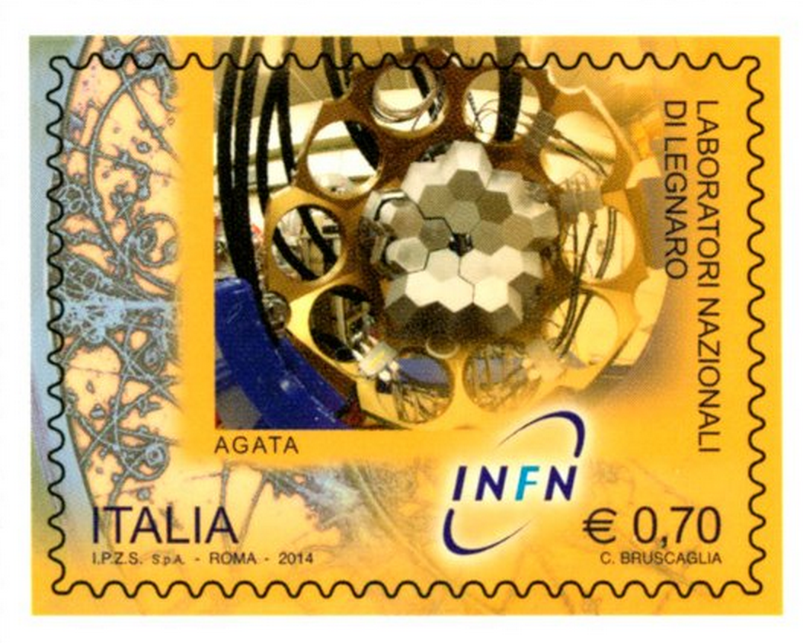
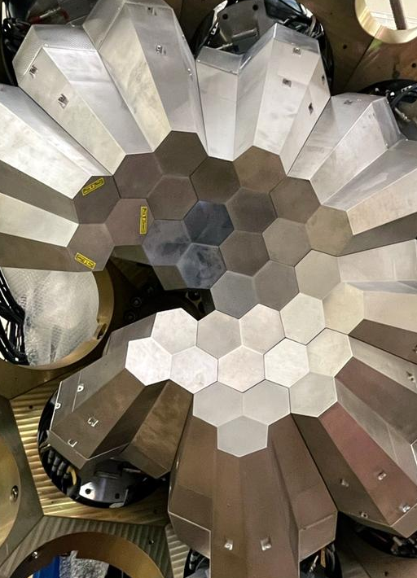
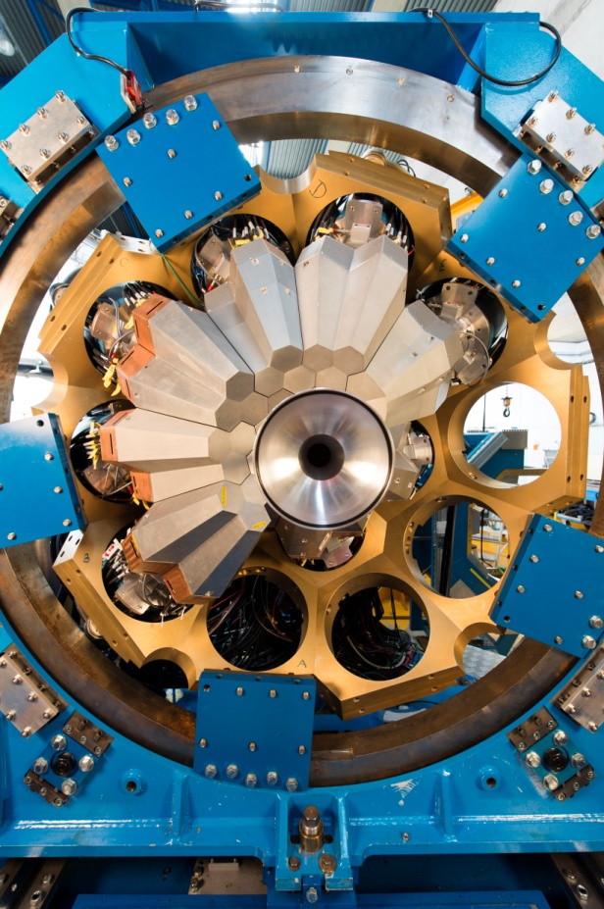
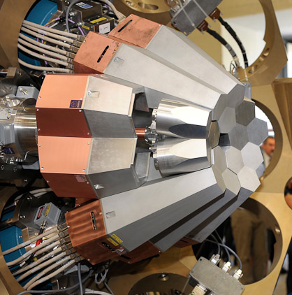
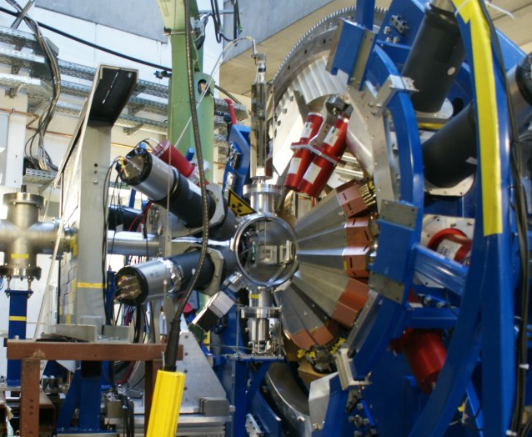
The AGATA time line
Celebration 10(+2) years
AGATA@LNL
AGATA@GSI
AGATA@GANIL
AGATA@LNL
M. Zielinska physics coordinator
2009
2011
2014
2021-2025
Phase 1
Phase 2

Slide 4
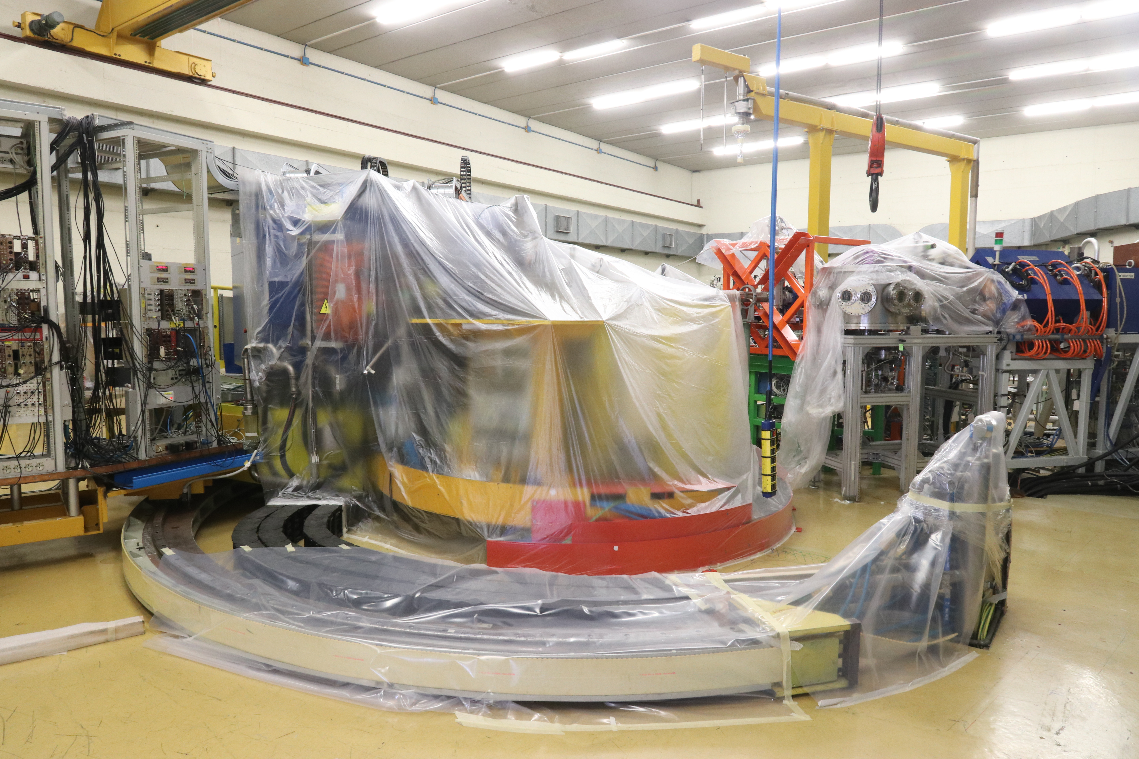
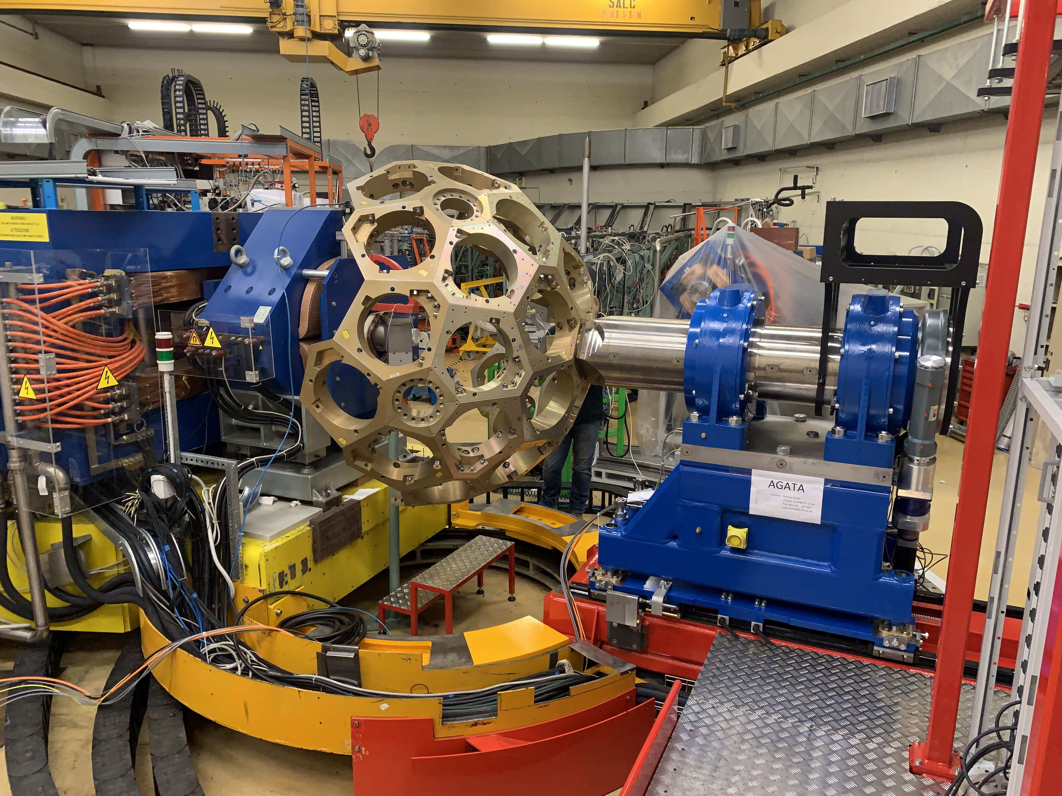
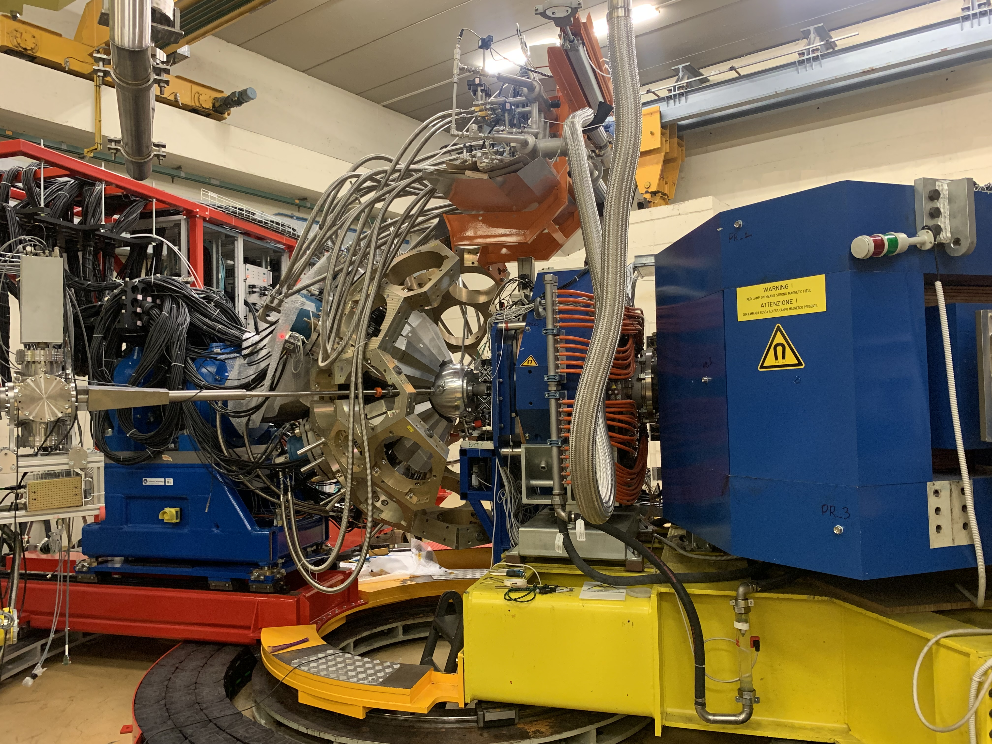

AGATA installation: PRISMA conf.
Ground breaking 10/3/2021
26/11/2021
Commmissioning 26/4/2022
~more than a year of data taking!!

Slide 5
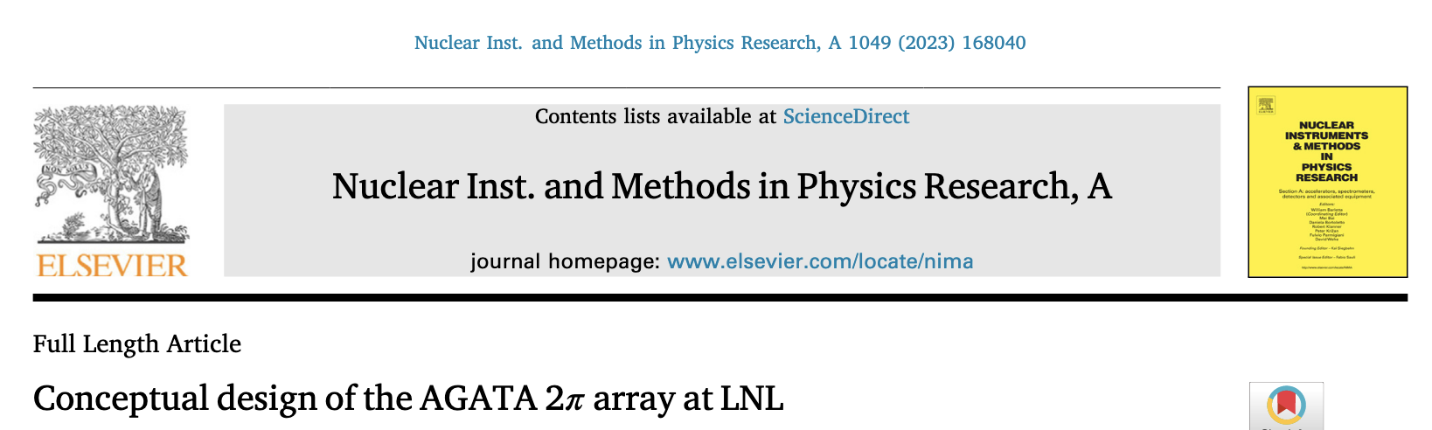
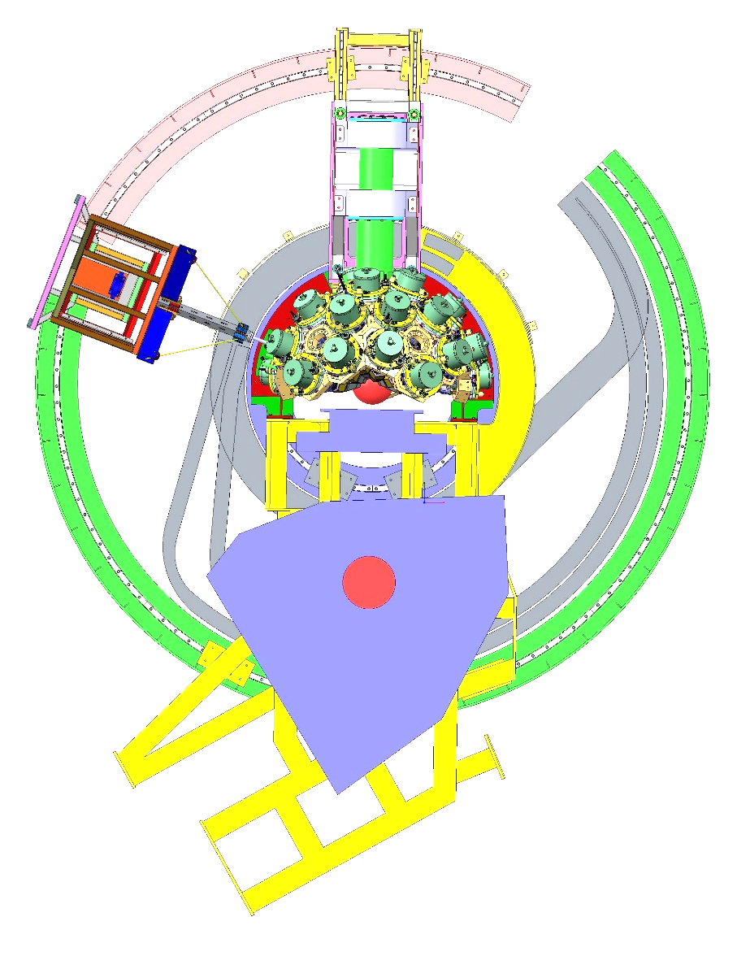
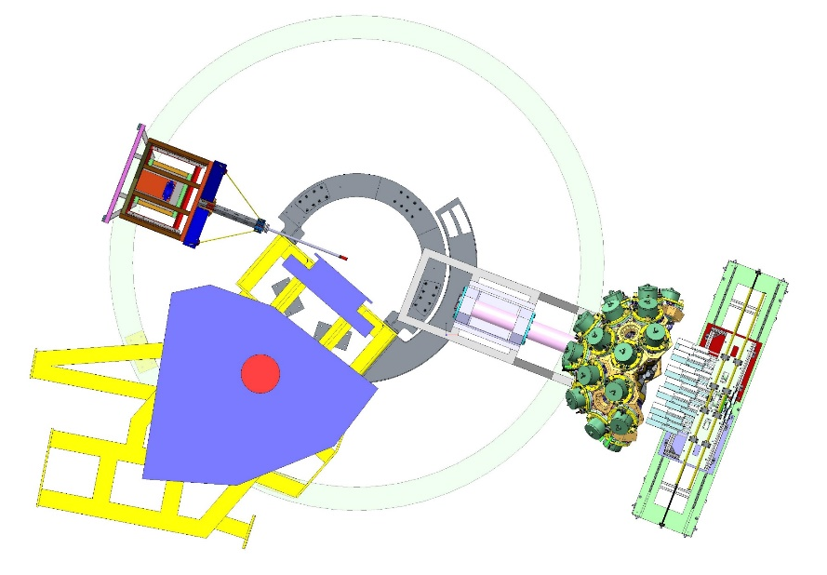
Two different configurations
AGATA coupled with PRISMA
AGATA zero degrees
PRISMA
NEDA
Current configuration

Slide 6
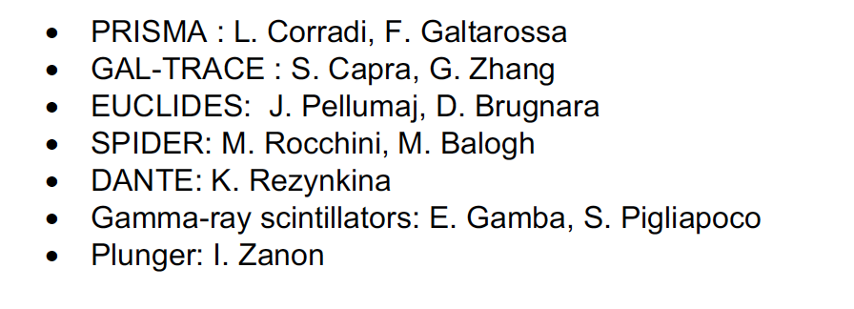
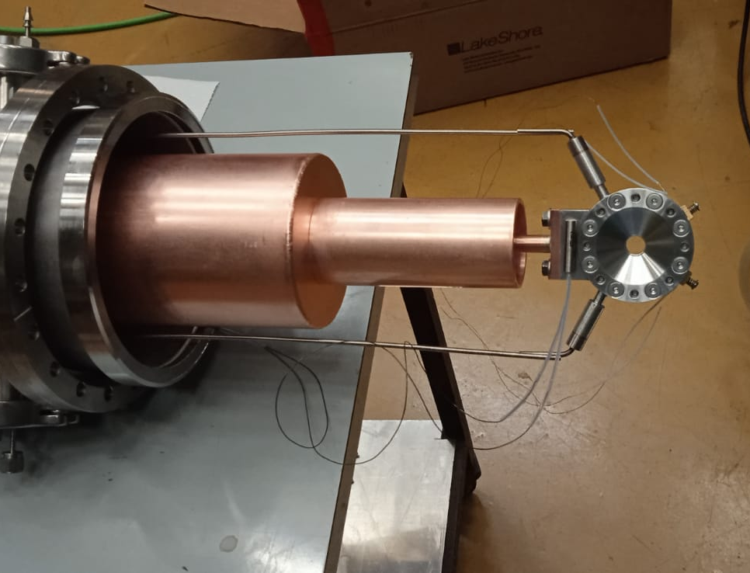
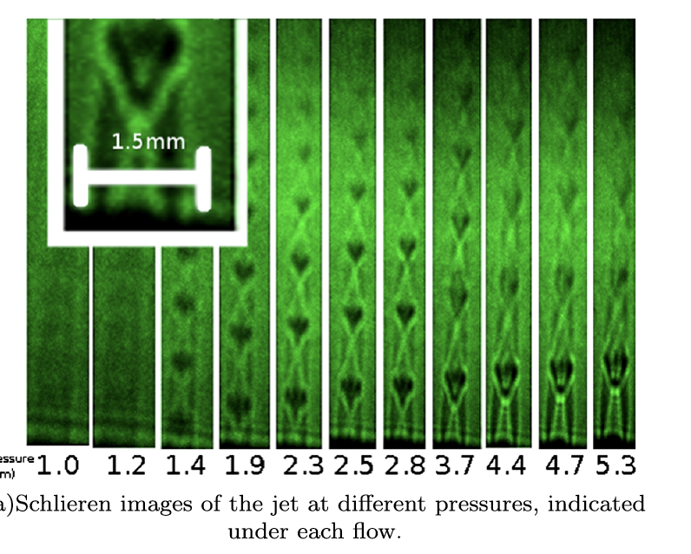
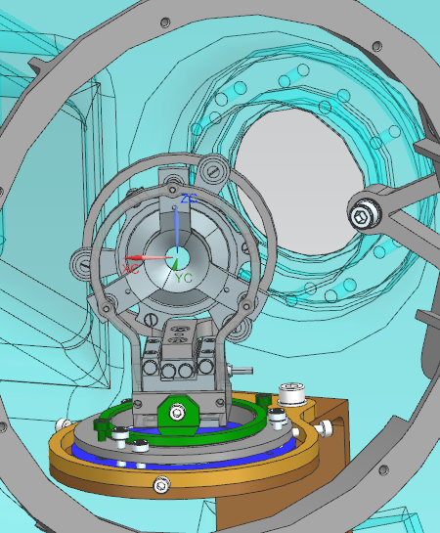
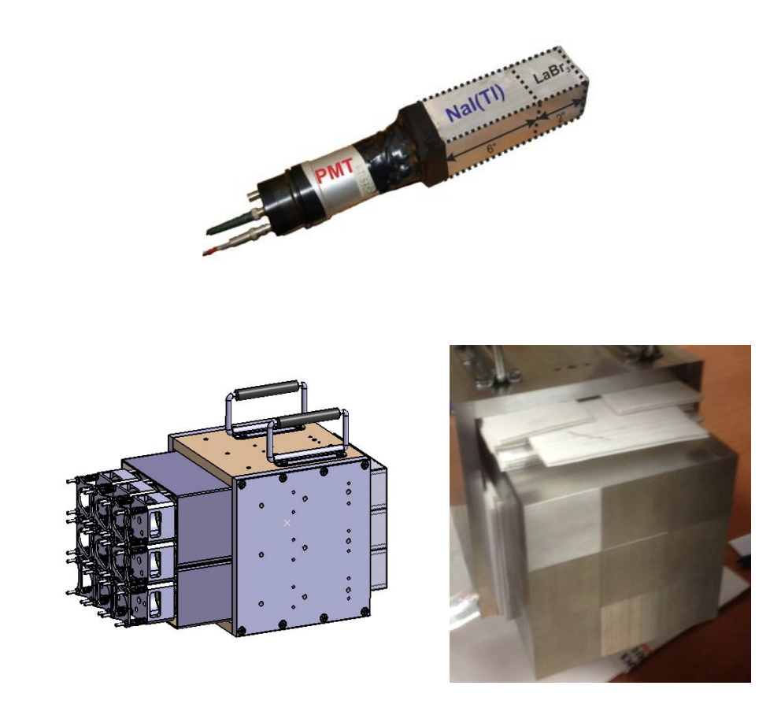
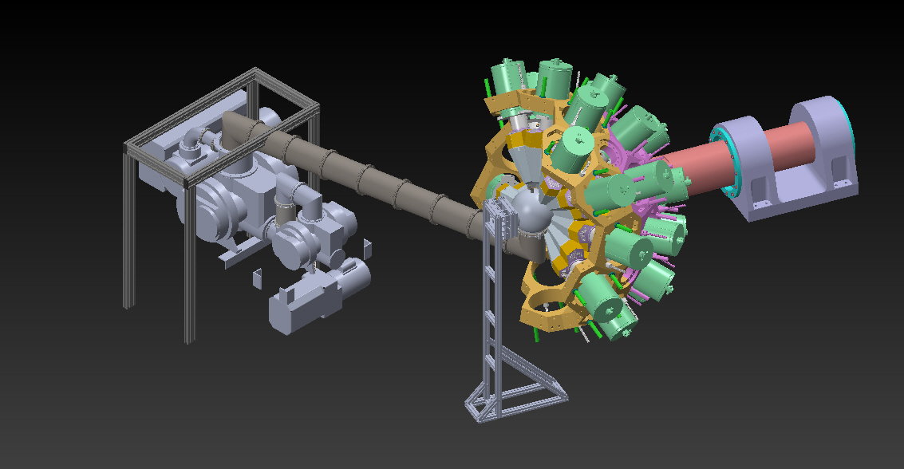
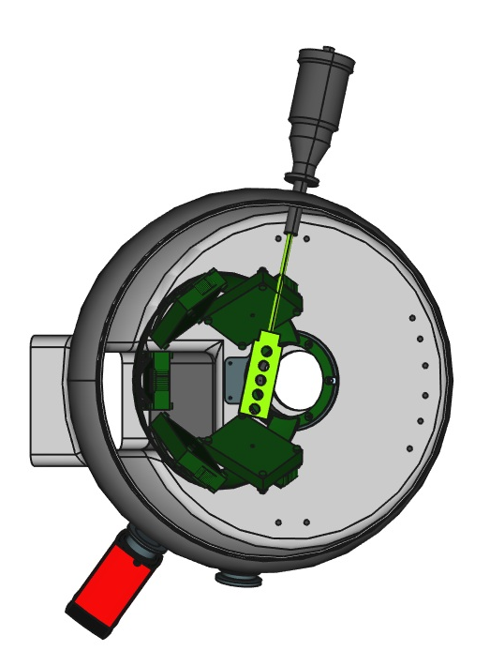
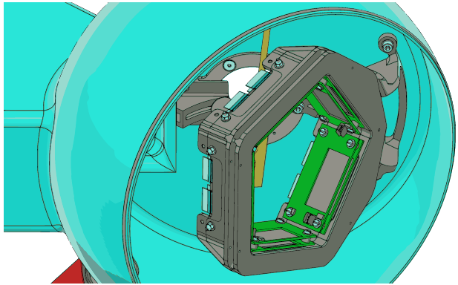
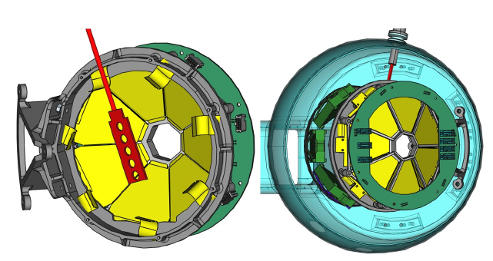
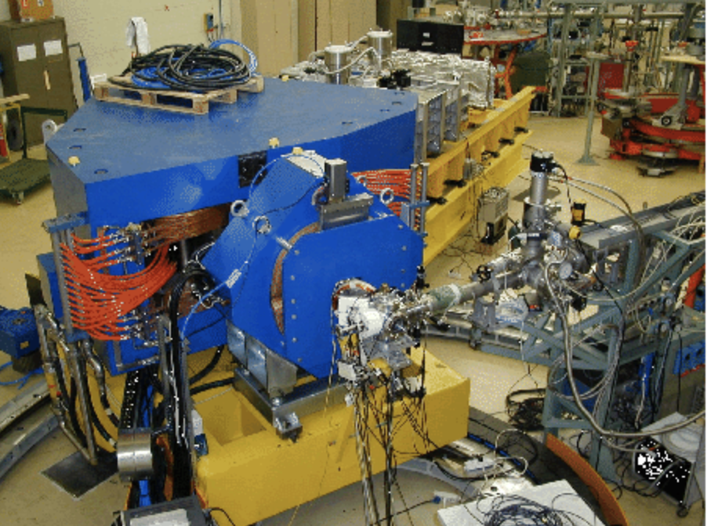
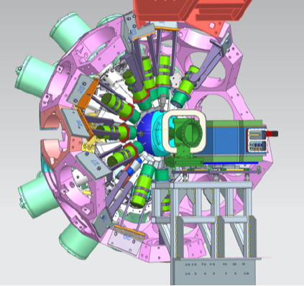
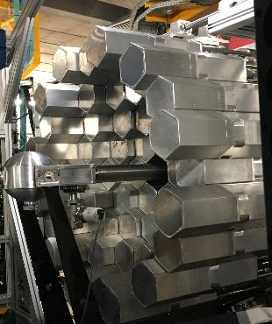
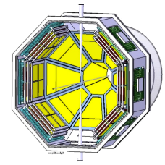
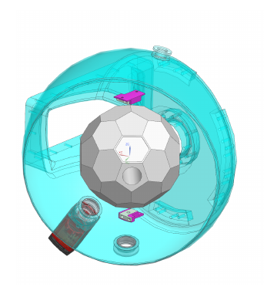
Complementary detectors
First PACs
Targets: CTADIR + SUGAR
J. Benito
PARIS
SLICES
CHYMENE TRACE
GRIT
NEDA

Slide 7
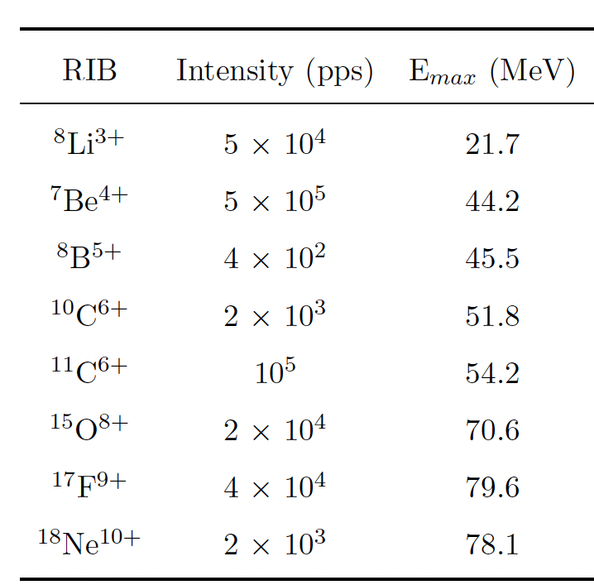
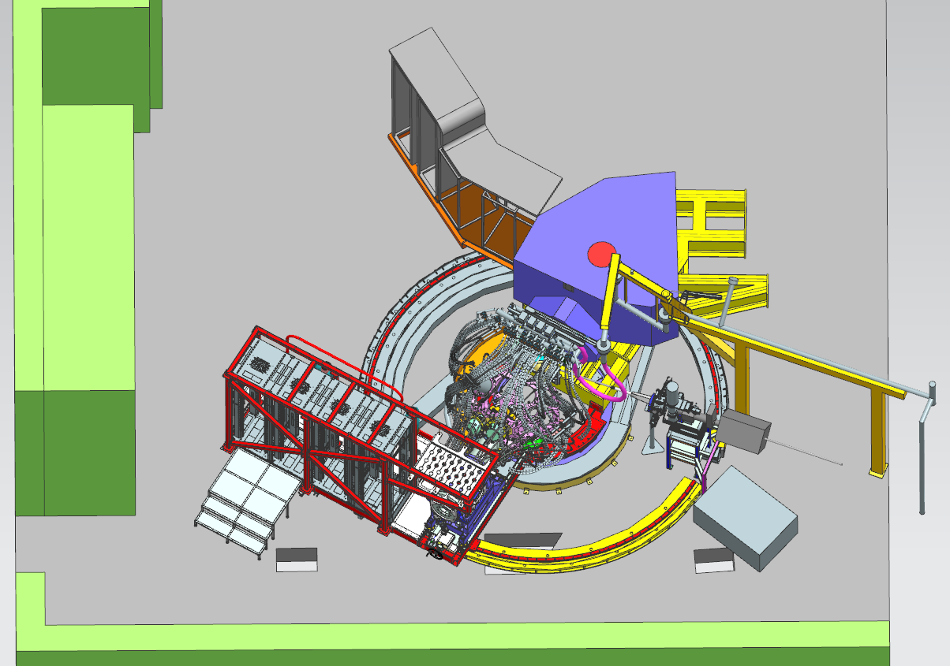
Exotic beams (endorsed by PAC)
Possibility to connect the facility EXOTIC for the In-Flight production of light Radioactive Ion Beams to the gamma-ray Spectrometer AGATA
Beam
Exotic

Slide 8
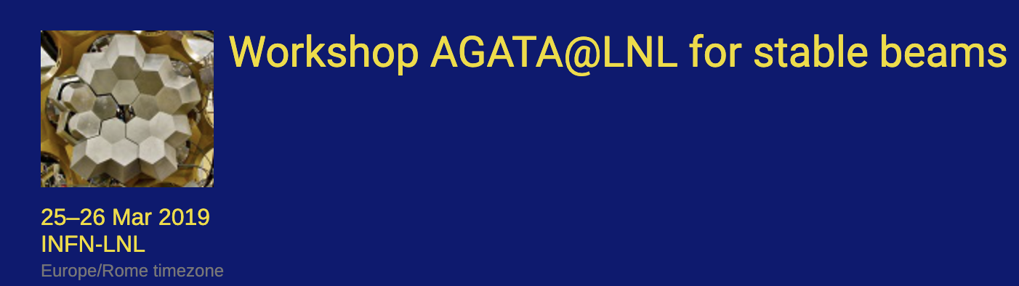
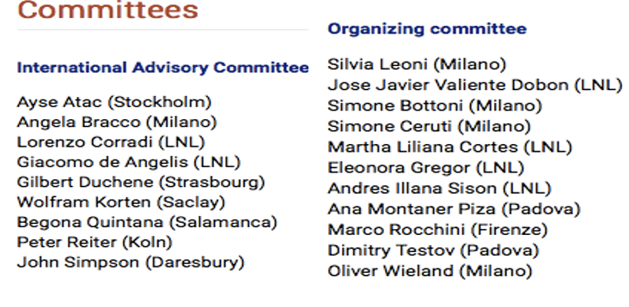
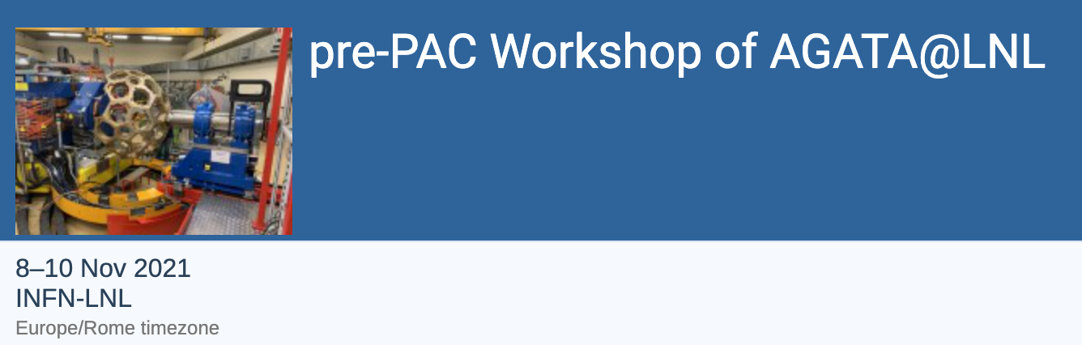
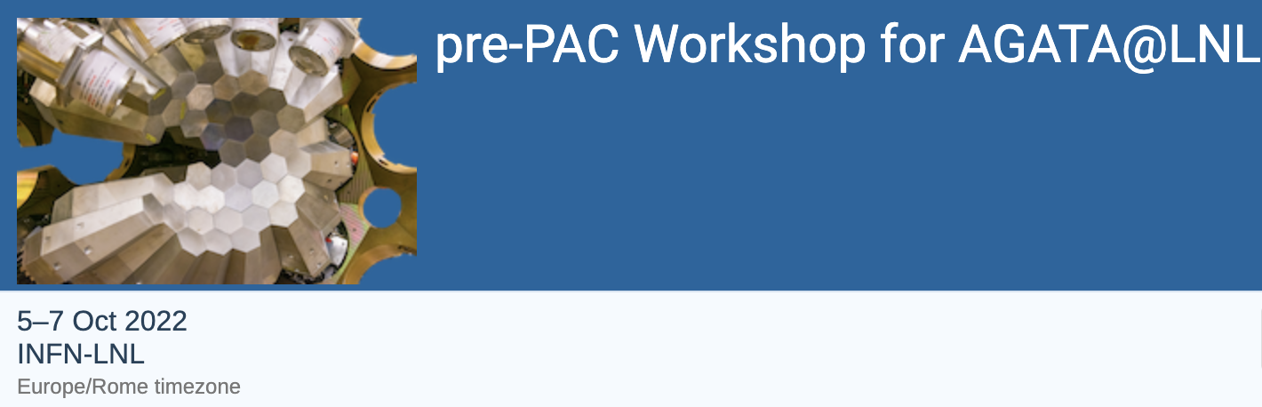
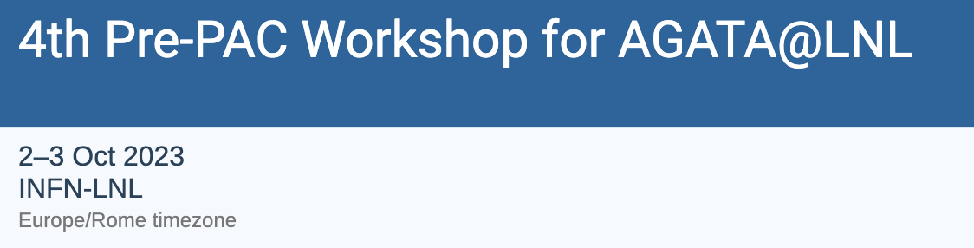
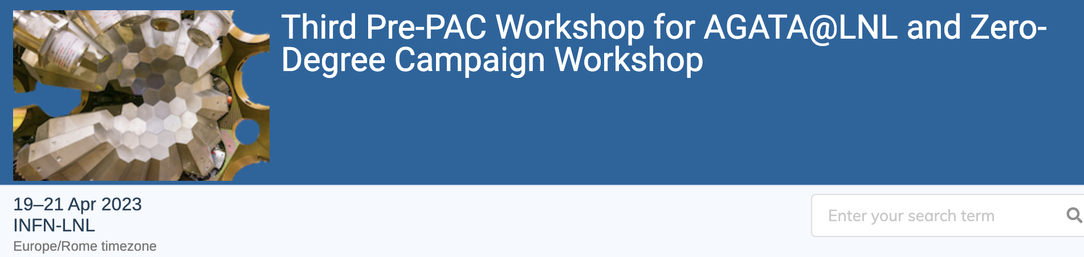
LNL beam time
60 Letters of intents for STABLE BEAMS
genesis
2019
2021
04/2022: AGATA with STABLE BEAMS
2022
 |  |  |  |  | TANDEM |  |  |  |  | TAP | TAP
1. PAC
Feb. 22
2. PAC
Dic. 22
01/2023-12/2023: AGATA with STABLE (Tandem-Piave-ALPI) BEAMS
2023
TAP | TAP | TAP | TAP | TAP | TAP |  |  | TANDEM | TANDEM | TANDEM | TANDEM
3. PAC
July 23
4. PAC
Dic./Gen. 23
01/2024 … AGATA with STABLE (Tandem-Piave-ALPI) BEAMS
2024
TAP | TAP | TAP | TAP | TAP | TAP
5. PAC July 24?

Slide 9
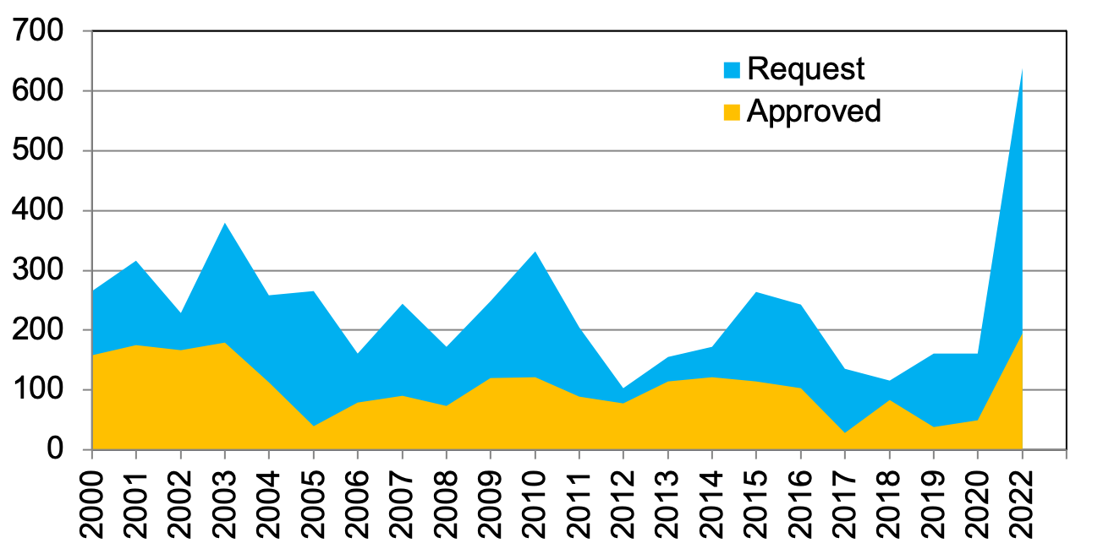
GAMMA PAC peaks
CLARA
AGATA D.
AGATA 1π
GALILEO
10-12 July 2023 PAC (TANDEM) – next December/January 2023.
There will be two PACs fixed per year

Slide 10

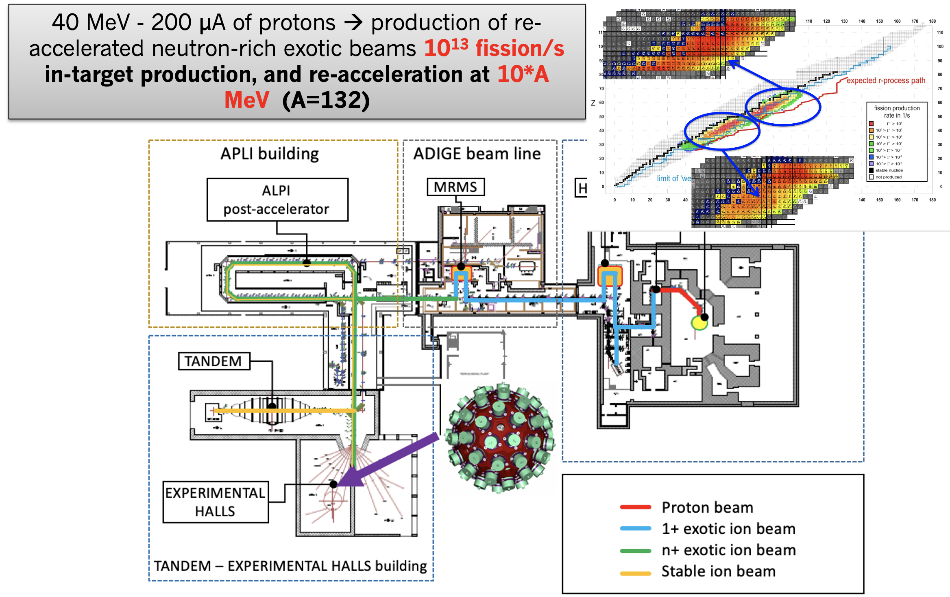
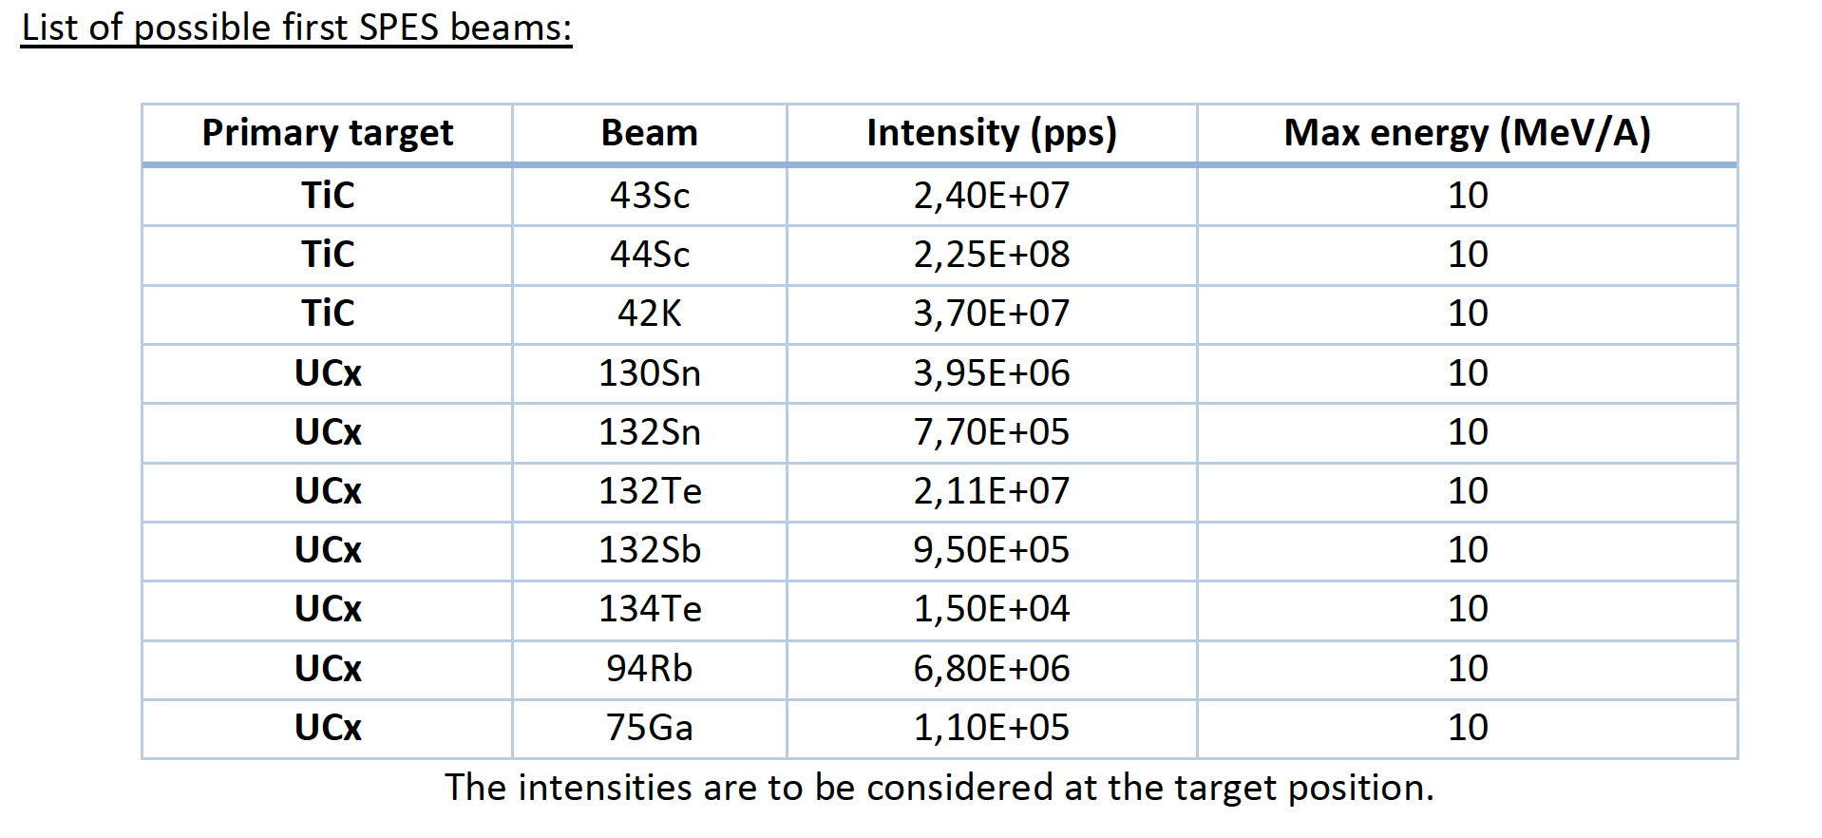
PrePAC + Workshop zero degrees
Meeting devoted to the discussion of the future campaign involving AGATA at zero degrees → preliminary information about DayOne SPES beams

Slide 11
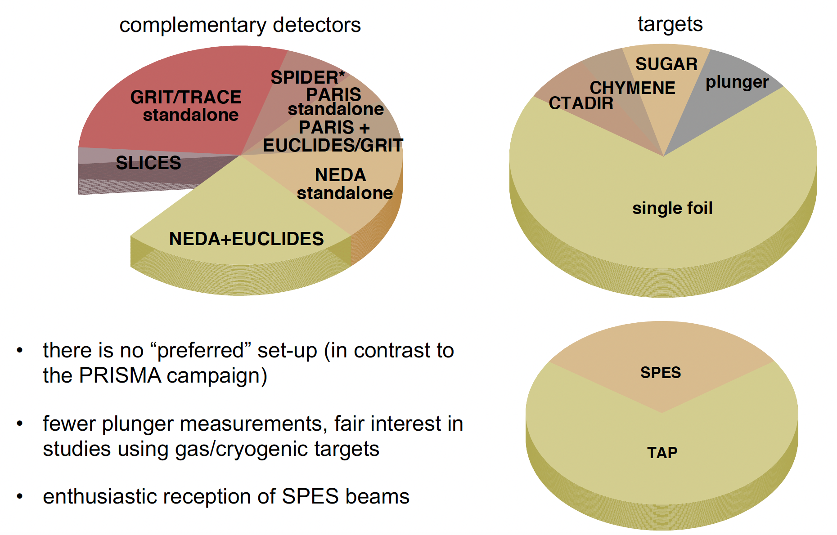
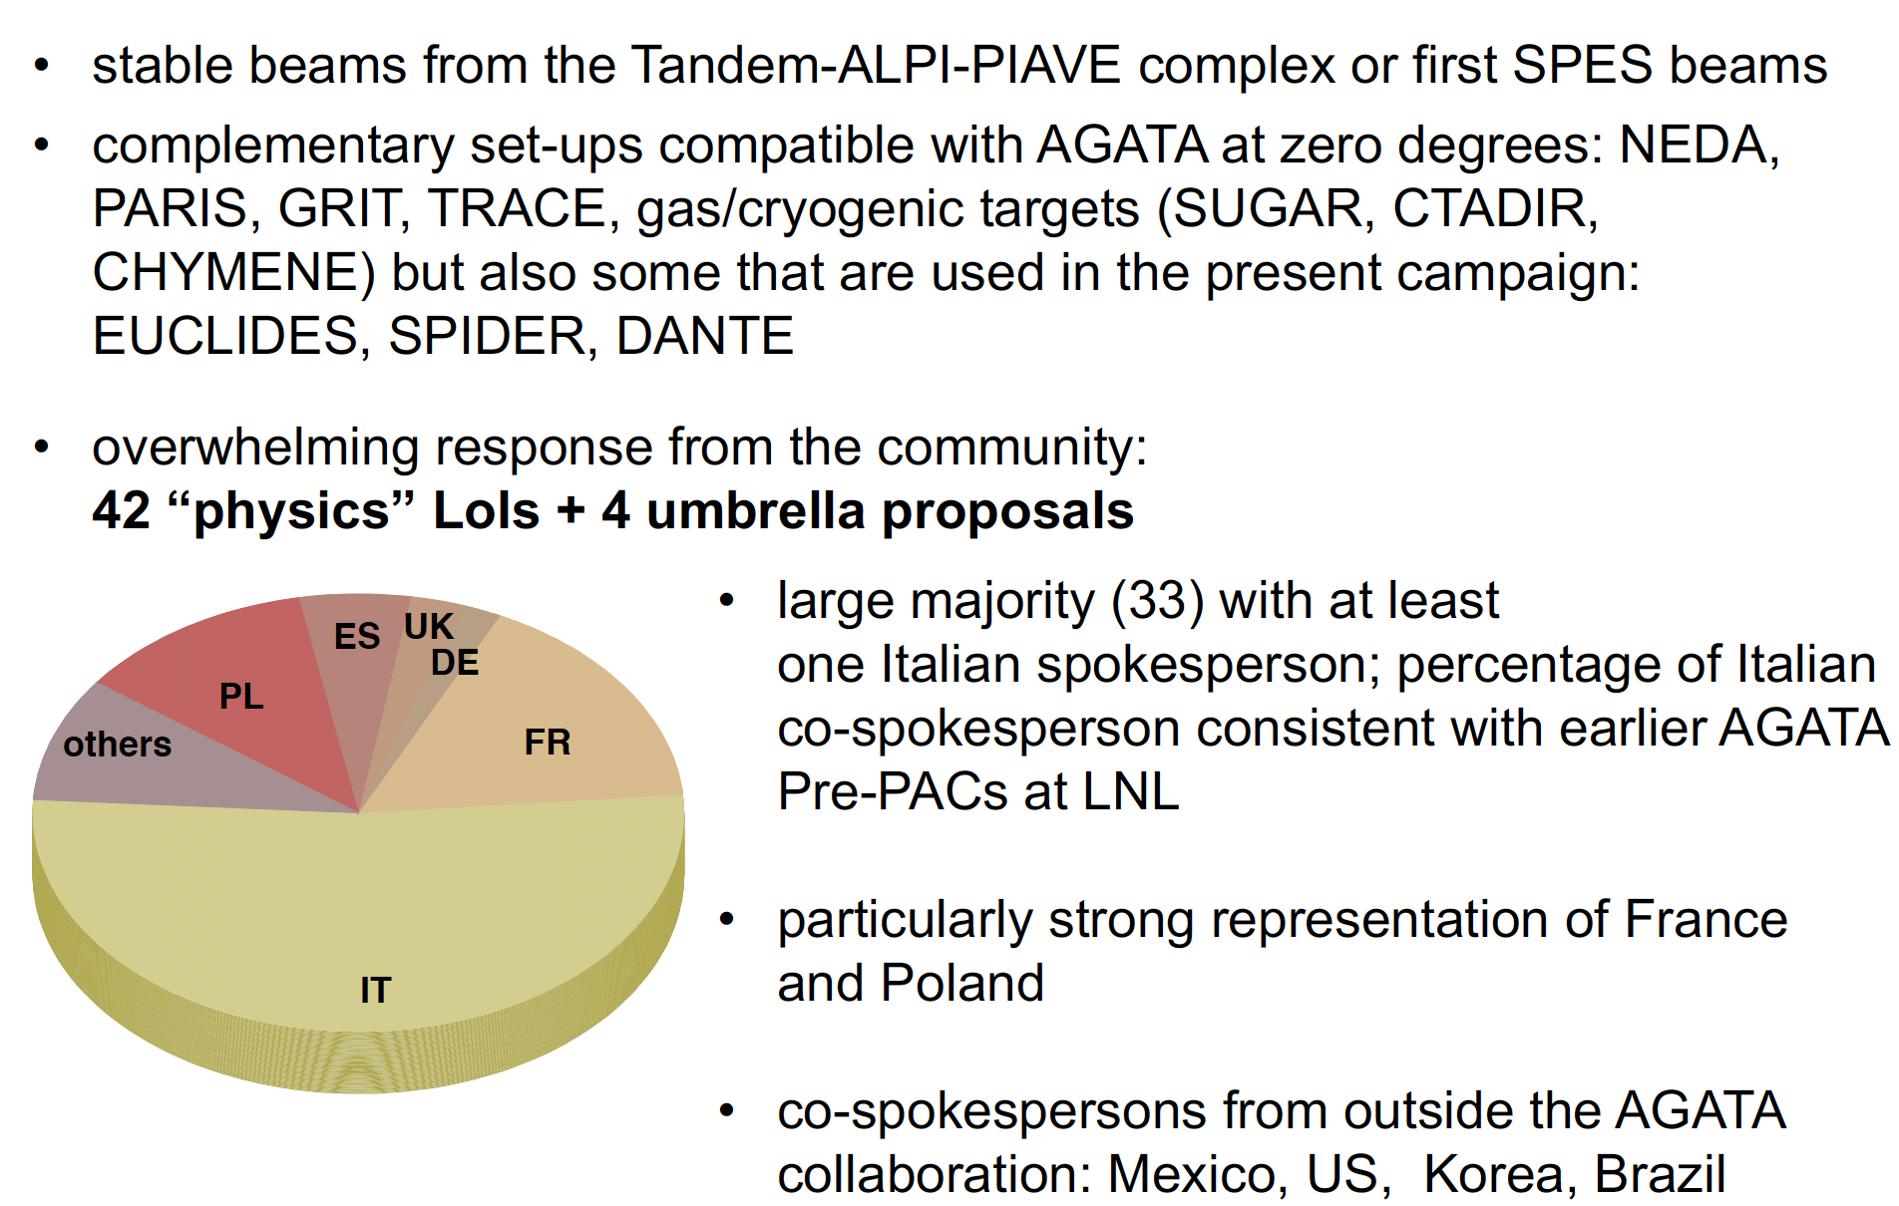
PrePAC + Workshop zero degrees
Large Variety of complementary detectors
Strong response
from the community
(13 for SPES)
Spokespersons:
18 France
13 Poland
6 Spain
3 UK
2 Germany
10 Others
Enough requests for at least 1.5 more year of AGATA operation at LNL (with STABLE beams) – up to 2027

Slide 12
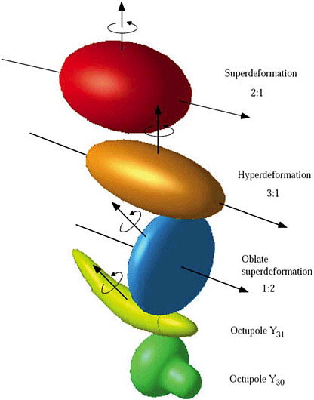
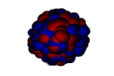
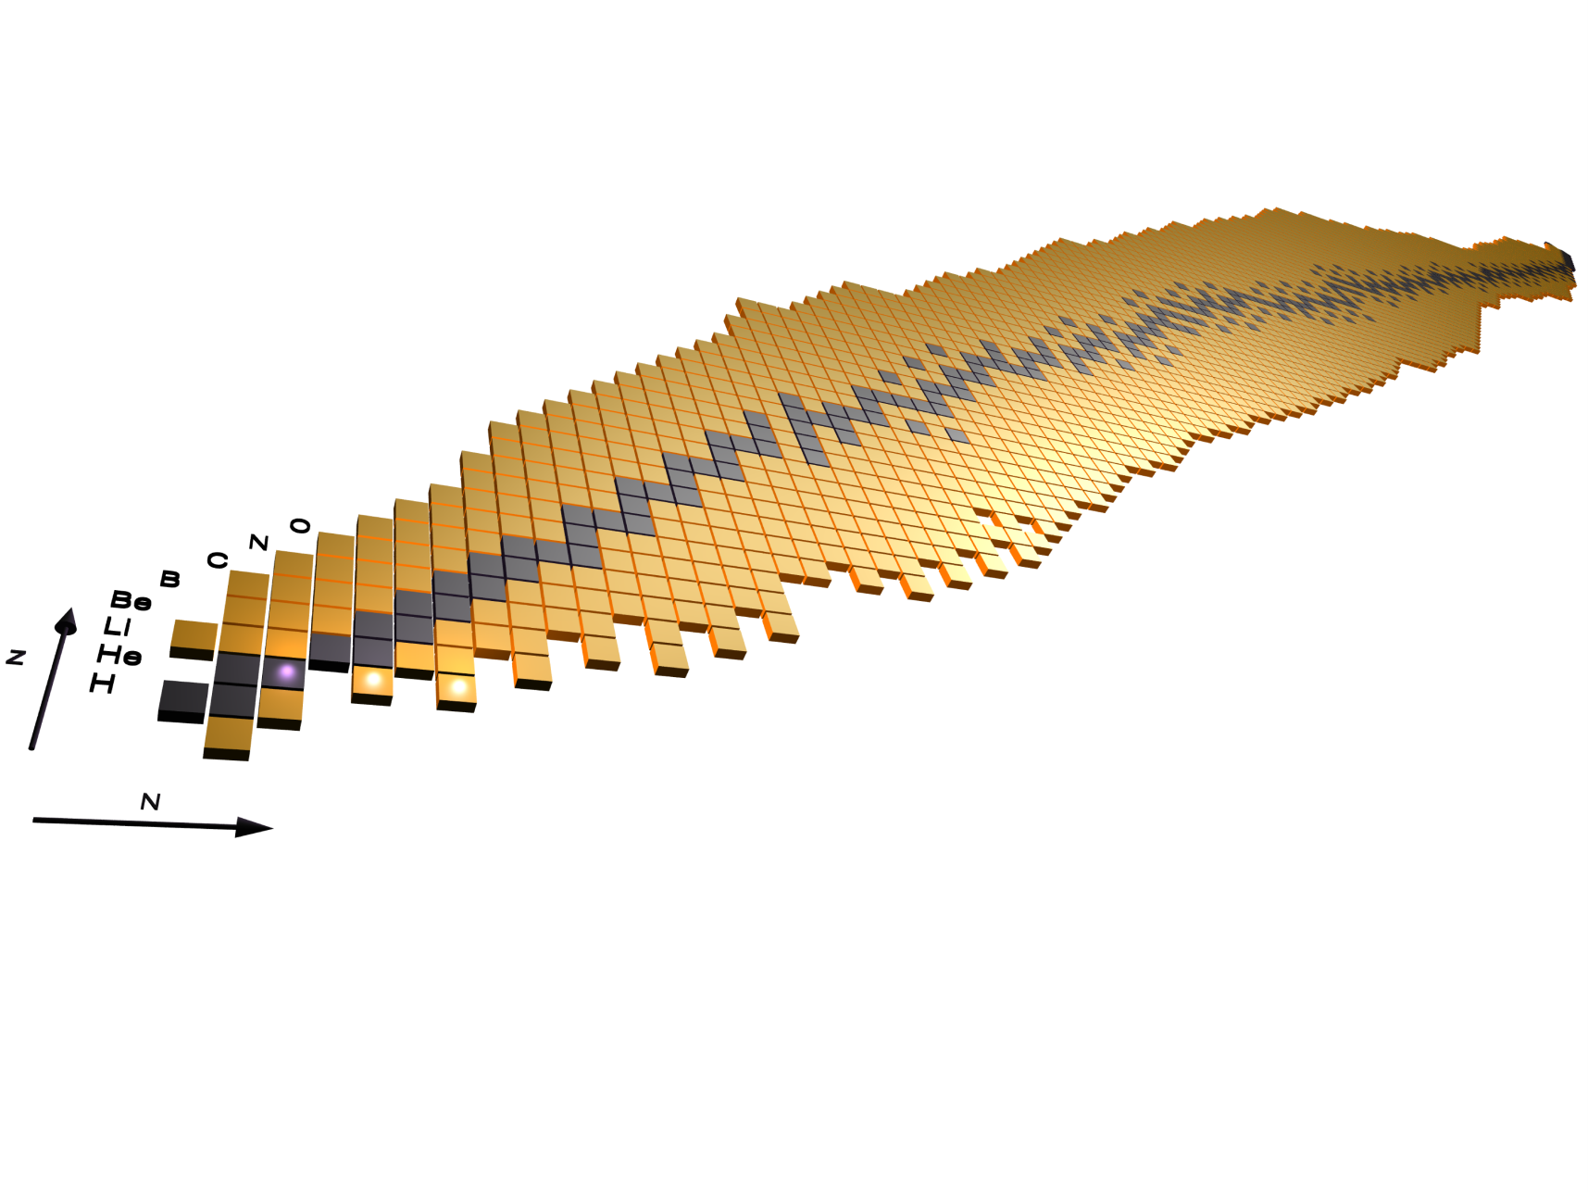
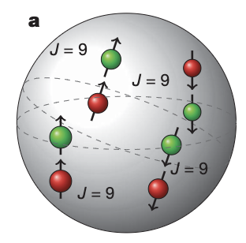
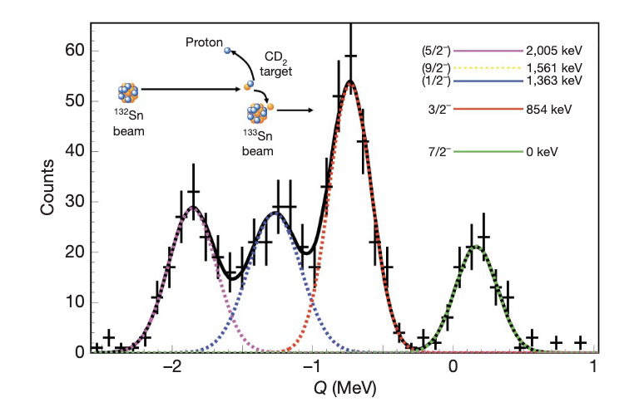
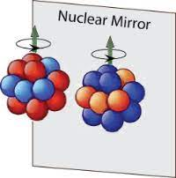
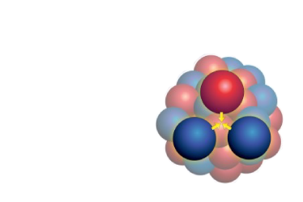
Physics addressed Zero degrees conf.
Hot rotating nuclei, GDR,
superdeformation, high-spin states…
Isospin symmetry, proton neutron pairing and spectroscopy of N~Z nuclei
Direct reactions, Coulex and lifetimes around ¹³²Sn
Reactions relevant for astrophysics, structure of ¹²C, three-body force ¹⁶C

Slide 13
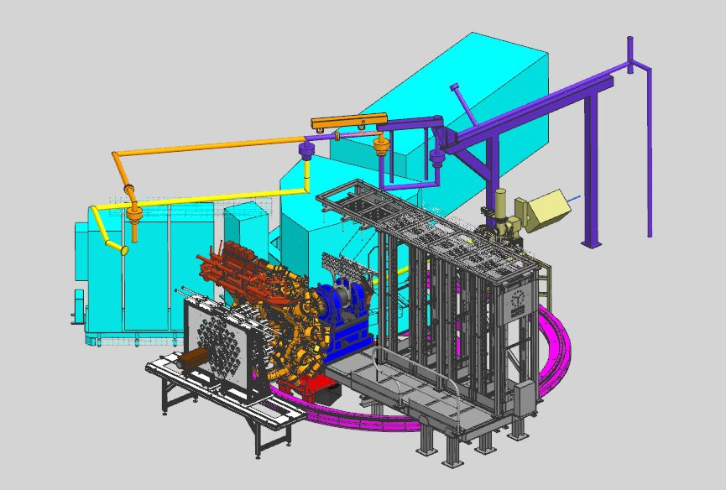
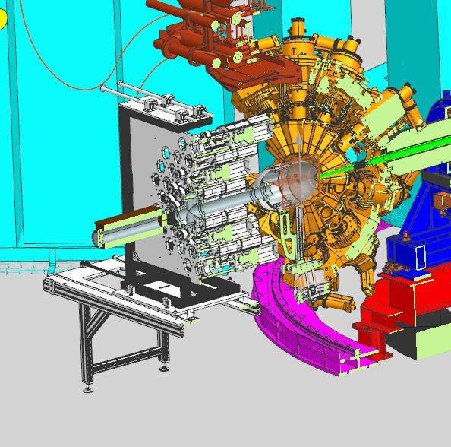
Status Zero degrees design
Production of several parts are on going.

Slide 14
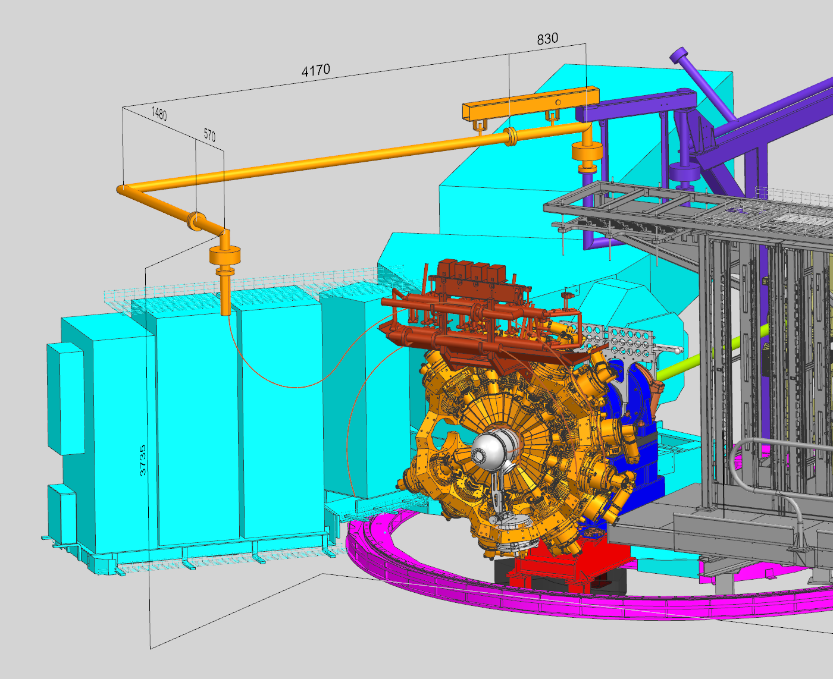
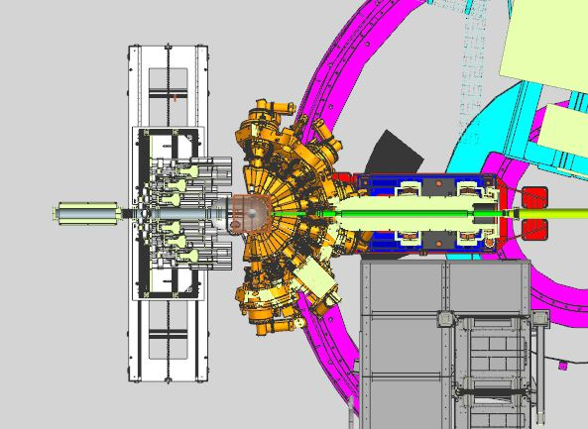

Status zero degree design
Two possible design for the new LN2 line (waiting for the best offer)
We are at a good point with the final designs: beam line, beam dump, reaction chamber vacuum system compliant with rotations of AGATA (fixed)

Slide 15

First AGATA physics campaign
Priority A
Priority B
Pathway to nuclear structure in heavy neutron rich nuclei in the vicinity of N=126 and nuclei northwest of ¹³²Sn via multinucleon transfer reactions (P.Reiter)
Probing Multiple Shape Coexistence in ¹¹⁰Cd with Coulomb Excitation (M.Zielinska, K.Wrzosek Lipska, A.Nannini, P.Garrett)
Understanding the nature of 0⁺ states in ¹¹⁰Sn and ¹¹²Sn and ¹⁰⁸Cd
( N. Marginean, M.Ciemala, F.Crespi)
Lifetimes in the ¹⁹⁶Os region populated with multinucleon transfer reactions
(D. Brugnara, M. Sedlak, J. Pellumaj)
Search for a Josephson like effect in the ¹¹⁶Sn+⁶⁰Ni system
(L. Corradi, S. Szilner)
The low energy fusion in the system ¹²C + ²⁶Mg
(G. Montagnoli)
Shape Coexistance Coulex of ⁷⁴Se
(W.Korten, K.Wrzosek Lipska, E.Clement)
Test Ni/Zn target vicinity of the Z=28 neutron rich isotopes
(R.M.PerezVidal/S.Bottoni/E.Sahin/A.Illana )
Isospin Mixing in the N=Z-36 ⁷²Kr
(G. de Angelis, B. Rubio)
Coexisting Shapes in ⁹⁶Zr
(D. Doherty, N. Marchini, M. Zielinska)
Fusion fission for gamma ray spectroscopy of neutron rich nuclei around N=50 (A. Gottardo, M. Caamano, JJVD)
Evolution of the mixing between single particle and intruder configurations at N=20
(F. Galtarossa, A. Gottardo)
Lifetime measurements intruder states towards the island of inversion along the N=20 shell closure
(Z. Irene, D. Brugnara)
Establishing the properties of ¹⁹Ne cluster states important for X ray bursts
(C.Wheldon, T.Kokalova)

Slide 16
Second AGATA physics campaign
Search for octupole structures in the light U Th and Pa isotopes via Multinucleon transfer reactions
(A. Goasduff G. De Angelis)
Octupole correlations in the neutron deficient plutonium isotopes (J.F.Smith/D.Mengoni )
Priority A
Priority B
Probing nucleon nucleon correlations in the ⁴⁸Ca+²⁰⁸Pb system below the Coulomb barrier(T. Mijatovic L. Corradi)
Investigating the low-lying states of ¹⁹⁶Os via lifetime measurements (D.Brugnara/M.Sedlak/J.Pellumaj)
Isospin Mixing in the ⁷²Kr Lifetime measurement of E1 isospin forbidden transitions (A.Ertoprak/G.DeAngelis/B.Rubio)
Towards the ¹³²Sn nucleus via lifetime measurements (M.Siciliano/I.Zanon/S.Bottoni)
Emergence of enhanced collectivity near magic nuclei: Coulomb excitation of ⁶⁰Ni (K.HadynskaKlek/M.Rocchini/N.Marchini)
The fusion dynamics far below the barrier for ¹²C+²⁴Mg by gamma particle coincidences with AGATA+Si detectors (G.Montagnoli/A.Stefanini)
Study of shape coexistence in ⁶⁰Fe via lifetime measurement of excited 0⁺ states
(G.Pasqualato/J.Ljungvall )
Lifetime measurements around ⁴⁸Ca
(C. Fransen, A. Gottardo, D. Menogni)
Evolution of deformation along the calcium isotopic chain: Coulomb excitation of ⁴⁴Ca (M.Balogh/K.HadynskaKlek/P.J.Napiorkows)
Doorway states and the development of deformation in the Island of inversion around ³²Mg (S.Lenzi/D.Ackermann)
Nuclear structure in the vicinity of the Z=28 neutron rich isotopes with AGATA and PRISMA
(R.M.PerezVidal/S.Bottoni/E.Sahin/A.Illana )
Spectroscopy and lifetime measurements toward the Island of Inversion (K.Wimmer/S.Bottoni/G.Benzoni/F.Recchia/P.Aguilera)
Test of the CKM unitarity and the existence of Fierz interference through the measurement of superallowed beta decay of light nuclei (J.Ha/F.Recchia )
Lifetime of the 6793 keV state in ¹⁵O (J.Skowronski)

Slide 17
Third AGATA physics campaign
Priority A
Priority B
Searching for intruder bands in ¹⁰⁶Pd via Coulomb excitation (N. Marchini, A. Nannini, M. Rocchini, K. HadinskaKleck)
Decay-out of the oblate, triaxial and highly-deformed bands in ^{136,137}Nd (C. Petrache/O. Stezowski )
The emergence of enhanced collectivity near magic nuclei:
Coulomb excitation of ⁶⁰Ni (K. HadinskaKleck, N. Marchini, M. Rocchini,)
The fusion dynamics far below the barrier for ¹²C+²⁴Mg by gamma particle coincidences with AGATA+Si detectors (G.Montagnoli/A.Stefanini)
Isospin Mixing in the ⁷²Kr Lifetime measurement of E1 isospin forbidden transitions (A.Ertoprak/G.DeAngelis/B.Rubio)
Precise measurement of the B(E2; 2⁺₁ → 0⁺₁) in ⁵⁶Ni (F. Galtarossa, A. Gottardo)
Test of the isospin symmetry in the A=22 triplet via multi-nucleon transfer reactions (P. Aguilera, F. Recchia)
Evolution of deformation along the calcium isotopic chain: Coulomb excitation of ⁴⁴Ca (M.Balogh/K.HadynskaKlek/P.J.Napiorkows)
Shell and shapes above ⁵⁶Ni: lifetime measurements in ground-state and side band of ⁶⁰Zn (E. Pilotto, G. Pasqualato)
Two-Phonon Octupole excitation in ⁹⁶Zr
(D. Stramaccioni, J.J. Valiente-Dobon, A. Gadea)
Lifetime of the 6793 keV state in ¹⁵O (J.Skowronski)

Slide 18
Summary AGATA physics campaign
PAC@LNL 21-23 February 2022
PAC@LNL 05-06 December 2022
28 proposals submitted
10 (+3 commissioning) priority A
5 priority B
24 proposals submitted
6 priority A
10 priority B
PAC@LNL 10-11-12 July 2023
19 + 3 experiments performed
15 proposals submitted
Tandem only beams:
8 approved priority A
3 approved priority B
prePAC@LNL 2-3 October 2023
TAP beams:
20 LoIs submitted
April 2022-June 2023: 22 experiments – 9 months of beam time for AGATA - 80% beam time (without beam preparation)
October-December 2023: 7 experiments scheduled - 90% TAP beam time (without beam preparation) → 3 already performed + 1 currently running.

Slide 19

AGATA target/beam requests
2019
2023
New targets ³H, ^{9,10}Be, ²³²Th, ²³⁸U
New beams ¹⁴C, ²³⁸U ²⁰⁴Hg
Coordination with LNL USERS
New targets ³H
New beams ¹⁴C
Coordination with LNL USERS
Targets: ⁹Be, ²³²Th, ²³⁸U → ALL APPROVED and USED
Beams: ²³⁸U test with Ta in progress
Notes:
NOTA: Nel centro va il “Sistema AGATA” portato ai LNL dalla Collaborazione internazionale.
Su questo investimento internazionale convergono le infrastrutture che lo faranno funzionare. Per questi intervento, la collaborazione AGATA e/o GAMMA e la Divisione Ricerca ha alcune stime dei costi, pero l’idea fondamentale è che questi interventi siano fatti a beneficio dei LNL e perche restino come improvement alla infrastrutture locali.
Questo certamente significa una razionalizzazione dei costi e degli sforzi in vista ad un miglioramento delle condizioni di sperimentazione non solo per AGATA, nel periodo che questo apparato possa restare ai LNL, ma pure la esperimentazione eseguita con la strumentazione locale (anch’essa migliorata in quest’operazione) o altri apparati che possano venire ai LNL negli anni successive per lavorare con SPES.

Slide 20






Data Centre for AGATA
AGATA DAQ Servers
Sala VAX → V1 electronics
New data centre → V2 electronics

Slide 21

Lifetime measurement of heavy systems
¹⁹⁶Os

Slide 22


Shape transitions in Os isotopes
An almost perfect γ -unstable/triaxial is predicted for ¹⁹⁶Os
Smooth transition from a more axial rotational behavior towards predominately vibrational nuclei through triaxial configurations
Beyond mean field calculations
P.R. John et al., PRC 90, 021301(R) (2014)

Slide 23


Lifetime measurements in the Os
Analised by: B. Gongora and J. Pellumaj
Measurement of lifetimes with an inversed plunger AGATA and the spectrometer PRISMA
τ⁻¹ ~ B(E2: J_{i} →J_{f}) = 1/(2J_{i} +1)‹ψ_{f} ||E2|| ψ_{i}›²

Slide 24


¹⁹⁶Os, ²⁰⁰Pt lifetime measurements
Setup inversed plunger

Slide 25


¹⁹⁶Os, ²⁰⁰Pt lifetime measurements
Z identification with the PRISMA IC
2⁺ of ¹⁹⁸Pt

Slide 26
Summary
Rich experimental campaign thanks to a overwhelming response from the community. So far 26 experiments performed.
The experimental (TANDEM + PIAVE + ALPI beams) finished this summer
This semester only TANDEM (again large response of the community).
Next PAC December/January next year (TANDEM + PIAVE + ALPI beams).
Exciting results from the performed experiments to come!
Big thanks to the AGATA collaboration, GAMMA group and LNL/PD/Mi technical staff

Slide 27































The young stregth of AGATA@LNL

Slide 28
END

