Slide 1

The LNL computing and network infrastructure
LNL User Community Meeting – 16 November, 2023
Michele Gulmini
INFN-LNL
Divisione Ricerca – Servizio Tecnologie Informatiche

Slide 2
Outline
LNL Computing Infrastructure
  New VAX Computing Room
  New Data Center
LNL Network Infrastructure
  Fiber Installations
  Network gateway and VPN for experiments
  Wi-Fi support
M.Gulmini, LNL User Meeting, 16 November, 2023

Slide 3
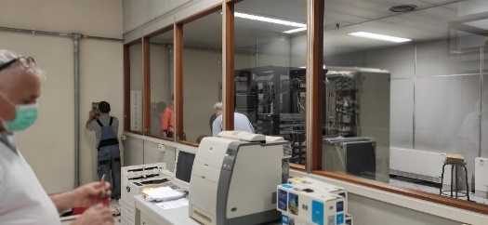
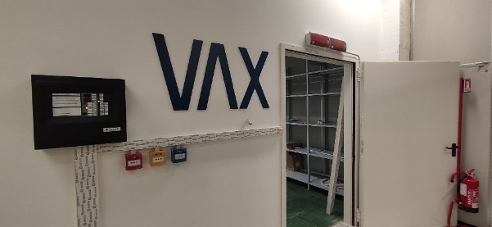
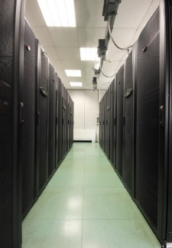
LNL Computing Infrastructure – Data Centers
The support for AGATA@LNL 2π was an opportunity for the LNL to renew and upgrade the computing infrastructures
  VAX Computing Room renovation
  New Data Center
GRID Data Center
New Data Center
VAX Room
New VAX Room
Support for AGATA DAQ, up to 20kW IT power, V1 electronics, ancillaries
Support for AGATA DAQ up to 2π configuration, V2 electronics, ancillaries

Slide 4
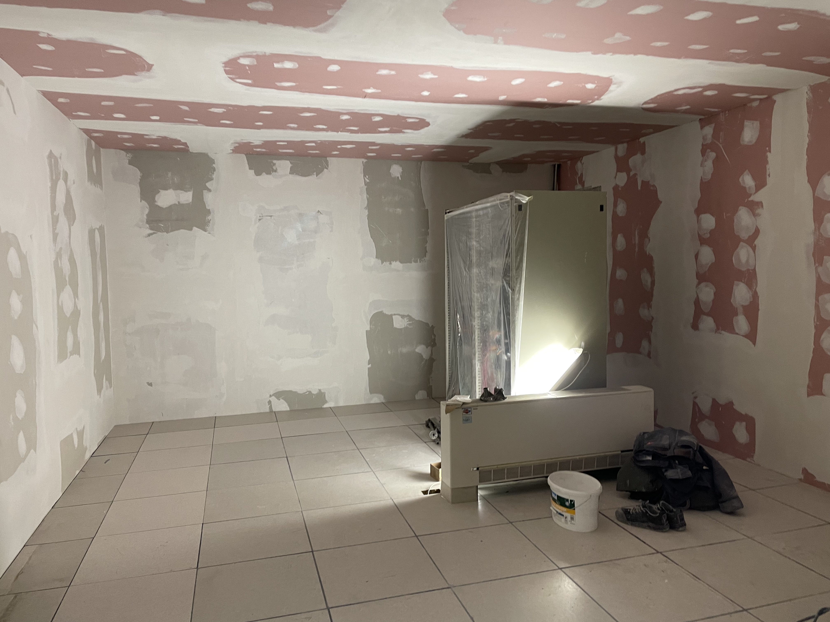
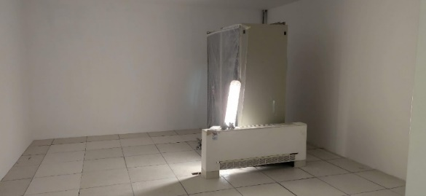
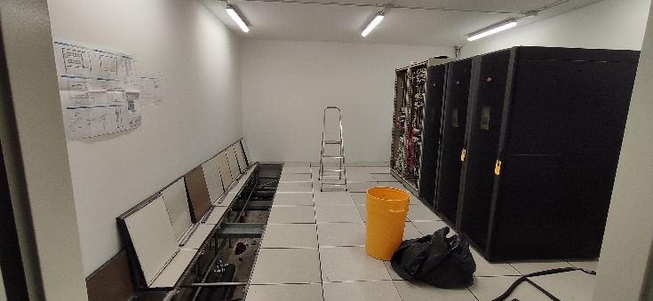
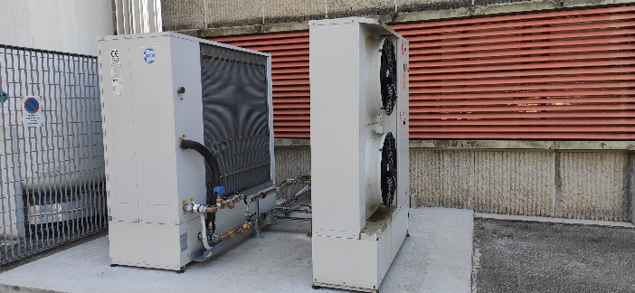
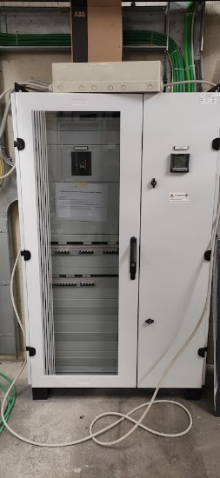
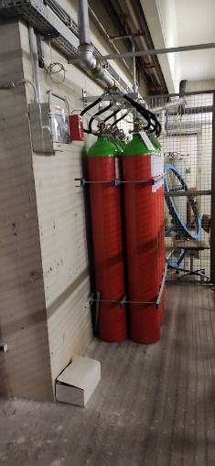
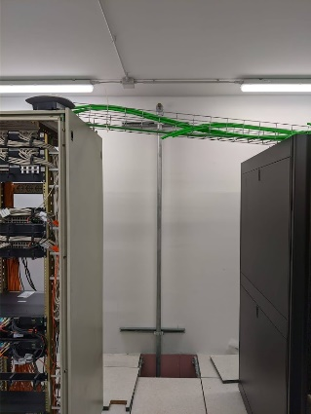
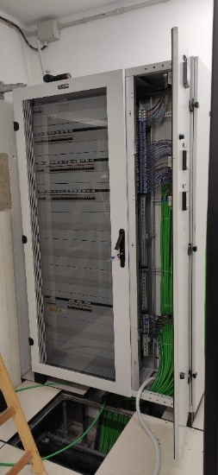
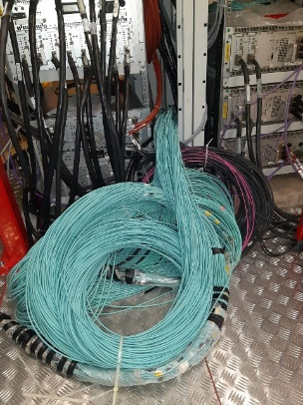
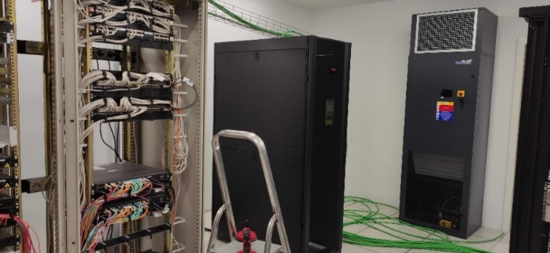
New VAX Computing Room (Feb 2022)
REI120 walls
New racks
Power distribution: electric panels
Fire estinguishing system
Cooling
AGATA fibers

Slide 5
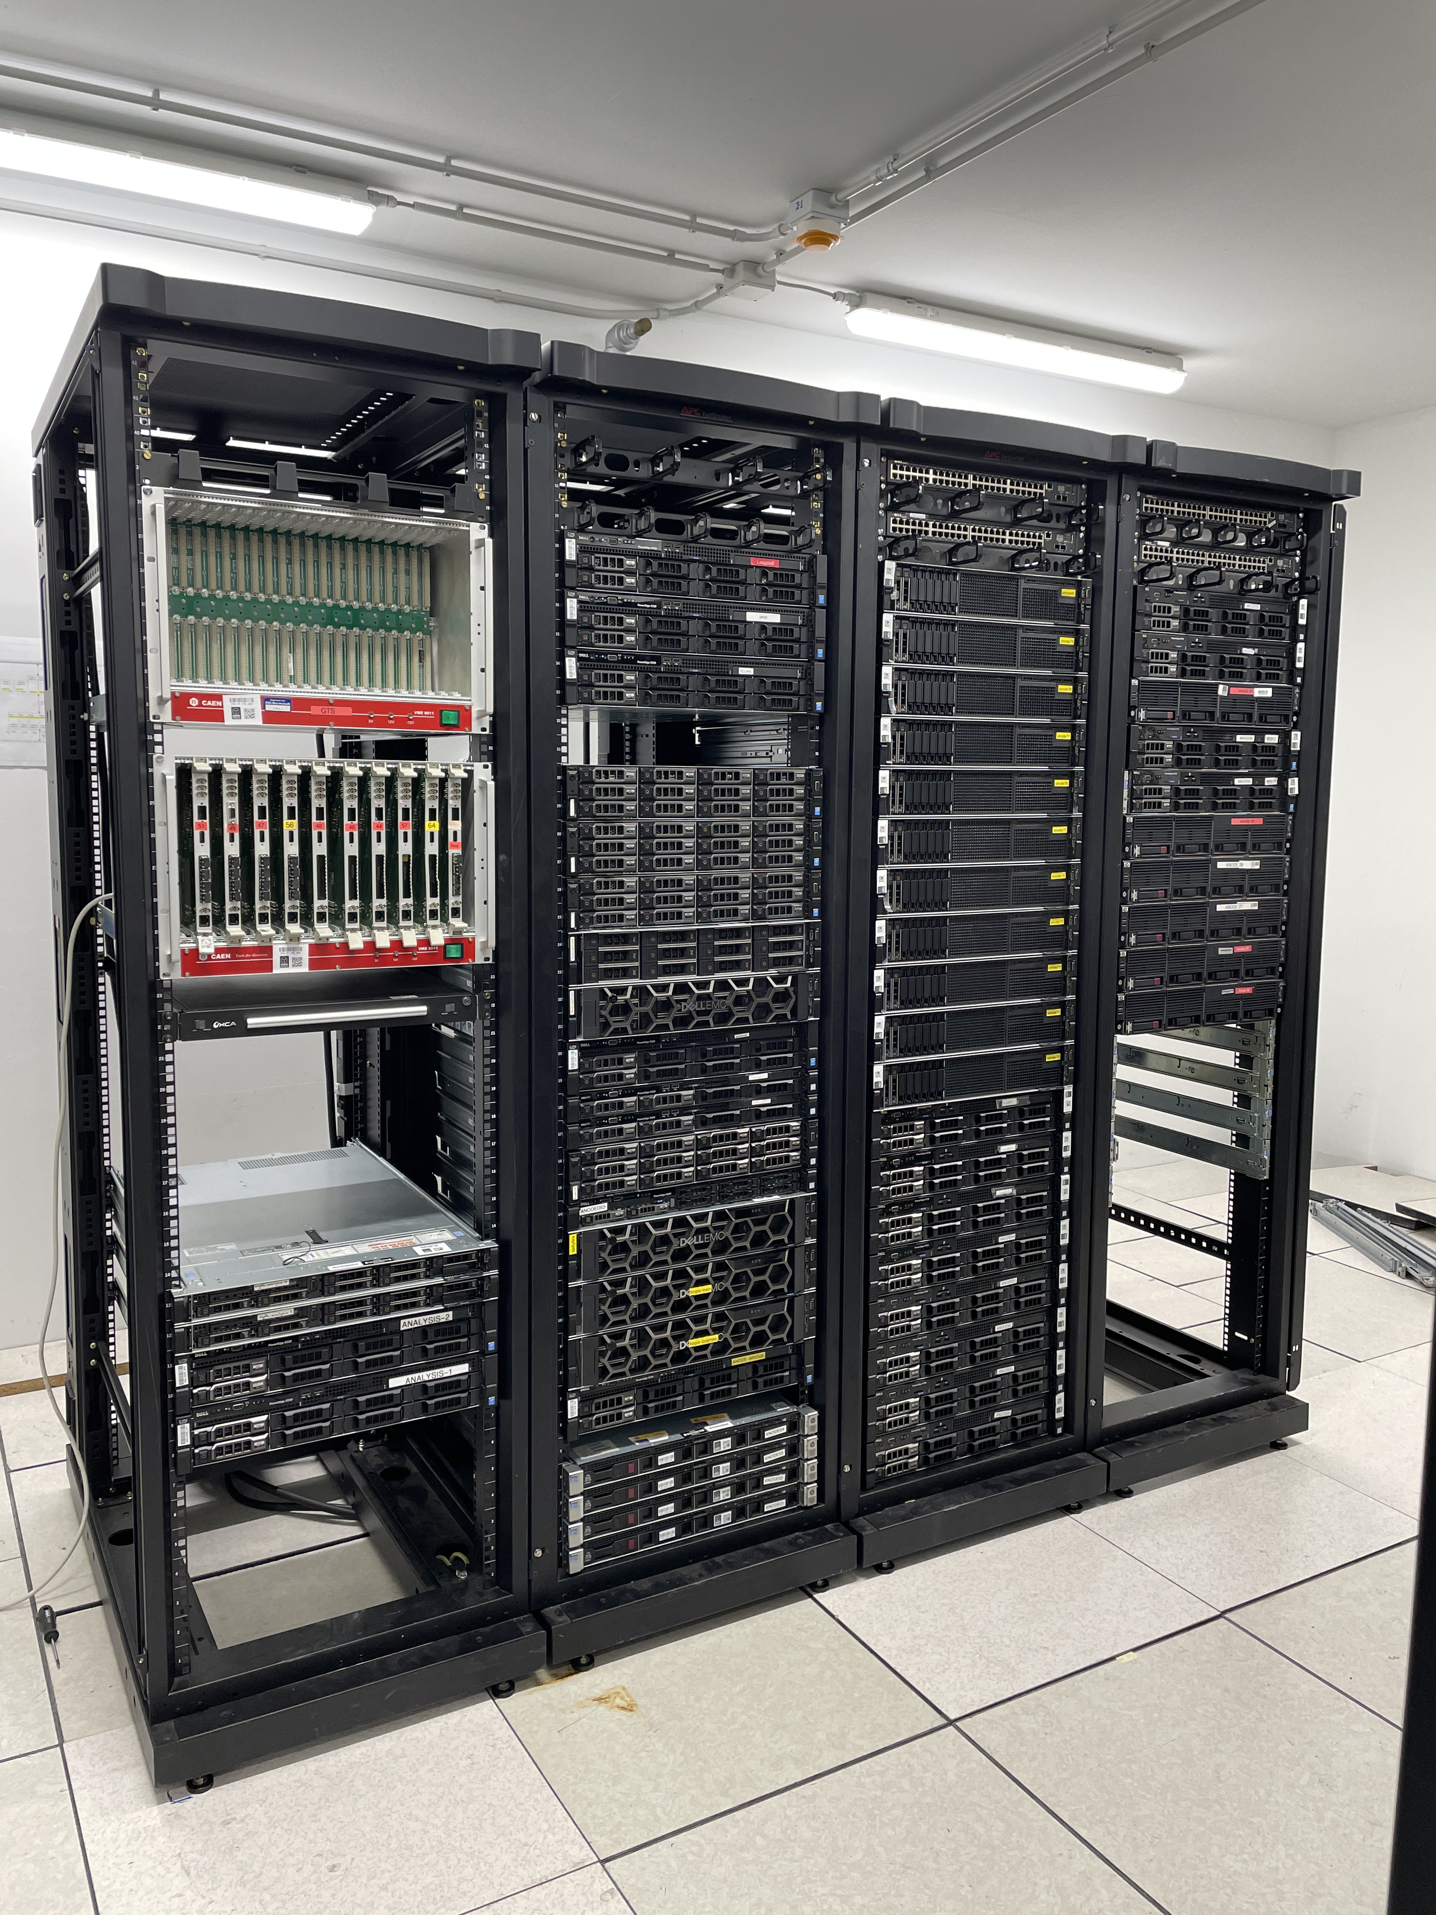
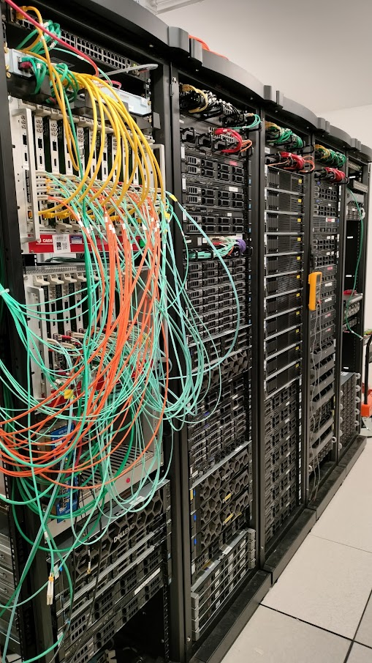
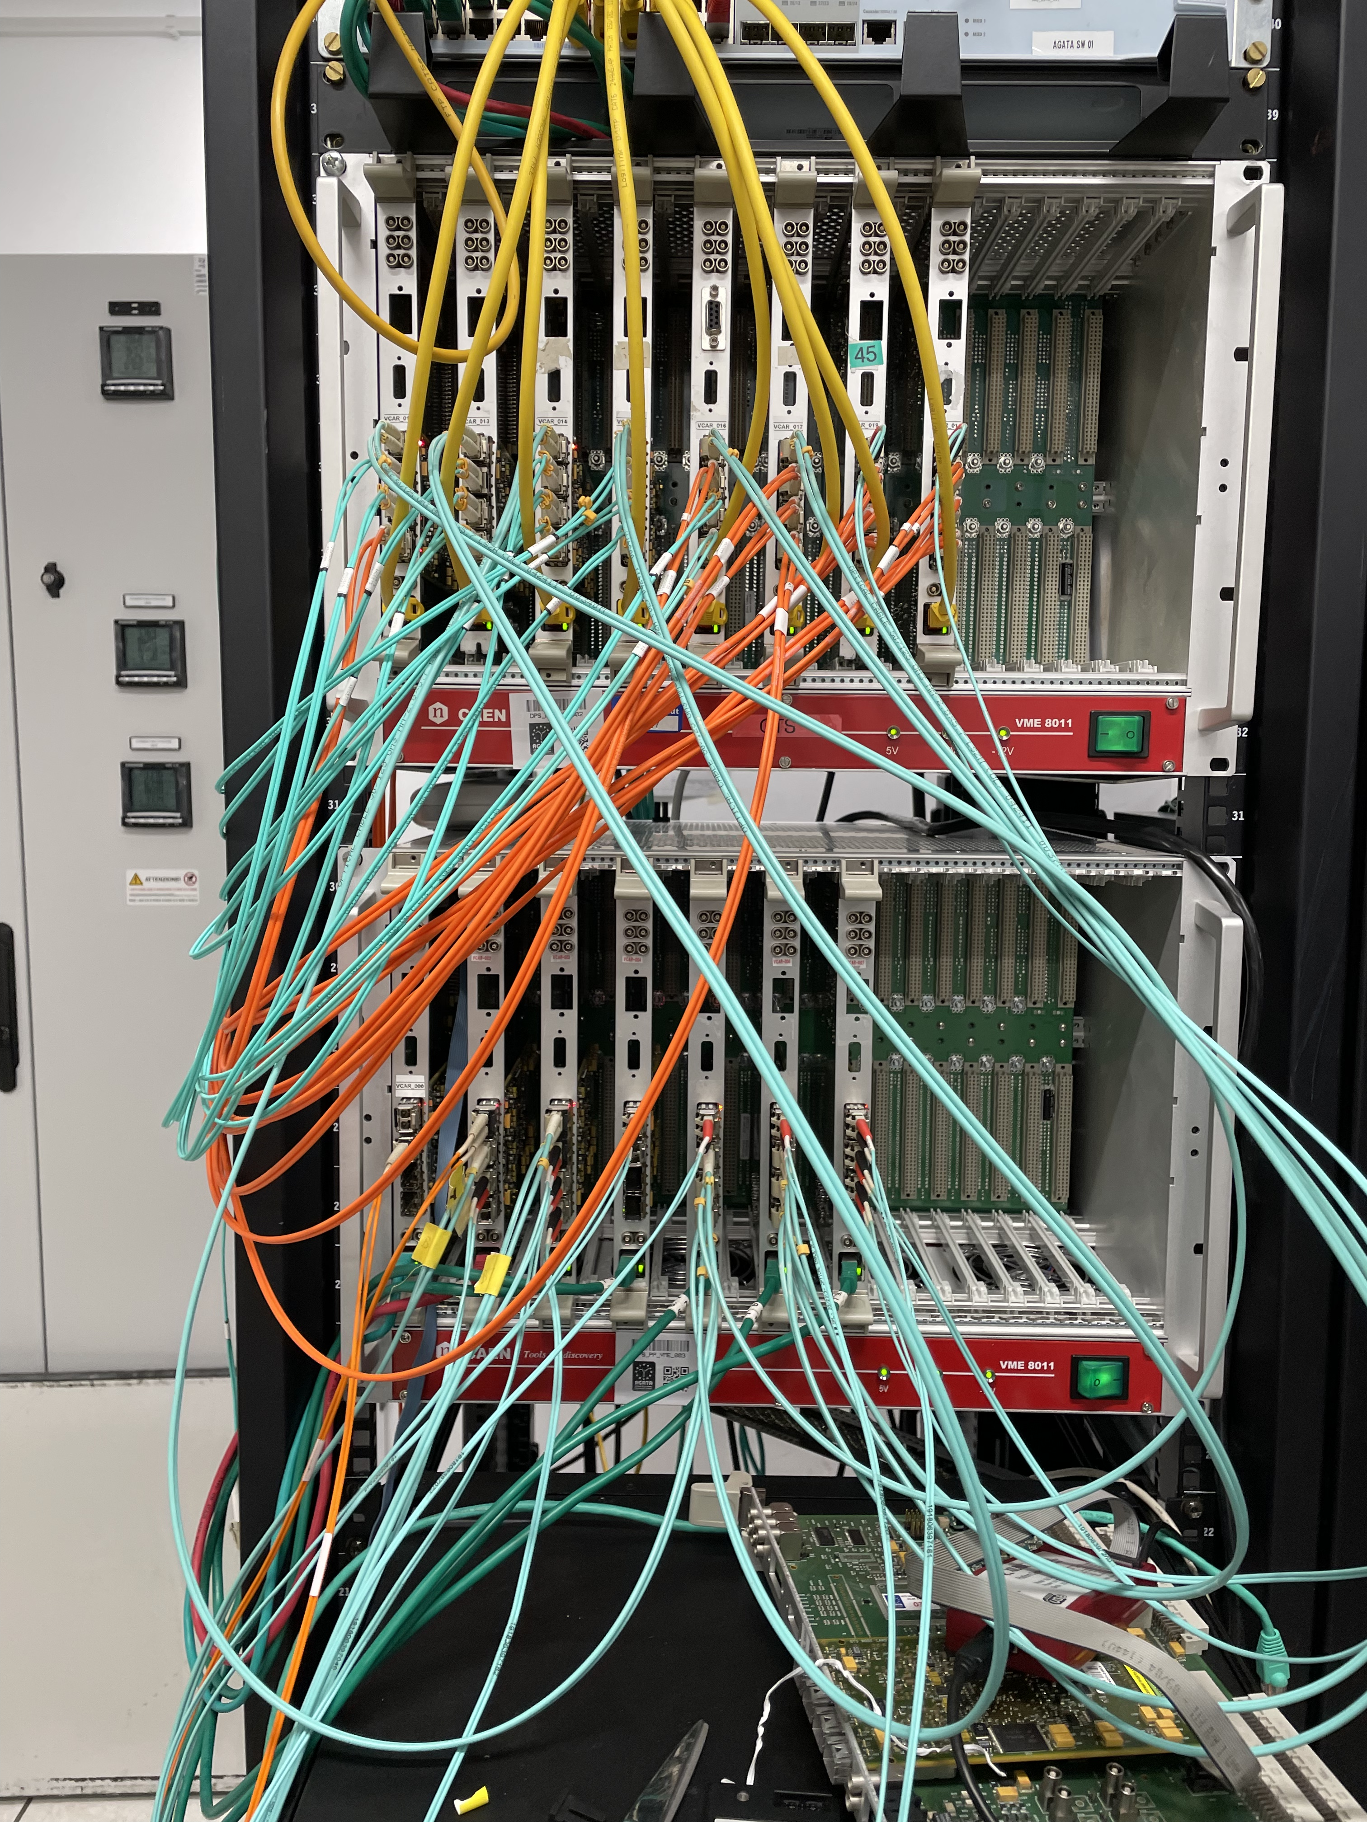
New VAX Computing Room
AGATA DAQ (March/May 2022)

Slide 6
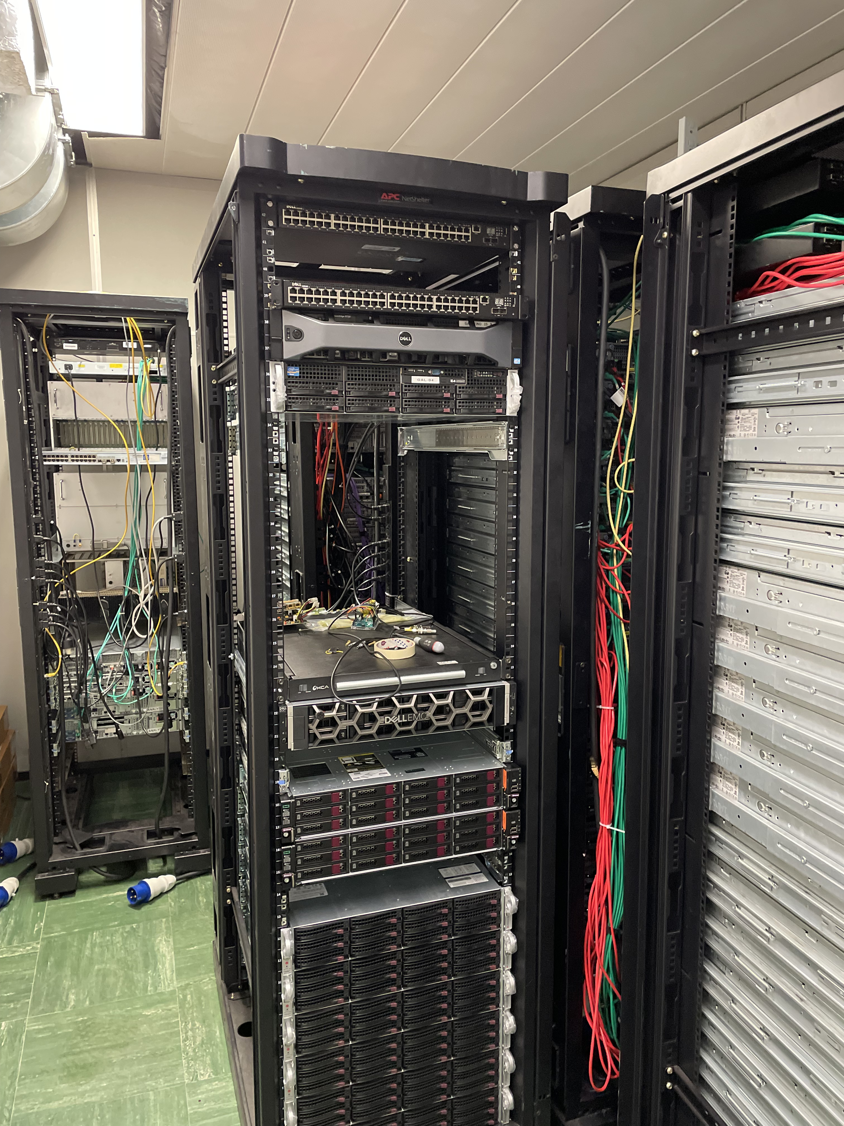
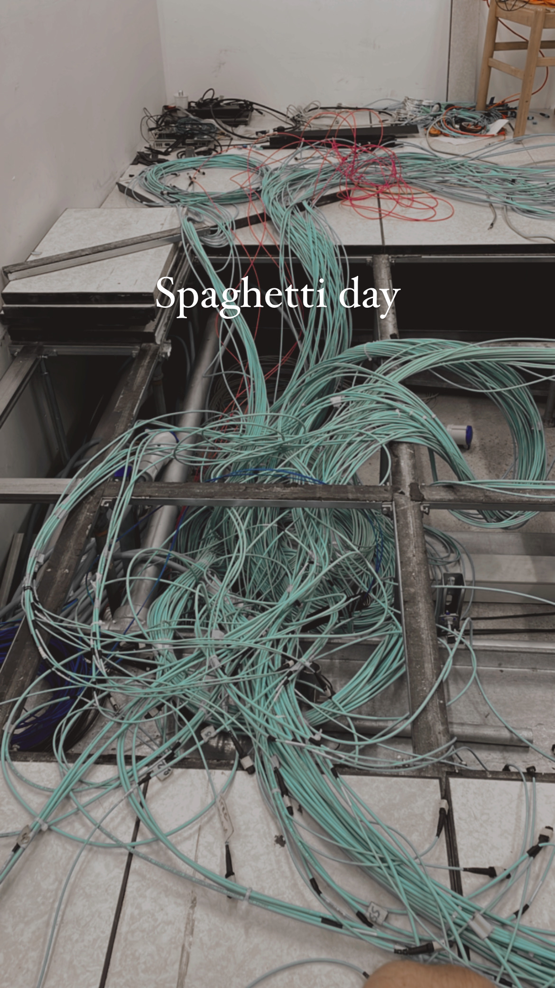
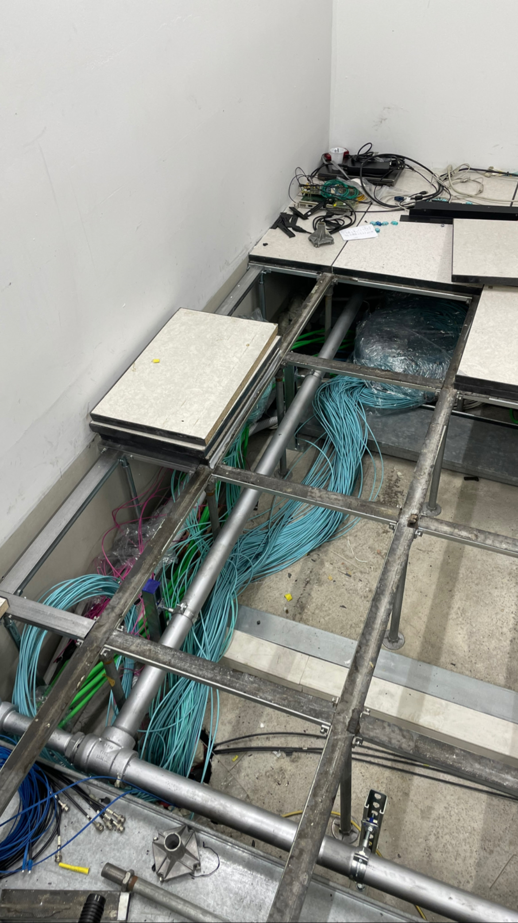
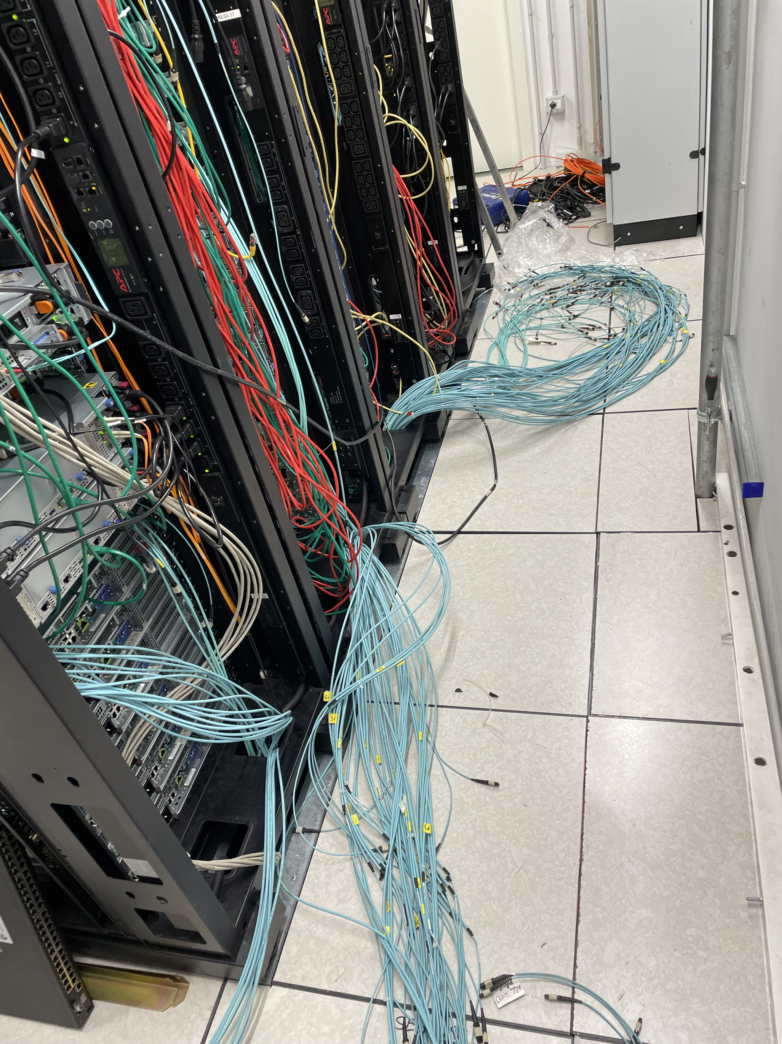
New VAX Computing Room
Summer 2023
Fiber reorganization and Upgrade of the air conditioning

Slide 7
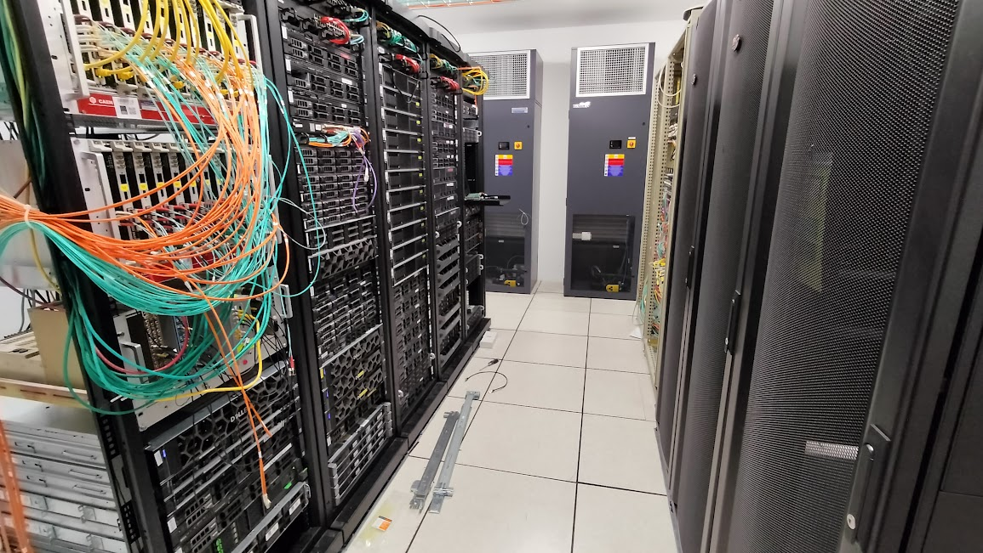
New VAX Computing Room
Today
Up to 20 kW IT power
5 AGATA DAQ racks
2 Network racks
2 LNL IT racks
Coming: GARR-T POP
  1 rack
  2 x 100 Gb internet link
  Terabit ready

Slide 8
LNL Computing Infrastructure:
New Data Center
GRID Data Center
New Data Center
The New Data Center will replace the Grid Computing Room
  AGATA@LNL DAQ + ancillaries, local experiments, local IT network services
  INFN Business Continuity and Disaster Recovery center (LNL, CNAF, LNF)
  LHC-Grid Tier2 Data Analysis Center: CMS and Alice experiments
  PNRR: ICSC (Italian Center for Supercomputing) and Terabit (Terabit Network for Research and Academic Big Data in Italy) projects
  INFN Cloud and CloudVeneto (INFN-LNL, INFN-PD, UniPD) Data Center
  Regione Veneto supercomputing HPC infrastructure - Application
          UniPD, UniVE, UniVR, INFN-LNL, INFN-PD

Slide 9
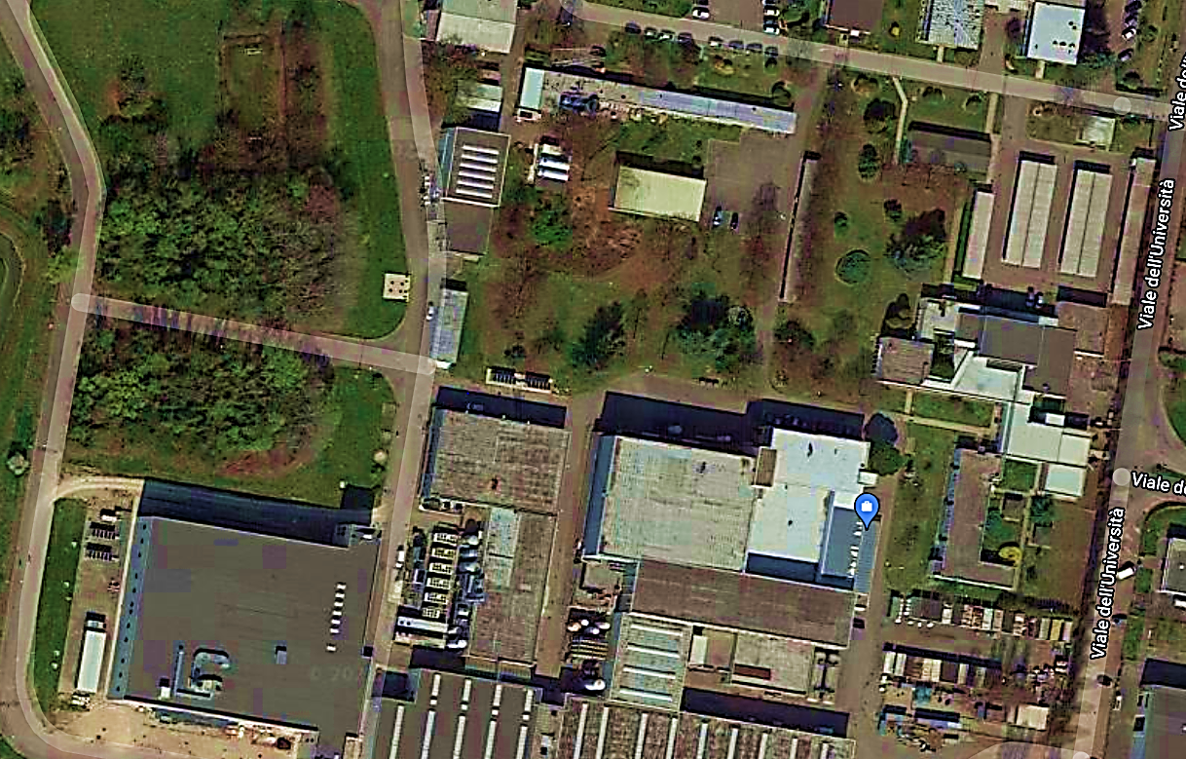
LNL New Data Center
LNL
Entrance
Project phases:
Phase 0: Building
Phase 1: AGATA DAQ support
Phase 2: Scientific Computing (Grid Data Center replacement)
Phase 3: Upgrade for New Applications
NEW DATA CENTER
AGATA
VAX
SPES
GRID
M.Gulmini, LNL User Meeting, 16 November, 2023

Slide 10
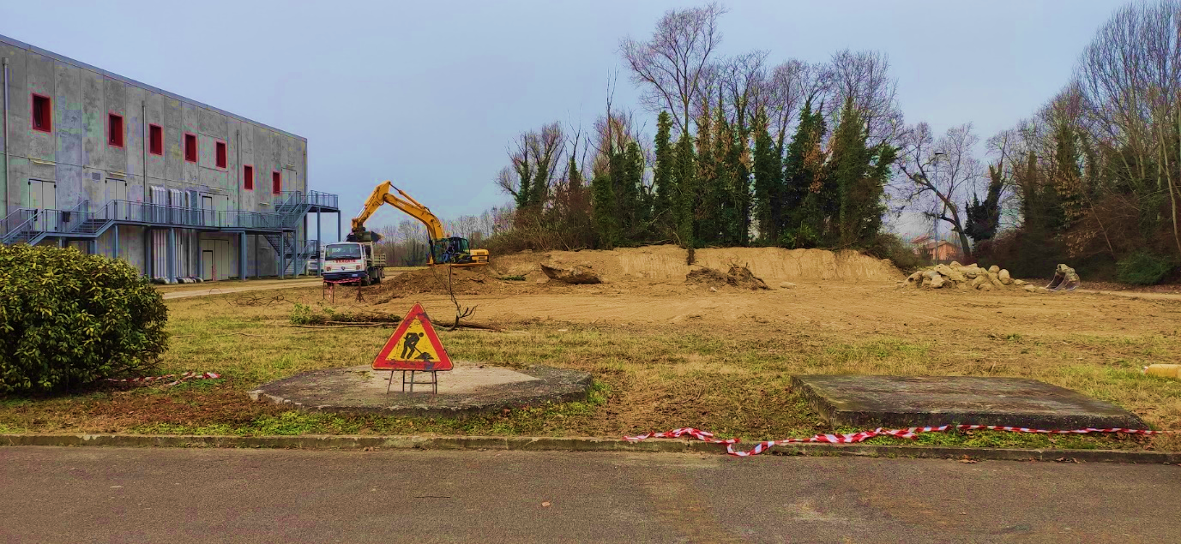
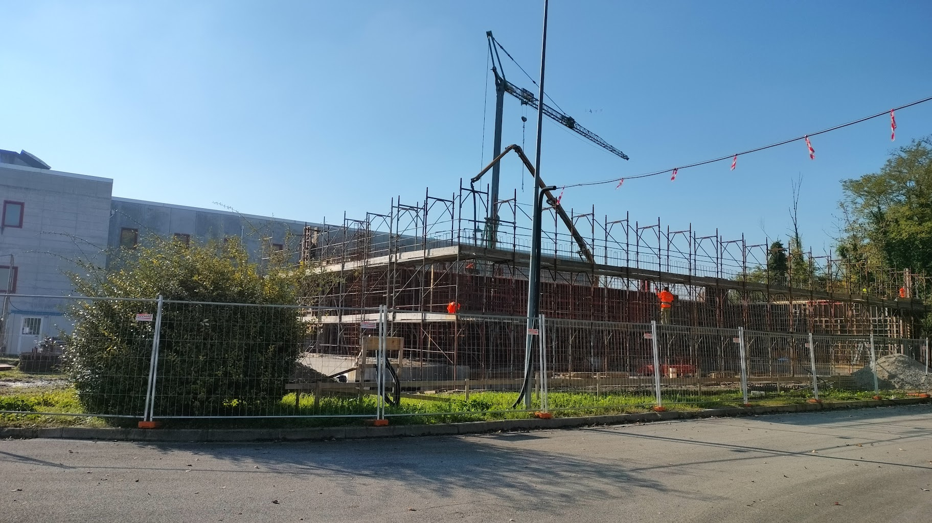
New Data Center
Nov 2023 – Building
15/11/2023
Ready Feb 2024
M.Gulmini, LNL User Meeting, 16 November, 2023

Slide 11
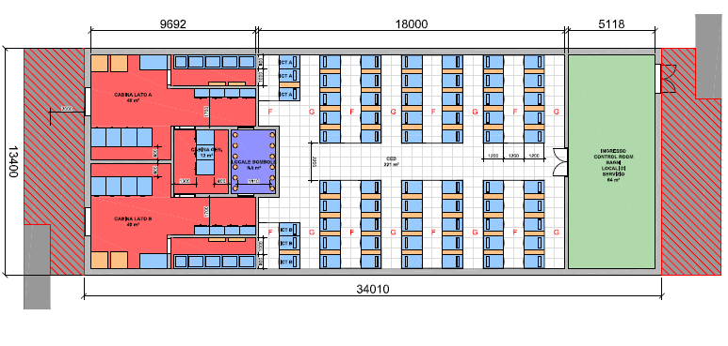
New Data Center: layout
Technical Rooms
Racks
Entrance/Temporary Storage Area
Energy Efficiency: Annual PUE ~1.2
High Availability: Tier3 “Uptime Institute” classification
Phase 1 and 2 Funded (INFN + PNRR):
  40 computing racks
  6 network racks
  390 kW IT power
Tender DONE (waiting for contract signature)
Ready: end 2024
HW installation and operation: 2025
Phase 3: application to Regional Research HPC Center
  Up to 66 computing racks
  Up to 1 MW IT power
M.Gulmini, LNL User Meeting, 16 November, 2023

Slide 12
Network Infrastructure: fibers
  2022-2023
  AGATA Control Room: New rack, OM4 fibers to VAX: 2x10Gb link
  Hall 1 – AGATA: 24 OM4 fibers to VAX
  Hall 1 – PRISMA: 12 OM4 fibers to VAX: 2x10Gb link
  SPES Building: full backbone (16 new network racks, OM4 and SM fibers)
  2024
  New Data Center: OM4 and SM fibers
  LNL Buildings (LAE, Auriga)
  Guest Houses
M.Gulmini, LNL User Meeting, 16 November, 2023

Slide 13
Network Infrastructure for experiments
AGATA (+ancillaries), NUCLEX, GARFIELD: dedicated VPN network
  OpenVPN access: personal certificates delivered on demand
    Easier access to for external users and experts
    Requires “LNL User” Registration, INFN-AAI account, security course…)
  Configurable gateway in terms of services (ntp, dns, dhcp, …)
  Dedicated network subnet/VLAN
  Easily extendable to the different parts of the lab through the laboratory switch VLAN configuration
Small DAQ setups provided by users
  Private network for the devices, dedicated gateway
  Contact well in advance the Information Technologies – Network Service
User personal devices: normal registration on general LNL network
  email to calcolo@lnl.infn.it
M.Gulmini, LNL User Meeting, 16 November, 2023

Slide 14
Wi-Fi Network
Wi-Fi is available in the LNL working areas
  eduroam, INFN-dot1x
Ongoing: gradual replacement of older devices with new access points
Tandem Building
  Improved signal quality in the meeting room
  Some issues during VAX Computing Room works are now fixed
Guest Houses
  Guest Houses C and B miss fiber network infrastructure (no cabling at all)
    Very weak signal from other buildings
    Fibers installation scheduled in 2024
  Temporary solution for Guest House C in Advanced Test Phase
    Mesh Technology
    Available by end 2023
M.Gulmini, LNL User Meeting, 16 November, 2023

Slide 15
Thanks
Q&A
M.Gulmini, LNL User Meeting, 16 November, 2023

Slide 16
SPARE
M.Gulmini, LNL User Meeting, 16 November, 2023

