Slide 1
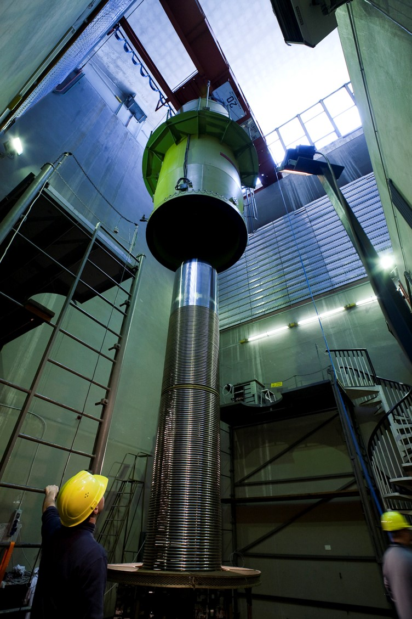
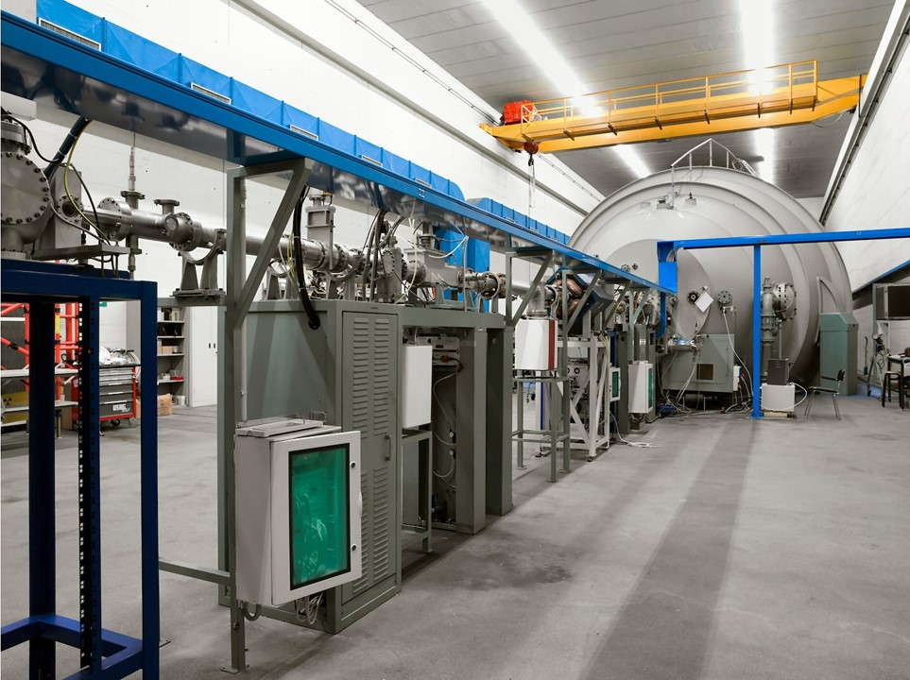
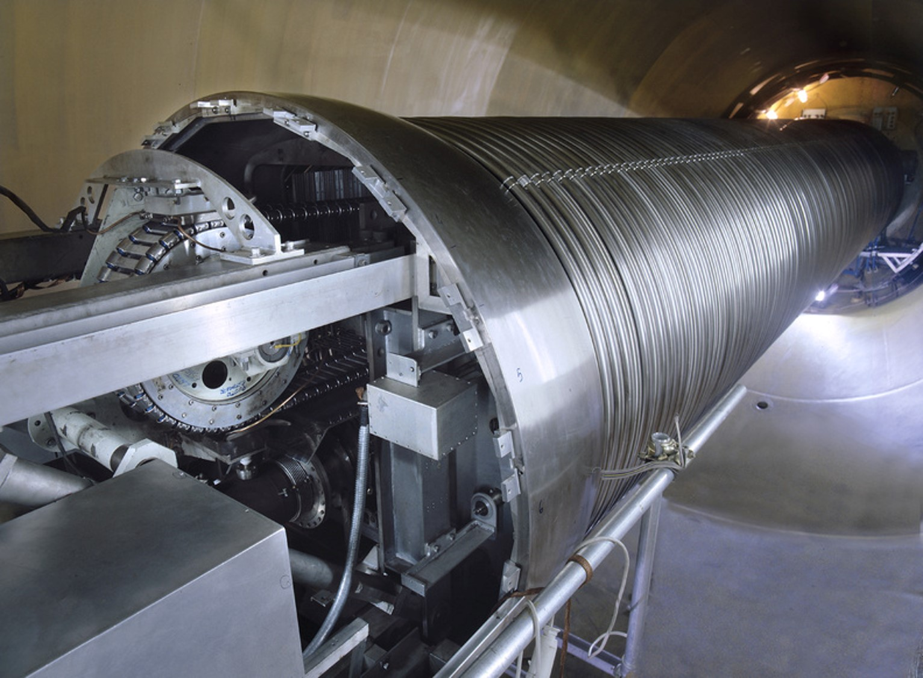
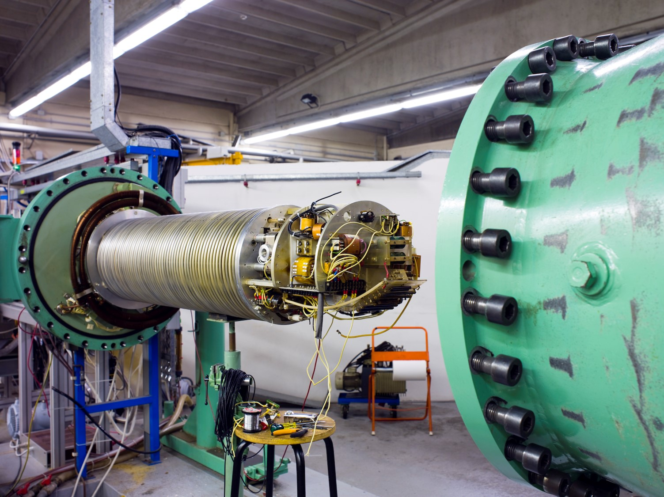
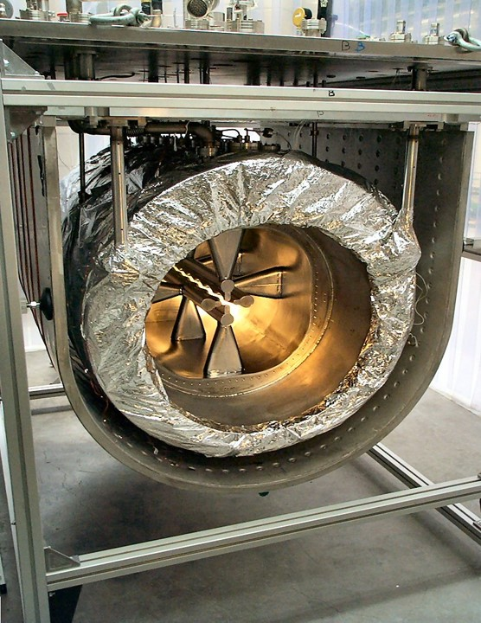
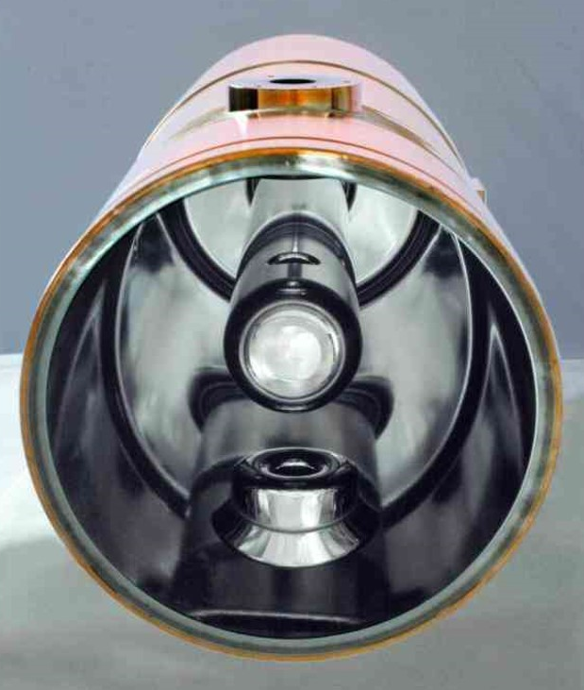
News from the accelerator division E. Fagotti

Slide 2
Outline
General considerations on LNL accelerators
PIAVE-TANDEM-ALPI complex: current status
PA AD tests
CN/AN2000 news

Slide 3
Outline
General considerations on LNL accelerators
PIAVE-TANDEM-ALPI complex: current status
PA AD tests
CN/AN2000 news

Slide 4
Global LNL beam production(2010 - now)

Slide 5
Global LNL beam production (2012 – 2023*)
*estimation
Notes:
TANDEM operation will proceed till the end of this year.
We should recover average beam time we offered during 2012-2016.

Slide 6
AGATA campaign on PTA complex
-
-
-
-
-
Notes:
We reached 4218 h on AGATA until now and we should reach 4640 h for the end of the year. If so this will be 71% of beam on target guaranteed at GANIL in the last campaign.

Slide 7
PTA:current status and perspective for next campaign
PIAVE-ALPI complex started ordinary maintenance last June. An issue on PIAVE ECR high voltage transformer resulted in earlier maintenance.
PIAVE ECR insulating transformer special maintenance will be completed before the starting of the next year beam campaign.
In the meantime, last part of the year will be used to finalize Tantalum, Calcium and Magnesium production with ECR source. In case of success Ca and Mg beam from PIAVE could be schedule since the beginning of the next campaign.
Cryogenic system was already restarted.
Users shifts can restart on mid February following accelerator division beam tests.
PIAVE - ALPI
TANDEM
TANDEM operation resumed on October 12th and it will proceed till December 22nd.
A technical issue on TANDEM injector was the main cause of Ca and Mg beams suppression. We will test Ca production with TANDEM injector at the beginning of the next year. New Ca and Mg beam could be available in April.

Slide 8
PTA 2024 time schedule

Slide 9
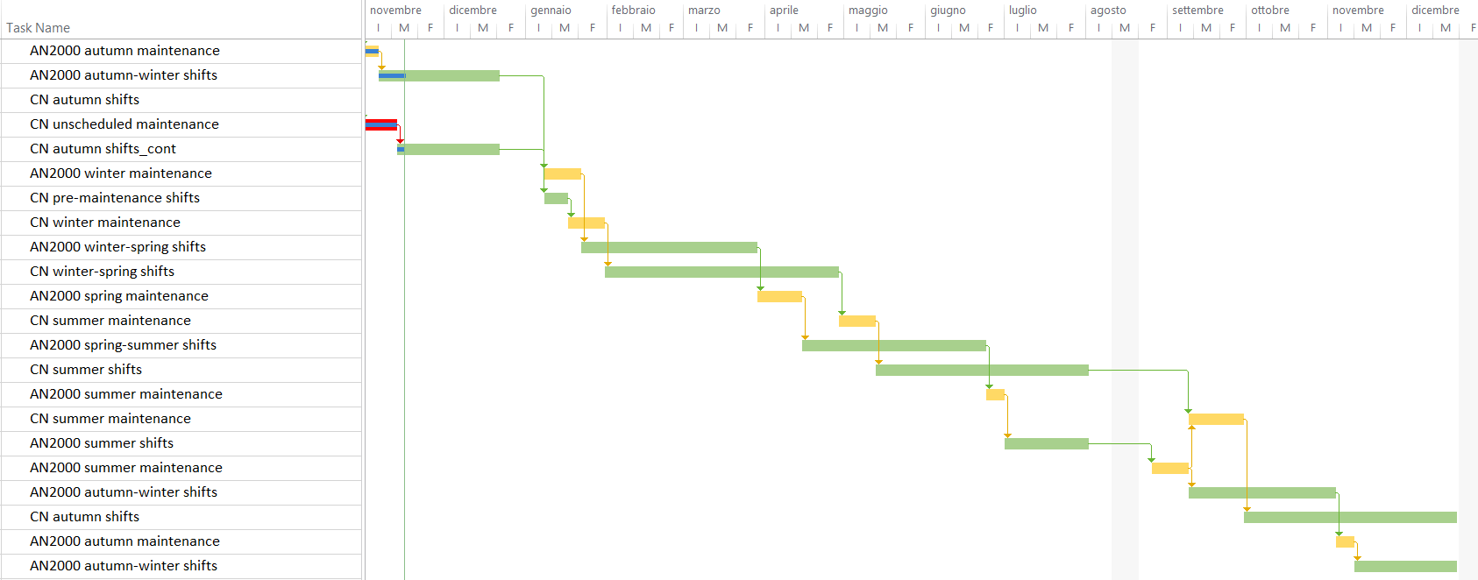
CN/AN2000 2024 time schedule

Slide 10
Outline
General considerations on LNL accelerators
PIAVE-TANDEM-ALPI complex: current status
PA AD tests
CN/AN2000 news

Slide 11
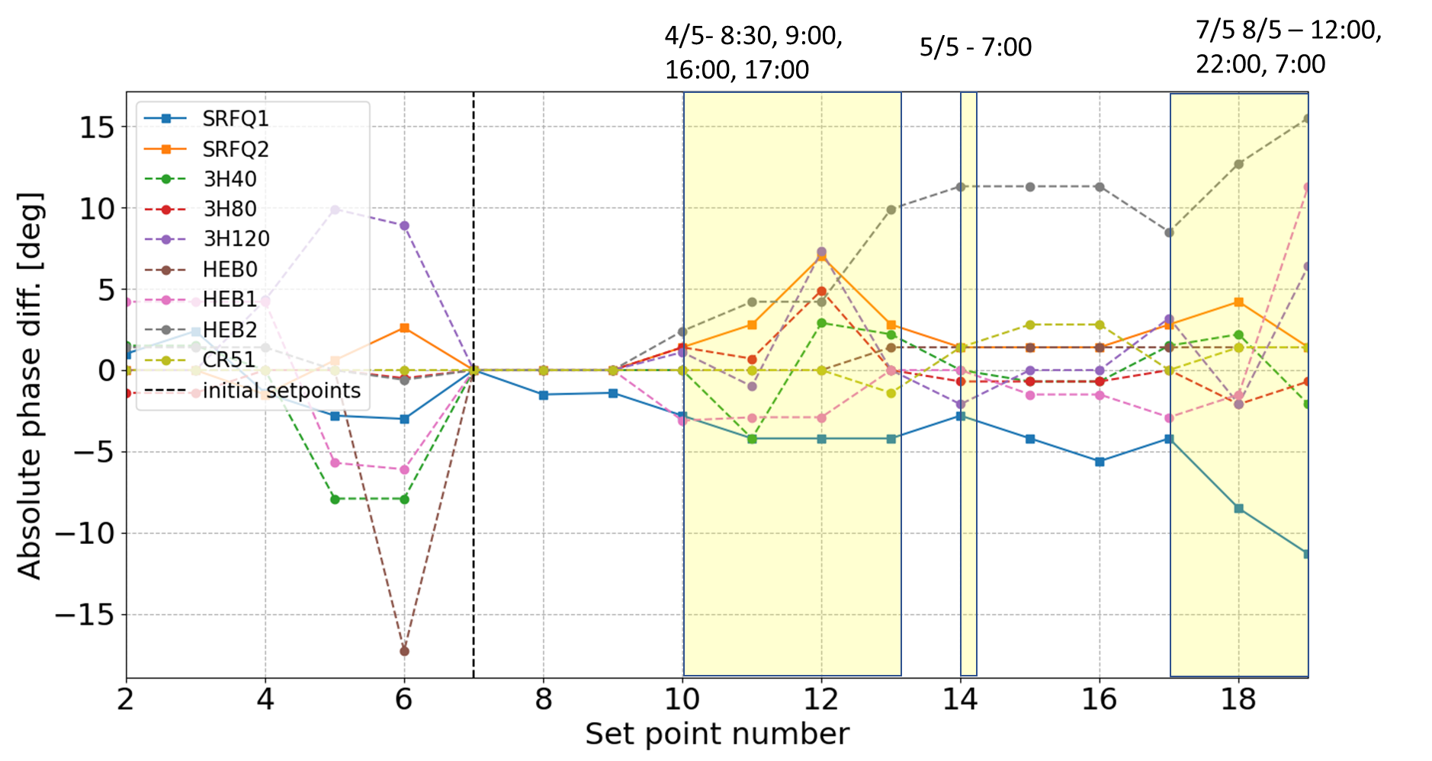
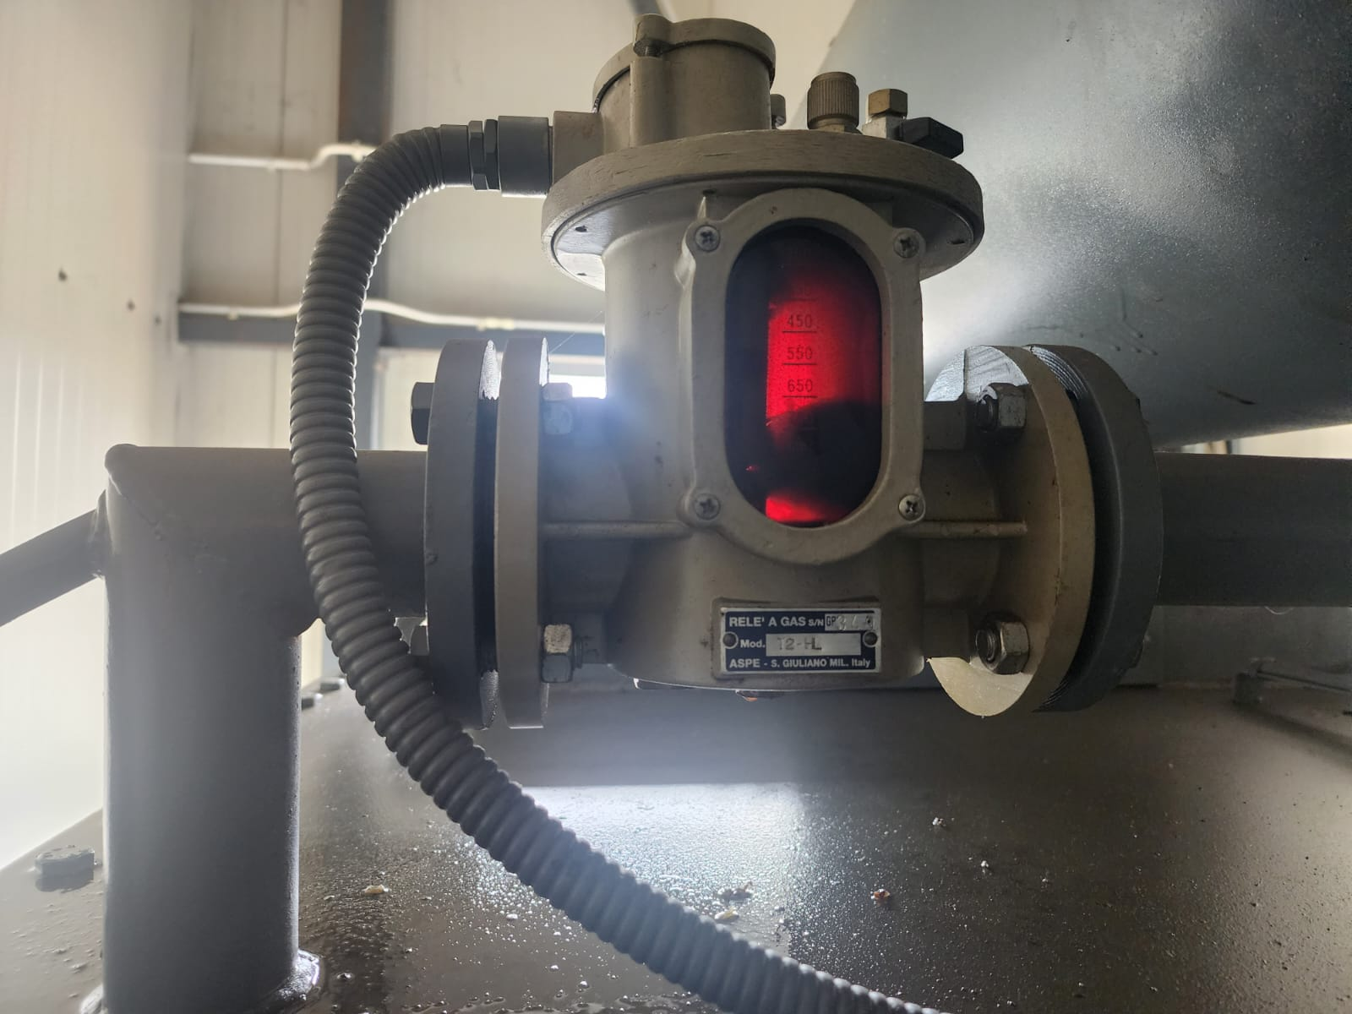
PTA accelerators status: opportunities
First long campaign with PA configuration highlighted some weak points to fix:
Phase references for some cavities such as SRFQ1, SRFQ2 and B3H change with time. Time-scale is in the order of hours. It could be related to LLRF controller or to master clock, but it is probably related to both. Deep impact on SPES. [New LLRF (HW & SW)! – Master clock upgrade?]. No impact on AGATA.
SRFQ alignment was not correct, probably due to bad positioning of cryostat. [Already realigned].
Slew rate of magnets power supplies is too slow. This imply a not negligible increase in accelerator setting time. Automatic procedures based on ML and GA are affected by this setting time. [Interaction with company to improve power supplies].
Insulating transformer for PIAVE ECR platform suffered lack of maintenance in the last 20 years and it is undergoing performances degradation.
Ca and Mg beam production with ECR failed.

Slide 12
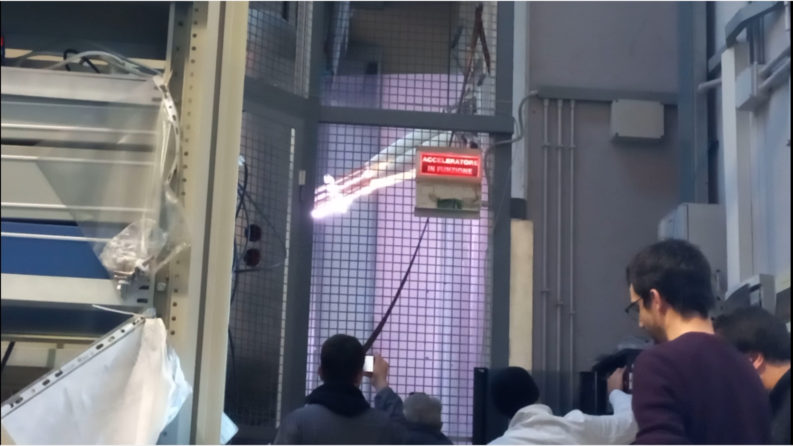
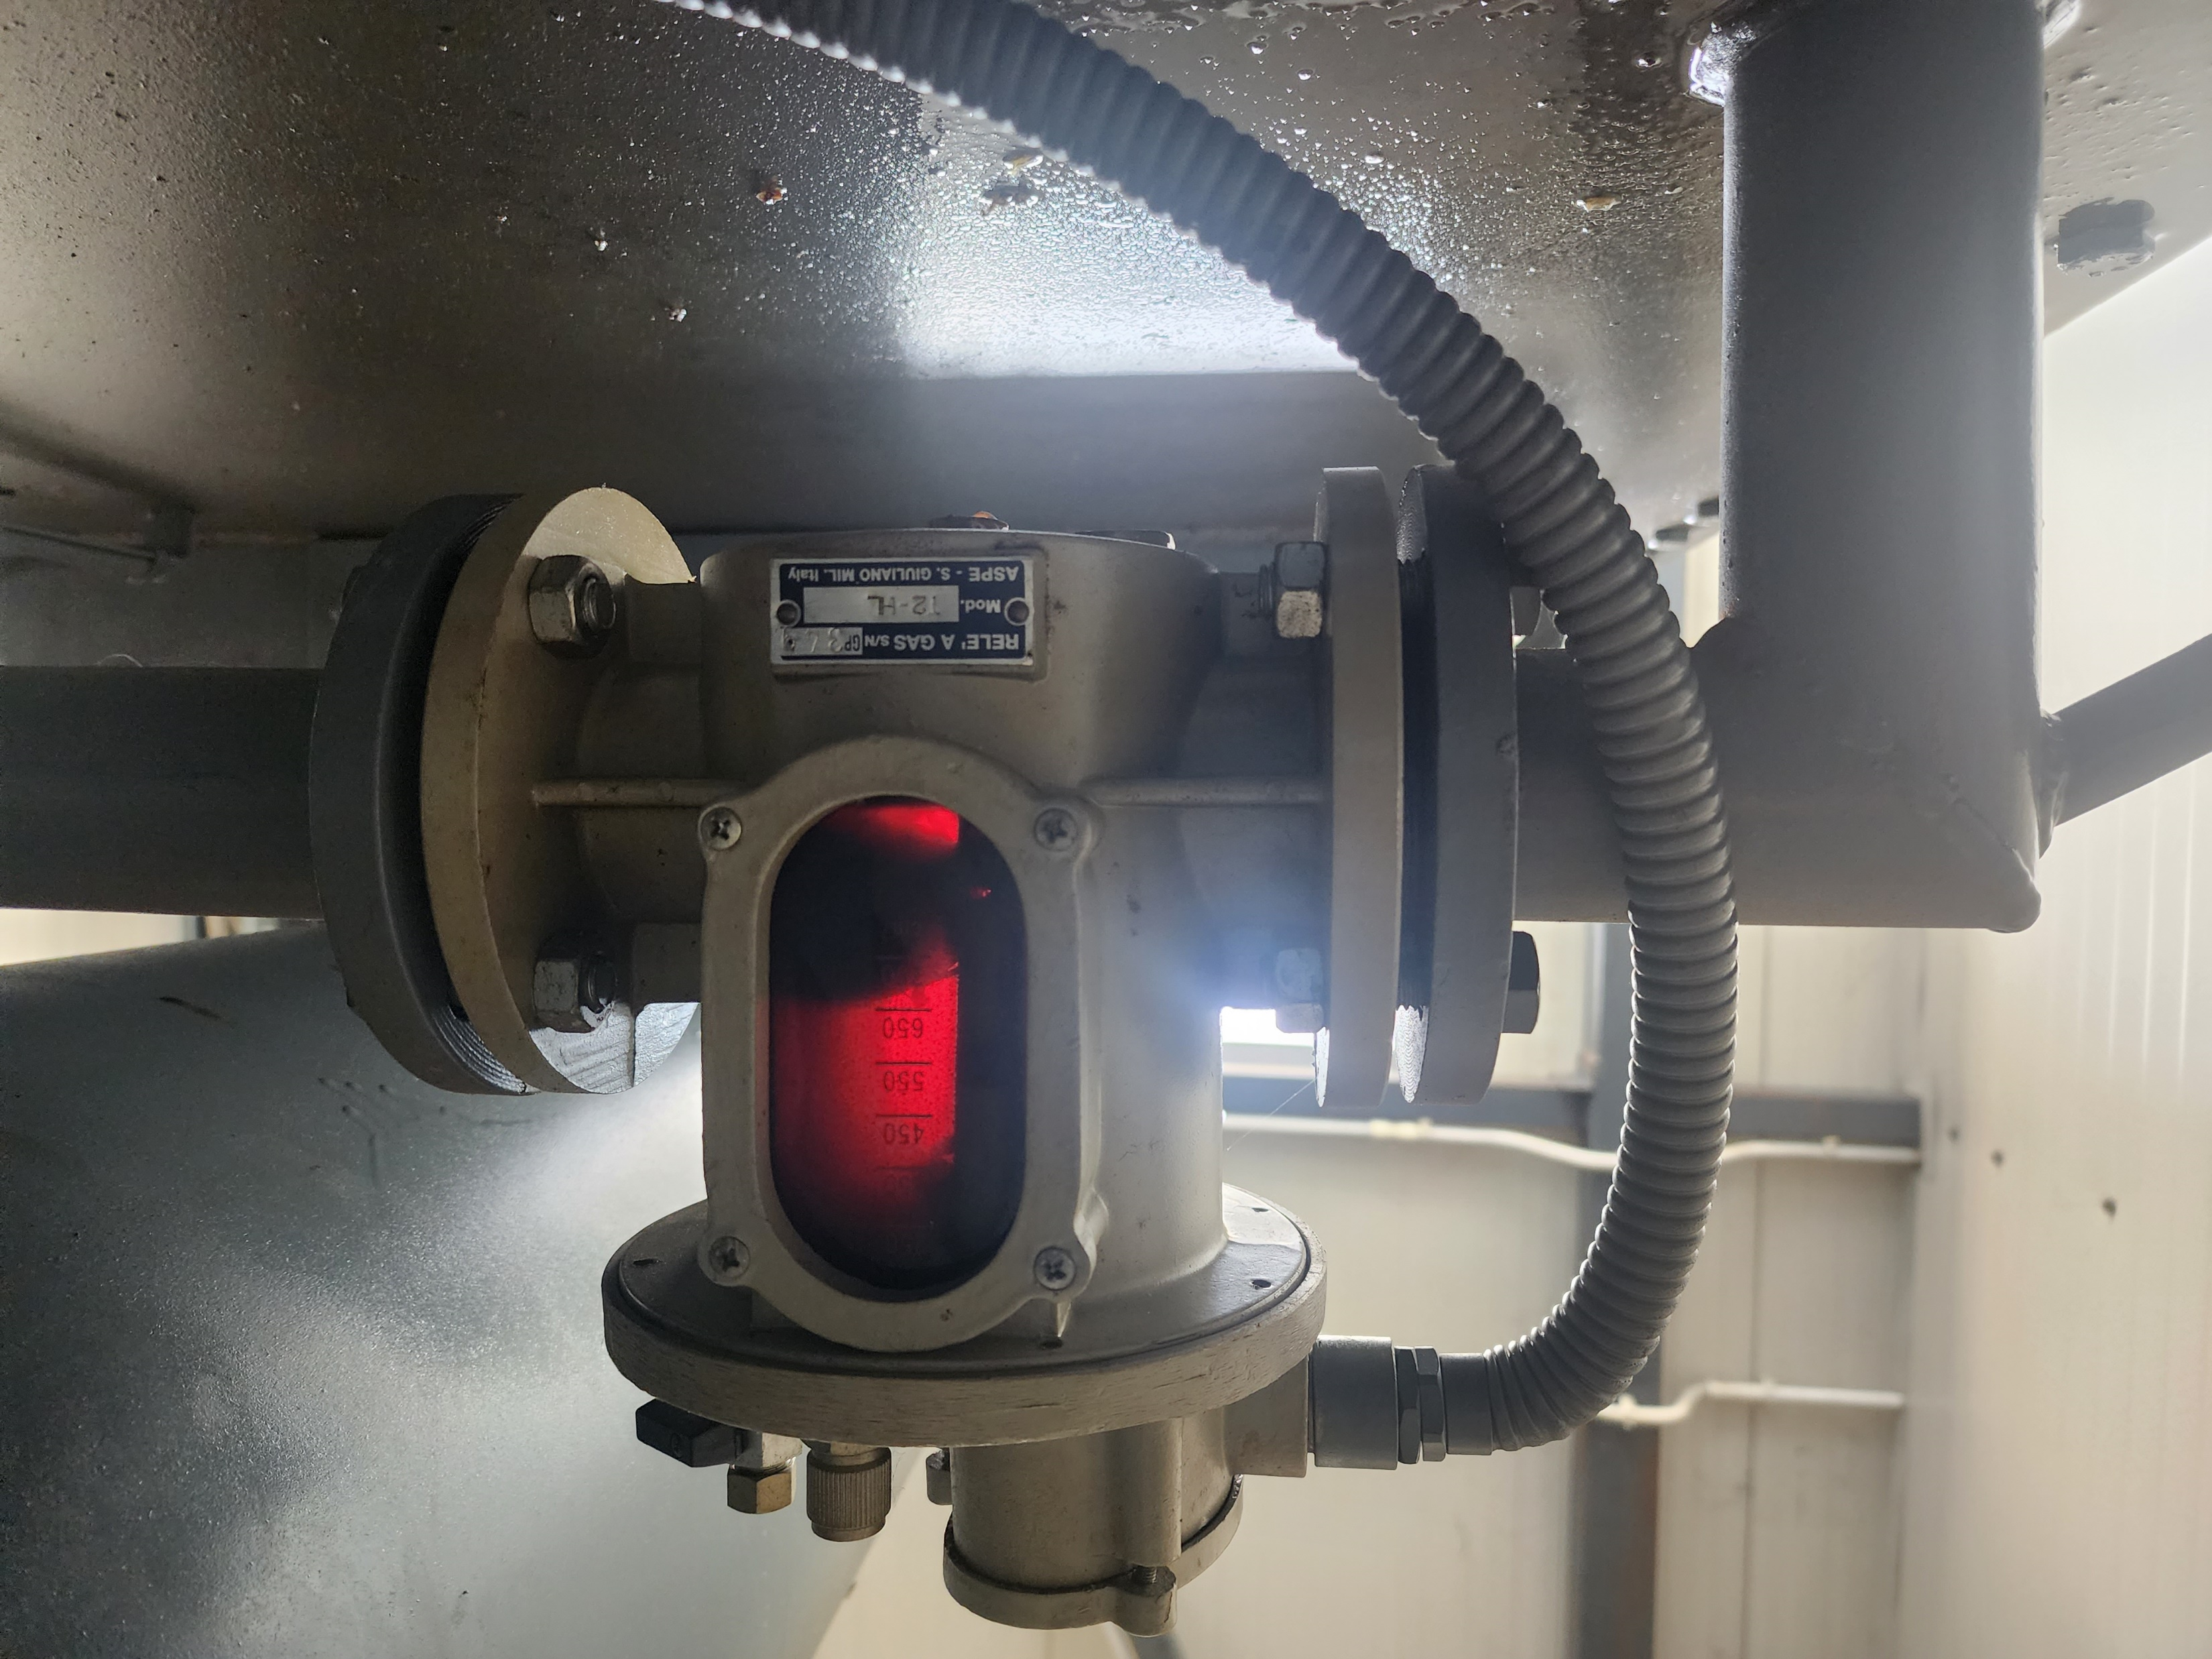
PIAVE ECR and Insulating Transformer
At the beginning of 2023 we observed discharge along the cables from the Tx to the ECR platform that kept us from putting it at high voltage
After cleaning insulators and HV cables situation improved but we heard sparks that forced us to work below 200 kV
During last experiment a possible overheating of the transformer caused the firefighting system to activate, thus stopping measurement
To restore the operability of the platform we planned an extraordinary maintenance to the transformer:
Oil purification
Substitution of the safety systems (buchholz relay)
Installation of new cables from the transformer to the platform
Special maintenance will be completed on January.
buchholz relay

Slide 13
Ca and Mg issues
Ca and Mg are considered very difficult beams for both ECR and Tandem source!
ECR SOURCE
Despite the problems to the transformer the ECR was able to produce beams for the PIAVE-ALPI complex
Unfortunately we did not succeed in producing Ca and Mg beams (even if extensively tested in the past)
A subsequent inspection revealed that the oven’s components were not enough clean( Ca and Mg are really reactive)
We decided not to let them be available for users before new tests will confirm availability
We plan to test at least Ca before the end of the year
NEGATIVE IONS SOURCES
Experiments are going as expected
Here again, we had some problems only with Ca, due to bad properties of an important components of the ion source that worsen its performances (ionizer)
For this reason, we had to cancel the Mg experiment because the ion source was not is an “optimum shape”
We suspect that other ionizers could not have the expected properties, so we are testing them on a bench
To be confident for the future experiments, we will test Ca and eventually Mg during the experimental campaign with PA

Slide 14
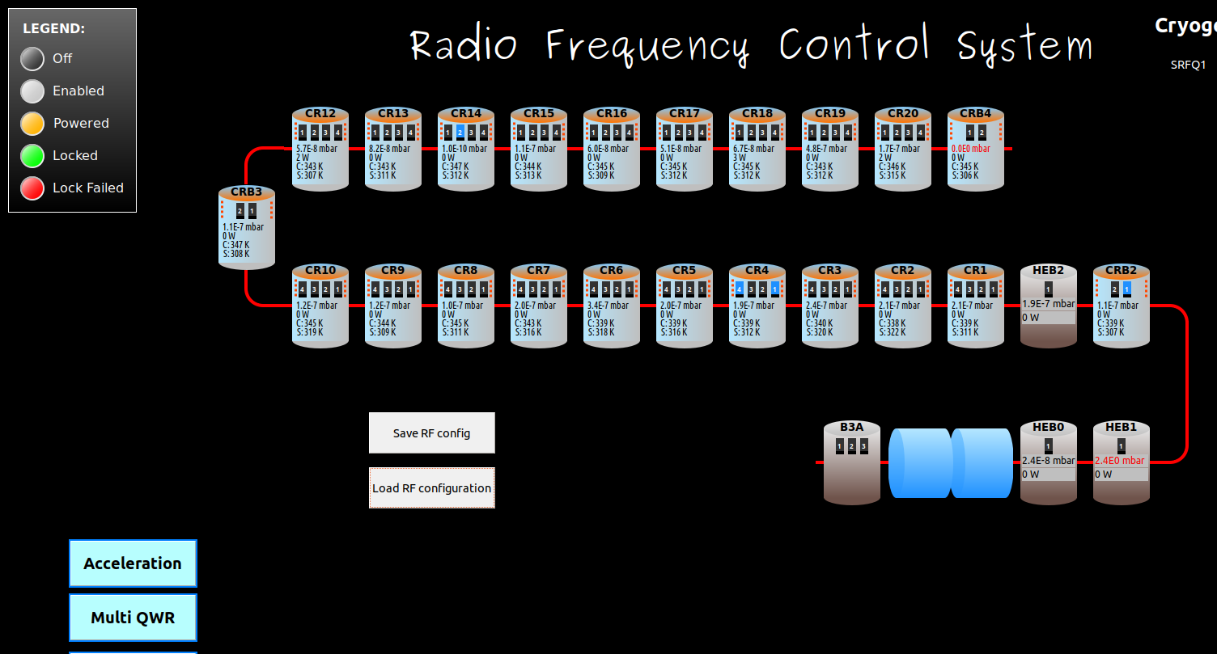
RF system status
All cavities, but SRFQ1/2 will be controlled by the new epics-based control system. This will allow:
Data archiving
Automatic procedure for conditioning and phasing (improved setup time)
Availability of high level optimization procedures involving RF (i.e. Bayesian Genetic etc..).
To be done:
SRFQ1/2
New LLRF HW controller upgrade

Slide 15
Overlall RF cavities performances
CR19 installed after maintenance: cavities performance to be tested ASAP - coupler problem solved
CR15 & CRB2 : vacuum leak problems on the coupler shaft feedthrough solved - feedthroughs replaced without removing the cryostat
Not usable cavities (1 LB + 1 MB + 2 HB):
CR4-4, CR14-2: cavity issue
The two worst cavities in CR19, CR20: malfunctioning LLRS (no spares available @160 MHz)

Slide 16
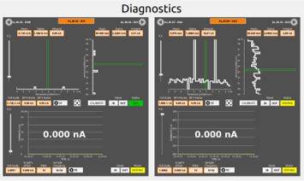
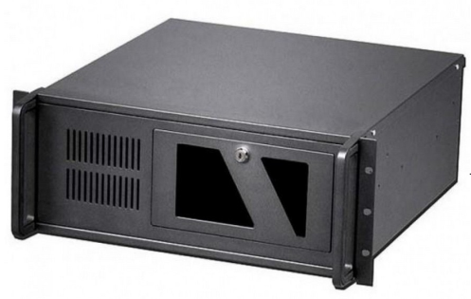
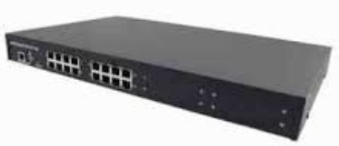
Beam diagnostics controls
Diagnostic Control
Status report received from diagnostic group
corrective actions expected by the end of January 2024
Few VME spart parts
Diagnostic Upgrade status:
large part of the material is now in house, purchase of some parts and services moved to 2024
Time slot and resources for the installation to be defined
Electronic upgrade finalization will require short time - extra funds or many years – current accelerator division budget
Notes:
La Sostituituzione dei 13PC industriali con 8 Device master passando da controllo distribuito a centralizzato pare essere andata a buon fine (scopo di migliorare l’affidabilità e la manutenzione)
Sw e interfaccia per diagnostiche SPES in produzione in ALPI
NOTA Elettrovalvola diagnosticha dopo ID2 è ancora posticcia? (era stata smontata al volo da ADIGE)
Le problematiche riguardano principalmente movimentazioni e in particolare acquisizione su VME
PIANO UPGRADE DIAGNOSTICHE
Motivazione dei cambiamenti:
Obsolescenza del sistema VME parti di ricambio a costo elevato rispetto alla nuova soluzione
Vantaggi in termini di velocità, accuratezza e flessibilità del sistema.
Il piano temporale dipende fortemente dalla possibilità di fare nuovi acquisti di elettronica per completare l’installazione di ambo i progetti.
Il costo per il sistema di preamplificazione, acquisizione e gestione movimentazione è di circa 5k€ per ogni diagnostica, ma il sistema ha modularità di 4 diagnostiche quindi si ragiona in multipli di 20k€, tuttavia una gestione ottimizzata della elettronica richiederebbe l’acquisto a lotti omogenei.
12 Baco → 36k€ → 1 lotto 24 preamplificatori → 44k€ → 1 lotto
12 Box Motori → 18k€ → 1 lotto
24 preamplificatori → 44k€ → 1 lotto
7 Racks →13k€ → possibile acquistare singolarmente
7 PDU → 5k€ → 1 lotto
24 set di cablaggi per diagnostiche 20k€ →possibile suddividere in più anni. Tot circa 180k€
Non considerato: acquisto nuove griglie, movimentazioni, installazione cablaggi da parte di ditte e quanto necessario per la parte di Piave

Slide 17
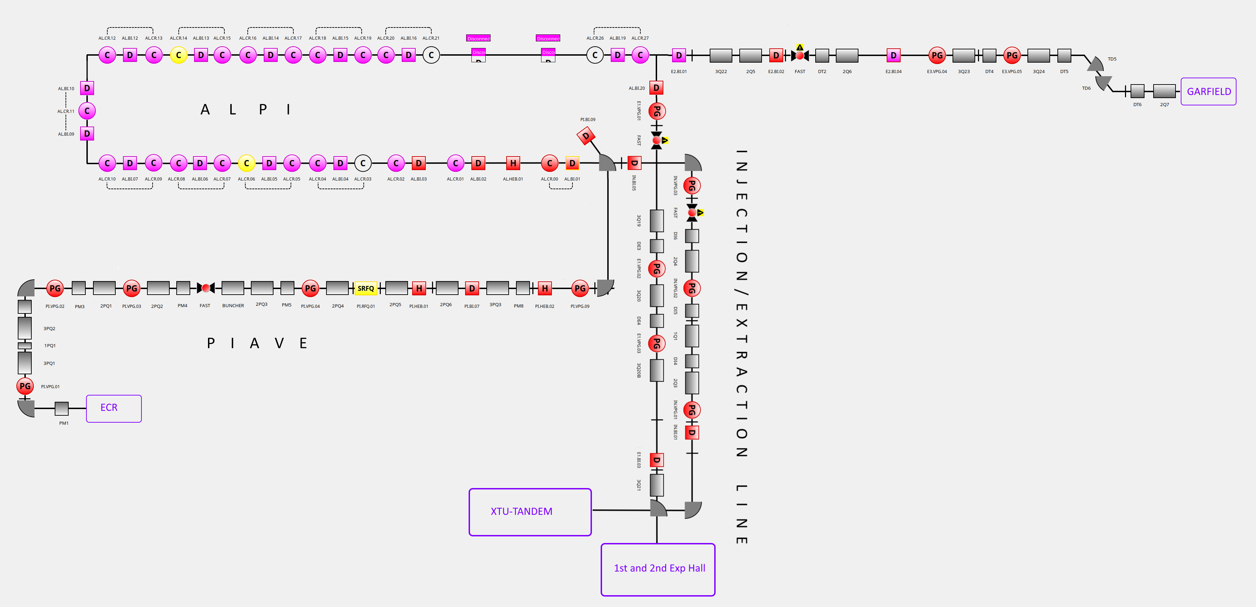
Vacuum system maintenance status
ALPI | LINES IN&OUT, III Exp. Hall | PIAVE | I & II Exp. Hall | XTU TANDEM
4 TMP-600 2 TMP-300 4 PP 2 Rack | 3 TMP-300 |  | 2 TMP-300 4 PP 2 Rack
5 TMP-600 4 TMP-300 6 PP 4 Rack |  |  | 1 TMP-300 2 PP
12 TMP-600 9 TMP-300 14 PP 7 Rack
1 TMP-600 3 TMP-300 3 PP 2 Rack | 5 TMP-600 7 TMP-300 12 PP 3 Rack |  | 3 TMP-300 2 PP
 | 3 TMP-300 6 PP 2 Rack |  | 3 TMP-300 2 PP | 3 TMP-600 4 TMP-300 7 PP 4 Rack
 |  | 3 TMP-1000 4 TMP-600 8 PP 2 Rack | 4 TMP-300 4 PP 3 rack
2022
2023
2024
≤ 2022
2025
2023
2024
2024
2027
2025
2026
2026
≥ 2027
Notes:
DESCRIZIONE GENERALE
In questa slide ha cercato di fare una programmazione temporale per il cambio di tutte le apparecchiature del complesso acceleratori dei LNL.
Le scritte in verde sono il materiale già presente a magazzino dei LNL,
le scritte in arancio sono forniture incomplete da completare (sono incomplete perché i fondi MAC non erano sufficienti).
Le scritte in rosso è il materiale da finanziare.
Nella slide non si vedono n.1 gruppo di controllo della III sala (perché fuori dal bordo dello schermo) e 3 del Vano Tandem (perché non disegnati).
NOTE SIGNIFICATIVE
Come si vede con il materiale in casa, recuperato in parte da quanto acquistato per progetto SPES, copriamo le installazioni del 2023.
Nel 2024 si farà il basso beta di ALPI, i rack ci sono ma va già pianificato l’acquisto di 2 pompe TMP-600 e 12 pompe primarie. Per le 8 TMP-300 ci sono due possibilità: si aggiungono alla lista, oppure si utilizzano quelle previste per le sale sperimentali (che poi bisognerà cmq riacquistare).
Si vede che le installazioni prevedono sempre 5 o 6 rack all’anno. E’ difficile pensare a un impegno impiantistico superiore, dati i tempi di fermo macchina.
Nel 2026 è previsto l’aggiornamento delle linee SALITA/DISCESA e VANO TANDEM, e solo alla fine viene PIAVE e Sala Esperimenti II, all’ultimo posto.
ALTRE CONSIDERAZIONI
I prezzi stimati sono i seguenti (già ivati)
RACK = 13 k€ + PLC + Moxa + Cablaggio e installazione → 24 k€ installato
TMP 300 lt/s = 10 k€ montate su diagnostiche ALPI e linee IN&OUT da XTU-TANDEM
TMP 600 lt/s = 13 k€ montate su criostati ALPI e linee in III sala
TMP 1000 lt/s = 16 k€ montate in tre punti su tre punti in PIAVE
PP 28mc/h = 5k€ multiroot
Pompaggio centralizzato = 1,5k€ per ogni coppia di criostati
IP = 11 k€ (da aggiornare)
Ne risulta che:
Sistema (Costo Ivato in k€)
ALPI 353
LINES 441
PIAVE 188
XTU 171
SALA1 101
SALA2 104
Totale 1368k€
Da un’ultima gara MAC a circa 10k€ si prende la TMP piccola per 8k€, mentre con la valvola gate si sale a circa 10 k€. Le valvole gate a mio avviso non sono in priorità per quanto detto, tant’é che esistono i kit di sostituzione completa delle guarnizioni da VAT.
Abbiamo acquistato con i fondi MAC2020 pompe non a lievitazione completa magnetica, ma solo parziale, che richiedono manutenzione. Così abbiamo risparmiato, rimandando il costo negli anni, ma necessario personale per la gestione delle manutenzioni.
A mio avviso si possono tenere le cifre indicate affermando in sede di presentazione che questi costi tengono conto anche di eventuali sostituzioni di valvole e sensori a corredo del sistema di pompaggio.
L’impegno del personale non è gravoso, dato che sono solo assemblaggi di componenti già pronti. Stimo 2 settimane gruppo di pompaggio con 3FTE.
Considerato costo di rimozione e installazione cavi a cura della ditta solo per i rack ancora da acquistare.

Slide 18
Outline
General considerations on LNL accelerators
PIAVE-TANDEM-ALPI complex: current status
PA AD tests
CN/AN2000 news

Slide 19
Accelerator division tests (under construction)
From 1 - 15 February: Xe beam (if possible), $≥$ 1 GeV.
Where we are (w.r. to last campaign):
Re-alignment of the SRFQ12 and SRFs cavities
New SRF control system
We need to check on the bunchers calibration. Huge impact on the long. dyn.
New results from TSO.
Two main parts to investigate
“Standard” linac studies pre-runs
Where the magic happens…

Slide 20
TSO for ALPI plan
The ability to sustain a very large noise environment was the main outcome of the last experimental shift.
Extension to the second half of ALPI, up to FC7 that now is digitalized.
From PM1 - PM9
From DI8Bis - FC7
Tests on several algorithms (transverse optics):
Swarm PSO
Genetic (DNSGA II)
Genetic (SMS-EMOA, selection based on dominated hypervolume)
Bayesian
Longitudinal phases optimization (longitudinal optics):
The best of the previous ones.
Indicators:
$∆t_{TSO}<∆t_{manual}$
Tr_{TSO} $≥$ Tr_{manual}
Main idea: support to the optimization of transmission of the LNL accelerator lines.
TSO usage in ALPI (3 +1 scenario), starting from scaled rigidity reference values:
PIAVE SRFQ optimization
Transport up to DU2 from PIAVE SRFQ
Transport up to FC7 from PIAVE SRFQ with phased cavities
Current loss due to injector first order moment instability
Steerer re-setting

Slide 21
Possible experiments (tbd, second priority)
B$ρ$ scaling + TSO
Procedure check with different A/q: usage of different Xe isotopes.
For a $∆\frac{A}{q}$as small as possible
New synchronous phases studies
Low energy section synchronous phases will be changed accordingly to optimization.
When finished, we will come back to the previous setting. It will be a check of the reproducibility (the last one failed).

Slide 22
Outline
General considerations on LNL accelerators
PIAVE-TANDEM-ALPI complex: current status
PA AD tests
CN/AN2000 news

Slide 23
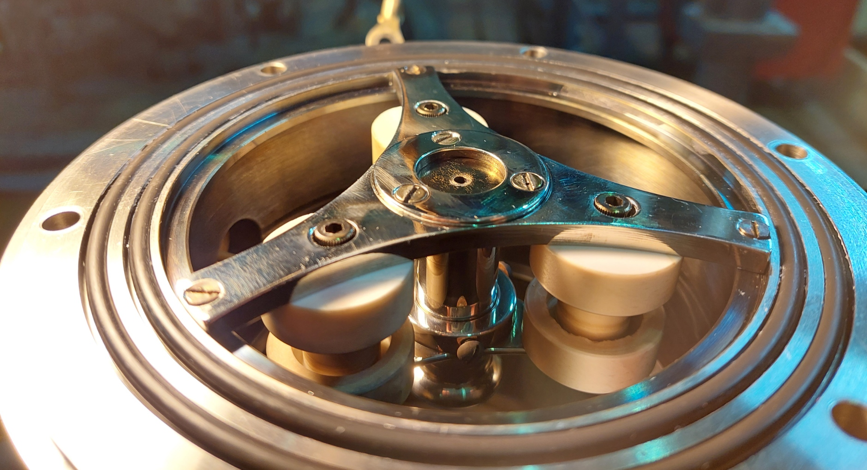
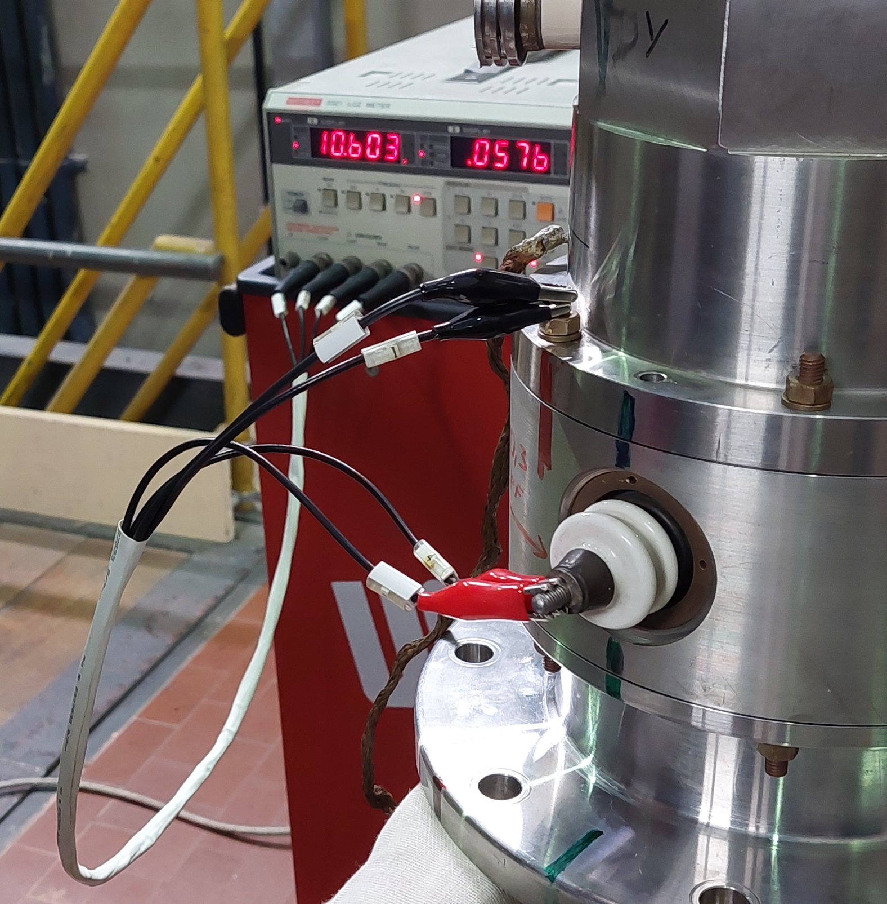
CN accelerator: status
Sep 2023:
ordinary maintenace for gas filling
substitution of ion beam source with a refurbished one and set up
check of all wiring system for the HV terminal controls
check of 3MHz signal and substitution of 2 6AU8 electronic tubes
Oct 2023:
restart of calendar shifts with 4He++
difficulties on 4He2+ beam extraction
test for pulsed beam revealed a failure inside the bunching system (machine opening was needed)
Nov 2023:
main capacity measurements revealed an issue on the buncher circuit
bunching system was dismounted for checking inside components
all stainless-steel components of the buncher refurbished and re-assembled in order to recover right position (thickness measurements revealed a measure mismatch)
electronics oscillators and power supply was checked and repaired
after refurbishing, capacity was verified to have the right value.

Slide 24
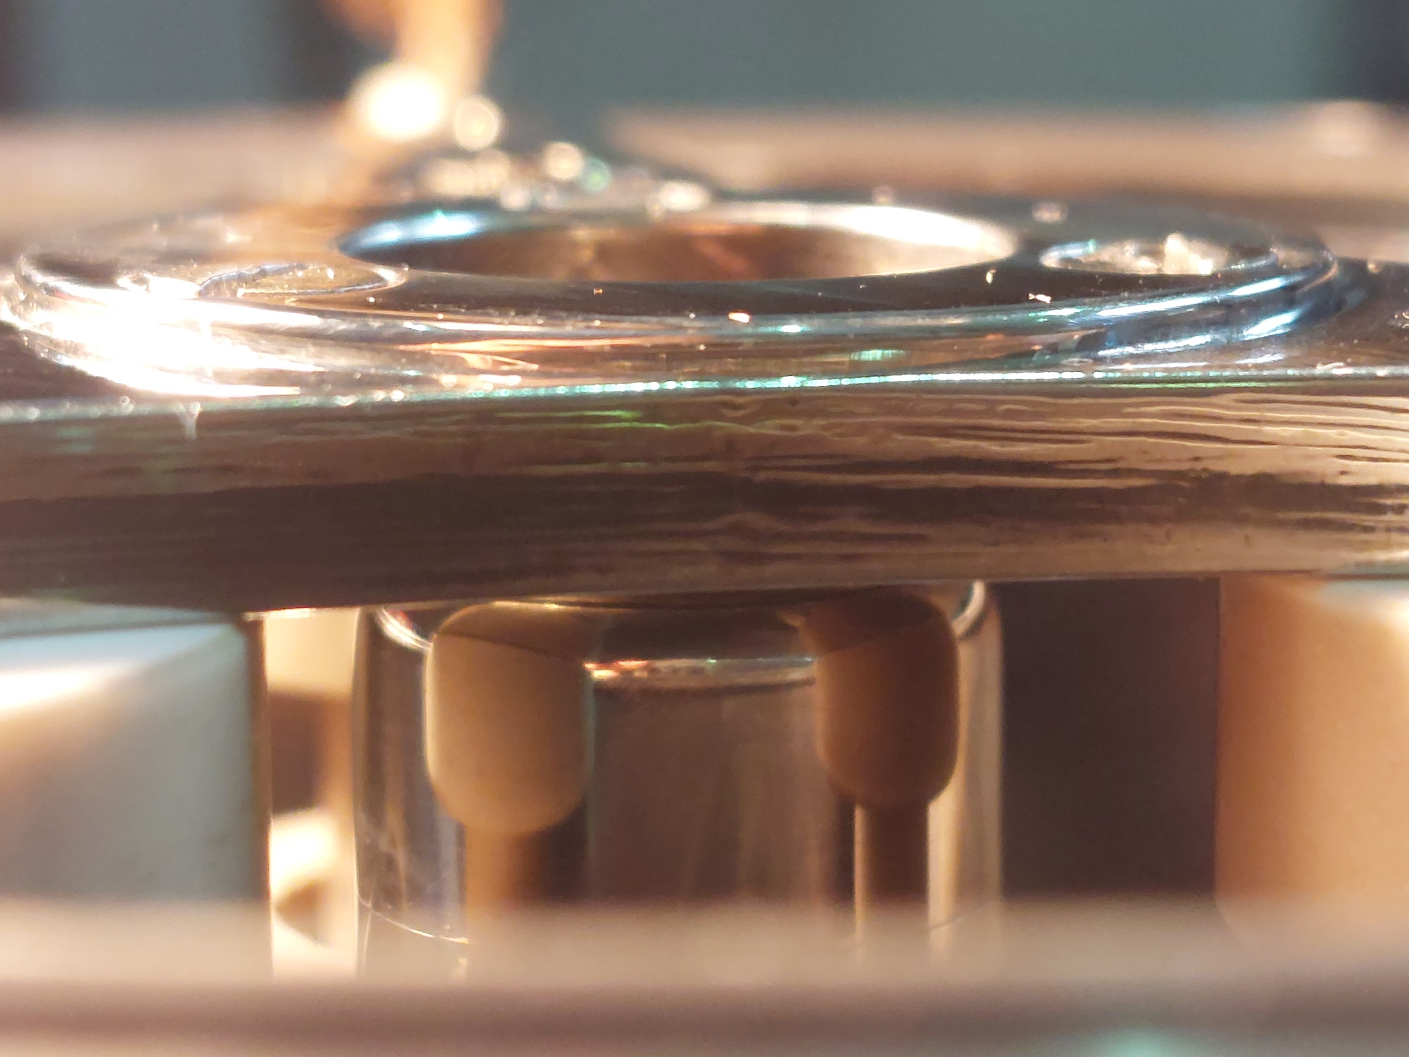
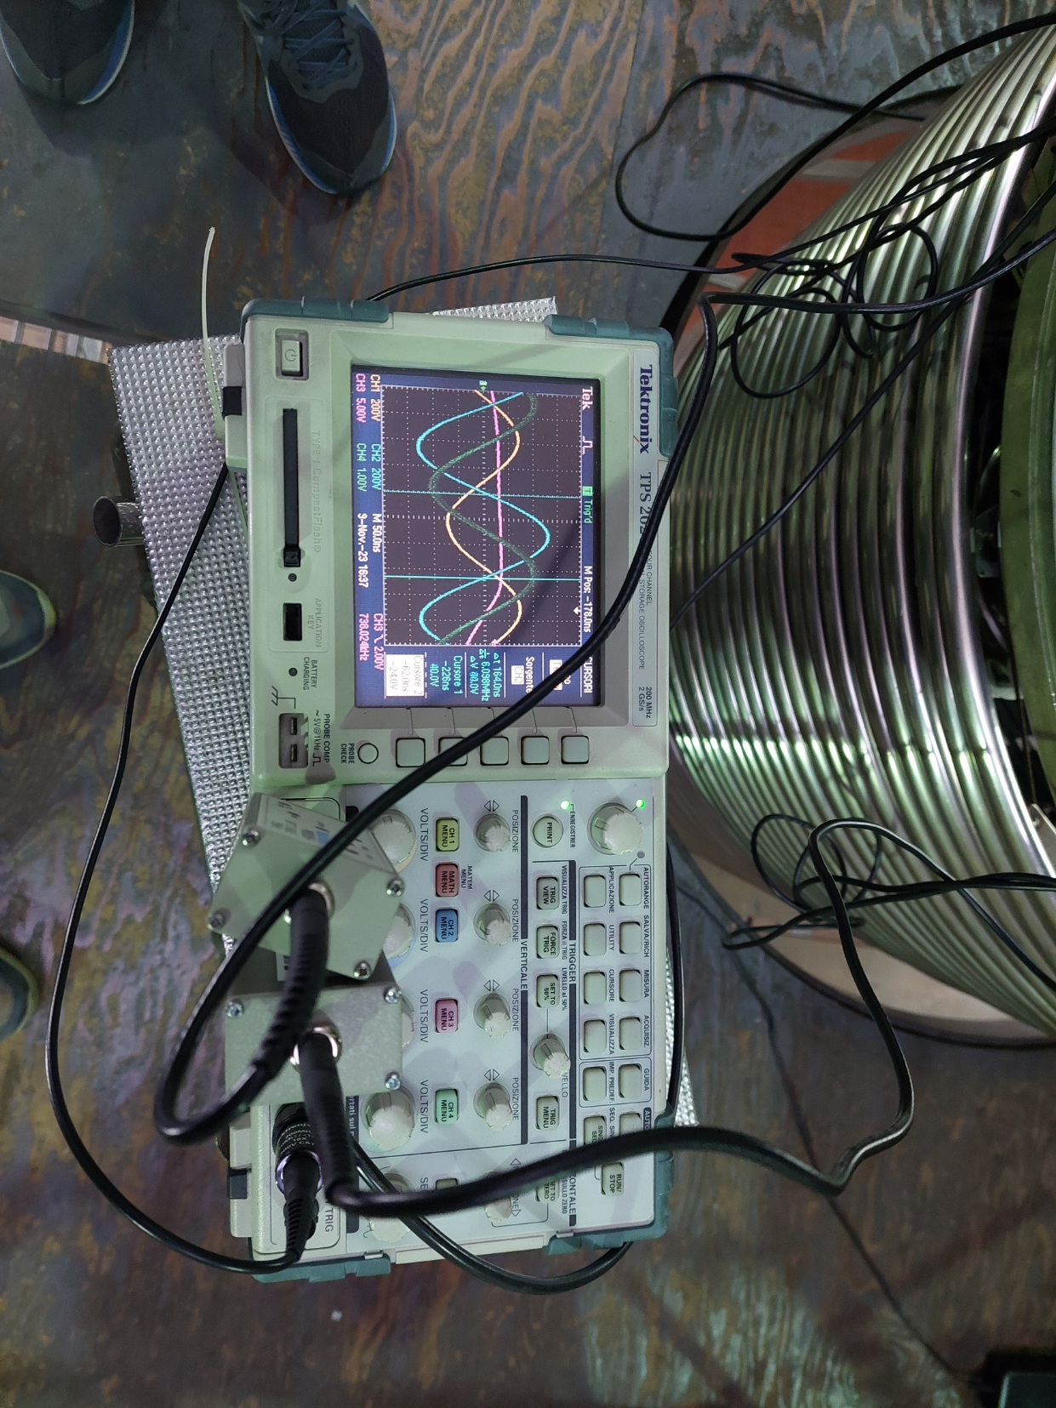
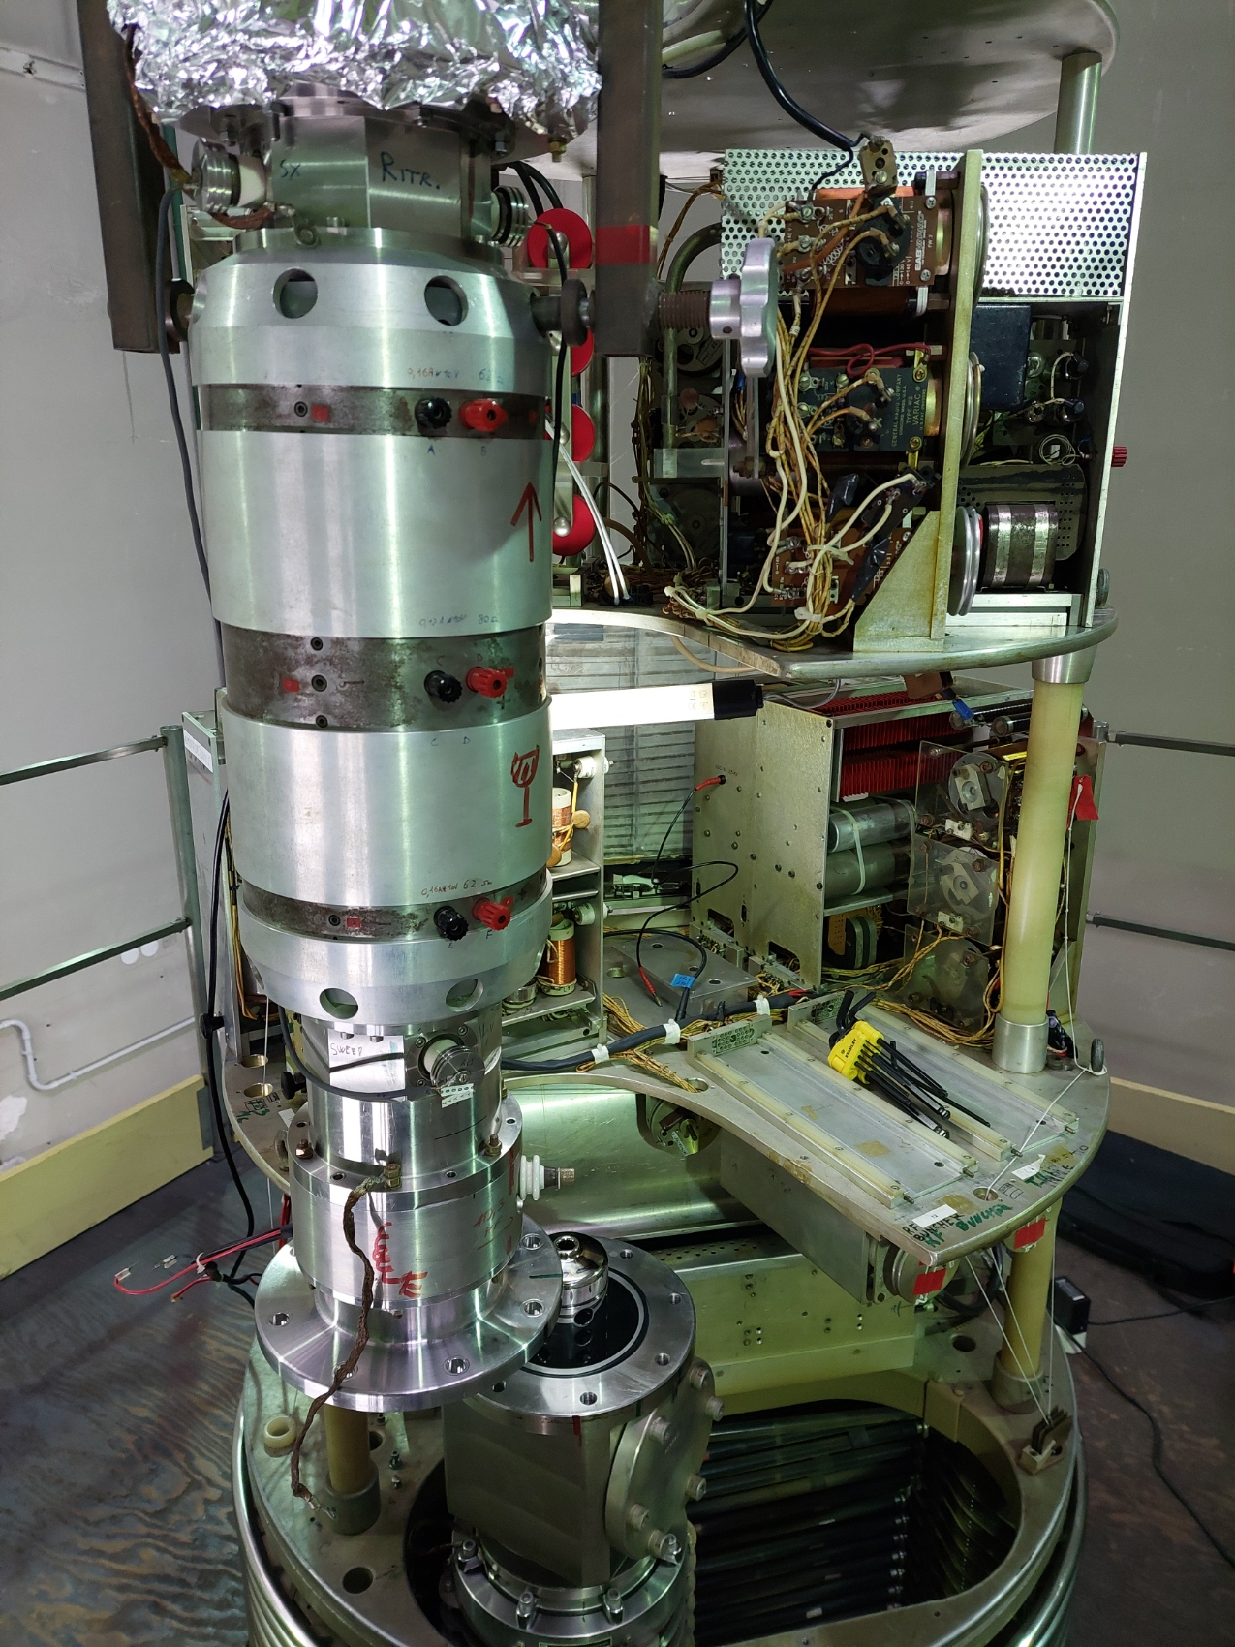
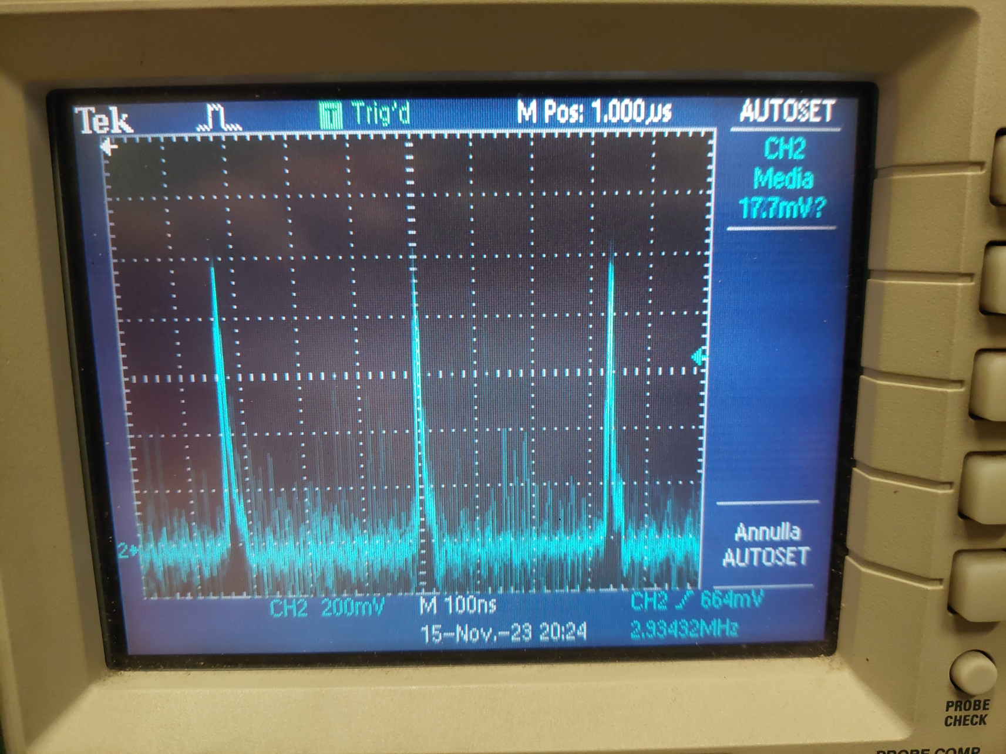
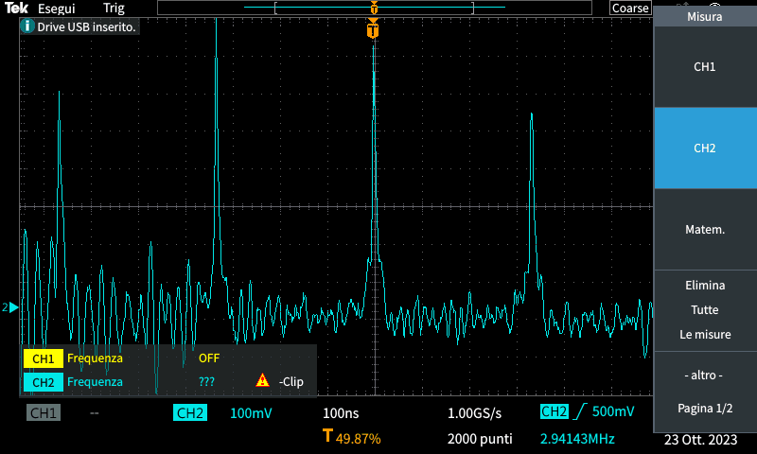
CN accelerator: status
global pulsing system was checked
ion source was changed
after special maintenance 3MHz beam was successfully tested with good compression ratio and peak voltage
during first shift the Behlke 120V power supply experienced a failure and was changed with a new one

Slide 25
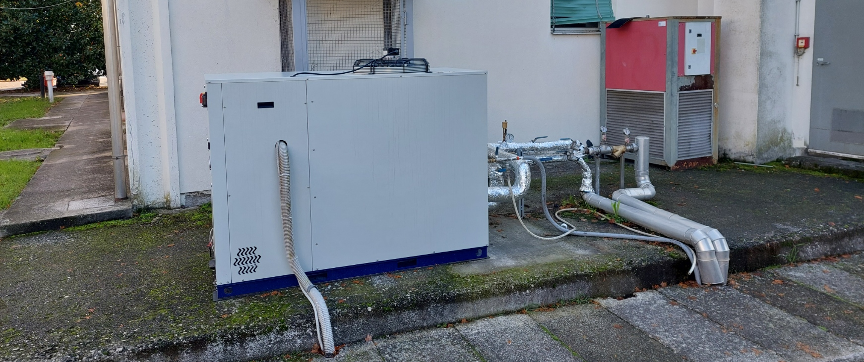
News from AN2000
Sept 2023 – Oct 2023:
A new chiller for water cooling was installed (old one remains as spare)
A small water leak in the cooling distribution causes the pump to stop for low pressure alarm. A temporary patch used till maintenance. Issue will be fixed in January.

Slide 26
CN/AN2000 summary
Considering CN global conditions, maximum voltage for the next experimental campaign will be limited to 5.5 MV
4He2+ beam will not be available
Pulsed beam will be available, but limited in time to three weeks at maximum for each campaign
It will be advisable to schedule experiments requiring pulsed beam near maintenance period: April and July
No comments/restriction on AN2000

Slide 27
Thank you

