Slide 1
DRD3 update: DRDT and WG

Slide 2
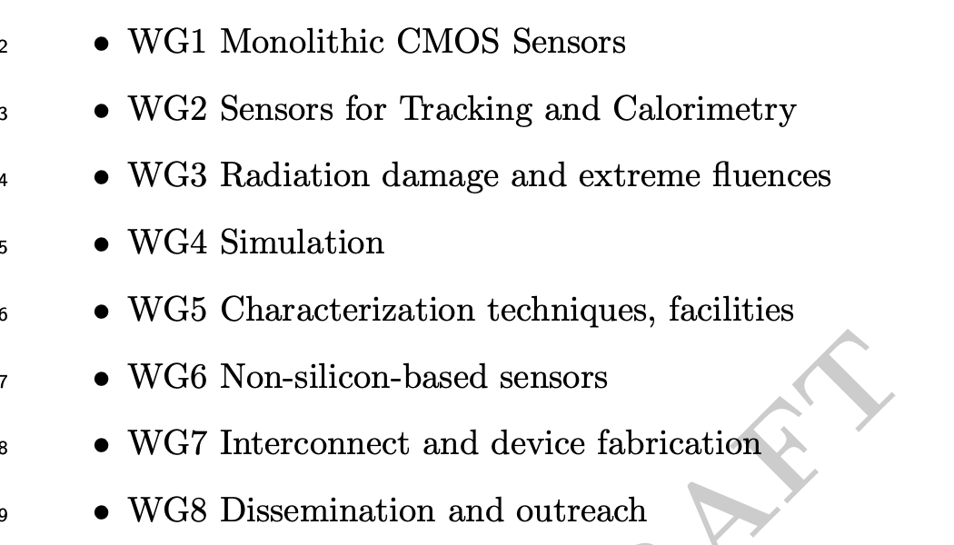
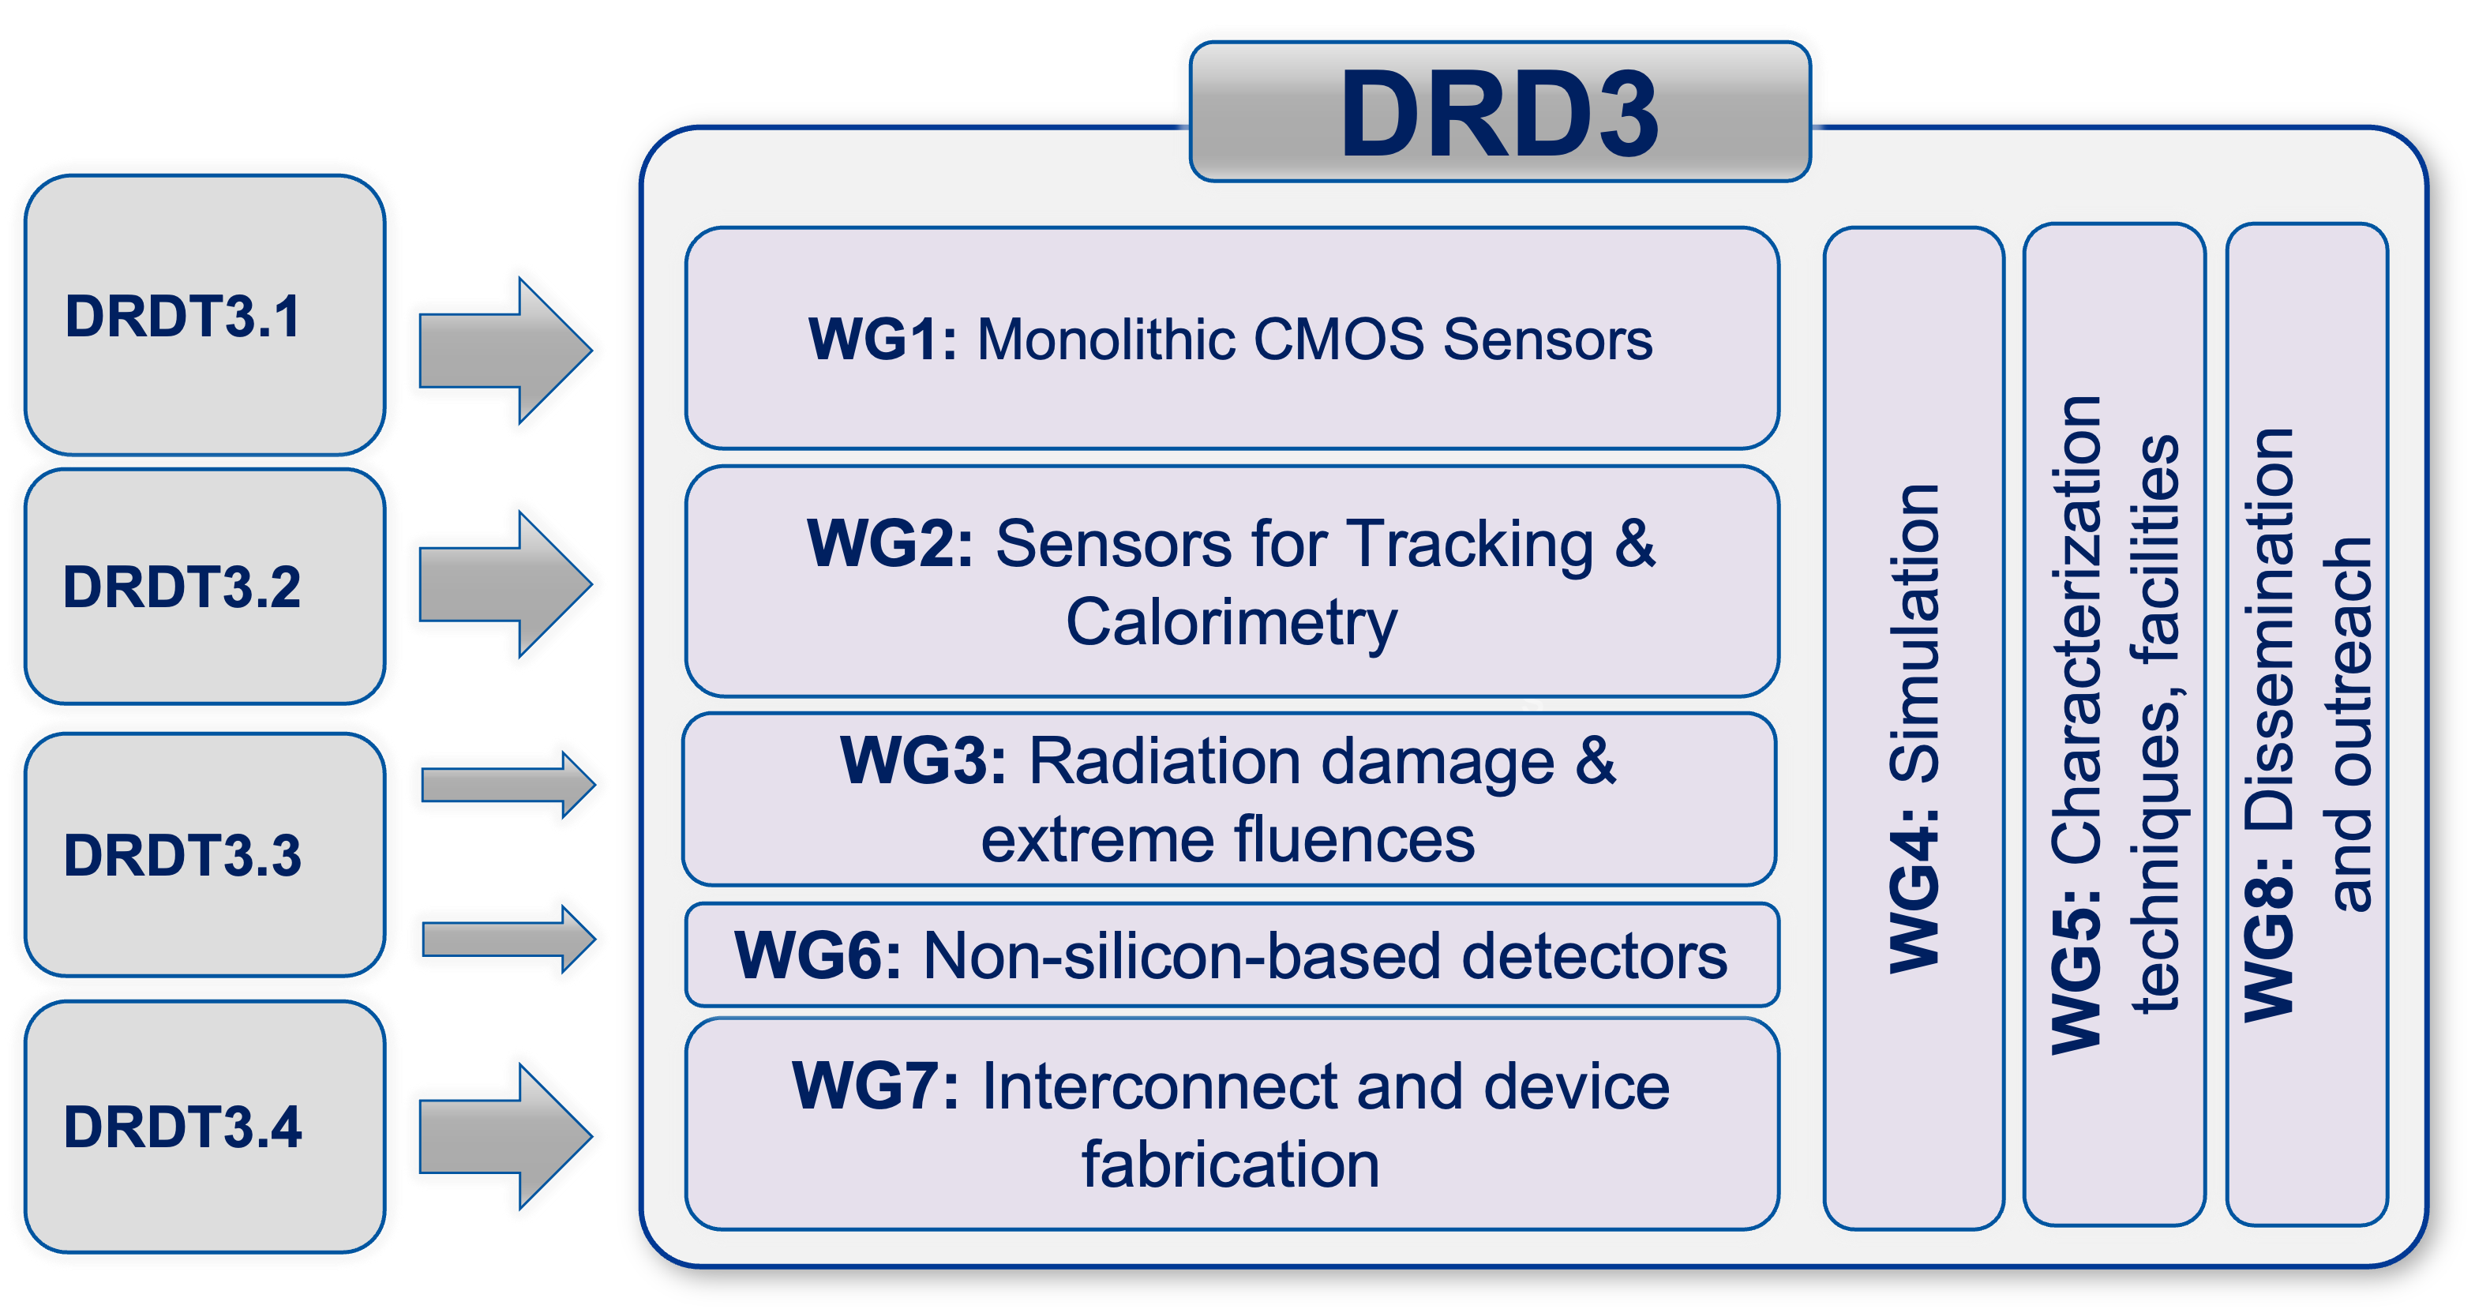
DRD3 update: DRDT and WG
Two building blocks: DRDTs and WGs
From roadmap
Social networks

Slide 3
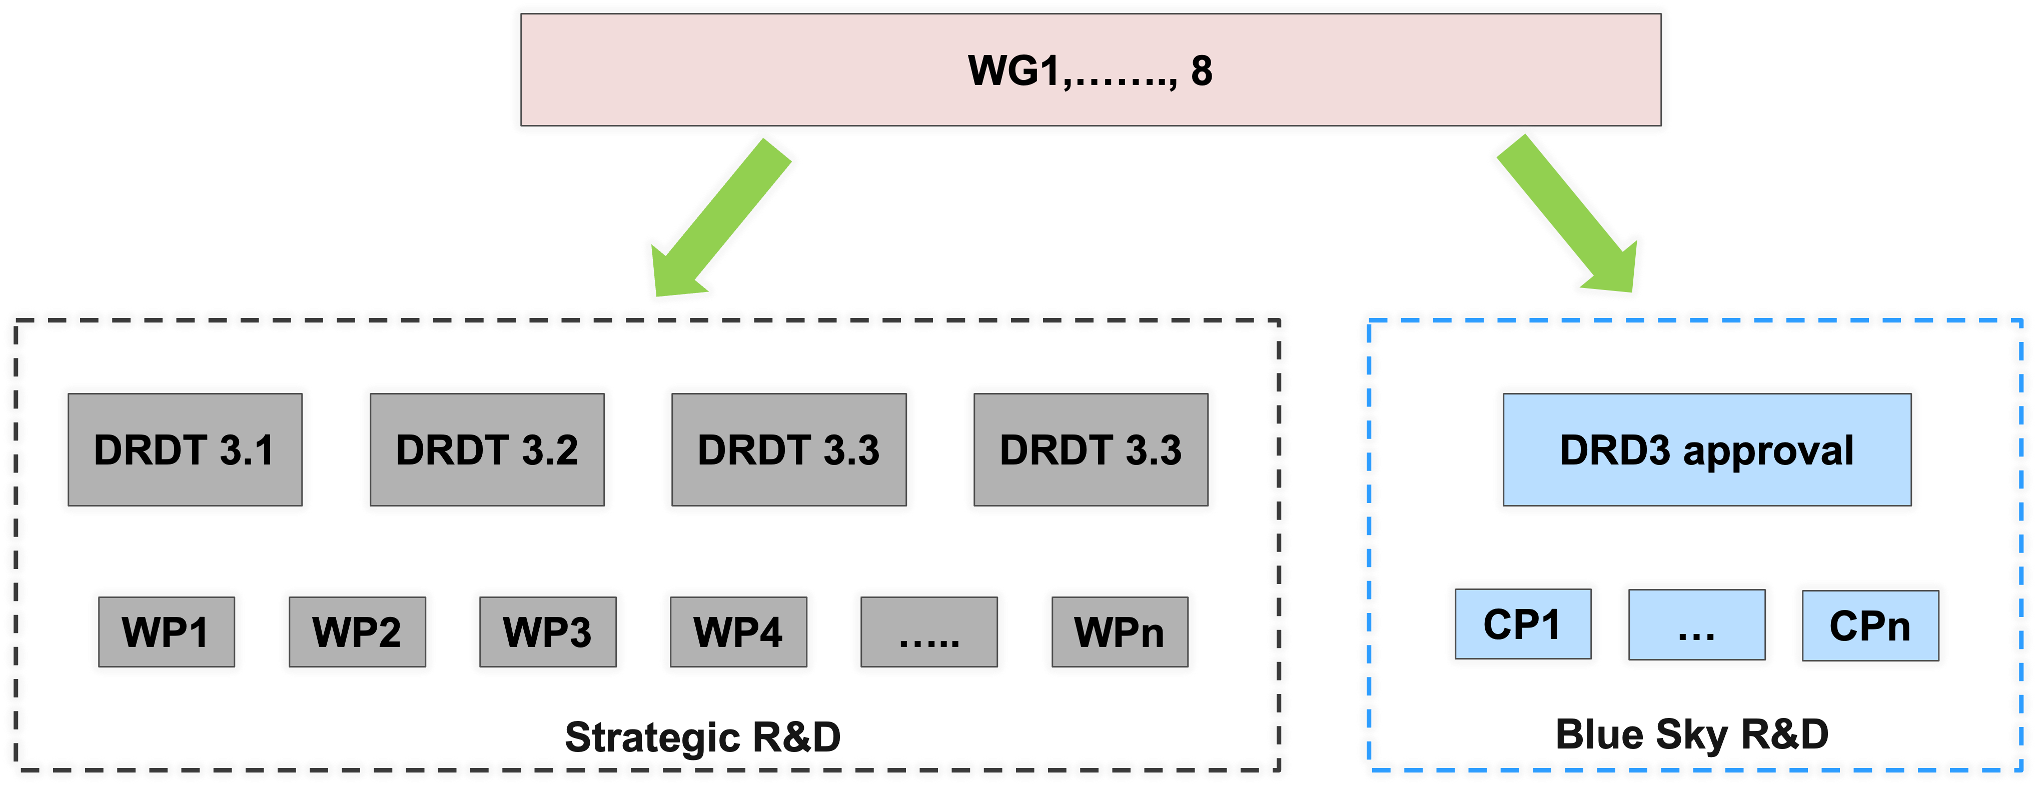
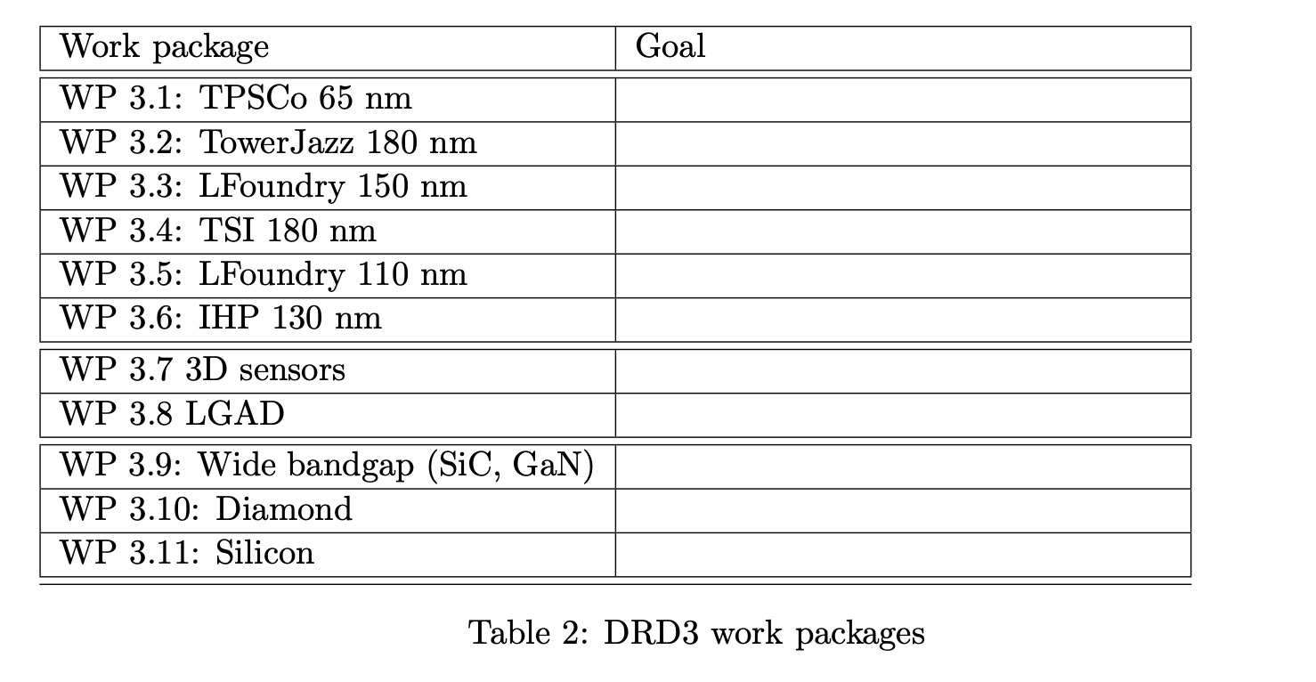
Implementation of the DRD3 mandate
Strategic R&D via Work Package, identified by technology
Blue sky R&D via common project, approved by the DRD3
Projects to be defined by the community

Slide 4
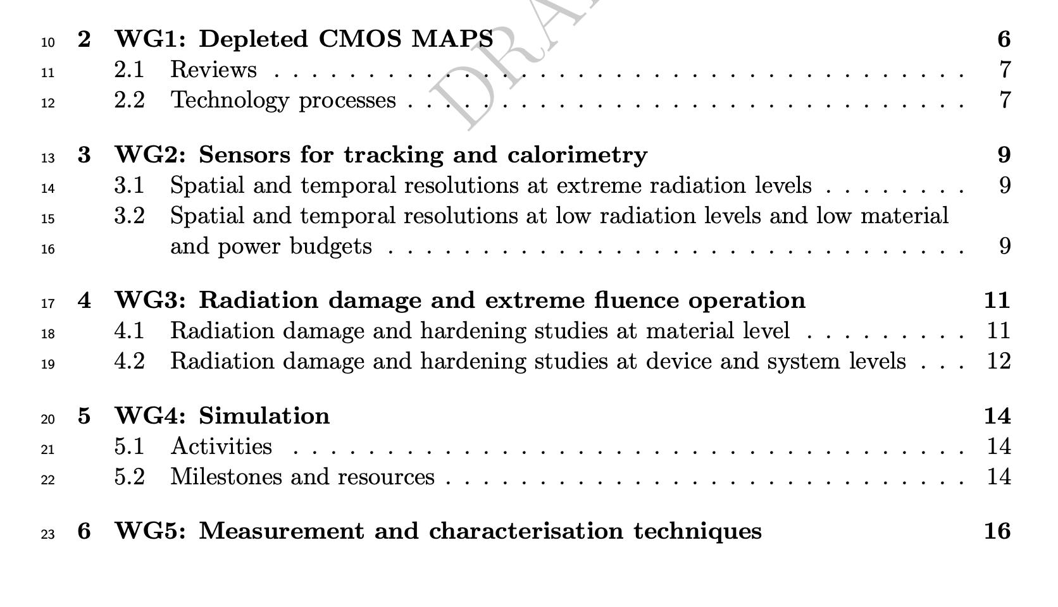
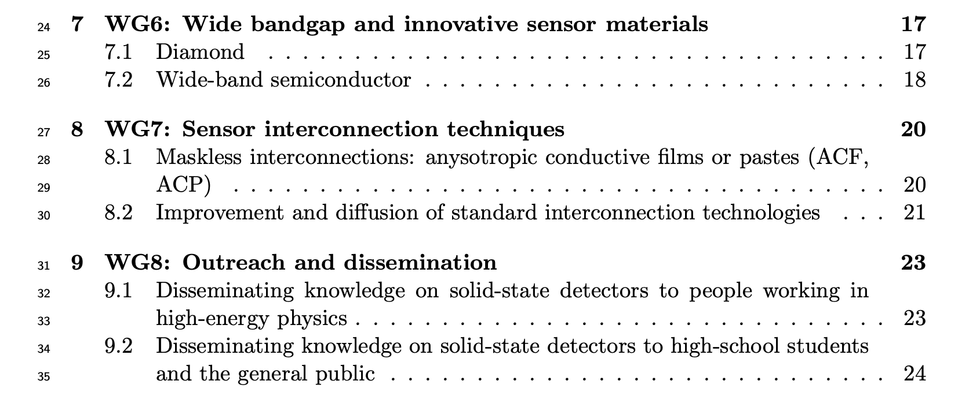
WG description

Slide 5
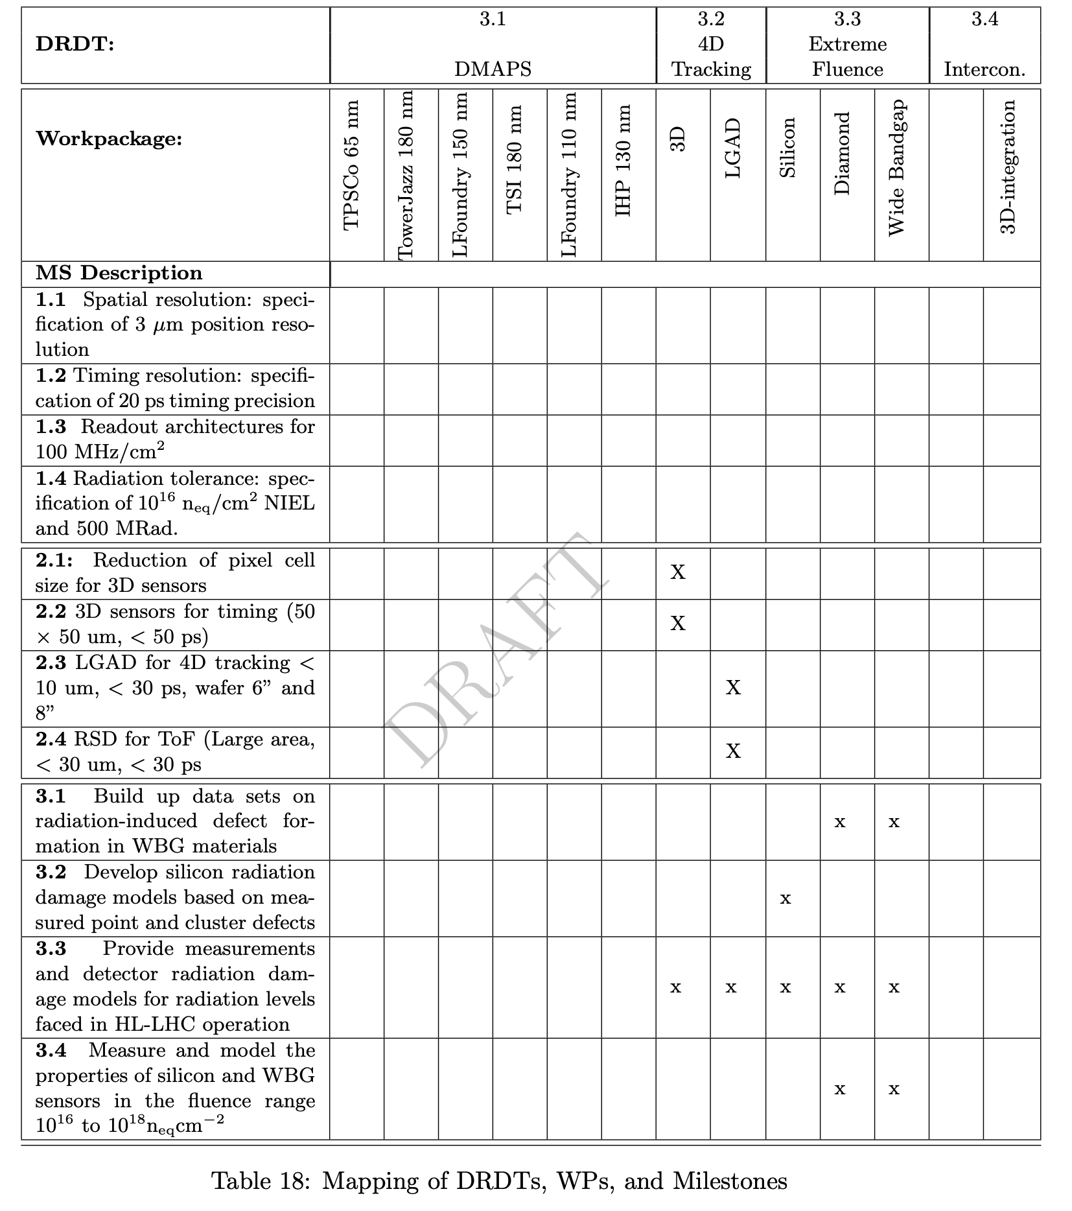
Relationship between WG and WP
WGs define the milestones geared to meet the WP (strategic) and CP (blue sky) goals

Slide 6
Forming the collaboration

Slide 7
Next Questionnaire
Shortly, we will send a new questionnaire to the community.
This questionnaire will ask to indicate to which Milestones each group is interested and with what resources.

Slide 8
DRD3 interplay with DRDn, Industry
The most considerable interplay is with DRD7 (electronics), on the field of DMAPS
Presently, there is no DRD3 group that has expressed interest in silicon for calorimetry. We still need to develop this field
Industry: the present plan is to collaborate with industry in the same way we did in RD50

