Slide 1
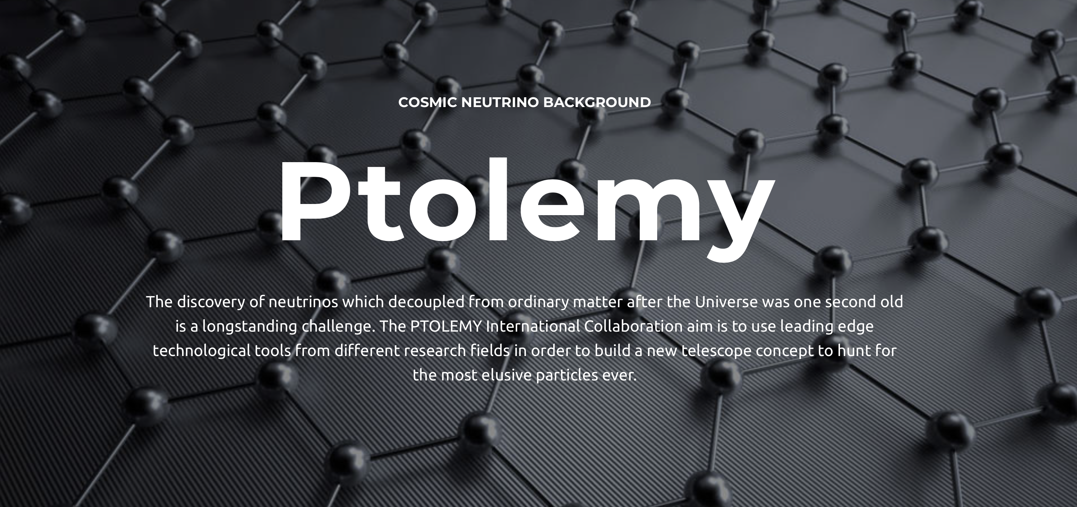

E-Gun Injection from a Zero Field Chamber
Chris Tully (Princeton)
26 June 2023
LNGS
PTOLEMY General Meeting
http://ptolemy.lngs.infn.it

Slide 2
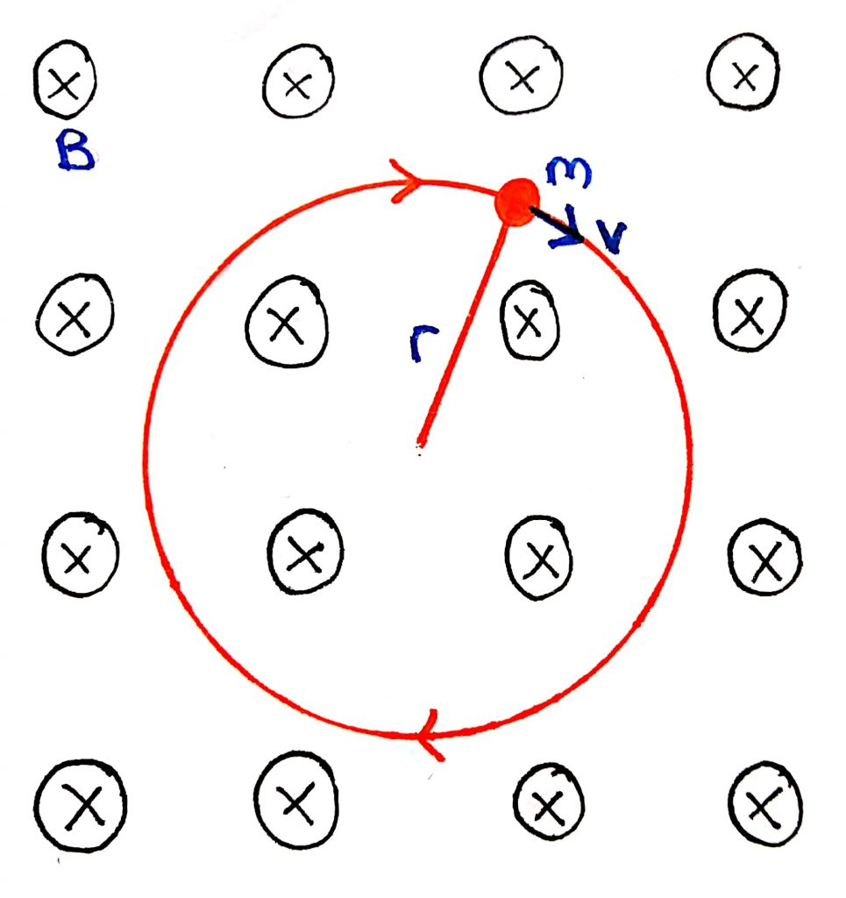
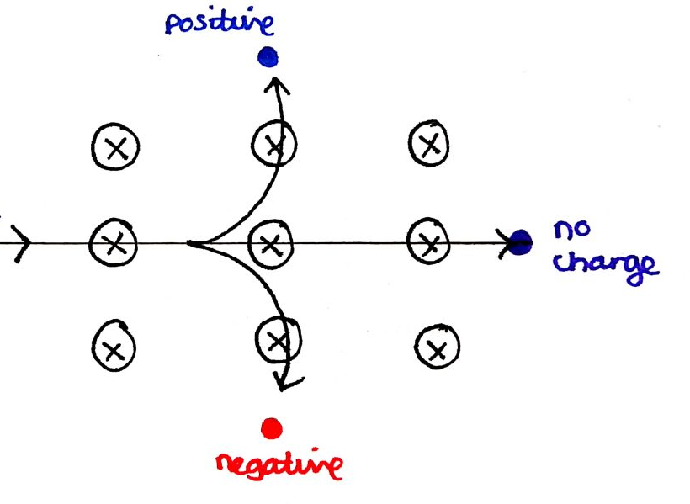
Motion of a Charged Particle in a B Field

Slide 3
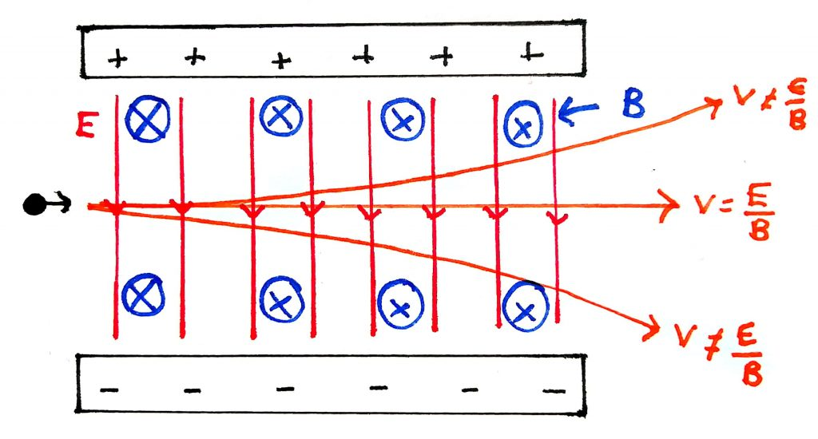
Classic Velocity Selector
Is this the only way to select velocity?

Slide 4
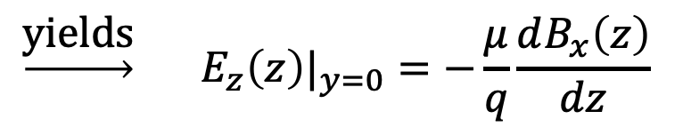
PTOLEMY Filter Concept
Auke Pieter Colijn (PATRAS 2019)
y
x
x
z
Enforce zero drift in y (rotate E):
$$\underset{→}{\text{yields}} {E_{z}\left(z\right)|}_{y=0}=−\frac{μ}{q}\frac{dB_{x}\left(z\right)}{dz}$$

Slide 5
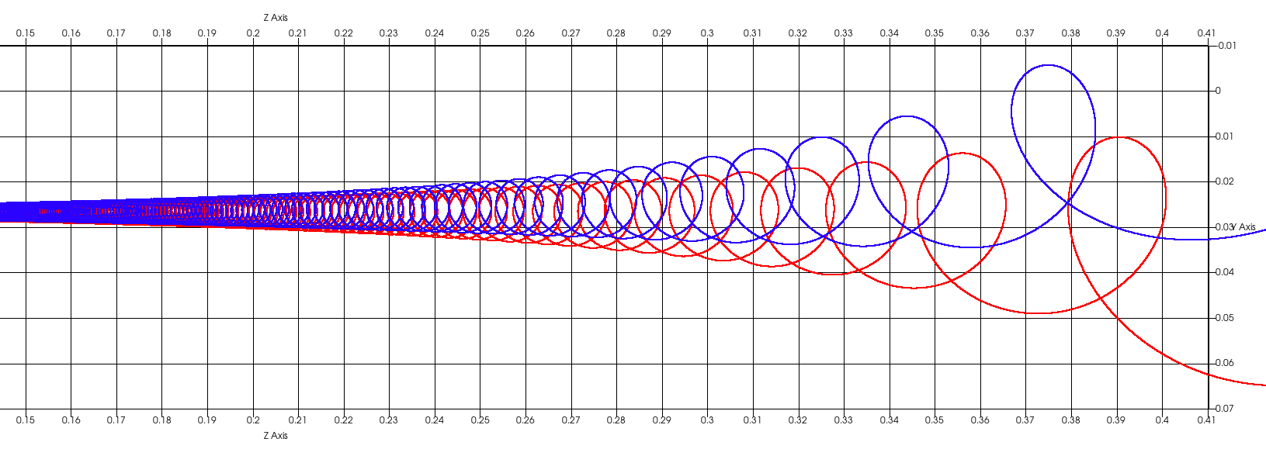
Bingo!
High
B Field
Low
B Field
Selected velocity based on cyclotron drift
New type of particle accelerator (useful for fusion reactor heating)
https://www.intechopen.com/chapters/82927

Slide 6
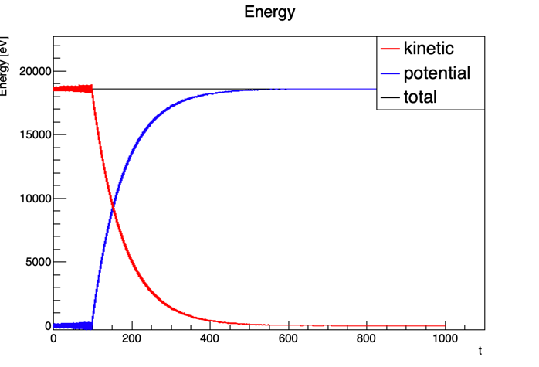
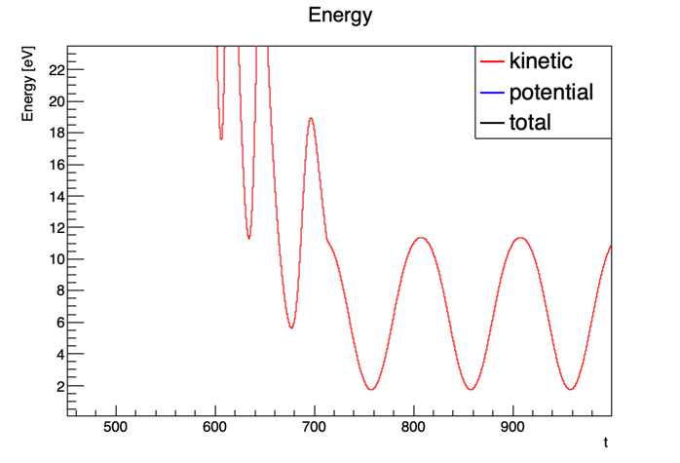
Lorentz4 Code
https://github.com/gkrossi/lorentz4
LNGS software
Nicola Rossi
Marcello Messina
18,600eV
[ns]
[ns]

Slide 7
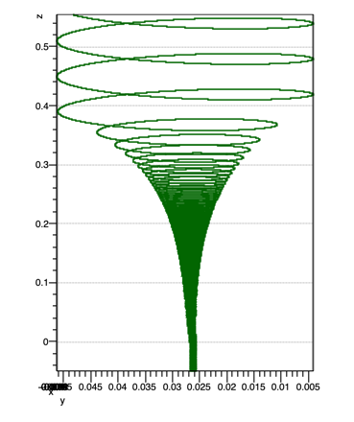
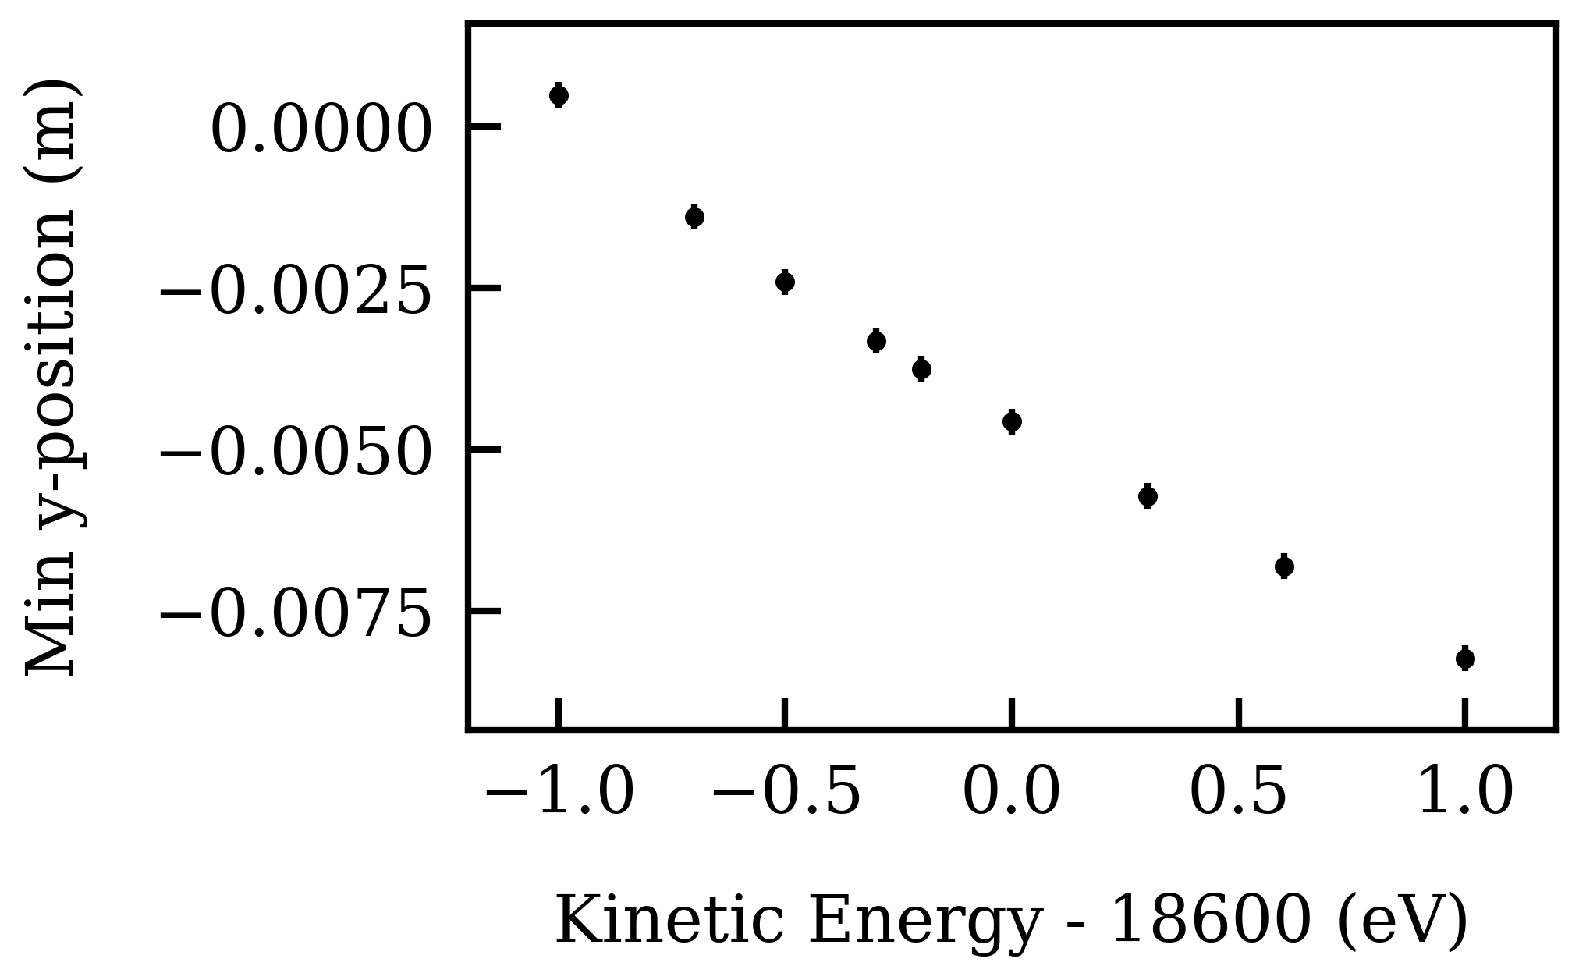
How well can one select velocities?
400mm
Deflection is ~ 4mm/eV
(over a drift distance of 400mm)
45mm

Slide 8
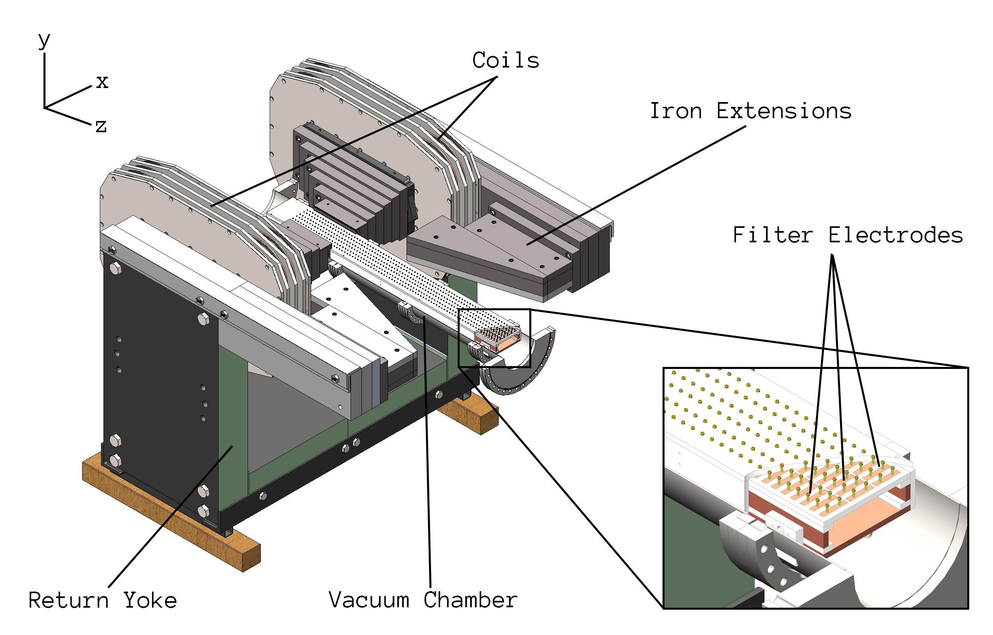
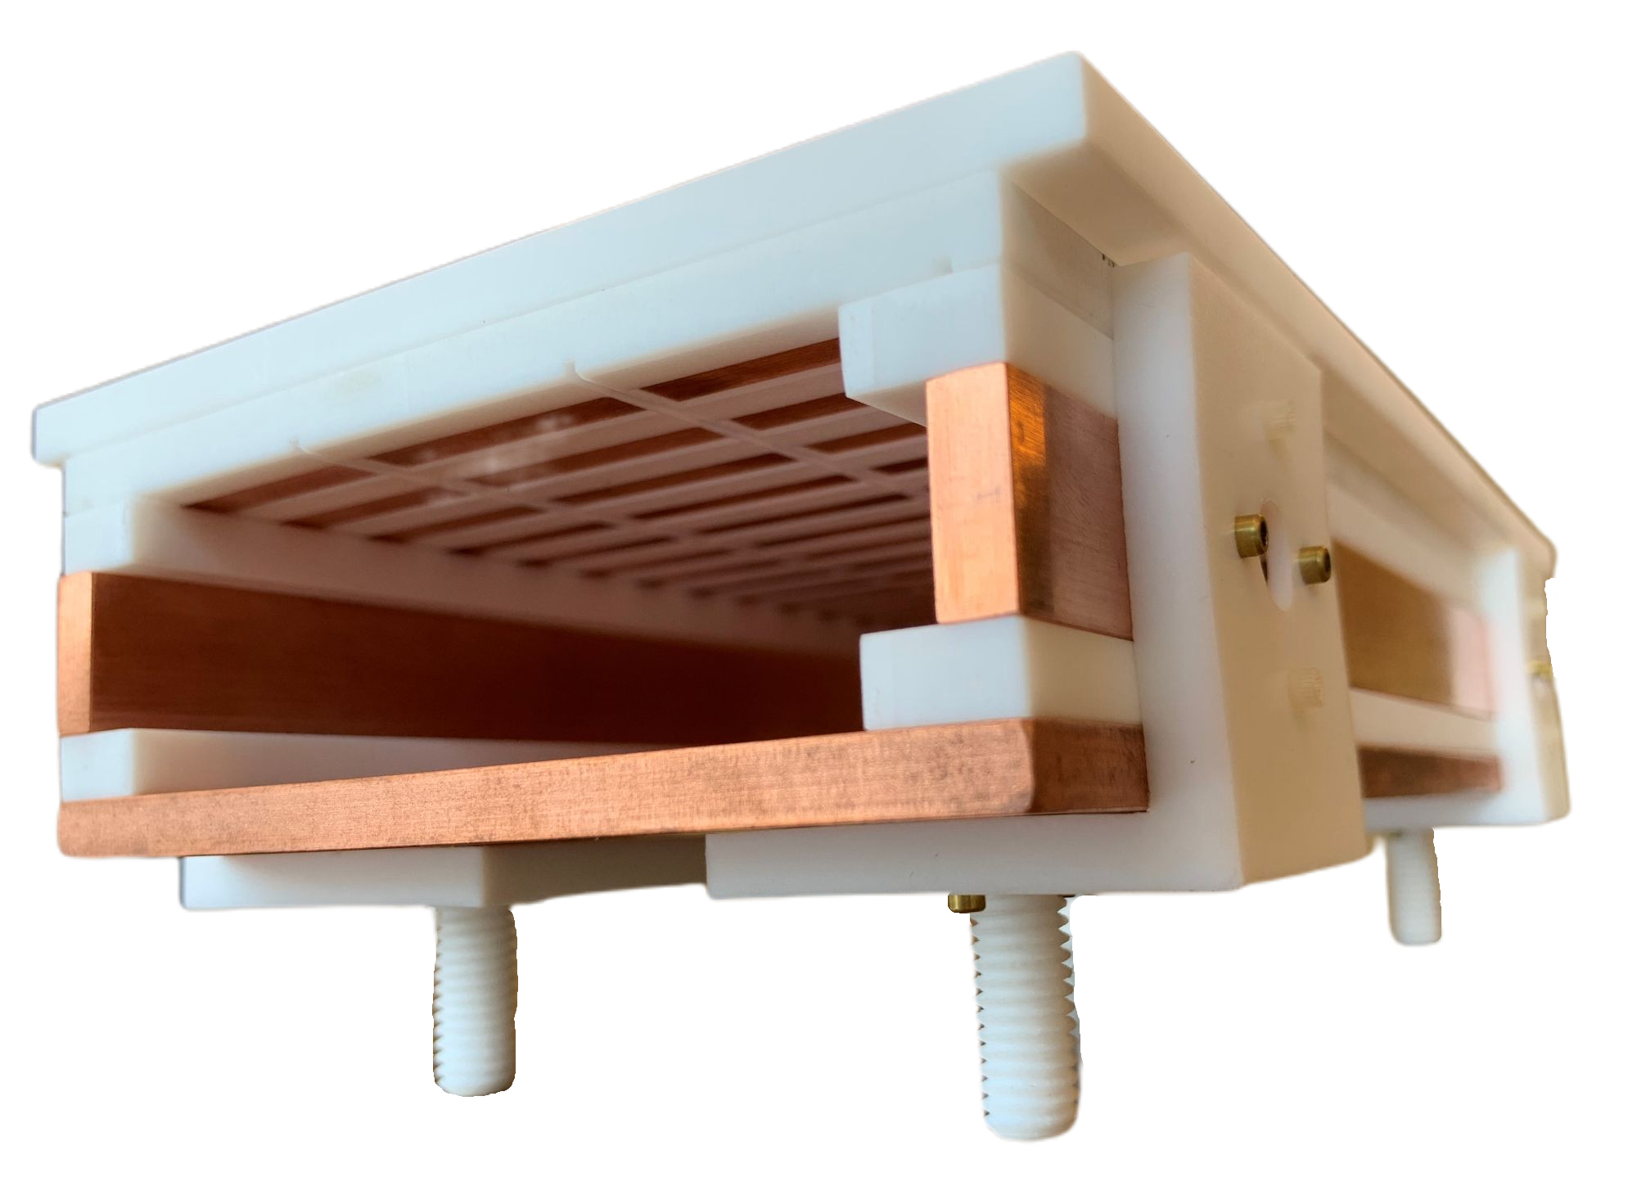
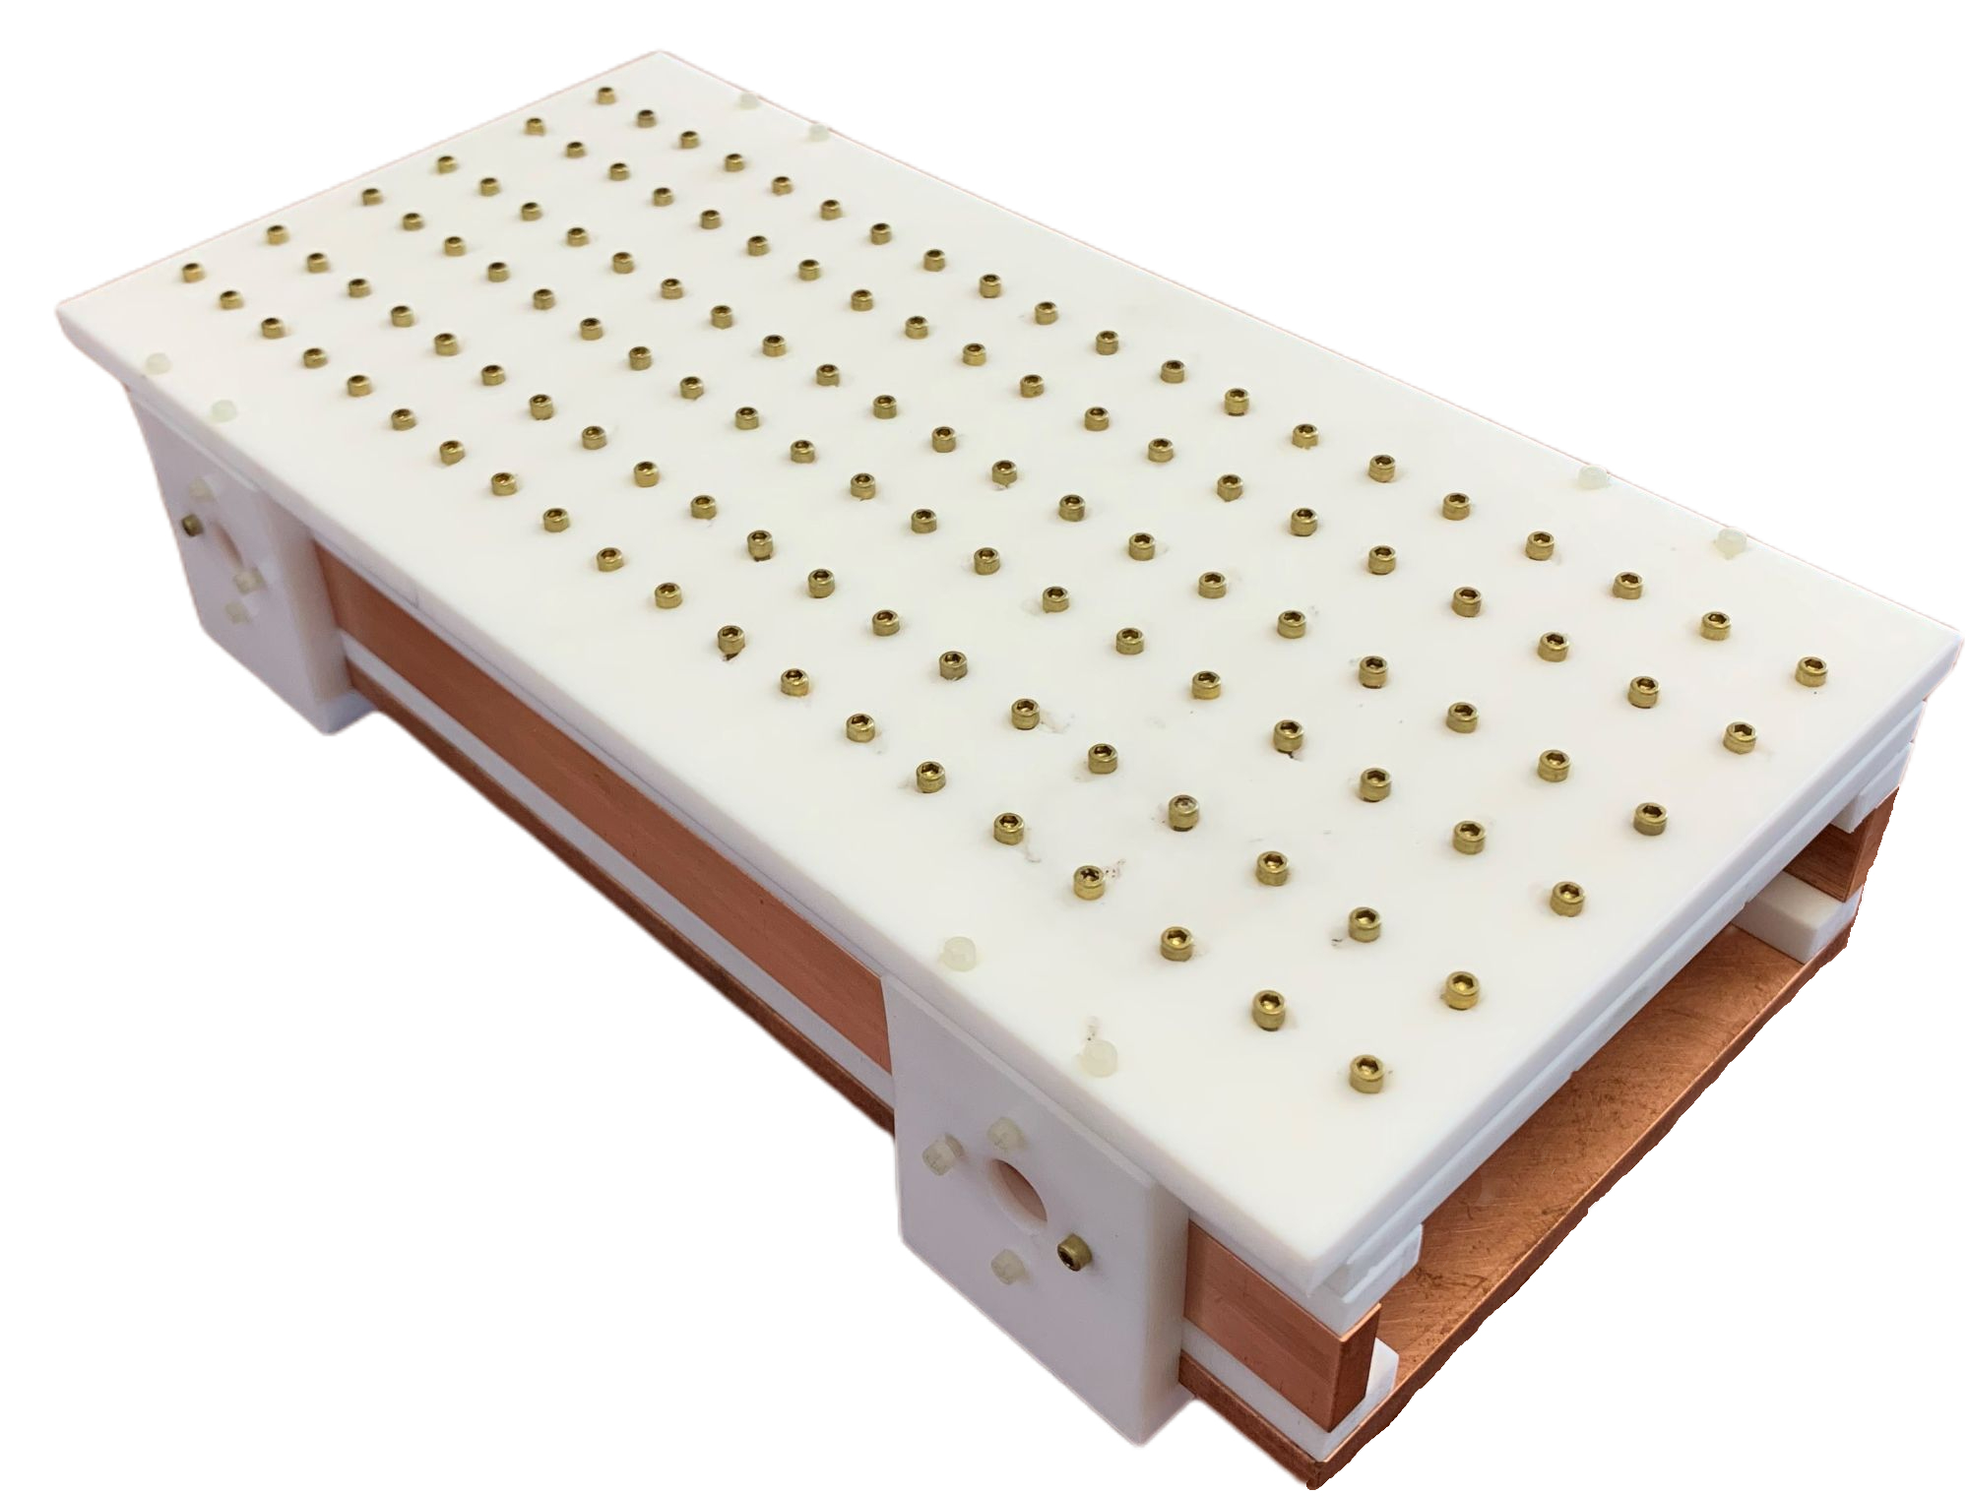
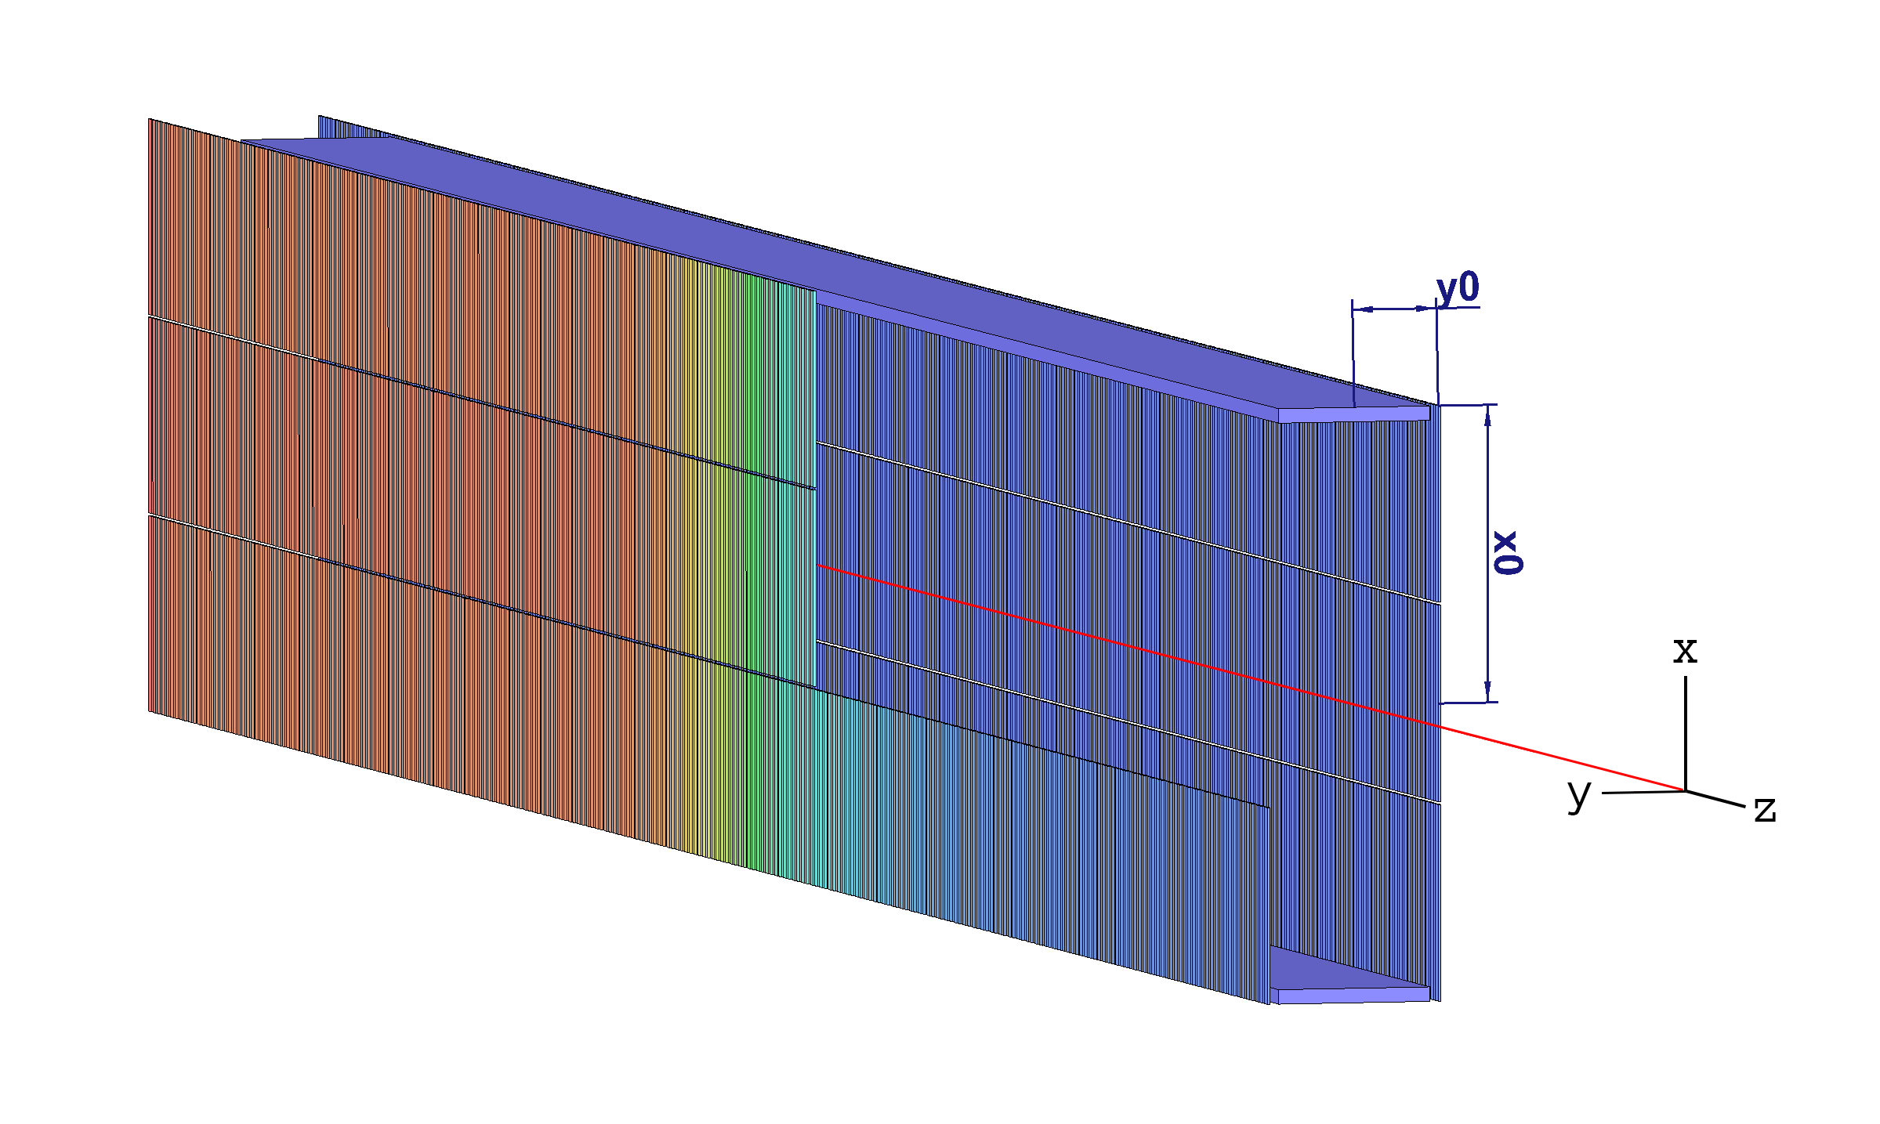
Electrode Prototype
Andi Tan (Princeton)
Wonyong Chung (Princeton)
Electrode Voltages

Slide 9
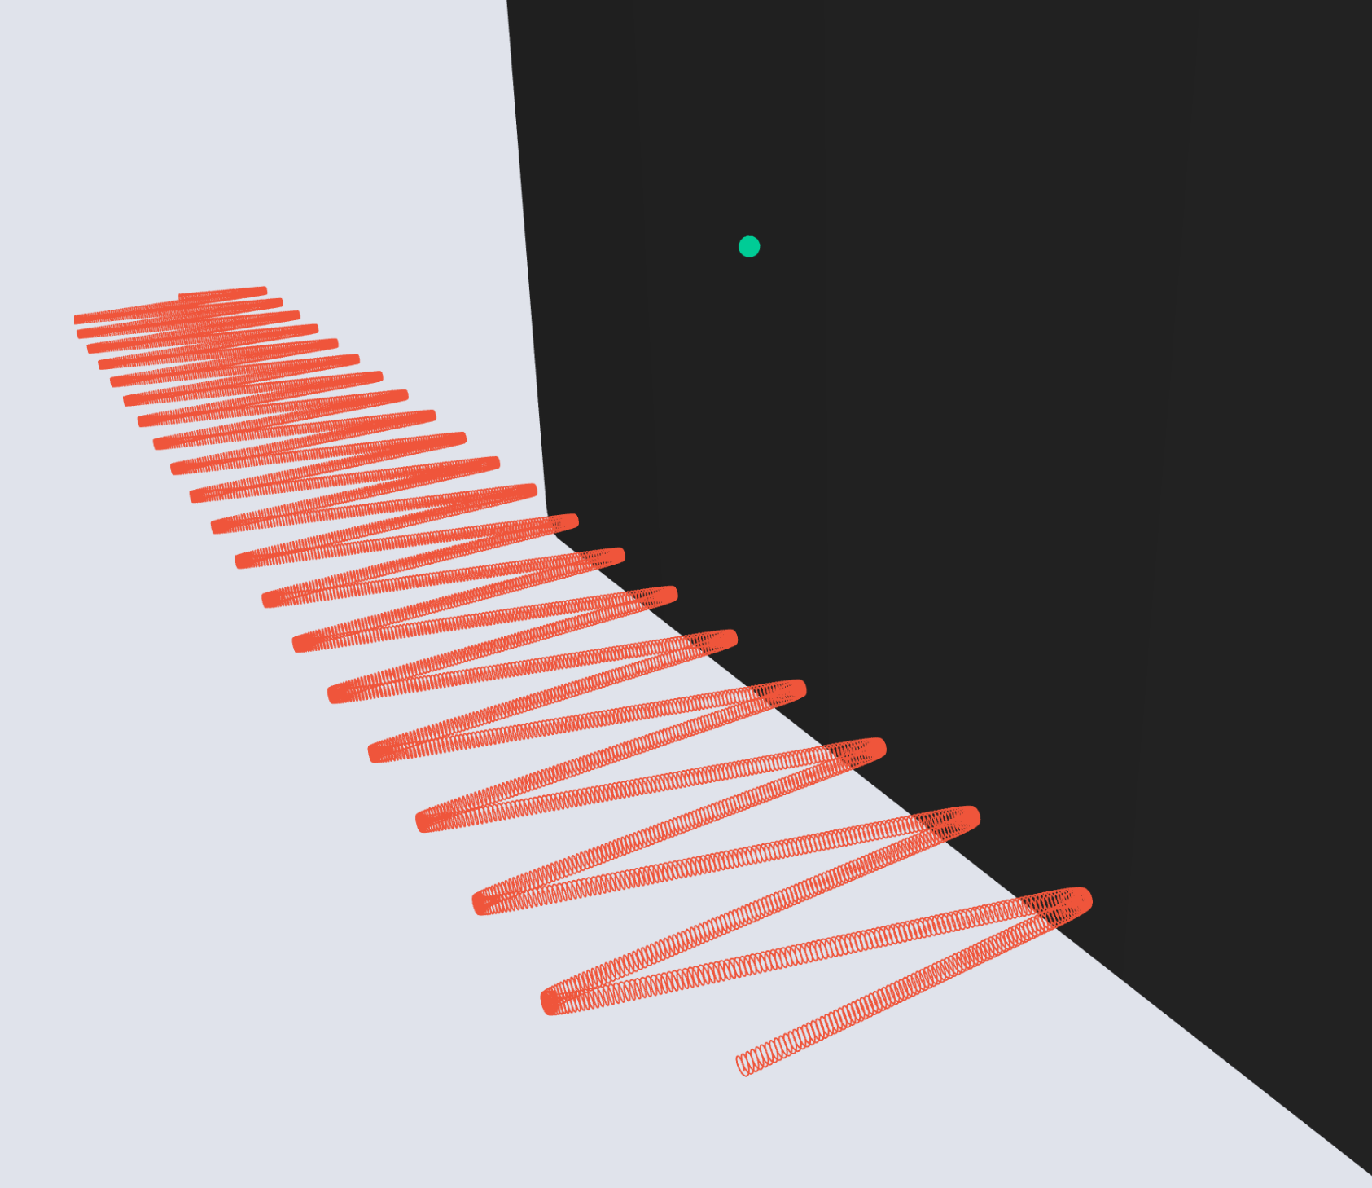
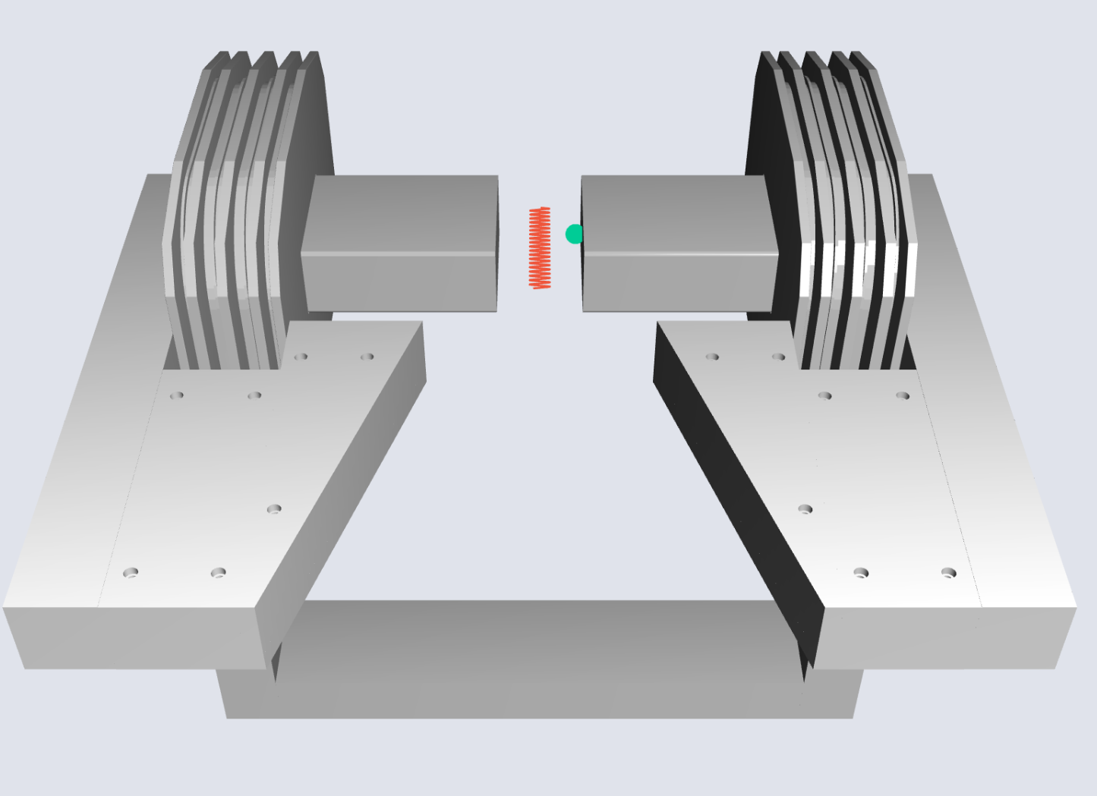
Pitch 85 Long Trajectory
Andi Tan (Princeton)

Slide 10
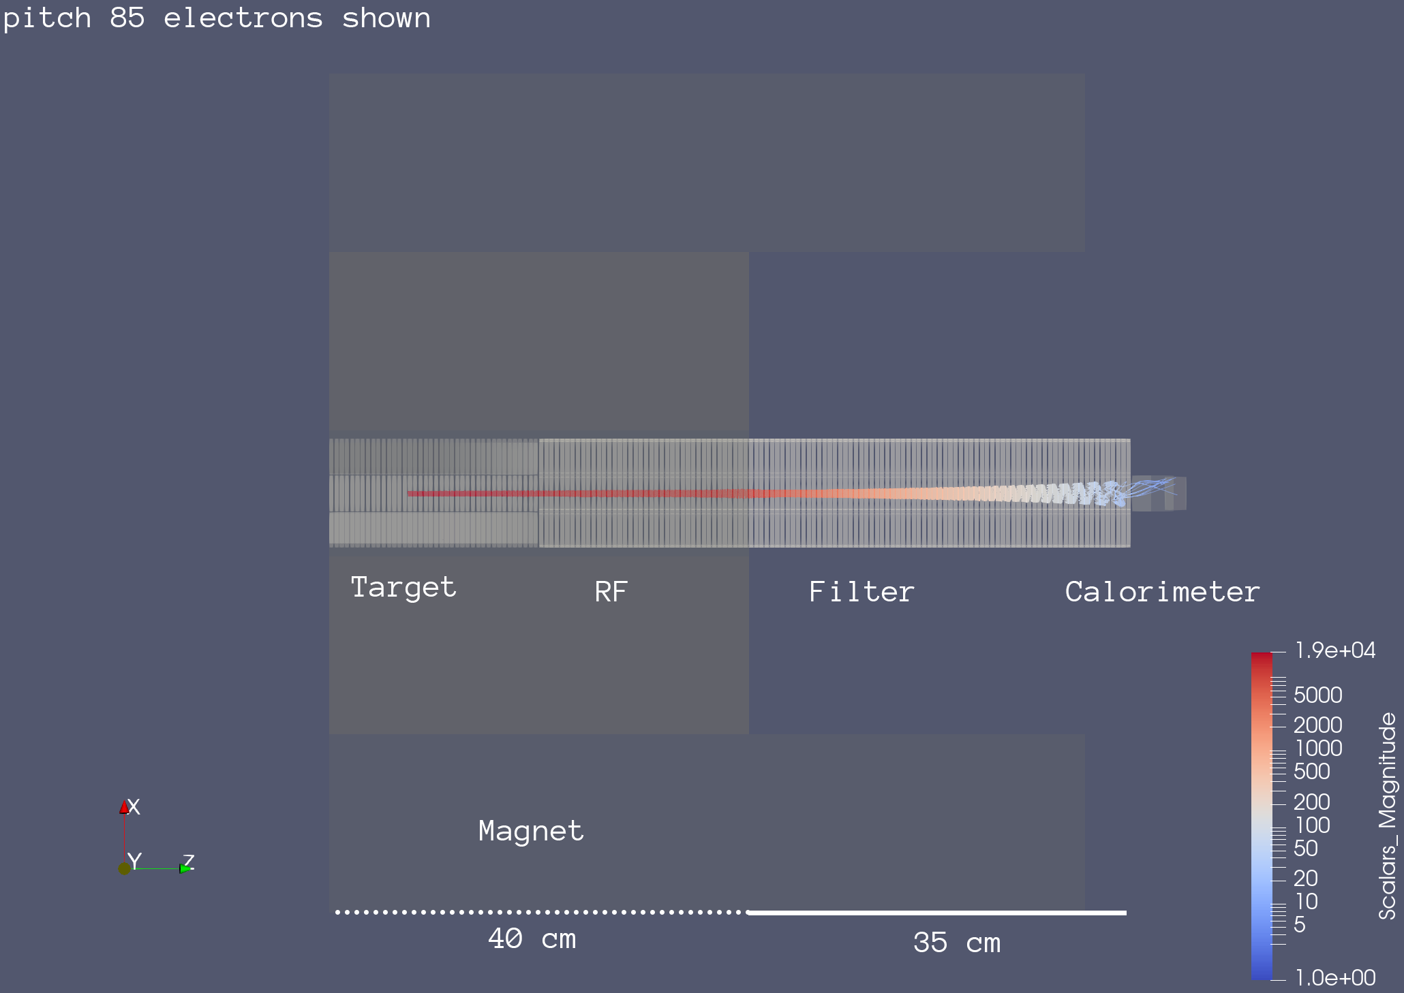
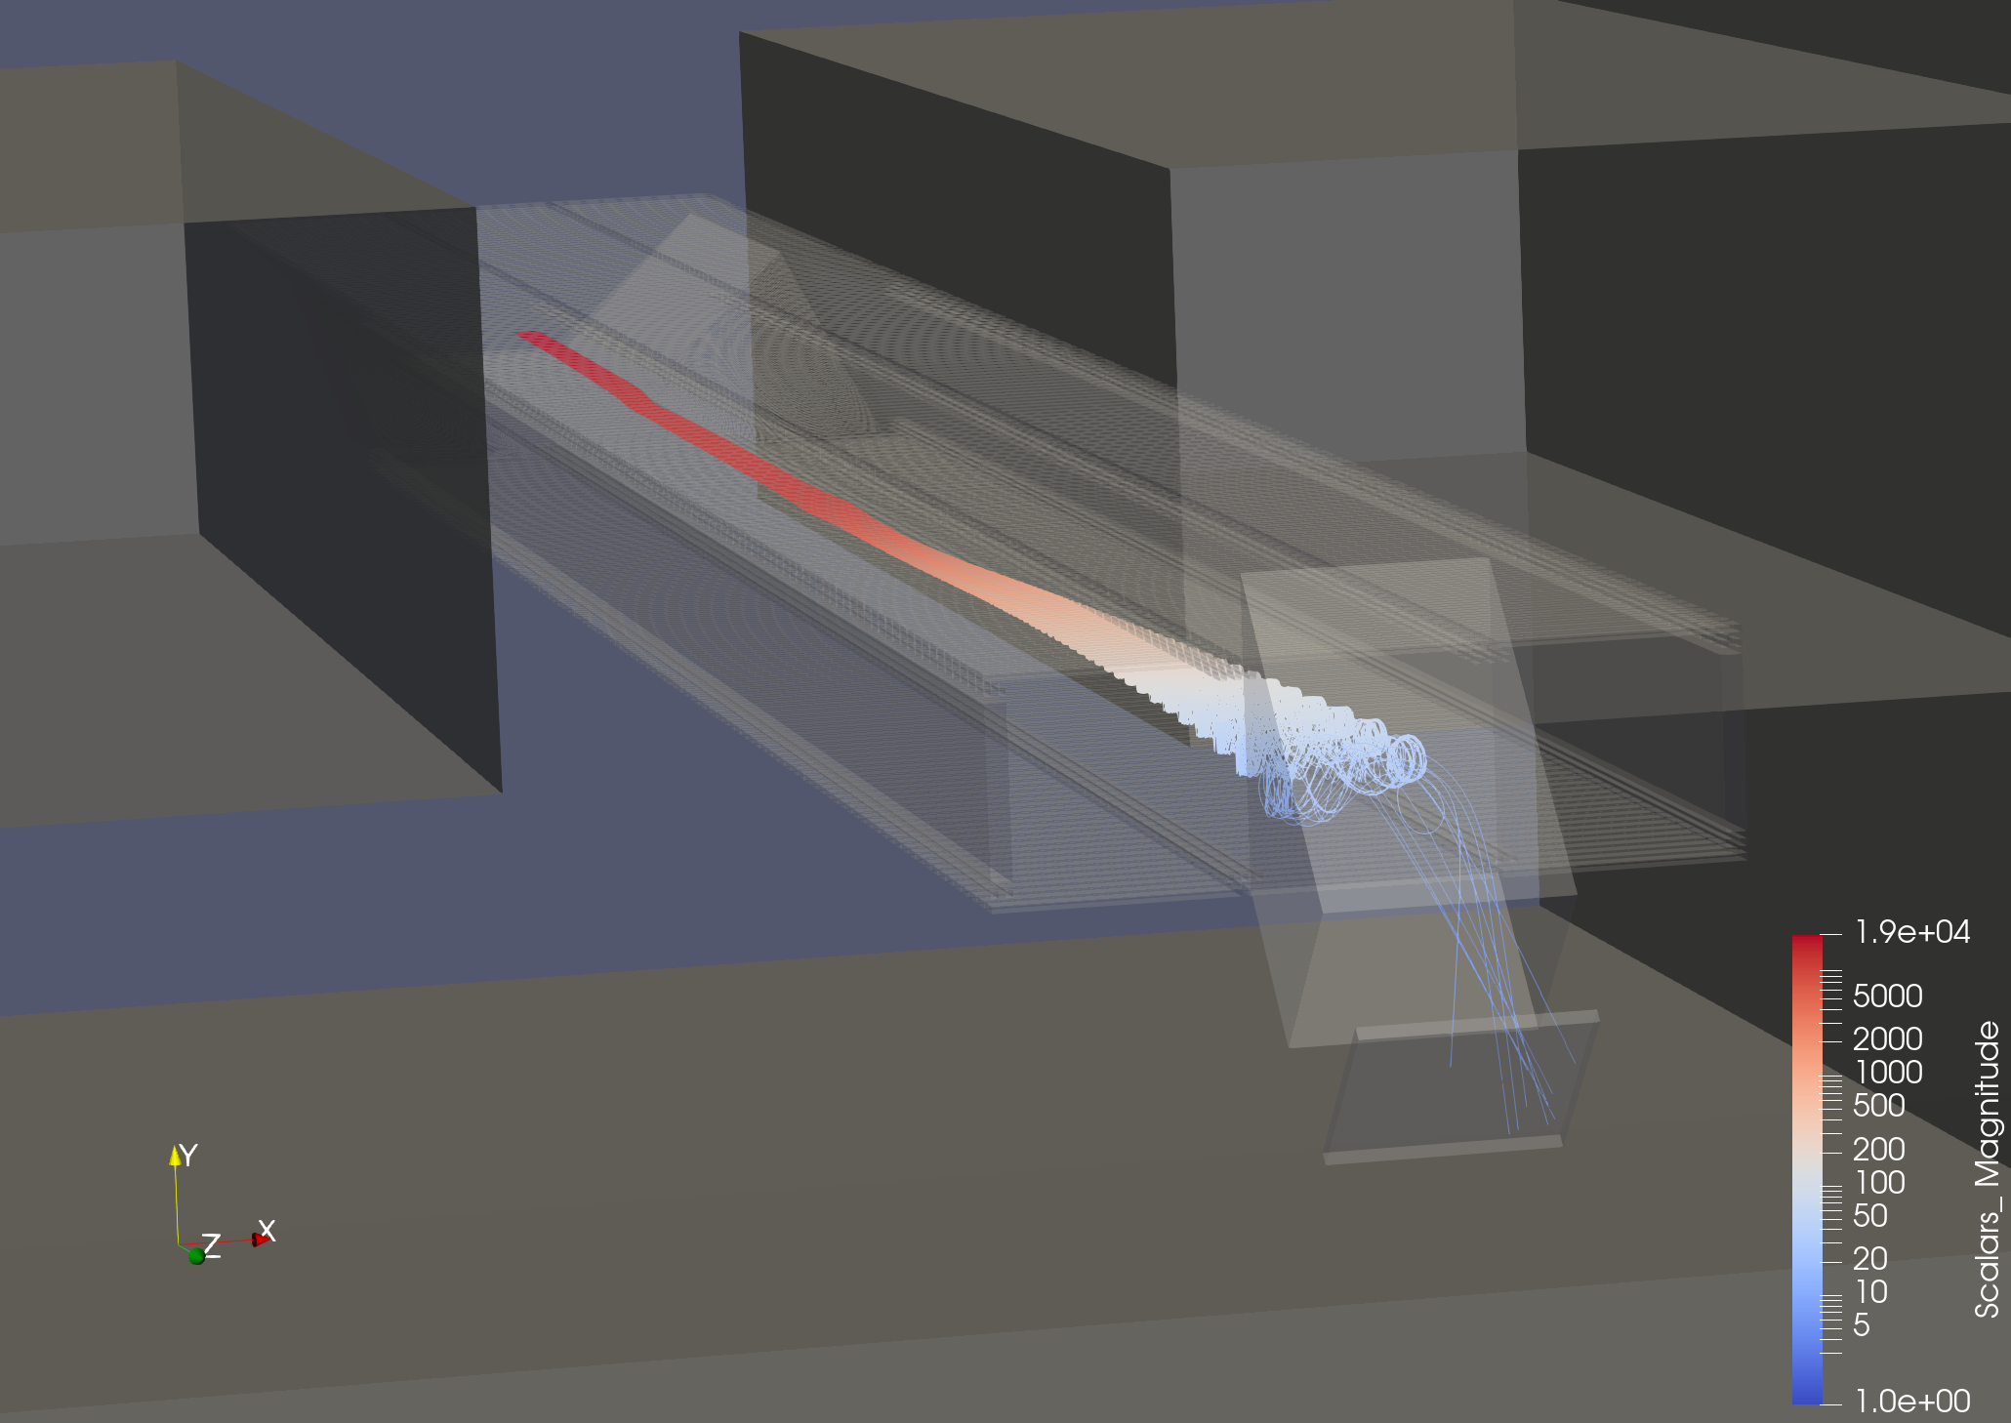
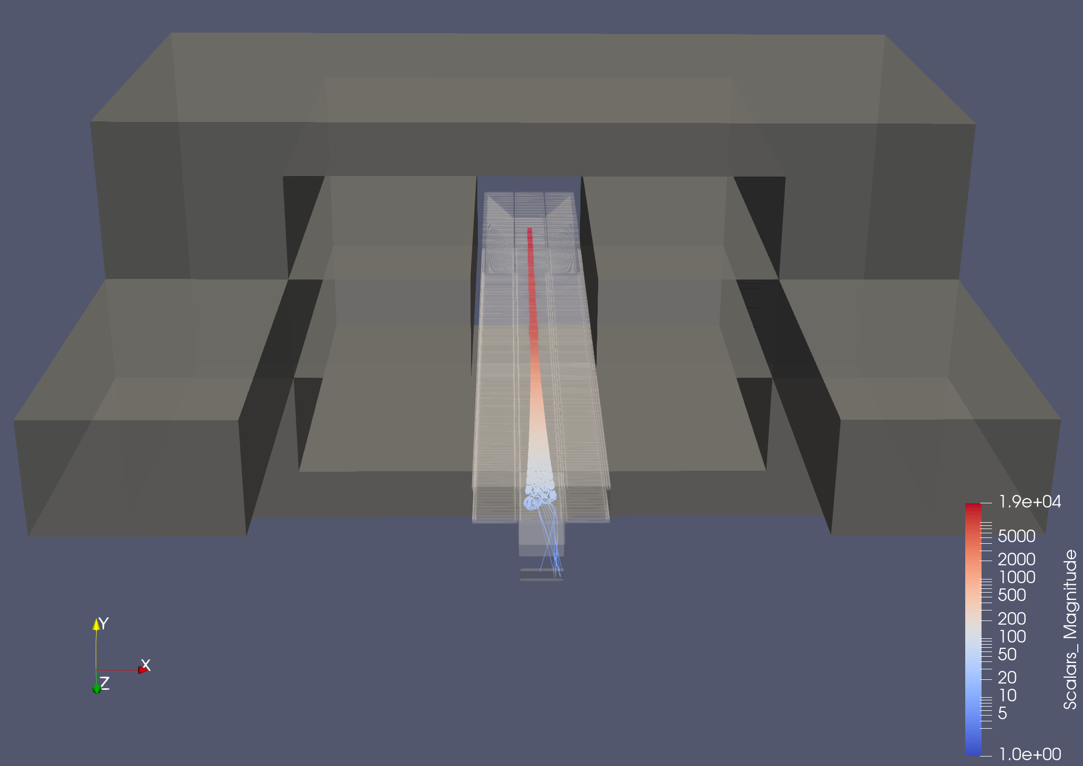
End-to-end Transport w/Kassiopeia
Wonyong Chung (Princeton)

Slide 11
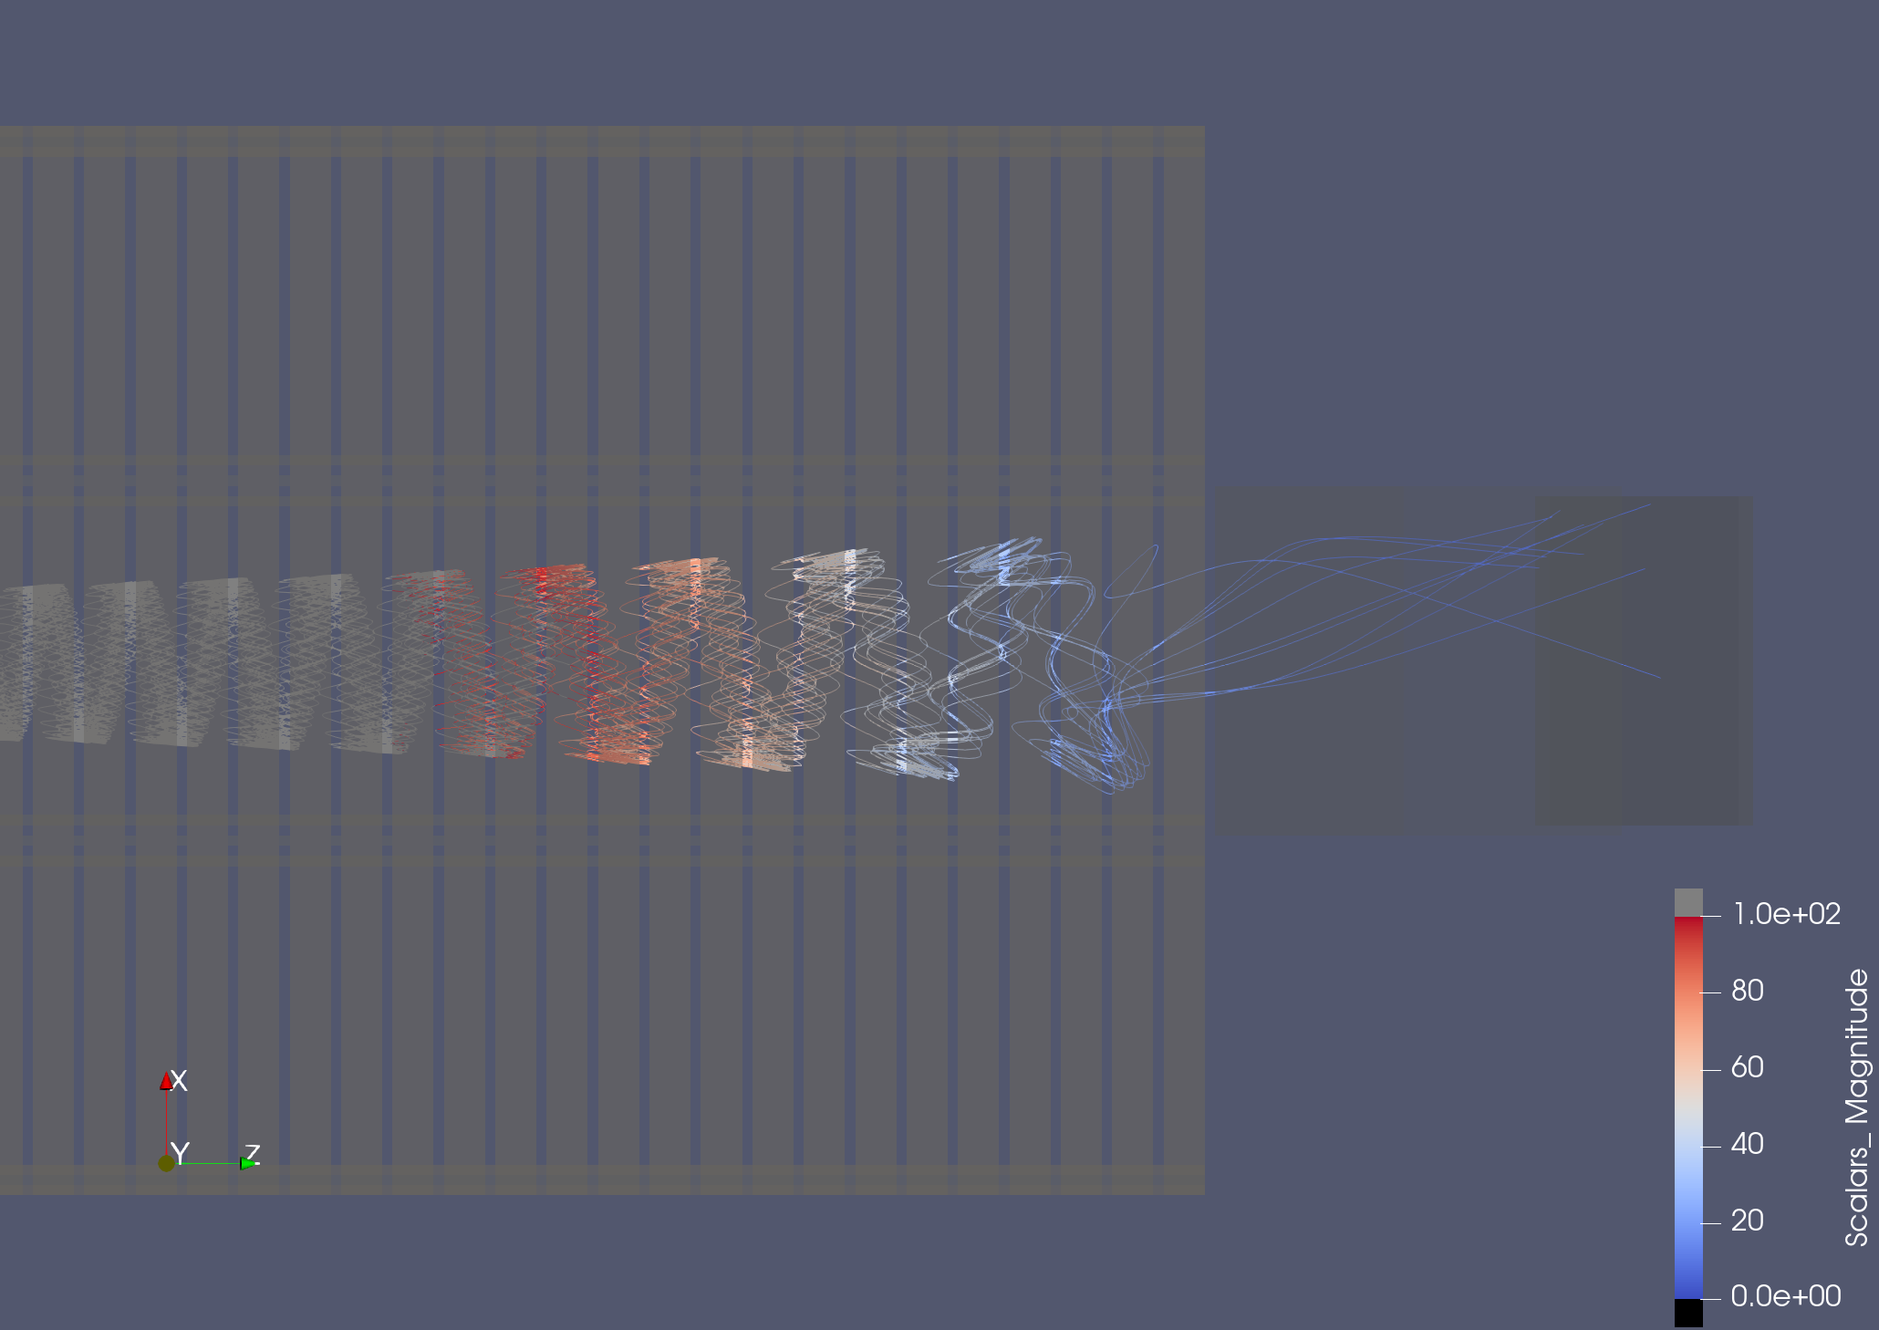
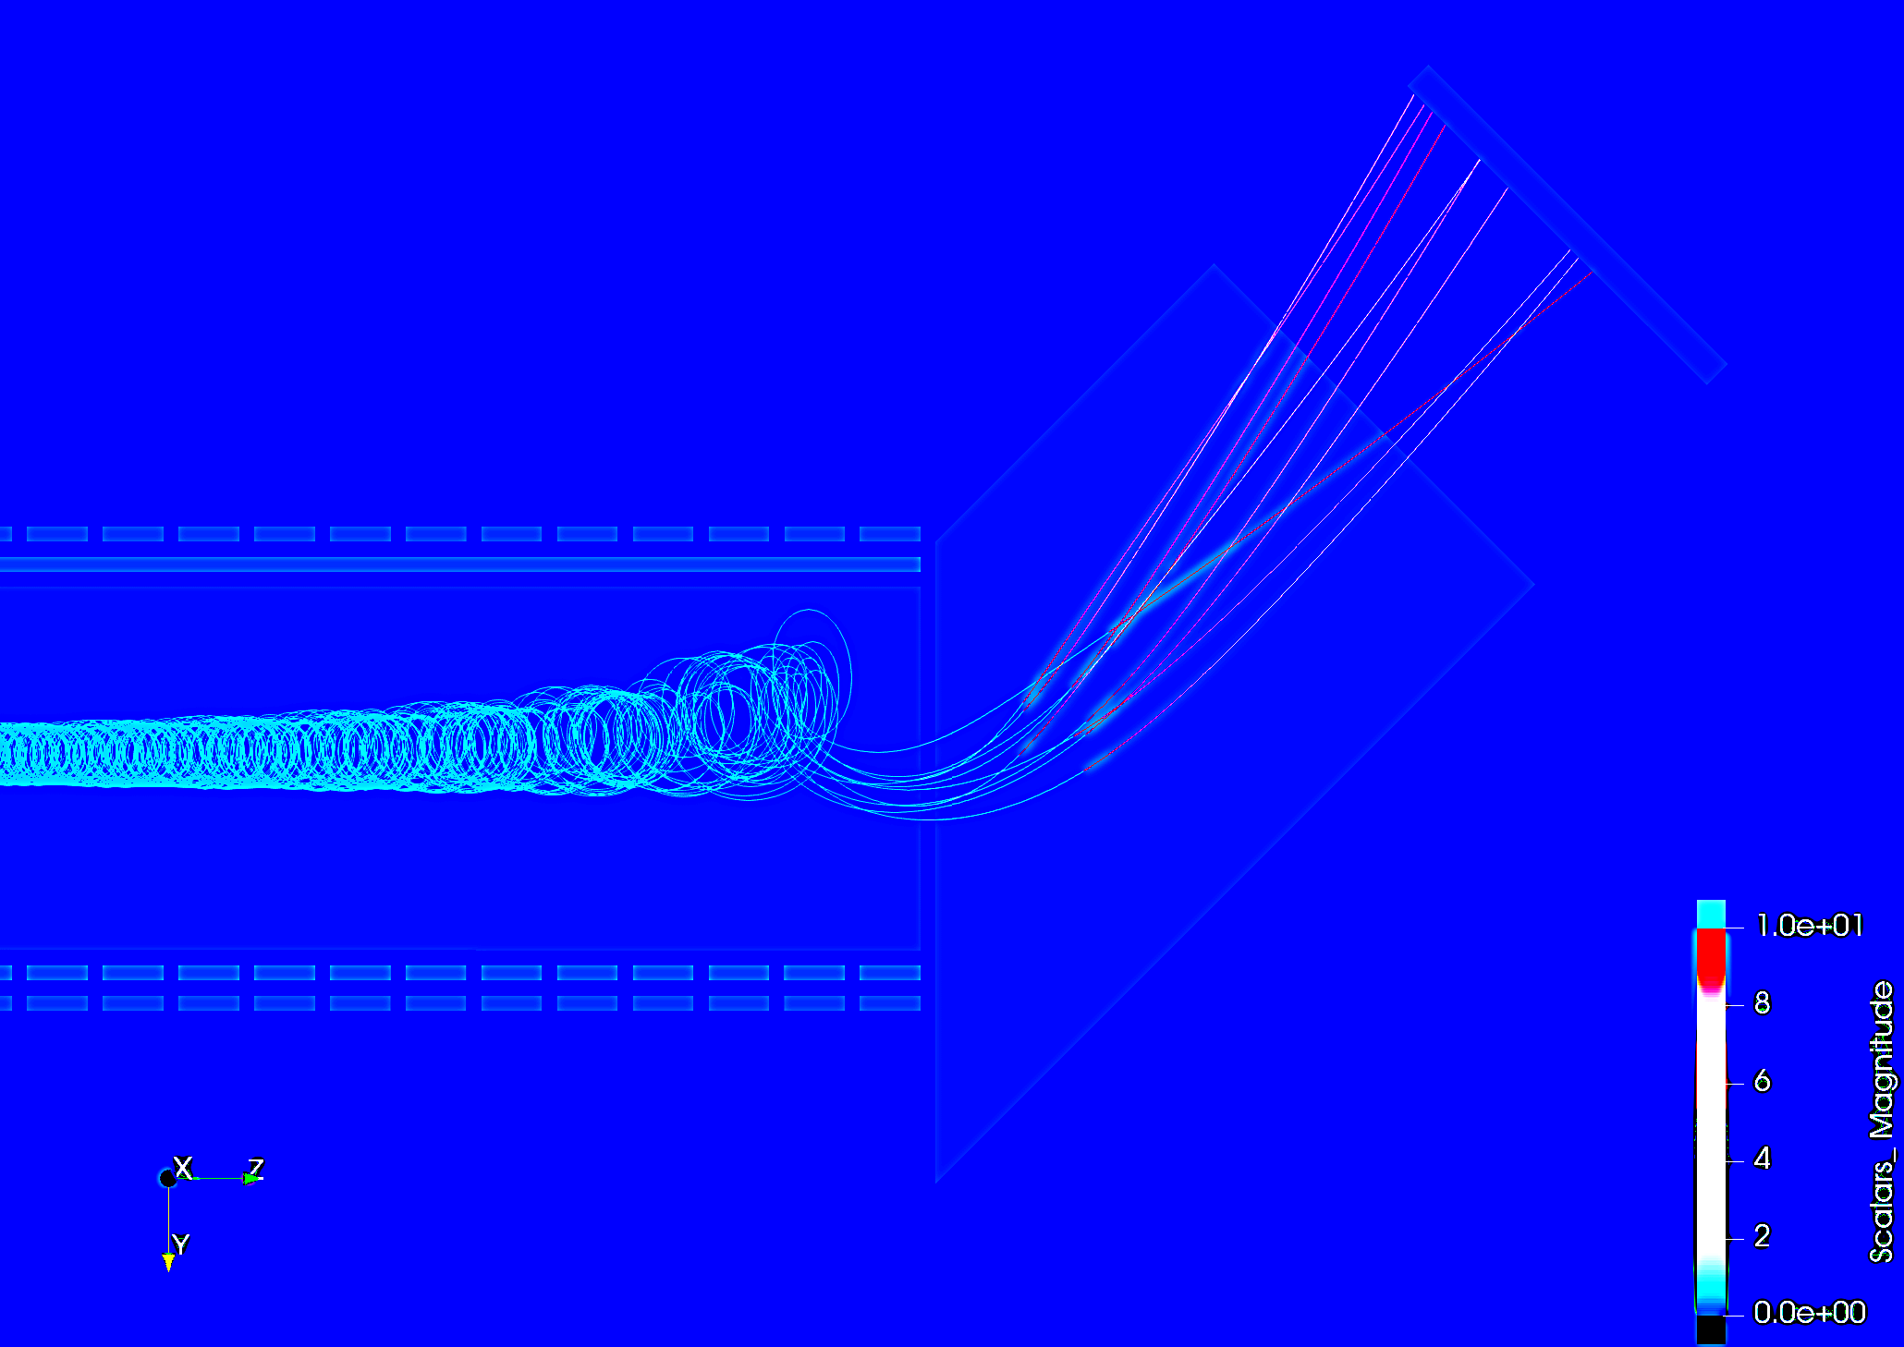
Zero-Field Calorimeter Transition
Wonyong Chung (Princeton)

Slide 12
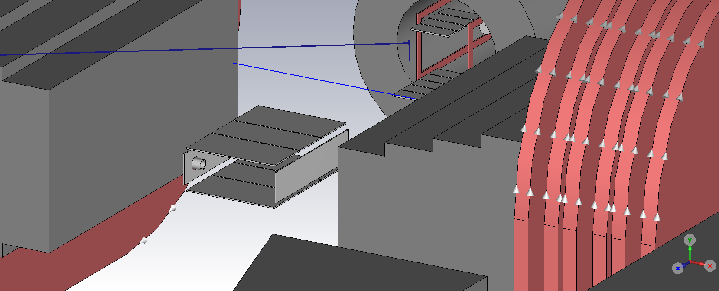
Zero Field Injection into Princeton Magnet

Slide 13
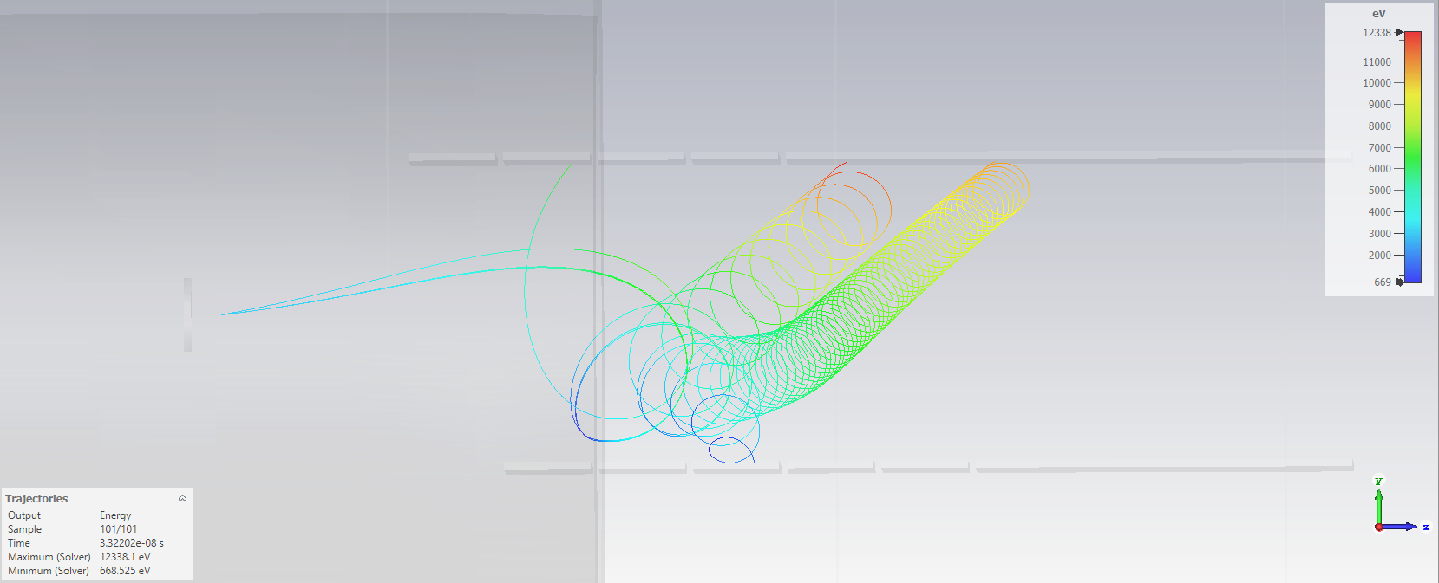
First Simulations of Non-Adiabatic Transition

Slide 14
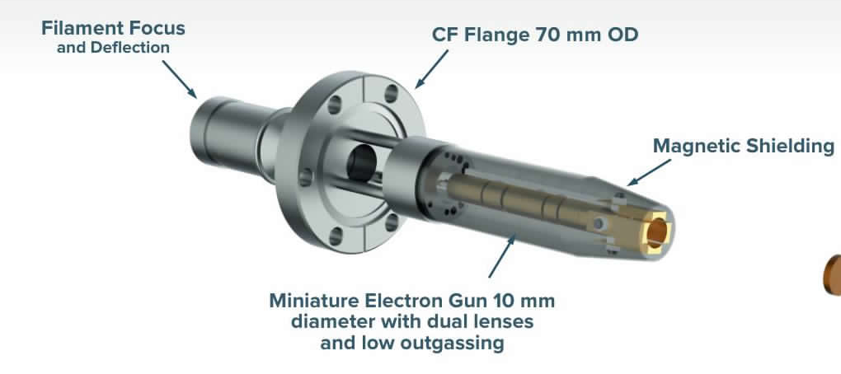
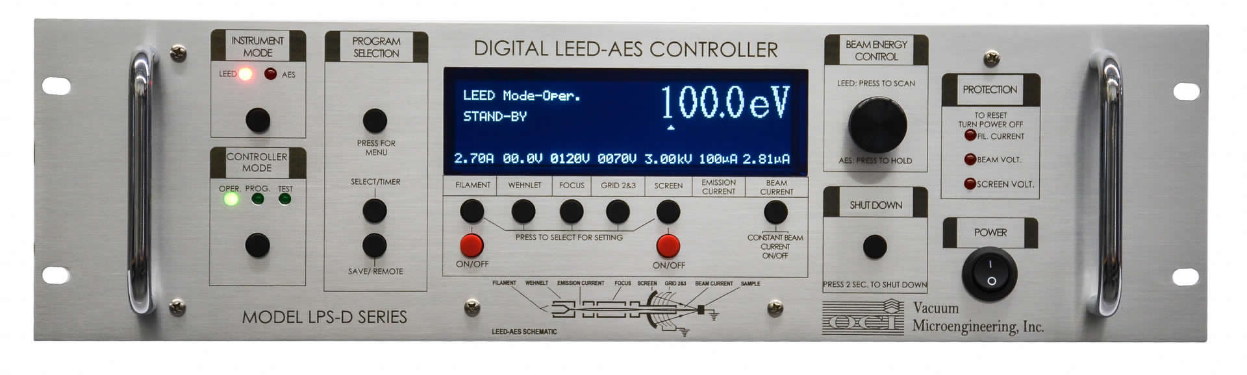
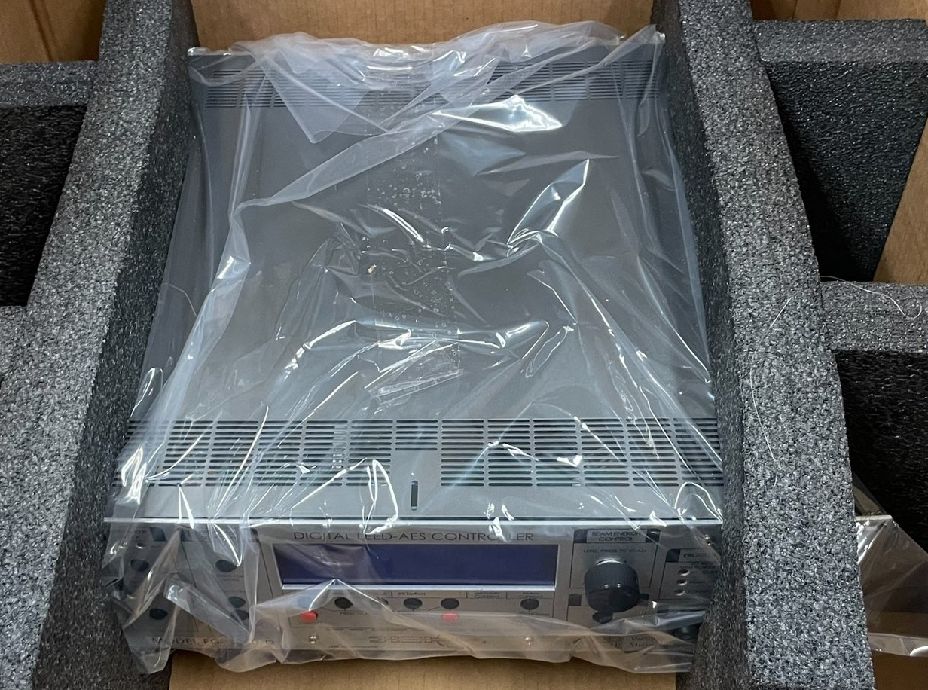
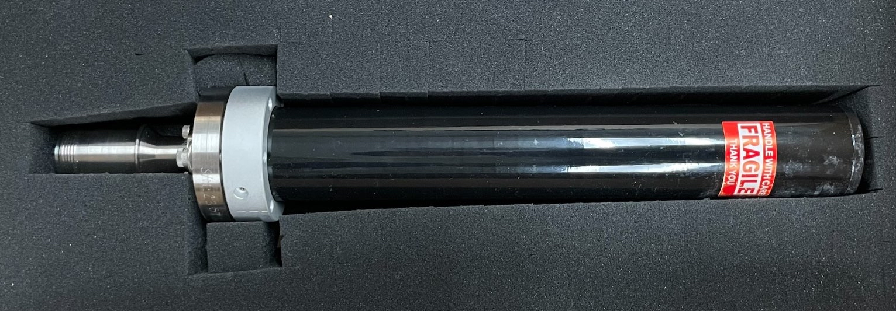
E-Gun Arrived at Princeton (5eV-3keV)

Slide 15
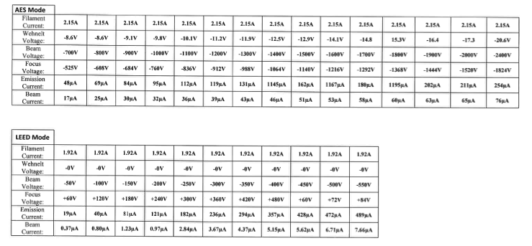
Test Data Sheet

Slide 16
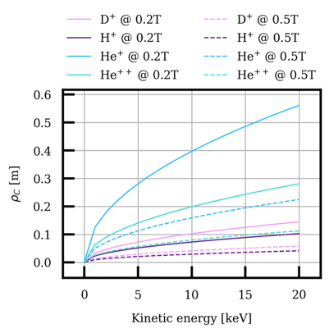
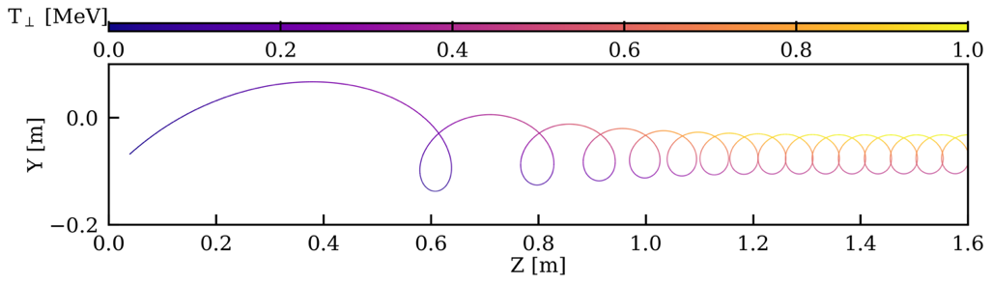
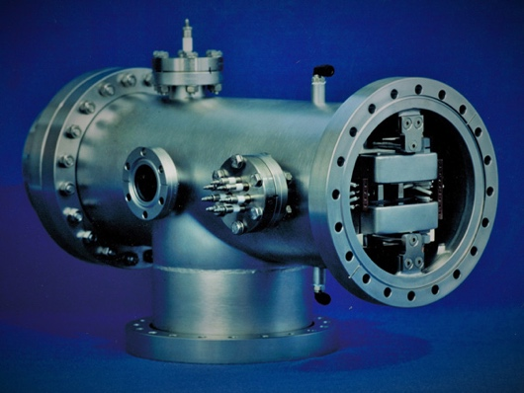
Other Applications
New type of particle accelerator (useful for fusion reactor heating),
Chung, Tan and Tully, (Highly Efficient) “Charged Particle Beam Injection into Magnetically Confined Plasmas”
https://www.intechopen.com/chapters/82927
16

Slide 17
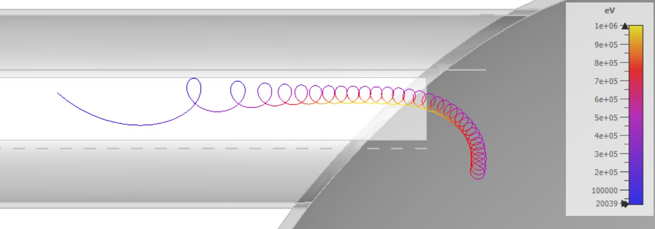
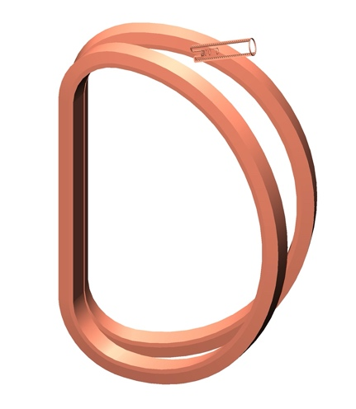
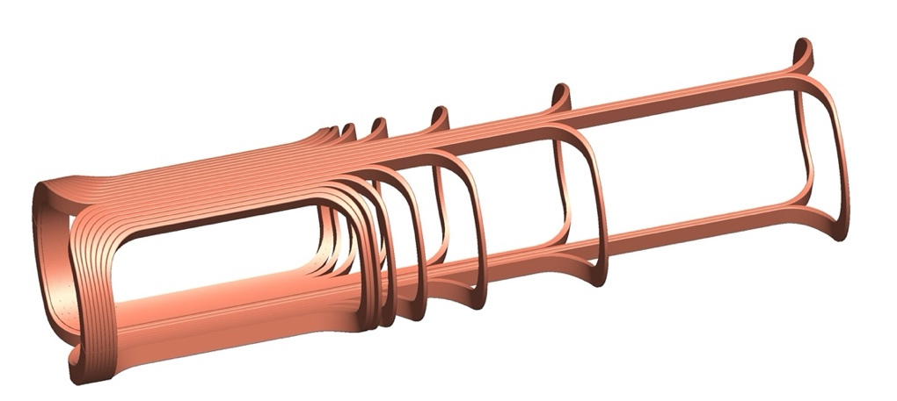
Injection into a Toroidal Fusion Reactor
Filter Coils w/ Counter-Dipole
Iron-Free Filter Coils
ITER-scale Coils

Slide 18
Plans
Include example of velocity selector
Include spectrometer precision
Include views of end of filter
Include views of e-gun hardware
Describe relationship between e-gun injection and plasma heating
Describe funding proposal to ARPA-E/PU to develop ion injection version – long-term possibility to fund an iron-free high-field superconducting conduction-cooled filter coil
Original idea (iron-free) counter-dipole winding

Slide 19
Plans
B Field:
  Magnetic shielding and Zeroing Coils
  Measure B Field Map
Solving for Voltages: (working with Jessica Fox (Caltech))
  Develop Template Method for Non-Adiabatic Injection
  Starting w/ CST, but may move to Relaxation Approach to solving E fields (templates) as an input to Lorentz4
Setup E-Gun at Princeton
  Extend vacuum chamber and electrodes to central region
  Use “slow drift” test system for electron detection

Slide 20
Backup

Slide 21
Detection Concept: Neutrino Capture
Basic concepts for relic neutrino detection were laid out in a paper by Steven Weinberg in 1962 [Phys. Rev. 128:3, 1457] applied for the first time to massive neutrinos in 2007 by Cocco, Mangano, Messina [DOI: 10.1088/1475-7516/2007/06/015] and revisited in 2021 by Cheipesh, Cheianov, Boyarsky [https://arxiv.org/abs/2101.10069]
What do we know?
Gap (2m) constrained to
m < ~200meV
from precision cosmology
CνB Detection Requires:
few x 10⁻⁶ energy resolution set by m_{ν}
KATRIN ~ 10⁻⁴ (current limitation)
Electron flavor expected with
m > ~50meV
from neutrino oscillations
PTOLEMY: 10⁻⁴ x 10⁻²
(compact filter) x (microcalorimeter)

Slide 22
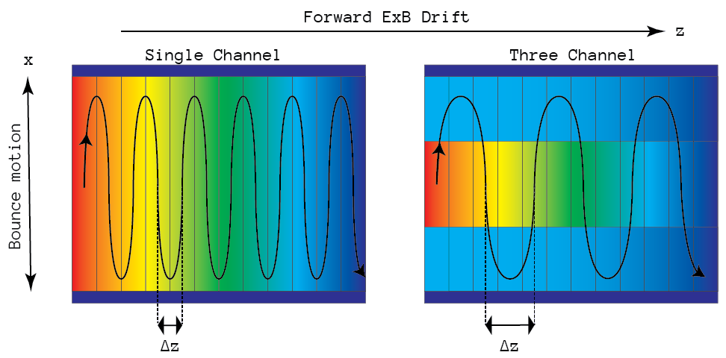
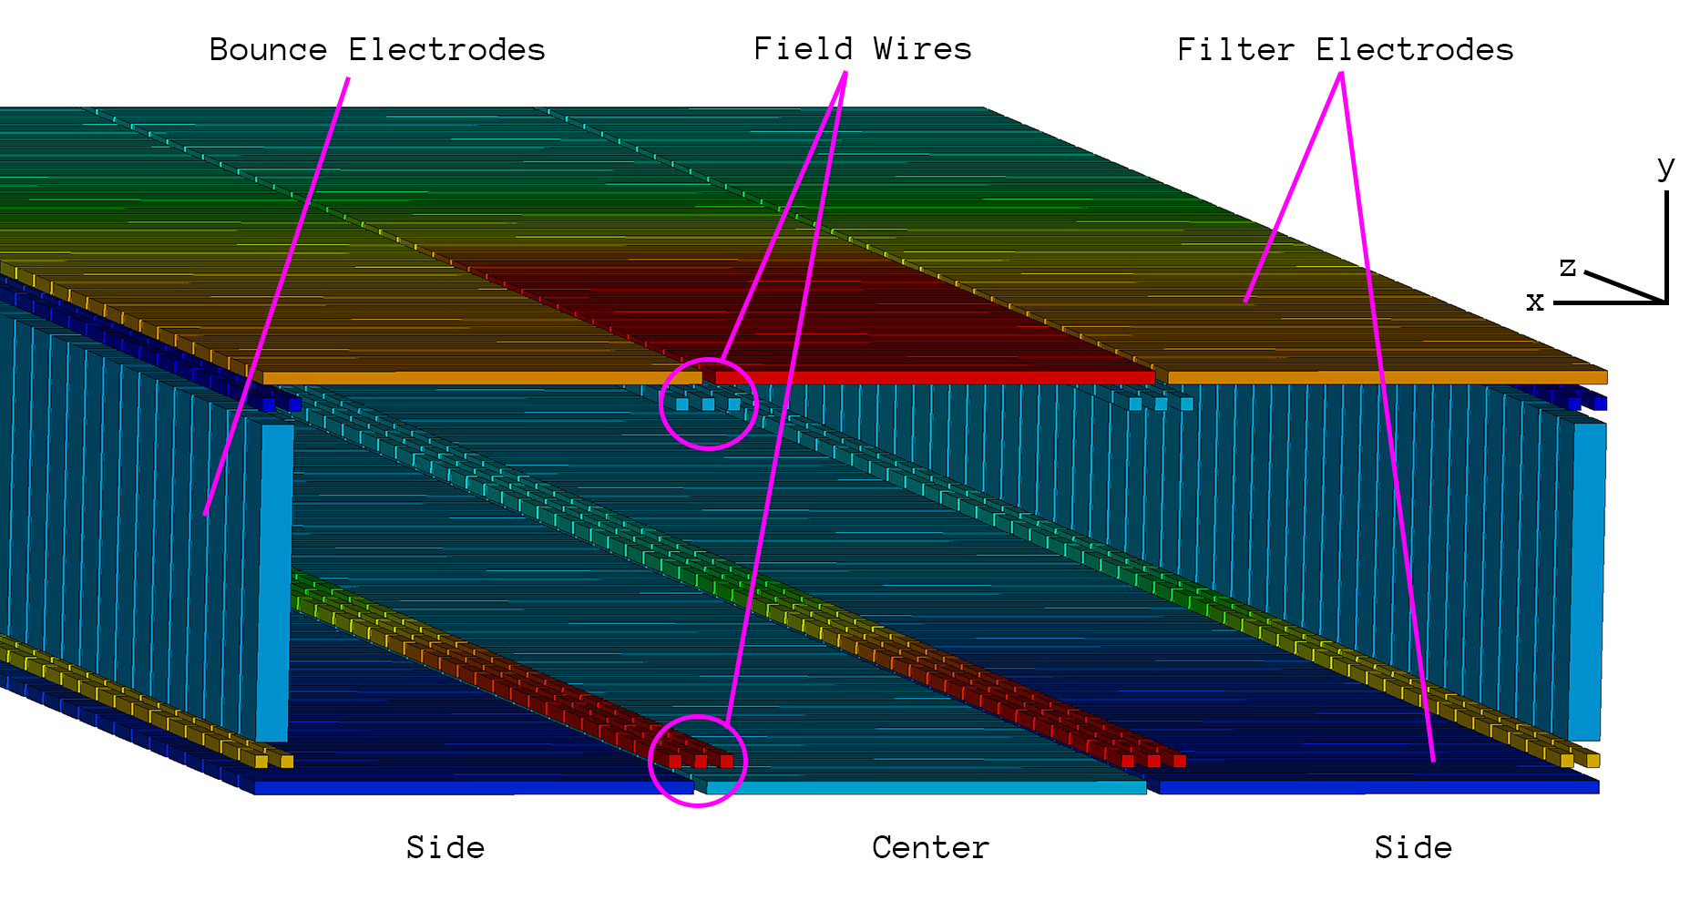
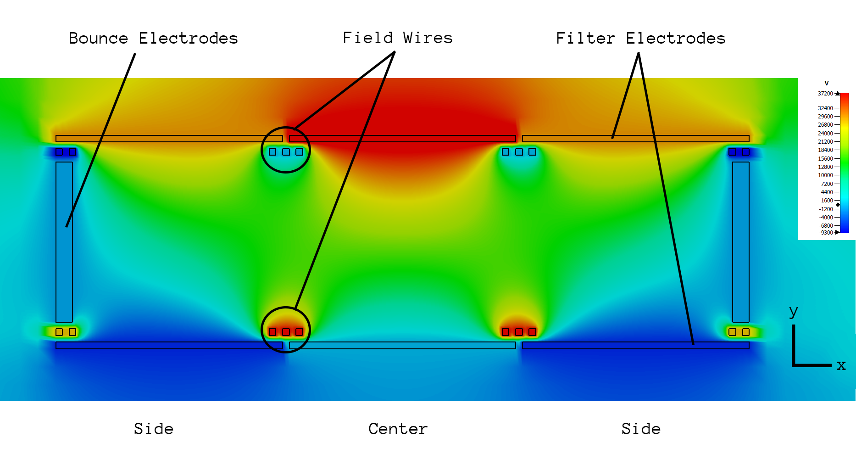
Bobsledding (pushing electron up potential)
Dynamically Adjusted
(side channels)
to Total Energy “Selector”
Transverse “Selector”
(one channel)

Slide 23
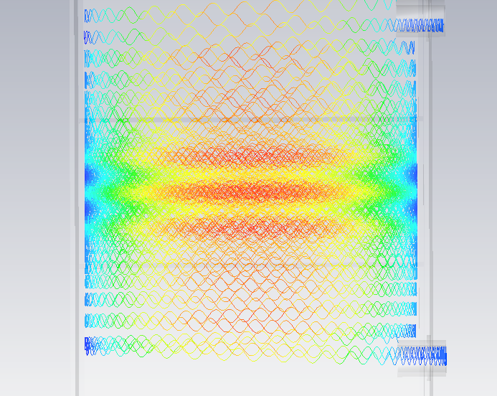
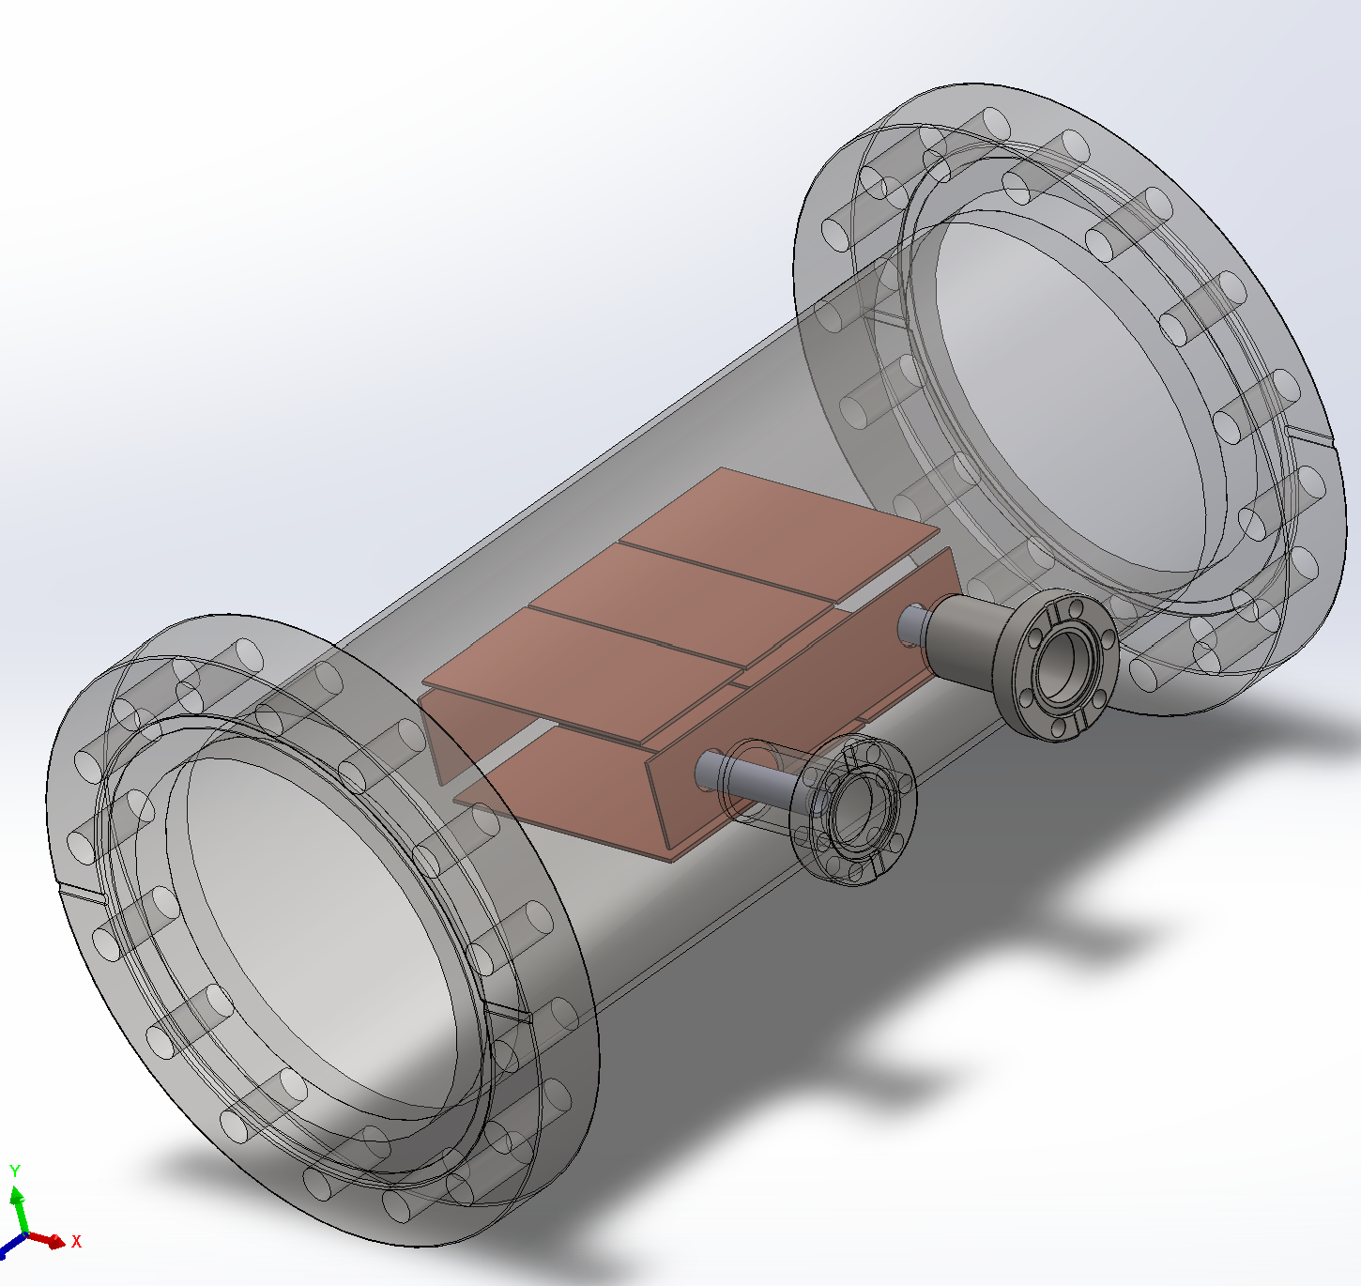
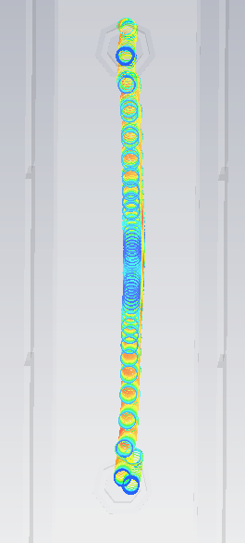
Ultra-slow electron drift region
Top View
50-100m/s drift
C¹⁴ Disk
C¹⁴ Disk
Phoshor/SiPM
Phoshor + SiPM
Side View

Slide 24
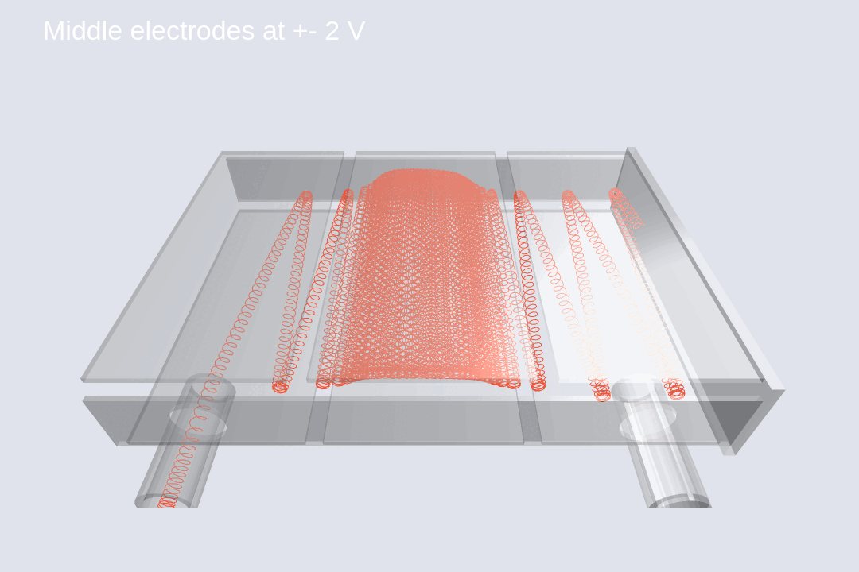
Scanning ExB Voltages to Maximize Duration
of Antenna Signal
Circular Cavity w/ Pin Antenna

