Slide 1
FLYDOS
Grant Giovani CSN 5
Neutron dosimetry for aircrew and onboard electronic components
06/07/2023
Alessandro Calamida (& LEMRAP Group - INFN)
IEAv (Brazil) – Instituto De Estudos Avançados

Slide 2
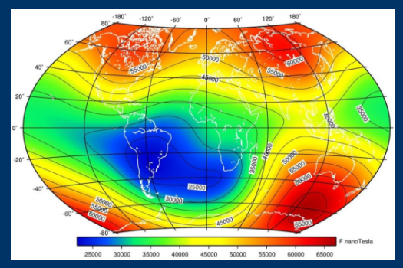
Framework
Data gap on neutron measurements at flight altitudes.
Sensitive targets:
Aircrew radiation protection:
2013/59/EURATOM and D. Lgs. 101/2020;
Single Event Effects (SEE):
Affecting on-board electronics;
Collaboration:
INFN-LNF;
IEAv (Brazil), Instituto De Estudos Avançados.
Importance of neutron spectrometry and dosimetry at flight altitude in the SAA:
Very few data available;
Barycentre now in South Brazil - Van Allen Belts closest to the Earth's surface:
Minimum geomagnetic field;
Highest flux of neutrons (95% of SEE in satellites occur in SAA + poles).

Slide 3
Objectives:
Validation of:
Codes for aircrew dosimetry:
New code REP by IEAv;
Models for SEE in aircrafts.
Through neutron measurements function of the elevation (dedicated flight up to 12 km).
Neutron Spectrum – Compact ERBSS;
Individual Dose –personal dosimeter extended to high-E;
Organ Dose – Sensors in anthropomorphic phantom;
Ambient dose – Commercial dosemeters from IEAv;
Thermal neutron mapping on-board aircraft (SEE-related);
Validation of a new aircrew dosimetry code (REP).

Slide 4
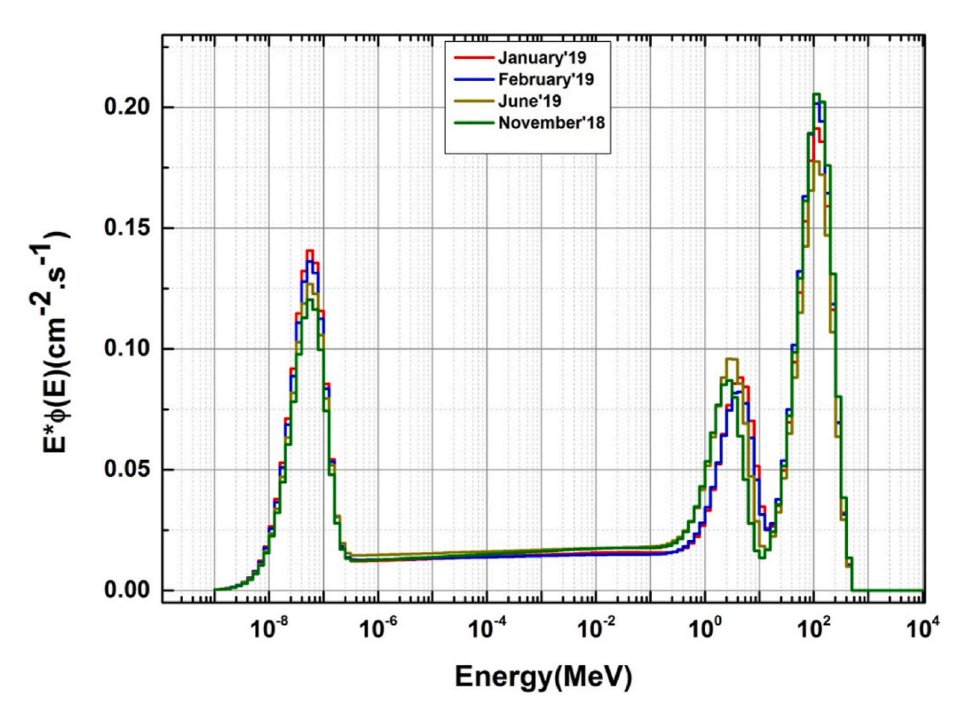
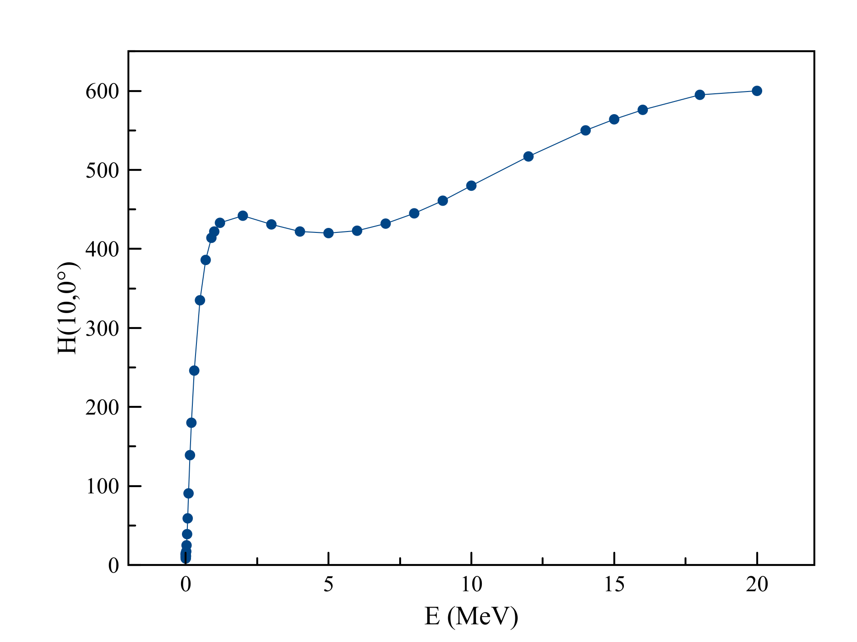
Neutrons at High Elevations
According to the IEC 62396 Part 5, almost $\sim 50÷60 \%$ of the dose equivalent at high elevations is due to neutrons.
Cosmic neutron spectra, Gulmarg, India, ~2600 m.
Fluence to Dose coefficients for neutrons.

Slide 5
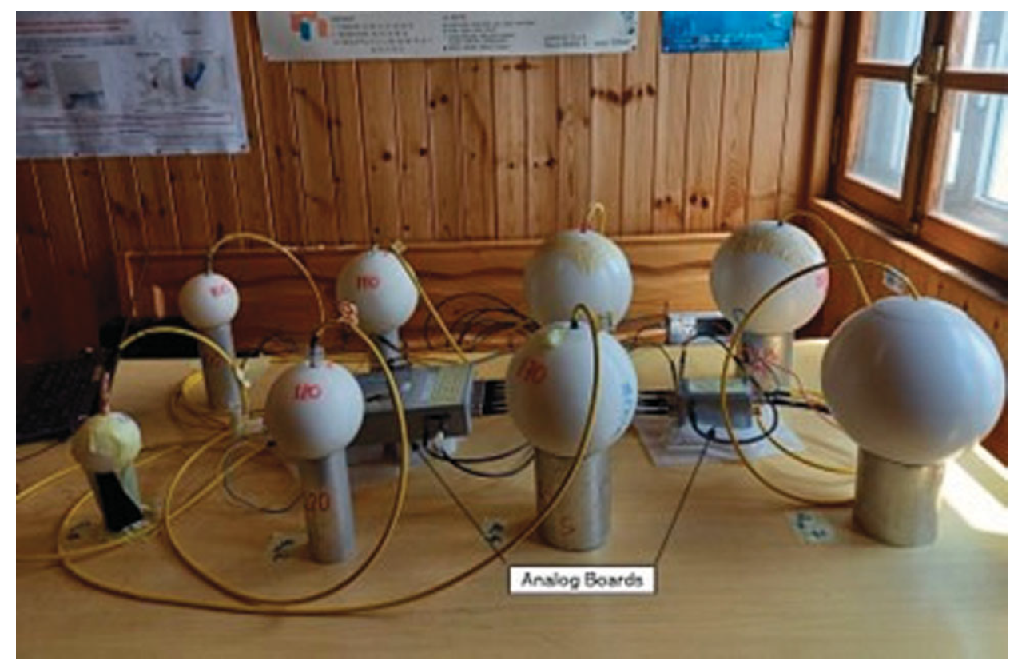
Neutron Spectrum with Extended Range Bonner Sphere Spectrometer (ERBSS)
³He based, 8 spheres (2 high-energy);
Compact and stand-alone (no PC allowed);
Calibrated in ISO reference neutron fields;
Tested at high altitudes at Testa Grigia lab (~3500 m);
Final measurement in the SAA at high altitudes with a dedicated flight from 8 km to 12 km.

Slide 6
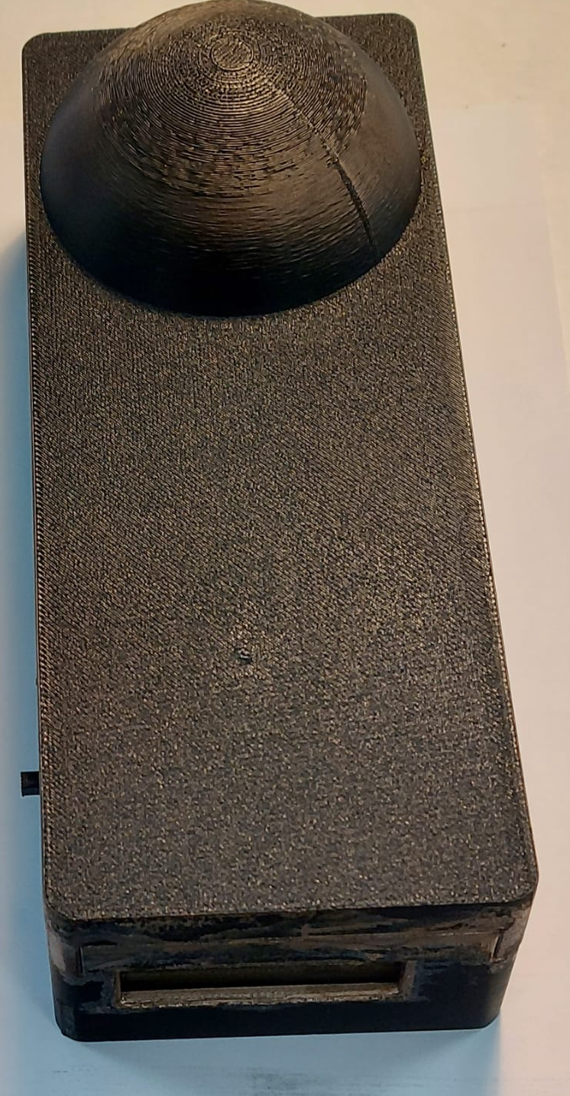
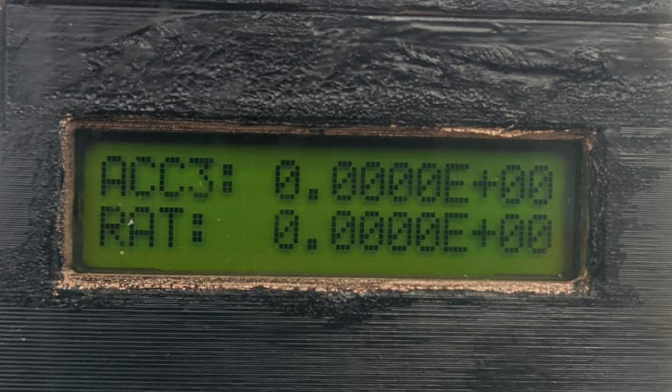
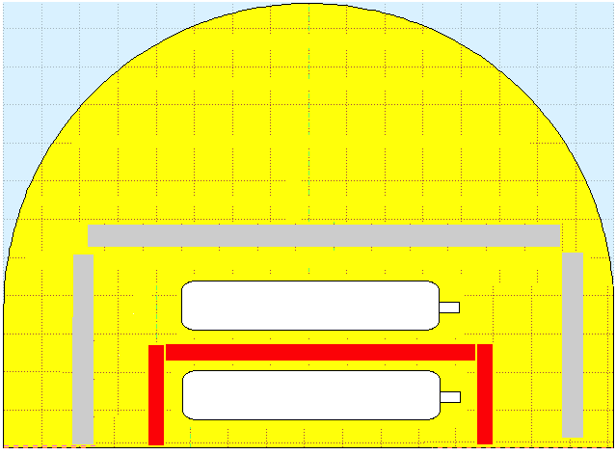
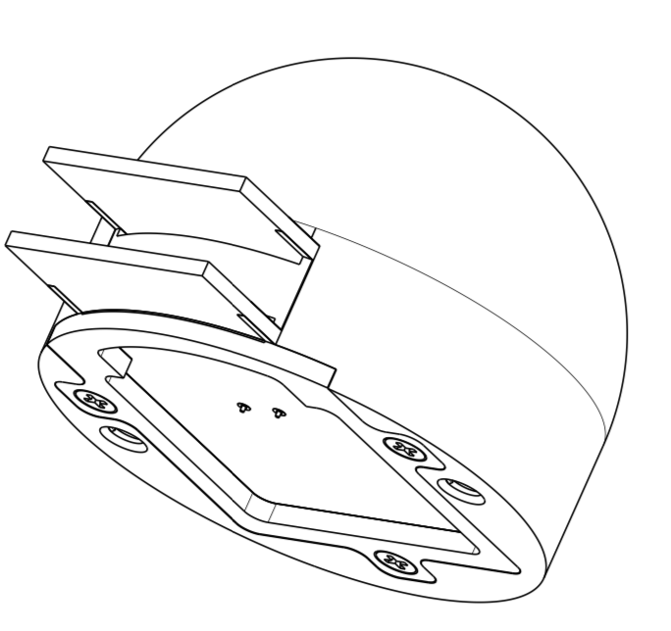
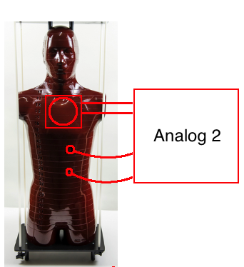
Individual dosimetry
DOIN patented design will be:
Extended to high-Energy;
Calibrated in reference ISO fields;
Tested at high-elevation (Testa Grigia);
Final measurements onboard the dedicated flight (8 km to 12 km);
IEAv will develop an anthropomorphic phantom (RANDO-type) for:
Allocating DOIN-H;
Allocating internal neutron sensors for organ-dose measurements.

Slide 7
Thermal neutron mapping on-board
According to International IEC and Aeronautic EASA Standards, thermal neutrons are mainly responsible for SEE onboard;
Only numerical works were done to estimate the distribution of the thermal neutron field onboard;
The dedicated flight will comprise an ³He based thermal neutron detector mapping their distribution onboard with the purpose of providing MEASURED data for the first time.

Slide 8
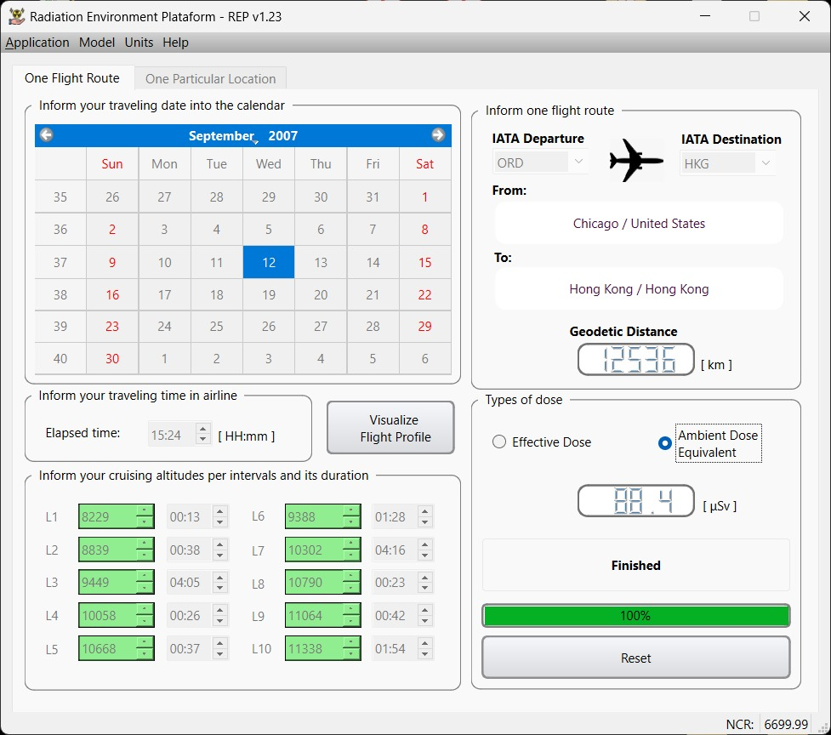
Aircrew dosimetry
IEAv developed a new code (REP) for aircrew dosimetry:
Possibility to change nuclear models;
Directional distributions are given up to 80 km;
FLYDOS measurements will be fundamental for the validation of REP and other existing aircrew dosimetry codes.

Slide 9
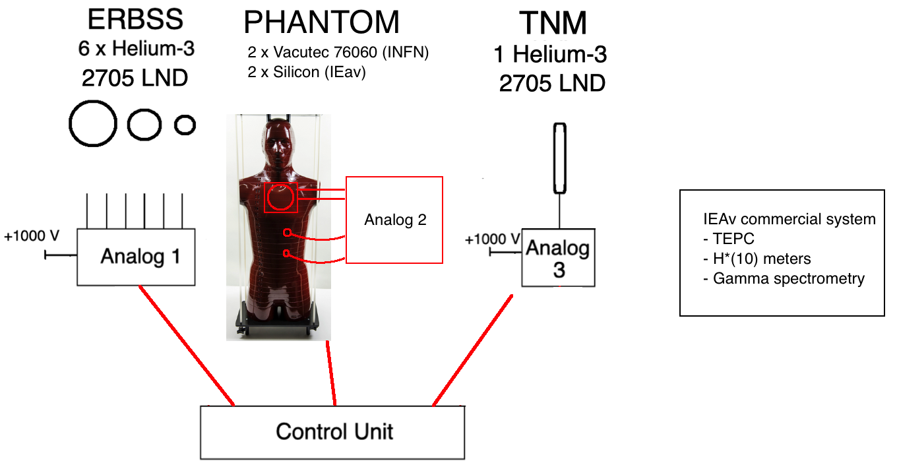

Slide 10
FLYDOS Participants
PI of the Project
Name | Institution | FTE
Alessandro Calamida | INFN-LNF (assegnista) | 1
Roberto Bedogni | INFN-LNF (T.I., Ric. II) | 0.5
Claudio Cantone | INFN-LNF () | 0.3
Jose-Maria Gomez-Ròs | INFN-LNF (associato) | 0.3
Antonino Pietropaolo | INFN-LNF (associato) | 0.3
Claudio Antonio Federico | IEAv Brazil (senior Res.) | 0.3
Odair Lelis Gonçalez | IEAv Brazil (senior Res.) | 0.2
Adriane Cristina Mendes Prado | IEAv Brazil (junior Res.) | 0.3
Williams Principe Fernandes | IEAv Brazil (junior Res.) | 0.3
Felipe B. Gaspar | IEAv Brazil (Master Student) | 0.5
Maurizio T. Pazianotto | IEAv Brazil (senior Res.) | 0.3
Guilherme Gazolla Santana | IEAv Brazil (Master Student) | 0.2
TOTAL |  | 4.5

Slide 11
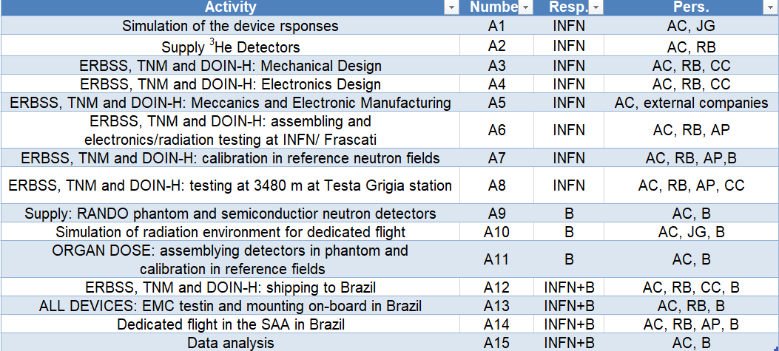
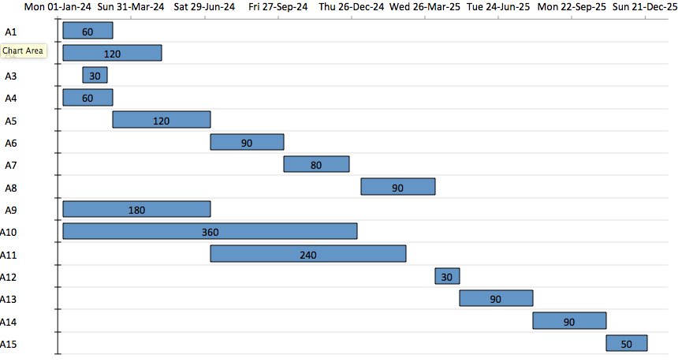
FLYDOS Activities

Slide 12
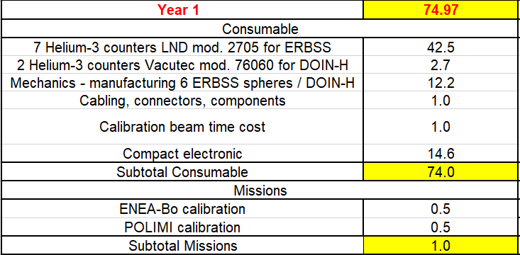
FLYDOS Budget
The IEAv group will co-fund the project in-kind by providing the following equipment and facilities for 74 k€:
The RANDO human phantom, 36 k€;
The dedicated flight, for an estimated cost of 20 k€;
The semiconductor detectors that will be installed in the phantom organs, 1 k€;
The beam time for the Organ Dose system calibration, 1 k€;
The manufacturing of the mechanical support for the FLYDOS in the aircraft, 5 k€.
The WENDI system for ambient dose equivalent measurement onboard, 11.5 k.
The systems for acquiring micro-dosimetric spectra (TEPC) and total deposited dose in Silicon (LIULIN) are already available at IEAv.

Slide 13
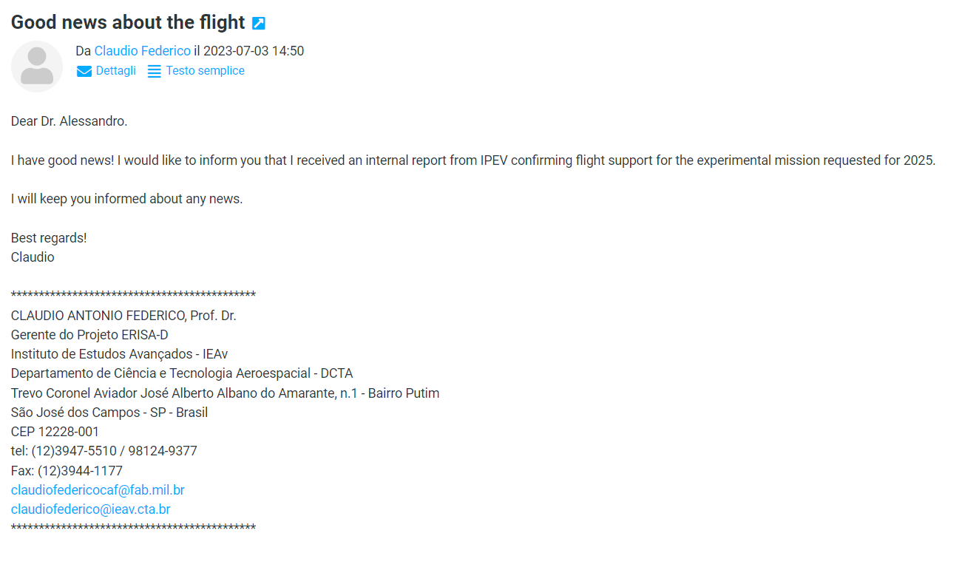
Flight Confirmation

Slide 14
Conclusions
The data gap for neutrons in the SAA will be filled;
The dose measurements will allow to assess accurately the effective dose delivered to the aircrew, allowing to solve a long-term problem for the aircrew safety;
The dose data will allow to experimentally validate a new MC code for the effective dose estimation developed by IEAv, the REP code;
The mapping of the thermal neutrons in the aircraft will be the first experimental measurement of this kind ever made and it will allow to have a better understanding of SEE occurrence inside the aircraft.

Slide 15
Thanks you all for the Attention!!!

