Slide 1
CIF 07/06/2023
Gianmario Cesarini
PP1 Heaters

Slide 2
PP1 Heaters

Slide 3
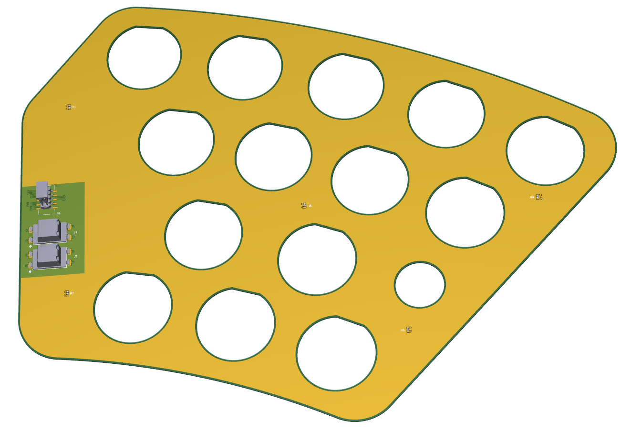

Slide 4
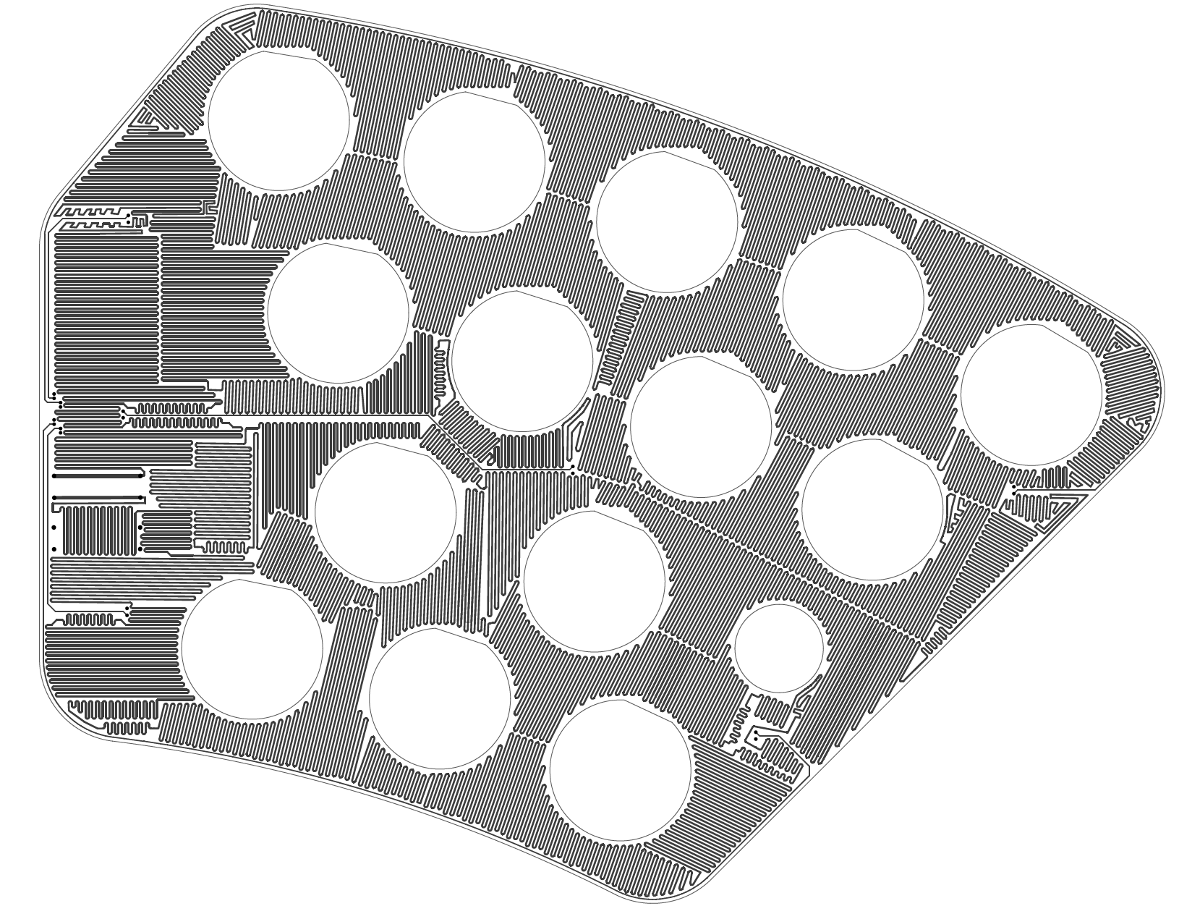
T = 35 μm
W = 0.5 mm
Total length ~50 m
R = 48 Ω

Slide 5
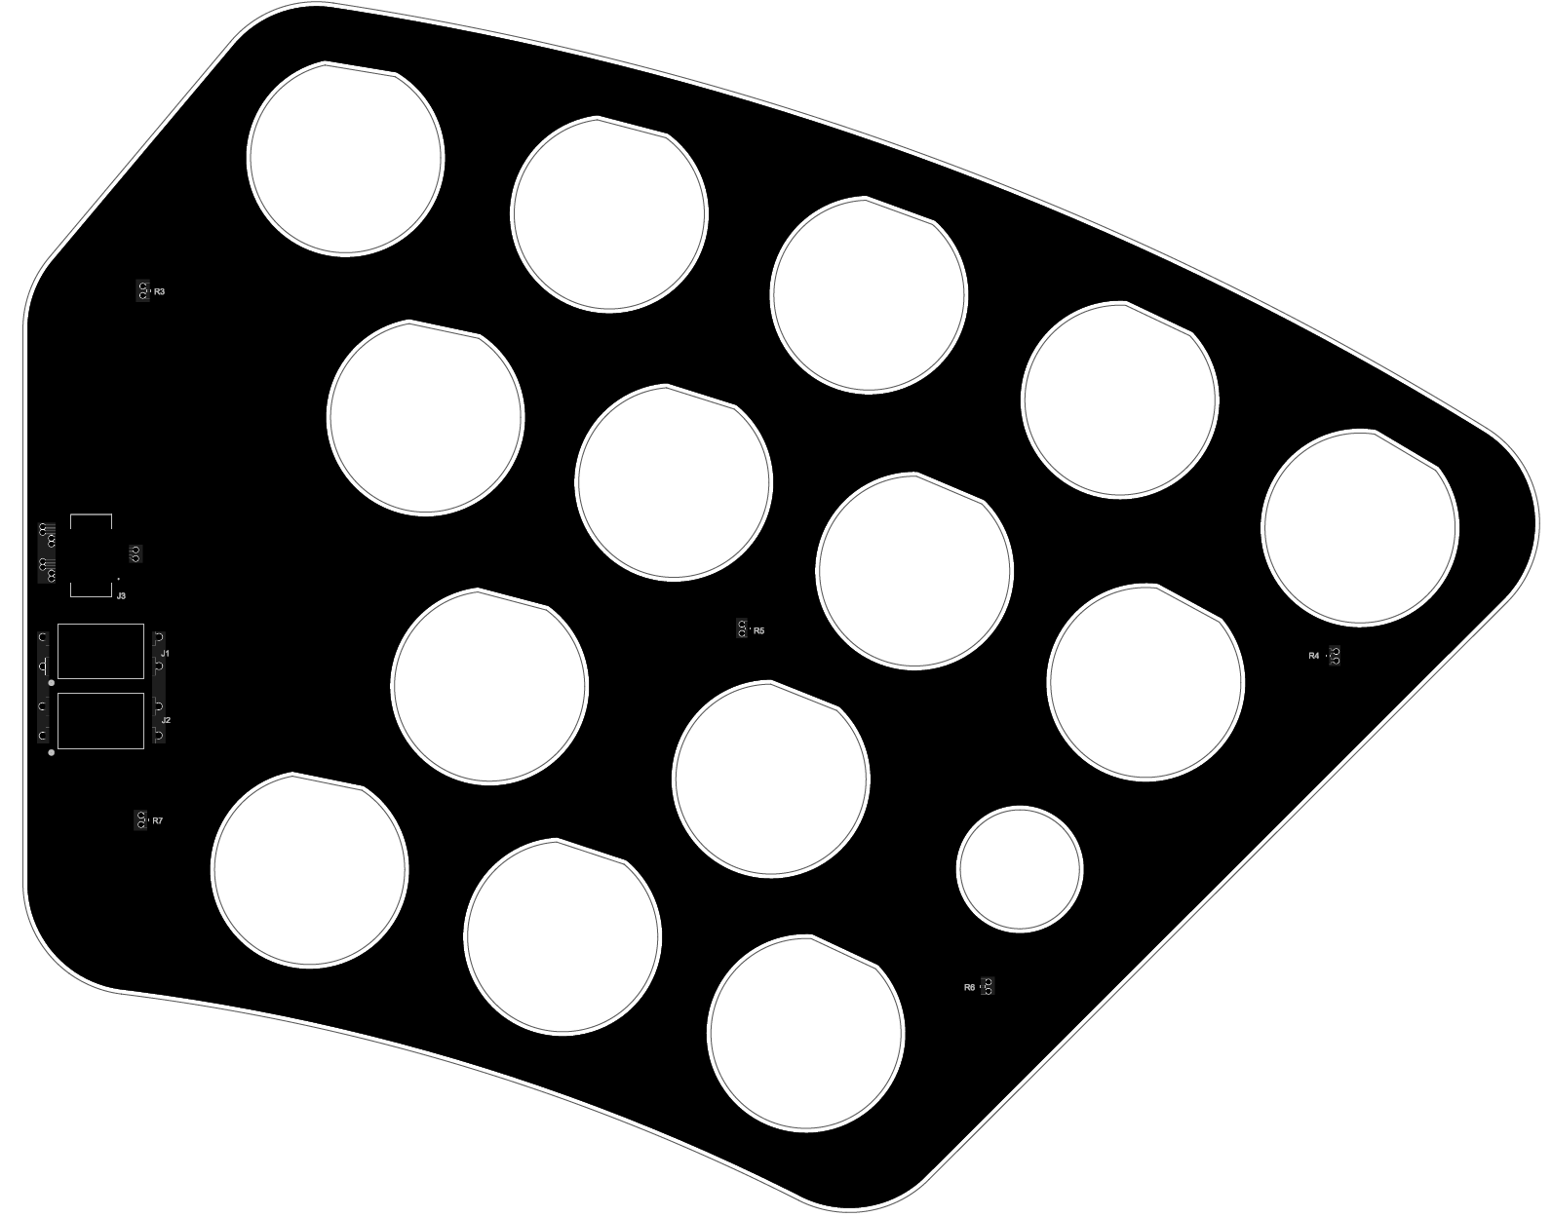
Heater with copper layer to homogenize the surface temperature and minimize the thermal contact resistance
T_{Cu} = 35 μm
Top
Thermal Diffusivity (·10⁻⁶) [m²/s]
Cu | 111
AA6061 | 70
Kapton* | 0.12
FR4 | 0.14
Bottom
* Thermal diffusivity of aromatic polyimide thin films by temperature wave analysis
Journal of Applied Physics 105, 113506 (2009)

Slide 6
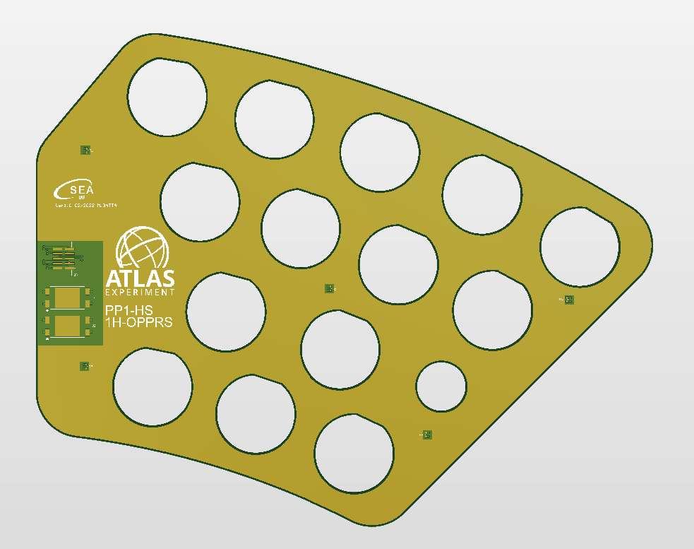
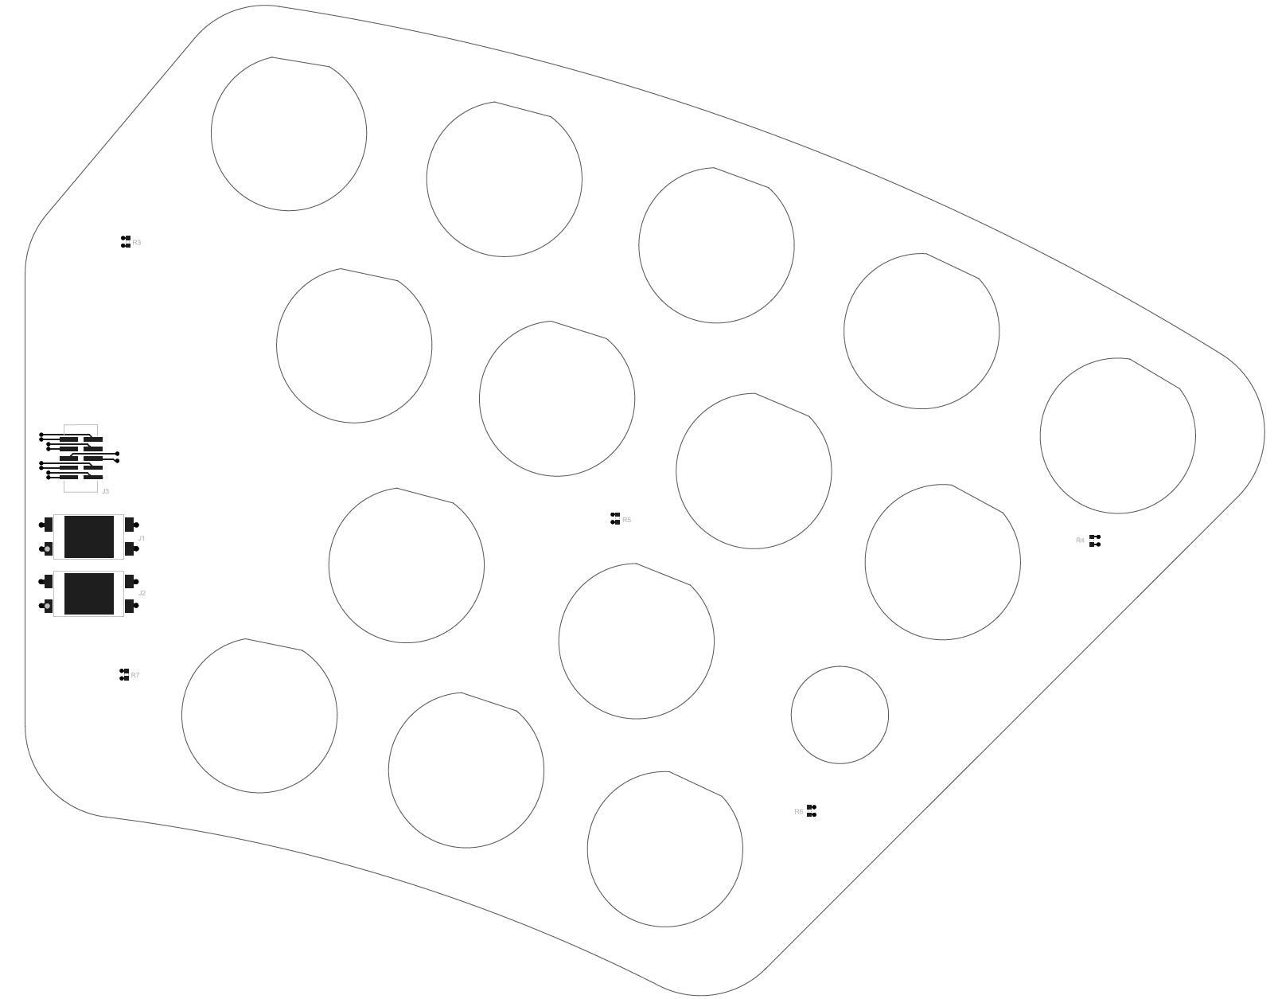
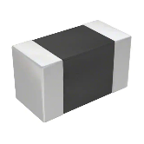
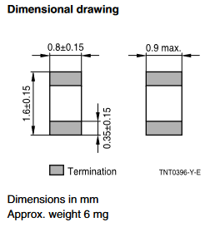
F – Feedback
I – Interlock
M – Monitoring
SMD NTC 10kΩ
F
F
M
M
I
I
I
I
F
F
Short Circuit
NTC 10 kΩ
Top layer pad
Bottom layer pad
0.4 mm
FR4
Copper Strips

Slide 7
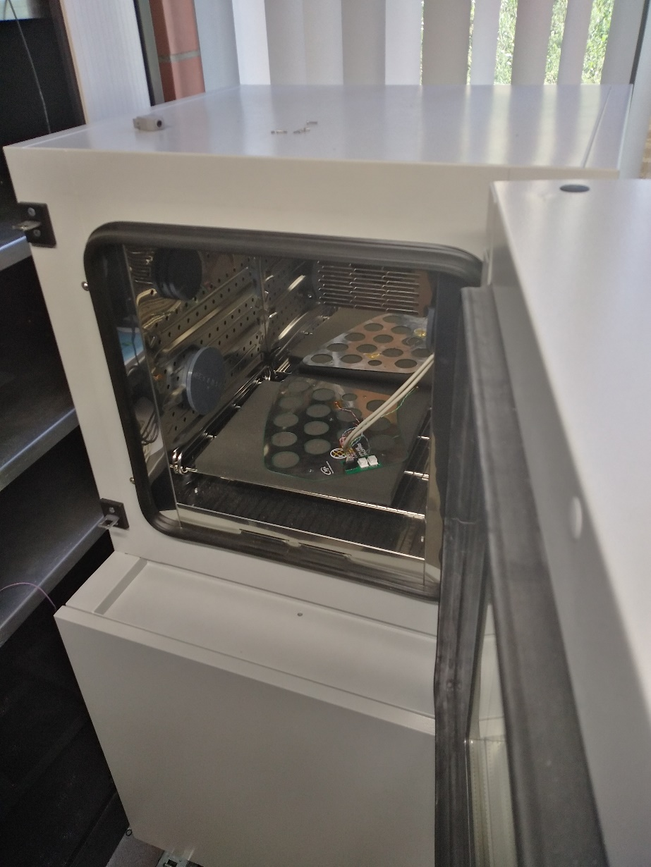
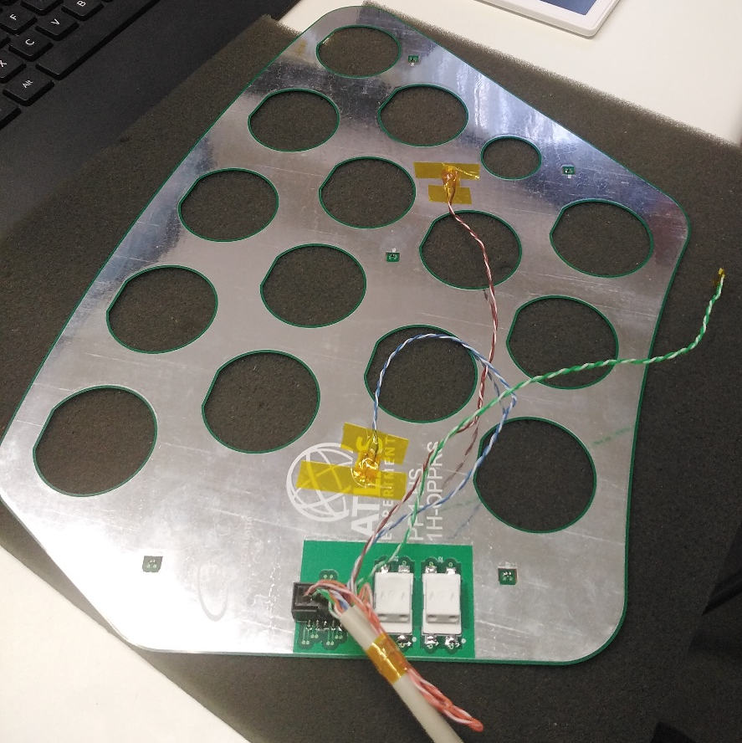
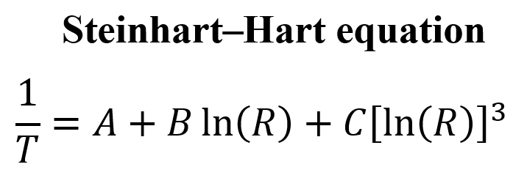
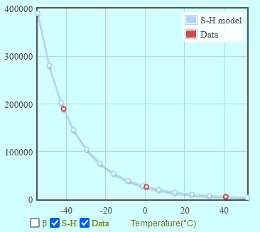
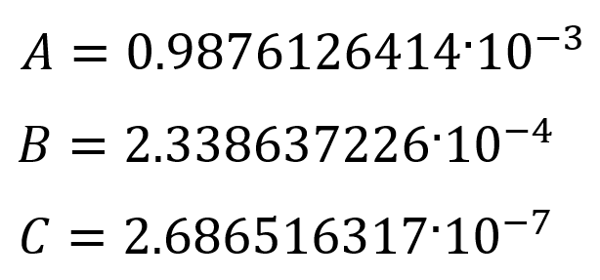
Calibration carried out in the small climatic chamber of the Electronic Service at three temperatures:
-40°C, 0 °C and 40 °C
PT100
NTC 10 kΩ
R [Ω]

Slide 8
Climatic Chamber Dew Point -60 °C
Climatic Chamber
Dry Air Inlet
Aluminum panel
Cold Dry Air -55 °C
Insulating Material
Test Box
(Dew Point <-30 °C)
Heater
Dry Air Exhaust

Slide 9
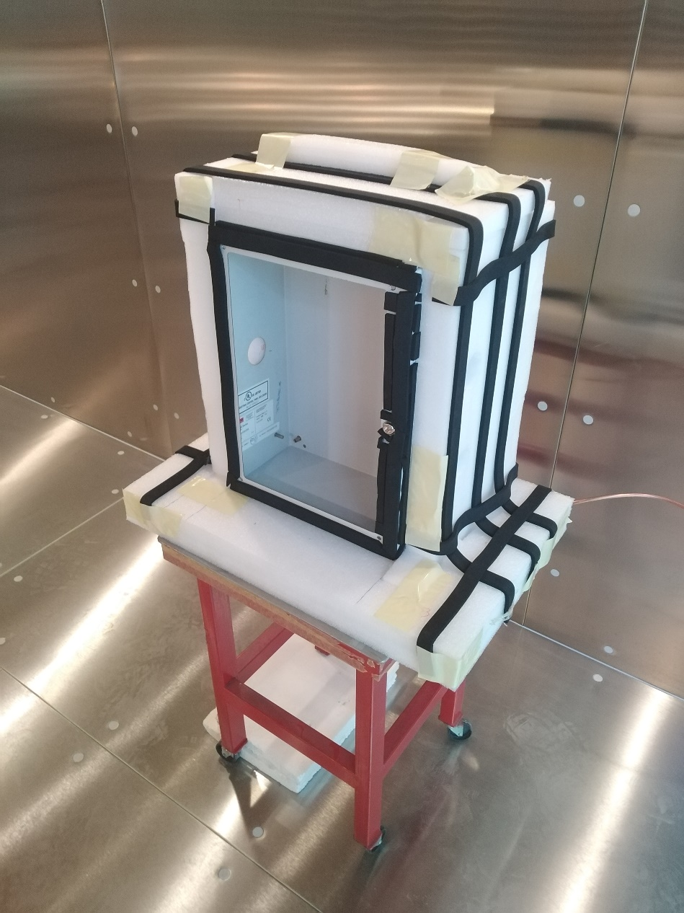
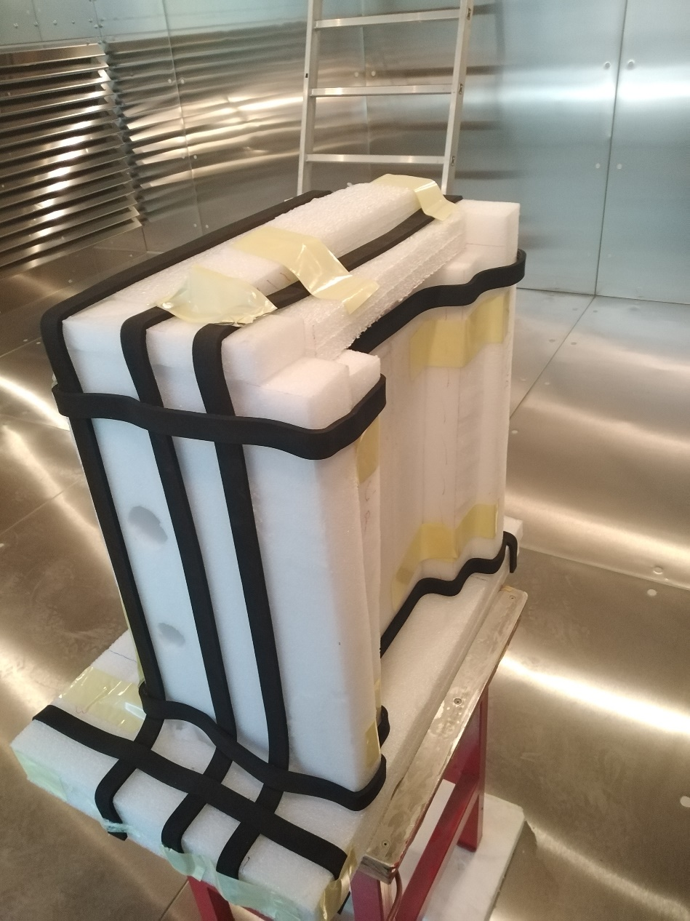
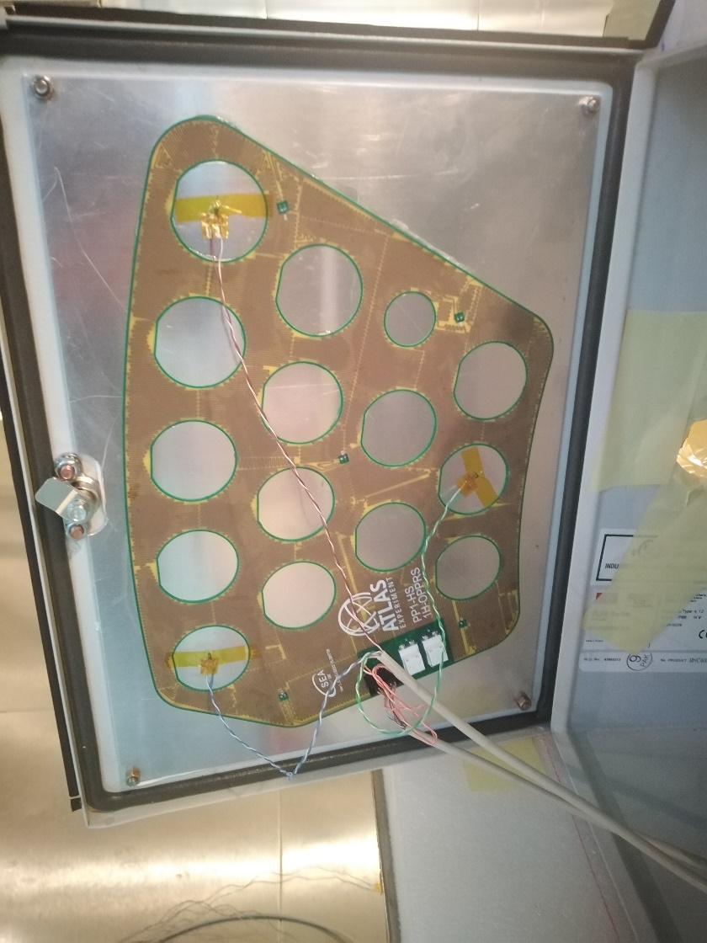
2 mm thick aluminum sheet
Dry Air Exhaust
Sensor cables
Dry Air Inlet

Slide 10
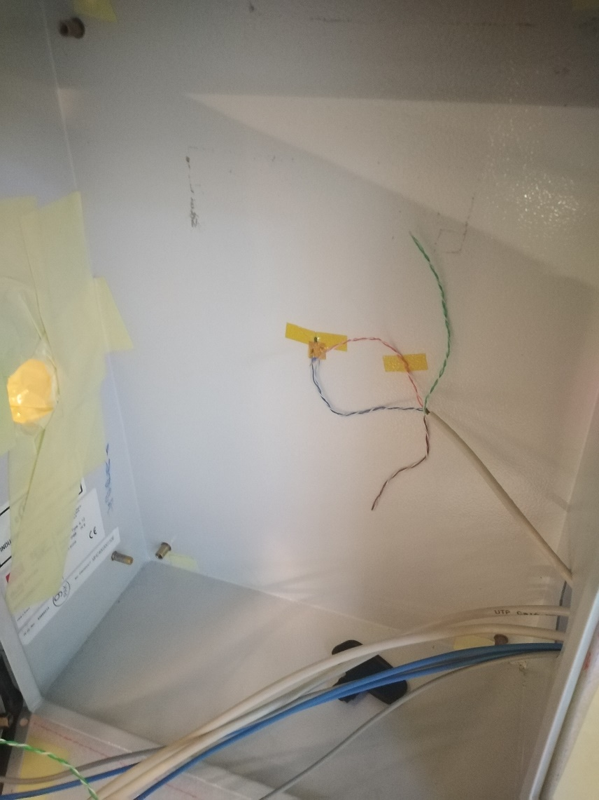
Top Left
Top Right
Box Wall
Box Air
NTC_1
NTC_4
NTC_3
NTC_2
NTC_5
Bottom Center

Slide 11
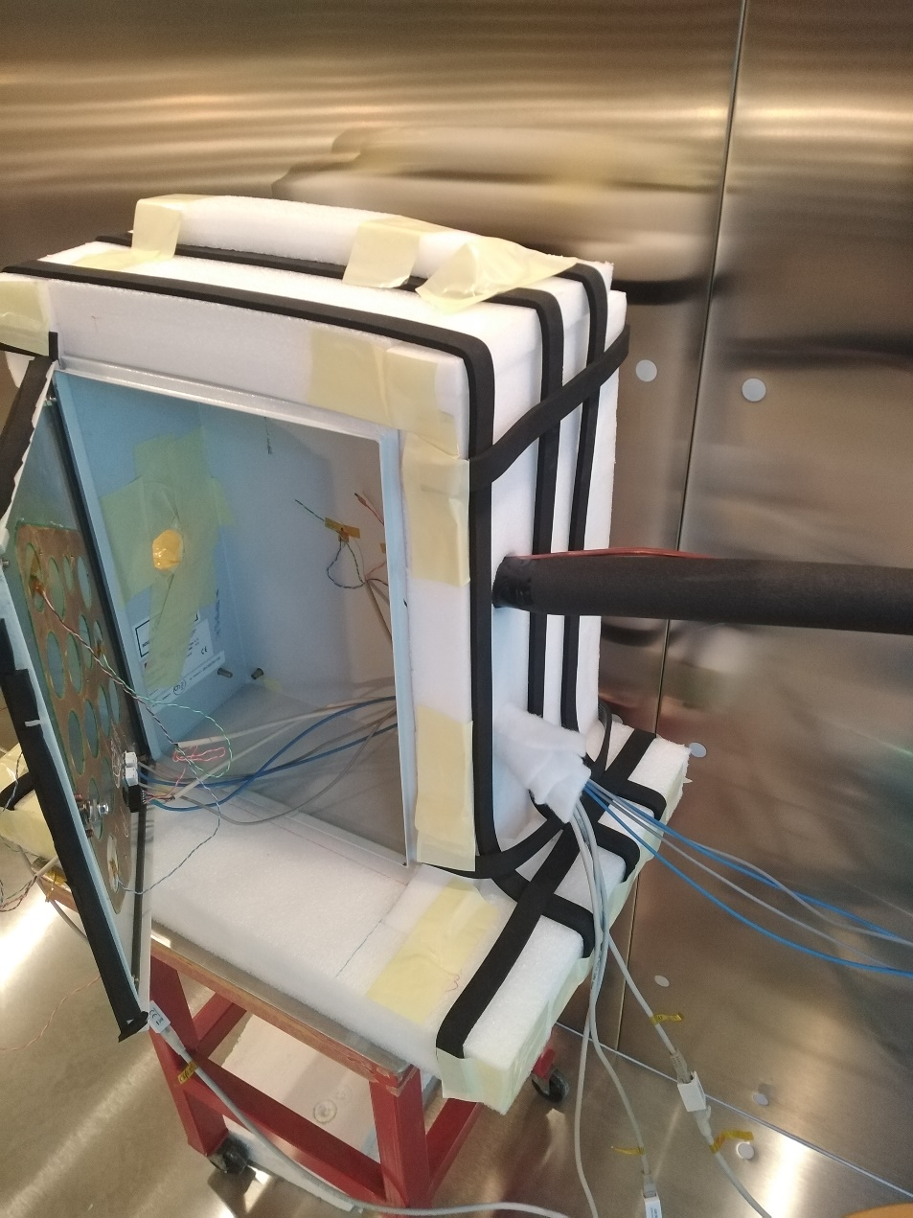
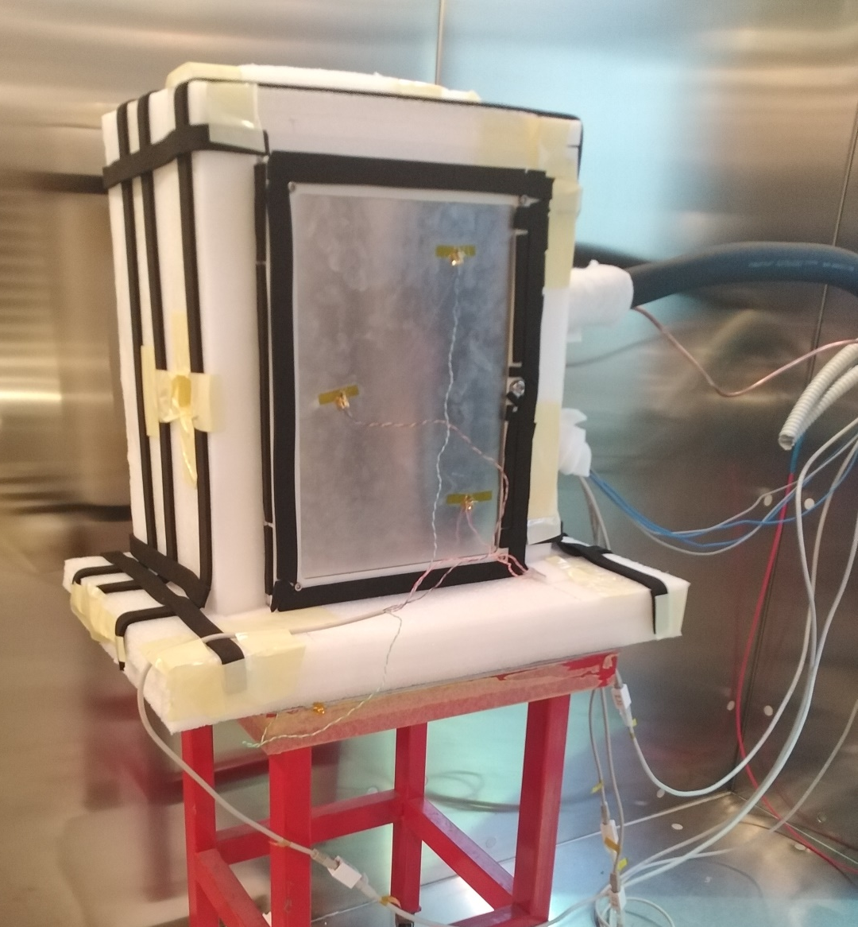
Dew Point sensor pipe
Top Right
Bottom Center
Top Left
Armaflex

Slide 12
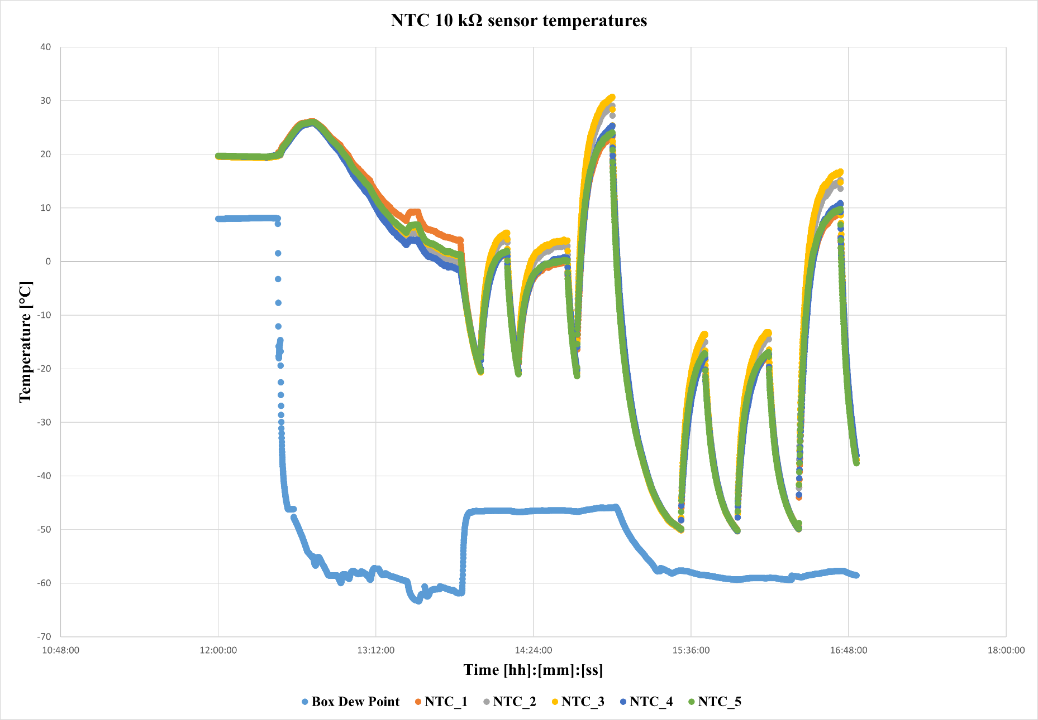
flow reduction in the box
Both resistors
Top resistor
Bottom resistor
zero flow in the box

Slide 13
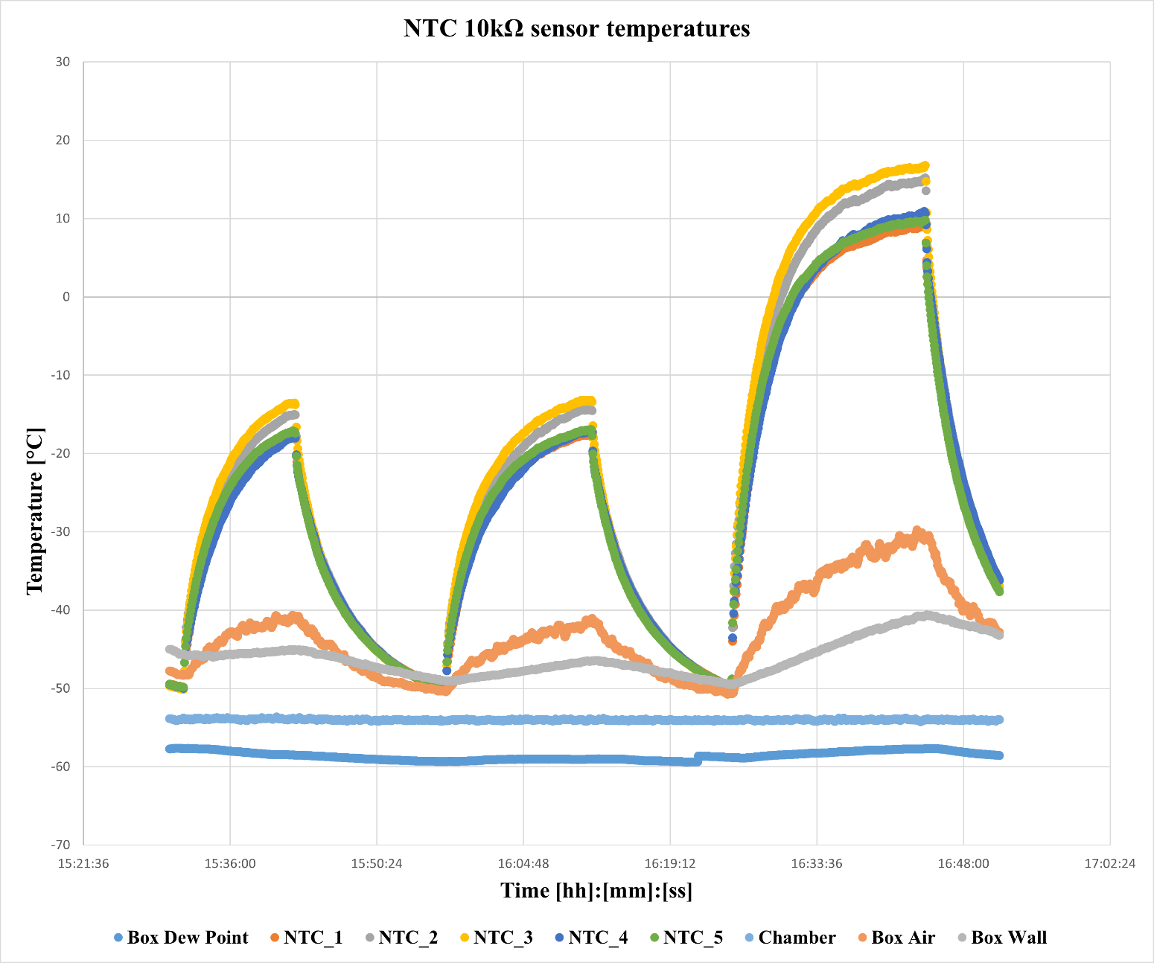
Both
Top
Bottom

Slide 14
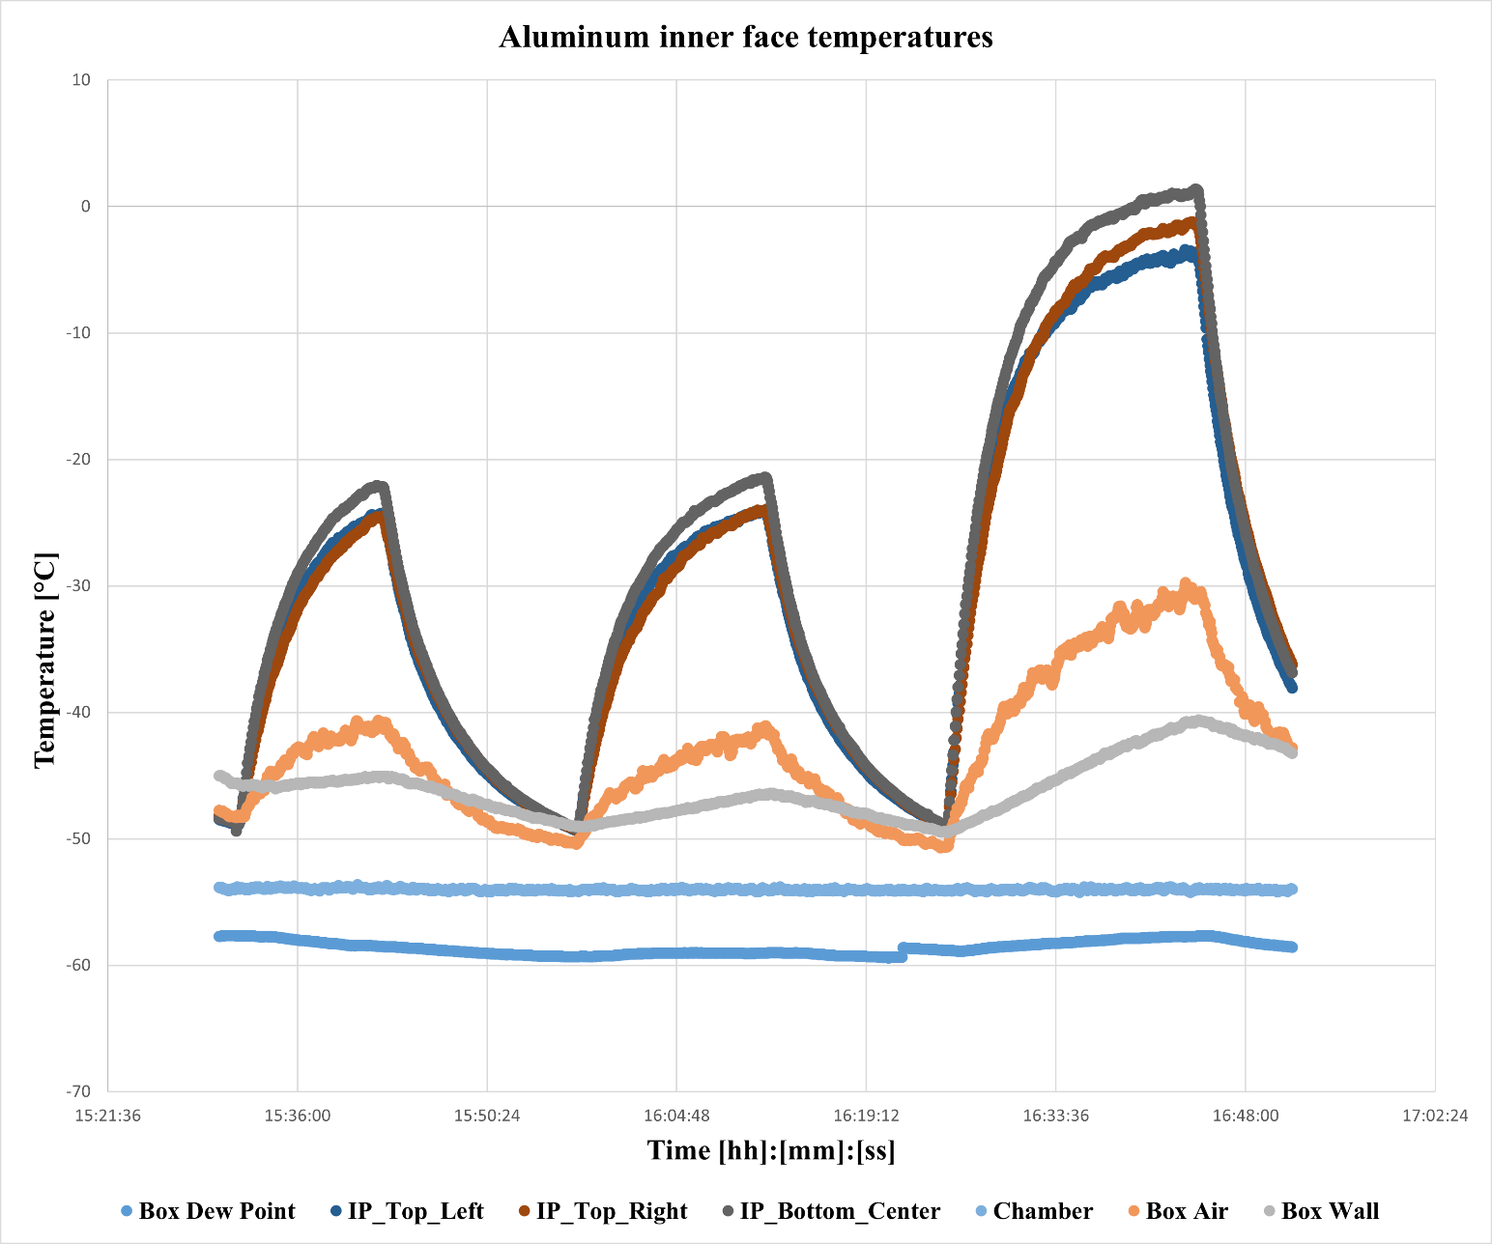
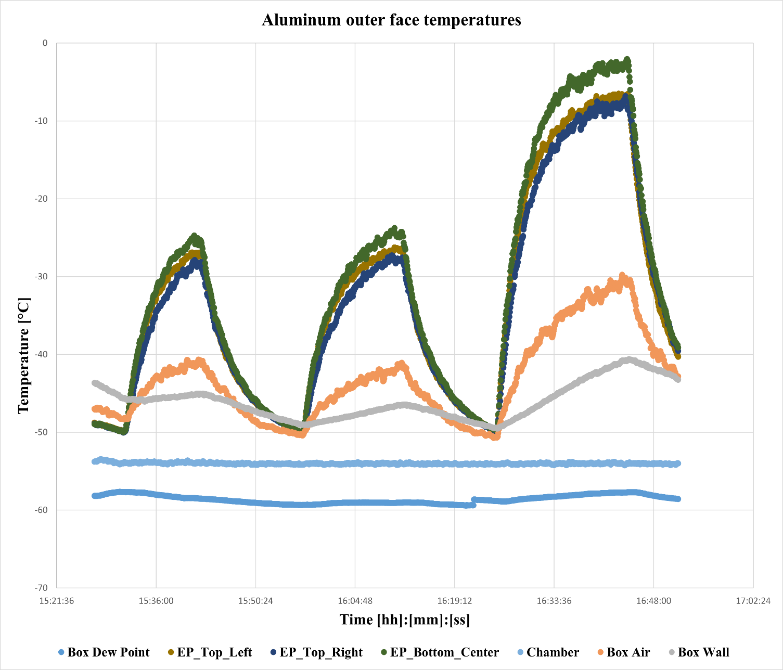
14
15/05/2023

Slide 15
Time to reach -30 °C and saturation temperature when the climatic chamber temperature is -55 °C and the test box temperature is -50 °C
 | Top (min) |  | Bottom (min) |  | Both (min)
 | T = -30 °C | T_{sat} | T = -30 °C | T_{sat} | T = -30 °C | T_{sat}
Heater without tinned copper foil | --- | --- | 3 | 19 | 1 | 17
Heater with tinned copper foil | 3 | 8 | 3 | 14 | 1 | 19

Slide 16
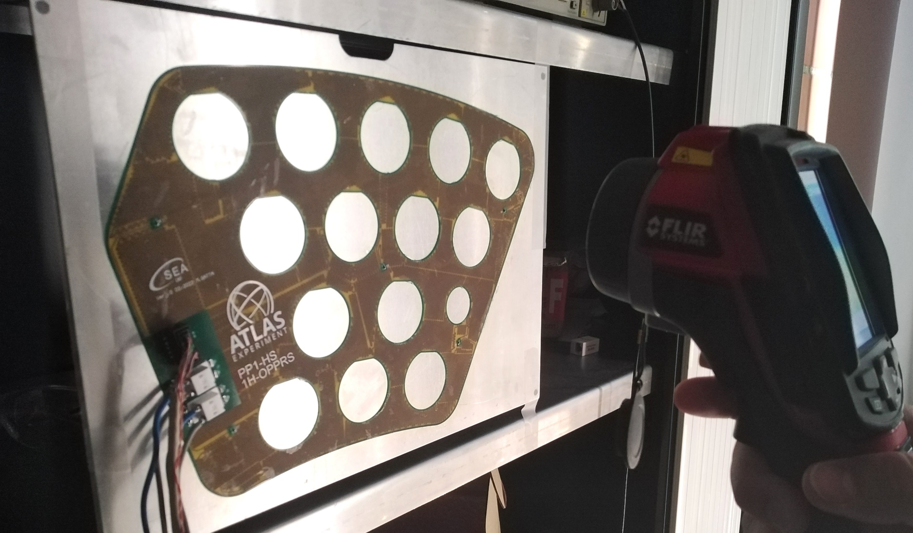
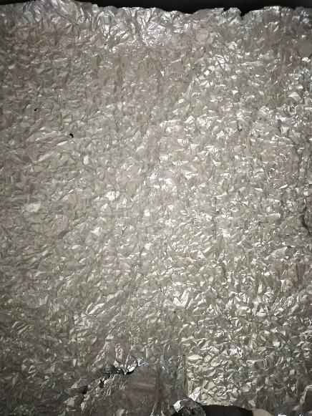
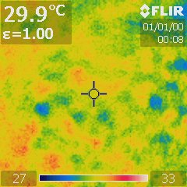
Test with IR camera to see the surface temperature distribution
test performed only on the heater without tinned copper foil
FR4 emissivity 0.9
Reflected temperature ~30 °C (reflector method)
Temperature measurement only via NTC sensors

Slide 17
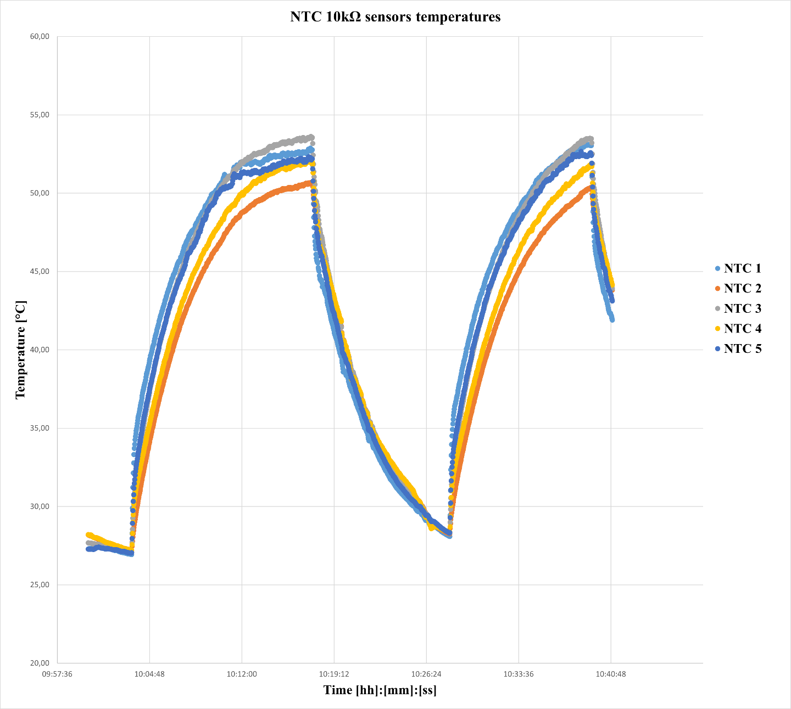
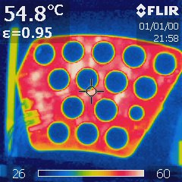
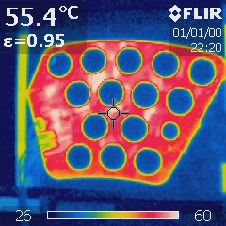
Top
Bottom
Top Resistor
(image obtained near the peak of saturation temperature)
Bottom Resistor
(image obtained near the peak of saturation temperature)

Slide 18
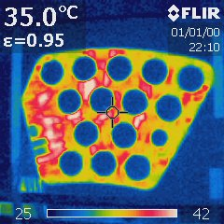
(Only Bottom Resistor)

Slide 19
Climatic Chamber

Slide 20
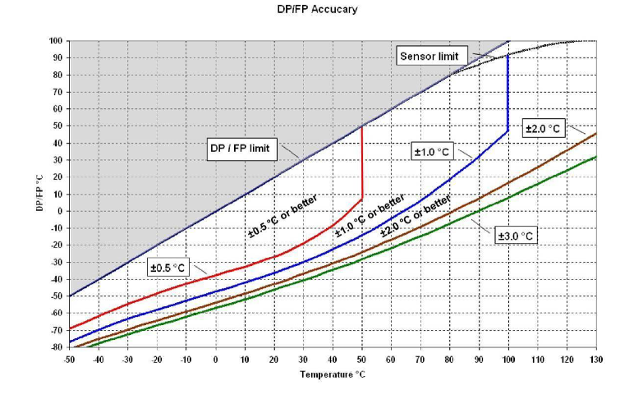
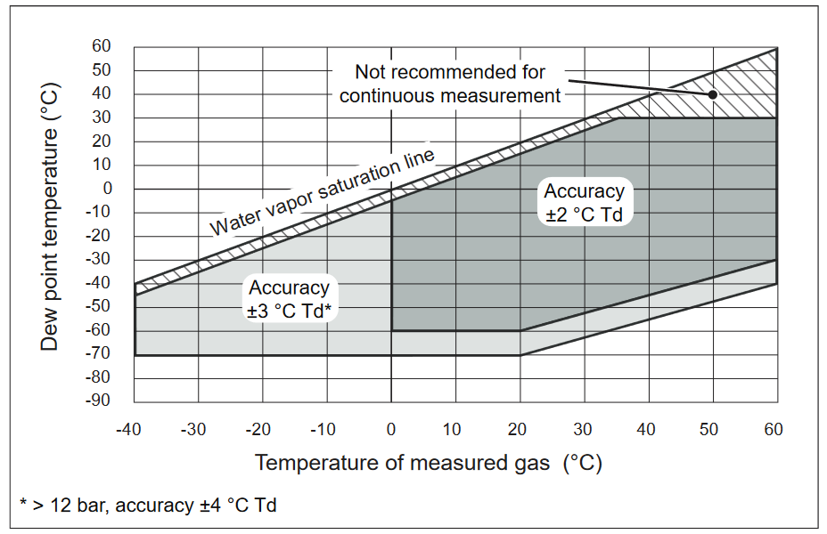
Comparison of dew point sensors in the functional test
Dew Point Sensor Rotronic Hygroflex 5
Dew Point Sensor Vaisala DMT143

Slide 21
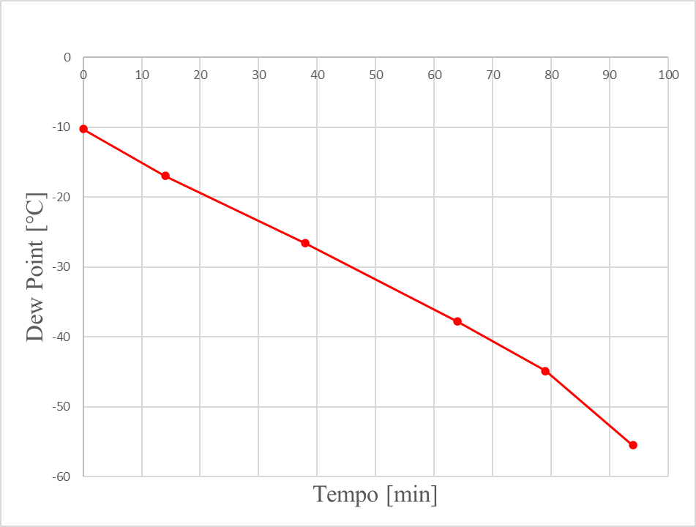
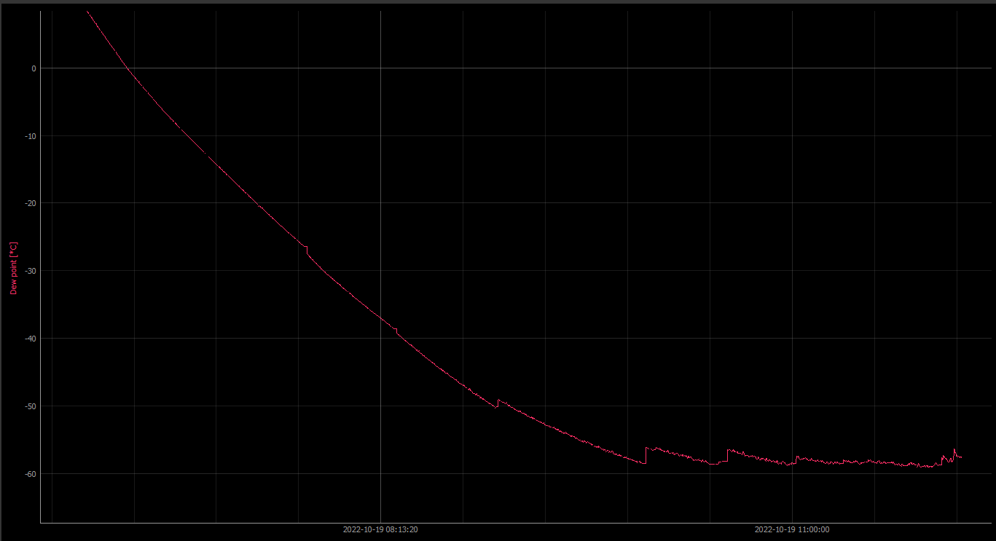
Drying of the climatic chamber environment and comparison between dew point sensors
Initial conditions:
Internal temperature of the climatic chamber 21.5 °C
Initial Dryer Dew Point -73 °C
Internal initial Dew Point Chamber 12.5 °C
External line pressure reducer 3 bar
Overpressure 1.8 mbar
Dew Point reading with chamber instrument
(External line pressure reducer 2.8 bar - Overpressure 1.7 mbar)
0
-10
-20
The dew point sensor of the climatic chamber differs considerably from the Vaisala (after 90 minutes the difference is already over 20 °C)
Sensore Dew Point Sensor Vaisala DMT143 Data
-30
Dew Point [°C]
Autocalibrations
-40
-50
-60
Time [h]
2
4
6

Slide 22
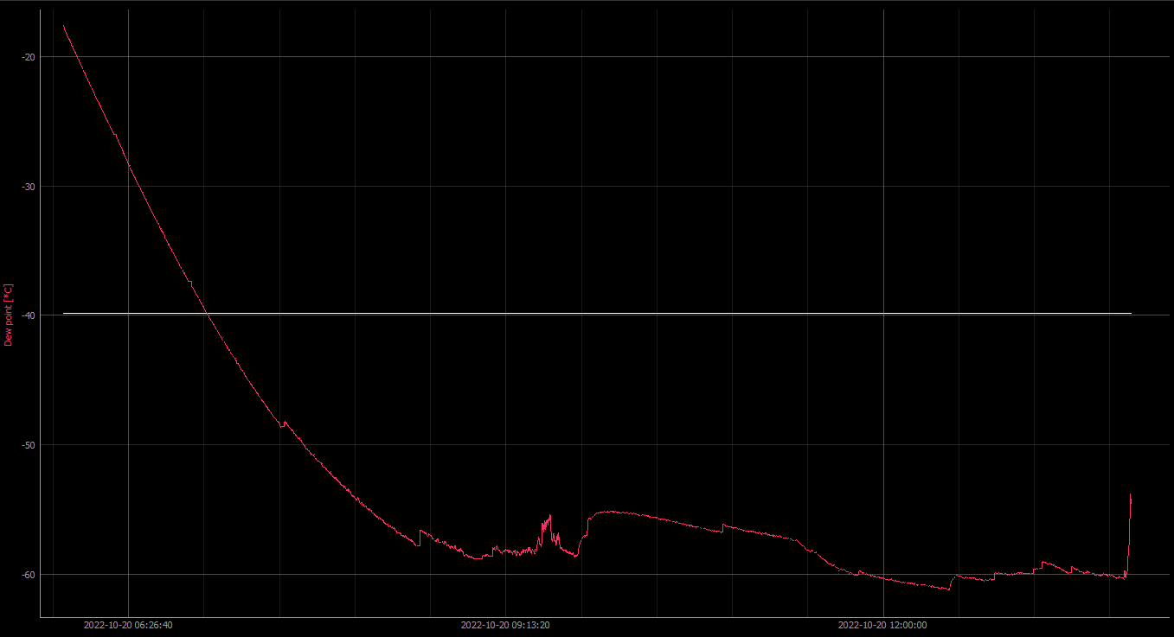
Initial conditions:
Chamber internal temperature 21 °C
Dryer Dew Point -74 °C
Internal Dew Point Chamber -20.8 °C
External line pressure reducer 2.8 bar
Overpressure 1.65 mbar (after one hour 1.88 mbar)
Dew point variation test with overpressure
Dew point variation test with refrigeration and subsequent heating
-20
-30
Dew Point [°C]
-40
Overpressure
test
Temperature
test
-50
-60
Time [h]
2
4
6

Slide 23
Dew Point as a function of the overpressure by regulating the pressure reducer
(20/10/2022)
The dependence on the overpressure is approximately 2.5 °C from 0.9 mbar to 2.20 mbar (reducer pressure), but since the requirement of -60 °C is stringent, it is advisable to stay between 1 and 2 mbar (upper limit up to which work is considered safe of the climatic chamber)
T_{CC} = 20.4 °C
Pressure (bar) | Overpressure (mbar) | Dew Point (°C)
2,8 | 2,20 | -58.6
2.4 | 1.87 | -58.3
2.0 | 1.64 | -58.2
1.6 | 1.40 | -58.3
1,2 | 1.21 | -58.2
0.8 | 1.0 | -57.7
0.4 | 0.9 | -56.0
1 | 1.2 | -56.9
2 | 1.75 | -58.2
2.4 | 2.0 | -58.4
Overpressure reference:
First results from the upgrade of the Extreme Energy Events experiment, M. Abbrescia et al 2019 JINST 14 C08005

Slide 24
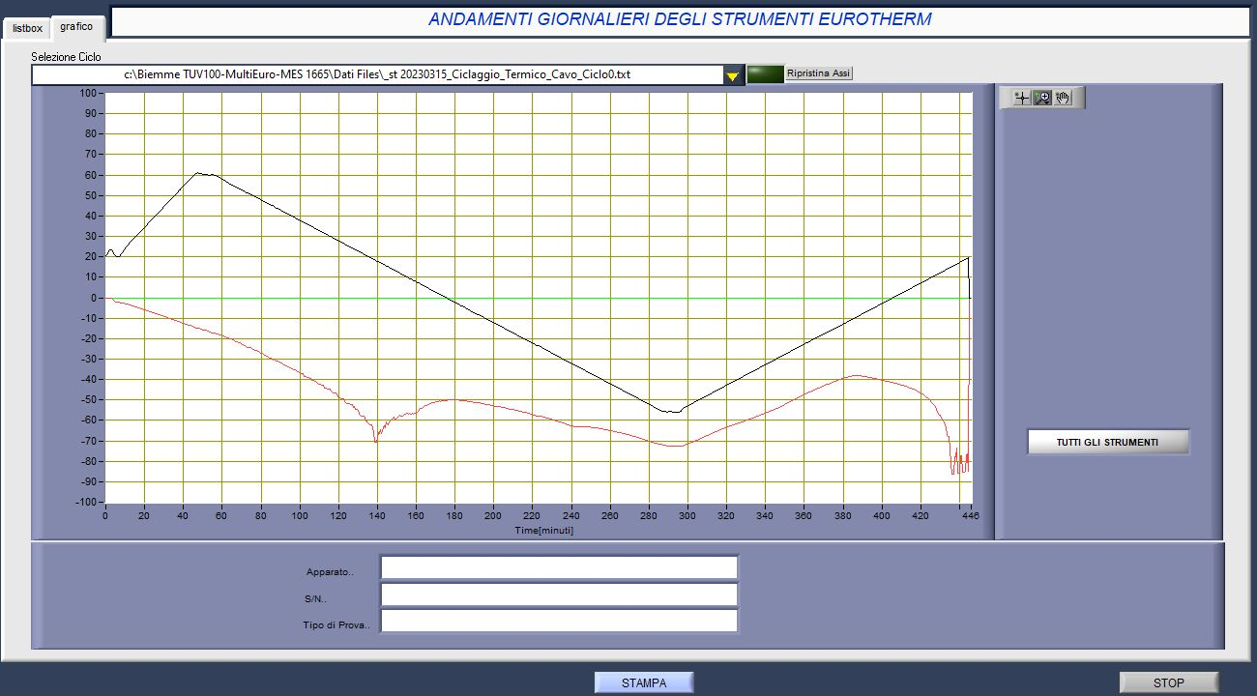
Thermal Cycle for Type I Cable Test
(20/03/2023)

Slide 25
