Slide 1



INFN in Euratom Horizon 2020
participation in three projects
Decommissioning &
accident remediation
Radwaste monitoring
Radwaste predisposal monitoring

Slide 2
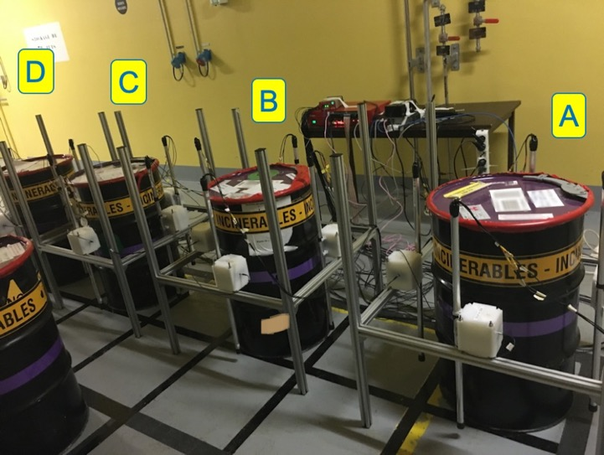
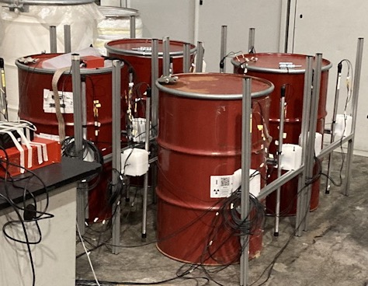
9 european partners
INFN leader of WP7 - long-term radwaste monitoring

Slide 3
External monitoring: what comes out of a radwaste drum?
beta particles are mostly stopped inside the material and in air
alpha particles are immediately stopped inside the material
fission fragments are immediately stopped inside the material
neutrons, from fission or (α,n) reactions, come out very easily typically at low dose-rates; in some cases there can be many
gamma rays are penetrating, therefore they come out easily and abundantly
basic radioactivity coming out is gamma rays and neutrons
they carry information from inside and are worth monitoring
easier external monitoring

Slide 4
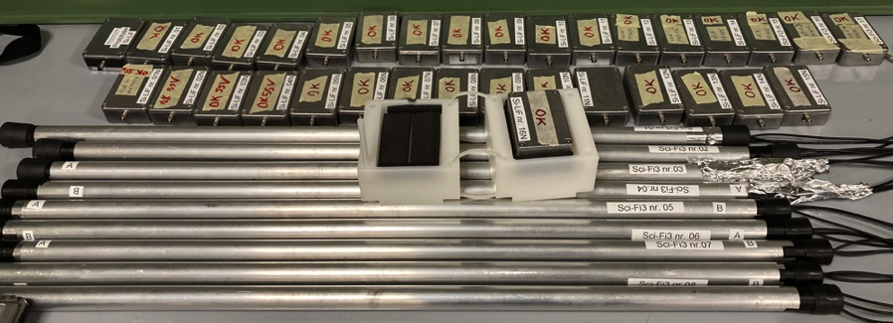
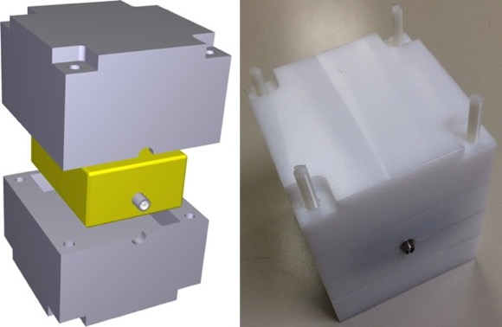
what was built
SiLiF thermal neutron detectors
PET neutron moderators
SciFi gamma ray detectors

Slide 5

Test at ORANO La Hague on four drums (with Pu)

Slide 6
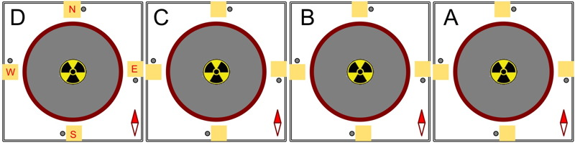
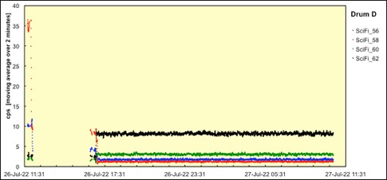
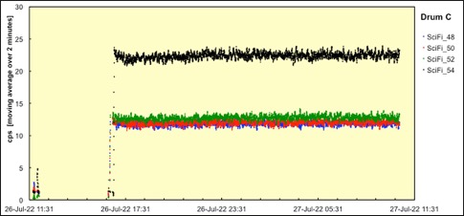
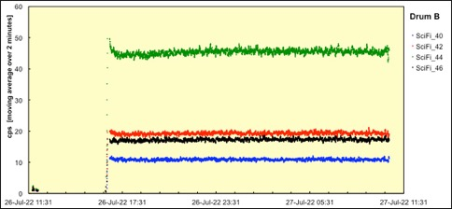
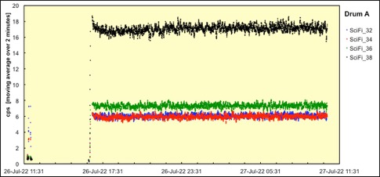
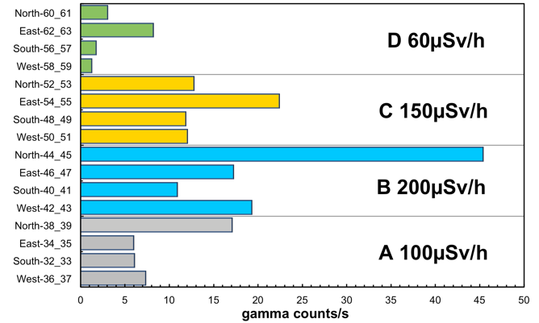
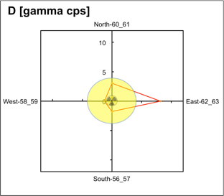
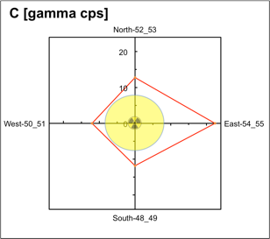
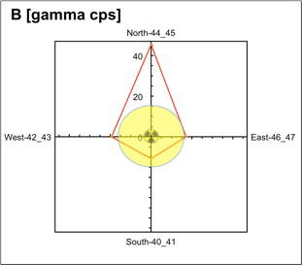
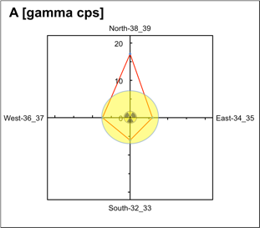
Test at ORANO La Hague on four drums (with Pu)
SciFi gamma detectors
gamma source

Slide 7
Test at Nucleco ENEA Casaccia

Slide 8
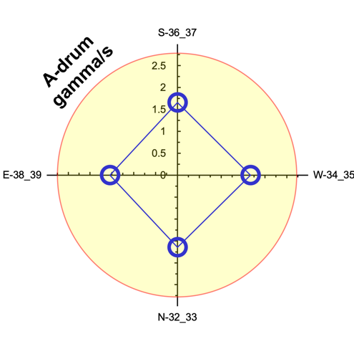
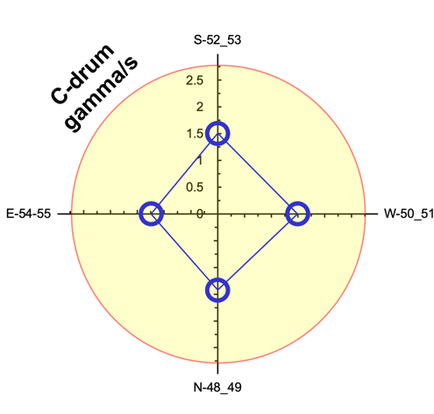
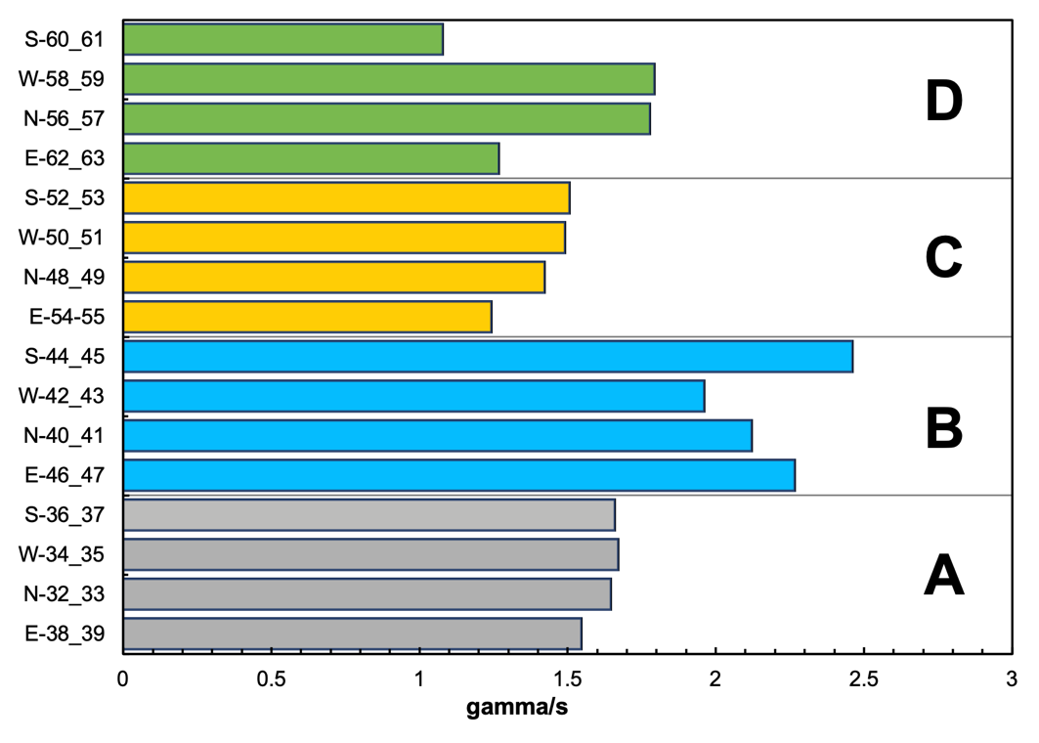
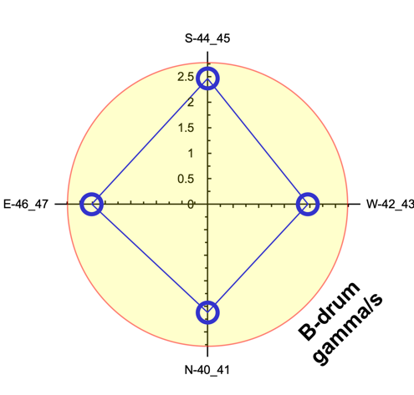
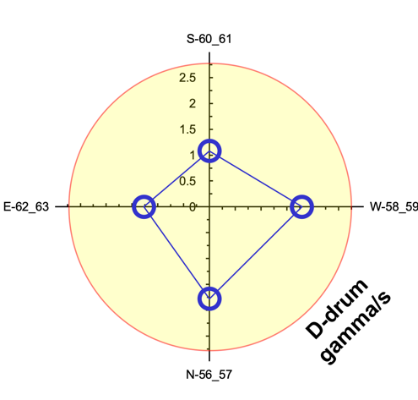
Test at Nucleco ENEA Casaccia

Slide 9
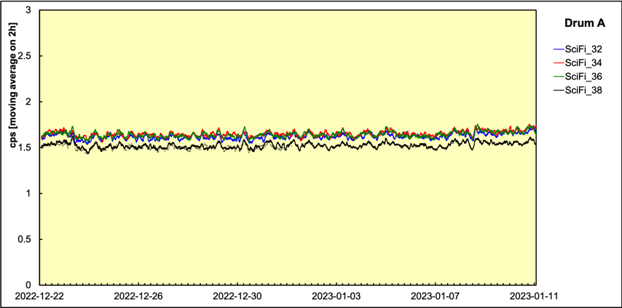
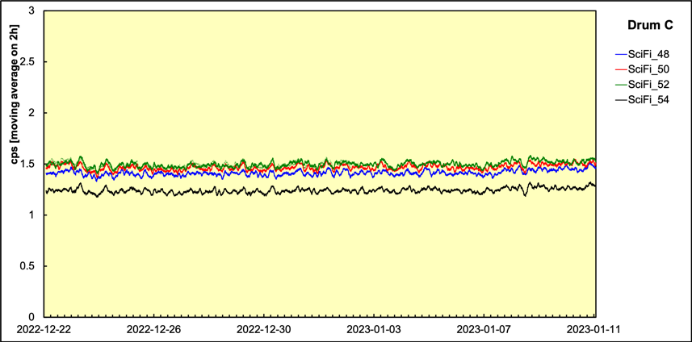
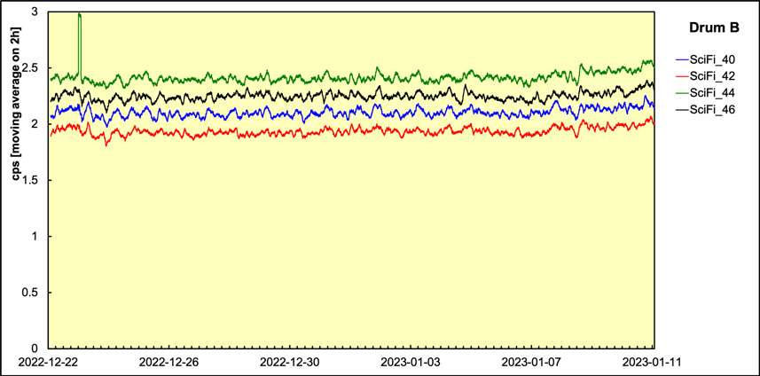
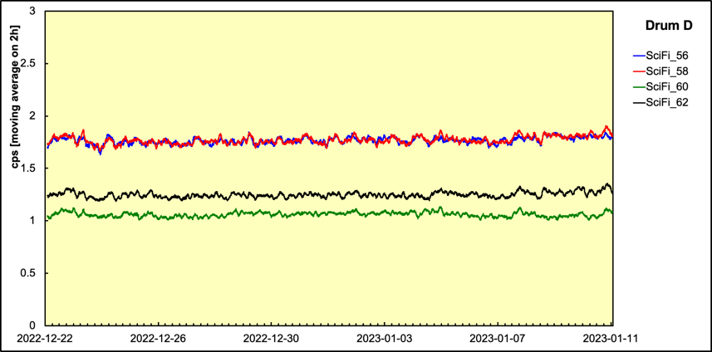
Test at Nucleco ENEA Casaccia

Slide 10
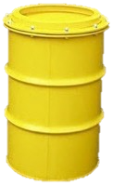
47 european partners
WP7 - Innovations in cemented waste handling and pre-disposal storage
INFN involved in WP7.3 - Testing and monitoring
T7.2 State of the art
T7.3
Testing and monitoring
T7.4
Digital Twin
T7.1 Management
T7.7 Reporting
T7.5 Data and Decision
T7.6 Demonstration

Slide 11
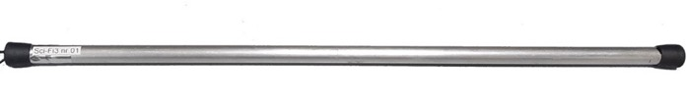
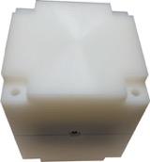
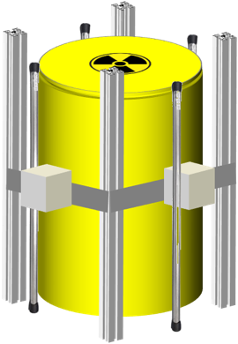
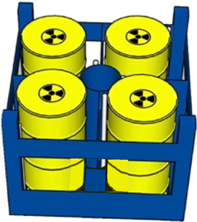


External radiological monitoring: how to
gamma ray detector from MICADO
Developed WiFi front-end and
data acquisition electronics
neutron detector from MICADO
installed on stillage
installed on single drums
AzureDB

Slide 12
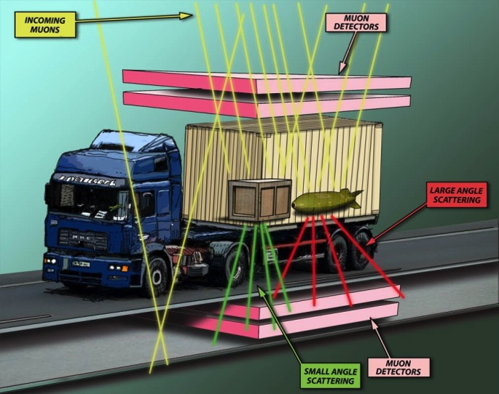

Looking inside thick objects: muon tomography
Cosmic
muon
µ_{in}
detect and classify atomic number Z and density
multiple Coulomb scattering
average deflection
<θ_{scatt}> = f(Z,ρ)
1
2
2 detectors above and 2 below
event-by-event:
  measure (X₁, Y₁), (X₂, Y₂)
  measure (X₃, Y₃), (X₄, Y₄)
  obtain in & out directions
  obtain θ_{scatt}
θ_{scatt}
µ_{out}
3
collect statistics
  divide the volume into voxels
  reconstruct (Z,ρ) in voxels
scan duration governed by the
limited incoming muon rate
4
muon tomography is useful to investigate
unknown legacy radwaste with NDA

Slide 13
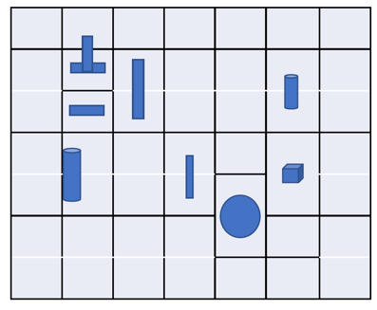
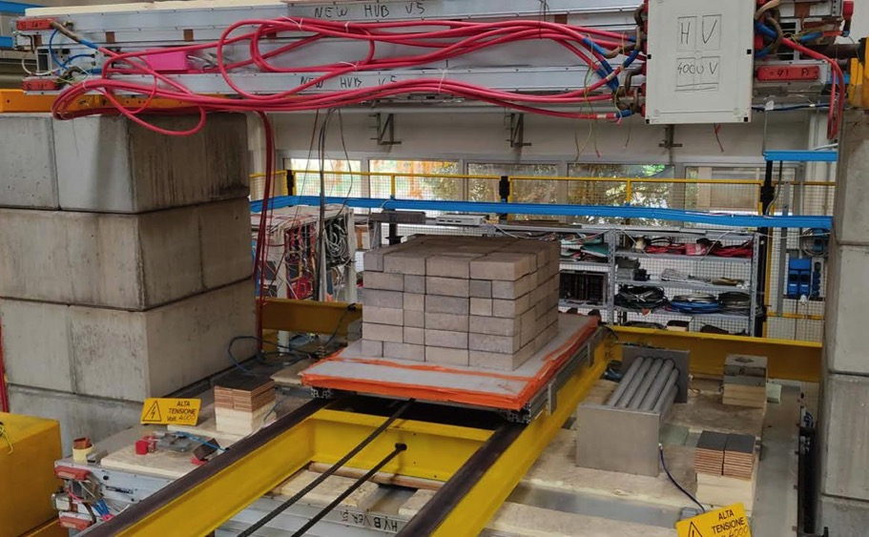
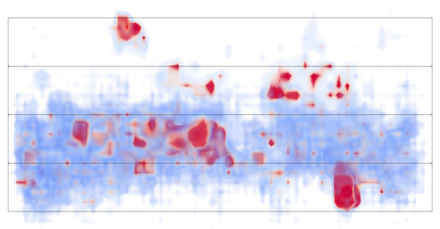
Test with samples of various metals in cement
Top view (sketch)
Cosmic
muon
Side view (real data)
Top view (real data)

Slide 14
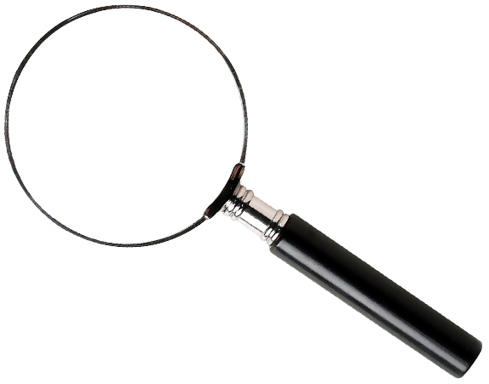
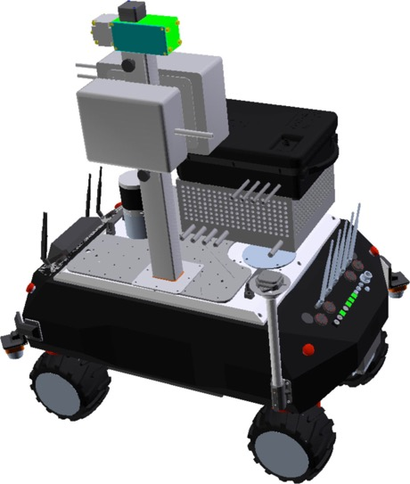
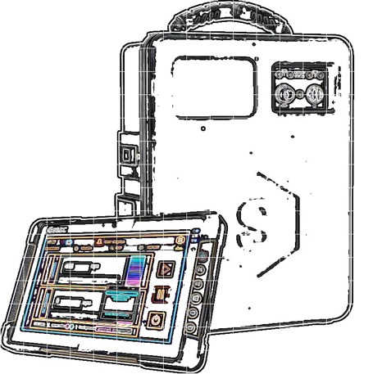
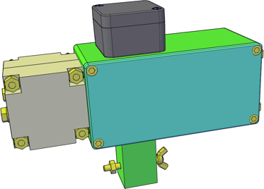

11 european partners
INFN involved in
WP3 (Low cost sensors for dose rate mapping)
WP4 (Gamma and neutron detection and identification)

Slide 15
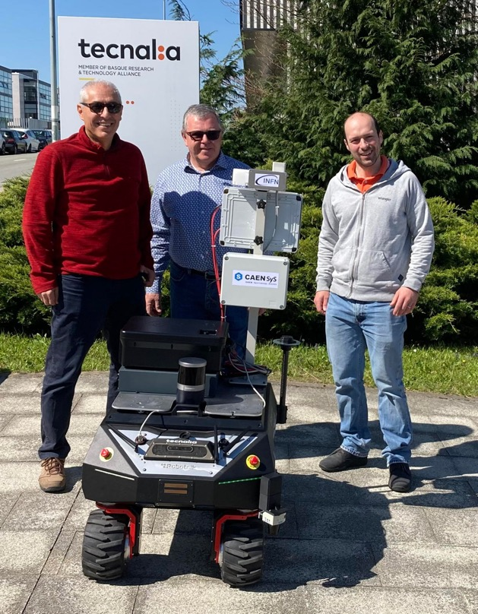
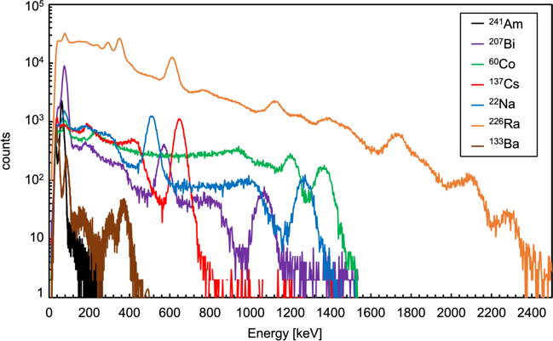
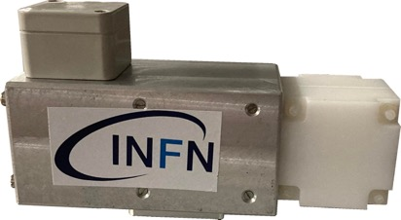
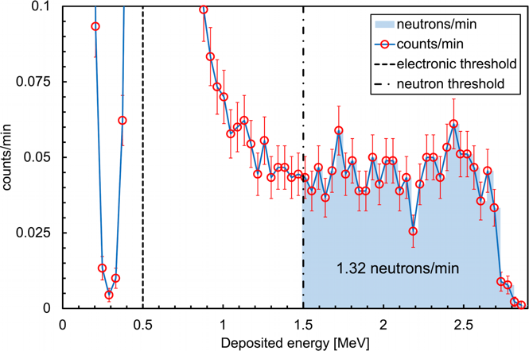
the MiniRadMeter installed on the robot's top position
gammas
neutrons

Slide 16
INFN PADOVA in CLEANDEM
The main goal: Gamma and neutron detection and identification technologies
Upgrade and integrate n/g detection systems on the UGV Platform for the monitoring of the area, to identify the presence of neutrons or also to be able to discriminate between Uranium and Plutonium;
Have sensors to equip the UGV arms able to identify the gamma emitters and used for hot spot characterization of the zones/elements identified as critical during the monitoring phase of the area or small tubes and pipes not easily accessible.
INFN Padova specifically participates to:
Preliminary studies through MonteCarlo simulations to optimize the detection procedures and optimizing the detectors performances
First validation tests for a toolbox of probes addressing the gamma/neutron detection and source identification (different shapes NaiL, Stilbene, CLLB,CeBr)
Once the identified the final components (Stilbene NaIL, CeBr), the systems have been prepared and tested extensively in laboratory, before with point-like laboratory sources with gamma and neutron (137Cs, 60Co, 241Am, 252Cf, etc.) sources
Study the g/n rejector factor mostly focused on the g/n detection system.

Slide 17
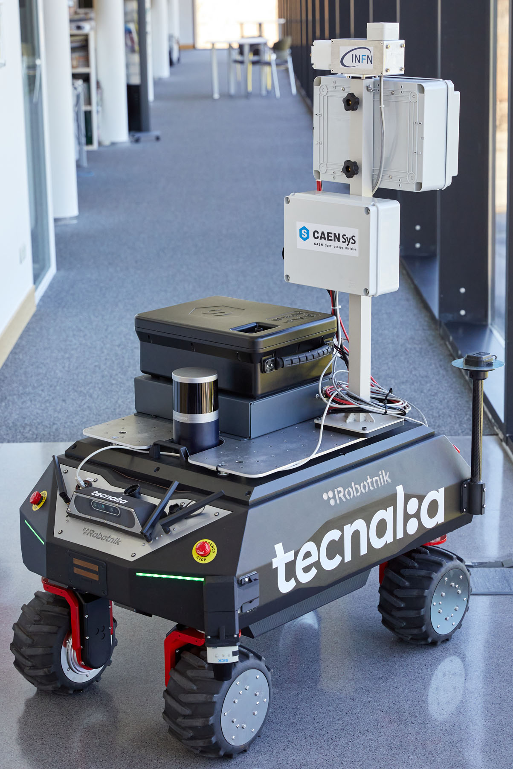
Integration of the Gamma and neutron detection and identification technologies
Stilbene diam.2” length 2”
CeBr diam. 1.5” length 1.5”
NaIL rectangular shape 4”x4”x2”

