Slide 1
Charge sharing & high-Z reconstruction
Wei-Shuai Zhang; Rui Qiao; Ke Gong; Wen-Xi Peng

Slide 2
Background: charge sharing
beam
4th
float
3rd
float
2nd
float
1st
float
Seed
float
1st
float
2nd
float
3rd
float
4th
beam hitting the readout strip
beam
4th
float
3rd
float
2nd
float
1st
float
1st
float
2nd
float
3rd
float
4th
beam hitting the floating strip
Page 2

Slide 3
Background: high-Z saturation
fC
Saturation(>3000 ADC)
 | saturated? | processed？
 | Yes | No
 | No | Yes
 | No | No
Channel
Ch4 is seed channel
0
1
2
3
4
5
6
7
8
Page 3

Slide 4
Background: the detector
The 3.6 cm width detector is divided into 10 sections.
Each section has unique strip width & capacitance.
Each section has 40 implant strips and 20 readout channels.
0ohm
0ohm
68 pf
47 pf
20 pf
100 pf
60 um width
25 um width
3.6 cm
Page 4

Slide 5
0 channel saturated
Page 5

Slide 6
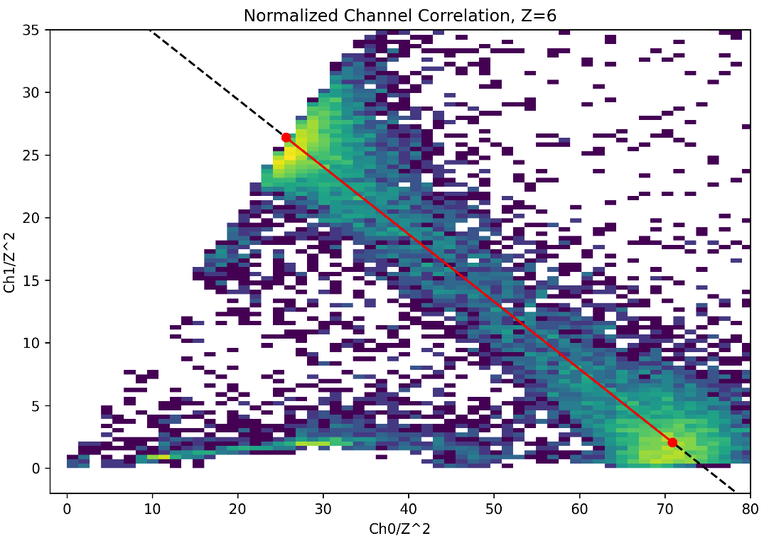
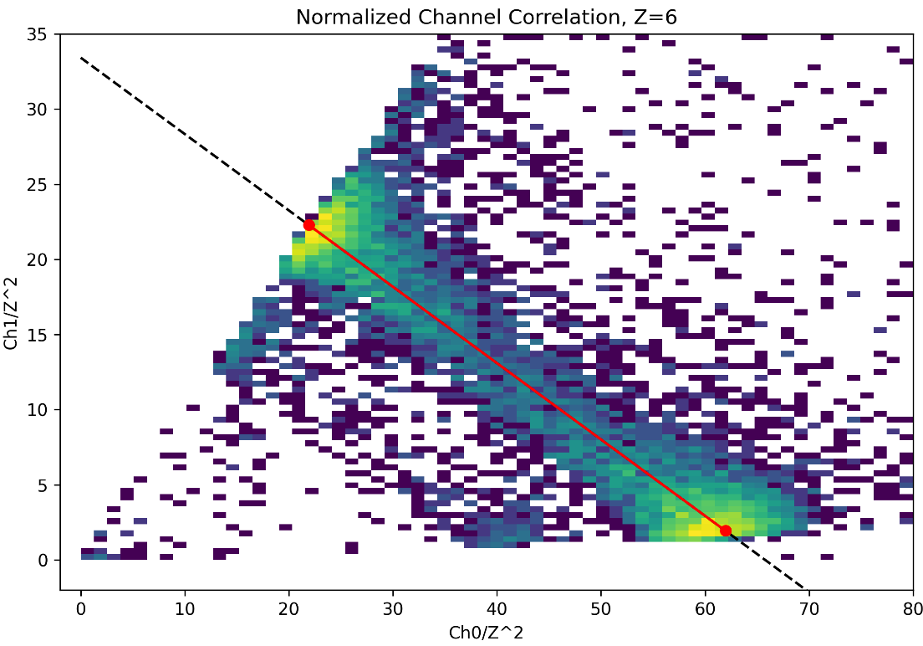
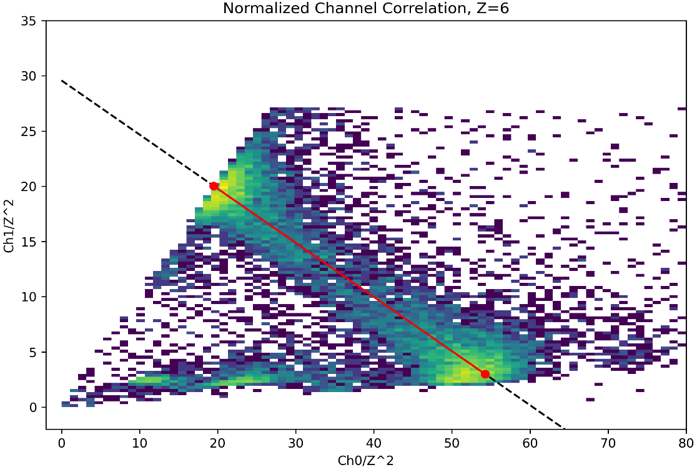
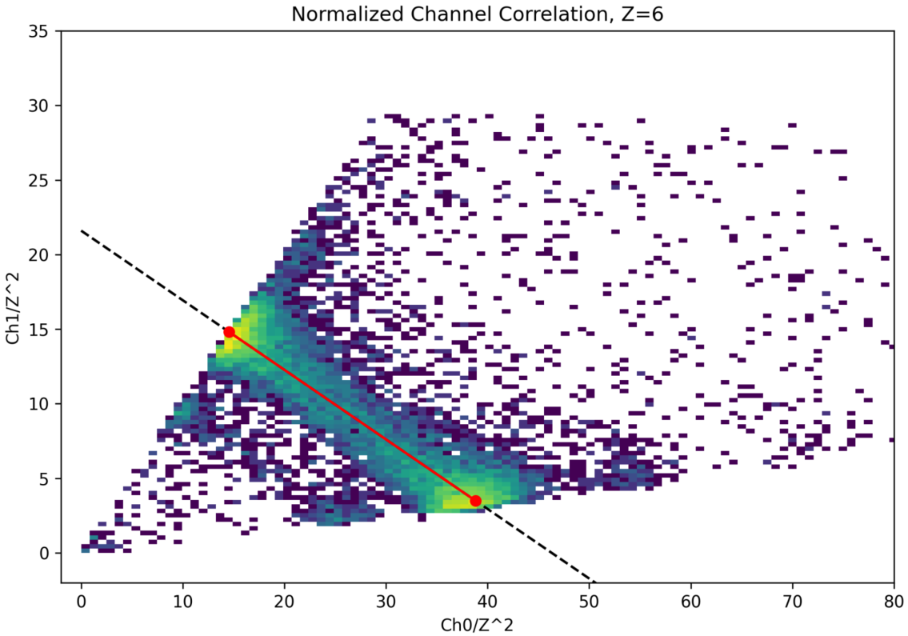
0 channel saturated——Ch0 vs Ch1 for Z=6
Section0_60um_0ohm
Section4_60um_100pF
Section2_60um_47pF
Section3_60um_20pF
Page 6

Slide 7
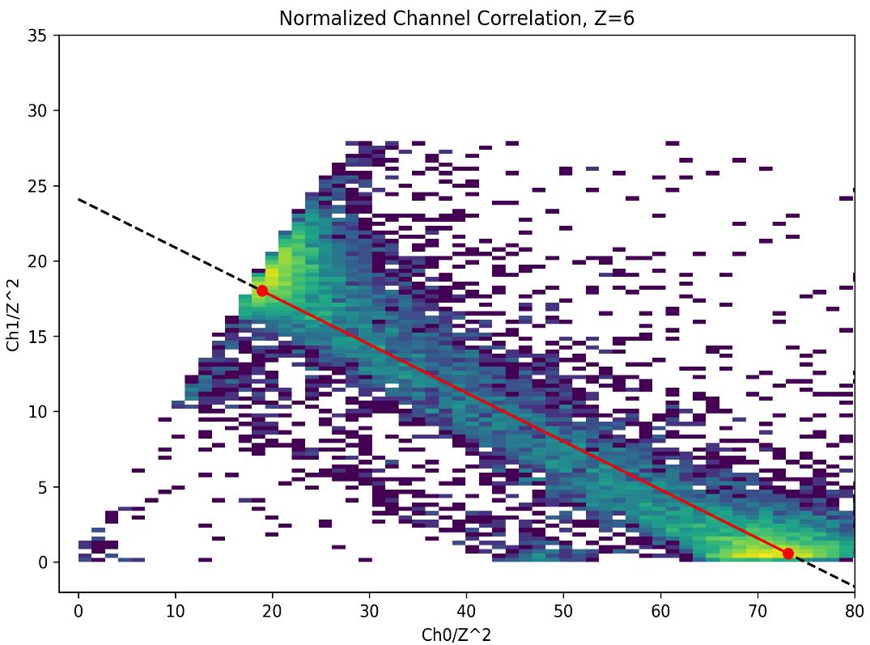
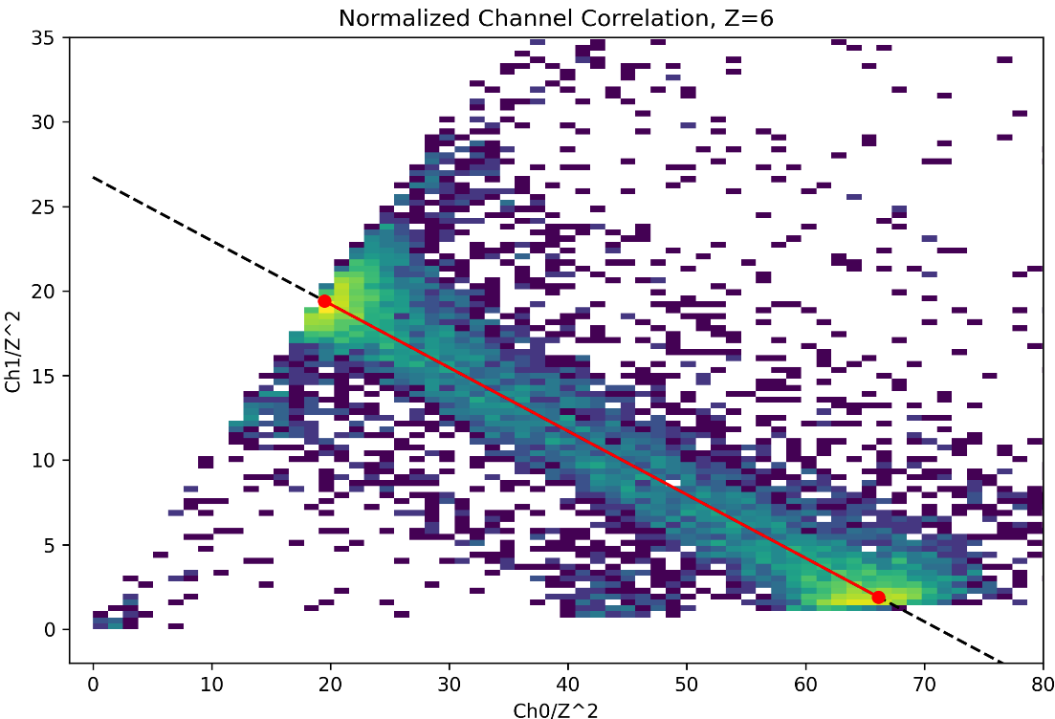
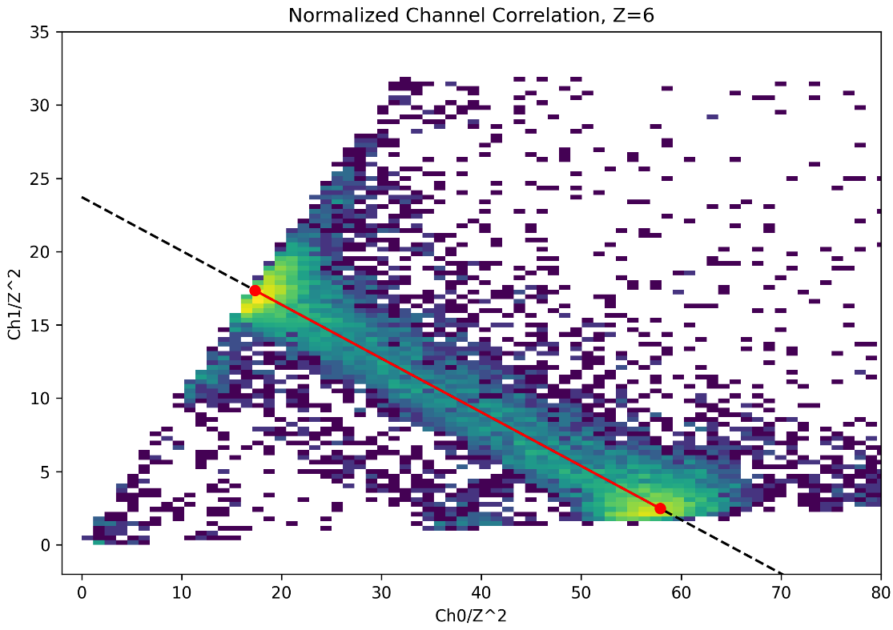
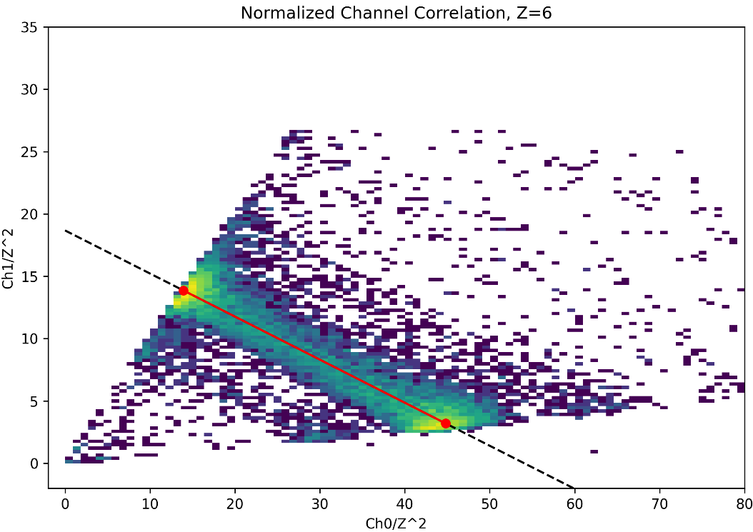
0 channel saturated——Ch0 vs Ch1 for Z=6
Section9_25um_0ohm
Section5_25um_100pF
Section7_25um_47pF
Section6_25um_20pF
Page 7

Slide 8
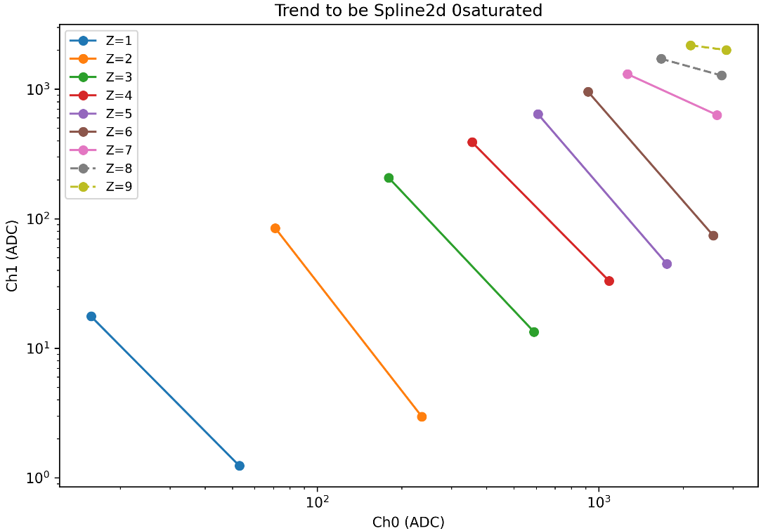
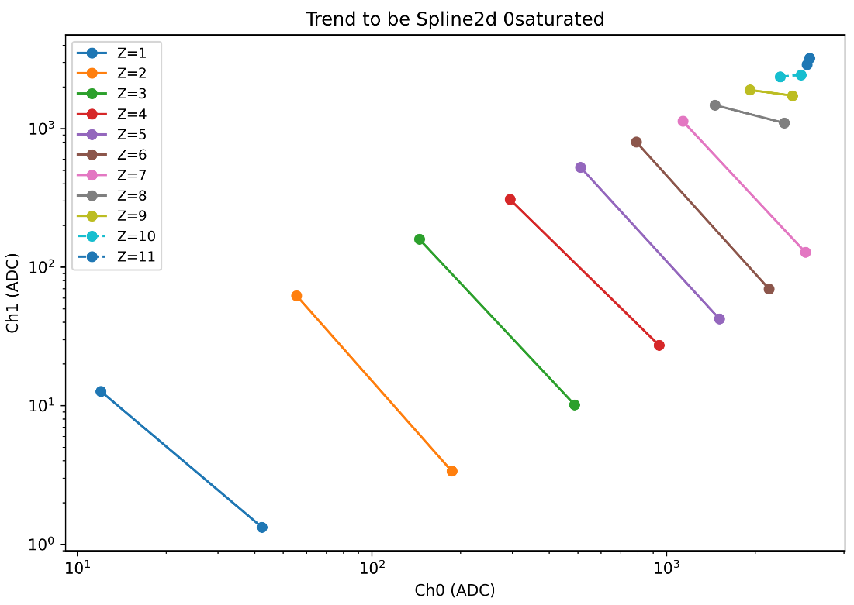
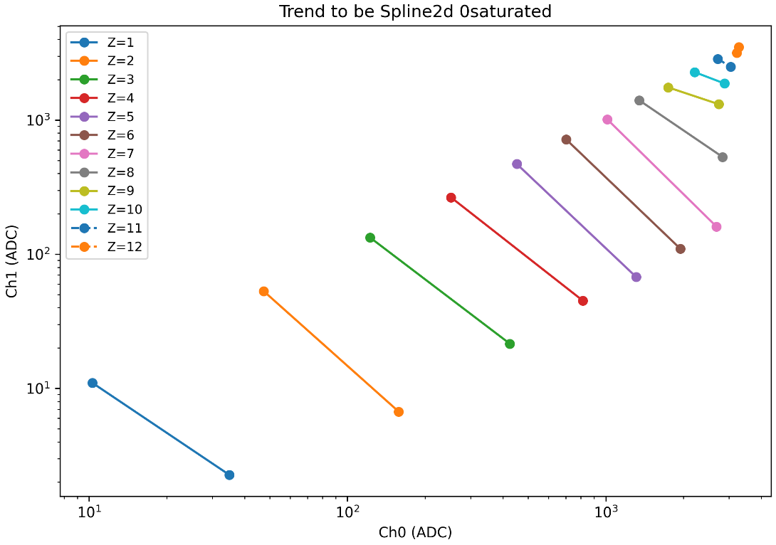
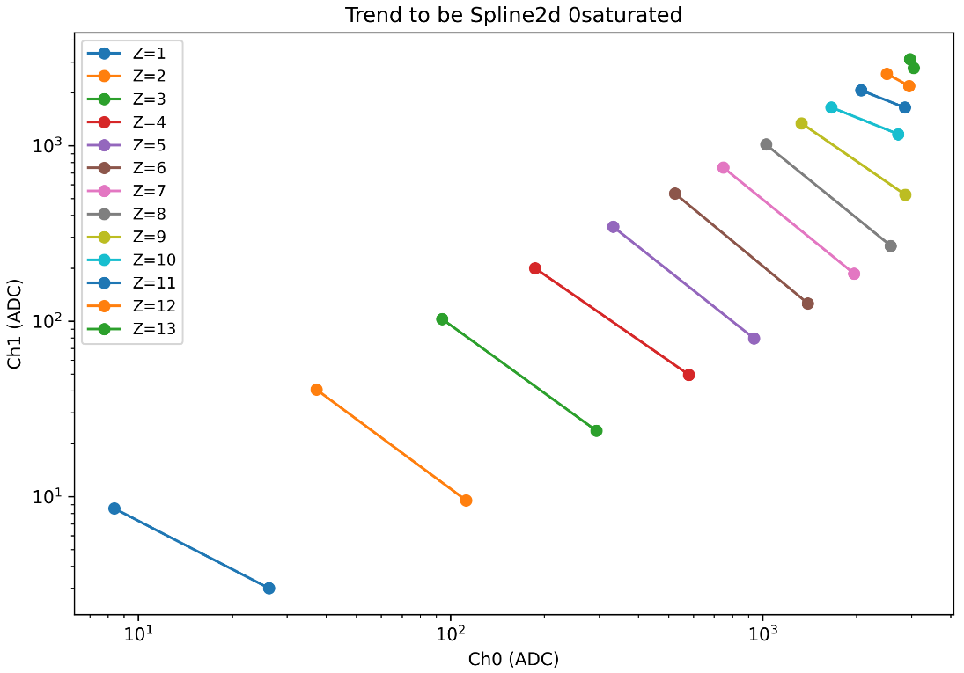
0 channel saturated——To be interpolation in two-dimension （good_z）
Section0_60um_0ohm
Section4_60um_100pF
Section2_60um_47pF
Section3_60um_20pF
Page 8

Slide 9
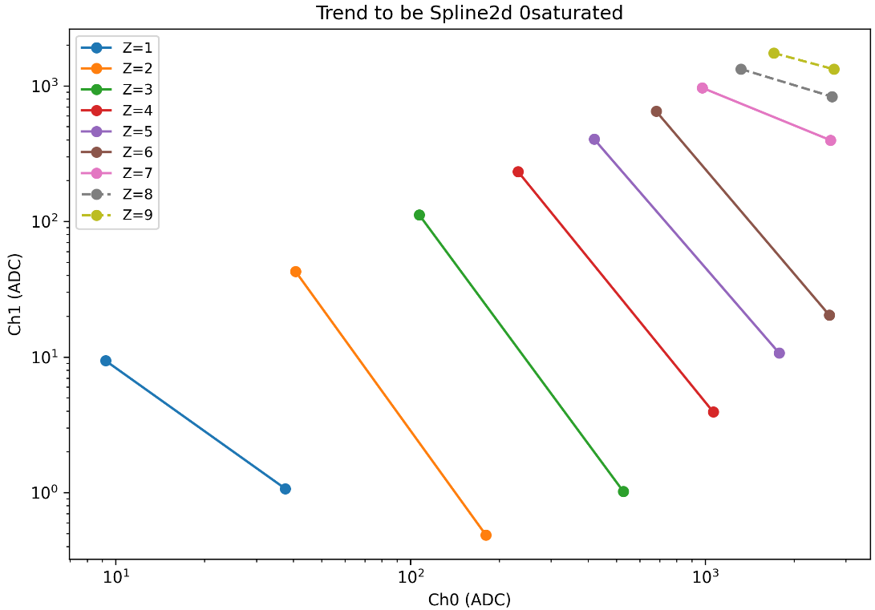
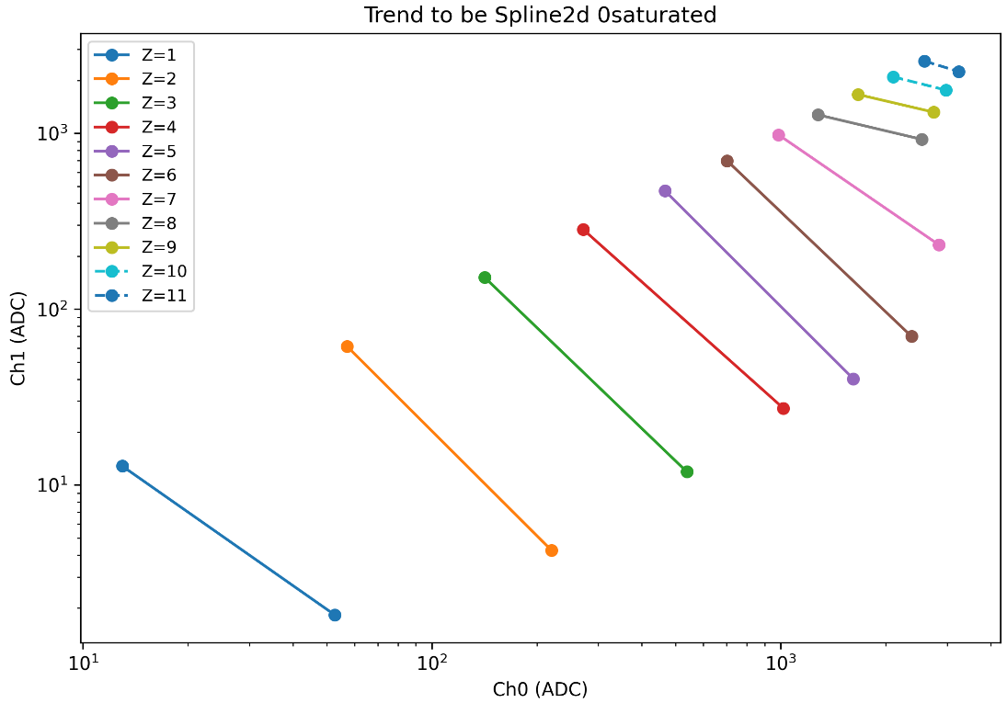
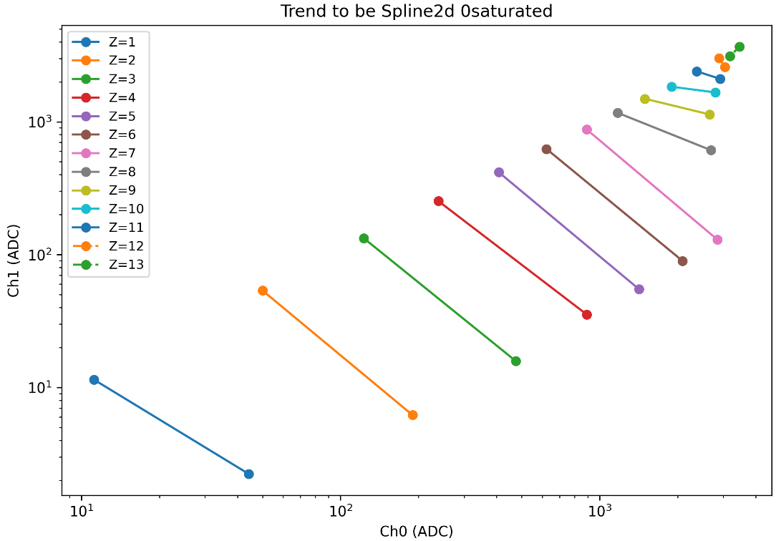
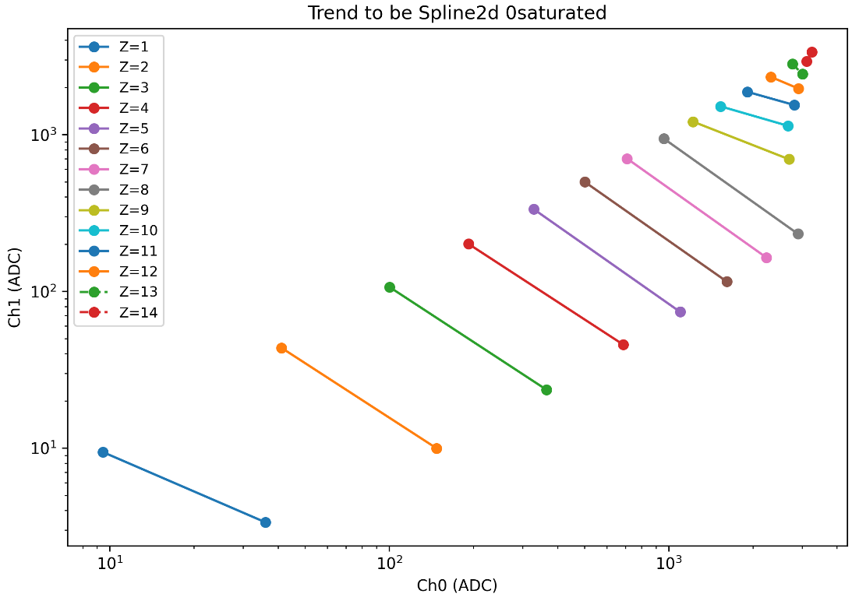
0 channel saturated——To be interpolation in two-dimension （good_z）
Section9_25um_0ohm
Section5_25um_100pF
Section7_25um_47pF
Section6_25um_20pF
Page 9

Slide 10
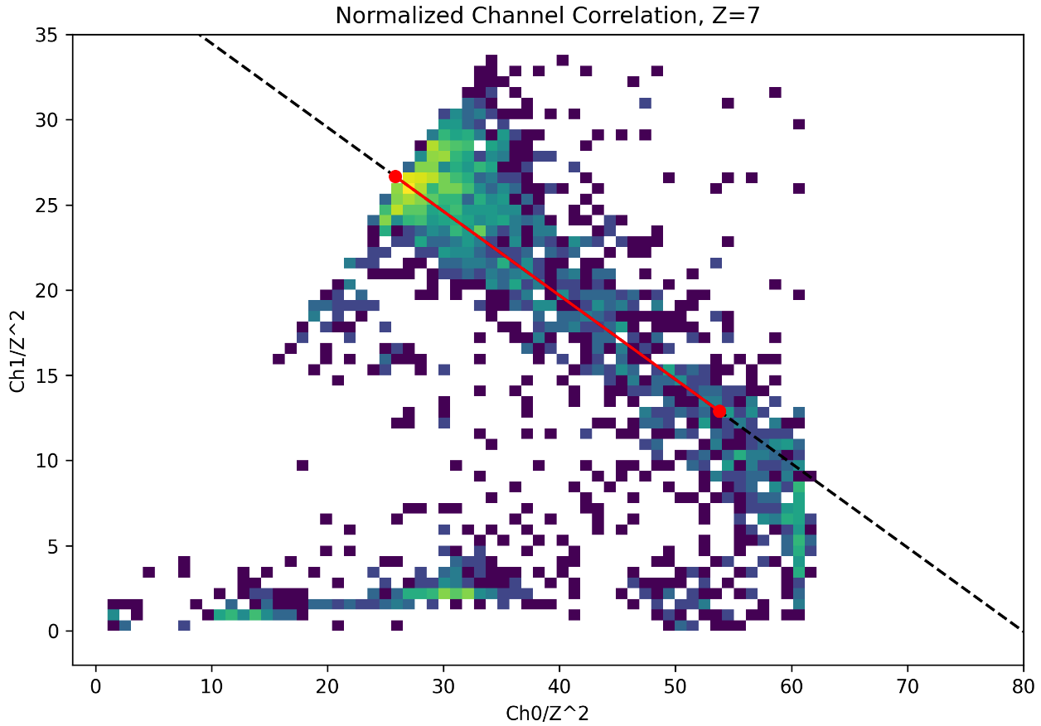
0 channel saturated
Section0_60um_0ohm
Z=6
Z=7
Page 10

Slide 11
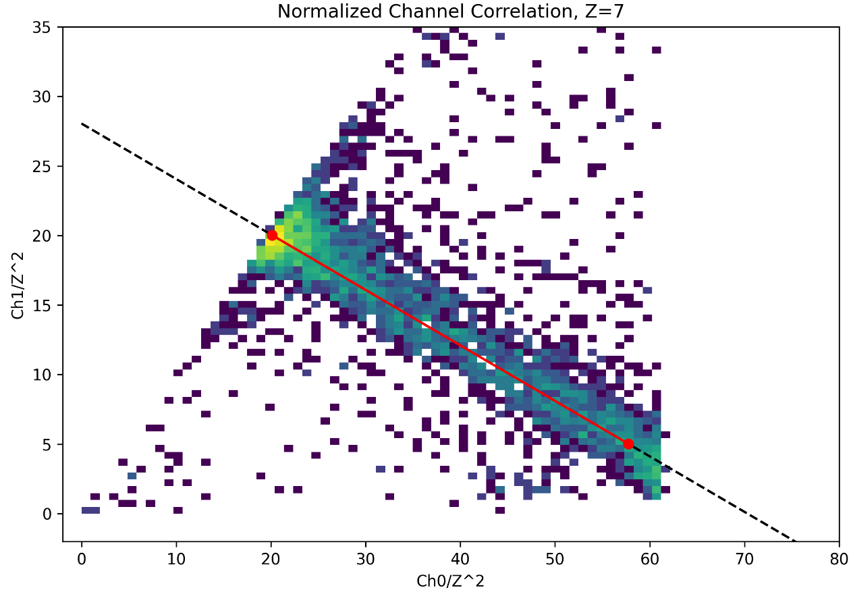
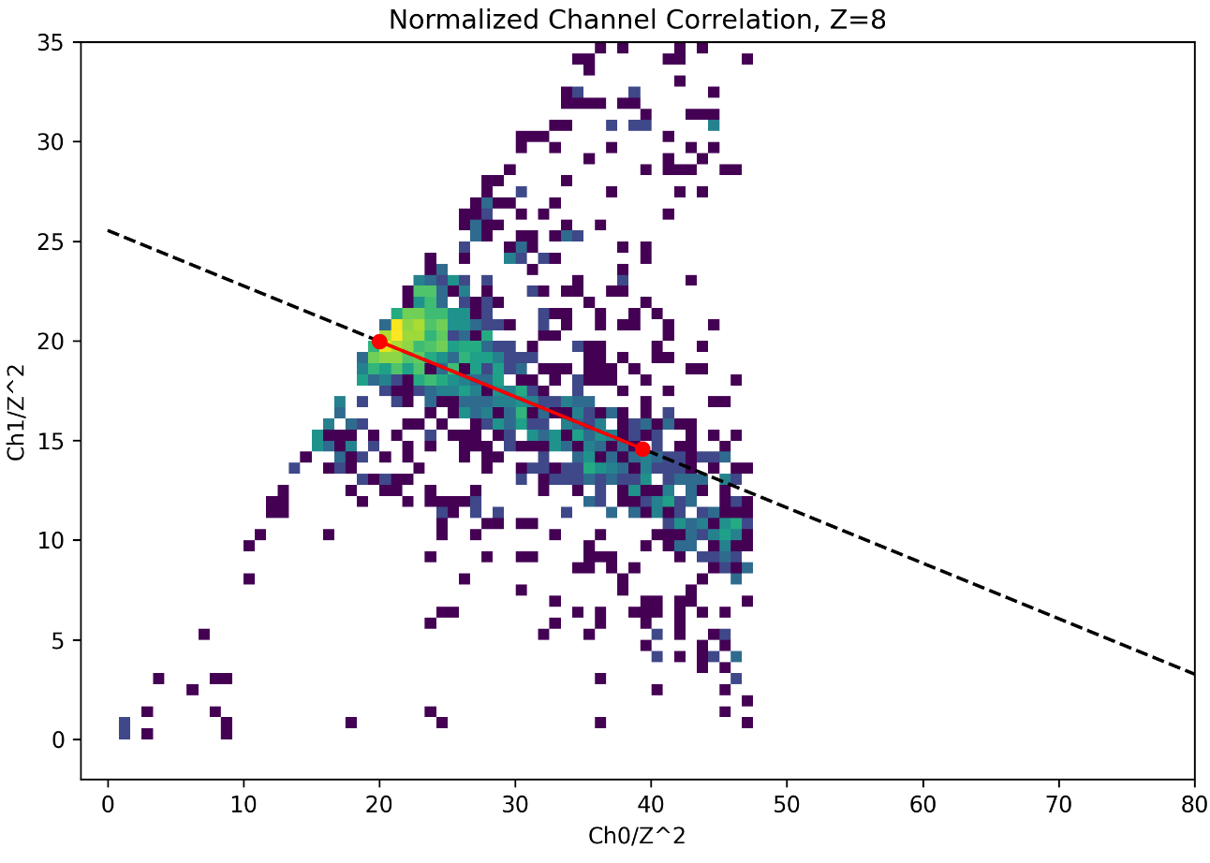
0 channel saturated
Section5_25um_100pF
Z=7
Z=8
Page 11

Slide 12
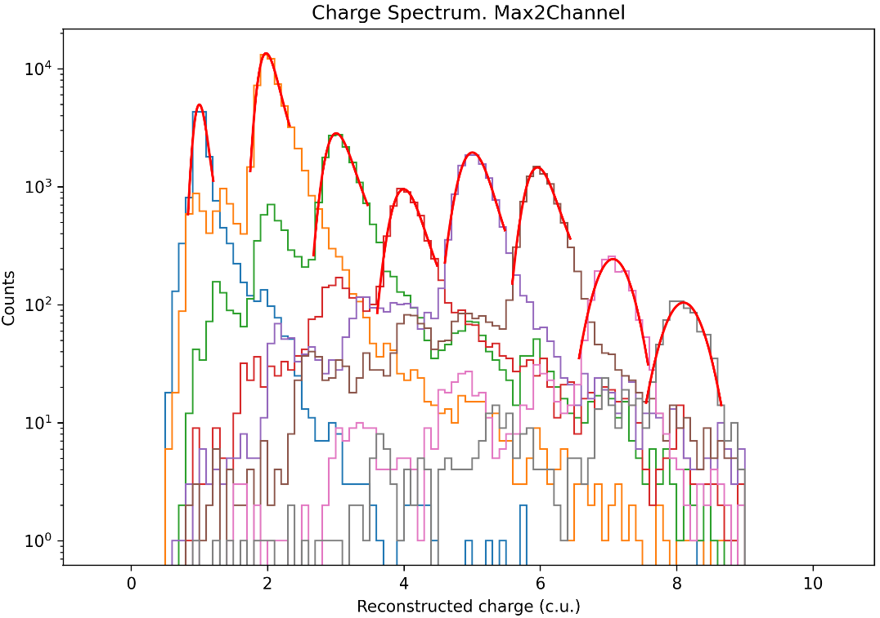
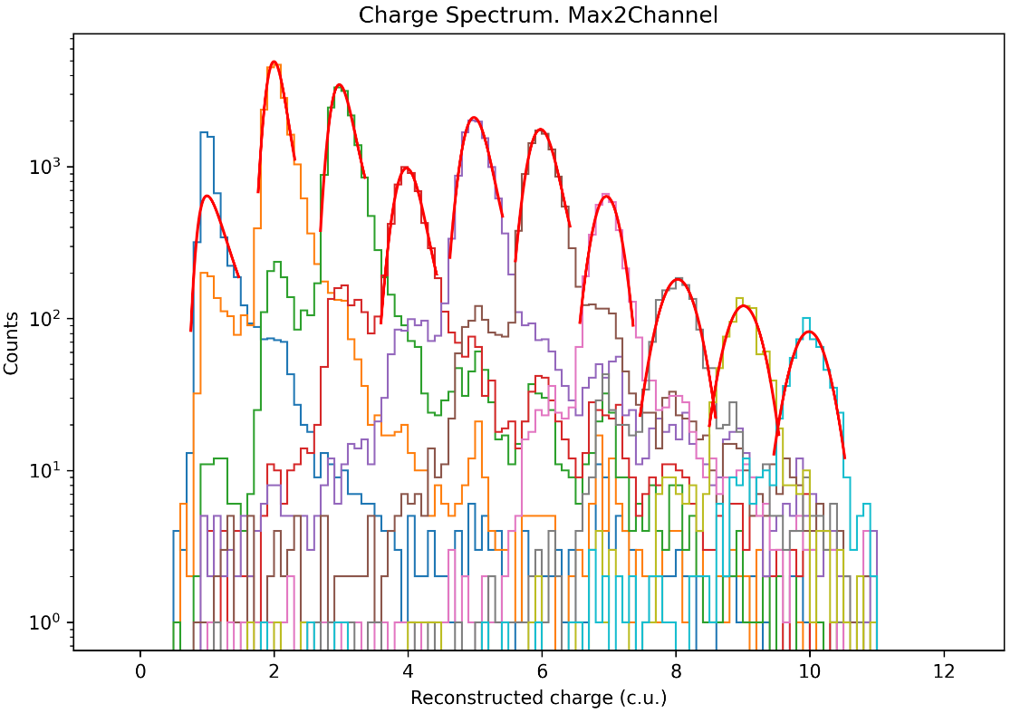
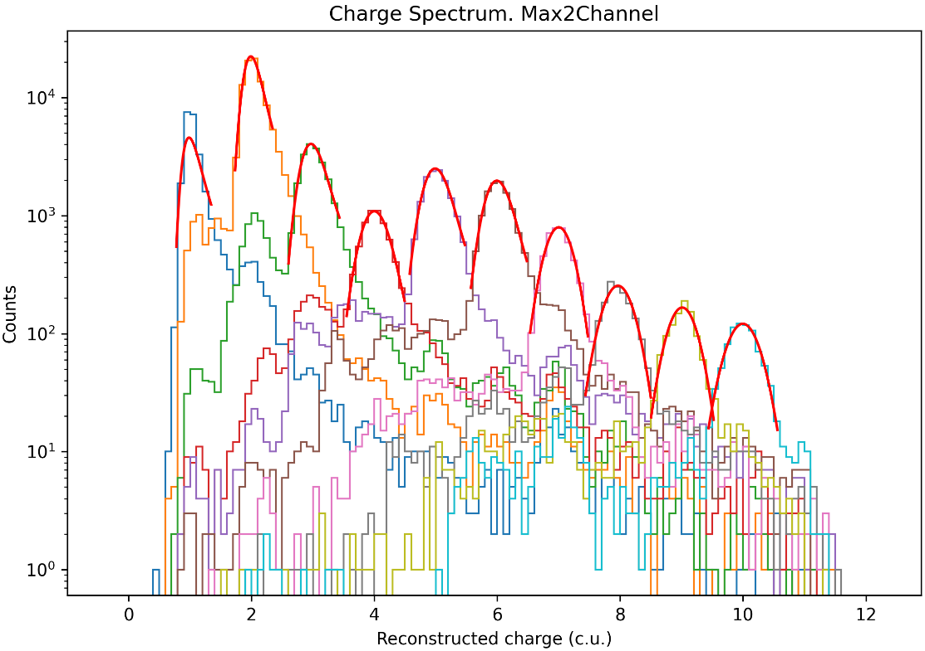
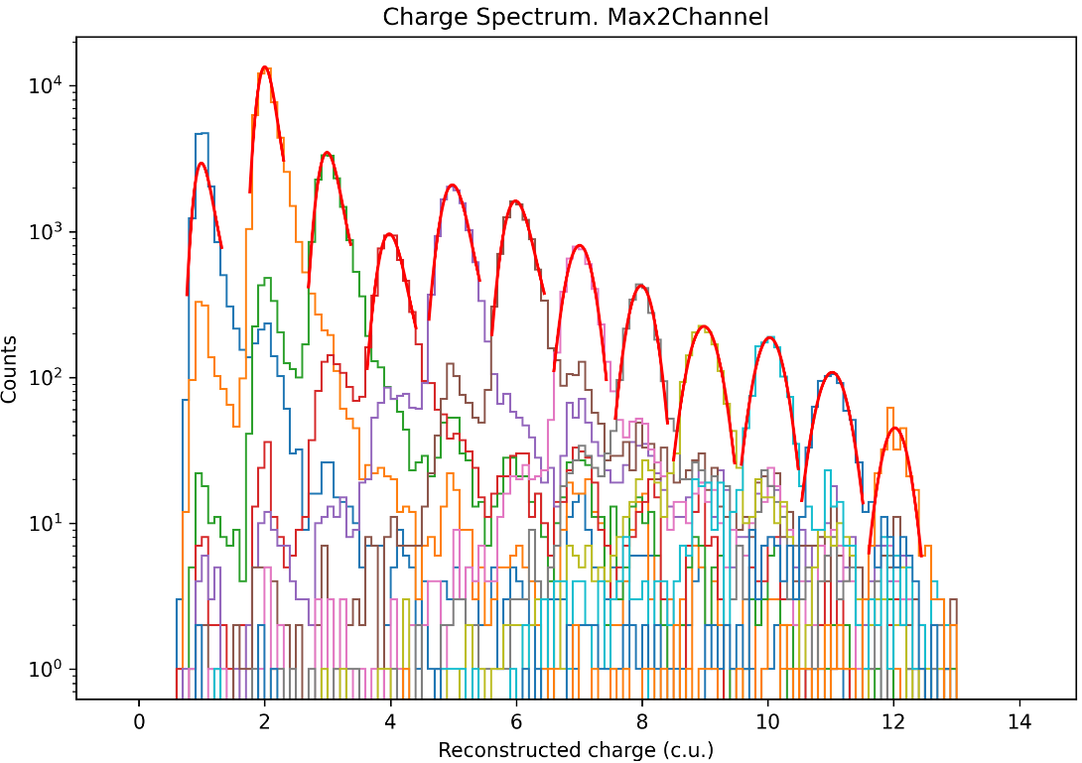
0 channel saturated——Reconstruction of the charge spectrum
Section0_60um_0ohm
Section4_60um_100pF
Section2_60um_47pF
Section3_60um_20pF
Page 12

Slide 13
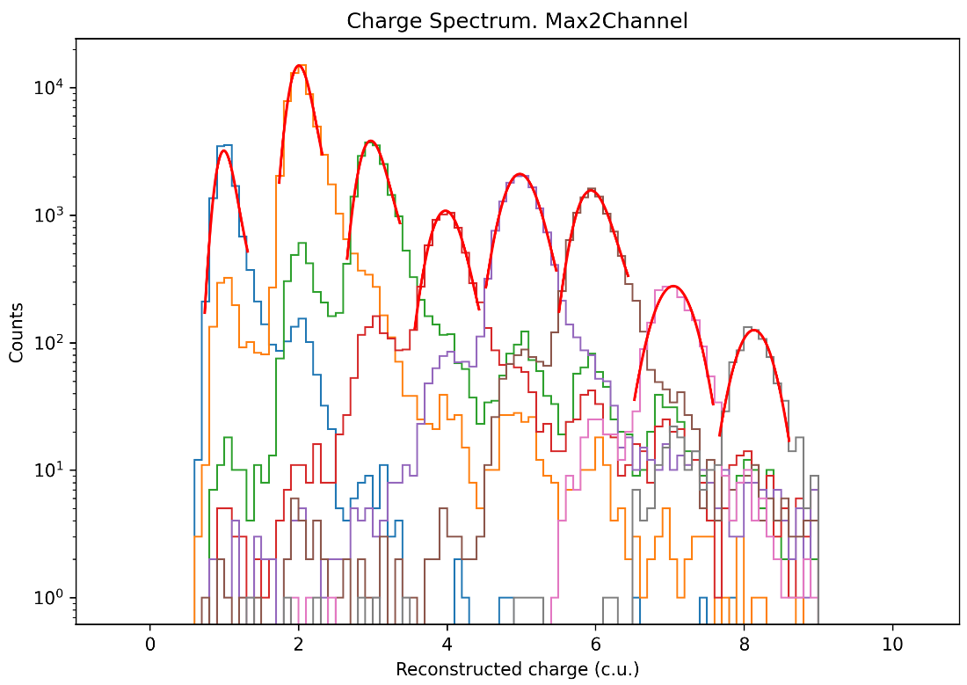
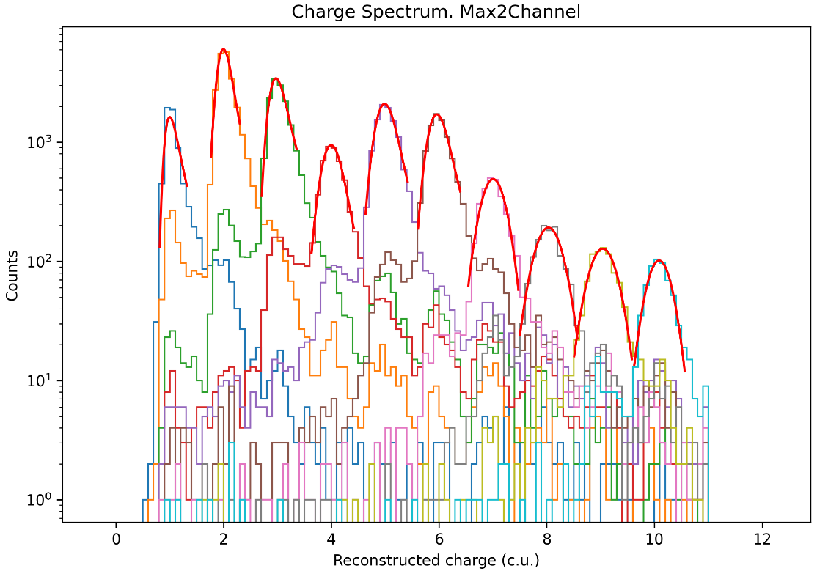
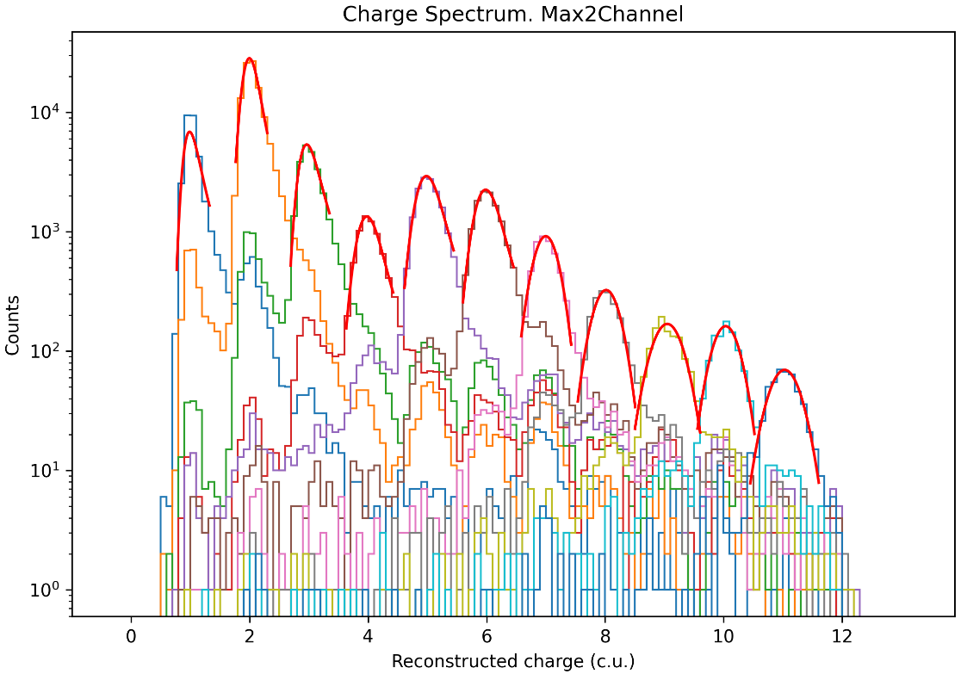
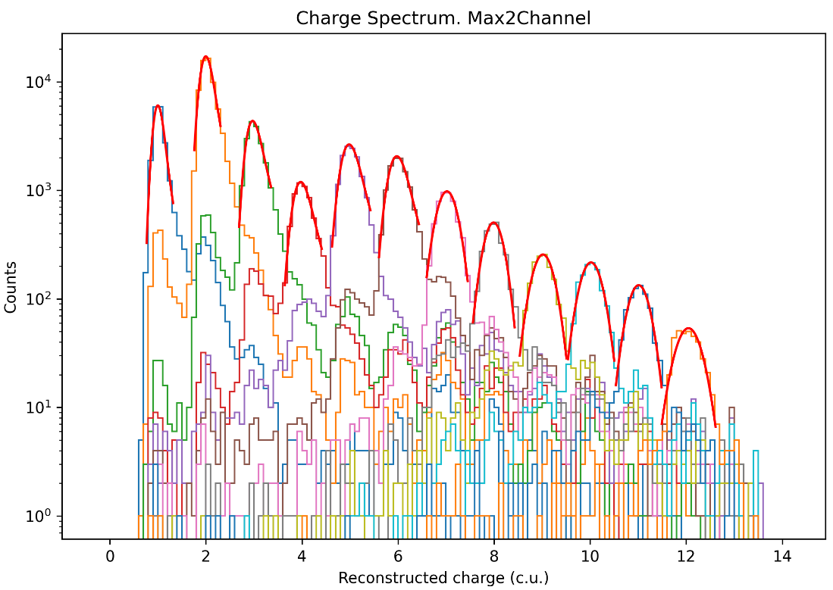
0 channel saturated——Reconstruction of the charge spectrum
Section9_25um_0ohm
Section5_25um_100pF
Section7_25um_47pF
Section6_25um_20pF
Page 13

Slide 14
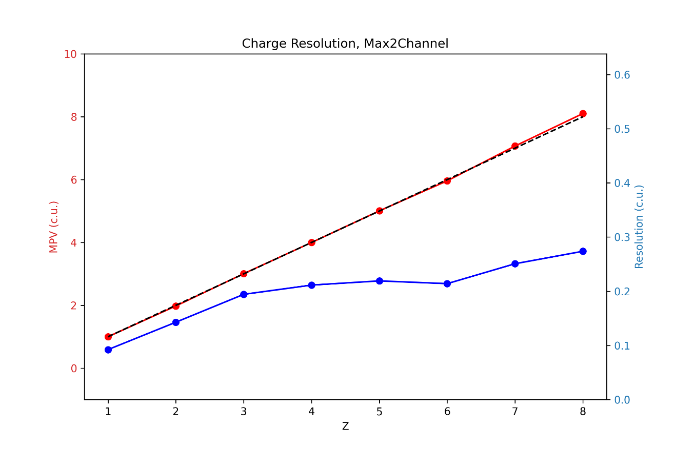
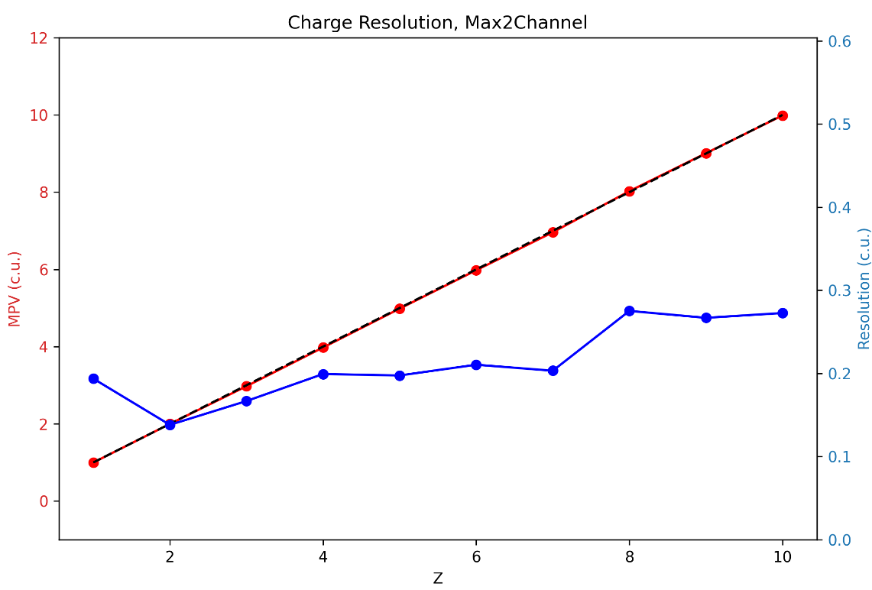
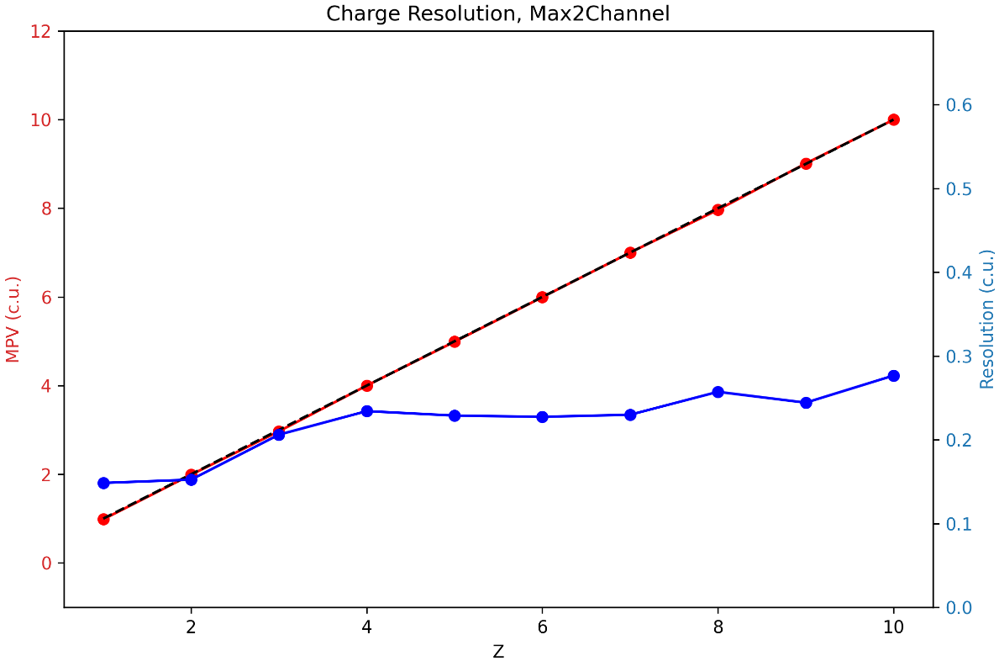
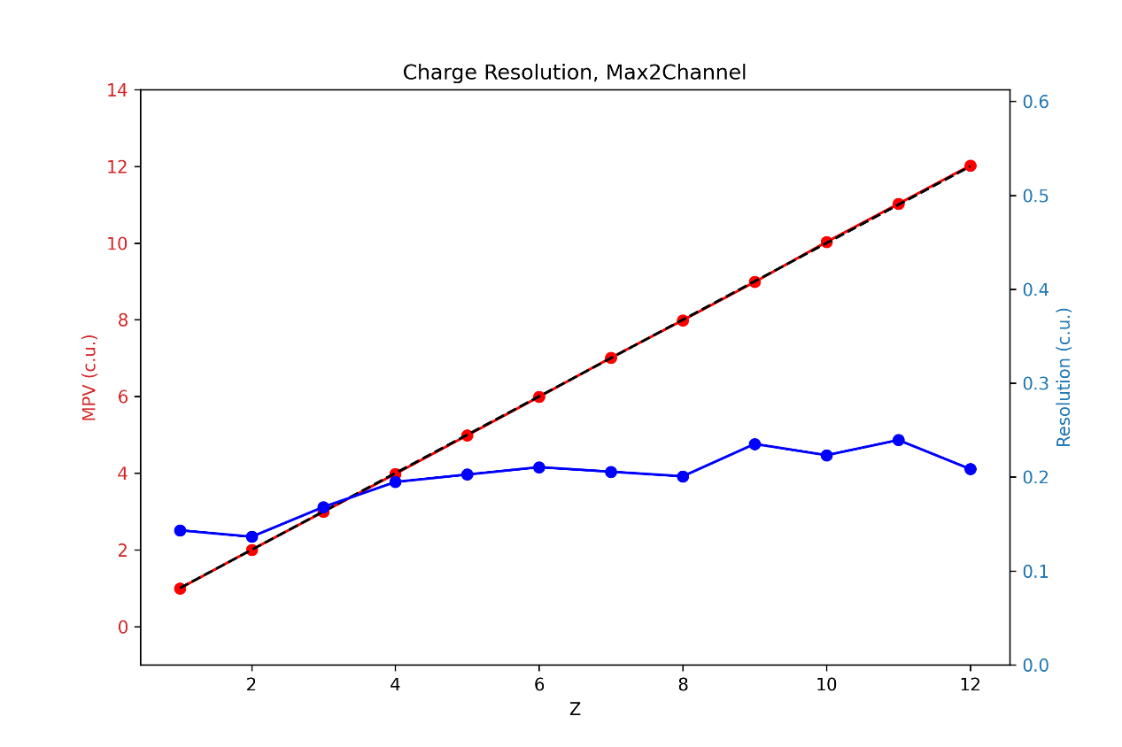
0 channel saturated——Charge resolution
Section0_60um_0ohm
Section4_60um_100pF
Section2_60um_47pF
Section3_60um_20pF
Page 14

Slide 15
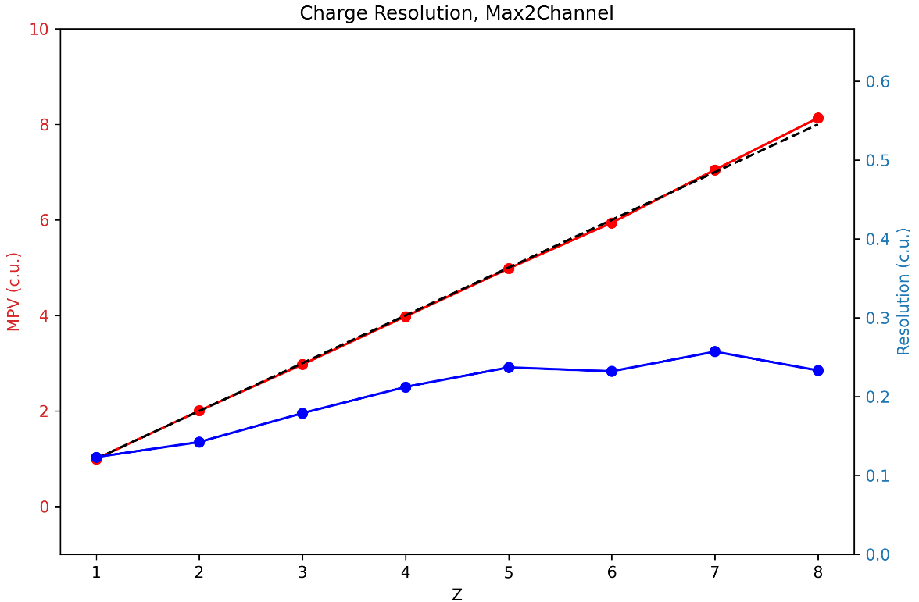
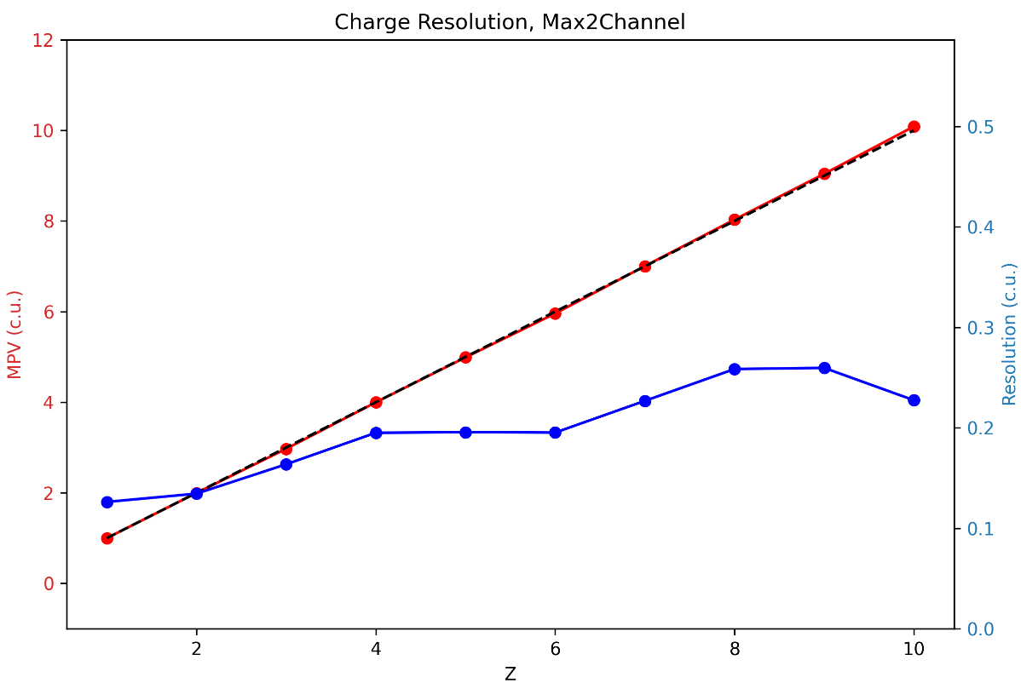
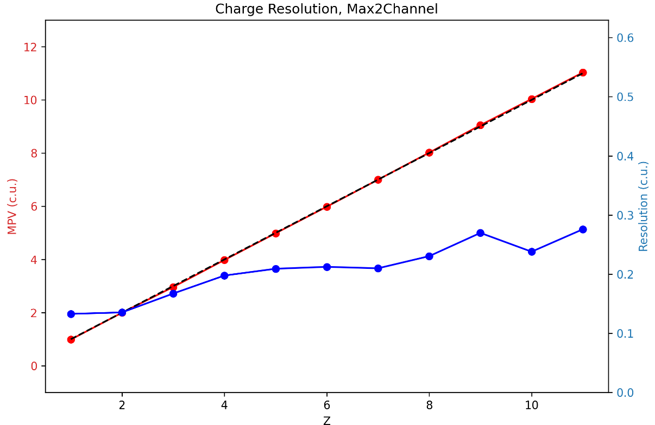
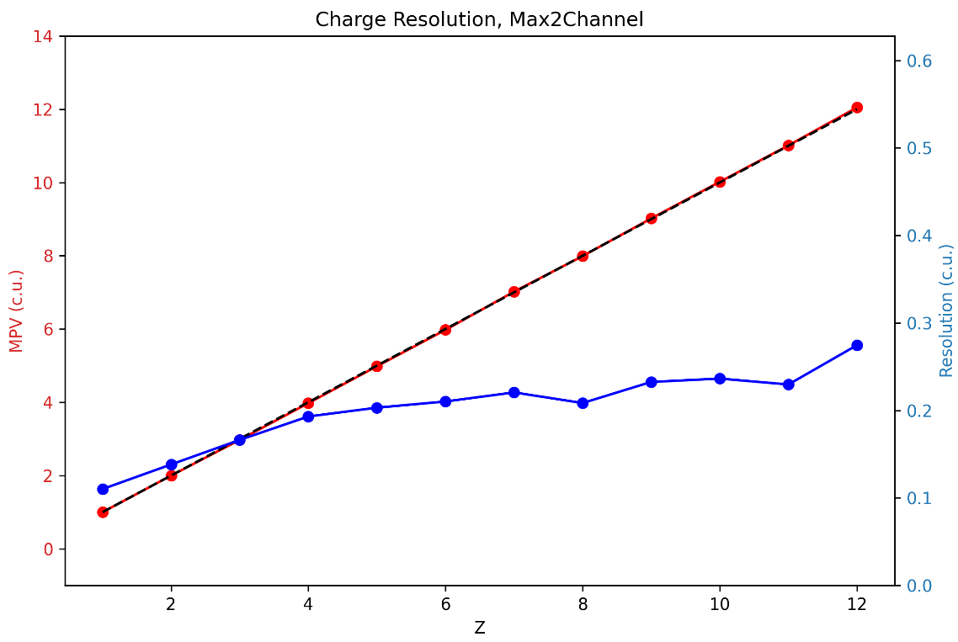
0 channel saturated——Charge resolution
Section9_25um_0ohm
Section5_25um_100pF
Section7_25um_47pF
Section6_25um_20pF
Page 15

Slide 16
1 channel saturated
Page 16

Slide 17
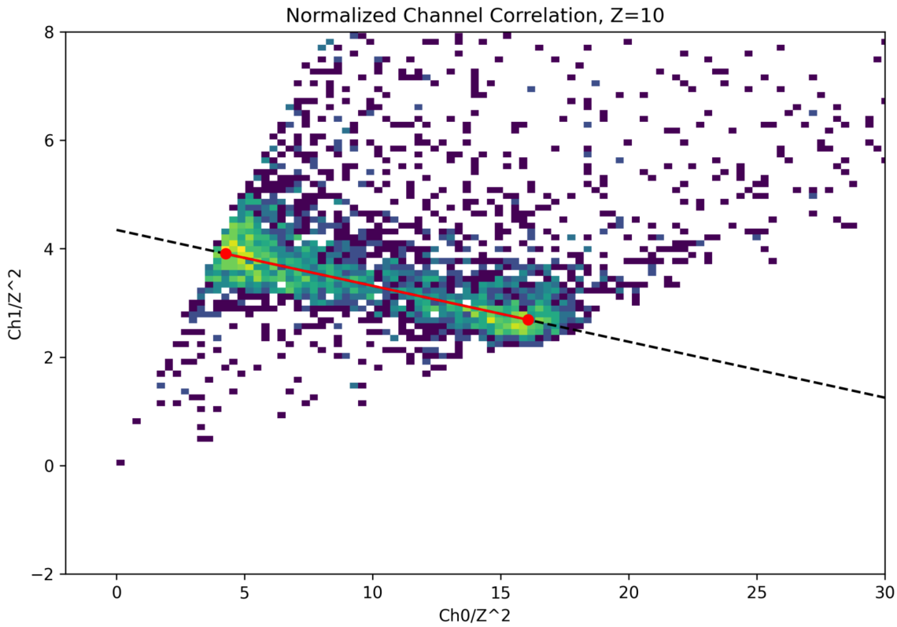
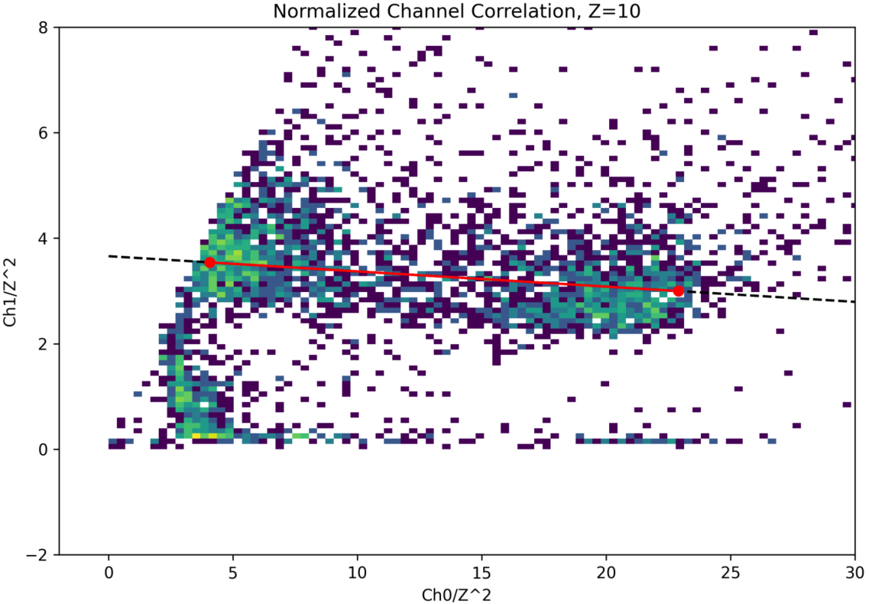
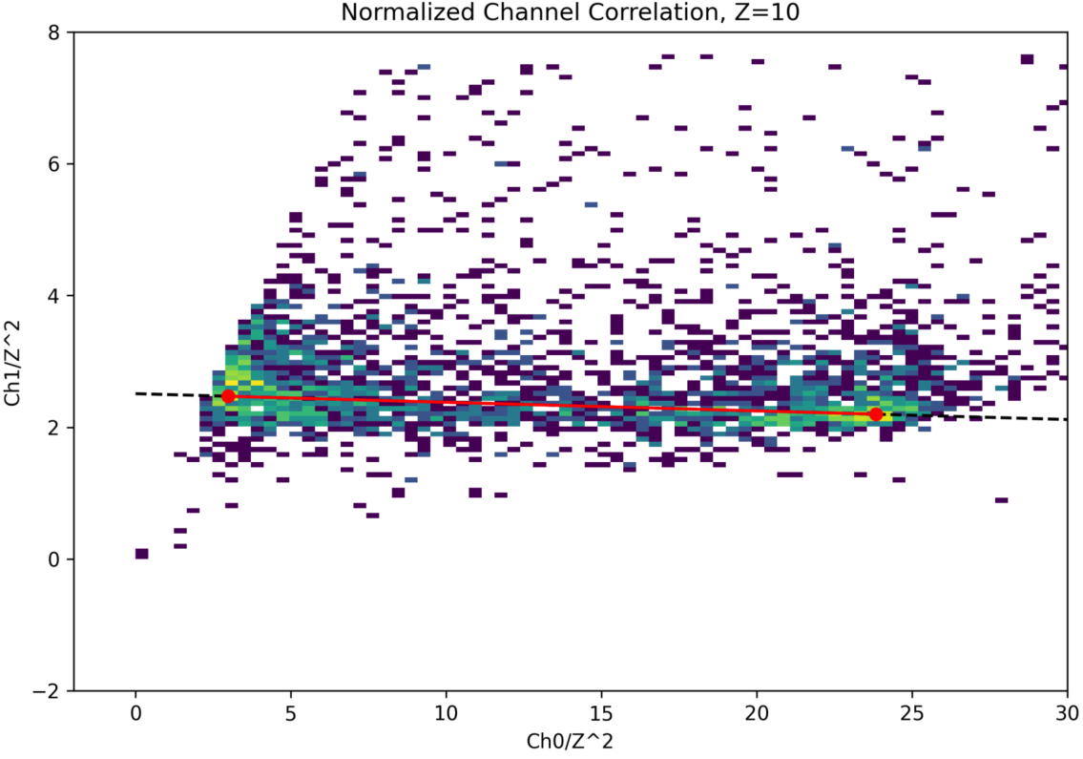
1 channel saturated——Nearly saturated Z
Z=10
Z=10
Section3_60um_20pF
Section2_60um_47pF
Z=10
Section4_60um_100pF
Page 17

Slide 18
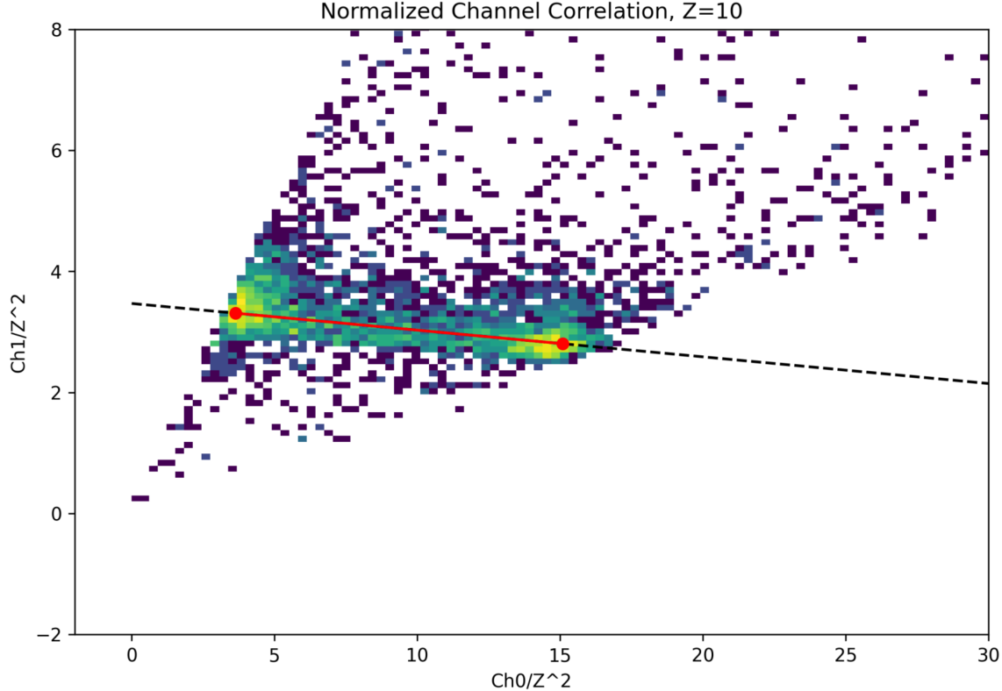
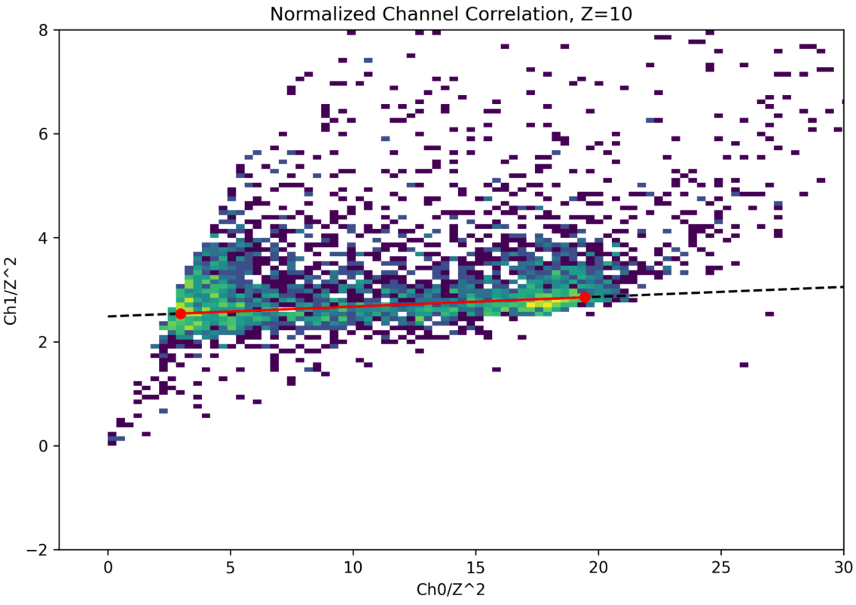
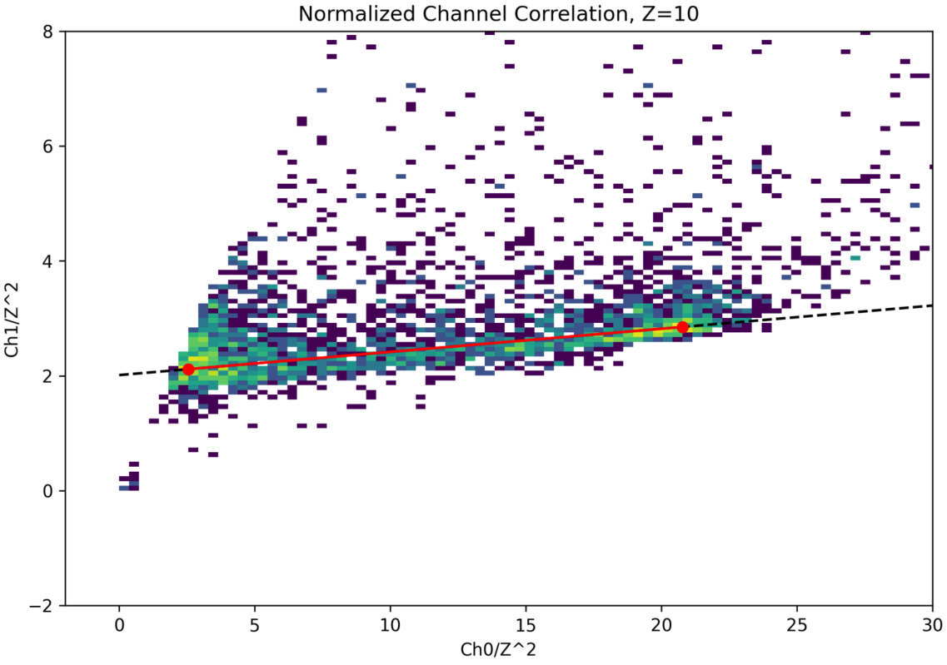
1 channel saturated——Nearly saturated Z
Z=10
Z=10
Section6_25um_20pF
Section7_25um_47pF
Z=10
Section5_25um_100pF
Page 18

Slide 19
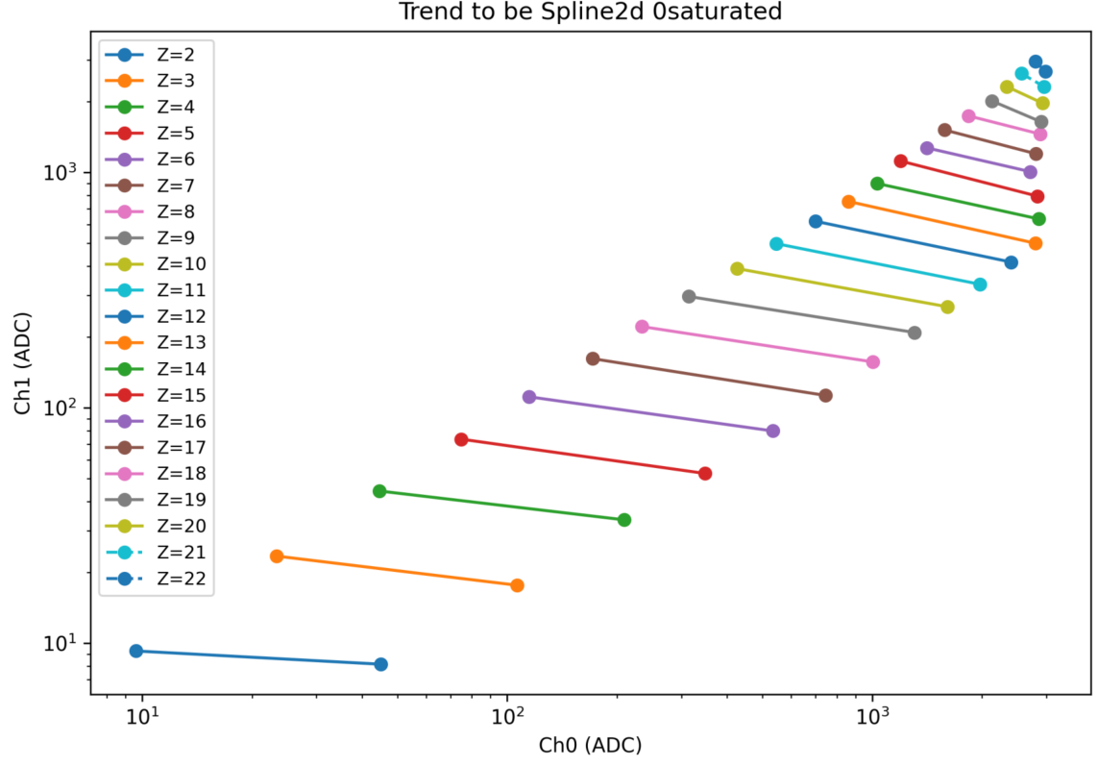
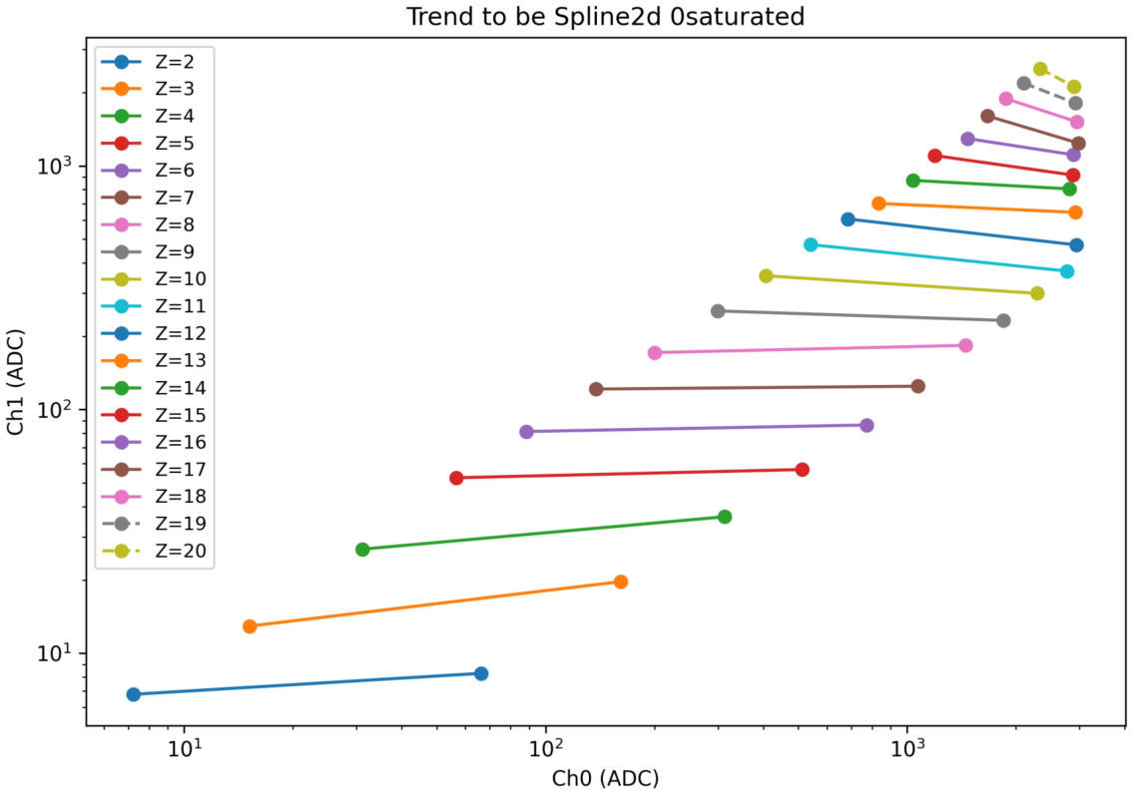
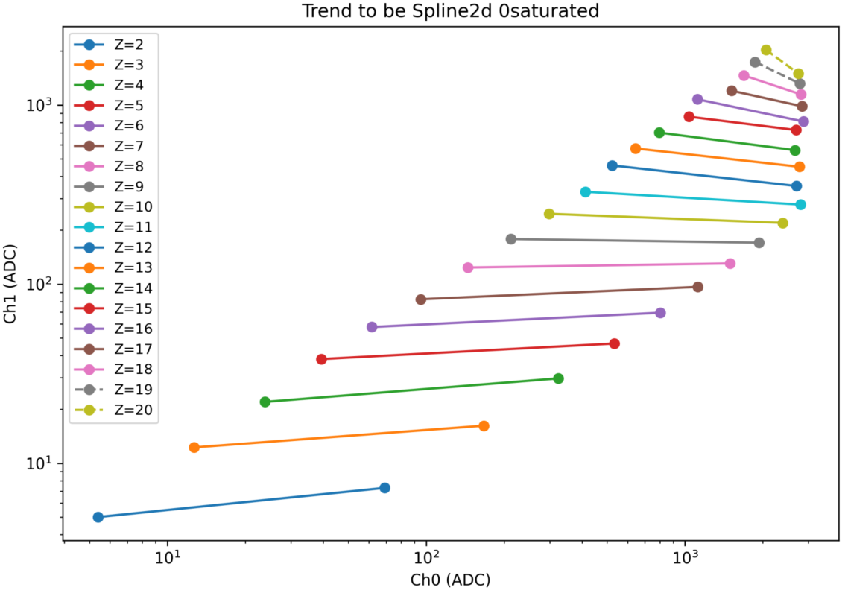
1 channel saturated——To be interpolation in two-dimension （good_z）
Section3_60um_20pF
Section2_60um_47pF
Section4_60um_100pF
Page 19

Slide 20
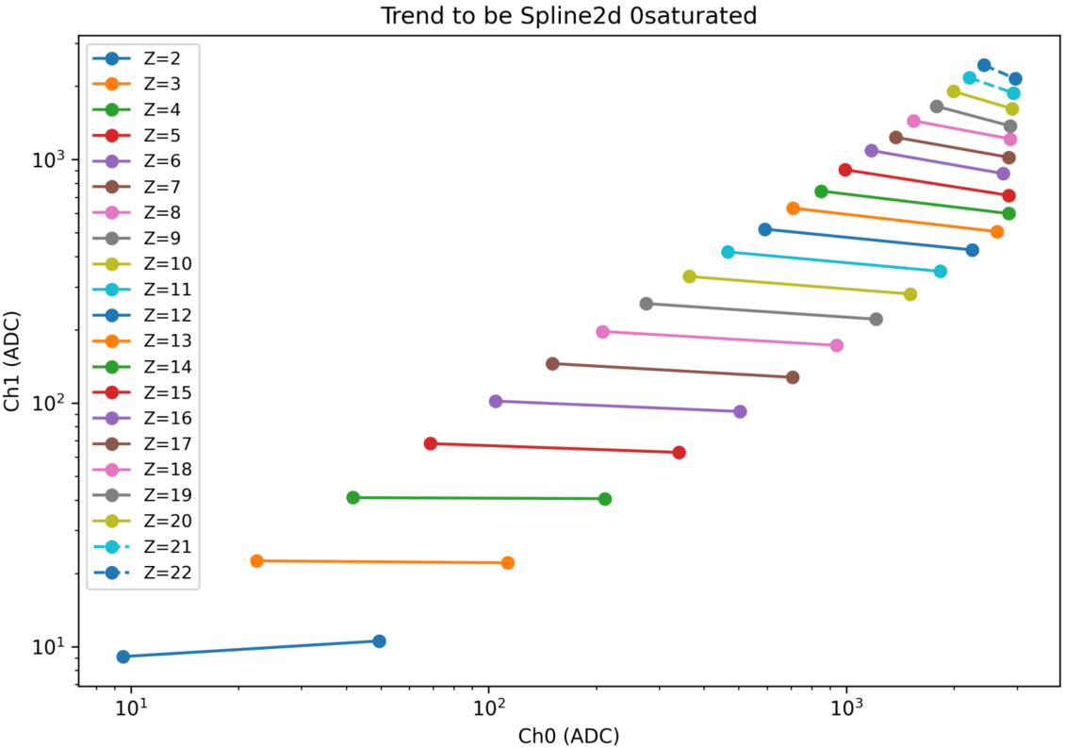
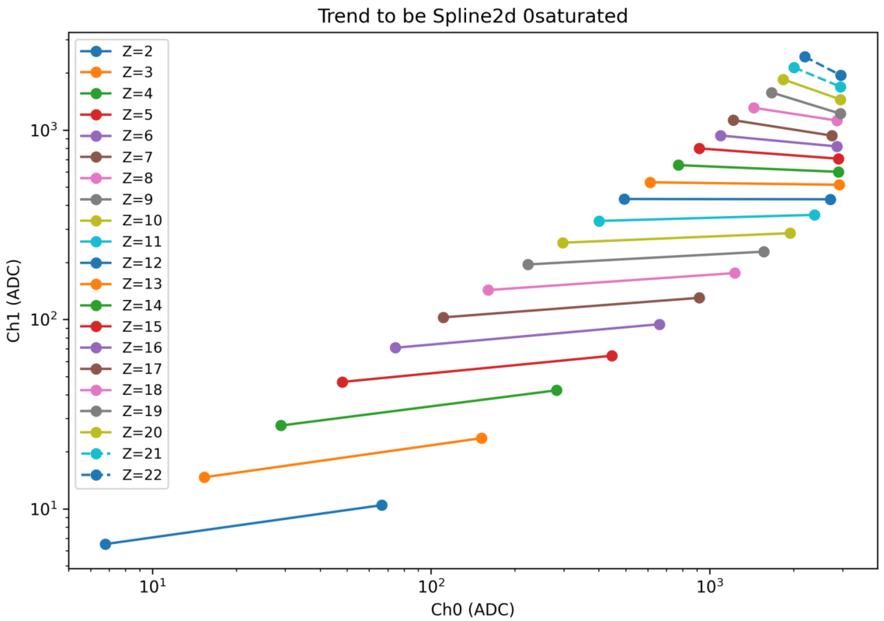
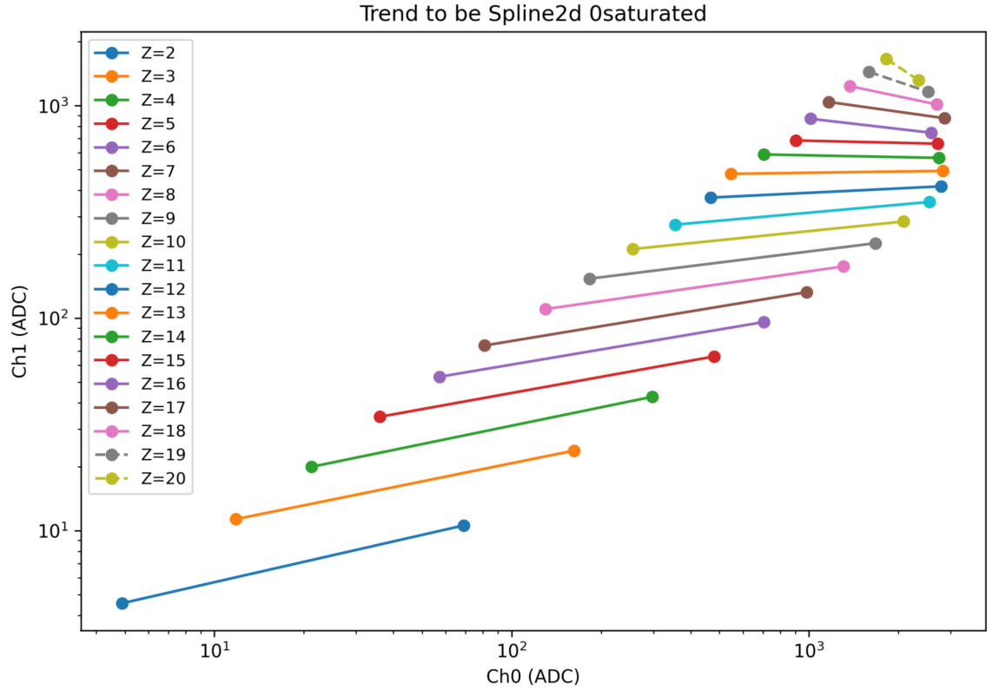
1 channel saturated——To be interpolation in two-dimension （good_z）
Section6_25um_20pF
Section7_25um_47pF
Section5_25um_100pF
Page 20

Slide 21
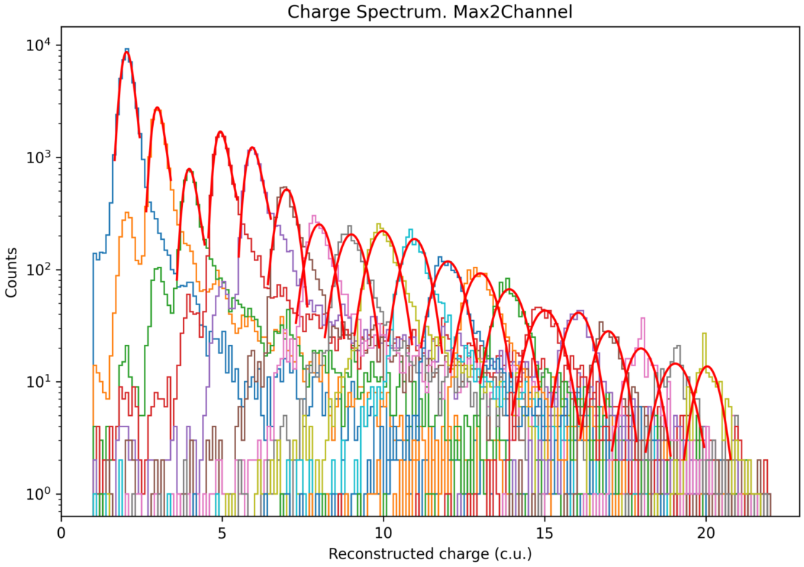
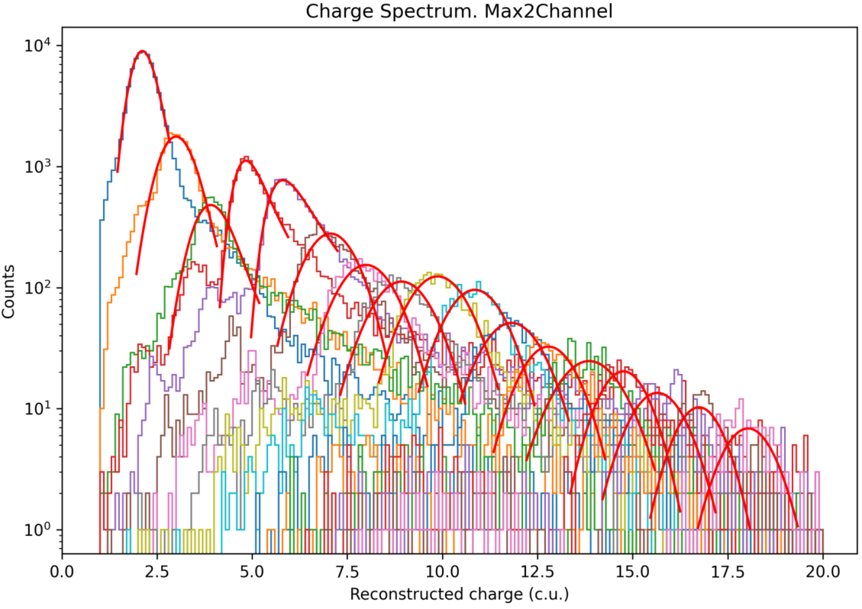
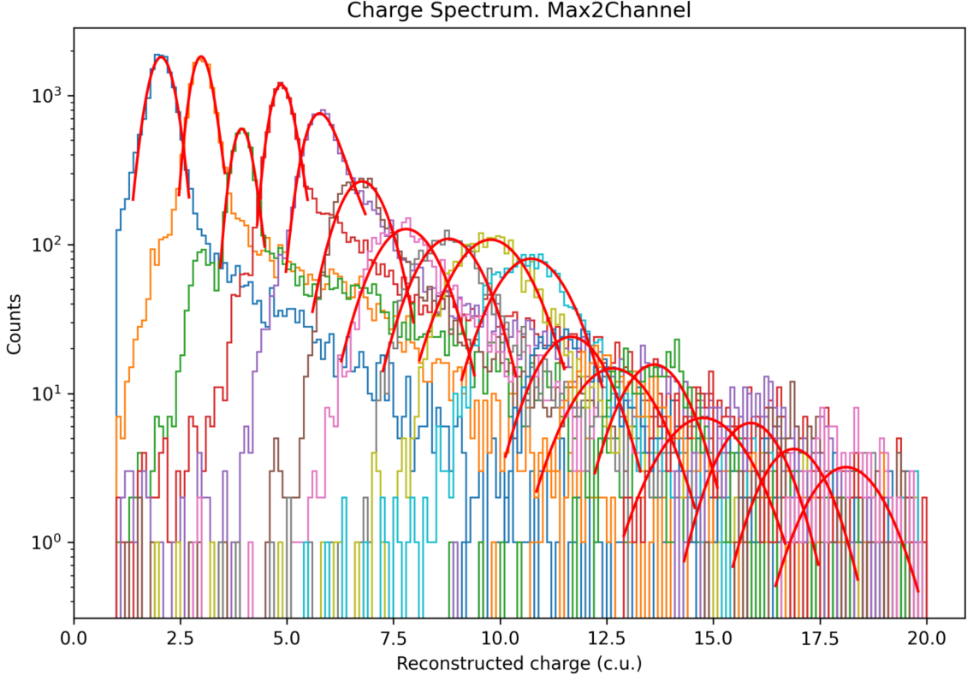
1 channel saturated——Reconstruction of the charge spectrum
Section3_60um_20pF
Section2_60um_47pF
Section4_60um_100pF
Page 21

Slide 22
1 channel saturated——Reconstruction of the charge spectrum
Section6_25um_20pF
Section7_25um_47pF
Section5_25um_100pF
Page 22

Slide 23
1 channel saturated——Charge resolution
Section3_60um_20pF
Section2_60um_47pF
Section4_60um_100pF
Page 23

Slide 24
1 channel saturated——Charge resolution
Section6_25um_20pF
Section7_25um_47pF
Section5_25um_100pF
Page 24

Slide 25
Conclusion
We show the results for 0-channel saturation and 1-channel saturation respectively

