Slide 1
Status of the paper:
Section 1- Introduction: almost final
Section 2- Experimental set-up: almost final
-> plot on the dose to be checked
Section 3 – Experimental results (introductory part): almost final
Section 3.1- Results without irradiation: almost final,
-> plots on time resolution and cluster size to be added
Section 3.2 – Results under irradiation: good shape
new structure proposed, including plots for comparing performance of the various chambers, originally thought for Section 3.3

Slide 2
Section 3.3 Overall gas mixture evaluation: propose to delete it and include relative plots in Section 3.2
Section 4 Conclusions: to be written

Slide 3
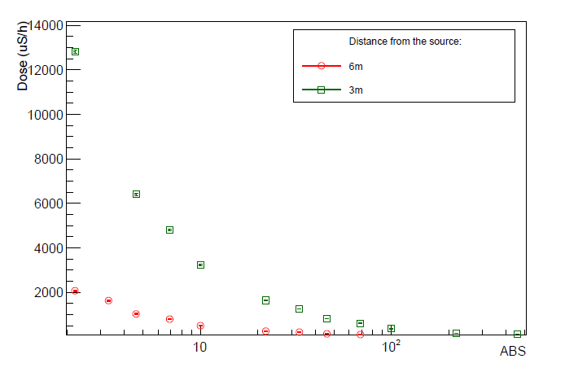
Dose: issue about absorbed dose (measured in Gray) and equivalent dose (measured in Sievert). Equivalent dose measures the biological damage and should be used here.
Why use Sievert, which is the unit for Equivalent Dose? → check what has been measured, and change to Gray here and everywhere. → to check how the dosimeter was calibrated (for gammas, neutrons, or other particles, check on the datasheet)

Slide 4
“New” layout of section Performance under irradiation
First, comparison of efficiency and current density at low and high rate, for the various gas mixtures. Two experiments shown, the other are “analogous”.
→ Postpone plots and considerations about the rate measured.

Slide 5
… then comments: first comment, plateau efficiecy decreases at high rate
It decreases more for ECO2 and ECO3, because of the larger currents. → look at the currents
The plateau efficiency is NOT the maximum efficiency reached (efficiency still growing at the plateau)
- Maybe add a point for CMS? Maybe add points for other experiments?

Slide 6
Current densities J_knee, measured at HV_knee. They are larger for ECO2 and ECO3 beacuse of the wider charge distributions.
Possible solutions:
add isobutane to the mixture (is there a good reference? Okay, it’s an hydrocarbon and, like all other hydrocarbons, has well known quenching properties)
Add SF6 (not possible beacuse of its high GWP and shift in the WP)
Aging effects important point to investigate → main goal for RPC@GIF++ and AidaInnova task 7.2

Slide 7
Anyhow, larger currents are at the base of the shift in the operating voltage; we have to compensate increasing the applied voltage
The shift is larger for ALICE, while current densities are larger for CERN EP-DT. Why?
→ The other ingredient is resistivity
Note that the shift is not SO larger for ECO2 and ECO3 with respect to STD (except for ALICE).

Slide 8
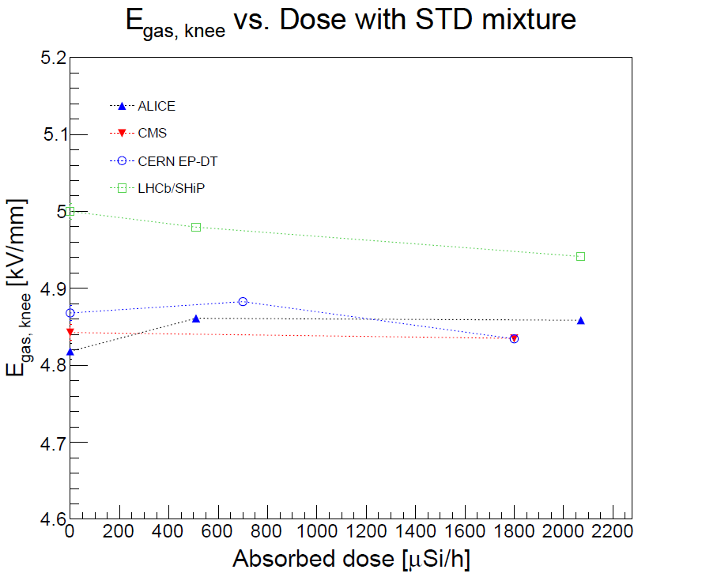
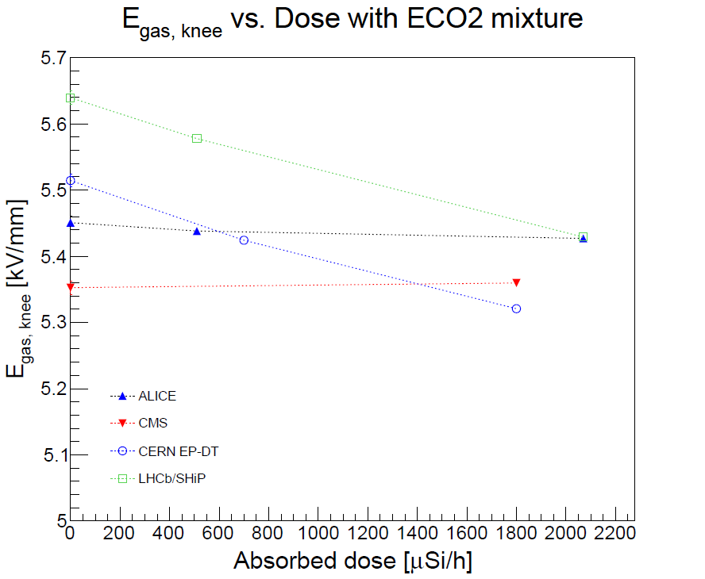
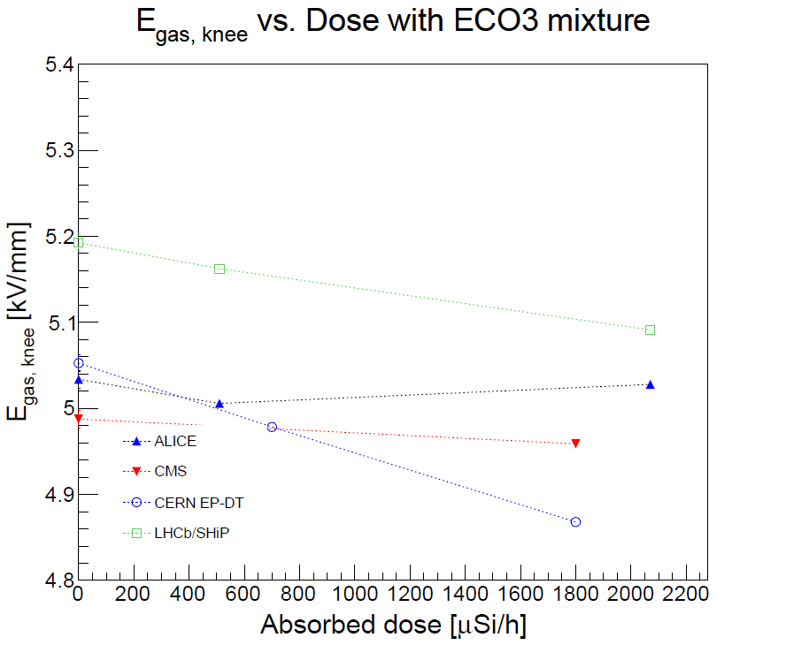
Do we understand the shift? Compute HV_gas and plot efficiency curves vs HV_gas → Maybe Luca for ALICE? Ask to CERN EP-DT to check it?
→ Insert plot(s)
HV_gas = HV_app – ρ d J
ρ resistivity
total electrode thickness
J current density
ρ resistivity = 0.6 x 10¹¹ Ωcm

Slide 9
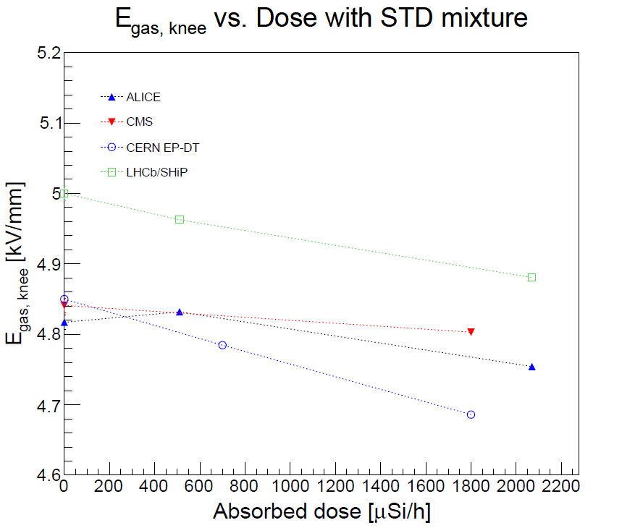
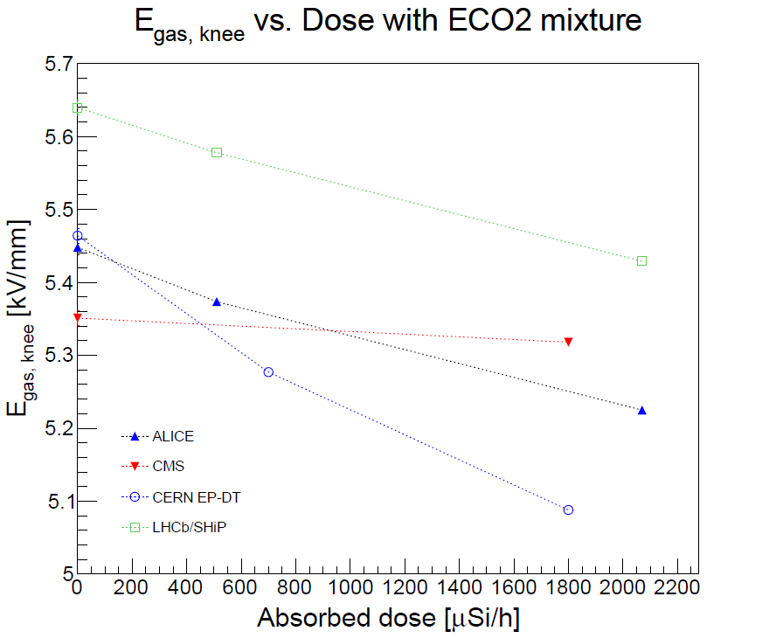
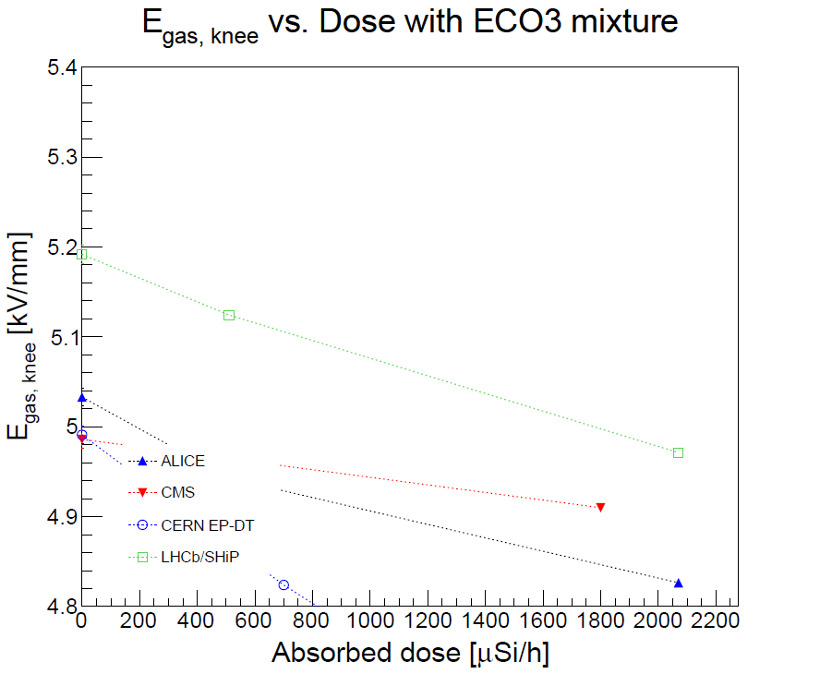
ρ resistivity = 10¹¹ Ωcm
These plots change significantly with the resistivity value used → need an indipendent measurement → how much significant the check that we do?
E_gas, knee MUST be different in the various cases, because efficiency measured is different, at the knee → we are not making comparison at fixed efficiency, so no need to have same value of E_gas, knee

Slide 10
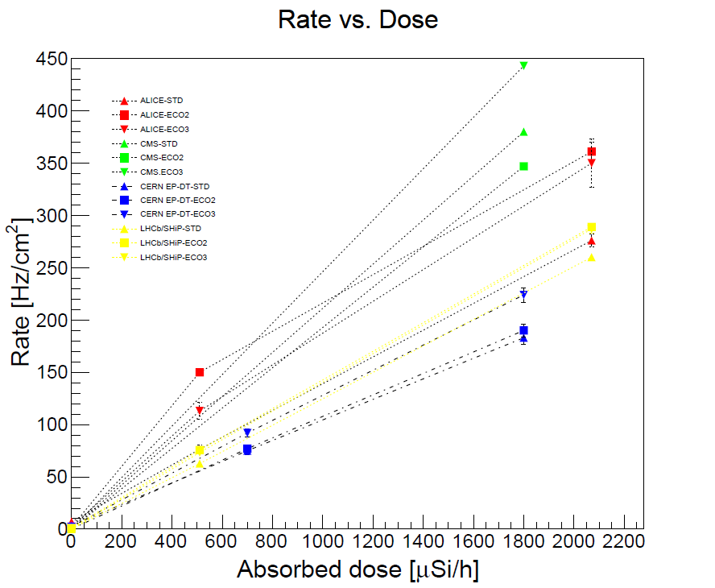
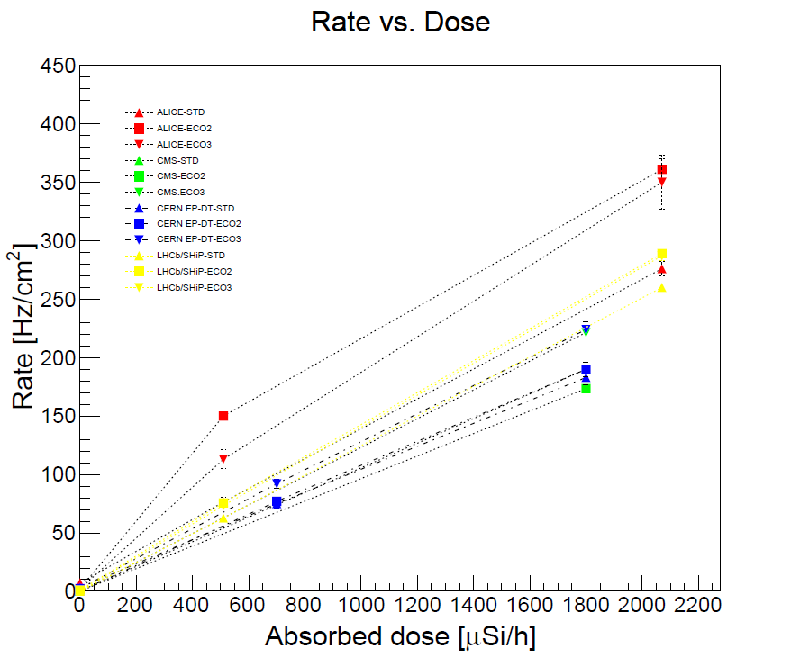
We HAVE to make a correlation between Dose and measure rate
But which one?
→ Check how the rate for CMS was computed (double gap, twice the value?)
Disclaimer: rates should be corrected by efficiecy, but the correction should NOT be so large, because efficiency for Compton electrons should be larger than efficiency to MIPs.

Slide 11
Pending issue: add plots about
Cluster size at the knee (no irradiation and irradiation, STD ECO2 and ECO3) → check that cluster size is computed in the SAME way in all cases;
time resolution at the knee (no irradiation and irradiation, STD, ECO2 and ECO3) → check that time resolution is computed in the SAME way in all cases.
Maybe add a time distribution? Add cluster size vs. HV in few cases?

