Slide 1
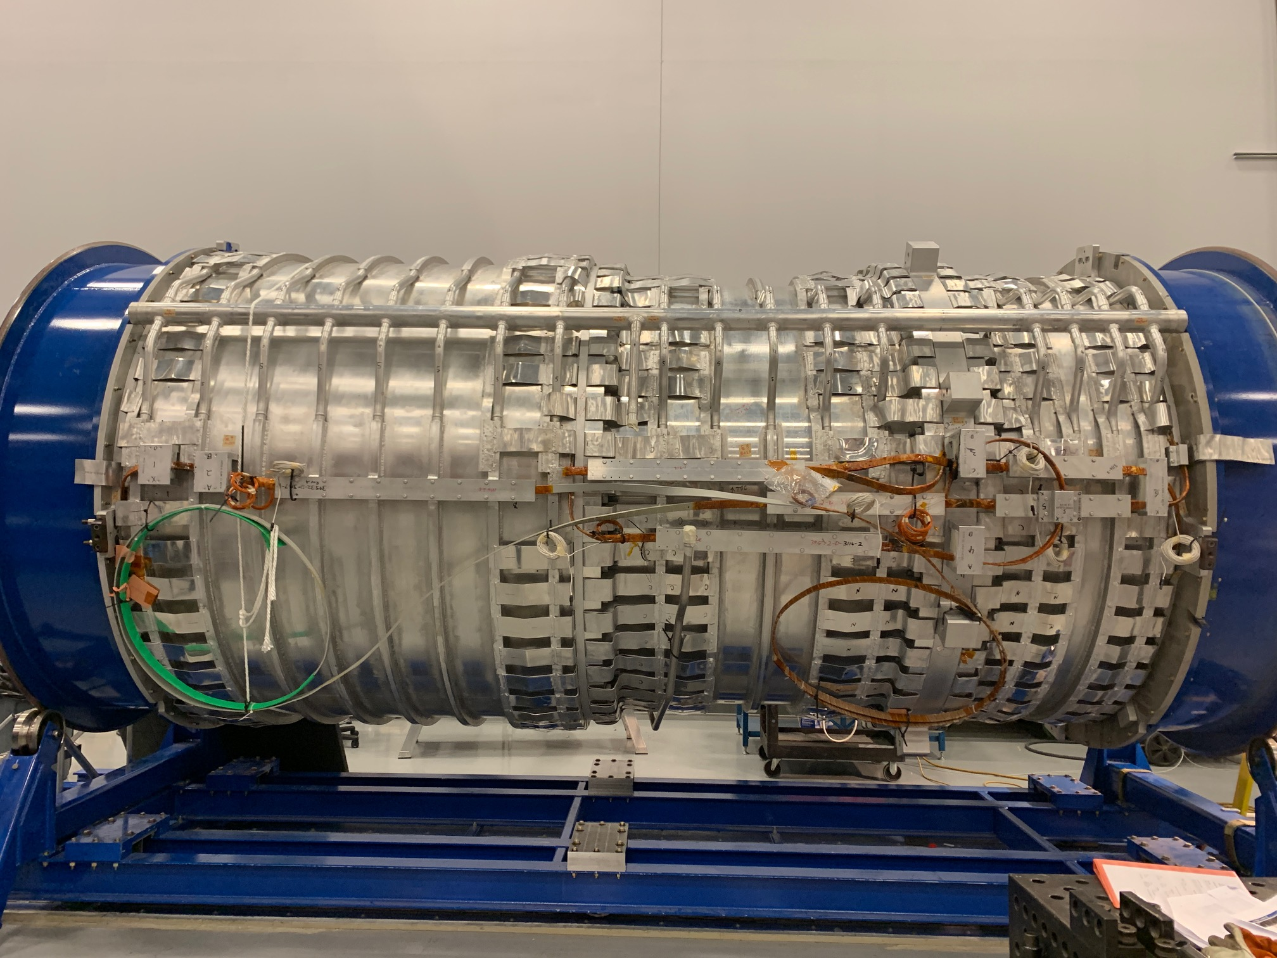
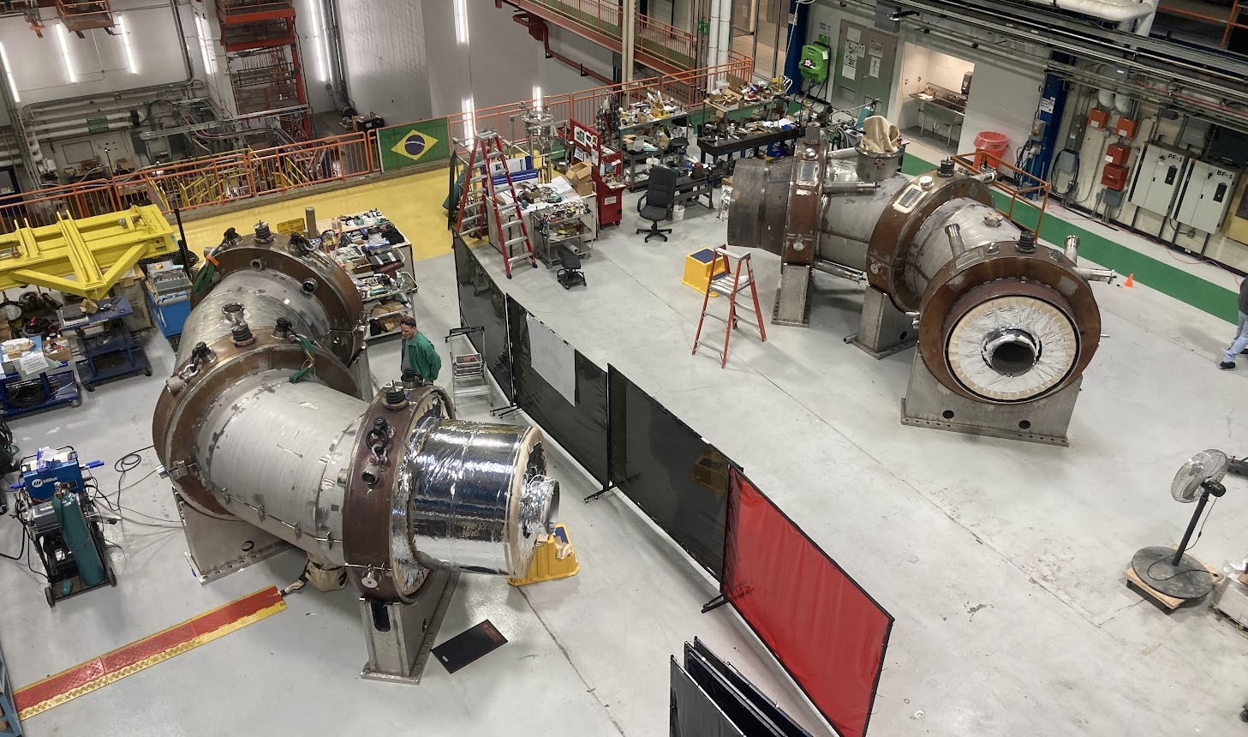
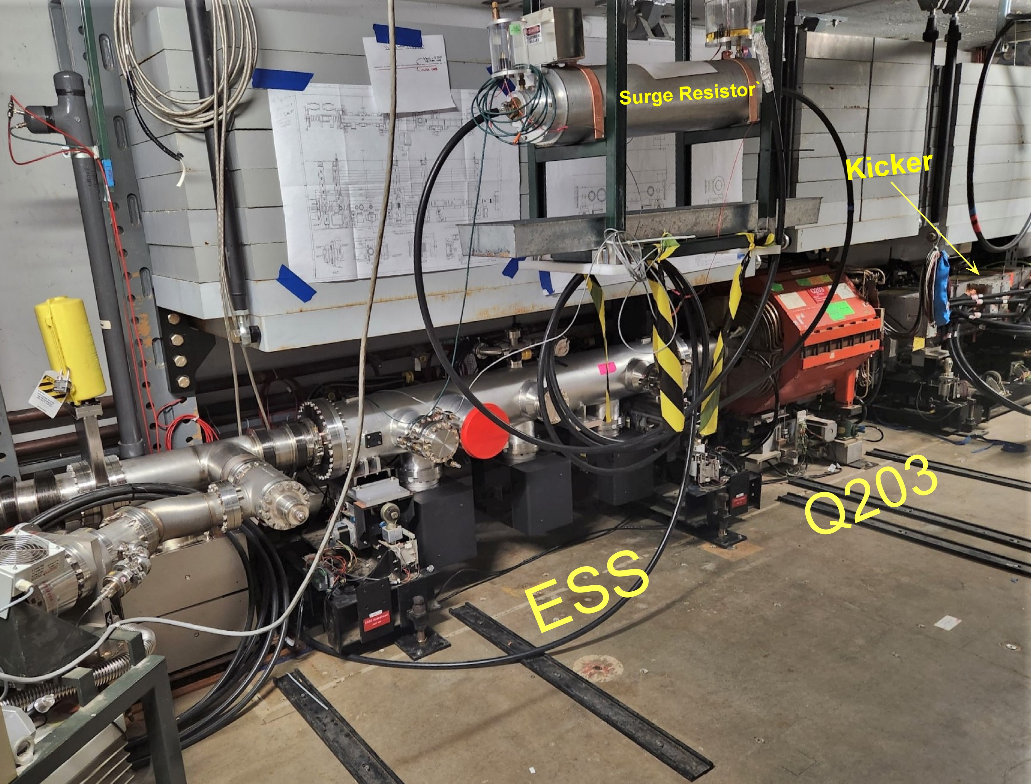
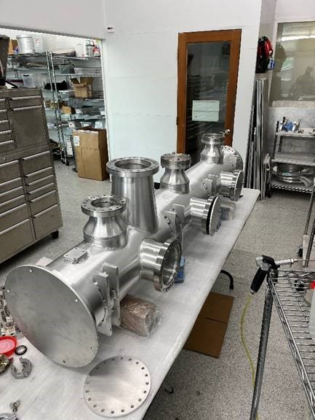
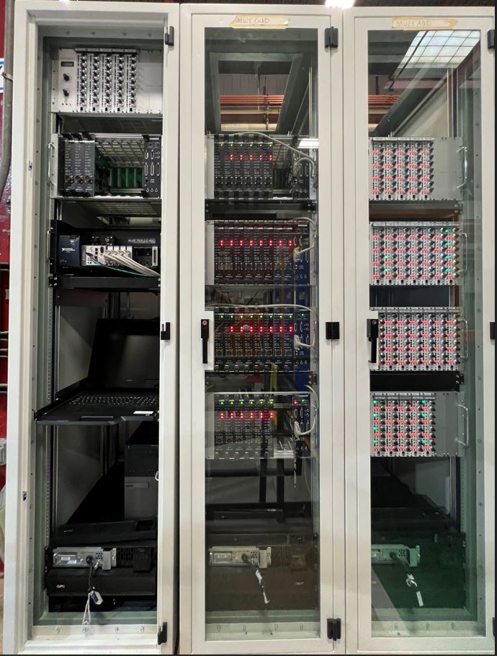
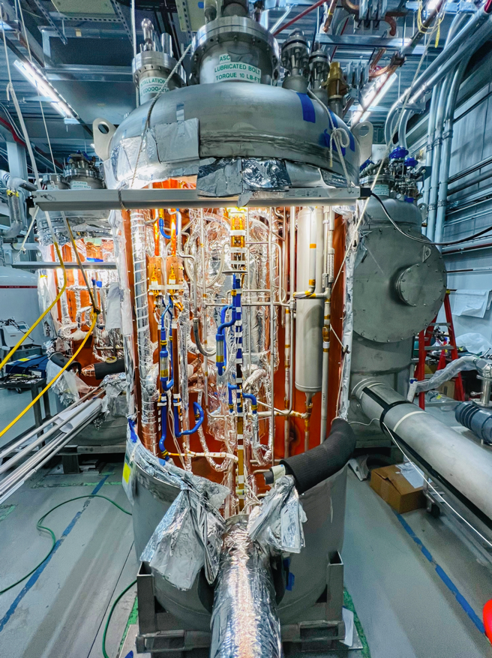
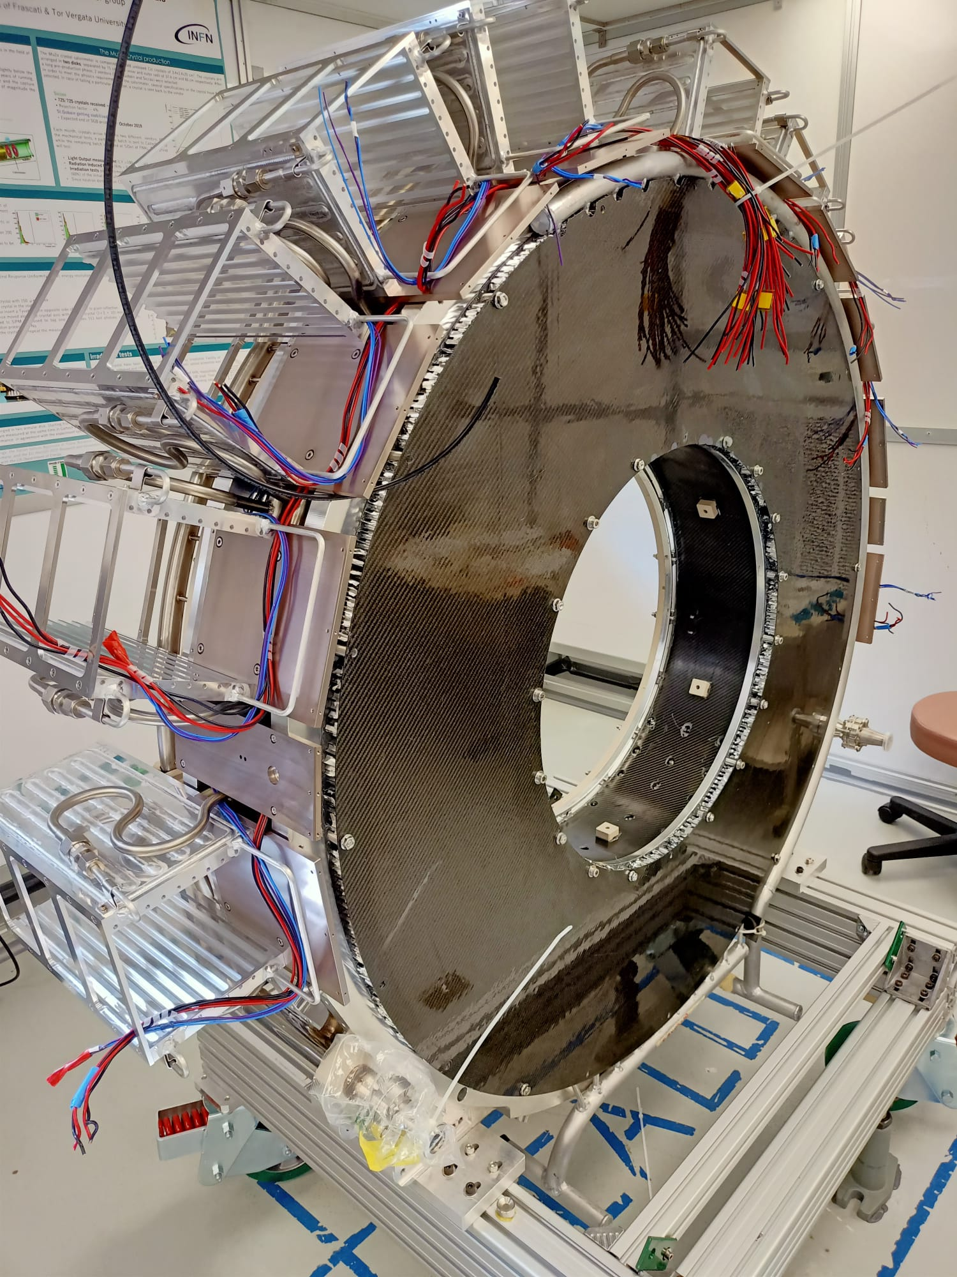
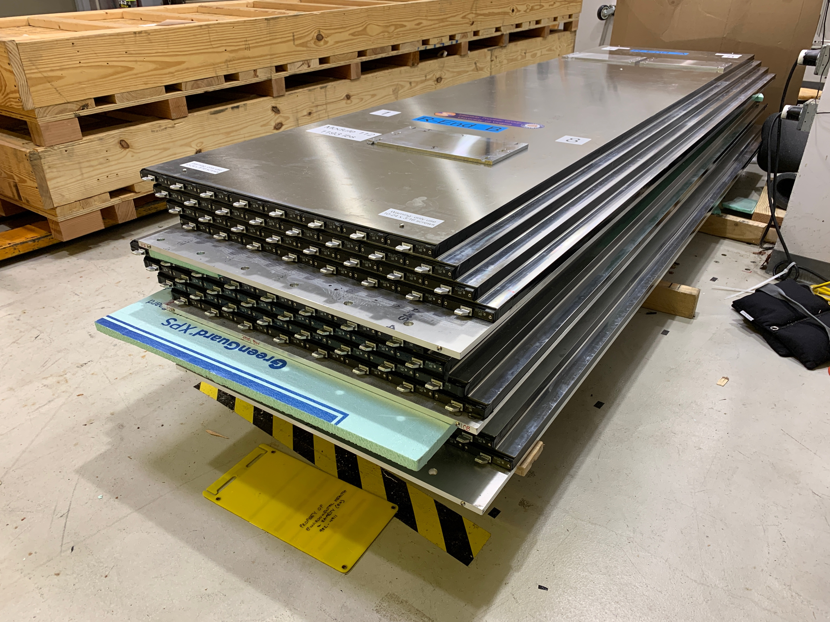
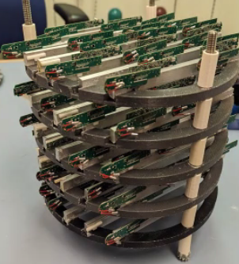
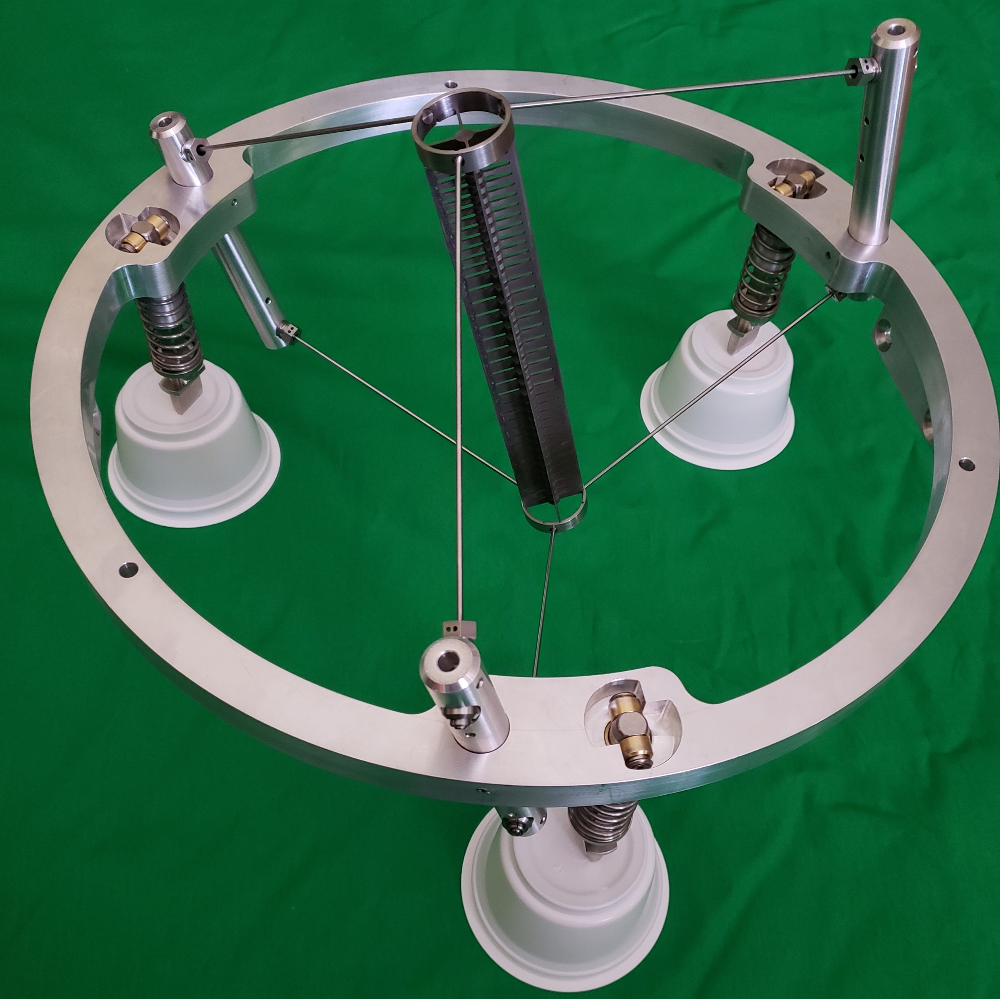
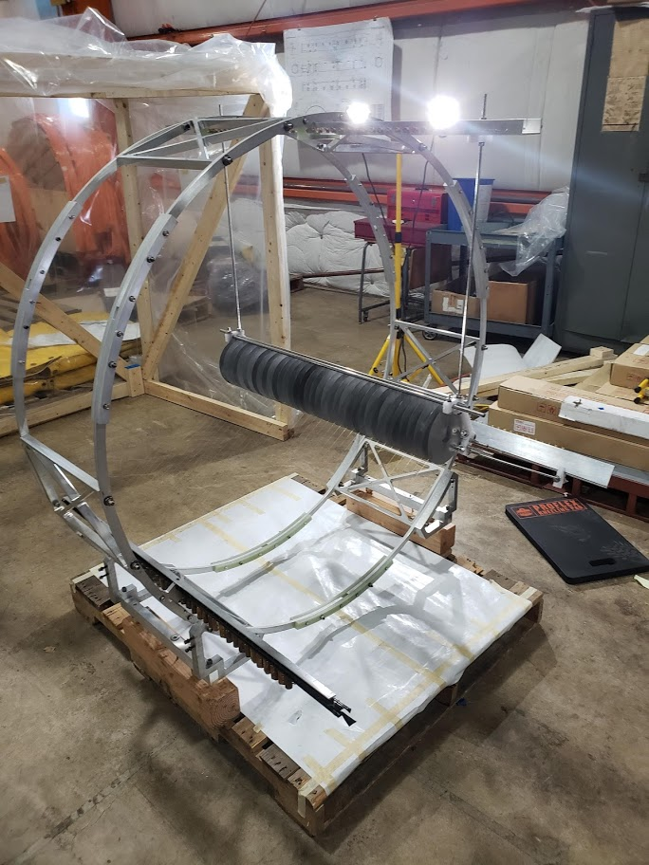
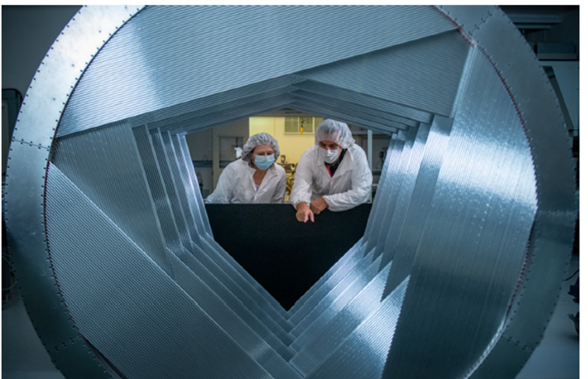
Mu2e Short Status report
& introduction
S. Miscetti
LNF INFN
Mu2e Italy Meeting
10 May 2023
S.Miscetti , LNF/INFN
CSN1 national meeting
May 2023, La Biodola

Slide 2
Mu2e experiment Overview
Project Rebaseline & Dir Review on Feb 2023
Stato dell’esperimento
  Solenoids
  Accelerator
  Tracker
  CRV
  News and plans
Today agenda
Bent crystals
Electronics
Cooling
Simulation

Slide 3
Mu2e has been re-baselined + Dir Review 2023
Mu2e has been rebaselined last year
Total Cost - 305 M$ (including contingency+risks)
Dir Review Feb 2023 went fine
CD4-early finish – Project complete - Dec 2025
Schedule reset Feb-2023
Following costs and schedule since October 22, then Feb 2023
Schedule still tight
SV not nice (also for calorimeter system !!!)
However huge “real” progresses on all fronts + some problems
May 23 – 2023 , Briefing with DOE, Project Team only
→ Hope not to see any descoping

Slide 4
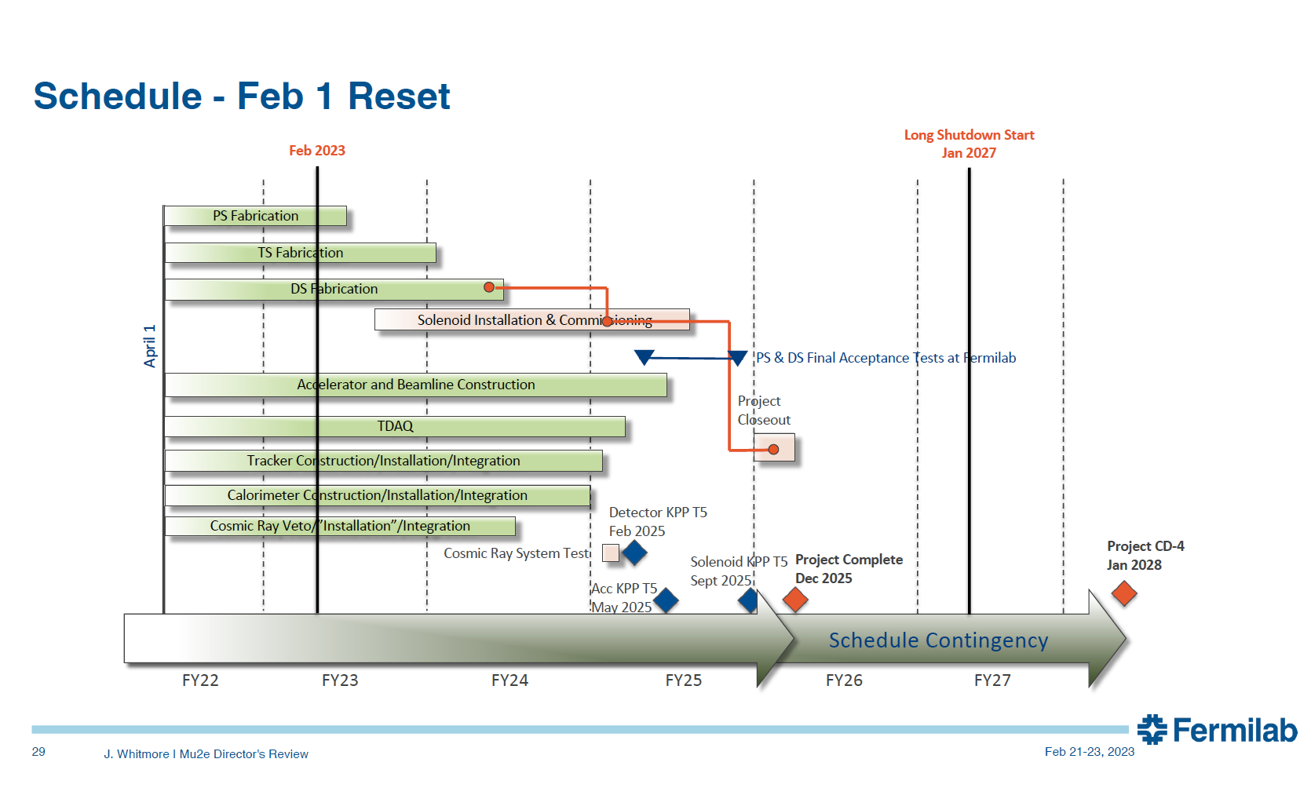
Project Schedule to hold

Slide 5
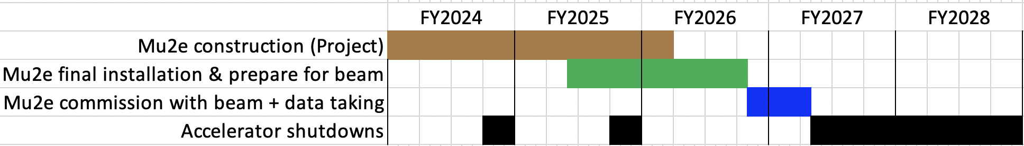
Mu2e timeline - operations included
Detector KPP
Solenoid KPP
Project complete
Beam on target
Long shutdown
Detailed field map complete
External shielding installed
CRV modules installed
Detector train inserted
We need to commit ourselves to achieve the following goals
  Complete the project in 2025
  Get data on tape in 2026
  Process, analyze, and publish first results in 2027
Rumors exist to delay Long Shutdown
→ we should not count on that. Keep up schedule

Slide 6
Calorimeter Basic Milestons
FEE delivery .. Being met (June 2023)
DIRAC FPGA delivery → being met (June 2023)
Digital electronics delivery + CRR
→ delicate story here. Let’s see what Franco will report
CRR also need to be done early this summer
In schedule we have first ½ on Sep 2023, second ½ Jan 2024
Install TDAQ-IFB cabling south side – Nov 2023
Difficult to meet
→ Disk-1 ready to Move (27 Feb 2024)
→ Disk-0 ready to Move (27 March 2024)
→ Move Disk1-Disk-0 to pit ( June 2024)
→ Cooling station commissioned – July 2024
Each month we delay .. Total schedule can slip
→ Increase presence at FNAL this summer is a must. Week start-up.

Slide 7
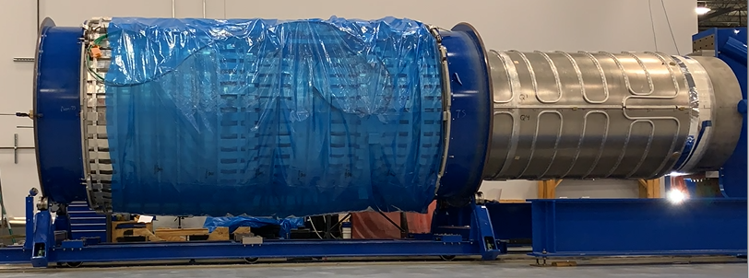
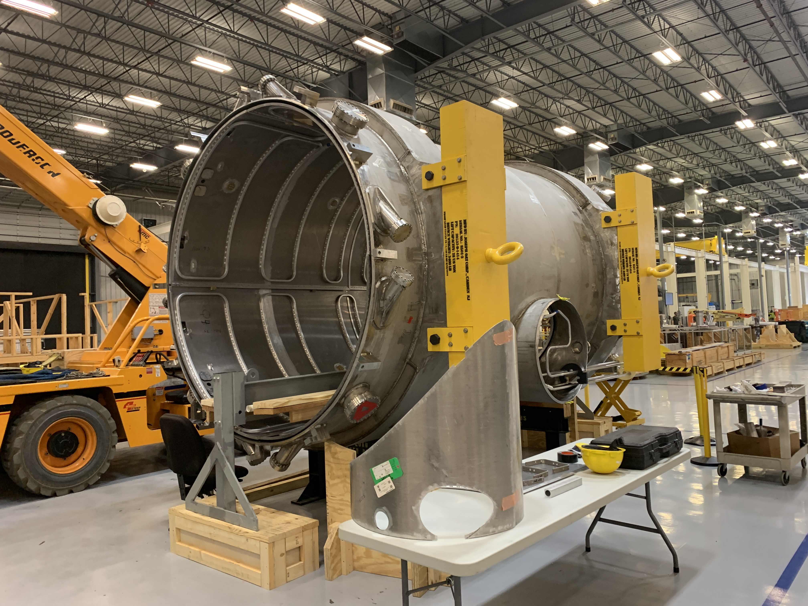
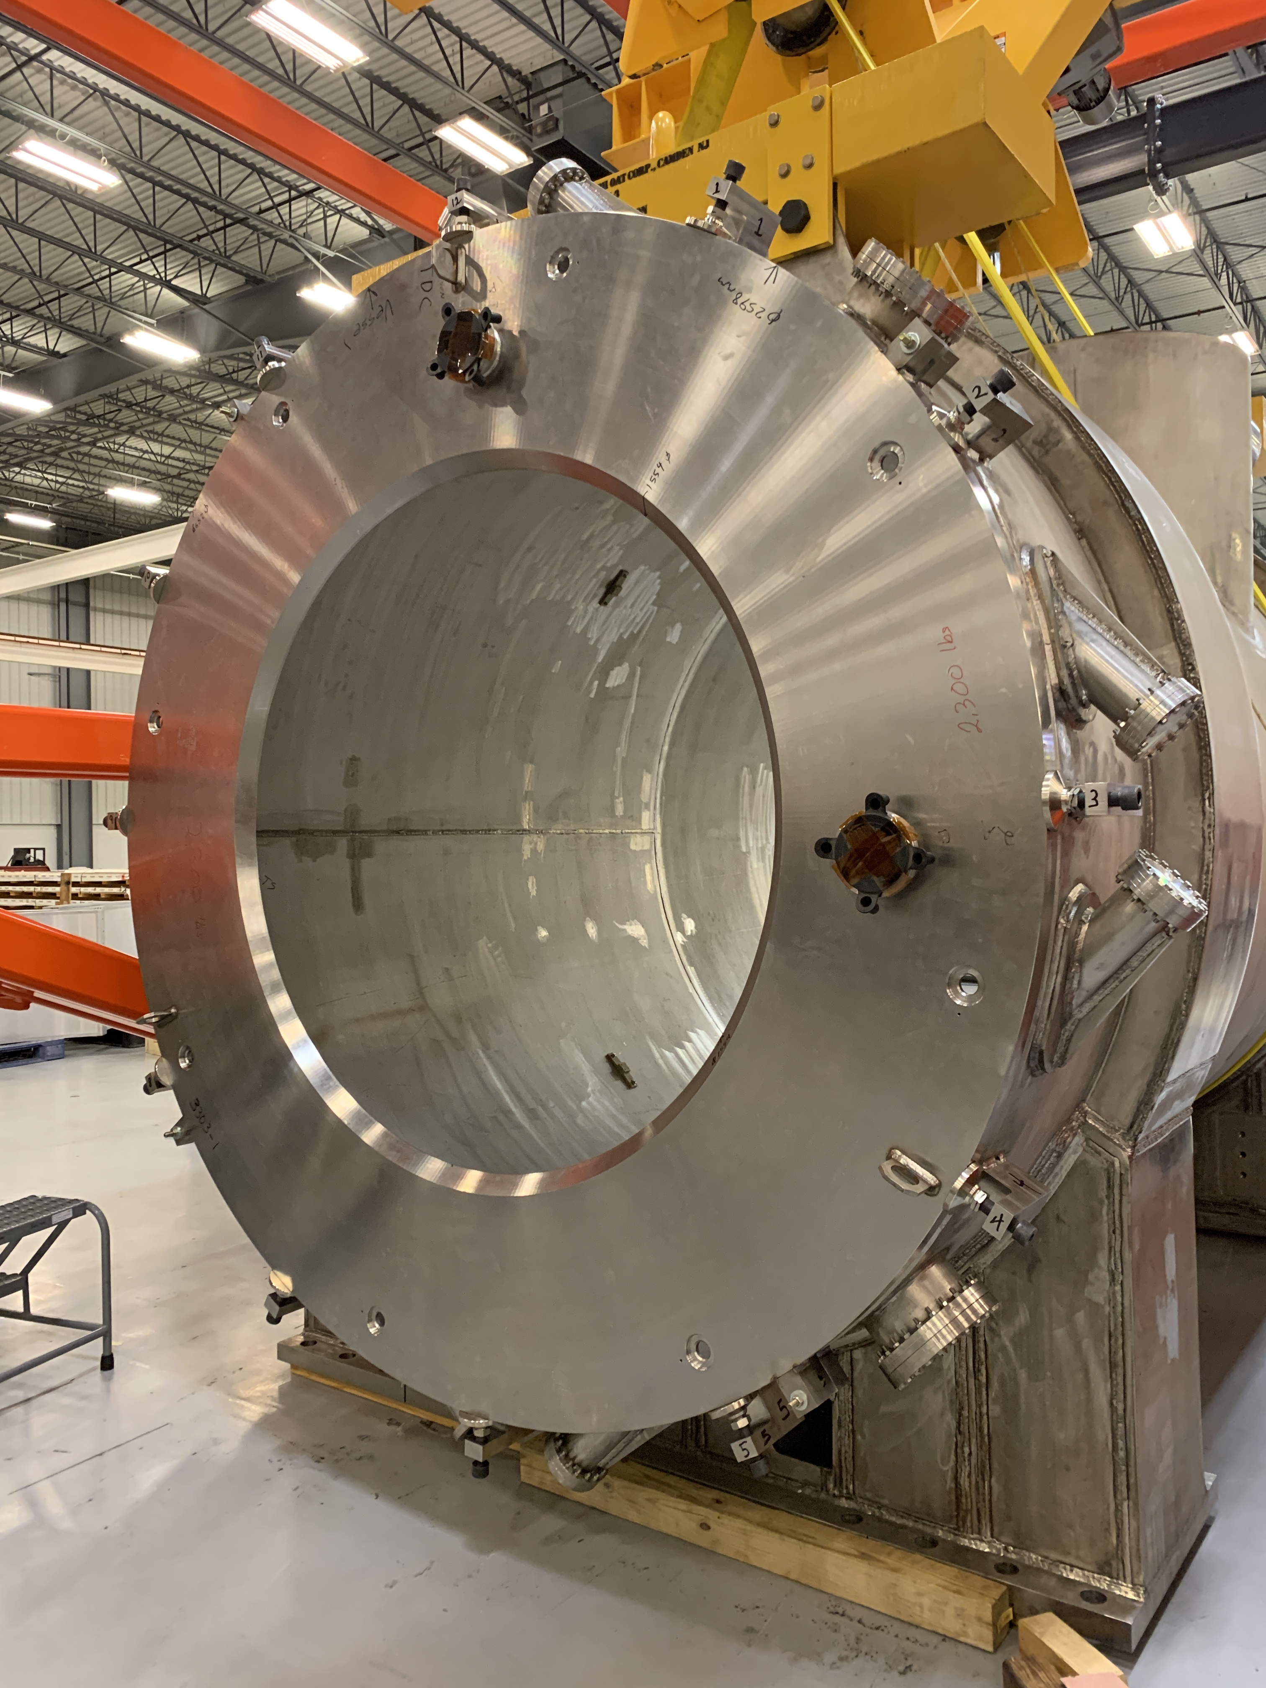
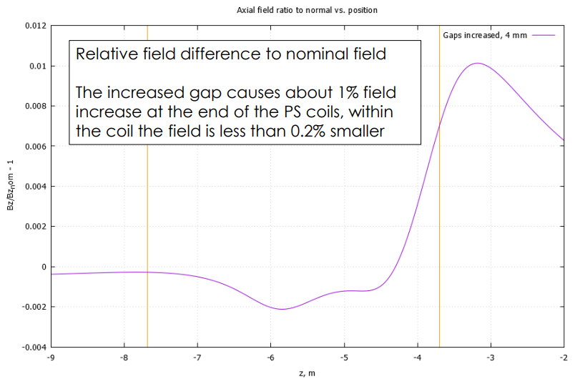
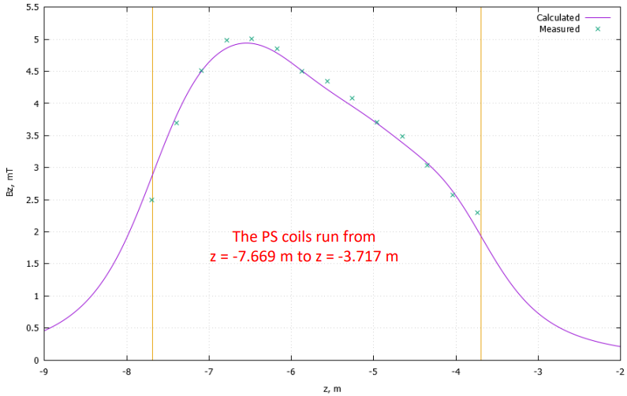
Production Solenoid
Preparation of coils
Assemble coils together into a “cold mass”
Insert shielded inner bore into cold mass
Insert cold mass/inner bore assembly into outer thermal shield and vacuum vessel
Close up vacuum vessel
First 3 steps completed
→ Problems of PS anchor ring
installed backward solved.
Clocking the end-plate of 2 degrees
+8 mm overall length. Larger coil-coil spacing. Effect on B-field acceptable (<1%)
PS field check at 10A, OK
Last steps
→ Rework outer thermal shield, insulate and insert into vacuum vessel
Build Chimney
Close up Vacuum Vessel and leak test
LN2 cold test
Pack and ship

Slide 8
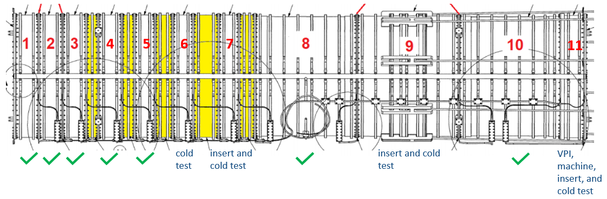
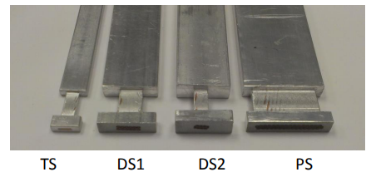
Detector Solenoid - 1
DS-2 conductor
11/11 coils wound (DS11 was just completed)
10/11 coils VPI’d and machined
8/11 coils inserted into shells
7/11 coils cold tested
VPI =Vacuum Pressure Impregnation
DS-11 wound 1 year ago, damaged during machining - Rewound using spare DS1 conductor
If other fabrication failure occurs
→ DS1-DS5 tested, no risk
→ DS6-7 still to be tested. Still at risk
→ DS11 same raw-coil that 6 and 7. Wait to insert DS11 on shell until 6 and 7 are not tested
→ If fail, reuse DS11 conductor. Plan C for DS11 – Use Spare DS-2 conductor

Slide 9
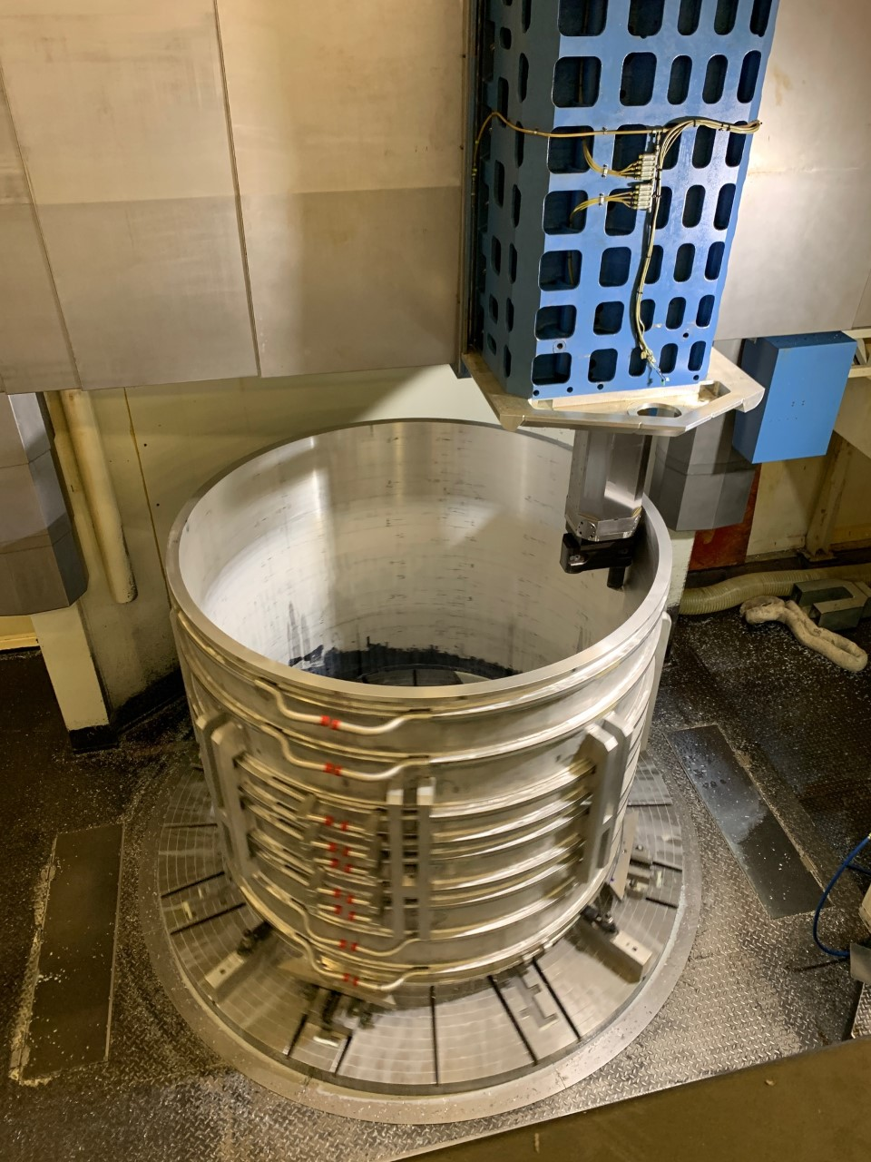
Detector Solenoid - 2
-DS 9 shell cylindricity was badly distorted
Now back to machinable state
Filled with Stycast.
Now final Wall thickness acceptable
Finish coil fabrication and testing
Assemble cold mass (simpler than PS)
Assemble inner bore/thermal shield,
insert into cold mass
Install outer thermal shield in vac vessel
Insert cold mass into vacuum vessel
Build out chimney
(cryogenic piping, bus work, instrumentation)
Close up vacuum vessel and leak check
LN2 cold test
Pack and ship

Slide 10
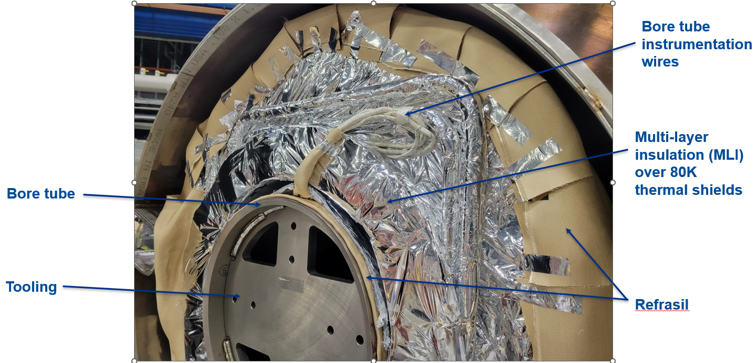
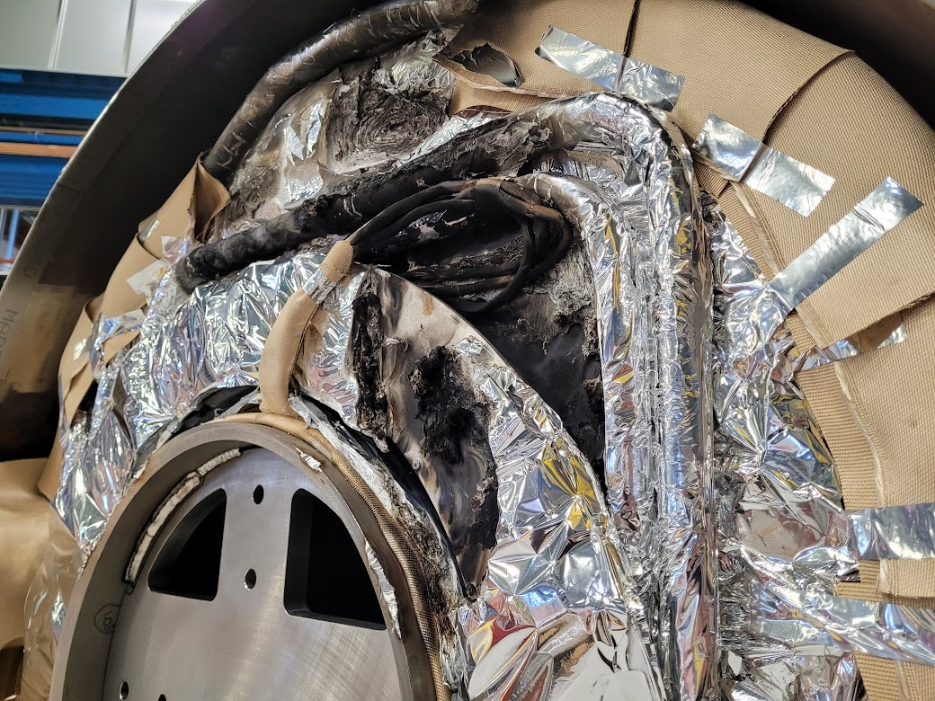
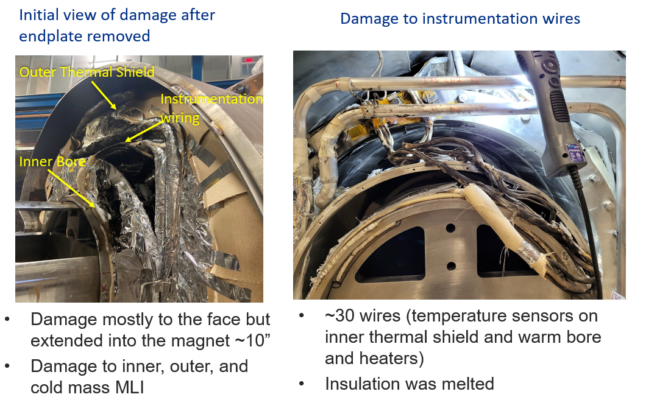
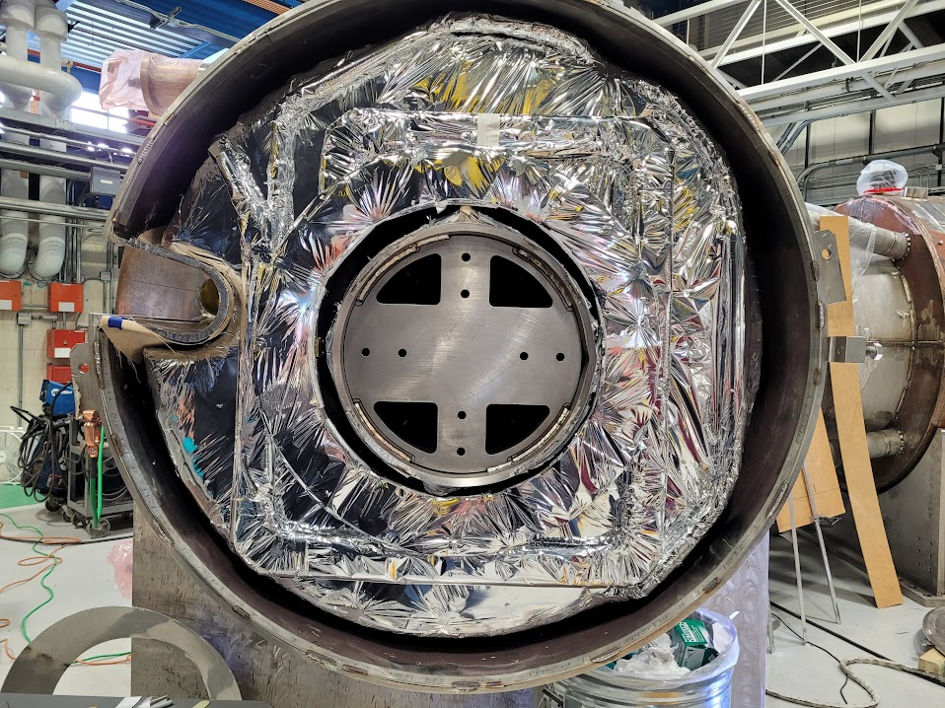
TSU fire and recovery
While TSu was being completed (welding of end plate to bore tube) a fire occurred (Jan 2023)
Fire department arrived. New welding procedure established + 2 months stop for RCA + improving welding procedure
Damage on the end plate. Long recovery plan in action. Now is OK! Schedule: + 3 months slipage on TSU, 1 month on TSD

Slide 11
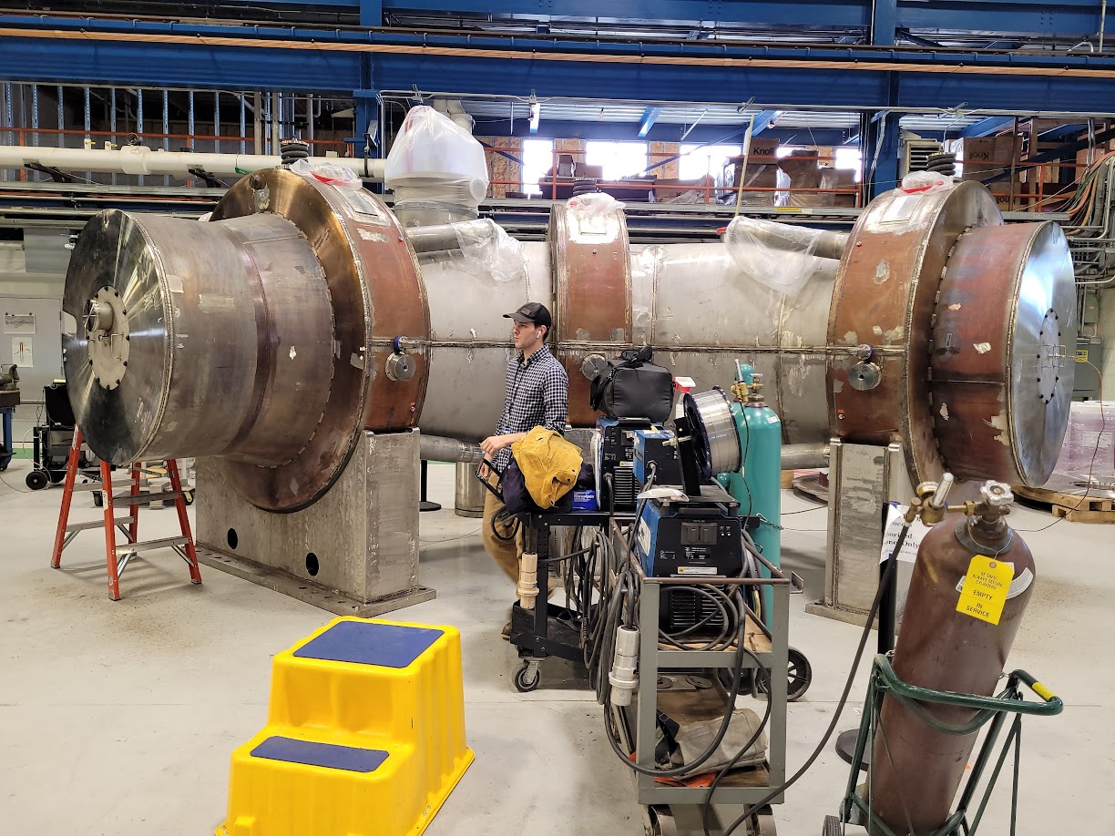
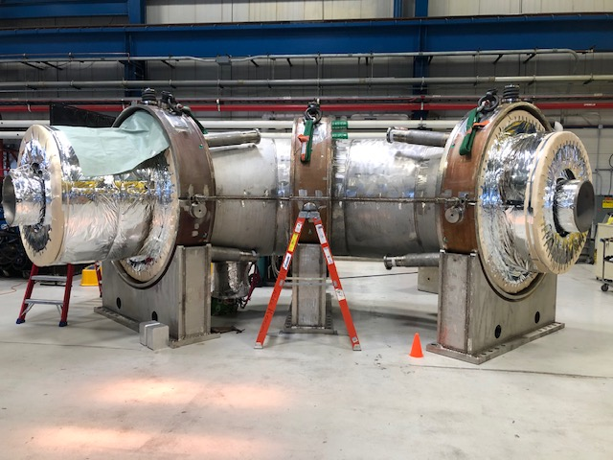
Status of Transport Solenoid
Vacuum vessel welding is complete – no further incidents
Preparing to leak check TSU
Start up operation on TSD

Slide 12
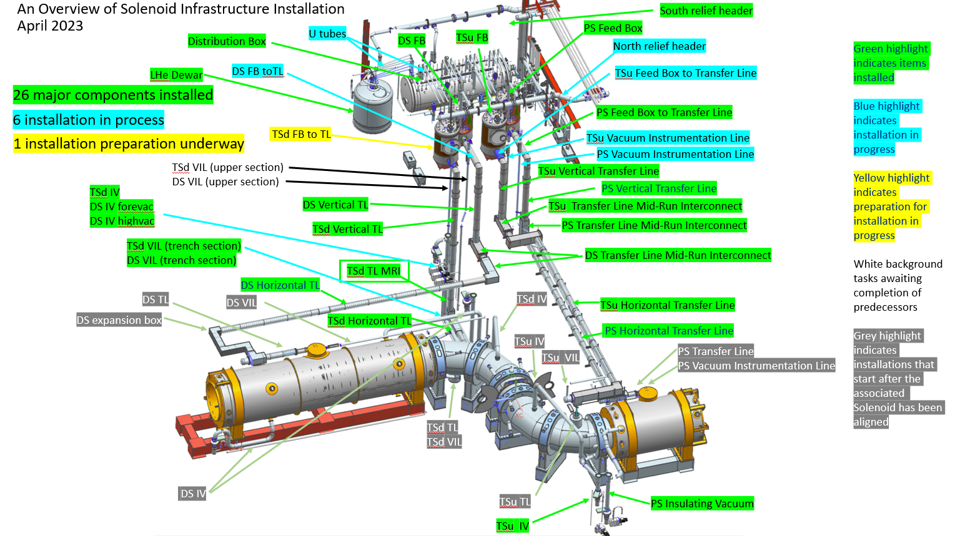
Cryogenic Distribution Installation
Great improvement on preparation of cryogenics, distribution lines and services
in Mu2e hall→ Getting ready to receive first magnet end of 2023

Slide 13
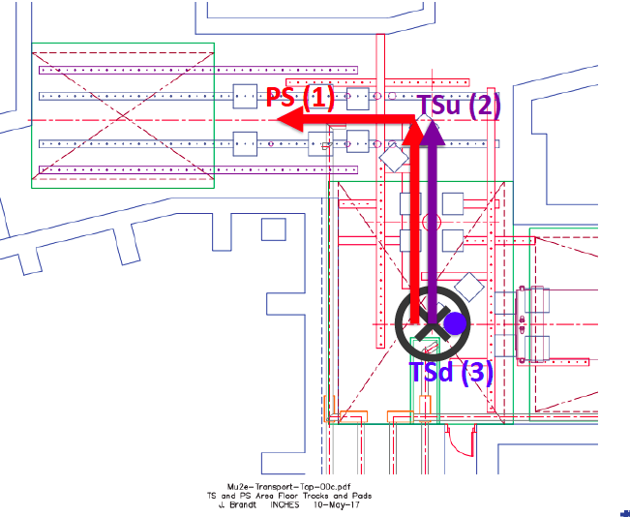
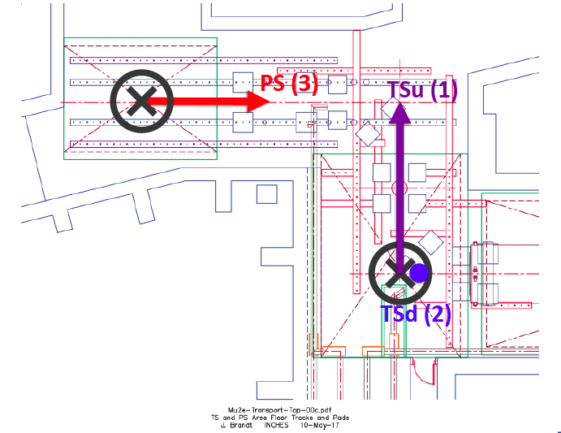
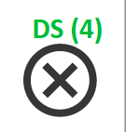

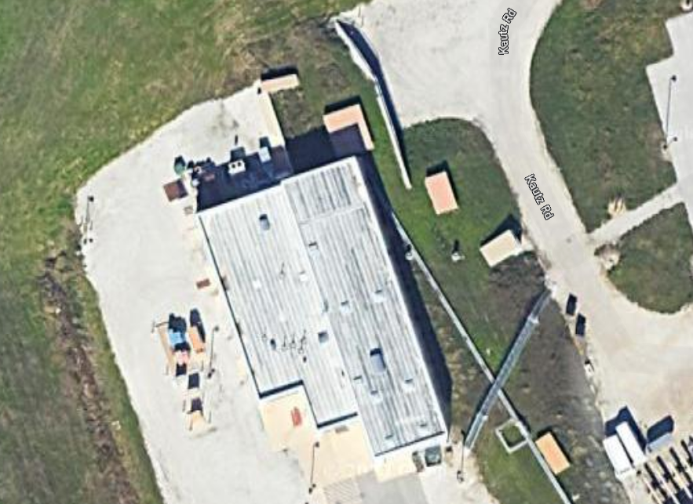
Solenoid Delivery - installation problem
PS delivery: October 2023 (SLIPPING)
TSu delivery: October 2023 + TSd delivery: November 2023 (HOLDING)
DS delivery: May 2024 (HOLDING)
It is likely that TSu/TSd will be ready to install before PS
BASELINE – OPERATION STEPS
REVISED – OPERATION STEPS
PS hatch
→ Do not interrupt installation in Mu2e Hall when magnets are ready
→ Need to use a different (PS) hatch + external crane

Slide 14
Accelerator: Slow Extraction progress et al.
Dec/2022 Prototype ESS inserted to study Resonant Extraction while co-sharing Beam with g-2
First Production ESS will be inserted
After g-2 experiment is completed
ESS HV supply being commissioned
Fabrication of first production ESS on-going:
  →procurement of parts & QC complete
  →Rough assembly complet + full assembly under-way
- Repeat similar work for 2nd ESS later this year
HV test on going
Conditioning still needed above 60 kV
Many 8 GeV beam commissioning studies on going
2/3 shifts/week to Mu2e vs g-2 running
Achieved: preparation of 1/3 AC dipole vacuum vessel. Still 2 to go!
To Do:
  Complete AC dipole
  improve BPM system to keep up commissioning

Slide 15
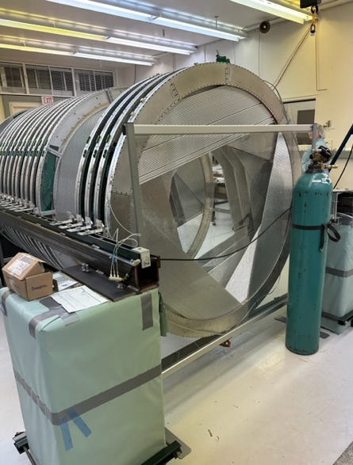
Tracker Construction status
UMN Tracker Panel Production
  Production panels complete
    216 panels needed for detector.
    Remaining are spares.
    Last set of 10 panels in QC/repair.
      Congratulations to UMN team!
    Starting to breakdown panel factory.
    UMN team transitioning to
    HV/LV module fabrication.
FNAL Tracker Plane Construction
(36 total)
  Plane construction continues.
    23 planes completed (61%).
    Plane 24 undergoing leak check.
    On track to complete late 2023/early 2024.
  Several planes stored at pressure to
  study long term behavior.
  Plan to store all planes at pressure.
Remaining problem is complete the
production of analog and digital electronics
Preamp production started
FPGA received. CRR’s almost complete

Slide 16
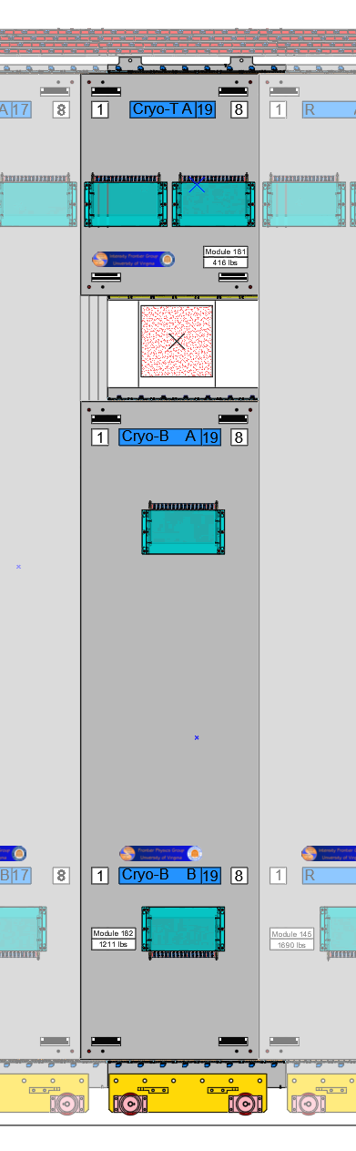
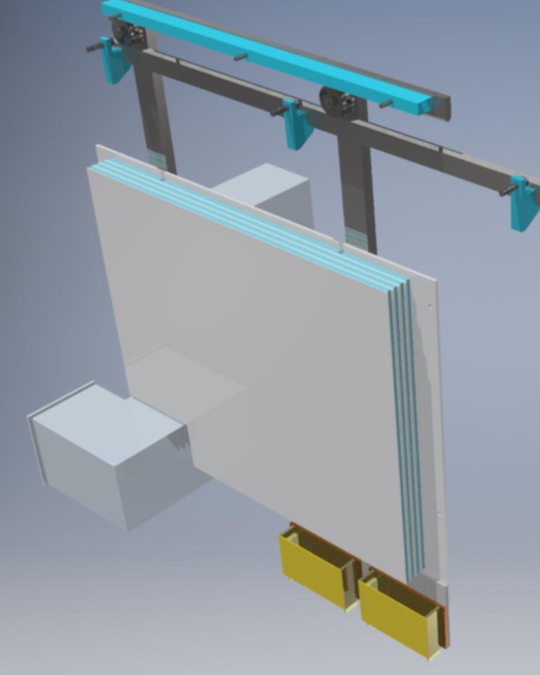
Cosmic Ray Veto Construction Status
Top/Bot Cyro Module
CRV-Cryo-T
CRV (80/83 modules completed)
Final 3 cryo modules surround DS cryo transfer line
Successful cryo module CRR completed
  Final 3 Cryo modules can now be fabricated
  Next CRR will focus on the module support structure
On track to complete all modules by end of July 2023
CRV-Cryo-B
Outer Cyro Module
Cryo Transfer Line
CRV-Cryo-Outer
Module production ~ completed. Electronics delay similar to other detectors.

Slide 17
Other problems/items (not –yet- for CSN1)
B field measurement (If? When ? How ?)
→ EB Task force. Report completed. New look for additiona
problems due to rebar in concrete surrounding DS.
Higher CR background (Corsica vs CRAY) → see SDF
Computing Review (next week) + tutorials expected soon
TDAQ – runControl. It is still a pity: workshops + task force
+ review/re-organization
Org Chart for operations
  → Long discussion on-going. EB Task force being assigned

Slide 18
Next plans
New IFC meeting … summer 2023?
- discuss of MOF contribution for 2023-2024
Calibration in-situ + VST in SIDET + TestBeams
Improve DCS+Runcontrol (otsDAQ →Mu2eDAQ) for commissioning
Work on AFG (Acceleratore Feedback Group) – Caphri+Intensity
Simulation of background + physics processes
-- Cosmics, antiprotons
  mu- → e+, RMC/RPC, photon conversions, pi+ →e+ X, mu+ →e+X
Mu2e-II (?)
- Not time to discuss it here
→ great progresses for snowmass
→ Preparation for PAC presentation in June + LDRD’s request O(10 M$)

Slide 19
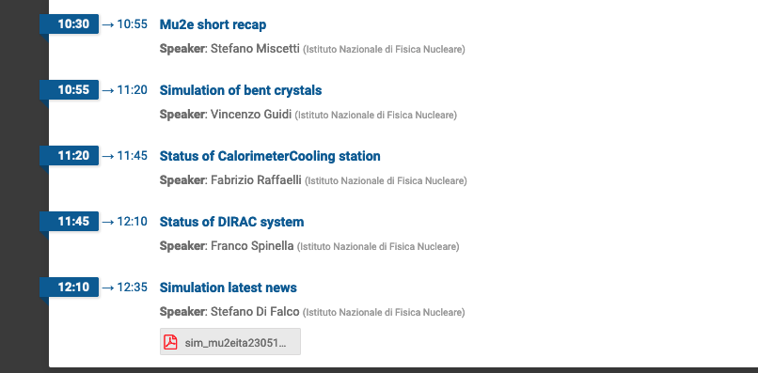
Today Agenda

