Slide 1
Status of mu2e calorimeter cooling station.
Summary.
Status of the cooling station specifications.
Concerning on cooling fluid.
• Conclusions .

Slide 2
Status of the cooling station specifications.
Preliminary specifications (docdb 44515) have been discussed with Fermilab.
A new release of Docdb 44515 is available for further discussion.
Main observations of the preliminary cooling plant specifications:
It was difficult to parse which parts of the specification were describing the cooling station, and which parts were describing the chilled fluid loops through the calorimeter supplied by the cooling station.
Clearly need a section in the specification specifying the codes that the chiller system must satisfy.
Operating modes.
Reliability/up-time
Plan on fully draining the chilled fluid loops through calorimeter about twice a year to facilitate extraction of the detector train for servicing.

Slide 3
Status of the cooling station specifications.
On basis of observations of the preliminary cooling plant specifications: We have reorganized the document by adding a few paragraphs and move some argument from uno place to another place.
New chapters were added:
2.3 Operating modes.
2.4 Secondary circuit description
2.6 Features and maximum dimensions of chiller skid.
2.23 Applicable documents (Fermilab standard)

Slide 4
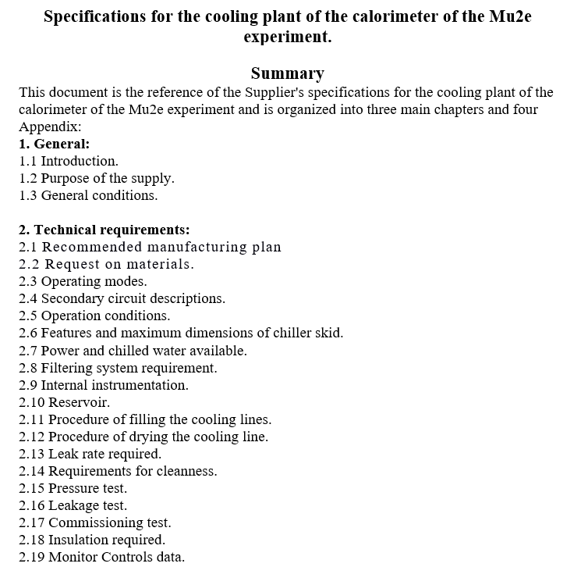
Status of the cooling station specifications.

Slide 5
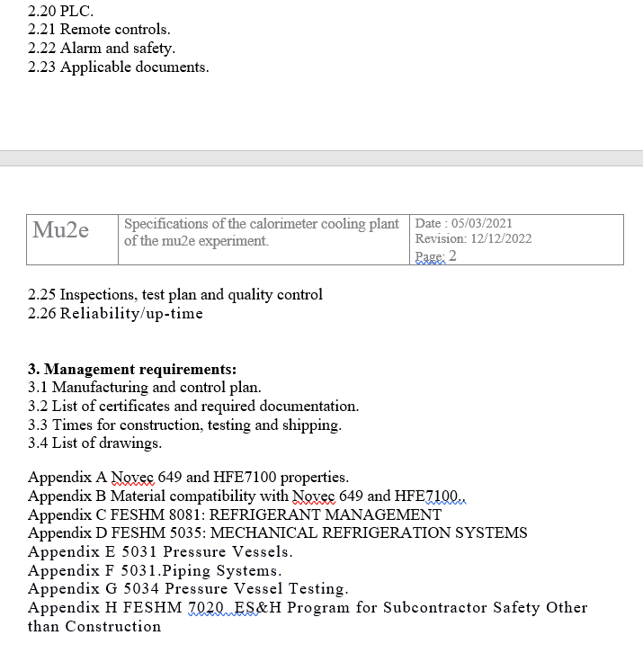
Status of the cooling station specifications.

Slide 6
Status of the cooling station specifications.
Many technical questions on the specification were asked by the Fermilab group. Some of these we are able to answer with no interaction, others require internal discussion.
An additional meeting is needed to discuss some of these topics.
We list some that can be answer:
Must be serviceable in place (as installed) (Of course)
Does the system need to be relieved to the outside (or can it be relieved in the detector hall)
Potential environmental and oxygen deficiency impacts. (Safety data Sheet)
Are there any requirements on the maximum noise levels generated by the operating skid?(Options: an open Skid or close with acoustic panel)
Upper limit on heat to be transferred to air? (The main contribution of heat is due to the fluid pump efficiency ( about 3-4 kwatt )
Interfaces (flange types and locations) probably need to be more explicitly specified. (We have solution that must be discussed with Fermilab group that is included in the new)
Note that this section also seems to indicate that the fluid for the chilled fluid loops will be 3M Novec 649 or HFE7100. Not obvious this is the way to go given the current circumstances.
Should the vendor be invited to propose a solution here as well? (vendor suggested HFE7100)
Do we have an idea of how much fluid might be lost per year of operation of this system? (can be estimated)

Slide 7
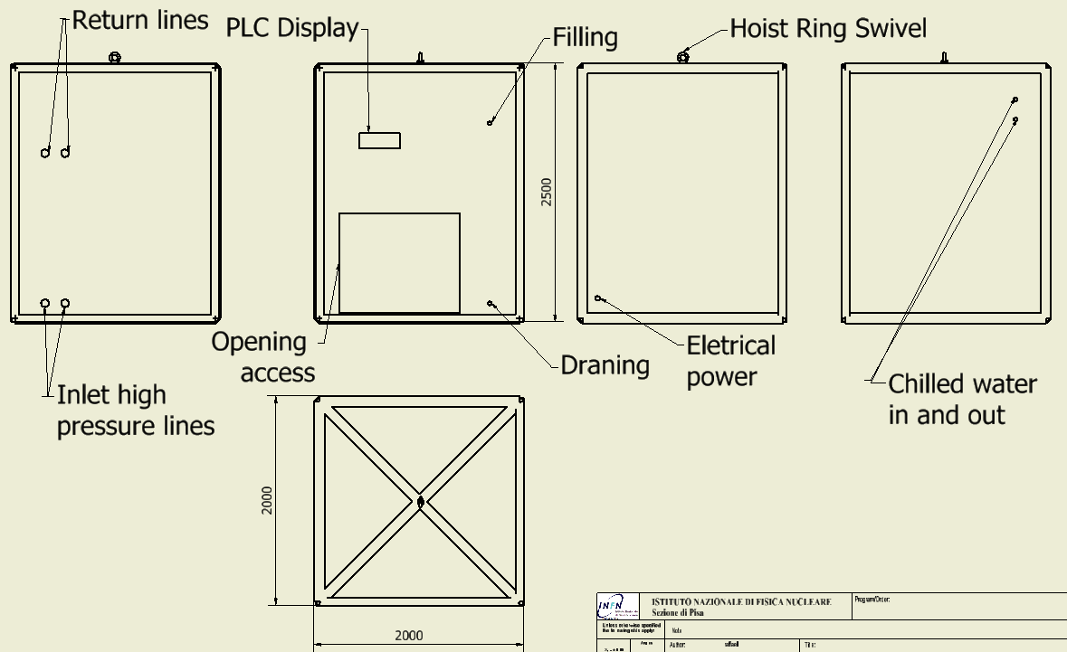
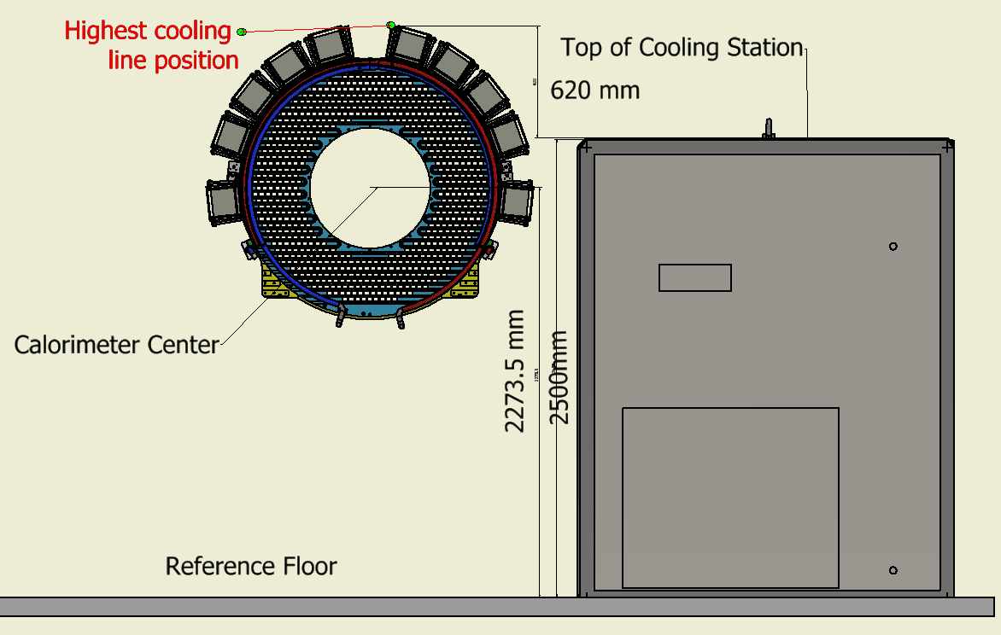
Status of the cooling station specifications.
Must be revised with Fermilab.

Slide 8
Concerning on cooling fluid.
The lowest operating temperature is -22 ⁰C. This allow us to operate the SIPM at -10 ⁰C.
Monophase cooling fluids.
Fluid operated at operating temperature that are not non-corrosive, nonexplosive and nonflammable and have good thermal properties are:
(Alcohol and water Ammonia e salt and water are excluded)
Mixture of organic fluid with water.(glycol ethylene, etc.).
Silicon Fluids. SYLTHERM™ 800, SYLTHERM™ XLT, and SYLTHERM™ HF S
Aromatics (HC): Modified hydrocarbons Dowtherm J (DIETHYLBENZENE based) for Dow Chemical.
Silicate-ester (SE) formation of flammable alcohols and silica gel.
Tyfoxit mixture with water 1.21 Ph 11-12 we must care about corrosion problem (no oxygen and use corrosion inhibitors).
Aliphatics (PAO): Aliphatic hydrocarbons of paraffinic and iso-paraffinic.
Hydrofluoroether fluids thermal stability, non-flammability and low toxicity (They have characteristic of solvent)

Slide 9
Reasons for the use the fluids family of Hydrofluoroether.
These cooling fluids have a good thermally characteristics in our temperature range (15/-22 C).
These fluids are inert. In case of spilling no damage is procured to the experiment apparatus.
These fluids have been used for at least 20 years in CERN for various experiments. There are many articles regarding the use of fluids under radiation.
Most of air condition system use this type of fluid (R404)
The hydrofluoroether presented has unique properties that set it apart from the other fluids. It has excellent low temperature heat transfer abilities that result in a much reduced pump power requirement for circulation in a secondary system. The hydrofluoroether is non-corrosive and nonflammable. It has very good toxicological and environmental properties as well, making it a safe, long term solution for secondary heat transfer systems.

Slide 10
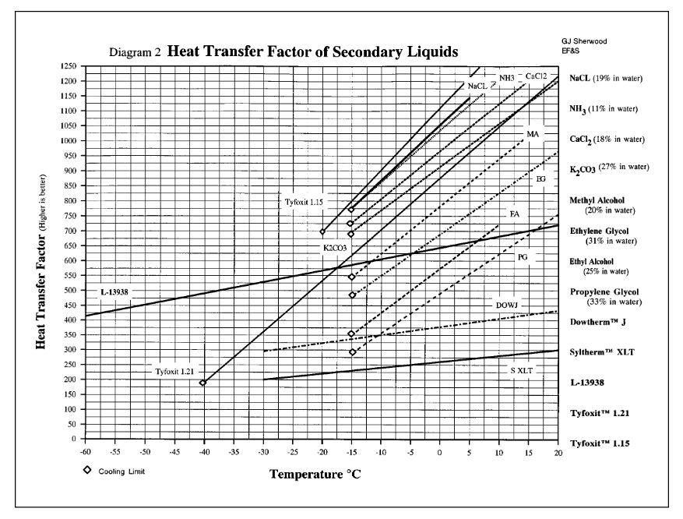
Concerning on cooling fluid.
In comparing different fluids (given the same velocity, diameter of tube, and temperature change of the liquid during the heat transfer process) a fluid with twice the heat transfer factor of a second fluid can transfer twice the energy of the second fluid.

Slide 11
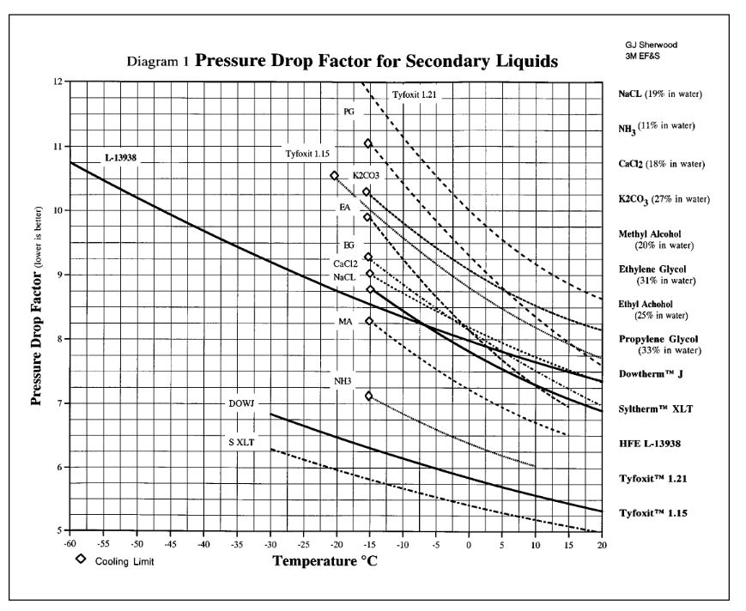
Concerning on cooling fluid.
lower pressure drop factor relates to reduced frictional loses for the same fluid velocity and tube geometry.

Slide 12
Concerning on cooling fluid.
After several iteration with the 3M representative. 3M suggest to use the Novec 7100. We started contacting the 3M at the end of June 2022.
We received the follow message (10/01/2023). It say that 3M is pulling out form the market these family of fluids from 2025. See the written link below.
https://urldefense.proofpoint.com/v2/url?u=https-3A__news.3m.com_2022-2D12-2D20-2D3M-2Dto-2DExit-2DPFAS-2DManufacturing-2Dby-2Dthe-2DEnd2Dof2D2025&d=DwMFAg&c=gRgGjJ3BkIsb5y6s49QqsA&r=C1c2SP7lm8tmVU466Gc9vg&m=2YDzWpmHs9SOgSo_F6HL6v5yruD0STfOfp519X7sFAZ1dEf0sJyb_POutqVunSvG&s=DN2nBCk-95kmwCXn5ylJZ0JIANZzMp-ESqOf_6Gann4&e=
The patent for the production of these fluids has expired. There are other companies that now are producing these fluids.
I don’t know the USA situation regarding these fluids. we must inform ourselves as soon as possible

Slide 13
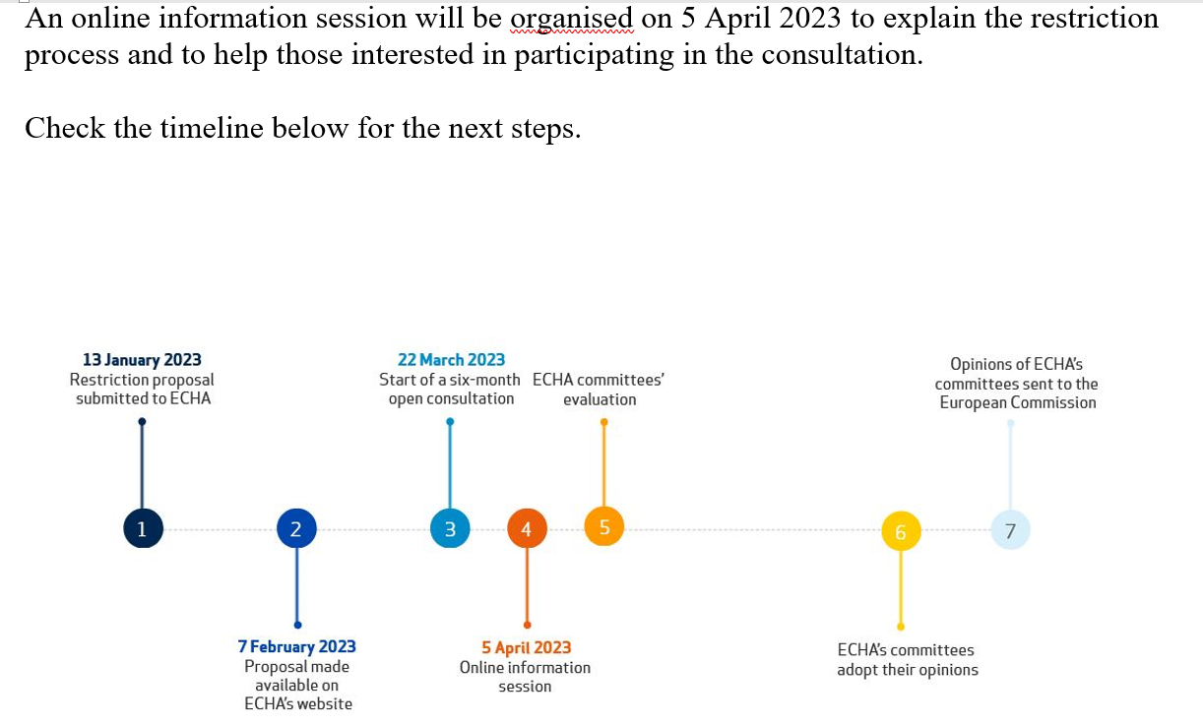
Per- and polyfluoroalkyl substances (PFASs)
They all contain carbon-fluorine bonds, which are one of the strongest chemical bonds in organic chemistry. This means that they resist degradation when used and also in the environment. Most PFASs are also easily transported in the environment covering long distances away from the source of their release.
EUROPE COMUNITY

Slide 14
Conclusions.
Cooling Plant specifications. The chapters regarding the control interface and safety are not yet written because we need the support of the slow control and data acquisition people. We did not have a meeting with them yet. We hope to arrange a meeting soon in Fermilab with a proper stakeholder.
Already 11 company has been informally contact with preliminary specifications.
We have to proceed with a formal tender invitation to have a feedback with vendors to understand the price implication on our requests.

