Slide 1
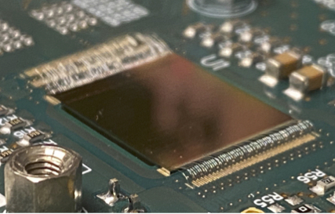
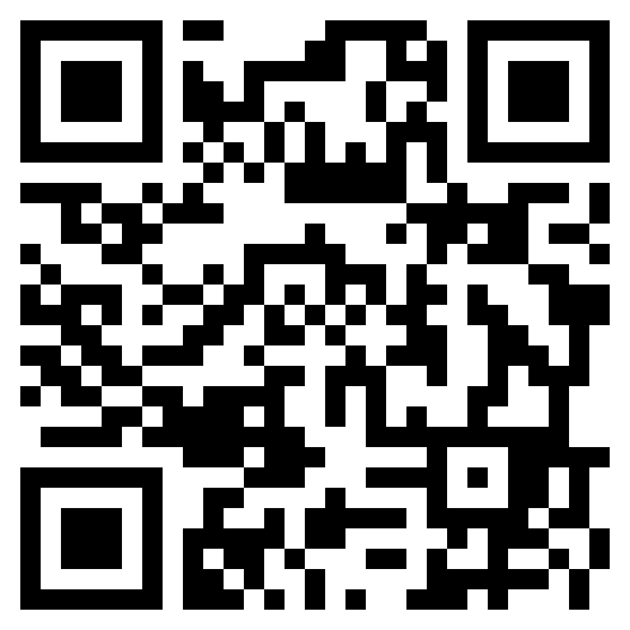
FEE 2023
XII INTERNATIONAL MEETING ON FRONT-END ELECTRONICS
for Particle Physics, Photon Science and related applications
Turin, 12-16 June 2023
Local organizing committee
Angelo Rivetti
Sara Garbolino
Andrea Di Salvo
Manuel Rolo
Marcello Tardiola
INFN – Sezione di Torino, Italy
Stefania Bufalino
Politecnico di Torino, Italy
Organizing committee
Giovanni Ambrosi – INFN Perugia, Italy
Valerio Re – U. Bergamo, Italy
Michael Campbell – CERN
Mark Prydderch – RAL, UK
Grzegorz Deptuch – BNL, USA
Paul O’Connor – BNL, USA
Jean Francois Pratte – U. Sherbrooke, Canada
Zhen’an Liu – IHEP, China
International advisory committee
Wladek Dabrowski – AGH Krakow, Poland
Christophe De la Taille – Omega, IN2P3/CNRS, France
Angelo Dragone – SLAC, USA
Carlo Fiorini – Politecnico di Milano, Italy
Heinz Graafsma – DESY, Germany
Patrick Pangaud – CPPM, France
Matteo Porro – EuXFEL, Germany and U. Ca’ Foscari, Venezia, Italy
Veljko Radeka – BNL, USA
Angelo Rivetti – INFN Torino, Italy
Manobu Tanaka – KEK, Japan

Slide 2
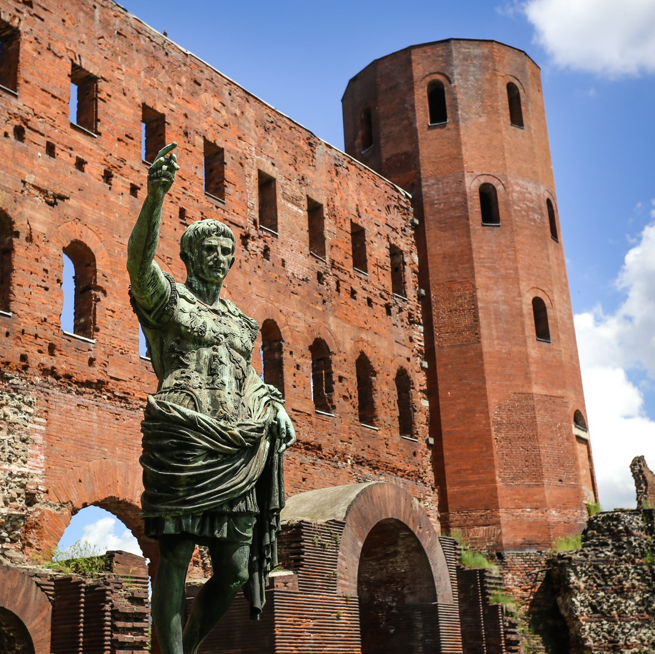
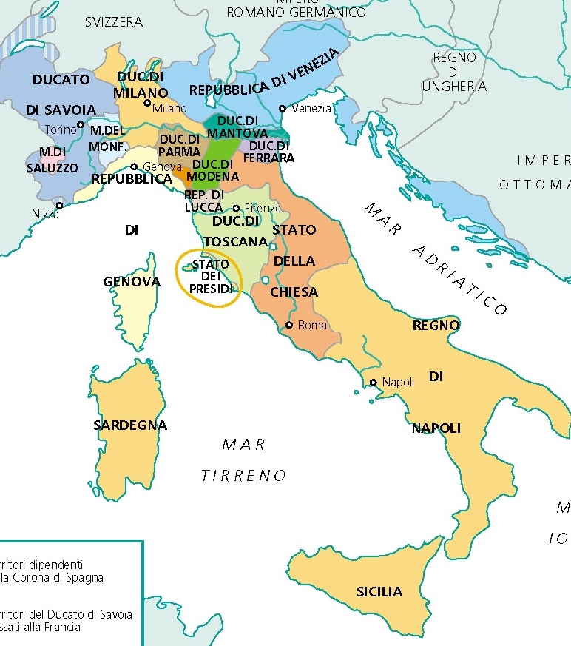
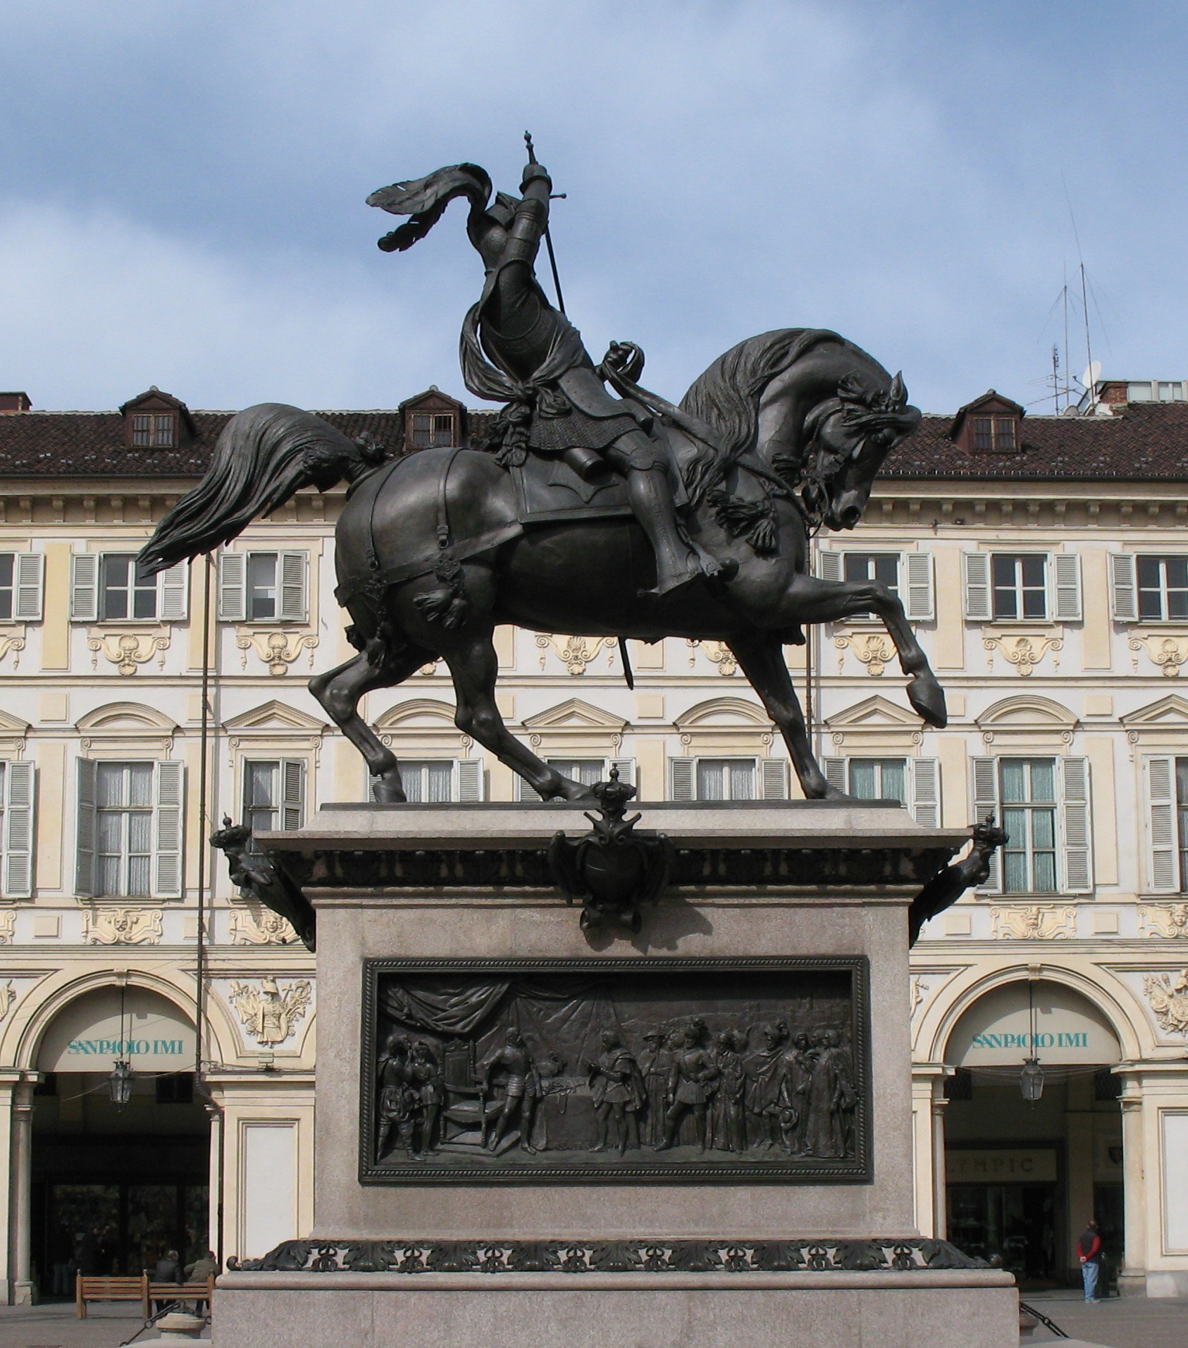
Welcome to Torino…

Slide 3
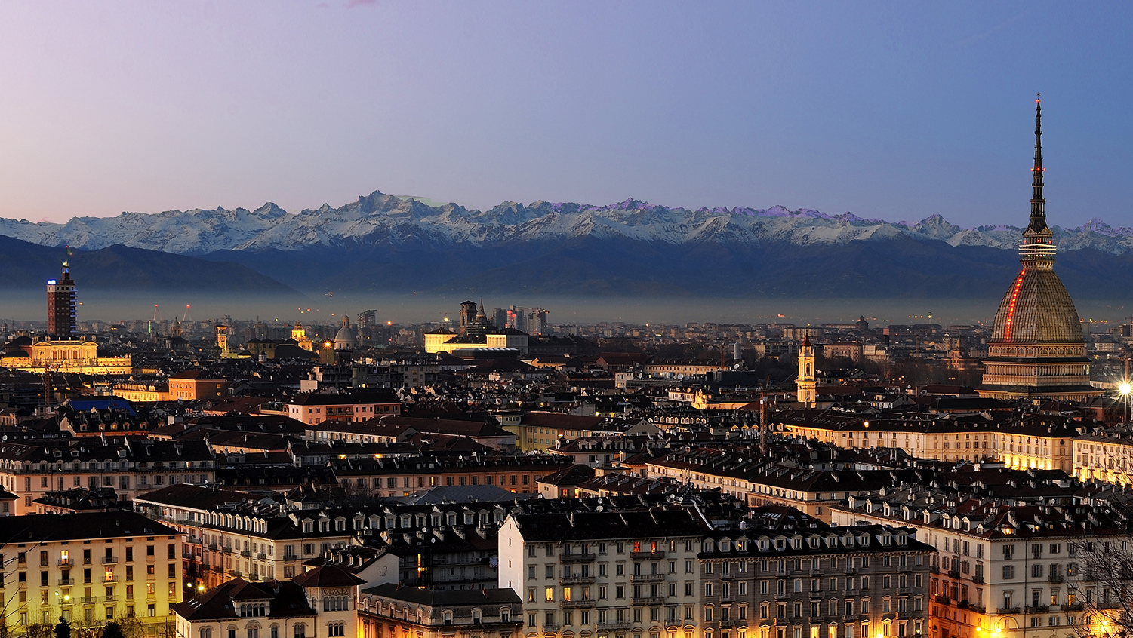
…sotto la Mole!

Slide 4
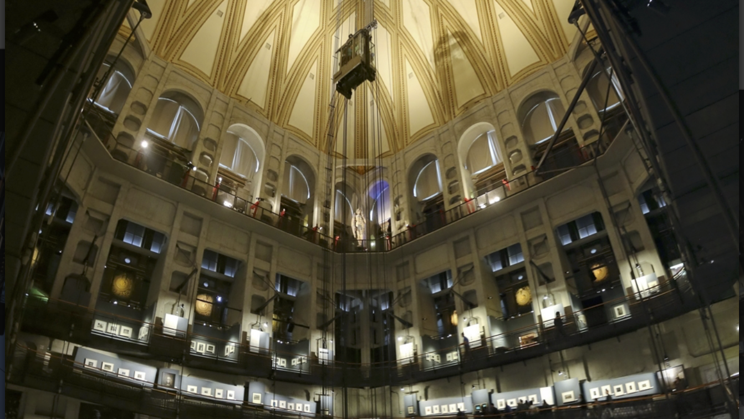

Slide 5
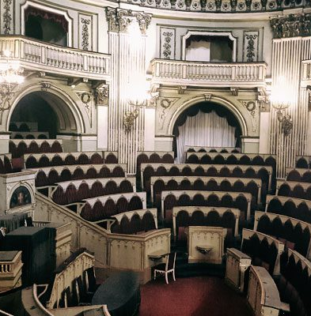
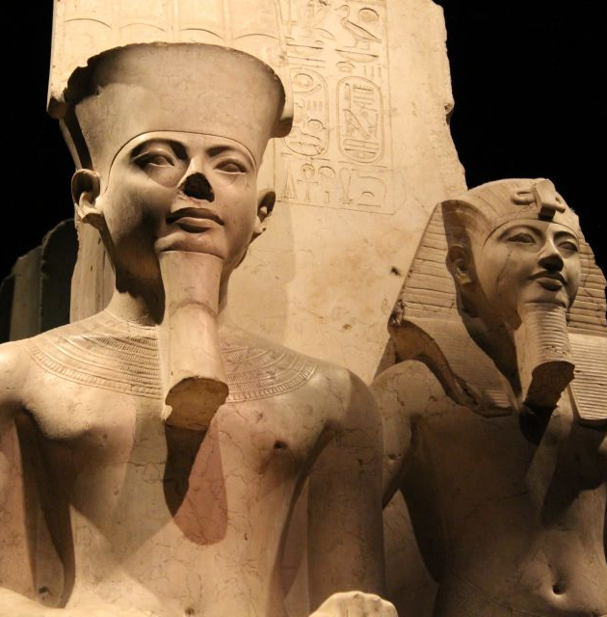
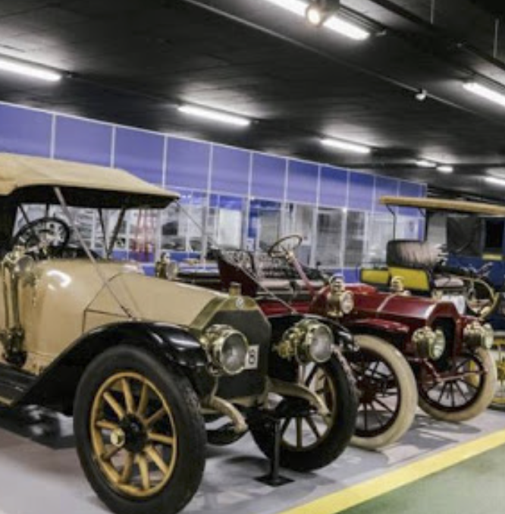
Some local attractions…

Slide 6
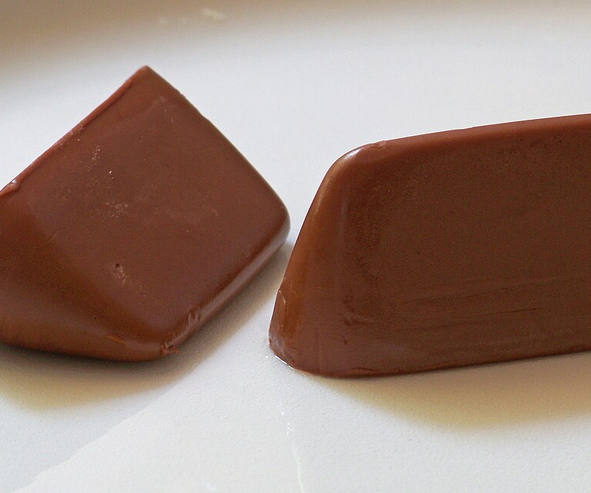
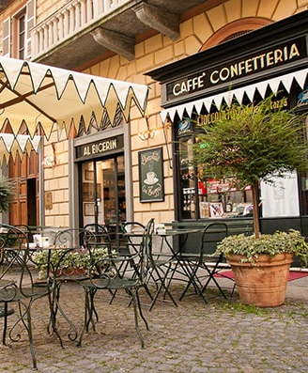
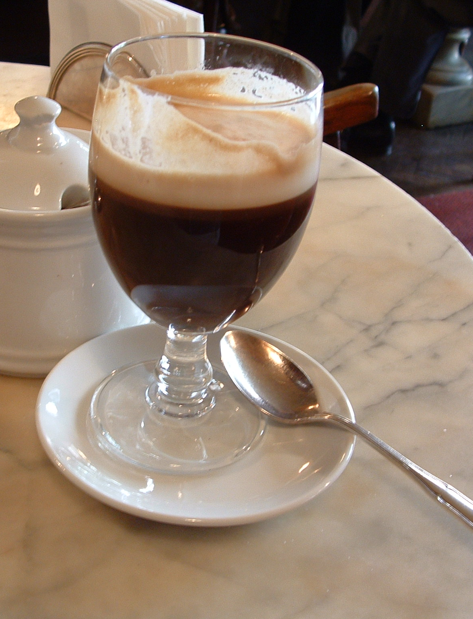
Additional attractions
Piazza della Consolata 5…since 1763

Slide 7
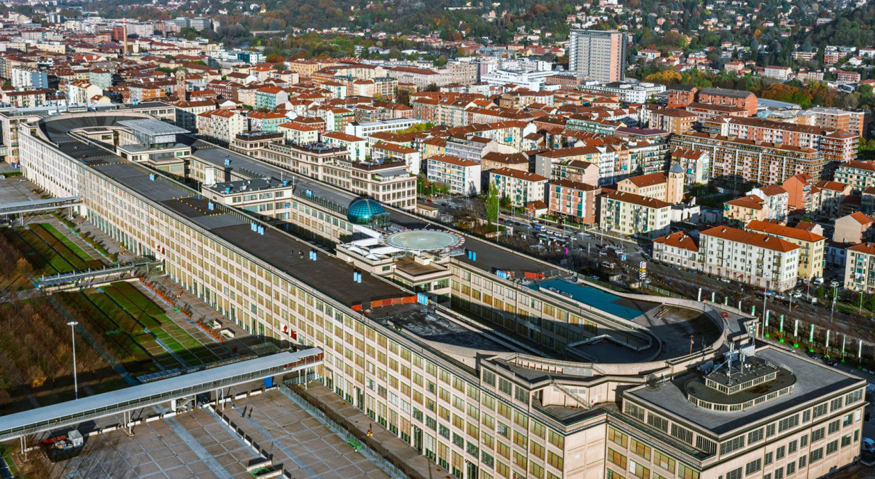

Slide 8
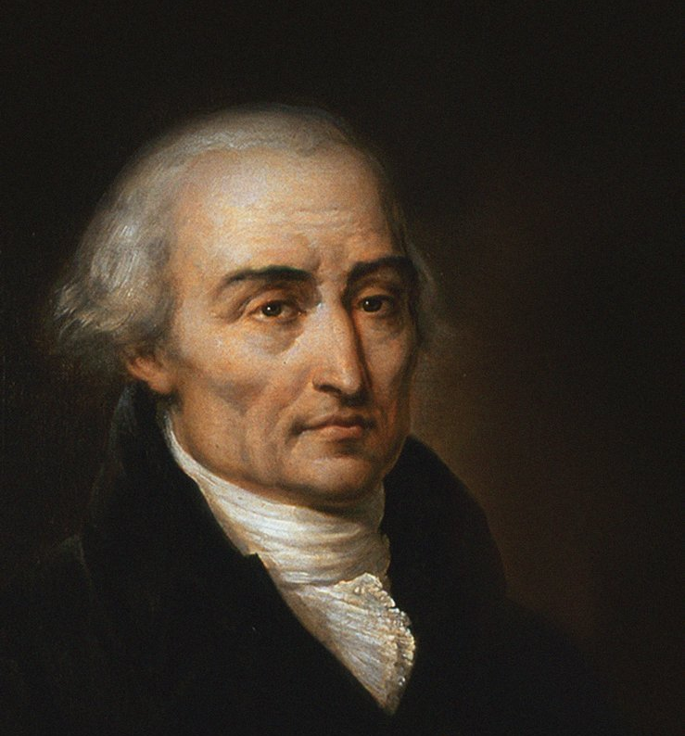
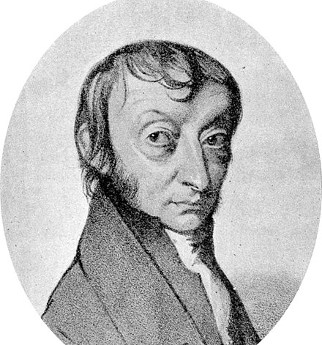

Slide 9
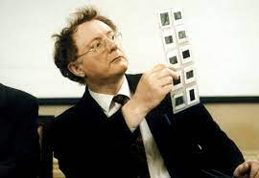
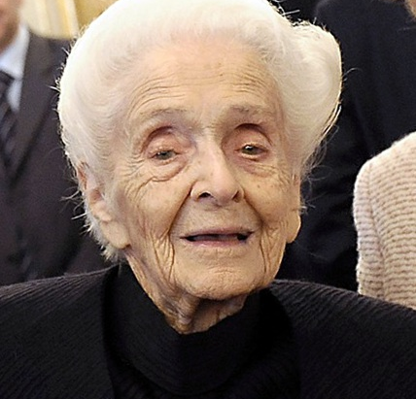
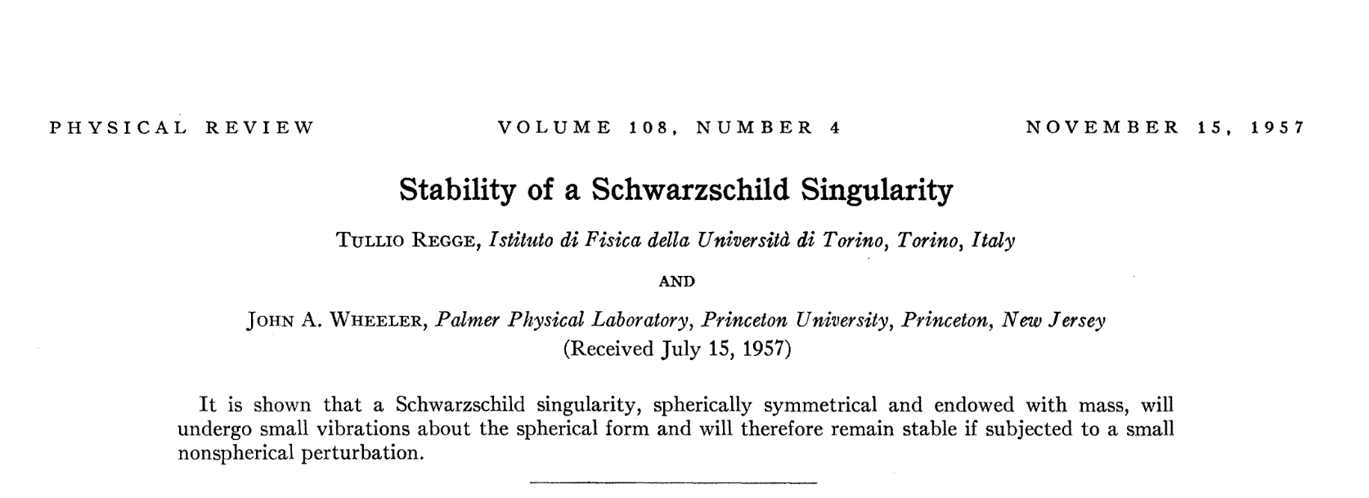
…and in more recent times
Tullio Regge
Rita Levi-Montalcini, Nobel laureate in Medicine, 1986

Slide 10
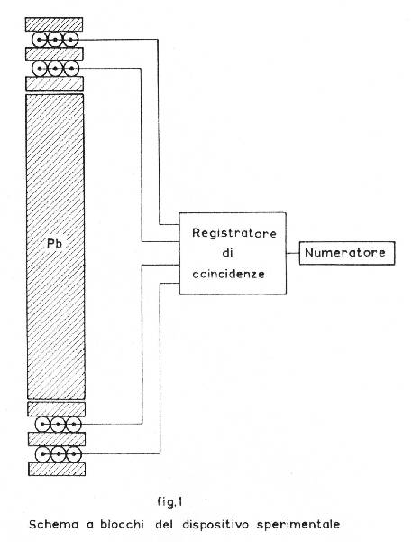
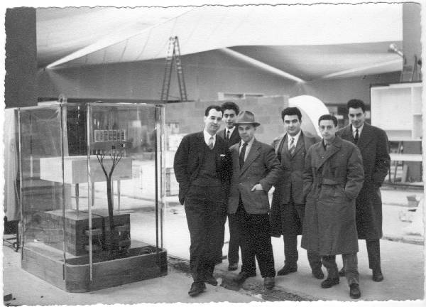

Slide 11
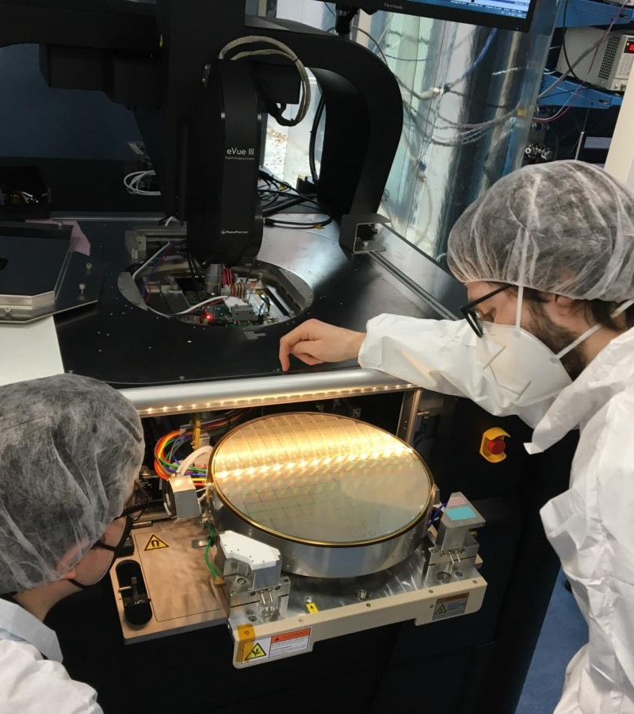
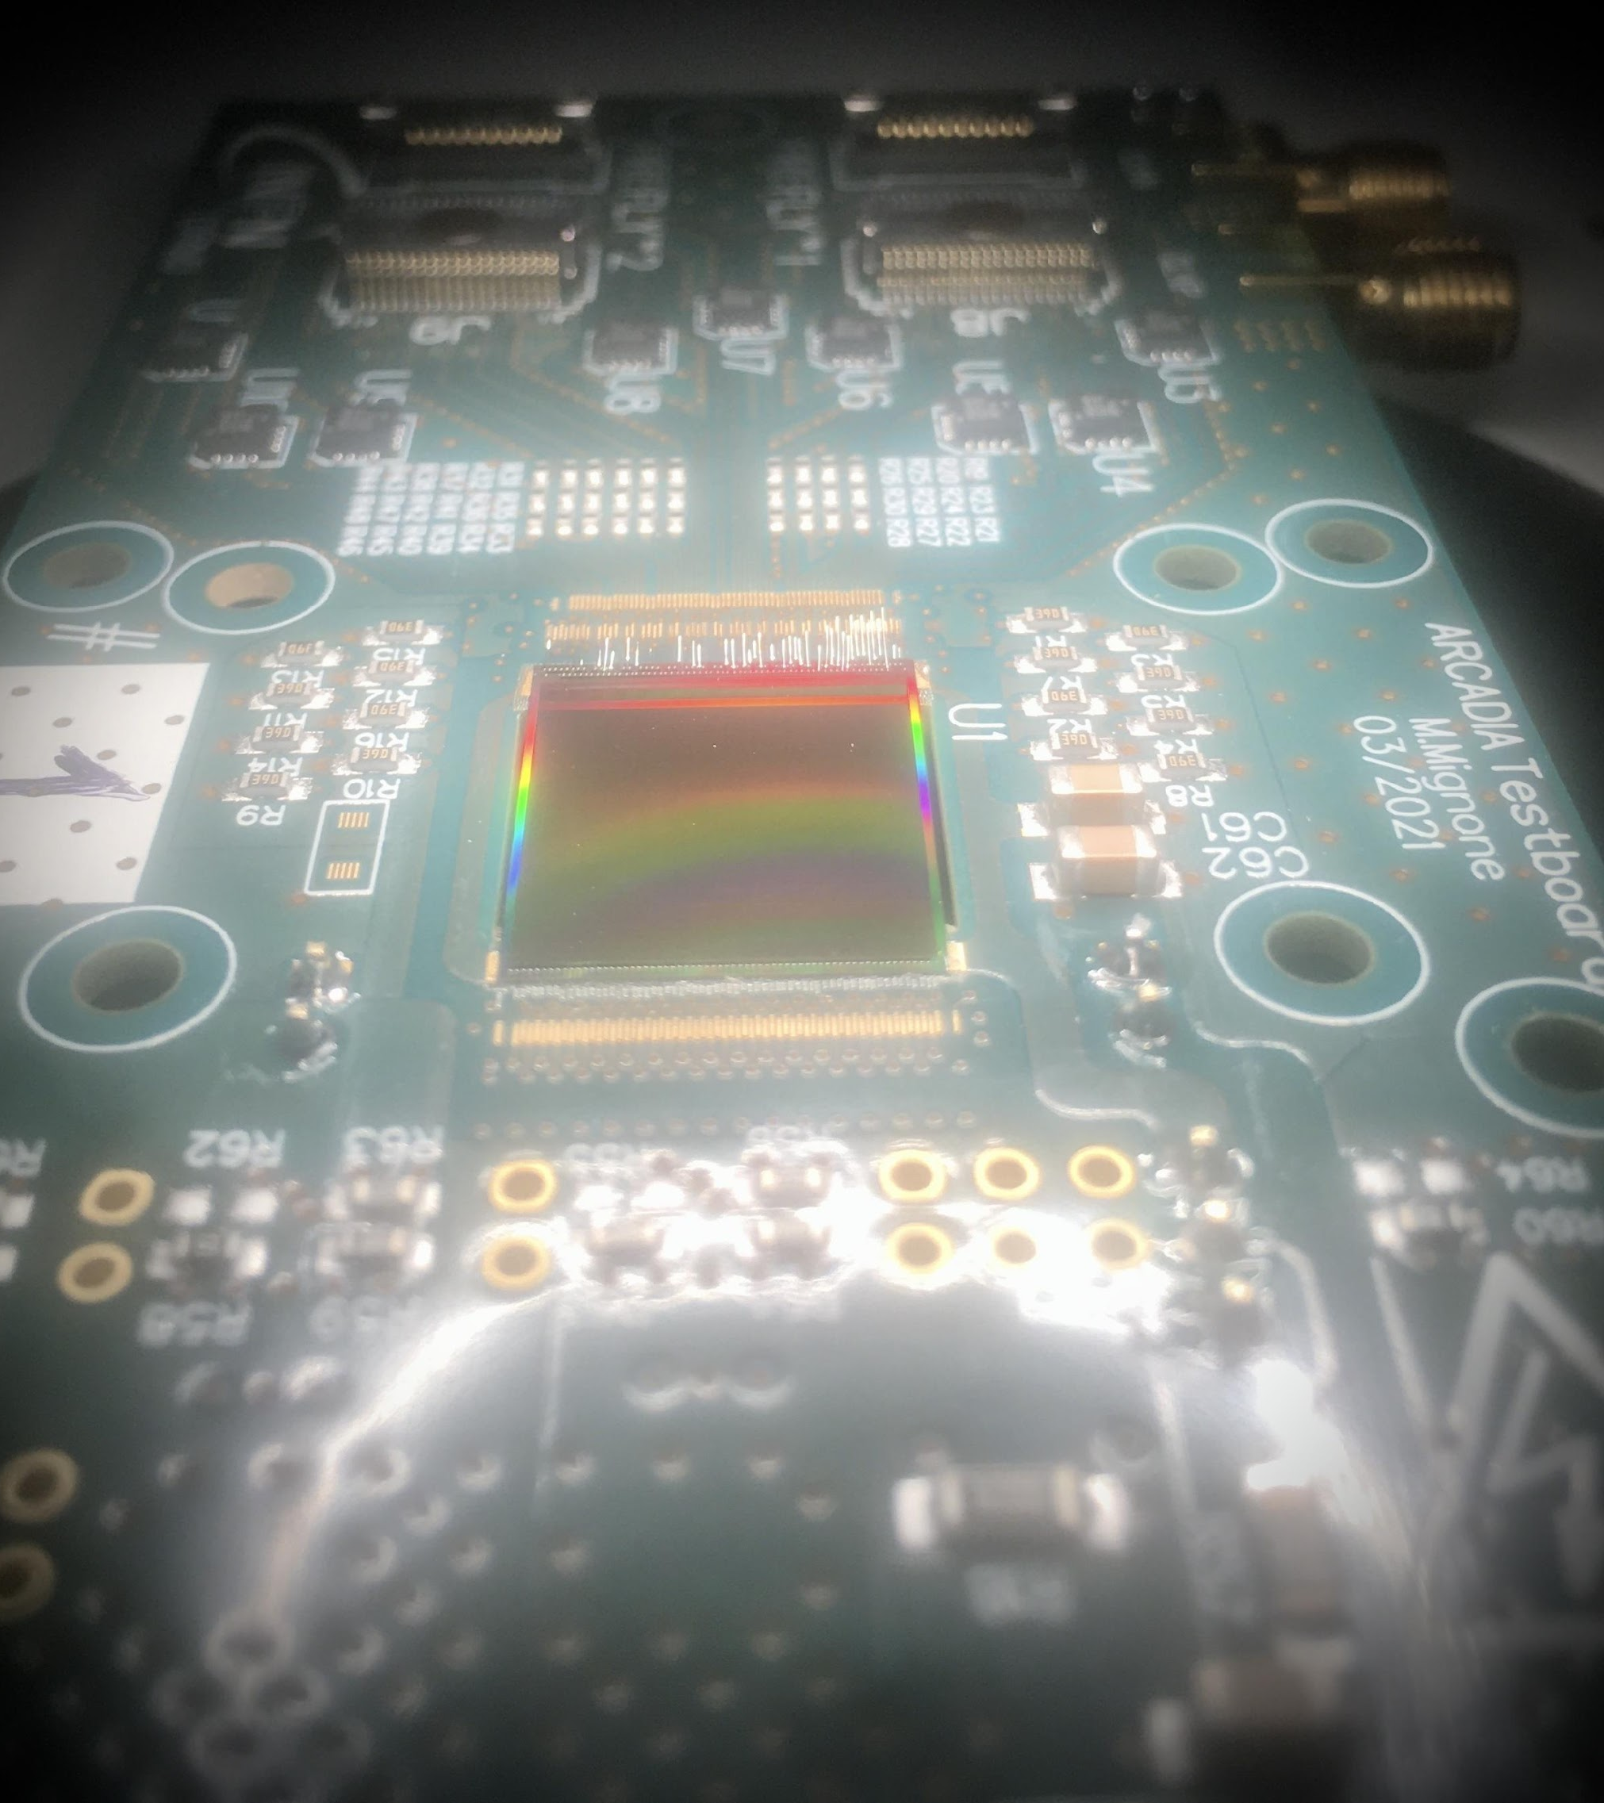

Slide 12
XII Front-End meeting on (Integrated) Front-End Electronics for Particle Physics, Photon Science and related applications
Tradition started in Perugia and Yellowstone
Continued every 3 (2) years
With a break for the pandemic
Only in person
By invitation only
Presentations longer than in usual conference
To allow you to go in detail…
…in a friendly and informal environment
Coffee breaks can be as productive as the talks!
Minimize the overhead: no proceedings. Only slides on a public website

Slide 13
Some numbers
50 talks organized in 18 sessions
About 60 total attendees

Slide 14
Practical info’s
Talk duration is supposed to be 25 minutes talks + 5 minutes for discussion
Use coffee breaks and lunches for additional questions and discussions!
From time to time looks also at your session chair☺
Please upload on indico your slides before the session
In case you have issues come with a USB pen during the coffee breaks before your session
Upload also a pdf version, just in case
Coffee breaks and lunches served always in the same place, one floor upstairs

Slide 15
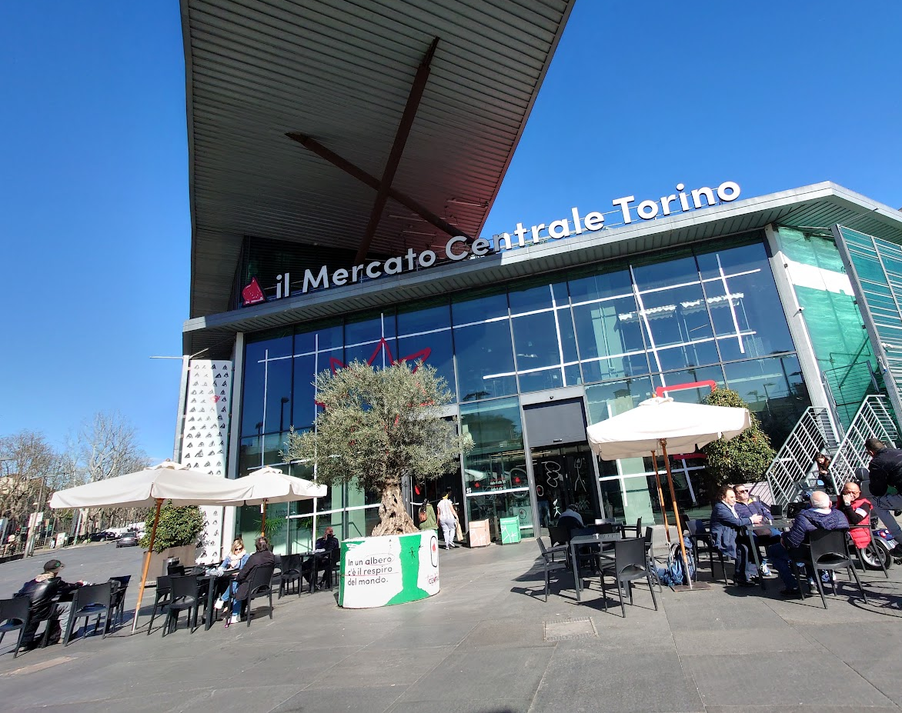
Social/networking events: welcome reception
Tomorrow, June 13th
After the session, join us outside of the room
We will go by metro to the city center (metro stop “Porta Nuova”, exit Piazza Carlo Felice-square with garden in front-of the station)
Walking tour of the city center
Welcome reception at “Mercato Centrale”, piazza della Repubblica 25, Torino

Slide 16
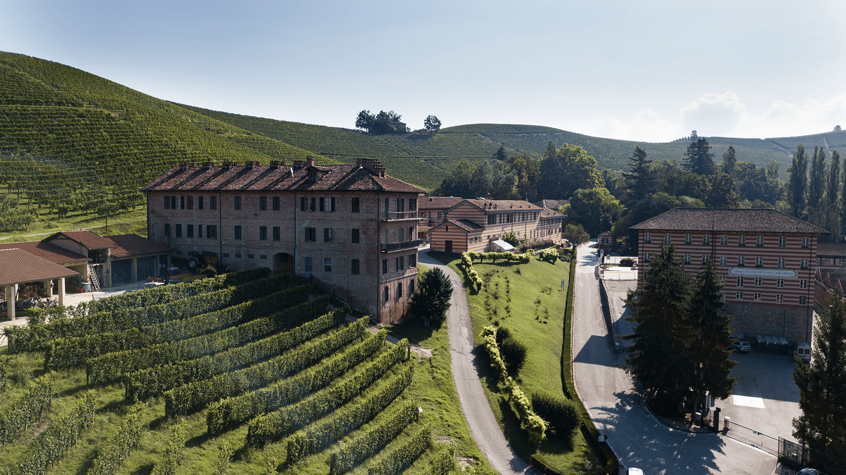
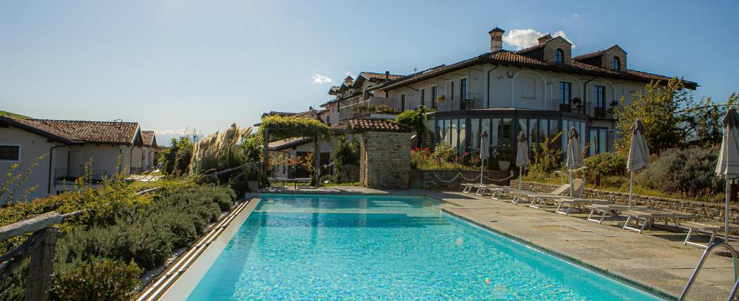
Social/networking events: networking afteroon
Wednesday June 14th
By bus. Bus will start from conference location
About 1 hour bus trip to the Langhe
Visit one historical place + social dinner
Bus back to Torino with one stop in Lingotto and one in the city center (piazza Carlo Felice)

Slide 17
FEE 2023
XII INTERNATIONAL MEETING ON FRONT-END ELECTRONICS
for Particle Physics, Photon Science and related applications
Turin, 12-16 June 2023
Enjoy an intersting and productive workshop!
Local organizing committee
Angelo Rivetti
Sara Garbolino
Andrea Di Salvo
Manuel Rolo
Marcello Tardiola
INFN – Sezione di Torino, Italy
Stefania Bufalino
Politecnico di Torino, Italy
Organizing committee
Giovanni Ambrosi – INFN Perugia, Italy
Valerio Re – U. Bergamo, Italy
Michael Campbell – CERN
Mark Prydderch – RAL, UK
Grzegorz Deptuch – BNL, USA
Paul O’Connor – BNL, USA
Jean Francois Pratte – U. Sherbrooke, Canada
Zhen’an Liu – IHEP, China
International advisory committee
Wladek Dabrowski – AGH Krakow, Poland
Christophe De la Taille – Omega, IN2P3/CNRS, France
Angelo Dragone – SLAC, USA
Carlo Fiorini – Politecnico di Milano, Italy
Heinz Graafsma – DESY, Germany
Patrick Pangaud – CPPM, France
Matteo Porro – EuXFEL, Germany and U. Ca’ Foscari, Venezia, Italy
Veljko Radeka – BNL, USA
Angelo Rivetti – INFN Torino, Italy
Manobu Tanaka – KEK, Japan

