Slide 1

ASTRA: a high dynamic range front end embedded with HV monolithic silicon micro-strip sensors
Fabio Cossio (INFN Torino)
on behalf of the ASTRA group
XII Front-end Electronics Workshop
Torino - 14.06.2023

Slide 2
Outline
ASTRA versions overview and motivation
ASTRA monolithic implementation
ASTRA readout architecture
Results from first measurements
Summary and outlook

Slide 3
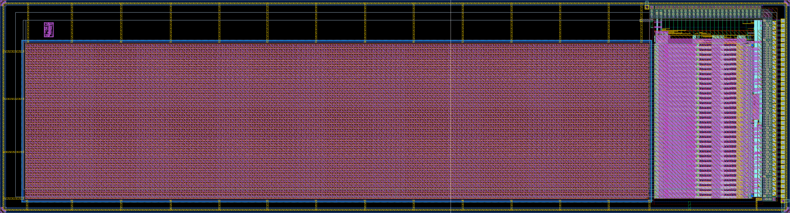
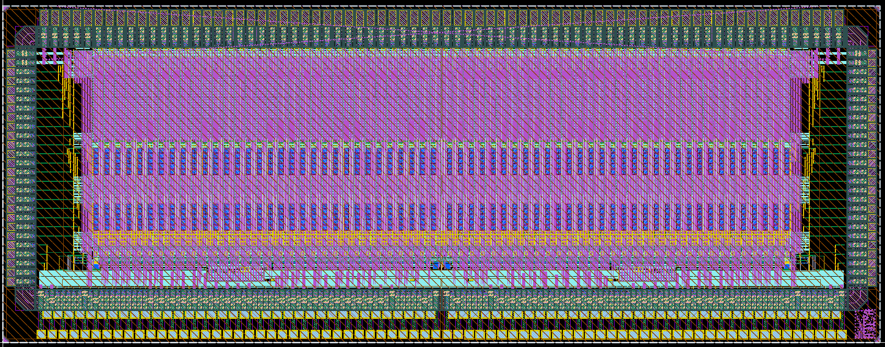
ASTRA: Adaptable Space sTrip Readout ASIC
Family of ASICs for the readout of silicon strip sensors (100 µm strip pitch readout). Two versions:
32-channel monolithic
64-channel with only electronics for commercial µstrips
Two versions share the same electronics with configurable Gain, Peaking Time, Readout mode (analog or digital)
1.3 cm
STRIPS
monolithic
8.0624 mm
standalone
3.1 mm
ASTRA32
3 mm
ASTRA64

Slide 4
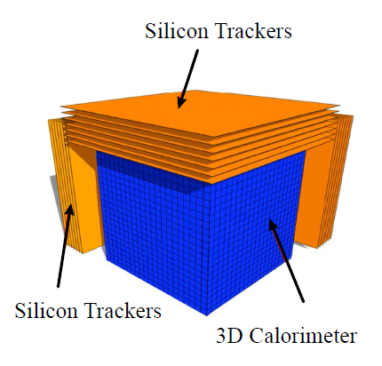

ASTRA requirements for space strip sensor
Target applications
Silicon Charge Detector (SCD) of the High Energy cosmic-Radiation Detection (HERD) facility on board of future China’s Space Station
  SCD design carried out by INFN Perugia: silicon strip detector for cosmic Rays tracking and complementary charge measurement
  Readout electronics current version based on IDEAS IDE1140 commercial ASIC
  32/64 channels (pre-Amp + Shaper + Sample&Hold) for 100μm strip pitch readout
  Low power consumption: < 1 mW/channel
  High dynamic range for high Z identification: 10k to 1000k electrons → 1.6-160 fC
  Low noise: SNR > 10 → ENC < 1000 electrons at C_{in} = 100 pF
  Adjustable shaping time: τ = 1-10 μs
Fully depleted monolithic active CMOS microstrip sensor using the same readout electronics architecture within the INFN Project ARCADIA (see Lucio Pancheri slides from yesterday)

Slide 5
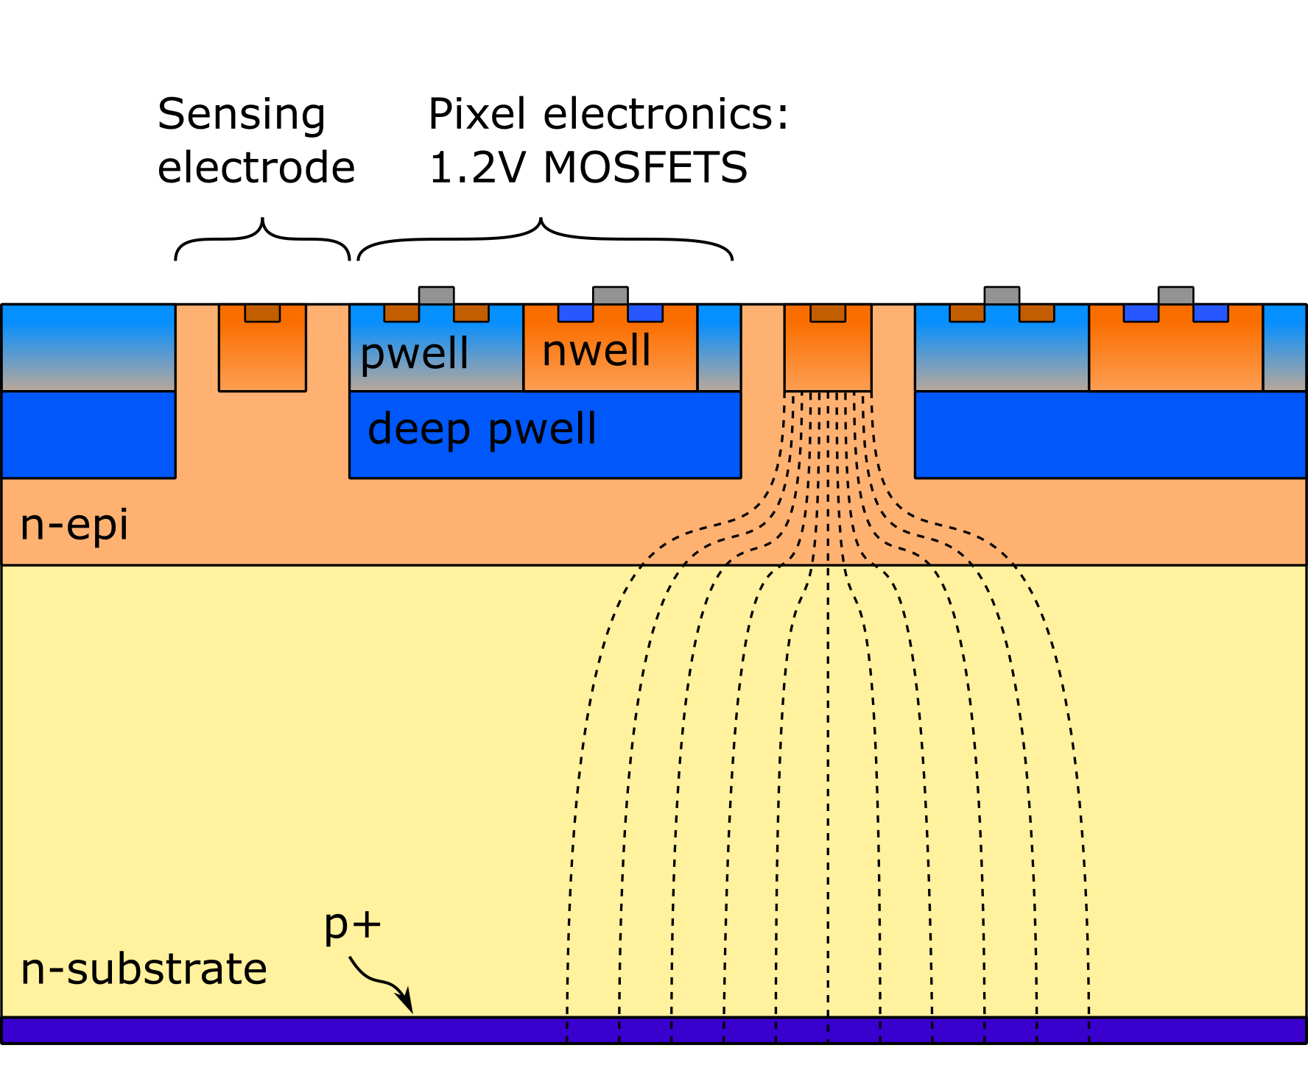
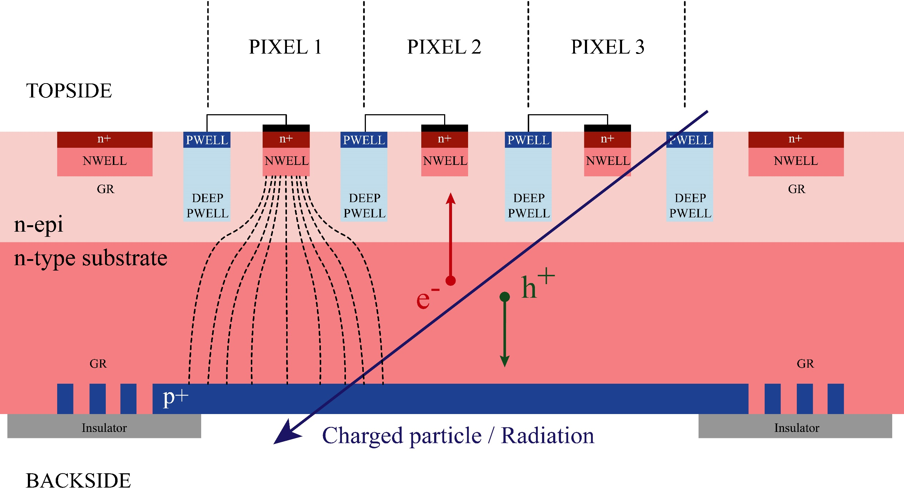
ARCADIA FD-MAPS
Advanced Readout CMOS Architectures with Depleted Integrated sensor Arrays
110 nm CMOS process (LFoundry)
n-type high resistivity active region
Fully depleted substrate: depletion grows from back to top
Electronics buried in deep p-well
Sensing electrodes biased at low voltage (< 1V)
CMOS circuitry can be implemented, but no triple well process for deep n-well NMOS isolation
Only HVT transistors (1.2 V) available

Slide 6
ASTRA monolithic implementation

Slide 7
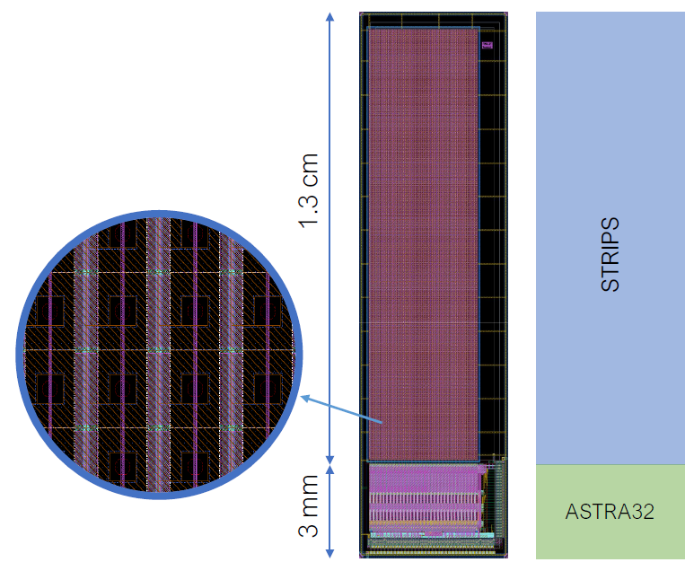
ASTRA-32 with monolithic Si-Strips
Fully depleted monolithic pixelated strips based on ARCADIA sensor design
32 columns of 2 x 256 pixels connected in parallel
50 x 50 μm² pixels
Total strip capacitance between 5 and 10 pF
The 32 columns are read by an array of 32 readout channels
Modular layout allows to characterize the electronics independently of the microstrips
Future versions with the electronics fully included in the deep p-wells in the microstrips and larger active area

Slide 8
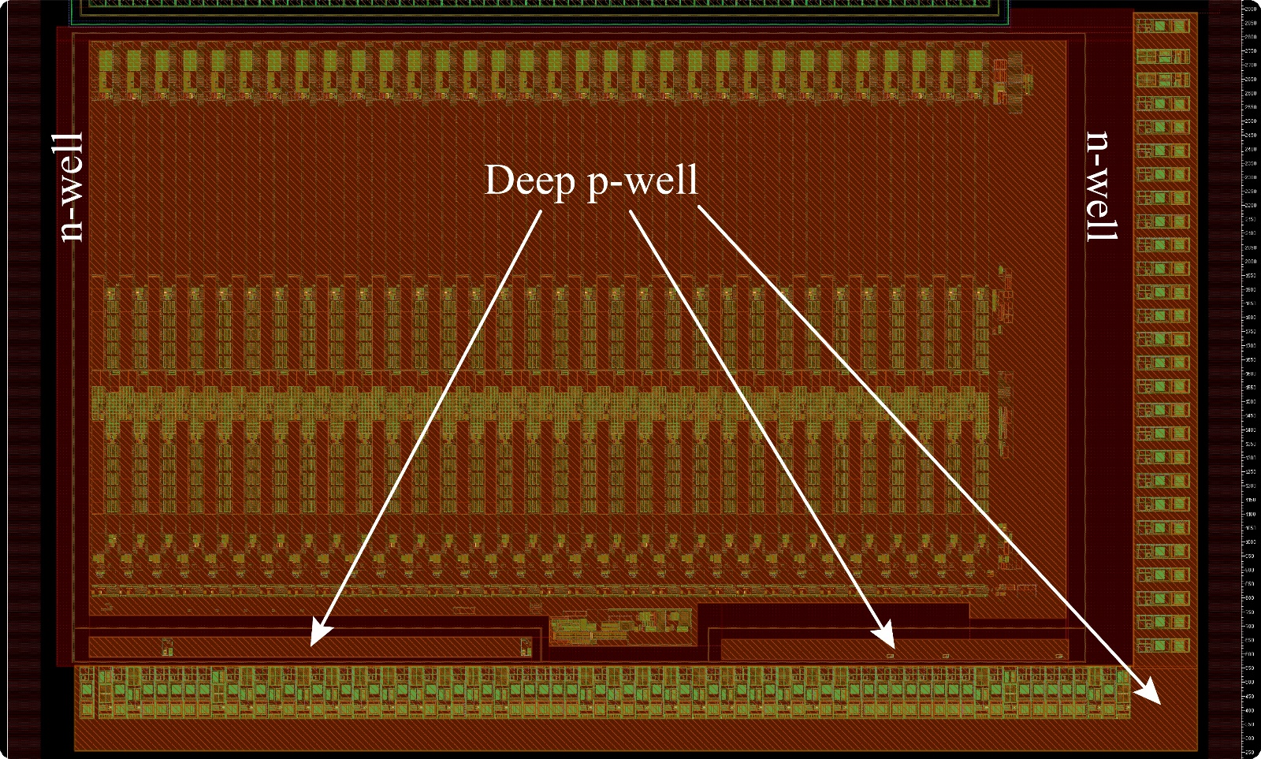
Electronics enclosure
Electronics enclosed in a large deep p-well
Protected by n-well guard rings
Guard rings are biased at 1.2 V
They collect stray electrons generated in the substrate directly below the electronics
1.3 cm
3 mm

Slide 9
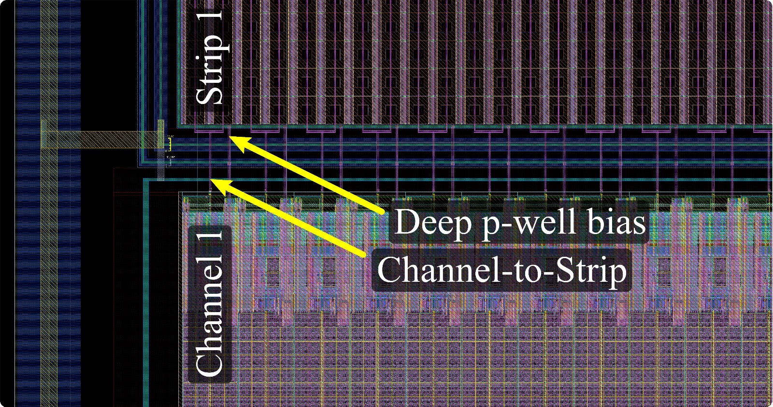
Strips – electronics interface
n-well guard ring
1.3 cm
Two pixel-columns connected to channel FE input using top metal (ME6)
GND connection to the deep p-wells surrounding the pixels active region
n-well guard ring also around the microstrips to collect stray electrons generated in the depleted substrate outside the active sensor volume
3 mm

Slide 10
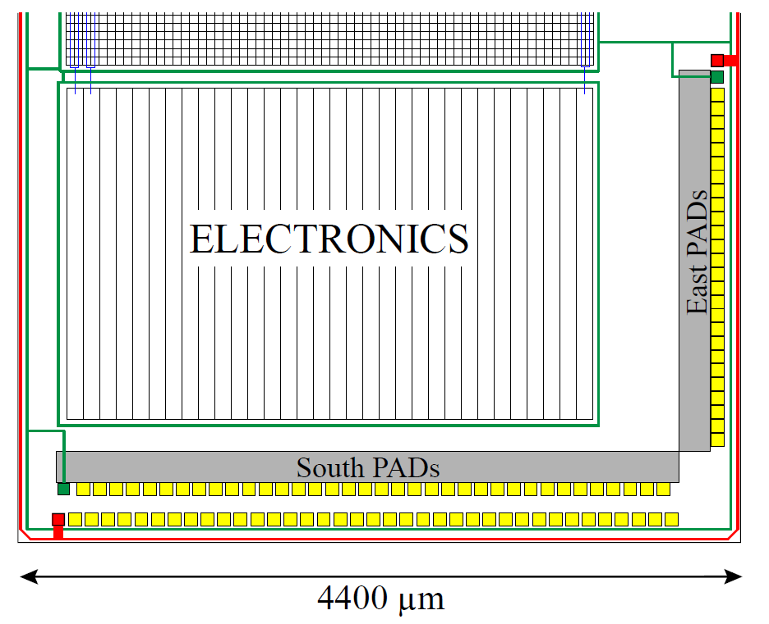
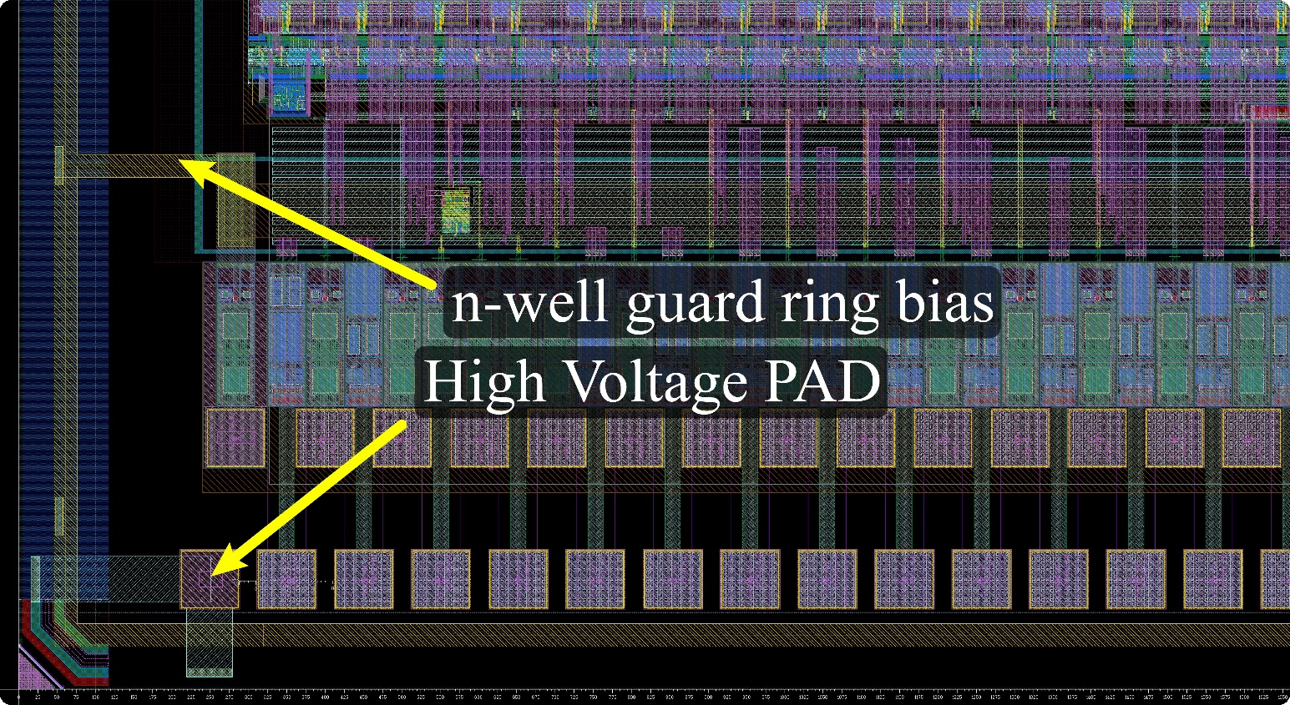
Top-side back-biasing
Substrate bias can be applied also from the top via dedicated pads
top-side back biasing p-well structure
n-well 1.2V guard ring
1.3 cm
3 mm

Slide 11
ASTRA architecture

Slide 12
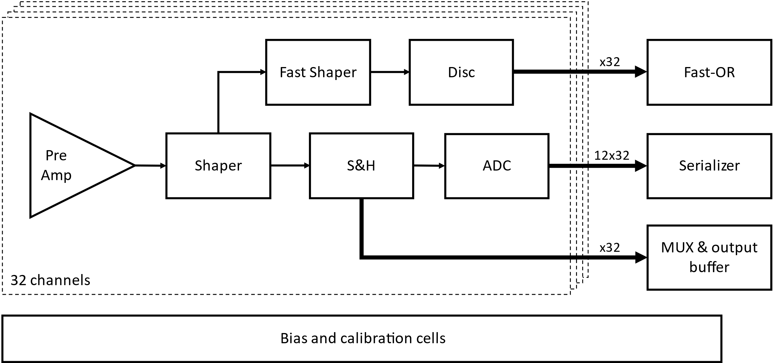
ASTRA channel architecture
preAmp: CSA + TP injection circuit
Slow Shaper branch for charge measurement with externally controlled S&H circuit
Analogue readout: MUX-differential output buffer
Digital readout: Wilkinson ADC and serializer
Trigger output: Fast Shaper branch providing a fast-OR output

Slide 13
Preamplifier stage
CSA suitable for both input signal polarities and with 2 programmable gain configurations
Gm feedback implemented with current mirrors, also providing output charge amplification with pole-zero cancelation
Inverting stage to feed the shaper with the correct signal polarity
pol 1
Feedback n
2
C_{f}
1
pol 0
CSA
IN
to shaper stage
C_{z}
TP inj
Inv stage
pol 0
pol 1
2
Feedback p
3

Slide 14
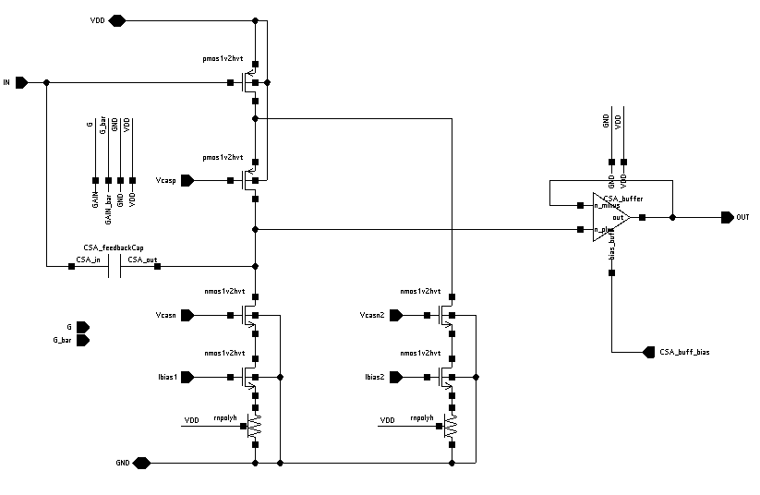
CSA – core amplifier
Thick oxide input transistor for commercial μstrip version to reduce gate leakage current
(Vin > 0.8 V for monolithic ASTRA)
Telescopic cascode amplifier with PMOS input transistor and split bias current with source degeneration
Programmable gain (C_{f} = 200-400 fF) to make it suitable for different sensors topologies
Output stage implemented with voltage-buffer OpAmp to reduce voltage headroom loss introduced by HVT transistors
Test-pulse injection circuit to test and calibrate the FE
C_{f}

Slide 15
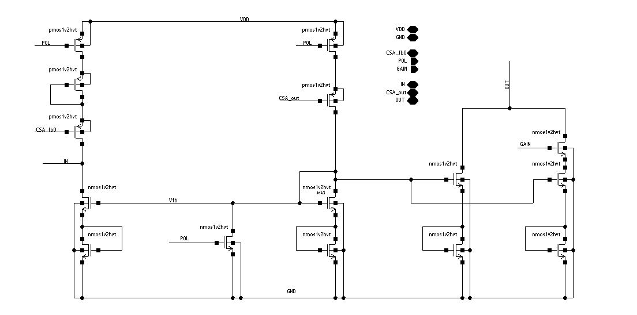
CSA – feedback and output network
Gm feedback implemented with current mirrors, also providing output charge amplification with pole-zero cancelation
Programmable switches for Gain and Polarity select
pol 0
1 : 50

Slide 16
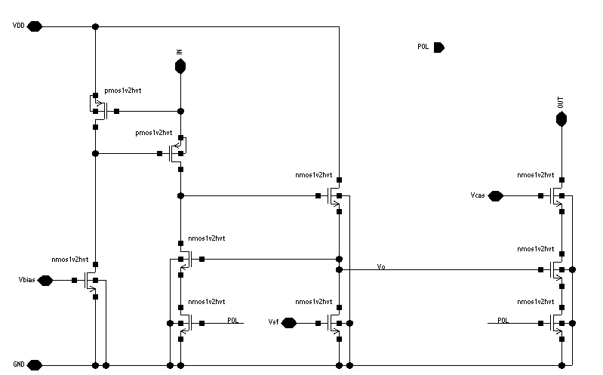
Inverting stage
IN
Inverting stage to feed the shaper with the correct signal polarity
Programmable switches to turn ON/OFF this stage according to the selected polarity
Current mirror with g_{m} boosting and source follower buffer
OUT

Slide 17
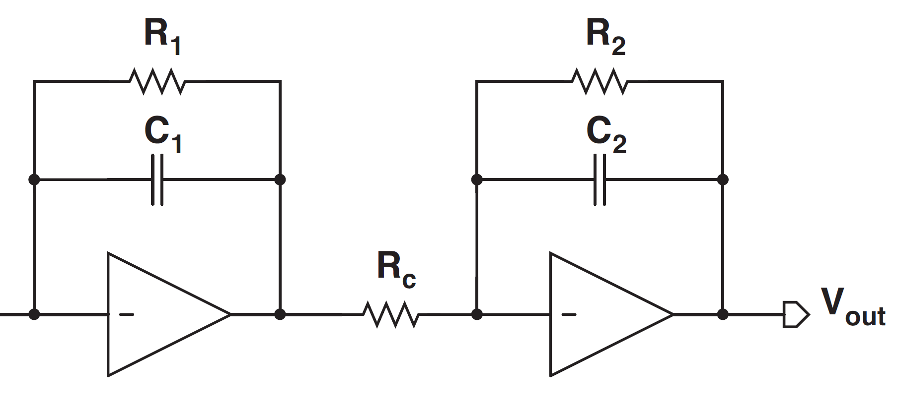
Shaper stage
CR-RC Shaper with 4 programmable peaking time settings between 1.5 and 9 μs
Shaper core amplifiers employ same architecture of CSA core amplifier but with scaled-down bias current and transistors size
Baseline holder (BLH) circuit to control Shaper DC output voltage (nominal V_{BLH} = 870 mV)
BLH
V_{BLH}
Fast Shaper

Slide 18
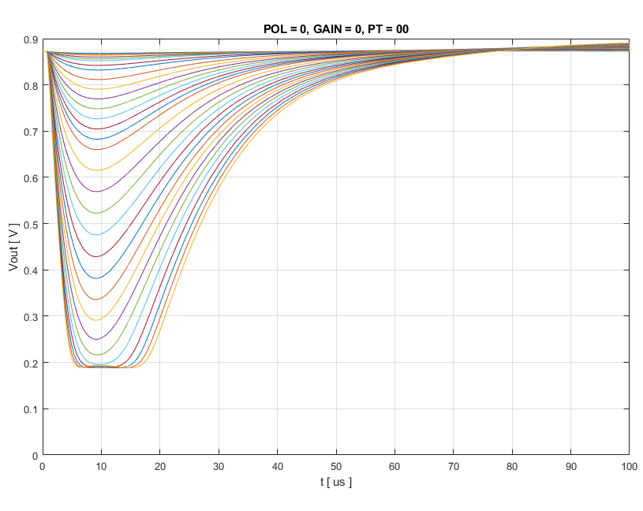
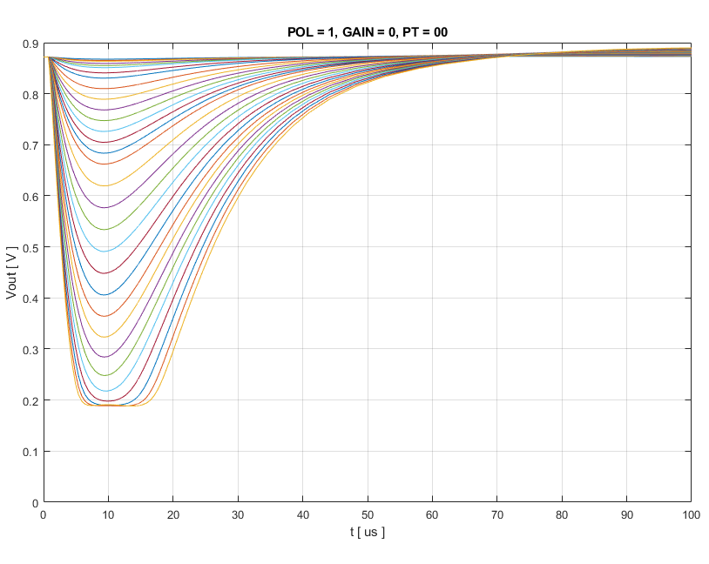
Slow shaper – simulation (1-200 fC)
Standard gain, pol=0, T_{p} = 9 μs
Standard gain, pol=1, T_{p} = 9 μs

Slide 19
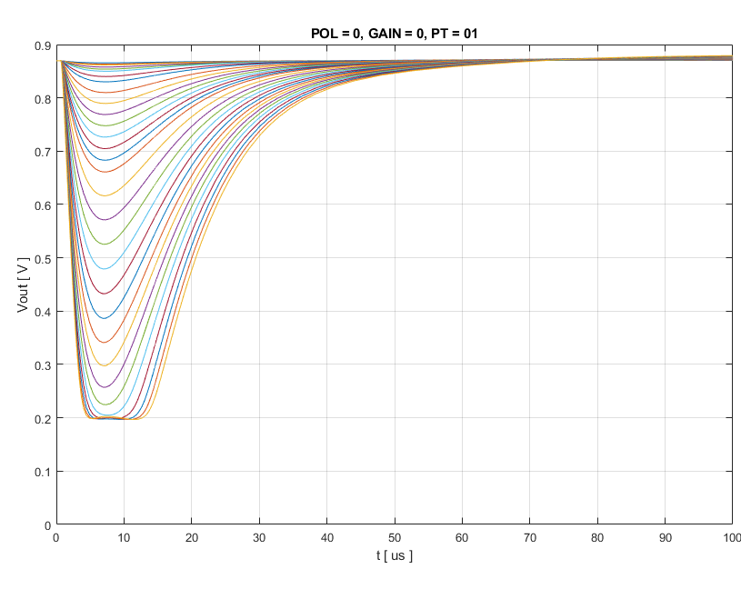
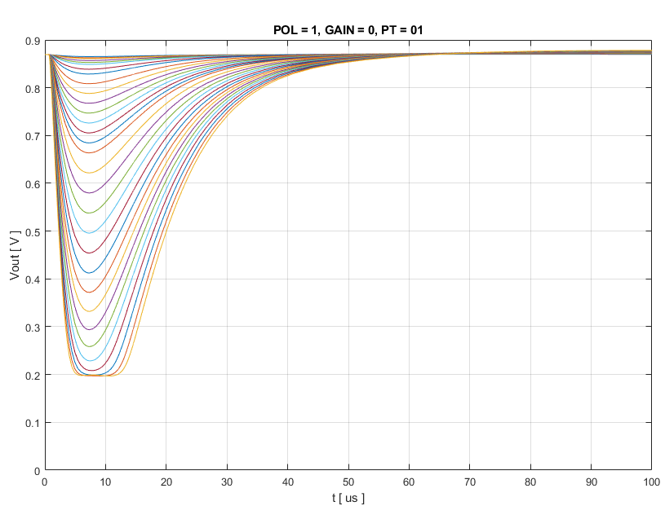
Slow shaper – simulation (1-200 fC)
Standard gain, pol=0, T_{p} = 7 μs
Standard gain, pol=1, T_{p} = 7 μs

Slide 20
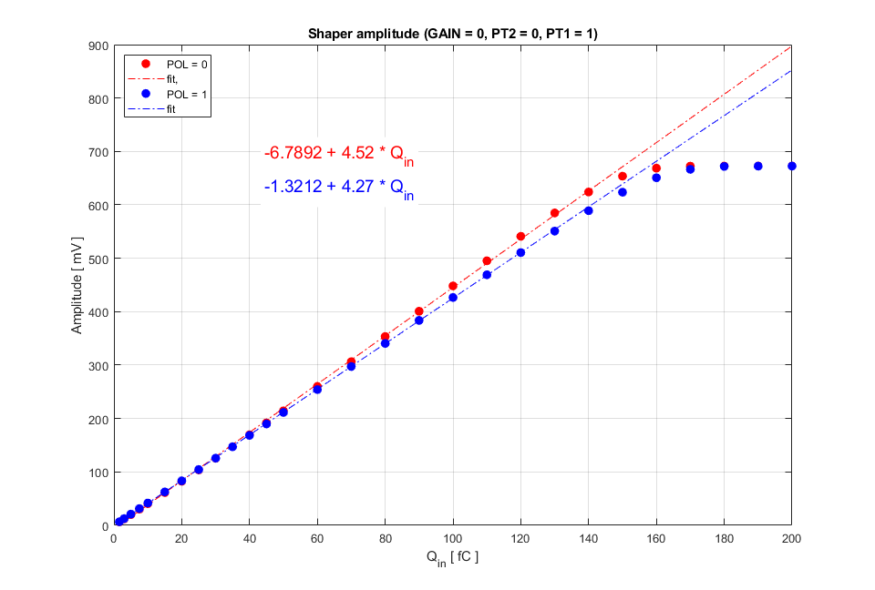
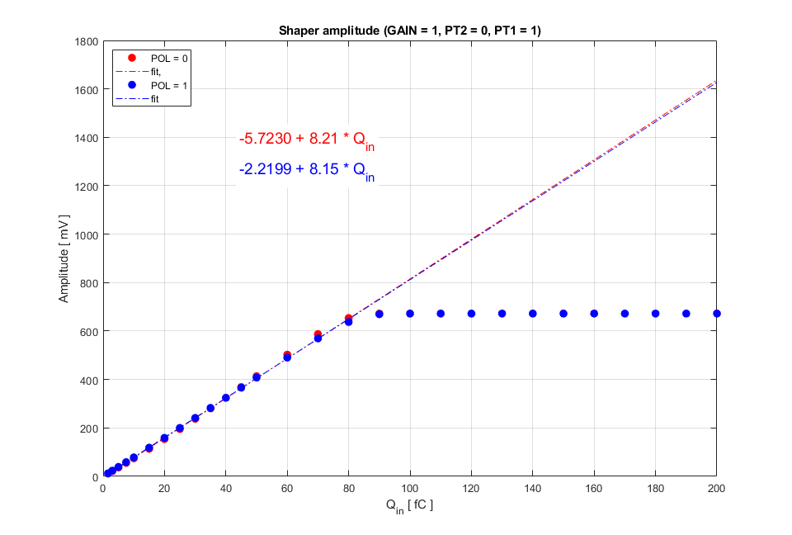
Slow shaper – simulation (1-200 fC)
Standard gain, T_{p} = 7 μs
High gain, T_{p} = 7 μs
Standard gain, T_{p} = 6.5 us

Slide 21
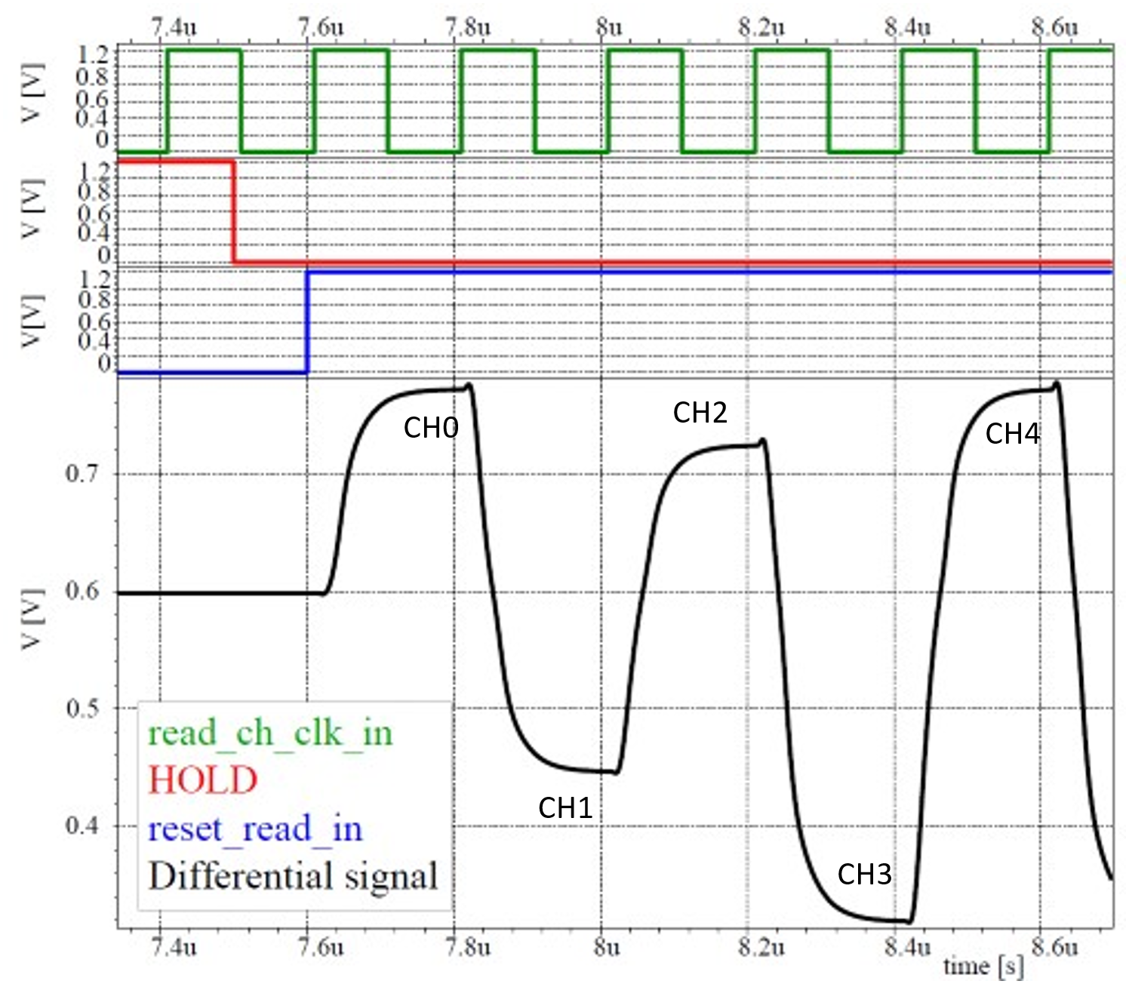
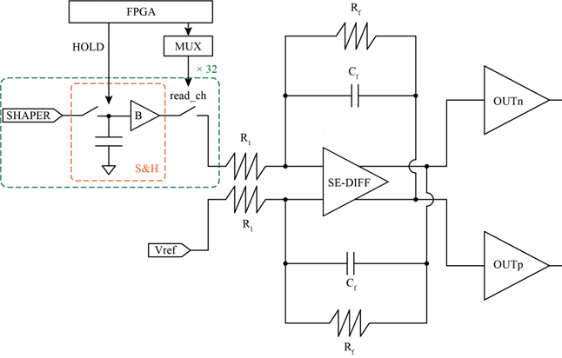
Analogue readout
External HOLD signal to store the shaper output peak voltage for each channel
MUX to send off-chip the sampled signals of the channels (5 MHz readout clock frequency)
Unity-gain single ended to differential folded cascode amplifier
Class-AB output buffers can drive 50 Ω resistor and 20 pF capacitor
trigger
external ADC

Slide 22
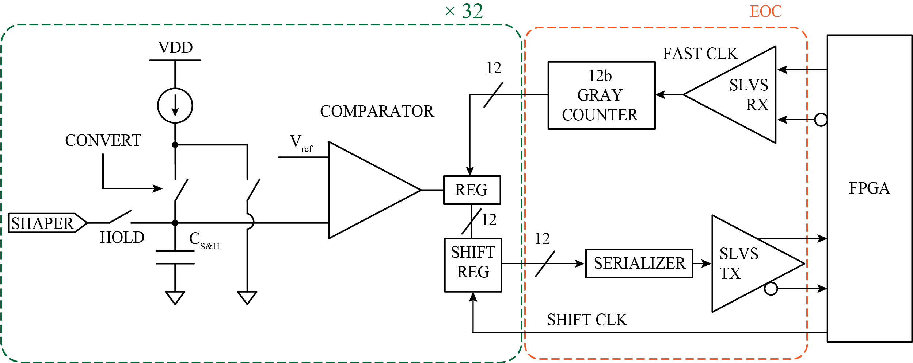
Digital readout
Analogue MUX is kept disabled, signal stored in the S&H capacitor is digitized by on-channel Wilkinson ADC with programmable recharge current
12-bit Gray counter
Serializer + SLVS Tx link
100 MHz clock
I_{ADC} [nA] | MAX recharge time [μs] | # BITs
70 | 2.7 | 8
35 | 5.4 | 9
17 | 11.1 | 10
9 | 20.9 | 11
4.5 | 41.9 | 12

Slide 23
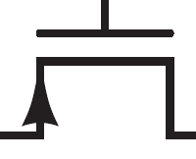
Fast branch – trigger output
C
V_{b}
FAST OR
-
mask
12 C
Vth
SLVS Tx
Fast Shaper
LE discriminator
32-channel Fast OR
Fast shaper: ~800 ns peaking time, ~25 mV/fC
LE discriminator with hysteresis (Vth generated off-chip and common to all 32 channels)
Fast OR logic to generate trigger output: each channel can be masked to remove noisy channels

Slide 24
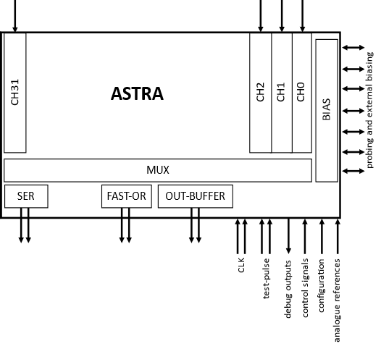
ASTRA layout
3 mm
4.4 mm

Slide 25
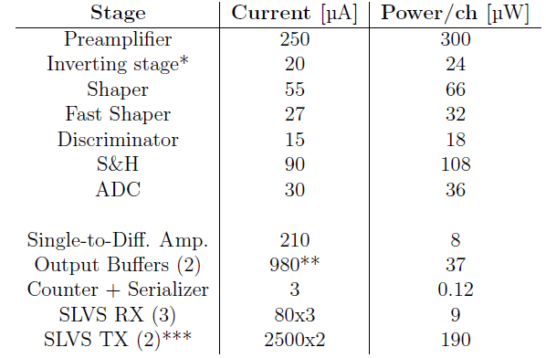
ASTRA specifications
Technology | 110 nm CMOS Image Sensor
Power supply | 1.2 V
Number of channels | 32/64
Input polarity | Positive and negative
Sensor capacitance | Up to 100 pF
Input dynamic range | 1.6 - 160 fC
Peaking time | 1.5 µs to 10 μs
ENC | < 1000 e⁻
Outputs | Multiplexed pulse height, Digitized pulse height, Channels FastOR
Test and calibration | Internal injection circuit
Power consumption | <1 mW / channel

Slide 26
ASTRA first measurements

Slide 27
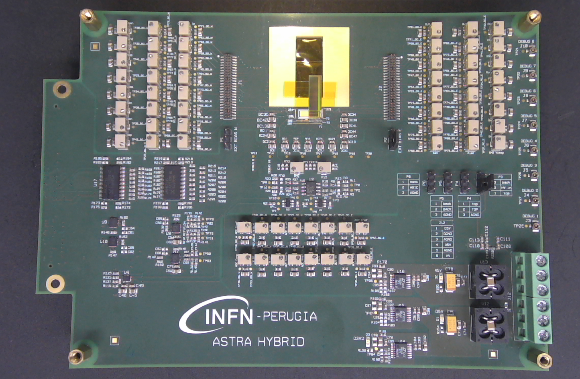
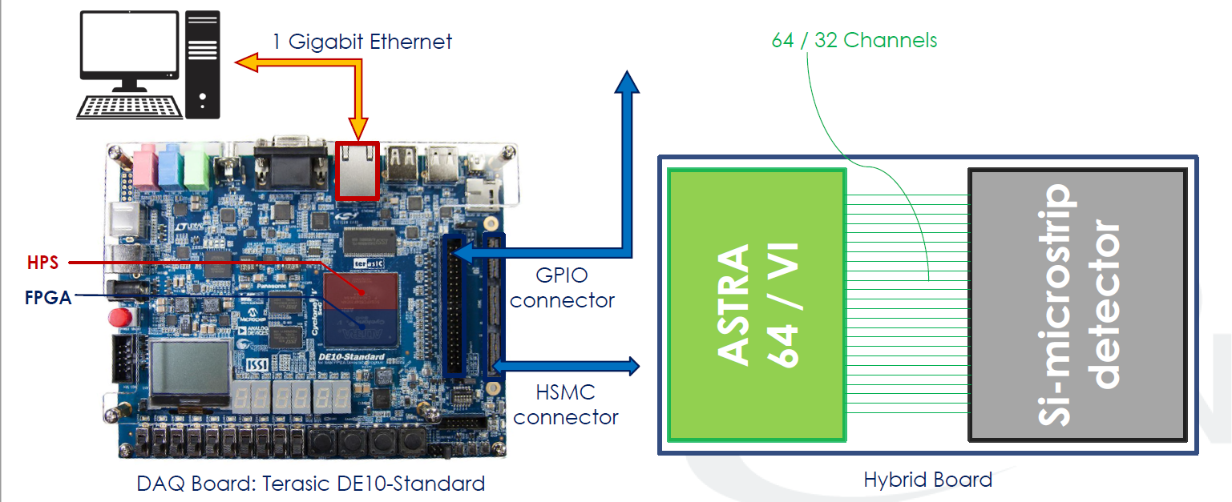
ASTRA testboard and DAQ (INFN Perugia)
Testboard
Can accommodate both ASTRA-32 (monolithic version) and ASTRA-64
Trimmer resistors for external bias (optional)
ADCs for analogue MUX readout digitization
3.3V/1.2V level shifters and CMOS/LVDS buffers for digital signals transmission
LDOs for ASTRA 1.2V AVDD and DVDD power supplies, and for 3.3V discrete components
Sensor HV bias (from top and bottom)
DAQ
Based on Terasic DE10-Standard development board with Intel Cyclone V FPGA
Handles ASTRA configuration, readout operations and data acquisition

Slide 28
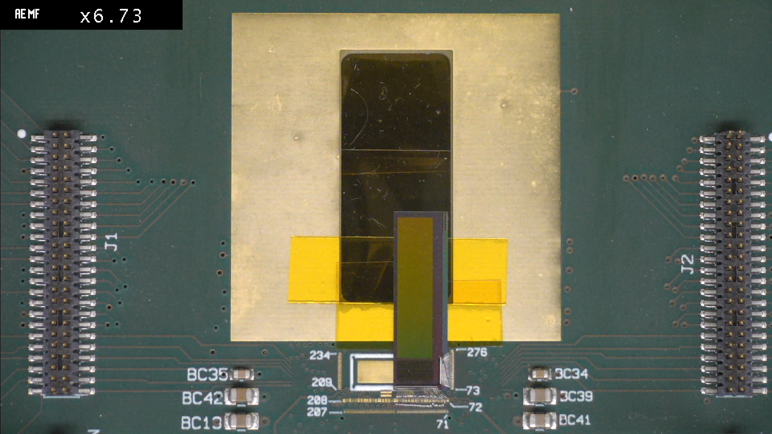
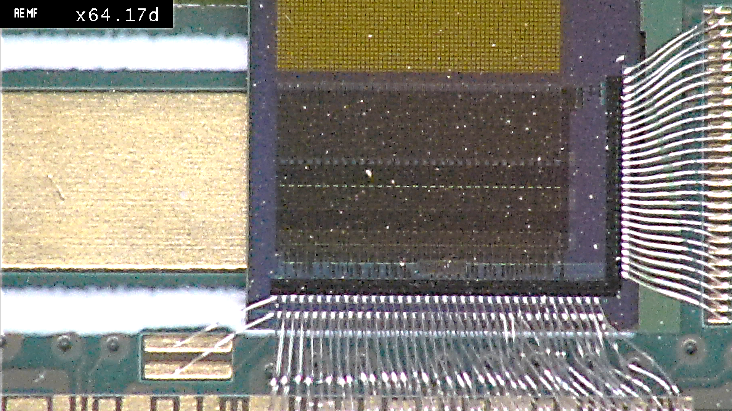
ASTRA-32 with monolithic Si-Strips

Slide 29
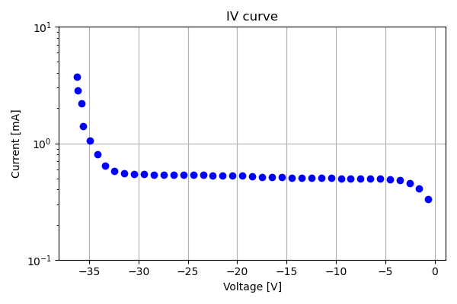
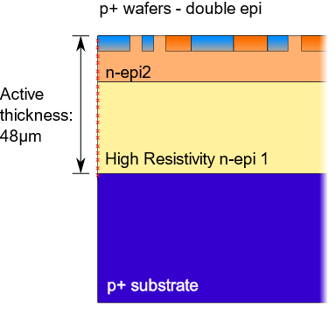
IV curve
Backside voltage applied from top (HV = 30 V)

Slide 30
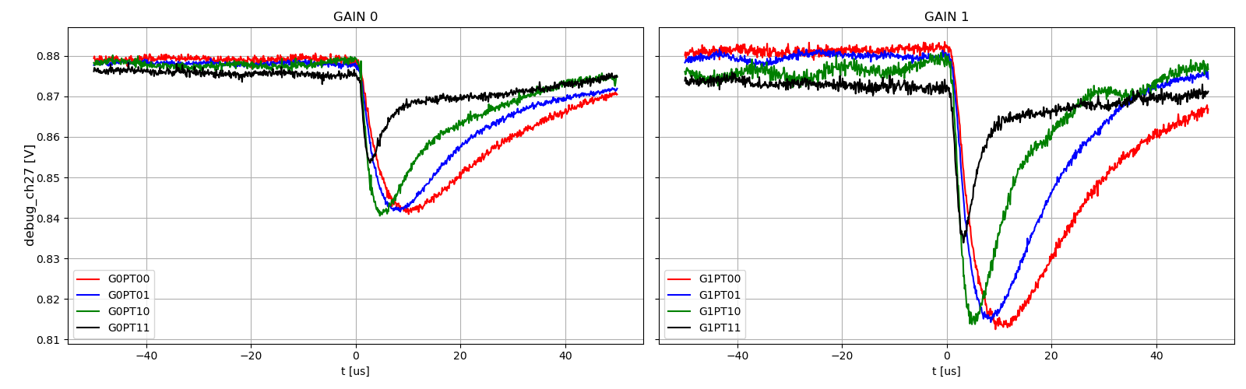
Front-end response
Test-pulse injection: ~7.5 fC
Slow shaper response for different gain and shaping time settings
Waveforms measured from debug output

Slide 31
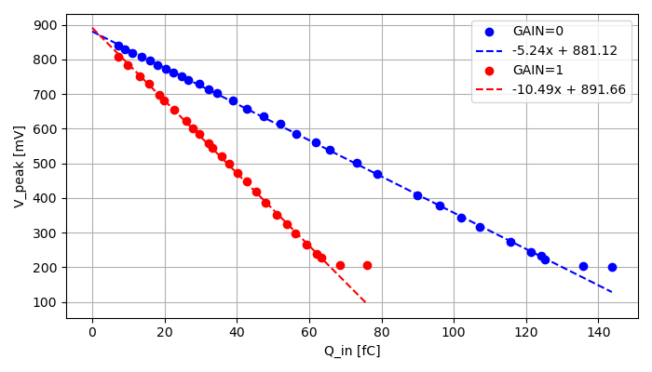
Front-end linearity
Slow Shaper peak voltage from debug output
Shaping time settings: 7 μs
Higher gain compared to simulations:
  4.3 mV/fC (GAIN = 0)
  8.1 mV/fC (GAIN = 1)
PT = 01

Slide 32
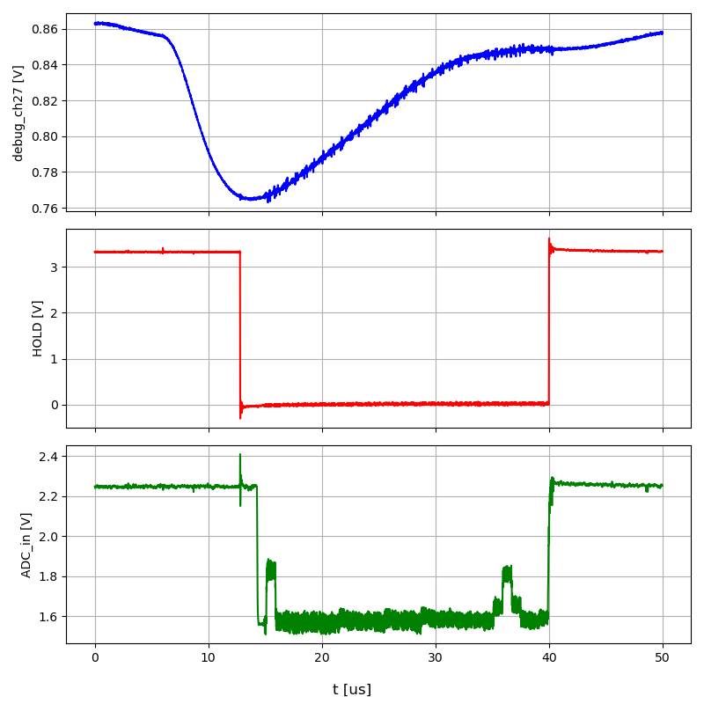
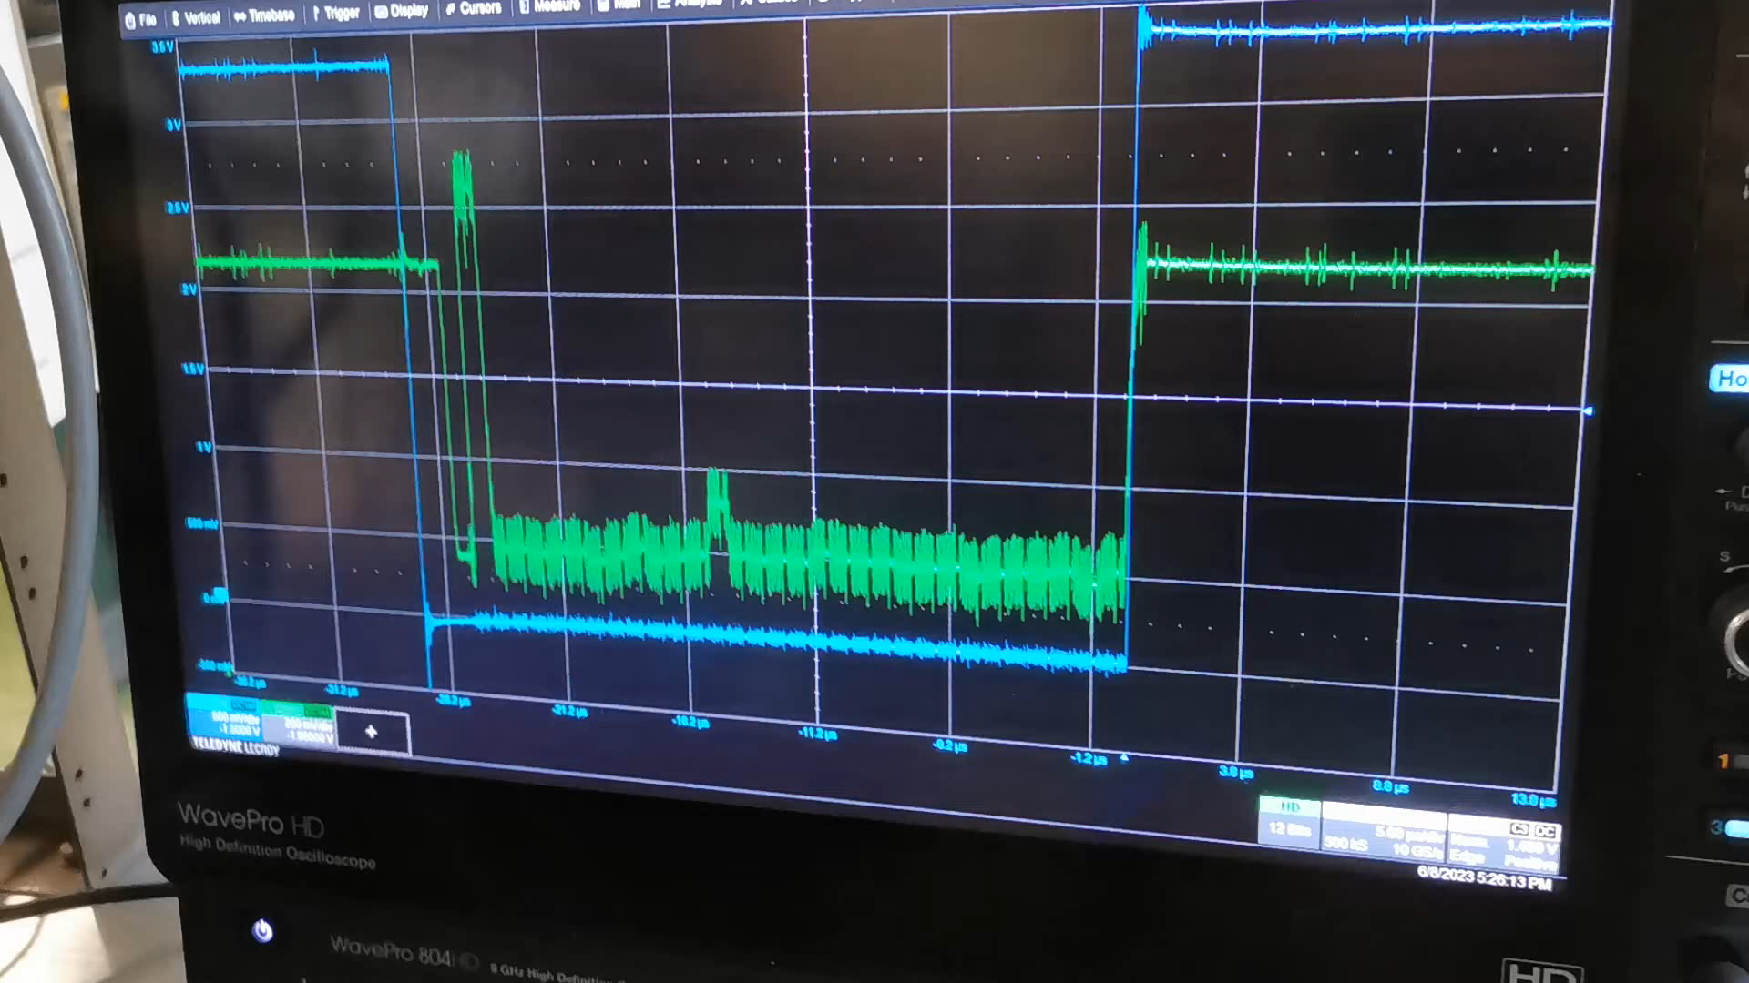
Analogue readout with ⁹⁰Sr
ASTRA FastOR signal provides trigger to the FPGA
FPGA sends HOLD signal and then start readout of analogue MUX
Noisy channel excluded from FastOR

Slide 33
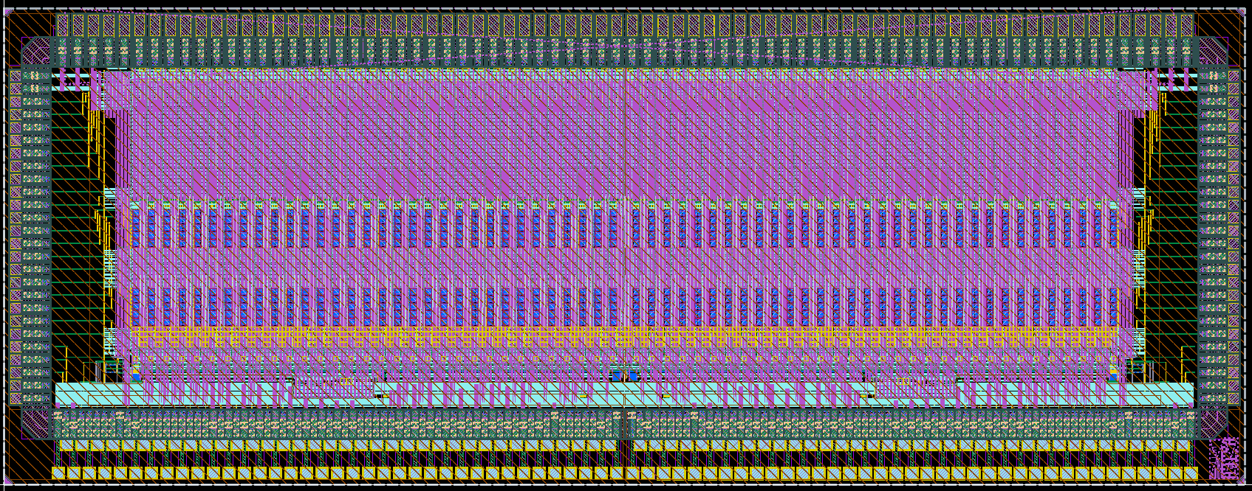
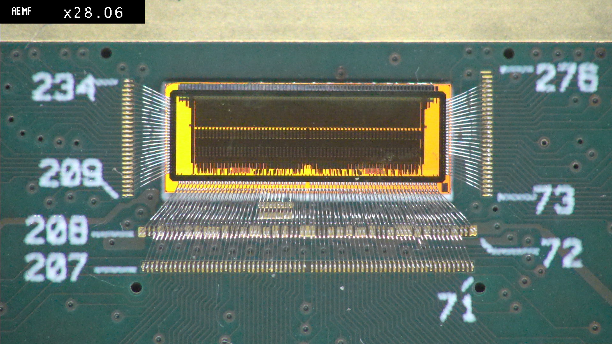
ASTRA-64
8.0624 mm
3.1 mm
Developed for readout of silicon strip sensors (INFN Perugia)
Made of 2 independent ASTRA-32 blocks

Slide 34
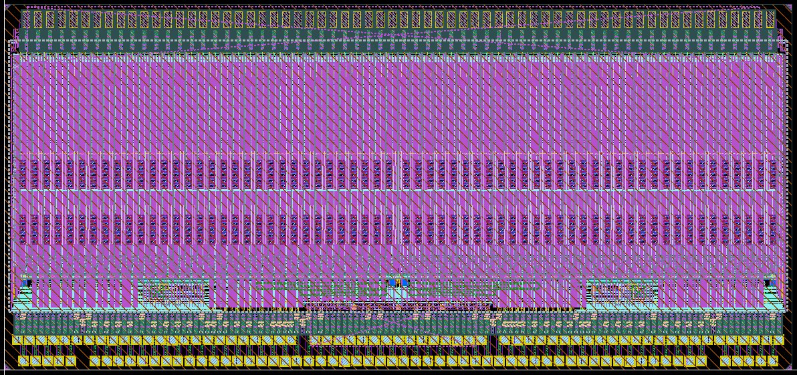
ASTRA-64 v2
Removed side pads to be 2-side abuttable
Already available from ARCADIA RUN2
Design of PCB hosting ~4 ASTRA-64 v2 ASICs starting soon
3.1 mm
6.674 mm

Slide 35
Summary and outlook
The ASTRA ASICs family includes
  A 32-channel fully depleted monolithic active microstrip sensor with embedded electronics built on the top side and compatible with a standard CMOS process fabrication flow
  A 64-channel ASIC with only the readout electronics for commercial µstrips with two different layout flavors
Each ASTRA channel performs signal amplification and charge measurement, and the configurability of the chip makes it suitable for the readout of different topologies of Si-strip sensors
  Positive and negative input signal polarities readout capability
  2 gain settings providing input dynamic range up to 80 or 160 fC, suited for different thickness sensors
  4 peaking time configurations: 1.5-10 μs
  Dual-readout mode: analogue and digital + FastOR trigger output
ASTRA electrical characterization just started this month
Future version of monolithic ASTRA envisions the electronics fully included in the deep p-wells in the microstrips allowing for wafer-level detector stitching

Slide 36

ASTRA Design and Test Group
G. Ambrosi, M. Barbanera, E. Bianco, F. Cossio, M. D. Da Rocha Rolo, M. Duranti, R. A. Giampaolo, A. Rivetti
fcossio@to.infn.it

Slide 37
Backup slides

Slide 38
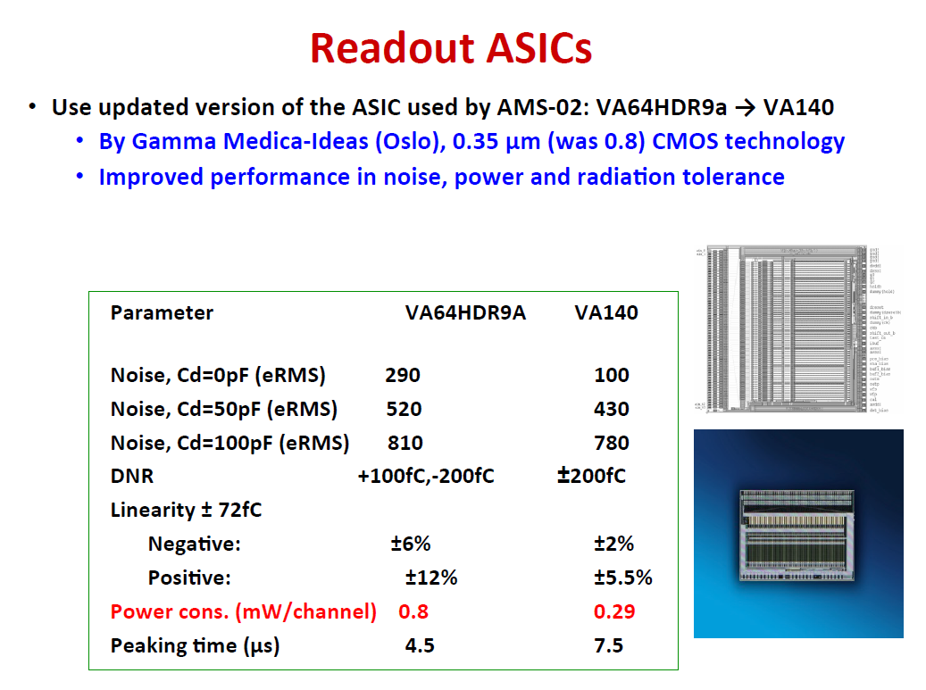
IDE1140 ASIC
Previously VA140
64 channel
High dynamic range charge sensitive preamplifier-shaper circuit
Large integration time
Simultaneous sample and hold with multiplexed analogue readout
Calibration facilities
Internally generated biases

Slide 39
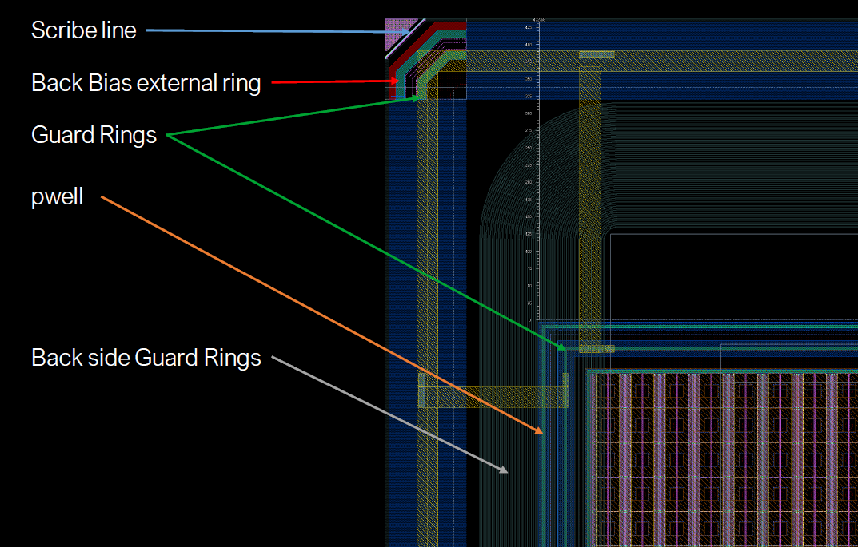
Edge and back structures
1.3 cm
3 mm

Slide 40
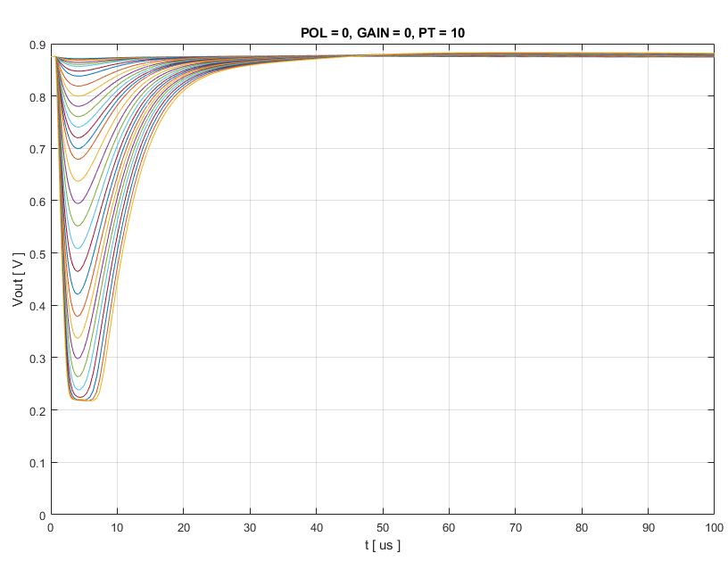

Shaper – response (1-200 fC)
Standard gain, pol=0, T_{p} = 4 μs
Standard gain, pol=1, T_{p} = 4 μs

Slide 41
ENC vs C_{in}
Standard gain, T_{p} = 4 μs
Standard gain, T_{p} = 7 μs

Slide 42
Noise – Peaking Time optimum
C_{in} = 10 pF
C_{in} = 100 pF

Slide 43
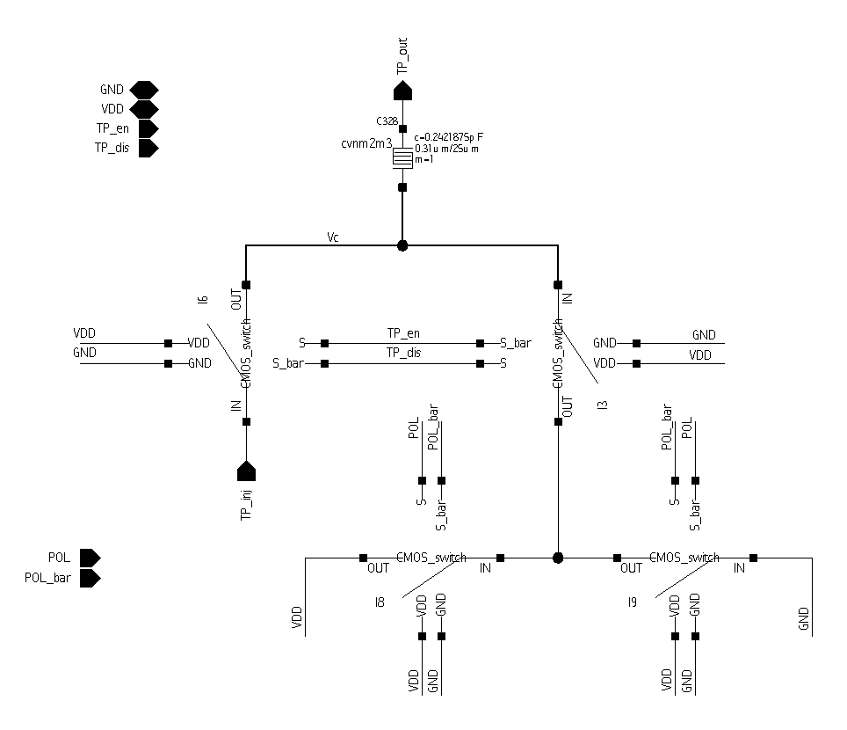
Test pulse injection circuit
C_{inj} = test-pulse injection capacitance connected in series at the input of each channel (shorted to GND or VDD when test-pulse is disabled)
External reference voltage (TP_{inj}) used to generate a voltage step (from VDD or GND to TP_{inj}) across C_{inj} thus injecting a current at the input of the preamplifier

Slide 44
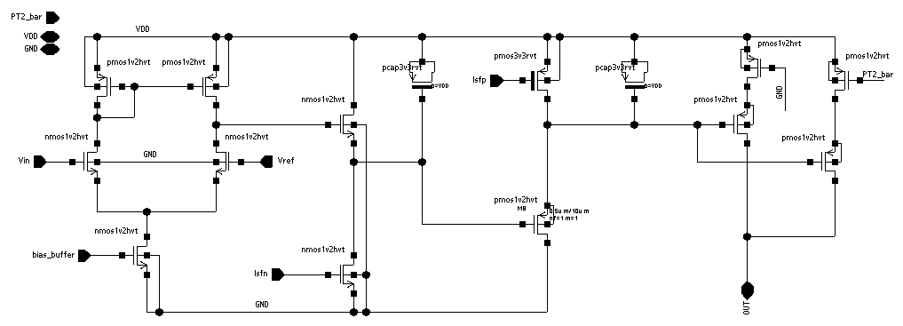
Baseline Holder circuit
Differential stage + current starved SF

Slide 45
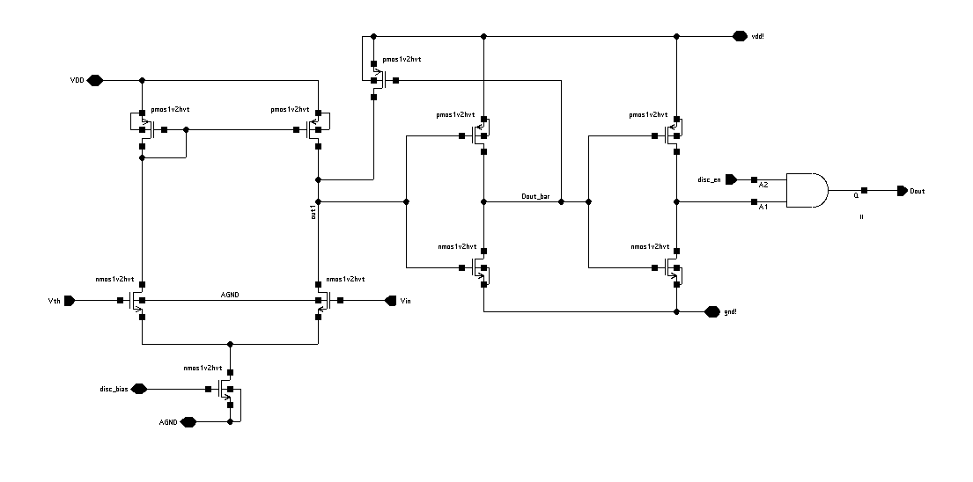
Hysteresis discriminator

Slide 46
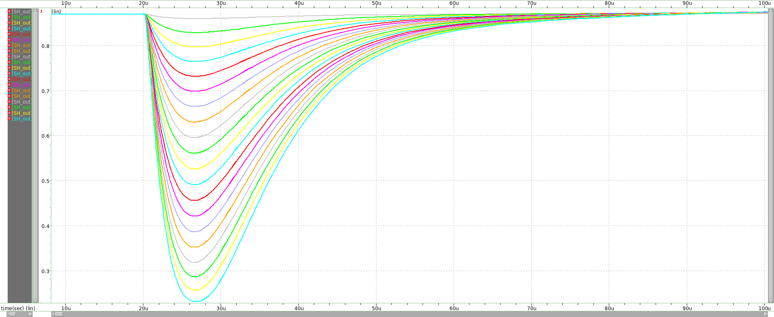
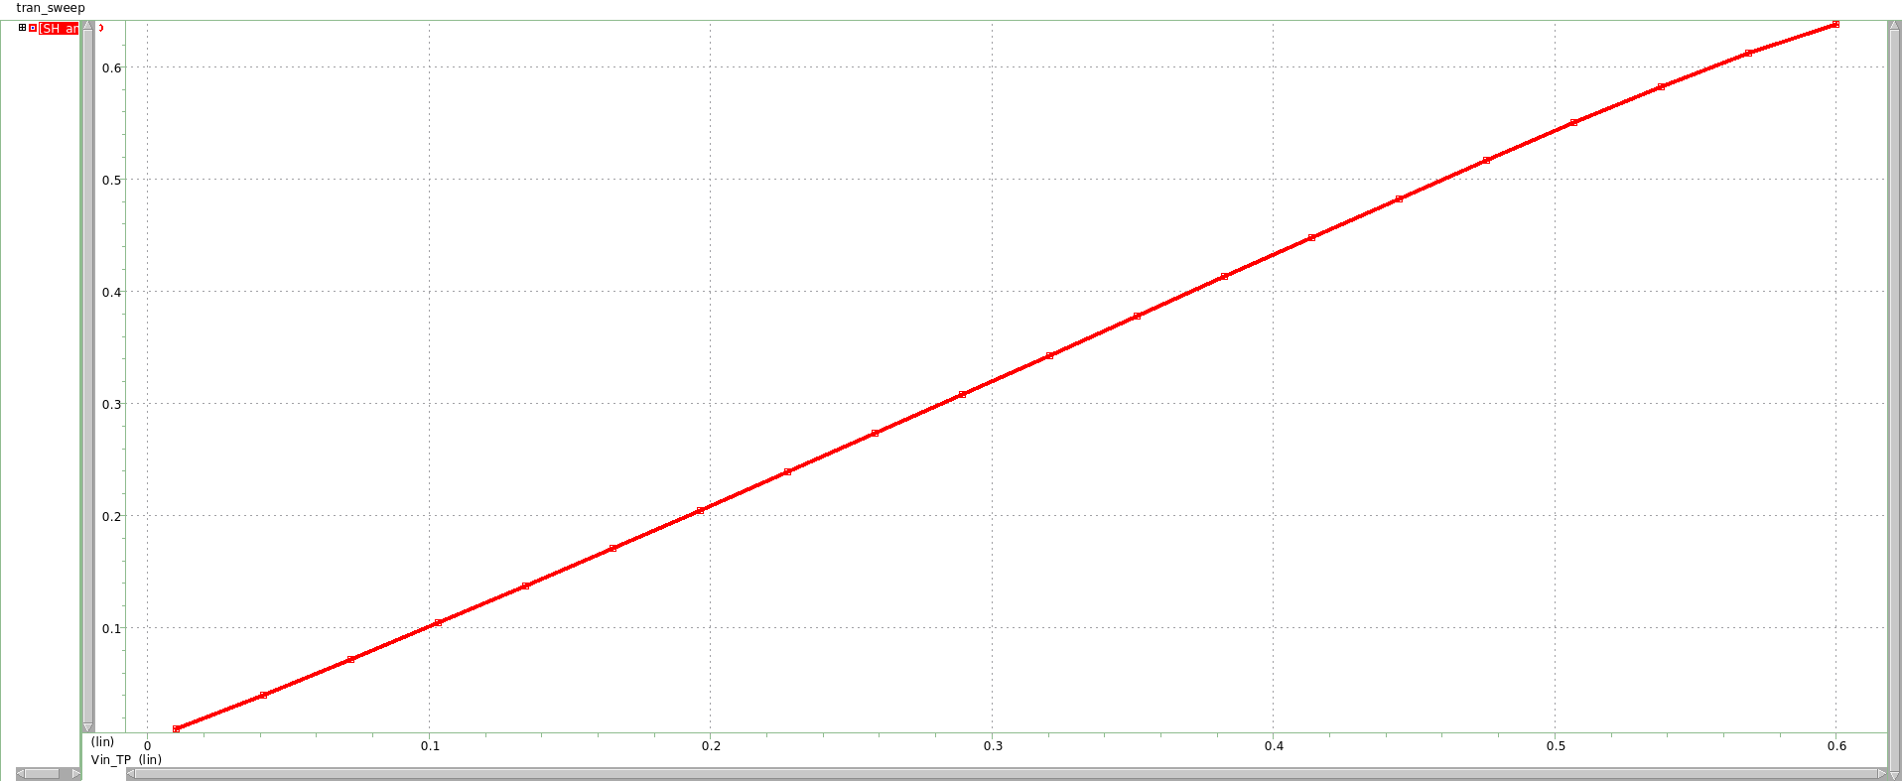
Test pulse simulation
C_{inj} = 242 fF
TP_{inj} = 10mV – 600mV
Q_{in} = 2.5 fC – 145 fC

Slide 47
Analogue readout
MUX
read_clk
read_en
External HOLD signal opens the switch and store the shaper output peak voltage for each channel
MUX allows to send off-chip the sampled signals of the channels one by one (5-10 MHz readout clock frequency)
ch0
0
ch1
0
ch2
1
ch30
0
HOLD
MUX
Slow shaper output
ch31
0
ch0
bit_out
ch1
ch2
outp
external ADC
outn
ch30
output buffer
ch31

Slide 48
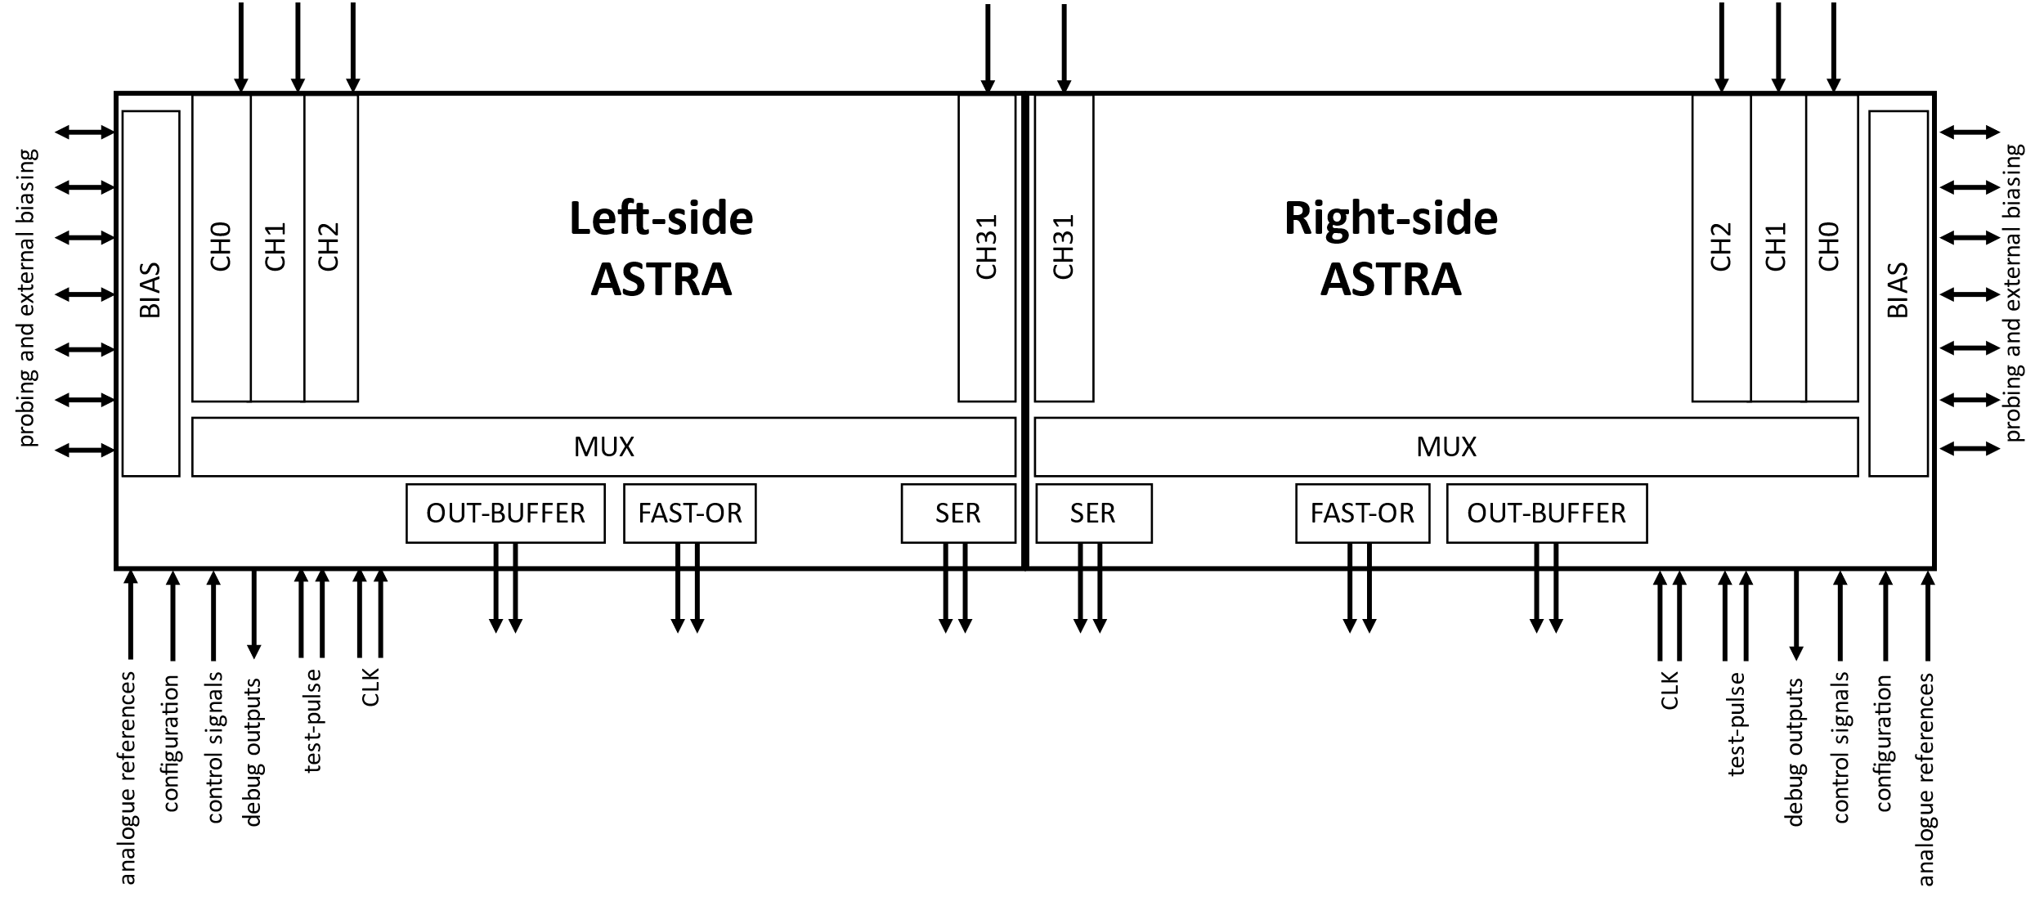
ASTRA-64 architecture
2 independent 32-channel blocks

Slide 49
ASTRA-64
8.0624 mm
3.1 mm

