Slide 1



Results for the ARCADIA sensors in 110 nm CMOS technology
XII Front-End Electronics Workshop
12-16 June 2023
Lucio Pancheri¹
on behalf of the ARCADIA collaboration
¹University of Trento and TIFPA-INFN

Slide 2
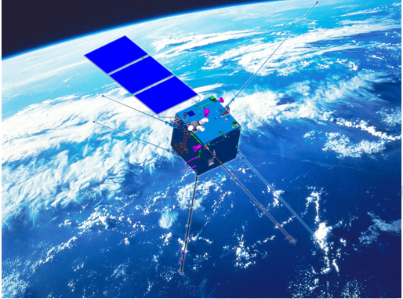
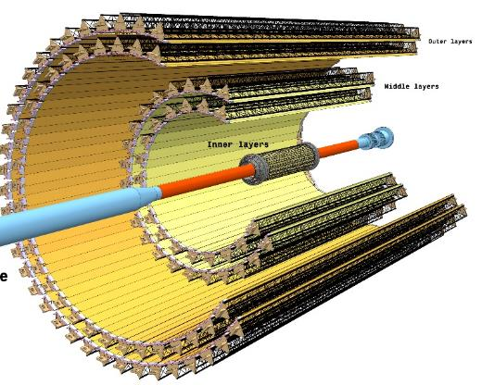
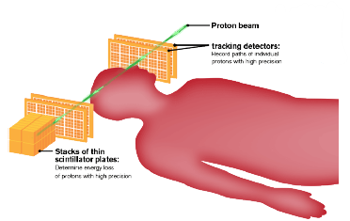
Motivation
Large-area monolithic pixel detectors for particle tracking: low power, high rate capability, low cost per unit area, low material budget
Target applications:
  Medical imaging (e.g. Proton Computed Tomography)
  Astro-particle detection on satellites
  High Energy Physics experiments
CSES-01 http://cses.roma2.infn.it
ALICE Inner
Tracking System
LHC - CERN
Piero Giubilato, ERC project iMPACT
New ITS

Slide 3
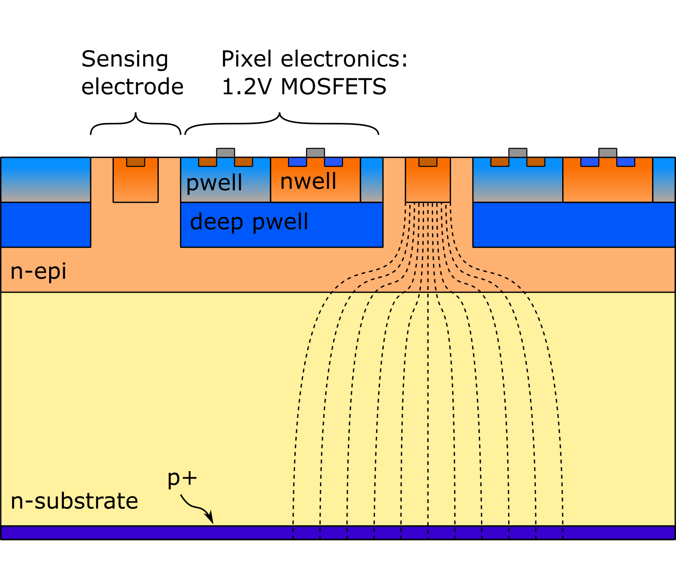
Sensor concept
Customized 110nm CMOS process (LFoundry)
n-type high resistivity active region
Reverse-biased junction at the bottom: depletion grows from back to top
Sensing electrodes can be biased at low voltage (< 1V)
nwells with electronics shielded by deep pwells
n-epi layer: reduce punch-through current between p+ and deep pwells

Slide 4
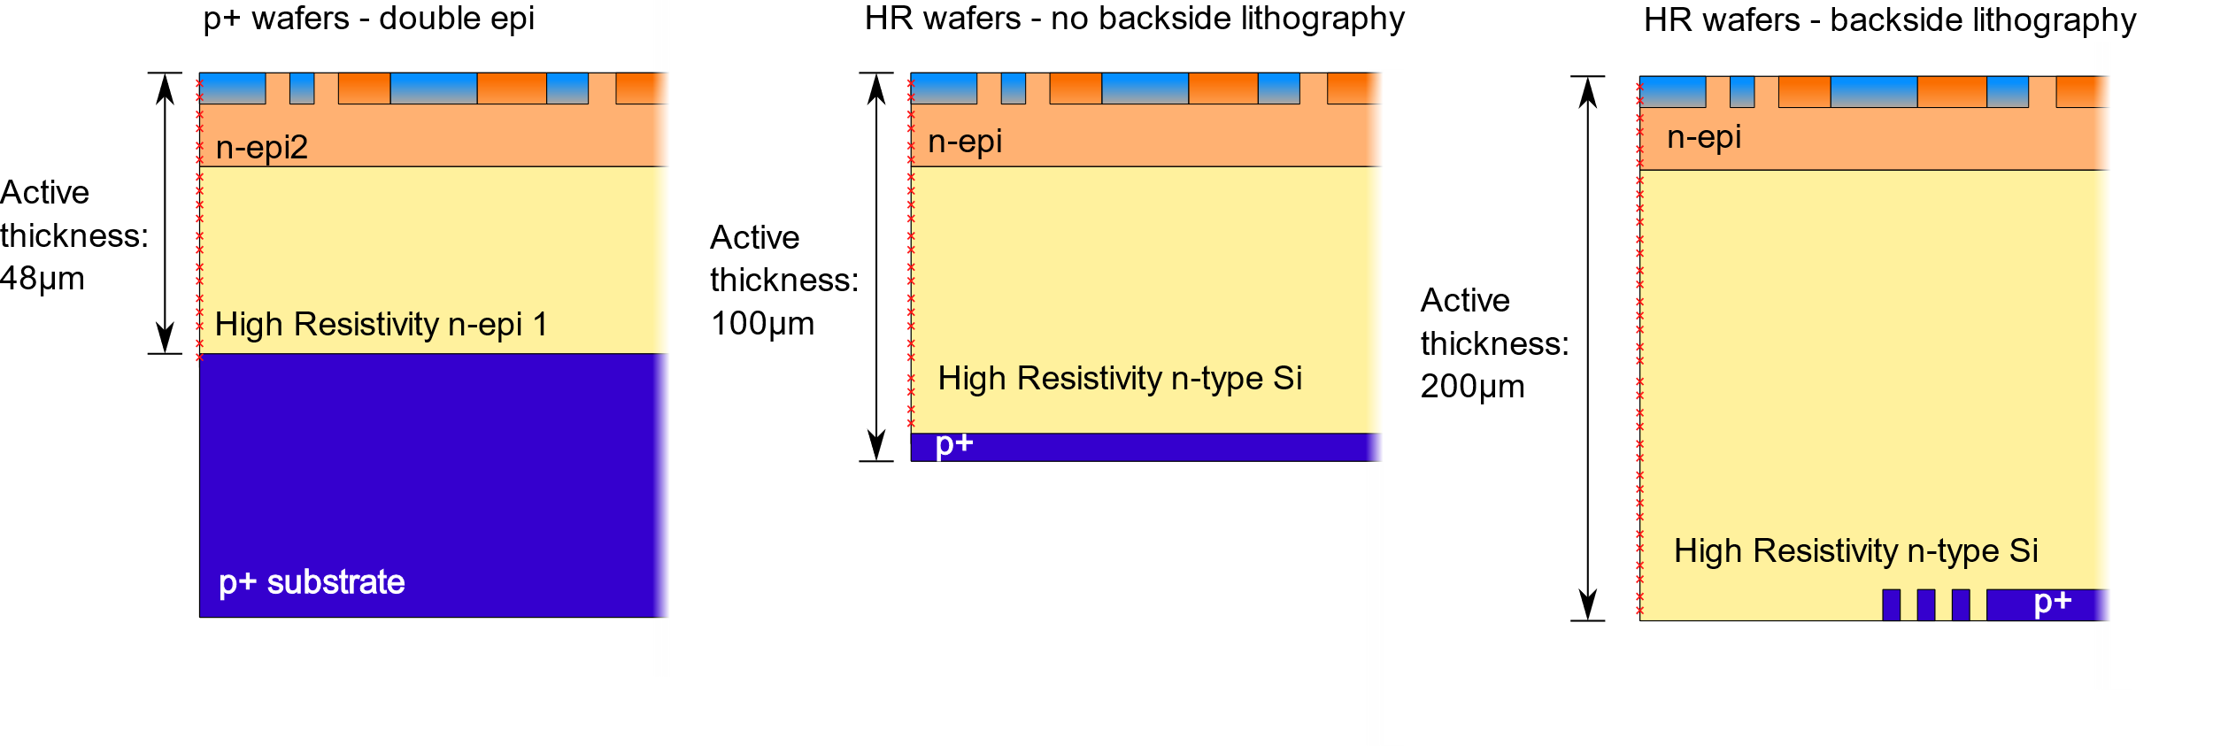
Wafer post-processing: starting material and backside process
Type 1:
Post-processing: thinning
to 100 or 300μm total
thickness
Type 2:
Post-processing: thinning, backsided p+ implantation and laser annealing
Type 3:
Post-processing: thinning, lithography, backside p+ implantation and laser annealing, insulators and metal deposion

Slide 5
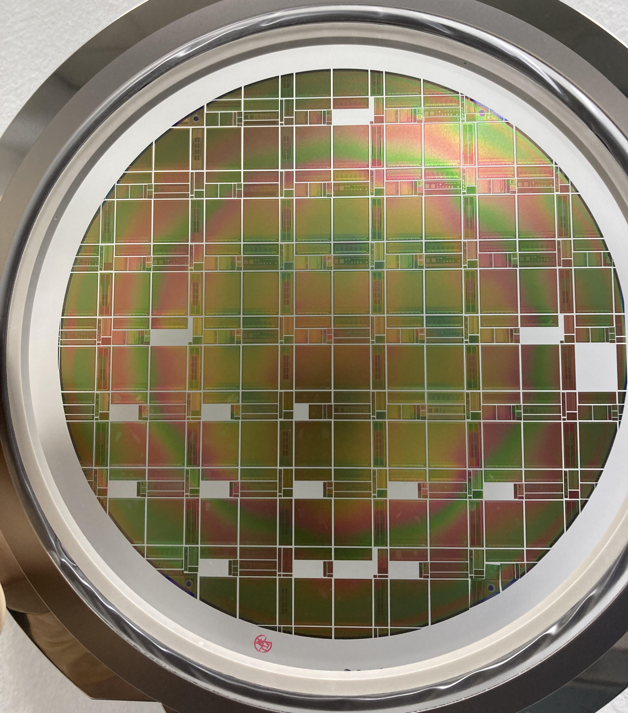
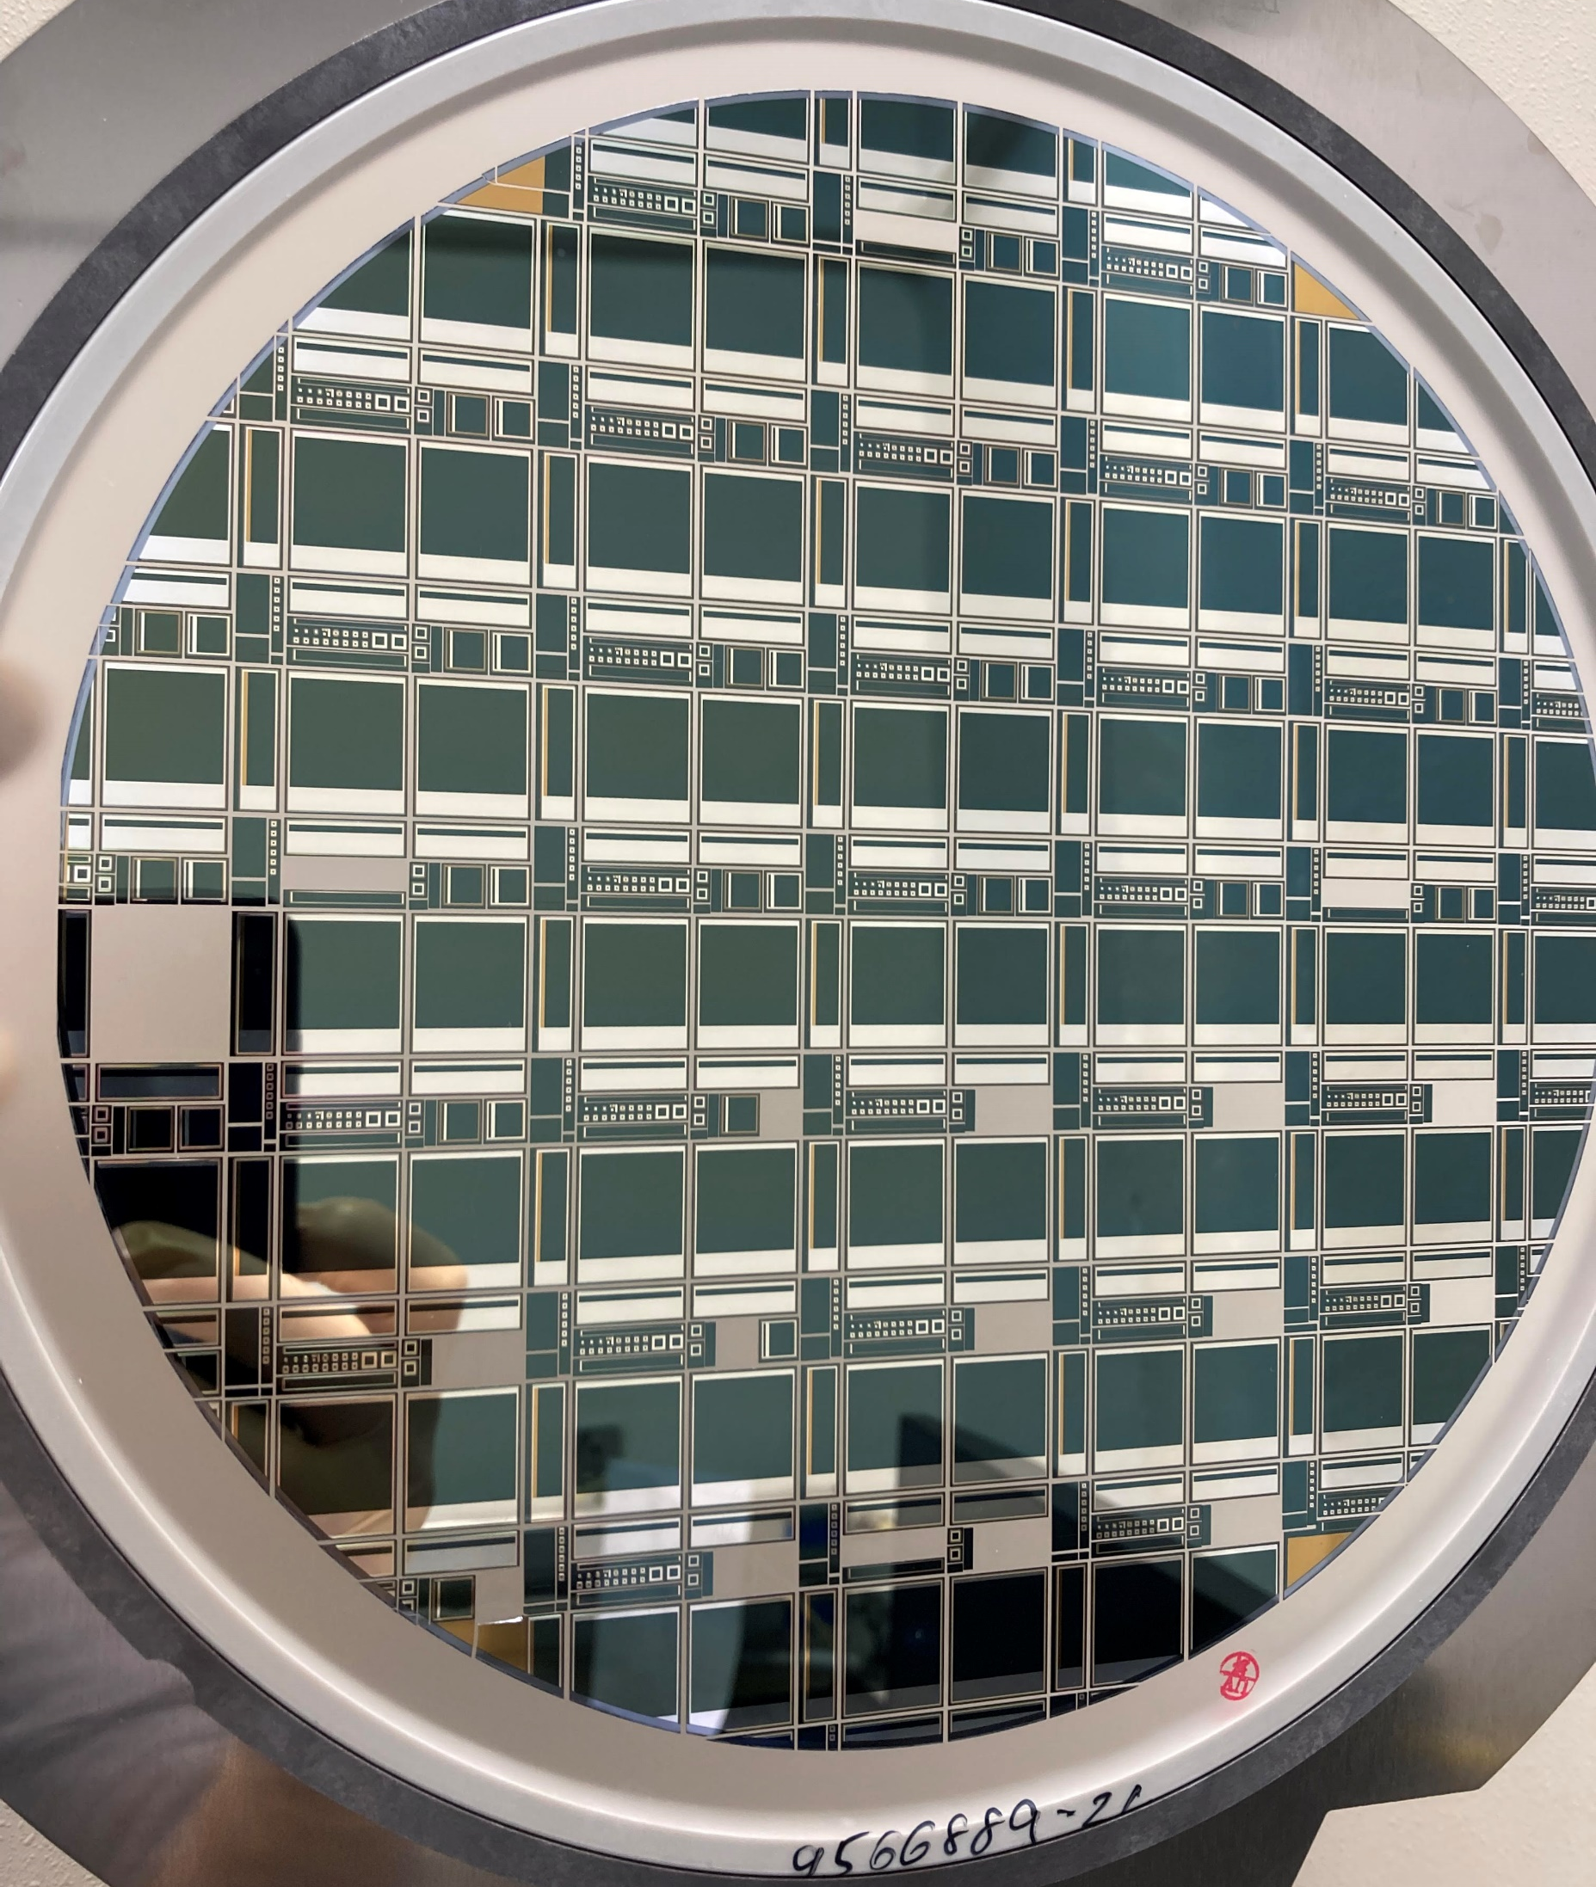
Production
Back side (on 200-μm
active thickness only)
Devices produced:
Main demonstrator: 25μm pixel sensor - 512 x 512 array
Small pixel arrays with different pitch (10 μm – 25 μm – 50 μm) with and w/o active readout
Strip detectors with and w/o active readout (see the talk of Fabio Cossio on Wednesday 14)
Test structures for sensors characterization and process qualification
Front side
Micrograph of test
structures block

Slide 6
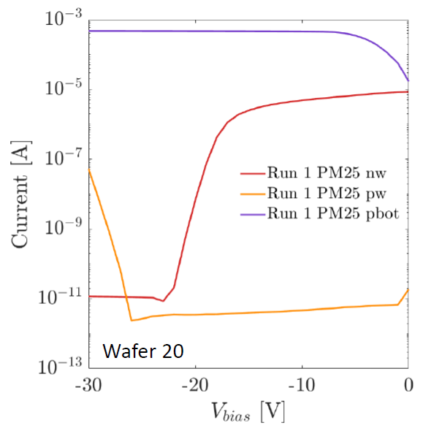
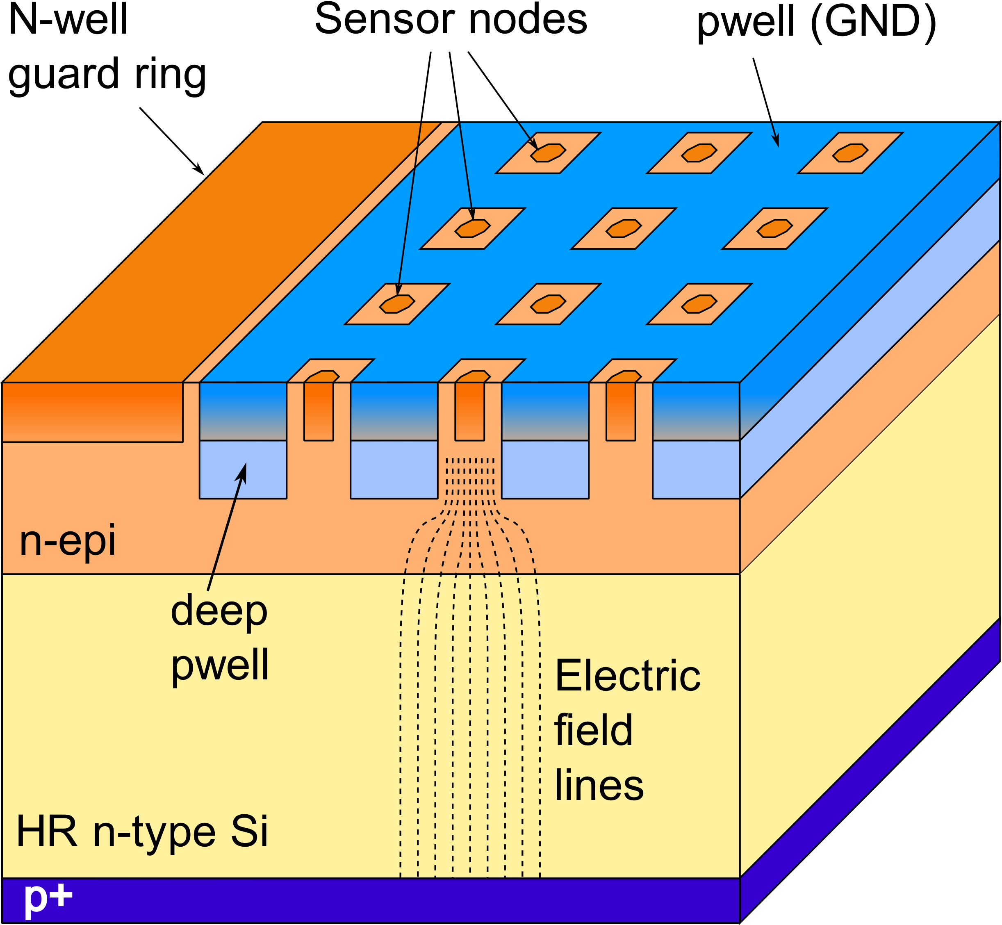
Sensor characteristics - IV curves
Backside bias current (thermal generation at the dicing line)
Measured on pixel test structures
(arrays of pixels connected in parallel)
Pwell
Punch-through
current
Pixel dark current
Punch-through
onset voltage V_{PT}
Full depletion
voltage V_{depl}

Slide 7
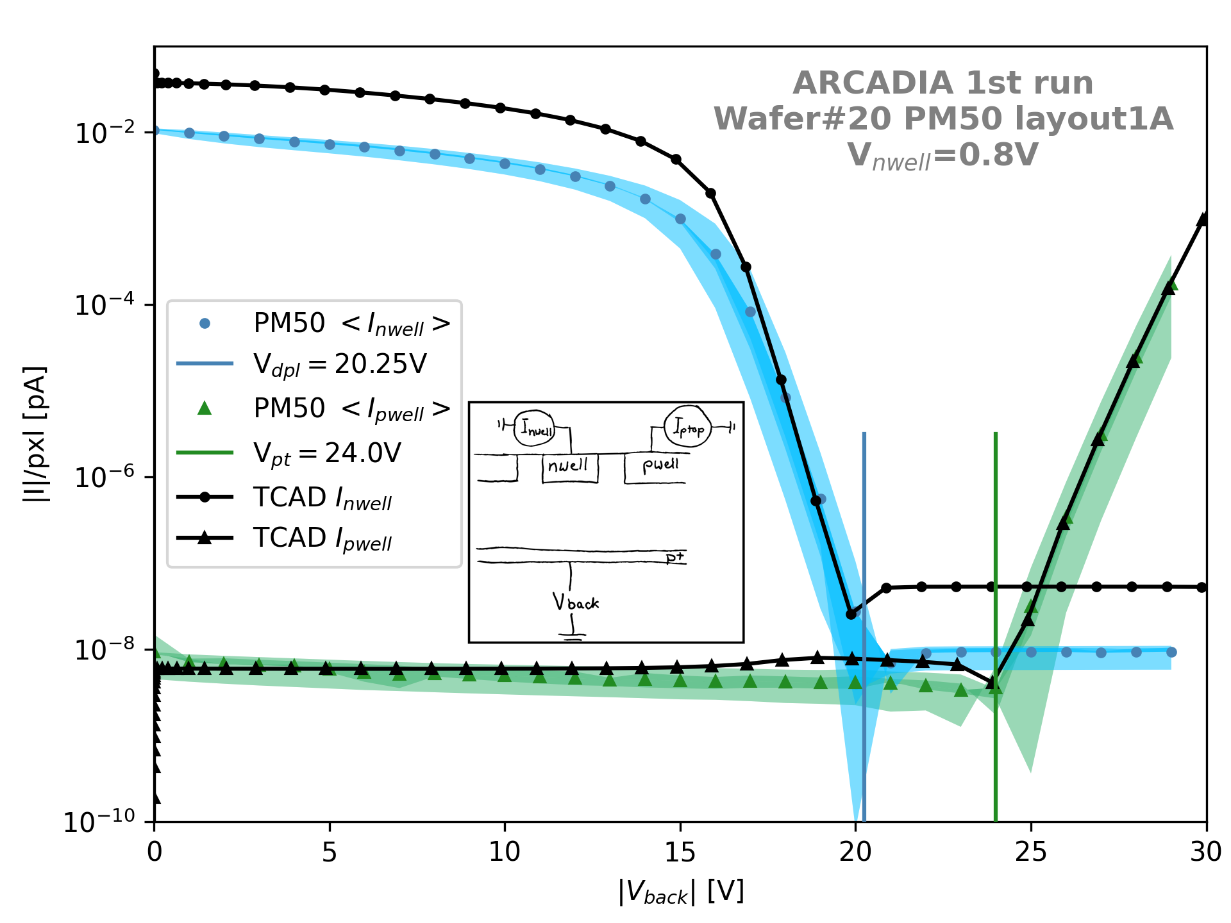
Pixel Current-Voltage curves – comparison with TCAD models
Experimental data acquired for different pixel layouts
Intra-wafer and inter-wafer variations were evaluated
Process parameters in TCAD simulations adjusted on
experimental results
C. Neubüser
V_{depl}
V_{PT}

Slide 8
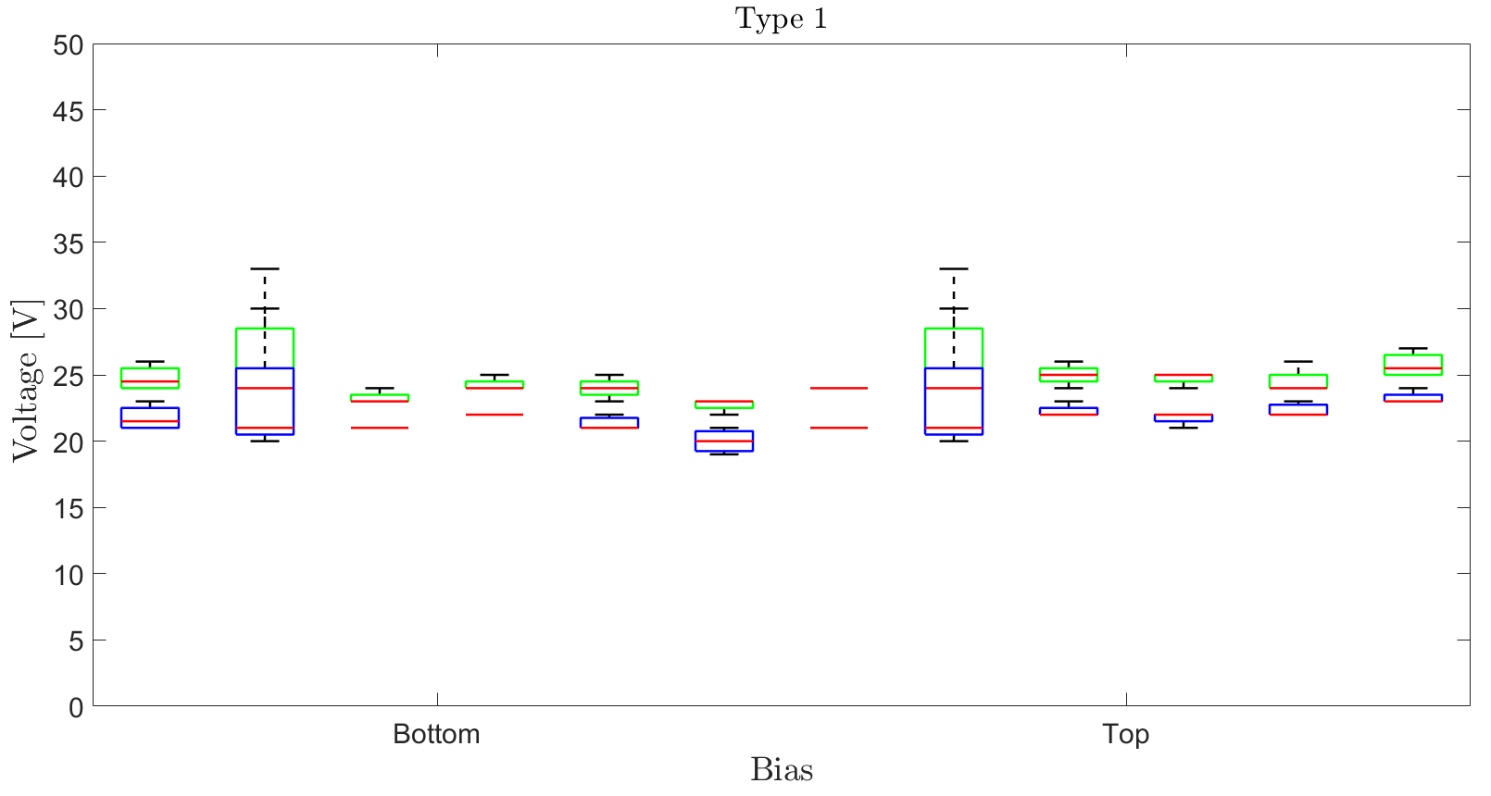
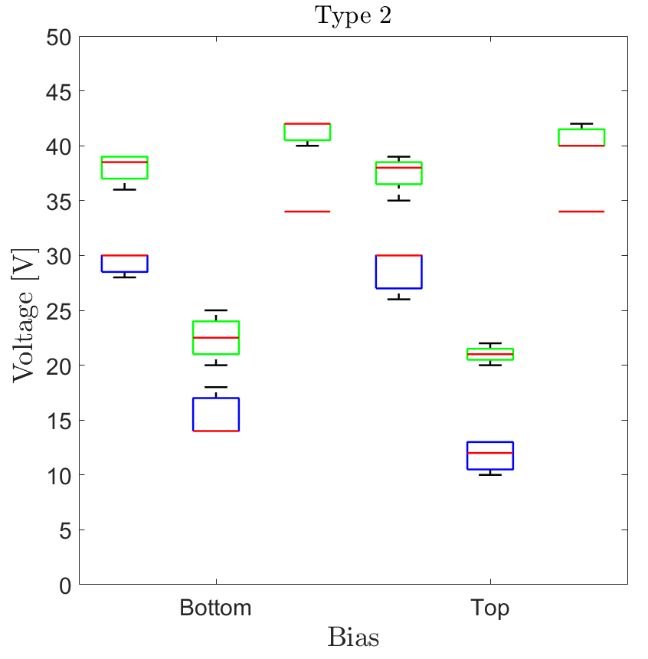
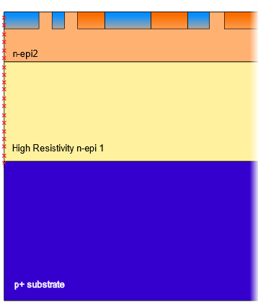
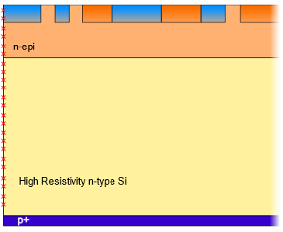




Backside bias: bottom and top
The chip periphery behaves like a resistor: For substrates of Type 1 and 2, substrate bias
can be applied both from the bottom and from the top
$$V_{bias}$$
$$V_{bias}$$
$$V_{bias}$$
$$V_{bias}$$
$V_{depl}$ and $V_{PT}$ are very similar for the two considered biasing schemes
FEE 2023
L. Pancheri
8
Notes:
In the plots at the bottom of the slide is reported as an example a comparison of the IV curves of the frontside n sensor nodes and of the frontsdie internal pwell for the TM With 50um pix. Pitch coming from waf. with 100um substrate thickness
Black simulation and green exp.
Dip in the curves taken as ref for the PT and full depletion extr.
From CV curves we extracted the Cap values listed in the table with C decr. along With pixel size as well as increasing the frontside nwell bias
I will now describe the employed biasing scheme and main characteristics of the laser setup

Slide 9
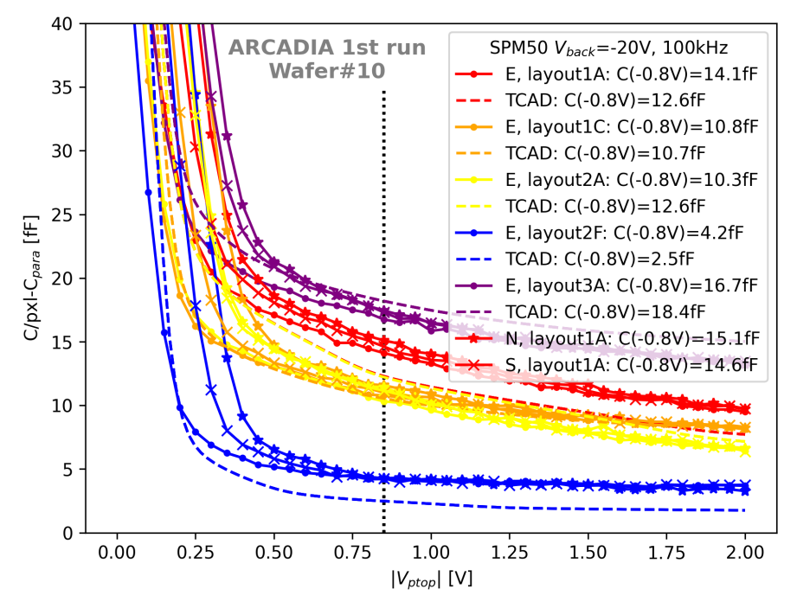
Pixel Capacitance-Voltage curves – comparison with TCAD models
Experimental data for different
pixel layouts
comparison with TCAD simulation
results
Capacitance is dominated by the perimeter of the sensor node
C. Neubüser

Slide 10
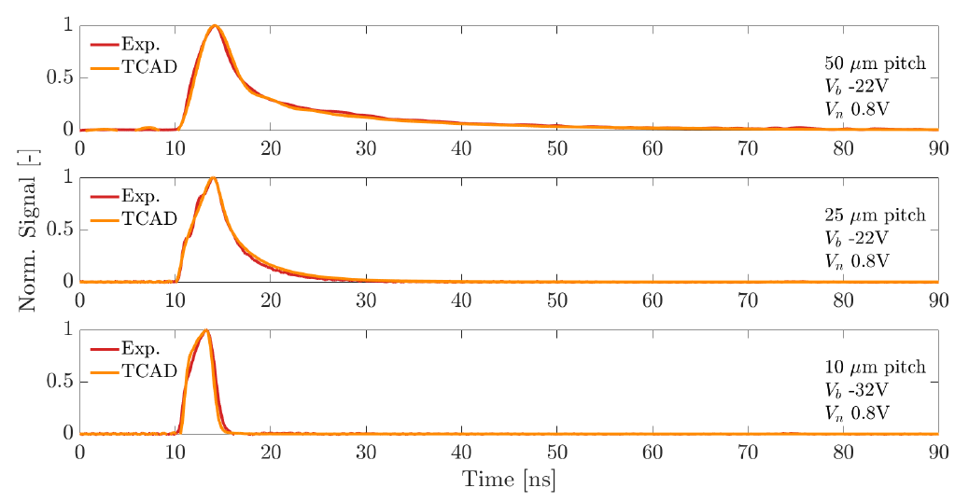
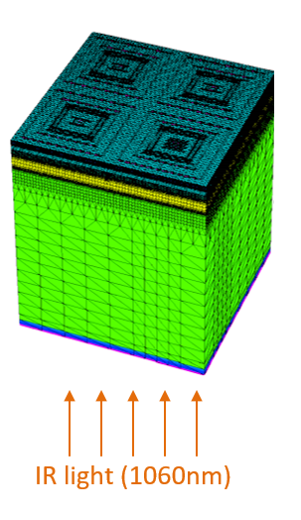
Pulsed laser characterization – comparison with TCAD models
Infrared laser diode @ 1060nm, < 100ps FWHM: generation in the whole active thickness
Pixel array test structures with 100μm active thickness (maskless backside p+ implantation)
T. Corradino

Slide 11
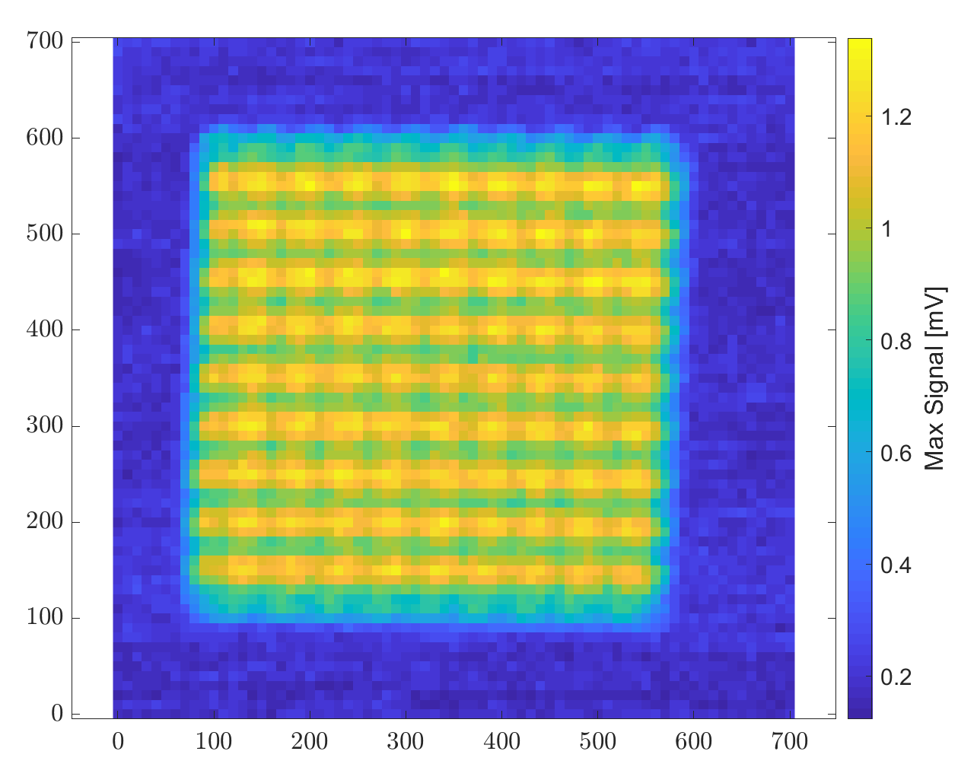
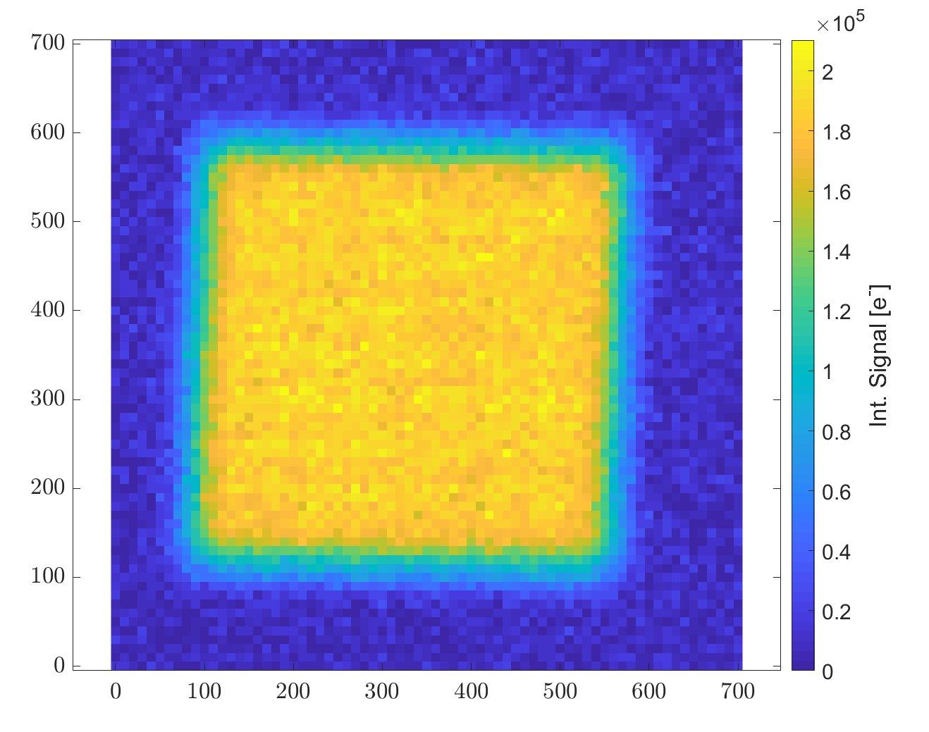
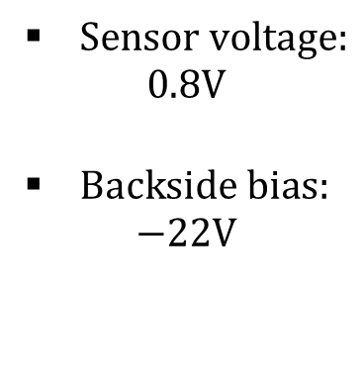
Red laser scan – test pixel arrays
50 µm – pitch pixel test structures
Focused red laser incident on the backside – spot size 10 µm FWHM
Mechanical scanning with 10 µm step size in x and y
$Sensor voltage:$
$$0.8V$$
$Backside bias:$
$−22V$
Signal peak amplitude: higher in the
Pixel center (fast charge collection)
Integrated signal: uniform across the pixel array

Slide 12
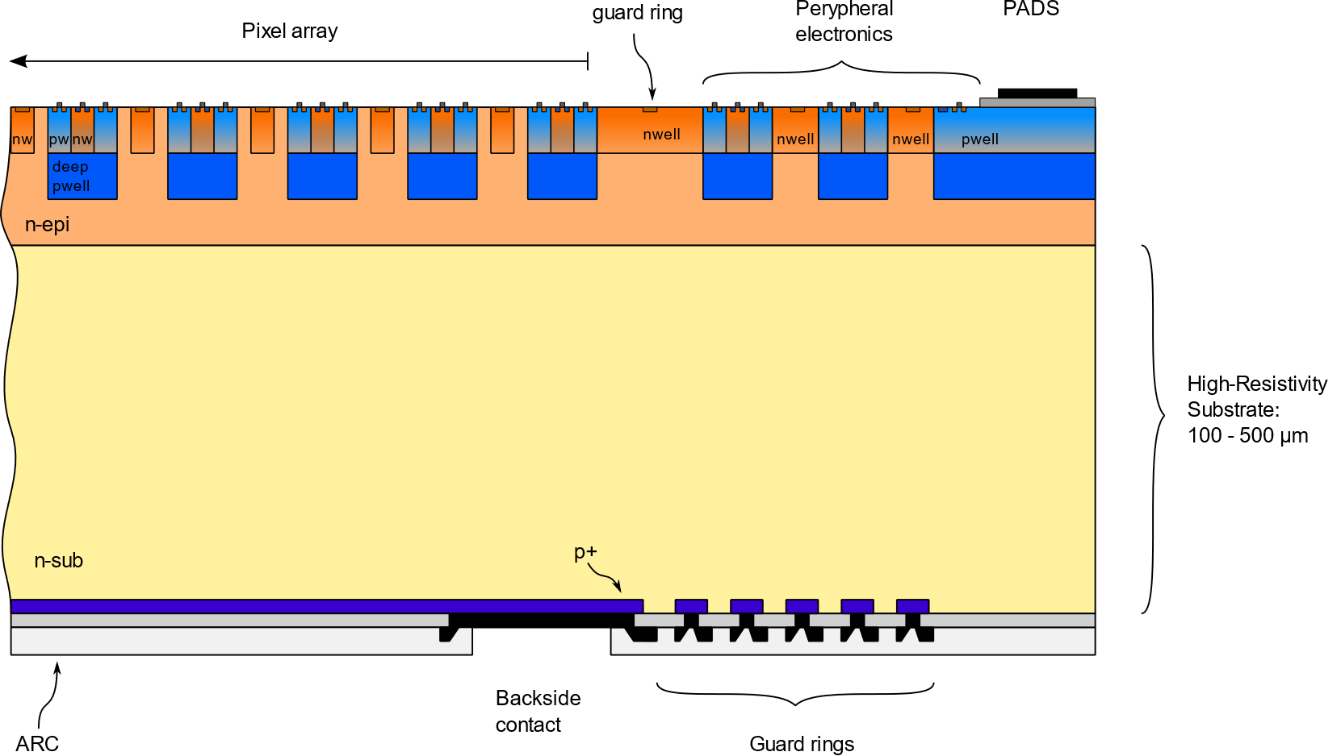
Pixel array cross section – backside lithography – type 3 substrates

Slide 13
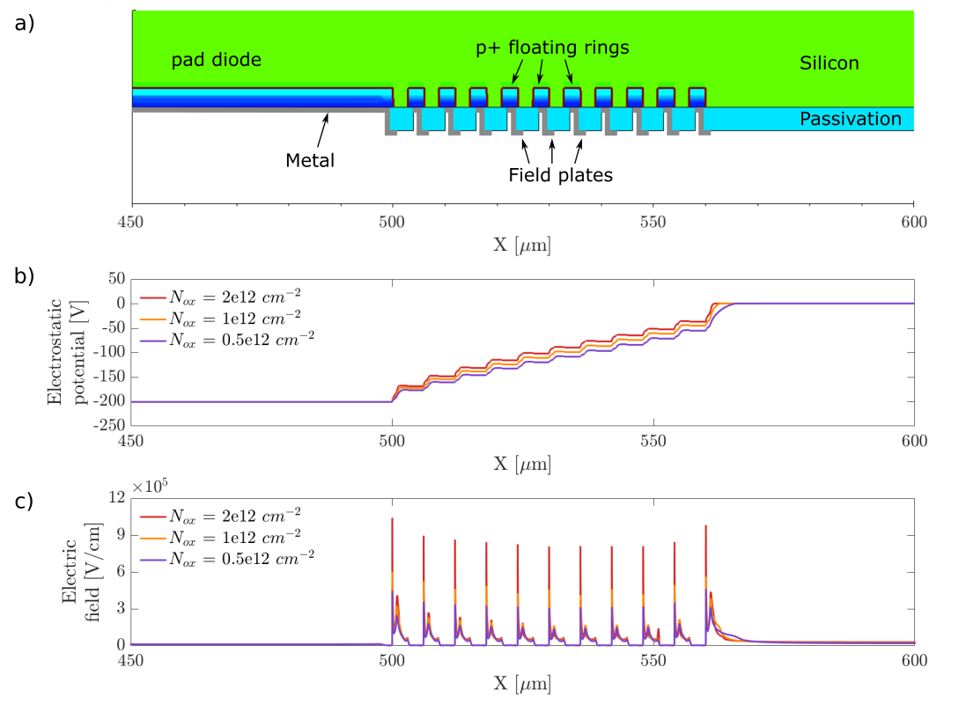
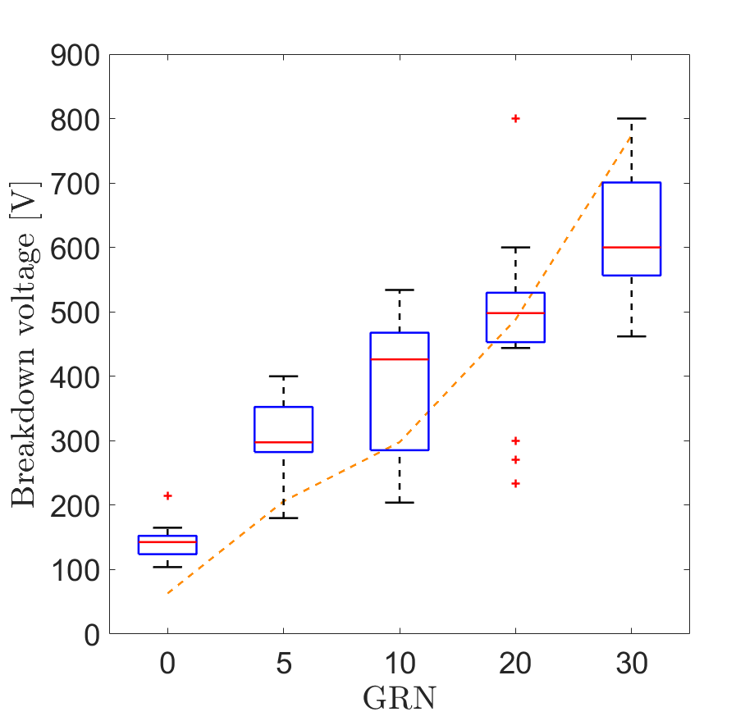
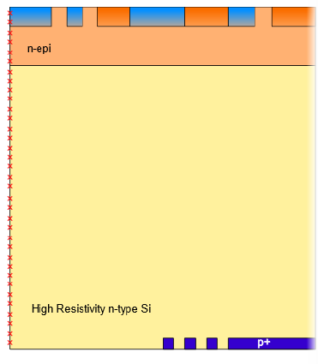
Electrical characterization – backside termination
Backside diodes with variable number of guard rings (GRN)
Large bias voltage: possibility to deplete a thick sensor (tested up to 400μm thickness)
T. Corradino

Slide 14
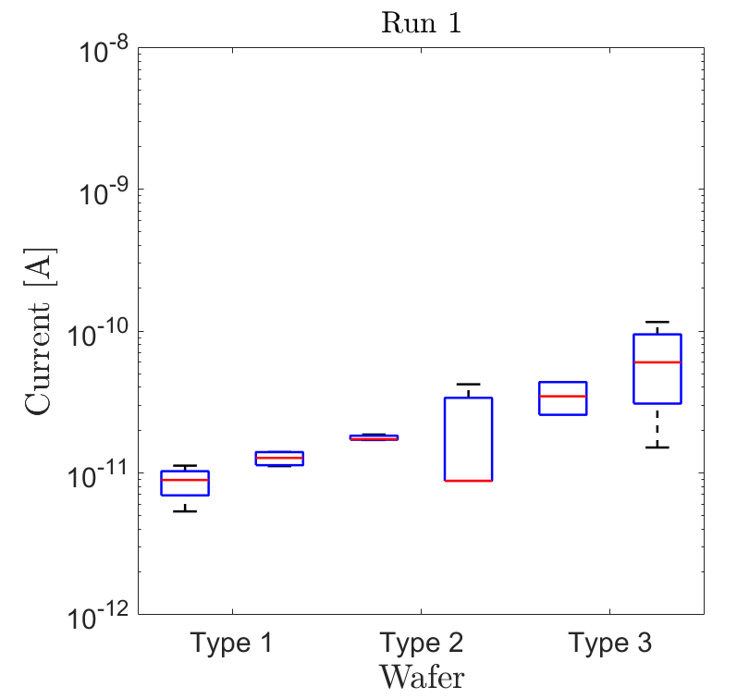
Pixel characteristics
Measured on pixel test structures
Pixel dark current roughly proportional to sensor thickness
Sensor characteristics vs. active thickness.
Active thickness (μm) | 48 | 100 | 200
Sensor bias voltage (V) | 25 | 20-35 | 60-100
Dark current density (pA/cm²) | 100-350 | 230 - 500 | 650 - 2000
Sensor characteristics vs. pixel size (@ 100μm active thickness)
Pixel pitch (μm) | 10 | 25 | 50
Sensor area (% of pixel area) | 36% | 19% | 16%
Sensor capacitance (fF) | 1.9 | 3 | 12.7
Time for 90% charge collection with picosecond IR laser (ns) | 4 | 10 | 31
Array size: 1.5mm x 1.5mm
Active thickness:
48μm
100μm
200μm
T. Corradino

Slide 15
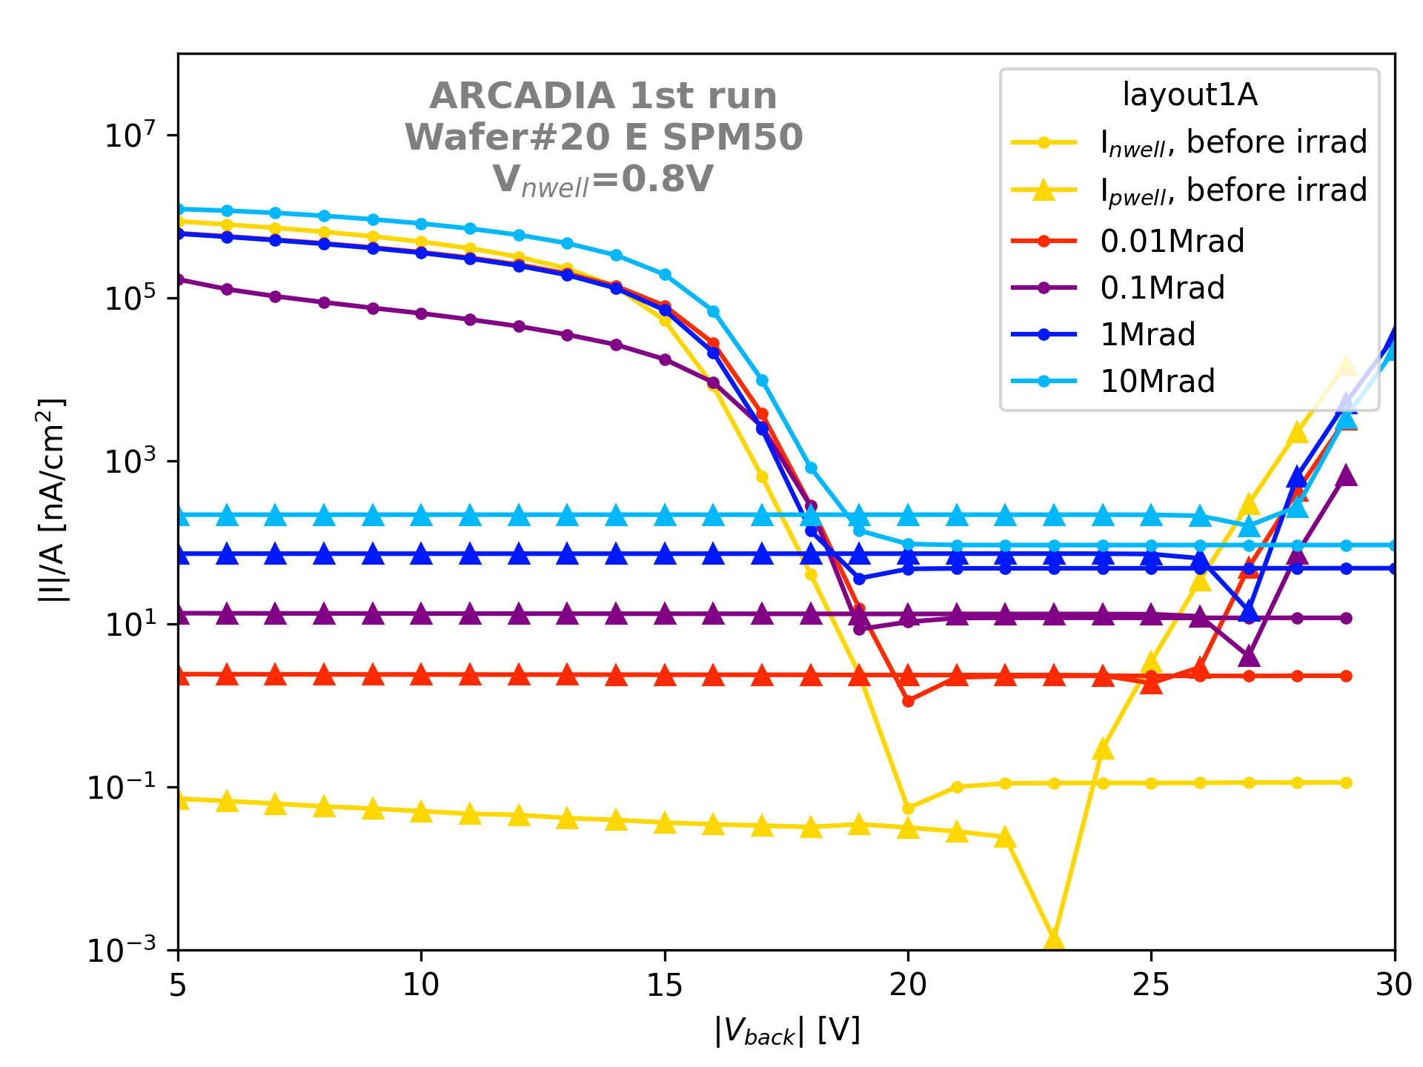
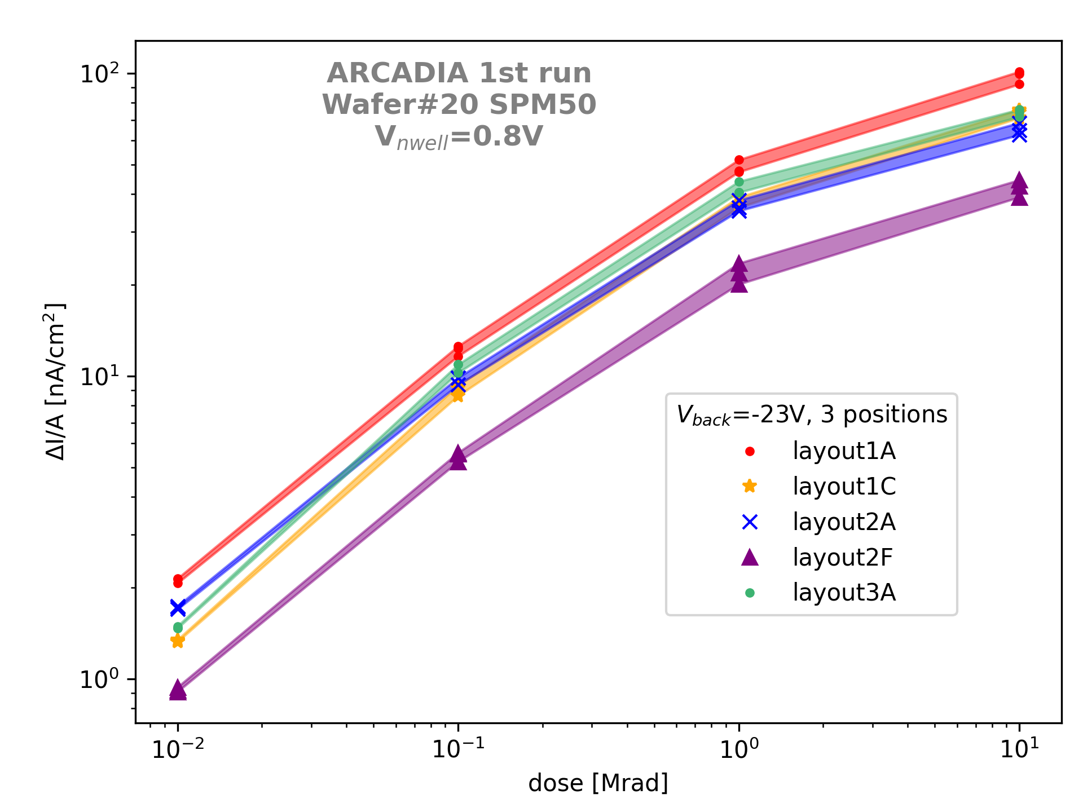
Pixel radiation hardness – ionizing radiation
TID with X-rays – Irradiation @ university of Padova, Italy
Main effect: increse of pixel leakage current with dose (due to surface generation)
C. Neubüser
FEE 2023
L. Pancheri
15

Slide 16
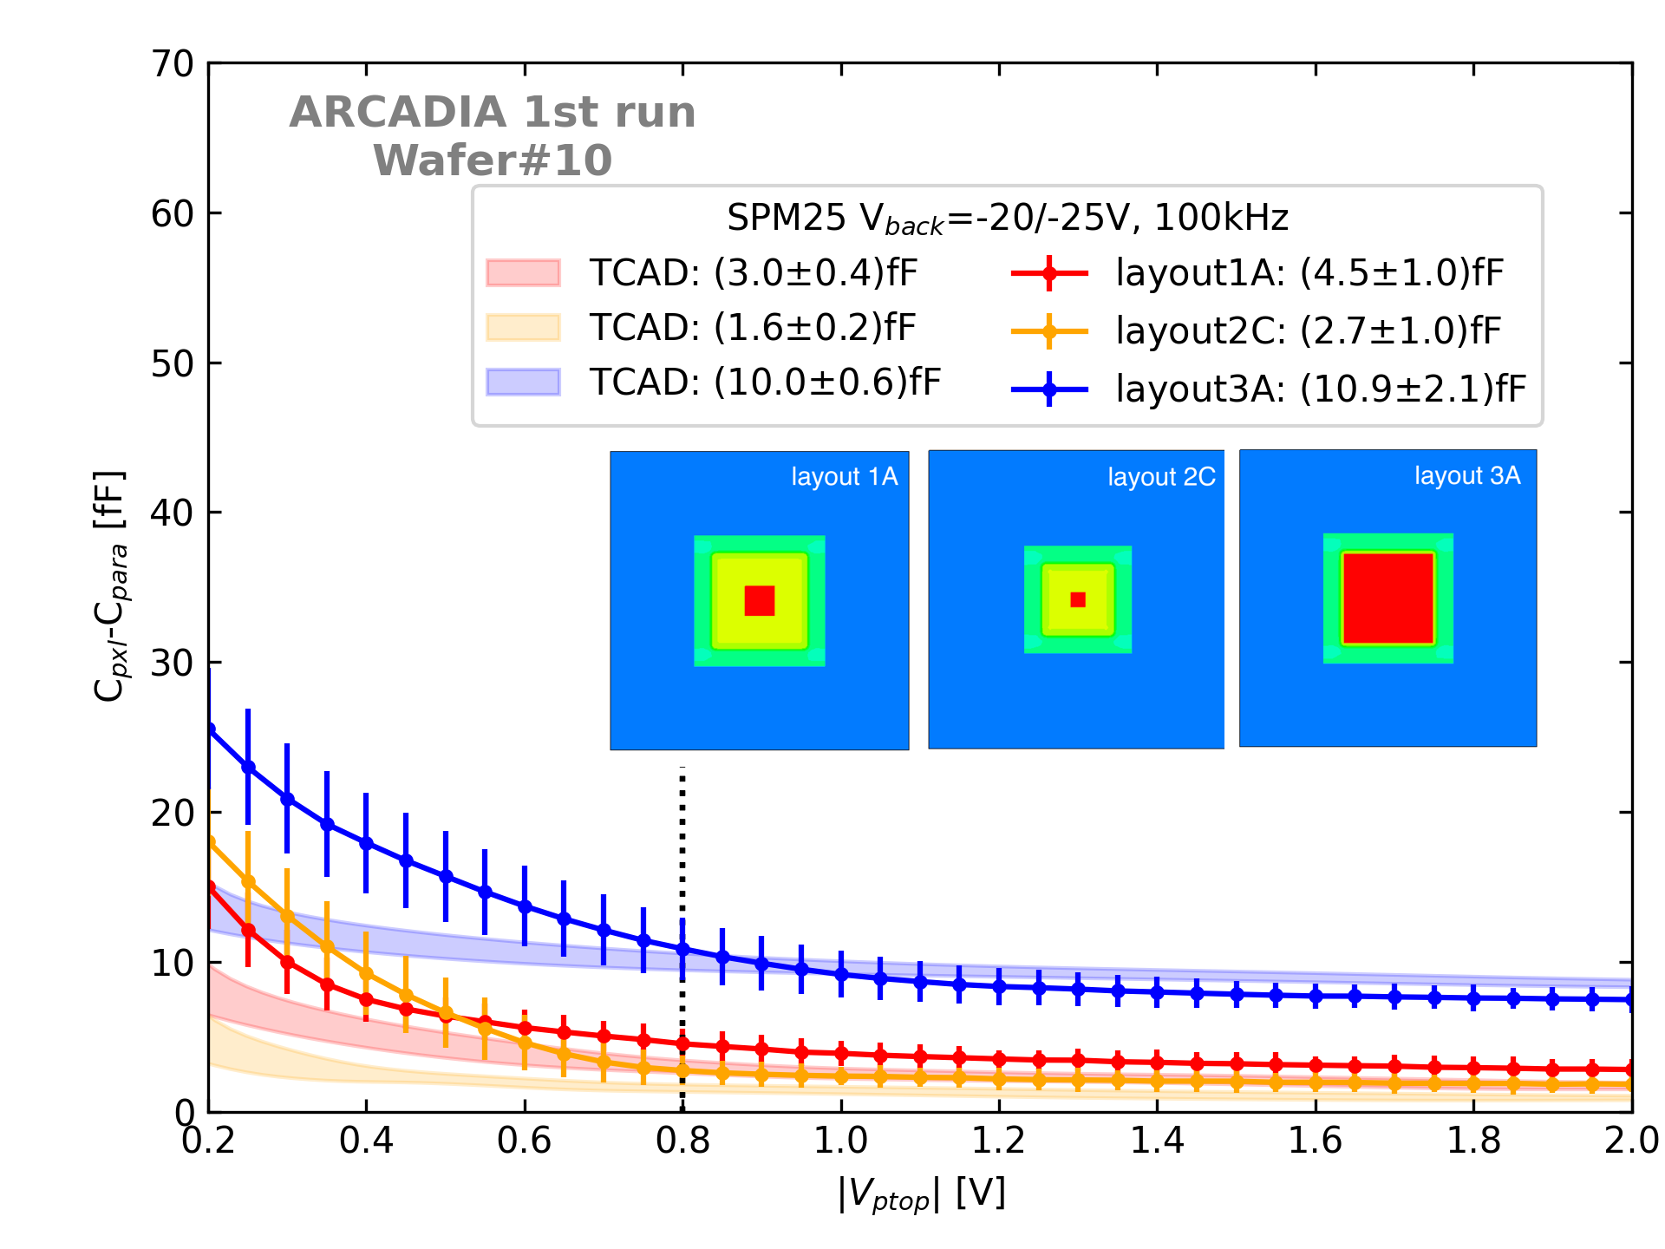
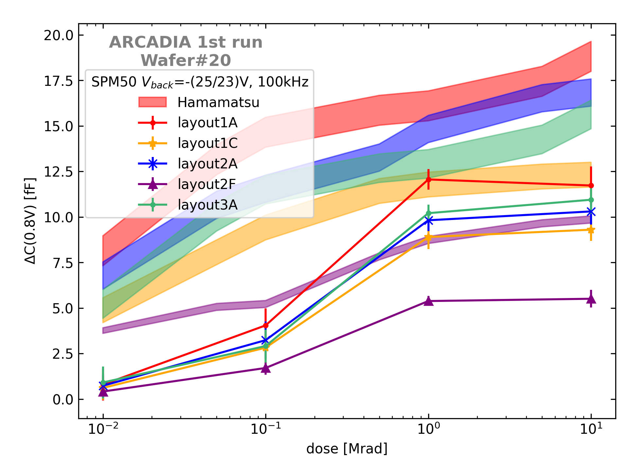
Pixel radiation hardness – ioniziong radiation
Pre-irradiation – CV curves
Post-irradiation – C vs. dose
C. Neubüser
Good agreement with simulation results
Perugia model (with Hamamatsu parametrization)
overestimates the increase in sensor capacitance.
FFEE 2023
L. Pancheri
16

Slide 17
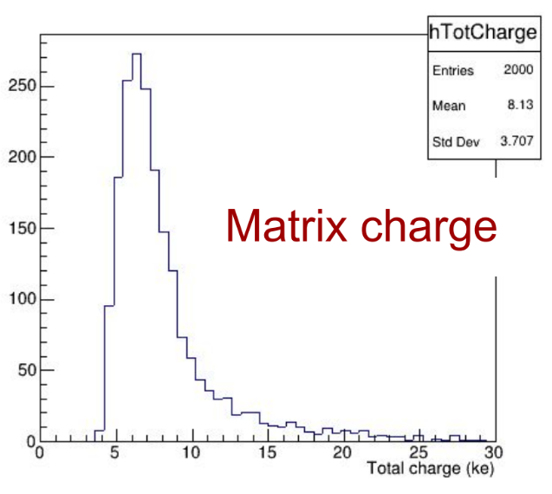
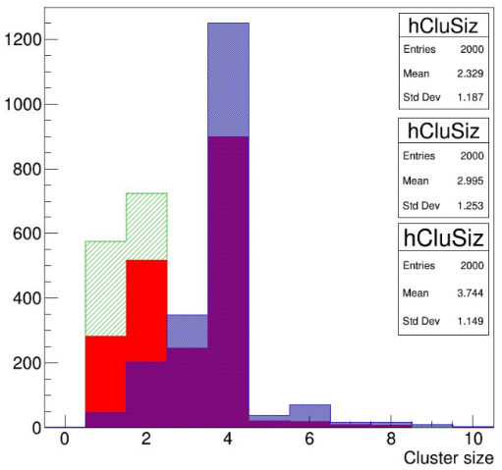

Particle detection: Monte Carlo simulation of charge and cluster size
200MeV muons - perpendicular incidence
Simulated total charge distribution
Simulated cluster size distribution
Active thickness:
100μm
Threshold: 200 e⁻
C. Ferrero
25μm pixel pitch
Simulation domain: 5x5 matrix

Slide 18
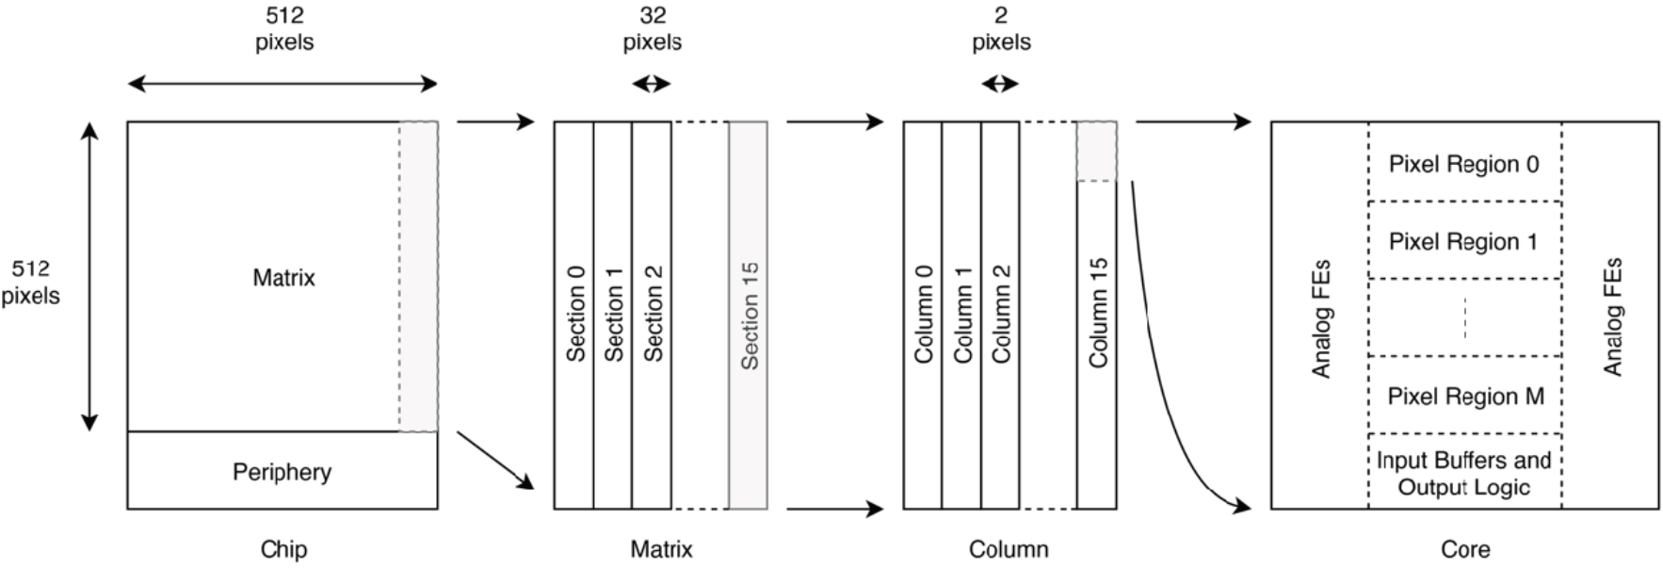
Main demonstrator: 512 x 512 pixel array for charged particle tracking
Pixel pitch: 25μm – Array core area: 1.28cm x 1.28cm
Pixel electronics: analog and digital. In-pixel threshold and data storage
Architecture: event-driven. Pixel detecting events (charge pulses) send their address to the chip peripheral circuits
Low power (20mW/cm²) and high event rate (100 MHz/cm²)
M. Rolo

Slide 19
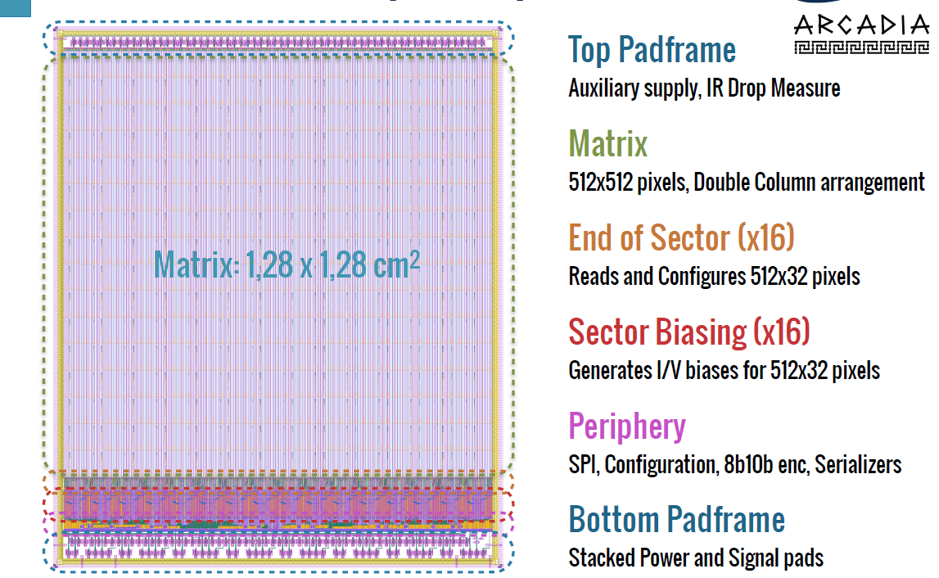
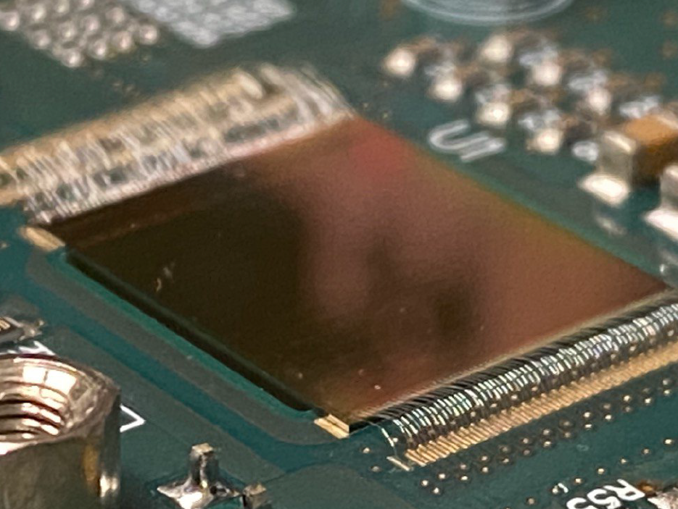
ARCADIA Main Demonstrator – chip floorplan
512 x 512 pixel sensor mounted on PCB
Detail of pixel layout
M. Rolo

Slide 20
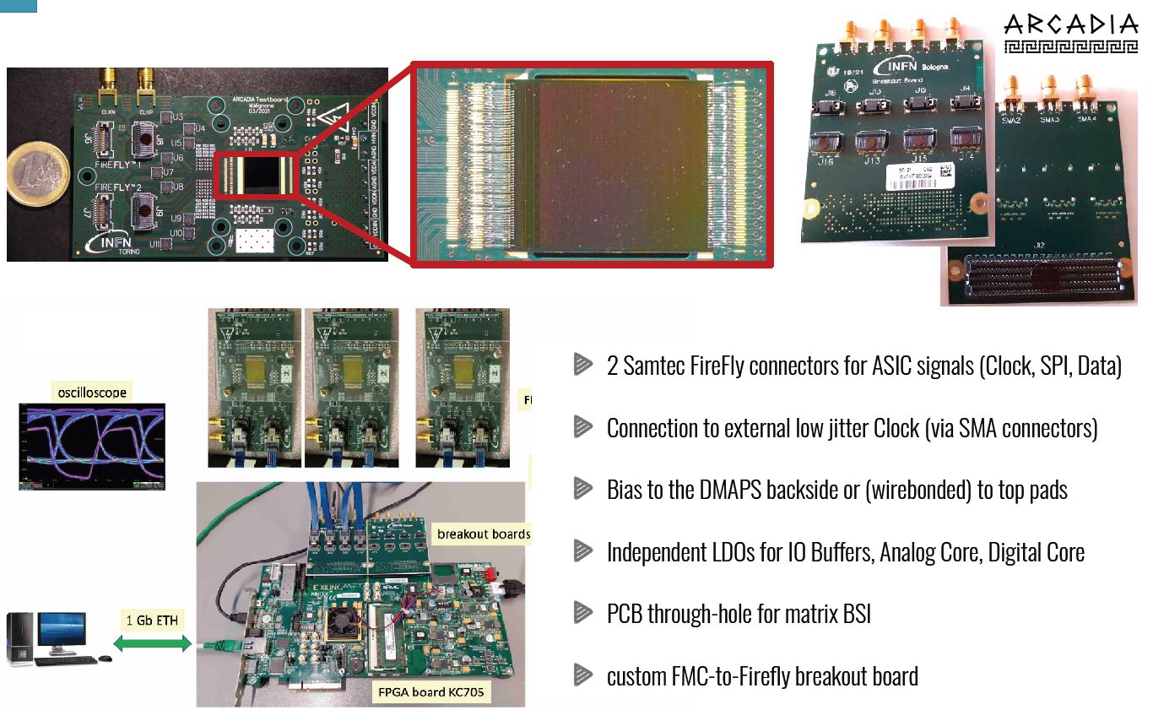
Front-end board and DAQ
M. Rolo

Slide 21
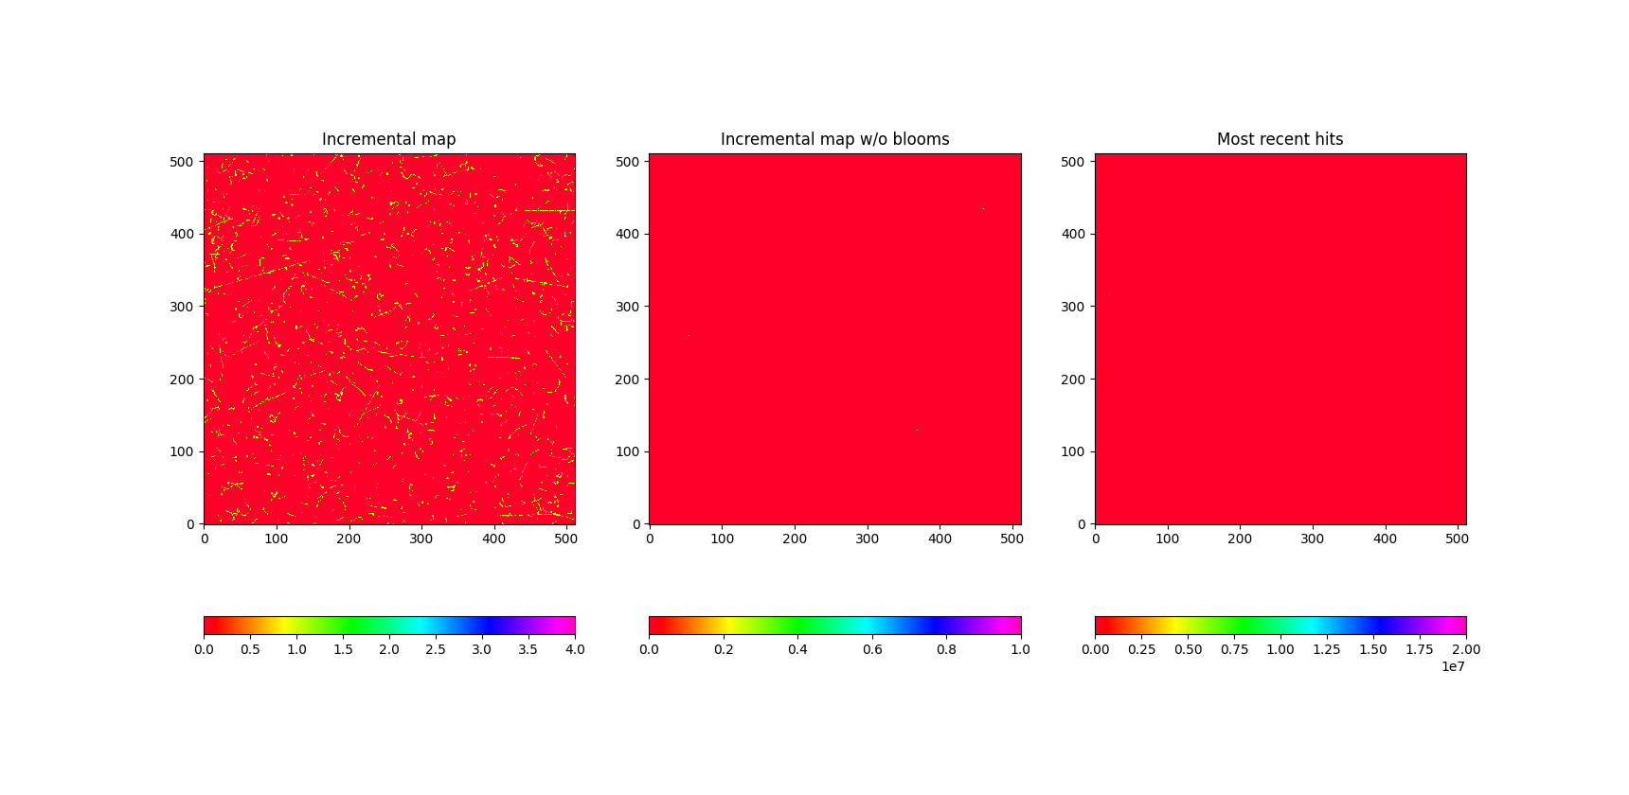
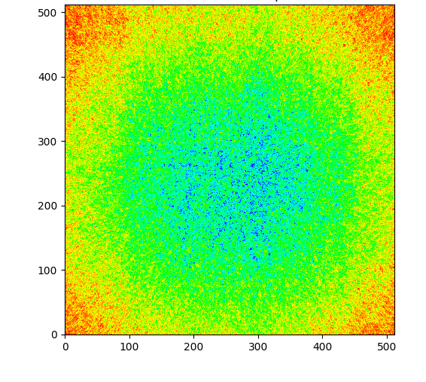
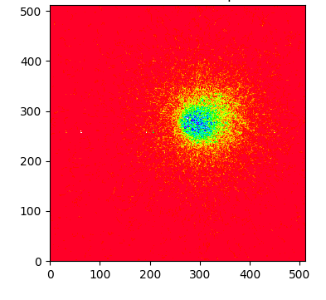
Main prototype: charged-particle detection
Cosmic rays (4h acquisition)
Sensor placed vertically
⁹⁰Sr beta source (1cm²) placed at 8 mm from the sensor surface
Collimated ⁹⁰Sr beta source
Collimator diameter: 1mm
Total power consumption: 10mW/cm² at low event rates.
Design specification: 20mW/cm² at event rates up to 100 Mevents/cm² (to be verified in a test beam)

Slide 22
Work in progress
Characterization:
Extensive testing (test beam foreseen in the next months)
3-layer telescope → tracking performance
Extended radiation hardness characterization on test structures and on main demonstrator
Design:
Sensors with high timing resolution (particle ToF – upgrade of ALICE experiment at CERN)

Slide 23
Thank you!
The ARCADIA collaboration:
F. Alfonsi, G. Ambrosi, A. Andreazza, E. Bianco, G. Balbi, S. Beolè, M. Caccia, A. Candelori, D. Chiappara, T. Corradino, T. Croci, M. Da Rocha Rolo, G. F. Dalla Betta, A. De Angelis, G. Dellacasa, N. Demaria, B. Di Ruzza, A. Di Salvo, D. Falchieri, M. Favaro, A. Gabrielli, L. Gaioni, S. Garbolino, G. Gebbia, R. Giampaolo, N. Giangiacomi , P. Giubilato, R. Iuppa, M. Mandurrino, M. Manghisoni, S. Mattiazzo, C. Neubüser, F. Nozzoli, J. Olave, L. Pancheri, D. Passeri, A. Paternò, M. Pezzoli, P. Placidi, L. Ratti, E. Ricci, S. B. Ricciarini, A. Rivetti, H. Roghieh, R. Santoro, A. Scorzoni, L. Servoli, F. Tosello, G. Traversi, C. Vacchi, R. Wheadon, J. Wyss, P. Zuccon

