Slide 1

FASTIC+: a general-purpose fast readout including one TDC per channel
J. Alozy, E. Auffray, F. Bandi, R. Ballabriga, M. Campbell, J.M Fernández, D. Gascon, S. Gomez, J. Kaplon, N. Kratochwil, A. Paterno, S.Portillo,
J. Mauricio, R. Manera, A. Mariscal, M. Piller, A. Pulli, A. Sanuy, J. Silva
ICCUB – Universitat de Barcelona
CERN microelectronics section (EP-ESE-ME)
XII Front-End Electronics Workshop
2023/06/13
Notes:
This work is being done in collaboration between Institute of Science Cosmos (University of Barcelona) and CERN Microelectronics section.

Slide 2
Outline
Introduction
FastIC (2020)
FastIC+ (2023)
Summary

Slide 3
I. Introduction
CERN Microelectronics Section & University of Barcelona Collaboration.
Objective: develop scalable FE electronics for photosensors with intrinsic gain (PMT, MCP, SiPM) to perform precise measurement of:
  Time: approach intrinsic single photon time resolution of the sensor: 10 - 100 ps
  Energy: linear (< 3%) for 1000s p.e. range (~10 bit)
    Precise time-walk correction
    PID
What does scalable mean?
  System on chip: input stage, comparators, TDC, serializer
  Low power (<10 mW/ch) including everything
  Compact:< 1 mm² per readout channel (or “pixel”)
  Fabrication cost < 1 $/ch for volume production
Notes:
The ICCUB and the CERN microelectronics group started a collaboration to develop scalable integrated readout electronics for fast detectors:
- MCPs, PMTs or SiPMs
The goal is to achieve precise measurement of timing and energy.
- On the timing side, we would like to approach the intrinsic single photon time resolution of the sensor.
- For the energy measurement the target is at least a10 bit dynamic range with a linearity better than 3%.
And what does scalable mean?
System on chip: input stage, comparators, TDC/ADC, digital back-end, serializer
Low power (<10 mW/ch) including everything
Compact:< 1 mm² per readout channel (or “pixel”)
Fabrication cost < 1 $/ch for volume production

Slide 4
Outline
Introduction
FastIC (2020)
FastIC+ (2023)
Summary

Slide 5
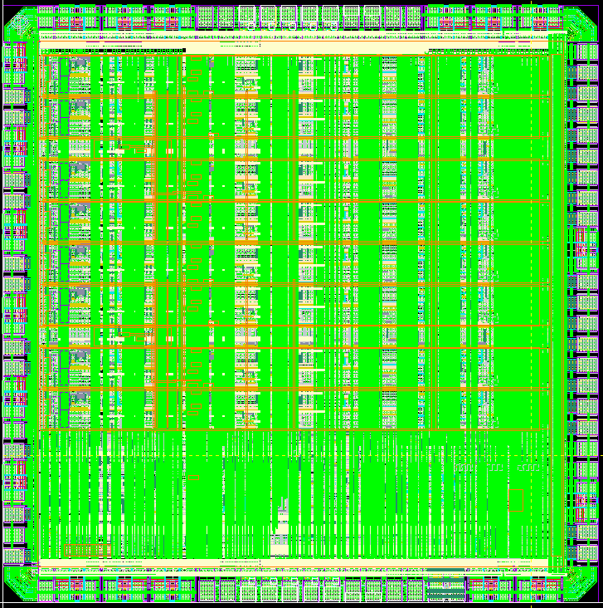
II. FastIC architecture
FastIC current mode ASIC.
  8 Inputs: 8 Single Ended (POS/NEG) / 4 differential / 4-ch active summation (POS/NEG).
  3 Output modes: binary (SLVS or CMOS) and Analog.
  Tech: 65 nm CMOS
  Size: 2x2 mm²
  Power: 12 mW/ch
Notes:
FastIC is an 8-ch chip in a standard CMOS 65nm technology.
The ASIC includes an input stage that can be configured to process the signal from positive or negative or differential polarity detectors, and it can perform the active summation of 4 channels.
3 paths generated at the input stage: time, energy and trigger
The output of the chip can be read in binary mode (SLVS or CMOS) and in analog mode.

Slide 6
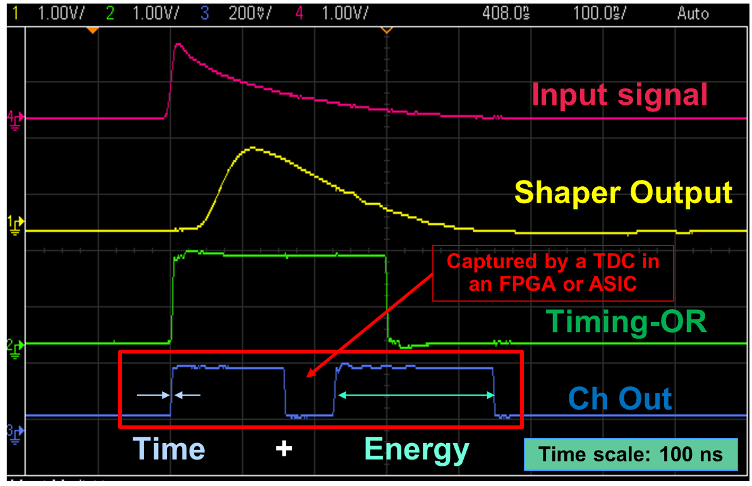
II. FastIC: Linearity of the Energy measurement
FastIC provides a measurement of the time and energy per channel in two consecutive pulses:
  Based on HRFlexToT ASIC [1]
  Linear energy by pulse width encoding
    “Wilkinson ADC-like” conversion
    Controlled by on-chip state machine
    1st pulse:
      Time-of-Arrival
      Non-Linear ToT (optional)
    2nd pulse: energy response
  It can also operate in Non-Linear ToT mode:
    High rate (>3 MHz) applications.
[1]: Sanchez, D., Gomez, S., et. al. HRFlexToT: A High Dynamic Range ASIC for Time-of-Flight Positron Emission Tomography, 2021, IEEE TRPMS, https://doi.org/10.1109/TRPMS.2021.3066426
Notes:
Here we can see an example of the Input/Output signals of the ASIC:
- The yellow line shows the output in analog mode.
- The blue line is the binary output
- The first pulse encodes the timing in the rising edge, and optionally the NL-ToT in the falling edge
- The second pulse encodes the energy response in the pulse width.
- This second pulse can be disabled if we want to operate at rates higher than 3 MHz.

Slide 7
Outline
Introduction
FastIC (2020)
FastIC+ (2023)
Summary

Slide 8
III. FastIC+: integration of 25 ps bin TDC on FastIC
Specifications:
  System-on-Chip.
  Per channel TDC.
  ToA: 25 ps time bin.
  ToT: <500 ps time bin.
  Backwards compatibility with FastIC (if possible).
  Must work in all the Front-End readout configurations:
    High Energy Resolution mode: Time (ToA) + Energy (ToT)
    High Speed mode: Time (ToA+ToT)
    Hybrid mode: Time (ToA+NL-ToT) + Energy (ToT)
    Single pulses: Time (ToA) / Energy (ToT)
  Lowest power consumption overhead possible (<5 mW/ch).
  Scalable & reusable design for future developments.
Notes:
The ASIC specifications are: per channel TDC, 25 ps time bin for ToA and less than 500 ps for ToT.
It should be backwards compatible with the previous FastIC, and all the different operating modes of the ASIC.
We would like to keep the power consumption as low as possible.
And finally, the design must be scalable and reusable in future developments.

Slide 9
III. FastIC+: integration of 25 ps bin TDC on FastIC
Features:
  8+1 channels:
    8 for channels’ Time+Energy
    1 for Trigger timestamp capture
  TDC architecture: PLL-based flash TDC
    VCO frequency: 1.28 GHz
    #VCO taps: 16
    3 counter levels: Ultra-Fast (25ps), Fast (780ps) & Coarse (25ns)
  Conversion rate: 40 MHz (peak)
  Pulse filtering to reduce bandwidth:
    Pulse Width
    Trigger validation
  Digitized data is sent via an SLVS link @ 1.28 Gbps.
    Max sustained rate: ~3 MHz / channel
  ASIC Size: ~2.9 x 2.9 mm²
  Power consumption: 3~4 mW/channel
Notes:
The TDC processes 8+1 channels: 8 for Time+Energy and 1 for Trigger timestamp capture
The TDC architecture is flash, based in a PLL.
- We have 16 taps oscillating at 1.28 GHz
- And we have 3 counter levels: ultra-fast, fast and coarse.
The peak conversion rate is limited to the reference clock.
We implemented some mechanisms to reduce the volume of useless data.
Digitized data is sent via a single SLVS link which allows a sustained rate of 3 MHz per channel.
The size of the ASIC will be smaller than 9mm² and the power consumption will be around 3.5mW

Slide 10
III. FastIC+ TDC Block Diagram
TDC Processing chain:
FERO
BERO
Arbiter & Mux
Global FIFO
8xTime+Energy
FERO
FERO
FERO
FERO
1xTrigger
x9
x9
VCOPhase<15:0>
VCOCounts<4:0>
CoarseCounts<11:0>
PLL
Coarse Counter
Statistics
Serializer
101101…
RefClk (40 MHz)
CoarseCounts<23:0>
SyncRst
Notes:
This is an overview of the TDC building blocks

Slide 11
III. FastIC+ TDC Block Diagram
PLL Macro:
FERO
BERO
Arbiter & Mux
Global FIFO
8xTime+Energy
FERO
FERO
FERO
FERO
1xTrigger
x9
x9
VCOPhase<15:0>
VCOCounts<4:0>
CoarseCounts<11:0>
PLL
Coarse Counter
Statistics
Serializer
101101…
RefClk (40 MHz)
CoarseCounts<23:0>
SyncRst
Notes:
Let’s start by the PLL…

Slide 12
III. FastIC+ TDC: PLL design – Block Diagram
Features:
  PLL M: 32
  VCO stages: 16 (td<25ps)
  Radiation Hard
VCIn
Digital
Ph Det
Chg
Charge
Pump
Loop Filter
VCO
16
Buffers
16
VCtrl
ClkRef
(40 MHz)
VcoPhase<15:0>
(Thermometer Encoding)
Dch
VCFilt
To TDC
FERO
ClkFb
(40 MHz)
Clock
Manager
ClkVco
(1.28 GHz)
VcoCounts<4:0>
(Gray Counter)
5
Digital
Flow
Analog
Flow
ClkSer
ClkFsm
ClkVco’
ClkTdc
Notes:
The PLL multiplies by 32 the 40 MHz reference clock. The 16 oscillator stages provides a time bin better than 25 ps.
The design is Radiation Hard since this IP block will be reused in future Radiation Hard ASICs

Slide 13
III. FastIC+ TDC: PLL design – Block Diagram
Charge Pump:
  3-bit adjustable I_{CP}: [4uA~67uA] (default: 40uA)
  Regulated Cascode Current Mirror
  Vctrl feedback loop
VCO
VCIn
vref_p
vref_p
+
Chg
12uA
16
16
Digital
Ph Det
Charge
Pump
Loop Filter
VCtrl
VCO
Buffers
-
ClkRef
(40 MHz)
i_ref
VcoPhase<15:0>
(Thermometer Encoding)
Dch
VCFilt
Chg
vref_n
VCFilt
+
To TDC
FERO
ClkFb
(40 MHz)
Clock
Manager
ClkVco’
(1.28 GHz)
-
VCIn
DCh
VcoCounts<4:0>
(Gray Counter)
5
vref_n
+
vref_n
+
-
-
Digital
Flow
Analog
Flow
ClkSer
ClkFsm
ClkVco
ClkTdc
i_ref
i_ref
Notes:
The charge pump has a programmable current source: 4 to 67 uA
The design is based on a regulated cascode current mirror
- Impedance boosting
- Fixes VDS between transistor pairs in the mirror
It additionally hast a Vctrl Feedback loop to prevent Charge Sharing Effects

Slide 14
III. FastIC+ TDC: PLL design – Block Diagram
Loop Filter:
  3-bit adjustable R₁: [0.51kΩ~4.08kΩ] (default: 2.55kΩ)
  3-bit adjustable C₁: [13pF~104pF] (default: 65pF)
  3-bit adjustable C₂: [1pF~8pF] (default: 5pF)
VCO
VCIn
Digital
Ph Det
Chg
Charge
Pump
Loop Filter
VCO
16
Buffers
16
VCtrl
ClkRef
(40 MHz)
VcoPhase<15:0>
(Thermometer Encoding)
Dch
VCIn
VCtrl
VCFilt
To TDC
FERO
ClkFb
(40 MHz)
Clock
Manager
ClkVco’
(1.28 GHz)
VCInFilt
VcoCounts<4:0>
(Gray Counter)
5
Digital
Flow
Analog
Flow
ClkSer
ClkFsm
ClkVco
ClkTdc
Notes:
The loop filter capacitors are quite large:
- The VCO gain (Kvco) is around 7 GHz/V
- We need to compensate it by adding large capacitors

Slide 15
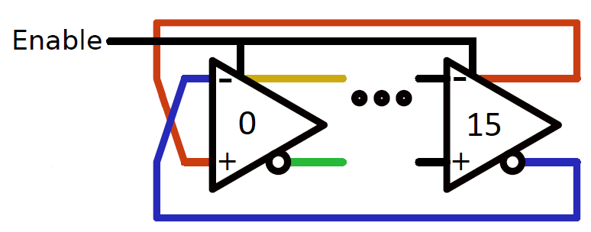
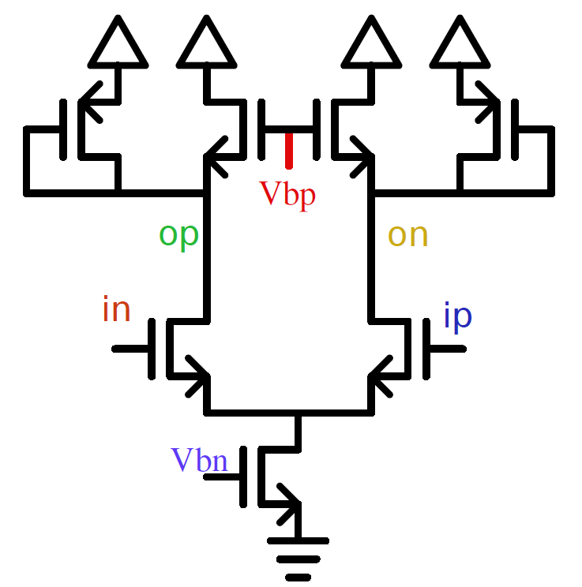
III. FastIC+ TDC: PLL design – Block Diagram
VCO:
  Consists of a chain of 16 Delay Elements.
  Delay Element: Maneatis Cell with symmetric load
VCO
Biasing:
VCtl
Bias
Vbn
Vbp
VCIn
VCO Core:
Digital
Ph Det
Chg
Charge
Pump
Loop Filter
VCO
16
Buffers
16
VCtrl
ClkRef
(40 MHz)
VcoPhase<15:0>
(Thermometer Encoding)
Dch
VCFilt
To TDC
FERO
ClkFb
(40 MHz)
Clock
Manager
ClkVco’
(1.28 GHz)
Delay Element:
Digital
Flow
Analog
Flow
ClkSer
ClkFsm
ClkVco
ClkTdc
Maneatis Cell
Notes:
As previously said, the VCO has 16 Delay Elements, based on the Maneatis Cell
Why Maneatis cell?
- Wide tuning range (pass all corners)
- Better PSRR. Decouples control voltage from VDD

Slide 16
III. FastIC+ TDC: PLL design – Block Diagram
Buffers:
  Isolate the VCO taps from the readout.
  Allow to individually compensate non-uniformities in time bins.
VCIn
Digital
Ph Det
Chg
Charge
Pump
Loop Filter
VCO
16
Buffers
16
VCtrl
ClkRef
(40 MHz)
VcoPhase<15:0>
(Thermometer Encoding)
Dch
VCFilt
To TDC
FERO
ClkFb
(40 MHz)
Clock
Manager
ClkVco
(1.28 GHz)
VcoCounts<4:0>
(Gray Counter)
5
Digital
Flow
Analog
Flow
ClkSer
ClkFsm
ClkVco’
ClkTdc
Notes:
Finally the buffers isolate the VCO from the Time Capture Registers and also allows the compensate non-uniformities in time bins.

Slide 17
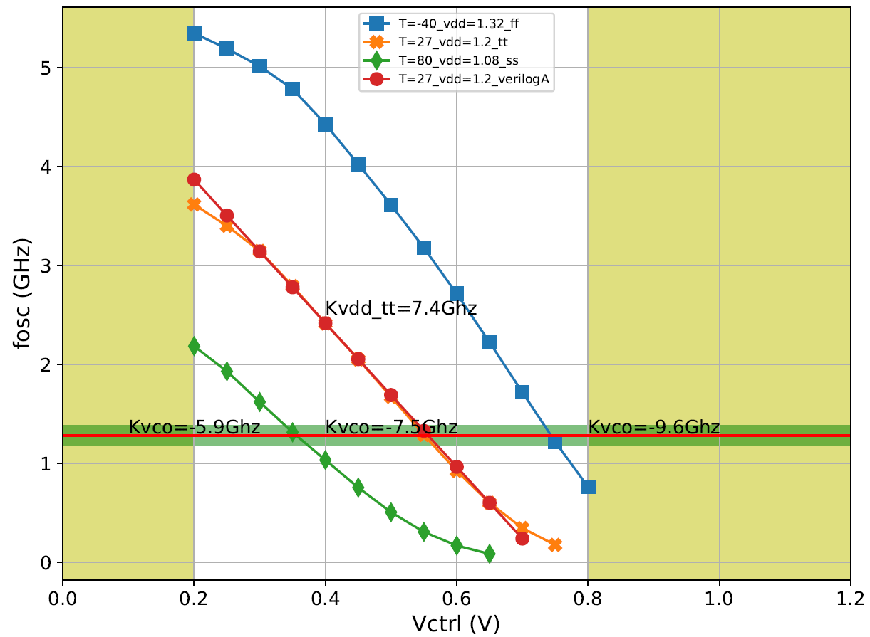
III. FastIC+ TDC: PLL design – Simulation Results
Vctrl vs. F_{osc} corners:
  Slow (green): 80ºC, V_{DD}=0.8, SS model
  Typical (red): 27ºC, V_{DD}=1.2, TT model
  Fast (blue): -40ºC, V_{DD}=1.32, FF model
Phase noise: -80 dBc/Hz
Phase margin: ~60º
Jitter: < 5ps
Power consumption: 12 mW
The PLL locks at 1.28 GHz in all corners
Notes:
The PLL converges at 1.28 GHz in all cases
The phase noise is -80dBc/Hz at 100 MHz
The phase margin is around 60º
We obtain a jitter better than 5 ps with 12 mW of power consumption

Slide 18
III. FastIC+ TDC Block Diagram
Front-End Readout (FERO) Macro:
FERO
BERO
Arbiter & Mux
Global FIFO
8xTime+Energy
FERO
FERO
FERO
FERO
1xTrigger
x9
x9
VCOPhase<15:0>
VCOCounts<4:0>
CoarseCounts<11:0>
PLL
Coarse Counter
Statistics
Serializer
101101…
RefClk (40 MHz)
CoarseCounts<23:0>
SyncRst
Notes:
Now let’s move to TDC Front-End Readout.

Slide 19
III. FastIC+ TDC: FERO design – Block Diagram
TDC input Hit processing chain:
  FERO Control: avoids multiple Hits within 25 ns time window.
  UF-TCM: array of 16 master-slave optimized flip-flops that captures the state of the PLL’s VCO.
    Based on PicoTDC Capture Flip-Flops.
    Only for Rising Edge.
  Hit Sync: synchronizes the Hit with the 1.28 GHz PLL clock.
  Fast TCM: captures the PLL’s VCO Gray Counter (#oscillations within a 25 ns period):
    Rising Edge
    Falling Edge
  Sync 40MHz FFs: resamples data at 40 MHz (metastability resolution):
    From this point all the data is synchronous (no stringent timing constraints).
Rising Edge (25ps time bin):
- Ultra-Fast (16b)
- Fast (5b)
- Data Enable (1b)
Falling Edge (390ps time bin):
- Fast (5b) + Phase(1b)
- Data Enable (1b)
Others (3b)
FERO Control
Ultra-Fast Time Capture Matrix (UF-TCM)
Hit Sync
Fast TCM
(Rise)
Fast TCM
(Fall)
Sync
40MHz
FFs
OUT
Hit
32
Standard Dells
Full Custom
[2] M. Horstmann; J. Christiansen; S. A.; G. Lumer-Klabbers; J. Prinzie: PicoTDC, Workshop on picosecond photon sensors for physics and medical applications, 2015, Prague
Notes:
This block needs to be done very carefully. If we don’t constrain the digital flow correctly, we may lose all the timing performance.
The processing chain has the following elements:
- Front-End Readout Control to prevent multiple hits in the same clock period
- The Ultra-Fast Time Capture Matrix containing 16 sampling elements to store the state of the VCO with the Hit rising edge.
- Master-slave flip flops optimized for timing, based on PicoTDC flip-flops
- The Hit synchronization block to work at the PLL clock frequency.
- Then we have the standard cell flip-flops to capture the PLL Counter.
- And finally, we have a block which resamples the data at 40 MHz to prevent metastability issues.
In total, one input Hit produces 32 output bits that will be processed in next stages.

Slide 20
III. FastIC+ TDC Block Diagram
Coarse Counter:
  Counts the number of 40 MHz clock periods.
  Extends the dynamic range of the ToA & ToT measurements.
  A dedicated ASIC synchronous reset pad (SyncRst) allows to synchronize at the detector level.
FERO
BERO
Arbiter & Mux
Global FIFO
8xTime+Energy
FERO
FERO
FERO
FERO
1xTrigger
x9
x9
VCOPhase<15:0>
VCOCounts<4:0>
CoarseCounts<11:0>
PLL
Coarse Counter
Statistics
Serializer
101101…
RefClk (40 MHz)
CoarseCounts<23:0>
SyncRst
Notes:
The coarse counter counts at 40 MHz and extends the dynamic range of both ToA and ToT
Moreover, it provides synchronization at the detector level with the Synchronous Reset pin

Slide 21
III. FastIC+ TDC Block Diagram
Back-End Readout (BERO):
FERO
BERO
Arbiter & Mux
Global FIFO
8xTime+Energy
FERO
FERO
FERO
FERO
1xTrigger
x9
x9
VCOPhase<15:0>
VCOCounts<4:0>
CoarseCounts<11:0>
PLL
Coarse Counter
Statistics
Serializer
101101…
RefClk (40 MHz)
CoarseCounts<23:0>
SyncRst

Slide 22
III. FastIC+ TDC: BERO design – Block Diagram
TDC Back-End Readout processing chain:
UFRise<4:0>
UFastRise<15:0>
Debubble & Encode
Hit Pipeline (Rise)
Pulse
Factory
Pulse
Processor
FIFO
To Arbiter…
Stage#0
Stage#1
Stage#2
FastRise<4:0>
Hit Pipeline (Fall)
FastFall<4:0>
Stage#0
Stage#1
Stage#2
Notes:
Once Hit edges are captured, we need to process them in the Back-End Readout block.

Slide 23
III. FastIC+ TDC: BERO design – Block Diagram
Debuble & Encode:
  Removes Bubbles from the Ultra-Fast Counter (sampled VCO phase).
  Encodes unary counter to binary natural.
UFRise<4:0>
UFastRise<15:0>
Debubble & Encode
Hit Pipeline (Rise)
Pulse
Factory
Pulse
Processor
FIFO
To Arbiter…
Stage#0
Stage#1
Stage#2
FastRise<4:0>
Hit Pipeline (Fall)
FastFall<4:0>
Stage#0
Stage#1
Stage#2
Notes:
The debbubling logic corrects the TDC bubbles that may occur in the Time Capture Registers, and then encodes the thermometer counter into binary natural.

Slide 24
III. FastIC+ TDC: BERO design – Block Diagram
Hit Pipeline (Rise, Fall):
  Adds a systematic latency to the acquired pulses.
    Current implementation: 3 stages → 75 ns (Freq = 40 MHz)
  This will allow to receive a trigger validation from an external system:
    E.g.: PET Coincidence system.
UFRise<4:0>
UFastRise<15:0>
Debubble & Encode
Hit Pipeline (Rise)
Pulse
Factory
Pulse
Processor
FIFO
To Arbiter…
Stage#0
Stage#1
Stage#2
FastRise<4:0>
Hit Pipeline (Fall)
FastFall<4:0>
Stage#0
Stage#1
Stage#2
Notes:
This block is a bunch of flip-flops connected in cascade which adds a fixed latency of 75 ns to the data.
This delay allows an external trigger system, like PET Coincidence system, to compute the trigger validation.

Slide 25
III. FastIC+ TDC: BERO design – Block Diagram
Pulse Factory:
  Collects rising & falling edge counters and joins them appropriately in a single packet.
    An FSM keeps track of the collected edges.
  Filters pulses not validated by an external trigger (optional).
  Discards malformed pulses (2 consecutive rising or falling edges).
UFRise<4:0>
UFastRise<15:0>
Debubble & Encode
Hit Pipeline (Rise)
Pulse
Factory
Pulse
Processor
FIFO
To Arbiter…
Stage#0
Stage#1
Stage#2
FastRise<4:0>
Hit Pipeline (Fall)
FastFall<4:0>
Stage#0
Stage#1
Stage#2
Notes:
The pulse factory combines rising & falling edges to build a pulse in a single packet.
It performs trigger validation filtering, if necessary.

Slide 26
III. FastIC+ TDC: BERO design – Block Diagram
Pulse Processor:
  Performs data encoding:
    Rising Edge counters: UltraFastRise, FastRise, CoarseRise → Timestamp
    Rising & Falling Edge counters: FastRise, FastFall, CoarseRise, CoarseFall → Pulse Width
  Filters pulses by pulse width (optional).
UFRise<4:0>
UFastRise<15:0>
Debubble & Encode
Hit Pipeline (Rise)
Pulse
Factory
Pulse
Processor
FIFO
To Arbiter…
Stage#0
Stage#1
Stage#2
FastRise<4:0>
Hit Pipeline (Fall)
FastFall<4:0>
Stage#0
Stage#1
Stage#2
Notes:
Then, rising & falling edge counters are encoded into Timestamp (ToA) and Pulse Width (ToT).
It also allows to filter pulses by width, if necessary.

Slide 27
III. FastIC+ TDC: BERO design – Block Diagram
FIFO:
  Stores data until the Arbiter grants the bus to the TDC channel.
UFRise<4:0>
UFastRise<15:0>
Debubble & Encode
Hit Pipeline (Rise)
Pulse
Factory
Pulse
Processor
FIFO
To Arbiter…
Stage#0
Stage#1
Stage#2
FastRise<4:0>
Hit Pipeline (Fall)
FastFall<4:0>
Stage#0
Stage#1
Stage#2
Notes:
Finally, pulses are stored into the Channel FIFO waiting for the Arbiter grant.

Slide 28
III. FastIC+ TDC Block Diagram
Arbiter & Mux:
  Receives bus requests from the TDC channels.
  Two arbitering policies: Round-Robin and Pulse sorting by Timestamp.
FERO
BERO
Arbiter & Mux
Global FIFO
8xTime+Energy
FERO
FERO
FERO
FERO
1xTrigger
x9
x9
VCOPhase<15:0>
VCOCounts<4:0>
CoarseCounts<11:0>
PLL
Coarse Counter
Statistics
Serializer
101101…
RefClk (40 MHz)
CoarseCounts<23:0>
SyncRst
Notes:
The Arbiter & Multiplexer receives the requests from the TDC channels.
We implemented two arbitering policies: Round-Robin and Pulse sorting by Timestamp. This second capability may simplify the data post processing.

Slide 29
III. FastIC+ TDC Block Diagram
Global FIFO:
  Interface between the different TDC channels and the Serializer.
FERO
BERO
Arbiter & Mux
Global FIFO
8xTime+Energy
FERO
FERO
FERO
FERO
1xTrigger
x9
x9
VCOPhase<15:0>
VCOCounts<4:0>
CoarseCounts<11:0>
PLL
Coarse Counter
Statistics
Serializer
101101…
RefClk (40 MHz)
CoarseCounts<23:0>
SyncRst
Notes:
The multiplexed data from the Arbiter is stored into the global FIFO.

Slide 30
III. FastIC+ TDC Block Diagram
Statistics:
  Provides packet drop counters at very low data rate (~1 kHz): malformed packets, filtered by trigger validation, filtered by pulse width, FIFO packet drops.
  Coarse counter extension to prevent timestamp dynamic range errors if there is low activity rate.
FERO
BERO
Arbiter & Mux
Global FIFO
8xTime+Energy
FERO
FERO
FERO
FERO
1xTrigger
x9
x9
VCOPhase<15:0>
VCOCounts<4:0>
CoarseCounts<11:0>
PLL
Coarse Counter
Statistics
Serializer
101101…
RefClk (40 MHz)
CoarseCounts<23:0>
SyncRst
Notes:
We additionally have a block which provides statistics at very low rate. This can be very helpful to debug readout problems.
Moreover, it provides an extended Coarse Counter to prevent overflow errors when operating at low rates.

Slide 31
III. FastIC+ TDC Block Diagram
Serializer:
  Aurora 64b/66b protocol.
  80/160/320/640 MHz DDR (160/320/640/1280 Mbps).
FERO
BERO
Arbiter & Mux
Global FIFO
8xTime+Energy
FERO
FERO
FERO
FERO
1xTrigger
x9
x9
VCOPhase<15:0>
VCOCounts<4:0>
CoarseCounts<11:0>
PLL
Coarse Counter
Statistics
Serializer
101101…
RefClk (40 MHz)
CoarseCounts<23:0>
SyncRst
Notes:
Finally, a Serializer implementing the Aurora protocol. It supports data rates from 160 Mbps to 1.28 Gbps.

Slide 32
III. FastIC+ TDC Single Shot Precision (preliminary)
Sources of inaccuracy:
  Reference clock (estimation): σ_{ClkRef} = 3.0 ps
  PLL Core Jitter: σ_{PLL} = 5.0 ps
  TDC bin quantization error: σ_{td} = 24.4 ps / sqrt(12) = 7.0 ps
  PLL Buffers Jitter: σ_{Buff} = 0.28 ps
  Time Capture Register Jitter: σ_{TCR} = 0.8 ps
  PLL → FERO interconnections: = ???
  Electronics noise contribution for 1 pe⁻ *: 30.0 ps
*: 330 pF 3x3 SiPM,
LCT5 S13360 SiPM,
Vov = 4.5 V, L = 1.2 nH
$$σ_{TDC}=\sqrt{σ_{ClkRef}^{2}+σ_{PLL}^{2}+σ_{Td}^{2}+σ_{Buff}^{2}+σ_{TCR}^{2}}=9.15 ps$$
$$σ_{FastIC+}=\sqrt{σ_{FE}^{2}+σ_{TDC}^{2}}=\sqrt{{30.0}^{2}+{9.15}^{2}}=31.4 ps → +4.5\%$$
Notes:
We have done a preliminary study of the Single Shot Precision of the full TDC.
The expected TDC resolution should be around 9 ps
Assuming an Electronics Noise contribution for 1 pe of 30 ps, the Single Shot Precision of FastIC+ should be around 31.4 ps, an increase in 4.5% wrt the previous FastIC ASIC.

Slide 33
III. FastIC+ TDC Power Consumption (preliminary)
Total power consumption: : P_{TDC} < 27 mW (estimation)
  PLL: ~14 mW
  Time Capture Registers: ~2.7 mW
  TDC Digital Readout: <10mW (estimation)
Power consumption per channel: P_{TDC_CH}< 3.4 mW (estimation)
FastIC (2020) power consumption (lab measurement): P_{FASTIC} =12 mW/ch
  8xSLVS individual outputs contribute a total power consumption of 22 mW
  P_{FASTIC_OUT_CH} = 2.75 mW/ch
FastIC+ (2023) power consumption (estimation), without binary outputs:
$$P_{FASTIC+}=P_{FASTIC}+( P_{TDC_{CH}}−P_{{FASTIC}_{{OUT}_{CH}}})=12.65\frac{mW}{ch}→ +5.4\%$$
Notes:
Regarding the Power Consumption, we expect to have a Power Consumption lower than 27 mW
3.4 mW/ch
FastIC has 12 mW/ch of power consumption.
In FastIC+ we can power down the individual SLVS binary outputs and save 2.75 mW/ch
The expected power consumption will be around 12.65 mW/ch, an extra 5.4%.

Slide 34
Outline
Introduction
FastIC (2020)
FastIC+ (2023)
Summary

Slide 35
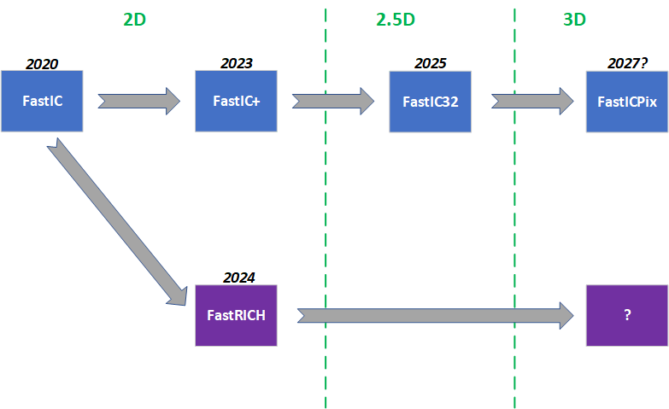
IV. Summary
FastIC+ converts FastIC in a System-on-Chip:
  Density: allows higher segmentation (<C_{Det})
  Scalability: allows to build larger detectors
Good trade-off between power & time resolution:
  Should not worsen electronics jitter contribution for 1 pe⁻ more than 4.5% (FastIC: 30 ps, FastIC+: 31.36 ps)
  Overall power consumption increases by +5.4% (FastIC: 12 mW/ch, FastIC+: 12.65 mW/ch)
Multiple mechanisms to reduce bandwidth:
  Filter by pulse width
  Filter by trigger validation
Supports sustained event rates up to 3 MHz/ch.
  This could be scaled (if necessary) in future ASIC versions by adding more serializers.
Scheduled submission: september 2023

Slide 36
  Thanks a lot for your attention !!!
  Comments or questions ?
  jmauricio@fqa.ub.edu

Slide 37
  BACKUP

Slide 38
II. FastIC: Design Specifications
Parameter | Value
Technology | 65 nm CMOS TSMC
Power consumption | ~ 12 mW/ch in SE mode (V_{DD} = 1.2 V), depends on operation mode (~ 3 mW/Input Stage). Non-Linear ToT 6 mW/ch.
Input voltage | Adjustable input node DC voltage.
Number of channels | Input channel configuration (current mode processing): 8 Single Ended (SE) or 4 Differential (DIFF).
Connection Type | Configurable SE (Pos/Neg polarity), DIFF, Sum of 4 (Pos/Neg polarity)
Electronics Time Jitter | ~ 30 ps_{rms} SPTR (330 pF 3x3 SiPM, LCT5 S13360 SiPM, Vov = 4.5 V, L = 1.2 nH)
Energy Resolution | Linear (~ 2.5 % Linearity error)
Dynamic Range | The linear energy measurement has 10-bit dynamic range up to ~25 mA of input current.
Maximum Rate | ~ 2 MHz (Linear ToT readout) > 50 MHz (Non-linear ToT. Pulse-shape-dependent)
Testing and Calibration | Yes
Interface | I2C
Output | Configurable Digital (single-ended CMOS or differential SLVS) or Analog output (10 pF load).

Slide 39
II. FastIC: Linearity of the Energy measurement
FastIC provides a measurement of the time and energy per channel in two consecutive pulses
  Based on HRFlexToT ASIC [1]
  Linear energy by pulse width encoding
    “Wilkinson ADC-like” conversion
    Controlled by on-chip state machine
Linearity error is below 3%
  Saturation is reached at 25 mA of input current.
  Other operating modes (negative, differential and summation) behaves similarly with a low linearity error.
  This makes FastIC suitable to different detectors: LYSO/LSO, BGO, Cherenkov, Monolithic, etc
  Different trigger modes, including cluster trigger for monolithic
[1]: Sanchez, D., Gomez, S., et. al. HRFlexToT: A High Dynamic Range ASIC for Time-of-Flight Positron Emission Tomography, 2021, IEEE TRPMS, https://doi.org/10.1109/TRPMS.2021.3066426
Notes:
The energy measurement islinear energy with a dynamic range from a few microamperes to ~20 mA (in the negative polarity stage) and to ~25 mA (in the positive polarity). The input stage generates replicas (in current mode) of the input signal that are fed in three different paths. The Time path provides an accurate measurement of the particle time of arrival using a precise leading edge discriminator. The Energy path generates a digital pulse at its output whose duration is directly proportional to the input signal amplitude. The third path is for Trigger purposes and might be used to set its threshold above the first photoelectron, allowing to ignore dark count events from the detector. The Cluster Trigger adds the trigger signal from multiple channels before discrimination. This is useful to trigger on detectors in which the signal is shared by different channels (e.g. PET detectors based on monolithic crystals). The chip provides the interface between detectors and Time-to-Digital Converters (TDCs).

Slide 40
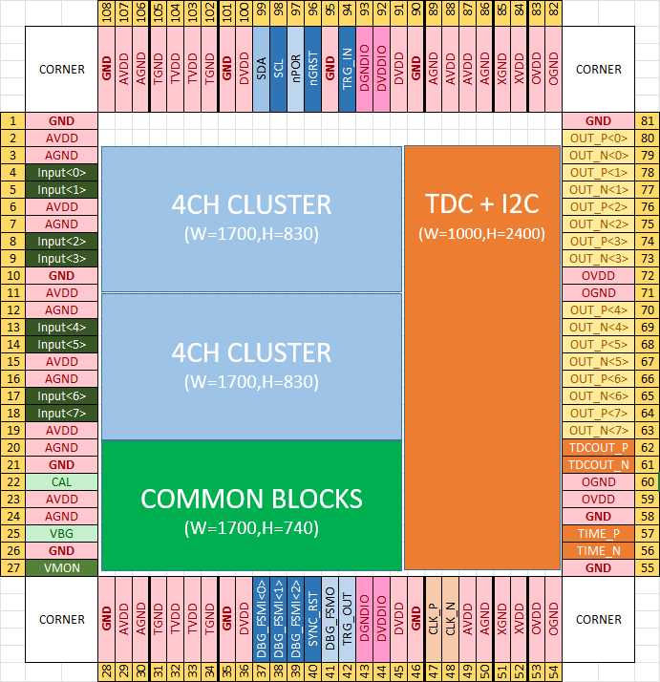
II. FastIC+ Pad Ring (preliminary)
Die Size:
- X: 2920 um
- Y: 2890 um
Pad Pitch: 100 um
New Pads (10):
SYNC_RST
GND
XVDD/XGND
TDCOUT_P / TDCOUT_N
(2)
(3)
(2)
(2)
(4)
(1)
(3)

Slide 41
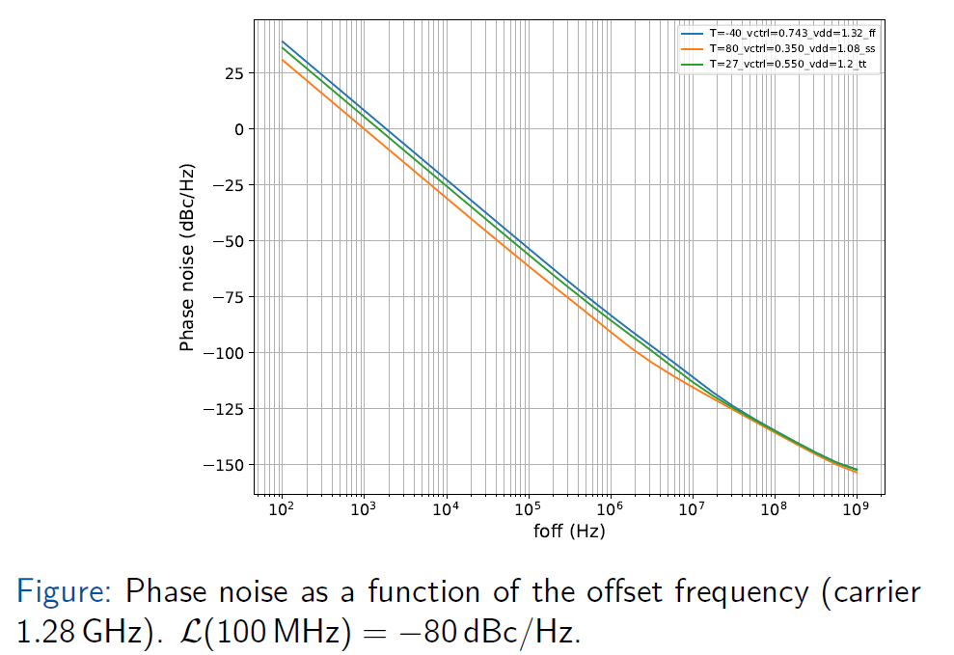
III. FastIC+ TDC: PLL Phase noise vs. Offset Freq.

Slide 42
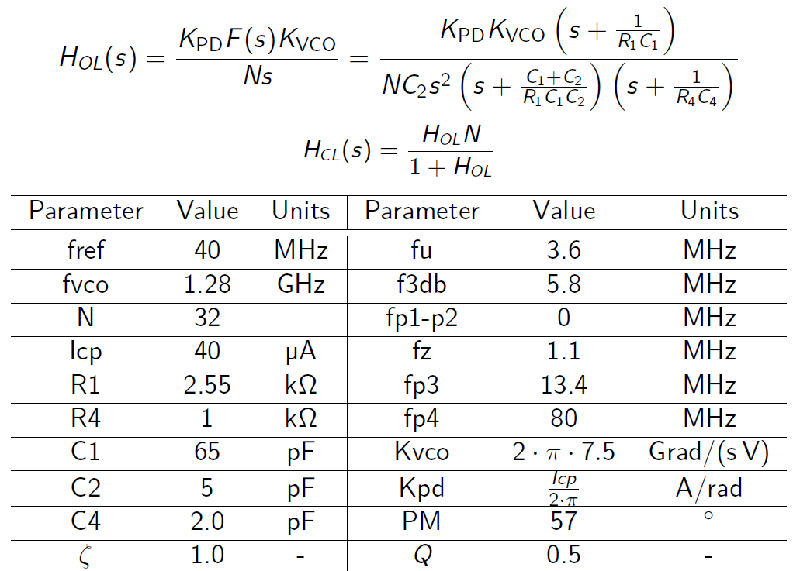
III. FastIC+ TDC: PLL design – PLL Linear Model

Slide 43
III. FastIC+ TDC: PLL design – Block Diagram
Buffers:
  Isolate VCO Delay Elements from outside.
  Slew Rate adjustment (per Delay Element) to improve TDC bins uniformity.
  Odd stages can be disabled to reduce power consumption at expenses of time bin (50ps).
VCO
‘1’
Even Stages
VCIn
Digital
Ph Det
Chg
Charge
Pump
Loop Filter
VCO
16
Buffers
16
VCtrl
ClkRef
(40 MHz)
In<2*i>
Out<2*i>
VcoPhase<15:0>
(Thermometer Encoding)
SlewRise[2*i]<3:0>
OutCopy<2*i>
To TDC
FERO
SlewFall[2*i]<3:0>
Clock
Manager
Buffers:
EnableSmallBin
Odd Stages
In<2*i+1>
Out<2*i+1>
Digital
Flow
Analog
Flow
ClkSer
ClkFsm
ClkVco
ClkTdc
SlewRise[2*i+1]<3:0>
OutCopy<2*i+1>
SlewFall[2*i+1]<3:0>

Slide 44
III. FastIC+ TDC: FERO Control Asyncrhonous FSM
Prevents that two edges occur within the 25 ns clock period:
  The readout throughput is limited at 40 MHz.
  The second pulse must be filtered to prevent the Time Capture Registers to fire twice.
Post-layout simulations:
Delay Hit → Z: 93.4 ps
- σJitter: 58 fs
- σProcess: 5.9 ps

Slide 45
III. FastIC+ TDC: FERO design – Block Diagram
Allows simulataneous rising & falling edge capture:
  Rising edge: Fast Counter + Ultra-Fast Counter (Time Capture Registers) (25 ps).
  Falling edge: Fast Counter (390 ps).

Slide 46

III. FastIC+ TDC: BERO design – Block Diagram
Debubble & Encode:
  Rectifies TDC Ultra-Fast Counter code infeasibility due to non-homogeneous TDC bin widths:
    0000101111111111 → 0000011111111111
  This can result in significant errors (around the counter overflow):
    0000000000000010 → 0000000000000011
    This would produce an error equivalent to 16 TDC counts (390 ps).
  Finally, the bits are encoded in a binary natural counter.
The MSB is employed to determine the phase of the VCO during the moment of capture.
UFastRise<15:0>
Debubble & Encode
Hit Pipeline (Rise)
Pulse
Factory
Pulse
Processor
FIFO
To Arbiter…
Stage#0
Stage#1
Stage#2
FastRise<4:0>
Hit Pipeline (Fall)
FastFall<4:0>
Stage#0
Stage#1
Stage#2
Notes:
First, we have the Ultra-Fast Counter debubbling, which fixes unfeasible codes produced by non-homogeneities in the TDC bins.
This can be potentially dangerous in case that the error occurs in the MSB, which holds the VCO phase information.
Finally we encode the data in binary natural.

Slide 47
III. FastIC+ TDC Frame Types
0 - High Speed:
1 - High Energy Resolution:
2 - Hybrid Mode (NL-ToT):
3 - Hybrid Mode (Linear ToT):
ToA
CH Out<0>
…
NL ToT
…
ToA
CH Out<0>
Linear ToT
…
…
ToA
CH Out<0>
NL ToT
Linear ToT
…
…
ToA
CH Out<0>
NL ToT
Linear ToT
…
…

Slide 48
V. FastIC Roadmap: FastRICH (2024)
Application specific: RICH/TORCH (LHCb) and PID: small Cdet (MCP/PMT and small SiPMs)
Small dynamic range (single photon regime)
Constant Fraction Discriminator (no energy readout needed)
System-on-Chip: integrated TDC, digital signal processing and serializers
Radiation hard
Standard multichannel chip: readout of 2D sensor matrices
Notes:
The next member of the family will be the FastRICH, a readout chip designed for the LS3 enhancements and the Upgrade II of the LHCb RICH detector. The 16-channel radiation-hard FastRICH will be capable of reading out MAPMTs, MCPs, and SiPMs, with peak hit rates up to 40MHz. The low-power readout, with 4 lpGBT/VTRx-compatible 1.28GHz SLVS output links, is optimized for bandwidth reduction, allowed by the use of a Constant Fraction Discriminator for time-walk compensation, a programmable hardware shutter, and a custom readout protocol. Preliminary simulations show <20 ps timing resolution (electronics jitter contribution) for small sensors (1x1 mm²), with a total power consumption of <10mW per channel.

Slide 49
V. FastIC Roadmap: FastIC32 (2025)
Generic: wide range Cdet (MCP/PMT to large SiPMs)
Large linear dynamic range (1000s of pe)
System-on-Chip: integrated TDC, digital signal processing and serializers
Not radiation hard
Vertical 2.5 D integration: high density and optimal interconnect
Notes:
The next planned goal will be to explore vertical integration, by developing the FastIC32, a 32 ch pixelated System-on-Chip (SoC)

Slide 50
V. FastIC Roadmap: FastICPix (2027)
Generic: wide range Cdet (MCP/PMT to large SiPMs)
Large linear dynamic range (1000s of pe)
System-on-Chip: integrated TDC, digital signal processing and serializers
Not radiation hard
Vertical 3D integration: towards ultimate SPAD timing performance
Notes:
The ultimate dream will be FastICpix, a 3D integrated sensor exploiting segmentation to target a 10 ps single photon time resolution.

Slide 51
V. FastRICH (2024)
FastRICH block diagram

Slide 52


V. FastIC32: a hybrid photosensor
2.5D and 3D Integration
  Photon Detection Module (PDM) in which SiPMs with TSVs down to 1 mm pitch
  Connected to the readout ASIC on the opposite side of a passive interposer
FastIC 32
Integrated Photon Detection Module
Hybrid SiPM module being developed for ultimate timing performance in ToF-PET

Slide 53
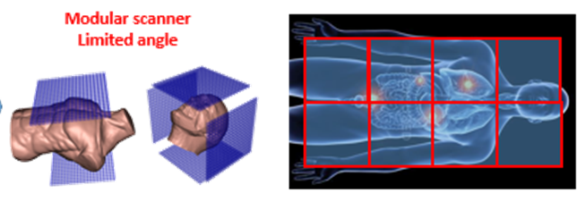
V. FastIC32: PETVision
The PETVision Project was approved. Call: Horizon EIC 2022 Pathfinder-open.
  5-year project starting in September 2023
The aim of PetVision is to leverage on 3D / 2.5D integration techniques to build a modular ToF-PET scanner, with next-generation performance and affordable cost.
Partner | PI | Country
JSI | Rok Pestotnik | SI
FBK | Alberto Gola | IT
ICCUB | David Gascon | ES
Oncovision | Jorge Alamo | ES
CSIC | Jose Maria Bennloch | ES
TUM-MED | Wolfgang Weber | DE
MGH | Georges El Fakhri | USA
Simulation of the capability of the proposed planar TOF PET imager: Reconstructed Image (3mm slices) of an XCAT digital phantom acquired by two 120x60cm² panel detectors (above and below the patient) assuming 100 ps TOF resolution and 10 mm scintillator thickness (A) and with small 4 panel system used to image head (B) and torso (C)

Slide 54
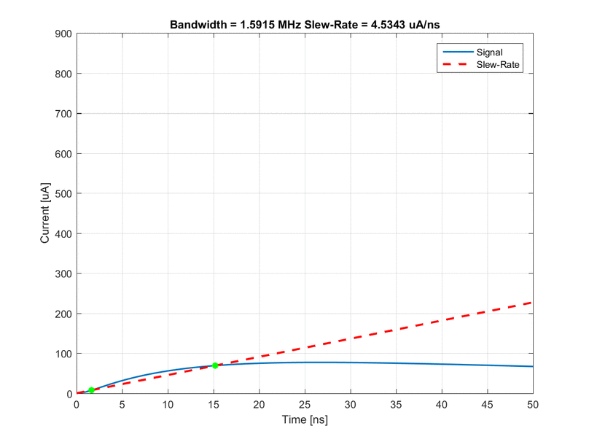
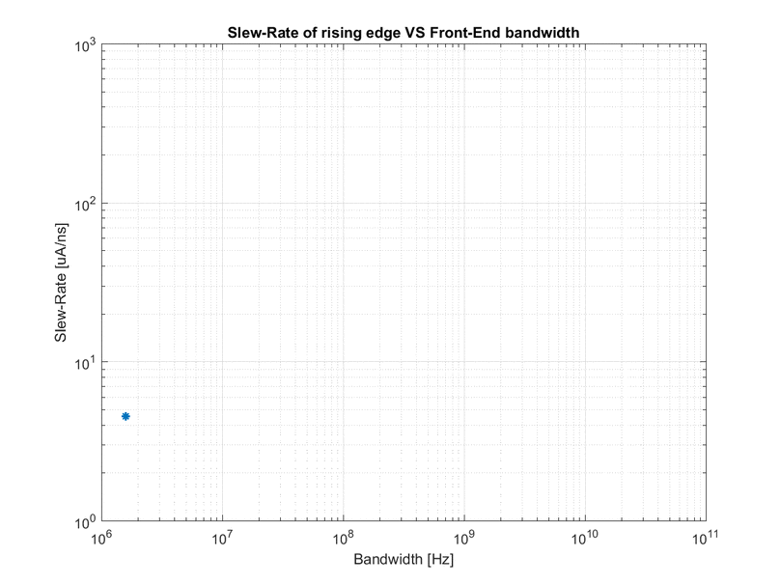



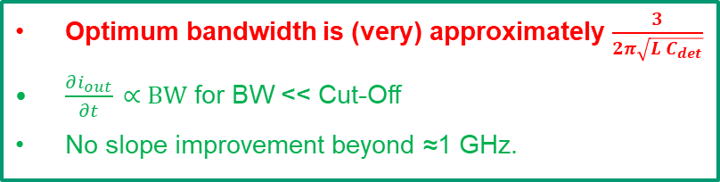


V. FastIC32: Effect of interconnects (inductance)
Additional poles from parasitics ≈ $\frac{3}{2π\sqrt{L C_{det}}}$
Optimum bandwidth for connecting inductances 5 nH – 25 nH and Cdet = 10 pF – 1 nF
$$\frac{∂i_{in}}{∂t}$$
$$\frac{∂i_{out}}{∂t}$$
Lwb / Cdet
5 nH / 10 pF | 5 nH / 1 nF | 25 nH / 10 pF | 25 nH / 1 nF
1.3 GHz | 270 MHz | 560 MHz | 81 MHz
J. M. Fernández-Tenllado, et alt, "Optimal design of single-photon sensor front-end electronics for fast-timing applications," IEEE NSS/MIC 2019,
doi: 10.1109/NSS/MIC42101.2019.9059805.
See also:Sensors 2020, 20(16), 4428; https://doi.org/10.3390/s20164428
$$\frac{∂i_{out}}{∂t}$$
Optimum bandwidth is (very) approximately $\frac{3}{2π\sqrt{L C_{det}}}$
$\frac{∂i_{out}}{∂t} \text{∝} BW$ for BW << Cut-Off
No slope improvement beyond ≈1 GHz.
$$SR=\frac{\text{∂}i_{out}}{\text{∂}t}\text{∝}\left(\frac{\text{∂}i_{in}}{\text{∂}t}\right)∗\left({BW⋅e}^{−t⋅BW} \right)$$
Optimal FE and interconnect BW should match signal BW
Courtesy: J. M. Fernandez-Tenllado (UB/CERN)
Notes:
Optimizing only FE chip is not enough. Let’s consider the parasitic inductance. This is pulse shape and slew rate of the signal as fucntion of FE electronics bandwith and considering interconnection parasitics.
If we start with very low bandwith SR improves with BW but at some point there is no imporvement anymore
because additional poles from input parasitic network limit the SR of the input signal. No gain in increasing BW, indeed degradation because higher integrated noise.
Optimal FE BW thus depends on the value of parasitics. This shown here for typical values and in case there is no improvement for FE BW higher tan 1 GHz.

Slide 55
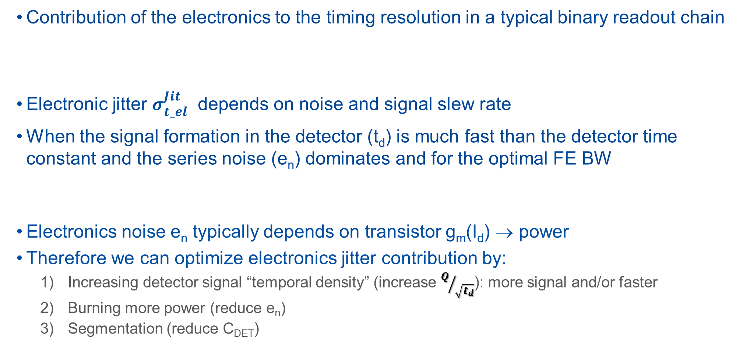
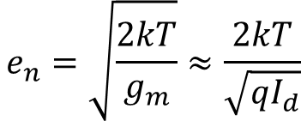
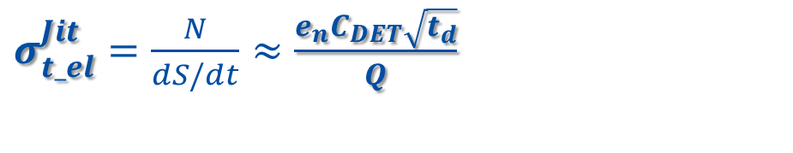
VI. How to improve the contribution of the electronics to the final timing?
55
Contribution of the electronics to the timing resolution in a typical binary readout chain
Electronic jitter $σ_{t_el}^{Jit}$ depends on noise and signal slew rate
When the signal formation in the detector (t_{d}) is much fast than the detector time constant and the series noise (e_{n}) dominates and for the optimal FE BW
Electronics noise e_{n} typically depends on transistor g_{m}(I_{d}) → power
Therefore we can optimize electronics jitter contribution by:
  Increasing detector signal “temporal density” (increase $Q/{\sqrt{t_{d}}}$): more signal and/or faster
  Burning more power (reduce e_{n})
  Segmentation (reduce C_{DET})
$$σ_{t_el}^{2}={\left(σ_{t_el}^{TW}\right)}^{2}+{\left(σ_{t_el}^{Jit}\right)}^{2}+{\left(σ_{t_el}^{TDC}\right)}^{2}={\left({\left[\frac{t_{r}V_{th}}{S}\right]}_{RMS}\right)}^{2}+{\left(\frac{N}{dS/dt}\right)}^{2}+{\left(\frac{{TDC}_{Bin}}{\sqrt{12}}\right)}^{2}+ …$$
C. De La Taille, Electronics Tutorial IEEE/NSS Manchester 2019
$σ_{t_el}^{Jit}=\frac{N}{dS/dt}≈$ $\frac{e_{n}^{ }C_{DET}\sqrt{t_{d}}}{Q}$
$$e_{n}=\sqrt{\frac{2kT}{g_{m}}}≈\frac{2kT}{\sqrt{qI_{d}}}$$
Notes:
Electronic jitter depends on noise and signal slew rate. Typically, noise is proportional to the square root of the BW.
Signal slew rate is inversely proportional to signal rise time and thus proportional to the BW, at least for a simplied linear FE.
Therefore, the electronics jitter should be inversely proportional to the square root of the BW:
Then in principle we should maximize the BW of our electronics…
But is this completely correct?

Slide 56
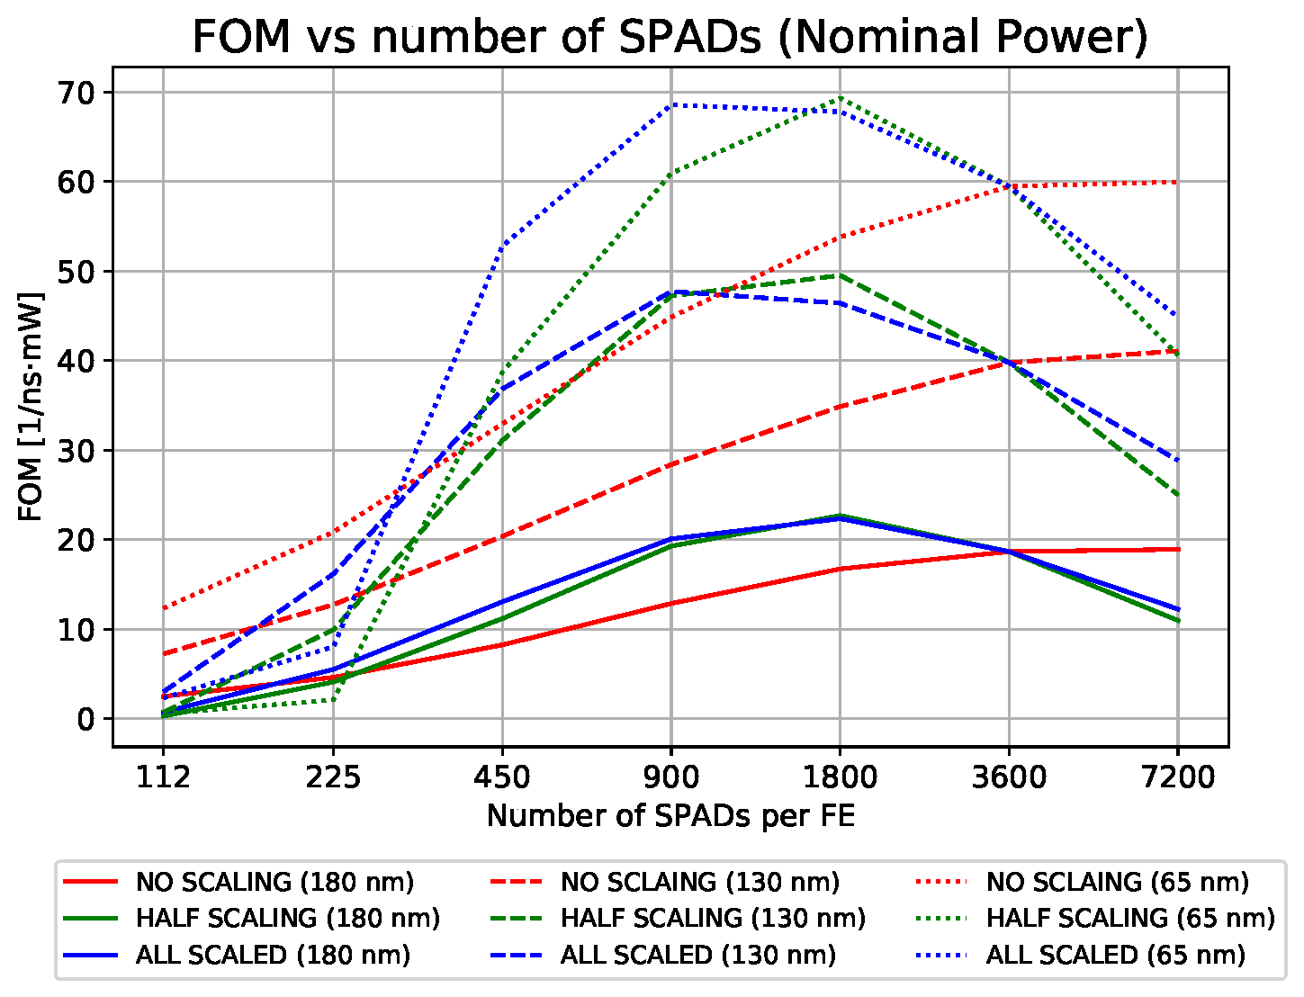

VI. Segmentation
Segmentation is promising: but don’t forget power !!!
What is the optimal segmentation for a given power budget?
  $FOM= \frac{1}{Jitter∙Power∙{10}^{12}} \left[\frac{1}{ns∙mW}\right]$
  “Electronics noise” jitter for 1 firing cell
How does CMOS technology scaling impacts?
  Compare: 180, 130 and 65 nm nodes
Typical 3x3 mm² SiPM
3600 cells (50 um)
Divided in groups of N SPADs
Each group readout by FE
Total power kept constant
Segmentation factor 4 for a typical 3x3 mm² SiPM
Power required to achieve 10 ps “electronic noise” jitter with optimal segmentation for a 3x3 mm² SiPM?
180 nm: 10 mW
130 nm: 3 mW
65 nm: 2 mW
R. Manera et al., "Study of Optimal Segmentation for Active Hybrid Single-Photon Sensors," 2021 IEEE Nuclear Science Symposium and Medical Imaging Conference (NSS/MIC), Piscataway, NJ, USA, 2021, pp. 1-3, doi: 10.1109/NSS/MIC44867.2021.9875648.

Slide 57
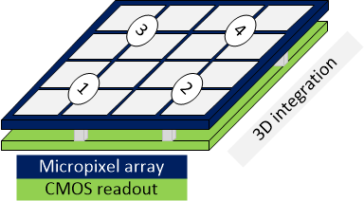
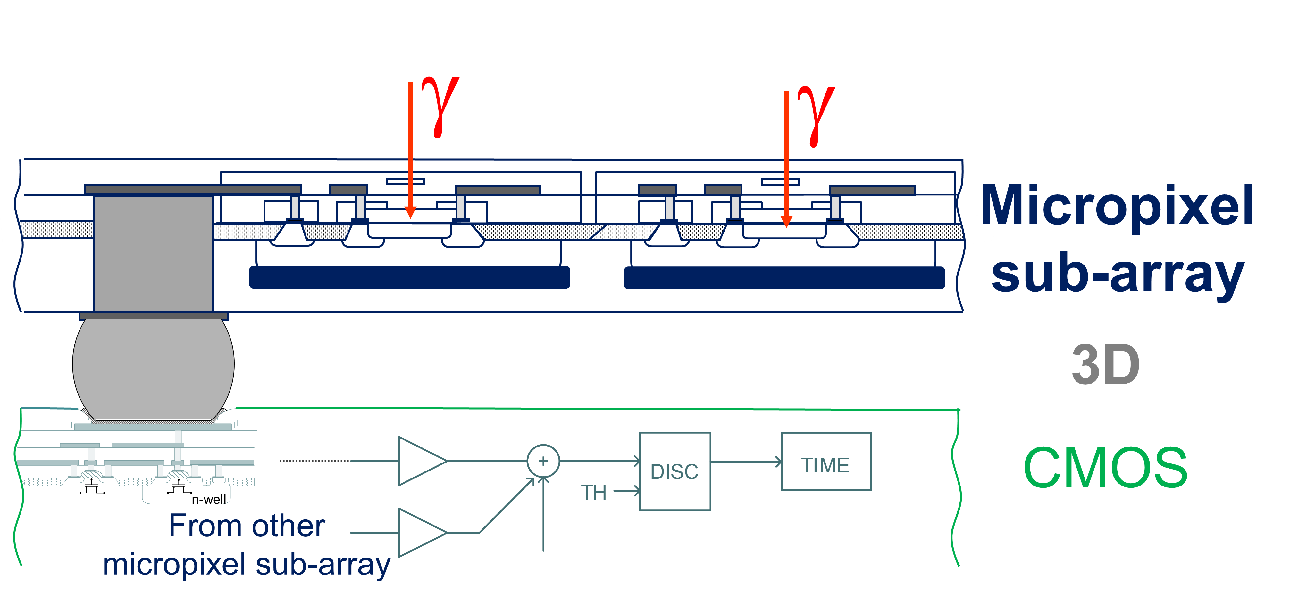
VI. FastICPix
FastICpix: try to exploit optimal segmentation
  Optimization for a given power budget !
  Investigation of new circuit topologies
  3D integration
Electronic noise jitter < 1 ps for next generation of detectors based on prompt light
Time tagging of first(s) photons
Optimal and adaptable
segmentation:
with hybrid detector
Optimal solution between these
2 extreme configurations?
No segmentation
Maximum
segmentation

Slide 58
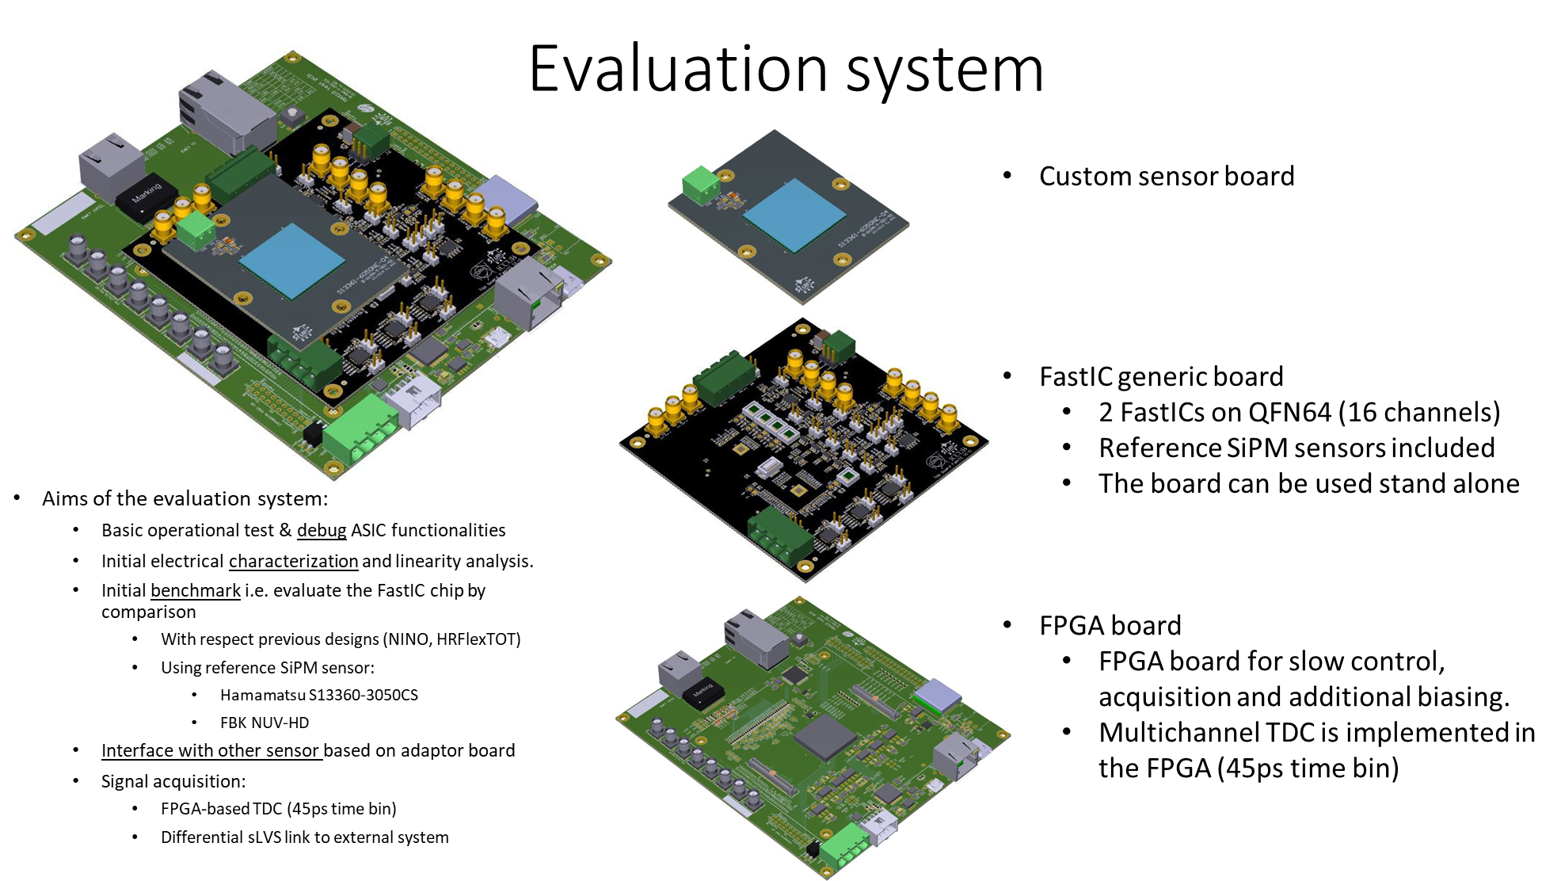
II. FastIC evaluation system

Slide 59
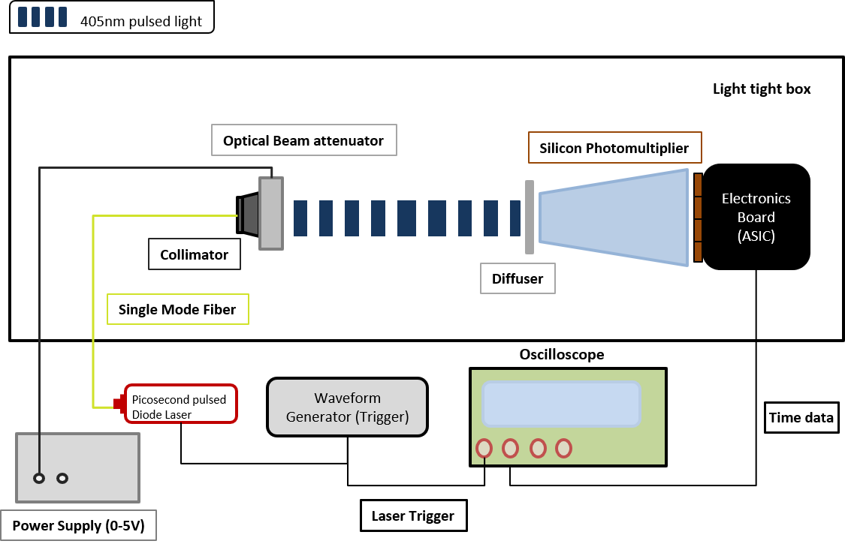
II. FastIC: SPTR measurements with SiPM and blue laser light
FASTIC and HRFlexToT used for comparison.
The setup is as follows:
  Advanced Laser Diode Systems A.L.S. GmbH (PiL040X) at 405 nm and a tuned intensity level of 50%, jitter < 3 ps and < 45 ps pulse width .
  Sensor: S13360-3050CS (Hamamatsu)
  Agilent MSO 9404A 4 GHz oscilloscope (20 GS/s).
  Several measurements are performed to identify the optimal threshold.

Slide 60
Performance: SPTR measurements with SiPM and blue laser light
Sensor: HPK S13360-3050CS
Results are obtained by performing a Gaussian plus an exponential fit of the delay histogram.
  Best SPTR FASTIC: 176,03 ps
  Best SPTR HRFlexToT: 202,05 ps

Slide 61
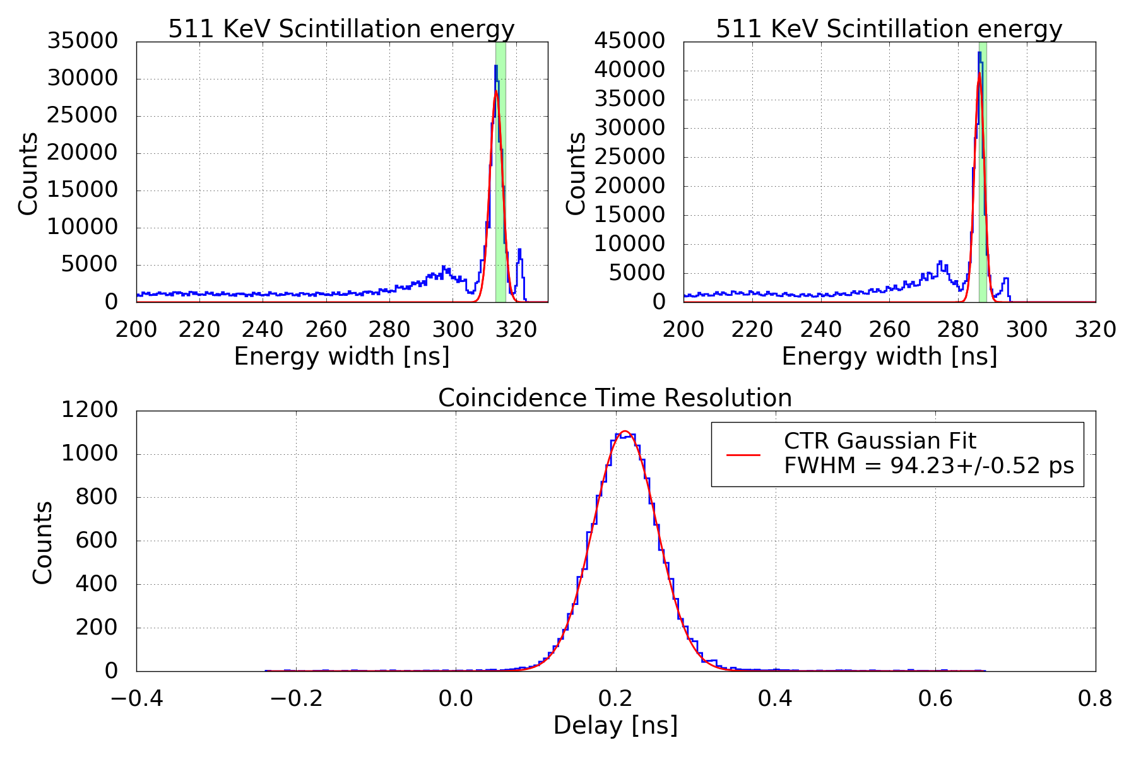
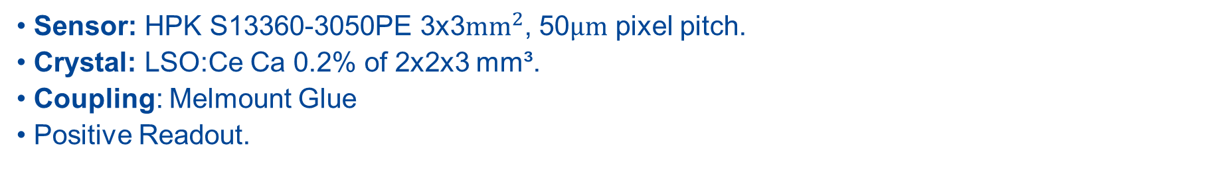
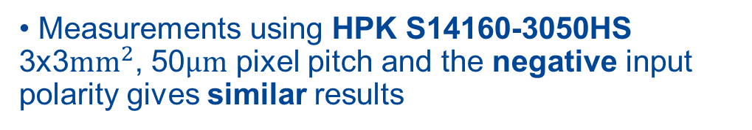
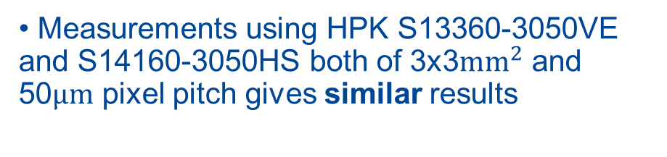
II. FastIC performance: CTR with scintillation light.
Sensor: HPK S13360-3050PE 3x3$mm^{2}$, 50$μm$ pixel pitch.
Crystal: LSO:Ce Ca 0.2% of 2x2x3 mm³.
Coupling: Melmount Glue
Positive Readout.
FWHM = 94 ps
Measurements using HPK S13360-3050VE and S14160-3050HS both of 3x3$mm^{2}$ and 50$μm$ pixel pitch gives similar results
Measurements using HPK S14160-3050HS 3x3$mm^{2}$, 50$μm$ pixel pitch and the negative input polarity gives similar results
For 1 sigma around 19 K events are selected.
FastIC Bias voltage 60.0 V (~7 V of Over-voltage)
Notes:
I. CTR results using HPKK sensor

Slide 62
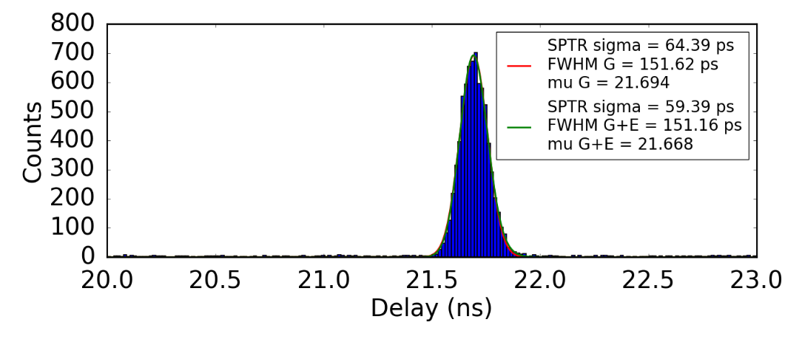
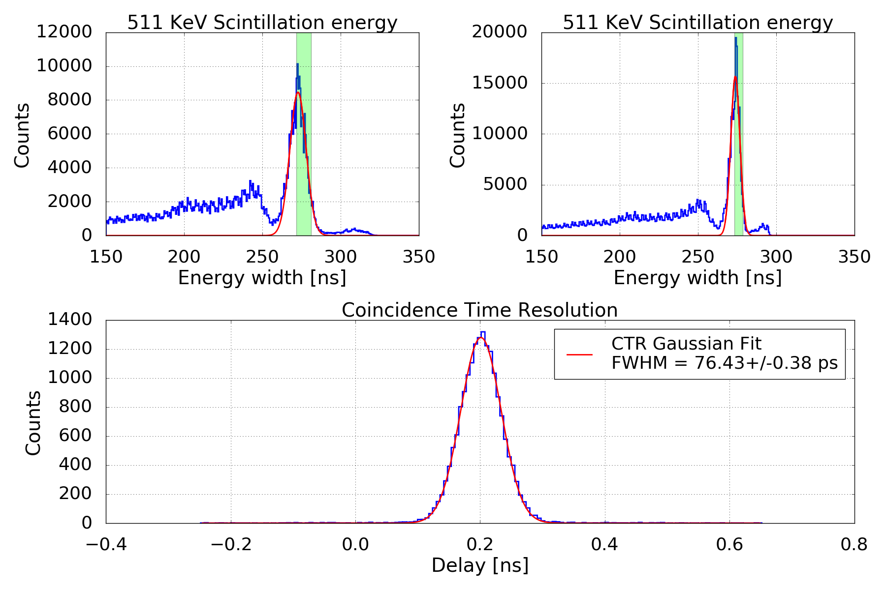
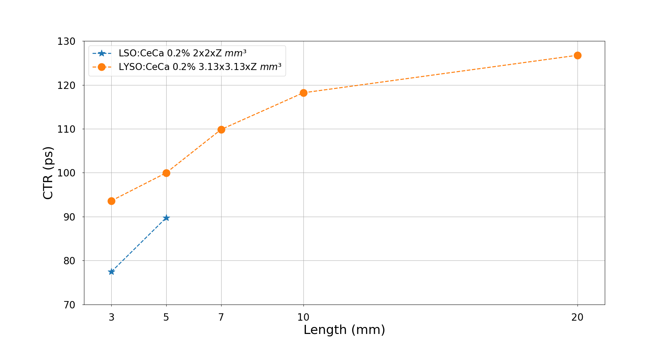
II. FastIC performance: CTR with scintillation light.
Sensor: FBK-NUVHDLFv2b 3x3 mm², 40 pixel pitch.
Crystal: LSO:Ce Ca 0.2% of 2x2x3 mm³.
SPTR with FBK-NUVHDLFv2b 3x3 mm²
150 ps FWHM
CTR versus crystal length for LYSO and LSO
FWHM = 76 ps
  Input “amplifier” < 3 mW/ch
  Complete signal processing < 12 mW/ch
Notes:
FastIC coupled to FBK HD-NUV Low Field SiPM achieves a Single Photon Time Resolution of 150 ps FWHM and CTR of 76 ps FWHM with a small LSO crystal.
LYSO and LSO crystals of different lengths coupled to FBK NUV-HD Low Field SiPM were measured. A CTR of 126.4 ps FWHM can be achieved for a 20 mm crystal length.

Slide 63
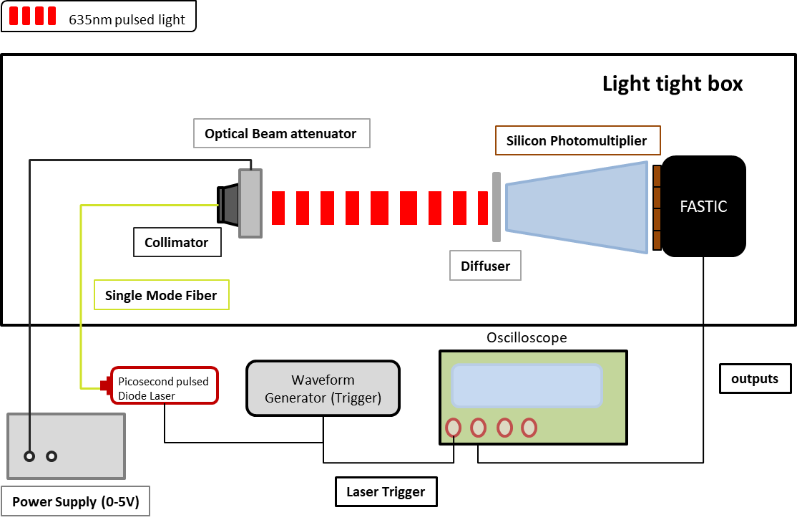
FastIC performance: SPTR measurements with SiPM and red light
FASTIC and HRFlexToT used for comparison.
The setup is as follows:
  PicoQuant PDL 800-D laser at 635 nm and a tuned intensity level of 50%, jitter < 20 ps rms and 30 ps pulse width.
  Sensor: S13360-3050CS (Hamamatsu).
  Agilent MSO 9404A 4 GHz oscilloscope (20 GS/s).
  Several measurements are performed to identify the optimal threshold.

Slide 64
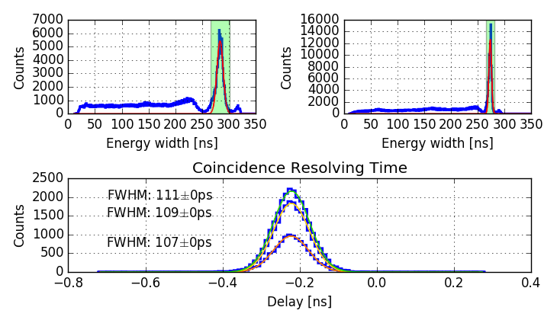
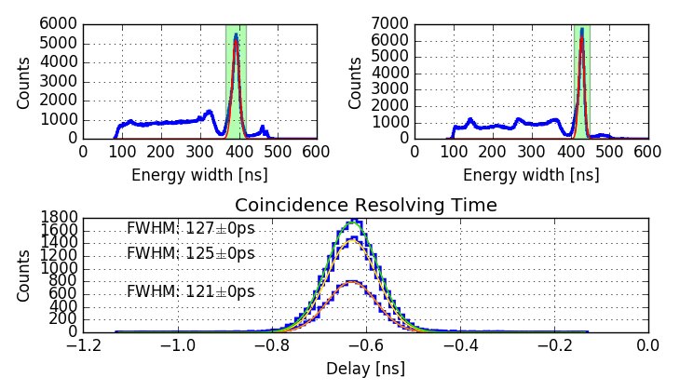
FastIC performance: CTR with scintillation light.
Sensor: HPK S13360-3050CS 3x3$mm^{2}$, 50$μm$ pixel pitch.
Crystal: LSO:Ce Ca 0.2% of 2x2x5mm³.
FastIC Bias voltage 60.0 V (7 V of Over-voltage)
HRFlexToT Bias voltage 60V (7V of Over-voltage)
FWHM = 107 ps
FWHM = 121 ps
Different amount of events are selected in coincidence from the 511 keV energy peak.
For 1 sigma around 13 K events are selected, and 25 K and 30 K for 2 and 3 sigma respectively.
Notes:
I. CTR results using HPKK sensor

Slide 65
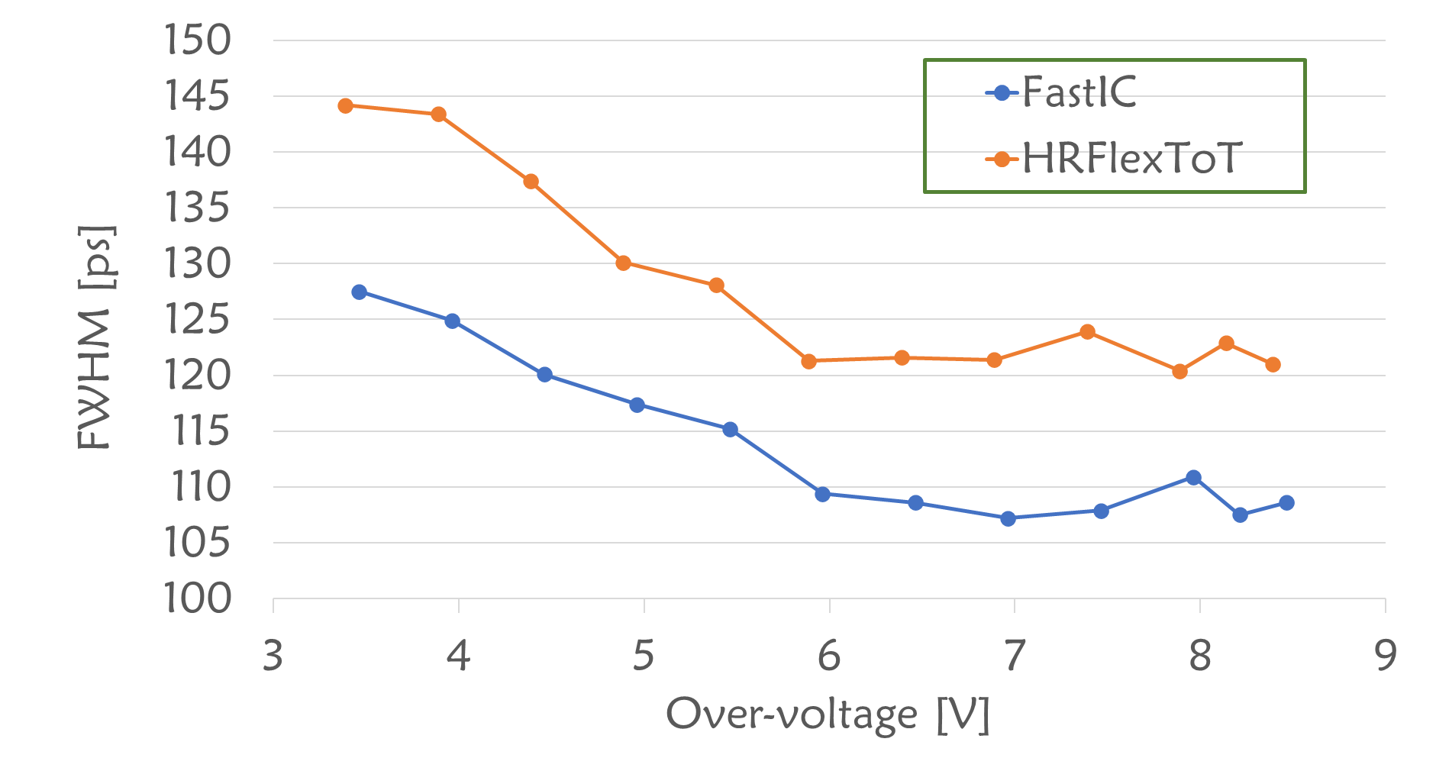
FastIC vs HRFlexToT: CTR with scintillation light.
Best CTR is achieved at over-voltages from 6 V to 8.5 V for both ASICs
Sensor: HPK S13360-3050CS 3x3$mm^{2}$, 50$μm$ pixel pitch.
Crystal: LSO:Ce Ca 0.2% of 2x2x5mm³
HRFlexToT → FWHM = 121 ps
FastIC → FWHM = 107 ps
Improvement: 11,5%
Different amount of events are selected in coincidence from the 511 keV energy peak.
For 1 sigma around 13 K events are selected, and 25 K and 30 K for 2 and 3 sigma respectively.
Notes:
I. CTR results using HPKK sensor

Slide 66
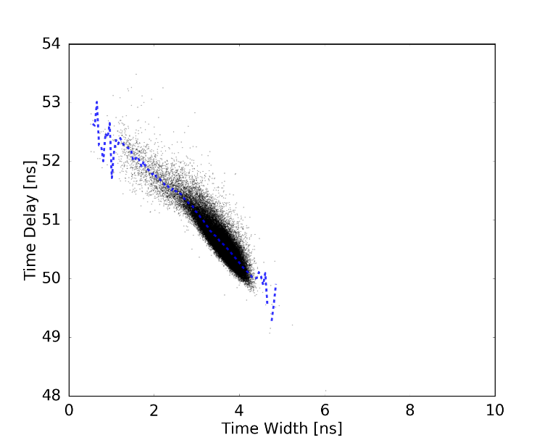
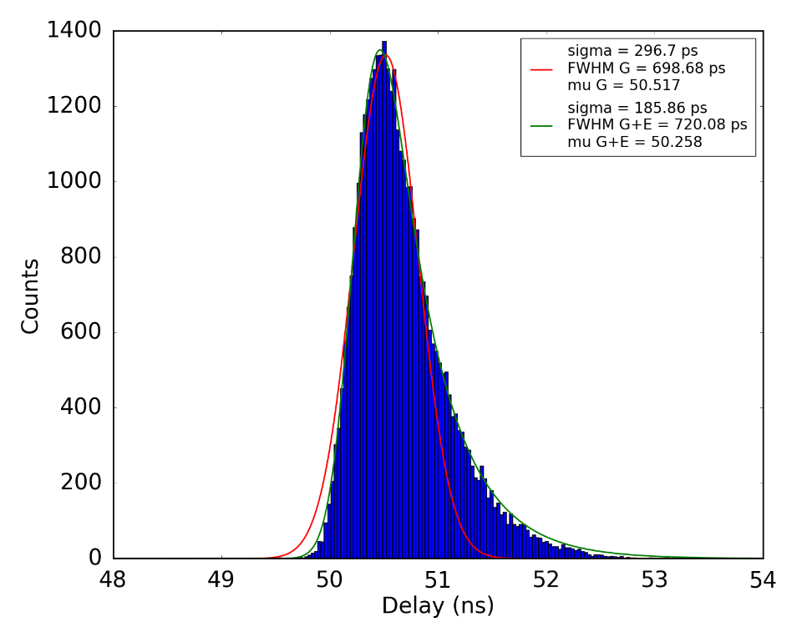
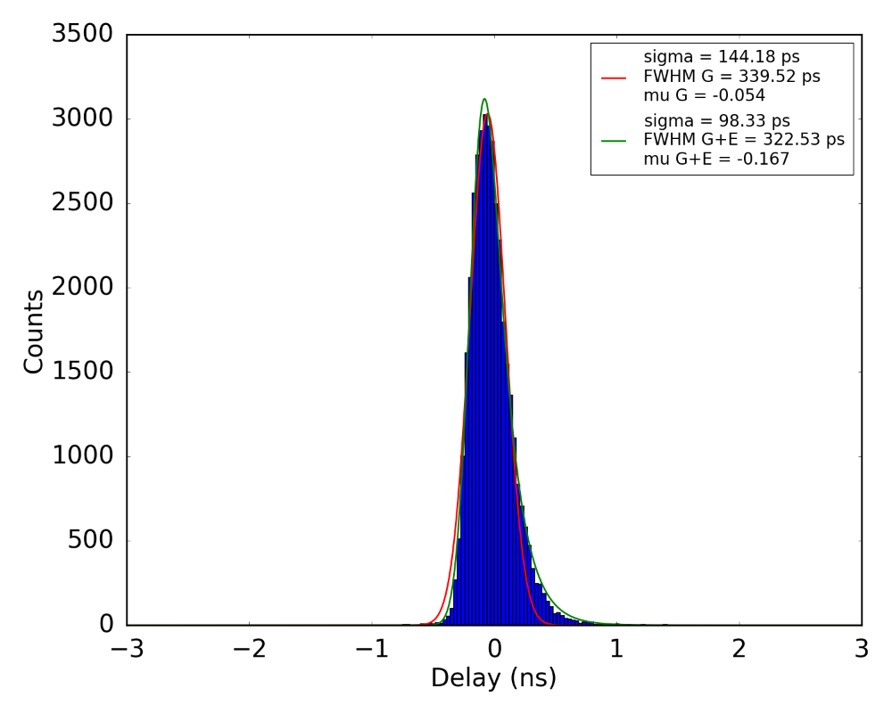
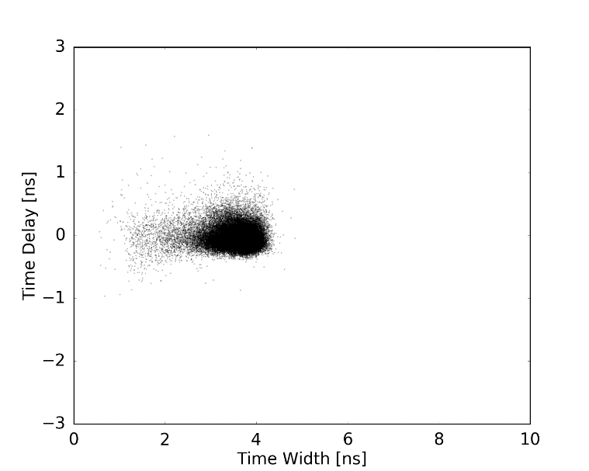

FastIC performance: Time resolution with a PMT.
Time-walk needs to be corrected for measurements at low light intensity with a PMT to improve the time performance.
Time histogram with TW correction
Scatter plot without correction
Time histogram without TW correction
$$340 ps FWHM \sim TTS$$
Corrected scatter plot

