Slide 1


Front-End Electronics Workshop 2023
Readout ASICs for photon science at LCLS-II-HE
Lorenzo Rota – TID-ID Integrated Circuits, SLAC
lorenzor@slac.stanford.edu
Contributions from:
C. Bakalis, S. Block, D. Doering, A. Gupta, A. Habib, J. Hasi, M. Hammer, C. Hansson,
R. Herbst, C. Kenney, H. Kim, P. King, G. Liu, B. Markovic, F. Mele, A. Miceli, A. P. Perez, B. Reese, L. Ruckman,
J. Segal, H. Shi, S. Strempfer, J. Weizeorick, A. Dragone

Slide 2
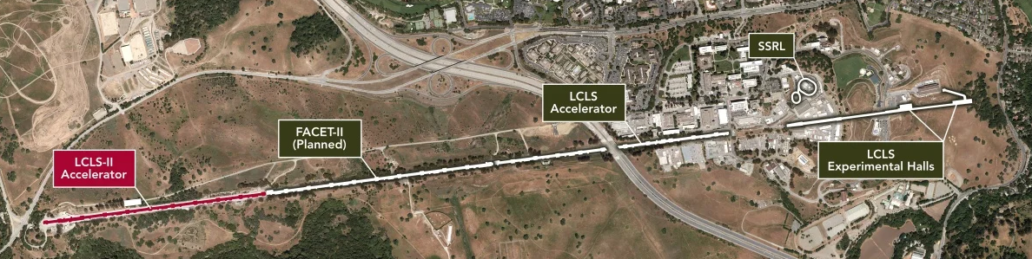
LCLS-II & LCLS-II-HE: revolutionary tools for X-ray science
LCLS-II will be the first XFEL to be based on continuous-wave superconducting accelerator technology
Continuous repetition rate of 1 MHz, with photon energies between 250 eV and 12 keV

Slide 3
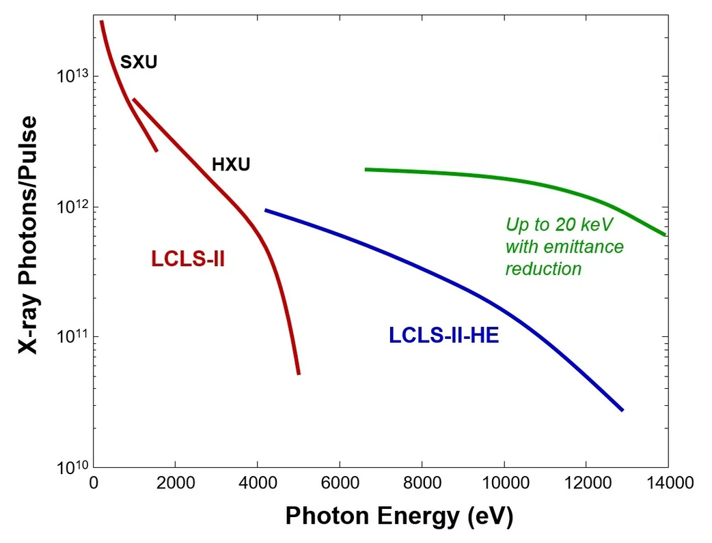
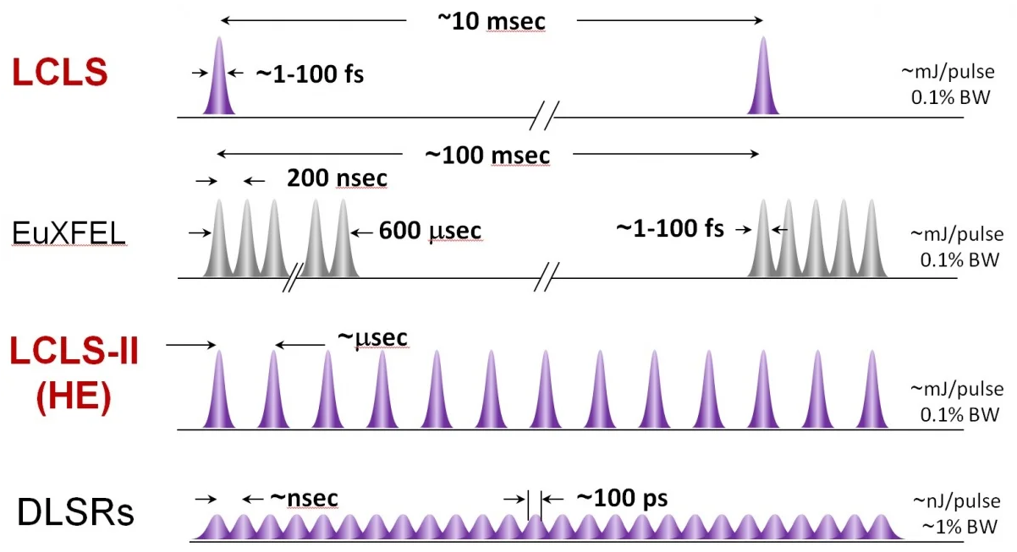
LCLS-II & LCLS-II-HE: revolutionary tools for X-ray science
LCLS-II will be the first XFEL to be based on continuous-wave superconducting accelerator technology
Continuous repetition rate of 1 MHz, with photon energies between 250 eV and 12 keV

Slide 4
SLAC long-term X-ray detector development plan
  Bigger, Faster, Higher resolution and Higher Energies
With goals built into projects progressively meeting science priorities and requirements
ePixUHR_{35kHz} (2019-2027)
Full frame 35kHz for HE first light
Sensors for hard X-rays
ePixUHR (2019-2029)
Full frame 100kHz-1MHz
“General purpose” cameras
Efficient information extraction
(Advanced Calibration / Edge-ML)
ePixHR_{5kHz} (2016-2023)
5kHz for LCLS-II first light
ePixHR10k for tender Imaging
ePixHR250M for soft-ray Imaging
SparkPix (2020-2027)
25kHz
100kHz-1MHz
ePix (2013-2018)
Revolutionary Experiment Specific
X-ray Cameras
Information extraction at full rate (1MHz CW, 3GHz burst)
Advanced features (triggering, sparsification, zero suppression etc.)
5kHz
In use at LCLS
120Hz
1MHz-1GHz

Slide 5
SLAC long-term X-ray detector development plan
  Bigger, Faster, Higher resolution and Higher Energies
With goals built into projects progressively meeting science priorities and requirements
ePixUHR_{35kHz} (2019-2027)
Full frame 35kHz for HE first light
Sensors for hard X-rays
ePixUHR (2019-2029)
Full frame 100kHz-1MHz
“General pourpose” cameras
Efficient information extraction
(Advanced Calibration / Edge-ML)
ePixHR_{5kHz} (2016-2023)
5kHz for LCLS-II first light
ePixHR10k for tender Imaging
ePixHR250M for soft-ray Imaging
SparkPix (2020-2027)
25kHz
100kHz-1MHz
ePix (2013-2018)
Revolutionary Experiment Specific
X-ray Cameras
Information extraction at full rate (1MHz CW, 3GHz burst)
Advanced features (triggering, sparsification, zero suppression etc.)
5kHz
In use at LCLS
120Hz
1MHz-1GHz

Slide 6
ePixUHR-35 kHz: overview
Summary of main specifications
Noise: <100 e⁻, single-photon resolution at 4 keV
Dynamic range: 10⁴ @ 8keV
Size: 192x168 pixels with 100 µm pitch,
~2x2cm²
Frame-rate: 35 kHz
(pixel and ADC meet designed for 100kHz operation)
Goals of 1st prototype:
Demonstrate path towards >25kHz detector on single ASIC on 130 nm
Retire risks associated with TSV and 3D stacking (ePixHR2.5D)
Evaluate performance at system level & at LCLS-II beamline at 35 kHz
Goals of 2nd prototype:
Optimize pixel front-end circuitry for optimal performance
Si Sensor
100 µm pitch
Pixel matrix: 192 (H) x 168 (V) - Clusters
ePixUHR ASIC
Readout
Readout
x16
Readout
Slow control & analog bias
Serializers & clock spine
x16 LVDS outputs @ 1.1 Gb/s

Slide 7
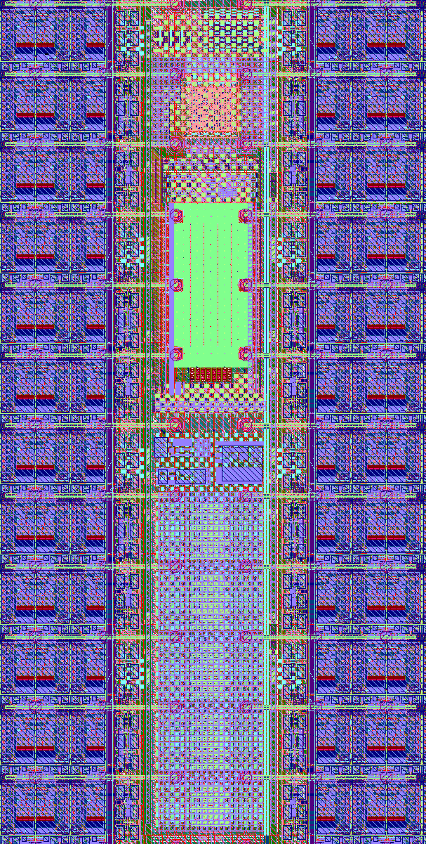
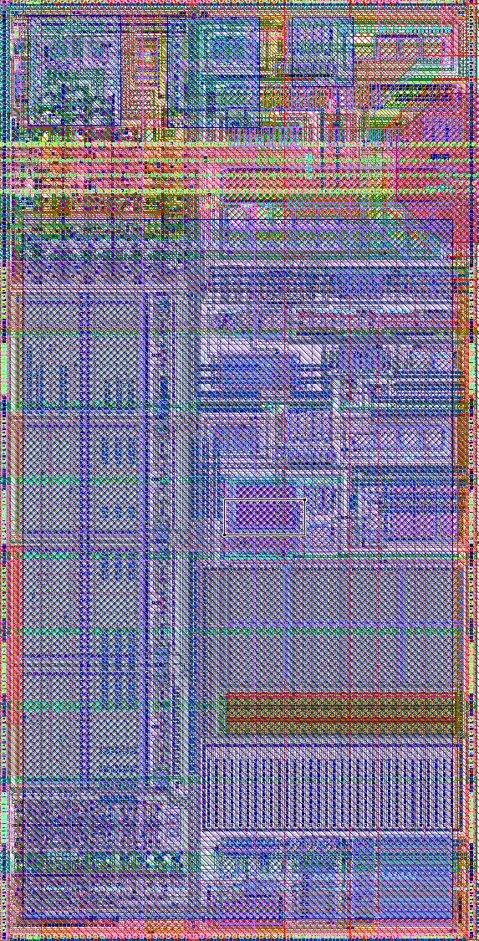
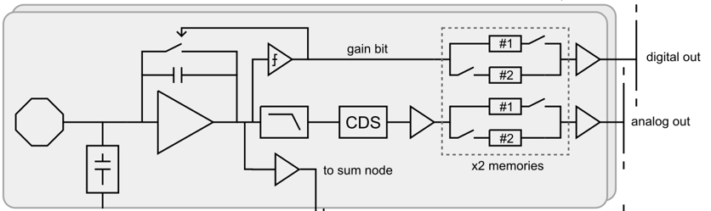
Pixel matrix architecture
600x1200 µm
Digital
logic
ADC
Pixel analog front-end block diagram
Cluster
Pixel
72 pixels → 1 ADC @ 8 MSPS
Digital logic for pixel configuration and readout
Operates at 100 kHz – 1 MHz
Si sensor: 100x100 µm²
ASIC: 50x100 µm²
Power consumption of different blocks in matrix
(power density: 0.94 W/cm²)

Slide 8
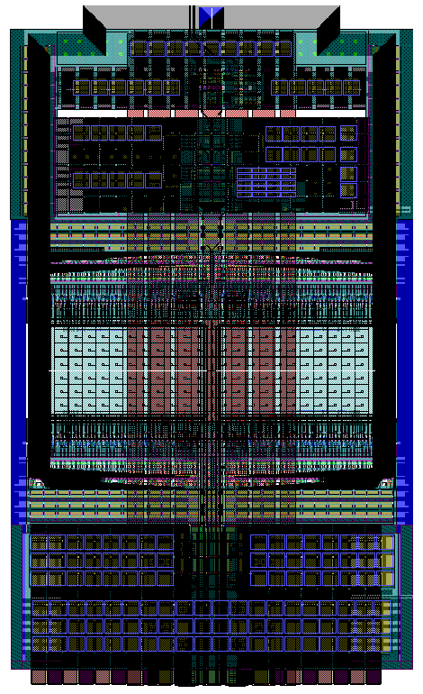
12b Analog-to-Digital Converter
260 um
Differential Successive Approximation Register (SAR) architecture :
Optimized switching scheme to reduce both area and power consumption (on ADC local reference buffers)
Novel circuit to perform built-in single-ended to differential conversion
Based on custom-designed MOM capacitors with differential metal strips [Harpe, JSSC’19]
Total of 384 ADCs + local reference buffers operating synchronously in pixel matrix
180 um

Slide 9
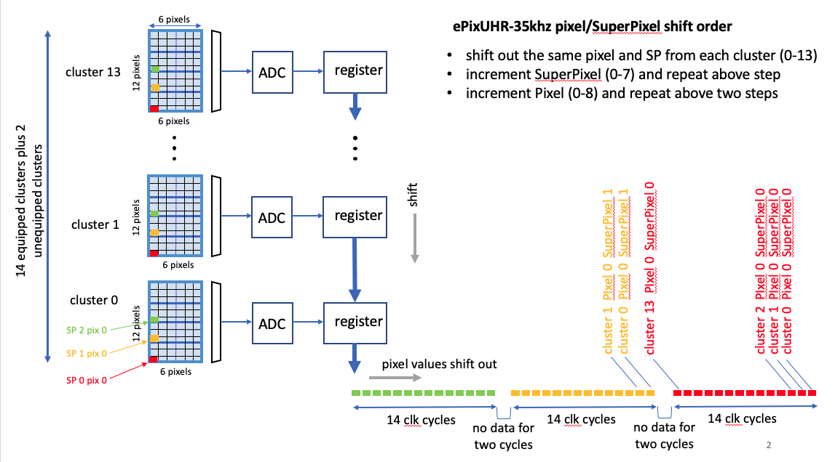
Moving data to the ASIC periphery
A/D conversion is synchronous in all clusters in pixel matrix
Data is shifted to cluster below
Matrix acts as a large shift register

Slide 10
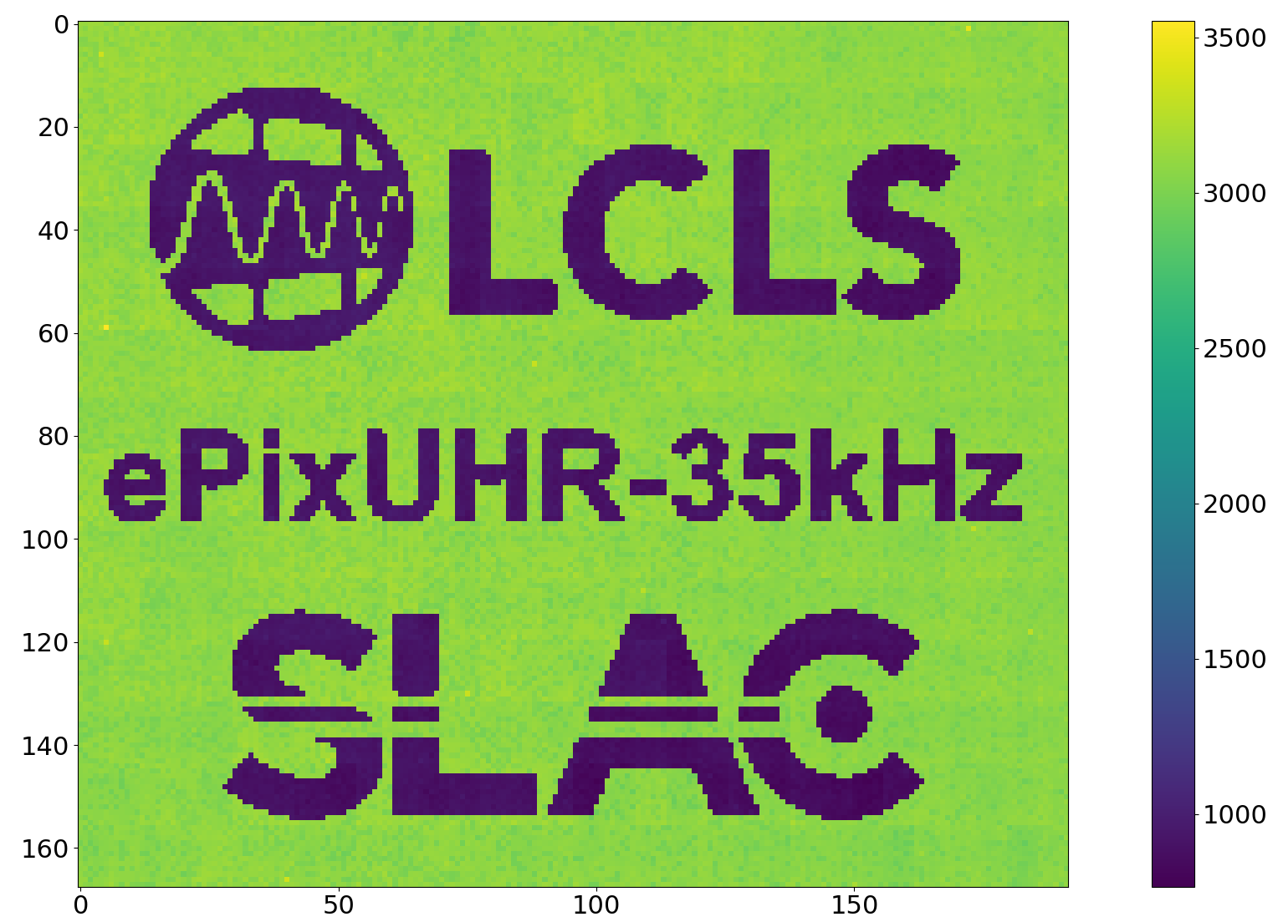
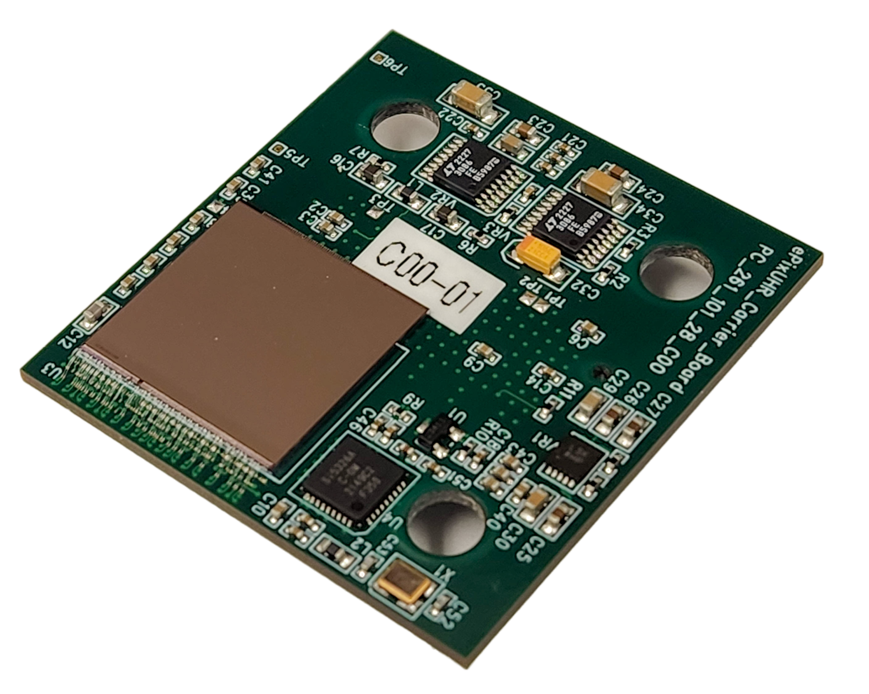
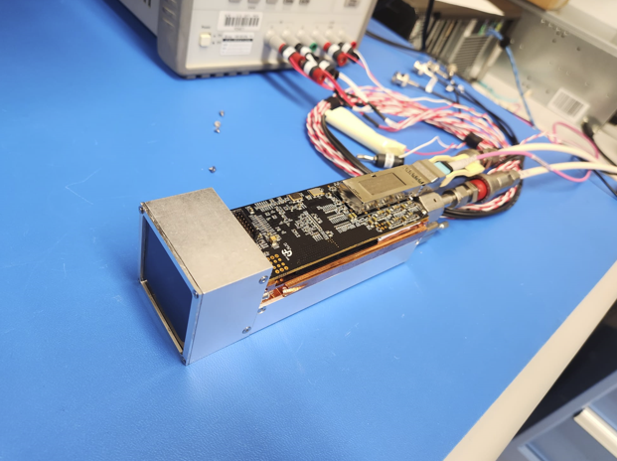
Results – prototype system
Prototyping carrier
Prototyping camera
Pixel matrix test-pattern obtained at a clock frequency of 35 kfps
First prototype readout architecture is fully functional up to the target frame-rate of 35kHz
ASIC has been assembled on prototype camera system with cooling block (no Si sensor)

Slide 11
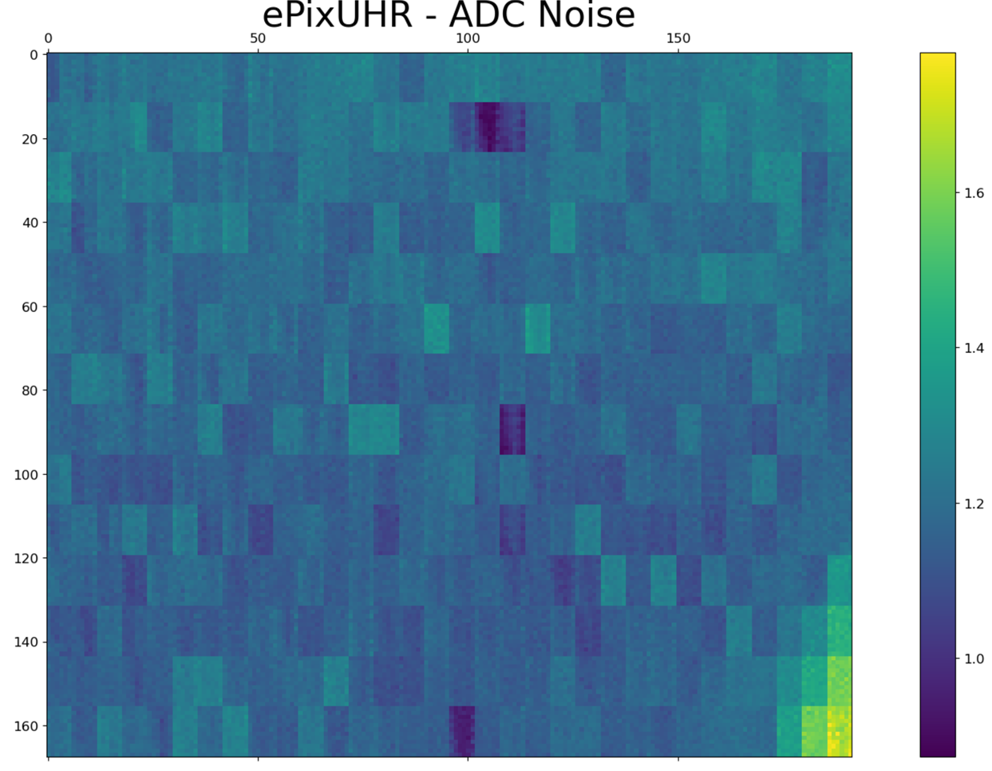
Results – ADC matrix
Preliminary
ADC: no missing codes in any of the 384 ADCs, linearity better than 0.2% (limited by test setup)
Hard to evaluate ADC performance because of limitations in ASIC/test setup:
  Can only test all ADCs simoultaneously
  Calibration voltage distributed across all matrix
  Noise <1.2 ADUs (limited by test setup)
  Non-linearity due to kick-back on calibration line?
Range ~650mV
1 ADU = 150uV
Noise on calibration line

Slide 12
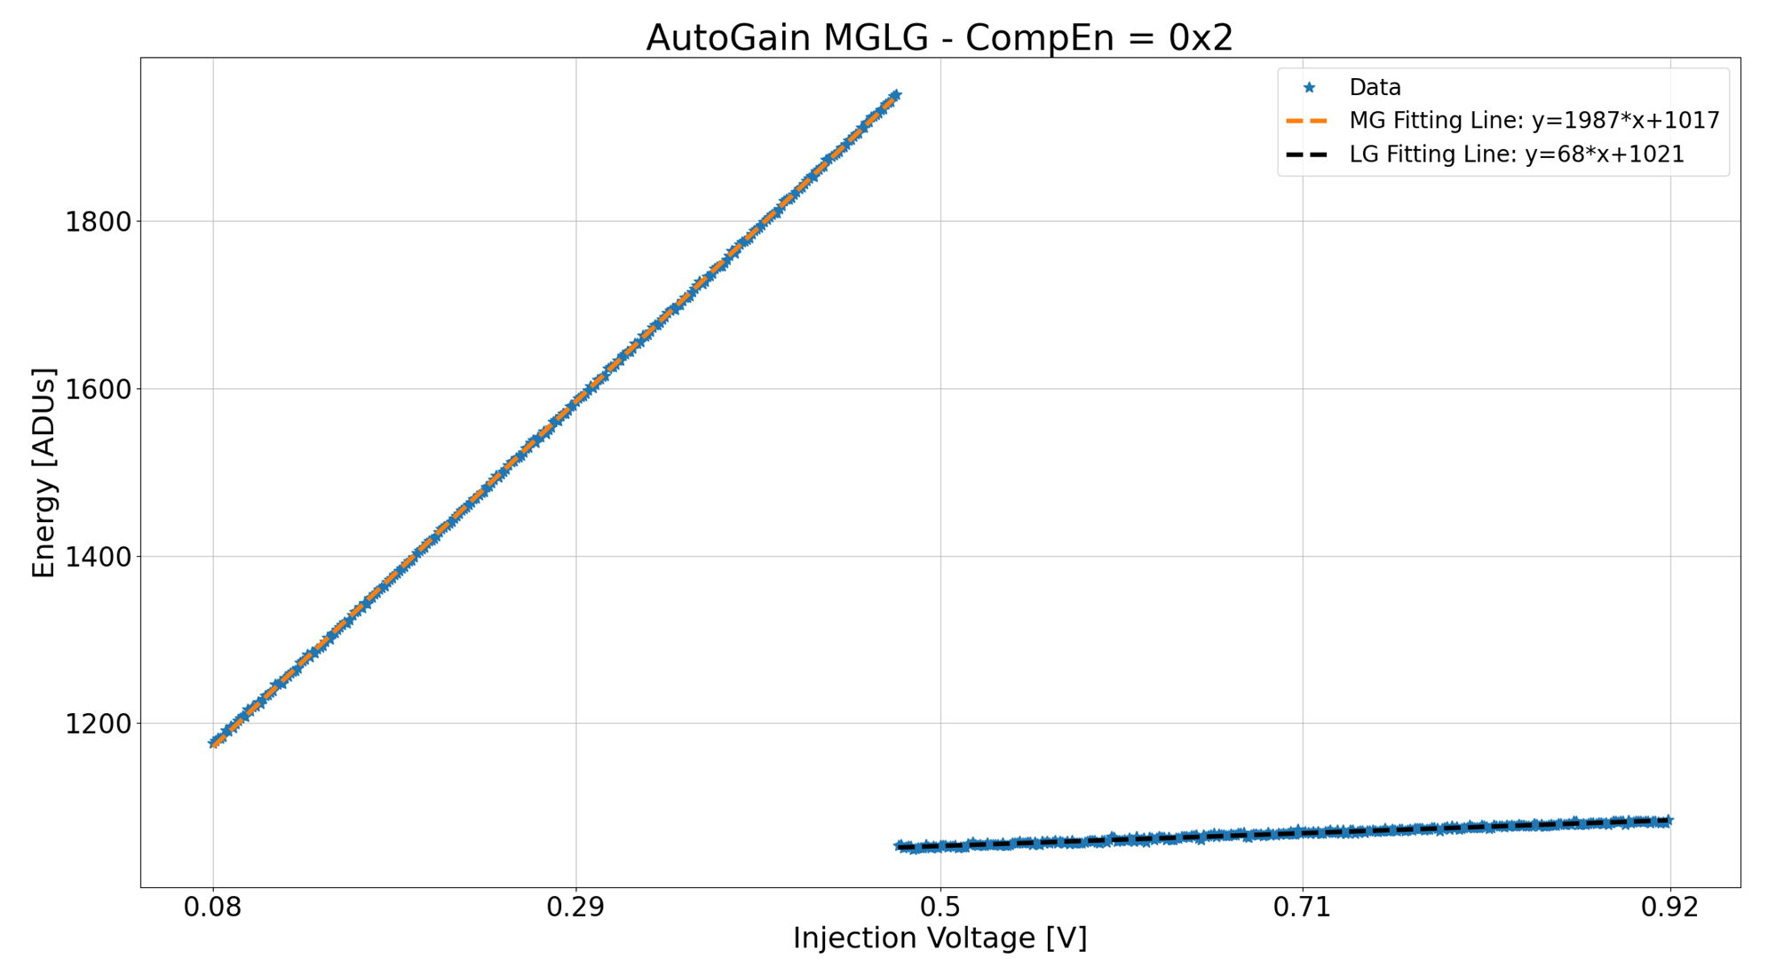
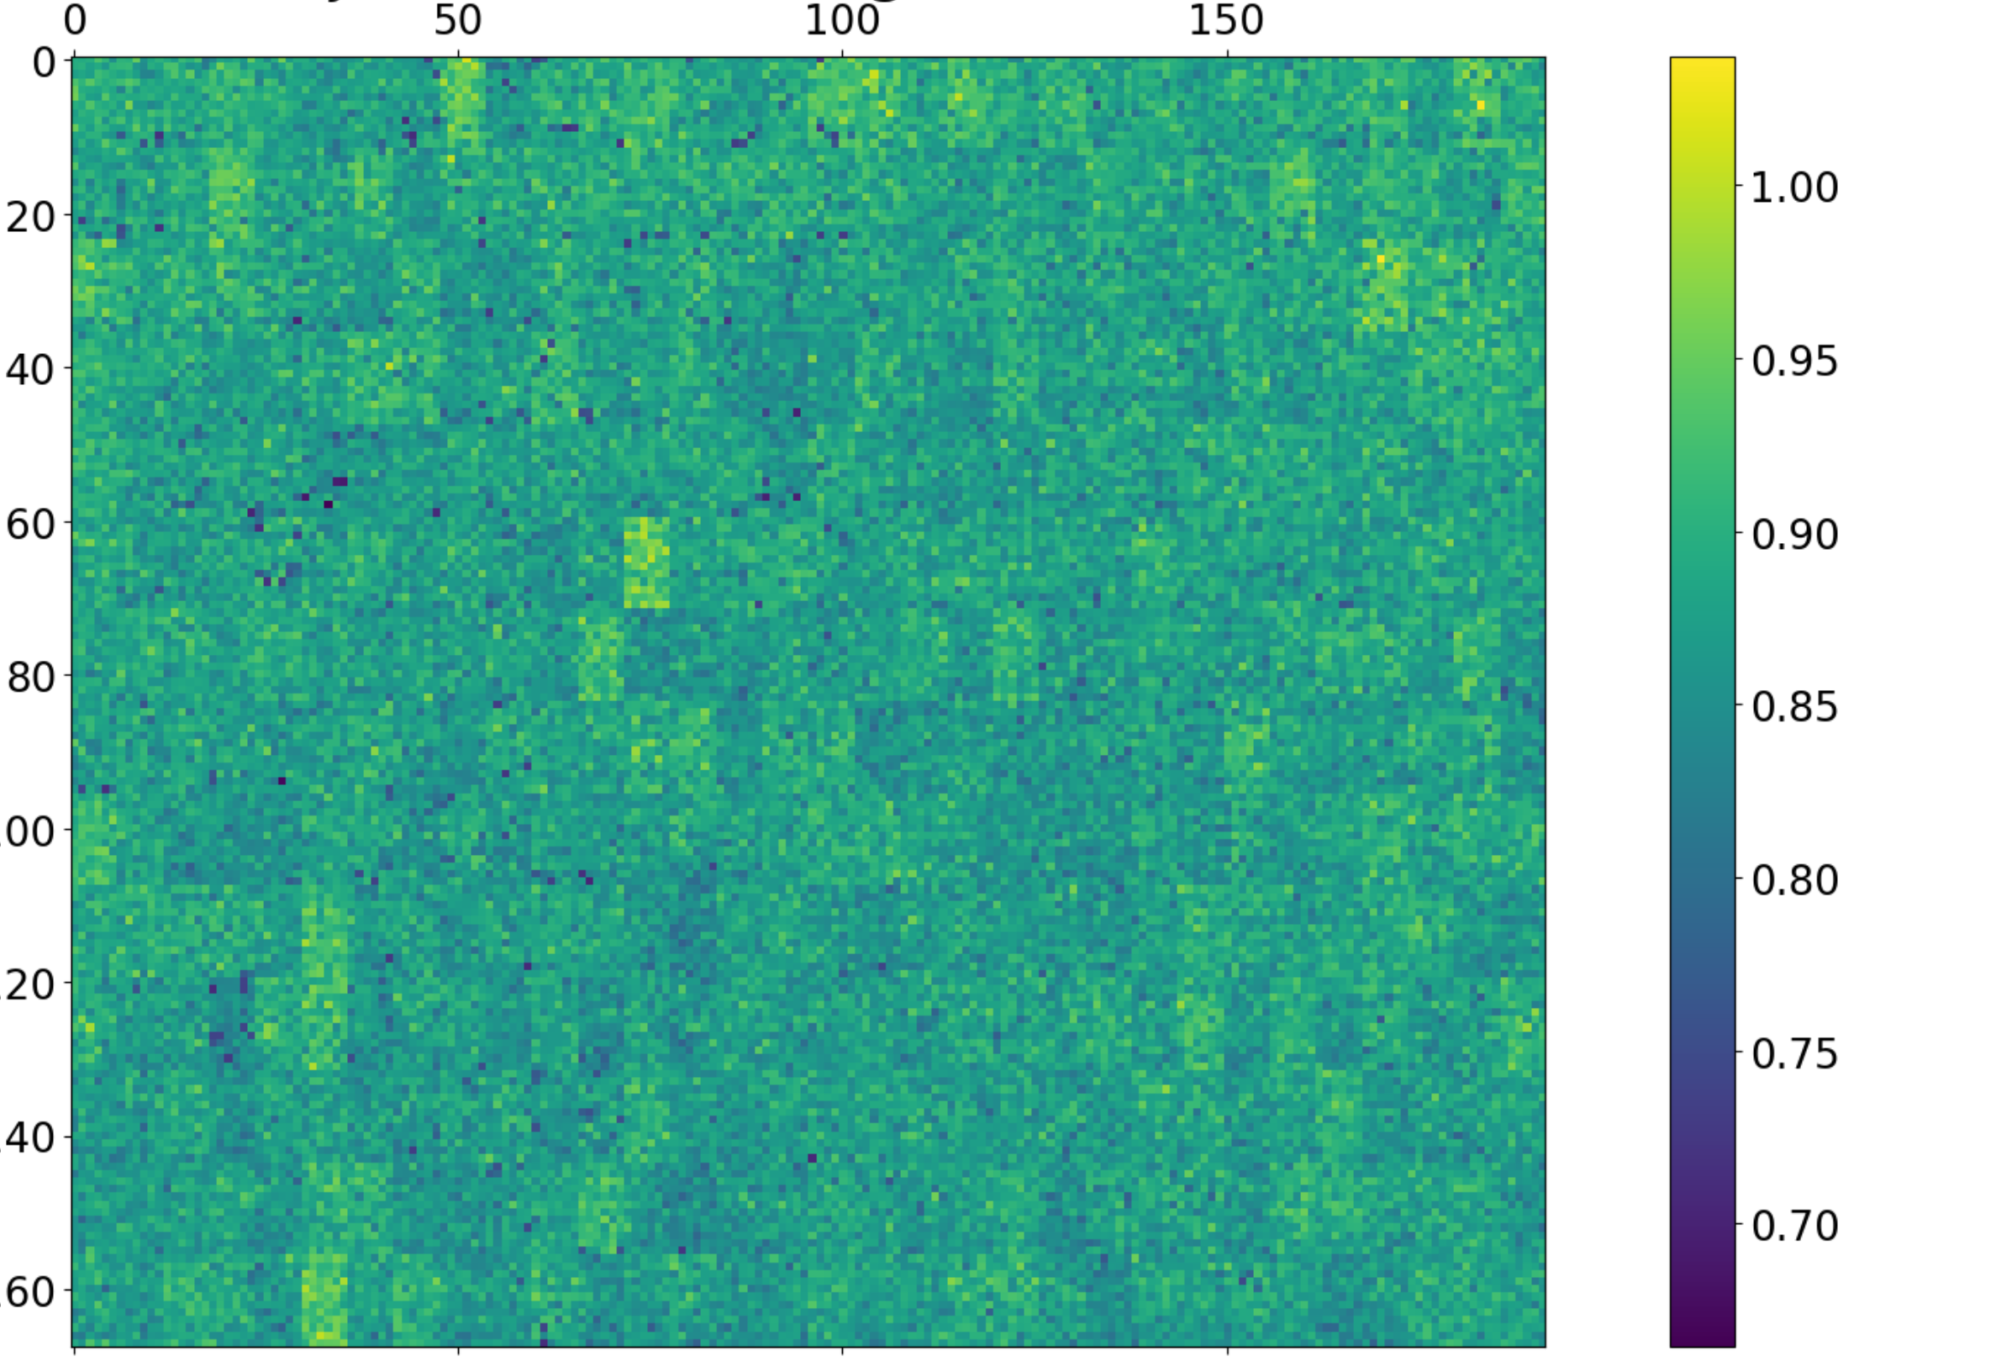
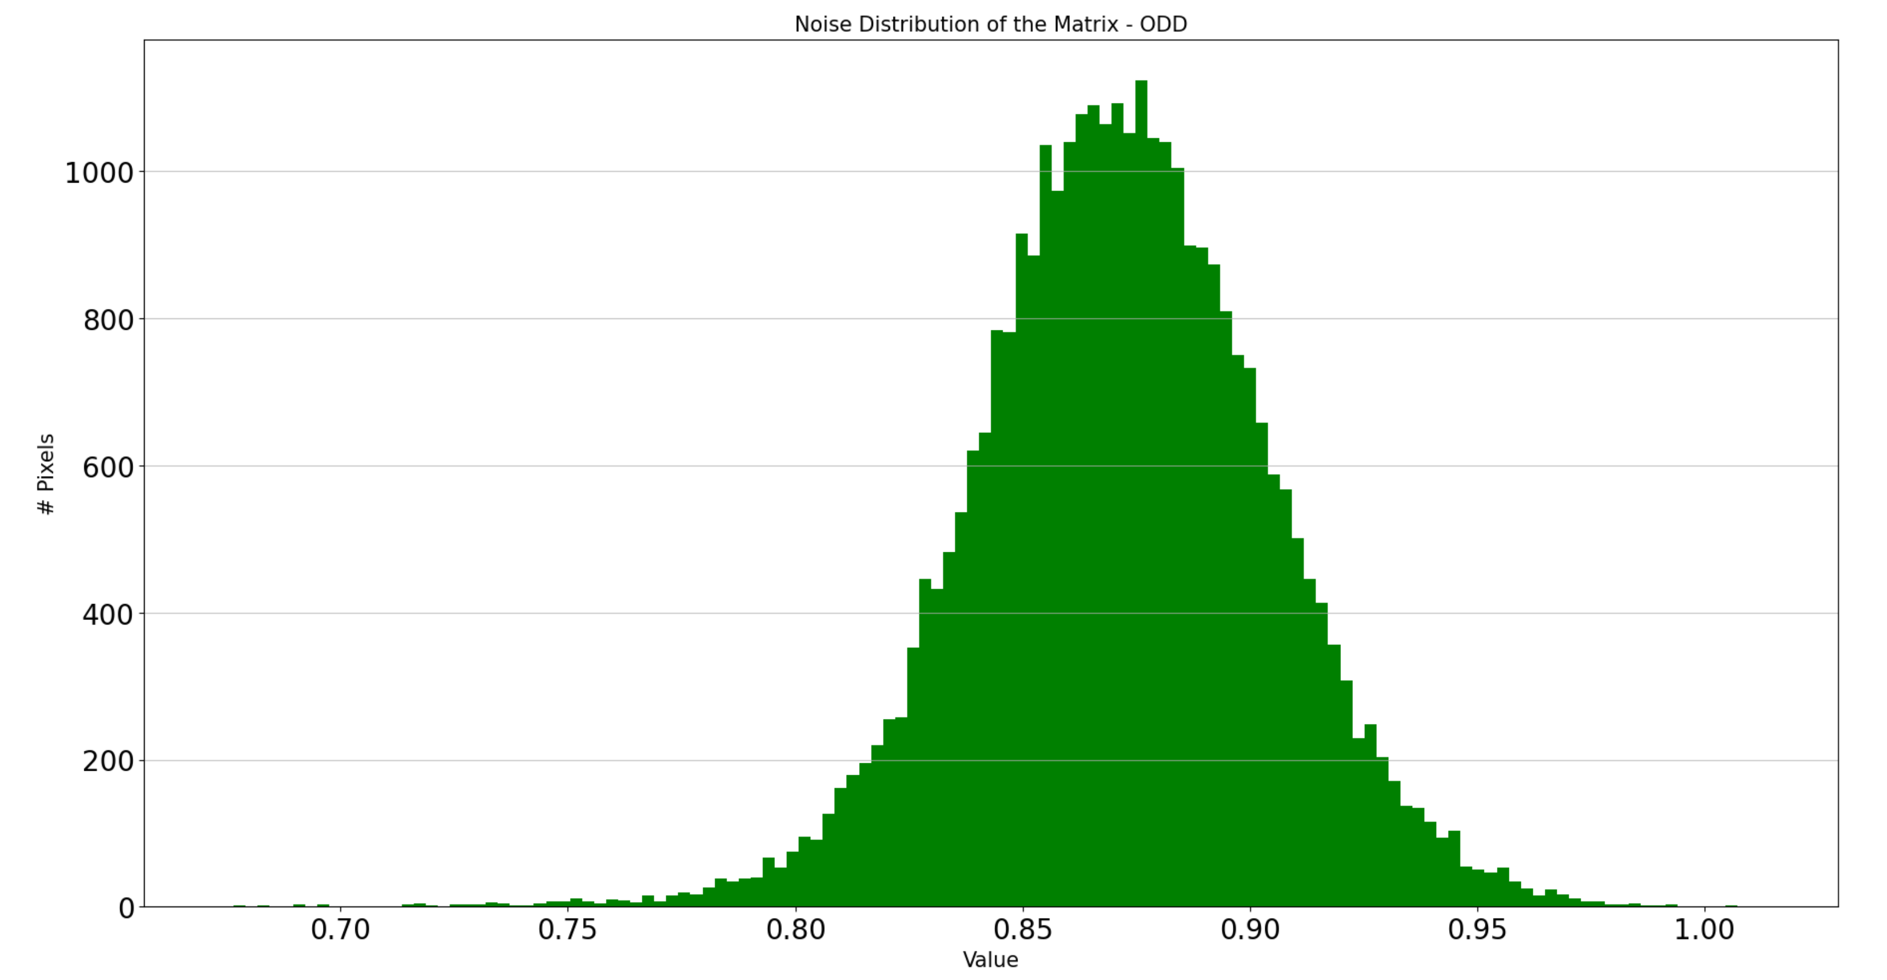
Results – pixel response
Preliminary
Response of full-readout chain with pixel injection circuitry, pixel configured in auto-gain switching mode:
Noise map of pixels in High-Gain mode [ADUs]
MG
LG
‘Correlated pre-charging’ circuit reduces noise after gain-switching [1]
‘CompEn’ feature = pixel is not allowed switch near the end of the integration phase

Slide 13
Towards ePixUHR-100kHz
Current design will be upgraded with 5 Gb/s links (CML/SST) (2024)
New FPGA readout architecture is currently being designed (2024)
ePixUHR 35kHz
ePixUHR 100kHz
Matrix
100 kHz
Matrix
100 kHz
ASIC
Same
Slow control
Slow control
Bottleneck
1 Gb/s I/Os
Upgrade with
5 Gb/s links
5 Gb/s I/Os
New readout
architecture
PCB / FPGA
ePixHR
ePixUHR

Slide 14
SLAC long-term X-ray detector development plan
  Bigger, Faster, Higher resolution and Higher Energies
With goals built into projects progressively meeting science priorities and requirements
ePixUHR_{35kHz} (2019-2027)
Full frame 35kHz for HE first light
Sensors for hard X-rays
ePixUHR (2019-2029)
Full frame 100kHz-1MHz
“General pourpose” cameras
Efficient information extraction
(Advanced Calibration / Edge-ML)
ePixHR_{5kHz} (2016-2023)
5kHz for LCLS-II first light
ePixHR10k for tender Imaging
ePixHR250M for soft-ray Imaging
SparkPix (2020-2027)
25kHz
100kHz-1MHz
ePix (2013-2018)
Revolutionary Experiment Specific
X-ray Cameras
Information extraction at full rate (1MHz CW, 3GHz burst)
Advanced features (triggering, sparsification, zero suppression etc.)
5kHz
In use at LCLS
120Hz
1MHz-1GHz

Slide 15
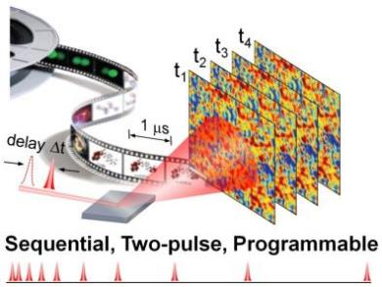
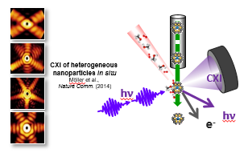
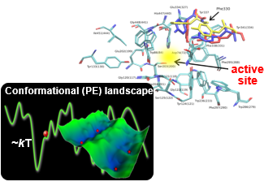
The science case for detectors: high-rate and versatility
Require full frame 100 kHz detectors
Require 1 MHz detectors Sparse Data
Imaging non-identical objects
e.g. Heterogeneity of functioning nano-catalysts
Stochastic Dynamics
e.g. Glass transition,
charge fluctuations in quantum materials
“Rare Events”
e.g. Dynamic function of enzymes
XPCS, XSVS
Require 1 MHz detectors
Event Driven

Slide 16

SparkPix family
Four different pixel detectors in SparkPix family (currently):
I | Front-end | Information extraction | Frame-rate
SparkPix-ED | energy | triggering | 1 MHz / 100 kHz CW
SparkPix-RT | energy | data compression | 100 kHz
SparkPix-S | energy | sparse readout | 1 MHz
SparkPix-T | timing | sparse readout | 1 MHz → see tomorrow’s talk

Slide 17
Energy + triggering
SparkPix-ED
vent
r
iven

Slide 18


SparkPix-ED: science driver & concept
This talk
Rare events in X-ray scattering experiments
Science case: capture interesting events happening at random, stochastic times that make their observation difficult
Requirements: record N high-resolution images at closely spaced times around the rare event
Detector
1 MHz
Stream
low-res
EDGE computing
Trigger generation
Trigger: read memories
Memories:
N frames hi-res
Data analysis
  Operation:
  Low-resolution images are continuously sent to the EDGE computing layer @ 1 MHz
  Meanwhile, N images are continuously recorded & stored in the detector in a ring-buffer
  EDGE computing layer continuously analyzes data for rare events, then generated a trigger
  The trigger starts the readout of the high-res N images recorded around the event of interest
L. Rota et al., “SparkPix-ED: a readout ASIC with 1 MHz frame-rate for rare event experiments at LCLS-II”, IWORID 2021

Slide 19
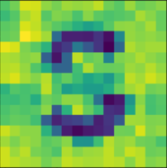

MHz mode
Fast read-out to triggering layer: 1 MHz stream
Sum signal of 9 pixels, resulting in a SuperPixel (SP) of 300*300 µm²
Sum operation reduces SNR by √9
+
High-resolution read-out
The ring-buffers in each pixel are read-out
Read-out rate: 1 MHz / (N * 9)
Read-out rate in 1st prototype: 25 kHz (N=4)
Can be run in “CW imager” mode: 100 kHz

Slide 20
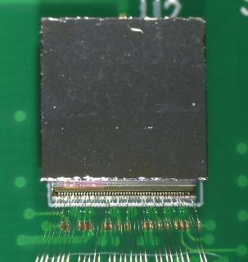
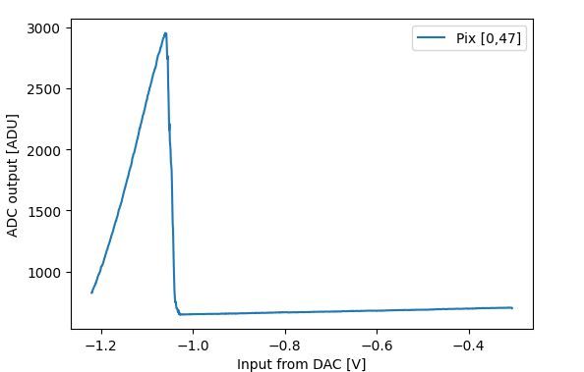
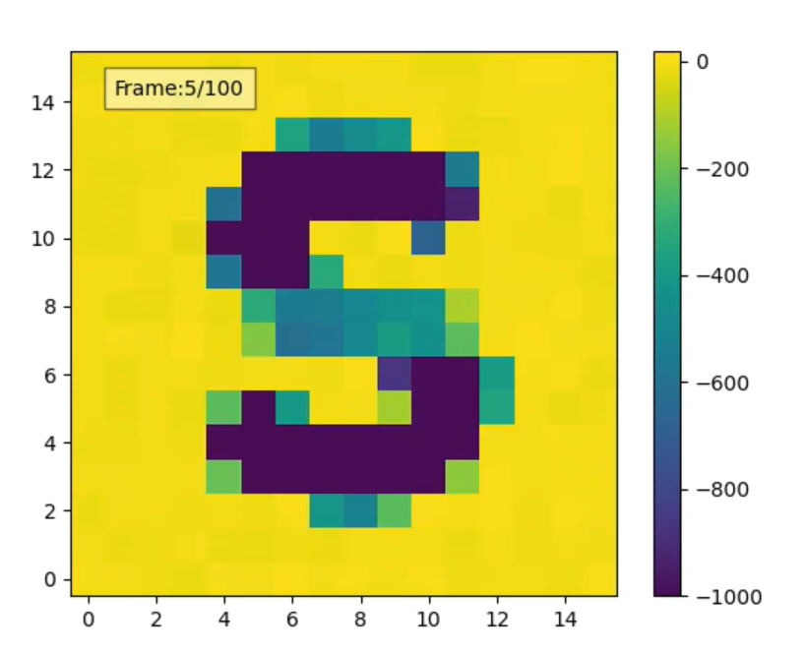
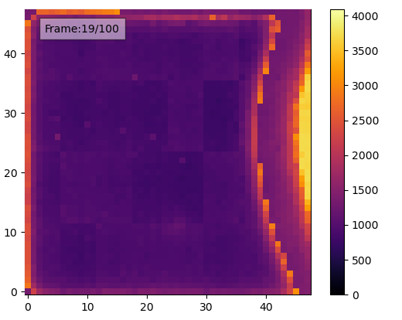
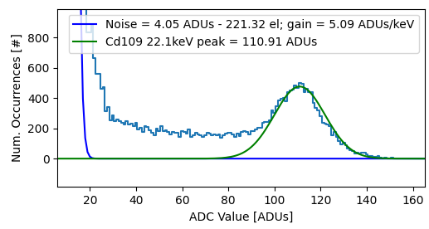
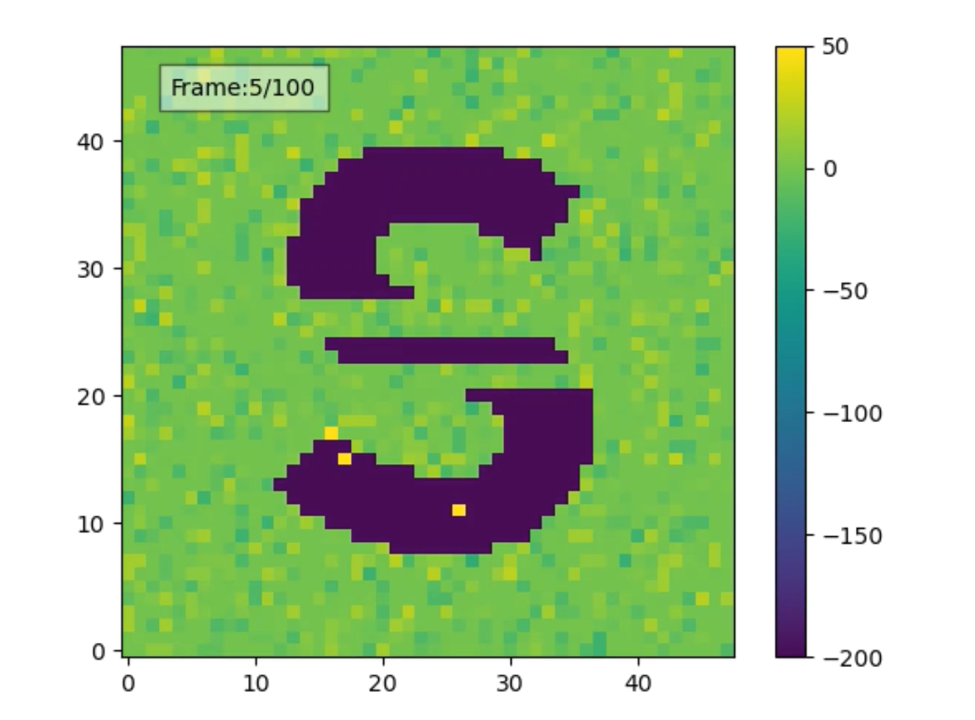
SparkPix-ED: overview of results from 1st prototype
Pixel response with charge injection
Sum: 1 MHz
SparkPix-ED ASIC with 48x48 prototype Si sensor
Spectrum of Cd109 source (preliminary, raw data).
Hi-res: 0.1 MHz
Gain switching
Illuminated with red laser from right side

Slide 21
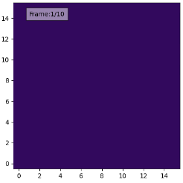
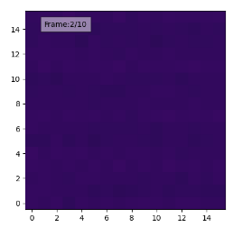
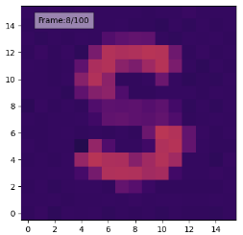
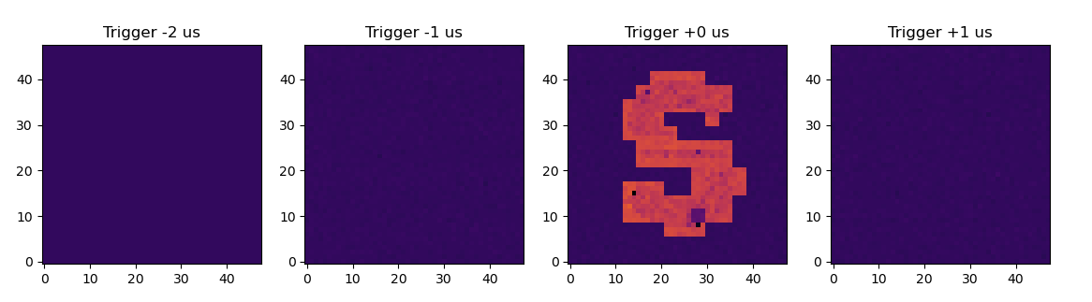
SparkPix-ED: fast trigger mode
ASIC
…
Inject at frame 8
Switch to
memories
readout
…
1 MHz stream
FPGA
Trigger condition:
>20 pixels in low-gain
Triggered on frame 8
DAQ
Frame 6
Frame 7
Frame 8
Frame 9
Fast images not stored
(data reduction)

Slide 22
Energy + data compression
SparkPix-RT
eal
ime

Slide 23
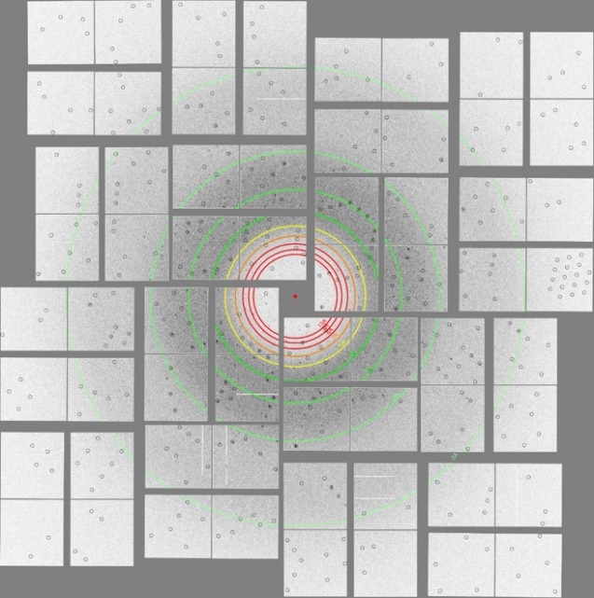
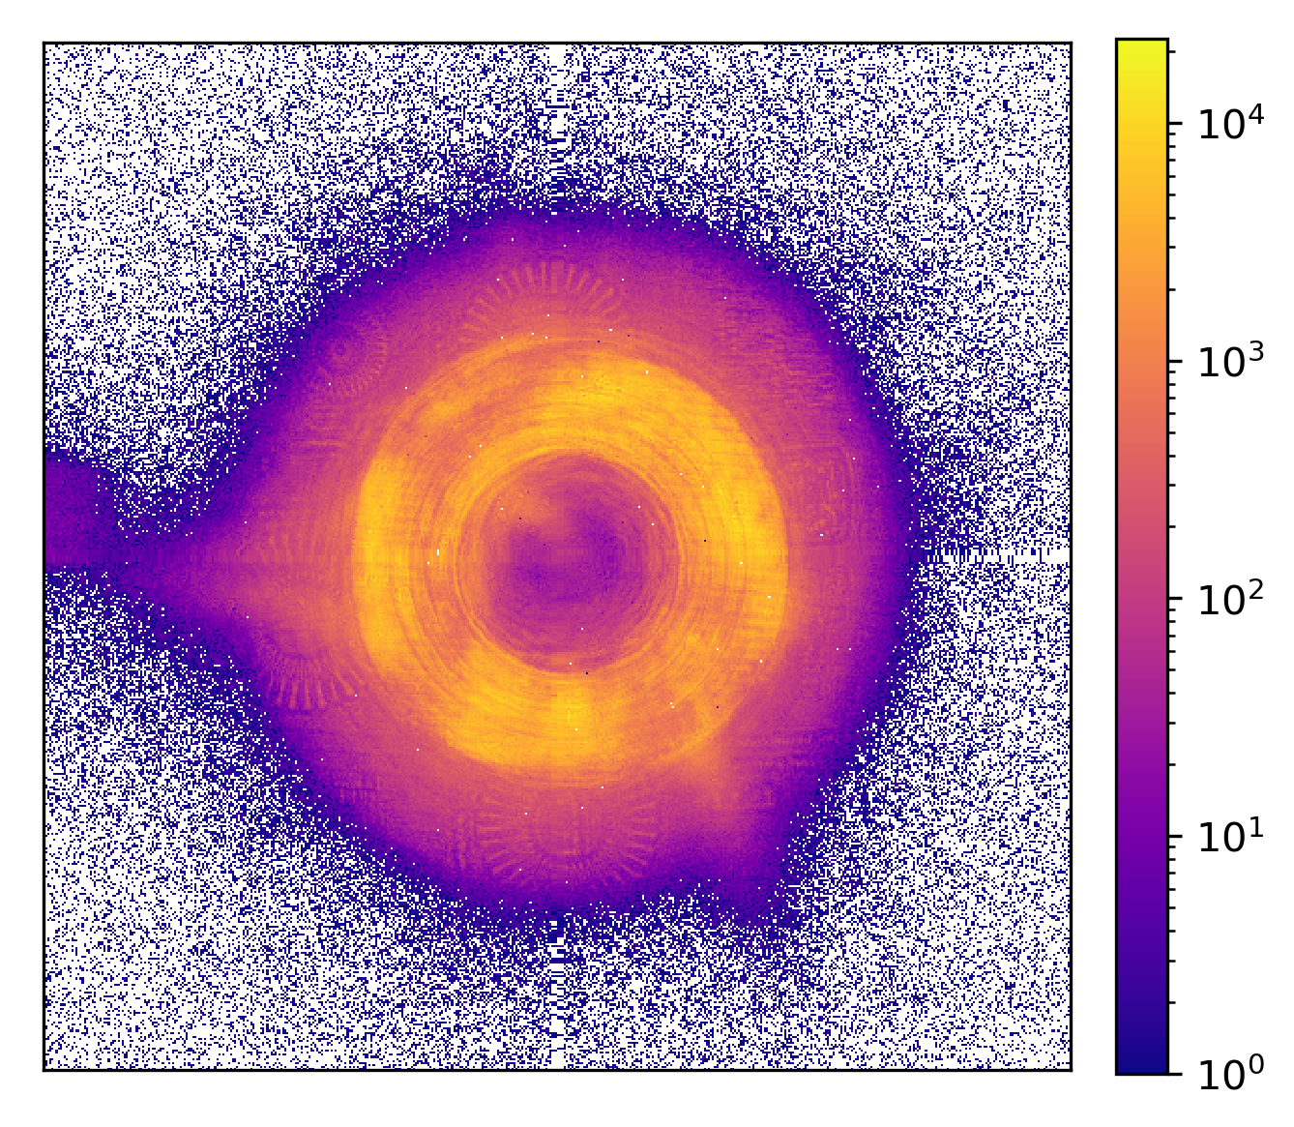

SparkPix-RT: motivation
  Next-gen photon science sources are facing a data deluge problem
  LCLS–II: MHz readout with on-line data reduction
  APS-U: Increases in brightness motivate the development of high-speed scanning microscopy instruments with rates approaching 1 MHz
  Collaboration between Argonne & SLAC detector groups:
  SLAC is developing ePixUHR & SparkPix family: front-end, FPGA, etc…
  ANL studying techniques for data compression on-ASIC
  Technical scope of SparkPix-RT project:
  Evaluate real-time compression in algorithms, in-ASIC
  Leverages modularity: front-end circuitry of ePixUHR/SparkPix-ED
Examples of techniques that will benefit form MHz rate detector.
Top: diffraction pattern at LCLS
Bottom: ptychography image at APS

Slide 24
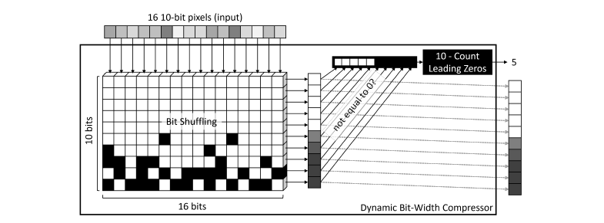
Compression algorithms
Initial Work – Compression performance on photon counting detector data
Lossless – Zero suppression
Pre-processing of data depends on the type of detector
Photon counting: information is already quantized
Charge integrating: pre-processing is needed before compression →
pedestal correction, thresholding, gain correction
We are exploring techniques for on-ASIC, real-time data calibration

Slide 25
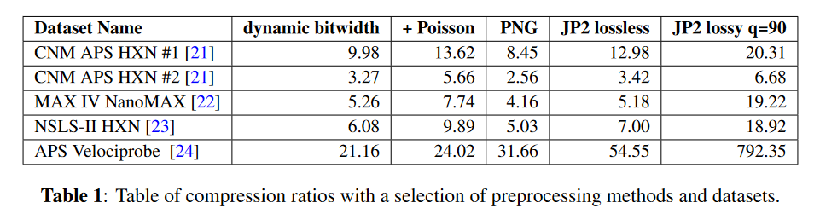
Compression algorithms
Initial Work – Compression performance on photon counting detector data
Lossless
Lossy
On photon counting detector data, the lossless compression performs similar to more complicated compression methods such as PNG and JP2

Slide 26
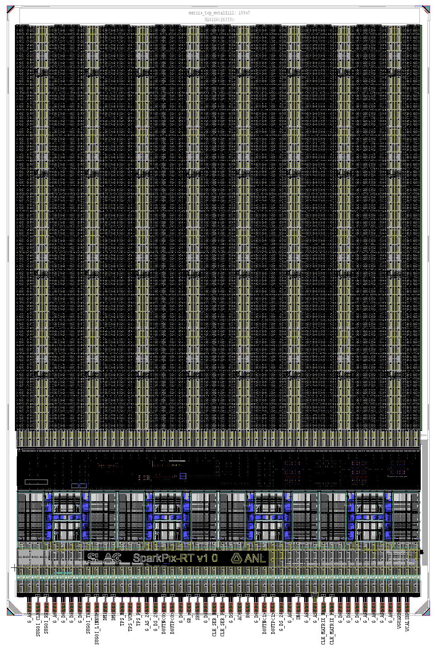
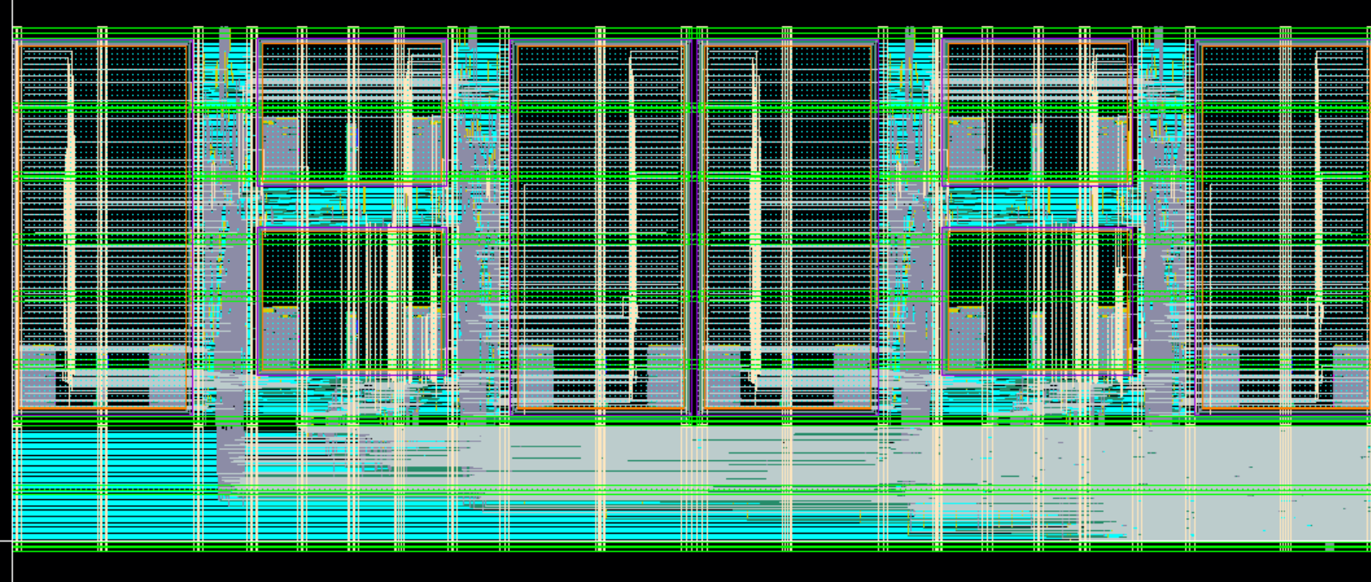
SparkPix-RT: status and next steps
  Digital logic implemented in periphery of ASIC
  1st prototype (MPW) is now in-fab, expected delivery in Aug 2023
  Working towards a 100kHz, full-scale (~2x2 cm²) demonstrator
7.5 mm
Layout of (half) compressor digital logic
SRAM
SRAM
SRAM
SRAM
SRAM
SRAM
SRAM
SRAM
5 mm

Slide 27
Energy + sparse readout
SparkPix-S
parse

Slide 28
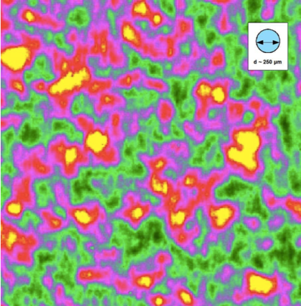
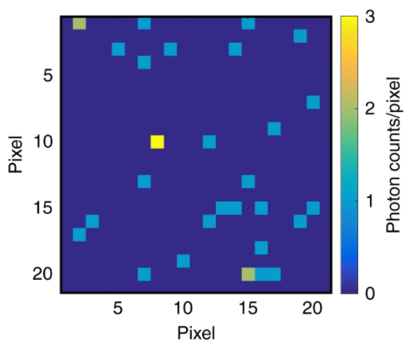
SparkPix-S: science driver and detector needs
  X-ray Photon Correlation Spectroscopy (XPCS) and Speckle Visibility
  Spectroscopy (XSVS) will open new areas of science at LCLS-II:
    Study spontaneous fluctuations at the atomic scale from
    microseconds down to the femtosecond timescale
    Access stochastic fluctuations of matter on ultrafast timescales
  XPCS and XSVS experiments will benefit from a 2D integrating detector with:
    Fine spatial resolution
    Operating at 1 MHz, the max rate of LCLS-II
    Discriminating between 0, 1, 2, 3…. photons/pixel/frame
    On-line data reduction through sparsified readout
  XPCS speckle pattern
Signal of photon events in a small region in a speckle pattern [1]
[1] W. Roseker et al., Towards ultrafast dynamics with split-pulse X-ray Photon Correlation Spectroscopy at Free Electron Laser sources

Slide 29
SparkPix-S: overview
  Goal is to meet the main requirements of XPCS/XSVS experiments in a single camera solution:
    High-spatial resolution: 50um pixel pitch
    High frame-rate: 1 MHz
    Low-noise performance < 60 e⁻
  Designed to be compatible with different sensors:
    4 - 12 keV → Si sensor
    0.25 - 2 keV → investigated in future phase of the project
  Moved away from “cluster” approach due to several reasons:
    sparse readout, small pixel pitch (area, IR drop, routing)
  Column-parallel ADCs in periphery (adapted from ePixUHR)
  Sparsification digital engine from SparkPix-T (adapted)
Sensor
(different variants for
soft and hard X-rays)
Pixel matrix & ADCs
SparkPix-S ASIC
x48 column SAR-ADC @ 10b
Sparsification Engine
Sparsification Engine
Slow control & analog bias
x4 LVDS output
@ 1 Gbps
  Block diagram of SparkPix-S prototype

Slide 30
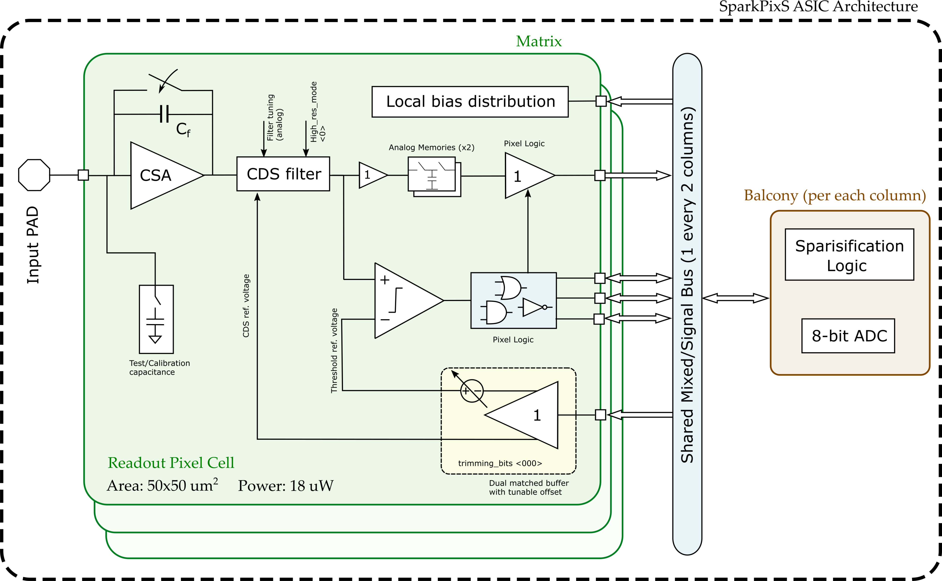

SparkPix-S: pixel overview
Filter is programmable: trade frame-rate for better noise performance.
Integration and readout are pipelined
using 2 analog memories.
Each pixel negotiates access to a bus shared every two columns.
Asynchronous sparse logic
Fixed gain,
dual supply,
synchronous reset CSA.
10b SAR ADC (100um pitch) serving two columns.
Threshold generation strategy based on a matched buffers with tunable offset + auto-zeroed comparator.

Slide 31
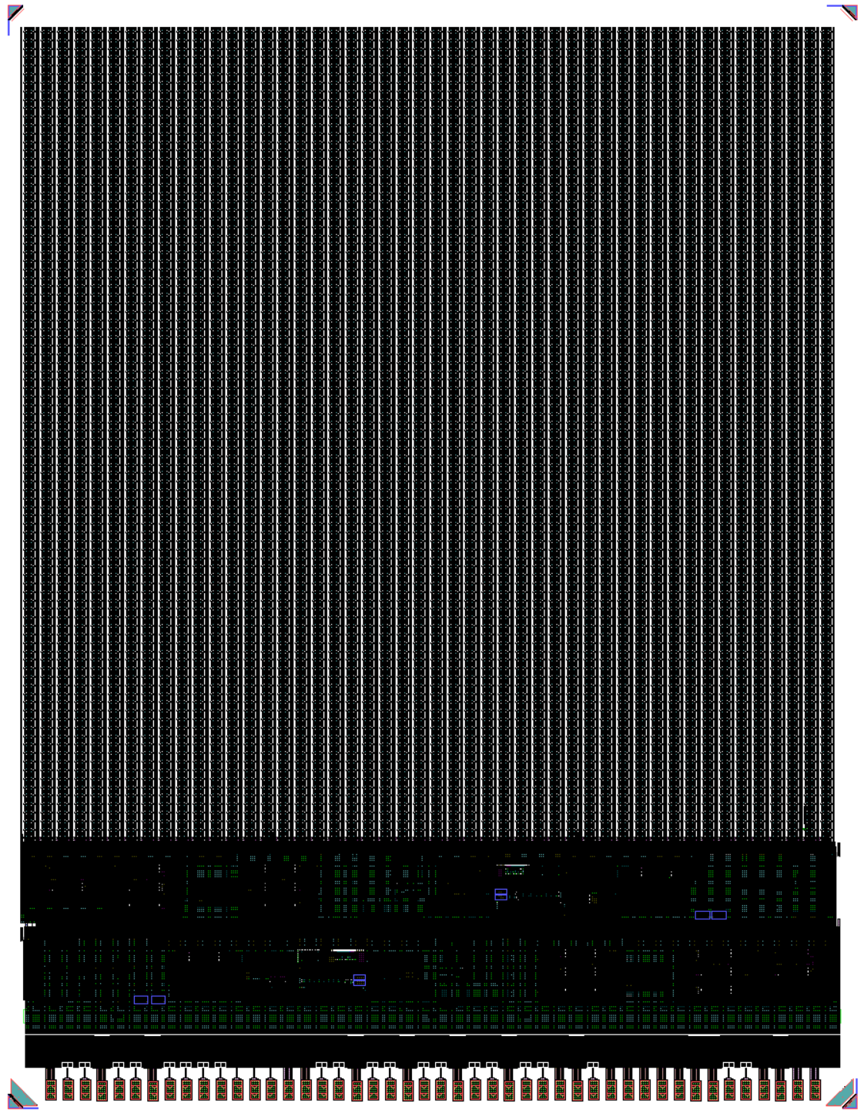
SparkPix-S: status and next steps
  First MPW has been designed between July 2022 – May 2023
  Chip is now in fab, expected delivery in August 2023
  Simulated performance of first prototype:
    Noise: 50-55 e⁻
    Dynamic range: 50keV
  Full-scale design will feature x8 5Gb/s output links to meet the
  1% occupancy spec @ 1 MHz
  Targeting tape-out of 1st full ASIC in mid 2024
7 mm
5 mm

Slide 32
Summary

Slide 33
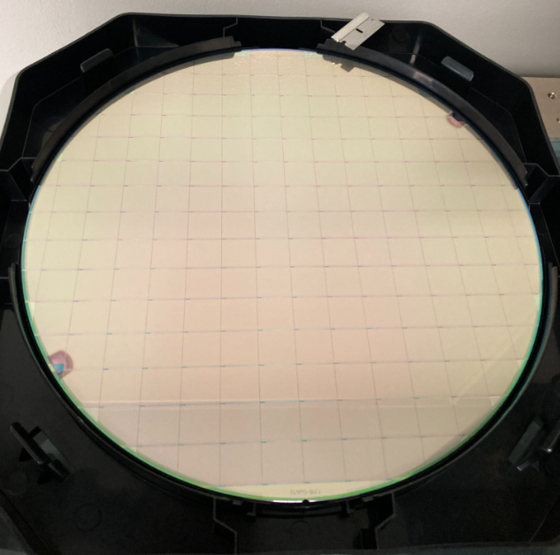
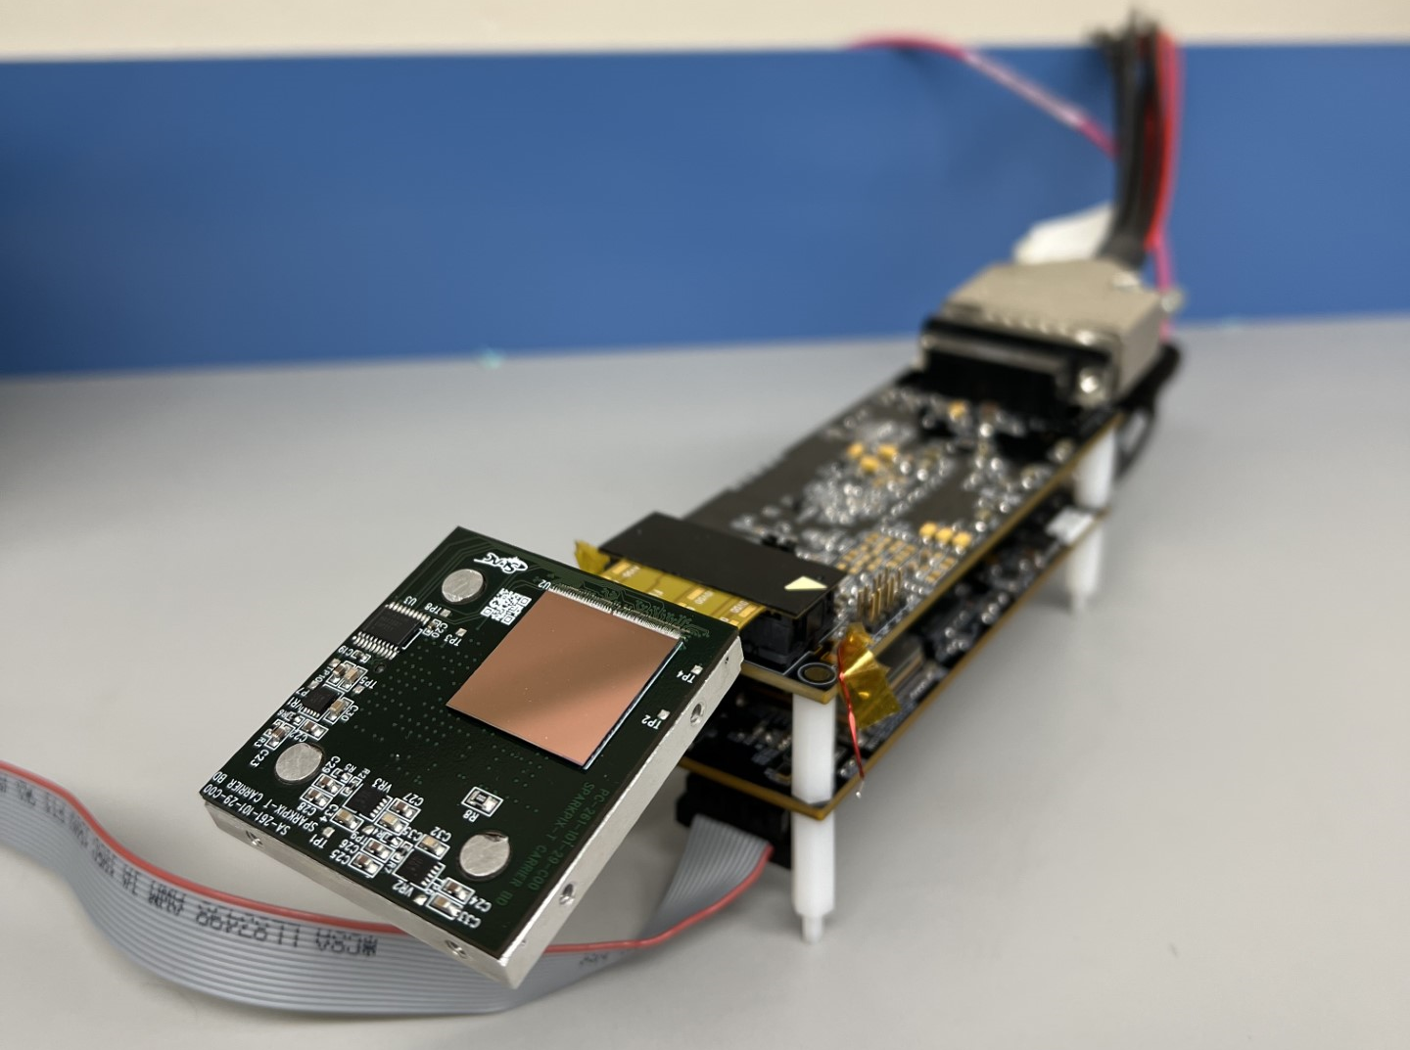
Summary
SLAC is developing a new family of ultra high-rate X-ray detectors to meet the science goals of LCLS-II / LCLS-II-HE
Full-frame detectors:
ePixUHR-35kHz: first large-scale ASIC functional, characterization on-going
ePixUHR-100kHz: upgrade clocking & increase output throughput, 1st prototype in 2024
Detectors with on-ASIC information extraction:
SparkPix-T: 1st full-scale prototype is alive, characterization on-going, beam-time at TMO beamline
SparkPix-ED: 1st prototype demonstrated low-latency feedback, re-assessing science specifications
SparkPix-RT: 1st MPW in fab, currently scaling the design to full-scale for late 2023 submission
SparkPix-S: 1st MPW in fab, characterization will start in fall, full-scale ASIC in mid-late 2024

Slide 34
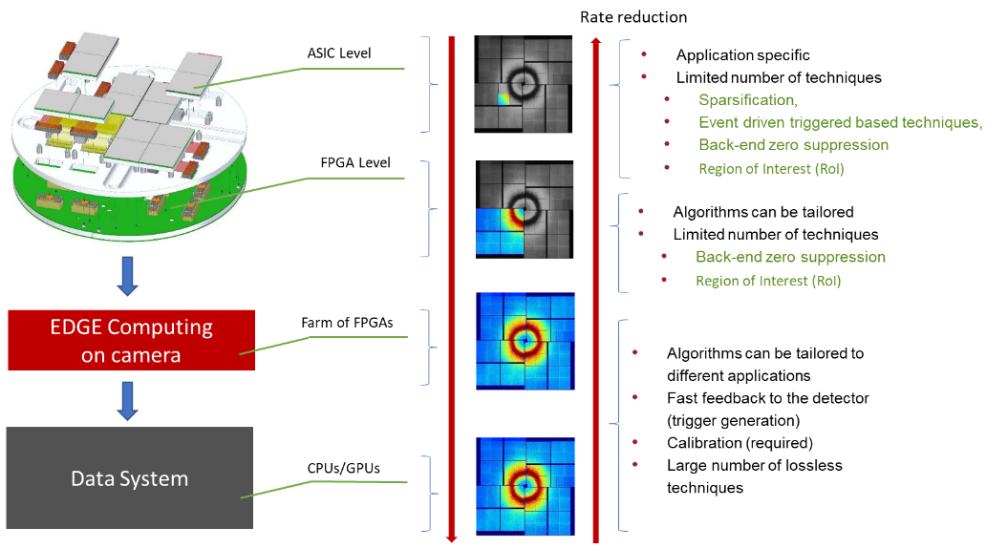
Future research directions
What is the path forward?
Distributed processing for efficiency (energy, information)
Leverage AI/ML for real time data extraction with low latency
(see Ryan’s talk)
Develop adaptive data driven readout architectures
Develop supporting technology for high bandwidth on detector communication
Adopt beyond CMOS technologies with heterogenous integration
Push computing as close as possible to the source

Slide 35
Backup slides

Slide 36
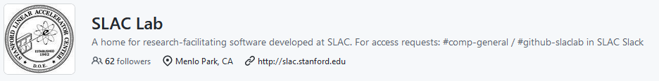
Methodology towards higher rates
Large number of detectors to be designed & commissioned in next years at LCLS-II
Strategy:
  Top-down approach: focus is on delivering detectors systems to meet LCLS-II science program
  Modularity, following the success story of the ePix family
  Sensors:
    Sensors compatible with different detectors (pitch, polarity, etc.)
  ASICs:
    CMOS 130 nm node selected: cost-effective, availability & good analog performance
    “Overhead” of IP blocks development & prototyping (communication, biasing, control, etc.) is spread over multiple projects / fabrication runs
  FPGA & readout cards:
    Common data protocols & slow-control interface
    Common readout cards, mechanics, cooling strategies etc..
    Firmware & software are modular (and open-source!)
https://github.com/slaclab

Slide 37
1 to 1,000 Hz

Slide 38
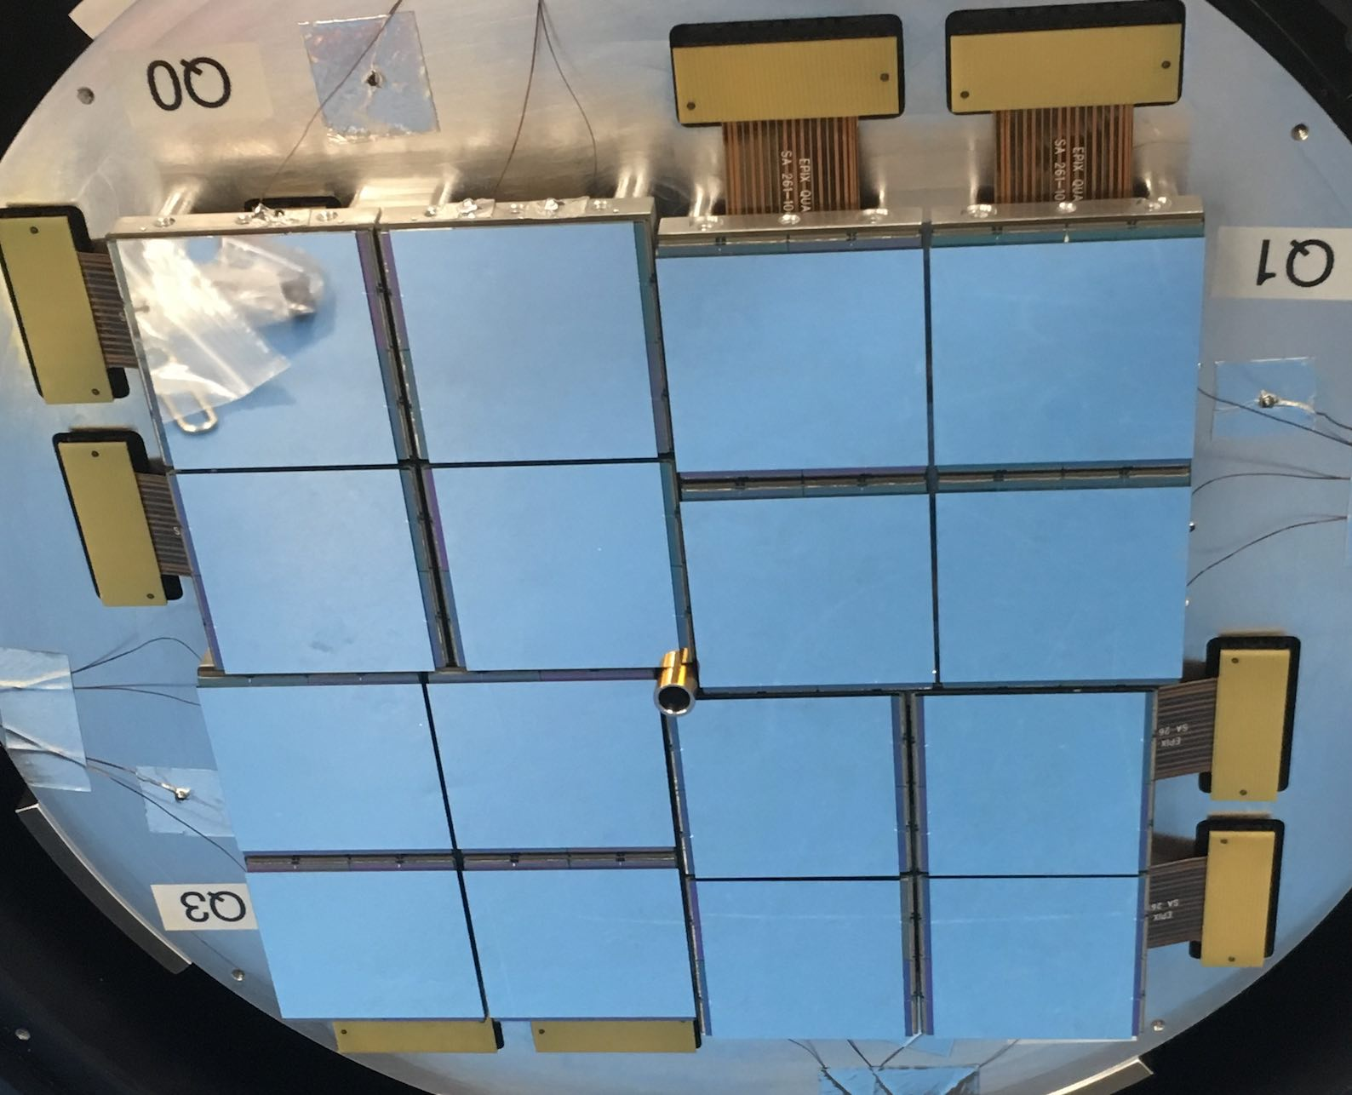
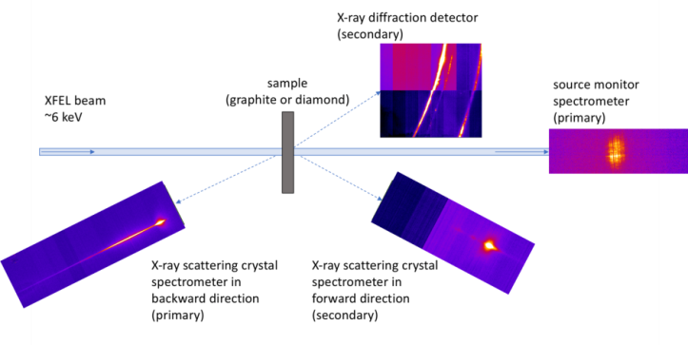
ePix X-ray Detectors 1-120 Hz
Energy integrating hybrid
Common platform: off-chip ADCs, near identical balconies
Deployed at:
  Broad science impact: Photo-chemistry, HIV, inertial fusion, etc.
  LCLS and LCLS II
  EuXFEL, etc.
ePix100
  50 um pitch, 120 Hz
  rms noise ~45 e-, full well ~ 800 keV
EMP hardened
Vacuum compatible ~1e-7 Torr
250nm CMOS
ePix100
Jungfrau
Characterizing the ionization potential depression
in Dense Carbon Plasmas with High-Precision
Spectrally Resolved X-ray Scattering (June 2019)
PI: D. Kraus (HZDR) et al.
ePix100

Slide 39
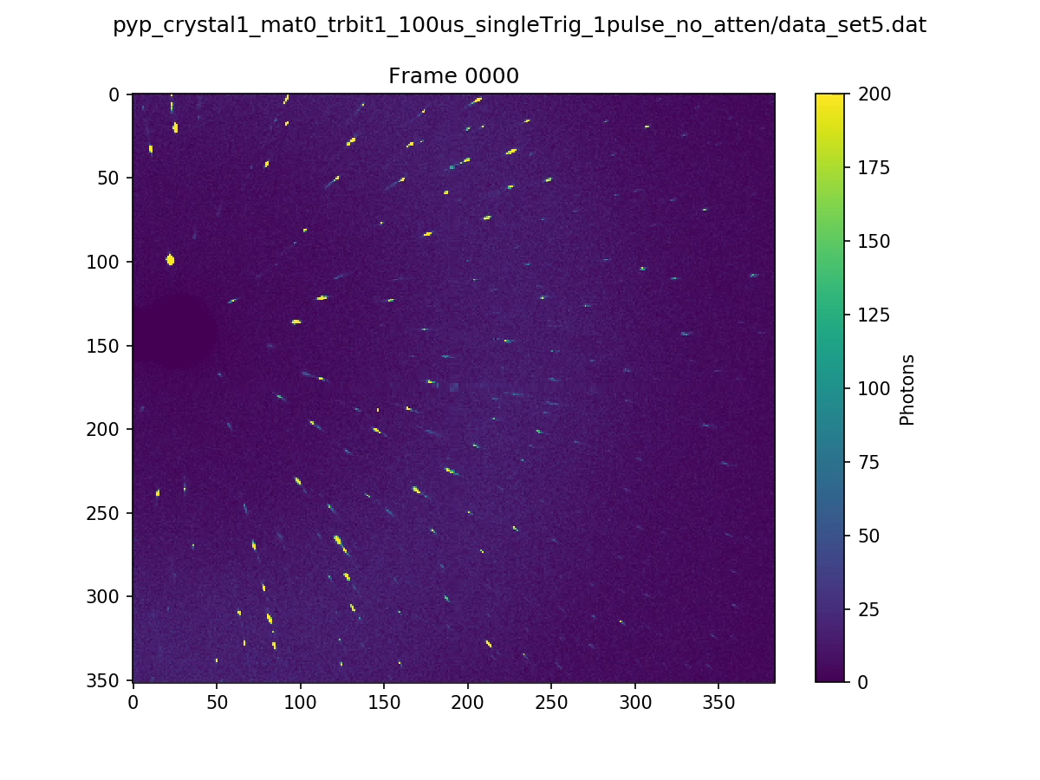
ePix10K 120 – 1000 Hz
ePix10K
  100 um pitch, 1 kHz
  rms noise ~100 e-, full well ~80 MeV
  Auto-ranging per pixel per frame
Deployed at:
  Broad science impact: Photo-chemistry, HIV, inertial fusion, etc.
  LCLS and LCLS II
  Ultra-fast electron diffraction,
  Strong Field QED at FACET-II, APS, EuXFEL, etc.
Near-Physiological-Temperature Serial Femtosecond X-ray Crystallography Reveals Novel Conformations of SARS-CoV-2 Main Protease Active Site for Improved Drug Repurposing
https://www.biorxiv.org/content/10.1101/2020.09.09.287987v1.full.pdf

Slide 40
5 to 7 kHz

Slide 41
ePixHR @ 5-7 kHz
32
X-ray Pump and X-ray Probe TXI instrument @ LCLS
Photon energies between 2 and 5 keV
Hybrid, synchronous, integrating detector
100 um pixels
Auto-ranging gain in pixel – up to 64 MeV/pix/frame
r.m.s noise < 100 e-
Move ADCs from board to the Read Out Chip
Thin entrance window sensors for tender x-rays – codeveloped with SINTEF
Row selector
144
Bias
ΣΔ
ΣΔ
ΣΔ
DEC
DEC
DEC
Temp
ΣΔ
Serializer
6
Sigma-delta ADC per column
DEC
Global Registers
SACI
CMD unit
LVDS Output Buffers

Slide 42
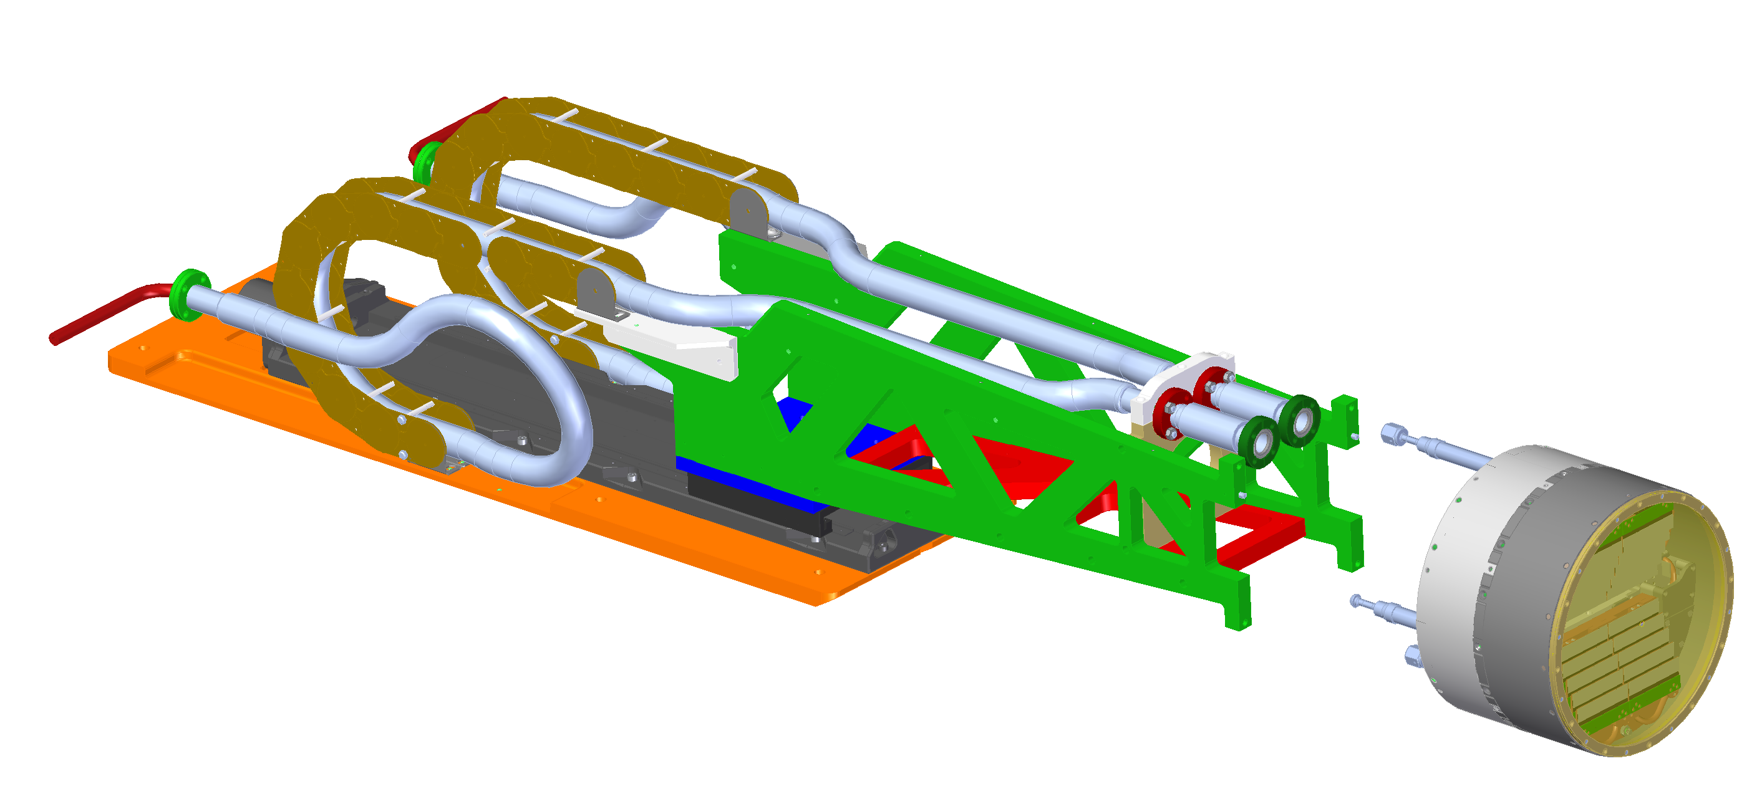
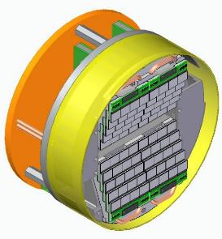
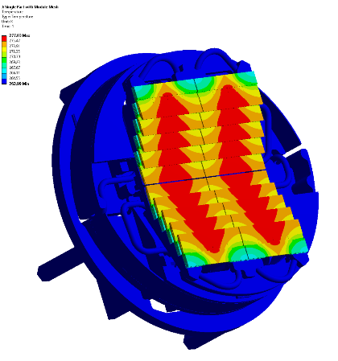
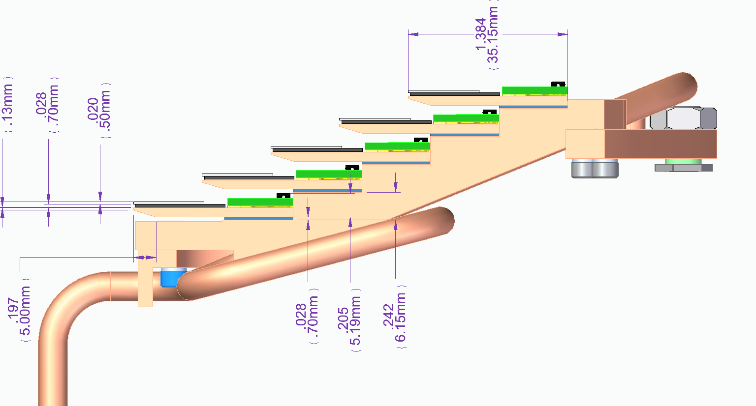
ePixHR @ 5-7 kHz
Shingled for better fill factor
Moves 0.5m along beam and 2-jaw beam aperture
CO2 two-phase cooling system due to high areal power density
CO2 phase change cooling is the default technology for future LCLS high rate detectors

Slide 43


ePixHR @ 5-7 kHz
First beam at LCLS of prototype
Used LCLS-II DAQ
Soft X-rays only
Photon beam pulse rate at 120 Hz (LCLS-I)
Operated Detector at ~ 5kHz
LCLS-II timing generating 4920 triggers/sec with 120Hz x-ray beam. 1 x-ray event every 41 events 5kfps
Soft FEL X-ray pulses

Slide 44


ePixM – Monolithic / Hybrid Soft X-ray Imager @ 5kKz
Combined monolithic CIS and Hybridized to Back-End ASIC
Monolithic CMOS Image Sensor
50 um pitch
Auto-ranging with 2 gains
15 e- noise in High Gain
Full well ~ 500 keV
Multiplex 384 FE pixels to ADC input
LFoundry 150nm
Back-End ASIC
Array of 192 ADCs
4 ADC rows
5 kHz frame rate
X-rays E_{γ} = 250 eV – 2keV
Back-illuminated Monolithic CMOS Imaging Sensor
Solder bumps
Back-end, ASIC with array of 192 ADCs

Slide 45

ePixM – Monolithic / Hybrid Soft X-ray Imager @ 5kKz
Solder Bump Array (IZM and SLAC in house)
Sparse array of signal bumps
Double column of power & control bumps along one edge for redundancy and improved yield
Encountered significant problems when initially bump bonding
Added dense array of mechanical bumps
ADC connecting bumps
Mechanical
Bumps
Power/Control
Bumps

Slide 46


ePixM – Performance
Auto-ranging demonstrated
Gain switching seen with single 22 keV photons
Good QE
Science sensors fabricated and ready for IZM bonding
BE ADC ASICs fabricated
1.0
0.9
QE @ 277 eV ~84%
0.8
Quantum Efficiency
0.7
ALS beamline 6.3.2
Eric Gullikson
Electrical
Test Pulses
0.6
HG
Back thinned to 115 microns thick
Implanted
Microwave annealed
LG

Slide 47


ePixM – Performance
15.7 e- noise in High Gain
Prototype monolithic CMOS sensor
Front illuminated
700um thick
Fe-55
Photon Energy (eV)
Back illuminated
Fully depleted
Post thinning, implant, and microwave anneal
Fe-55

Slide 48

Cluster & pixel layout
Pixels
Timing & Control
Pixels
Distributed ADCs and dig. logic in matrix → pixel circuitry displaced
Need to re-route from bump pad to pixel input
Can be done on-ASIC → do not need special Si sensor
Routing and shielding implemented in SparkPix-ED
ADC
Si sensor
1200 um
ADC Refs & Decaps
PS
AP
M8
M7
ADC Cap
M6
Cluster
M5

Slide 49


Cluster & pixel layout
Noise across pixel in a cluster is “uniform”: no visible difference between pixels above ADC and pixel above “analog” front-end
Shielding + RDL of bump connections on ASIC demonstrated
Pixels
Timing & Control
Pixels
Cluster Layout
Cluster Noise Map
ADC
[11,5]
[0,5]
ADC Refs & Decaps
[11,0]
[0,0]

Slide 50

ePixUHR digital readout logic

Slide 51
Clock distribution and serializer
Digital balcony with datapath split into multiple identical blocks (DigRO)
Clock is generated by FPGA or external PLL
CMOS clock spine with duty-cycle re-generation circuit
Serializers generate local lock for each DigRO, skew is handled in FPGA
Fully functional up to >1.1 Gbps with forced air cooling
DigRO
DigRO
DigRO
DigRO
…
…
Serial
Serial
Serial
Serial
Pad Frame
Data_out<0>
Data_out<7>
CLK_SER (from FPGA)
Data_out<8>
Data_out<15>

Slide 52


ASIC-FPGA codesign
Having a behavioral model of the ASIC allows us to speed up the firmware/software design of the camera.
  Ease the testing and verification of the ASIC logic before the tape-out.
  Development of FW/SW and integration with DAQ can now run in parallel to the ASIC fabrication.
We target the emulation of the ASIC inside the FPGA (done for Fabulous, and under progress for ePixUHR).
Simulation
Emulation
EpixUhrTb.vhd
Xilinx Kintex UltraScale
EpixUhr (Top Level)
EpixUhrEmulation (Top Level)
U_Core
U_Core
ePixUHR_ASIC_behav
ePixUHR_ASIC_behav
U_App
U_App

Slide 53

Methodology: co-design
Data reduction on-ASIC → must ensure data quality and integrity after reconstruction
Industry-standard verification frameworks (UVM) are very powerful, but…
We developed an agile verification frame-work:
  Development of ASIC and FPGA digital logic is done in parallel (not sequentially)
  Simulate full ASIC + FPGA + Software stack
  Verification code = Deployment code
  Enable emulation of ASIC within FPGA
Additional benefits:
Integration with LCLS-II DAQ starts while ASIC in fab
Enables design space exploration of heterogeneous architectures: co-design of detector
Emulated
App
Core
FPGA
Software / DAQ

Slide 54

Methodology: co-design

Slide 55
SparkPix-ED: specifications
Detector | SparkPix-ED
Mode | High-res mode | Fast-trigger mode
Pixel Pitch [um] | 100 | 300
Frame rate [kHz] | 100 | 1000
Matrix size | > 192 x 144 | > 64 x 48
Read Noise [e⁻ rms] | 100 | 500
Well depth [4keV photons] | 10⁴ | 10⁴-10⁵ [*]
Power consumption [W/cm²] | 1.2
Data rate [Gb/s] | 44 | 50
CMOS tech node [nm] | 130 nm
Main design challenges:
Pixel operation from ~1 MHz
Maintain similar noise performance, linearity, dynamic range, power as ePixHR10kt (5 kfps)
Implement ADCs and digital logic distributed across pixel matrix, in the same die
[*] 10⁵ assuming photons are equally distributed over 9 pixels

Slide 56


SparkPix-ED: overall architecture
Digital
logic
ADC
600x1200 µm
x8 LVDS out @ 1 Gb/s
Pixel
Cluster
ASIC: 5x6 mm
Operates at 35 kHz -100 kHz
Si sensor: 100x100 µm²
ASIC: 50x100 µm²
72 pixels → 1 ADC @ 8 MSPS, 12b
Digital logic for pixel configuration and readout
Balcony includes:
Analog biasing
Digital read-out logic
Slow control/configuration

Slide 57
SparkPix-S: specifications
  Charge-integrating, synchronous front-end architecture with sparse readout engine
  Sparse readout needed: 1 MPix @ 1 MHz with 8b/pixel = 1 TB/s
Parameter | Hard X-ray | Soft X-Ray
Energy sensitivity | 4-12 keV | 250 eV-2 keV
QE at max energy | >70% @ 12keV | >70% @ 250eV
Occupancy (pix hit/pulse) | <1%
Frame-rate | 1 MHz
Pixel full well | 5 ph/pulse
Read-out noise | <60 e⁻ (30e⁻ long term) | <15 e⁻
Sensitive Area | >0.5 MPix - 40x40 mm²
Pixel size | 50 x 50 µm²
Data rate | ~40 Gb/s (full-size ASIC)

Slide 58

ePixUHR ADCs: DAC testing line
Pixel
ADC
ePixUHR
AdcCalibEn
External DAC
16-bit DAC8812
FPGA
There is a single DAC line (Vcal_p) that is fed to all the ADC following this distribution line.
DAC

Slide 59


Slide 60


