Slide 1
Pixel detectors for x-ray imaging (at synchrotrons)
Roberto Dinapoli:: Electronics and Photon Science Detector Groups :: Paul Scherrer Institut
FEE2023::Torino::June 2023

Slide 2
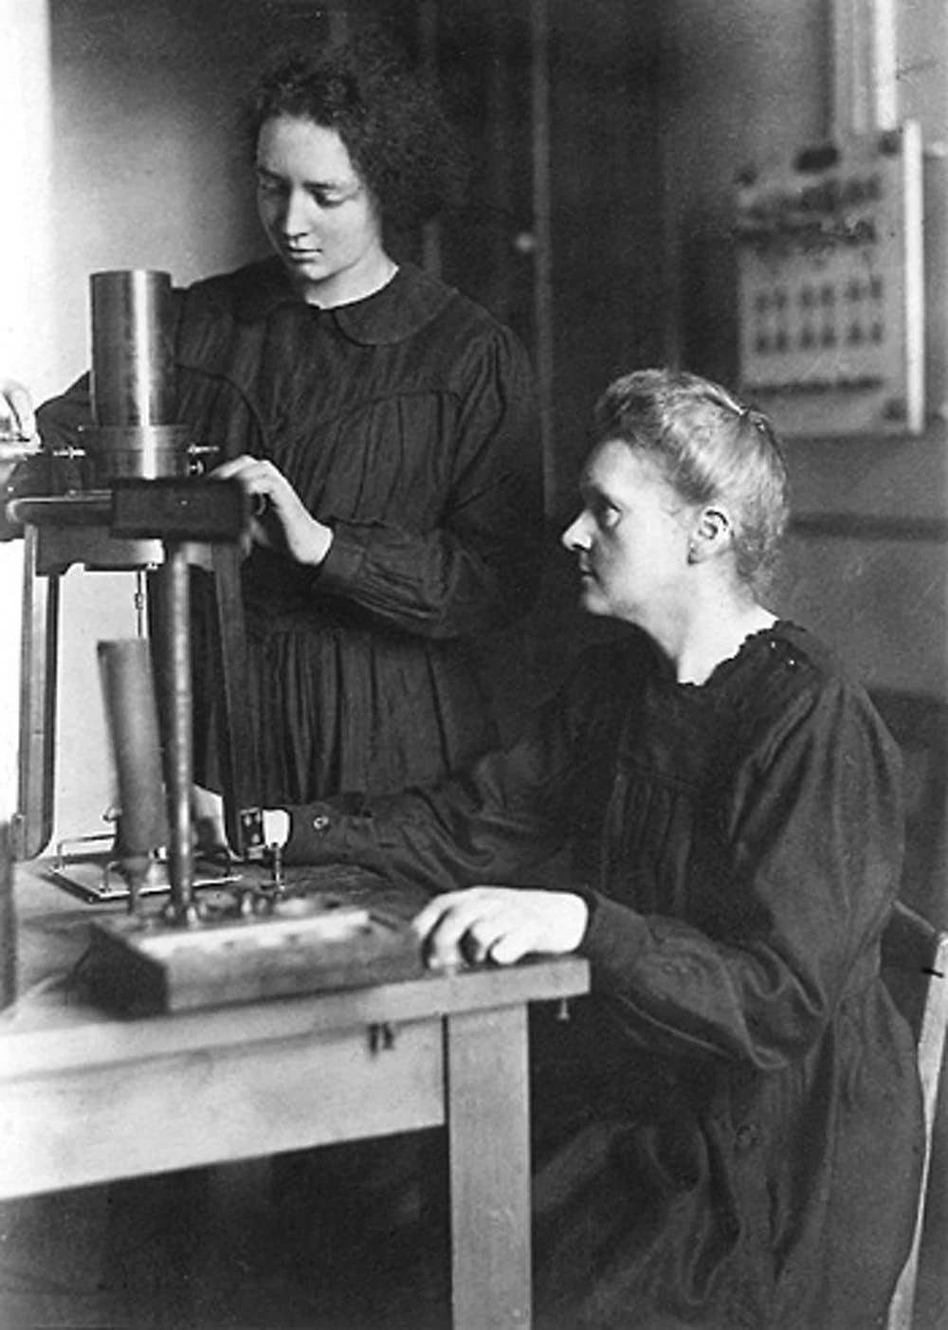
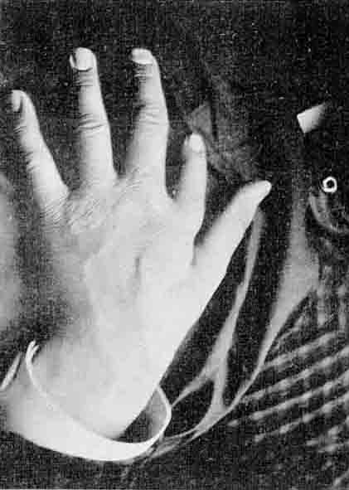
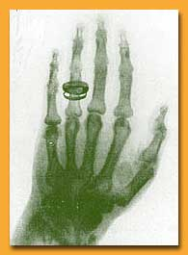
X-ray imaging
X-rays
X-rays
Marie Curie and her daughter in the lab
Source
Sample
Detector

Slide 3
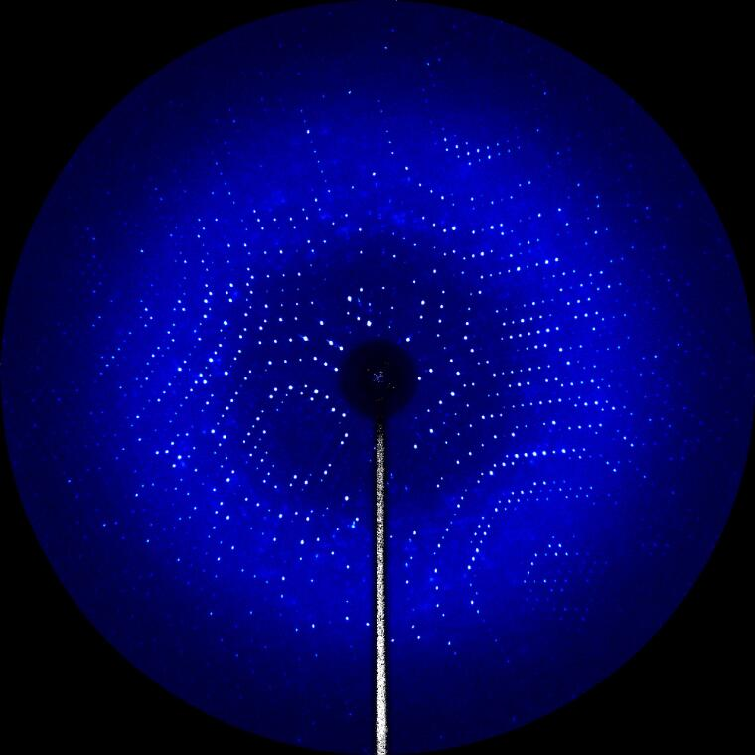
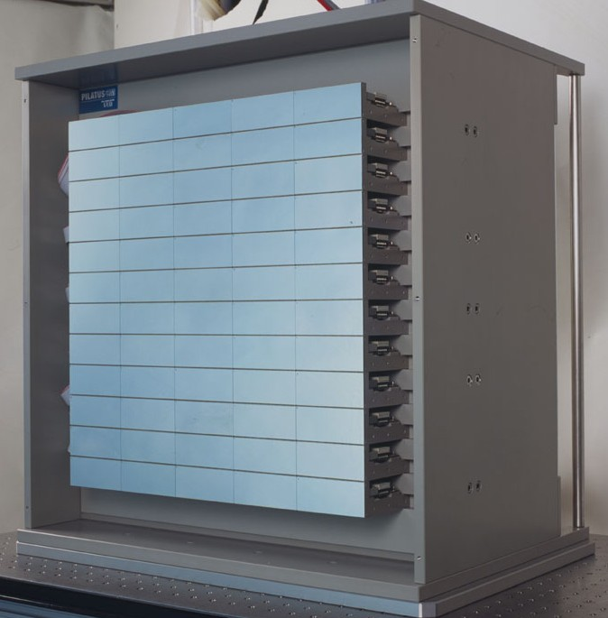
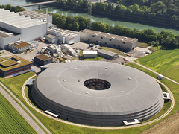
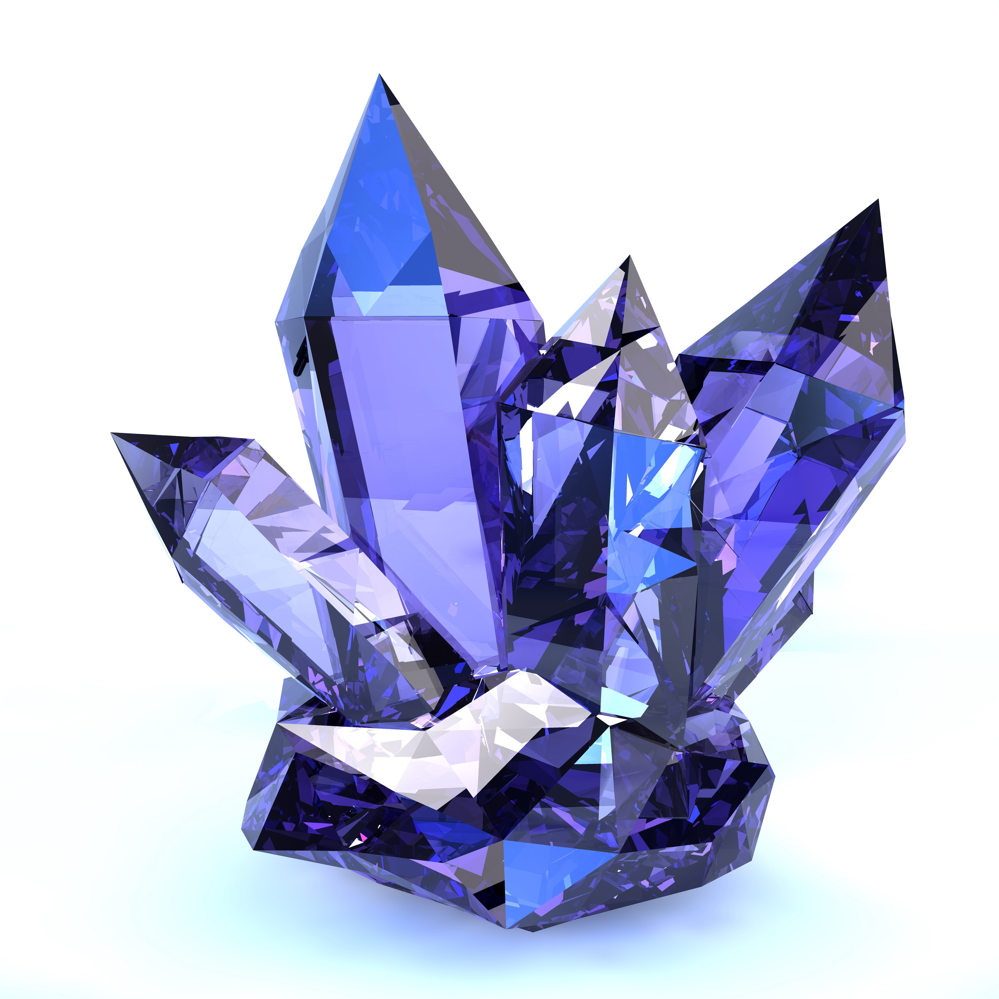
X-ray imaging in Photon Science (PS)
SLS
X-Rays
Electrons
L=288m
Synchrotron light source
Source
Sample
Detector

Slide 4
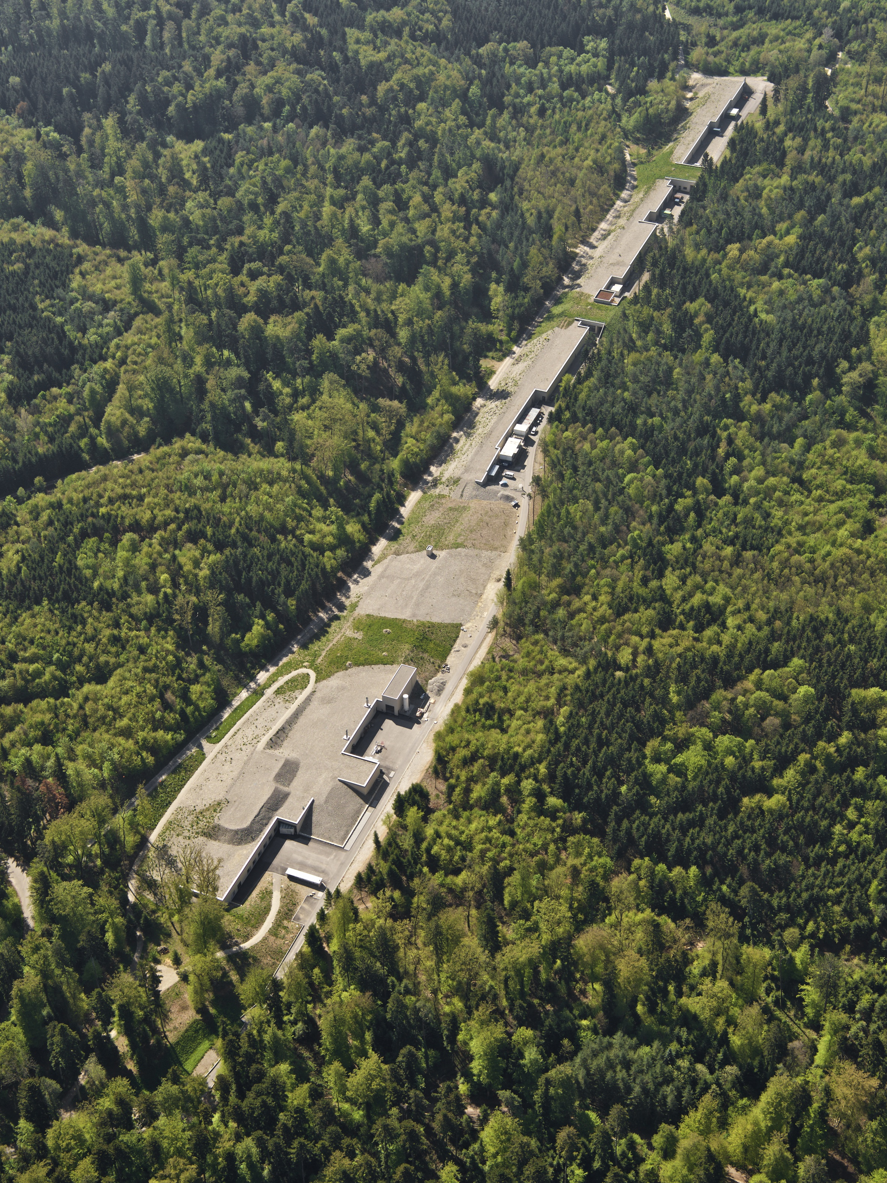
X-ray imaging in Photon Science (PS)
SwissFEL
X-Rays
L=740m
L=288m
Free electron laser
Source
Sample
Detector

Slide 5
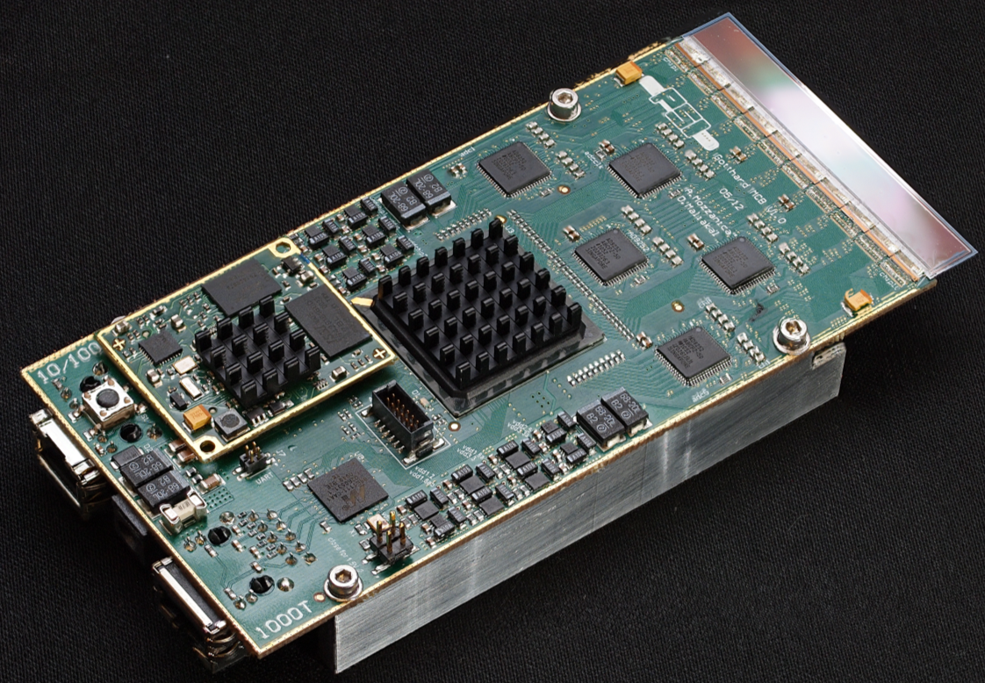
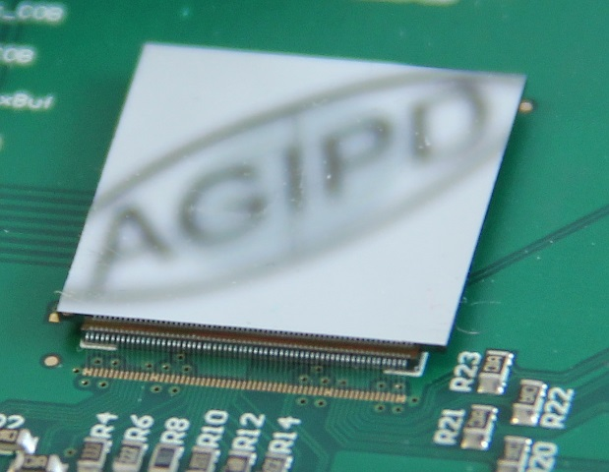
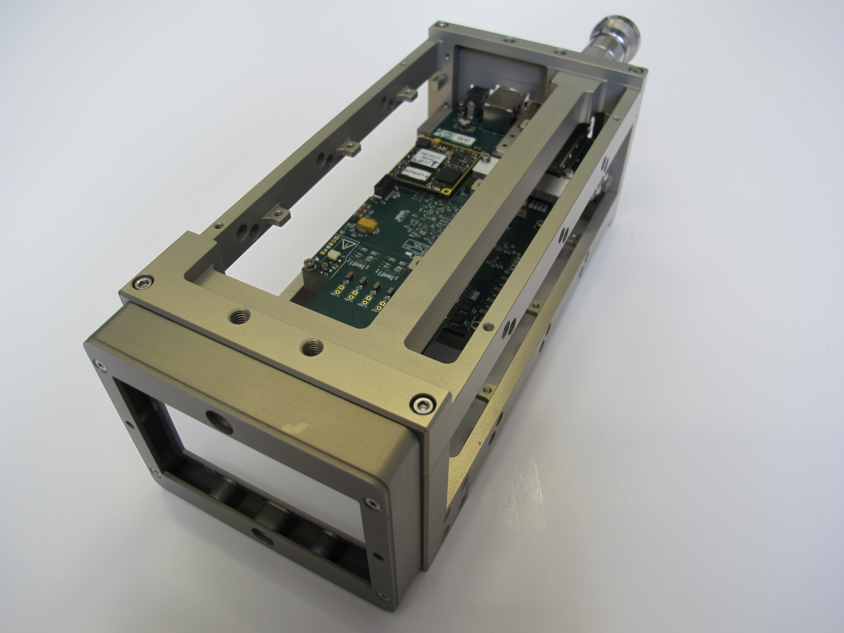
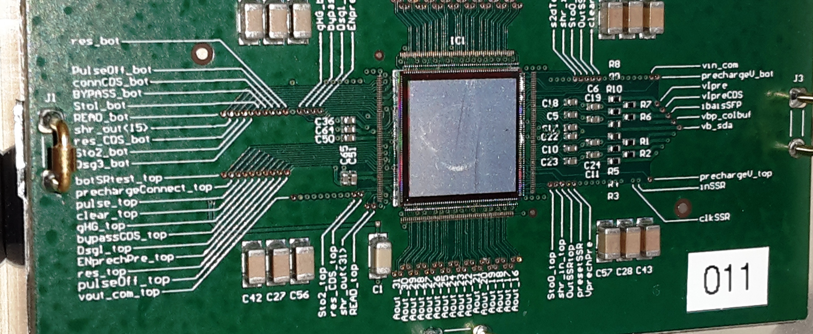
Charge integrating detectors (since 2008)
 | GOTTHARD¹ | AGIPD² | JUNGFRAU | MÖNCH
Status | In operation at EuXFEL | At beamline (EUXFEL) | 2x 16M at SwissFEL | At beamline (SLS)
Pixel size | 50 µm (Strips) | 200 x 200 µm² | 75 x 75 µm² | 25 x 25 µm²
Maximum system size | Modules (=10 ASICs) | 1Mpixel (=16 Modules) | 16Mpixel (=32 Modules) | Single Chips (=2x3 cm²)
Noise (r.m.s.) | <300 e⁻ ENC | < 322 e⁻ ENC < 214 e⁻ ENC (HG) | < 100 e⁻ ENC (G0) < 35 e⁻ ENC (HG0) | <35 e⁻ ENC
Dynamic range | < 1.10⁴ x 12.4 keV (3 gain stages) | < 1.10⁴ x 12.4 keV (3 gain stages) | < 1.10⁴ x 12.4 keV (3 gain stages) | < 500 x 12.4 keV (2 gain stages)
Maximum frame rate | 40 kHz (cont.) 1 MHz (burst) | < 5 MHz (burst*) * 352 frames | 2.4 kHz (cont.) < 1 MHz (burst) | 6-8 kHz (cont.)
Not covered
²⁾ Common development with University of Bonn (GER), University of Hamburg (GER) and DESY (GER), ¹⁾ Common development with Desy

Slide 6
Big facility challenges
Big systems!
Easy to ship and install
Easy to calibrate
Easy to use, stable operation
Easy to maintain/support
Reasonable unit production costs (for research)
Layout of a JUNGFRAU 4M

Slide 7
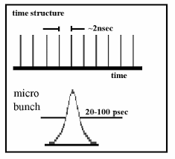
Photon science: how the input looks like
Bunches very close in time
Few photons/bunch
Synchrotrons
SLS standard bunch structure
t=0
0 or 1 ph/pixel/bunch
t=2ns
Pixel input
t=0
t=1us

Slide 8
How the input looks like
Energies from 4-5 keV to 20keV, typical energy at SLS=12keV
  Photons either stop or do not stop, no LET
  No material butget issues
1st gen.

Slide 9
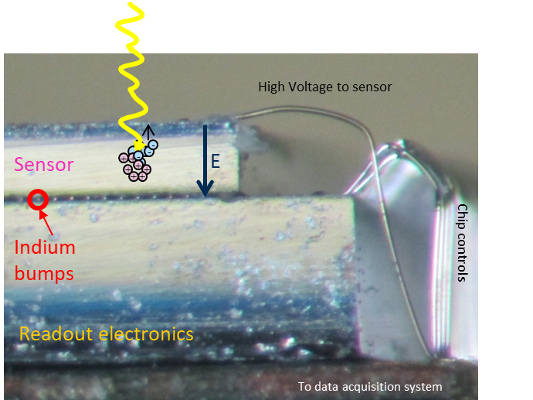
Hybrid detectors
Energies from 4-5 keV to 20keV, typical energy at SLS=12keV
  Photons either stop or do not stop, no LET
  No material butget issues
1st gen.
Room temperature operation
Direct conversion, high SNR
Fast highly parallelized readout
Full depletion: speed/radiation tolerance
Thick detectors possible
Silicon sensors:
  match perfectly required energy window
  Very high quality
Interconnection
  Cost, yield
  Minimum pitch->spatial resolution
  Input capacitance-> noise
Sensor and readout electronics can be optimized separately

Slide 10
Detector challenges
Single photon resolution
High dynamic range (n. photons/image)
High quantum efficiency
Very high incoming particle rate (Mcnts/pixel/s)
Complete frame readout at:
  High frame rates
  Negligible dead time
Large area detectors
Harsh conditions, in particular radiation tolerance
  BUT… No timing information required
  Easy access to the detector

Slide 11
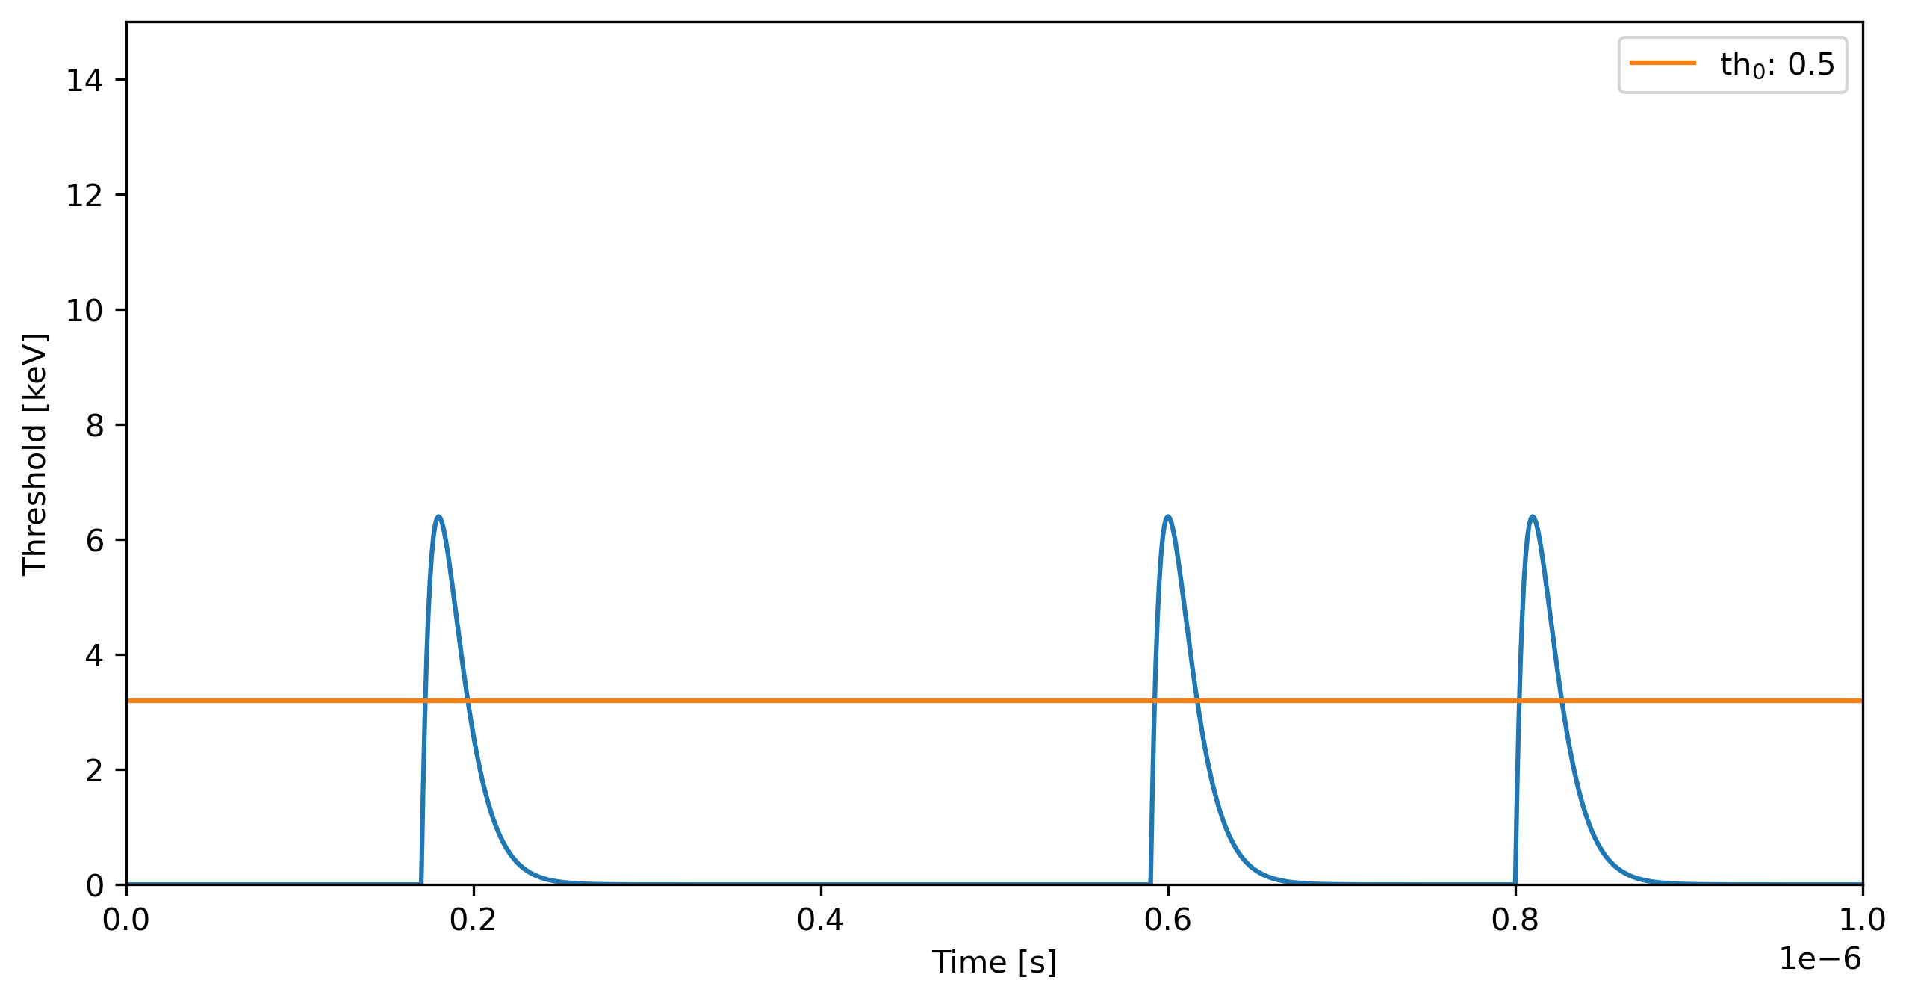
Single photon counting (SPC) at synchrotrons
Single Channel, general configuration
Vrf
VrfSh
Control and readout logic
TBs
Counter
Off pixel digital drivers
Analog Pulsing
Preamp
Vth
Shaper
ENABLE
RESET
Digital OUT
Pre-Shaper
Counter
0001
0010
0000
0011
Comparator
Notes:
Analog and Digital test modes

Slide 12
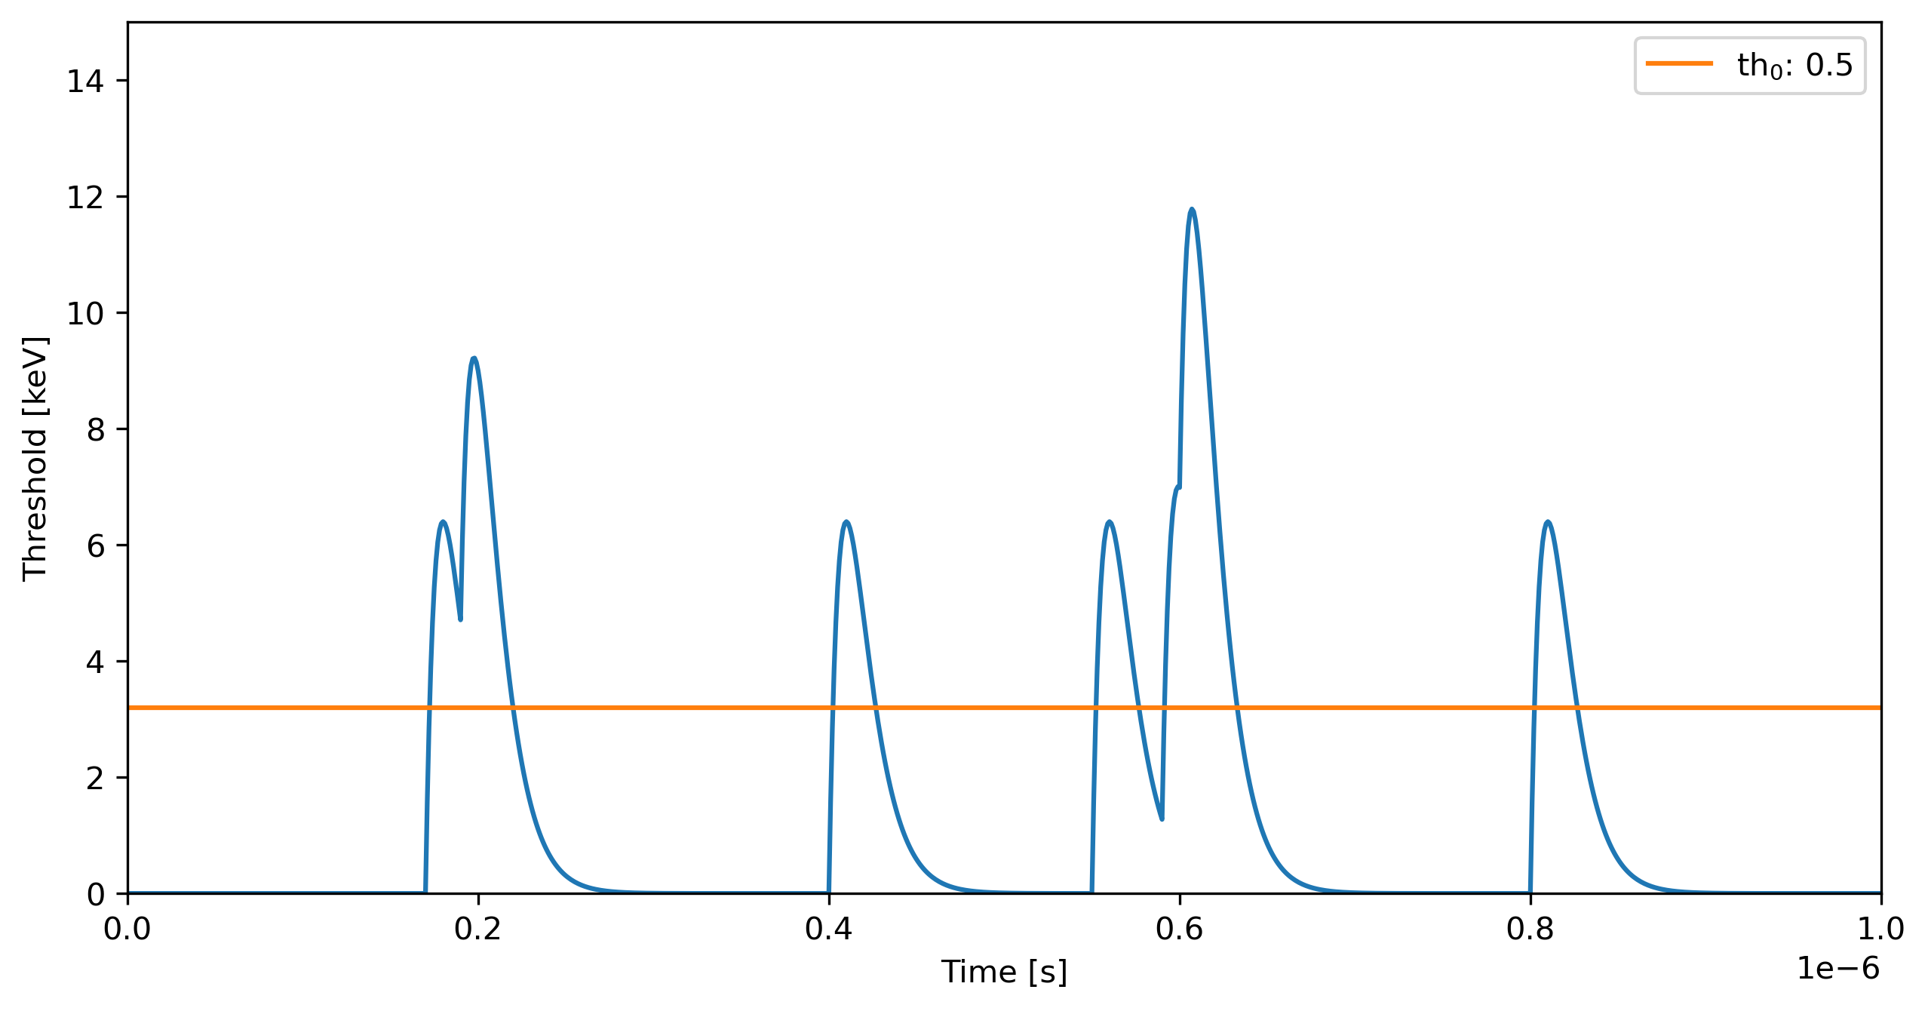
SPC shortcomings: Pile-up
0000
0001
0010
0011
0100
Counted pulses:4
Incoming pulses:7

Slide 13
Charge sharing and “corner effect”
Charge cloud
+1
Central hit:
no problem
+1
Shared hit: no problem if monochromatic and Eth=Ein/2
Calibration more complex
0
0
0
0
0
0
0
0
Shared hit: photon lost
0
0

Slide 14
SPC at synchrotrons: design challenges
Single Channel, general configuration
Vrf
VrfSh
Control and readout logic
Analog Pulsing
TBs
Counter
Off pixel digital drivers
Preamp
Vth
Shaper
ENABLE
RESET
Speed & flexibility vs noise & power consumption
Matching (uniformity; energy resolution)
ENABLE distribution
Dynamic range, RESET distribution, continuous R/W
Digital OUT
Testability/
calibration
D to A crosstalk,
Power distrib.
Digh frame rate
Data deluge
Notes:
Analog and Digital test modes

Slide 15
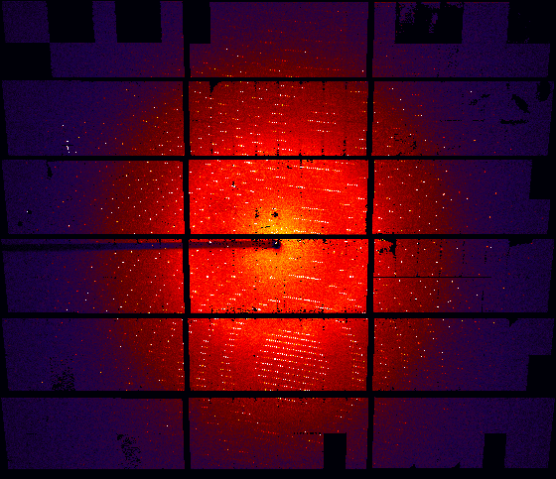
First generation X-ray pixel detectors at PSI
  Yes, pixel detectors can be spinned-off from HEP to photon science
PILATUS I, DMILL
Gen. 0

Slide 16
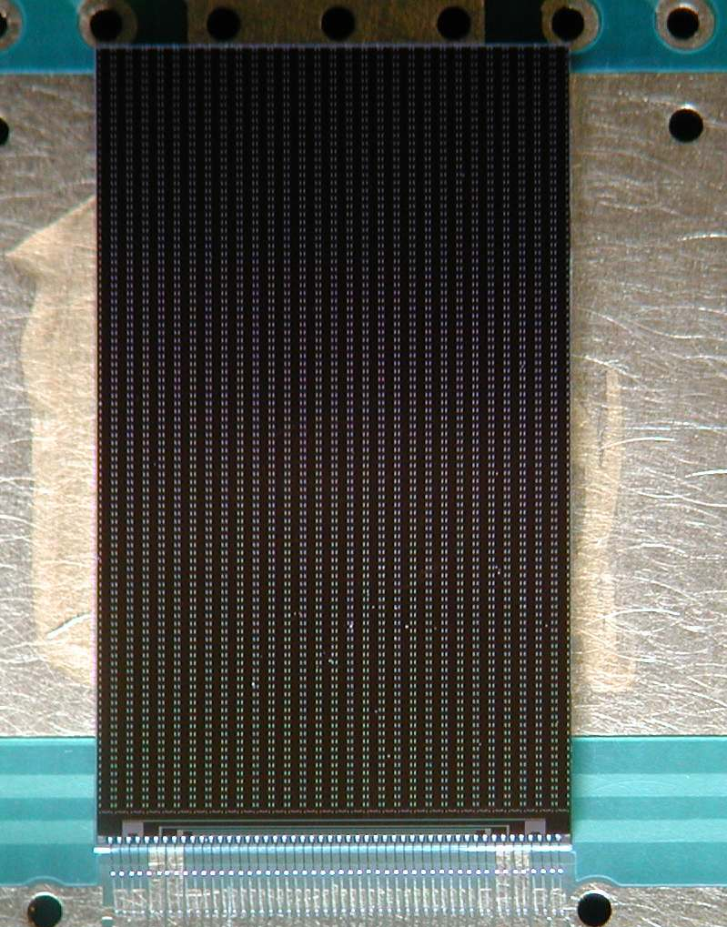
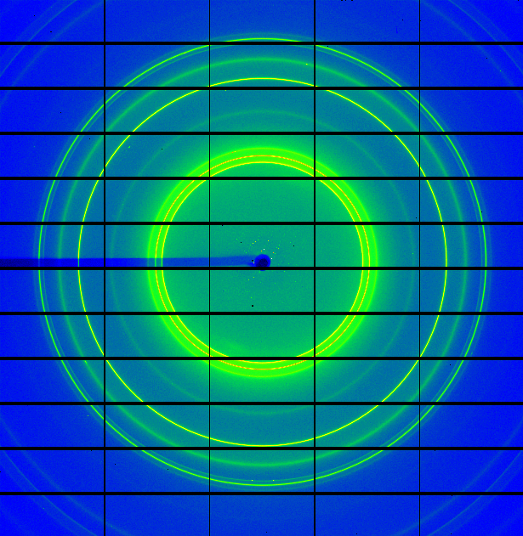
First generation X-ray pixel detectors at PSI
  Radiation tolerance
  Uniform response
  Single photon resolution
  Large dynamic range (n. photons/frame)
  Large area
1st generation
PILATUS II, UMC250nm
ELT design & libraries from CMS PSI46 chip (60Mrad)
6 trim bits
Large pixels (172µm pitch)
    Less charge sharing/corner effect
    Space for long counters (20 bits)
  Lower spatial resolution-> go far with detector (compromise on field of view)
  More input capacitance/noise-> high shaping time (compromise on photon flux)
Slow readout, long dead time, no continuous R/W (10 Hz)
  Pretty much everything is much easier (compromise on frame rate)

Slide 17
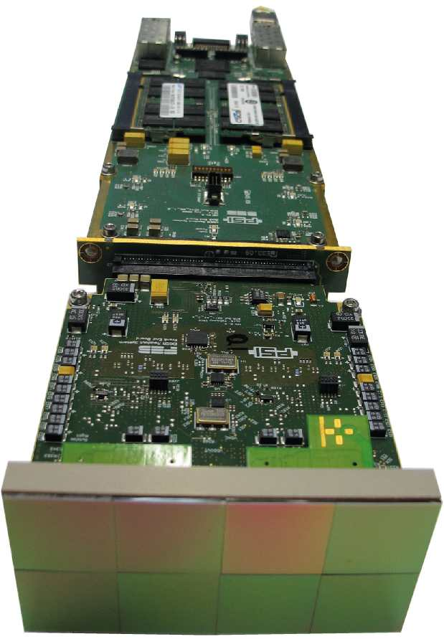
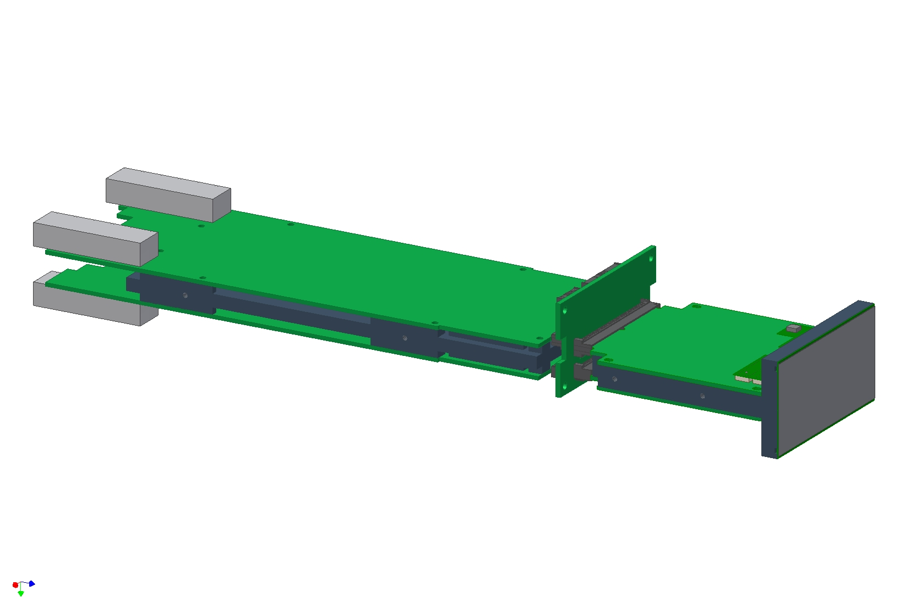
From a chip to a big area detector (EIGER)
  8 ASICs bump bonded to one sensor
  500 k pixel Modules
  38 X 77 mm² Sensitive area
Readout electronics behind detector head

Slide 18
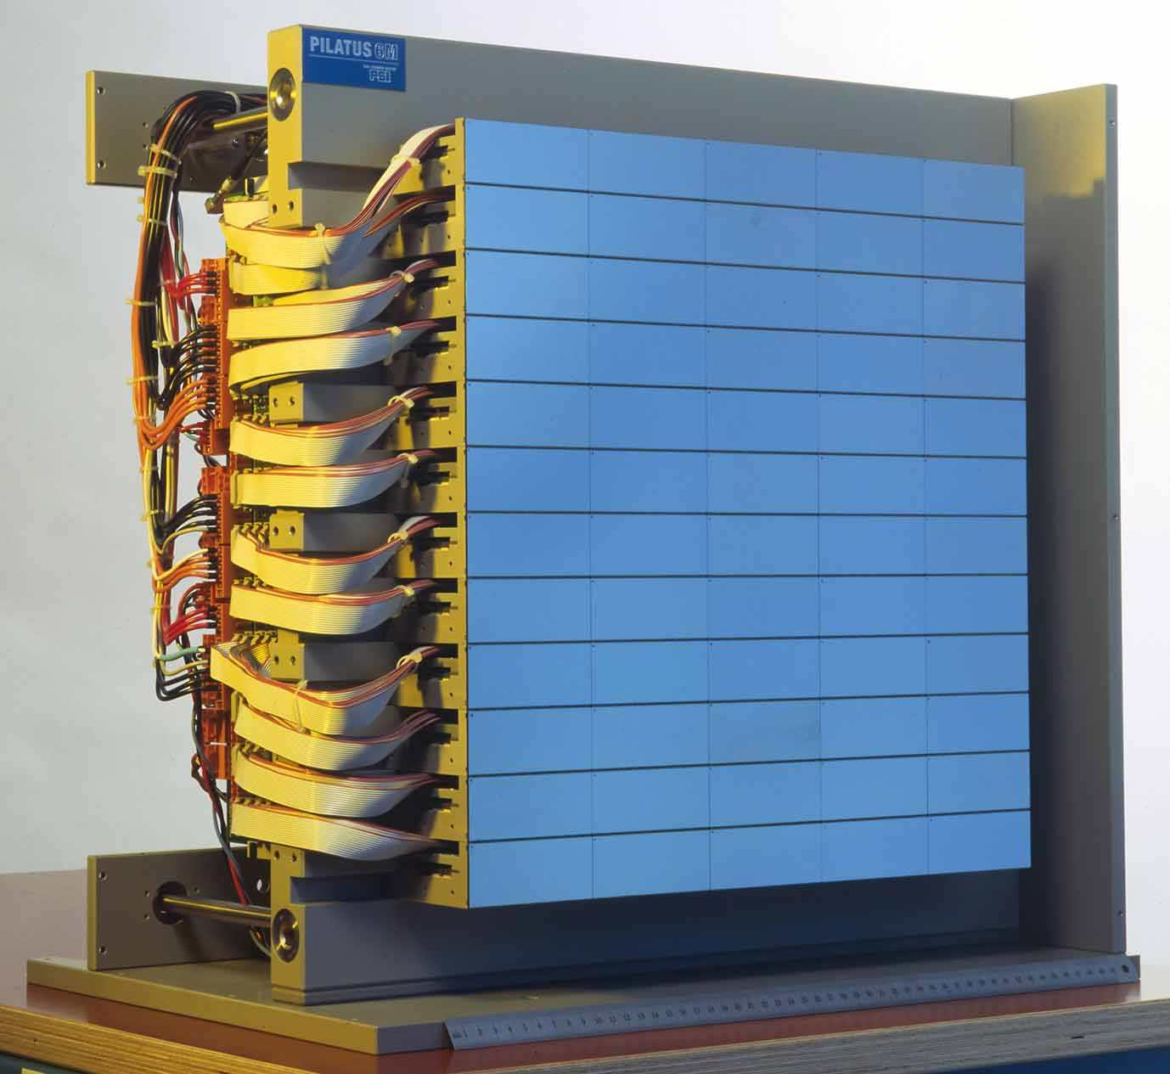
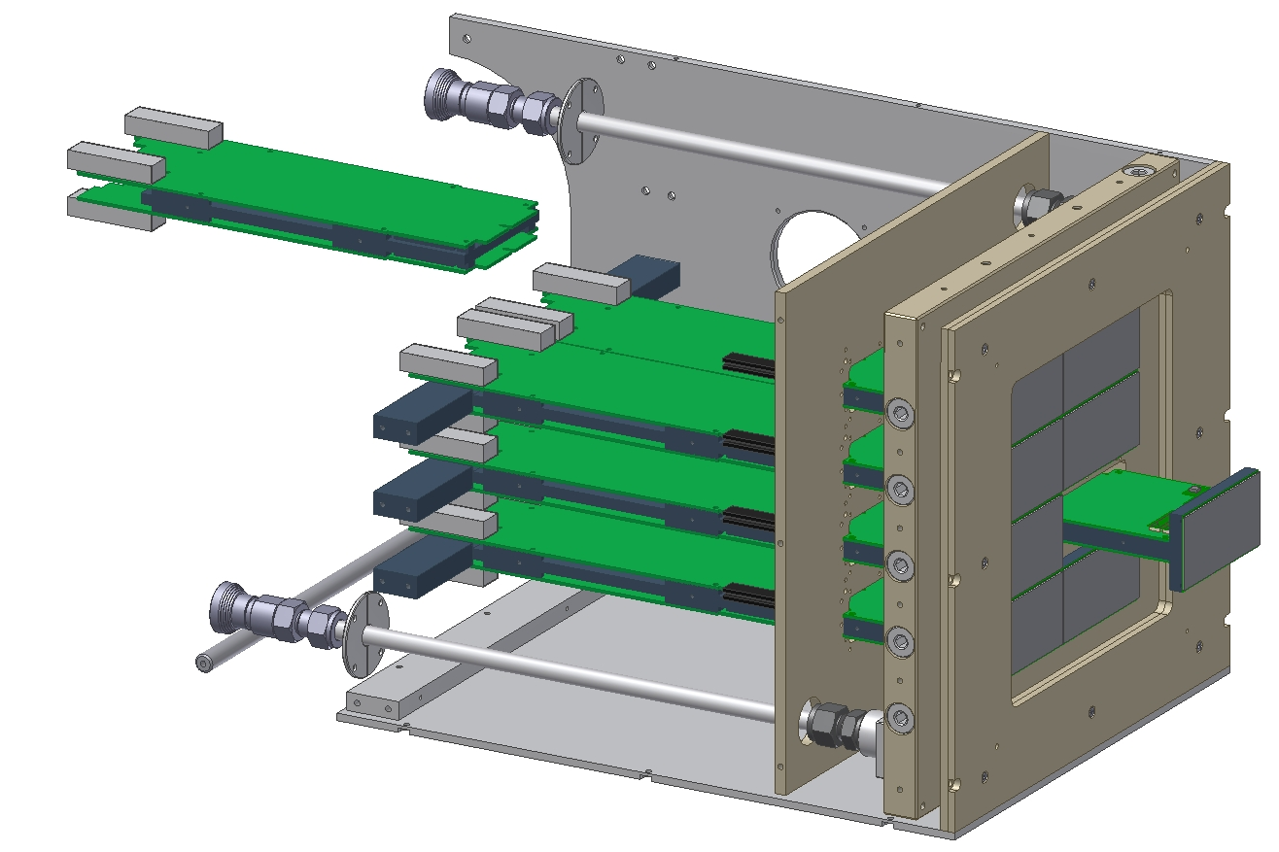
From a chip to a big area detector
EIGER 4Mpixels
8 modules
Pilatus II, 6Mpixels
60 modules

Slide 19
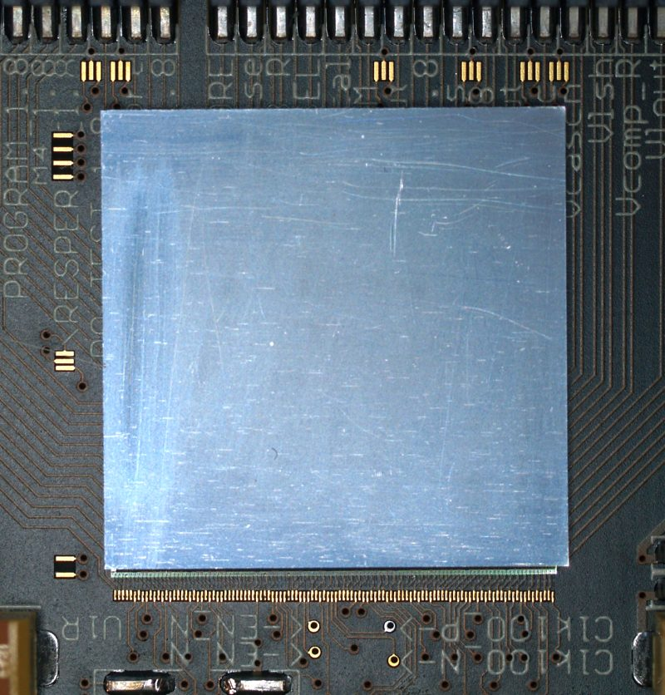
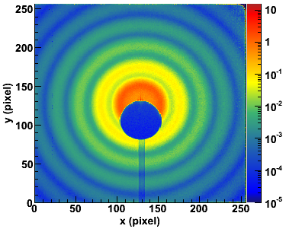
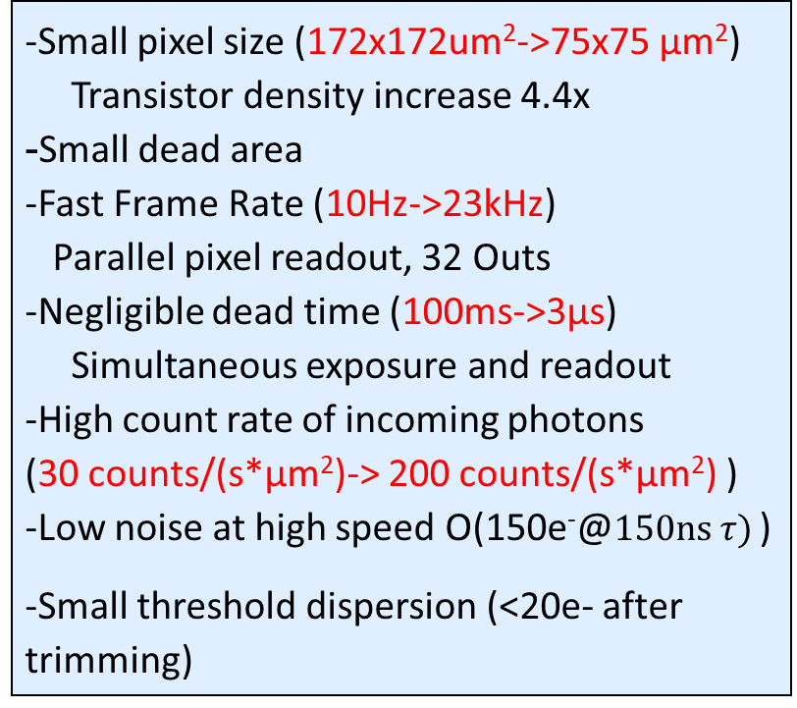
Second generation X-ray pixel detectors at PSI
Technology: UMC250
  -Small pixel size (172x172um²->75x75 μm²)
  Transistor density increase 4.4x
  -Small dead area
  -Fast Frame Rate (10Hz->23kHz)
  Parallel pixel readout, 32 Outs
  -Negligible dead time (100ms->3μs)
  Simultaneous exposure and readout
  -High count rate of incoming photons
  (30 counts/(s*μm²)-> 200 counts/(s*μm²) )
  -Low noise at high speed O(150e⁻@$150ns τ)$ )
  -Small threshold dispersion (<20e- after trimming)
EIGER
2cm
2nd generation

Slide 20
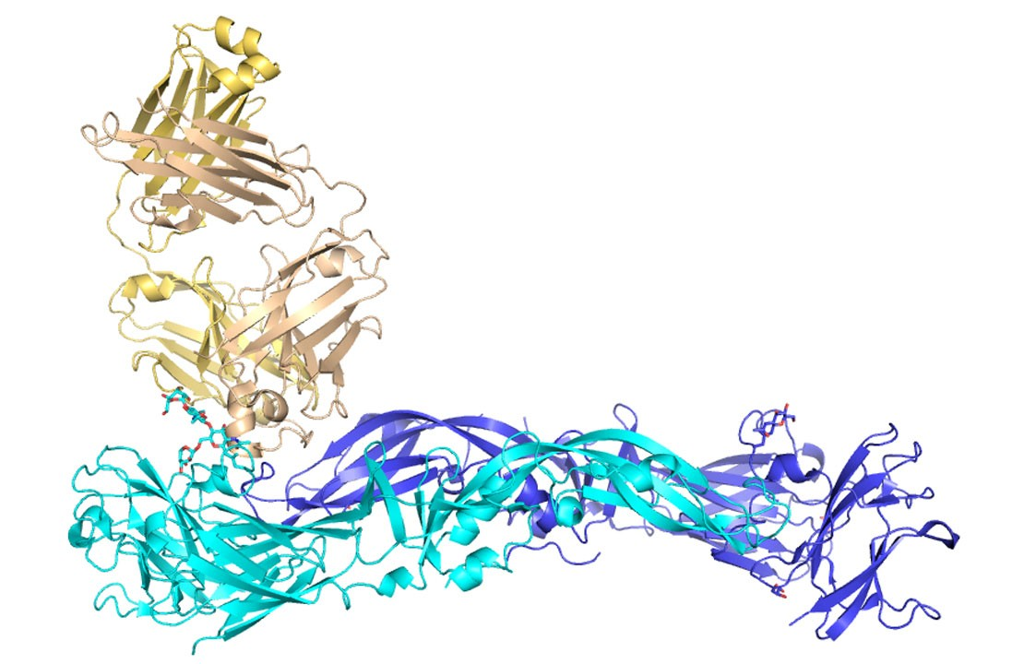
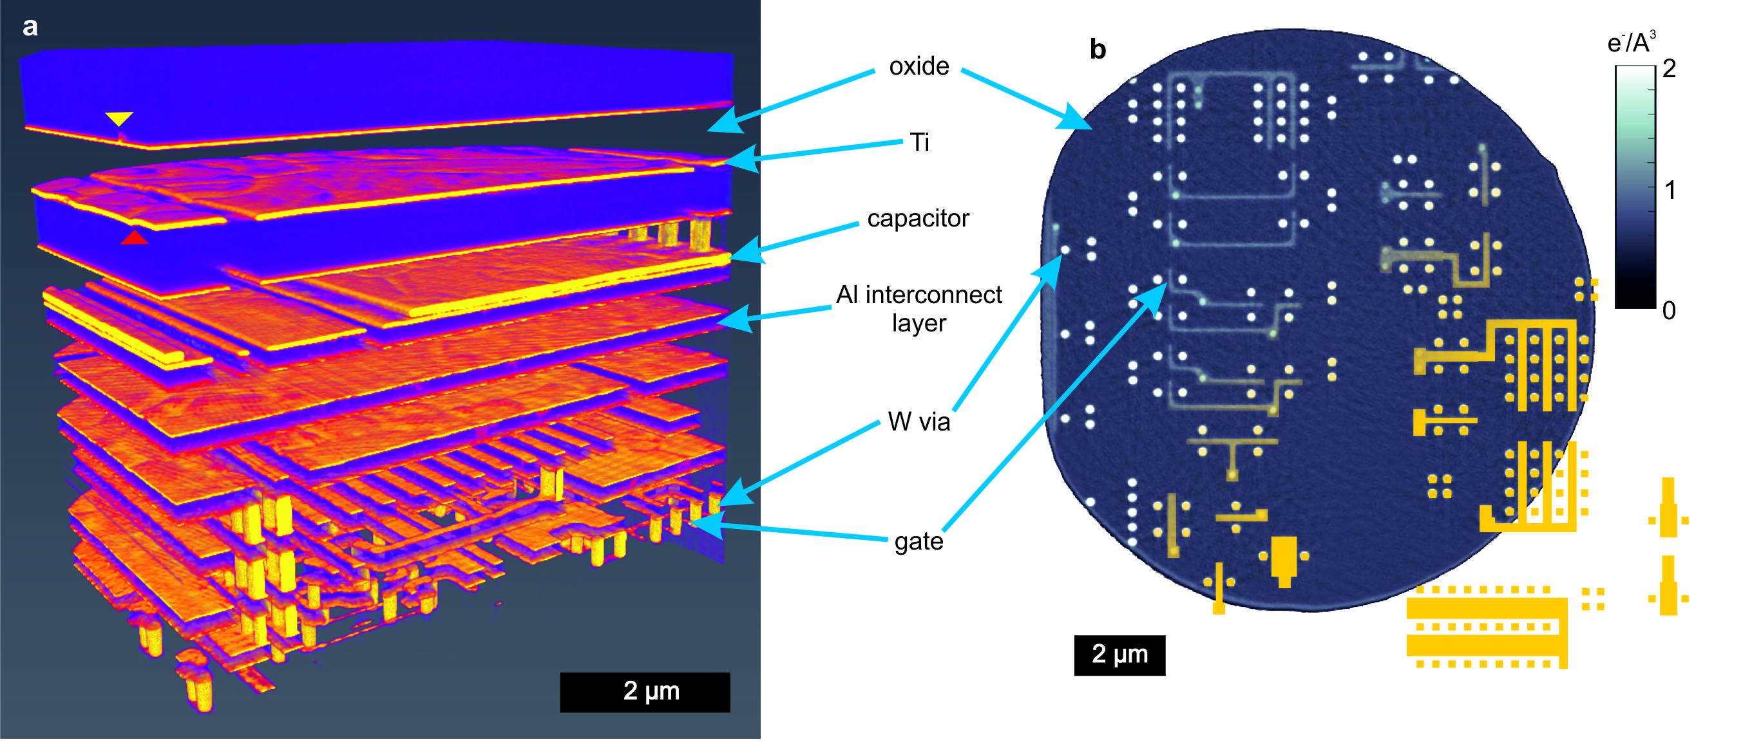
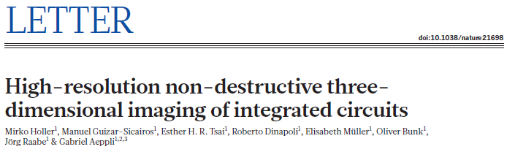
RELEVANCE
Was world fastest single photon counting X-ray detector
Enable unprecedented experiments in photon
science in a very wide range of applications
“Structural basis of potent Zika–dengue virus antibody cross-neutralization”
Nature volume 536, pages 48–53 (2016)
Notes:
a Nobel Prize measured with our detectors, several Science papers based on data taken EIGER (e.g. Zika–virus antibody cross-neutralization); Zika E protein structure

Slide 21
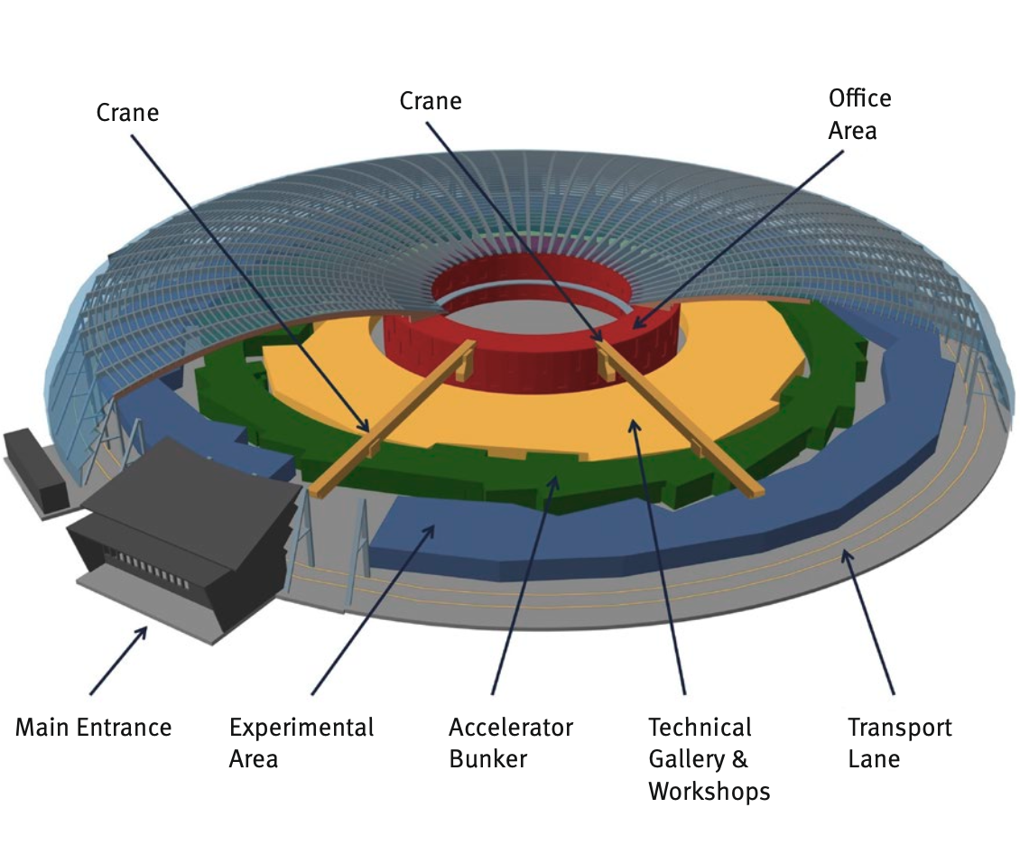
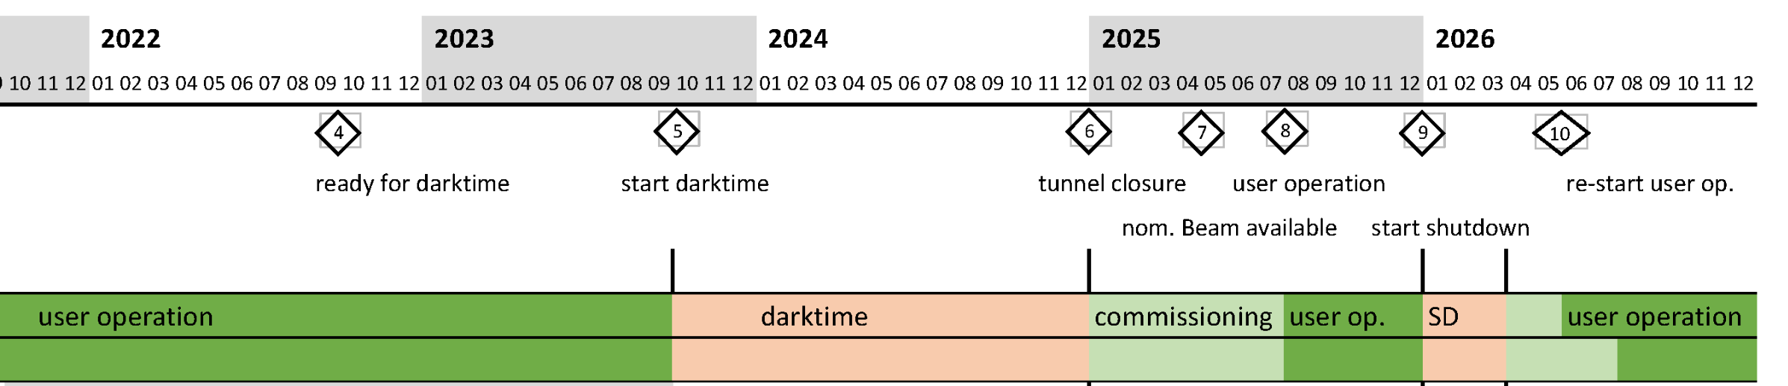
Diffraction limited sources, SLS 2.0
The «speed challenge»
Depending on beamline ~ 1000x flux
Dark period form autum 2023
First light planned 2025 with user
operation in later part of the year
This requires ~20MHz/pix/s
More flexibility for more applications
Can SPCs get there?

Slide 22
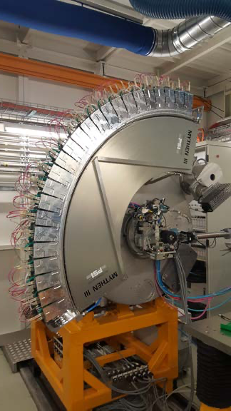
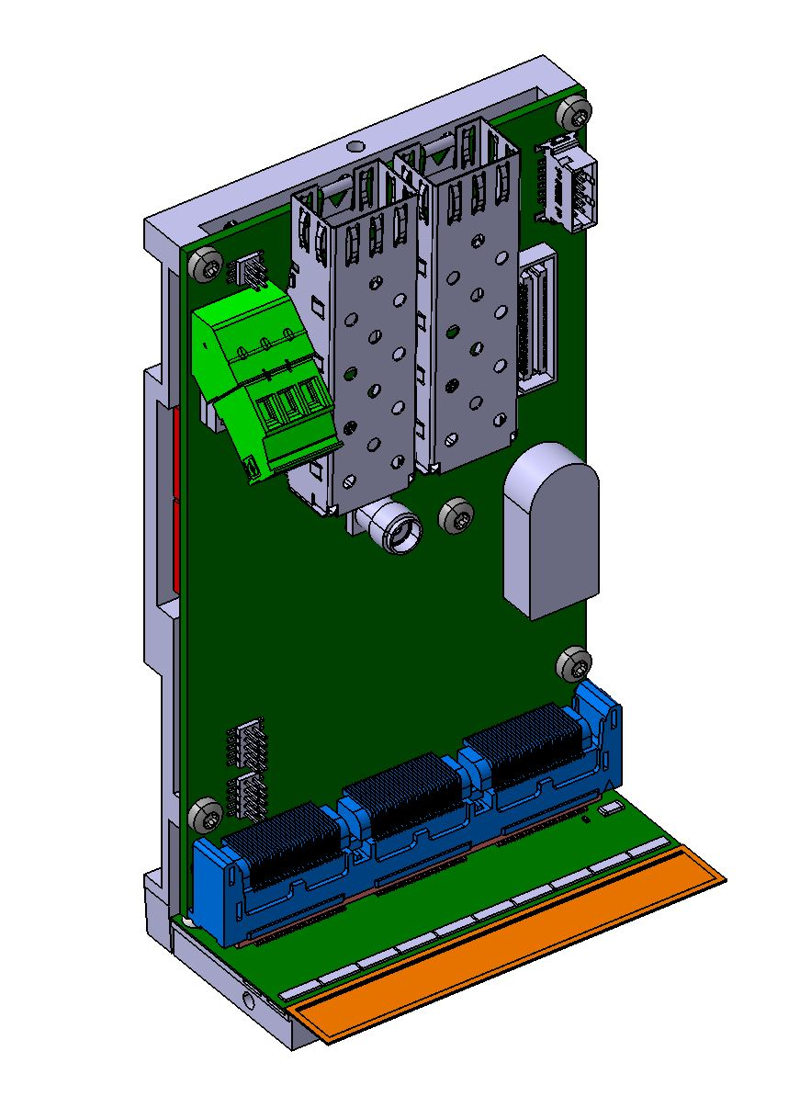
Mythen 3
Technology: UMC110AE
Hybrid strip detector
100/175e- RMS noise (high/standard gain)
Trimmed threshold dispersion < 6e-
300kHz frame rate
  @8bits, 1 counter (out of 24bitsx3counters)
  limited by RO electronics
320um thick silicon sensor
50um strips
3rd generation
Mythen 3 full detector
at the MS beamline
Mythen 3 module

Slide 23
MYTHEN 3, the channel
serialIN, TBLoad,
Control signals
Status register (3x6TB,3x1Mask,3 dummy)
21
Control and readout logic
Counting
logic
24x3 bits
TBs3
7
Counter 3
Vth3
6
Vrf
VrfSh
3rd generation
ChSel3
TBs2
7
Counter 2
Vth2
6
Vdc
ChSel2
Analog Pulsing
TBs1
7
Counter 1
6
Vth1
EN1,EN2,EN3
PUMPPROBE
DIGPULSING
POLARITY
ChSel1
serialOUT
Notes:
Analog and Digital test modes

Slide 24
Improving rate capabilities: multithresholding

Slide 25
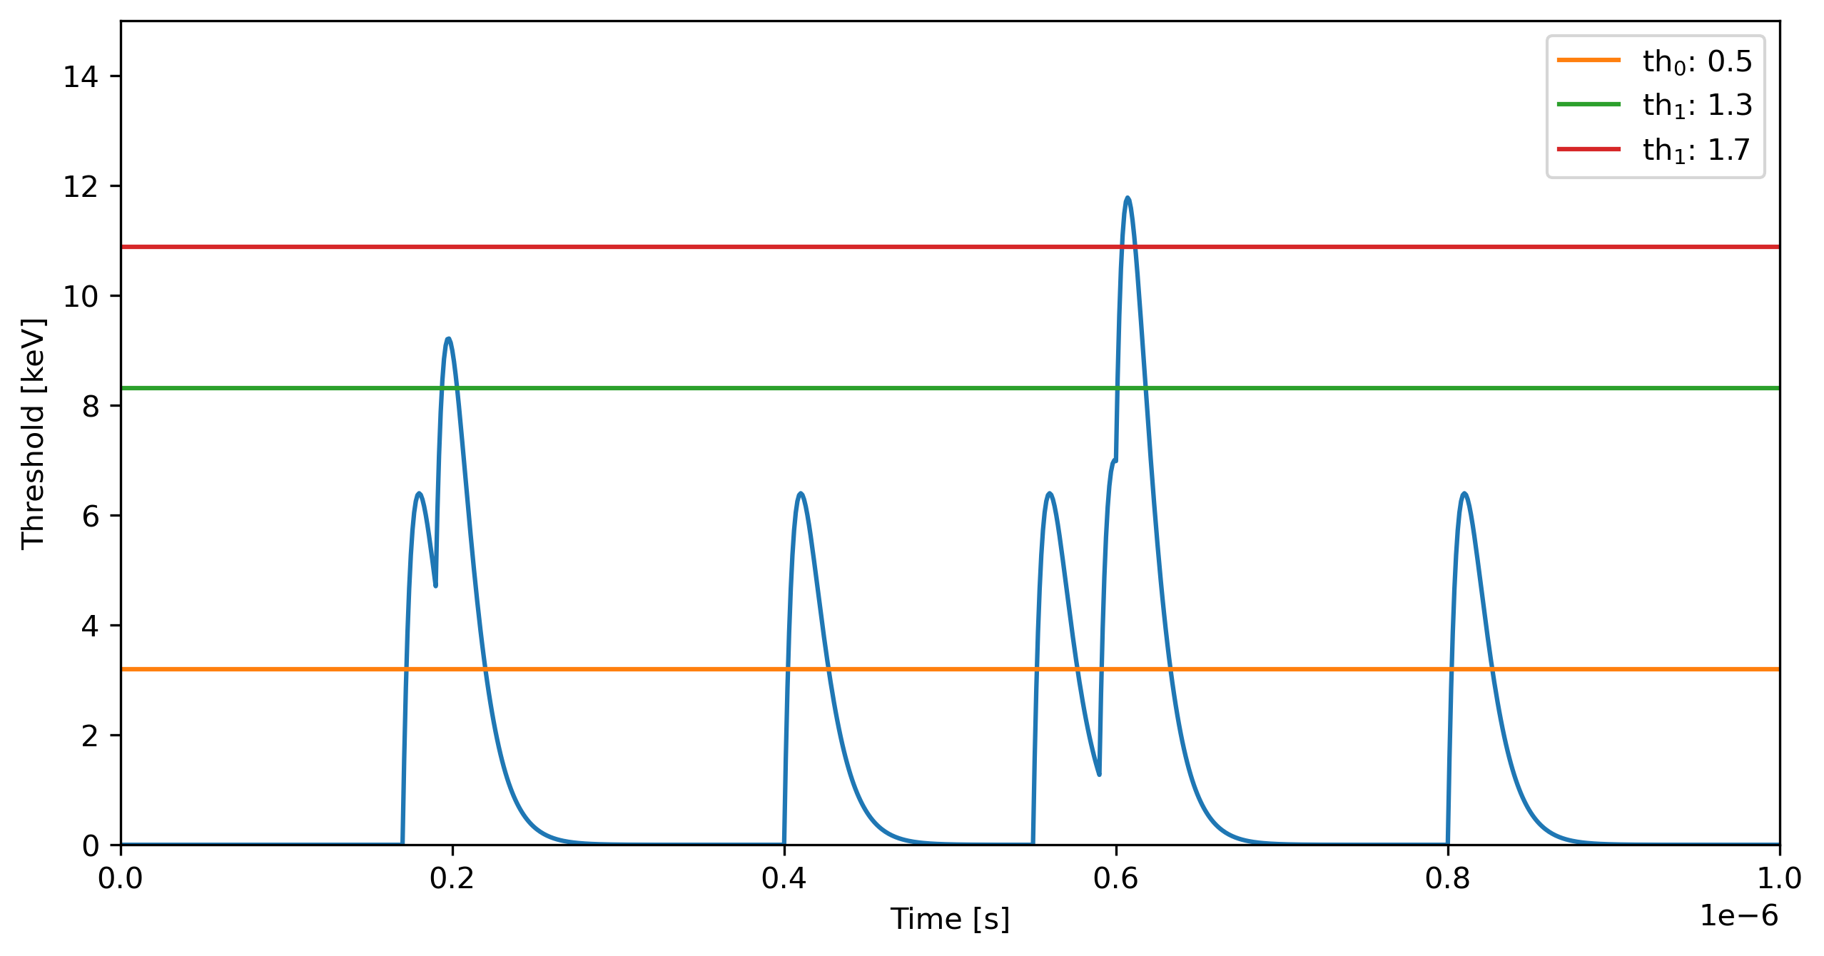
Improving rate capabilities: multithresholding
Counter 2: 1
Counter 1: 2
Total counts:7
Counter 0: 4
Incoming pulses:7

Slide 26
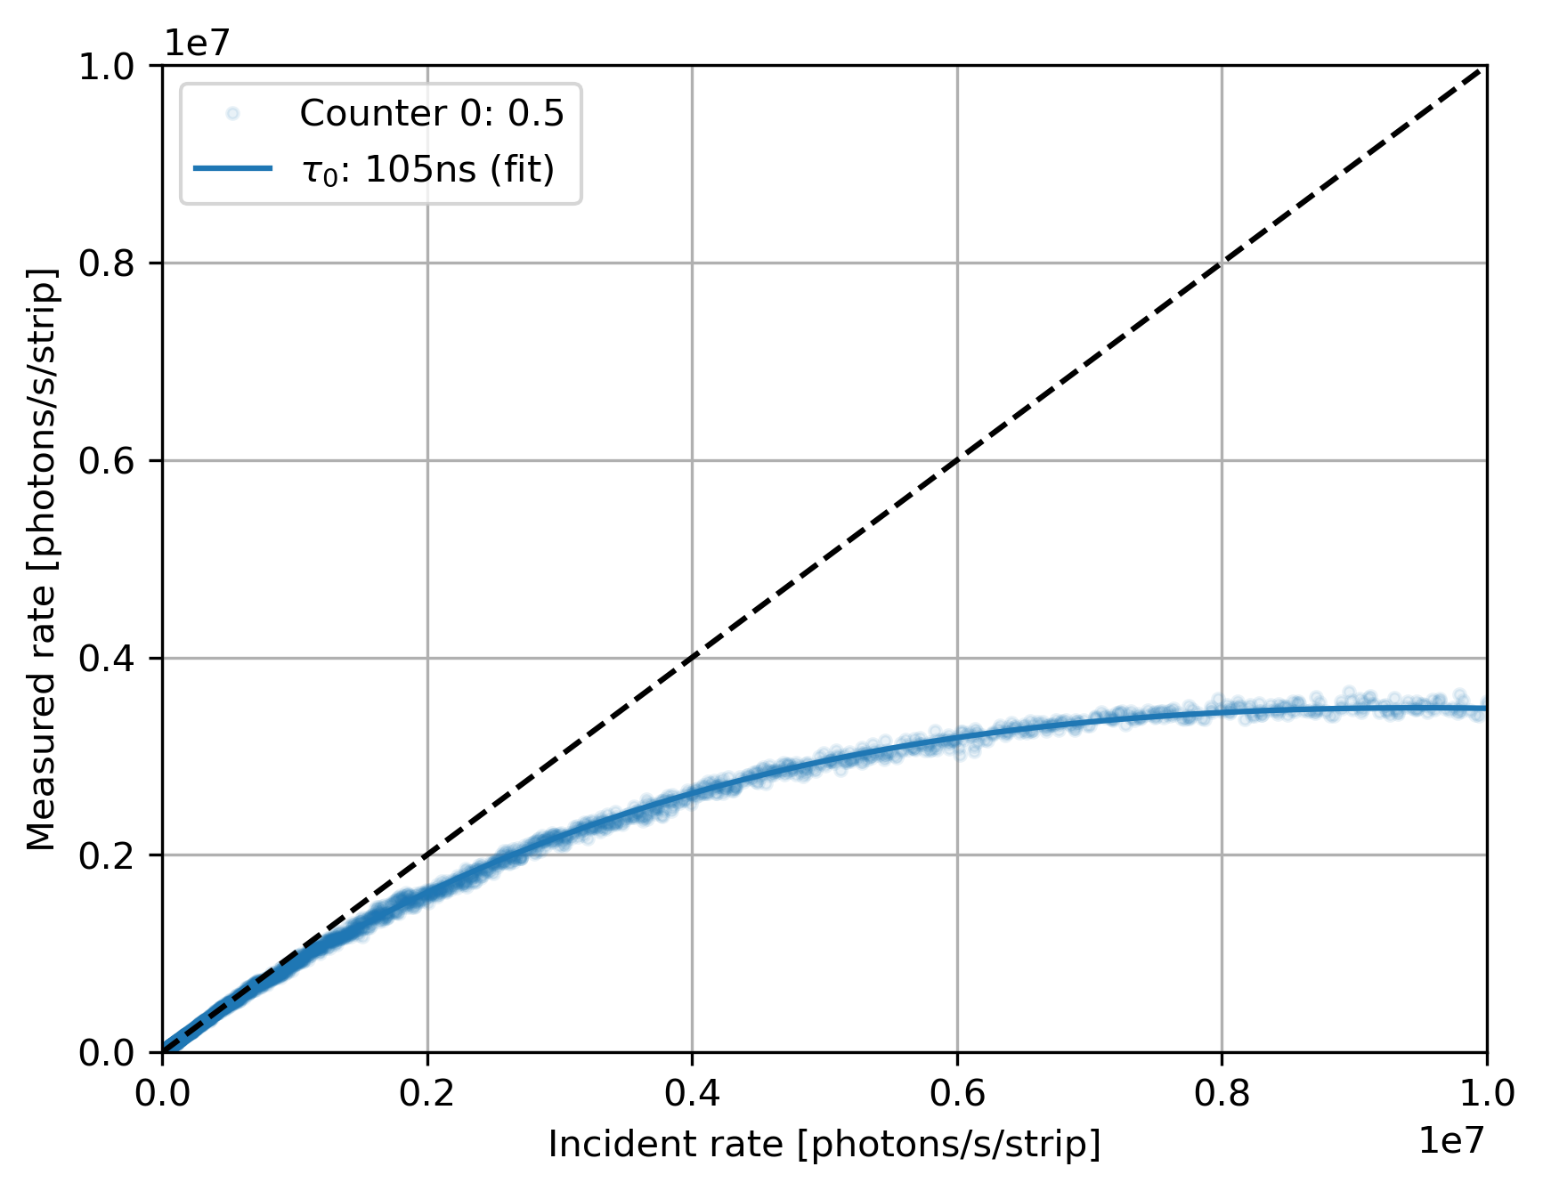

Mythen 3 (strips)
Paralyzable counter model: $m=ne^{−τn}$
Settings: standard
Energy: 15 keV
Noise 175e- RMS
MS beamline@SLS

Slide 27
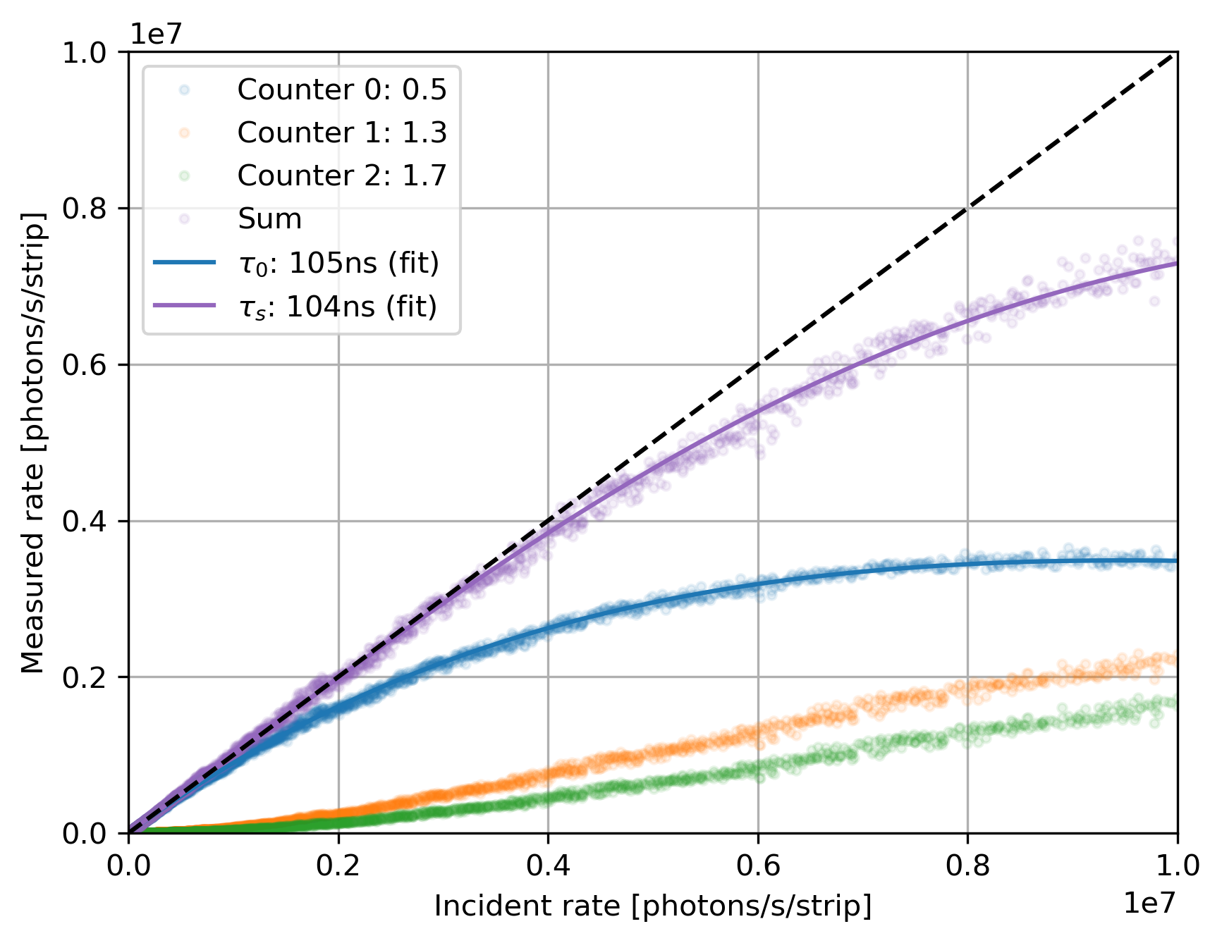
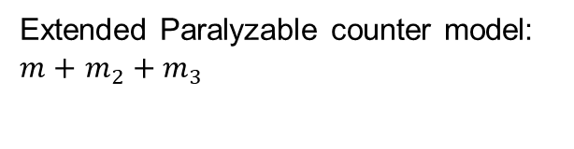
Mythen 3 (strips)
Extended Paralyzable counter model: $m+$ $m_{2}+m_{3}$
Settings: standard
Energy: 15 keV
Noise 175e- RMS
10% lost counts at:
th₀: 1.03M
th_{sum}: 6 M
MS beamline@SLS

Slide 28
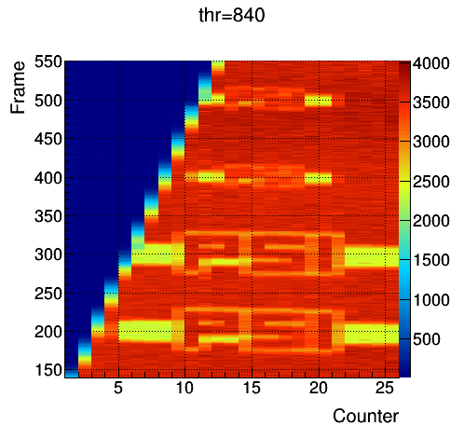
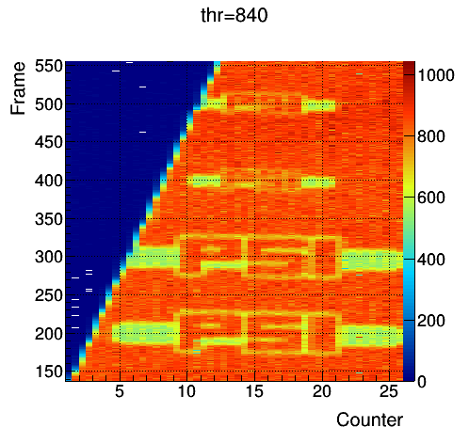
Interpolation: PSI logo
My 3.0.1
Counts
Counts
Direct beam of X-ray tube with W-anode
Threshold at 5 keV, 5 µm steps in vertical
2 µm Gold on 300 µm Silicon
Large logo: 1064 µm x 274 µm, small logo: 532 µm x 137 µm
→ Interpolation mode shows many more details
Notes:
Try it:
Image a PSI logo: gold on silicon plate in polychromatic beam of X-ray tube
Normal mode: large logo ca 1mm wide, ¼ mm high, small logo half the size, hardly recognizable
With interpolation mode: see many more details (like the rounded edges), also distinguish the small logo

Slide 29
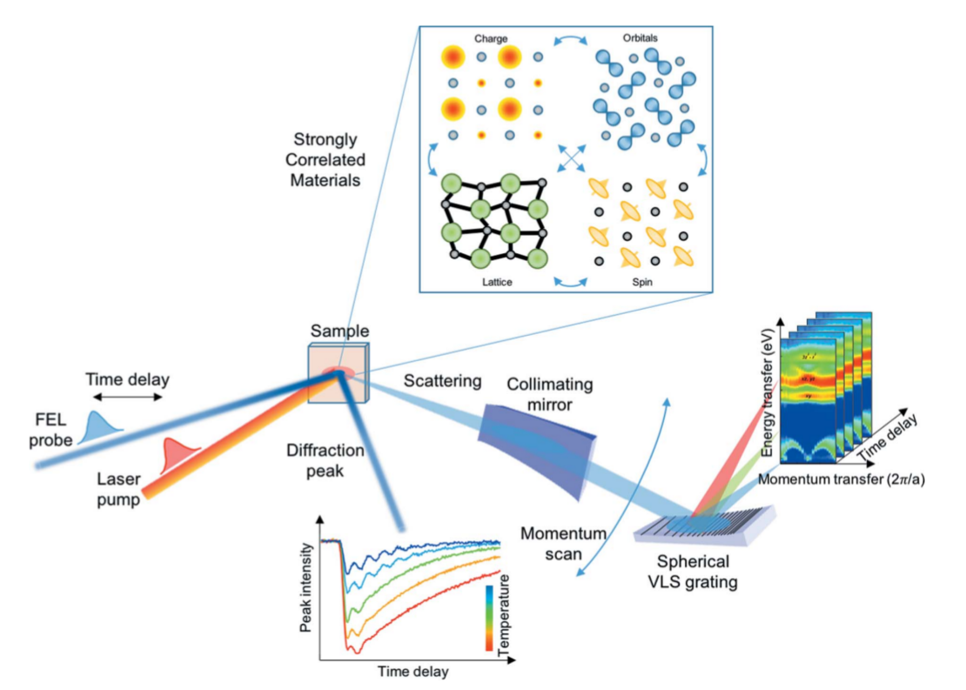
The «energy challenge»
Time resolved resonant inelastic X-ray scattering (tr-RIXS)
The «energy challenge», part 1
Soft X-ray applications at SwissFEL and SLS (250 eV – 2 keV)
      Hard x-ray applications at Synchrotrons, 24-80keV
doi: 10.1107/S1600577519003928
The «energy challenge», part 2
Page 29

Slide 30
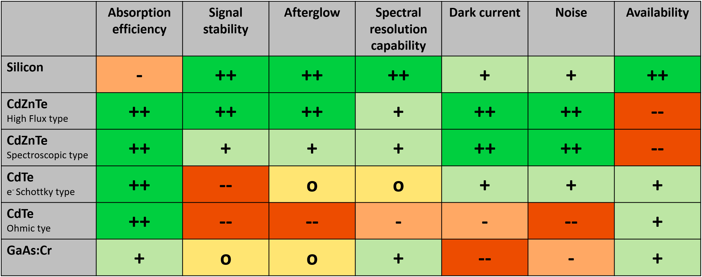
Studies on high-Z materials
E.g.”High-spatial resolution measurements with a GaAs: Cr sensor using the charge integrating MÖNCH detector with a pixel pitch of 25 μm”
The «energy challenge», part 2
☺ CdZnTe seems to be the material of choice at the moment as alternative to silicon to extend the photon energy range
😐 Still some issues with uniformity and defects
😐 Sensor yield relatively low (≈40 %)
☹ Biggest problem is the availability of larger sensors (>4×4 cm²)

Slide 31
Challenges of soft x-ray single photon detection
Single photon detection of X-ray in the energy range of 250 eV to 2keV:
  Low quantum efficiency (QE): attenuation length of 250 eV photons is ~ 100 nm in silicon.
  Low signal-to-noise ratio (SNR): small signal amplitude (~ 70 e-) with respect to the electronic noise
X-ray
Al
n+
n-
p+
Al
ASICS
Both can be addressed at sensor level!

Slide 32
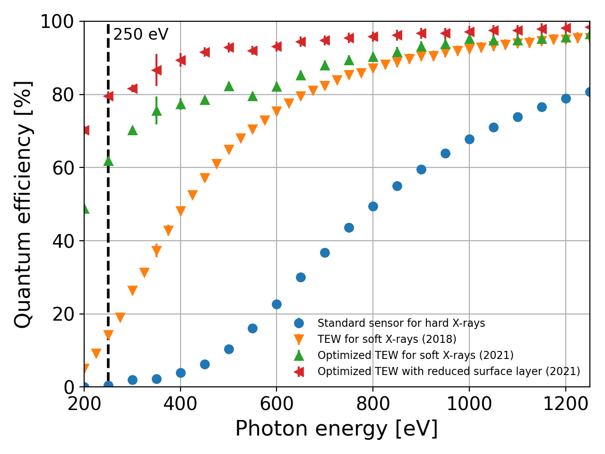

Challenges of soft x-ray single photon detection
Improve the QE:
  Reduce thickness of layers above Si
  Decrease the charge recombination in the silicon/layer interface
  Reduce the charge recombination in the highly doped implants
QE vs. X-ray photon energy
ASICS
Measurement
Opt. entrance window:
Maria Carulla &
M. Centis Vignali
X-ray
Al
x x
x x
x x x
n+
n-
  80 % QE for a planar pin diode @250eV
p+
Al
ASICS

Slide 33
Challenges of soft x-ray single photon detection
Improving the SNR:
  Increase the signal with Low Gain Avalanche Diodes (LGADs) with a multiplication factor 5-20
  ->Timing irrelevant for PS
X-ray
multiplication layer
n+
p-
=> iLGAD technology:
  Entrance window on the multip. layer
  Fill factor ☺
  Gain dependence on the photon energy ☹
  Leakage current ☹
p+
Al
ASICS

Slide 34
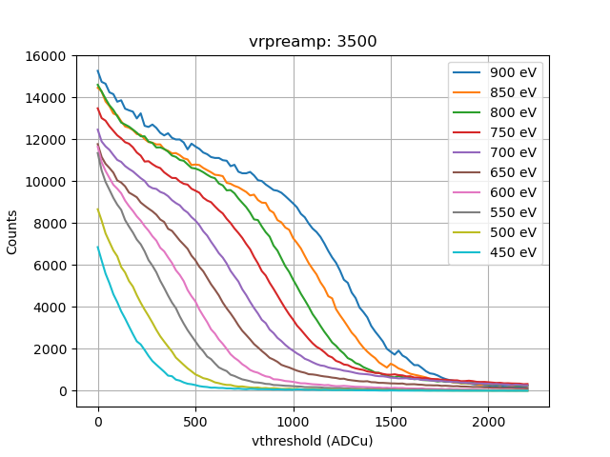
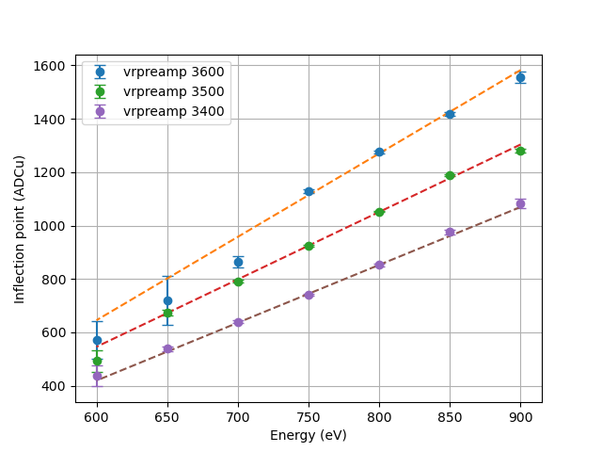
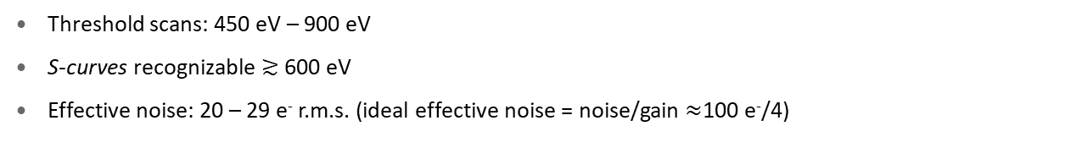
LGADs + Eiger
Threshold scans: 450 eV – 900 eV
S-curves recognizable $≳$ 600 eV
Effective noise: 20 – 29 e⁻ r.m.s. (ideal effective noise = noise/gain $≈$100 e⁻/4)

Slide 35
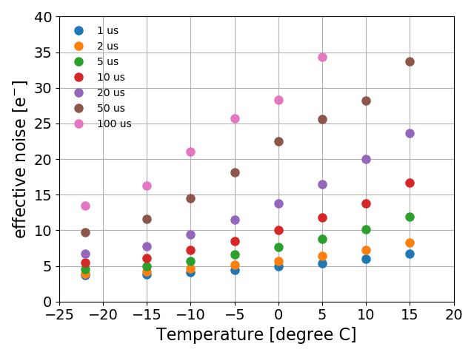

iLGAD with MöENCH
iLGAD pixel sensors of 25 um pitch with Moench readout chip:
  nominal noise of 35 e⁻ with standard sensor at RT (SNR=5 @ 700 eV)
  Various temperatures, RT down to -22 ºC to reduce the “effective” noise
“Effective” noise vs. T & exposure time
down to 3.7 e⁻ at -22 ºC
with 1 µs exposure:
SNR > 5 for soft X-rays
above 67 eV
(134 eV with 2x2
clustering).
300 V
A. Bergamaschi
exposure time
T
Page 35

Slide 36

Preview: Matterhorn
Technology: UMC110AE
75x75 µm² pixel size
ASIC: ~2x2 cm² Module: ~4x8 cm²
4 comparators
4x 16 bit counters
250 eV– 80 keV dynamic range
Electron and hole collection
2.5 kHz in full mode(4counters/16 bit)
Continuous read-write
<20ns gating speed
20 Mcts/pix/sec at 80% efficiency (with pileup tracking), <200e-
<100e- ENC for low photon rates
Corner effect mitigation, interpolation
3rd generation

Slide 37
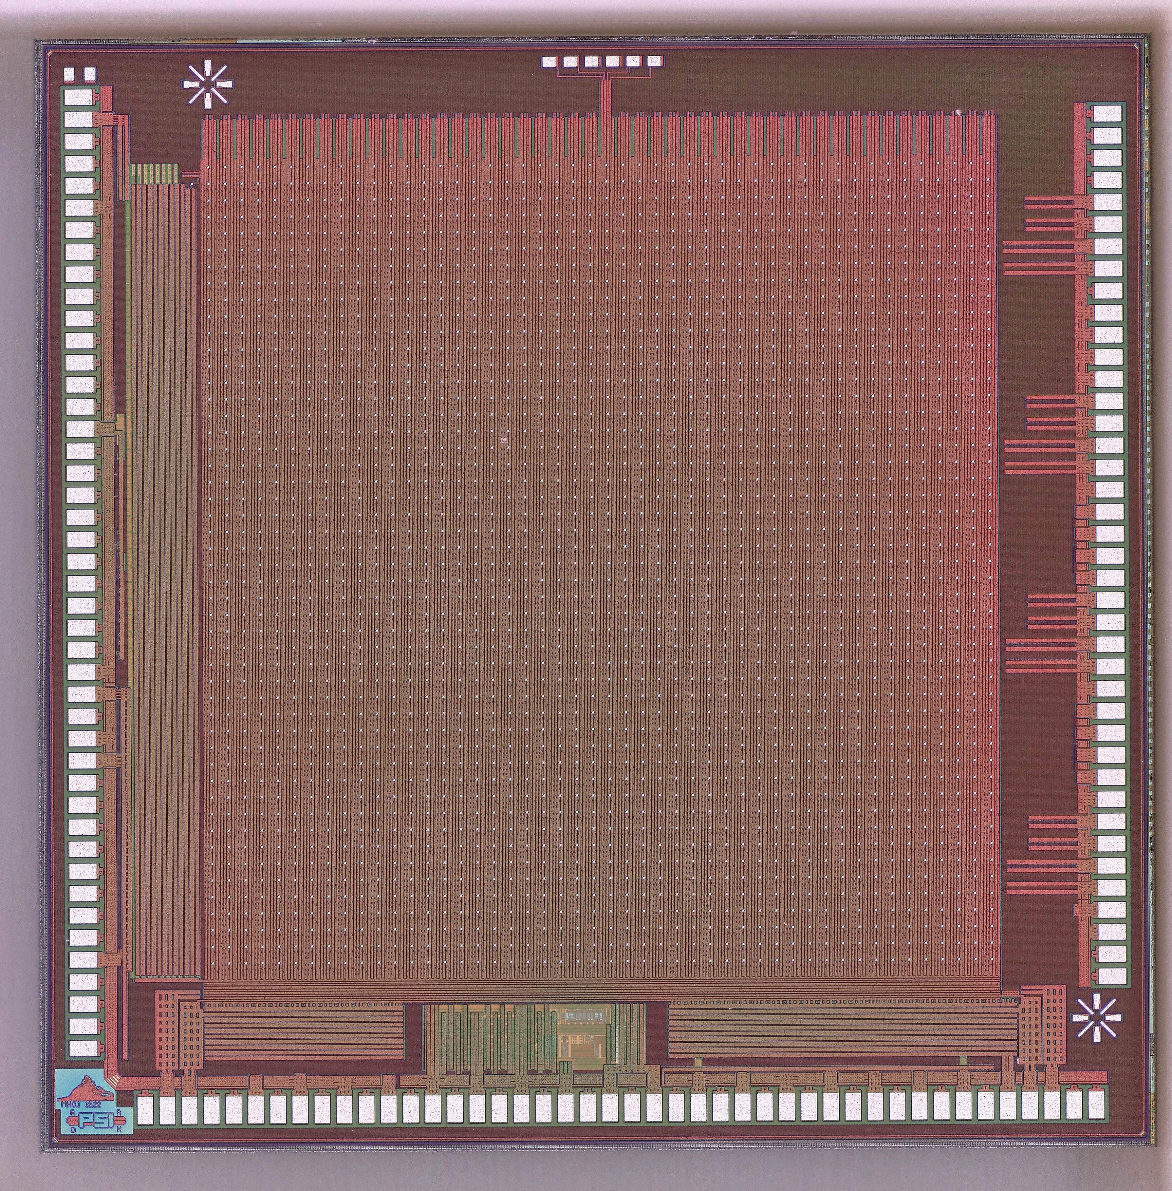
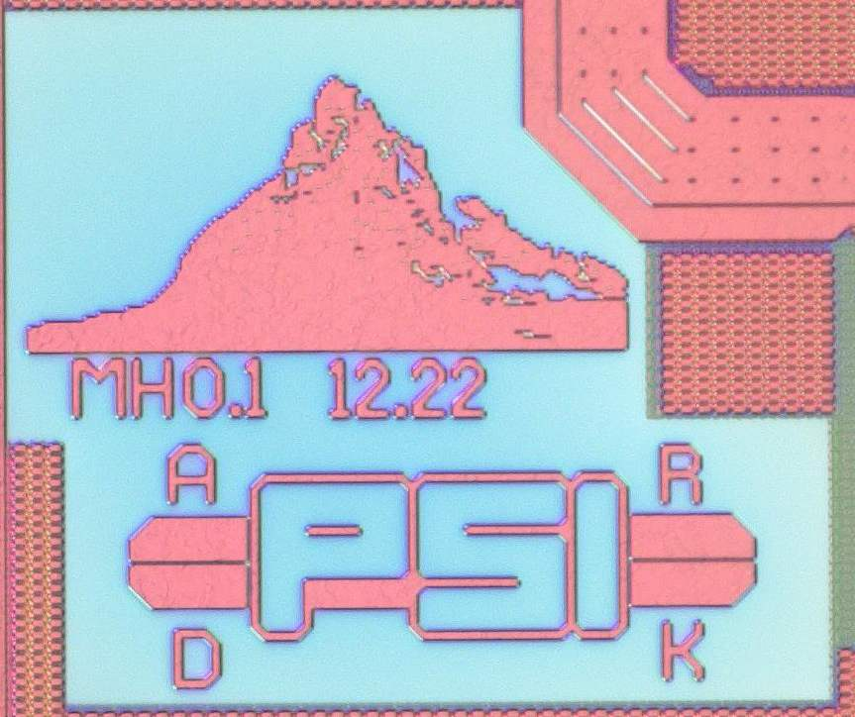
Preview: Matterhorn 0.1
75x75 µm² pixel size
ASIC: ~5x5 mm² (3.6x3.6 active=48x48=2304 pixels)
4 comparators; 4x 16 bit counters
250 eV– 20 keV dynamic range
Hole collection
<20ns gating speed (on small array)
20 Mcts/pix/sec at 80% efficiency (with pileup tracking), <200e-
<100e- ENC for low photon rates
3rd generation
Prototype submitted 05.12.2022, received 07.06.2023

Slide 38
Preview: Matterhorn 0.1
2 Different pre/shaper variations
2 Comparator variations
3rd generation
Slow control for chip configuration and debugging
Addressing
Readout
On-chip PLL
Serializers:1.6GHz,
Data rate: 1.28Gbit/s including 10b/8b encoding
17 kHz in 16bit/4cnt mode
140kHz in 8bit/1cnt mode
High-speed periphery with digital syntesys tools
Digital periphery
No circuitry on the sides, all addressing done from the bottom
Slow control
HS serializer
PLL
HS serializer
Differential driver
Differential driver

Slide 39
Conclusions
Photon science gets more and more powerful X-ray sources
Photon science detector group develops full detectors for synchrotrons and FELs
Many chips and chip generations were developed for these purposes:
  SPC for synchrotrons
    - Mythen (strip); Pilatus, Eiger, Matterhorn (pixel)
  CI for FELs
    Agipd (pixels) and Gotthard for EuXFEL; Jungfrau, Mönch (pixel) for SwissFEL
Main challanges for new generation detectors:
  High incoming photon rates of new light sources
    - SPC with fast shaping + multithresholding =>proven in Mythen 3, up to 20MHz/channel
    - Matterhorn development started, first MPW prototype received.
  Expanding the energy range to low (down to 250eV) and high (>80keV) energy
    First tests with FBK LGADs show 80%QE at 250eV, noise down to <5e-rms
    Research on High Z materials

Slide 40
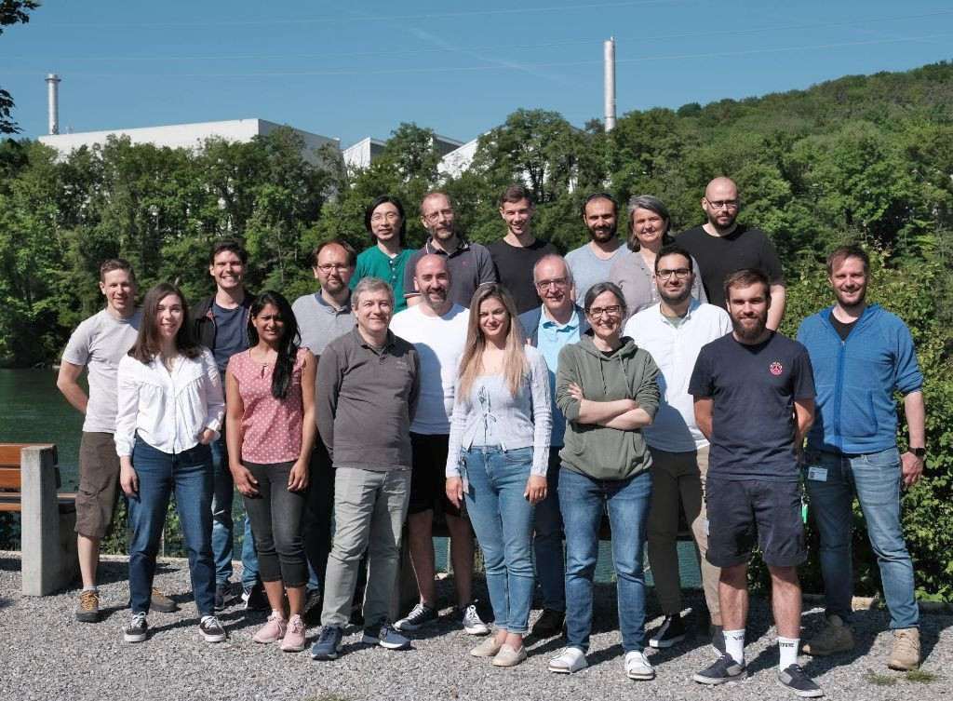
The Photon Science detector group
We are a very diverse group bringing together experts from many different fields,~20 people
Development of hybrid detectors for Photon Science
Back: J. Zhang, A. Mozzanica, T. King, D. Mezza, A. Bergamaschi, J. Heymes; Middle: E. Fröjdh, C. Lopez, M. Brückner, C. Ruder, B. Schmitt, K. Moustakas, D. Greiffenberg; Front: V. Hinger, D. Thattil, R. Dinapoli, S. Hasanaj, M. Carulla, S. Ebner; Missing: R. Barten, P. Kozlowski, F. Baruffaldi
Chip Design Team
Photon Science (PS):
R. Dinapoli (NUM)
K. Moustakas (PSD)
A. Mozzanica (PSD)
D. Mezza (PSD)
High energy physics (HEP):
B. Meier (NUM)

Slide 41
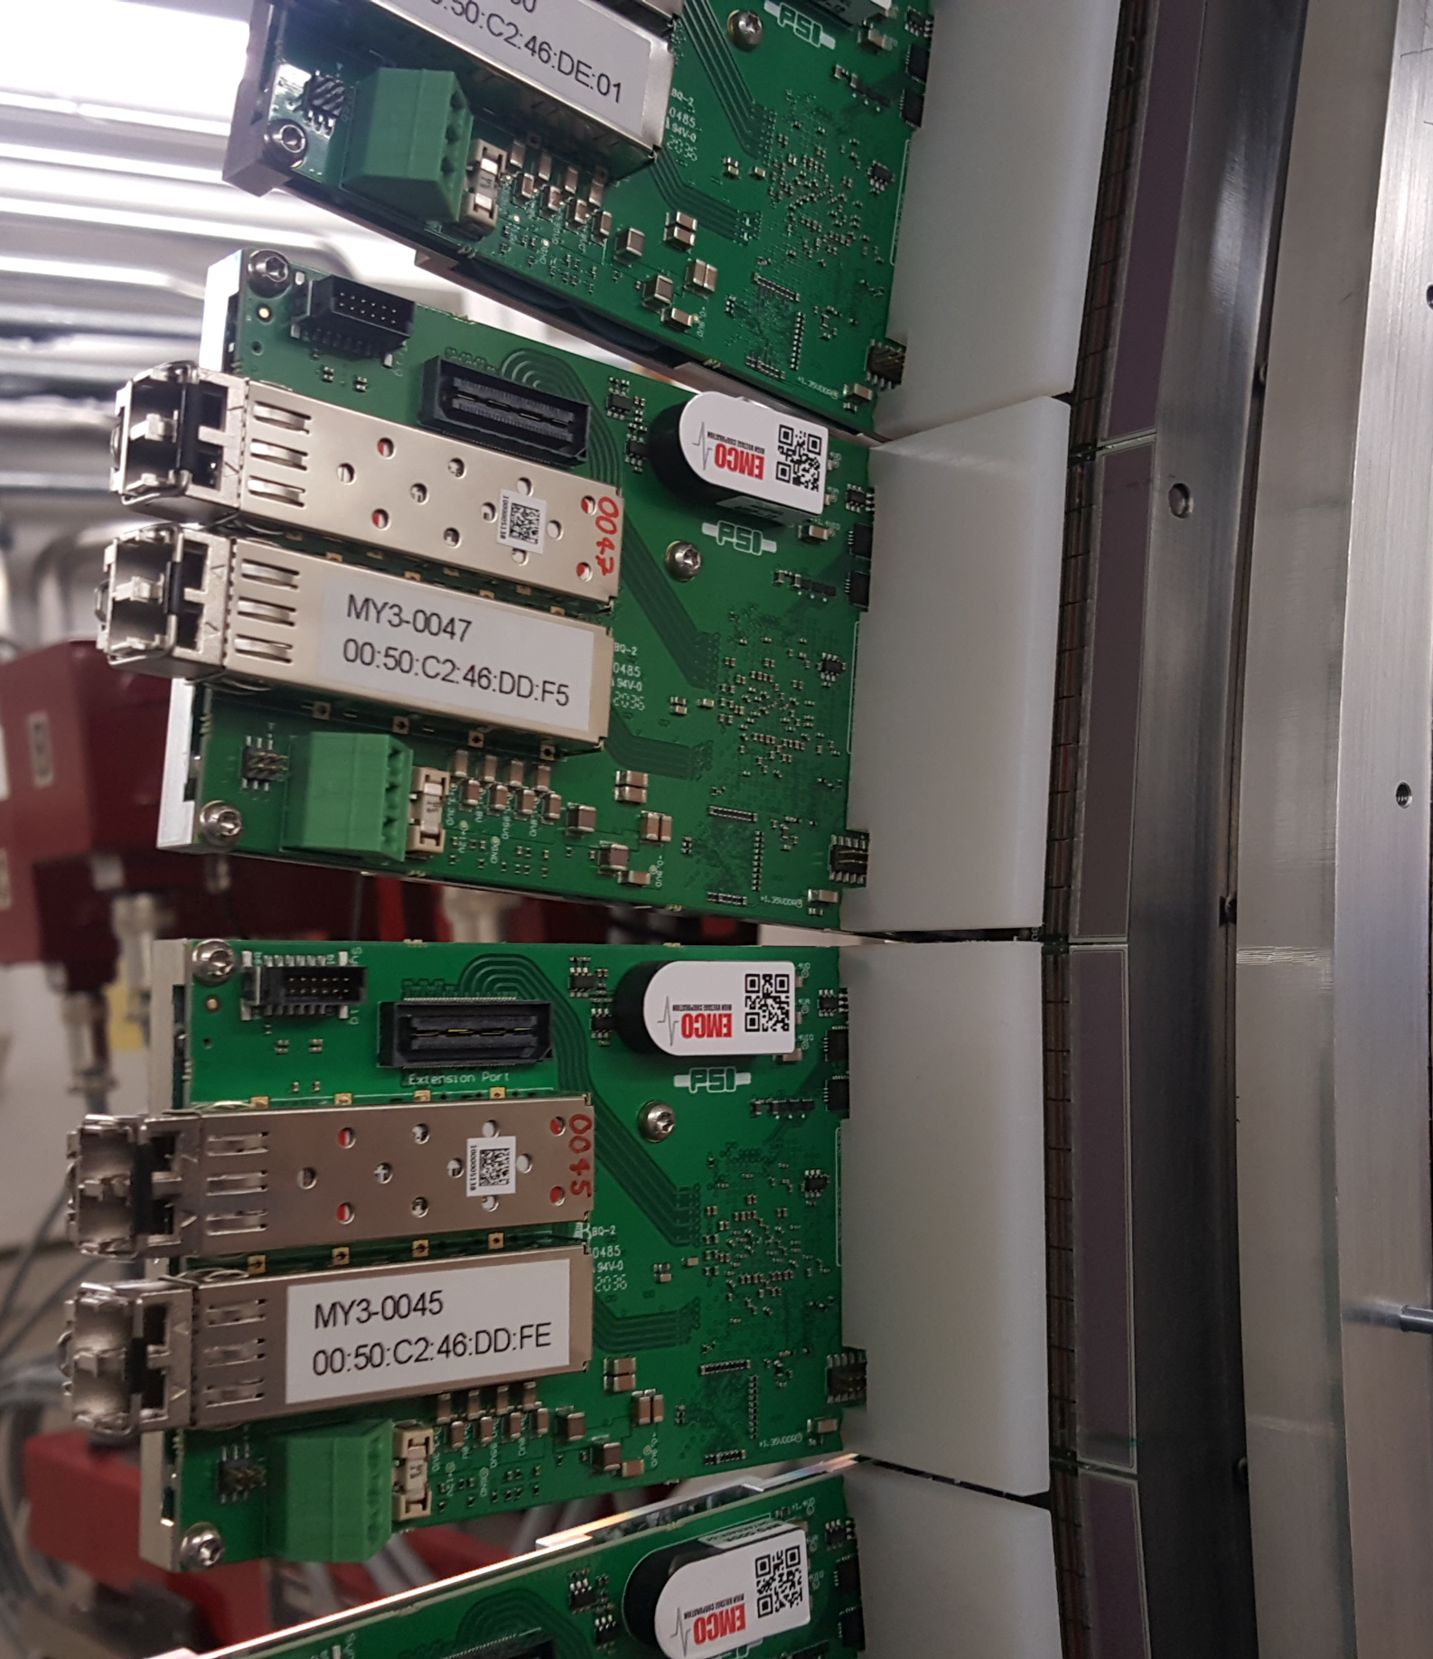








THANKS!
MYTHEN III
GOTTHARD II
EIGER
MÖNCH 0.3
JUNGFRAU 1.0/1.1
LCLS

Slide 42
BACKUP SLIDES

Slide 43
Requirements for an ideal detector
EIGER, designed by PSI-SLS detector group, was optimized to satisfy the main requirements for an ideal detector for synchrotron radiation applications:
Single photons sensitivity and no intrinsic noise
  single photon counting detector
Good spatial resolution
  Small pixel size (75x75μm²)
Fast Frame Rate ~tens kHz
  Simultaneous exposure and readout
  Negligible dead time (~ 3μs)
  Frame rate up to 22kHz in 4 bit mode
Detector that can be made as large as possible
  Modular detector system
  Data transfer parallel at half module level
  Projects for EIGER 16M Pixel (~32x32 cm²)
High count rate of incoming photons
  Count rates up to 1-2 million counts/pixel/second
No spatial distortion and uniform response
  for X-ray energy range few keV to >20 keV
Chip Size | 19.3x20.1 mm²
Pixel Size | 75x75 μm²
Pixel Array | 256x256 = 65536
Technological process | UMC 0.25μm; Rad tol. Design >4MRad
Sim. Analog Parameters | Gain: 44.6 μV/e- 30ns peaking time Timing: 151ns (Ret.to 0@1%) Noise: 135e-rms Static Power: 8.8μW/pixel(0.6W/chip)
Count Rate | 3.4x10⁹ xray/mm²/s
Transistors Matrix Periphery Transistor density | 28.44M >120 000 430/pix
Nom. power supplies | 1.1V(analog), 2V(digital), 1.8V(I/O)
Counter | binary, configurable 4,8,12bit, double buffered
Readout speed | ~22kHz@4bit mode
Threshold adjustment | Yes 6 Trim Bits
Analog out for testing | Yes
Overflow counter | Yes

Slide 44
Charge integration with analog readout
Preamp
reset
CDS
reset
PIXEL
Column bus
C_{fb}
Off-pixel
buffer
Detector
CS
Preamp
CDS
Stage
Storage
Test
Column
receiver
Calibrate
Column selection
MUX
Single ended
to differential
output driver
(1x/25cols)
Pads

Slide 45

MÖNCH
Micropixel with enhanced pOsition rEsolution usiNg CHarge integration
Small pixels 25 x 25 μm²
Low noise
  Single photon resolution >700 eV
      1.4 keV for clustering
  320 eV energy resolution FWHM
Large dynamic range
  Now static gain, will have switching
Currently 1x1 cm² prototype available
  400x400=160 kpixel
Fast frame rate (> kHz)
  currently 3 kHz, by design 6 kHz
  Ca. 20 TB/day
Dead-time free operation possible
M. Ramilli, et al. (2017) J. Instr. 12, C01071.http://dx.doi.org/10.1088/1748-0221/12/01/C01071
A. Bergamaschi, 12.11.2019

Slide 46
EIGER vs. MATTERHORN
 | EIGER | MATTERHORN
Node | 0,25 um | 110 nm
Pixel size | 75 x 75 um² | 75 x 75 um²
Comparators | 1 | 4
Counter depth | 4/8/12 bit | 4x16 bit configurable
Energy range | 5-25 keV | 250eV – 80 keV
Module size | 2x4 chips → 4x8cm | 2x4 chips → 4x8cm
Maximum count rate | 1M counts/pixel/s | 20M counts/pixel/s
Frame rate | 22 kHz | 160 kHz
Gating | us | < 20ns

Slide 47
Soft X-ray applications at SwissFEL and SLS
The «energy challenge», part 1
Soft X-ray applications at SwissFEL and SLS (250 eV – 2 keV)
  Access K-edges of biologically important elements
    e.g. water window 250-520 eV
  L-edges of 3d transition metals, Fe, Cu, etc.
  Possible applications:
    RIXS at FELs and synchrotrons
      Single photon detection necessary and interpolation desirable
    Contrast enhanced imaging:
      soft X-ray diffraction
      ptychography
      absorption spectroscopy
Time resolved resonant inelastic X-ray scattering (tr-RIXS)
doi: 10.1107/S1600577519003928
Page 47

Slide 48


Quantum efficiency limit
Soft X-rays (~ a few hundred eV) absorbed in the first micron of silicon sensor
  For conventional process, e.g. p⁺-n sensor: n⁺-implant depth ≈ 1-2 micron + aluminum
    Significant efficiency loss for X-rays below 1.2 keV → not usable for soft X-rays! (< 50% below 800 eV)
For soft X-ray detection, it is necessary to develop a thin entrance window process to improve the quantum efficiency (QE) and the charge collection efficiency (CCE)
Conventional assembly and efficiency loss
Measured / simulated quantum efficiency
~ 1-2 µm n⁺-implant + 500 nm Al
(hard X-ray sensor)
Locations that QE loss occurs:
loss inside silicon
loss at silicon surface
dots: measurement
line: simulation
x
x
x
x
x
x
x
x
x
x
x
loss in insensitive material
Page 48

Slide 49

Comparing deadtime models
[1] A. Bergamaschi et. al. Time-over-threshold readout to enhance the high flux capabilities of single-photon-counting detectors J. Synchrotron Rad. 18, 923-929. 2011
[2] P. Zambon, Dead time model for X-ray photon counting detectors with retrigger capability, NIMA 2021

Slide 50

Counting pile-up
Paralyzable counter: $m=ne^{−τn}$
Probablility of two and three events pile-up:
    $p_{2}=e^{−τn}(1−e^{−τn})$
    $p_{3}=e^{−τn}$ ${(1−e^{−τn})}^{2}$
$m_{s}=m+$ $m_{2}+m_{3}$
For characterization:
Fit first counter with the paralyzable model
Fit sum of counter 1,2 and 3 with the pile-up model
Glenn F. Knoll, Radiation Detector and Measurement 4th Edition, Wiley
M. Andrae The MYTHEN III Detector System - A single photon-counting microstrip detector for powder diffraction experiments ETHZ Doctoral Thesis

Slide 51

Rate Capability: Pile-up tracking with 3 counters
Determine dead time and noise
  If gain ↑ : noise ↓ and dead time ↑
Calculate rate per strip at 90% efficiency:
  ε _{sum} = ε₁+ε₂+ε₃
settings | 1 counter | 3 counters
Slow | 1.3 MHz | 7.4 MHz
Medium | 1.4 MHz | 8.2 MHz
Fast | 3.5 MHz | 20.9 MHz
Minimum achievable noise: 110 e- rms (not shown)
Notes:
In general: with increasing gain, the dead time also increases, but noise decreases
See plot: with 1c: dead times between 30 – 90 ns, with 3c: about 3 times less
Use dead time to calculate the possible count rate at 90% detection efficiency:
slow: 1C: 1.3MHz, 3c: 7.4 MHz
Fast: 1c: 3.5 MHz, 3c: ca 21 MHz
Meet requirements for SLS 2

Slide 52

Everything developed in-house
Hybrid detectors

Slide 53


History of the detector group
High energy physics: CMS pixel detector at the LHC, CERN
48 million pixels, 40 million images per second
1992 proposal, 2008 first collisions, Higgs boson 2012
X-ray detector development:
Late 90s, photon detectors at the time were too slow, foreseen bottleneck for SLS
Technology transferred from CMS group → our first photon counting detector PILATUS
53

Slide 54


Many other applications!
Example: Improving spatial resolution in electron microscopy with Mönch and ML
Postdoc working on using machine learning to find the entrance point of the electron
Information encoded in the track by physical processes
Simulated signal with
track overlaid
All signal assigned
to the correct pixel
200 keV electron tracks
Simulated MÖNCH 25µm pixel
J. P. van Schayck et al. “Sub-pixel electron detection using a convolutional neural network”. Ultramicroscopy 218 (2020), p. 113091.

Slide 55
Detector portfolio
Microstrips
Pixels
50 µm
25 µm
75 µm
Single Photon Counting
Hybrid detectors: Sensor and readout electronics can be optimized separately
Direct conversion, high SNR
Room temperature operation
Fast highly parallelized readout
Interconnection
  Cost, yield
  Minimum pitch
  Input capacitance & noise
MYTHEN III
EIGER
Charge Integrating
GOTTHARD II
MÖNCH 0.3
JUNGFRAU 1.0/1.1

Slide 56
48x48=2304 pixels; 1152pixels/serializer
Serializer speed=1.28Gbit/s
Full image: 1152x4x16=73728 bits
Frame rate: 1.28Gbit/s /73728=17.36kHz
Minimum image: 1152x1x8= 9216
Frame rate: 1.28Gbit/s /9216=138.9kHz
Final chip 256x256x4x16= 4 194 304/8 outputs

Slide 57

Paul Scherrer Institut
⬅ Basel
Germany ⬆
Aarau/Bern ⬇
Zurich ➔
Material sciences
Nanotechnology
Radiochemistry
Hotlab
Radiopharmacy
PSI East
Biology
ESI Platform
Quantum research
SwissFEL
Particle physics
Energy research
Proton accelerator
Neutron source
Muon source
Synchrotron
Light Source
PSI West
Proton therapy

Slide 58


Photon science: how the input looks like
Bunches very close in time
Few photons/bunch
Synchrotrons
SLS standart bunch structure
Free electron lasers
Bunches more distant in time
Many photons/bunch
$$10ms$$
SwissFEL bunch structure

Slide 59


Photon science: the X-ray sources
Bunches very close in time
Few photons/bunch
Synchrotrons
$\sim 2700 Pulses$ (600µs)
Bunches more distant in time
Many photons/bunch
Free electron lasers
$$220ns$$
EuXFEL bunch structure

Slide 60
Photon science: how the input looks like
t=0
0 or 1 ph/pixel/bunch
t=2ns
$$10ms$$
t=0
Up to 10⁴ ph/pixel/bunch
Incoming
photons
Sample
Detector

Slide 61
Photon science: how the input looks like
Energies from 4-5 keV to 20keV, typical energy at SLS=12keV
  Photons either stop or do not stop, no LET
  No material butget issues
=>Thin sensors (in general) not beneficial!
Low noise
…but most applications do not need few e- noise
High spatial resolution
…but most applications do not need micron resolution
Fast
  …but most applications do not need ns timing resolution
Rad tol.
  …but no SEUs, TID ~Tens of Mrad
1st gen.

Slide 62

Interpolation Mode
Sensor top view
A B C
Inter-strip communication between neighbors
Redistribute counts: left, central, right counter
→ Virtually split strips → better resolution
®patented
Notes:
New on-chip interpolation mode: thanks to 3 counters!
Inter strip communication, counts redistributed
---plot---
Charge sharing!
Virtually split strips to 3 regions → better estimate position of impinging photon → resolution
-------------------------------------------------------------------
No charge sharing in central counter
Focus: with 3 counters: on-chip interpolation, NEW ! Thanks to 3 counters
------------------------------------------------------------------
Reduce count rate: only 1ph/3strips: 3x less than single counter
-2x less to avoid pile-up during entire pulse
6x less
Interpolation in pixel:
Direct translation of concept: 9 counters: no space
Maybe 4 counters, shared among neighbours.
-corner counter: singal from all four pixels
-middle counter: signal btw 2 pixels
-central counter: only central counts w/o ch.sh.

Slide 63

Imaging with a Strip Detector
Beam position
[10]
strips
Thin slit in front of detector
Scan sample
Notes:
2D image with 1D detector
Slit
Scan sample
Small part imaged per step

Slide 64
Interpolation: PSI logo
My 3.0.1
Direct beam of X-ray tube with W-anode
Threshold at 5 keV, 5 µm steps in vertical
2 µm Gold on 300 µm Silicon
Large logo: 1064 µm x 274 µm, small logo: 532 µm x 137 µm
→ Interpolation mode shows many more details
Marie Andrä
Notes:
Try it:
Image a PSI logo: gold on silicon plate in polychromatic beam of X-ray tube
Normal mode: large logo ca 1mm wide, ¼ mm high, small logo half the size, hardly recognizable
With interpolation mode: see many more details (like the rounded edges), also distinguish the small logo

Slide 65



Interpolation: Siemens star
No interpolation
Interpolation
200 µm
200 µm
Imaging of a Siemens star in normal mode and interpolation mode
12.6 keV beam, threshold at 6.3 keV, 25 µm steps in vertical
External pitch of star: 60 µm, 2 mm diameter
→ Impossible to resolve spikes (in horizontal) in normal mode
→ Distinguishable in interpolation mode !
Von Leonhard Wimmer - Eigenes Werk, CC BY-SA 3.0, https://commons.wikimedia.org/w/index.php?curid=1142149
Marie Andrä
Notes:
Same experiment with a Siemens star: a bit more qualitative
Monochromatic 12.6 keV beam
Star: 2mm diameter, outer pitch 60 µm
Normal mode: impossible to distinguish the spikes (in strip direction)
But in interpolation mode: clearly see the spikes !
Proof-of-principle: interpolation improves the resolution!
Proof of principle works
Optimization of low threshold value required
Left and right counters are summed for 50 µm strip pitch in order to equalize bin size
Test with smaller strip pitches and sensor thicknesses ongoing

