Slide 1
Event-Driven, Arbitrated Protocols Implemented in Integrated Readout Circuits for Segmented Sensors
XII Front-End Electronics Workshop
Dominik Górni, Gabriella Carini, Grzegorz Deptuch, Anthony Kuczewski, Soumyajit Mandal, Giovanni Pinaroli, Abdul Rumaiz, Peter Siddons, Nicholas St. John
Jun 12 – 16, 2023
Torino

Slide 2
Motivation

Slide 3
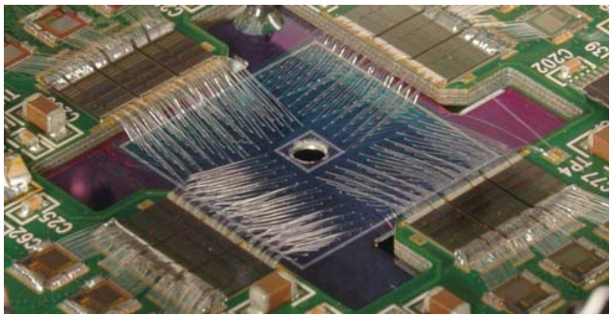
Readout from segmented sensors
How to read out data from segmented sensors to ensure data integrity and the least possible resource overhead, while providing the required speed and minimizing power consumption?
Maia X-ray Microprobe Detector Array System
D. P. Siddons et al., “Maia X-ray Microprobe Detector Array System,” vol. 499, pp. 012001–012001, Apr. 2014, doi: https://doi.org/10.1088/1742-6596/499/1/012001.

Slide 4
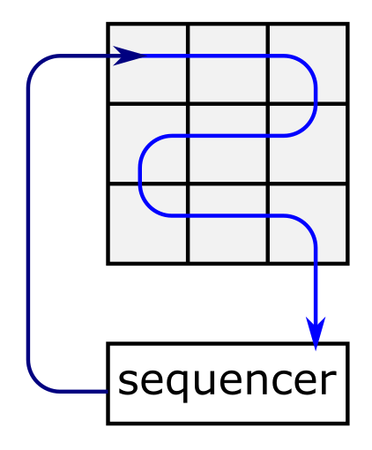
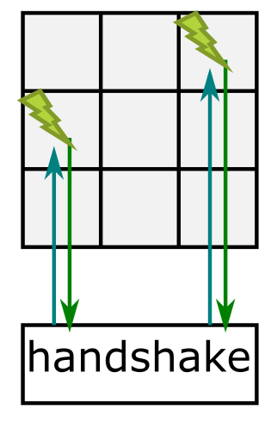
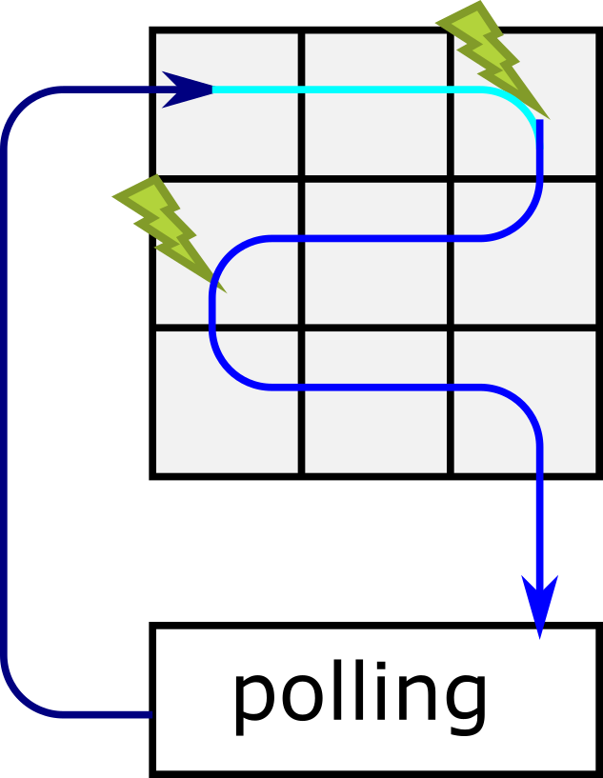
Frame vs Event driven readout
Fully sequential
All data are read out which requires additional processing and compression
Asynchronous sequence is started in response to an external event e.g., particle hit
Only relevant data are read out -> low throughput
External event sets a flag which is then checked by the readout circuitry
Frame readout
Event-driven readout
Sparse readout

Slide 5
Readout Circuits

Slide 6
Priority arbitration scheme
HIT – logic sum of all inputs inXX.
Back signal propagated through the multiple stages of gating logic to activate the channel with the highest priority.
Risk of toggling the active pixel during readout if pixel with higher priority generates event.
To avoid jumping to higher priority pixel, an image of the matrix needs to be snapshotted.
G.W. Deptuch et al., "Design and Tests of the Vertically Integrated Photon Imaging Chip," in IEEE Transactions on Nuclear Science, vol. 61, no. 1, pp. 663-674, Feb. 2014

Slide 7
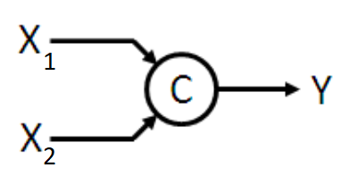
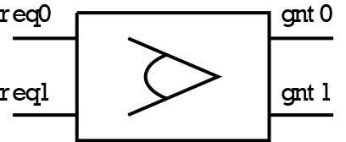
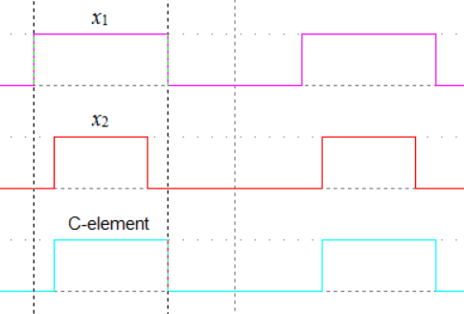
How to avoid toggling
By using global strobe signal which freeze the state of the pixels
By using memory elements
req0 | req1 | gnt0_{next} | gnt1_{next}
0 | 0 | 0 | 0
0 | 1 | 0 | 1
1 | 0 | 1 | 0
1 | 1 | gnt0 | gnt1
x₁ | x₂ | y_{next}
0 | 0 | 0
0 | 1 | y
1 | 0 | y
1 | 1 | 1
Arbiter based on Seitz arbiter
C-element
https://en.wikipedia.org/wiki/C-element
C. L. Seitz, “Ideas about arbiters”, Lambda, no 1, pp. 10–14, 1980.

Slide 8
Arbitration cell with C-elements
Request is cleared once acknowledge signal reached the arbitration cell and acknowledge path is detached after acknowledge signals changes to inactive
A. J. Martin and M. Nystrom, "Asynchronous Techniques for System-on-Chip Design," in Proceedings of the IEEE, vol. 94, no. 6, pp. 1089-1120, June 2006, doi: 10.1109/JPROC.2006.875789.

Slide 9
EDWARD readout architecture
EDWARD – Event Driven with Access and Reset Decoder
D. S. Gorni et al., “Event driven readout architecture with non-priority arbitration for radiation detectors,” Journal of Instrumentation, vol. 17, no. 04, p. C04027, Apr. 2022, doi: https://doi.org/10.1088/1748-0221/17/04/c04027.

Slide 10
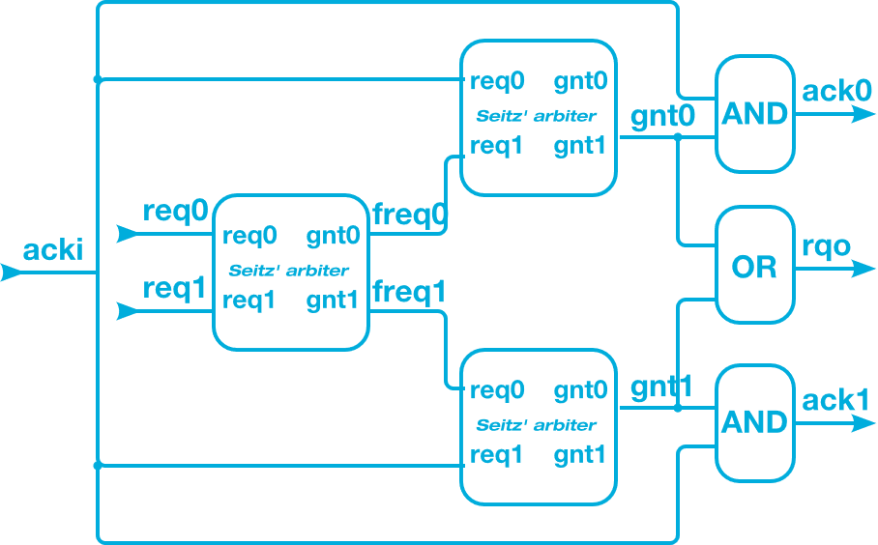
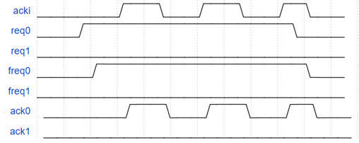
EDWARD arbitration cell
Acknowledge path is not detached until request is cleared in the pixel – it allows multiple “acknowledge tokens” to be sent without interruption from another requests.

Slide 11
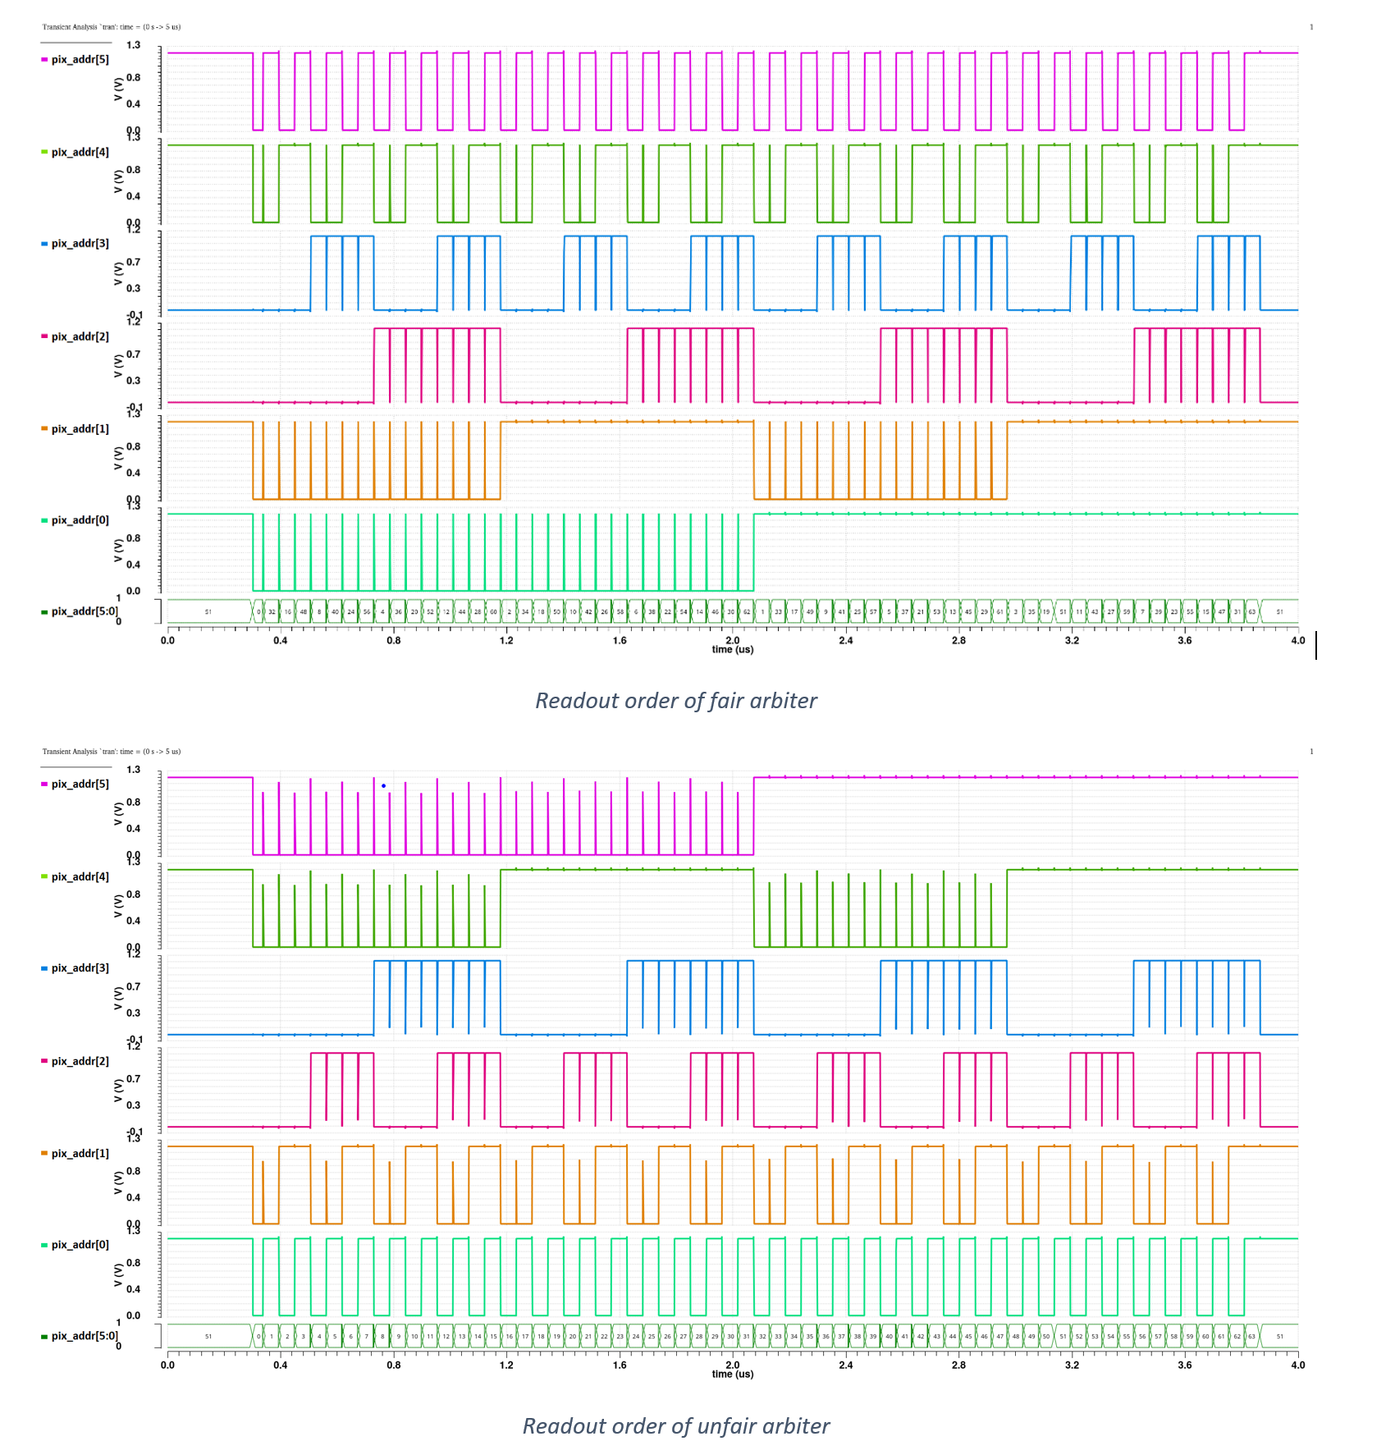
EDWARD arbitration cell – unfair version

Slide 12
EDWARD arbitration tree
WO/2022/221068 - EVENT-DRIVEN READOUT SYSTEM WITH NON-PRIORITY ARBITRATION FOR MULTICHANNEL DATA SOURCES

Slide 13
EDWARD in-pixel logic

Slide 14
Requests rate dependence

Slide 15
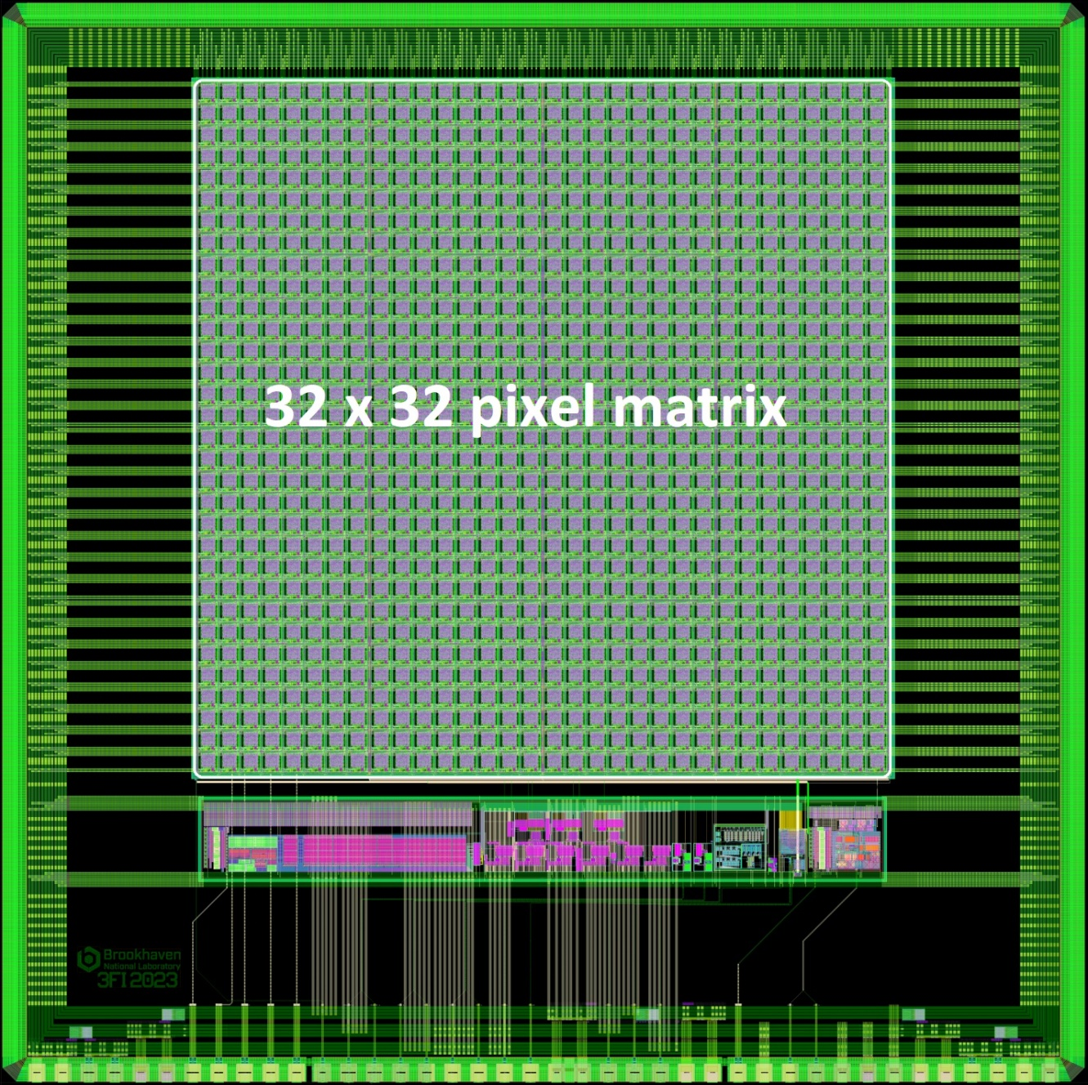
3FI65P1 chip
The 3FI65P1 contains a matrix consisting of 1024 pixels. The matrix is made up of 16 groups (4x4), which contains 64 pixels (8x8).
The EDWARD65P1 chip has an identical architecture, but in place of the AFE has been placed a signal generator with an exponential distribution.

Slide 16
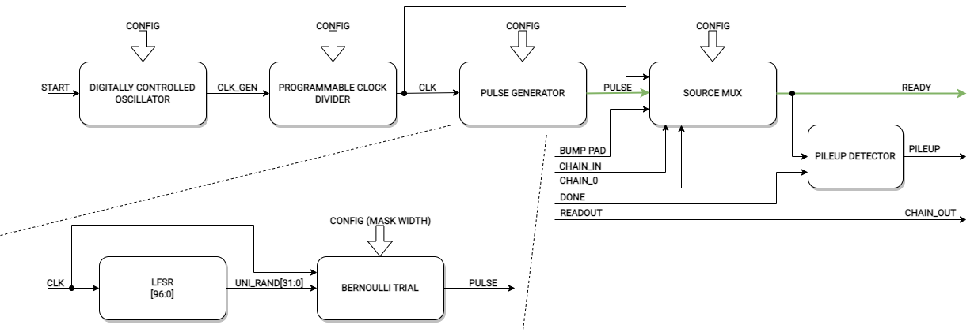
Poisson process signal generator
Alejandro Luis Veiga and Enrique Mario Spinelli, “A pulse generator with poisson-exponential distribution for emulation of radioactive decay events,” Latin American Symposium on Circuits and Systems, Apr. 2016, doi: https://doi.org/10.1109/lascas.2016.7451002.

Slide 17
Poisson process signal generator
$$for f_{gen}=61.7MHz and N_{mask}=12:$$
$$λ_{theoretical}=15 070.4 S/s$$
$$λ_{measured}=15 062.6 S/s$$

Slide 18
Only one pixel active
In this scenario only one pixel (with address ‘1’) is active.
Theoretical span of the readout delay:
$$t_{read,min}≈\frac{1}{2}\frac{1}{f_{acki}}+t_{prop}+t_{minWff} \\ t_{read,max}≈\frac{3}{2}\frac{1}{f_{acki}}+t_{prop}+t_{minWff} \\ t_{read,span}=t_{read,max}−t_{read,min}=\frac{1}{f_{acki}} \\ where: \\ t_{read}−readout time \left(from request to data latch in the peripherals\right) \\ f_{acki}−frequency of acknowledge clock \left(serializer slow clock\right) \\ t_{prop}−propagation time of the request through arbitration tree \\ t_{minWff}−minium width of the clock pulse for the flip−flop$$

Slide 19
Only one pixel active
In this scenario only one pixel (with address ‘1’) is active.
Measured span of the readout delay:
$$\frac{1}{f_{acki}}=56 ns \\ t_{read,min}=34.155 ns \\ t_{read,max}=89.955 ns \\ t_{read,span}=55.8 ns$$

Slide 20
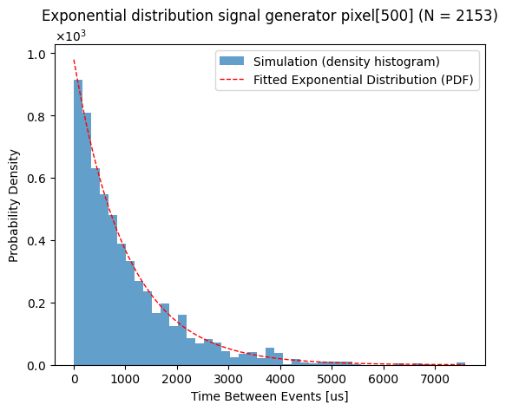
Low requests rate
$$for f_{gen}=62.11 MHz and N_{mask}=16:$$
$$λ_{theoretical}=947.8 S/s$$
$$λ_{measured}\left[1\right]=948.2 S/s$$
$$λ_{measured}[500]=978.6 S/s$$
[1]

Slide 21
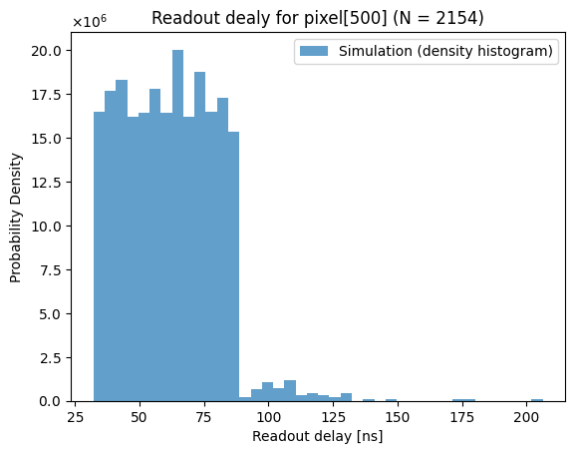
Low requests rate – readout delay
Max readout delay [ns]: 196.22
Min readout delay [ns] : 33.42
Max readout delay [ns]: 206.29
Min readout delay [ns] : 32.09
[1]

Slide 22
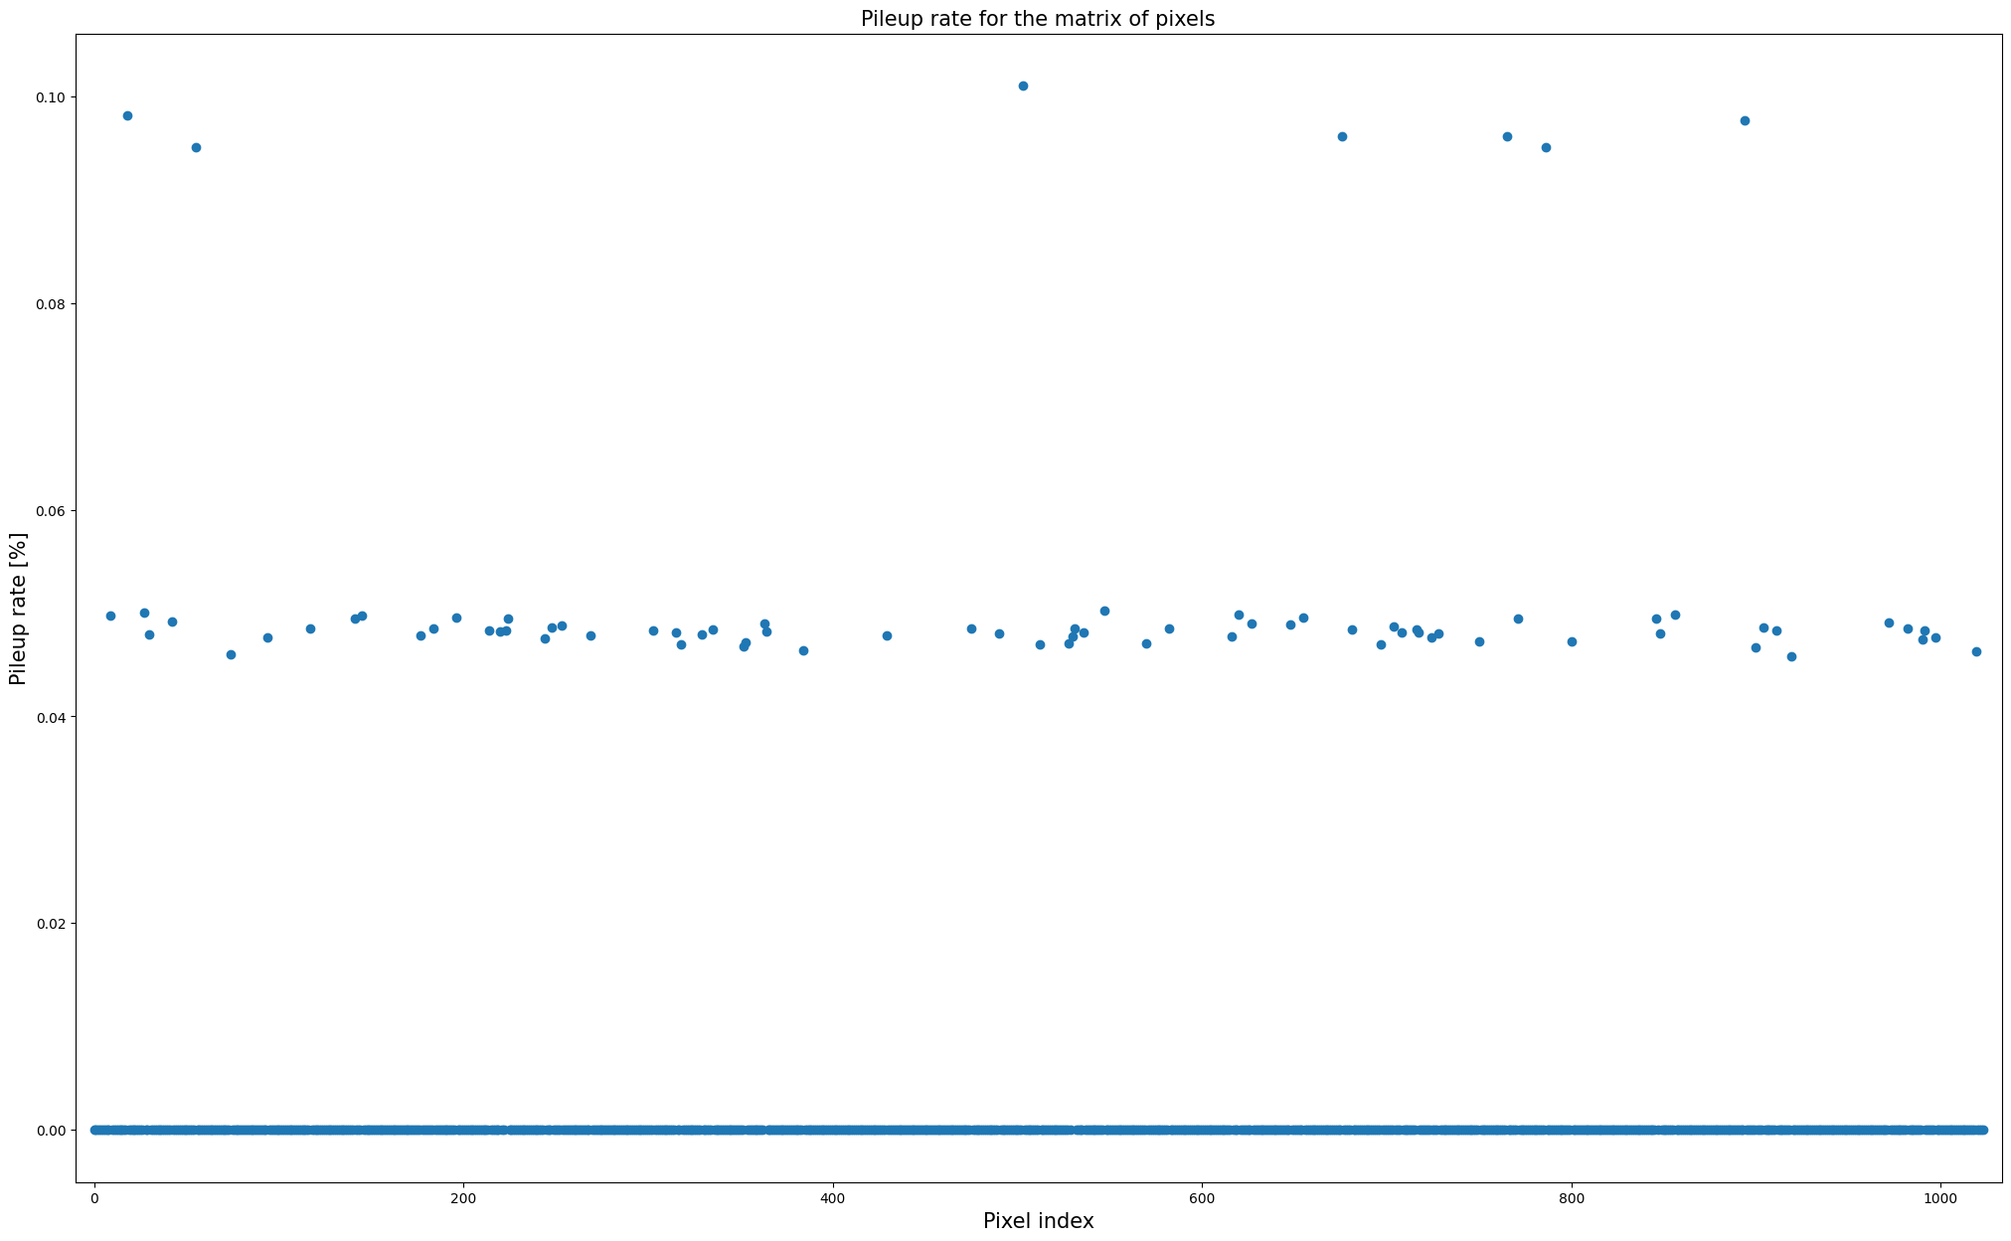
Low requests rate – pileup rate
Minimum pileup count value: 0 (0)
Maximum pileup count value: 2 (18)
Minimum pileup rate value: 0.0% (0)
Maximum pileup rate value: 0.10% (503)

Slide 23
Low requests rate – error bar plot
σ
μ
-σ
pixel address
 | μ [ns] | σ [ns]
min | 59.5 (265) | 16.9 (277)
max | 70.0 (760) | 19.3 (469)
cum* | 64.2 | 18.2
*the cumulative value for all pixels together

Slide 24
Low requests rate – error bar plot
 | μ [ns] | σ [ns]
min | 59.5 (265) | 16.9 (277)
max | 70.0 (760) | 19.3 (469)
cum* | 64.2 | 18.2
*the cumulative value for all pixels together

Slide 25
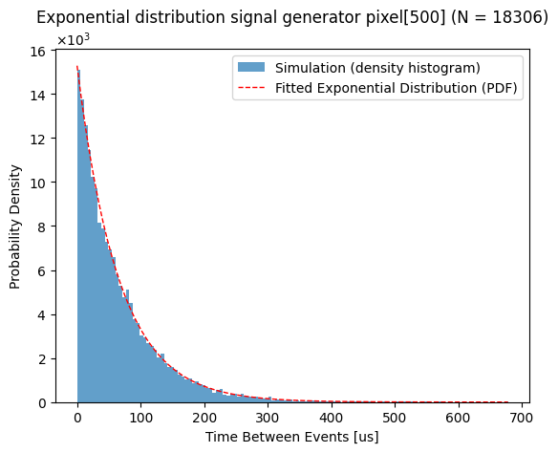
Medium requests rate
$$for f_{gen}=62.11 MHz and N_{mask}=12:$$
$$λ_{theoretical}=15164.0 S/s$$
$$λ_{measured}\left[1\right]=15169.2 S/s$$
$$λ_{measured}[500]=15275.8 S/s$$
[1]

Slide 26
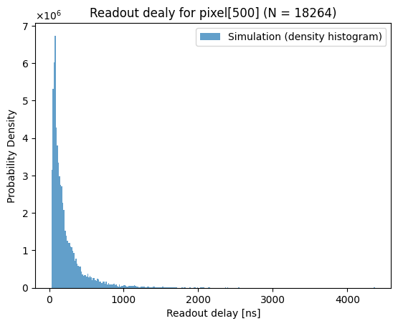
Medium requests rate – readout delay
Max readout delay [ns]: 5,177.62
Min readout delay [ns] : 33.42
Max readout delay [ns]: 4,368.29
Min readout delay [ns] : 32.09
[1]

Slide 27
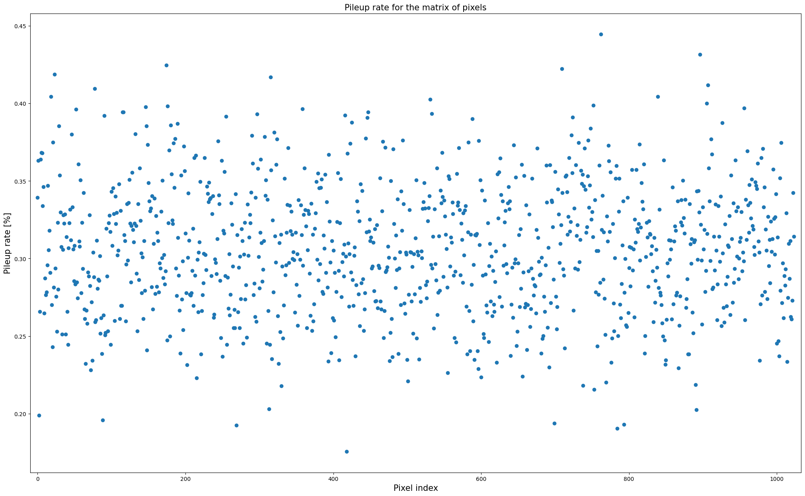
Medium requests rate – pileup rate
Minimum pileup count value: 32 (418)
Maximum pileup count value: 81 (762)
Minimum pileup rate value: 0.18% (418)
Maximum pileup rate value: 0.44% (762)

Slide 28
Medium requests rate – error bar plot
 | μ [ns] | σ [ns]
min | 223.0 (293) | 253.3 (1000)
max | 243.6 (766) | 304.0 (565)
cum | 232.6 | 272.9

Slide 29
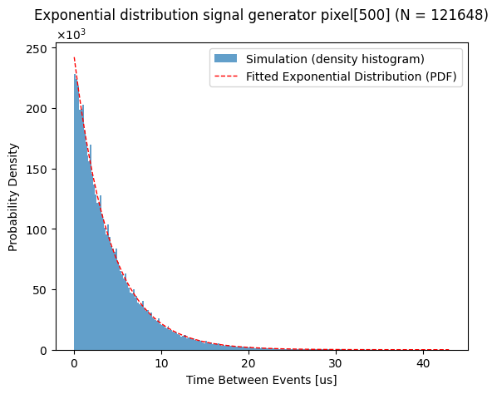
High requests rate
$$for f_{gen}=62.11 MHz and N_{mask}=8:$$
$$λ_{theoretical}=242.6 {kS}/s$$
$$λ_{measured}\left[1\right]=239.98 {kS}/s$$
$$λ_{measured}[500]=240.16 {kS}/s$$
[1]

Slide 30
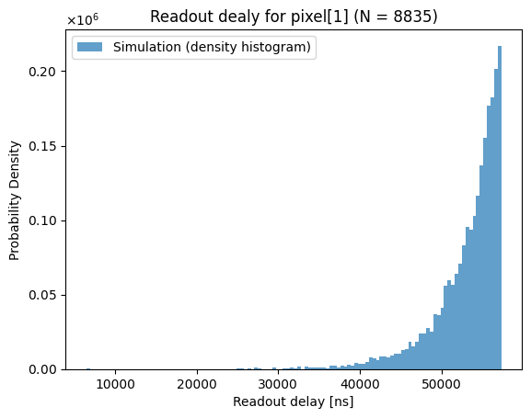
High requests rate – readout delay
Max readout delay [ns]: 57,332.82
Min readout delay [ns] : 21,534.22
Max readout delay [ns]: 57,334.29
Min readout delay [ns] : 6,477.49
[1]

Slide 31
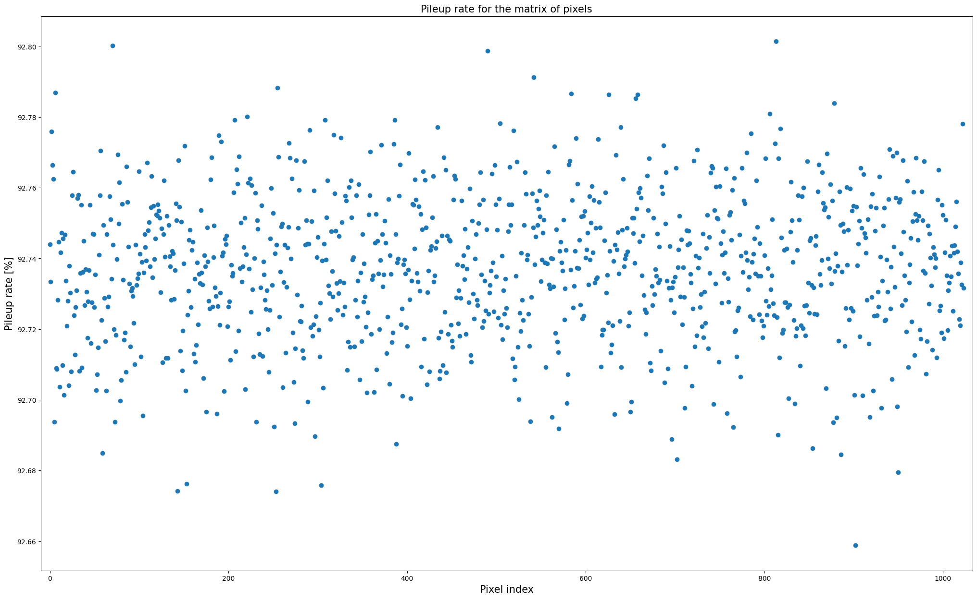
High requests rate – pileup rate
Minimum pileup count value: 111539 (902)
Maximum pileup count value: 113923 (813)
Minimum pileup rate value: 92.66 (902)
Maximum pileup rate value: 92.80 (813)

Slide 32
High requests rate – error bar plot
 | μ [ns] | σ [ns]
min | 53,056 (284) | 3,939 (171)
max | 53,332 (643) | 4,320 (95)
cum | 53,207 | 4,121

Slide 33
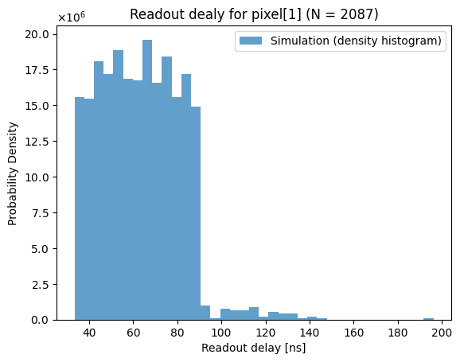
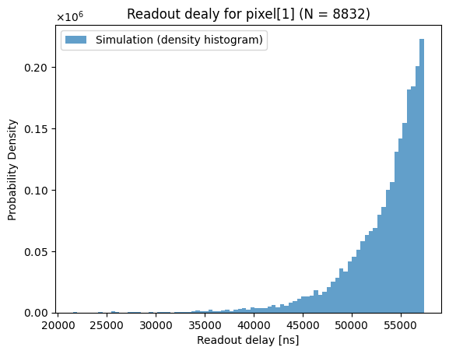
Readout delay comparison
Rate: Low Medium High

Slide 34
Comparison for readout using shift register (frame readout)
$$For 14 bit data: \\ T_{readout}=1024×14×\frac{1}{14×f_{acki}}=57.344 μs=57344 ns$$
$$For 1 bit data: \\ T_{readout}=1024×1×\frac{1}{14×f_{acki}}=4.096 μs=4096 ns$$
Rate | μ [ns]
Low | 64.2
Medium | 232.6
High | 53,200
To match EDWARD parallel readout speed from the pixel

Slide 35
Summary

Slide 36
Summary
Readout circuits for segmented sensors based on event triggering has been shown.
The dependence of the readout delay in relation to the requests rate was investigated.
In order to carry out this study, a circuit was designed to generate a signal to match the Poisson process (exponential distribution).
Based on this investigation, it was found that none of the pixels suffer from starvation regardless of the requests rate.
Hence the conclusion that there is no priority in readout between pixels.

Slide 37
Thank you for your attention!
Questions?

