Slide 1
Pixel detector with built-in signal processing and bandwidth-efficient data transmission
G.Pinaroli¹ , G.W.Deptuch¹, G.A.Carini¹, D.S.Górni¹, S.Mandal¹, P.Maj¹ ,N.St.John¹
Instrumentation Division, Brookhaven National Laboratory, Upton NY 11973, USA
XII Front-End Electronic Workshop
June 12 -16 , 2022, Turin , Italy

Slide 2

Pixel detector with built-in signal processing and bandwidth-efficient data transmission
Hybrid pixel detector with precision spectroscopy performances:
Low Equivalent Input Noise (ENC)
Output Voltage proportional to the impinging particle Energy
Continuous operation
Pixel size of ~100-150 um
We can define these developments as color camera detector
Platform for different applications using a matched sensor:
Full Field Fluorescence Imaging
Hard X-ray spectroscopy
Others…
Talk: “Event-driven arbitrated protocols
implemented in integrated readout circuits
for segmented detectors” by D. Gorni,
Today (06/12) at 12:30 PM
 | Si | Ge | GaAs | Diamond | CdTe | CZT | TIBr | a-Se
E_{g} [eV] | 1.12 | 0.67 | 1.43 | 5.5 | 1.44 | 1.57 | 2.68 | 1.90
W [eV] | 3.6 | 2.96 | 4.20 | 13.00 | 4.43 | 4.64 | 6.50 | 6.00
ε | 11.7 | 16.0 | 12.8 | 5.7 | 10.9 | 10 | 30 | 12
μ_{e} [cm²/ (V⋅s)] | 1650 | 3900 | 8000 | 1800 | 1100 | 1000 | 30 | 1-4
μ_{e} [cm²/ (V⋅s)] | 450 | 1900 | 400 | 1200 | 100 | 120 | 4 | 0.05
ρ [g/cm³] | 2.33 | 5.33 | 5.32 | 3.52 | 5.85 | 5.78 | 7.56 | 2.30

Slide 3
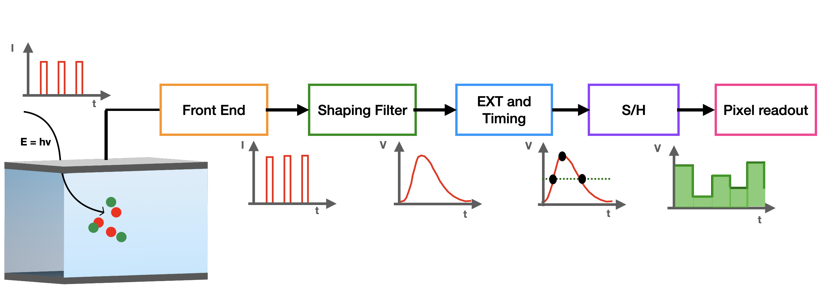

Generic readout chain for spectroscopic pixel detector
Low noise FE
Signal Gain
Continuous operation
Readout architecture of pixel/matrix
Extraction of max value
I -> V converter
Vout_{max} proportional to Q
Storage of the max amplitude value
Is there enough room to fit all of it in a 100-150 um pixel?
Power consumption? Readout? ….

Slide 4
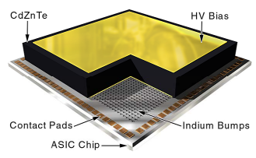
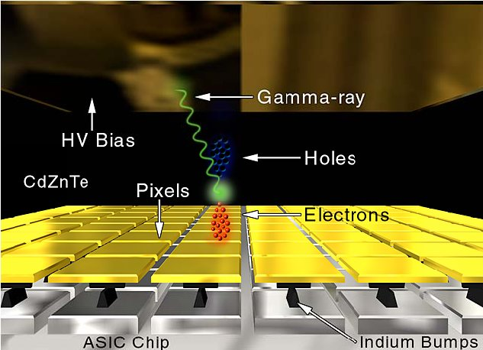
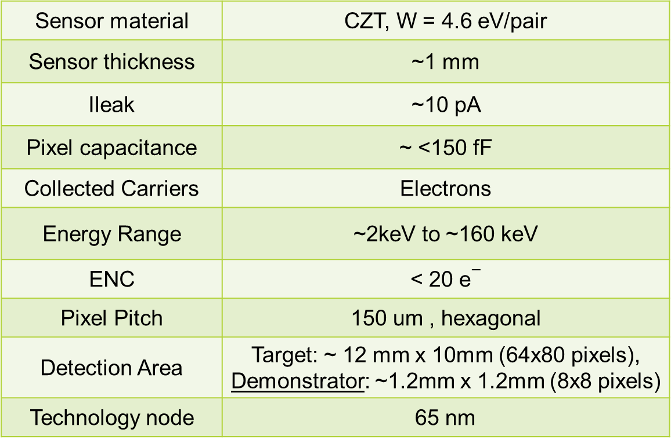
As example: HEXID ASIC
The Hyperspectral Energy-resolving X-ray Imaging Detector will be
an attractive detector solution for the next generation of space-borne
Hard X-ray Telescopes [*].
Sensor material | CZT, W = 4.6 eV/pair
Sensor thickness | ~1 mm
Ileak | ~10 pA
Pixel capacitance | ~ <150 fF
Collected Carriers | Electrons
Energy Range | ~2keV to ~160 keV
ENC | < 20 e$−$
Pixel Pitch | 150 um , hexagonal
Detection Area | Target: ~ 12 mm x 10mm (64x80 pixels), Demonstrator: ~1.2mm x 1.2mm (8x8 pixels)
Technology node | 65 nm
Figures from “Two-Dimensional Integrated Circuits for Hybrid Solid-State Pixel Detector”,
DOI: 10.1109/NSSMIC.2006.356182
[*] J. Tang, F. Kislat, H. Krawczynski,: Cadmium Zinc Telluride detectors for a next-generation hard X-ray telescope, https://doi.org/10.1016/j.astropartphys.2021.102563.

Slide 5
HEXID ASIC:
A pixelated chip for finely segmented CZT Sensors
suitable for Amplitude Spectroscopy in the hard X-ray regime

Slide 6
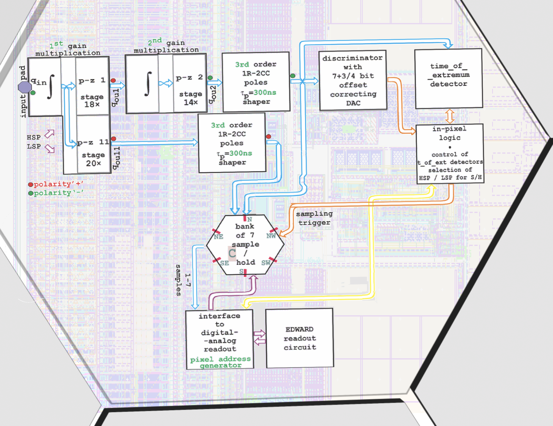
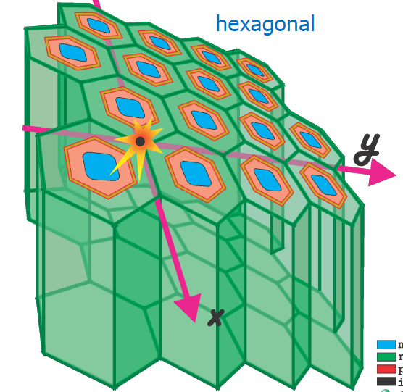
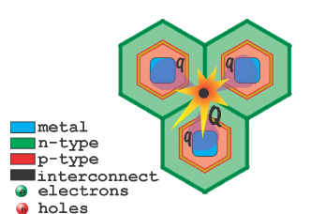
HEXID Architecture
In-Pixel signal processing:
Implementation of two processing paths, i.e., High Sensitivity Path (HSP) and Low Sensitivity Path (LSP), operating simultaneously, is achieved thanks to forking of p-z cancellation paths;
Triggering on the HSP for amplitude recording (S/H) for both readout chain
Sequenced readout of amplitude values of the pixel and its six neighbors
The advantage of using hexagonal over square pixels is that all the nearest neighbors of any given pixel are equivalent.
IEEE NSS-MIC 2022: Front-End Processing Chain for Finely Pixelated CZT Sensors Suitable for
Amplitude Spectroscopy, G.W., Deptuch et all.

Slide 7
CSA: Charge Sensitive Amplifier
BSA proprietary

Slide 8
CSA criteria of choice
For these developments, a suitable CSA architecture must fulfil very aggressive requirements:
Connectable in p-z cancellation configuration (high gain with cascaded stages, continuous operation)
FB network capable to handle leakage current and minimizing additional noise contribution and deliver very low ENC (< 20 e⁻)
Power consumption compatible with pixel integration
Silicon real-estate compatible with pixel size
Krummenacher’s / Manfredi’s [1]
Common Gate
Feedback (CGF) [3]
Common Source Feedback (CSF) [4]
operates in p-z cancellation,
RQI (typ. at some pAs) is required, but difficult to control and match,
larger I_{LEAK}+RQIs ⇒ loss of stability,
multiplied both RQI and sensor I_{LEAK} to next stages ⇒ shift of baseline.
feedback resistance ∝ current source,
I_{KRUM} must exceed I_{LEAK}, ⇒ parallel noise,
too large I_{LEAK} ⇒ loss of stability [2],
requires large (~pF) C_{int},
not connectable in p-z cancellation.
operates in p-z cancellation,
one-fit-all V_{RFB} is needed,
Reset Quiescent Current (RQI) is optional; if used, multiplied RQI to next stages ⇒ shift of baseline.
[1] F. Krummenacher, "Pixel detectors with local intelligence: An IC designer point of view", Nucl. Instrum. Methods Phys. Res., vol. A305, pp. 527-532, 1991, P.F. Manfredi, et al, “The analog front-end section of the BaBar silicon vertex tracker readout IC”, Nuclear Physics B - Proceedings Supplements, Vol. 61, Is. 3, February 1998, 532-538
[2] Y. Hu, et al, "A low-noise, low-power CMOS SOI readout front-end for silicon detector leakage current compensation with capability," in IEEE TCAS I, vol. 48, no. 8, pp. 1022-1030, Aug. 2001
[3] G. De Geronimo et al., “A CMOS detector leakage current self-adaptable continuous reset system: theoretical analysis”, Nucl. Instr. Meth. A 421 (1999) 322-333
[4] G. De Geronimo et al., “Front-End ASIC for a GEM Based Time Projection Chamber”, IEEE Trans. Nucl. Sci Vol. 51, No. 4, August 2004 1313-1317

Slide 9
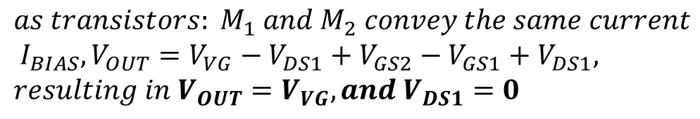
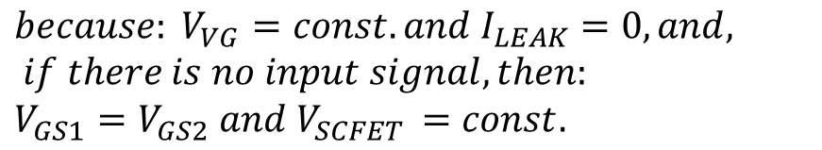
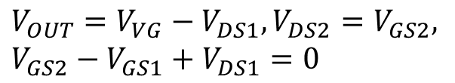
New CSA concept
Solution with SCFET which enables: 1) I_{LEAK} compensation, 3) Easy handling bias FB network, 3) p-z configuration
all shown for holes
Assuming:
no body effect in transistors,
negligible sensor leakage current,
very high open-loop gain of amplifier (OpAmp or OTA)
$$V_{OUT}=V_{VG}−V_{DS1}, V_{DS2}=V_{GS2},$$
$$V_{GS2}−V_{GS1}+V_{DS1}=0$$
Í
$$because: V_{VG}=const. and I_{LEAK}=0, and, if there is no input signal, then:$$
$$V_{GS1}=V_{GS2} and V_{SCFET }=const.$$
Ë
CSA with Self-Cascoded Field-Effect Transistor (SCFET) feedback network in configuration for integration of input charge signals [5];
CSA with (SCFET) configured in pole-zero cancellation scheme [5], realizing multiplication (gain) of input charge signal × n;
$$as transistors: M_{1} and M_{2} convey the same current \\ I_{BIAS}, V_{OUT}=V_{VG}−V_{DS1}+V_{GS2}−V_{GS1}+V_{DS1},$$
$$resulting in V_{OUT}=V_{VG}, and V_{DS1}=0$$
… in real conditions, V_{DS1} is only close to “0”, nevertheless transistor M₁ act as diode-connected, providing minimal voltage drop across and external voltage bias on its gate is not required
[5] G. W. Deptuch, P. Otfinowski, “Charge Sensitive Amplifier with Pole-Zero Cancellation”, provisional patent application USPTO Serial No. 63/379,887

Slide 10
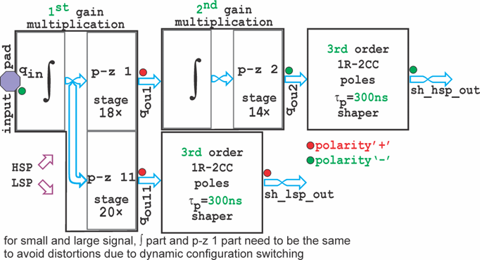
Dual amplification path and dual polarities
Inverter-type OTA amplifier with bias current reuse and active cascode gain boosting
either electrons or holes programmed or switched
90 dB open loop DC gain from a single stage amplifier,
intrinsically stable as it is single stage amplifier,
M₁ and M₂ = thick gate oxide devices, low gate leakage currents,
other transistors are selected to optimize swing and open loop gain,
local bias generated for cascode stages and inverter-type stage has its bias current defined by power supply to reduced interferences.

Slide 11
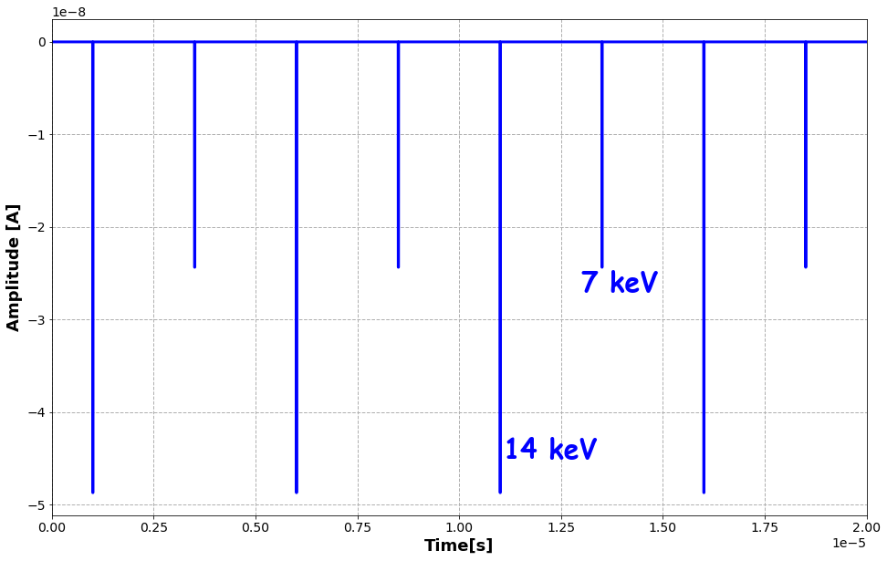
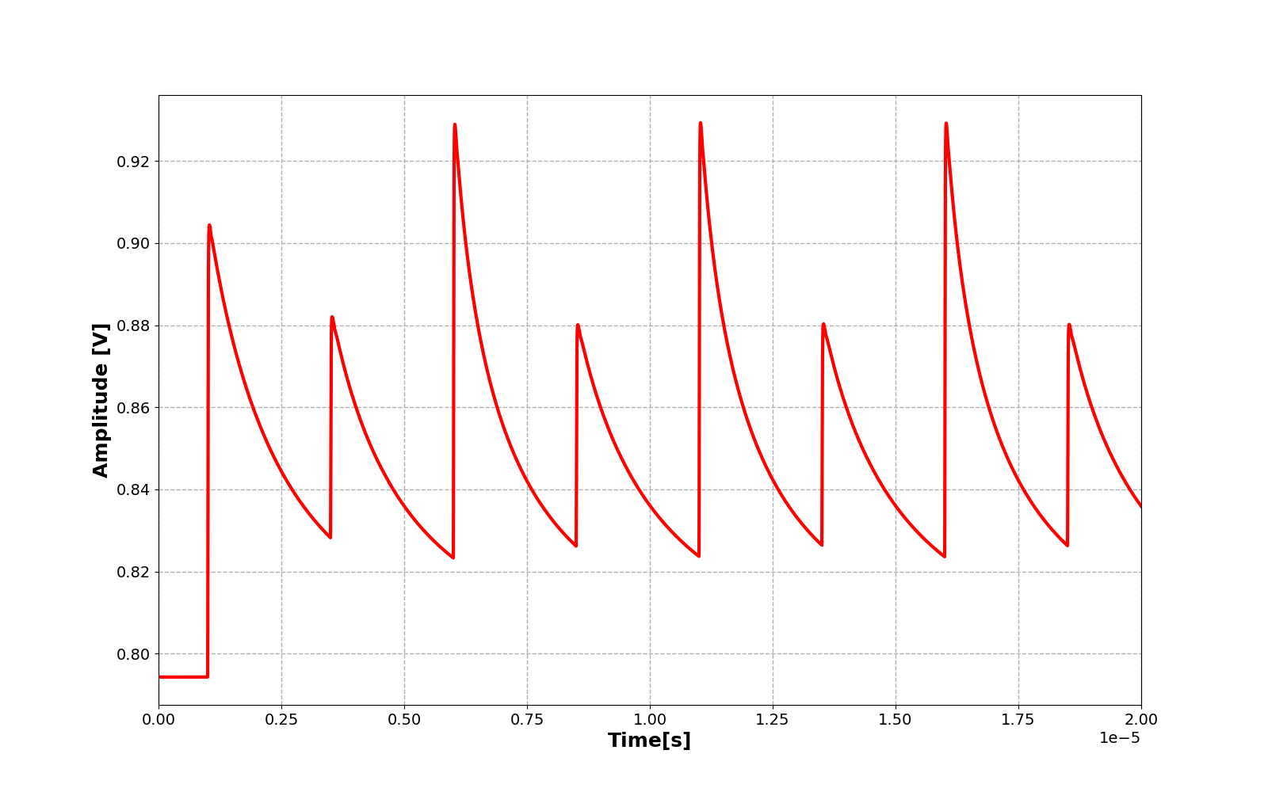
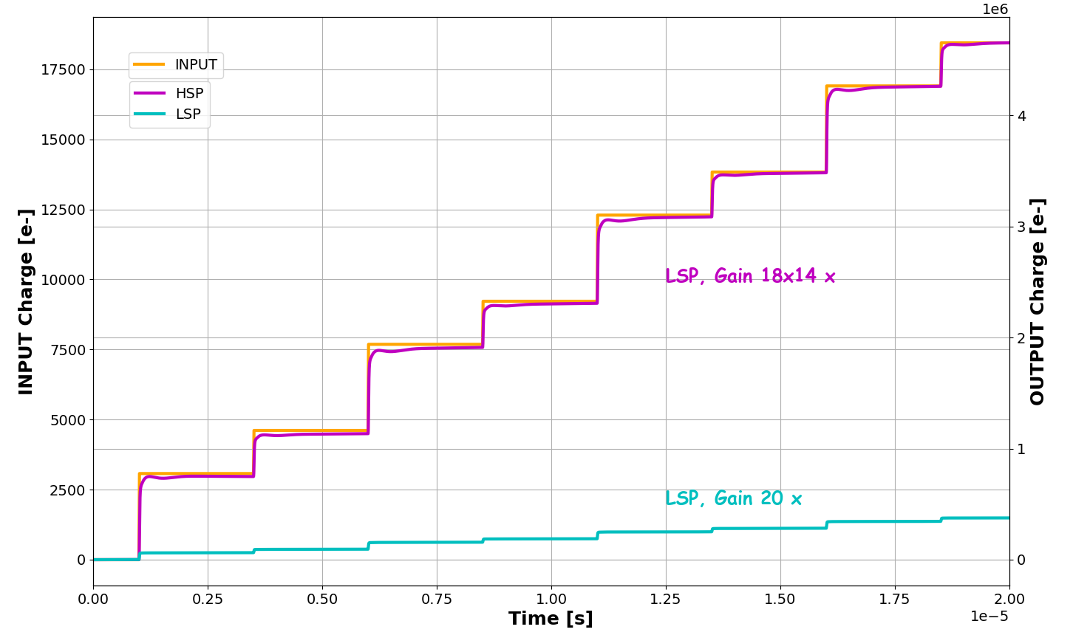
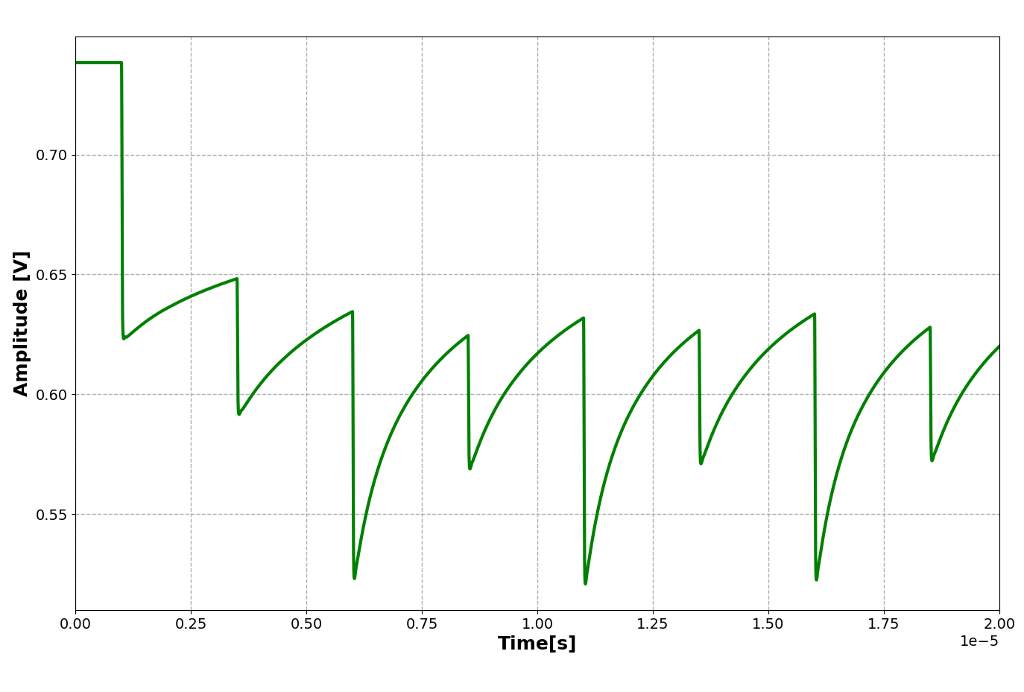
CSA in simulation
input
HSP two stage CSA ⇒ charge multiplication I_{OUT}=18×14×I_{IN}, with C_{f1}=4 fF, C_{c1}=18×4 fF, C_{f2}=40 fF and C_{c2}=14×40 fF
LSP one stage CSA ⇒ charge multiplication I_{OUT}=20×I_{IN}, with C_{f1}=4 fF, C_{c1}=20×4 fF,
a_out
c_out
left axis: orange 14keV and 7 keV
injections,
right axis: magenta Q_{out} HSP
cyan Q_{out} LSP

Slide 12
Shaping Filter with Baseline Adjustment

Slide 13
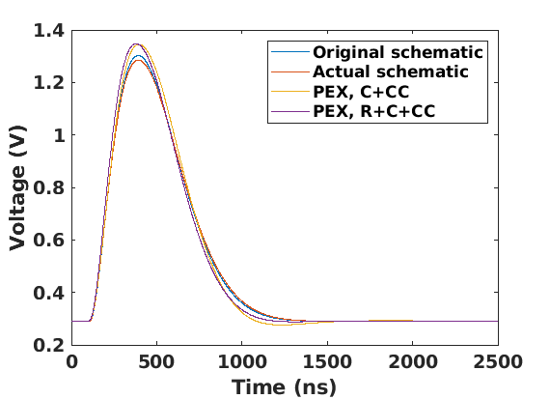
Shaping filter with baseline adjustment
3rd order, 1-real + 2-complex conjugate poles [*], shaping filter (τ_{p}=300 ns) with baseline adjustment using current-mode DAC (7.5 bit equiv. +1 bit for polarity setting DAC – k=8)
R_{pr} = 571.6 kΩ, C_{pr} = 304.0 fF
R_{pc11} = 183.2 kΩ /7 = 26.17 kΩ, C_{pc11} = 4.52 pF
R_{pc12} = 183.2 kΩ, C_{pc12} = 304.0 fF / 2 =152.0 fF, R_{pc13} = 183.2 kΩ
I current DAC = ±250 nA (baseline) + 1 μA (polarity)
DAC current is injected
into node ‘d’ for noise performance
IR drop across R_{pc12} ⇒ shifts of baseline.
Avoid AC coupling with voltage trim
$$H_{t}\left(s\right)=\frac{1}{s}\frac{−sC_{c}R_{pr}}{sC_{pr}R_{pr}+1}\frac{1}{s^{2}C_{pc11}C_{pc12}R_{pc12}R_{pc13}+sC_{pc12}R_{pc12}\left(1+\frac{R_{pc13}}{R_{pc11}}+\frac{R_{pc13}}{R_{pc12}}\right)+1}=\frac{−sC_{c}R_{pr}}{sC_{pr}R_{pr}+1}\frac{{−A}_{v}}{\frac{s^{2}}{ω_{0}^{2}}+\frac{s}{ω_{0}Q}+1}$$
C_{c} is coupling capacitance for the last stage of the CSA
[*] G. De Geronimo and S. Li, "Shaper Design in CMOS for High Dynamic Range," in IEEE Transactions on Nuclear Science, vol. 58, no. 5, pp. 2382-2390, Oct. 2011

Slide 14
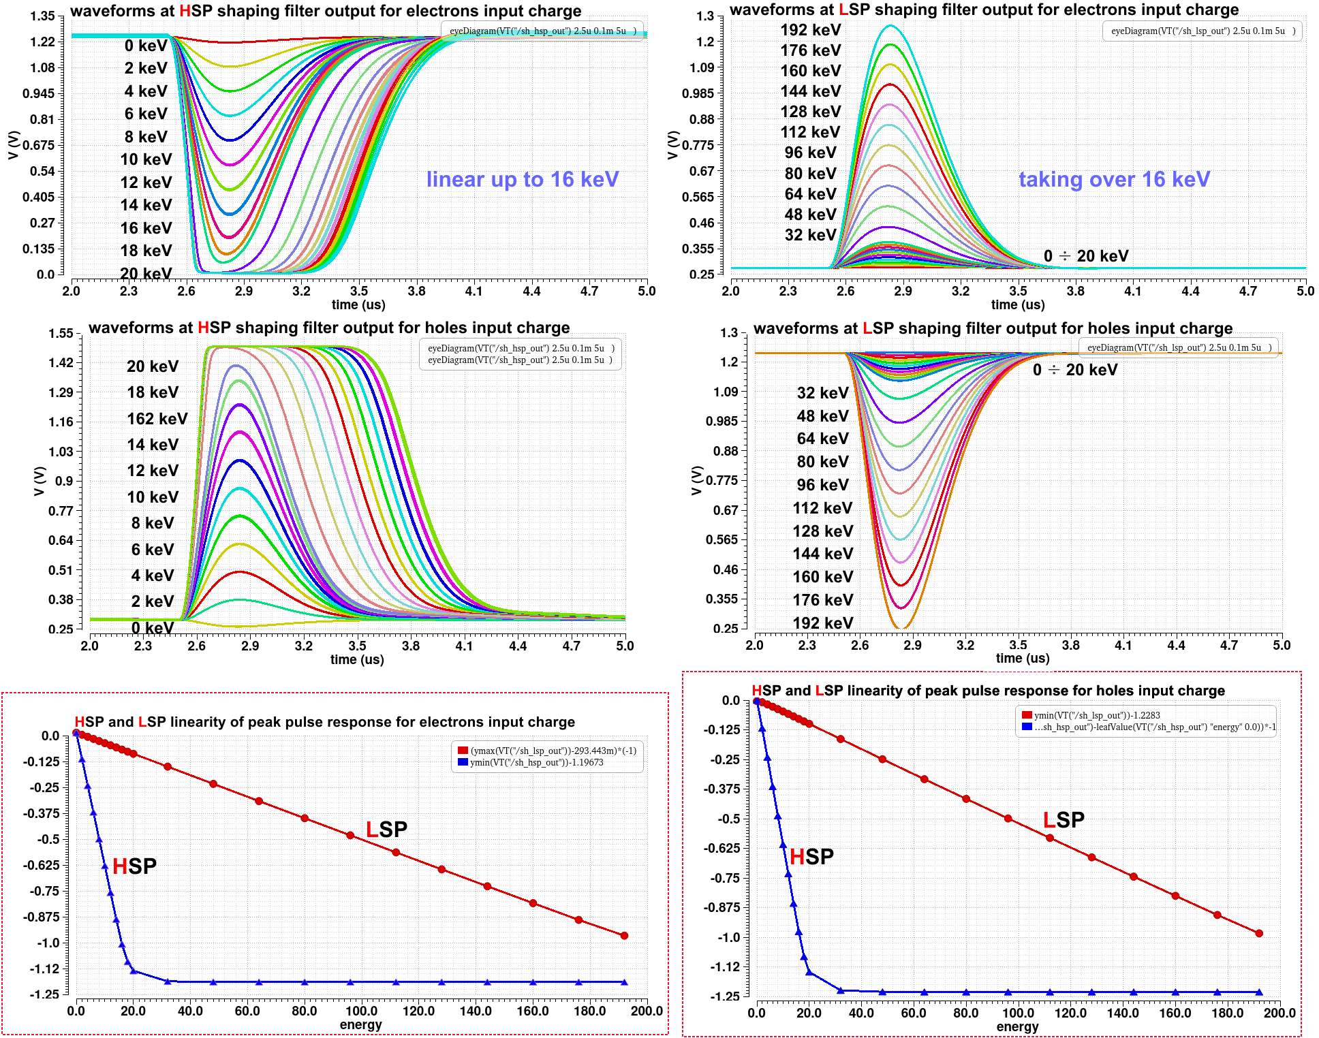
Transient simulations
Linearity of HSP and LSP responses
Both paths work simultaneously;
HSP is non-saturated up to 18 keV;
LSP continues to operate up to one order of magnitude of input charge signal more;
Saturated HSP returns to baseline without visible perturbations;
Excess charge is dissipated by the reset network;
Both paths offer about ~1 V signal swings;
HSP
LSP

Slide 15
HSP and LSP simultaneous responses (both polarities)
e⁻
Both Polarity are accepted
Both paths work simultaneously;
HSP is non-saturated up to 18 keV;
LSP continues to operate up to one order of magnitude of input charge signal more;
Saturated HSP returns to baseline without visible perturbations;
Excess charge is dissipated by the reset network;
Both paths offer about 1 V signal swings;
h⁺

Slide 16
Correct ENC reporting
1.5 ms long simulations with injections every 5 μs
(max noise frequency 250 MHz)
results presented in ‘eyeDiagram’ mode with period of 5 μs
Often SNR is incorrectly reported as
As ratio of pulse amplitude (transient sim.) to rms at not signal (AC noise sim.)
Simulation test setup for estimation
of noise (SNR and ΔE/E)
CSA uses passive, i.e., capacitors, and active, i.e., transistors, components in feedback path of high open-loop gain amplifier.
FE circuit transfer function is non-nonstationary ⇒ the noise (variance at specific points of time series data) needs to be calculated using transient noise simulation,

Slide 17
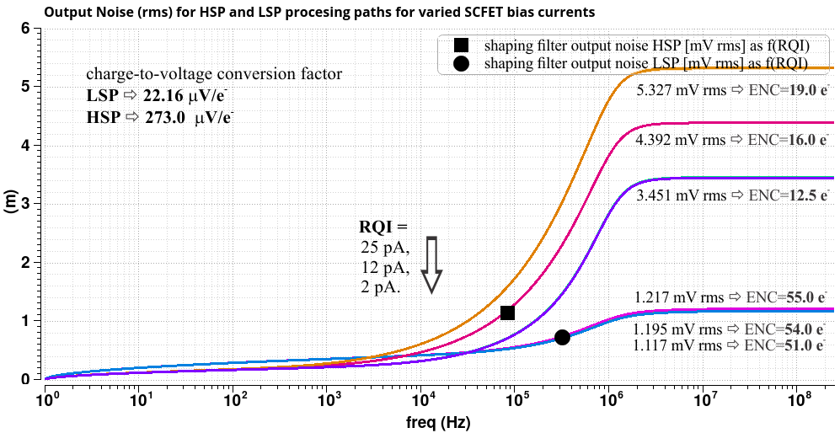
Noise simulations
AC “noise” SIMS estimates noise with no signal
RQI is the quiescent
current of the RESET.
It contributes to the parallel noise.
Programmable per Pixel with control bits.

Slide 18
S/H and readout sequencing

Slide 19
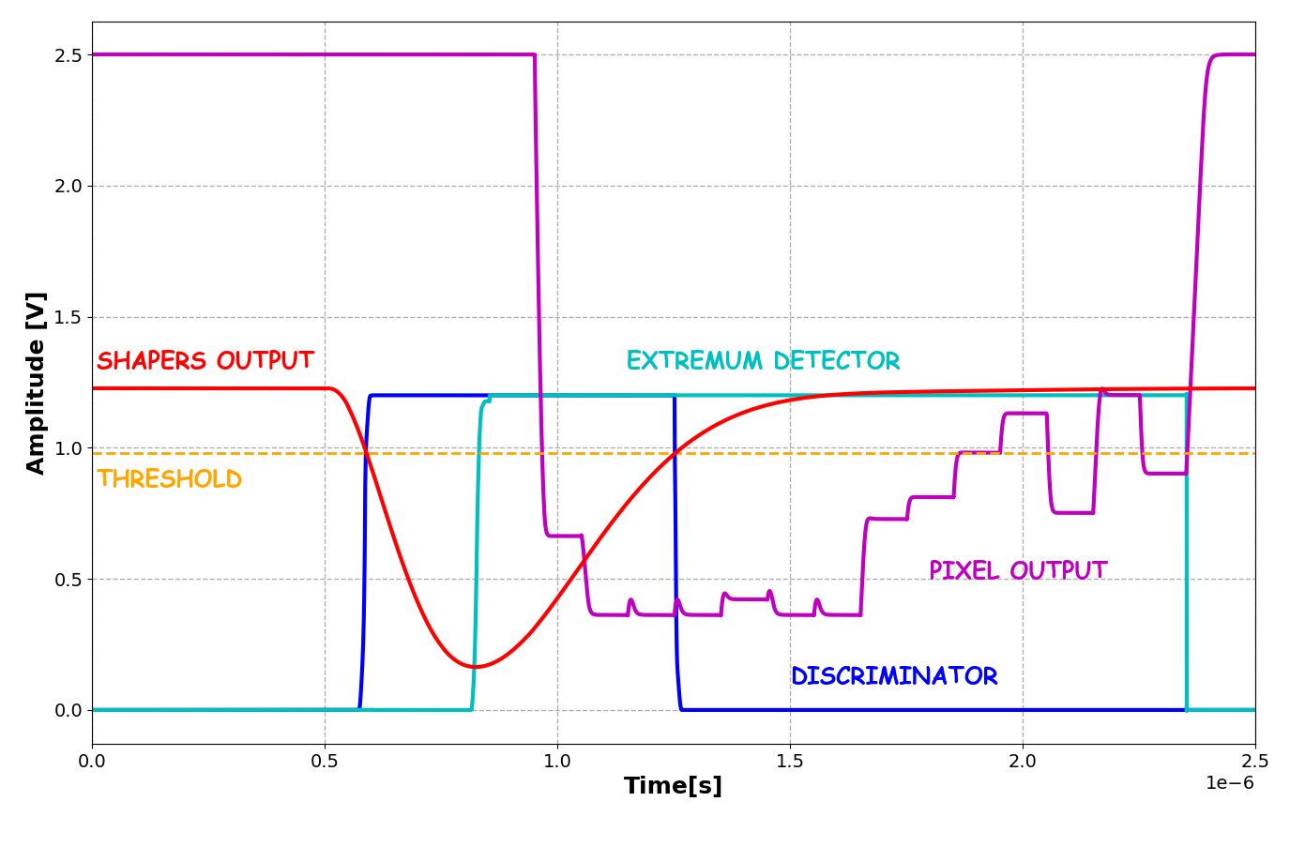
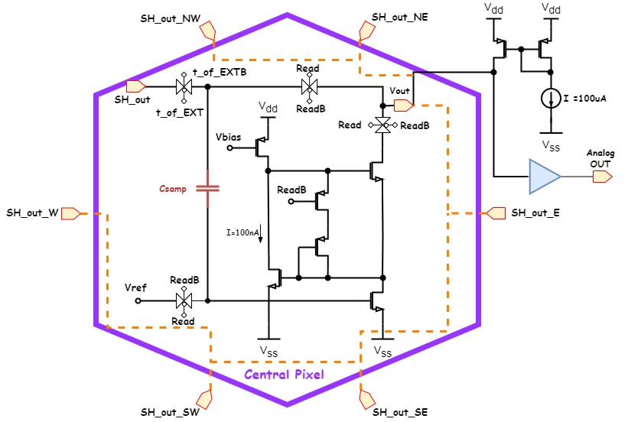
Common Source S/H and Readout Interface
S/H in tracking mode
Discriminator detects SHAPER crossing of threshold (adjustable)
S/H exits tracking mode when SHAPER peak value is reached hence enter in read mode
Adjacent pixel max value are stored in in-pixel S/H cells
Pixel S/H is “blind” during readout sequence (high rate configuration available)
Pixel address is sent simultaneously on digital lines
source follower = variable, typically <1, unless complicated architectures [US Patent No 11,108,981 B2]
CS with the S/H capacitor in feedback path is used
S/H for each adjacent pixel (HSP & LSP)

Slide 20
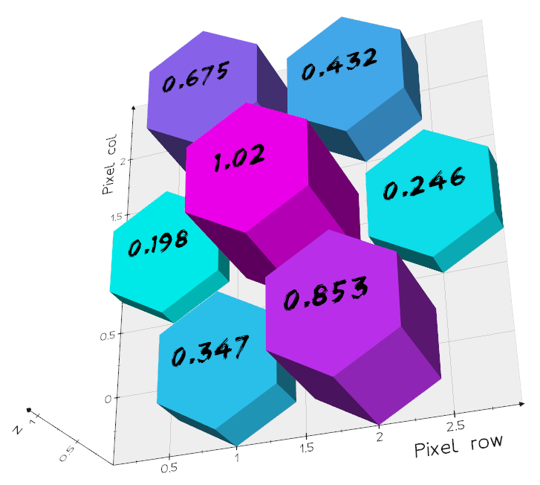
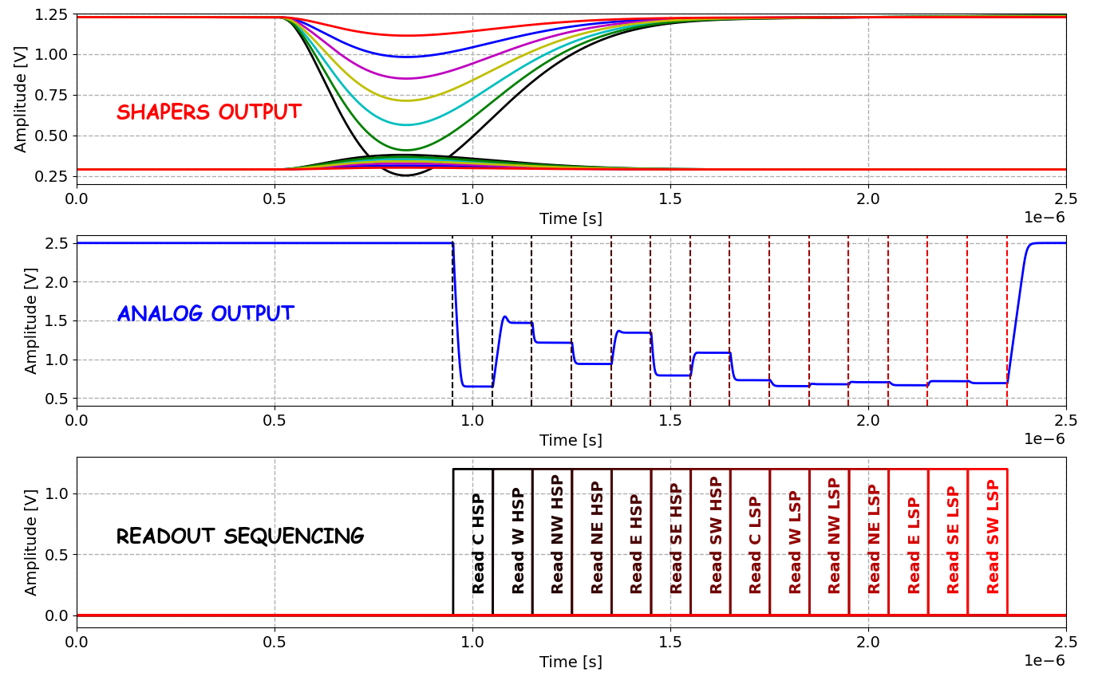
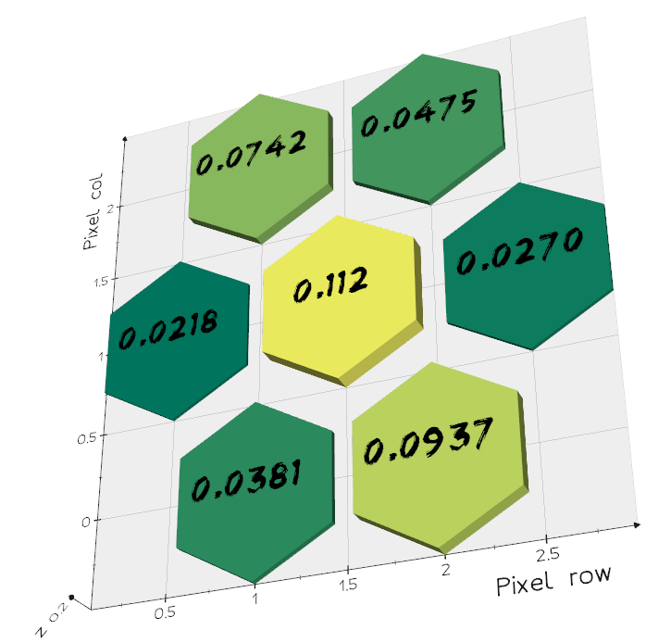
S/H readout sequence
Simulating an event @ 16keV with corresponding
charge sharing among adjacent pixels.
Output values must be referred to the corresponding baseline.
HSP
LSP

Slide 21
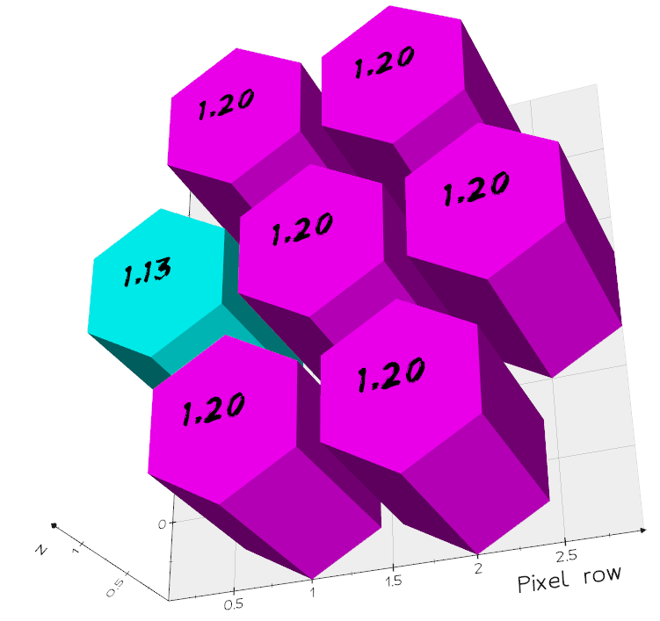
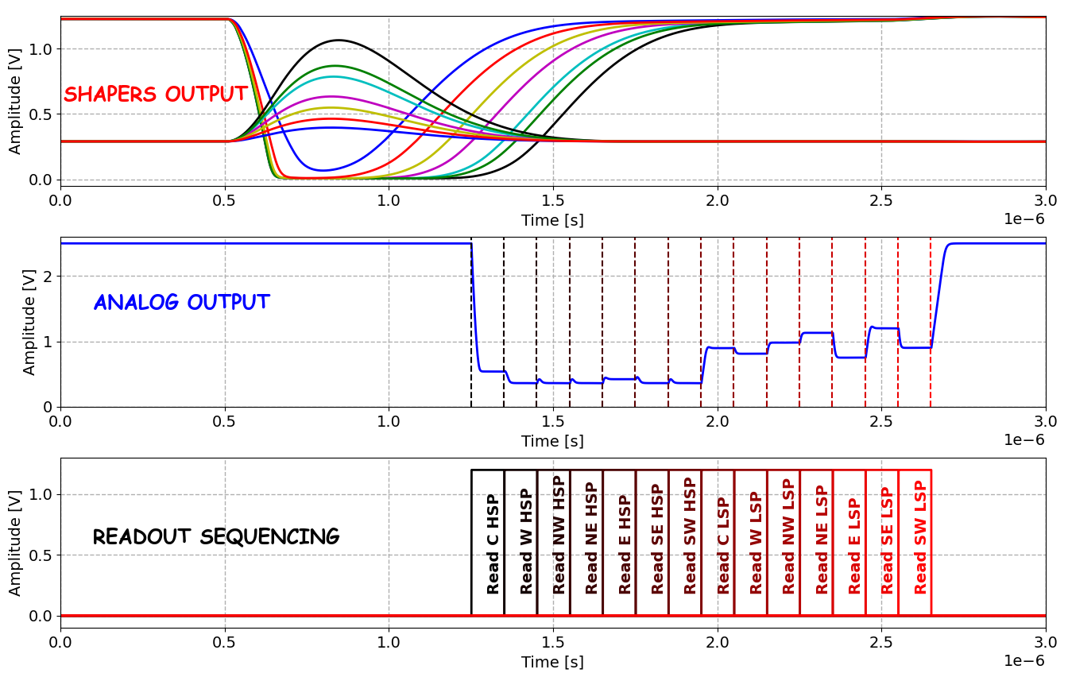
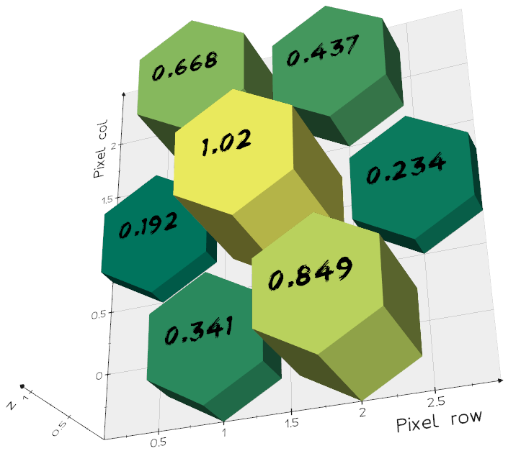
S/H readout sequence
Simulating an event @ 160keV with corresponding
charge sharing among adjacent pixels.
Output values must be referred to the corresponding baseline.
HSP
LSP

Slide 22
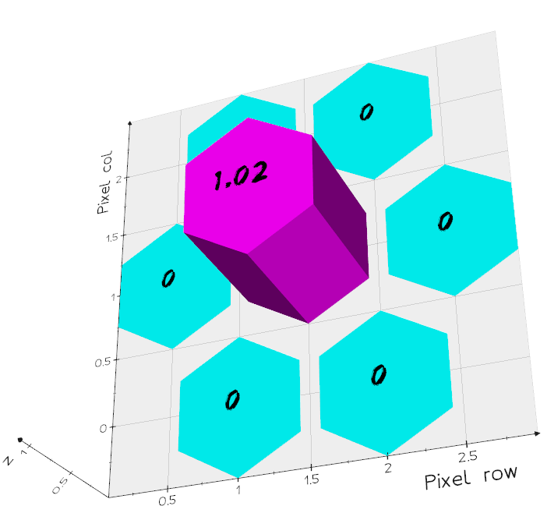
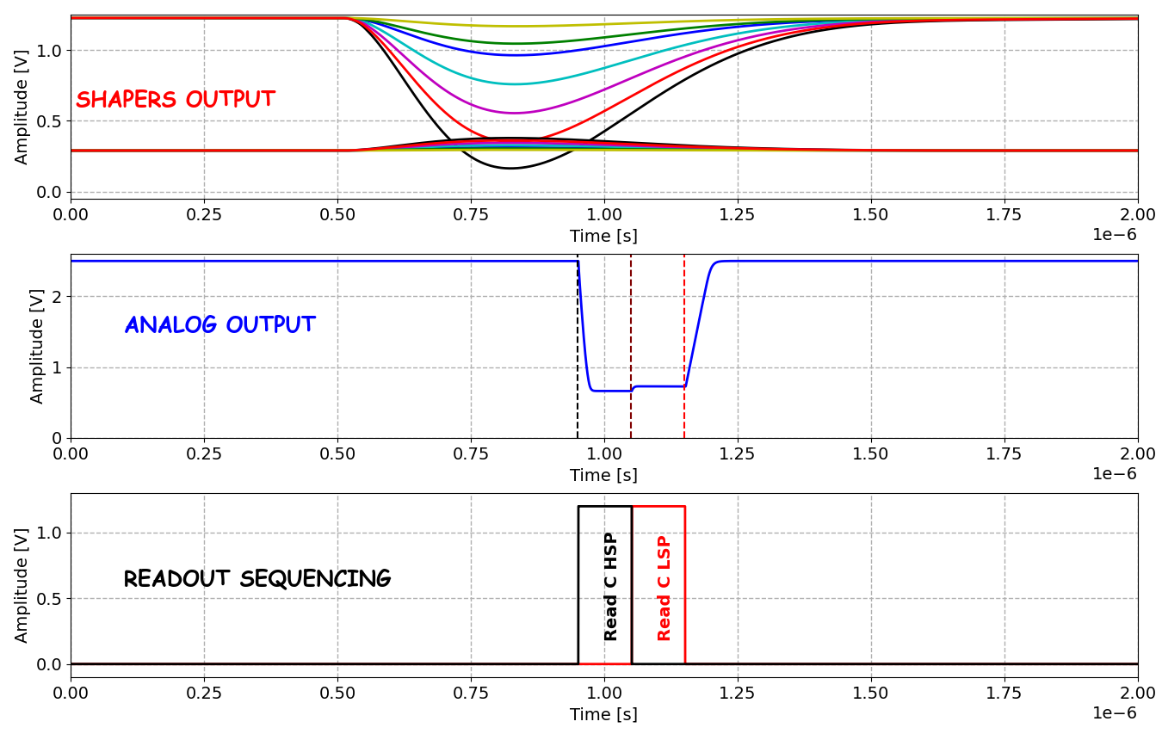
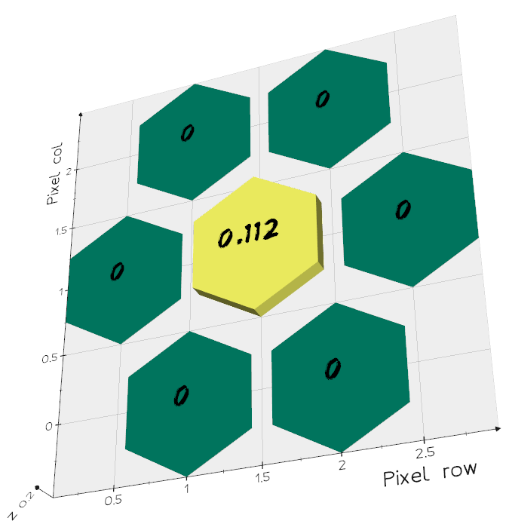
S/H readout sequence
Simulating an event @ 16keV. Only principal pixel (high-rate condition).
Output values must be referred to the corresponding baseline.
HSP
LSP

Slide 23
Sparsified readout
More details in: “Event-driven arbitrated protocols implemented in integrated readout circuits
for segmented detectors” by D. Gorni

Slide 24
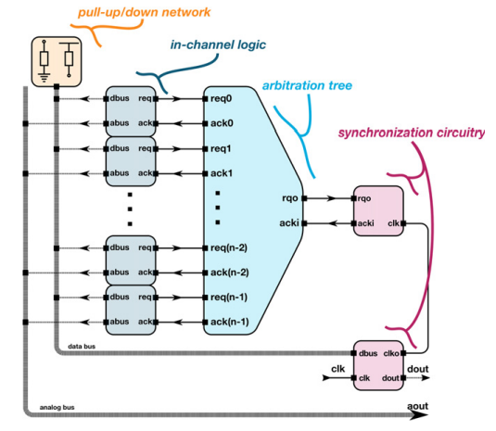
EDWARD:
Event Driven with Access and Reset Decoder
The high number of pixels requires robust, reliable, and preferably compact readout system on the chip to collect data from each structure and then transmit it out of the chip to communicate with acquisition systems.
Spectroscopy imaging is not Imaging -> Asynchronous and sparsed sources;
Optimal usage of available bandwidth (minimize dead time) -> Event driven readout instead frame readout;
Efficient transmission of data/configuration from/to multiple pixels;
Hierarchical design with arbitration tree -> No data collision;
EDWARD readout:
Fully Scalable with the number of pixels
In-pixel logic with Arbitration tree to provide access to each pixel
Analog data bus and digital data bus
Design defined by geometry constraint
Physical design with automatic P&R tools (ensure timing requirements
Ideal for In-pixel ADC (future developments)
First Physical implementation (1k pixel) submitted March 2023
[ᙂ]Event driven readout architecture with
non-priority arbitration for radiation detectors,
D.S. Gorni et al 2022 JINST 17 C04027
General structure of the EDWARD architecture with highlighted functional blocks.

Slide 25
HEXID demonstrator
8x8 pixels

Slide 26
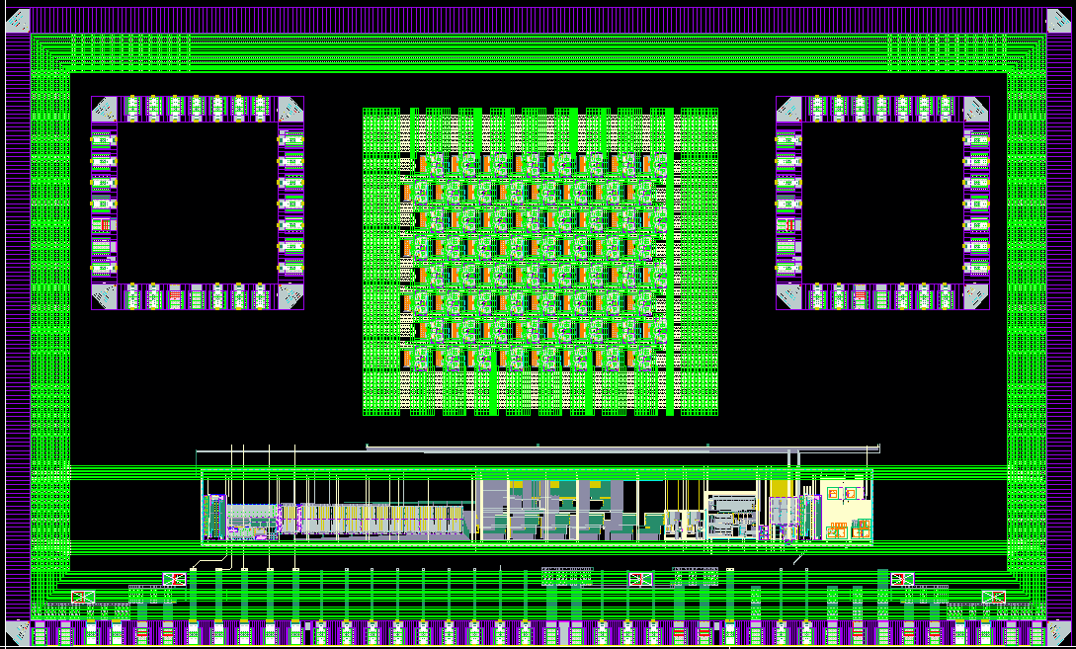
HEXID test chip
5mm
Pixel area 8x8
Test struc. A
Test struc. B
3mm
BGR, DACs
OUTPUT BUFF,
CLK Receiver,
Global Logic, I2C
Periphery
Expected submission: Aug 2023, MPW run, TSMS 65nm

Slide 27
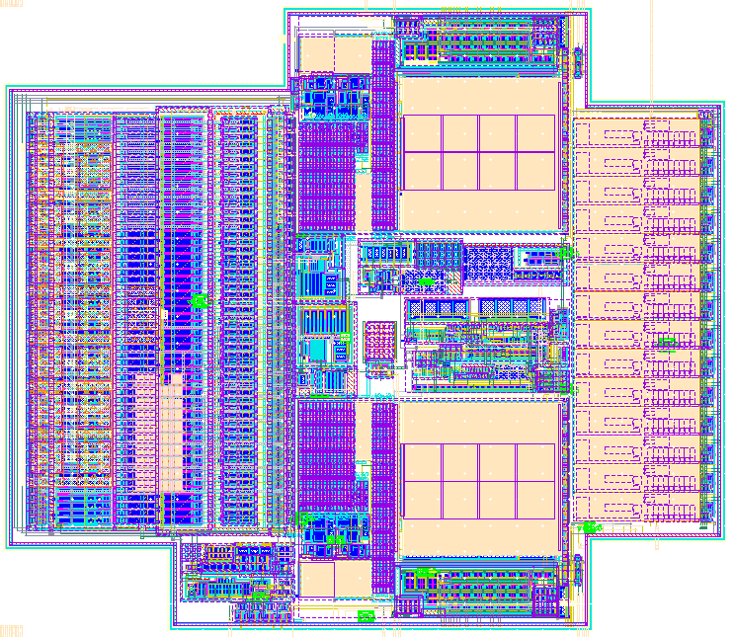
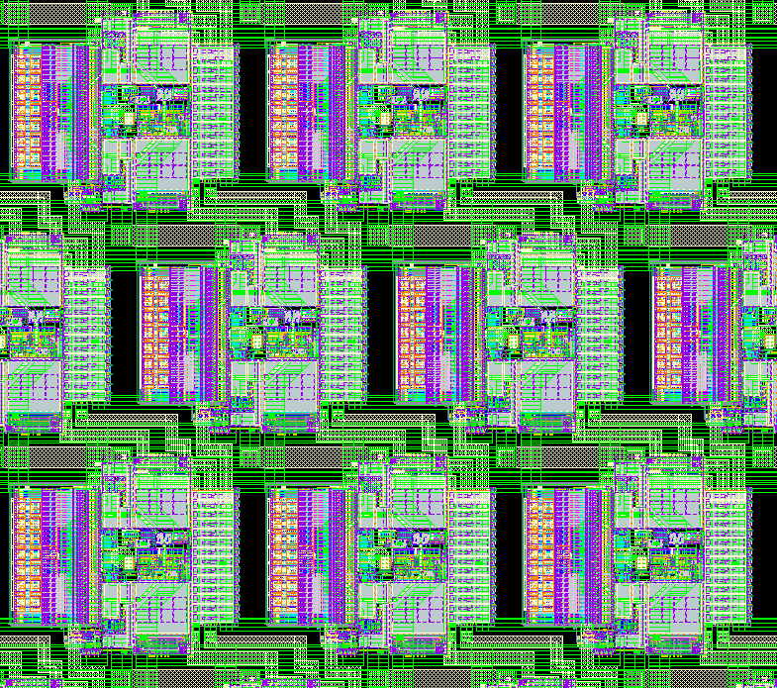
HEXID pixel
130um
~1200 Mosfet/Pixel
Custom Layout, MOMs above Mosfets
Power consumption: 0.5 mW/pixel
120um
CSA
SHAPER HSP
EXT and Timing
Detector
S/H
SHAPER LSP

Slide 28

HEXID pixel
Edward implementation:
Design defined by geometry constraint
Physical design with automatic P&R tools
(ensure timing requirements)

Slide 29
Summary

Slide 30

Pixel detector with built-in signal processing and bandwidth-efficient data transmission
Objectives and Key Challenges:
A pixelated chip for finely segmented CZT Sensors
suitable for Amplitude Spectroscopy in the hard X-ray regime
Handling two order of magnitude high DR with
a dual and built-in signal processing path
Optimize readout to cope with the nature of science
Development approach:
STATUS:
Front End architecture has been identified: Two path simultaneously
working covering wide energy range (2keV to 180keV)
Layout of several parts is present and verified (Silicon underway);
EDWARD Readout architecture has been developed.
  Sparsified readout platform;
  Analog Signal amplitude readout (In-pixel ADC in the future);
  Individual Pixel access and configuration;
Pixel Front-End architecture with spectroscopic capabilities:
  Low noise;
  Adaptive reset mechanism;
  High Dynamic Range (up to 180 keV);
Event Driven Readout Mode:
  Asynchronous and Sparsed sources;
  Associated neighbors pixel readout scheme;
  In-pixel configuration (calibration)
  Future development with in-Pixel ADC
NEXT STEPS:
Assembly of the entire test structure (85% done);
Submission of HEXID test structure (8x8 pixels)
  Validate chosen architecture with CZT sensor
  before large scale device;
  Expected submission Aug 2023

Slide 31
Thanks for your attention
Questions?

Slide 32
BACK-UP

Slide 33

Commonly used CSA concepts with I_{LEAK} compensation and with p-z cancellation
all shown for holes
Krummenacher’s / Manfredi’s [1]
input charge signal multiplication
$$I_{OUT} =n×I_{IN}$$
Ð
L
L
L
Í
Í
Common Gate
Feedback (CGF) [3]
Common Source Feedback (CSF) [4]
operates in p-z cancellation,
RQI (typ. at some pAs) is required, but difficult to control and match,
larger I_{LEAK}+RQIs ⇒ loss of stability,
multiplied both RQI and sensor I_{LEAK} to next stages ⇒ shift of baseline.
operates in p-z cancellation,
one-fit-all V_{RFB} is needed,
Reset Quiescent Current (RQI) is optional; if used, multiplied RQI to next stages ⇒ shift of baseline.
feedback resistance ∝ current source,
I_{KRUM} must exceed I_{LEAK}, ⇒ parallel noise,
too large I_{LEAK} ⇒ loss of stability [2],
requires large (~pF) C_{int},
not connectable in p-z cancellation.
[1] F. Krummenacher, "Pixel detectors with local intelligence: An IC designer point of view", Nucl. Instrum. Methods Phys. Res., vol. A305, pp. 527-532, 1991, P.F. Manfredi, et al, “The analog front-end section of the BaBar silicon vertex tracker readout IC”, Nuclear Physics B - Proceedings Supplements, Vol. 61, Is. 3, February 1998, 532-538
[2] Y. Hu, et al, "A low-noise, low-power CMOS SOI readout front-end for silicon detector leakage current compensation with capability," in IEEE TCAS I, vol. 48, no. 8, pp. 1022-1030, Aug. 2001
[3] G. De Geronimo et al., “A CMOS detector leakage current self-adaptable continuous reset system: theoretical analysis”, Nucl. Instr. Meth. A 421 (1999) 322-333
[4] G. De Geronimo et al., “Front-End ASIC for a GEM Based Time Projection Chamber”, IEEE Trans. Nucl. Sci Vol. 51, No. 4, August 2004 1313-1317

Slide 34
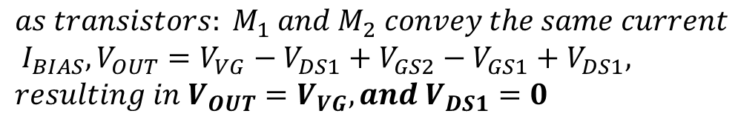
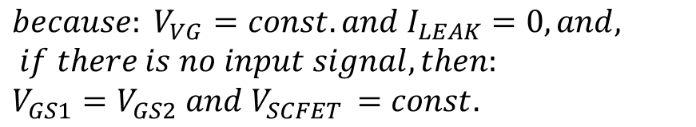
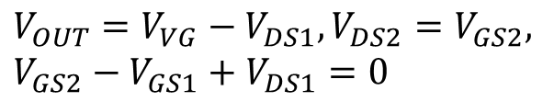
New CSA concept with I_{LEAK} compensation and with p-z cancellation
all shown for holes
assuming:
no body effect in transistors,
negligible sensor leakage current,
very high open-loop gain of amplifier (OpAmp or OTA)
J
J
L
$$V_{OUT}=V_{VG}−V_{DS1}, V_{DS2}=V_{GS2},$$
$$V_{GS2}−V_{GS1}+V_{DS1}=0$$
Í
$$because: V_{VG}=const. and I_{LEAK}=0, and, if there is no input signal, then:$$
$$V_{GS1}=V_{GS2} and V_{SCFET }=const.$$
Ë
CSA with Self-Cascoded Field-Effect Transistor (SCFET) feedback network in configuration for integration of input charge signals [5];
CSA with (SCFET) configured in pole-zero cancellation scheme [5], realizing multiplication (gain) of input charge signal × n;
$$as transistors: M_{1} and M_{2} convey the same current \\ I_{BIAS}, V_{OUT}=V_{VG}−V_{DS1}+V_{GS2}−V_{GS1}+V_{DS1},$$
$$resulting in V_{OUT}=V_{VG}, and V_{DS1}=0$$
… in real conditions, V_{DS1} is only close to “0”, nevertheless transistor M₁ act as diode-connected, providing minimal voltage drop across and external voltage bias on its gate is not required
[5] G. W. Deptuch, P. Otfinowski, “Charge Sensitive Amplifier with Pole-Zero Cancellation”, provisional patent application USPTO Serial No. 63/379,887

Slide 35

Charge gain maximization through cascading
$$I_{OUT} =n×m×I_{IN}$$
1st charge gain stage ‘×n’
2nd charge gain stage ‘×m’

Slide 36
ASIC Floorplan
HEXID_65nm chip (Final chip after test structure):
  Rotation help structuring vertical routing:
    less square chip: 64 × 80 pixels
    12,340.50 × 10,020.00 μm² active area
  10 × 8 - pixel groups combined into 5 blocks:
    64 × 80 pixels
    each block read out separately (5 outputs)
  sensor larger by 50 μm with respect to the lowest row of pixels
  distance from edge of sensors to wire-bonding pad not less than 400 μm (to allow tool access)
  75 wire bonding pads along one side (15 pads per group) @ pitch 120 μm
Approximated outside ASIC dimensions:
  12,550.00 × 10,750.00 μm²
8x8
pixels
Test structure:
  8x8 pixel to asset pixel circuitry and readout architecture
Edge circuitry, common blocks, I/O buffers

Slide 37
SENSOR & ASIC FLOORPLAN

Slide 38

Sensor PADs Floorplan
Hexagonal pad with pitch 150um
Area for one CZT contact
Uncontacted gap between pixels: 15 µm
150 µm
Metal mask for
sensor fabrication
Bare CZT Area
Sensor pads layout scheme.

Slide 39
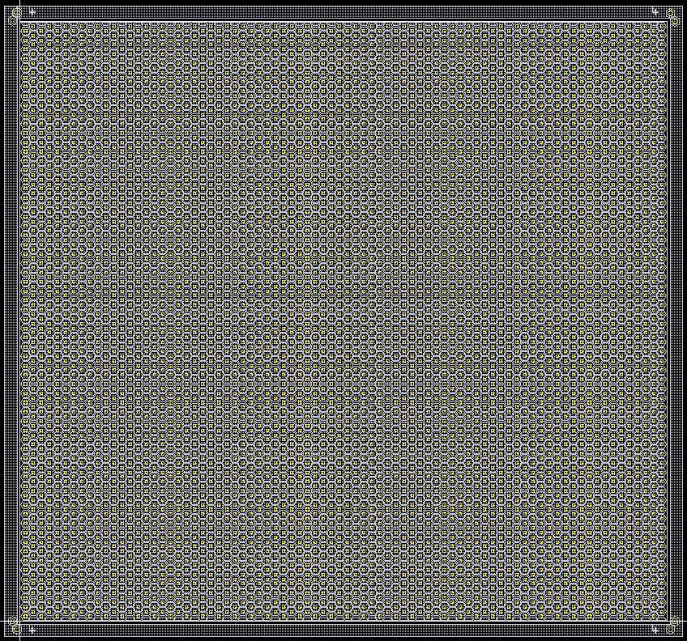
12,840.5 µm
Full Sensor Floorplan
Mask alignment
point
CZT Sensor:
  1 mm to 2 mm thick,
  ~1.3 x ~1 cm²
  64 x 80 pixels matrix
10,520 µm
Test structure:
  1 group = 8x8 pixel
8x8 test structure

Slide 40
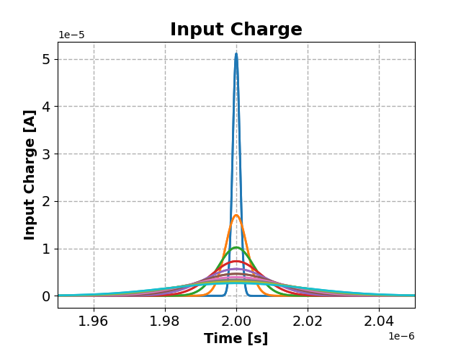
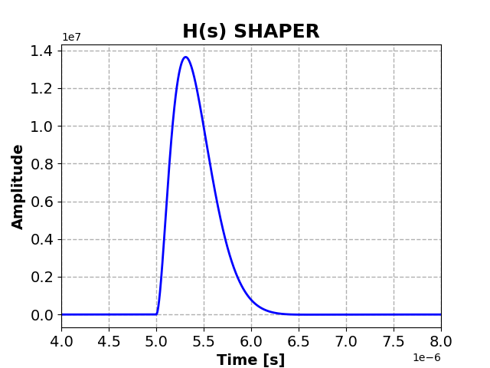
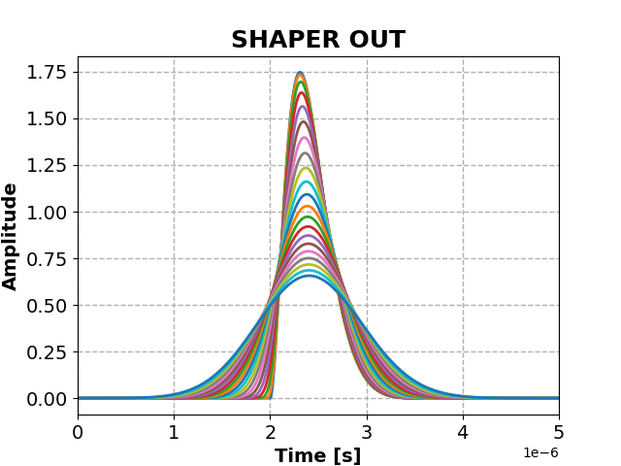
ToT simulations

Slide 41
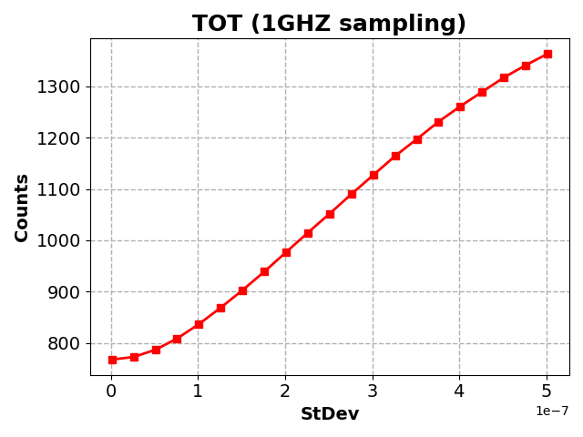
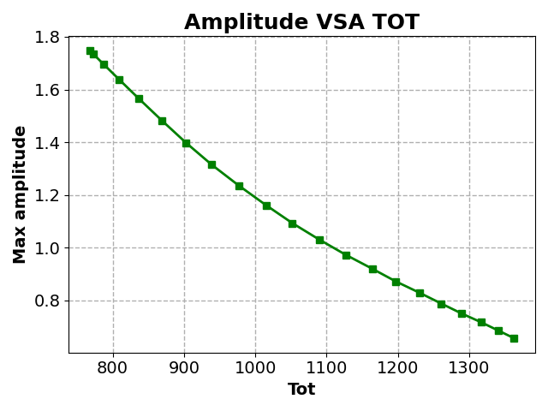
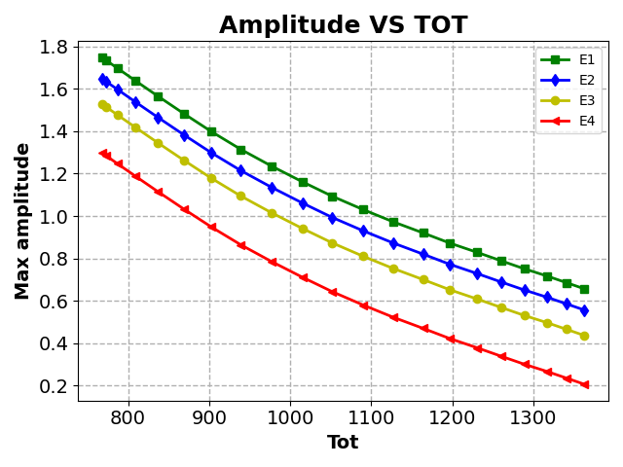
Threshold
Single Energy
If multiple
energies

