Slide 1



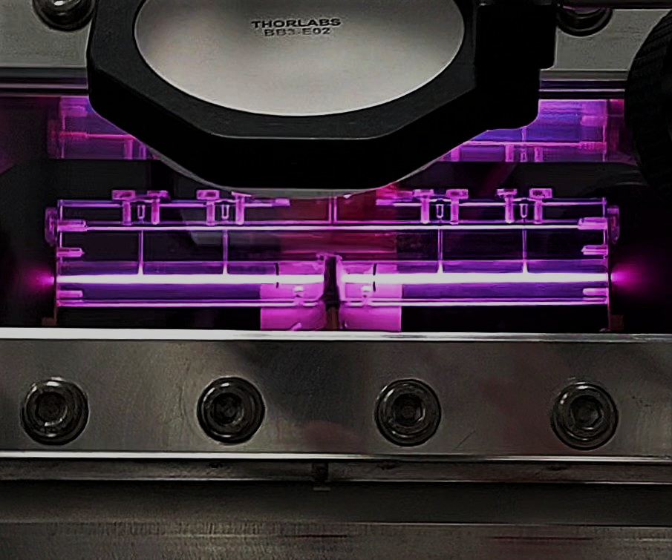
5th EuPRAXIA@SPARC_LAB TDR Review Committee
Plasma module development
A. Biagioni, R.Pompili
15th June 2023

Slide 2

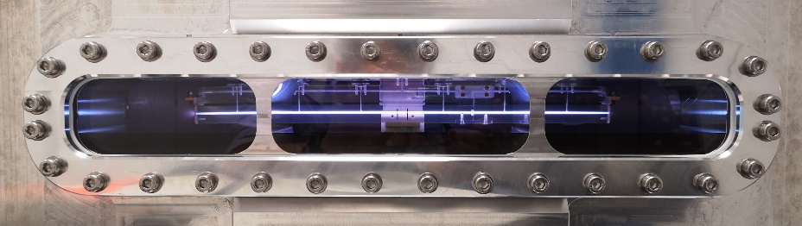
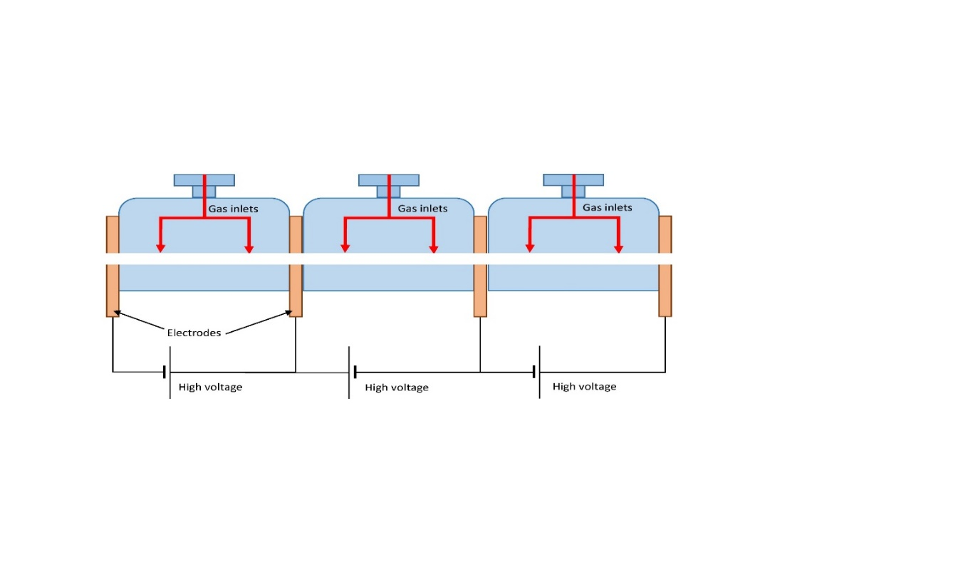
Introduction
Plasma module for the EuPraxia@SPARC_LAB project
1.1 GeV (1.5 GV/m 40cm capillary - density 10¹⁶ cm-3)
  Direct plasma discharge for 40cm long capillary
    Stability
    Longitudinal profiles
  Plasma sources operating at 100 – 400 Hz
    Vacuum system requirements (neutral gas)
    Study on materal science to increase capillary’s longevity
    High-voltage sources for plasma formation
Segmented capillary
    Plasma sources larger than 40 cm (m-scale)
    Longitudinal density modulation
    5 GeV case for EuPRAXIA (1.5 GV/m m-scale capillary - density 10¹⁶ cm-3)
40cm capillary
1
15th June 2023 TDR review committee

Slide 3
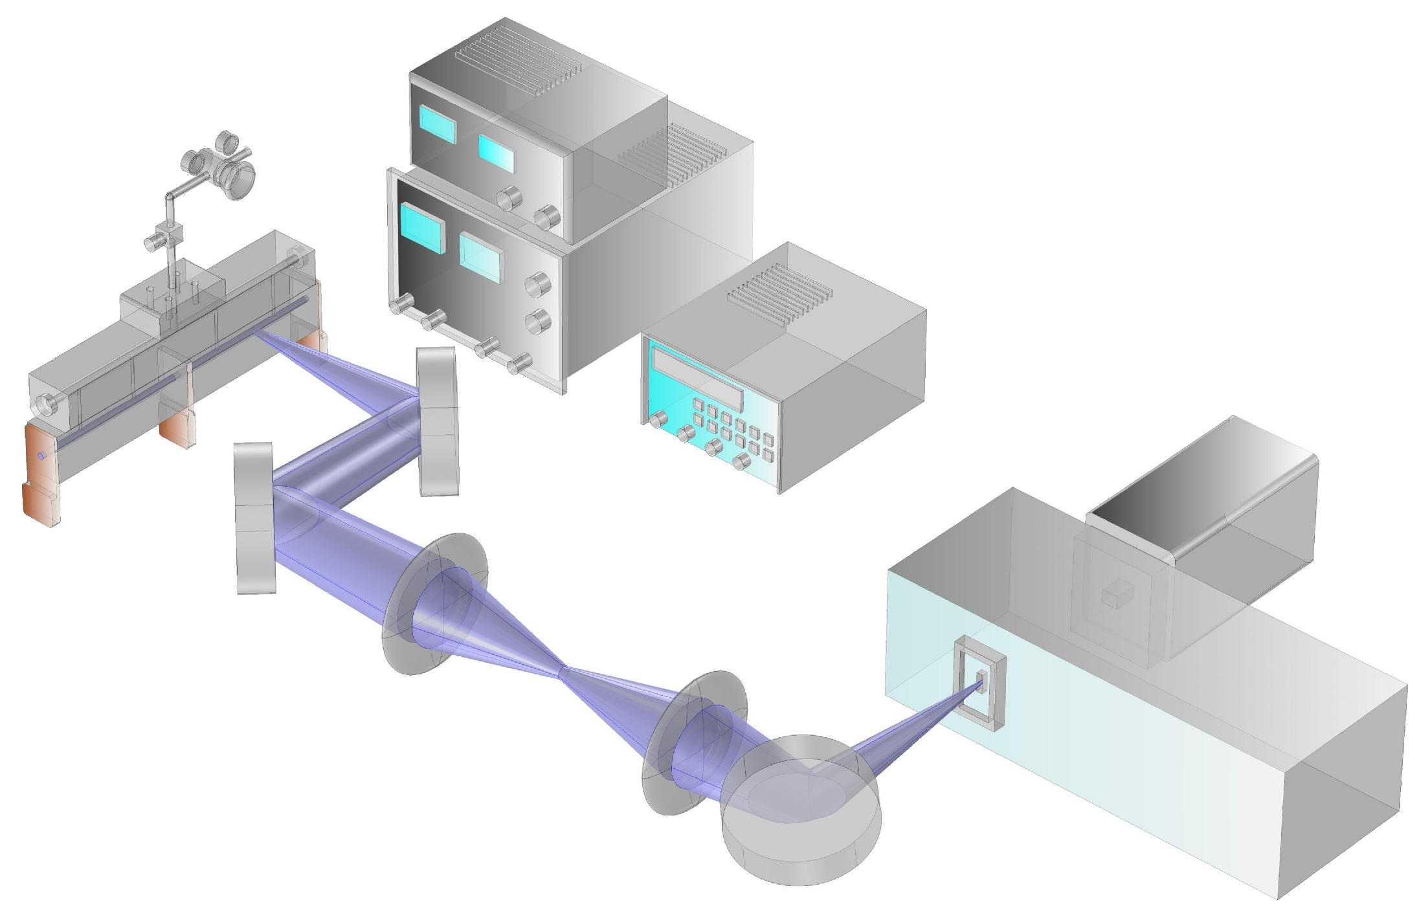
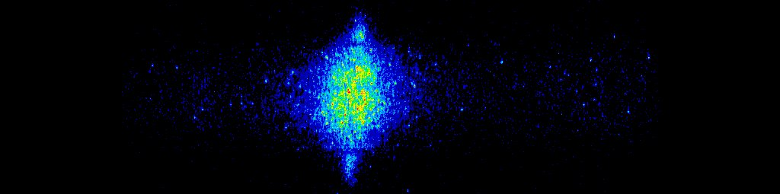
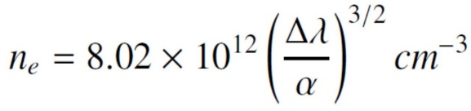
  Plasma sources operating at 100 – 400 Hz
Gas injection
HV generator
Vacuum system
        Neutral gas pressure
        Gas molecule (H2, Ar, N)
        Repetition rate
      Capillary’s longevity
      High-voltage sources for plasma formation
Pressure
regulator
HV pulser
RepRate
regulator
+
GND
Delay
generator
ICCD
camera
3cm long
capillary
Stark broadening technique
Spectrometer
Plasma light
2

Slide 4
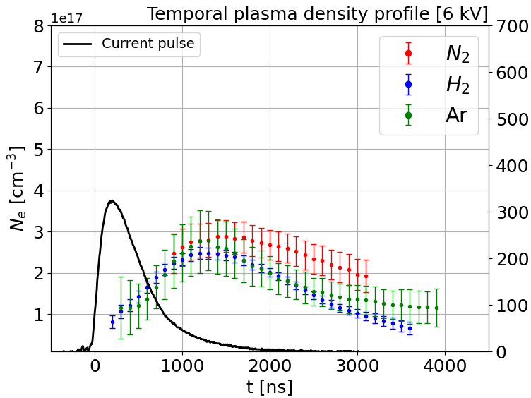
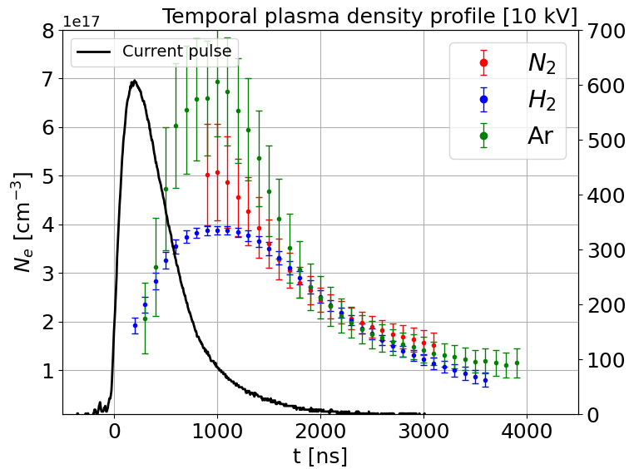

  Plasma sources operating at 100 – 400 Hz
Vacuum requirements
6 kV 60-70 mbar
10 kV 60-70 mbar
3
15th June 2023 TDR review committee

Slide 5
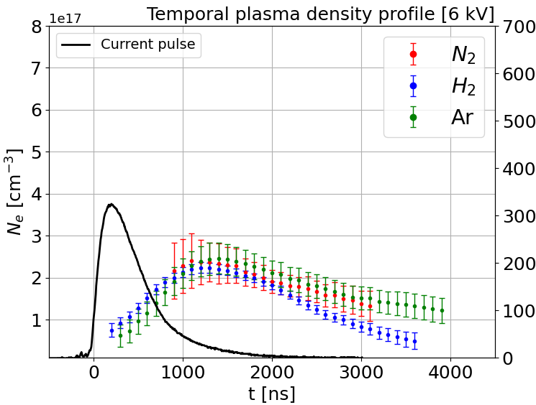
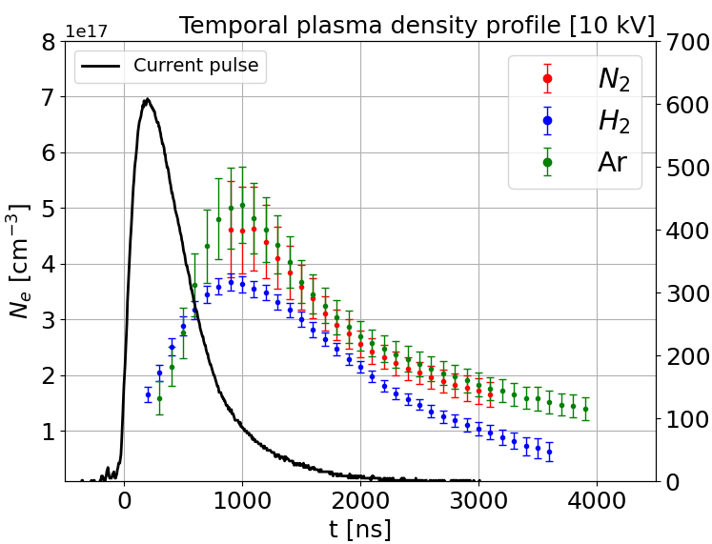
  Plasma sources operating at 100 – 400 Hz
6 kV 90-100 mbar
10 kV 90-100 mbar
4
15th June 2023 TDR review committee

Slide 6
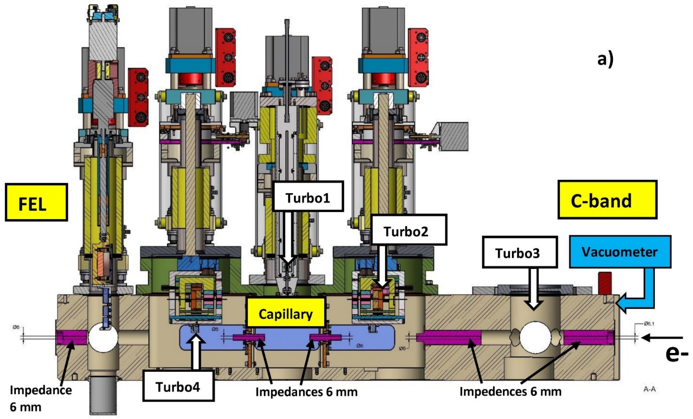
  Plasma sources operating at 100 – 400 Hz
60-70 mbar
 | Hydrogen |  | Nitrogen
 | C-band | FEL side | C-band | FEL side
1 Hz | 5.2x10⁻⁹ mbar | 2x10⁻⁷ mbar | 3x10⁻⁹ mbar | 1x10⁻⁷ mbar
10 Hz | 2.5x10⁻⁸ mbar | 6x10⁻⁷ mbar | 8x10⁻⁹ mbar | 2x10⁻⁷ mbar
Stable operation at 10 Hz by using N gas
600 MV/m acceleration gradient (similar to H2 gas)
5

Slide 7
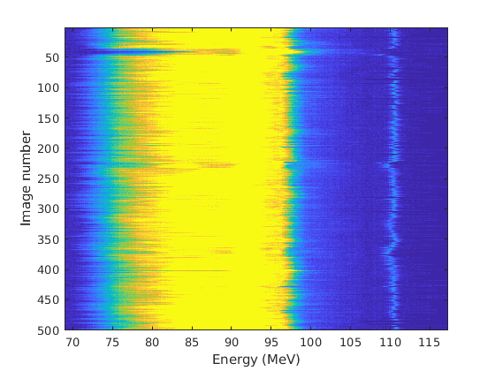
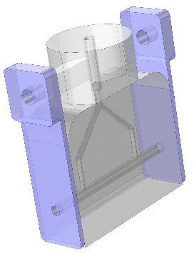
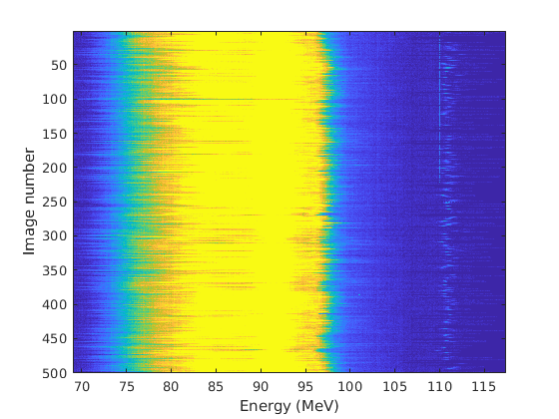
  Stable operation at 10 Hz with Nitrogen
Laser ON
3cm long capillary
Laser OFF
D
W
D
W
Plasma stabilization with laser
Results obtained by turning ON/OFF the laser stabilizing the plasma discharge
The laser hits the negative electrode of the capillary 200 ns before the discharge trigger
Witness energy jitter with laser ON(OFF): 0.6(1.2) MeV
6

Slide 8
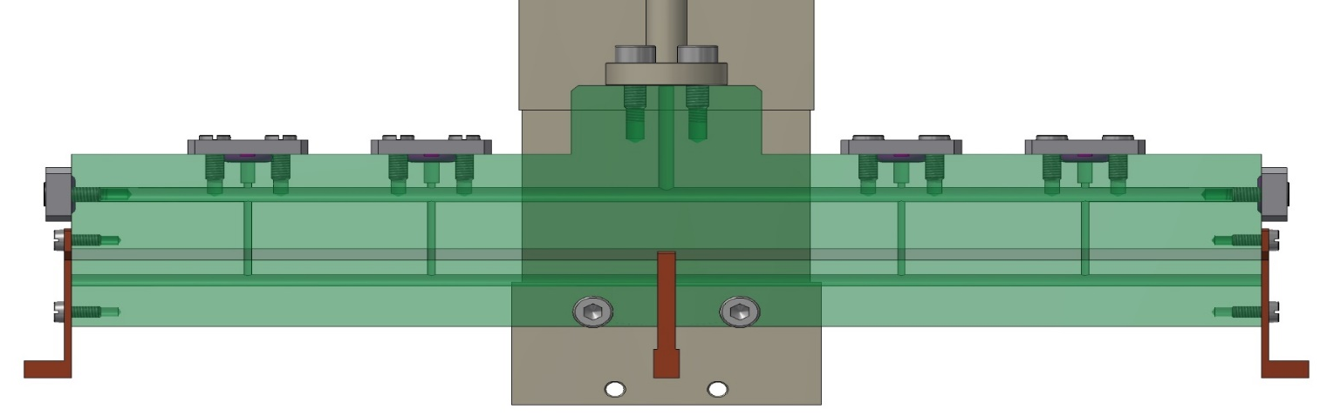
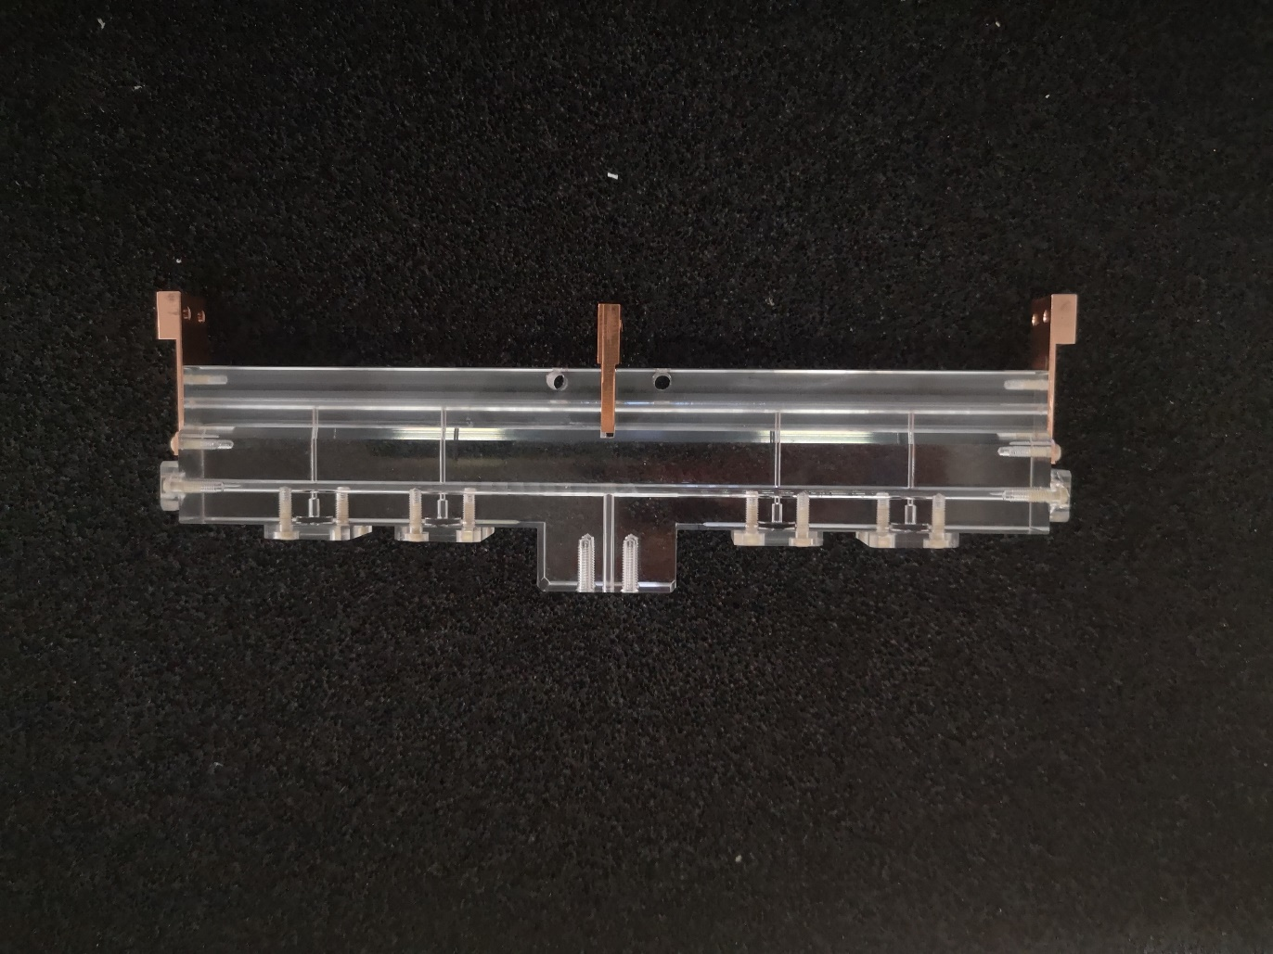
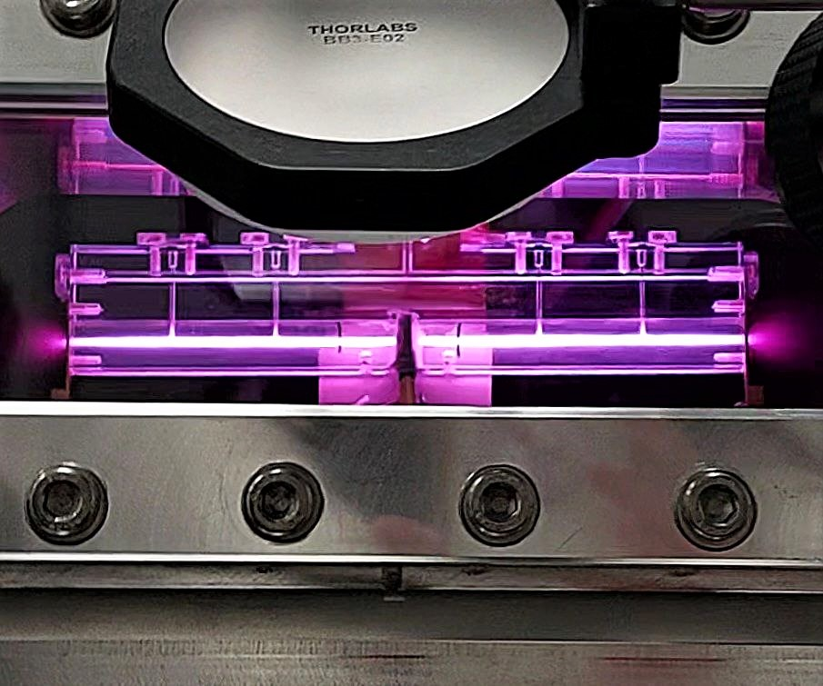
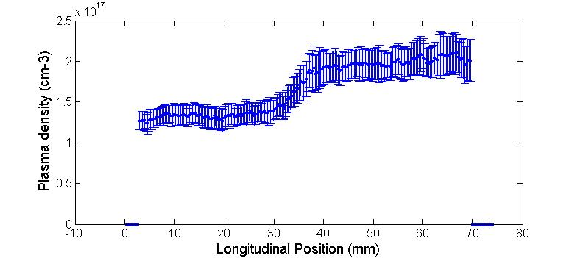
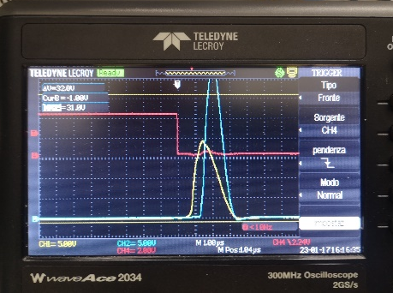
  Segmented capillary
6 kV
7.5 kV
8 cm
n_{e}
Measured longitudinal profile
    Plasma sources larger than 40 cm (m-scale) with HV pulses less tahn 10 kV
    Longitudinal density modulation
    5 GeV case for EuPRAXIA (1.5 GV/m m-scale capillary - density 10¹⁶ cm-3)
First result
7
15th June 2023 TDR review committee
15th June 2023
TDR review committee

Slide 9
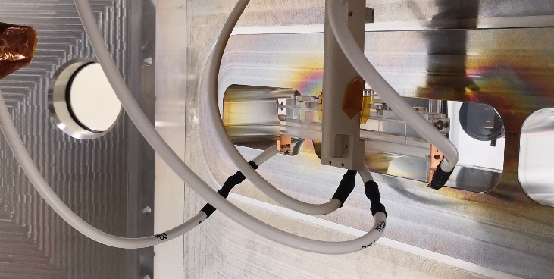
  Segmented capillary
Gas injection
HV generator
Common electrical ground
HV source design
Syncronization between sections
Plasma density modulation
+
Pressure
regulator
HV pulser
+
RepRate
regulator
Electrical
ground
+
GND
Delay
generator
+
ICCD
camera
15 cm long
Segmented
capillary
Stark broadening technique
Spectrometer
Plasma light
8

Slide 10

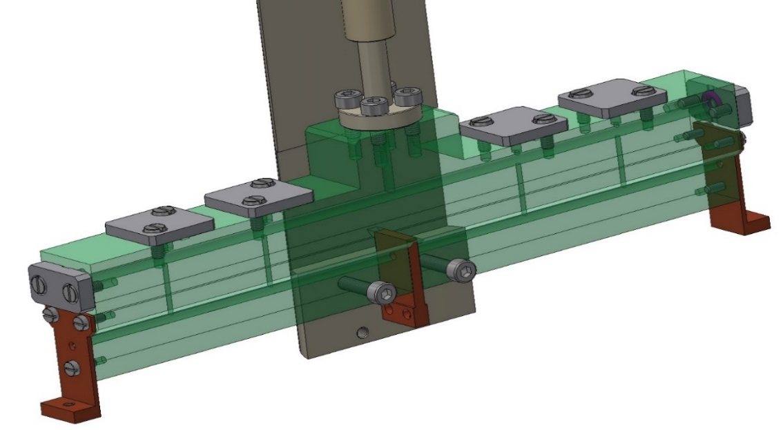
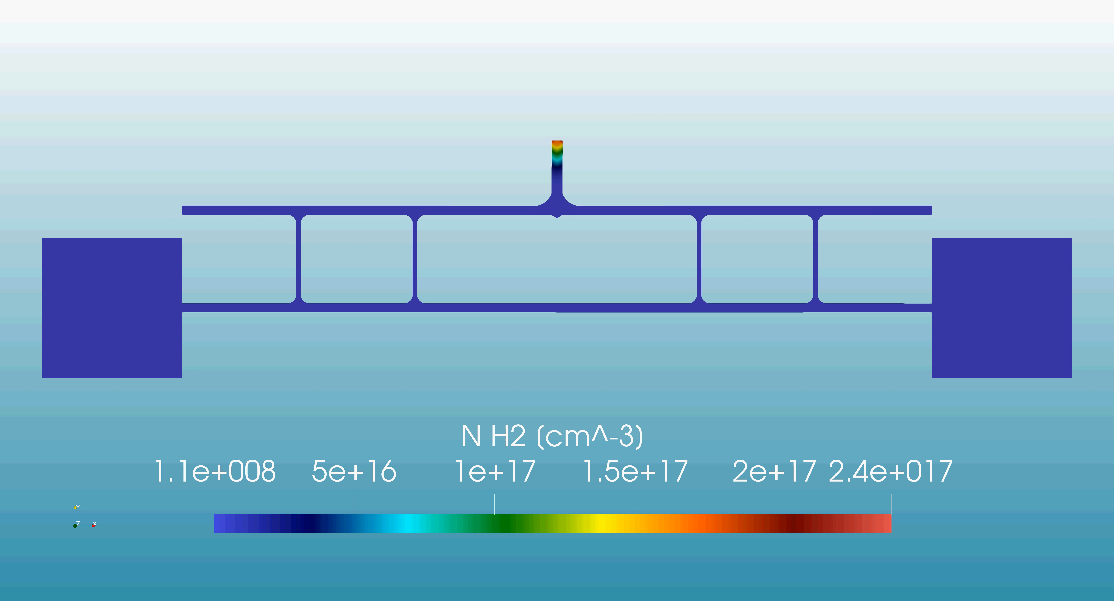
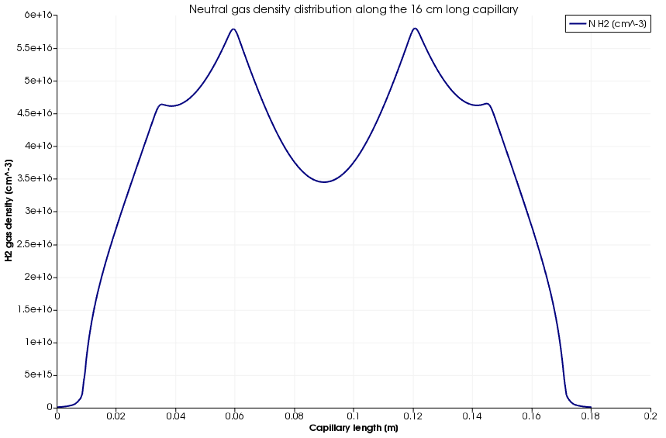
  Segmented capillary
5.5E16
inlet
HV₁
HV₂
electrical ground
electrode
electrode
9
15th June 2023 TDR review committee
15th June 2023
TDR review committee

Slide 11
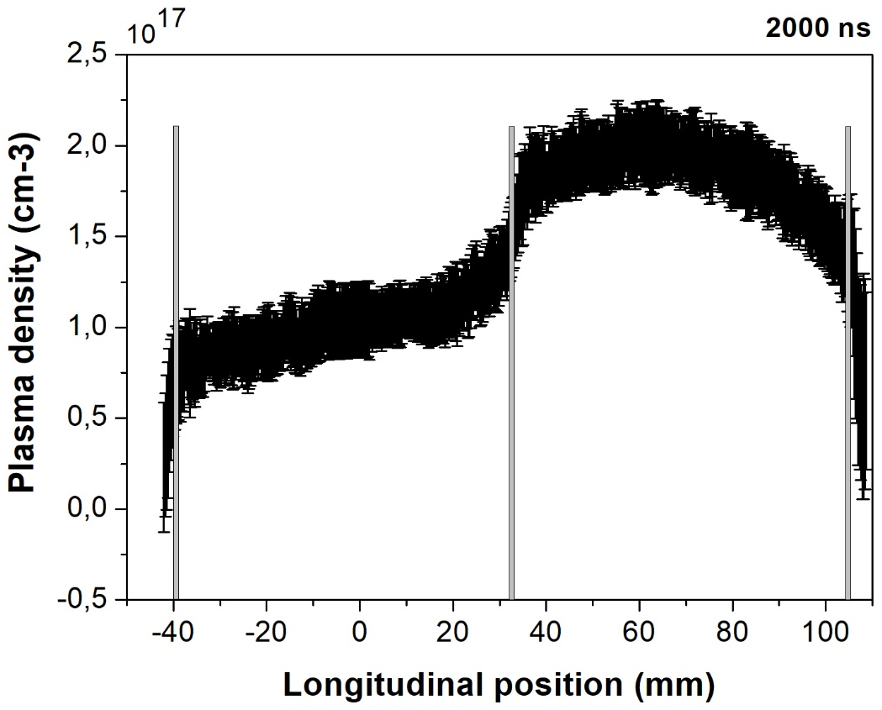
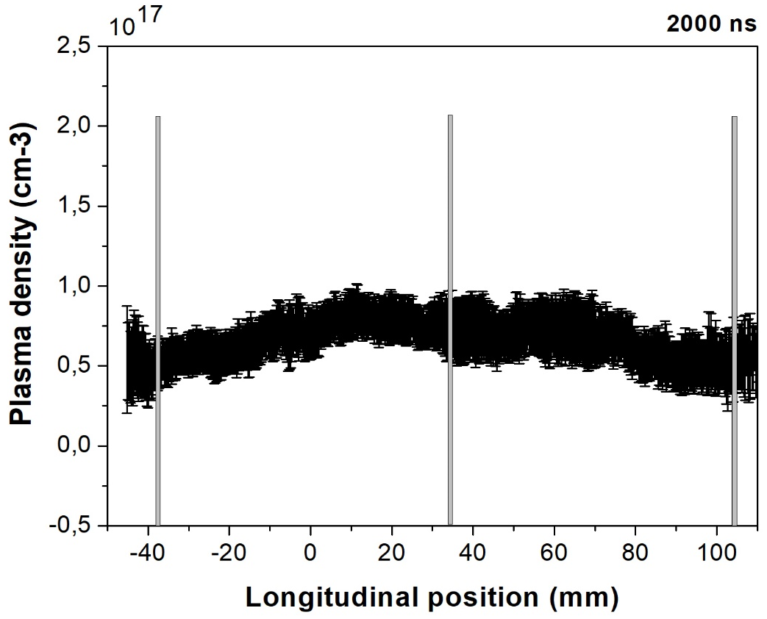
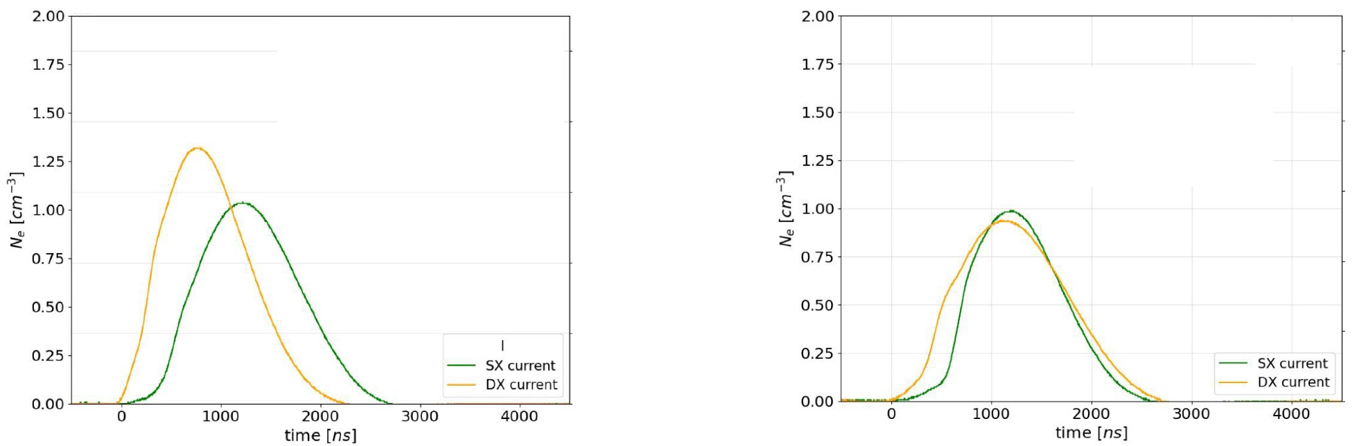
  Segmented capillary
x2
6kV
7.5kV
6kV
6kV
10

Slide 12
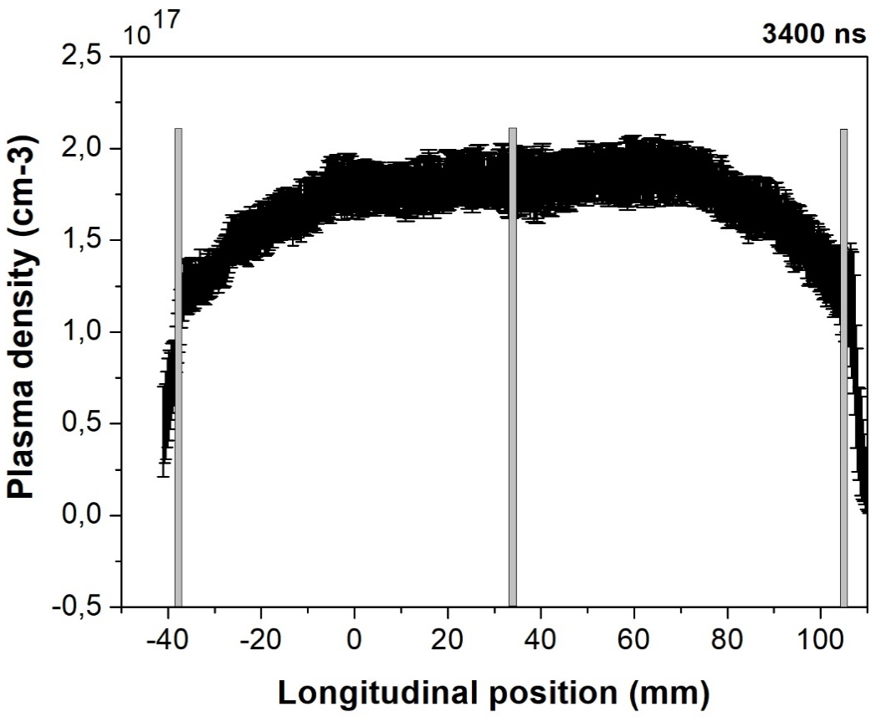
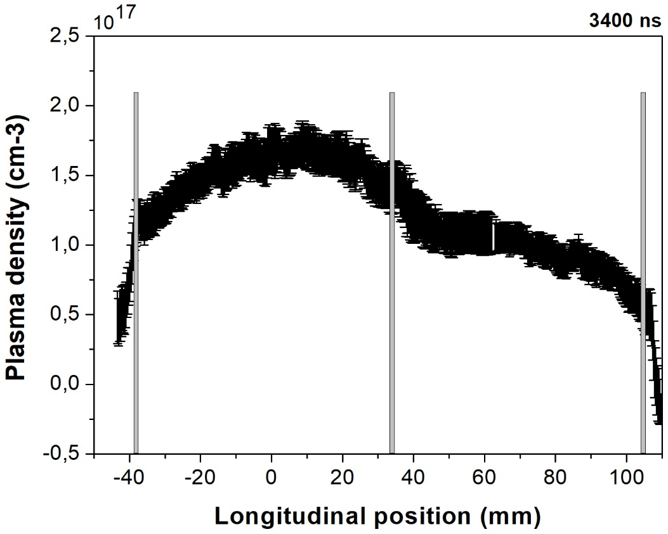
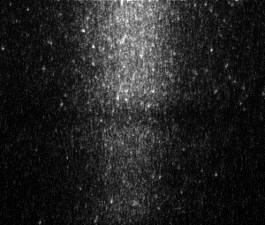
  Segmented capillary
Spectral line
x1.75
6kV
7.5kV
6kV
6kV
Central electrode
11

Slide 13
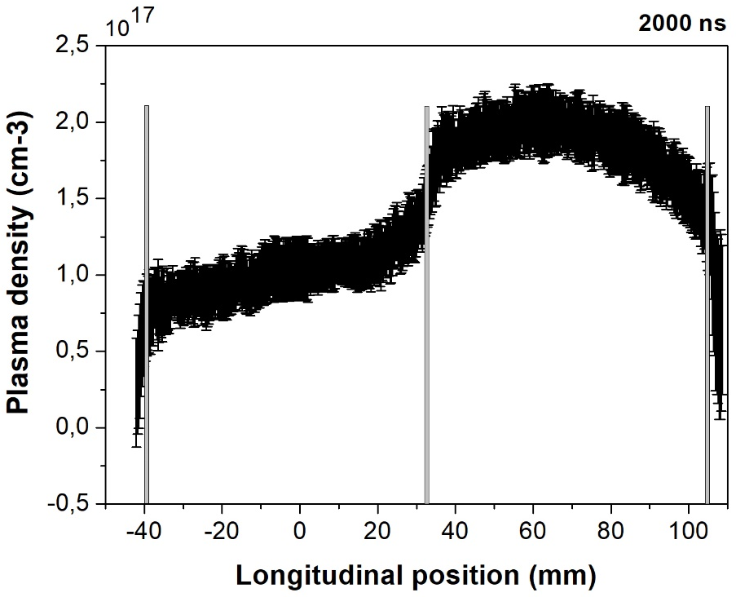



  Segmented capillary
    Each segment can be independently controlled
    Voltage amplitude
    Ignition
    Delay time after ionization
6kV – 7.5kV
6kV
7.5kV
6kV
7.5kV
6kV – 6kV
6kV
6kV
6kV
6kV
12

Slide 14
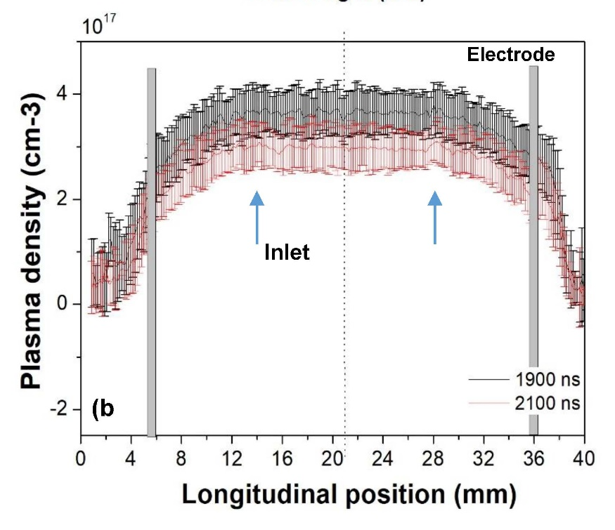
  Segmented capillary
6kV – 7.5kV_segmented
inlet
6kV – 6kV_segmented
Conventional capillary
10kV_3cm long_2 inlet
Longitudinal profile modulation (uniform or segmented) by using voltage, pulse syncronization or delay time
13

Slide 15
  Conclusions
Ongoing studies concerning all sections of the plasma module for EuPRAXIA@SPARC_LAB project
1.1 GeV (1.5 GV/m 40cm capillary - density 10¹⁶ cm-3)
  Direct plasma discharge for 40cm long capillary
    Stability
    Longitudinal profiles
  Plasma sources operating at 100 – 400 Hz
    Vacuum system
            Neutral gas pressure
            Gas molecule (H2, Ar, N)
            Repetition rate, stable operation at 10 Hz with N gas (600 MV/m acc. gradient)
    Study on materal science to increase capillary’s longevity
    High-voltage sources for plasma formation
Segmented capillary
    Plasma sources larger than 40 cm (m-scale)
    Longitudinal density modulation
    Different uses for each stage
    5 GeV case for EuPRAXIA (1.5 GV/m m-scale capillary - density 10¹⁶ cm-3)
40cm capillary
Segmented capillary
14

Slide 16
  Conclusions
Thank you for your
attention
15th June 2023
TDR review committee

Slide 17
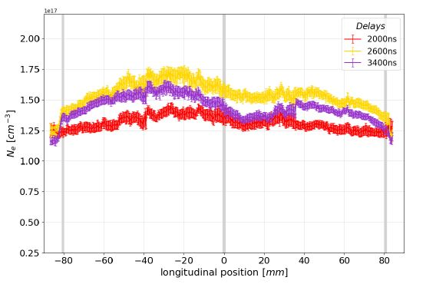
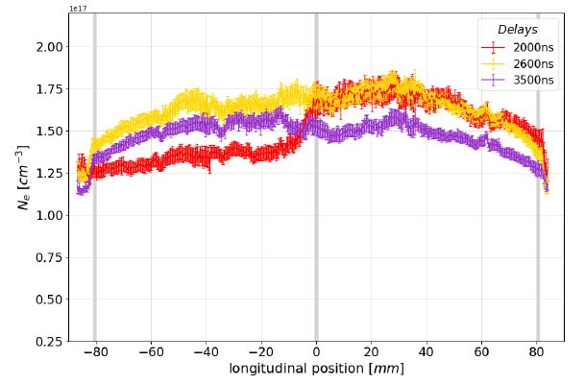
  Conclusions
5_5 kV
5_7 kV
15th June 2023
TDR review committee

