Slide 1
Photon Beamlines and Diagnostics
F. Villa for WP4

Slide 2
Last RC comments for the beamlines
Last review committee: Beamlines
General Comments
The RC acknowledges again the good progress made in the design of the photon beamlines and photon diagnostics for AQUA and ARIA. The RC appreciates the effort to follow recommendations of the last meeting to start with key elements and those components with a long delivery time: mirrors, beam position, spectrometers, and so forth.
Usually gas monitor systems to measure the number of photons per shot are used. A development for a promising alternative has been started with an interesting concept to measure the photon induced current from the mirror coatings.
A post mono measurement is certainly interesting for a specific experiment, but not suitable for setting up and tuning SASE.
The increase in personnel is highly appreciated and absolutely required for the photon beamline design and realization.
Recommendations
1. Continue the developments of an alternative method to measure the number of photons. Using a grating is certainly a more tricky method and should be considered only as a backup. The basic method must be stable and usable to tune FEL radiation.
2. Simulations should be continued, leading to a solid design.

Slide 3
Intensification on meetings and exchange with other FEL facilities
Visits and discussion with experts of FERMI, FLASH and SWISSFEL
  Data sharing on XGDM, polarization, time duration measurements
Participation to international conference (SPIE Optics+Optoelectronics) and workshop (EuPRAXIA WP13 workshop on 12-13/06)
  Discussion on most recent developments on diagnostics and beam manipulation
Discussion inside LEAPS WG 1.4 (Photon diagnostics)
  Possible collaboration opportunities on specific topics, in particular on time arrival monitor (with FERMI and PSI)

Slide 4
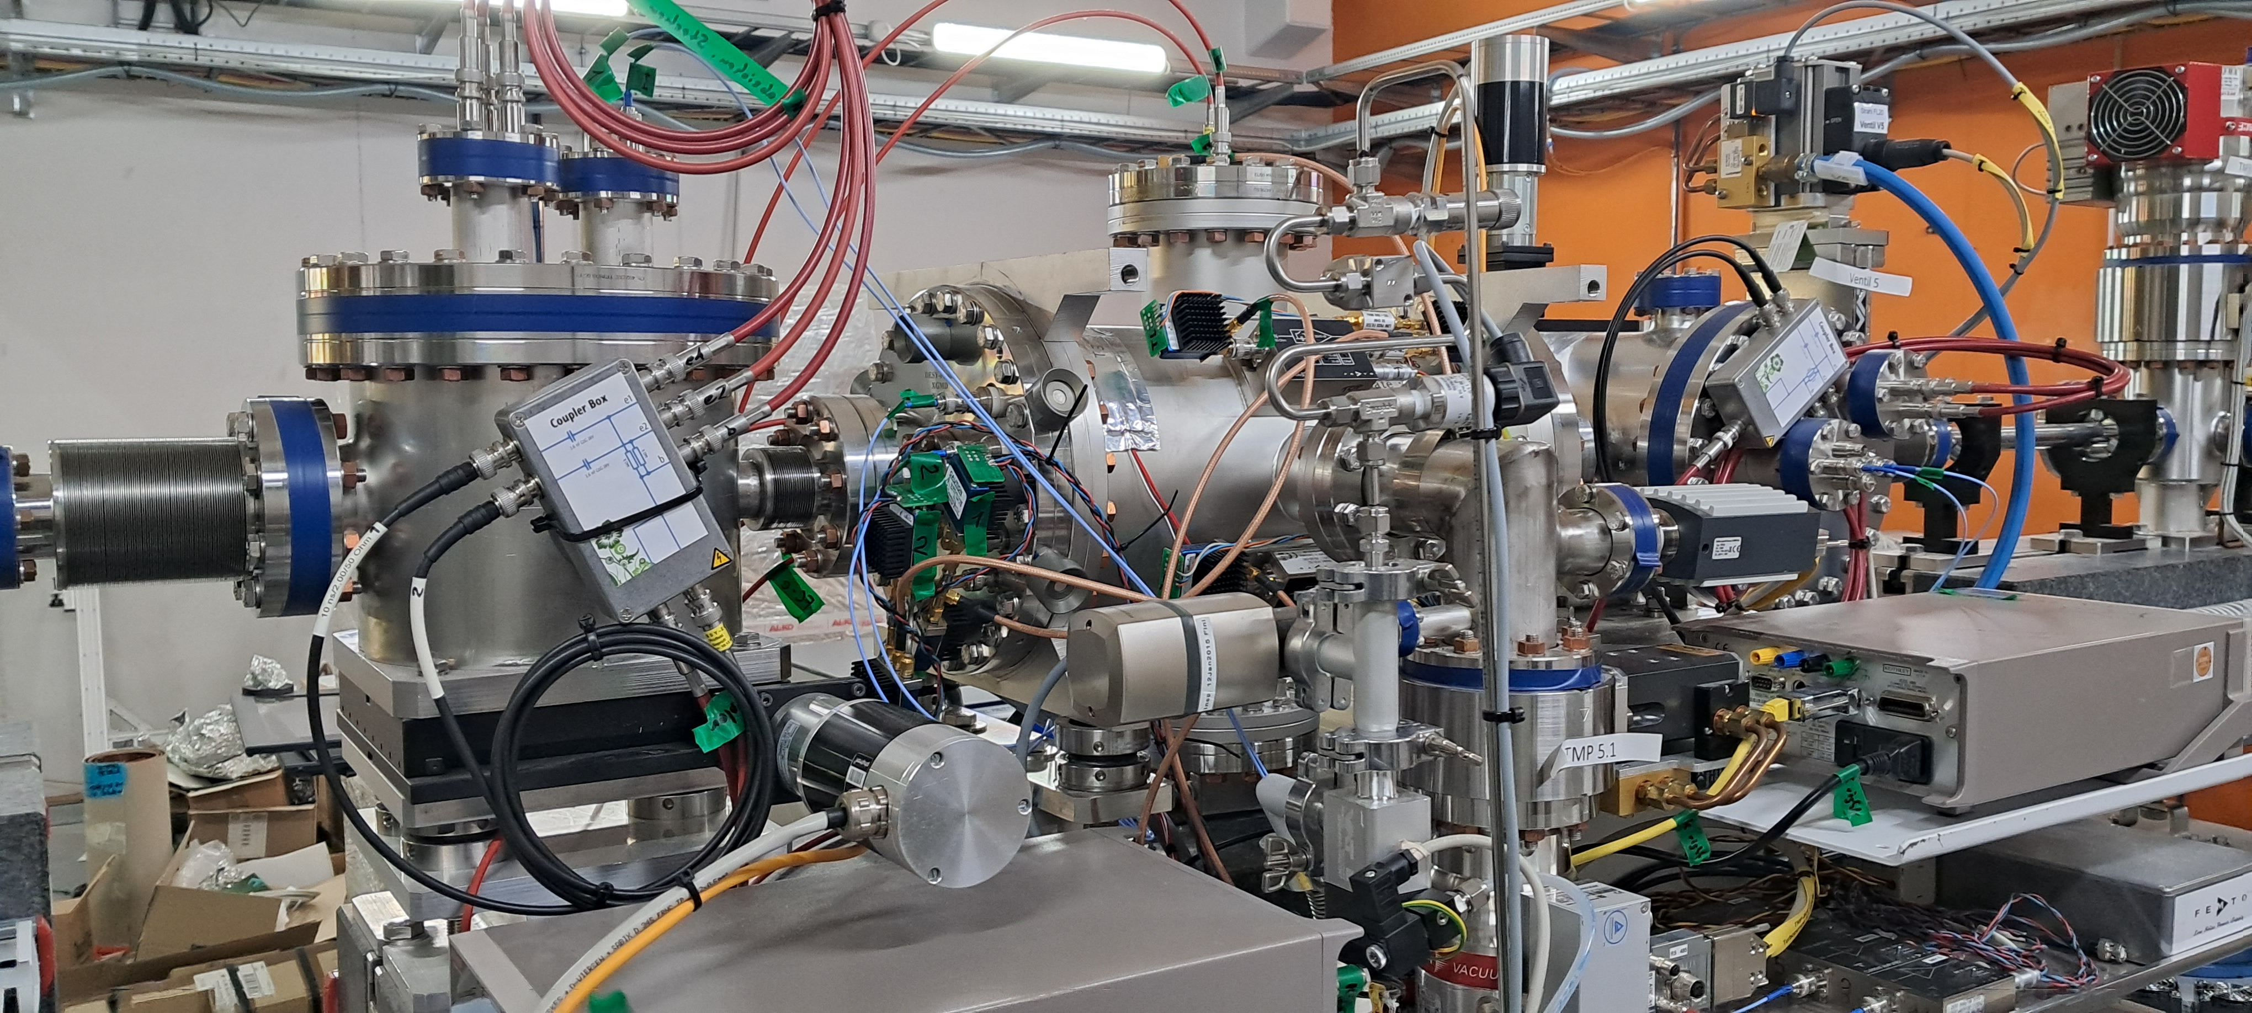
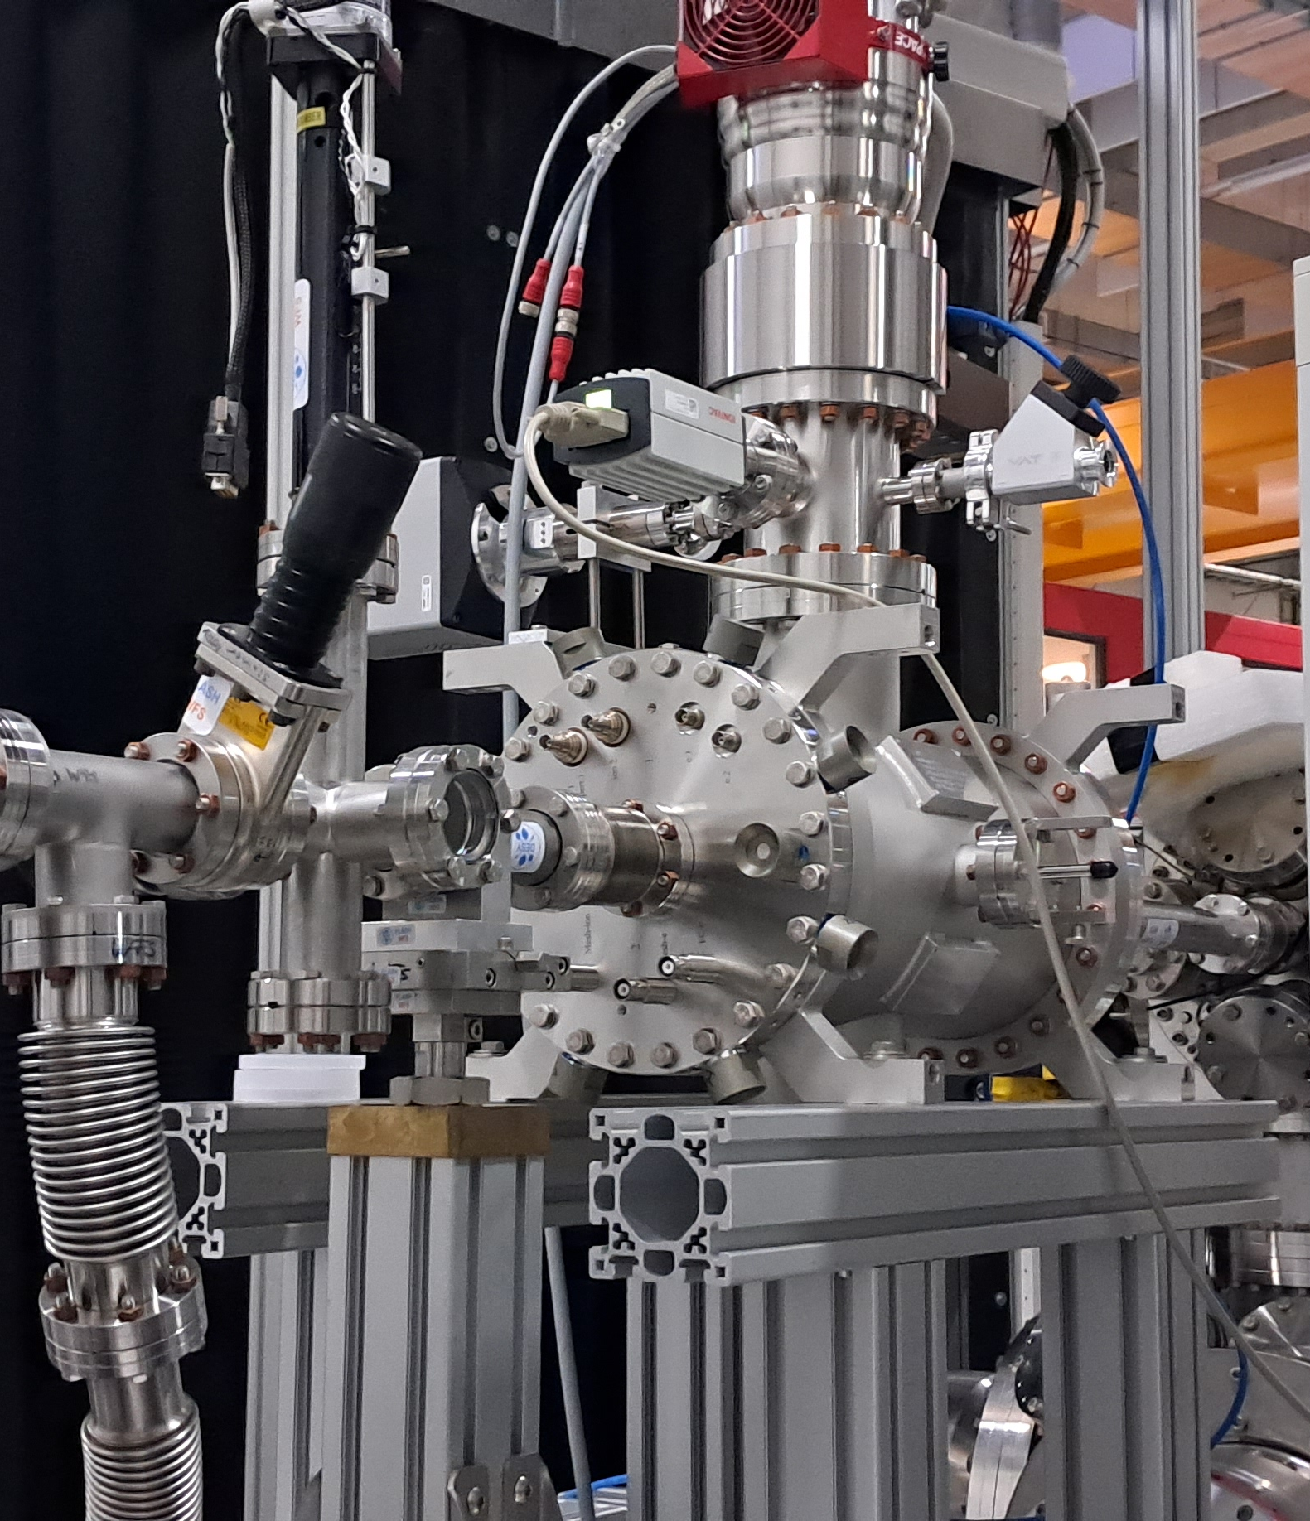
XGMD @ FLASH
K. Tiedke group give us CAD and part list required to build them

Slide 5
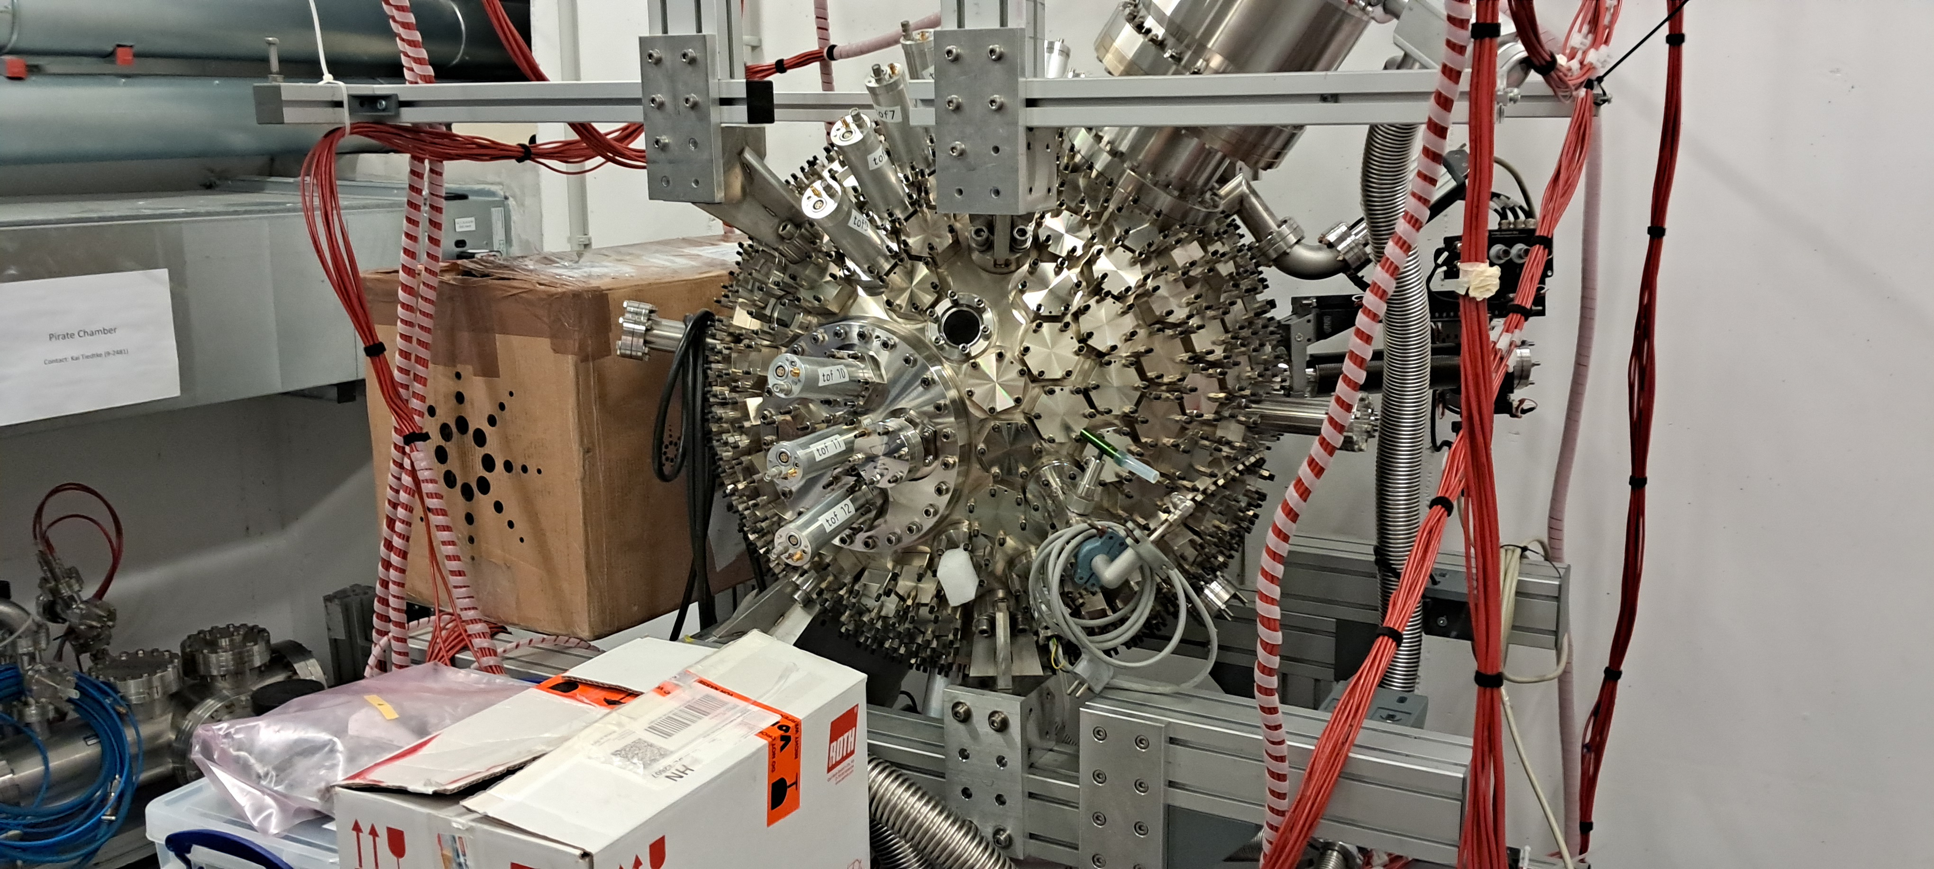
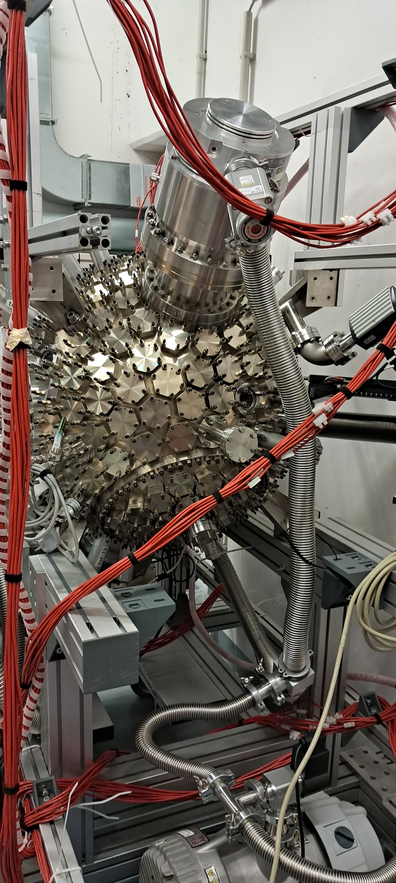
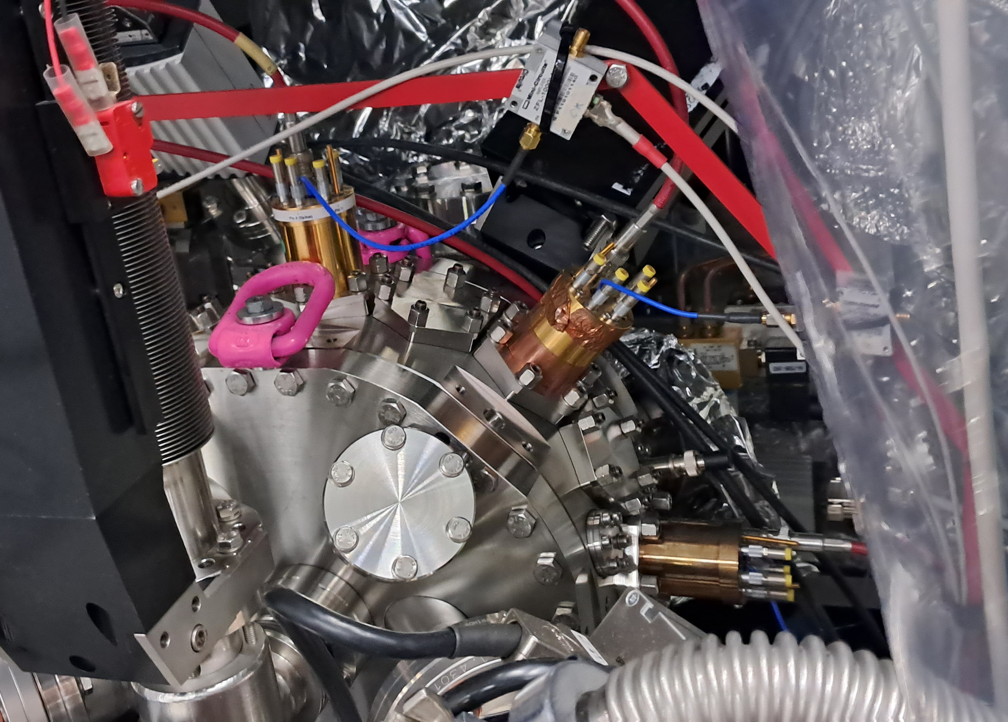
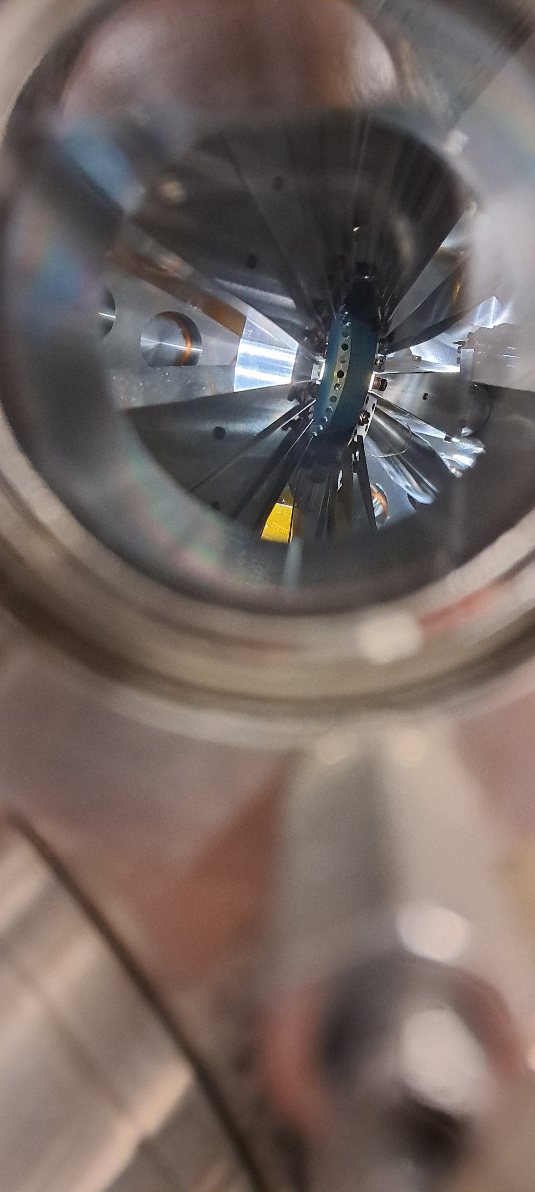
Time, polarization measurement using ToF @ DESY
Old chamber
New chamber
(@PETRAIII)

Slide 6
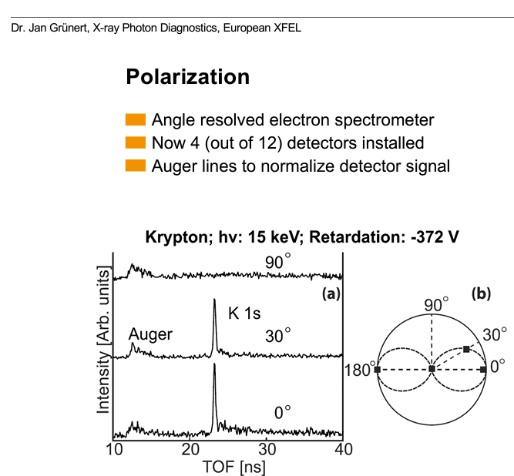
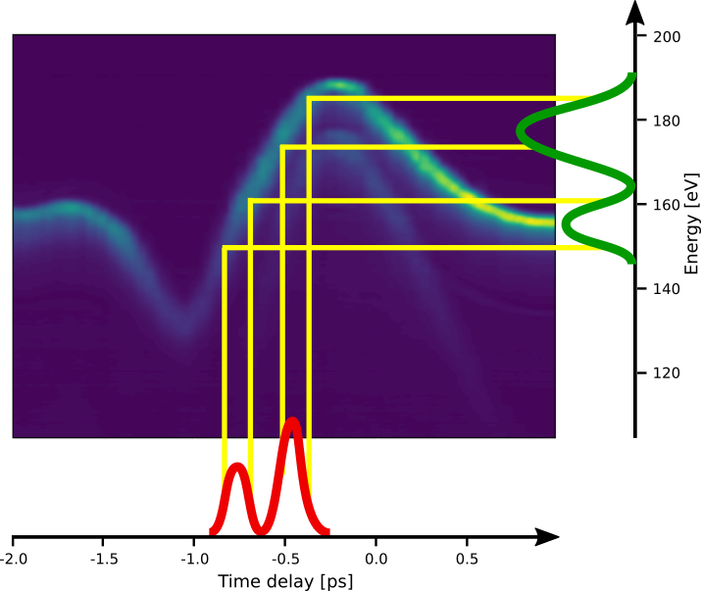
Time, polarization measurement using ToF
Photoelectron
spectrum
Streaking trace
FEL pulse
U. Frühling et al. Nat. Photonics 3, 523 (2009)
I. Grguraš et al. Nat. Photonics 6, 852 (2012)

Slide 7
Monochromators
For experiments: high resolving power monochromators only in phase two
  Allocated empty space during phase one
  Only for specific class of experiments (i.e. Raman spectroscopy) due to the high losses
For commissioning: k-mono for undulator gap and alignment commissioning
  Using the spectrometer:
    – As it is – with a collimating slit – changing the groove distribution to have a real monochromator
  Using solid attenuators with different absorption properties (edges)
  Design of dedicated monochromator (with additional space to host it)

Slide 8
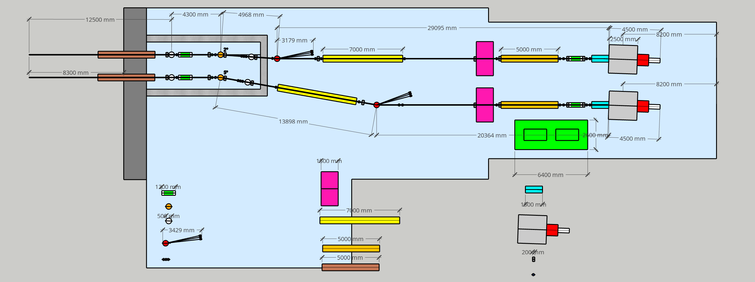
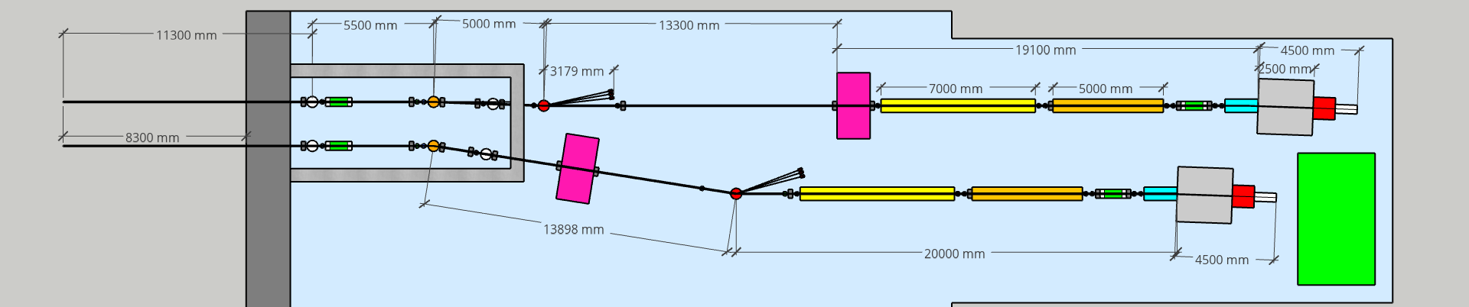
Beamline layout modifications
Option of reducing the beamline of about 4m
  More space for user instruments
  Larger focal spot in the user chamber (approx. +10%)
Laser hutch
XGDM
Polarization/time measure
K-B mirrors
Mirror
BDA
Monochromator
Exp. Chamber
Spectrometer
Split & delay line
Solid attenuators
Gas absorber
Valves
BPM/screens

Slide 9


WP 4
01.12.2022
LAST WP4 Photon beamlines summary
Ongoing actions
Outcome closed actions & Decisions
To Do
Experiment on the development and characterization of novel optics for focusing X-rays @Elettra
Started a technical document for all beamline elements
Simulation for the spectrometer and the monochromator
R&D on new concepts for intensity monitors in collaboration with FERMI
Integration of Marco and Luisa (DafneLight) and Andrea (Vacuum) in WP4 group
Obtained a preliminary beam parameters list from WA6 (FEL) for AQUA beamline
Preliminary optical simulation of the AQUA beamline transport
Preliminary beamline layout design and room footprint
Multi-physic simulations (thermal load, damage, contamination, …)
Safety hutch estimation (with safety WP)
Technical design of the components
Recruitment (PhD, postdocs)

Slide 10
WP 4
15.06.2023
WP4 Photon beamlines summary
Ongoing actions
Outcome closed actions & Decisions
To Do
Experiment on the development and characterization of novel optics for focusing X-rays @Elettra
Started a technical document for all beamline elements (=> XGMD)
R&D on new concepts (photon counting, time measurement)
Beamline layout optimization with user instrumentation requests
Obtained a preliminary beam parameters list from WA6 (FEL) for ARIA beamline
Multi-physic simulations (thermal load, damage, contamination, …)
Safety hutch estimation (with safety WP)
Technical design of the components
Recruitment (PhD, postdocs)
Optical simulation (mirrors, gratings, K-B, split&delay)

