Slide 1
Updates

Slide 2
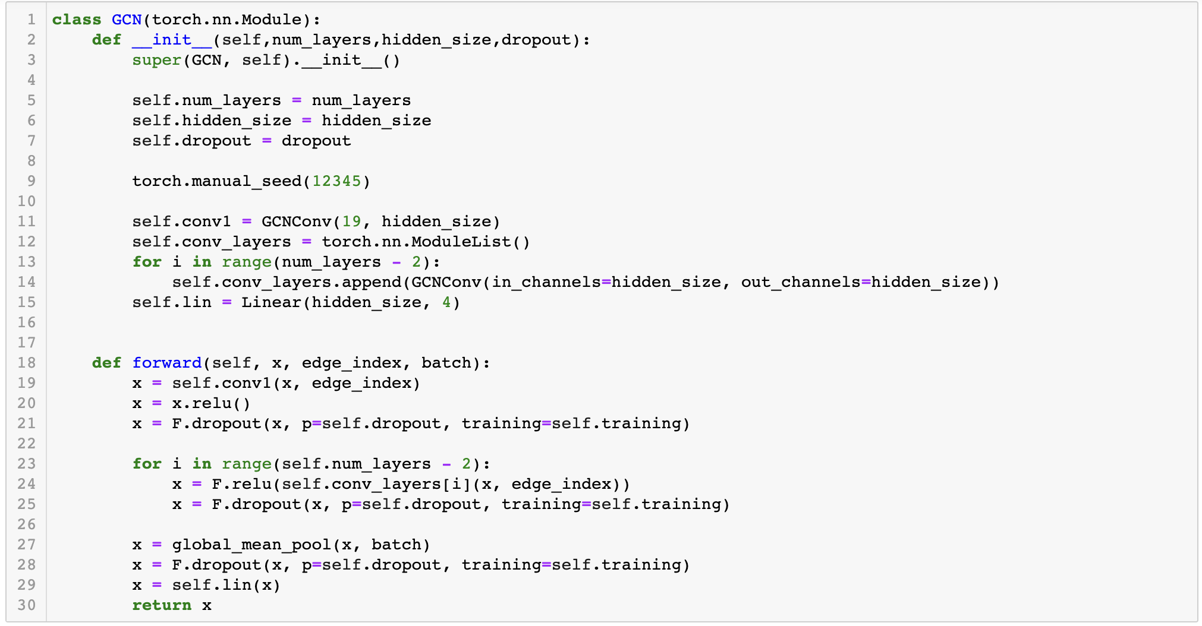
GNN architecture
Grid search | Features per node
Each trained for 150 epochs
Numbers of layers | [4,8,12]
Hidden channels | [50,100,250]
Dropout | [0.1,0.6]
Learning rate | [0.001,0.01,0.1]
Batch size | [100,200,500,1000]

Slide 3
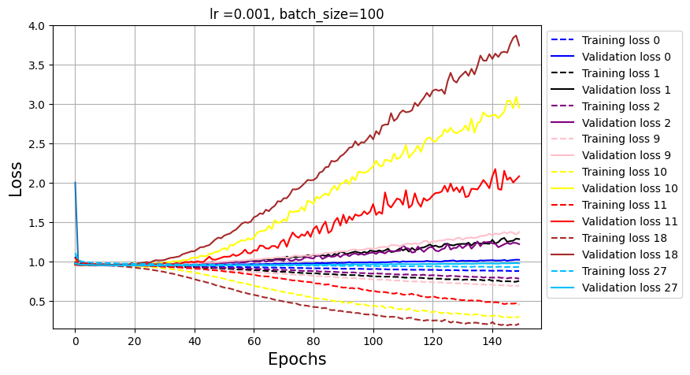
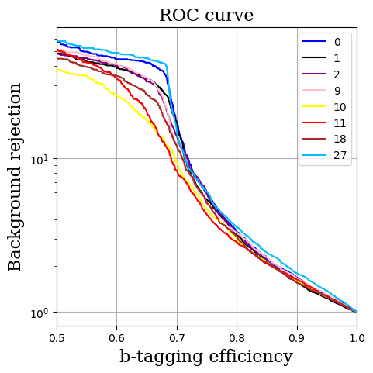
GNN performance
Hyperparameter | Features per node
Trained for 150 epochs on 30k jets
Number | 0 | 1 | 2 | 9 | 10 | 11 | 18 | 27
Numbers of layers | 4 | 8 | 12 | 4 | 8 | 12 | 4 | 4
Hidden channels | 50 | 50 | 50 | 100 | 100 | 100 | 250 | 250
Dropout | 0.1 | 0.1 | 0.1 | 0.1 | 0.1 | 0.1 | 0.1 | 0.6

Slide 4
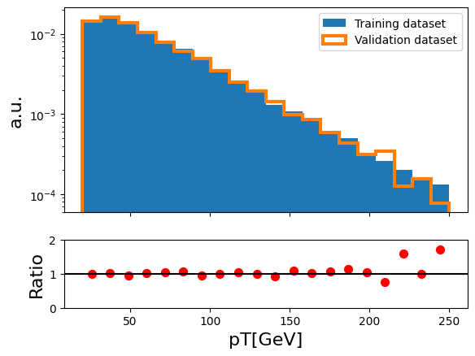
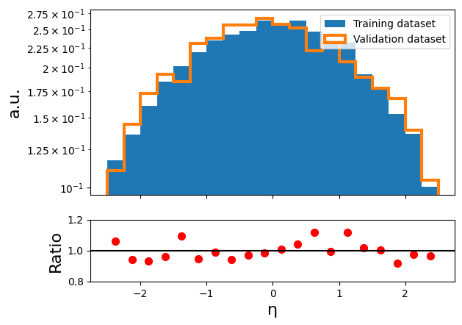
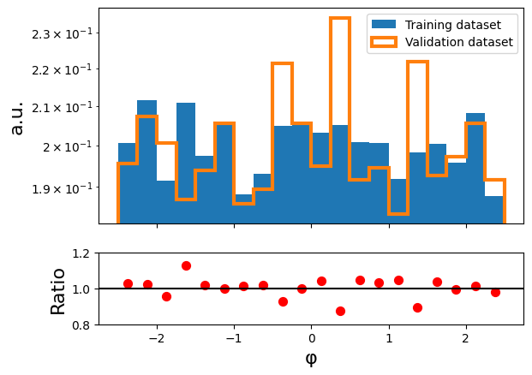
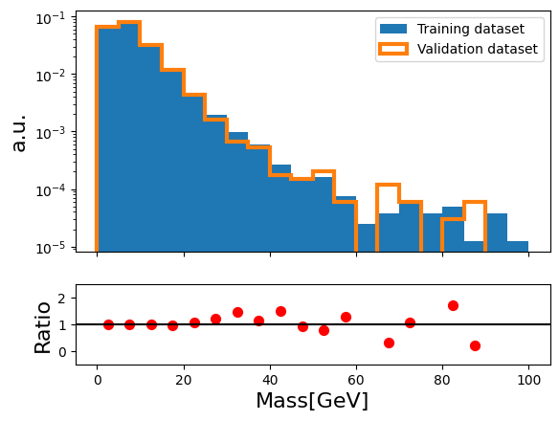
Variable distributions: Jets
Fraction of flavour | Features per node
Dataset | b | c | l | g
Training | 0.36 | 0.12 | 0.35 | 0.17
Validation | 0.36 | 0.12 | 0.36 | 0.16

Slide 5
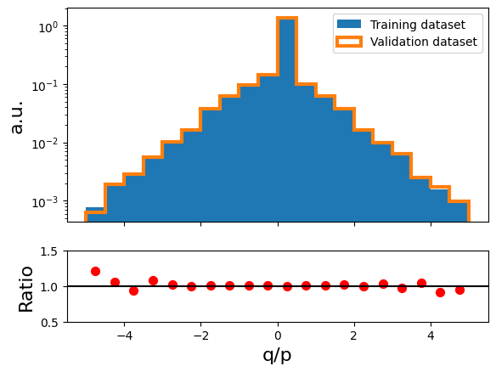
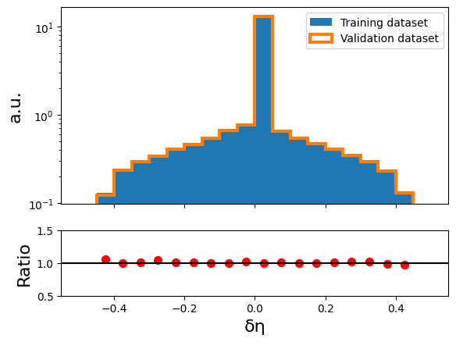
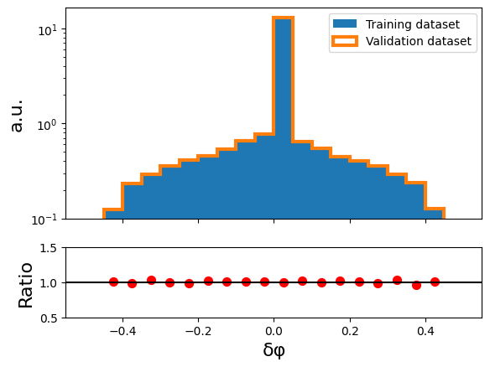
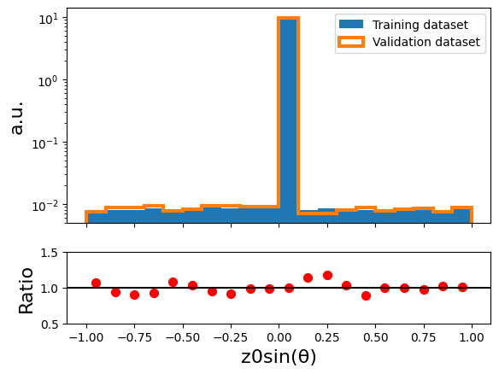
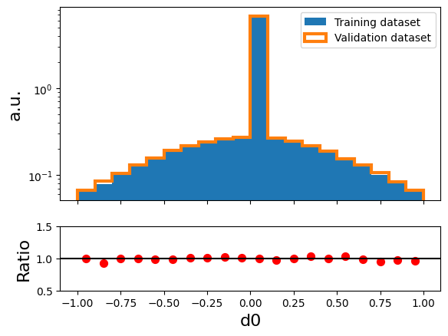
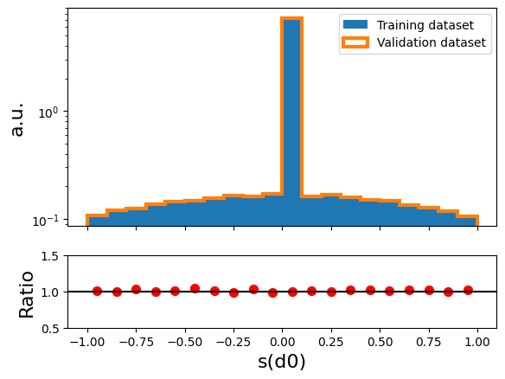
Variable distributions: Tracks

Slide 6
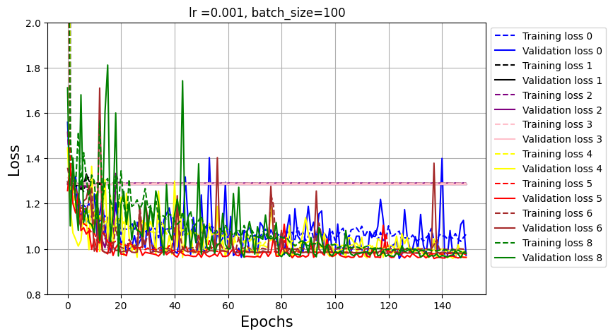
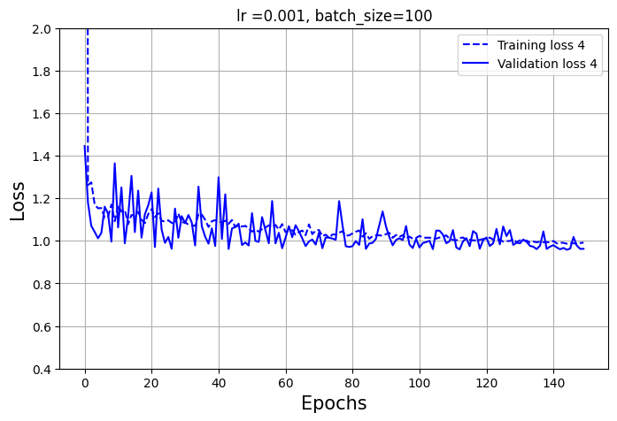
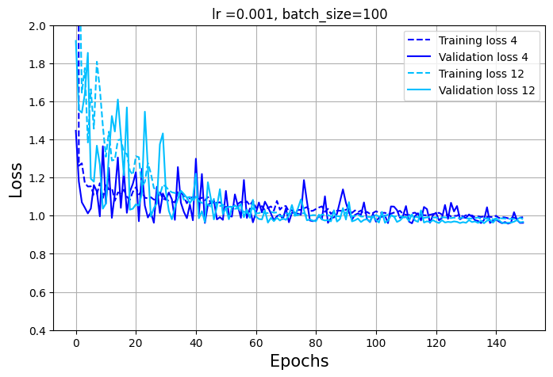
Grid search | Features per node
Each trained for 150 epochs
Numbers of layers | [2,4,8,12]
Hidden channels | [10,50,100,250]
Dropout | 0
Hyperparameter | Features per node
Trained for 150 epochs on 30k jets
Number | 0 | 1 | 2 | 3 | 4 | 5 | 6 | 8
Numbers of layers | 2 | 4 | 8 | 12 | 2 | 4 | 8 | 2
Hidden channels | 10 | 10 | 10 | 10 | 50 | 50 | 50 | 100
Num parameters | 464 | 684 | 1124 | 1564 | 6304 | 11404 | 21604 | 22604

Slide 7
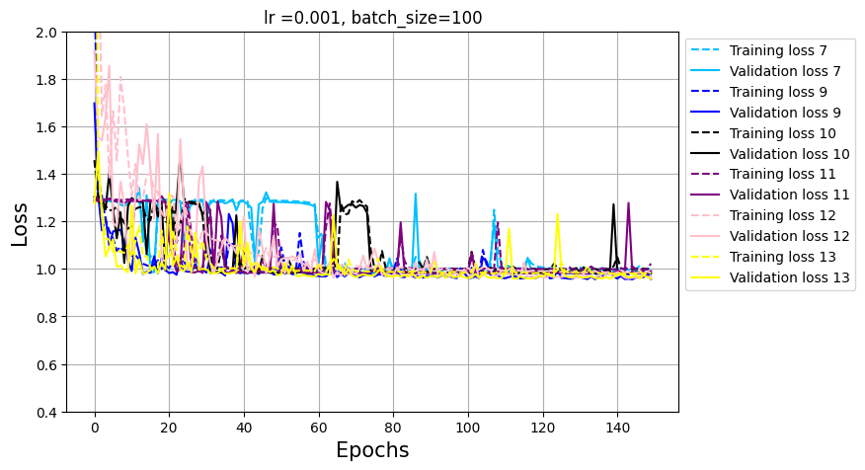
GNN performance
Hyperparameter | Features per node
Trained for 150 epochs on 30k jets
Number | 7 | 9 | 10 | 11 | 12 | 13
Numbers of layers | 12 | 4 | 8 | 12 | 2 | 4
Hidden channels | 50 | 100 | 100 | 100 | 250 | 250
Num parameters | 31804 | 42804 | 83204 | 123604 | 131504 | 257004

Slide 8
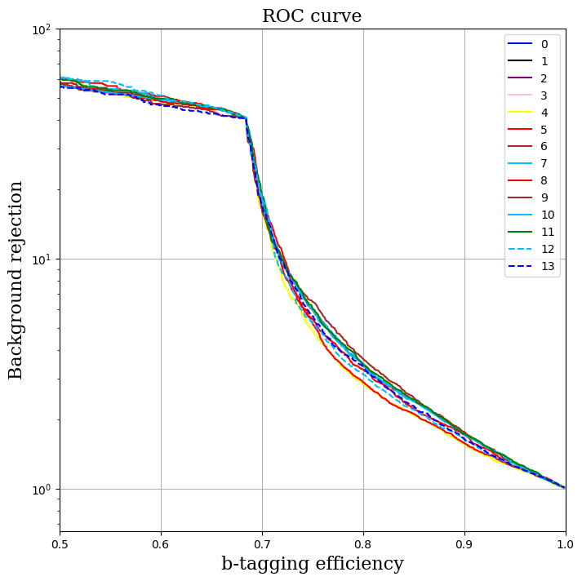
OLD
NEW

Slide 9
Next steps and conclusion
From root to pytorch_geometric.DataLoader optimization in time terms
Scaling of the track variables and resampling if necessary
Number of jets needed to train all the architecture in the hyperparameter grid search
Substitute the GCNConv layers with GAT layers
https://pytorch-geometric.readthedocs.io/en/latest/generated/torch_geometric.nn.models.GAT.html
Substitute the global_mean_pool with GlobalAttention
For the QT:
Data18 ntuples with r22 produced
Mc20: we asked for mc20e (2018) but the produced samples are mc20a(2015) → one/two weeks of delay

Slide 10
Thank you for your attention

Slide 11
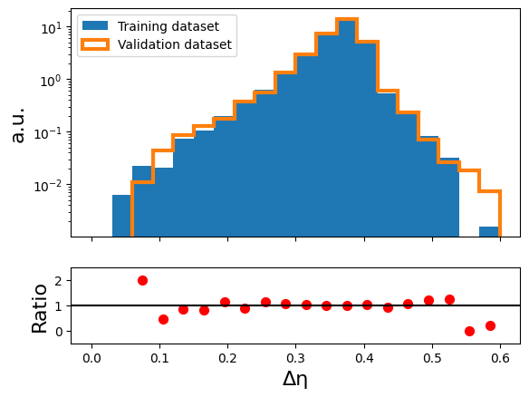
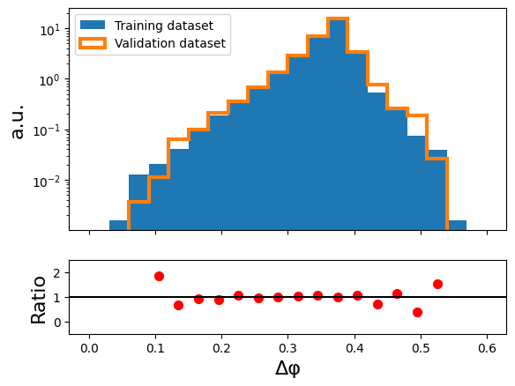
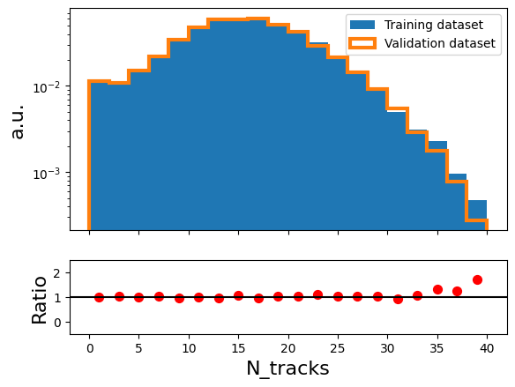
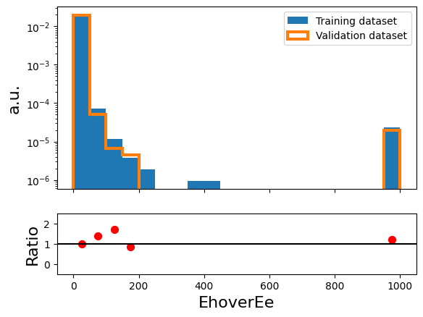
Variable distributions: Jets

Slide 12
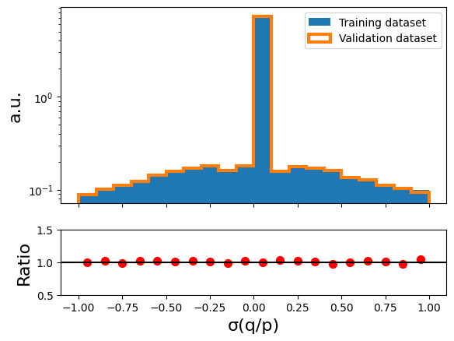
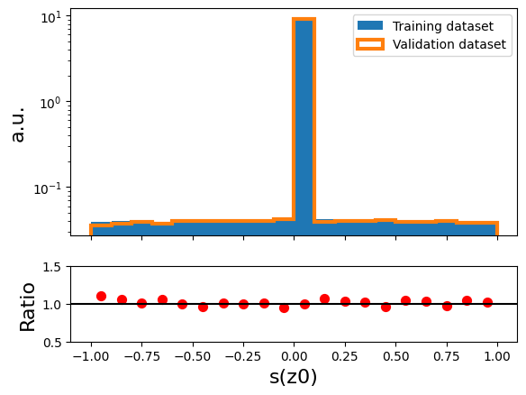
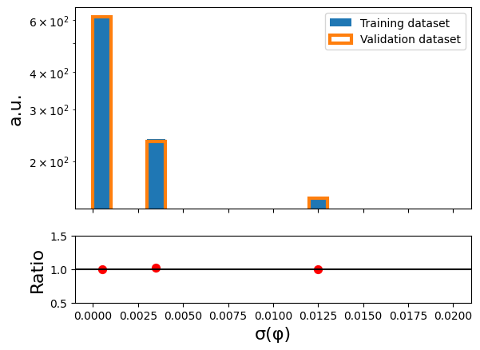
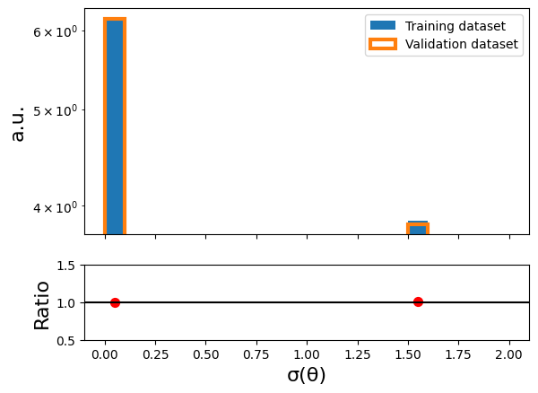
Variable distributions: Tracks

Slide 13
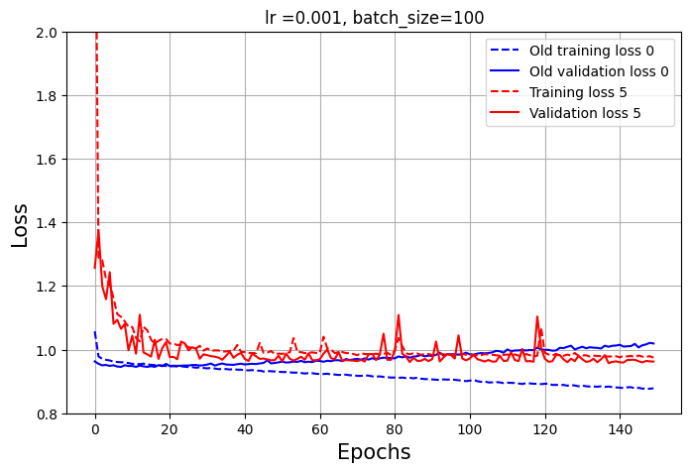
Hyperparameter
Trained for 150 epochs on 30k jets
Number | 0 - 5
Numbers of layers | 4
Hidden channels | 50
Num parameters | 11404

Slide 14
Number of parameters
Hyperparameter optimization | Features per node
Each trained for 150 epochs
Numbers of layers | [2,4,8,12]
Hidden channels | [10,50,100,250]
Dropout | 0
Learning rate | 0.001
Batch size | 100
$$n_{parameters}=$$
$$\left(19∗h_{nodes}+h_{nodes}\right)+$$
$$\left[{(h}_{nodes}^{2}+h_{nodes}\right)∗n_{layers}]+$$
$$(h_{nodes}∗4+4)$$
Input dimension: (40,19)
Output dimension: (40, $h_{nodes}$)
Total number of weights: $19∗h_{nodes}$

