Slide 1
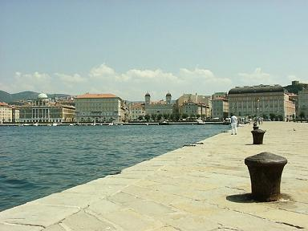
Update on strip Multiplicity
Carlo Stella & Lorenzo Vitale
University & INFN Trieste
on behalf of Trieste SuperB Group
Luciano Bosisio, Pietro Cristaudo, Livio Lanceri, Irina Rashevskaya, Carlo Stella, Lorenzo Vitale

Slide 2
dE/dx in SVT
Carlo Stella (diploma student) is studying dE/dx in the 6 double layers of SVT
Study was driven by FSSR2 (that provides a 3-bit ADC information for each recorded hit)
We are using full simulated events BRUNO (with 200 μm cylindrical Layer0)
e+e-e+e- (pairs) 160k events
Single particle (momentum distributions as inclusive soft π’s from ϒ(4s) and cc) 50k

Slide 3
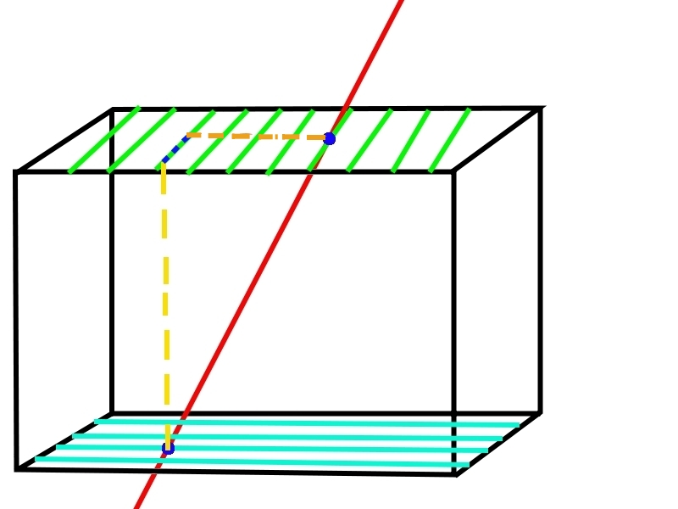
Pseudo Digitization procedure
Require particle identity (abs(SVTHits.pdg)==11 pairs, 211 π)
Use entrance and exit point to define path Δx in wafer and project it onto Z and RΦ
Use released energy ΔE in active silicon
Share the energy among the “Digitized” strips dE_{i}
First & last strip has random
flat dE_{i}, the others the same
Smear dE_{i} with gaussian
Apply two sets of thresholds
on dE_{i} (=each strip):
2880 e- 0.18(0.12)MIP-L0(L1-5)
4800 e- 0.30(0.20)MIP-L0(L1-5)

Slide 4
CAVEAT
In Frascati we had a Bug in Strip multiplicity (thr. was not applied on mult, dE/dx was ~ok)
Old BRUNO version (2-3 months ago) with some modifications (Active silicon in L0)
Neglect soft photons (probably below thr?)
No Landau fluctuations per strip (Landau only per global
Path Δx is assumed straight
Low stat for pairs in external layers (4-5)
Mean is truncated at 30

Slide 5
Strip multiplicity e± from pairs No threshold cut
L0 +45∘
L0 -45∘
L1 Z
L1 Phi
L2 Z
L2 Phi

Slide 6
Strip multiplicity e± from pairs after a 1st threshold cut on 2880 e-

Slide 7
Average strip multiplicity for e± from pairs (soft π’s ) No threshold cut
Layer | RO PitchZ (or +45∘) μm | <n>_Z | RO PitchPhi (or -45∘) μm | <n>_Phi
0 | 50 | 5.1 (4.6) | 50 | 5.2 (4.5)
1 | 100 | 4.0 (4.6) | 50 | 6.7 (2.8)
2 | 100 | 3.8 (4.3) | 55 | 6.6 (2.6)
3 | 100 | 3.9 (4.2) | 55 | 6.7 (2.6)
4 | 210 | 1.8 (2.0) | 100 | 3.7 (1.9)
5 | 210 | 2.0 (2.1) | 100 | 2.6 (2.5)

Slide 8
Average strip multiplicity for e± from pairs (soft π’s ) 2880 e- threshold cut
Layer | RO PitchZ (or +45∘) μm | <n>_Z | Clust. Eff. | RO PitchPhi (or -45∘) μm | <n>_Phi
0 | 50 | 4.6 (4.2) | 0.99(~1) | 50 | 4.6 (4.1)
1 | 100 | 3.8 (4.4) | 0.98(~1) | 50 | 6.2 (2.6)
2 | 100 | 3.6 (4.0) | 0.97(~1) | 55 | 6.0 (2.5)
3 | 100 | 3.7 (4.0) | 0.97(~1) | 55 | 6.1 (2.5)
4 | 210 | 1.8 (1.9) | 0.89(~1) | 100 | 3.5 (1.9)
5 | 210 | 1.8 (2.0) | 0.91(~1) | 100 | 2.4 (2.3)

Slide 9
Average strip multiplicity for e± from pairs (soft π’s ) 4800e- threshold cut
Layer | RO PitchZ (or +45∘) μm | <n>_Z | Clust. Eff. | RO PitchPhi (or -45∘) μm | <n>_Phi
0 | 50 | 3.7 (3.9) | 0.96(~1) | 50 | 3.7 (3.8)
1 | 100 | 3.8 (4.2) | 0.91(0.99) | 50 | 5.1 (2.5)
2 | 100 | 3.6 (3.9) | 0.91(0.99) | 55 | 5.1 (2.4)
3 | 100 | 3.8 (3.8) | 0.89(0.99) | 55 | 5.4 (2.4)
4 | 210 | 1.8 (1.9) | 0.73(0.97) | 100 | 3.4 (1.8)
5 | 210 | 1.9 (2.0) | 0.70(0.97) | 100 | 2.3 (2.3)

Slide 10
Conclusions
Comparison with Riccardo not straightforward (pixel multiplicity in first appox sqrt(2) larger)
Need more cross checks
Need to compute rates

Slide 11
Backup Slides

