Slide 1

Present status of the realistic shell-model approach
Angela Gargano
Meeting Iniziativa Specifica MONSTRE
11-12 Maggio 2023
Milano
Sezione di Napoli
*

Slide 2
Theoretical framework: Shell Model with effective Hamiltonian and operators derived within the many-body perturbation theory starting from realistic nuclear potentials
Three-body forces
Beta decays
Analysis of recent experimental data
Research lines

Slide 3
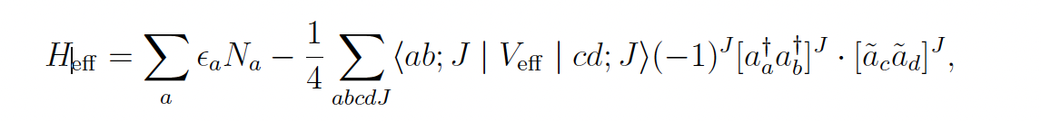
Shell model
defined in the model space for only valence nucleons
MODEL SPACE
H_{eff} should take into account - in an effective way -
all the degrees of freedom not considered explicitly
valence nucleons
Two alternative approaches:
Phenomenological
Microscopic
1
2

Slide 4
$$H=T+V^{2N}+V^{3N}=\left(T+U\right)+\left(V^{2N}−U\right)+V^{3N}$$
$$=H_{0}+H_{1}^{2N}+H_{1}^{3N}=H_{0}+ H_{1}$$
𝐻=T+𝑉^2𝑁+𝑉^3𝑁=(𝑇+𝑈)+(𝑉^2𝑁−𝑈)+𝑉^3𝑁
=𝐻_0+𝐻_1^2𝑁+𝐻_1^3𝑁=𝐻_0+ 𝐻_1
many-body perturbation theory
$H_{eff}$ = $H_{0}+H_{1}^{eff}$
whose eingenvalues belong to the set of eigenvalues of $H$ of
𝐻_eff = 𝐻_0+𝐻_1^eff
whose eingenvalues belong to the set of eigenvalues of 𝐻 of
Microscopic shell-model Hamiltonian
L. Coraggio et al, Part. Nucl. Phys. 62, 135 (2009)
L. Coraggio et al, Ann. Phys. 327, 2125 (2012)
L. Coraggio and N. Itaco, Front. Phys. 8, 345 (2020)

Slide 5
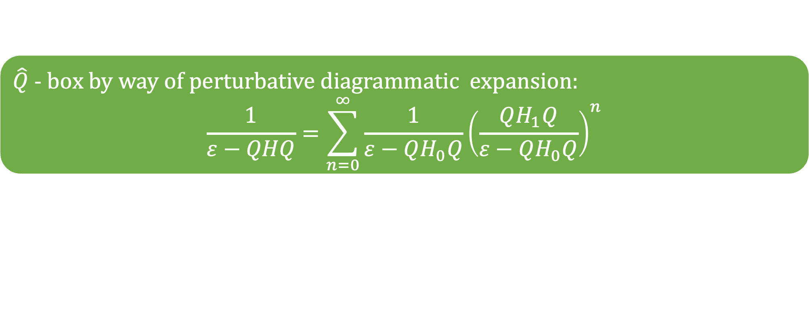
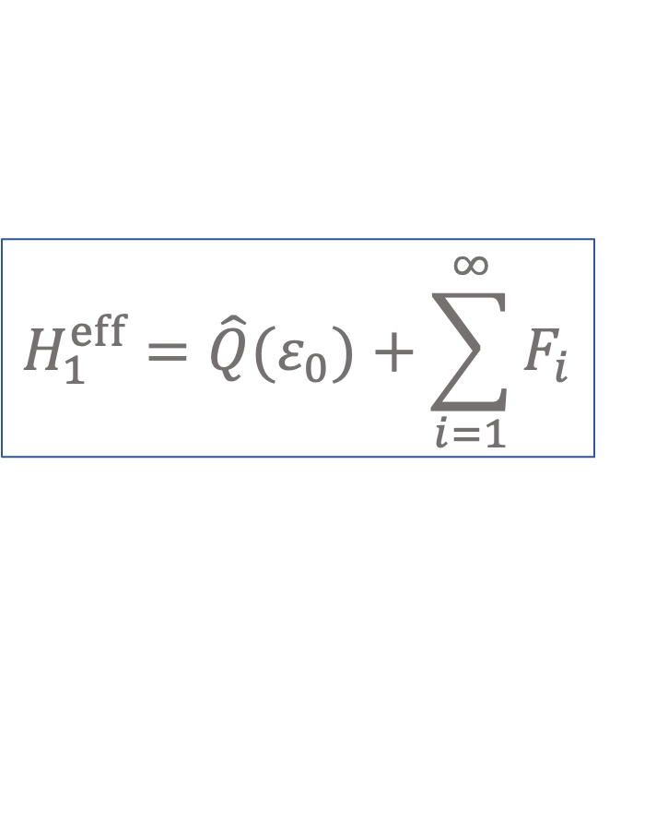
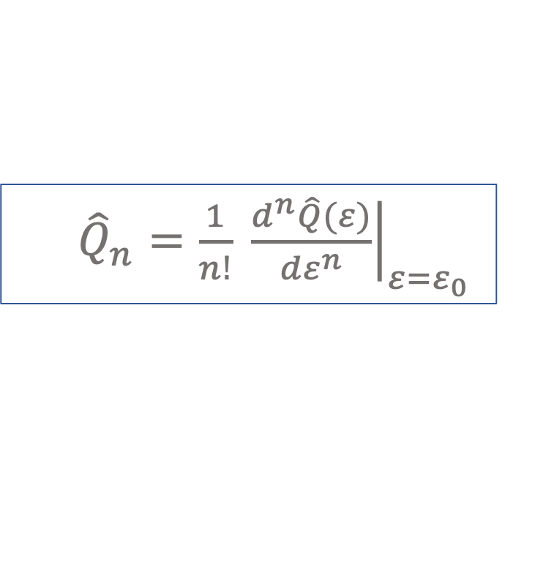
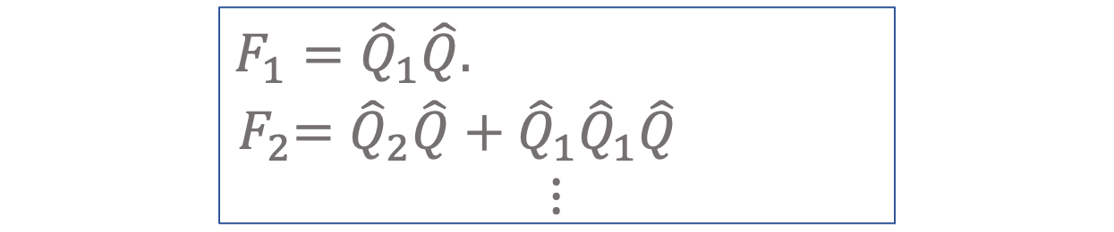
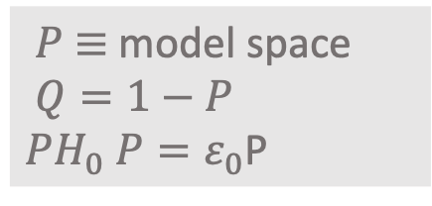
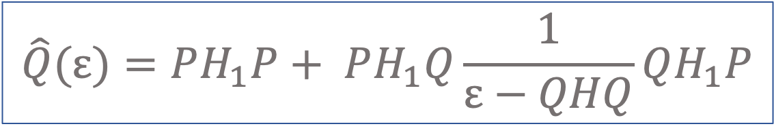
Folded-diagram expansion of the shell-model Hamiltonian
$$H_{1}^{eff}=\hat{Q}{(ε}_{0})+\sum_{i=1}^{∞}{F_{i}}$$
$$\hat{Q}(ε)=PH_{1}P+ PH_{1}Q\frac{1}{ε−QHQ}QH_{1}P$$
$\begin{matrix}F_{1}={\hat{Q}}_{1}\hat{Q}. \\ { F}_{2}={\hat{Q}}_{2}\hat{Q}+{\hat{Q}}_{1}{\hat{Q}}_{1}\hat{Q} \\ ⋮\end{matrix}$
$P$ $≡$ model space
$$Q=1−P$$
$PH_{0} P=ε_{0}$P
${\hat{Q}}_{n}={\left.\frac{1}{n!} \frac{d^{n}\hat{Q}(ε)}{{dε}^{n}}\right|}_{ε=ε_{0}}$
$\hat{Q}$ - $box by way of perturbative diagrammatic expansion:$
$$\frac{1}{ε−QHQ}=\sum_{n=0}^{∞}{\frac{1}{ε−QH_{0}Q}{\left(\frac{QH_{1}Q}{ε−QH_{0}Q}\right)}^{n}}$$

Slide 6
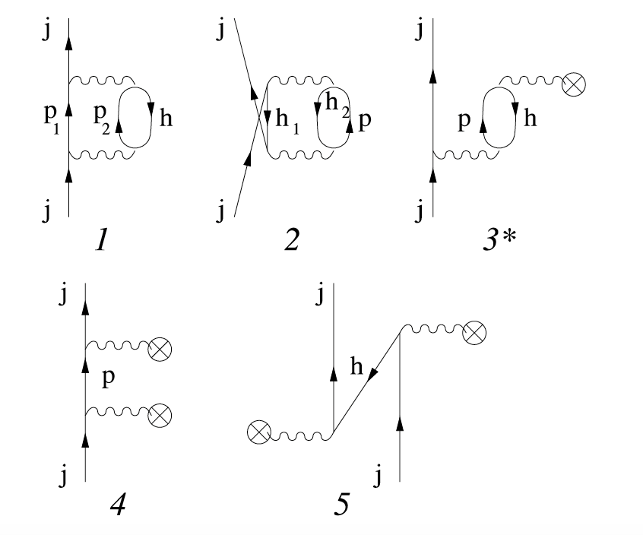
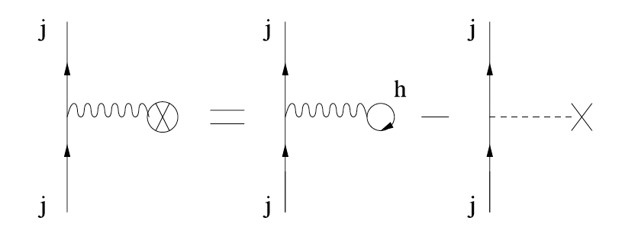
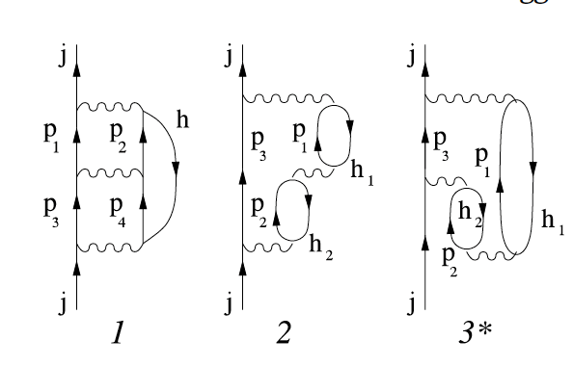
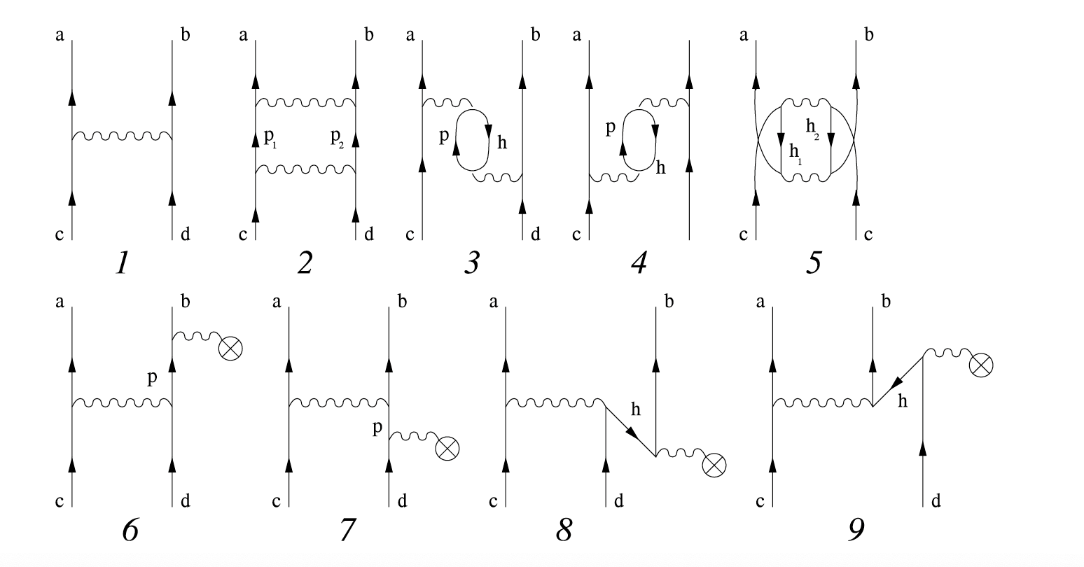
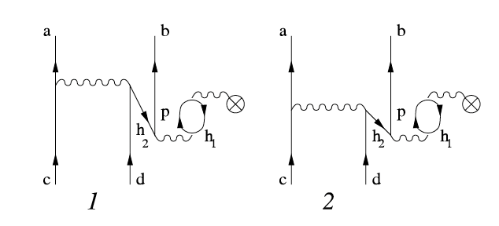

$\hat{Q}$ - box diagram expansion: NN potential
1-body diagrams up to 3rd order
other 41
+ 3rd order
diagrams
2-body diagrams up to 3rd order
other 133
+ 3rd order
diagrams
Notes:
41 +133

Slide 7
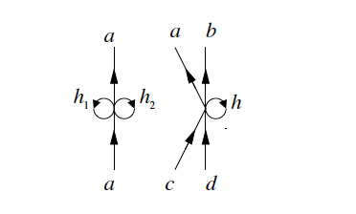
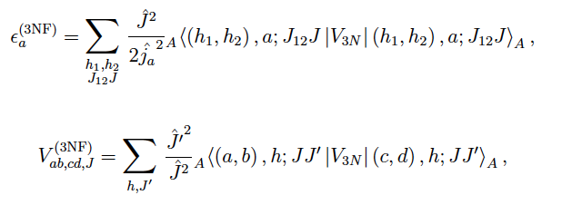
Normal-ordered decomposition of the 3N component of H
Starting from a reference state and using the Wick theorem, the three-body component of the nuclear Hamiltonian can be re-arranged into a sum of zero-, one-, two-, and three-body terms → only normal-ordered one- and two-body parts of 3N forces are included
normal-ordered one-body part of the 3N force
normal-ordered two-body part of the 3N force
Notes:
A successful approach to

Slide 8
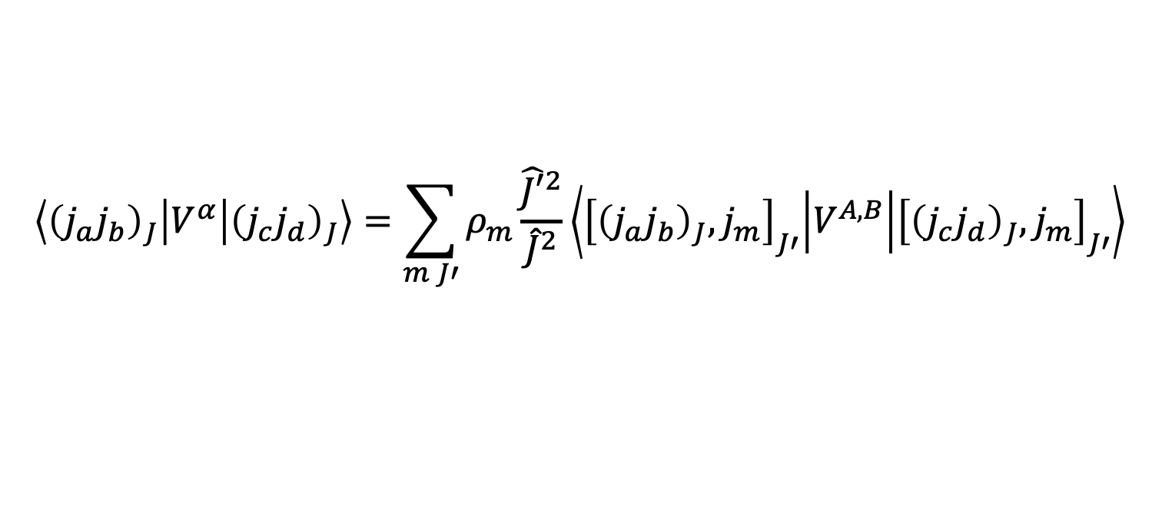
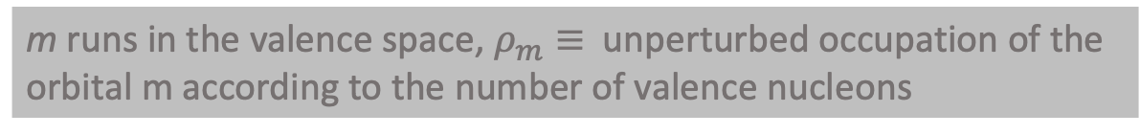
Induced 3N forces
For systems with more than 2-valence nucleons H_{eff} needs to account for the progressive filling of the valence space orbitals → the $\hat{Q}$-box should include many-body diagrams arising from the interaction - via the 2NF - of the valence nucleons with virtual excitations outside the model space
Second order 3-body diagrams
Density-dependent two-body contribution
$$\left\langle {\left(j_{a}j_{b}\right)}_{J} | V^{α} | {\left(j_{c}j_{d}\right)}_{J}\right\rangle =\sum_{m J′}{ρ_{m}\frac{{\hat{J′}}^{2}}{{\hat{J}}^{2}}\left\langle {\left[{\left(j_{a}j_{b}\right)}_{J},j_{m}\right]}_{J′} | V^{A,B} | {\left[{\left(j_{c}j_{d}\right)}_{J},j_{m}\right]}_{J′}\right\rangle }$$
m runs in the valence space, $ρ_{m}≡$ unperturbed occupation of the
orbital m according to the number of valence nucleons
Notes:
We include in our calculations diagrams with three incoming and outcoming valence particles which are shown in this picture B corresonds to the unteractions of the valence nucleons with core excitations and A to interaction of valence particles with excitations above the valence space.
Then to use standard SM codes which are usually limited to treat only 2-body interactions, we resort to the same approximation used to manage a genuine 3NF.

Slide 9
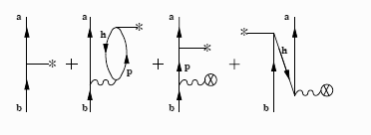
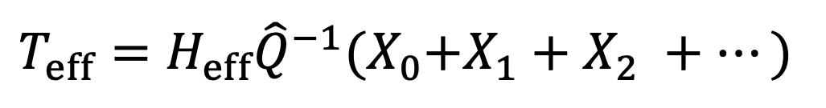
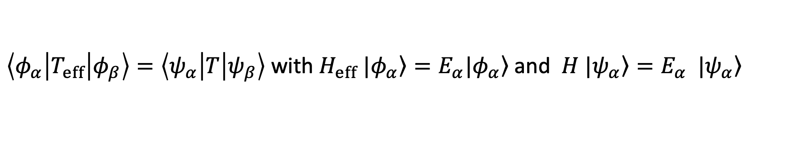

Effective operators
$\left\langle φ_{α} | T_{eff} | φ_{β}\right\rangle =\left\langle ψ_{α} | T | ψ_{β}\right\rangle$ with $\left.H_{eff} |φ_{α}\right\rangle =E_{α}|\left.φ_{α}\right\rangle$and $H\left.{ |ψ}_{α}\right\rangle =E_{α}$ $\left.{ |ψ}_{α}\right\rangle$
$T_{eff}=H_{eff}{\hat{Q}}^{−1}{(X}_{0}+X_{1}+X_{2} +…)$
K. Suzuki and R. Okamoto, Progress of Theoretical Physics, 93, 905 (1995)
Diagrammatic expansion at second order
* $≡$ bare operator
$≡$ two-body potential
L.Coraggio et al, PRC 95 , 064324 (2017)
L. Coraggio et al, PRC 100, 014316 (2019)
Notes:
\

Slide 10
Shell-model calculations and 3N forces
NN and 3N forces within the ChPT framework at N³LO and at NNLO, respectively
[D. R. Entem, R. Machleidt, PRC 66 (2002) 014002]
H_{eff} within the framework of the MBPT ($\hat{Q}$-box folded diagram expansion)
by including in the $\hat{Q}$-box one- and two-body Goldstone diagrams at third order in the
NN potential + at first order in the 3N one + induced 3N forces
[T. Fukui et al, PRC 98 (2018) 044305; Y. Z. Ma et al, PRC 100 (2019) 034324]
H_{eff} within the framework of the MBPT (𝑄 ̂-box folded diagram expansion)
by including in the 𝑄 ̂-box one- and two-body Goldstone diagrams at third order in the
NN potential + at first order in the 3N one + induced 3N forces
[T. Fukui et al, PRC 98 (2018) 044305; Y. Z. Ma et al, PRC 100 (2019) 034324]
Notes:
Now I would like to show some of our results to further highlight the role of 3NFs in explaining phenomena such as the location of the neutron dripline in isotopic chains and the shell evolution as a function of the number of valence nucleons, focusing in particular on the effects of the 3NF on the monopole component. Calculations are performed

Slide 11
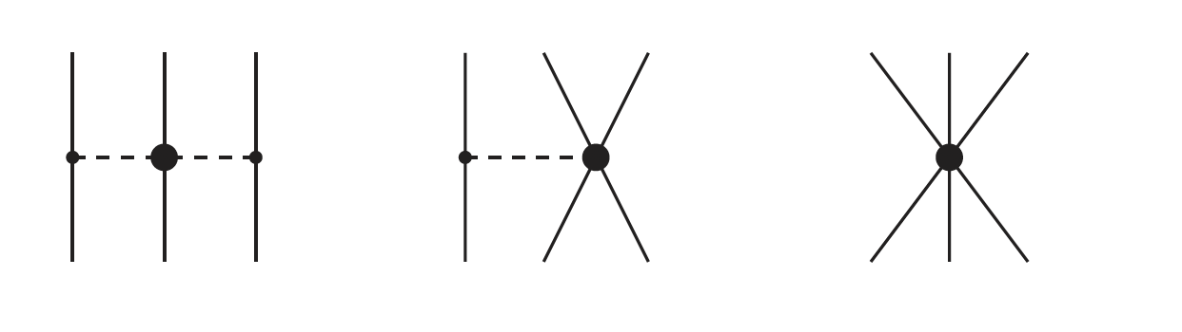
Chiral potentials derived in ChPT
Chiral potentials are organized in a systematic low-momentum expansion with short-range forces absorbed into contacts terms proportional to low-energy constants (LEC) and two- and many-body forces are generated on an equal footing
two-pion exchange
No new parameters
pure 3N-contact interaction
New LEC parameter: c_{E}
one-pion exchange +
NN-contact interaction
New LEC parameter: c_{D}
c_{D} and c_{E} may be fixed by an optimal over-all fit of the properties of
light nuclei, as for instance in P. Navrátil et al, PRL 99 (2007) 042501
Notes:
Most interaction vertices that appear in the 3N force also occur in the NN force → consistency requires that the parameters LECs carried by these vertices have the same values for NN and 3N terms

Slide 12
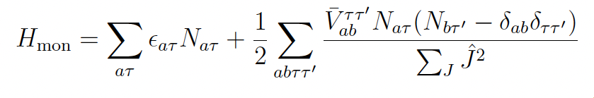
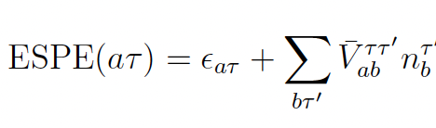
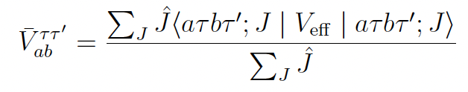
Monopole component of the SM effective interaction
Monopole component
Centroid
Responsible for the evolution
of the SP energies
Only centroids should be fitted to obtain results of a quality comparable with that provided by phenomenological interactions
Deficiencies in centroids are related to the bad saturation and shell formation properties of the NN
interaction and can be traced back to the lack of 3N forces
Eduardo Pasquini’s Ph.D. thesis (1976) and Strasbourg-Madrid group

Slide 13
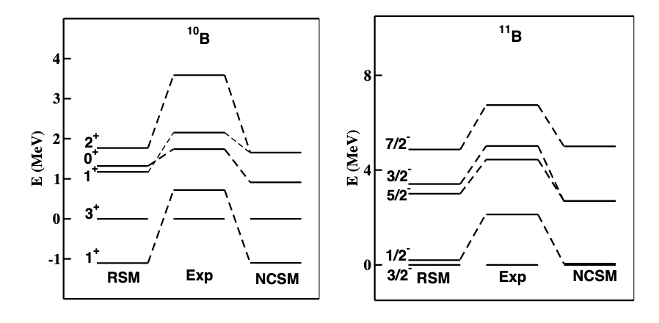
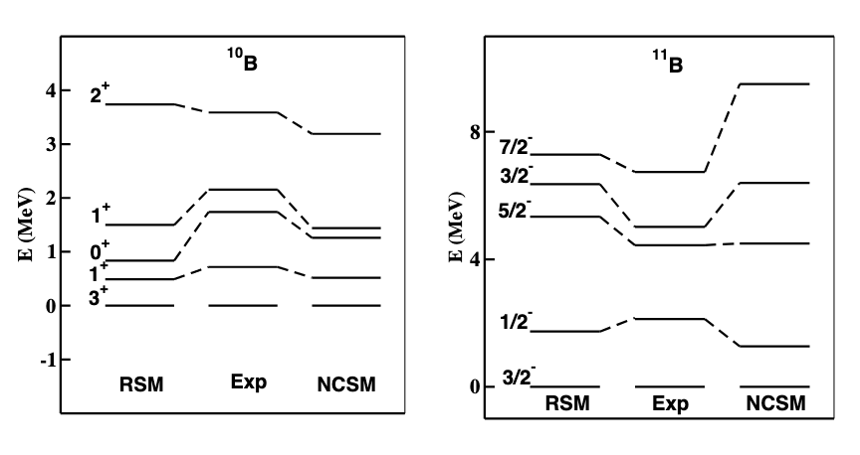
p-shell nuclei:B isotopes
Benchmark calculations: comparison of SM and ab initio NCSM results
NN force
L. Coraggio, et al, Ann. Phys. (NY) 327 (2012) 2125
NN+3N forces
T. Fukui et al, PRC 98 (2018) 044305
Notes:
Calculations for p-shell nuclei are used to test our method and investigate the impact of the necessary truncations and approximations that have been introduced.To this end, in fact, our results are compared with those obtained by the ab initio NCSM by using the same chiral potential
Agreement in the high energy spectrum is sligthly worse and this may be due to lack of higher-order contributions to the perturbative expansion of Heff. Only firse order contribution from the 3NF

Slide 14
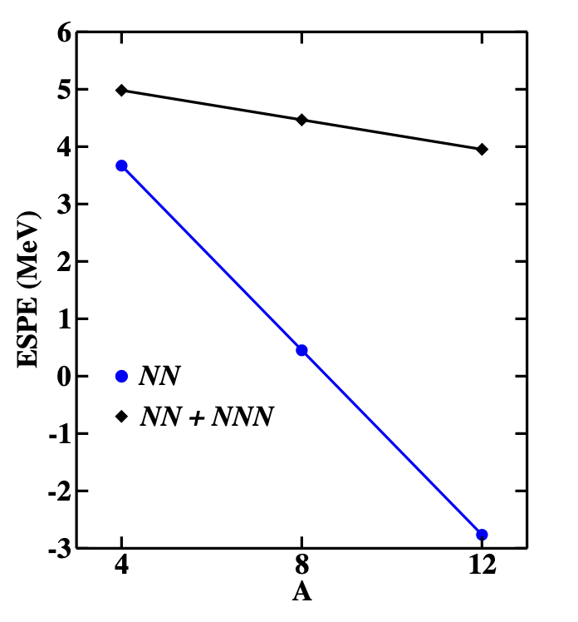
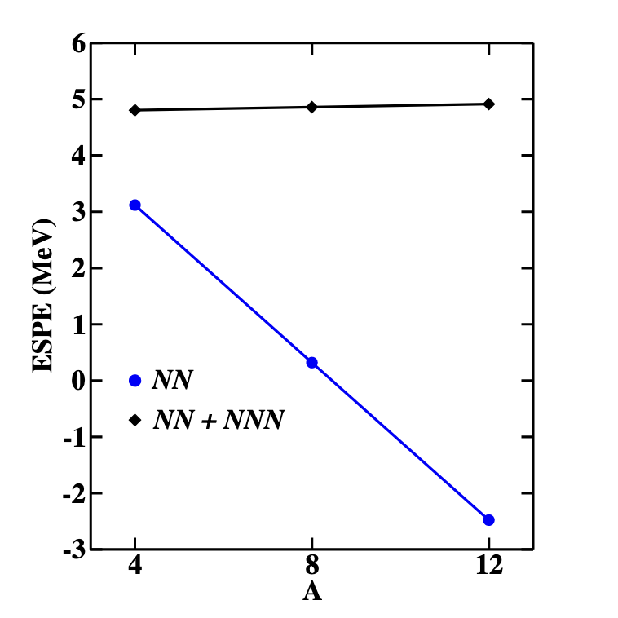


proton $0p_{1/2}$ ESPE relative to $0p_{3/2}$
neutron $0p_{1/2}$ ESPE relative to $0p_{3/2}$
3NF is essential to make explicit the spin-orbit splitting of the 0p orbitals
Relative ESPE rapidly drops down when considering only the N³LO NN potential, even becoming negative around A = 8, while relative ESPE is almost constant (4 ∼ 5 MeV) when the 3N potential is taken into account → which reflects on the spectra of ¹⁰B and ¹¹B
Notes:
Again we can check the effect of the 3N force on the ESPE in this case the 0p1/-0p3/2 spin
his reflects in the calculated energy spacings between yrast Jπ = 1/2
− and 3
2
− in 11B and, more important in
the higher excitation energy of the yrast Jπ = 2+ state
in 12C spectra

Slide 15

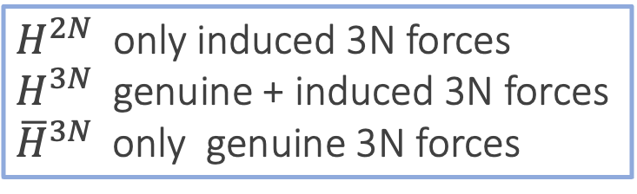
Two-neutron separation energies for Ca isotopes
$fp$ proton and neutron valence space
$fpg9/2$ $fp$ + neutron g_{9/2} orbital
$H^{2N}$ only induced 3N forces
$H^{3N}$ genuine + induced 3N forces
${\overline{H}}^{3N}$only genuine 3N forces
Y..Z. Ma et al, PRC 100. 034324 (2019)
L. Coraggio et al, PRC 102, 054326 (2020)
Notes:
The rather flat expt behaviour up to N=28 is well reproduced by both calculations. Then, the expt values are overestimated by the NN force only, while the repulsive contribution of the 3N force leads to less bound gs states and improves the agreement with expt. However, at N=36 a too sudden drop is predicted by theory which does not have an expt counterpart. 60Ca as bound system as evidenced by recent measurements. Furthermore, the neutron dripline is predicted beyond A=70 in agreement with DFT and GSM calculations 60Ca as bound system as evidenced by recent measurements. Furthermore, the neutron dripline is predicted beyond A=70 in agreement with DFT and GSM calculations
green and pink line almost overlap up to N = 32, but then differences between them start to grow and become larger and larger with increasing number of valence neutrons. Actually, from N = 34 on the inclusion of induced 3NFs brings an upshift of the two-neutron separation energies evidencing their attractive contribution which counterbalances in part the one arising from a genuine 3NF

Slide 16
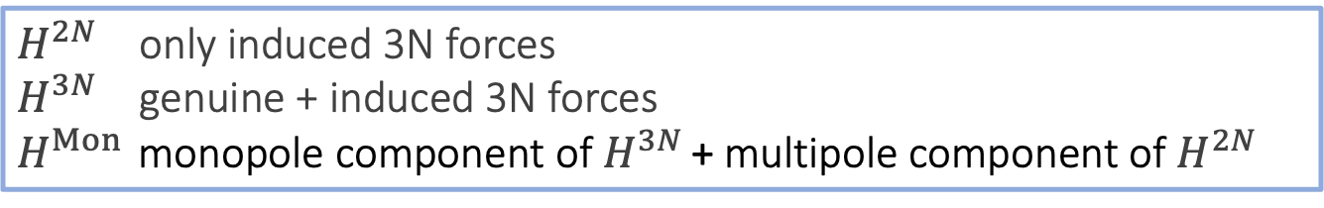


Two-neutron separation energies and $2_{1}^{+}$excitation
energies for nickel isotopes from N = 20 to 32
$fp$ proton and neutron valence space
$H^{2N}$ only induced 3N forces
$H^{3N}$ genuine + induced 3N forces
$H^{Mon }$monopole component of $H^{3N}$ + multipole component of $H^{2N}$
Notes:
NN force is not able to reproduce the drop at N=28 in the 2n separation The 3N force is also fundamental to describe the N=28 gap, that is in fact underestimated by about 2 MeV using the NN force only .
We see that pink and black lines are very similar thus confirming that major problems in the NN force arise from its monopole components obtained and also that central role of the monopole in determining the S2n evolution and the gap at N = 28 shell. N = 28 shell.

Slide 17
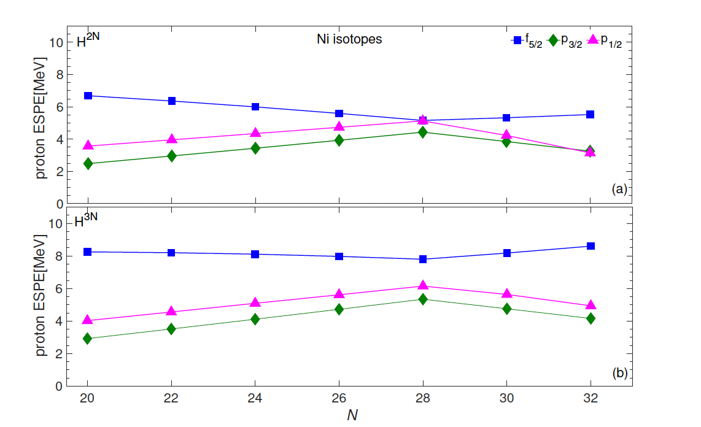
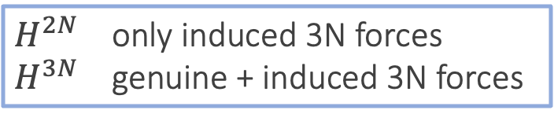
Neutron and proton ESPE for nickel isotopes with and without 3N force
$H^{2N}$ only induced 3N forces
$H^{3N}$ genuine + induced 3N forces
Notes:
I have reported neutron and proton ESPE spacings referred to the 0f7/2 orbital for Ni isotope obtained with and without the 3N force. As expected , the contribution of the 3NF leads to a substantial expansion of the orbital separations with respect to the NN force only . In partcular the 3N force provides an increase in the 0f7/2- 1p3/2 spacing and of the f7/2-f5/2 spin-orbit splitting of about 2-3 MeV

Slide 18

Monopole matrix elements ${\overline{V}}_{f_{7/2b}}^{ττ′}$ of the effective interactions with and without 3N force
3NF provides a repulsive contribution to all matrix elements, which makes the nn and pn matrix elements less
attractive and pp ones more repulsive.
The size of the contributions depends on the involved orbitals, ranging from few 10 to ~ 200 keV → substantial changes in the spacings between the ESPE’s in correspondence of a sizable occupation of a specific orbital
Changes produced by the 3N force are larger for non diagonal with respect to diagonal matrix elements, which leads to a larger gap between the f_{7/2} and the remaining orbitals
Notes:
This difference in the behavior of the ESPEs is due to differnces in the monopole components of the two effective Hamiltonian, To exemplify this point, I focus on the monopole components entering in the calculation of Ni56 (our Hamiltonian is density dependent so a different Hamiltonian is used for each nucleus).

Slide 19
Shell-model calculations for β decay studies
Calculations for nuclei which are currently candidates for the 0nbb detection :
⁴⁸Ca, ⁷⁶Ge, ⁸²Se, ¹⁰⁰Mo, ¹³⁰Te, ¹³⁶Xe
Interaction
V_{low-k} of CD-Bonn with Λ=2.6 fm⁻¹ + Coulomb force for protons
TBME +SP energies of H_{eff} @ third order
+ induced 3N forces
One major proton and neutron shell above ⁴⁰Ca, ⁵⁶Ni, ⁷⁸Ni, ¹⁰⁰Sn,
Effective operators within a a consistent approach
Notes:
\

Slide 20


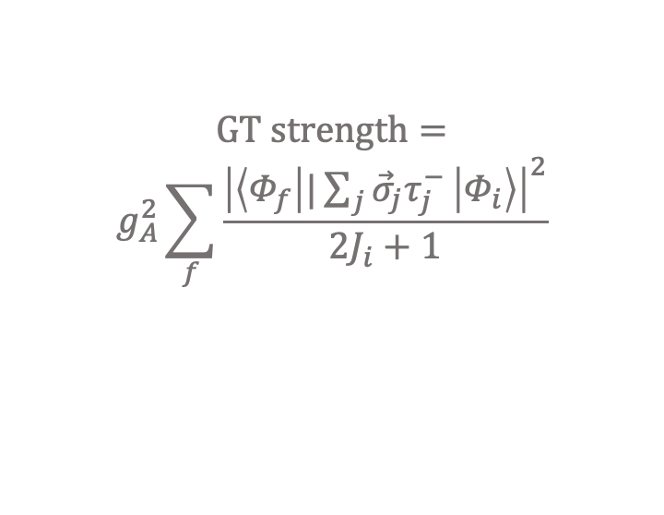
L. Coraggio et al, PRC 95, 064324 (2017)
Satisfactory description of the experimental data, without introducing ad-hoc quenching of the axial coupling constant g_{A,}
$$GT strength=$$
$$g_{A}^{2}\sum_{f}{\frac{{\left|\left\langle Φ_{f} | |\sum_{j}{{\vec{σ}}_{j}τ_{j}^{−}} | Φ_{i}\right\rangle \right|}^{2}}{2J_{i}+1}}$$
The quenching is automatically guaranteed by our procedure which accounts for the corrections due to the truncation of the Hilbert space
${ with g}_{A}$=1.27

Slide 21
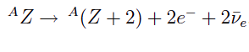
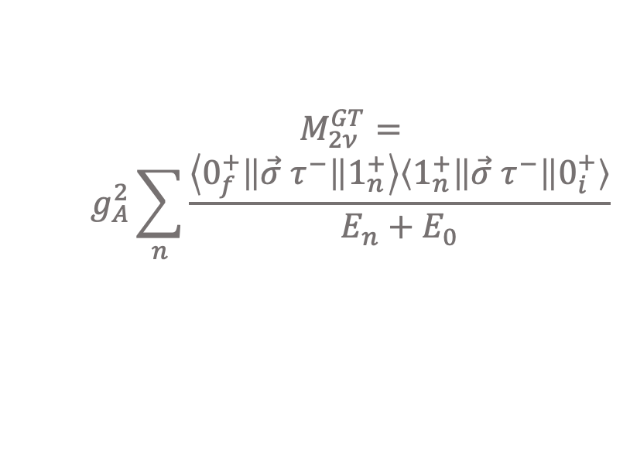
red → bare
black → eff
L. Coraggio et al, PRC 95, 064324 (2017)
L. Coraggio et al, PRC 100, 014316 (2019)
L. Coraggio et al, PRC 105, 034312 (2022)
Bare values are all spread on the lower side of the figure, except the one corresponding to ⁴⁸Ca, while effective values move closer to the identity line..This feature characterizes the nuclei that are described by way of a model space where some of its orbitals lack their spin-orbit counterparts
,
$$M_{2ν}^{GT}=$$
$$g_{A}^{2}\sum_{n}{\frac{\left\langle 0_{f}^{+}\left\|\vec{σ} τ^{−}\right\|1_{n}^{+}\right\rangle \left\langle 1_{n}^{+}\left\|\vec{σ} τ^{−}\right\|0_{i}^{+}\right\rangle }{E_{n}+E_{0}}}$$

Slide 22
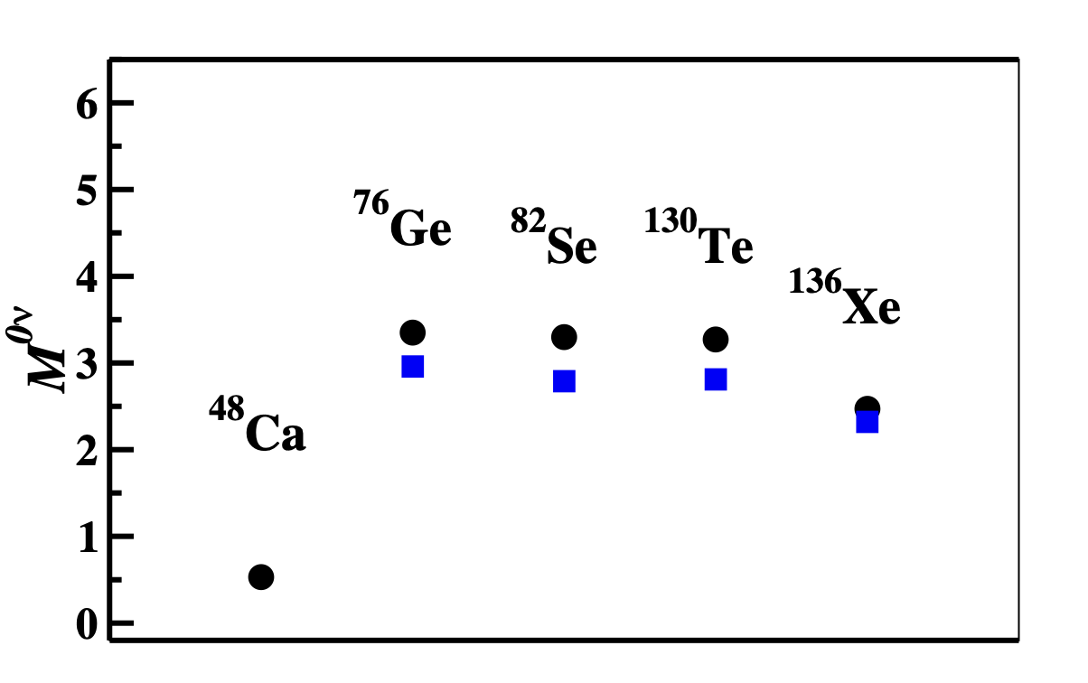
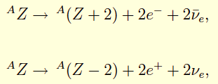
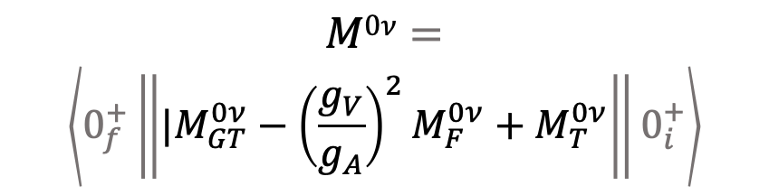
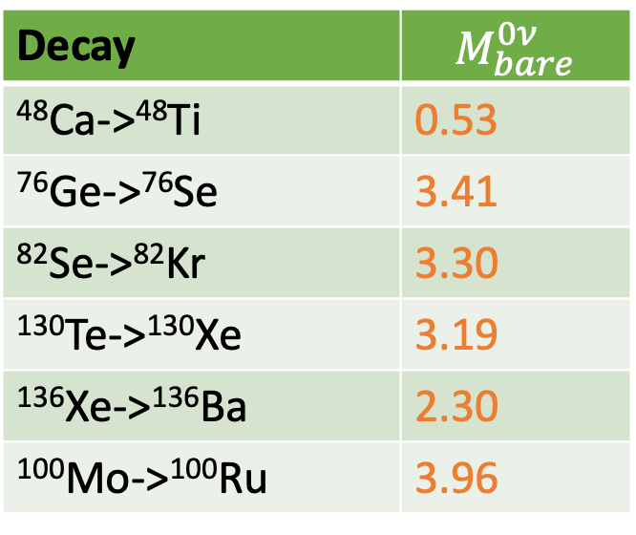
black → real inter
blue → phen inter
Decay | $$M_{bare}^{0ν}$$
⁴⁸Ca->⁴⁸Ti | 0.53
⁷⁶Ge->⁷⁶Se | 3.41
⁸²Se->⁸²Kr | 3.30
¹³⁰Te->¹³⁰Xe | 3.19
¹³⁶Xe->¹³⁶Ba | 2.30
¹⁰⁰Mo->¹⁰⁰Ru | 3.96
blue values from
J. Menéndez et al. Nucl. Phys. A 818, 139 (2009)
There is a general agreement among the different calculations, that is linked to a common quality of the different effective Hamiltonians
$$M0ν=$$
$$\left\langle 0_{f}^{+}\left\|{|M}_{GT}^{0ν}−{\left(\frac{g_{V}}{g_{A}}\right)}^{2}M_{F}^{0ν}+M_{T}^{0ν}\right\|0_{i}^{+}\right\rangle$$
within the closure approximation

Slide 23
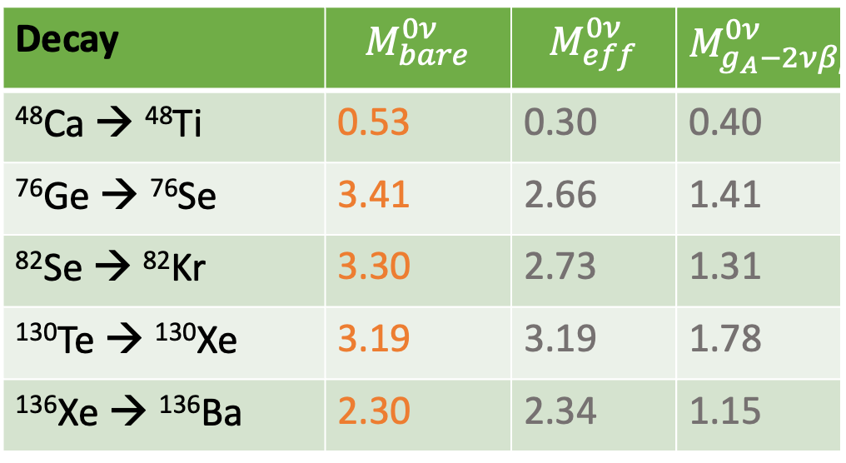
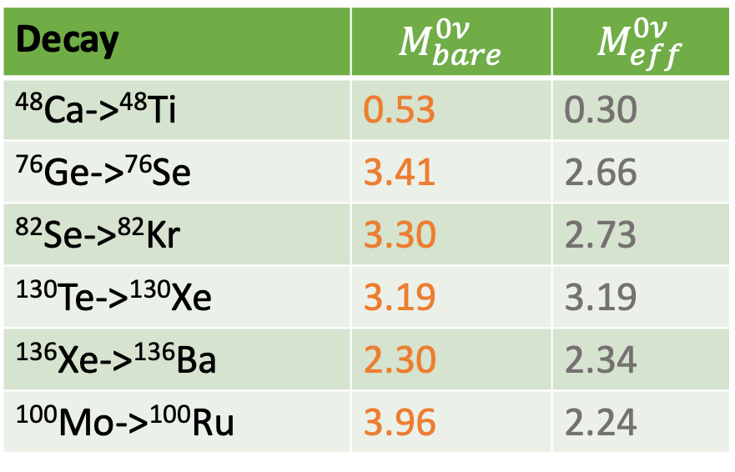
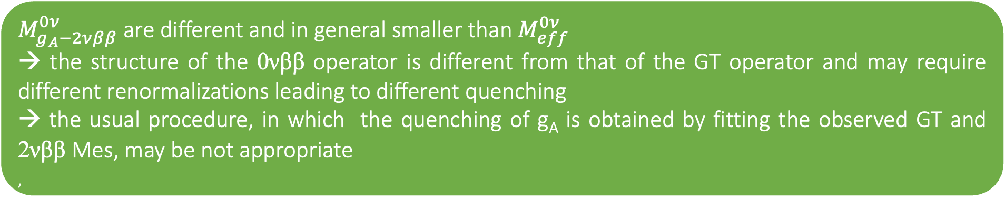
Decay | $$M_{bare}^{0ν}$$ | $$M_{eff}^{0ν}$$
⁴⁸Ca->⁴⁸Ti | 0.53 | 0.30
⁷⁶Ge->⁷⁶Se | 3.41 | 2.66
⁸²Se->⁸²Kr | 3.30 | 2.73
¹³⁰Te->¹³⁰Xe | 3.19 | 3.19
¹³⁶Xe->¹³⁶Ba | 2.30 | 2.34
¹⁰⁰Mo->¹⁰⁰Ru | 3.96 | 2.24
Decay | $$M_{bare}^{0ν}$$ | $$M_{eff}^{0ν}$$ | $$M_{g_{A}−2νββ}^{0ν}$$
⁴⁸Ca → ⁴⁸Ti | 0.53 | 0.30 | 0.40
⁷⁶Ge → ⁷⁶Se | 3.41 | 2.66 | 1.41
⁸²Se → ⁸²Kr | 3.30 | 2.73 | 1.31
¹³⁰Te → ¹³⁰Xe | 3.19 | 3.19 | 1.78
¹³⁶Xe → ¹³⁶Ba | 2.30 | 2.34 | 1.15
$M_{g_{A}−2νββ}^{0ν}$ from quenching factors deduced by our results for the 2νββ decay
$M_{g_{A}−2νββ}^{0ν}$ are different and in general smaller than $M_{eff}^{0ν}$
→ the structure of the 0νββ operator is different from that of the GT operator and may require different renormalizations leading to different quenching
→ the usual procedure, in which the quenching of g_{A} is obtained by fitting the observed GT and 2νββ Mes, may be not appropriate
,

Slide 24
Extension of calculations with 3NFs to heavier systems
Inclusion of higher-order contributions with 3N vertices in the perturbative expansion of the effective Hamiltonian
Inclusion of subleading 3NFs beyond the NNLO development as the short-range 3NFs at N³LO and N⁴LO that are shown to play a non-negligible role in few-body systems
Consistent calculations of all the effective operators for general observables, not just of the Hamiltonian, by including two-body meson-exchange corrections originating from sub-nucleonic degrees of freedom
Perspectives

Slide 25
Collaborators
Luigi Coraggio (UNICampania & INFN-NA)
Giovanni De Gregorio (UNICampania & INFN-NA)
Tokuro Fukui (Kyushu University- Fukuoka)
Nunzio Itaco (UNICampania & INFN-NA)
Riccardo Mancino (GSI Darmstadt)
Yuanzhuo Ma (Peking University)
Fredéric Nowacki (IPHC Strasboug)
Furong Xu (Peking University)

Slide 26
Thanks for your attention!

