Slide 1
Bent crystal-assisted Beam manipulations
A wide panorama: SHERPA and UA9
Davide Annucci
Ph.D. Student in Accelerator Physics
Sapienza Università di Roma
INFN Roma
davide.annucci@uniroma1.it
Ph.D. Seminars series
31/05/2023 – Aula Conversi

Slide 2
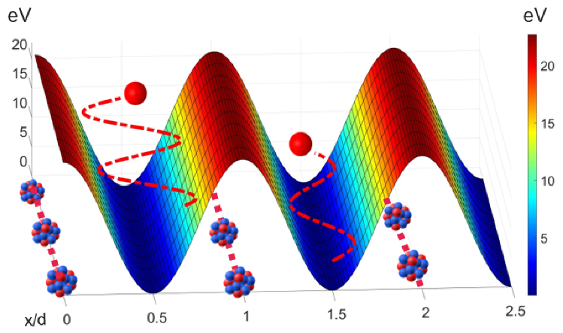
1 Introduction to Crystal Channeling

Slide 3
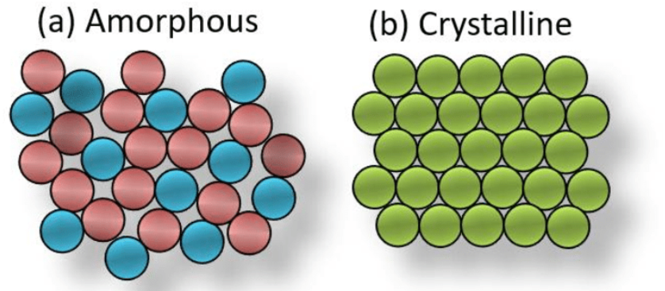
Crystalline vs Amorphous matter
Crystalline solids: Ordered atomic structure
Amorphous solids: Not-ordered atomic structure

Slide 4
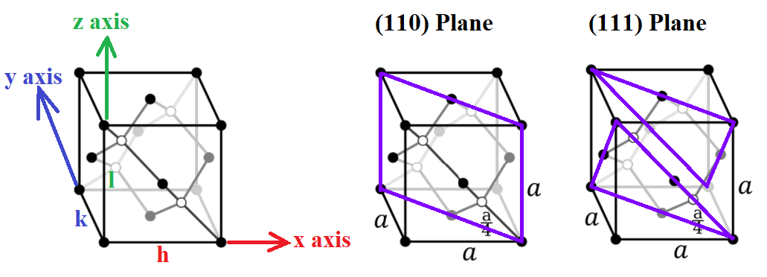
Crystals characterization
Ordered disposition of atoms in a crystalline lattice (called also Bravais Lattices)
Miller Indices $(h,k,l)$ define a plane family
In Silicon, the lattice is a Face Centered Cubic with Basis
Basis atoms shifted inward by ¼ along the length of the bulk diagonal

Slide 5
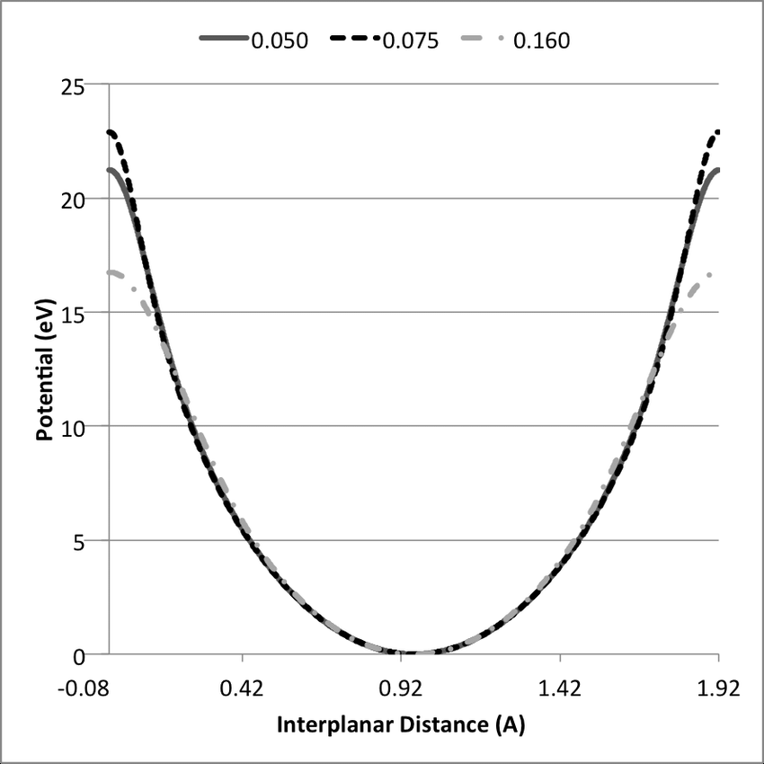
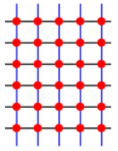
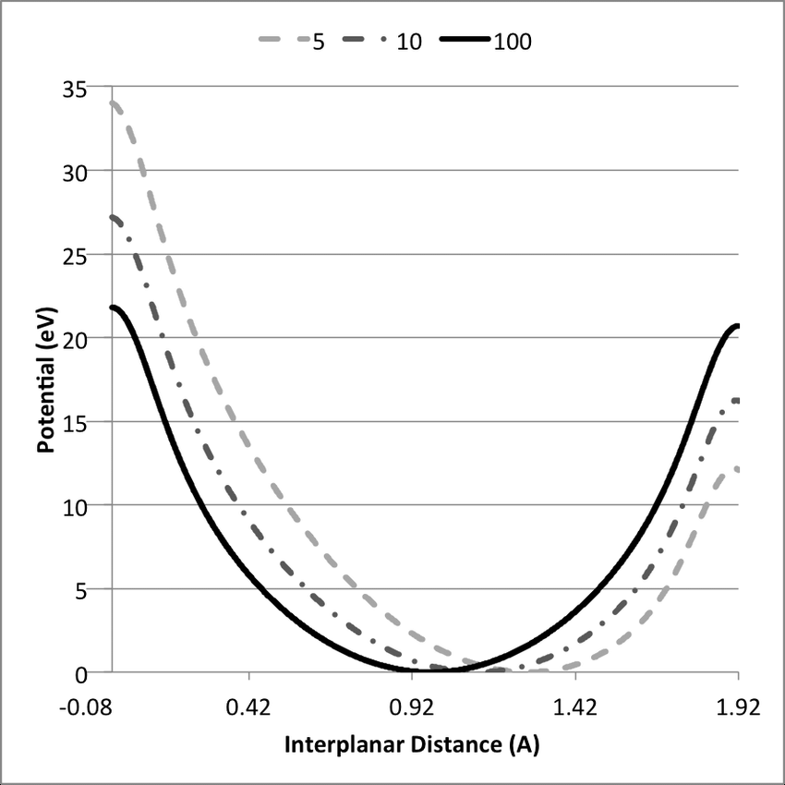
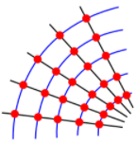
Interplanar Crystal Potential
Periodicity of the structure $→$ Periodicity of the potential
If the crystal is straigth
Periodic potential without perturbations
If the crystal is bent
Stress-Induced deformation in a controlled way
Centrifugal Repulsion effect

Slide 6
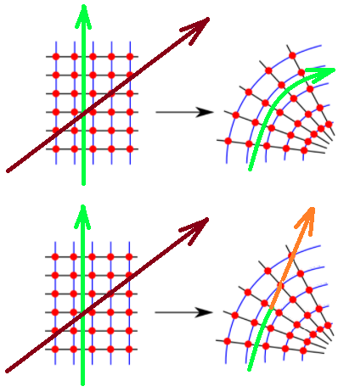
Crystal Channeling
A particle impinging on a crystal can behave differently depending on its alignement with the crystal.
Amorphous/Coherent Behaviour
If aligned with the crystal planes, the particle can be trapped by the interplanar potential, following a path constrained by the minima of this potential
This effect is known as Channeling
If the crystal is bent, the particle will follow the crystal plane bending
This effect has been used to bend particle beams using bent crystals
If the particle leaves the Channeling condition, the effect is known as Dechanneling

Slide 7
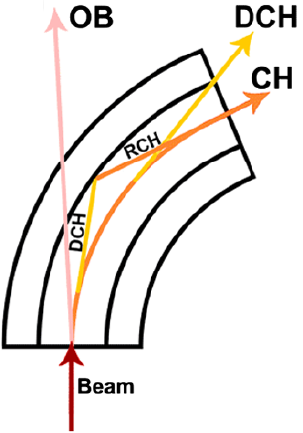
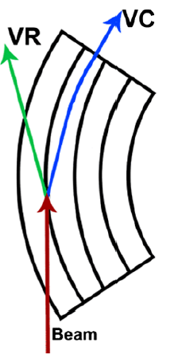
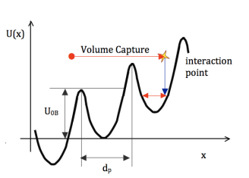
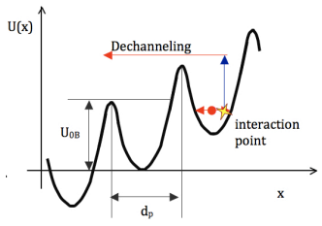
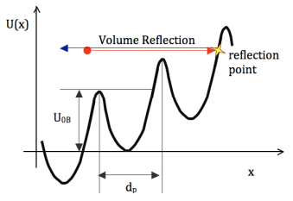
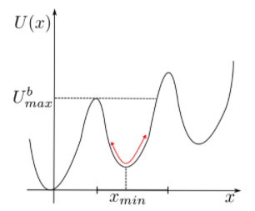
Coherent Processes in Bent Crystals
Channeling (CH)
Critical Angle $θ_{c}=\sqrt{2U/E}$
Charghed particles entering with ${θ<θ}_{c}$
can undergo Channeling
Dechanneling (DCH) – Volume Capture (VC) – Rechanneling (RCH)
No more CH condition: DCH can happen
(sometimes followed by RCH)
RCH is observed only with negative particles
Volume Reflection (VR)
Charghed particles reflected by the
crystal potential barrier

Slide 8
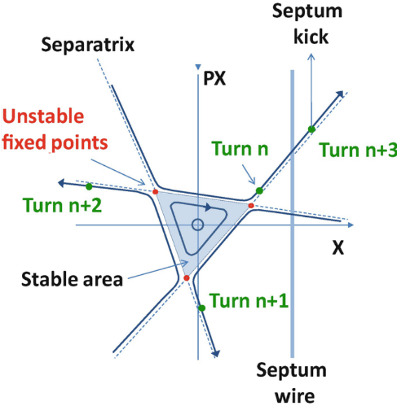
2 Beam Extraction

Slide 9
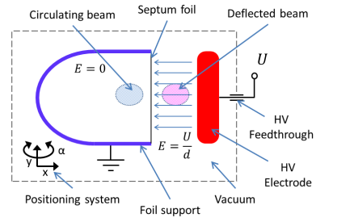
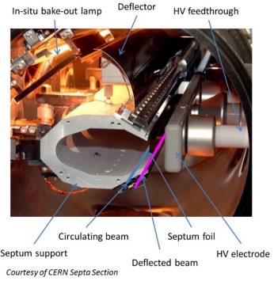
Resonant Beam Extraction
Standard technique consists in the Resonant extraction
$nQ_{x}+mQ_{y}=k$ ($n$, $m$, $k$ integer) $→$ Resonance condition
The Beam core (particles circulating on the nominal beam trajectory) is not perturbed and particles remain on trajectory
Part of the beam halo that enters the region where $E≠0$ (electrostatic septum) or $B≠0$ (magnetic septum) is deflected away and thus can be extracted
Circulating Beam
Circulating Beam
See Backup Slides
Septum
Tune = Number of Betatron Oscillations performed by a particle in one turn
Ext Beamlet

Slide 10
Resonant Beam Extraction disadvantages
Operating an accelerator near resonance is a risk if not done properly
Resonances can lead to beam instability if not correctly compensated afterward
Risks: The septum is very close to the circulating beam design orbit
If a powerful beam (i.e. MW of power) impacts on the septum, it is possible that the septum itself can overheat and/or eventually melt
If there is a malfunction on the magnets just
before the septum it is possible to have beam loss
Require strong pulsed Kicker magnets several
meters before the septum
Circulating Beam
Circulating Beam
Septum
Ext Beamlet

Slide 11
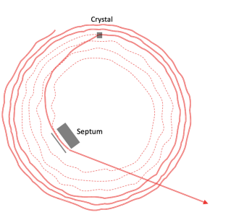
Non-Resonant Beam Extraction
Also Non Resonant beam extraction techniques relies on septa magnets but does not require Kicker magnets
The beam separation is not induced by a resonance but by an element of the accelerator
Crystal-Assisted beam extraction $→$ Slow non-resonant methodology currently under study
Single-turn or multi-turn extraction
D.Annucci et al
Phys. Rev. Accel. Beams 25, 033501
Circulating Beam
Circulating Beam
Bent Crystal
Ch Beamlet
Septum
Ext Beamlet

Slide 12
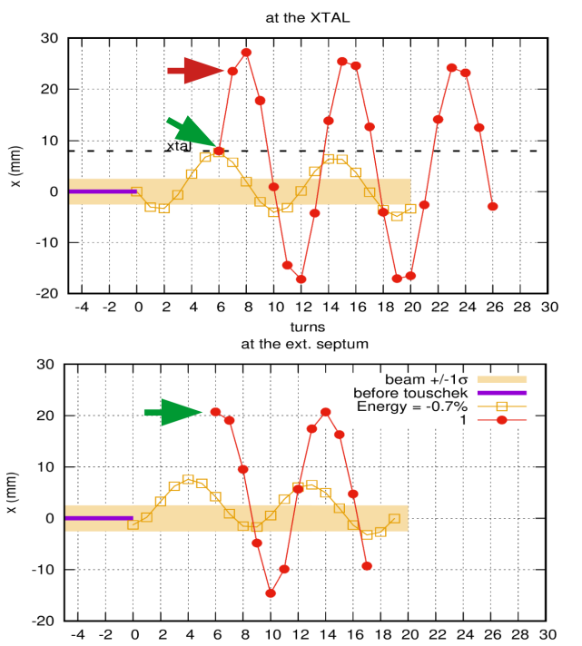
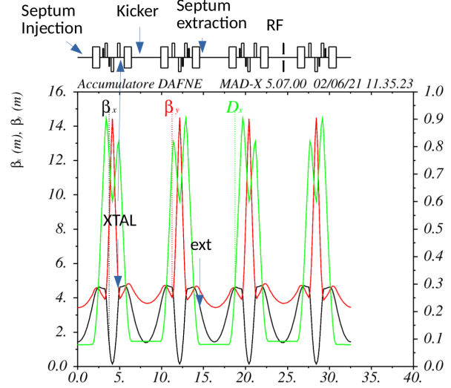
Extracted beam at INFN LNF
$\sim 60 m$ long S-Band 2856 MHz LINAC providing $500$/$800$ MeV $e^{+}$/$e^{−}$
It provides only 50 Hz bunches of 300 ns maximum length (Duty Cycle ${10}^{−5}$)
DAΦNE $e^{+}$/$e^{−}$ collider length $\sim 100 m$. $E_{cm}\sim 1 GeV$ (Φ-Factory)
Poseydon Project – Continuous extracted beam – ArXiv:1711.06877
Converting DAΦNE into a pulse-stretcher and a Storage Ring Facility to obtain an almost continuous extracted beam for users
Resonant or Crystal-Assisted extraction? Can we use crystals?
Sherpa Project (Slow High-Efficiency Extraction From Ring Positron Accelerator)
Prove the feasibility of 1 mrad deflection
With bent crystals
Damping Ring / DAΦNE extraction under study
D.Annucci et al
Phys. Rev. Accel. Beams 25, 033501

Slide 13
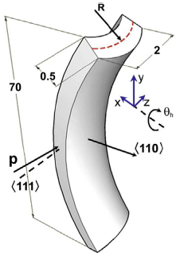
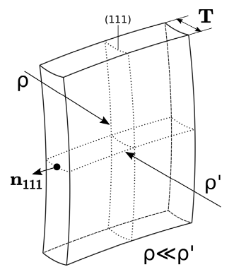
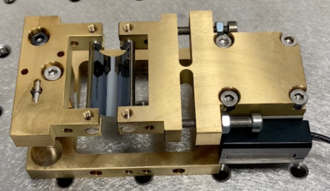
The SHERPA Project: Bent Crystal
In order to bend the crystal an holder must be used
Anticlastic and Quasi-Mosaic deformation
(110) plane: Anticlastic bending (induced by Anticlastic deformation)
(111) plane: Quasi-Mosaic bending (induced by Quasi-Mosaic deformation)
Specifically designed in order to achieve $\sim 1 mrad$ channeling angle
$\sim 15 μm$ Thickness
$\sim 1.5 cm$ Bending Radius
Crystal similar to the one used at MAMI by
INFN-Fe group for $e^{−}$
PhysRevLett.112.135503 (Mazzolari et al)

Slide 14
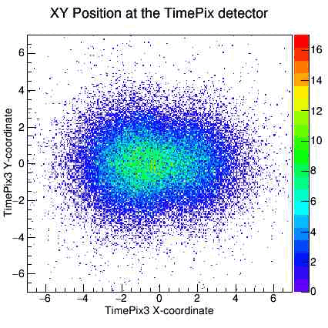
Crystal Alignment and Angular Scan
See Backup Slides
Several simulations performed to study the reliability of the Geant4 Channeling Routine
400 GeV protons at H8
MAMI $e^{+}$, $e^{−}$ 855 MeV
SHERPA $e^{+}$, $e^{−}$ 511 MeV
The beam spot distribution at the Si TPX3 detector has been simulated
The spot should be
$σ\left(x\right)×σ\left(y\right)=\left(0.5×0.5\right) {mm}^{2}$
The divergence should be
$σ^{′}\left(x\right)=500 μrad$ and $σ^{′}\left(y\right)=300 μrad$
Preliminary tests of the SHERPA TPX3 detector imaging at LNF BTF have been carried out

Slide 15
3 Beam Collimation and Coalescence

Slide 16
Crystal Assisted Beam Collimation
Crystal-Assisted beam collimation is conceptually similar to beam extraction, but the beam is deflected toward a Heavy Metal Absorber (High-Z material like W) using a crystal
If a collimator (SC) is placed directly on the beam halo$→$the Secondaries produced after the Hadronic Shower can interact with the circulating beam
With Crystal-Assisted collimation is possible to avoid most of the On-Axis Secondaries

Slide 17
Beam Coalescence
Reminder on VC
It is possible to use the Channeling effect to merge beams coming from different directions
This process is the «dual» of the beam extraction
Beam Extraction: A beamlet is extracted from the halo of the circulating beam
Beam Coalescence: Two beams are merged using coherent processes in a bent crystal, i.e. Channeling and Volume Capture
Amor. of Beamlet #2
Circulating Beam
Non-Channeled Beam
Beamlet #1 (Vol.Capture)
Merged Beam
Beam Extraction
Extracted Ch. Beamlet
Beamlet #2 (Channeling)
Beam Coalescence

Slide 18
Beam Coalescence – UA9/Config 1 at CERN
UA9 Setup under test at CERN – June 2023
A Beamlet is extracted from the main circulating beam using a crystal XTAL1 oriented in Channeling
The beamlet passes through XTAL2 oriented in Channeling
Subsequently, the beamlet is Volume-Captured by XTAL3 and thus is recombined to the circulating beam
XTAL 1
XTAL 3
Circulating Beam
Recombined Beamlet
Extracted Beamlet
Pre-Recombined Beamlet
Ongoing Activity
My Ph.D. thesis work
XTAL 2

Slide 19
Beam Coalescence – UA9/Config 2 at CERN
UA9 Setup under test at CERN – September 2023
A Beamlet (1) is extracted from the main circulating beam using a crystal XTAL1 oriented in Channeling
Another Beamlet (2) is extracted using XTAL2 oriented in Channeling
Subsequently, the beamlet (2) is Volume-Captured by XTAL3 and thus is recombined to the beamlet (1). The extracted beam exits in the direction of B1
XTAL 1
XTAL 2
Circulating Beam
Extracted Beamlet 2
Ongoing Activity
My Ph.D. thesis work
Extracted Beamlet 1
Extracted Merged Beamlet
XTAL 3

Slide 20
4 Conclusions

Slide 21
Take-Home messages
Bent Crystsal-Assisted beam extraction and coalescence are novel techniques currently under study
Beam Merging with crystals must be performed in an appropriate way
The Phasespace of the two impinging beamlets must be matched as possible otherwise the beam will degrade due to filamentation
Bent Crystsal-Assisted beam collimation is nowadays widely used at CERN
It will be possible to implement those setups in accelerators such as FCC or Muon Collider
Stay tuned! I will present my further results time by time ;)

Slide 22
I sincerely Acknoweledge the INFN Roma & INFN LNF that allowed me to perform all the necessary activity to develop this presentation
Many Thanks to Paolo Valente, Mauro Raggi, Marco Garattini, Alessandro Variola, Paola Gianotti, Luca Foggetta and the BTF Staff
I will be involved in Some important Test-Beam at CERN within the UA9 Collaboration
Many Thanks to Walter Scandale, the UA9 Collaboration and the CERN Staff
Now this is not the end
It is not even the Beginning of the End
But it is, perhaps, the End of the Beginning
- W.Churchill 10 Nov 1942

Slide 23
Many Thanks for Your Attention! Questions? Comments? Remarks?

Slide 24
A Backup Slides

Slide 25
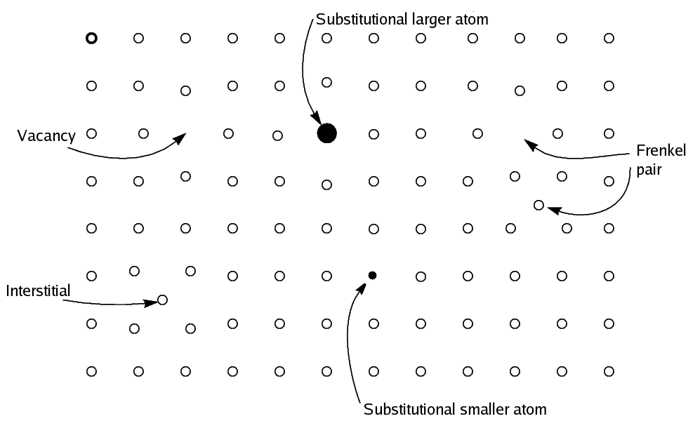
Crystal Imperfection
Backup
Assumption: Crystals are perfect
No Dislocations/Vacancies/Irregularity
But the reality is different
Crystal production is not perfect
Stress induced during crystal cooldown and further manipulation (cut, maching, …) can lead to lattice irregularities
Irregularities and imperfections lead to an uncontrolled potential well perturbation so it is possible that particles lose channeling conditions, i.e. by inelastic collision on «extra atoms»

Slide 26
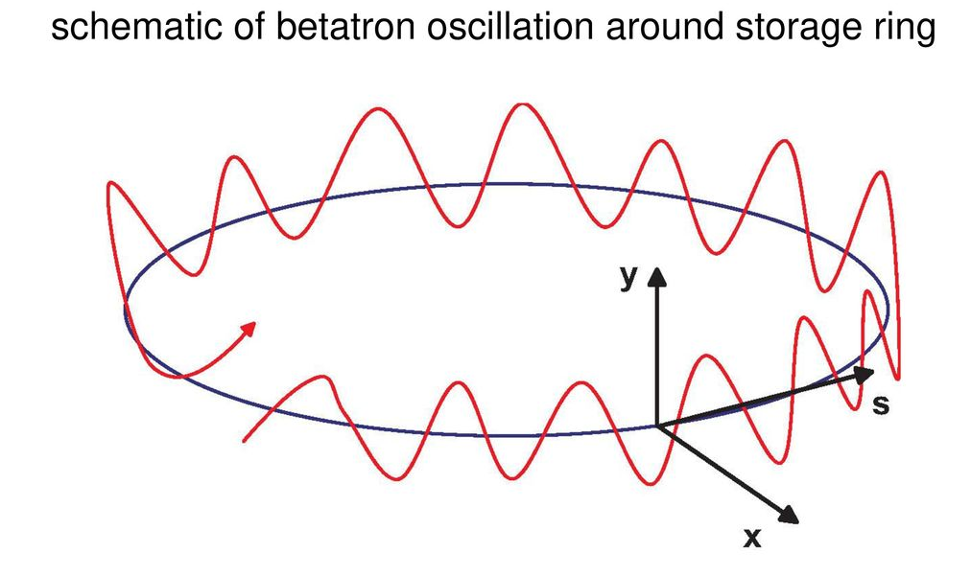
Resonance in Circular Accelerators
Backup
Resonance Condition $→$ $nQ_{x}+mQ_{y}=k$ ($n$, $m$, $k$ integer)
$p=\left|n\right|+|m|$ is the resonance order
Introduce the machine TUNE (horizontal & vertical)
Tune = Number of Betatron Oscillations performed by a particle in one turn

Slide 27
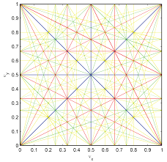
Resonance in Circular Accelerators
Backup
Resonance Condition $→$ $nQ_{x}+mQ_{y}=k$ ($n$, $m$, $k$ integer)
$p=\left|n\right|+|m|$ is the resonance order
Introduce the machine TUNE (horizontal & vertical)
Tune = Number of Betatron Oscillations performed by a particle in one turn
i.e. $Q_{x}=35.2$ and $Q_{y}=59.6$ means that in one turn the particle performs:
35 total oscillation + a fraction of oscillation equal to 0.2 in the X plane
59 total oscillation + a fraction of oscillation equal to 0.6 in the Y plane
Let $n=2$ and $m=1$ $→$ $k=2∗35.2+1∗59.6=130$
Considering the tune non-integer part only $→$ $k=2∗0.2+1∗0.6=1$
$p=\left|n\right|+\left|m\right|=3$ $→$ Third order Resonance

Slide 28
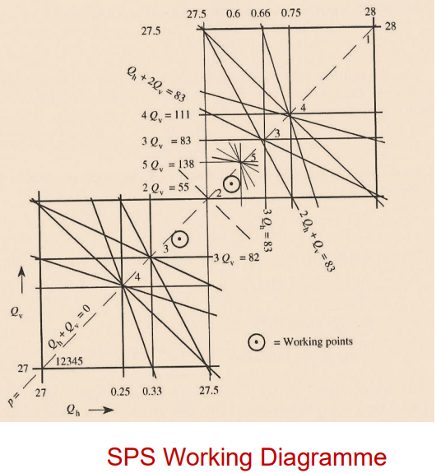
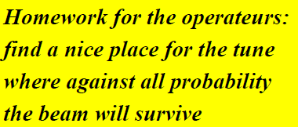
Resonance in Circular Accelerators
Backup
Operating the accelerator near resonances can lead to beam loss due to uncontrolled and unbalanced amplitude increase
Have a look to some CERN machines operational ranges

Slide 29
Non-Resonant Beam Extraction
Direct Extraction or Closed-Orbit Bump scheme
Direct extraction
Closed Orbit Bump
Circulating Beam
Circulating Beam
Bent Crystal
Ch Beamlet
Septum
Ext Beamlet
Circulating Beam
Circulating Beam
Magnet
Circulating Beam
Circulating Beam
Magnet
Septum
Extracted Beamlet
Bent Crystal
Magnet
Ext Beam
Davide Annucci - Phd Seminars
29

Slide 30
Non-Resonant Beam Extraction
Direct Extraction or Closed-Orbit Bump scheme
Direct extraction
Closed Orbit Bump
Circulating Beam
Circulating Beam
Bent Crystal
Ch Beamlet
Septum
Ext Beamlet
Magnet
Circulating Beam
Circulating Beam
Circulating Beam
Magnet
Circulating Beam
Bent Crystal
Channeled Beamlet
Extracted Beamlet
Septum
Magnet
Extracted Beam
Davide Annucci - Phd Seminars
30

Slide 31
Non-Resonant Beam Extraction
An alternative to the Direct Extraction scheme is the so called Closed-Orbit bump Scheme
Let’s learn how to build this extraction setup
All starts with the circulating beam on its unperturbed design orbit
Circulating Beam

Slide 32
Non-Resonant Beam Extraction
Add some magnets to induce a zig-zag beam trajectory
This is called a 3-Magnets closed-orbit bump
The beam travels for longer path and the Dispersions increases. This is due to the dipole magnets action that enhance $∆P/P$
Circulating Beam
Circulating Beam
Magnet
Circulating Beam
Circulating Beam
Magnet
Magnet

Slide 33
Non-Resonant Beam Extraction
Add a Bent Crystal just after the second magnet
If the crystal is placed correctly, the Halo of the circulating beam will undergo Channeling and thus the extracted beamlet can be further separated using the Septum Magnet
The circulating beam core is untouched
Circulating Beam
Circulating Beam
Magnet
Circulating Beam
Circulating Beam
Magnet
Septum
Extracted Beamlet
Magnet
Ext Beam

Slide 34
Crystal Assisted Beam Collimation
Circulating Beam
Circulating Beam
Heavy Metal
Heavy Metal
Bent Crystal
Ch Beamlet
Circulating Beam
Circulating Beam

Slide 35
B SHERPA Simulations / Profiles
My Master Thesis

Slide 36
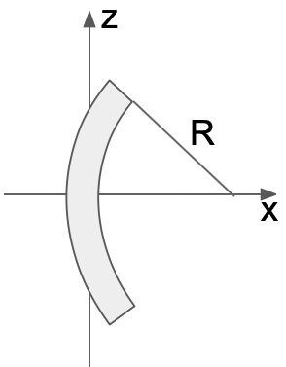
Geant4 Simulations structure
Backup
AngXin, AngYin, PosXin, PosYin, AngXout, AngYout, AngCry
T1 and T2 used to compute AngXin and AngYin because GPS has spot and divergence $σ\left(x\right),σ\left(y\right),σ^{′}\left(x\right),σ′(y)≠0$
Track impinges on XTAL, giving PosXin and PosYin
Bending is simulated
Particle outgo XTAL at known position and with
known direction, then it proceede straigth until T3
T3 and XTAL used to evaluate AngXout, AngYout
AngCry describes XTAL orientation

Slide 37
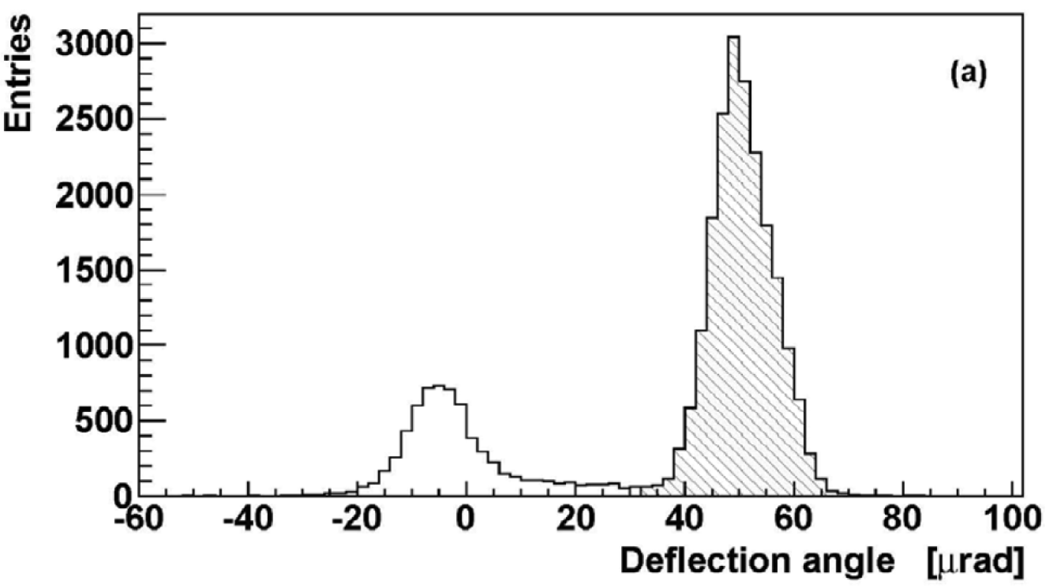
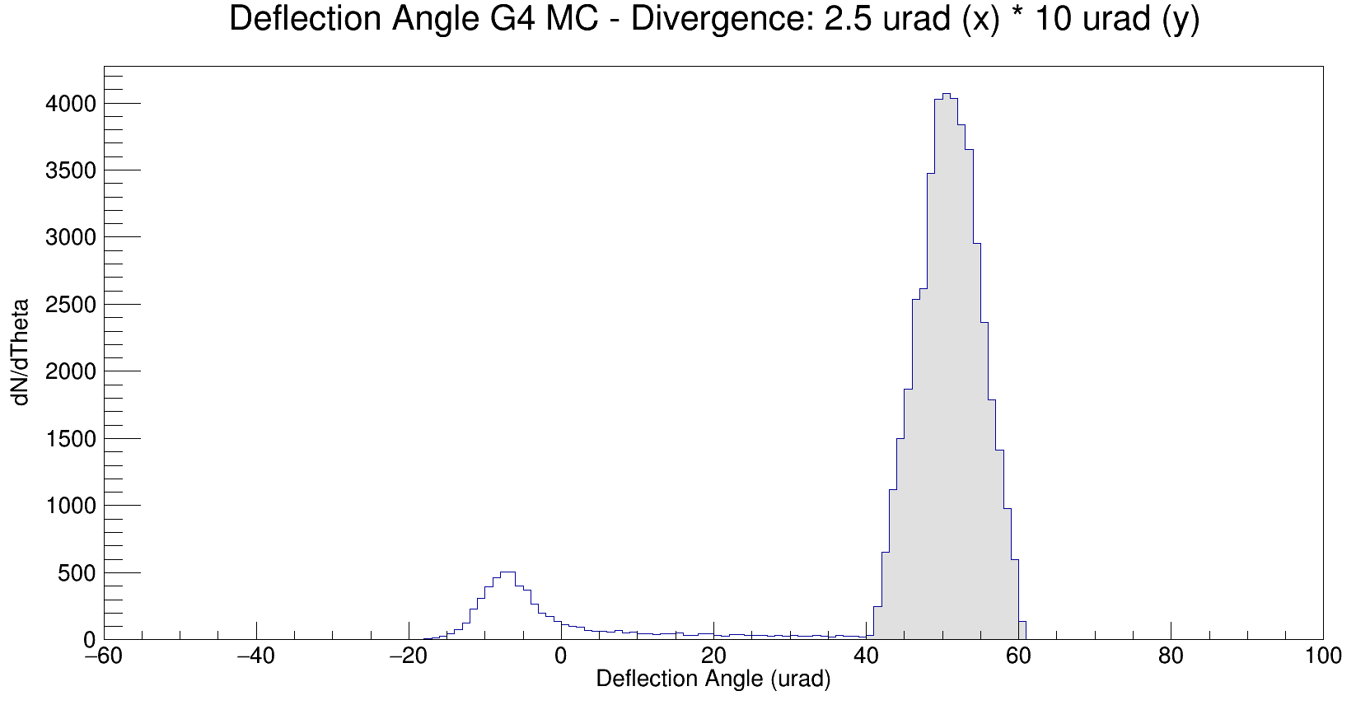
Geant4 Simulations
Backup
G4 Cannelling Example implemented only in version 10.05.p01
G4 Routine described in http://arxiv.org/abs/1403.5819 by Enrico Bagli et al.
No Rechanneling implemented, but considered «a posteriori»
Channeling, Dechanneling, Volume Capture and Volume Reflection implemented
The only lattice plane available is the (110)
Beam and crystal parameter and orientation modified by Data Cards
G4 output variables distributions are the TRUE variable distributions
Impinging/outgoing X/Y-angle and impinging/outgoing X-position
An intense work has been done in order to validate and cross-check the G4 routine. (reported SPS 400 GeV proton H8 UA9, by Scandale/Taratin)
Also MAMI setup with e- gives compatible
results with Geant4 simulations
UA9 SPS
Annucci G4

Slide 38
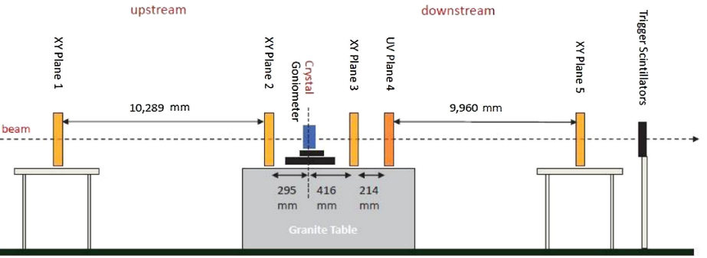
Geant4 H8 SPS Simulations
Backup
SPS 400 GeV proton H8 UA9 setup described in Physics Reports, Volume 815, 25 June 2019, Pages 1-107 (Scandale/Taratin)
Angular cut (SPS) $\left|θ_{x}\right|,\left|θ_{y}\right|<5μrad$. In G4, $σ^{′}\left(x\right)=2.5μrad$
$$ε_{ST}=76\%$$
$$ε_{G4}=(75.3±0.7)\%$$
SPS protons
Data
G4 protons
Simulation

Slide 39
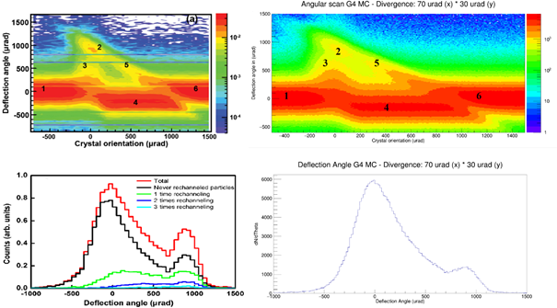
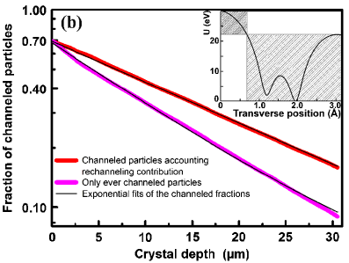
Geant4 MAMI Simulations
Backup
MAMI setup described in PhysRevLett.112.135503 (Mazzolari et al)
Angular Scan: the crystal is rotated wrt impinging beam
MAMI data collected with (111) plane; G4 Simulations carried on (110) plane
$ε_{G4}=\left(14.6±1.3\right)\%$; without Rech; but 50%particles recycled through Rechanneling
${→ε′}_{G4}=1.5×\left(14.6±1.3\right)\%=\left(21.9±1.9\right)\%$ considering Rechanneling «by hand»
Rechanneling is not negligible, if not decisive, only for the negative charges.
$ε_{Mami, Exp}=(20.1±1.2)\%$; $ε_{Mami, MC}=21.2\%$
(with Rechanneling)
Fair Agreement with ${ε′}_{G4}$
MAMI PRL Data
Our G4 Simulation

Slide 40
Geant4 INFN LNF BTF Simulations
Backup
511 MeV $e^{−}$ simulations in the INFN LNF BTF setup
It is necessary to disentangle the CH peak from the Background
Studies performed changing the $σ^{′}\left(x\right)$ mantaining fixed $σ^{′}\left(y\right)=300μrad$
Angular Scan: MAMI-like procedure. G4 Simulations carried on (110) plane
Divergence $σ^{′}\left(x\right)=200,500,1000μrad$ in this slide
$$σ^{′}\left(x\right)$$
$$200μrad$$
$$σ^{′}\left(x\right)$$
$$500μrad$$
$$σ^{′}\left(x\right)$$
$$1000μrad$$

Slide 41
Geant4 INFN LNF BTF Simulations
Backup
With $e^{−}$ is hard to observe Channeling, so we decided to do also 511 MeV $e^{+}$ simulations in the same configuration. SHERPA needs $e^{+}$ extraction
Studies performed changing the $σ^{′}\left(x\right)$ mantaining fixed $σ^{′}\left(y\right)=300μrad$
Angular Scan: MAMI-like procedure. G4 Simulations carried on (110) plane
Divergence $σ^{′}\left(x\right)=200,500,1000μrad$
$$σ^{′}\left(x\right)$$
$$200μrad$$
$$σ^{′}\left(x\right)$$
$$500μrad$$
$$σ^{′}\left(x\right)$$
$$1000μrad$$

Slide 42
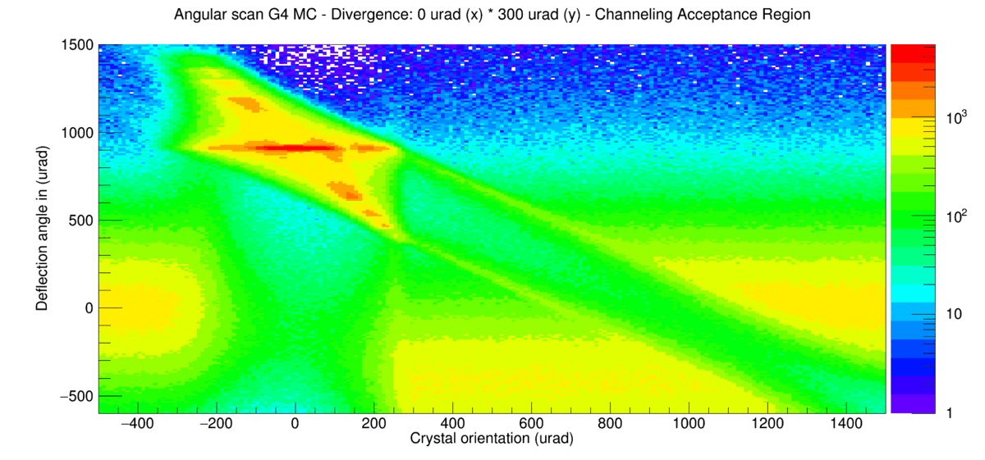
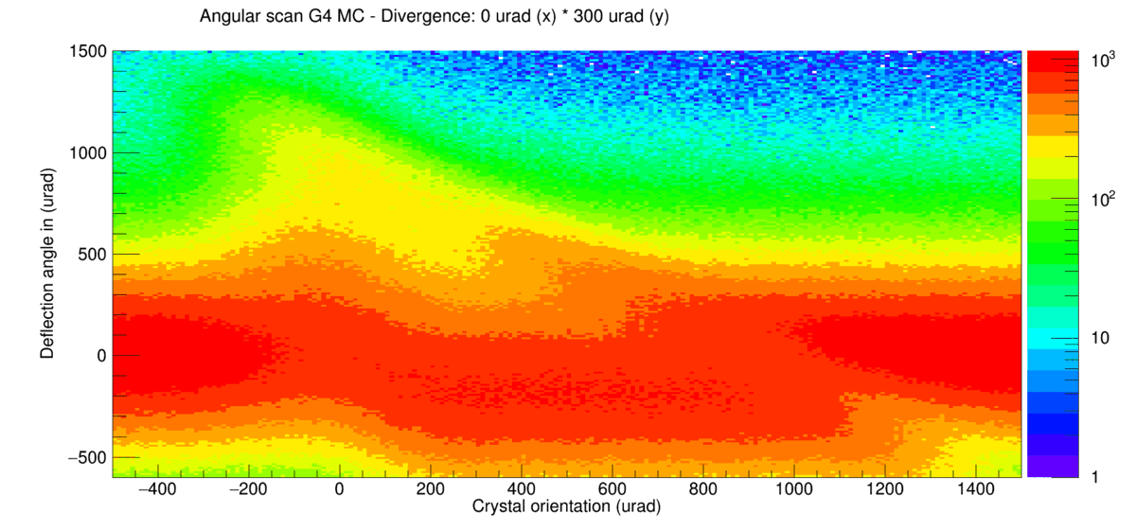
INFN LNF BTF 511 MeV $e^{+}/e^{−}$ Simulations
Backup
BTF SHERPA Geometry
Angular Scan: MAMI-like procedure. G4 Simulations carried on (110) plane
Spot RMS $1 {mm}^{2}$
Divergence $σ^{′}\left(x\right)=0→1000 μrad$ and $σ^{′}\left(y\right)=300 μrad$
Positrons simulations Electrons simulations

Slide 43
C SHERPA Simulations / Beam Spot
My Master Thesis

Slide 44
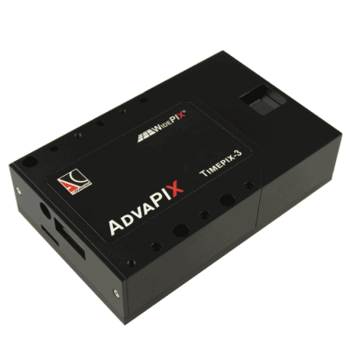
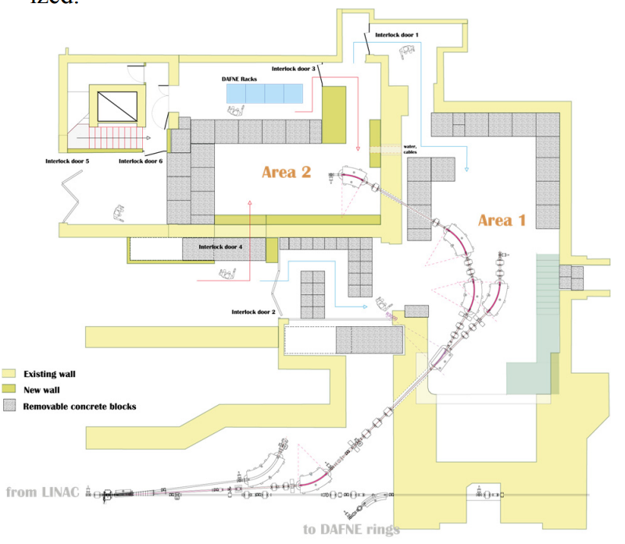
TimePix3 Beam Imaging Simulations
Backup
SHERPA Pixel Si detector measuring the outgoing positions
Active surface of $14×14 {cm}^{2}$; $256×256$ pixel matrix. $55 μm$ pixel pitch
Thickness $100 μm$
Only $e^{+}$ impact position available at SHERPA TPX3
No information about incoming direction $→$ No Anglular distribution
We evaluate positions, not angles
Monte Carlo tailored to reproduce the Beam imaging in BTF-II
BTF-II free space of 3 m limits the SHERPA experimental setup
TPX3 placed 2/3 m downstream the crystal

Slide 45
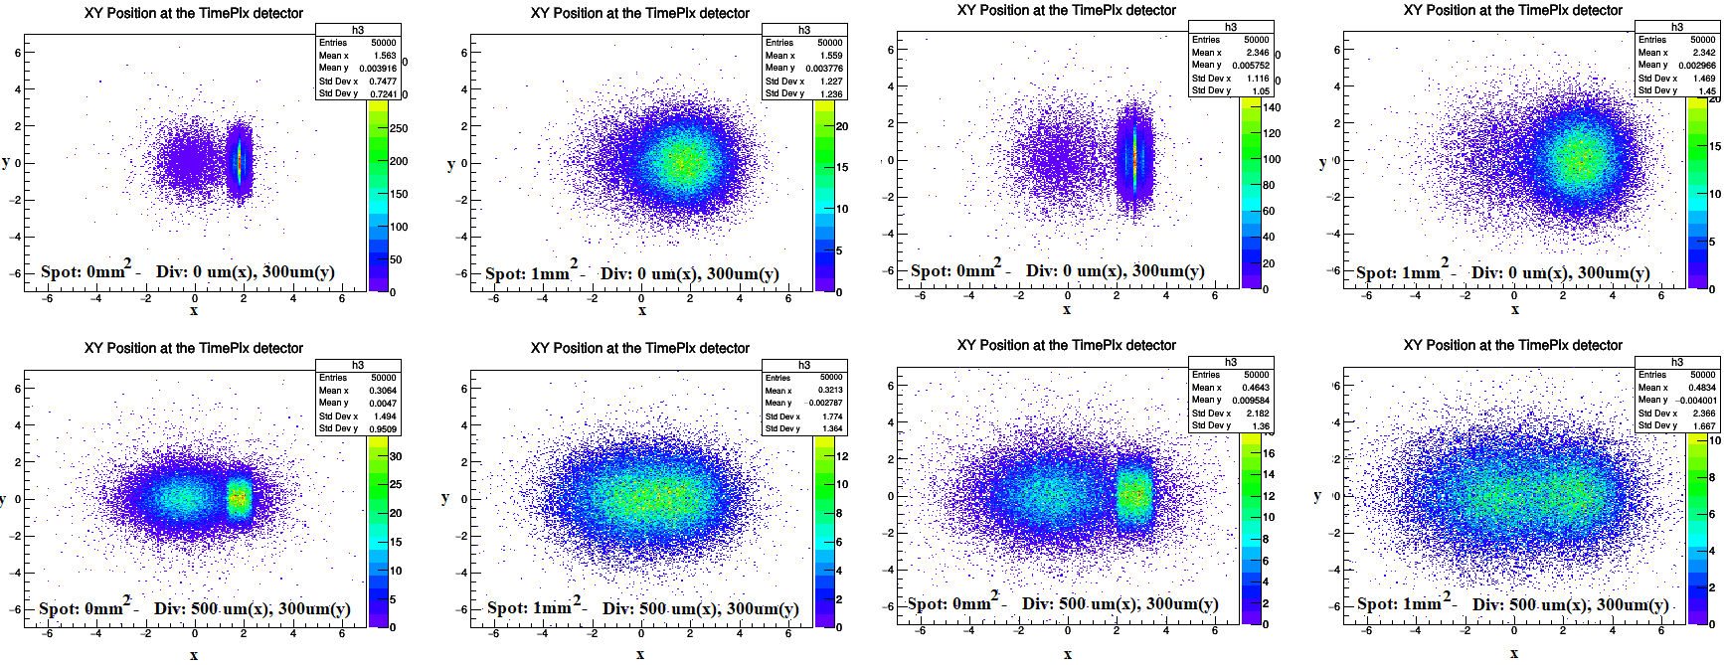
TimePix3 Beam Imaging Simulations
Backup
Spot $σ\left(x\right)×σ\left(y\right)=(0×0) {mm}^{2}$ or $σ\left(x\right)×σ\left(y\right)=(1×1) {mm}^{2}$ RMS
$σ^{′}\left(x\right)=0/500μrad$ (variable) and $σ^{′}\left(y\right)=300μrad$ (fixed)
Detector distance: 2/3 m from crystal: Spot imaging (2D)
Histo binning is chosen as the pixel pitch
no spot, no div
spot
no spot, no div
spot
2m
3m
div
spot & div
div
spot & div

Slide 46
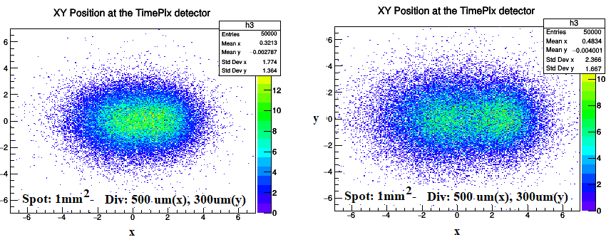
TimePix3 Preliminary Beam Indication
Backup
Simulations performed with variable spot and divergence
$σ\left(x\right)×σ\left(y\right)=(1×1) {mm}^{2}$ and $σ^{′}\left(x\right)=500μrad$ - the Channeling is visible
PROBLEM: it isn’t guaranteed BTF can reach $σ^{′}\left(x\right)=500μrad$
At 2 m the Channeling is not well separated. At 3 m it is better resolved
As a first result, we proved that the spos should be sub-mm RMS radius
We think that the $σ\left(x\right)×σ\left(y\right)=(0.5×0.5) {mm}^{2}$ configuration is still achievable at BTF
Relaxing a little bit requirements on $σ^{′}\left(x\right)$
2m
3m

