Slide 1
Analisi e studi in corso a Genova
Marco Ripani
Riunione JLAB12 – Roma, 9 Giugno 2011

Slide 2
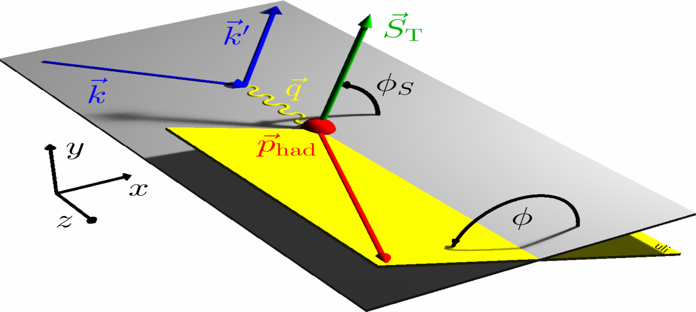
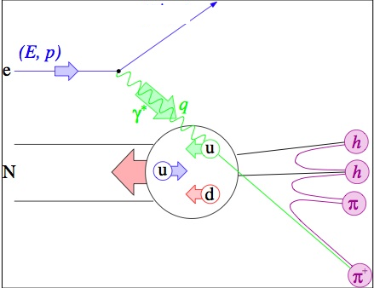
e’
(E’, k’)
(E, k)
e
N

Slide 3
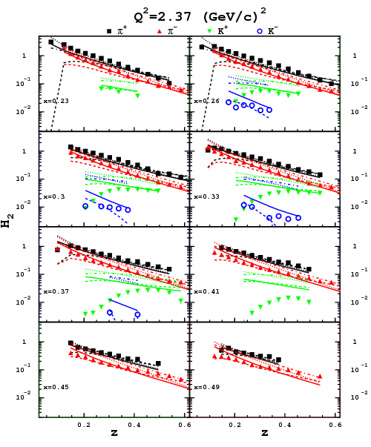
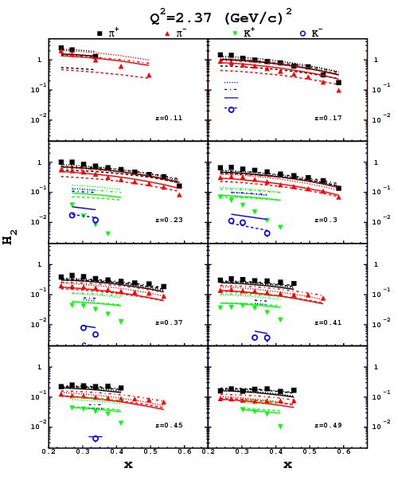
Data vs. pQCD
Solid – LO DSS
Dashed – NLO DSS
Dotted – LO Kretzer
Dot-dashed – NLO Kretzer
Sys.err. 15%
preliminary

Slide 4
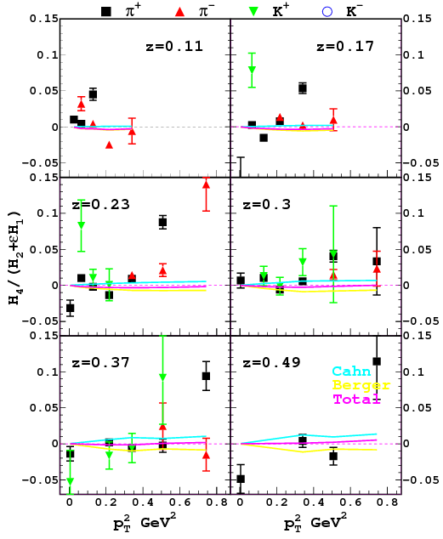
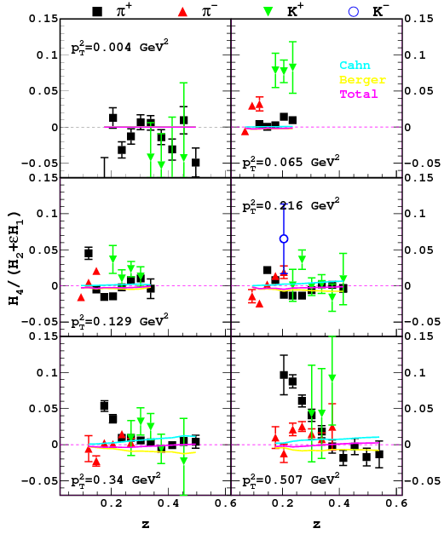
<cos2φ>
Cahn - M.Anselmino et al., PRD71,
Berger – A.Brandenburg et al., PLB347
<Q²>=2.2 GeV²
Sys.err. 2%

Slide 5
Spettroscopia

Slide 6
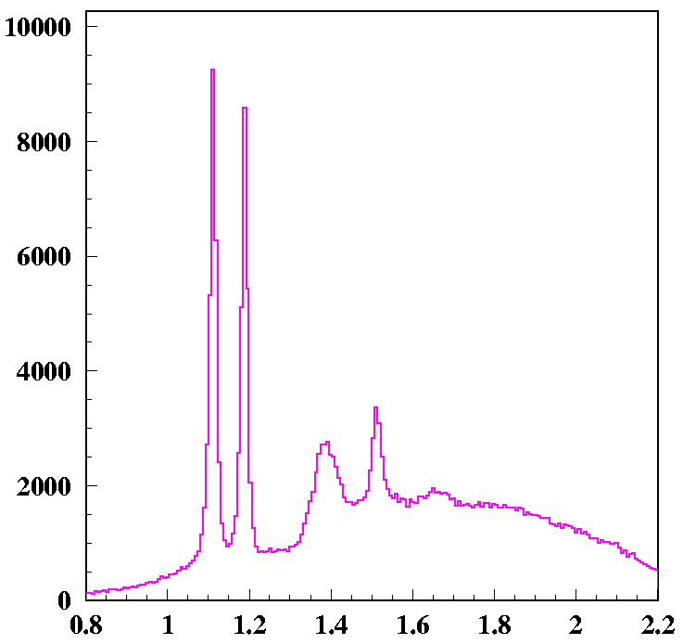
Λ*(1520) Production
Most prominent excited Λ seen in photo- and electro-production but production mechanism is still poorly understood because of the lack/disagreement of experimental data
Discrepancies between measured observables in different energy and angular range may point to different production mechanisms
Counts
Λ⁰(1116)
Σ⁰(1192)
Σ*(1385)
Λ(1405)
Λ*(1520)
M_{x}(γp→K⁺X ) (GeV)

Slide 7
Λ*(1520) Production
Most prominent excited Λ seen in photo- and electro-production but production mechanism is still poorly understood because of the lack/disagreement of experimental data
Discrepancies between measured observables in different energy and angular range may point to different production mechanisms
  first measurement at Daresbury and SLAC indicated dominance of t-channel K* exchange processes

Slide 8
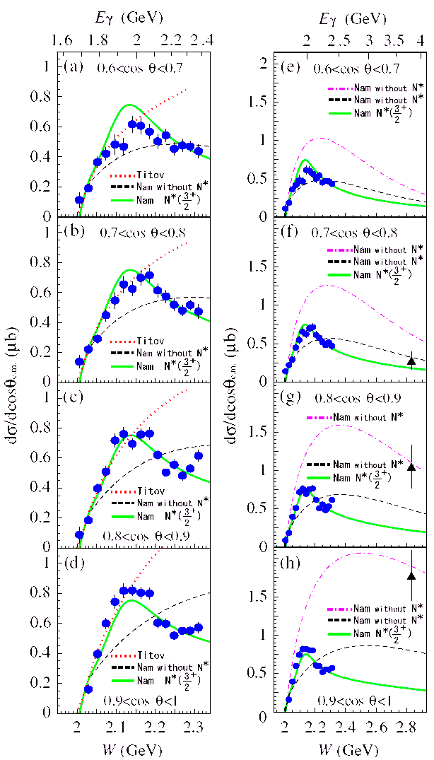
Λ*(1520) Production
Most prominent excited Λ seen in photo- and electro-production but production mechanism is still poorly understood because of the lack/disagreement of experimental data
Discrepancies between measured observables in different energy and angular range may point to different production mechanisms
  first measurement at Daresbury and SLAC indicated dominance of t-channel K* exchange processes
  Most recent data from LEPS suggest possible contribution from s-channel processes (nucleon resonances)

Slide 9
Λ*(1520) Production
Λ* differential cross section and decay angular distributions have been measured at CLAS in photo-production on the proton
The differential cross section is forward peaked suggesting the dominance of t-channel processes
CLAS PRELIMINARY

Slide 10
Λ*(1520) Production
Λ* differential cross section and decay angular distributions have been measured at CLAS in photo-production on the proton
The differential cross section is forward peaked suggesting the dominance of t-channel processes
The dependence of the t-slope from the photon energy shows a strong change at E~2.1-2.2 GeV, suggestive of different mechanisms contributing to the low–high energy region
Analysis completed and note in preparation for submission to Physics Working Group
NINA-Daresbury
SAPHIR (unpublished)
CLAS – g11
CLAS PRELIMINARY

Slide 11
GDH a basso impulso trasferito

Slide 12
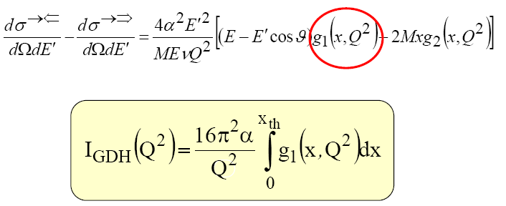
Goal: To measure the Generalized Gerasimov-Drell-Hearn (GDH) sum for proton & deuteron @ low Q² (0.01 – 0.5 GeV²) region. (by measuring g1 and then its first moment Γ₁ )
Method of the experiment :
  measure the scattering of polarized electrons off polarized targets down to 6° scattering angles (to achieve the needed low Q² )
  g1 to be extracted from the helicity dependent absolute inclusive cross-section difference .
Data taken from February to May, 2006.

Slide 13
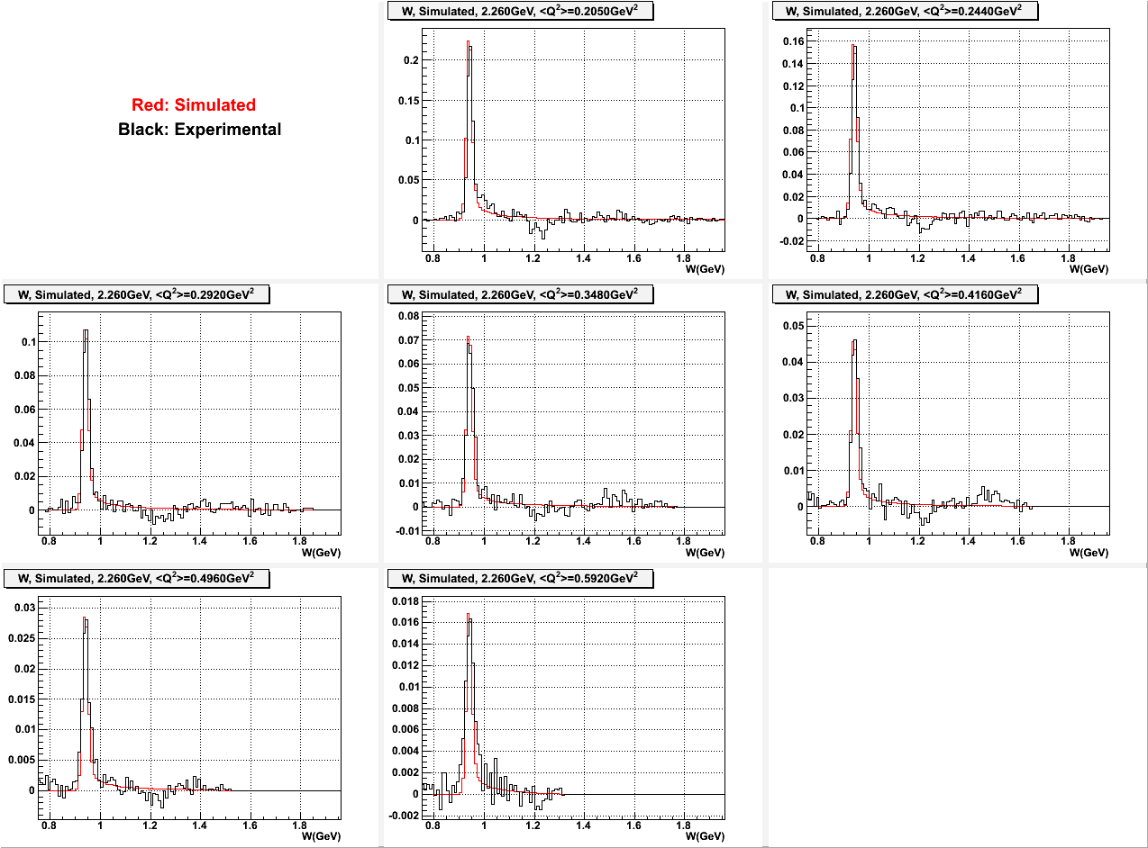
Differenza sezioni d’urto polarizzate

Slide 14
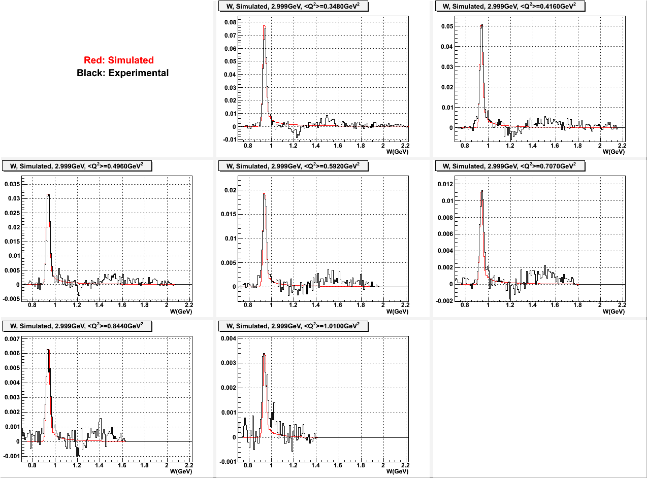

Slide 15
Misura del Fattore di Forma di Transizione della Λ⁰
Interazione debole di corrente carica (scambio di W)
Unica possibilità per misurare il vertice elettromagnetico pΛ⁰
Sfrutta la dipendenza dall’elicità dell’interazione debole (avviene solo se l’elettrone ha elicità left)

Slide 16
Studio di fattibilità con CLAS12 (tesi di B.Caiffi)
Sezione d’urto PICCOLISSIMA
Necessaria alta luminosità
Si pensa di usare solo il central detector:
  BST, CTOF e CND

Slide 17
Simulati i possibili fondi
Necessario
  Particle ID
  Invariant mass = M_{Λ}
  Missing mass = 0
  Altri constraints cinematici in via di studio

Slide 18
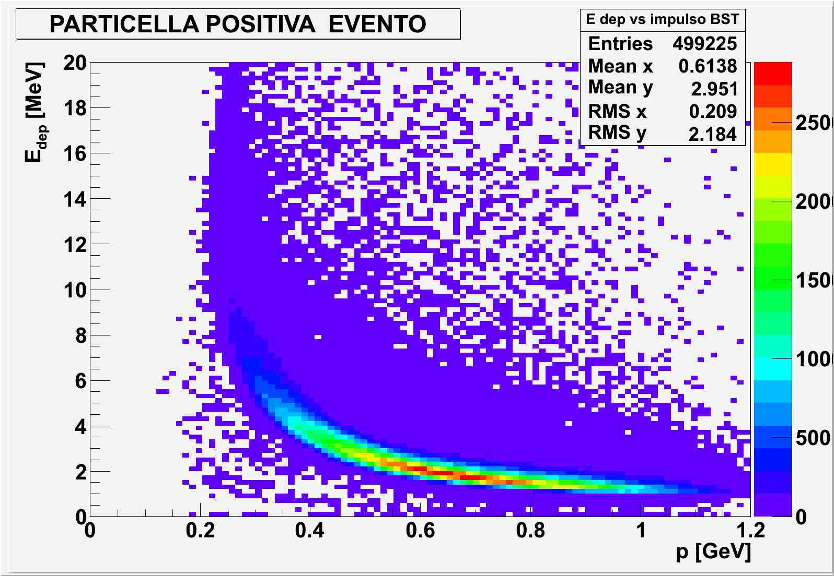
Protoni nel BST

