Slide 1
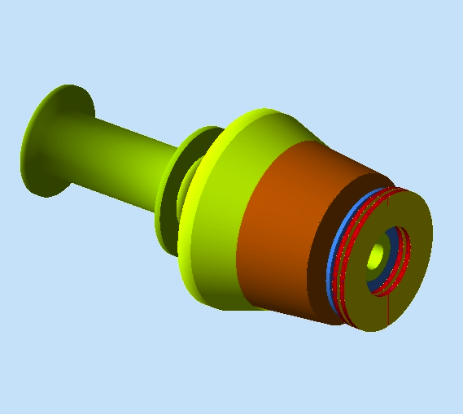
The Forward Tagger for CLAS12 a status update
R. De Vita, INFN- Genova
JLab12 Collaboration Meeting
Roma, June 9th 2011

Slide 2
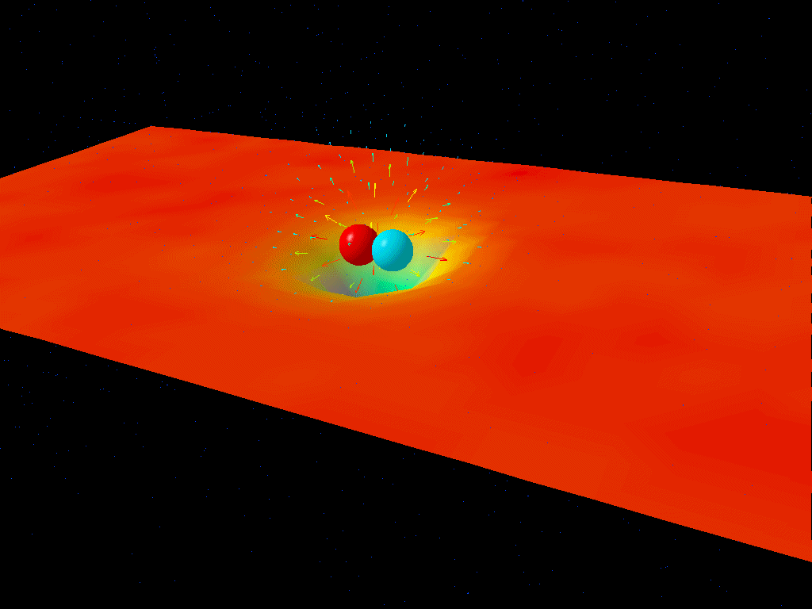
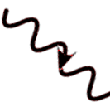
Meson Spectroscopy with CLAS12
The study of the light-quark meson spectrum and the search for exotic quark-gluon configurations is crucial to reach a deep understanding of QCD:
identify relevant degrees of freedom
understand the role of gluons and the origin of confinement
Photo-production is the ideal tool:
linearly polarized photon beam (NEW!)
large acceptance detector (CLAS12)
D. Leinweber
Visualization of the interaction between a quark and antiquark
Quasi-real photoproduction with CLAS12
(Low Q² electron scattering)
Forward Tagger
E’ | 0.5-4.5 GeV
ν | 7-10.5 GeV
θ | 2.5-4.55 deg
Q² | 0.007 – 0.3 GeV²
W | 3.6-4.5 GeV
Photon Flux | 5 x 10⁷ γ/s @ L_{e}=10³⁵
Forward
Tagger
CLAS12
e⁻
γ*
e⁻
p

Slide 3
Meson Spectroscopy with CLAS12
E11-005: Meson Spectroscopy with low Q² electron scattering in CLAS12
M.Battaglieri, R.De Vita, D.Glazier, C.Salgado, S.Stepanyan, D.Weygand and the CLAS Collaboration
Study meson spectrum in the 1-3 GeV mass range to identify gluonic
excitation of mesons (hybrids) and other quark configuration beyond the CQM
Approved by JLab PAC37 with rate A-
80+39 PAC days allocated
Additional Proposals and LOIs using the FT:
LOI11-001: Search for Scalar Mesons at low Q² using CLAS12
K. Hicks and the CLAS Collaboration
Presented to JLAB PAC37
New Proposal on the Production of the Strangest Baryon with CLAS12
In preparation

Slide 4
Experiment Layout
Calorimeter
Tracker
HTCC Moller cup
Scintillation Hodoscope
Moller Shield

Slide 5
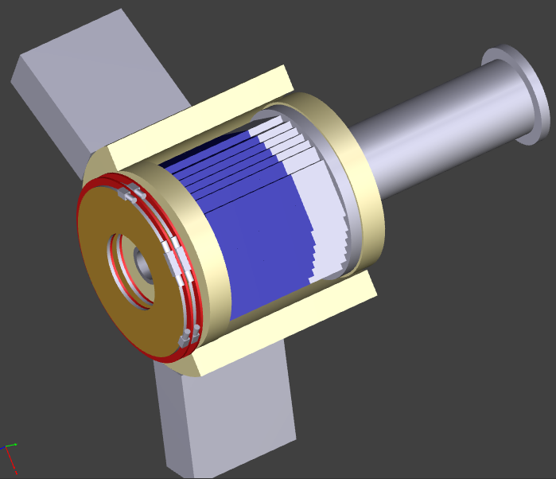
The Forward Tagger
Calorimeter + Scintillation Hodoscope + Tracker
Electron energy/momentum
Photon energy (ν=E-E')
Polarization ε⁻¹ ≈1 + ν²/2EE'
FT - Cal
Veto for photons
FT - Hodo
Electron angles
Q²= 4 E E' sin² ϑ/2
Scattering plane
FT - Trk
CAD implementation
A. Bersani

Slide 6
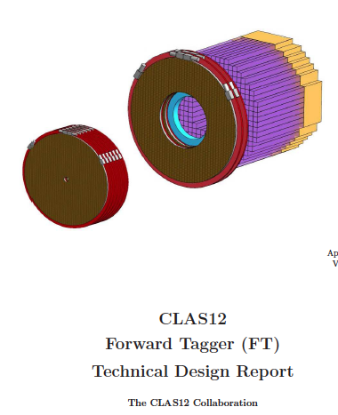
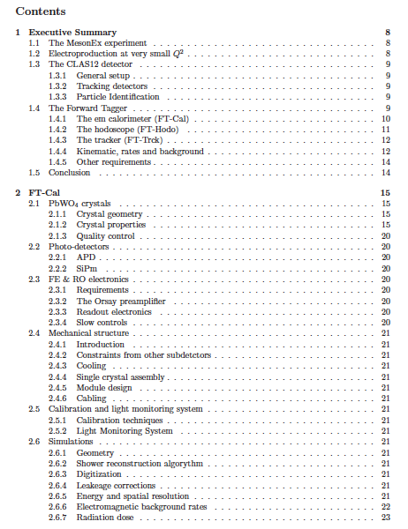
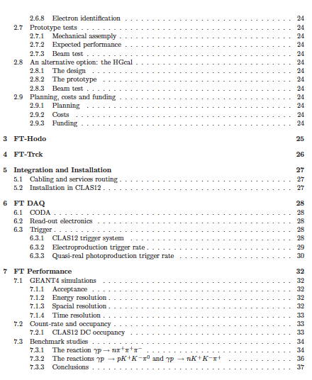
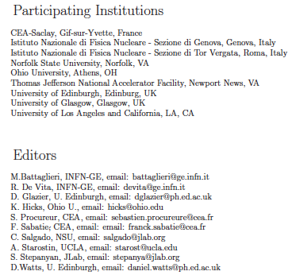
Technical Design Report
Ready by the end of the summer

Slide 7
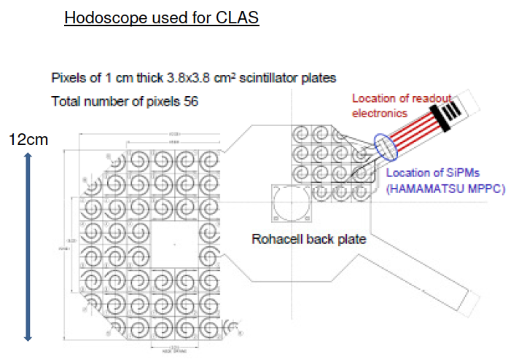
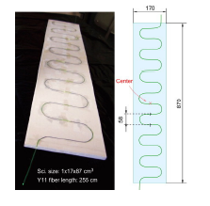
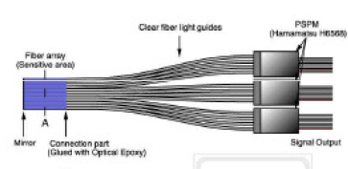
Scintillation Hodoscope
Similar to CLAS-Hodoscope: scintillator tiles+WLS fibres
D.Watts, D.Glazier
U. Edinburgh
Tiles+WLS fibers in Edinburgh ready for tests
Time resolution
FT-Hodo in GEMC
Other options are under study (G4 simulations and lab tests)
Scintillator fibres design
Embedded WLS design
(T2K 1.7ns)
Diamond detector array
(100ps, £100k)

Slide 8
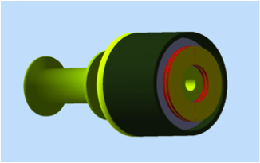
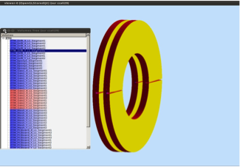
Tracker
G.Charles, S.Procurer, F.Sabatie
CEA-Saclay
Two layers of MicroMegas in GEMC
Full tracking using two MM-layers and FT-Cal
Matching with FT-Cal cluster information to reduce noise and evaluate e⁻ energy
Preliminary results indicate a resolution of Δθ~0.5^{O} and Δϕ<1^{O}
Full simulation with background are in progress
Detector construction quite simple (compared to the CLAS12 Forward-tracker)
200 mm strips
2k readout channels

Slide 9
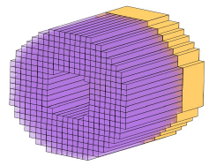
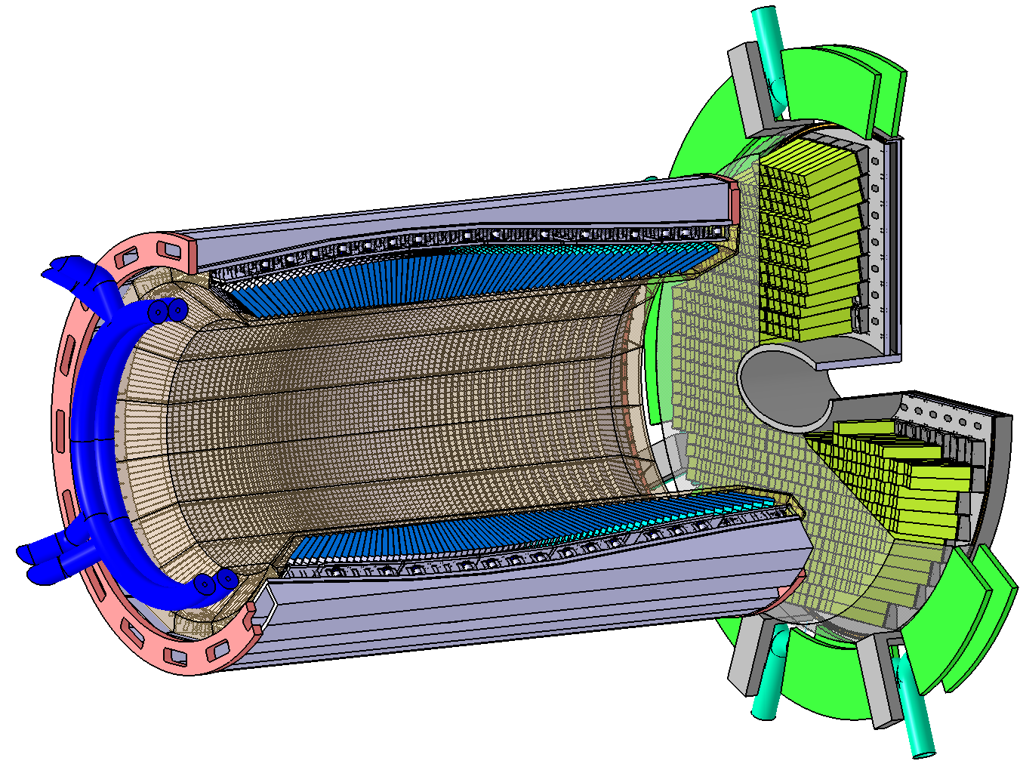
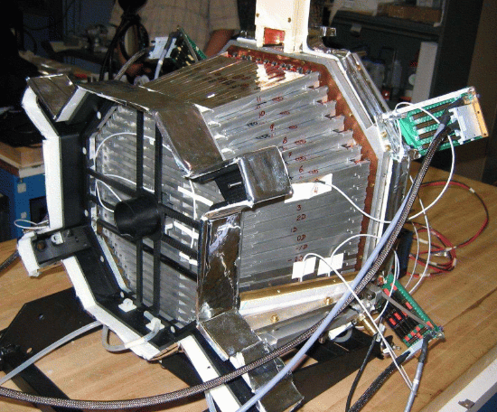
Calorimeter
Specifications:
High light yield
Good energy resolution (~2-3% @ 1 GeV)
Good time resolutions
Magnetic-field insensitive readout
Radiation hardness
PbWO₄ crystals with APD/SiPM based readout:
~400 PbWO₄-II crystals (15x15x200mm³)
10x10 mm2 Large-Area-APDs or 4-channel SiPM matrices by Hamamatsu
Custom preamplifier (IPN-Orsay)
Cooling at -25° to increase light yield
Exploit experience of
CMS-EC, CLAS-IC and
PANDA-EMC

Slide 10
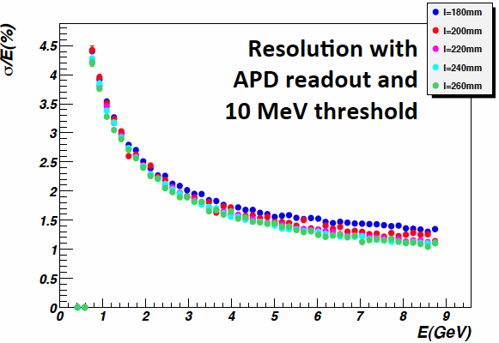
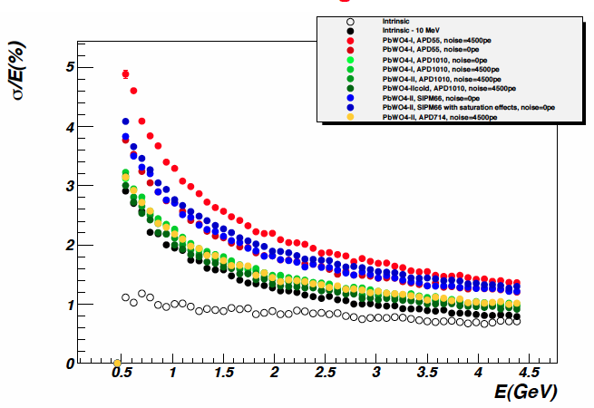
Simulations
Detailed simulations of the calorimeter response with GEANT4 CLAS12 package gemc
Optimization of crystal geometry:
Acceptance and resolution for different crystal shapes (squared, hexagonal, trapezoidal crystals) and arrangements around the beamline
Crystal length
Comparison of different readout options:
Regular 5x5 mm² APDs
Large area 10x10 APDs
SIPM matrices
Study of background and shielding:
Crystal rates
Radiation dose
DC occupancies
Optimization of Moller shield and calorimeter support structure

Slide 11
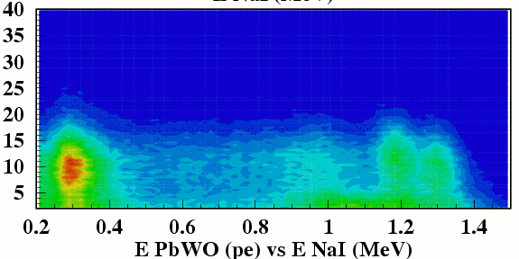
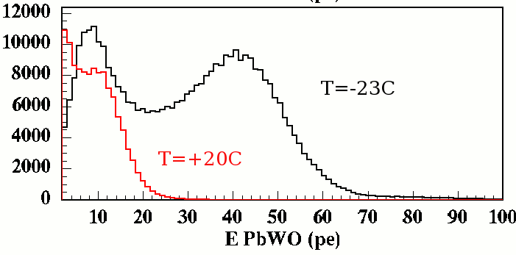
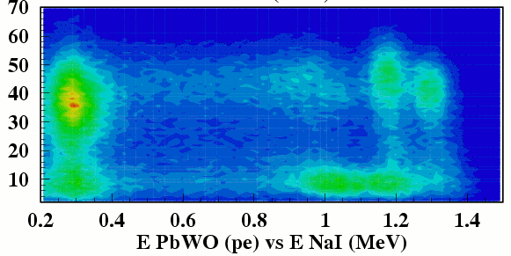
PbWO4 Crystals
PBW04-II Crystal from BTCP (Russia)
Characterization of dimension, light transmission, light yield and decay time with the ACCOS system at CERN
Detailed measurement of light absorption at U. Edinburgh with dedicated spectrophotometer (D. Watts)
Measurement of light yield and decay time with radioactive sources and cosmic rays (Genova)
PbWO4
PMT
NaI
Co60
T=+20°
T=-23°

Slide 12

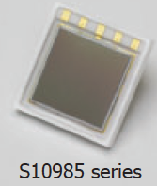
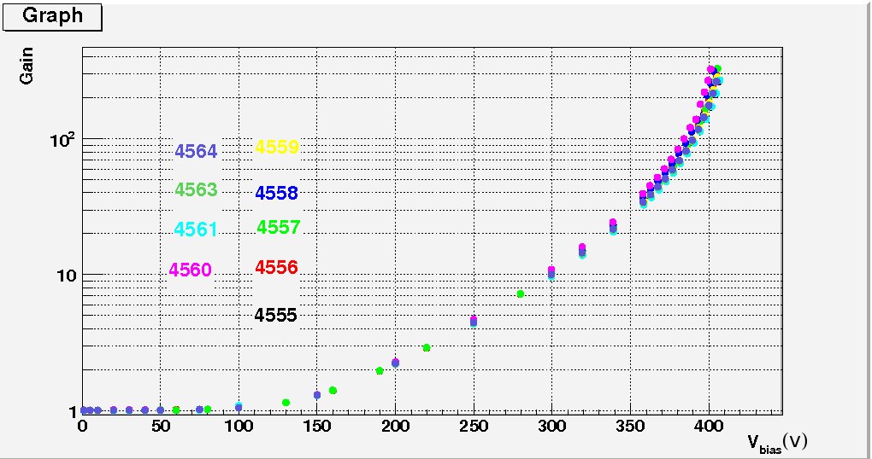
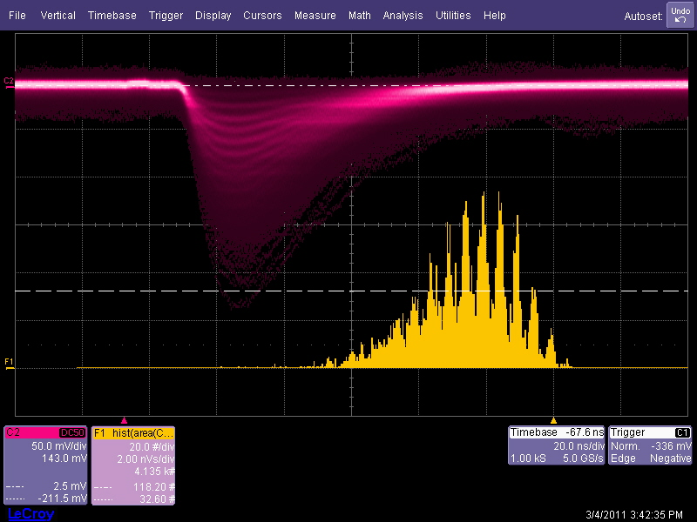
Light Sensors
A.Casale, A.Celentano
Hamamatsu LAAPD
10x10 mm²
APD and SiPM tested with Co60, YAP and laser
APD gain and T dependence
Hamamatsu SiPM
2x2 ch 3x3mm²
SiPM linearity (up to 2k incident optical γ)
S10985-25c
Single p.e. normalization
N p.e. estimated from distribution width
S10985-50c

Slide 13
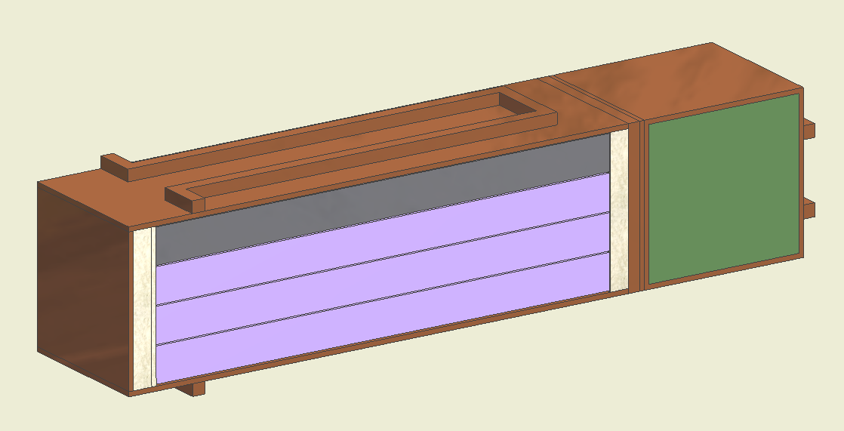
FT-Cal Prototype
9 PbWO-II 15x15x200 mm3 crystals
Test scheduled at BTF-LNF in July
Electron beam up 25-750 MeV, 1 to 10¹⁰ electrons per pulse
Testing different FT-Cal components:
Cryogenics (from -25^{O}C to +20^{O}C)
FE/RO electronics and light readout (APD/SiPM)
Clusters reconstruction
Linearity
Radiation damage with high energy electrons (up to 0.2 rad/h)

Slide 14
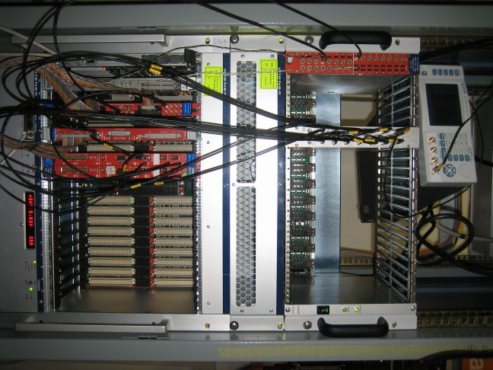
Data Acquisition
S. Boiarinov, JLab
A. Celentano, Genova
DAQ scheme for the FT-prototype similar to final CLAS12 scheme:
DAQ based on CODA software, using ROC board running VXWORKS as VME controller: the output data format can be BOS or EVIO.
For each detector channel, one FADC and one TDC to get both timing and energy information; FADCs with the same characteristics as the JLab ones: 250 Msamples/s, 12 bit resolution, 2 V max input signal.
External trigger distributed to the system by a Trigger Interface Board (TI): for on-beam prototype tests, trigger provided by fast scintillator placed in from of the detector. Self-triggering option, using the discriminator OR or MAJORITY output, for calibration runs.
Same base architecture as the real DAQ for the FT in CLAS12
FT-Prototype
9 ch
Amplifier +
Splitter x2
Discriminator
TDC
External
trigger
Red: Data
Blue: Trigger
Green: Read-out handling
Flash ADC
(2 boards,
8 channels each)
ROC + TI
VME 64x with VXS extension

Slide 15
Summary and Plans
R&D of different FT components is in progress
Test of calorimeter prototype planned for the summer
Mechanical design of full FT is in progress (INFN-Genova mechanical design group); second meeting for integration in CLAS12 in May 2011
Collaboration with IHEP-Protvino for the implementation of a LED based monitoring system for the calorimeter (designed based on ALICE-PHOS detector)
Collaboration with IPN-Orsay for the optimization of the light sensor preamplifiers
Completion of detector TDR by fall 2011

