Slide 1
Speed of Gravity and Cosmology Constraints from Binary Neutron Stars using Time Delays between Gravitational Waves and Short Gamma-ray Bursts.
Leonardo Iampieri
with Dr. Simone Mastrogiovanni, Prof. Francesco Pannarale
IV Gravi-Gamma-Nu Workshop - 05/10/2023

Slide 2
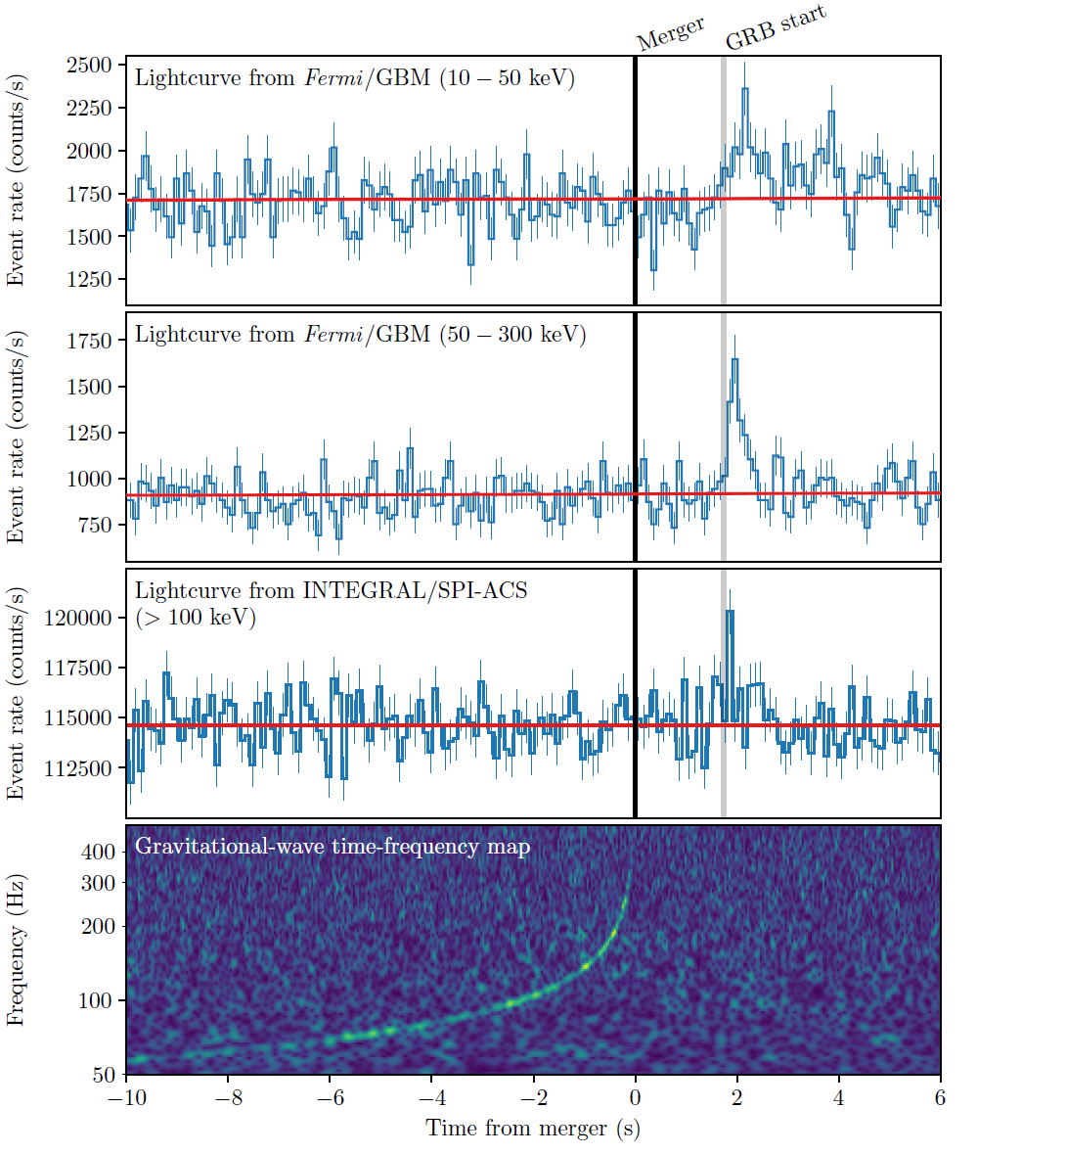
Multimessenger observations
17 August 2017: Joint detection of gravitational waves (GWs) and electromagnetic counterpart from coalescing binary neutron stars (BNS):
GW170817: Consistent with the merger of a BNS at ~40 Mpc.
GRB170817A: Detected by Fermi-GBM, short Gamma-ray burst (sGRB) arrived 1.74 s after the GW luminosity peak (merger). Luminosity of 10⁴⁷ erg/s.
AT2017gfo: Kilonova, observed from the X-ray to the radio for several days.
[B. P. Abbott et al 2017 ApJL 848 L12]
L. Iampieri IV Gravi-Gamma-Nu Workshop 05/10/2023

Slide 3
Speed of Gravity
Multi-messenger observations of BNS mergers can be used to constrain both the speed of gravity and the Hubble constant.
The observed time delay between GW and sGRB is given by:
Prompt Time Delay
Speed of Gravity
Observed Time Delay
Cosmological Redshift
Lookback Time
From GW170817, using the time delay measure, the following constraint was set on the speed of gravity:
[B. P. Abbott et al 2017 ApJL 848 L13]
L. Iampieri IV Gravi-Gamma-Nu Workshop 05/10/2023

Slide 4
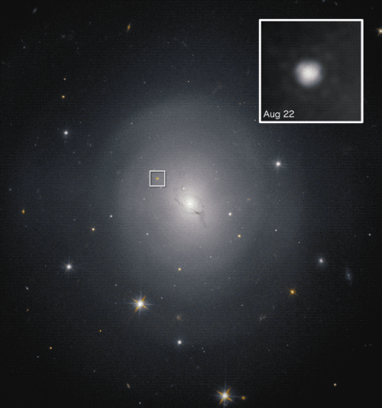
Hubble Constant
GW sources are standard sirens: we can derive the luminosity distance directly from the GW signal.
The luminosity distance is given by:
For GW170817, the redshift is obtained from the host galaxy identification (NGC4993).
These two observables were used to constrain the Hubble Constant (H0):
NGC4993
Luminosity distance
Hubble constant
[B. P. Abbott et al Nature volume 551 (2017)]
L. Iampieri IV Gravi-Gamma-Nu Workshop 05/10/2023

Slide 5
Summary and Goal
During the two next observing runs of Ligo and Virgo, O4 and O5, we expect ~0-10 joint GW-sGRB detections per year [Patricelli+, MNRAS, Volume 513, Issue 3 2022].
With Einstein Telescope (ET), we might expect ~100 joint GW-sGRB detections per year [Ronchini+, A&A 665, A97 (2022)].
Objectives: Exploit the hosteless (no single host identified) joint detections of ____GW-sGRB to:
Constrain speed of gravity and prompt time delay distribution. ! Never studied before !
Constrain H0 even in absence of redshift measure. ! New technique !
L. Iampieri IV Gravi-Gamma-Nu Workshop 05/10/2023

Slide 6
Generation of the GW-sGRB Mock Catalog
I performed an end-to-end simulation of GW and sGRB detections from BNS mergers. I assumed several scenarios for the GW detector network and for the prompt time delay distribution.
I generated 9 GW-sGRB Mock Catalogs for each detector network and prompt time delay model.
Ghirlanda+, A&A 594 (2016) A84
B.P. Abbot+, Living Reviews in Relativity volume 23 (2020) Michele Maggiore et al JCAP03(2020)050
J. Gair+ The Astronomical Journal 166 (2023)
A. Farah+, ApJ 895 (2020) 108
L. Iampieri IV Gravi-Gamma-Nu Workshop 05/10/2023

Slide 7
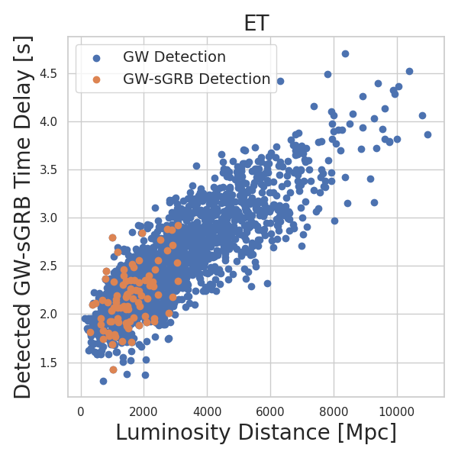
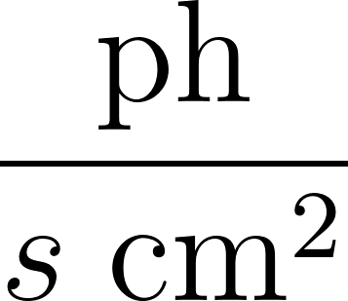
Catalog of Simulated GW-sGRB Detections
simulated BNS mergers.
Prompt time delay model is a gaussian centered around 1.7 s.
Detection Threshold: SNR > 12 for GW and Flux > 5 for sGRB.
L. Iampieri IV Gravi-Gamma-Nu Workshop 05/10/2023

Slide 8
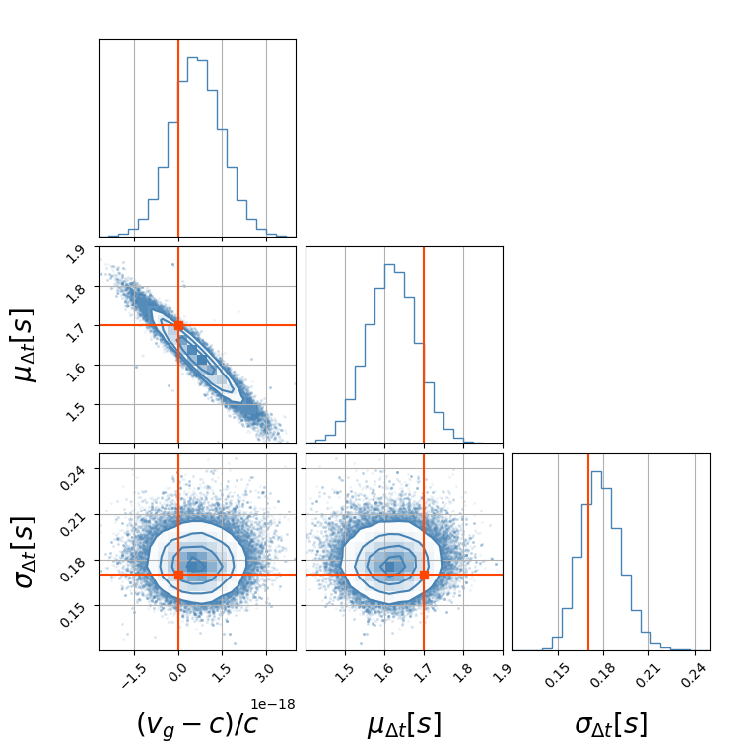
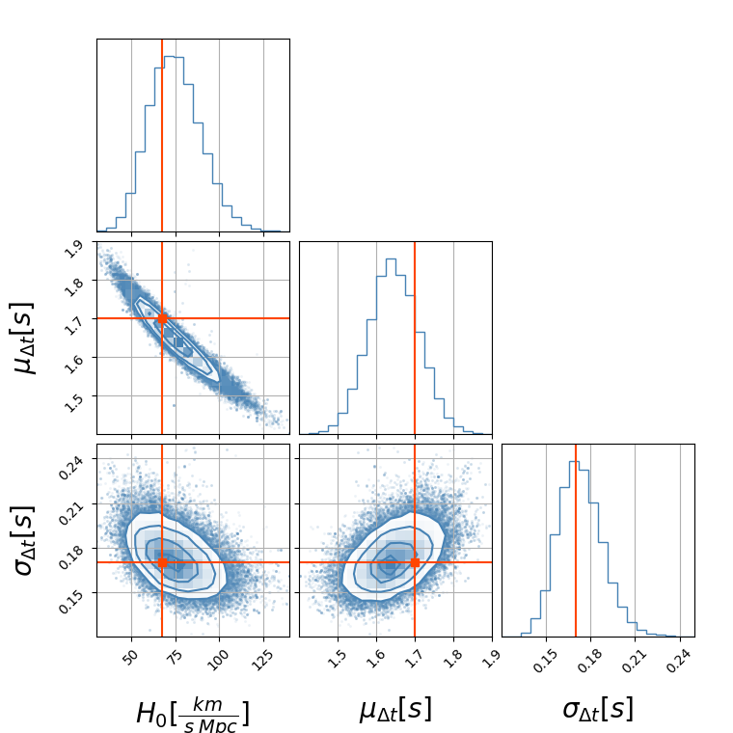
Forecast - 1
Joint and marginalized posterior distributions in the case of 100 events detected by ET and true value of s.
L. Iampieri IV Gravi-Gamma-Nu Workshop 05/10/2023

Slide 9
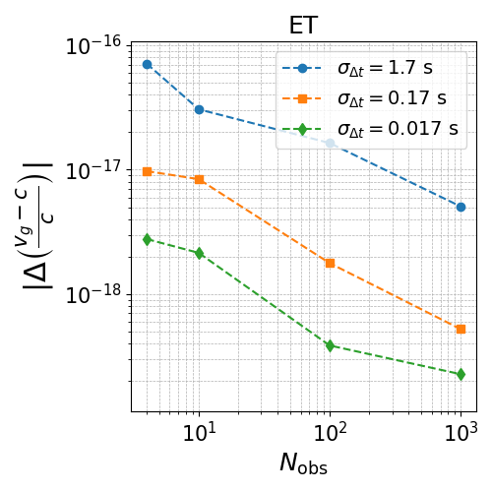
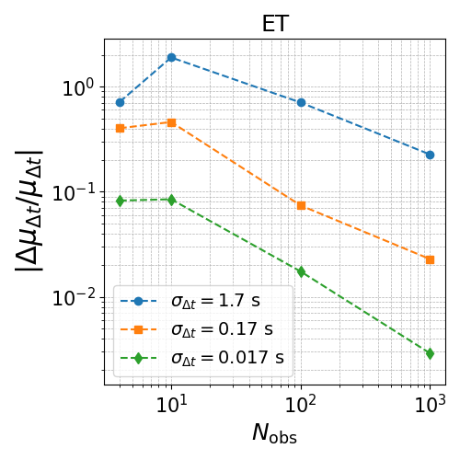
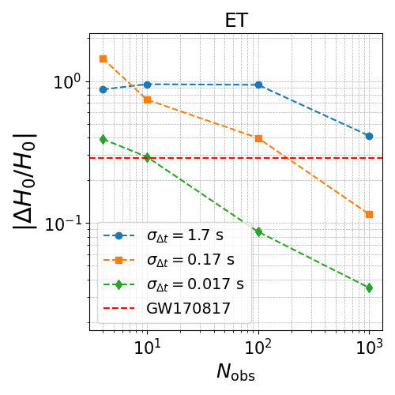
Forecast - 2
Precision on the population parameters as we combine more and more joint GW-sGRB detections.
L. Iampieri IV Gravi-Gamma-Nu Workshop 05/10/2023

Slide 10
Conclusions
I performed 108 Hierarchical Bayesian Inference Analyses for each detector network, prompt time delay model and number of joint GW-sGRB detections.
Speed of gravity and prompt time delay distribution can be jointly constrained with 10 observations for all detectors sensitivities.
For a joint constraint on H0 and the prompt time delay distribution we need at least a 100 event and the sensitivity of the Einstein Telescope.
This method of measuring the Hubble constant has different systematics with respect to both the Galaxy catalog method and the mass method and can thus be used to give an independent measure of H0.
L. Iampieri IV Gravi-Gamma-Nu Workshop 05/10/2023

Slide 11
Conclusions
Thanks for the attention
L. Iampieri IV Gravi-Gamma-Nu Workshop 05/10/2023

Slide 12
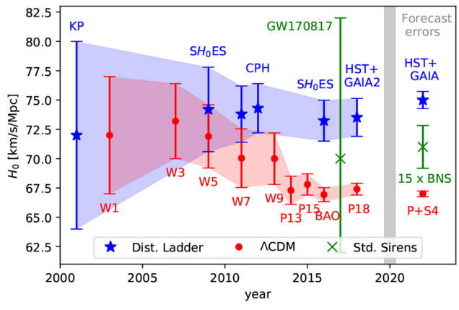
The Hubble tension
Discrepancy in the measured values of the Hubble Constant (H0):
Cosmic Microwave Background (early universe) - Planck experiment.
Standard candles (late universe) - SH0ES experiment.
Proposed solutions to the Hubble tension:
Unmodeled systematics in one of the experiments.
New physics such as modified gravity: Can introduce a speed of gravity different from light.
CMB
[J. Ezquiaga+ Front. Astron. Space Sci., 21 December 2018]
L. Iampieri IV Gravi-Gamma-Nu Workshop 05/10/2023

Slide 13
Bayesian Hierarchical Inference and IcaroGW
My objective is to reconstruct population properties from a set of noisy observation with selection biases.
I use Hierarchical Bayesian Inference (HBI) to reconstruct posterior distribution for the population parameters.
I implemented prompt time delay and merger rate models in IcaroGW (a package for HBI) to infer speed of gravity and Hubble constant.
I performed 108 HBI Analyses.
GW Likelihood (errors measurement)
Hierarchical Likelihood
Detection Probability
Prompt Time Delay and Merger Rate Model
L. Iampieri IV Gravi-Gamma-Nu Workshop 05/10/2023

Slide 14
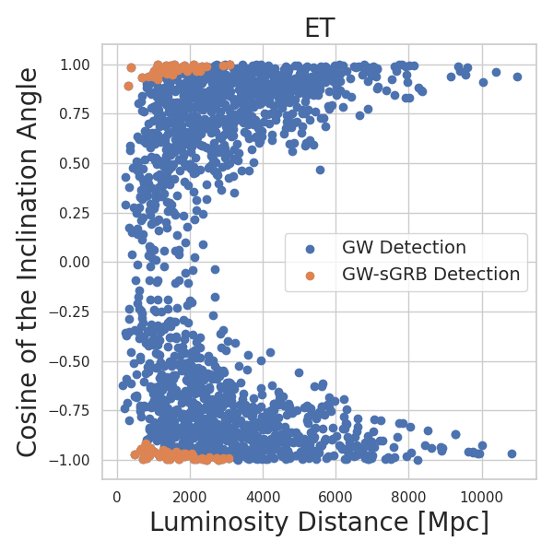
Catalog of Simulated GW-sGRB Detections
simulated BNS mergers.
Prompt time delay model is a gaussian centered around 1.7 s.
Detection Threshold: SNR > 12 for GW and Flux > 5 for sGRB.
L. Iampieri IV Gravi-Gamma-Nu Workshop 05/10/2023

Slide 15
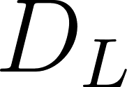
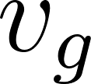
Summary and Goal - 2
To understand how to constrain H0 in the absence of a direct redshift measurement, consider the following qualitative discussion:
At low redshift, the observed GW-sGRB time delay is given by:
From a joint GW-sGRB detection we can measure both the luminosity distance and the observed time delay .
If the values of the prompt time delay and the speed of gravity are known, we can obtain an implicit redshift evaluation to use for cosmology.
Since we do not know the distribution of and the value of we must fit for them.
L. Iampieri IV Gravi-Gamma-Nu Workshop 05/10/2023

Slide 16
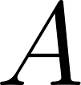
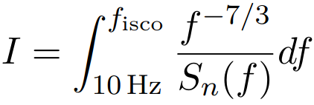
Signal-to-Noise Ratio
I used the 0-th post-Newtonian order approximation of the SNR:
Inclination Angle
Luminosity Distance
Antenna Patterns
Where is given by:
While , which encapsulates the noise curve of the detectors, is given by:
Detected
Chirp Mass
Power Spectral Density
L. Iampieri IV Gravi-Gamma-Nu Workshop 05/10/2023

Slide 17
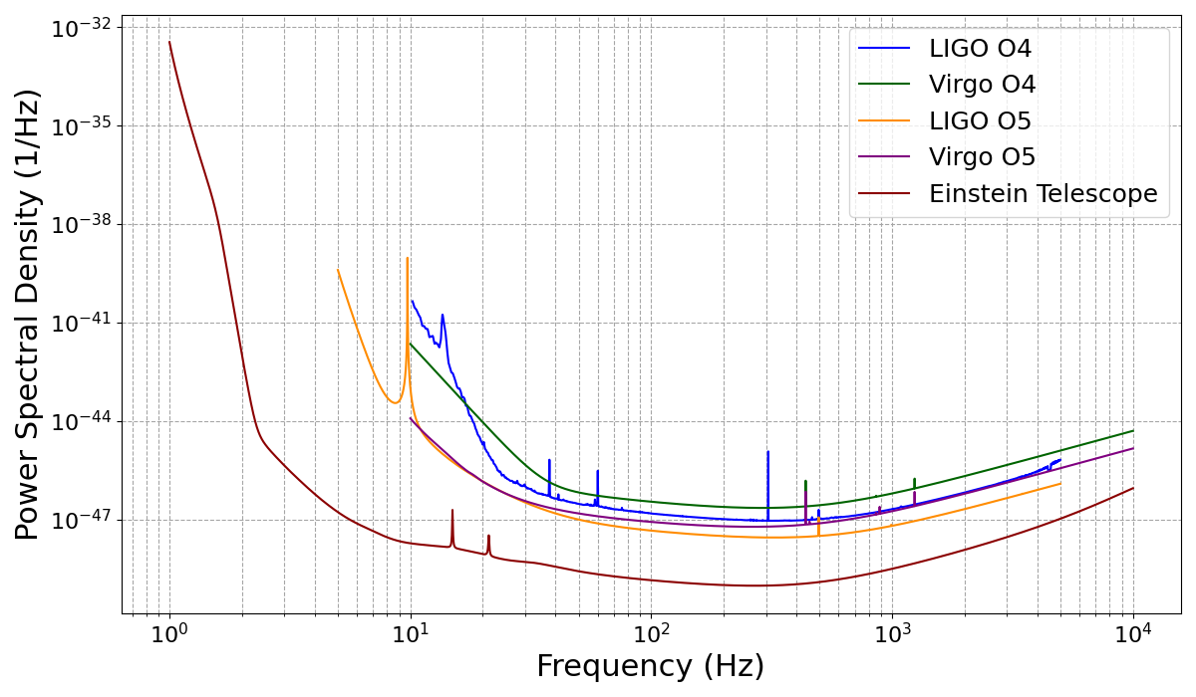
Power Spectral Density
Power Spectral Density as a function of frequency for current (O4) and future observational runs (O5, ET).
L. Iampieri IV Gravi-Gamma-Nu Workshop 05/10/2023

Slide 18
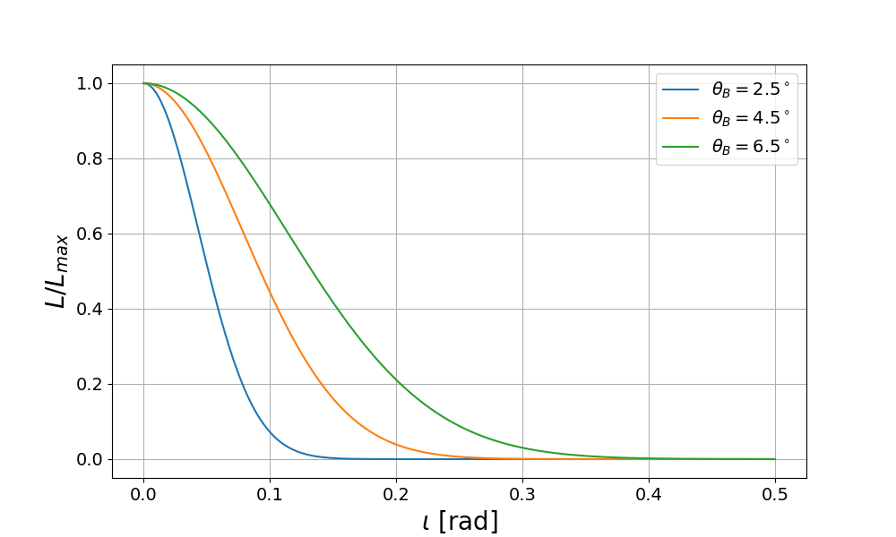
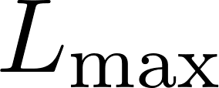
sGRBs Simulation
I chose the following simplified model to describe the sGRB intrinsic luminosity:
Where:
ɩ is the viewing angle.
is the width of the jet.
is the luminosity at the center of the jet. is drawn from a log-normal distribution with a mean of _______erg s and width of 0.56 dex.
L. Iampieri IV Gravi-Gamma-Nu Workshop 05/10/2023

Slide 19
Errors Generation
I generated the noisy value of luminosity distances by using the following likelihood:
True Physical Value
Noisy Counterpart
I sampled the noise of the detected time delays and the observed SNR from a Gaussian distribution:
L. Iampieri IV Gravi-Gamma-Nu Workshop 05/10/2023

Slide 20
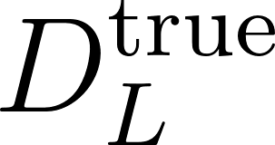
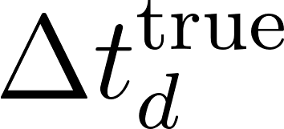
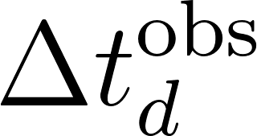
GW Likelihood
The overall Gravitational Wave Likelihood is given by:
For each GW detection, I generated Posterior Samples (PEs), i.e. the possible values of ( , ) from which the observed ( , ) were generated.
PEs are sampled from the posterior:
PE Prior
L. Iampieri IV Gravi-Gamma-Nu Workshop 05/10/2023

Slide 21
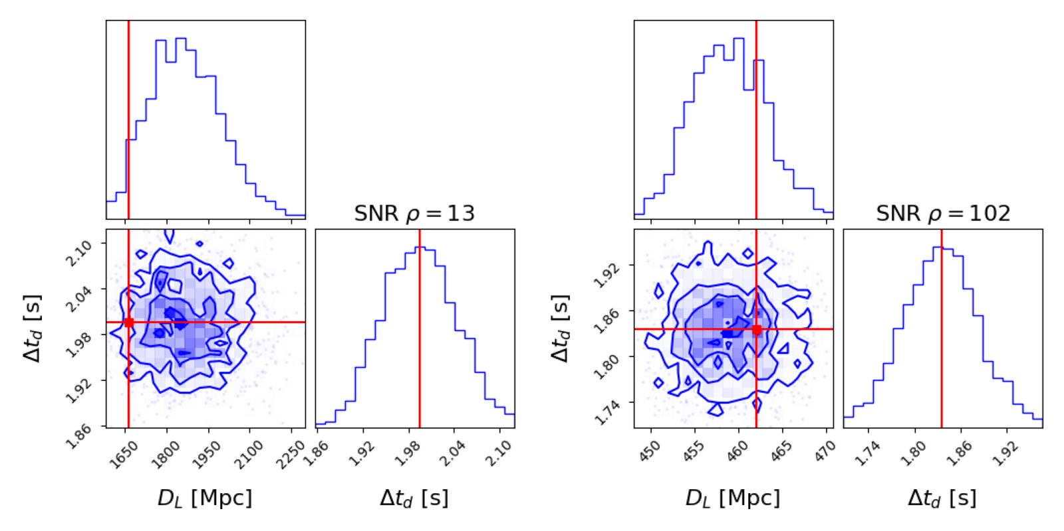
Posterior Samples
Posterior samples of luminosity distance and detected time delay for a signal with SNR = 13 and one with SNR = 102. Both events have been detected by ET.
L. Iampieri IV Gravi-Gamma-Nu Workshop 05/10/2023

Slide 22
Hierarchical Likelihood Evaluation
To evaluate the numerator in the Hierarchical Likelihood (HL) Expression I summed over the PE samples:
The second central quantity is the denominator of the HL Expression , which accounts for selection biases.
In order to assess selection biases I used “injections”, i.e. Monte Carlo simulations of injected and detected events.
I computed the integral in through Monte Carlo integration over detected injections:
L. Iampieri IV Gravi-Gamma-Nu Workshop 05/10/2023

