Slide 1

Decomposing the Galactic Centre
$γ$-ray emission with neutrino imaging and millisecond pulsar population
Mullard Space Science Laboratory
Space and Climate Physics
Paul Chong Wa Lai
Mullard Space Science Laboratory, University College London
Kinwah Wu (UCL), Matteo Agostini (UCL), Foteini Oikonomou (NTNU, Norway)
Beatrice Crudele (UCL), Ellis R. Owen (Osaka U, Japan)
IV Gravi-Gamma-Nu Workshop in L’Aquila
4-6 October 2023

Slide 2
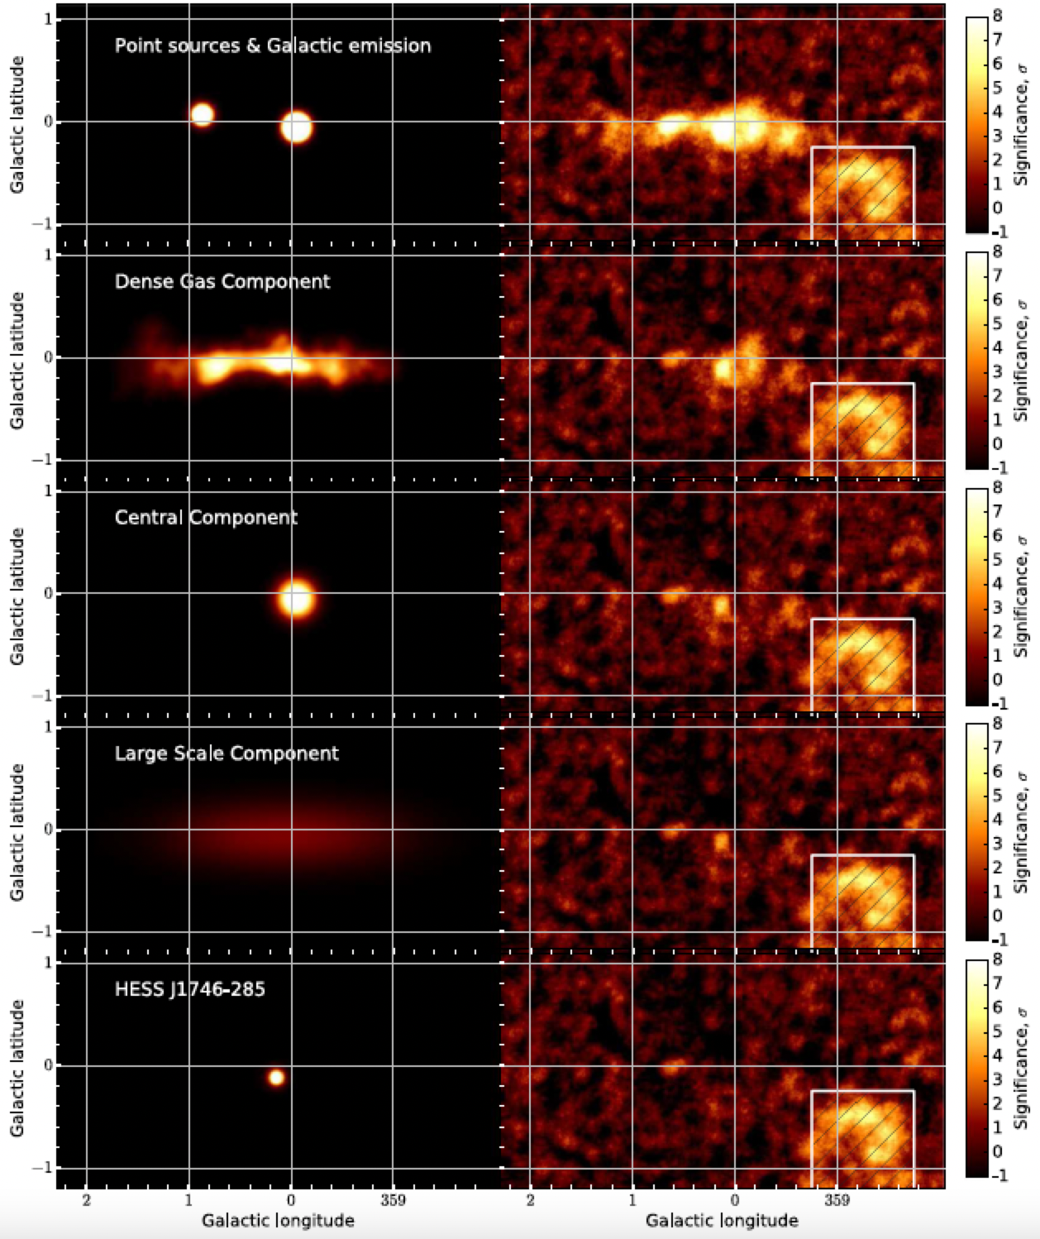
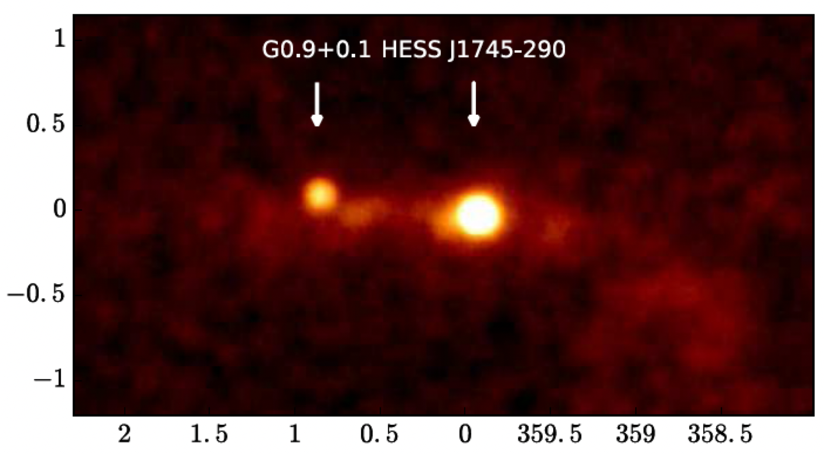

The Galactic Centre
$γ$-ray emission
~100 GeV – 45 TeV
(HESS 2018)
Notes:
SNR G0.9+0.1:
J1745-290: unknown origin, DM? What if it is also hadronic?
J1745-303: lower right ring
DGC:
CC
LSC:
J1746-285:

Slide 3
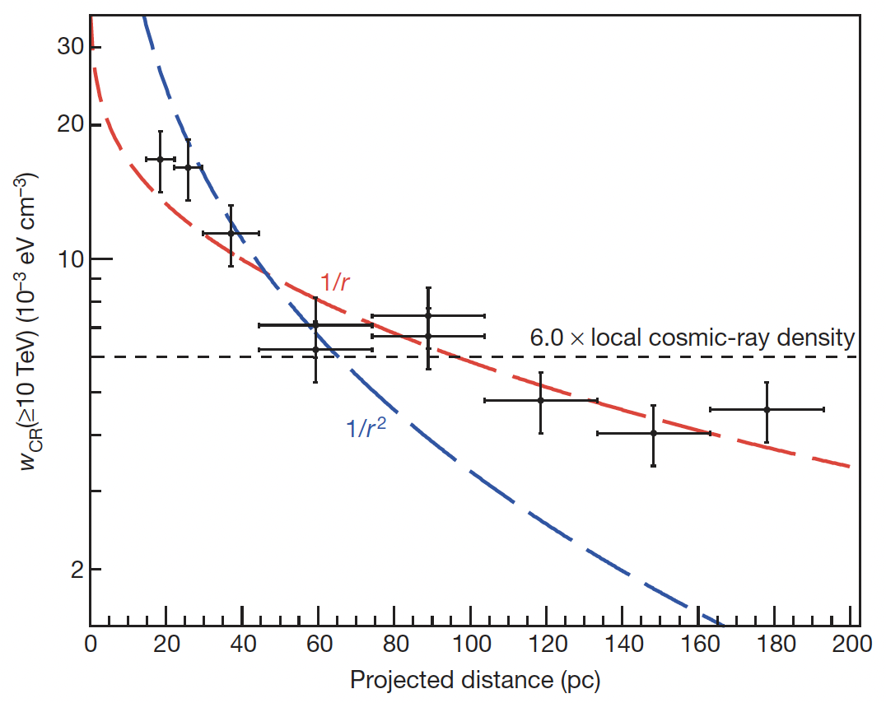
Which are hadronic?
Which are leptonic?
Cosmic-ray density
(HESS 2018)
(HESS 2016)

Slide 4
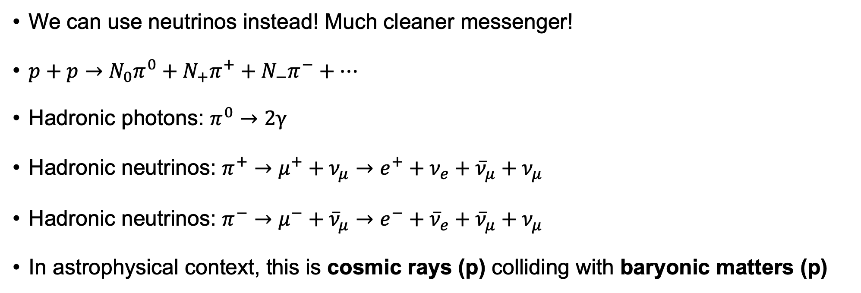
pp interactions (hadronic interactions)
We can use neutrinos instead! Much cleaner messenger!
$p+p→N_{0}π^{0}+N_{+}π^{+}+N_{−}π^{−}+…$
Hadronic photons: $π^{0}→2γ$
Hadronic neutrinos: $π^{+}→μ^{+}+ν_{μ}→e^{+}+ν_{e}+{\overline{ν}}_{μ}+ν_{μ}$
Hadronic neutrinos: $π^{−}→μ^{−}+{\overline{ν}}_{μ}→e^{−}+{\overline{ν}}_{e}+{\overline{ν}}_{μ}+ν_{μ}$
In astrophysical context, this is cosmic rays (p) colliding with baryonic matters (p)

Slide 5
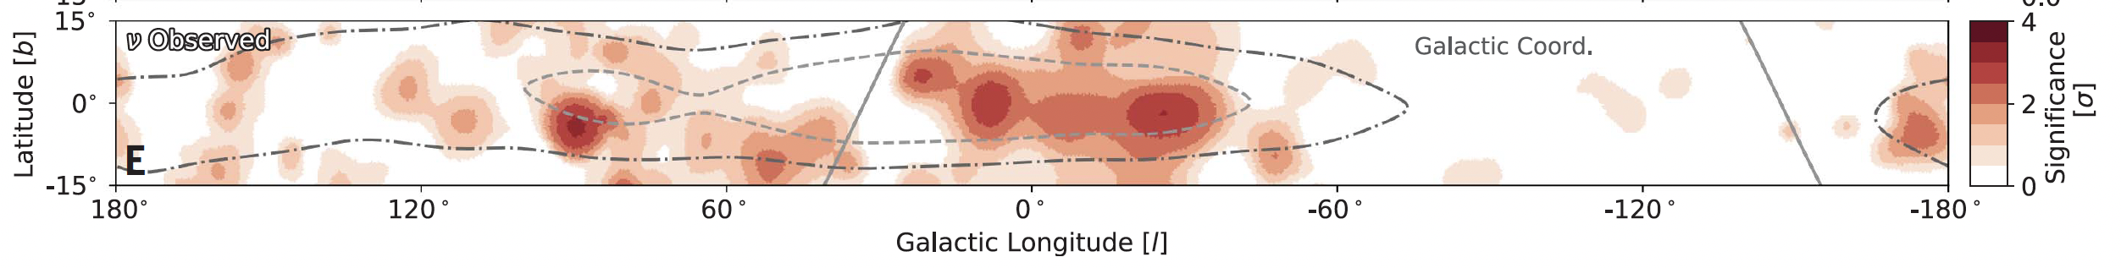
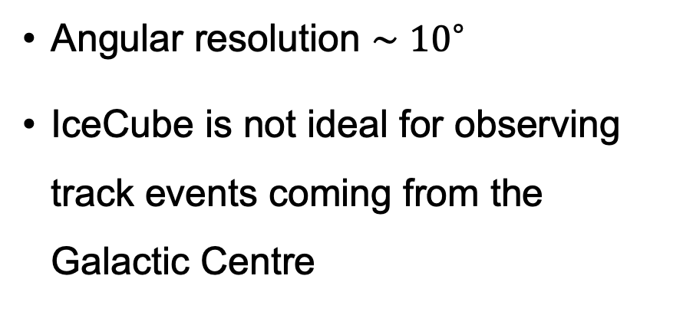
IceCube Milky Way neutrino map
(IceCube 2023)
Angular resolution $∼{10}^{∘}$
IceCube is not ideal for observing track events coming from the Galactic Centre
sensitivity of track events
(Schumacher+ 2022)

Slide 6
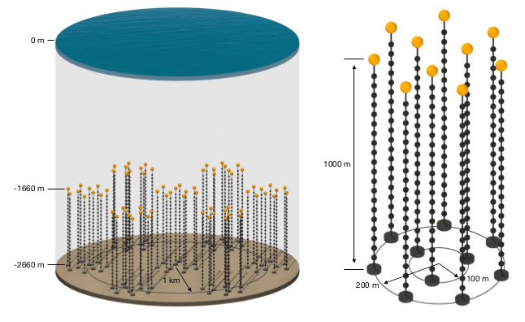
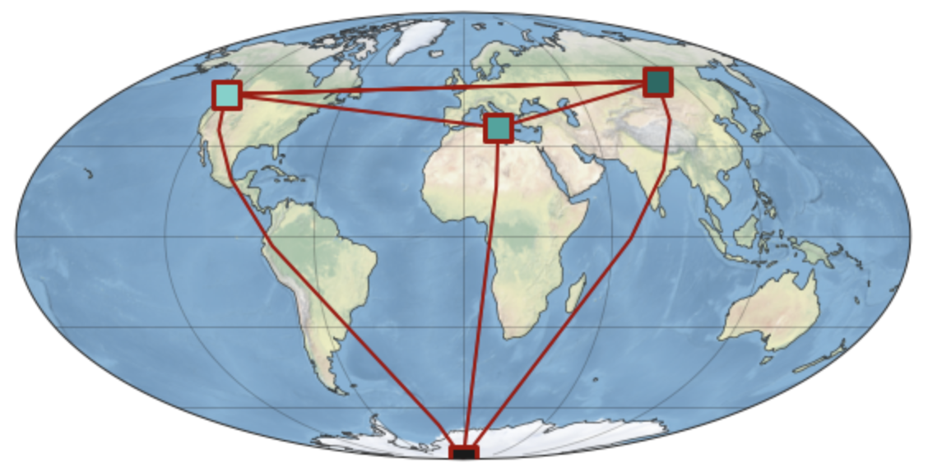



P-ONE and PLE$ν$M
2024-2025: first mooring line deployed (P-ONE-1)
Late 2020s: Full buildout
The Galactic Centre will be observed at $∼{0.1}^{∘}$ resolution
PONE
Baikal-GVD
KM3NeT
IceCube
Design of P-ONE (Agostini+ 20)
PLE$ν$M (Schumacher+ 22)

Slide 7
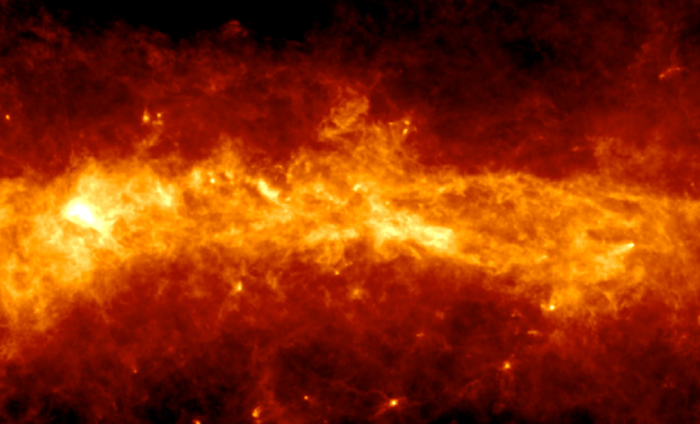












Schematic of the model
~200 pc
$$ν$$
pp
$$ν$$
pp
MSPs
$$ν$$
$$γ$$
$$γ$$
pp
CR p
CR p
pp
$$ν$$
$$γ$$
$$γ$$
Central Molecular Zone (CMZ)
nuclear star cluster
Sgr A* (GC)
(Molinari+ 11)

Slide 8
Why supernova remnants fail?
Observations suggest (HESS 2016)
A continuous injection
PeV cosmic rays
Supernova remnants are episodic
Cosmic rays from SNR are typically < 100 TeV (e.g., Bell+2013)

Slide 9
Millisecond pulsars as cosmic-ray accelerators
Protons can be accelerated to very high energies by pulsars (Blasi+ 2000; Arons 2003; Guepin+ 2020)
Spin-down luminosity:
Maximum proton energy:
Only 0.2% to 4.0% of the spin-down energy goes to protons (Guepin+2020)

Slide 10
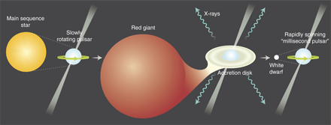
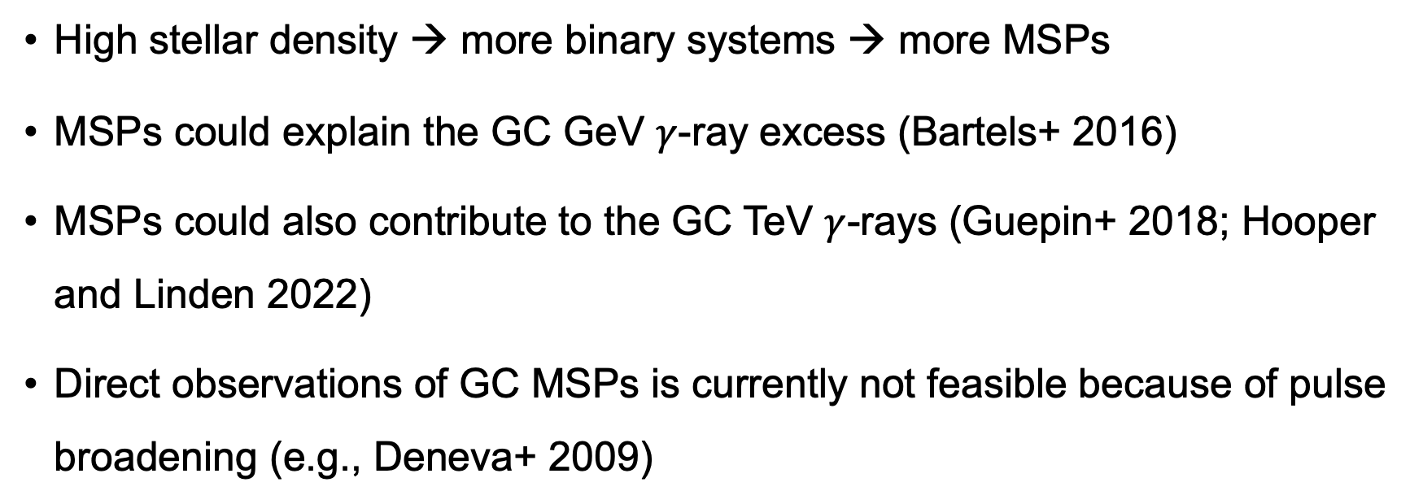
Millisecond pulsars (MSPs) in the Galactic Centre (GC)
Lorimer 2005
High stellar density → more binary systems → more MSPs
MSPs could explain the GC GeV $γ$-ray excess (Bartels+ 2016)
MSPs could also contribute to the GC TeV $γ$-rays (Guepin+ 2018; Hooper and Linden 2022)
Direct observations of GC MSPs is currently not feasible because of pulse broadening (e.g., Deneva+ 2009)

Slide 11
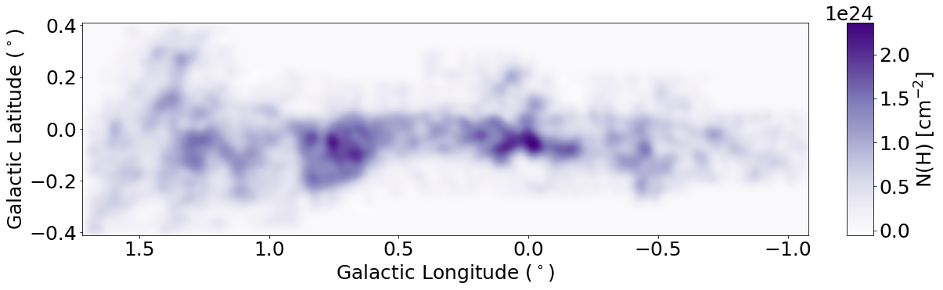
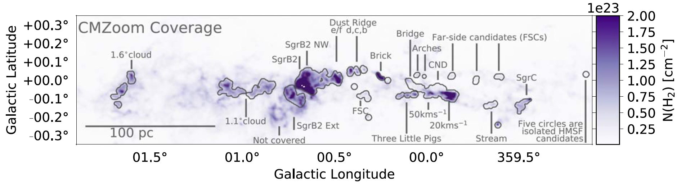
Gas density distribution
derived from
CS line emission
Tsuboi+1999
derived from
dust infrared emission
Molinari+2011

Slide 12
Synthetic neutrino image

Slide 13
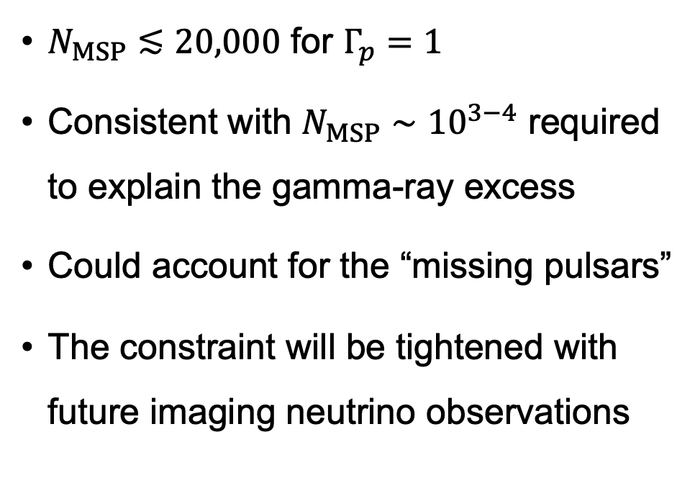
Constraining MSP population using gamma-rays
$N_{MSP}≲20,000$ for $Γ_{p}=1$
Consistent with $N_{MSP}∼{10}^{3−4}$ required to explain the gamma-ray excess
Could account for the “missing pulsars”
The constraint will be tightened with future imaging neutrino observations

Slide 14
Summary
A neutrino image of the Galactic Centre will determine:
a more accurate mass distribution
cosmic-ray distribution
A high-resolution neutrino image of the GC will be available
Implications:
population of millisecond pulsars
GeV excess and TeV emission
chemical and thermal properties of the Central Molecular Zone

