Slide 1
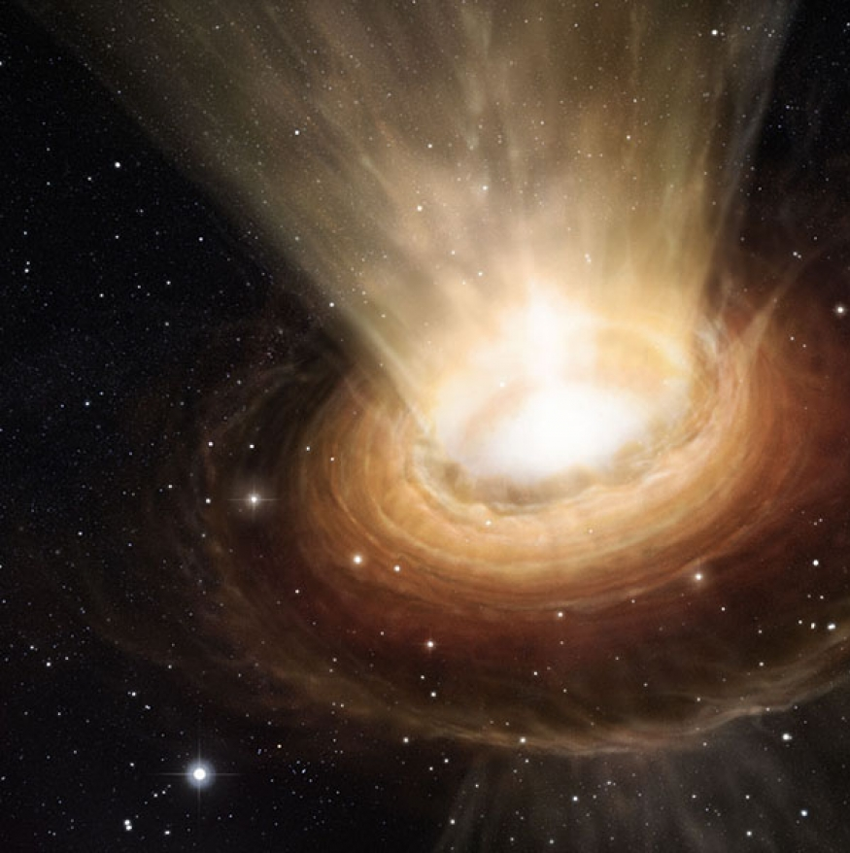
Astrophysical clues of axion-like particles
Francesco Schiavone
Università degli Studi di Bari & INFN Bari
IV Gravi-Gamma-Nu Workshop
Gran Sasso Science Institute, L’Aquila
4 October 2023

Slide 2
Experimentally, the neutron has no electric dipole moment
Or at least, it must be very small.
$$d_{N}≃\left(0.0±1.1\right)×{10}^{−26} e⋅\text{cm}$$

Slide 3
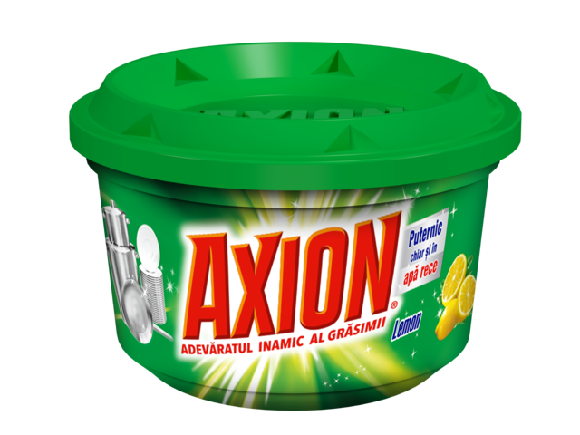
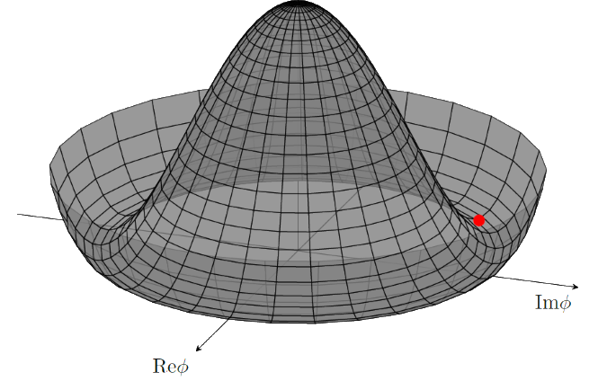
The strong CP problem and the QCD axion
QCD predicts a neutron EDM depending on an unknown parameter $\overline{θ}$
Strong CP problem: to match observations, $\overline{θ}$ must be «unnaturally» small ($<{10}^{−10})$
If $\overline{θ}$ were a field, it could spontaneously «relax» to zero via symmetry breaking (Peccei-Quinn mechanism, 1977)
The corresponding particle is called an axion [Wilczek and Weinberg, 1978]

Slide 4
Axion models and couplings
The QCD axion has an effective coupling to photons $g_{aγγ}$ proportional to its mass $m_{a}$
This is fundamental for detection!
String theory also predicts many axion-like particles (ALPs) with no clear $m_{a}$-$g_{aγγ}$ relationship
Effectively a «family» of axions

Slide 5
Bounds on ALP-photon coupling
https://cajohare.github.io/AxionLimits/docs/ap.html

Slide 6
ALPs from gamma-ray sources

Slide 7
Gamma-ray opacity of the Universe
The Universe is filled with an extragalactic background light (EBL) of astrophysical origin
Interaction of gamma rays with EBL produces $e^{+}e^{−}$ pairs (Breit-Wheeler process)
The resulting effective absorption of gamma rays is parametrized by optical depth $τ(E,z)$
Absorption generally increases with $z$ and $E$, i.e. the Universe is opaque to faraway gamma-ray sources

Slide 8
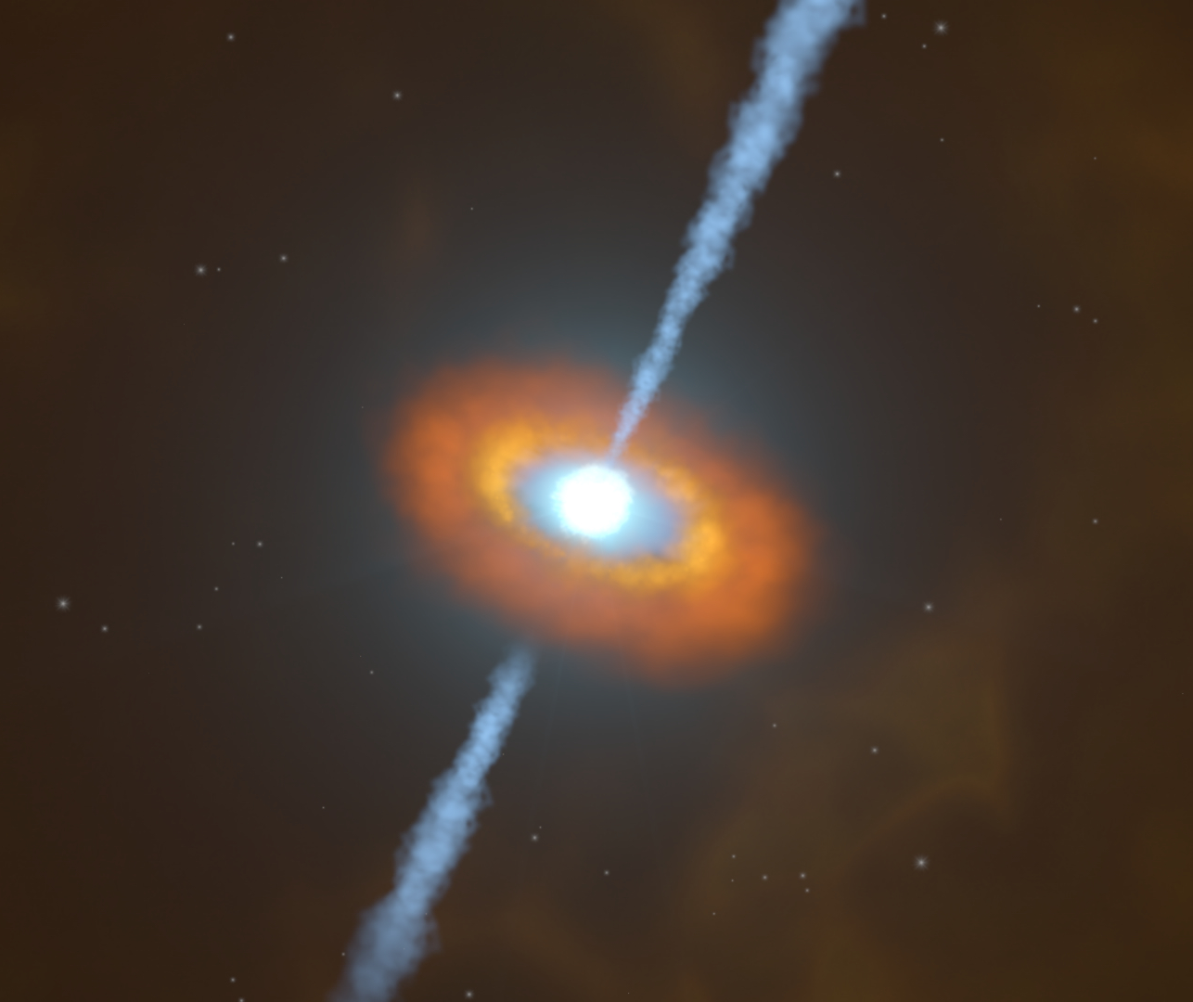
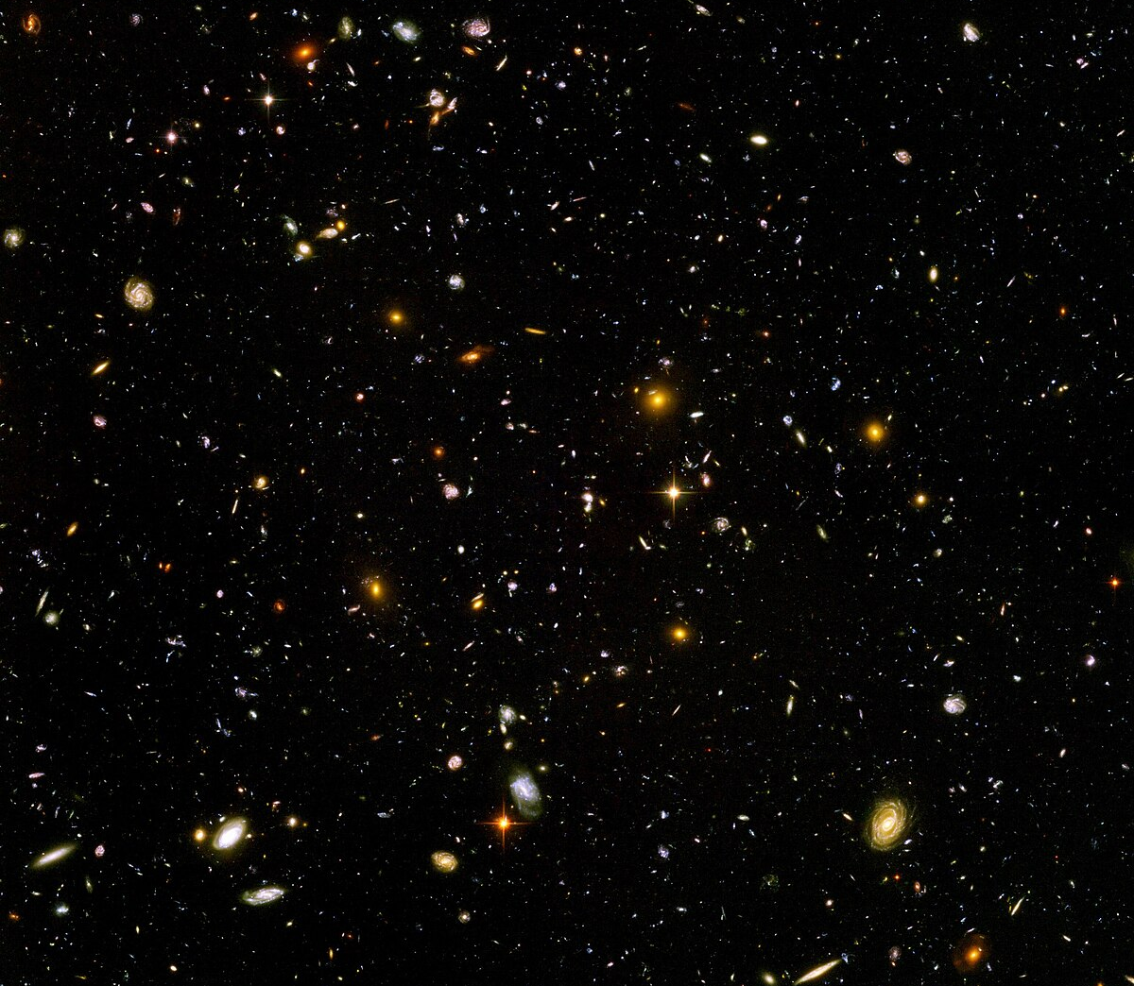
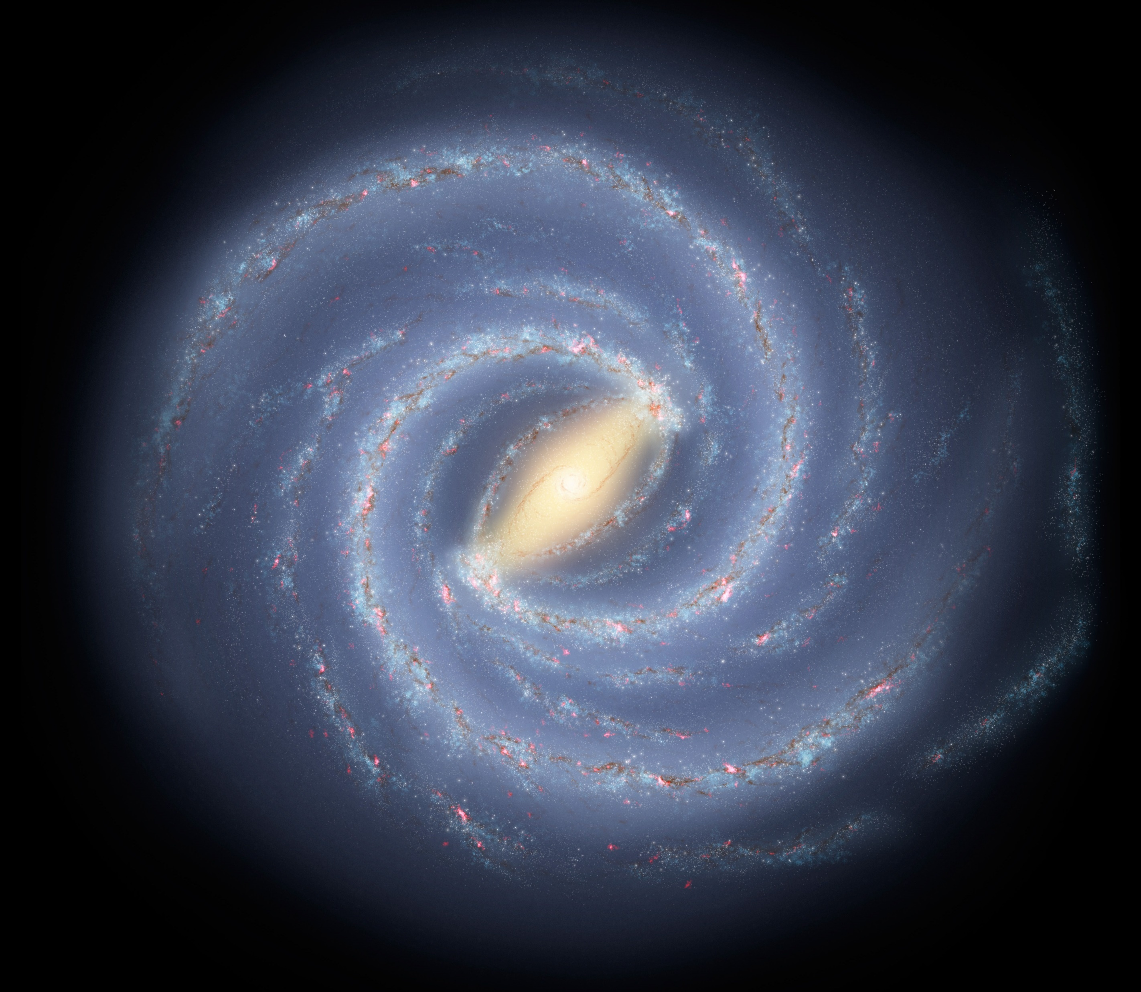
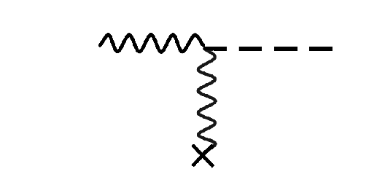
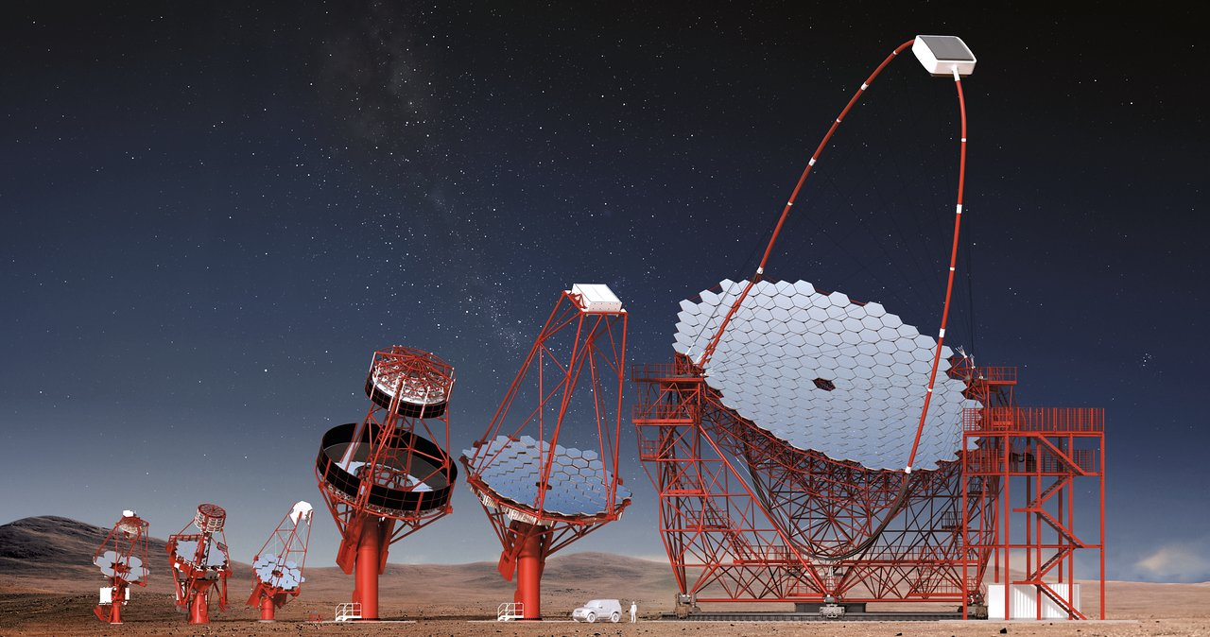
ALPs can reduce gamma-ray opacity
$$a$$
$$a$$
$$γ$$
$$γ$$
Light
(gamma-ray source)
«Wall»
(EBL)
Detector
Intra-cluster
magnetic field
(ICMF)
Galactic
magnetic field
(GMF)

Slide 9
Sources: TeV blazars
Active galactic nuclei (AGNs) with relativistic jets oriented towards Earth
Often found in galaxy clusters with intense (turbulent?) magnetic fields $𝒪(1 \text{μG})$
Several observations show harder spectra than expected from EBL absorption [Galanti & Roncadelli, arXiv:2205.00940 and refs.]
https://www.nasa.gov/content/goddard/black-hole-batteries-keep-blazars-going-and-going

Slide 10
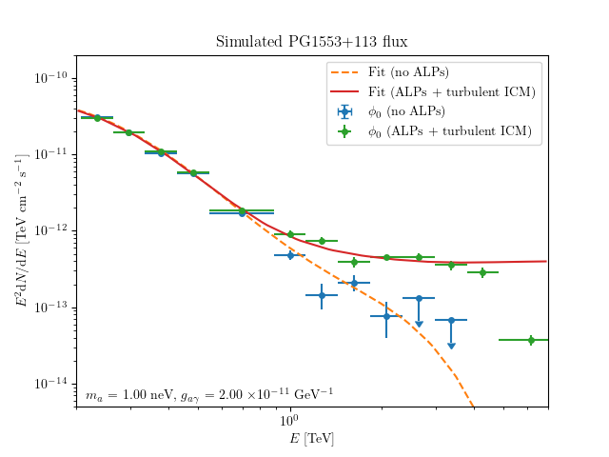
Observed photon flux
ONGOING WORK

Slide 11
Outlooks: CTA sensitivity [Meyer & Conrad, arXiv:1410.1556 ]
Turbulent magnetic fields require a complex statistical approach
A test statistic (TS) distribution is obtained for each point in the $(m_{a},g_{aγ})$ space
Improvements: combination of more sources and better magnetic field modeling

Slide 12
ALPs in multimessenger astronomy
Some recent literature

Slide 13
ALP constraints from GW170817 [Bhupal Dev et al, arXiv:2305.01002]
Massive ALPs could be produced by nuclear processes in neutron star mergers
Photon signal from $a→γγ$ decay
Contrary to standard processes ($1.7 \text{s}$ delay measured by Fermi-GBM), this should be a prompt signal

Slide 14
ALP constraints from GW170817 [Bhupal Dev et al, arXiv:2305.01002]
Gamma-ray observations of NS mergers can help constrain the ALP parameter space
In principle, it would be possible to resolve the ALP decay signal within $∼1 \text{s}$ from a GW event

Slide 15
Other relevant works
Edwards et al, arXiv:1905.04686
ALP-induced gravitational phase shift and radio enhancement from binaries
Mori et al, arXiv:2304.11360
Imprints of ALPs on gamma rays, neutrinos and GWs from supernovae
De Miguel & Otani, arXiv:2201.04059
ALP counterparts to flares from magnetars
Brito et al, arXiv:1706.06311
Gravitational waves from boson clouds around spinning black holes
Most of these effects exploit ALP-photon coupling!

Slide 16
Conclusions
Axions and axion-like particles are theoretically well-motivated and worth searching for
They could contribute to several astrophysical effects (e.g. gamma ray transparency)
There are interesting prospects for multi-messenger constraints
If detected, ALPs themselves could become another kind of «messenger»
Promising outlook with the next generation of gamma ray telescopes

Slide 17
Thank you for your attention!

Slide 18
Backup

Slide 19
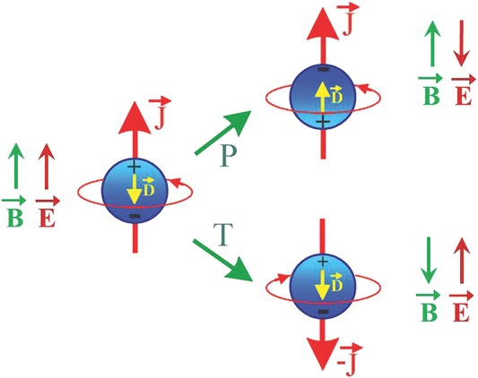
Neutron EDM violates CP symmetry
$$ℒ_{I}≃−μ \vec{J}⋅\vec{B}+d \vec{J}⋅\vec{E}$$
$$ℒ_{I}≃−μ \vec{J}⋅\vec{B}−d \vec{J}⋅\vec{E}$$
$$ℒ_{I}≃−μ \vec{J}⋅\vec{B}+d \vec{J}⋅\vec{E}$$
Jungmann 2013, Ann. Phys, 525: 550-564

Slide 20
The strong CP problem
Experimentally $d_{N}≃\left(0.0±1.1\right)×{10}^{−26} e⋅\text{cm}$, implying CP conservation for strong interactions
However, the QCD Lagrangian contains a CP-violating term
An unnaturally small value $\overline{θ}<{10}^{−10}$ would be needed to match observations
$$ℒ_{\text{QCD}}⊂\overline{θ}\frac{α_{S}}{8π}G_{αβ}\tilde{G^{αβ}}$$

Slide 21
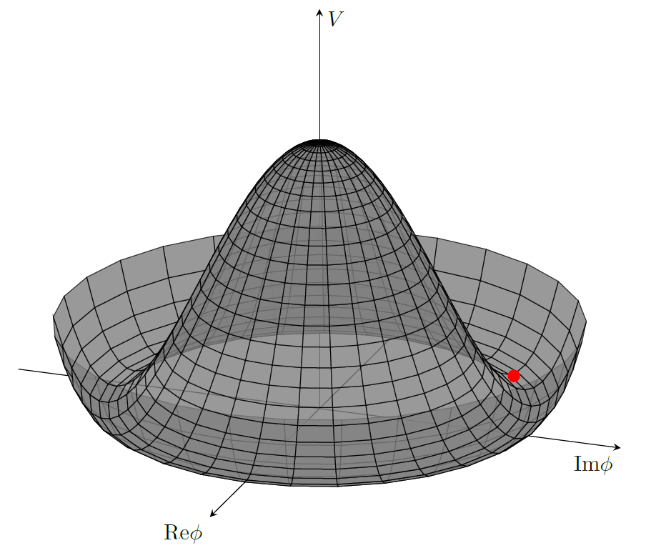
The Peccei-Quinn mechanism (1977)
What if $\overline{θ}$ was the phase of a field rolling down a potential?
Then it could relax to zero via a symmetry breaking mechanism (Higgs-like)
The corresponding particle is called an axion

Slide 22
Light shining through walls
Battesti et al, arXiv:1803.07547

Slide 23
Photon survival probability and observed flux
The observed photon flux is given by $φ_{\text{obs}}=P_{γγ}φ_{\text{int}}$
In the standard EBL case, $P_{γγ}=e^{−τ(E,z)}$
In the ALP case $P_{γγ}$ is computed numerically from magnetic field models, e.g. with gammaALPs [https://gammaalps.readthedocs.io/]
PRELIMINARY

