Slide 1
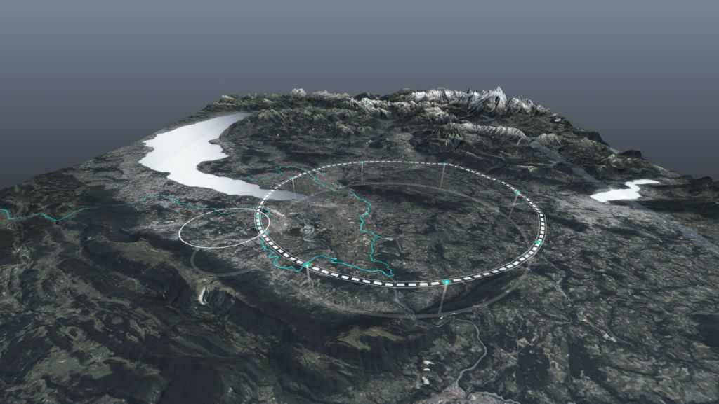










Laboratory Engagement with FCC Project
Emmanuel Tsesmelis (CERN)
on behalf of FGC and IFNC Teams
Open Meeting of the Laboratory Directors Group
INFN – Frascati National Laboratories
11 July 2023
http://cern.ch/fcc
Work supported by the European Commission under the HORIZON 2020 projects EuroCirCol, grant agreement 654305; EASITrain, grant agreement no. 764879; iFAST, grant agreement 101004730, FCCIS, grant agreement 951754; E-JADE, contract no. 645479; EAJADE, contract number 101086276; and by the Swiss CHART program
photo: J. Wenninger

Slide 2
CERN International Collaboration

Slide 3

Science for Peace
CERN was founded in 1954 with 12 European Member States
23 Member States
Austria – Belgium – Bulgaria – Czech Republic
Denmark – Finland – France – Germany – Greece Hungary – Israel – Italy – Netherlands – Norway
Poland – Portugal – Romania – Serbia – Slovakia Spain – Sweden – Switzerland – United Kingdom
CERN’s annual budget
is 1200 MCHF (equivalent
to a medium-sized European university)
3 Associate Member States
in the pre-stage to membership
Cyprus – Estonia – Slovenia
7 Associate Member States
Croatia – India – Latvia – Lithuania – Pakistan
Türkiye – Ukraine
(Brazil signed CERN Associate Membership Agreement
in March 2022, to be ratified in parliament)
6 Observers
Japan – Russia (suspended) – USA
European Union – JINR (suspended) – UNESCO
As of 31 December 2022
Employees:
2658 staff, 900 fellows
Associates:
11 860 users, 1516 others
Around 50 Cooperation Agreements
with non-Member States and Territories
Albania – Algeria – Argentina – Armenia – Australia – Azerbaijan – Bangladesh – Belarus – Bolivia
Bosnia and Herzegovina – Brazil – Canada – Chile – Colombia – Costa Rica – Ecuador – Egypt – Georgia – Honduras
Iceland – Iran – Jordan – Kazakhstan – Lebanon – Malta – Mexico – Mongolia – Montenegro – Morocco – Nepal
New Zealand – North Macedonia – Palestine – Paraguay – People's Republic of China – Peru – Philippines – Qatar
Republic of Korea – Saudi Arabia – Sri Lanka – South Africa – Thailand – Tunisia – United Arab Emirates – Vietnam
Notes:
The speaker can highlight CERN’s second mission as stated when it was established: to foster peaceful collaborations between nations that had recently been at war.
Additional information (OPTIONAL)
More than 40% of CERN’s budget is returned to industry through materials, utilities and services

Slide 4
A laboratory for people around the world
Distribution of all CERN Users by the country of their home institutes as of 31 December 2022
Geographical & cultural diversity
Users of 110 nationalities
19.4% women
Member States 7147
Austria 85 – Belgium 129 – Bulgaria 43 – Czech Republic 244 Denmark 49 – Finland 90 – France 844 – Germany 1225 Greece 119 – Hungary 73 – Israel 64 – Italy 1527
Netherlands 169 – Norway 79 – Poland 305 – Portugal 100 Romania 109 – Serbia 33 – Slovakia 70 – Spain 383
Sweden 103 – Switzerland 406 – United Kingdom 898
Associate Member States
in the pre-stage to membership 69
Cyprus 15 – Estonia 30 – Slovenia 24
Associate Member States 382
Croatia 38 – India 132 – Latvia 16 – Lithuania 14 – Pakistan 35
Türkiye 122 – Ukraine 25
Observers 2991
Japan 216 – Russia (suspended) 873 – United States of America 1902
Non-Member States and Territories 1271
Algeria 2 – Argentina 13 – Armenia 8 – Australia 21 – Azerbaijan 2 – Bahrain 4 – Belarus 18 – Brazil 122
Canada 199 – Chile 34 – Colombia 21 – Costa Rica 2 – Cuba 3 – Ecuador 4 – Egypt 20 – Georgia 32
Hong Kong 15 – Iceland 3 – Indonesia 5 – Iran 11 – Ireland 5 – Jordan 5 – Kuwait 4 – Lebanon 13 – Madagascar 1
Malaysia 4 – Malta 1 – Mexico 49 – Montenegro 4 – Morocco 19 – New Zealand 5 – Nigeria 1 – Oman 1
Palestine 1 – People’s Republic of China 333 – Peru 2 – Philippines 1 – Republic of Korea 147 – Singapore 2 South Africa 52 – Sri Lanka 10 – Taiwan 45 – Thailand 17 – Tunisia 2 – United Arab Emirates 7 – Viet Nam 1
Notes:
THIS SLIDE WILL INCLUDE THE NUMBER OF MEMBERS OF PERSONNEL OF THE VISITORS’ COUNTRY OF ORIGIN

Slide 5
The Example of the LHC and HL-LHC
Successful realisation of the LHC is testament to the strong and consistent support CERN received from its Member States & Associate Member States.
  CERN Council required significant support from Non-Member States, including the Observer States, before giving final approval to the LHC.
Construction of any future front-line accelerator is likely to be an even more global project for scientific, technical and financial reasons.
Siting future accelerator at CERN would build on the scientific, technical, diplomatic and personal relations established during the construction and operation of the LHC & HL-LHC and its experiments.
CERN’s international relations with States continue to grow, reflecting increased globalisation and the uniqueness of CERN’s experimental programme, centred on the LHC & HL-LHC.

Slide 6
FCC Global Collaboration Working Group (FGC)

Slide 7
The FCC Approach to Global Collaboration
FCC Collaboration being formed through a global, two-way and integrative process, while being geographically balanced and topically complementary.
Open to areas beyond conventional accelerator R&D (environment & sustainability; education & training; knowledge transfer to society; & public engagement) and in areas that are non-core activities for CERN (e.g. geology, geodesy, logistics & materials science).
Prepare foundations for industrial R&D and contributions via national laboratories, institutes and universities.
CERN is engaging in discussions with potential major partners as part of the FCC Feasibility Study for such a global project being hosted at CERN.

Slide 8
Mandate of FCC Global Collaboration
Working Group (FGC)
Engage with the participants - national laboratories, institutes and universities as well as industry in the MS, AMS and NMS - to carry out the following mandate:
  Encourage an expanded membership.
  Explore opportunities for future prospective participants.
  Support new participants in application process.
  Assist the new participants in defining areas of collaboration.
  Conclude relevant agreements.
  Facilitate the integration process.
  Facilitate interest in CERN non-core areas - geology, geodesy, logistics, materials science.
  Prepare the foundations for R&D and contributions by industry.
  Liaise with national contact persons and forums.
Convened by Emmanuel Tsesmelis (CERN International Relations)

Slide 9


Status of FCC Global Collaboration
Increasing international collaboration as a prerequisite for success:
→links with science, research & development and high-tech industry will be essential to further advance and prepare the implementation of FCC
150
Institutes
32
Companies
34
Countries
EC
H2020
FCC Feasibility Study: Aim is to increase further the collaboration, on all aspects,
in particular, on Accelerator and Particle/Experiments/Detectors (PED).

Slide 10
FCC Collaboration Continues to Grow
32 institutes admitted by the International Collaboration Board (6 June 2023)

Slide 12


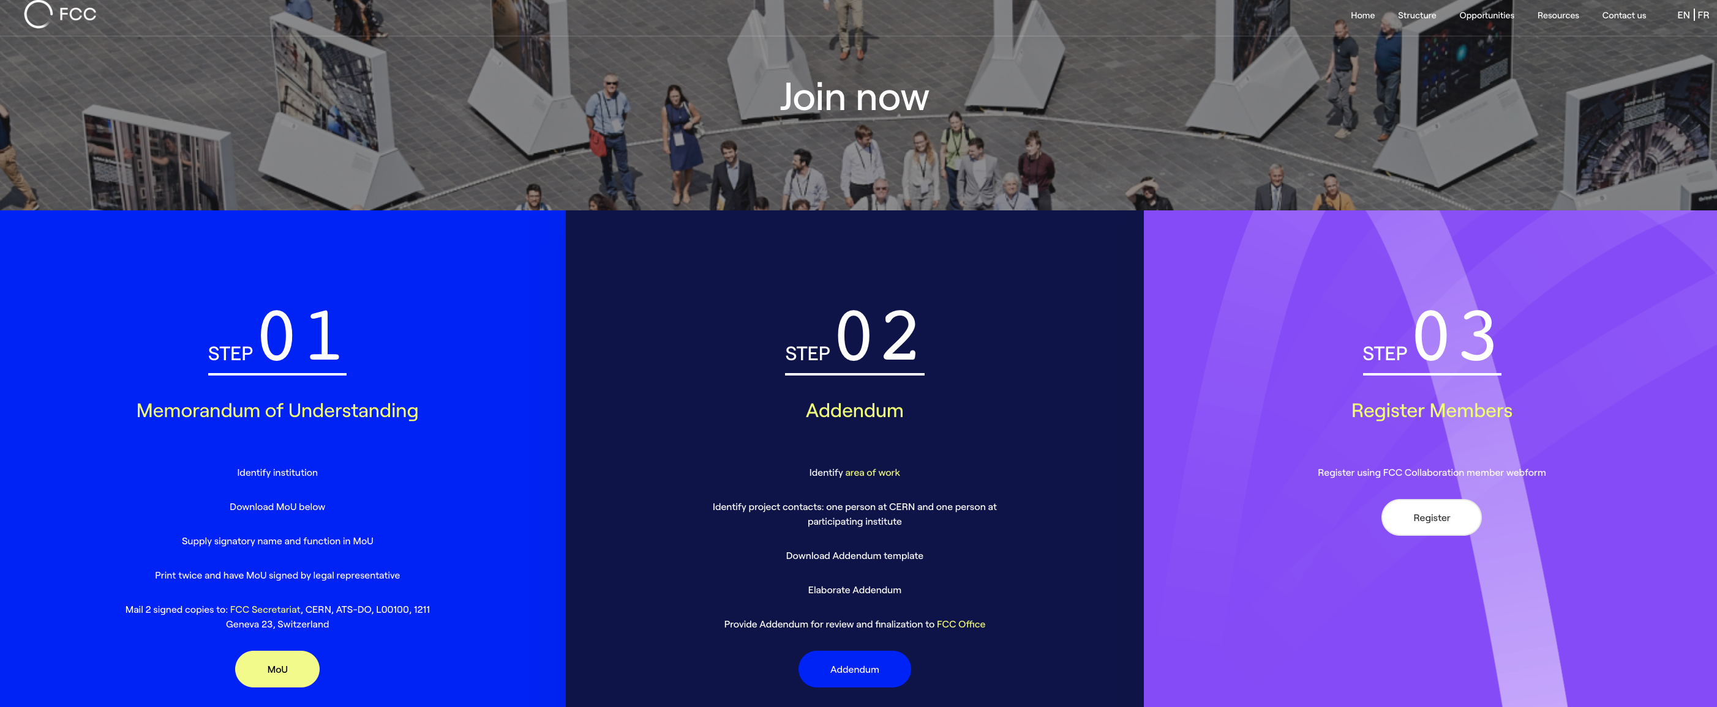
FCC Feasibility Study Collaboration Membership
Participation in FCC through MoU and Addenda.
The FCC MoU for the first phase of the study is being updated to cover the Feasibility Study.
The current participating institutes who wish to take part in the Feasibility Study can continue to participate on the basis of the previously signed MoU until the updated MoU is signed.
https://fccis.web.cern.ch/join-now

Slide 13

FCC Engagement Meetings
Overview
  Recently-launched extended forums with interested countries to discuss collaboration with FCC.
  Topics:
    Introduction to FCC Feasibility Study.
    Presentation of FCC physics, experiment, detector, accelerator and global collaboration.
    Presentations from the country scientific community.
Meetings
  Mexico (mini meeting on accelerator)
    June 2021
  Republic of Korea
    September 2021
  Pakistan
    September 2021
  Portugal
    November 2021
  Estonia
    March 2022
  Greece
    January 2023, June 2023
Much interest expressed by participating countries and the FCC looks forward to stronger / deeper involvement in the follow-up.

Slide 14
FGC Working Group
Work-plan
Priority Actions with Countries
  Strengthen existing collaborations with CERN MS, AMS, Observer States & NMS
    Organise events / workshops in the CERN MS & AMS
  Establish new FCC memberships of CERN institutional partners
    Member States: Bulgaria, Norway, Romania, Slovakia.
    Associate Member States in pre-stage to Membership: Cyprus, Slovenia.
    Associate Member States: Croatia, India, Lithuania, Ukraine.
  Establish new collaborations with CERN NMS with ICAs (total 50)

Slide 15
International Forum of National Contacts (IFNC)

Slide 16
Enlarging the Collaboration - Two Approaches
Two approaches, one globally-oriented (FGC), as just described, the other more Physics, Experiment, Detector (PED) oriented (IFNC), both to engage with countries with mature communities, a long-standing participation in CERN’s programmes and the potential to contribute substantially to the Organization’s long-term scientific objectives ➔ facilitate opportunities for national participation in the Feasibility Study and enlarge the HEP community of FCC
International Forum of National Contacts (IFNC)
Contact directly physics groups in a country, typically from LHC or Future Colliders groups to ask them to join as new institution
  Discuss the physics case and the opportunities
  → To study R&D/detector concepts for FCC.
  → To expand the FCC physics scope via the study of physics case studies.
  → To improve the theoretical calculations to exploit the FCC physics potential.
  Help forming a national FCC group, with strong PED component, which can hold its national FCC meetings, including the accelerator community where possible.
  Identify one or two National Contacts to exchange information between country situation and the FCC management, and to strengthen the national community.
  Exchange experience across countries (IFNC meetings).
  Orient the new efforts towards the FCC working groups.
  Establish list of participating institutes and institute contacts (IFIC) inside each country.
Convened by Gregorio Bernardi and Tadeusz Lesziak (National Contacts)

Slide 17
Enlarging the Collaboration - Actions
IFNC: FCC PED Kick-off Meetings (cf. FGC: FCC Engagement Meetings)
Overview
  Forums with interested countries to discuss collaboration with FCC on PED topics:
    Introduction to FCC Feasibility Study.
    Detailed presentations of FCC physics, experiment, detector.
    More general on accelerator and global collaboration.
    .
Recent Kick-off Meetings
  Nordic Countries (Denmark, Norway, Sweden, Finland), March 2021
  India (Bangalore), November 2022.
  Brazil (Rio de Janeiro), March 2023.
  + informal meetings.
On-going discussions
  With not-yet-deeply-involved European countries.
  Chile, Canada, Argentina (Japan and China have special status…)
Several other initiatives, such as encouraging national meetings; since FCC Week in Paris:
  Joint FCC France-Italy Workshop in Lyon in November 2022 Joint FCC-France & Italy Workshop in Lyon (140 participants)
  First Annual US-FCC Workshop at BNL in April 2023 US FCC Workshop (24-26 April 2023) ➔ ~25 US institutes signed up for FCC
  (cf France, UK, Italy, ~13-20 institutes each)
Enlargement of the FCC HEP community progressing → EoI for detectors in 2025, Proto-collaborations after next ESPP

Slide 18
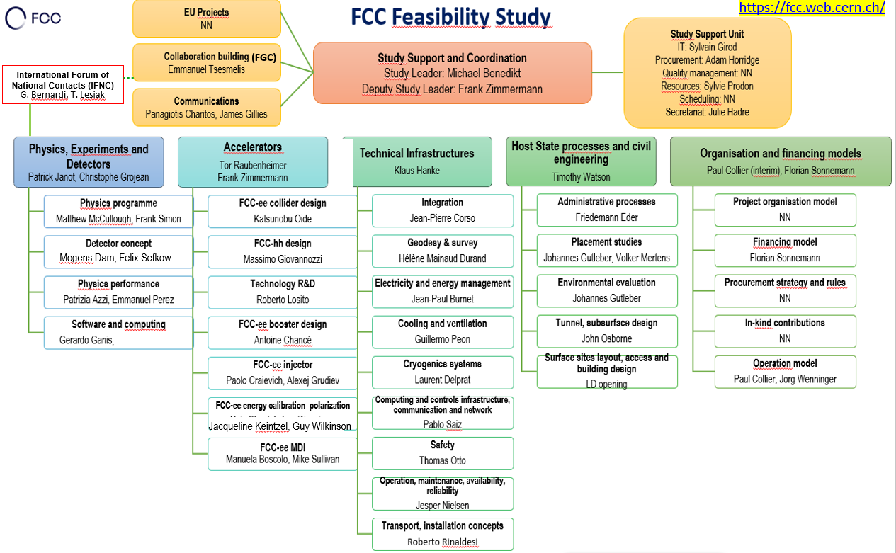
FGC and IFNC

Slide 19

Thank you

