Slide 1
Higgs searches @LHC exercise: Signal/background discrimination for the VBF Higgs four lepton decay channel with the CMS experiment
B. D’Anzi^{1,2} , G. Miniello² , W. Elmetenawee², N. De Filippis^{3,2} , D. Diacono² , A. Sznajder⁴
¹University of Bari; ²INFN BARI; ³Politecnico of Bari; ⁴University of Rio de Janeiro
Fourth ML-INFN Hackathon: Starting Level
23rd June 2023
Brief description of the exercise for the High Energy Physics (HEP) groups

Slide 2
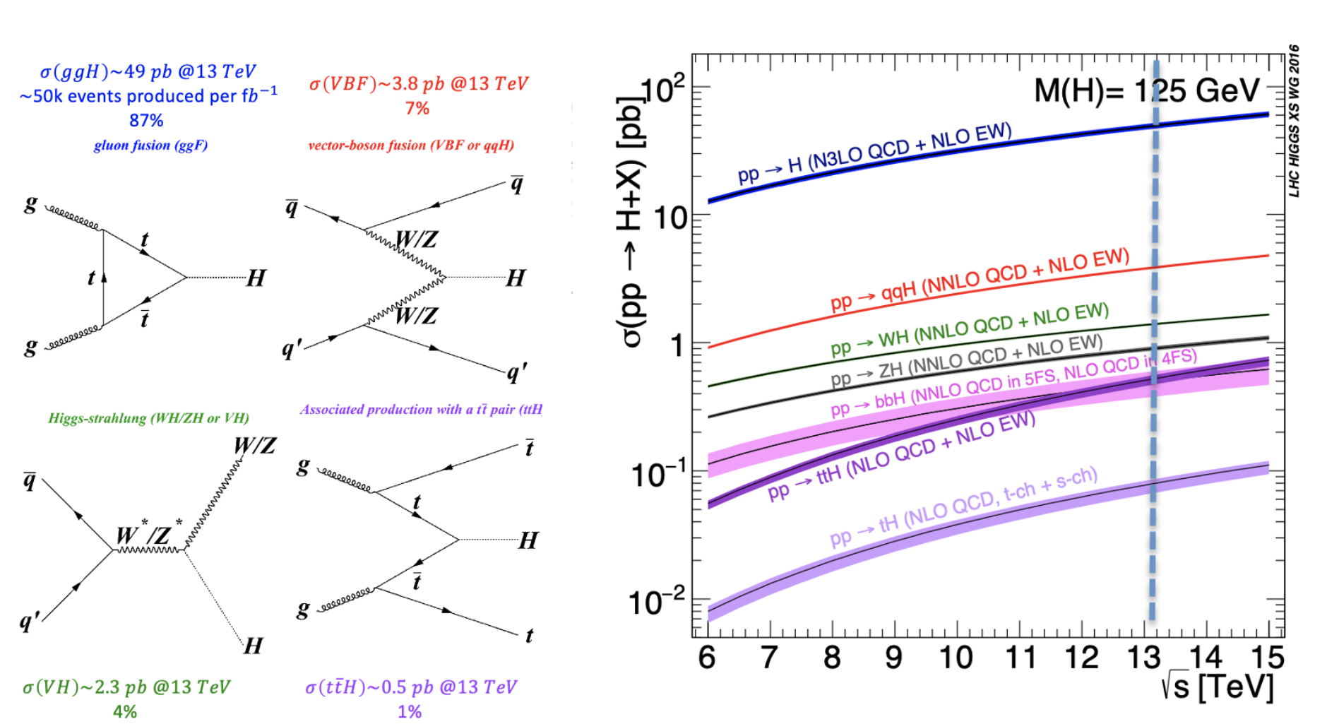
Binary classification task @CMS
Selection of single Higgs boson via vector boson fusion (VBF) production mechanism event with mass hypothesis of 125 GeV in the 4mu/4e decay channel @CMS Experiment @LHC (Monte Carlo simulated sample at generator level)
Irriducible backgrounds:
gg→ZZ→4mu + jets
qq→ ZZ→4mu + jets
WH →qqZZ→qq4mu (optional exercise)
ttH→ttZZ→qq4mu (optional exercise)
You will learn more about the Standard Model of particle physics!
First seen here.
The Higgs boson signal is a «rare» physical process @LHC, difficult to discriminate from the background with standard multivariate analysis techniques (i.e. by imposing cuts on single physical observables)
We use Machine Learning algorithm, a Deep Neural Network (DNN), for our multivariate analysis!
Higgs searches @ LHC: Aim of the hackathon exercise

Slide 3
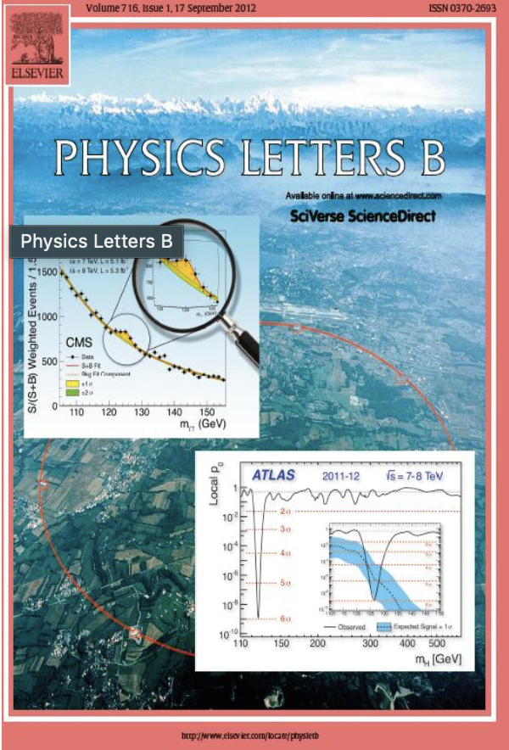
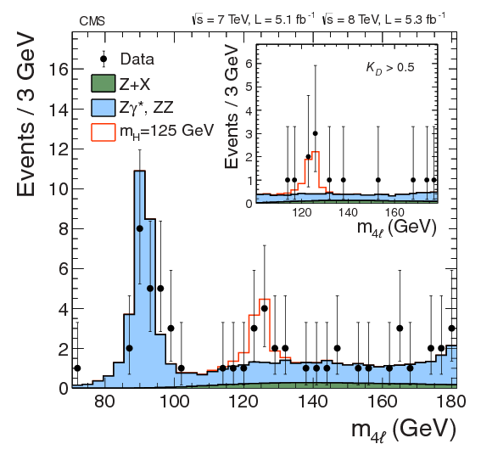
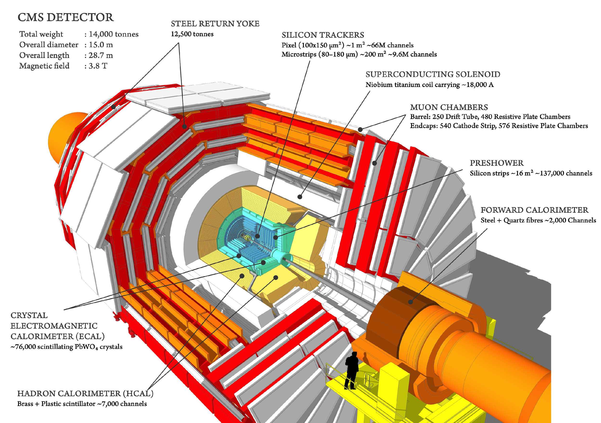
The Compact Muon Solenoid (CMS)
One of the two general-purpose experiments which detected the Higgs boson in 2012 @ Large Hadron Collider (LHC), CERN.
We will use 2018 MC data-set with which, after performing the binary classification task, you will be able to produce plots of physical observables (invariant mass, phi, eta distributions) for the Higgs signal and the main backgrounds as an actual particle physicist!
Higgs searches @ LHC: The data-sets

Slide 4
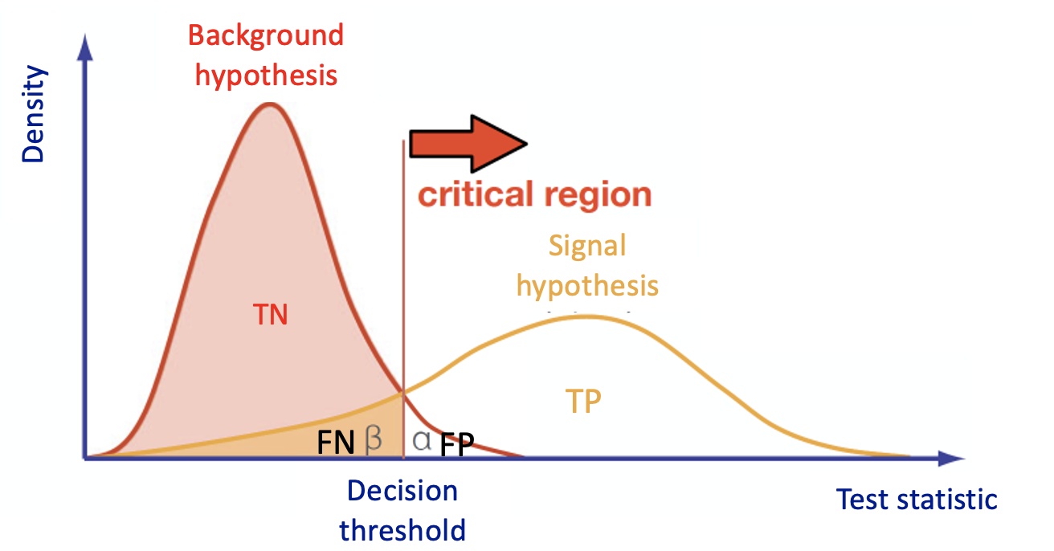
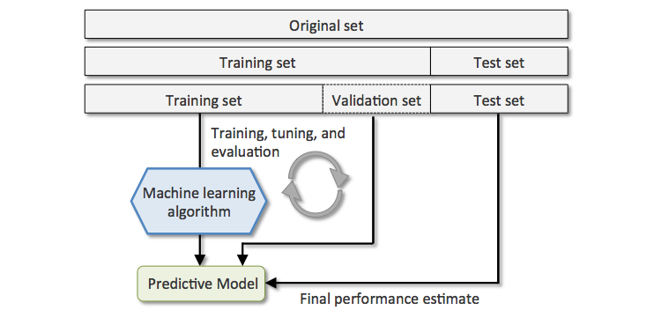
Hypothesis test and ML data-sets
In a Multivariate Analysis (MVA), the MVA algorithm is fed by a set of discriminating variables (input) which are combined to reach an optimal discrimination power between two categories (signal and background).
The discriminant output, also called discriminator, score , or classifier, is used as a test statistic and then adopted to perform the signal selection.
The classifier can be used as a variable on which a cut can be applied under a particular hypothesis test.
Machine Learning tools are models which have enough capability to define their own internal representation of data to accomplish two main tasks: learning from data and make predictions without being explicitly programmed to do so.
Higgs searches @ LHC: Multivariate Analysis and Machine Learning algorithms

Slide 5
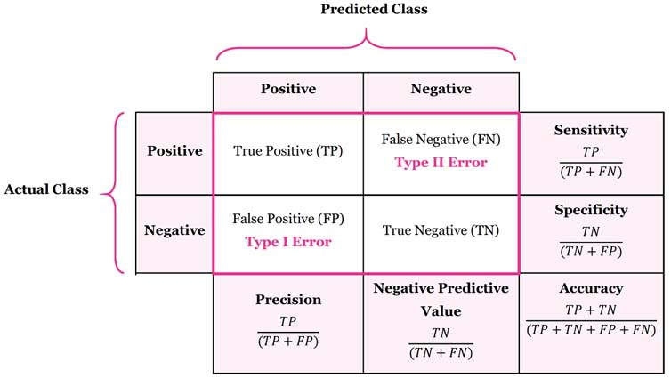
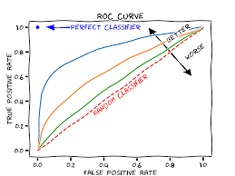
Evaluation Metrics
Evaluation metrics are used to measure the quality of our machine learning model. There are many different types of evaluation metrics available to test a model. These include the area under the Receiver Operating Characteristic – TPR vs FPR - curve (AUC), confusion matrix, accuracy, and others.
It is extremely important to use multiple evaluation metrics to evaluate your model. This is because a model may perform well using one measurement from one evaluation metric, but may perform poorly using another measurement from another evaluation metric.
NOTE: Precision == purity; recall==sensitivity == TPR == signal efficiency; FPR = FP/(FP+TN)
Higgs searches @ LHC: DNN Performance evaluation

Slide 6
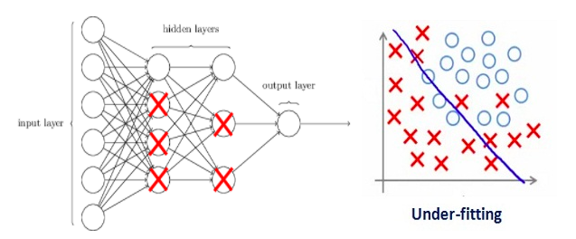
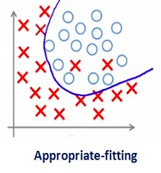
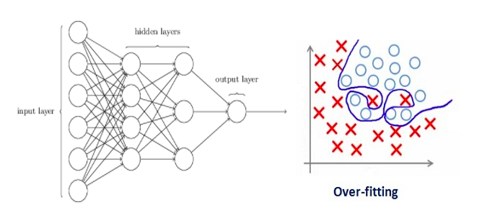
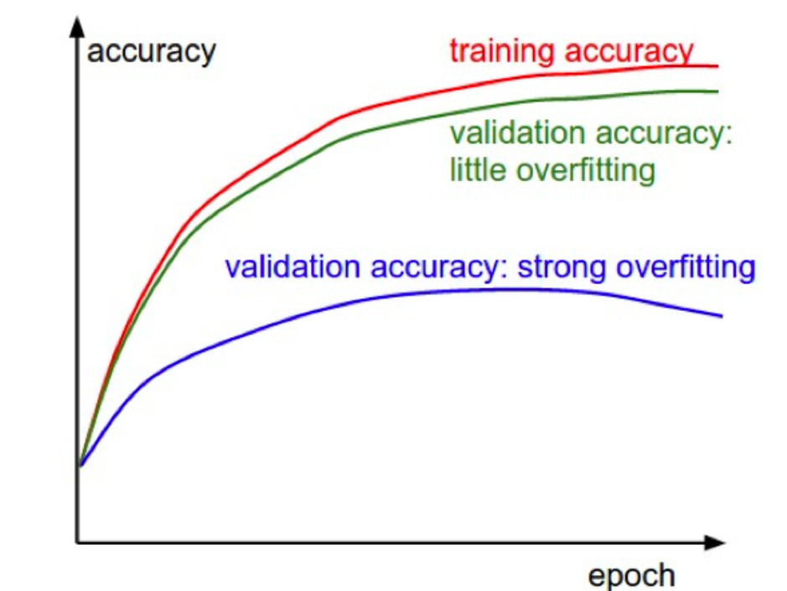
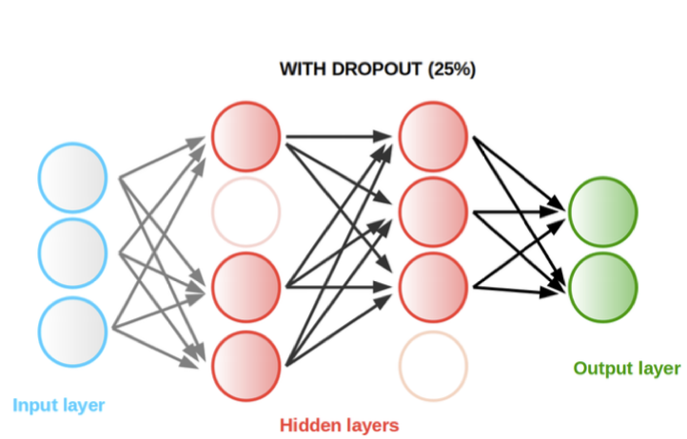
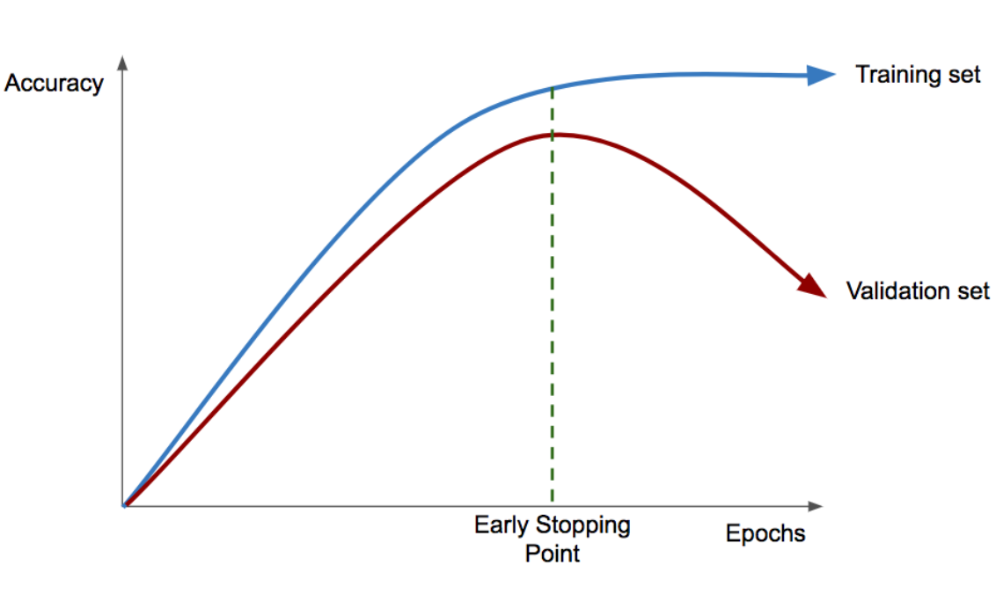
Optimization and regularization algorithms
One of the most common problems for ML technique users is the overfitting.
The overfitting takes place when the model performs exceptionally well on train data but it is not able to predict unseen data .
We overcome overfitting problem by using algorithms such as the Dropout or Early Stopping regularization techniques.
Higgs searches @ LHC: DNN Performance evaluation

Slide 7
Guideline to the exercise
We propose you some requests throughout a unique short exercise
Solving the requests is not mandatory to run the whole exercise and reach last cells of code where physical results are shown.
We suggest to complete the tasks by following their order (which follows an increasing order of difficulty)
Improvement of a ML algorithm performance in terms of ROC curve (ML challenge)
Implementation of a Deep Neural Network (DNN)
DNN Performance evaluation (figure of merits – ROC curves, Confusion matrices)
Preparing the signal and bkg data-sets (input variables study)
Optimization and regularization algorithms for the DNN training (callback functions)
Change the signal and background data-sets, input features
These sections are there just in case you are fast!
Higgs searches @ LHC: The exercise structure

Slide 8
Guideline to the exercise
You will find in the colab shared area the notebook 4th_MLHackathon2023_nocelloutput_students.ipynb
The notebook contains a lot of code already implemented (along with particle physics, statistical and machine learning theory support) in order to help you preparing the data samples and making plots by using scientific libraries (scikit-learn, Keras, matplotlib)
When you find «TASK for you» in the exercise, you need to complete parts (from 1 to 10 lines of codes usually)
You will have some questions and a final Machine Learning challenge where you have simply to upload your improved ML algorithm on the link you find at the end of the exercise!
Higgs searches @ LHC: The notebook

Slide 9
Workgroup and reporting
You are supposed to strongly interact with one another and collaborate in order to come to a shared solution.
Please do not hesitate to ask for help to the tutors: Brunella and Walaa.
For the afternoon session, we will discuss together the issues that you found while running the exercise so don't be shy ;) and report to us any difficulties you faced.
Ph. D. in CMS collaboration @ UniBA
Dr. in CMS collaboration @ UniBA
Higgs searches @ LHC: The tutors

Slide 10
Machine Learning Software
Higgs searches @ LHC: The notebook

