Slide 1
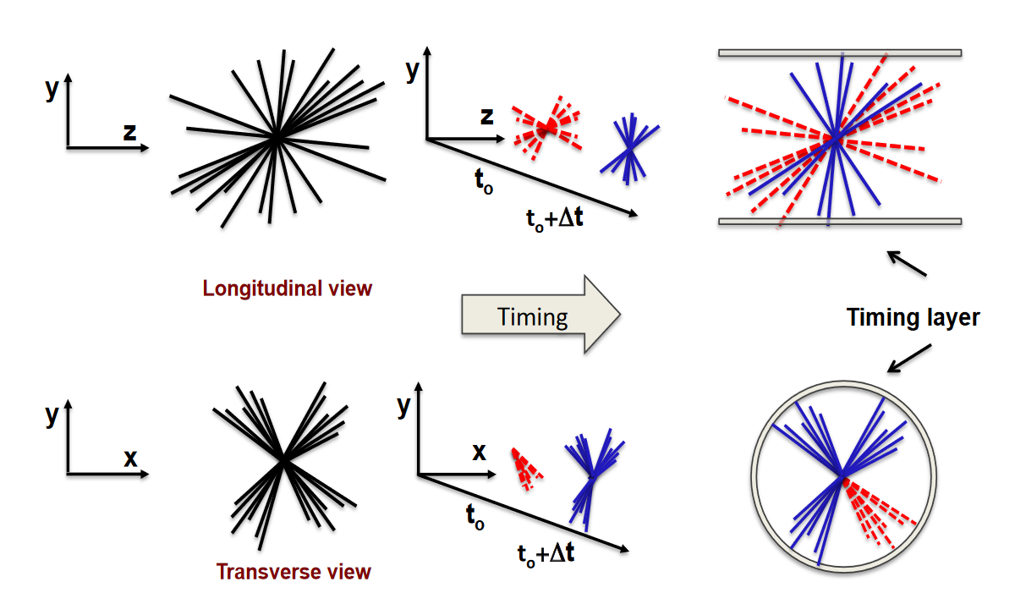
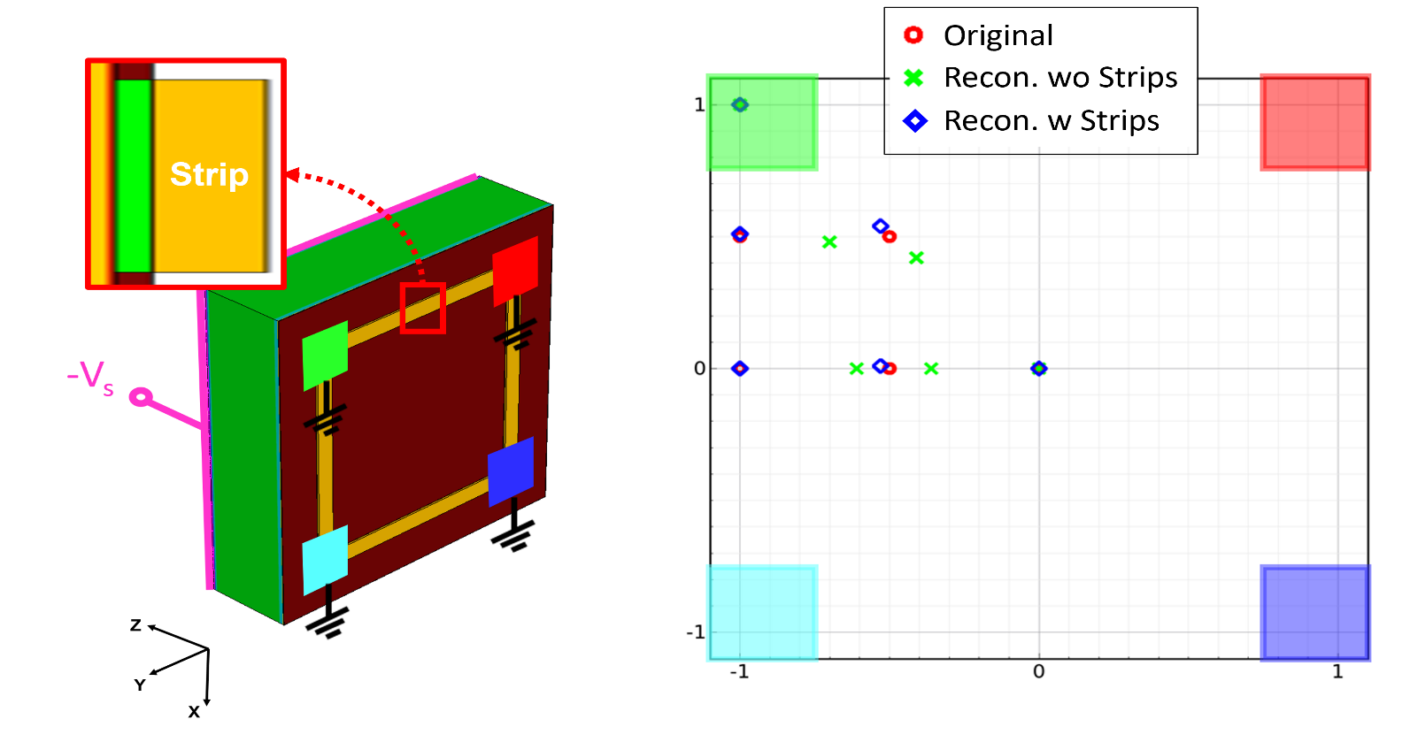
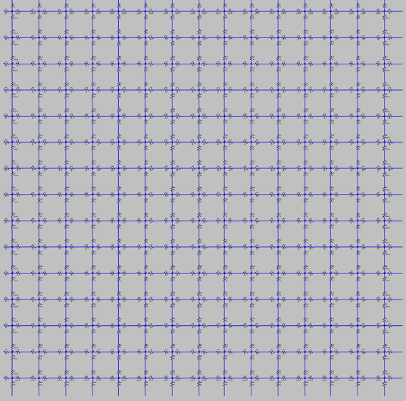
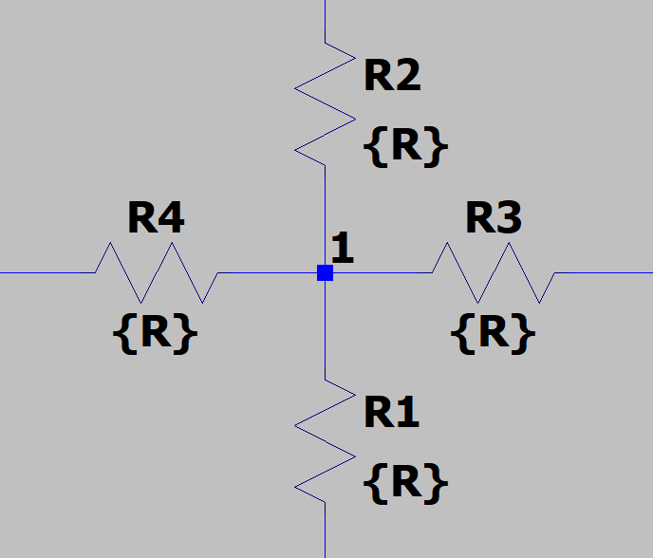
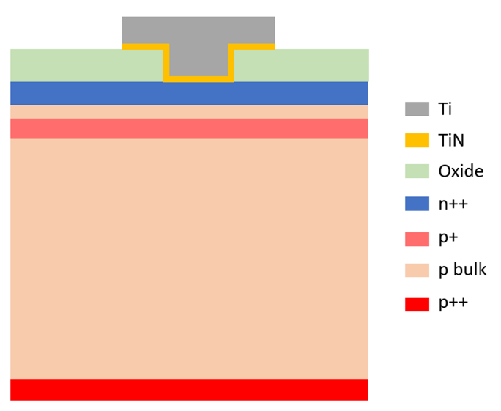
DC-coupled Resistive Silicon Devices: a new approach to detectors for 4D tracking
L. Menzio ^{(1,∗)}, T. Croci⁽⁴⁾, A. Morozzi⁽⁴⁾, P. Asenov^{(4,5)}, A. Fondacci^{(6,4)}, F. Moscatelli^{(4,5)}, D. Passeri^{(6,4)}, V. Sola^{(2,1)}, M. Ferrero⁽¹⁾, M. Mandurrino⁽¹⁾, R. Arcidiacono^{(3,1)}, N. Cartiglia⁽¹⁾, R. Mulargia⁽¹⁾, E. Robutti⁽⁷⁾, R. Cirio^{(2,1)}, R. Sacchi^{(2,1)}, A. Staiano⁽¹⁾, V. Monaco^{(2,1)}, M. Arneodo^{(3,1)}
1) Istituto Nazionale di Fisica Nucleare (INFN), Torino, Italy.
2) Dipartimento di Fisica, Università di Torino, Torino, Italy.
3) Università del Piemonte Orientale, Novara, Italy.
4) Istituto Nazionale di Fisica Nucleare (INFN), Perugia, Italy.
5) Istituto Officina dei Materiali (IOM) CNR, Perugia, Italy.
6) Dipartimento di Ingegneria, Università di Perugia, Perugia, Italy.
7) Istituto Nazionale di Fisica Nucleare (INFN), Genova, Italy.
4D Tracking
Current trackers technology will not suffice in the high luminosity environment proper of future HEP experiments
Vertexes pileup urges
Addition of timing information
Better spatial resolution
Trackers will need very low material budget for accurate measurement of low momentum particles
need low power consumption (no or air cooling systems)
4D Tracking
A new design of resistive silicon detector: DC-RSD
The DC-coupled read-out RSD (DC-RSD) are an evolution of the RSD, aiming at improved performance and scalability to large devices. Main RSD drawbacks:
The signal spreads outside a certain cell and worsens the signal/noise
The device leakage current is collected only at the periphery,
The signal containment is achieved through the DC-coupling of the electrodes to the n++ resistive layer.
After conducting several simulations, we discovered that the optimal choice involves a design in which the electrodes are positioned at the corners of a square and connected by low-resistivity strips.
In a second step, full 3D TCAD simulation campaign was conducted to characterize the device behaviour
y
The simulations of this innovative layout were performed following two different steps.
Firstly, the signal spread over the resistive surface was studied employing a original approach: the signal generated by the passage of a MIP in the device bulk was obtained with the use of the Weightfield2 package; such signal was then exploited as test input in a electronics schematics tool (LTSpice) simulation of the electrodes contacting the resistive sheet [1]. This method allows for exploring different options in very fast simulation times compared to the traditional packages
1
2
The difference in the reconstructed impact positions of the two layouts, with and without resistive strips, clearly shows that the best accuracy is achieved with the interconnecting strips.
This and many other designs (e.g. multi-pixels, various electrode shapes and dimensions) have been simulated in the last year, to identify the most promising ones for the first proof-of-concept production by FBK.
4
3
The proof-of-concept production: DC-RSD1
The first DC-RSD production will study the behavior of two types of electrodes layout, implemented with and without cell containment grid.
The layout is currently under design. The production should start by the end of the year.
After full characterization of the production, a new round of improved simulation (feedback from data) will help designing the optimize second prototype run.
In the second production, the inter-pad resistive strips will be implemented using Ti-TiN double metal layers.
Two options have been explored through simulations: the constant low-resistivity strips and gradient resistivity.
Various engineering runs (short-loops@FBK) have been carried out in order to study and acquire the necessary skills to achieve the needed contact resistance between metal and resistive layer.
The containment grid will be implemented with Isolated Trenches in this first production.
Signal spread and containment along the resistive sheet will be studied as a function of the electrodes pattern.
Conclusions
A novel detector design, the DC-coupled Resistive Silicon Detector, has been presented. It achieves controlled signal sharing, in a predetermined number of electrodes (more uniform performance over the sensor surface) and drain the device leakage current at every pixel.
A new simulation method has been devised, based on a 2-steps hybrid approach using 1. Weightfield2 and LTSpice, and 2. full 3D TCAD simulations.
The first step allows exploring various configurations in fast simulation times, identifying the workable parameters for the resistive sheet and the electrodes coupled with it.
The best combinations obtained were characterized through a full 3D TCAD simulation, to optimize the design and model the full detector behavior.
Stay tuned for the proof-of-concept production (Spring 2024)!
References
This work is supported by:
- H2020 project AIDAinnova, GA no. 101004761.
- Ministero della Ricerca, Italia, PRIN 2017, progetto 2017L2XKTJ – 4DinSiDe
- Ministero della Ricerca, Italia, FARE, R165xr8frt_fare
- INFN – FBK agreement on sensor production
- INFN - Gruppo V, RSD and 4DSHARE experiments
[1] L. Menzio, Development of Resistive Silicon Detectors for 4D tracking, PhD thesis (June 2023).
[2] L. Menzio et al., DC-coupled resistive silicon detectors for 4D tracking, Nucl. Inst. and Meth. in Phys. Res. A (2022).
[3] T. Croci et al., TCAD simulations of non-irradiated and irradiated Low-Gain Avalanche Diodes and comparison with measurements, J. Instrum. 17, C01022 (2022).
(*) luca.menzio@to.infn.it

