Slide 1


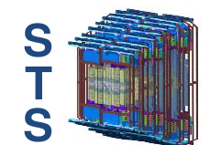
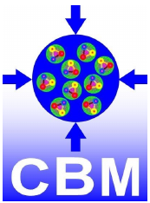
Vertex reconstruction and tracking performance of the STS detector with the mCBM setup at SIS18
Dario A. Ramirez Zaldivar
Goethe University Frankfurt - GSI
(CBM collaboration)

Slide 2
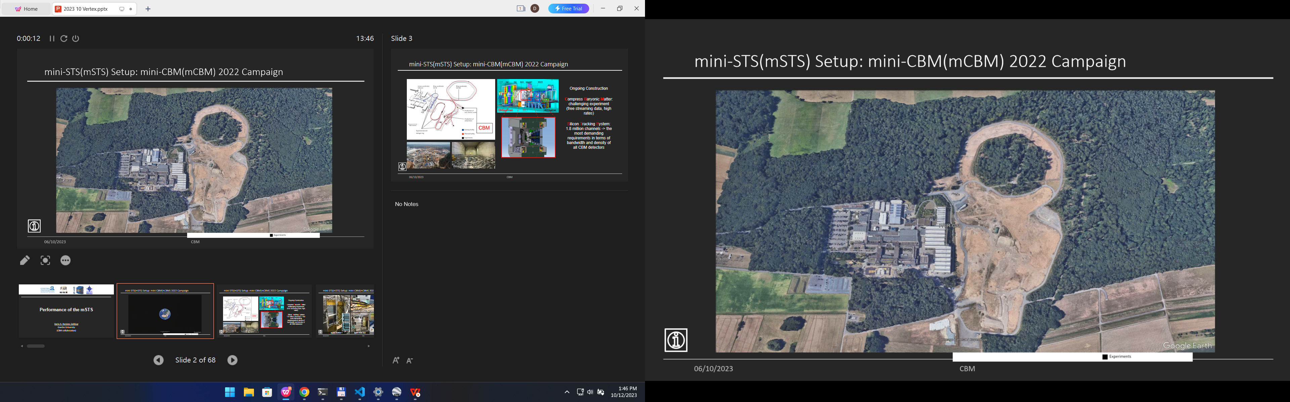
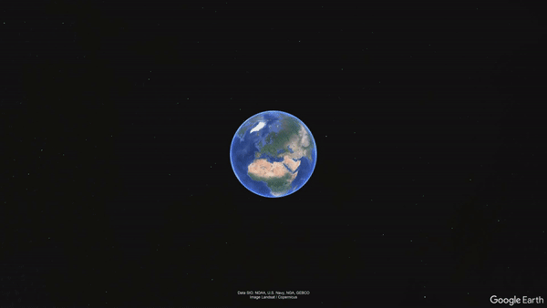
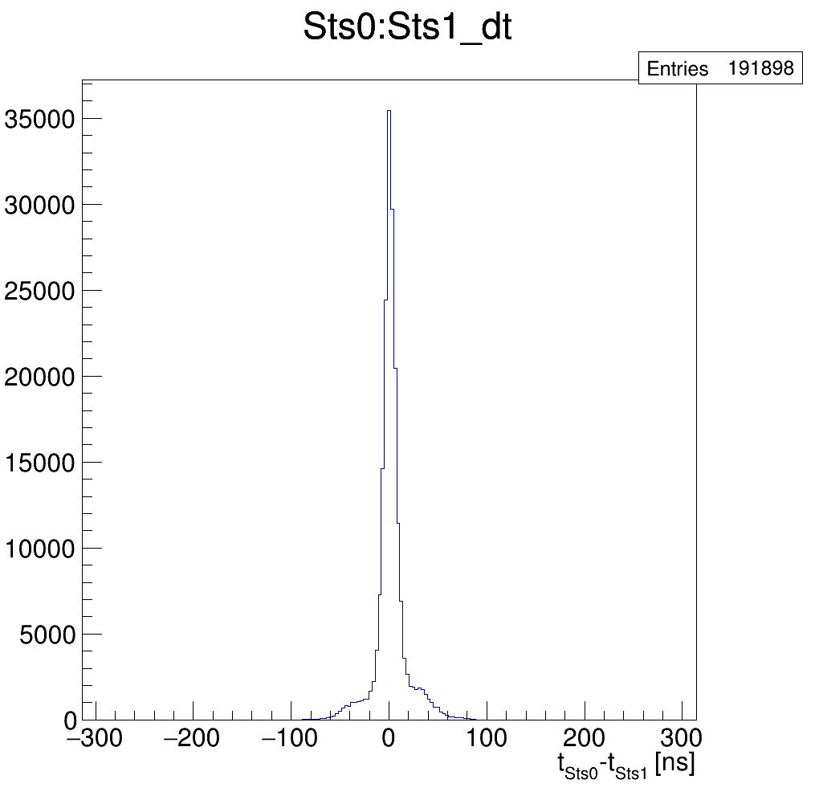
GSI - Facility for Antiproton and Ion Research (FAIR) - location
Notes:
For many year, in Darmstadt city, Germany, the Facility for Antiproton and Ion research have been under construction

Slide 3
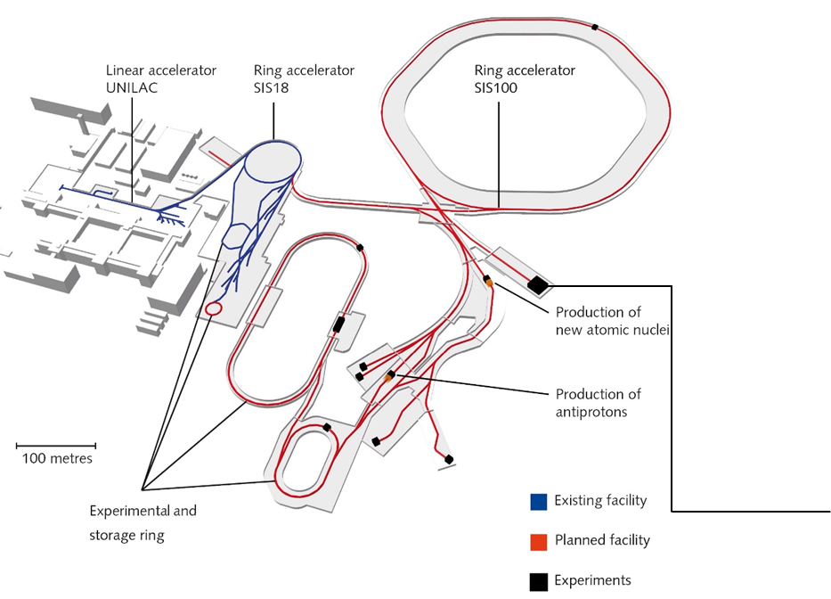
Facility for Antiproton and Ion Research (FAIR) - Construction site
https://www.youtube.com/watch?v=x0RTwqaRock

Slide 4
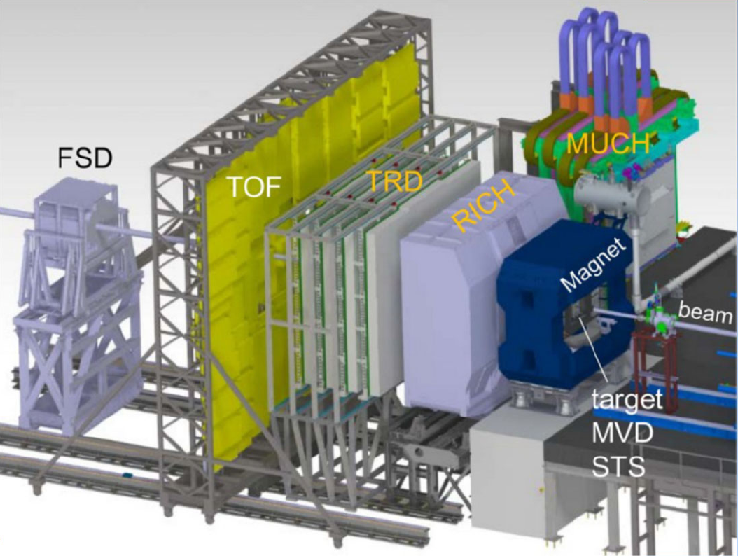
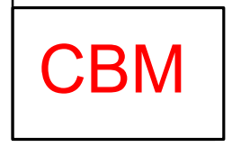
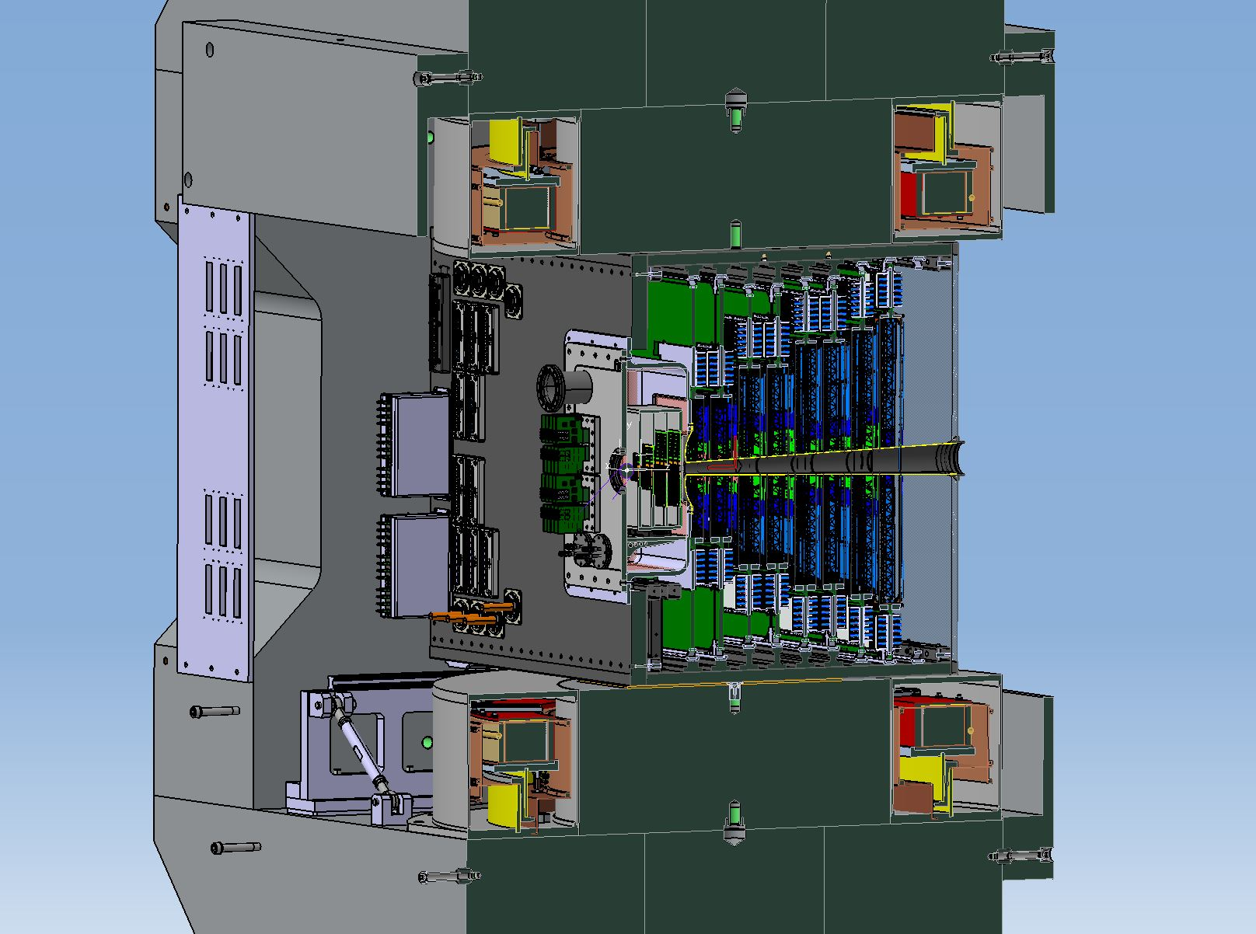
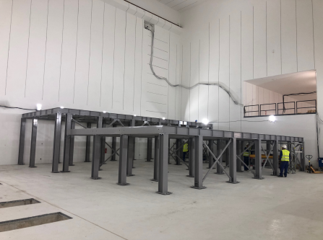
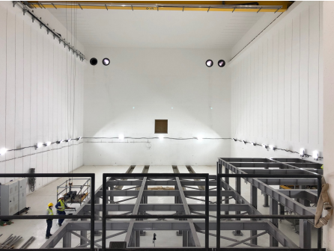
Facility for Antiproton and Ion Research - Compressed Baryonic Matter
CBM
- Fix target experiment
- Heavy ion collisions
- 700 particles/events Au+Au 12 AGeV/c
- High interaction rates: 10 MHz
- 2.5⁰ - 25⁰ polar angle coverage
- Free-streaming data (software trigger)
- Online track reconstruction
Silicon Tracking System:
- 8 Stations - 900 modules - 1.8M channels
CBM cave
- up-stream -
CBM cave
- down-stream -
Notes:
One of the main experiment of this future facility, is the Compressed Baryoninc Matter (CBM)
a fix target experiment that will collide heavy ion
at high interaction rates
One particular characteristic is the free-streaming data
which requires an online track reconstruction
The silicon tracking System, is the main pillar for this purpose, comprising 8 tracking stations, resulting in more than 1.8 million channels

Slide 5
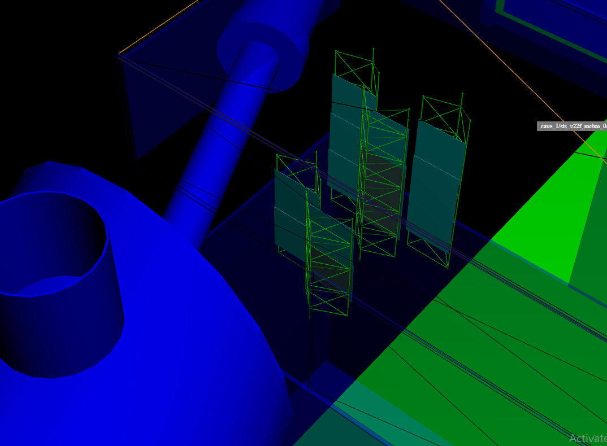
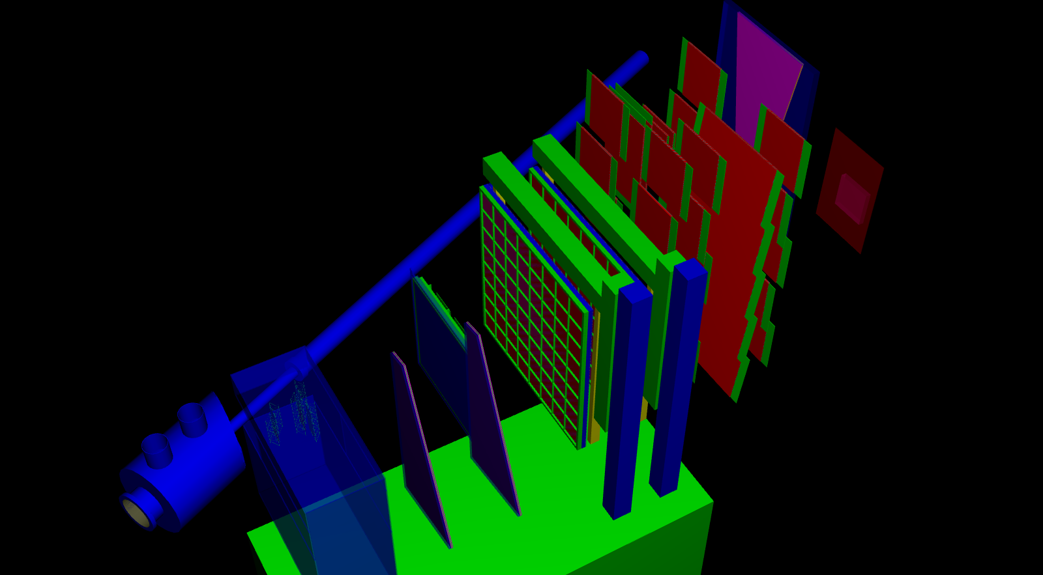
CBM - Small scale prototypes : mini-CBM (mCBM)
CBM
mini - CBM
mMUCH
RPC
mTOF
mRICH
mSTS
mTRD 2D
mTRD 1D
mSTS
mMUCH
GEM
mCBM@SIS18 goals:
... test and optimize the operation of the full system (...) under realistic experiment conditions.
... the free-streaming data acquisition system ...
... the online track and event reconstruction ...
... the offline data analysis and the detector control system ...
- First beam-time 2019
- Full setup during 2021-2022 data taking campaign
Notes:
with the main goal of test and optimized the full detector system under realistic conditions
a reduced version of CBM was assemble.
and I will talk to you about the performance of the mSTS setup obtained during the 2021 and 2022 beam campaign

Slide 6
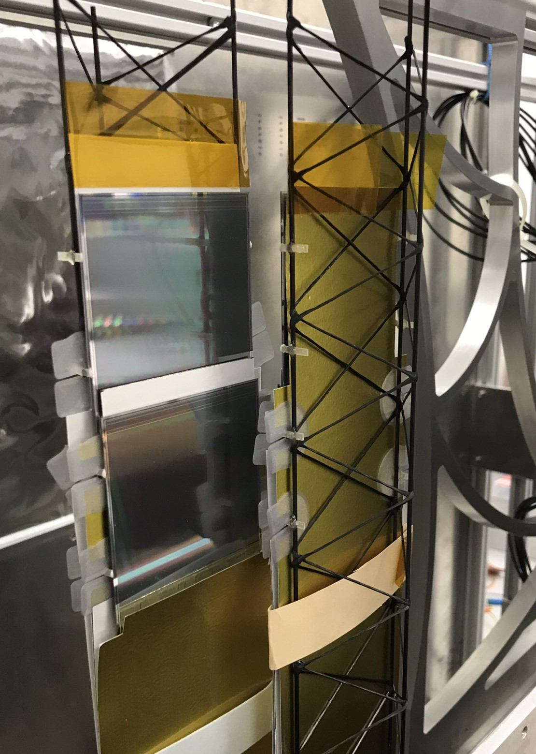
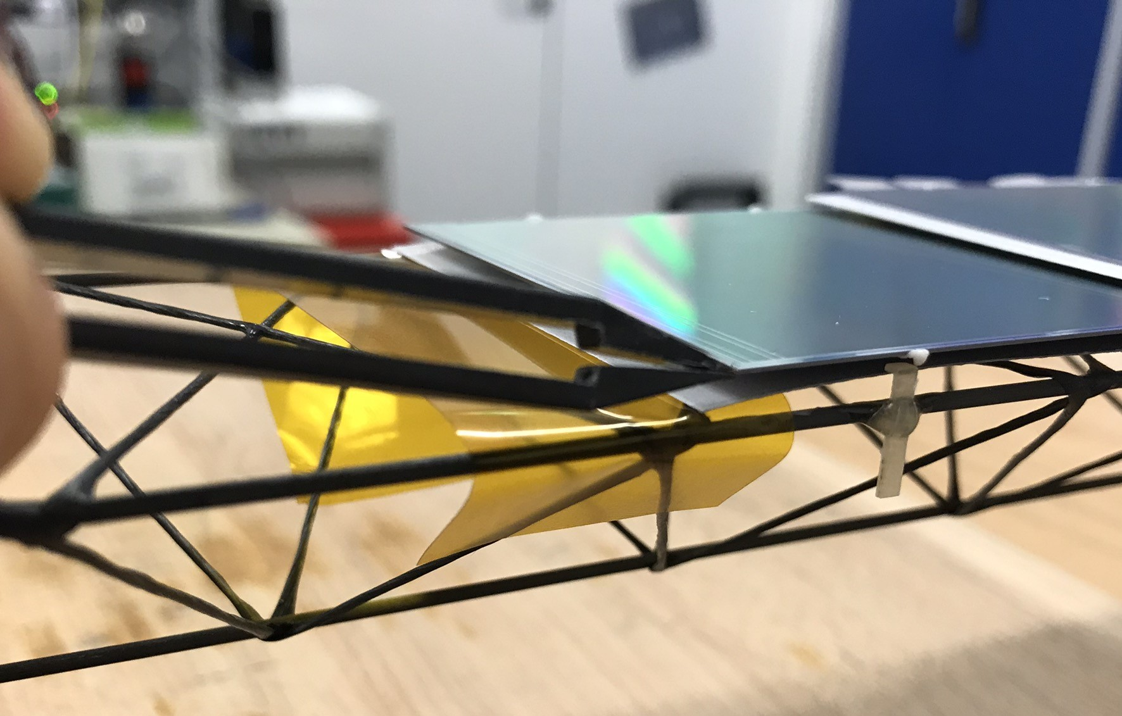
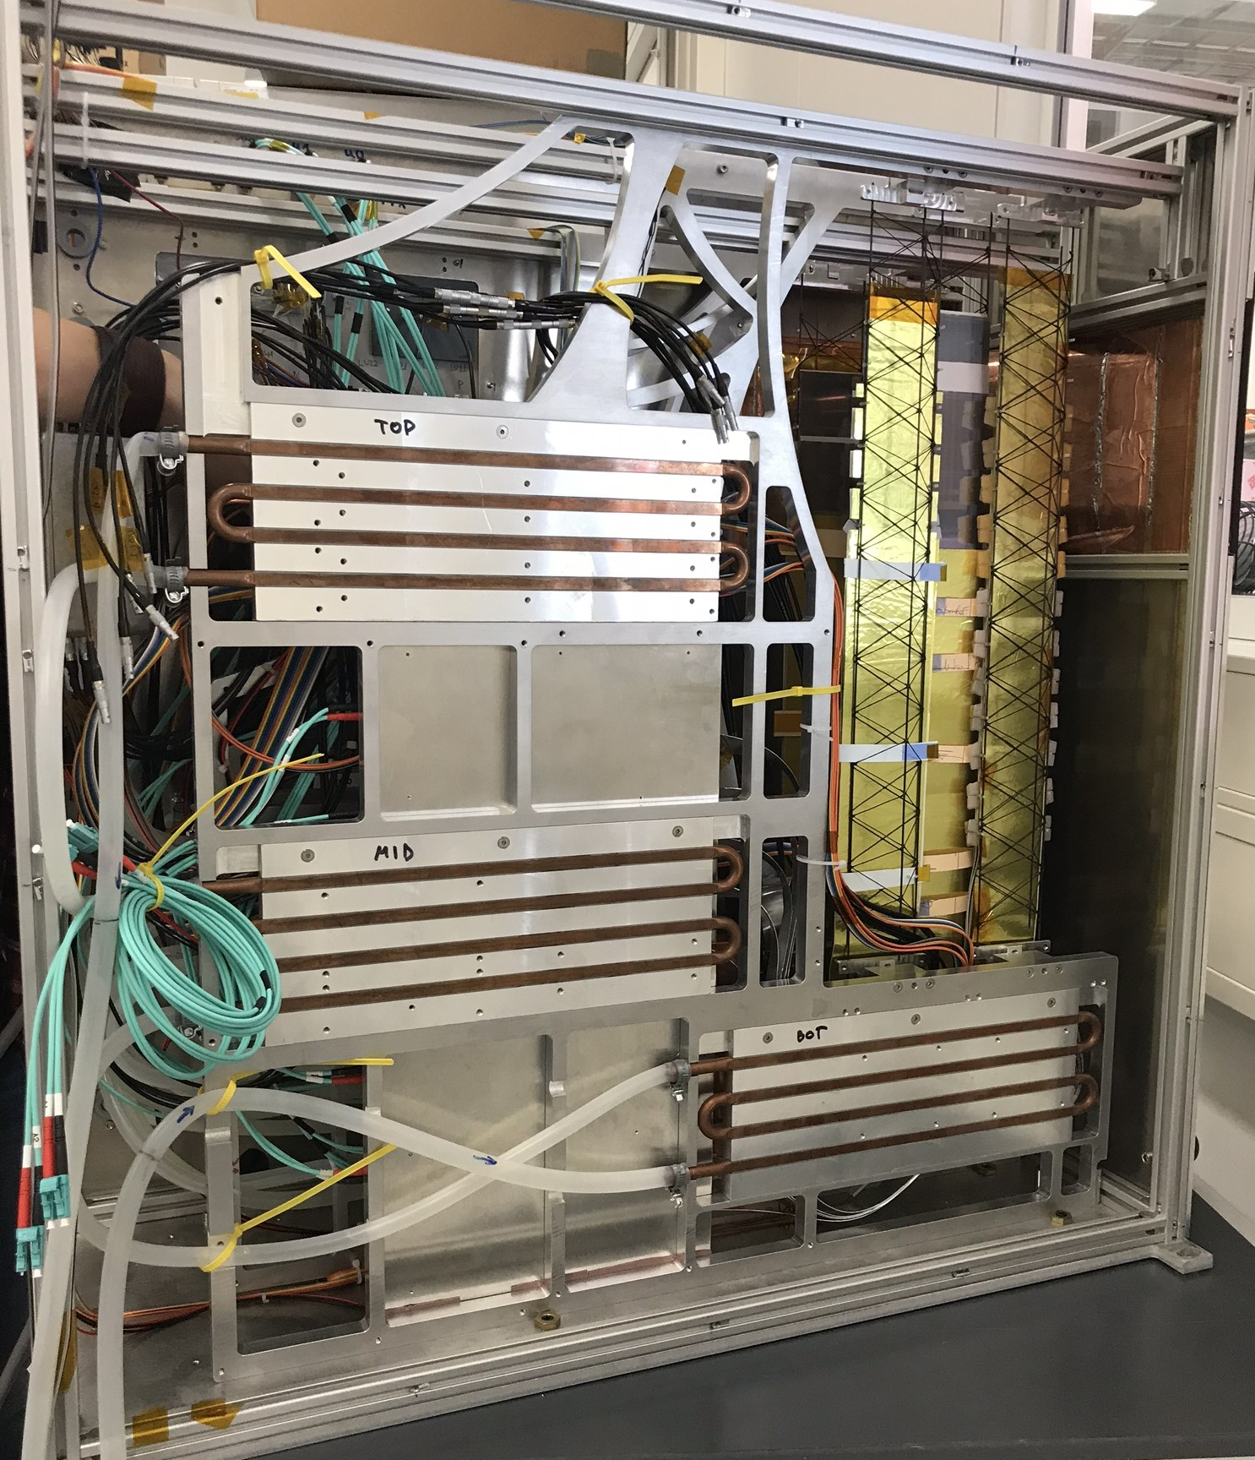
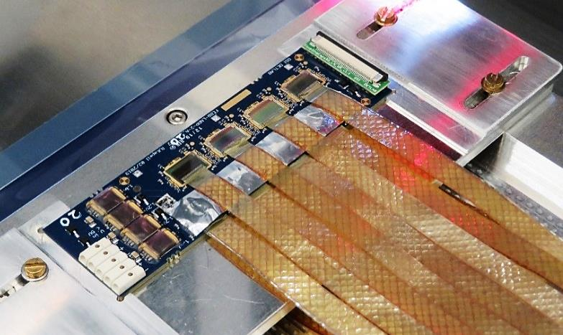
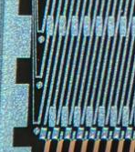
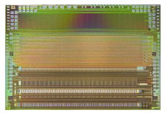
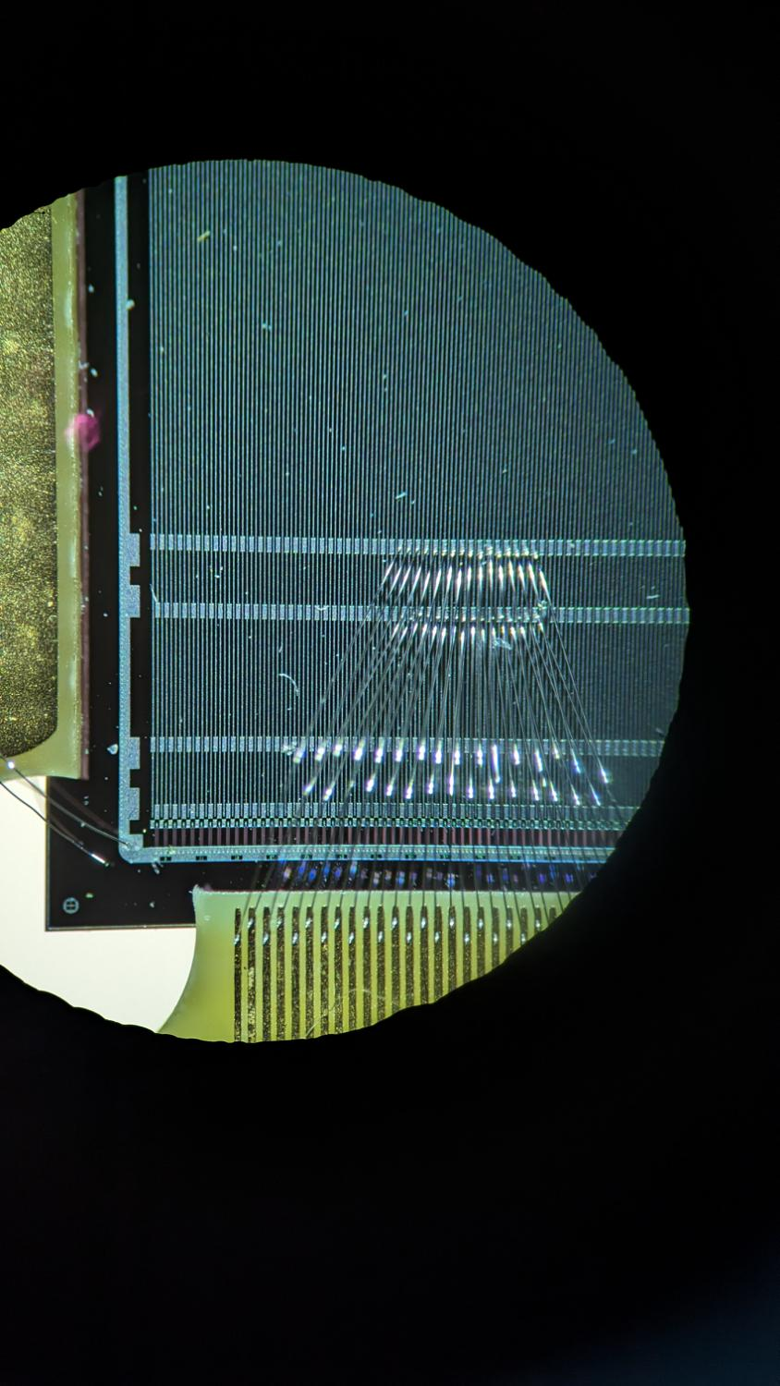
M. Teklishyn et al. TWEPP2023
https://indico.cern.ch/event/1255624/contributions/5444008/
mini-STS(mSTS) Setup
2 tracking stations
11 modules (~1% full STS): double-sided double-metal micro-strip silicon sensors
Sensor on carbon fiber ladder
STS-XYTER
mSTS Station 1
Open mSts box
Micro cables. Front-End Board (FEB)
Notes:
This mSTS setup, comprises 2 tracking stations with 11 double-sided double-metal micro-strips silicon sensors
this sensors are supported by light-weight carbon-fiber ladder, and interconnected with the FEB via micro-cables

Slide 7
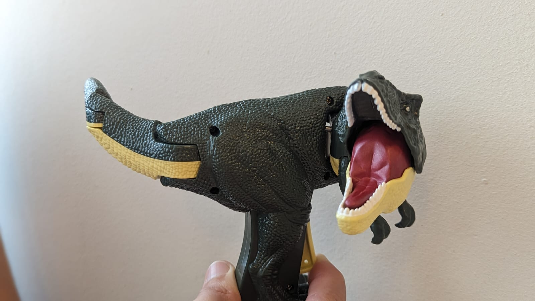
... time calibration ...
Notes:
Since the experiment will operate with free-streaming data, synchronization is of upmost importance

Slide 8
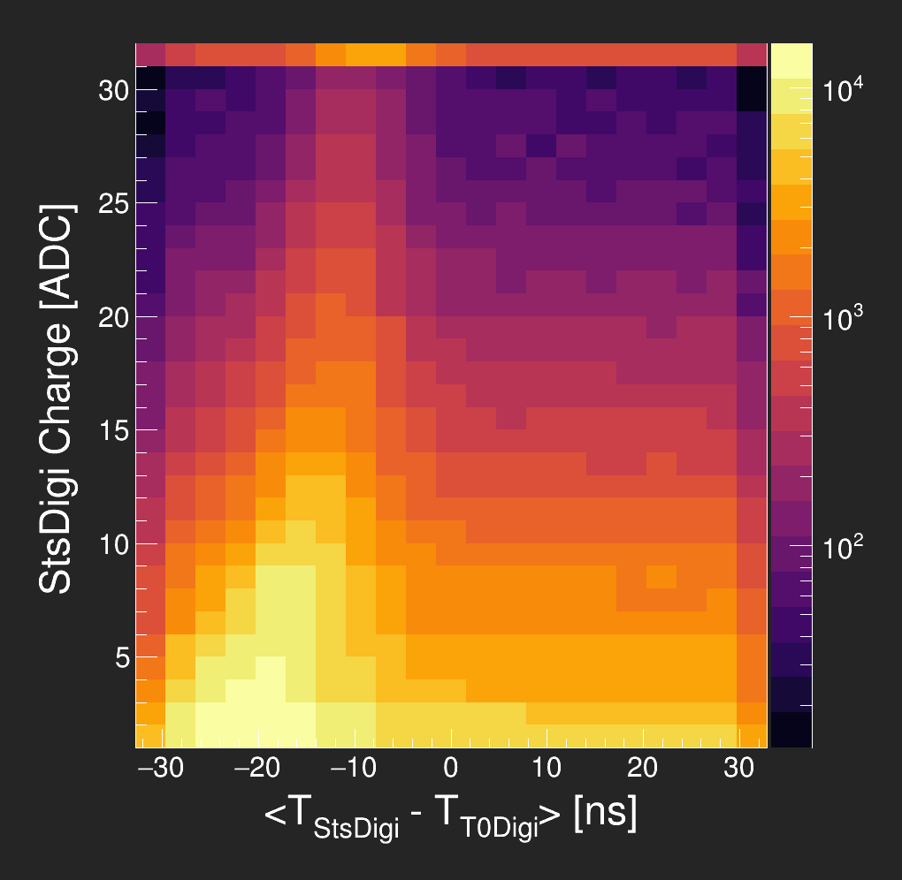
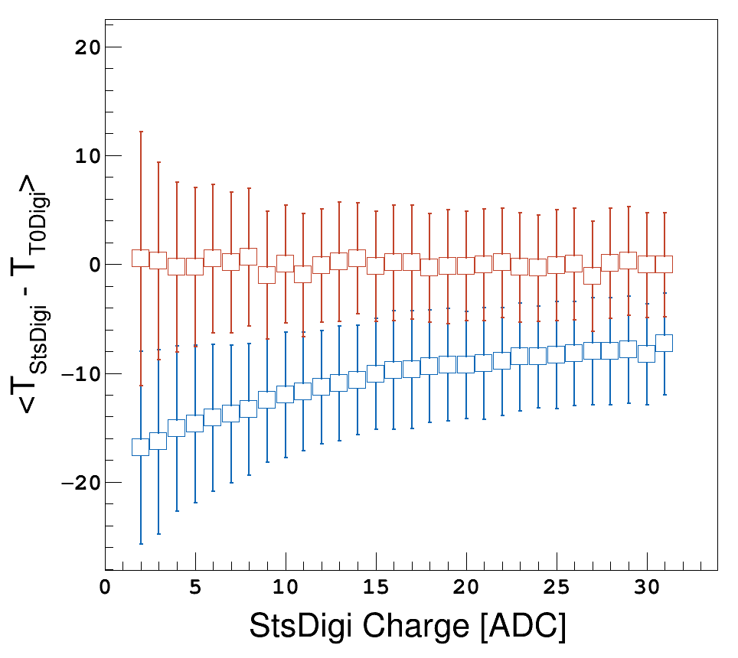
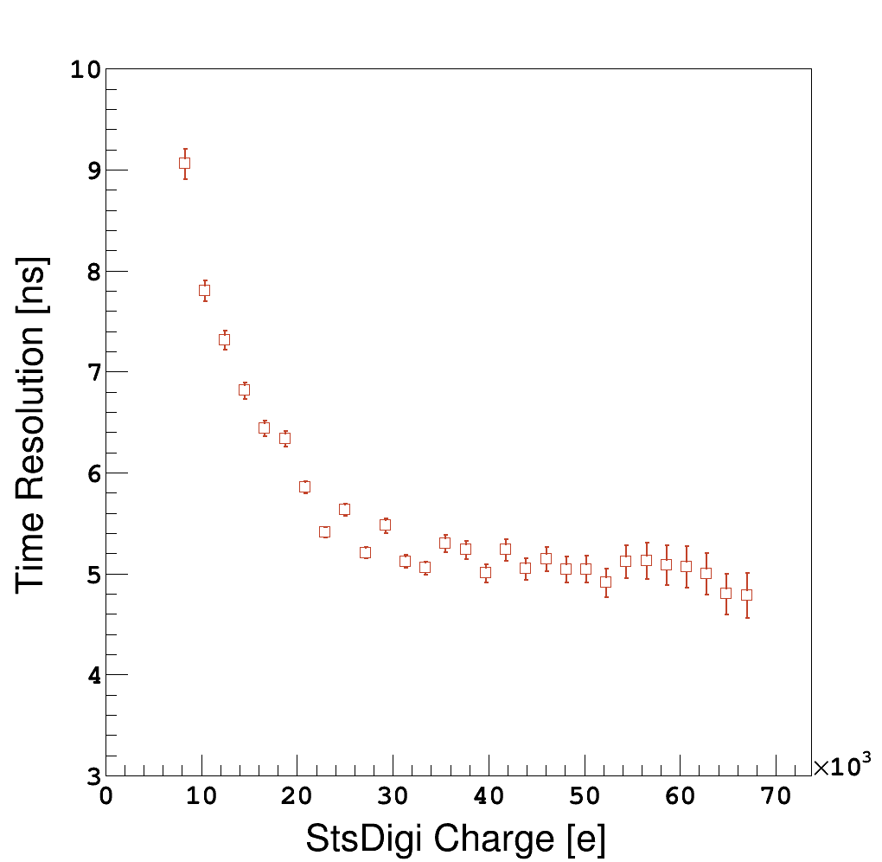
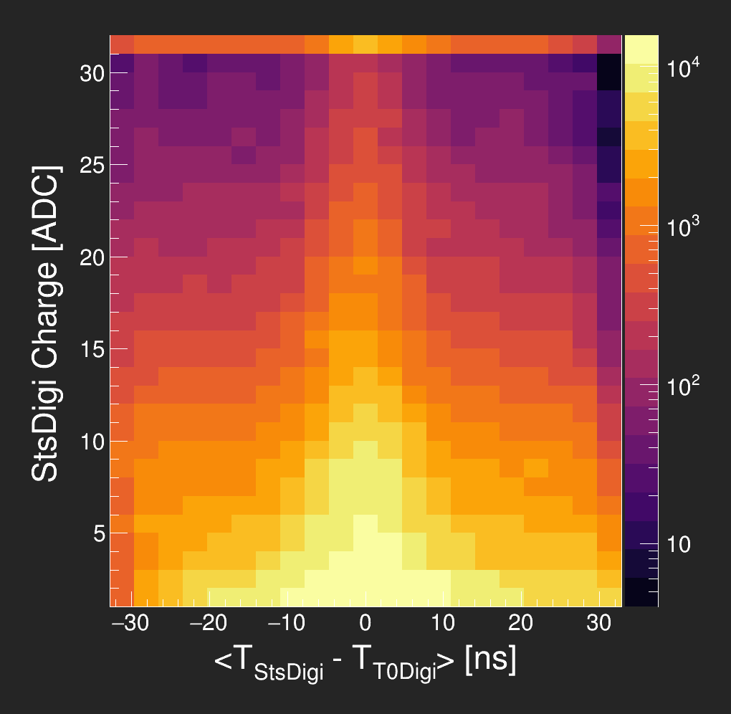
mSTS Time calibration - Time Resolution
Before
After
Time resolution
4.8 - 9.2 ns
Notes:
Therefore, proper time calibration must be performed
Left plots show Time difference between Sts and T0 Digis; after and before Time Walk correction.
Allows to extract the time resolution of the mSTS setup
Where time resolution have been plotted vs the Signal amplitude, and the values range from 4.8 - 9.2 ns

Slide 9
... we got time, what about space ...
Notes:
once our setup is fully synchronized, we can check our reconstructed hits

Slide 10
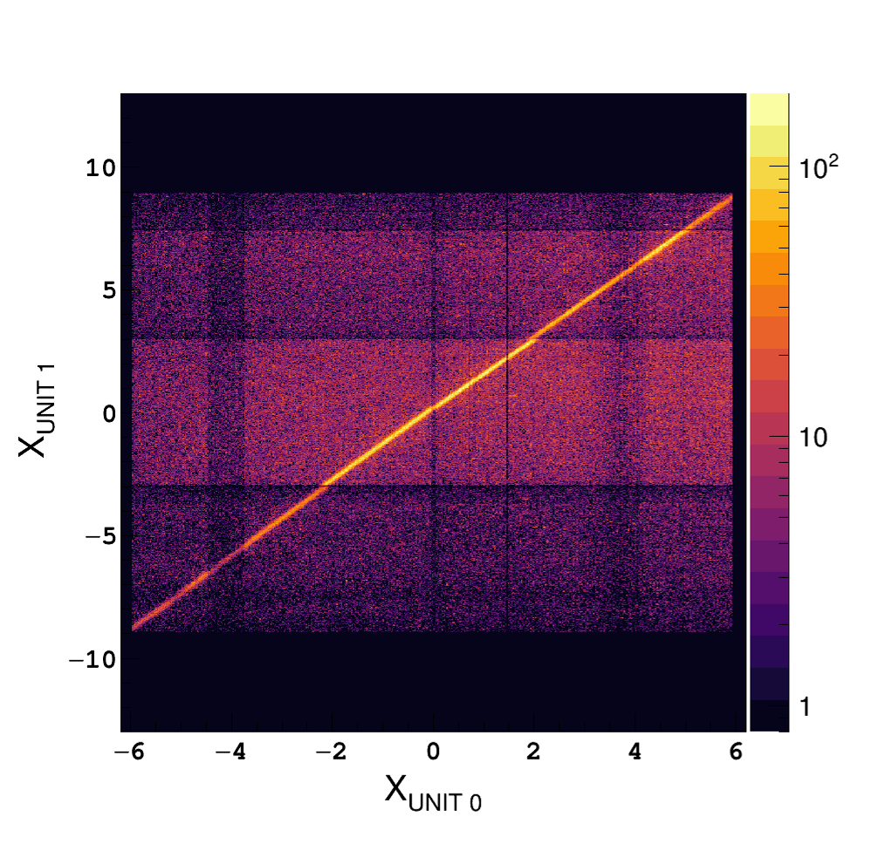
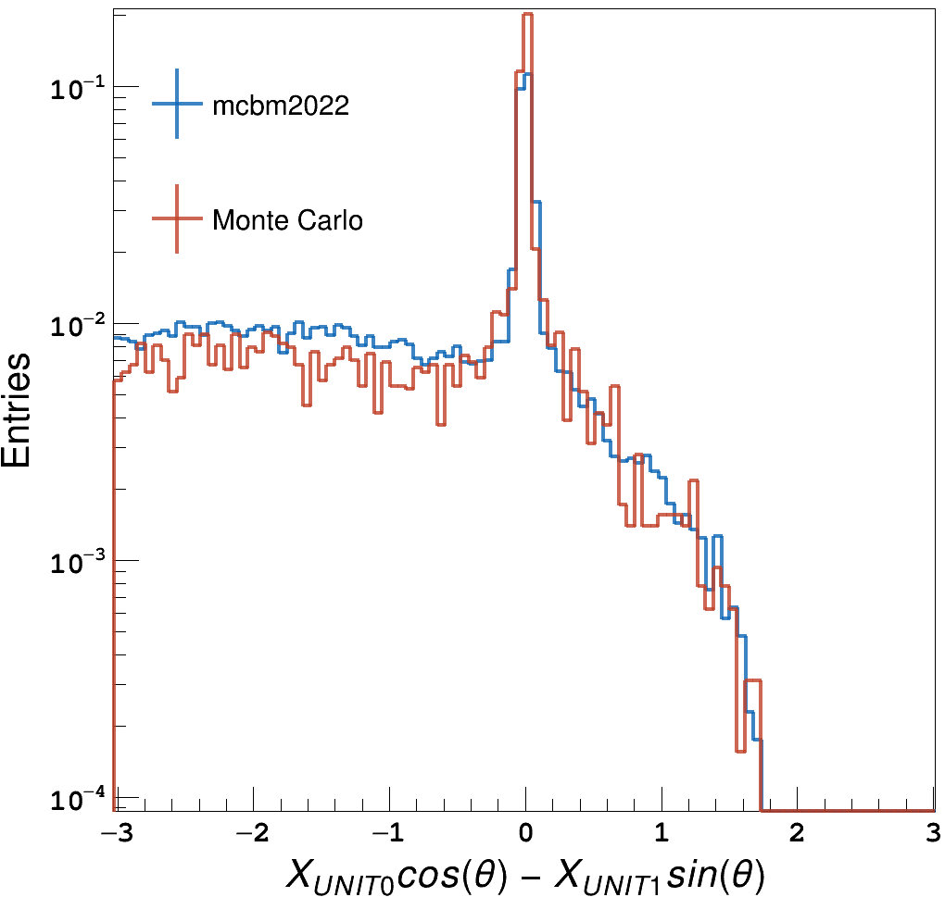
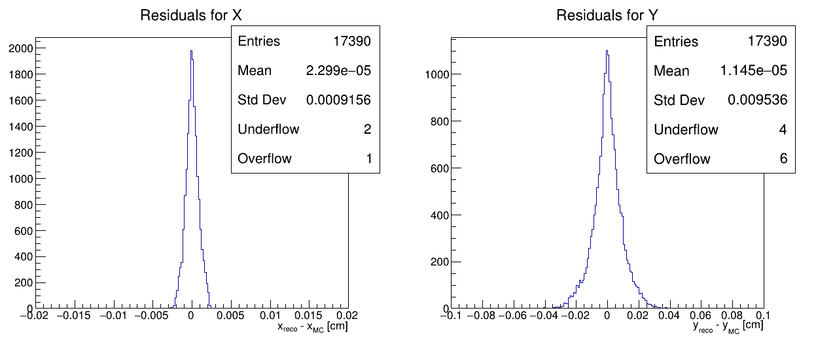
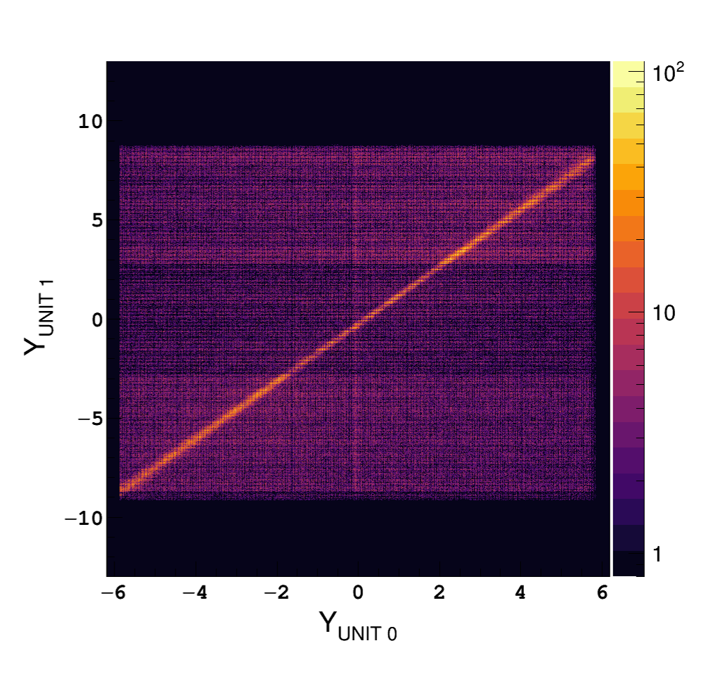
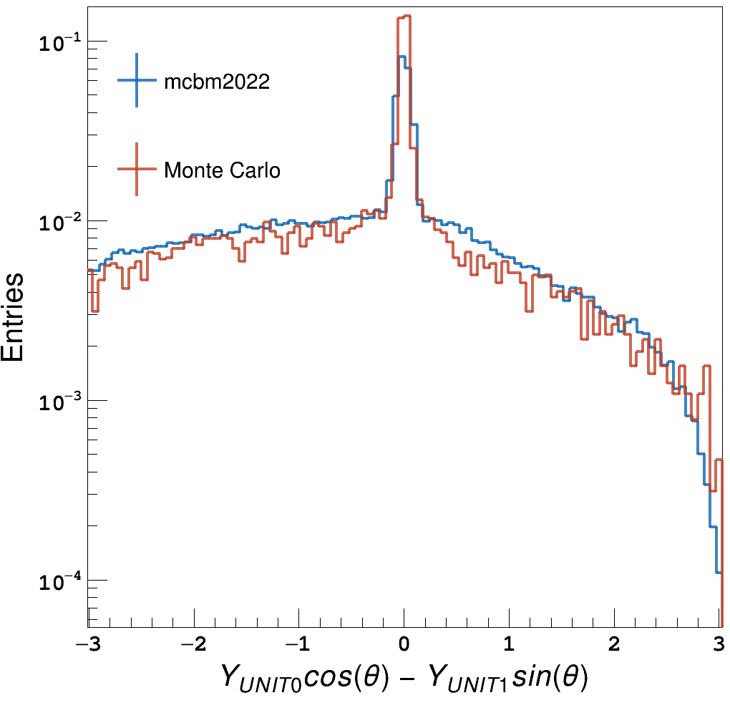
STS Space Resolution
XY Hit correlation inline with Monte Carlo expectations
[cm]
Space resolution 9 um
[cm]
[cm]
[cm]
[cm]
[cm]
Notes:
for it, spatial correlation of the transversal coordinates were built and compared to the MC expectation
- from a residual analysis we can extract the expected spatial resolution of ~9 um

Slide 11
... track-lets, beam spot ...
Notes:
now, we know we are all good on the space-time,
so, what can we do regarding sts-track-lets, and beam spot?!?

Slide 12
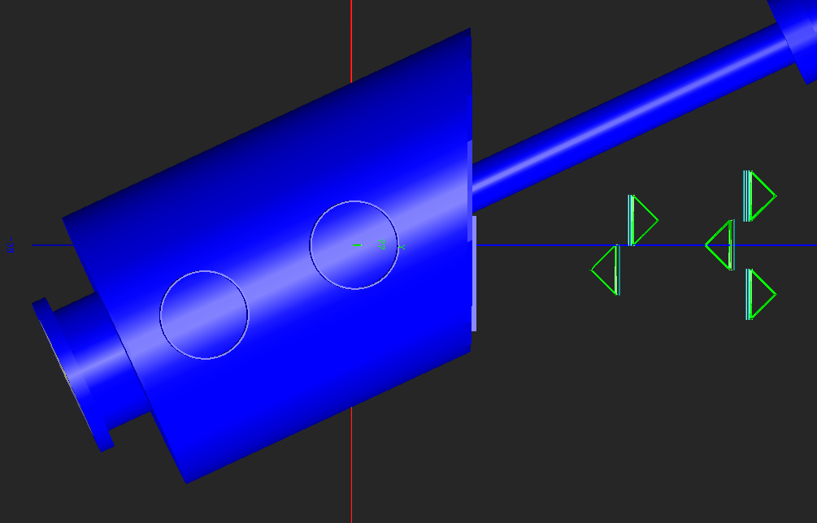
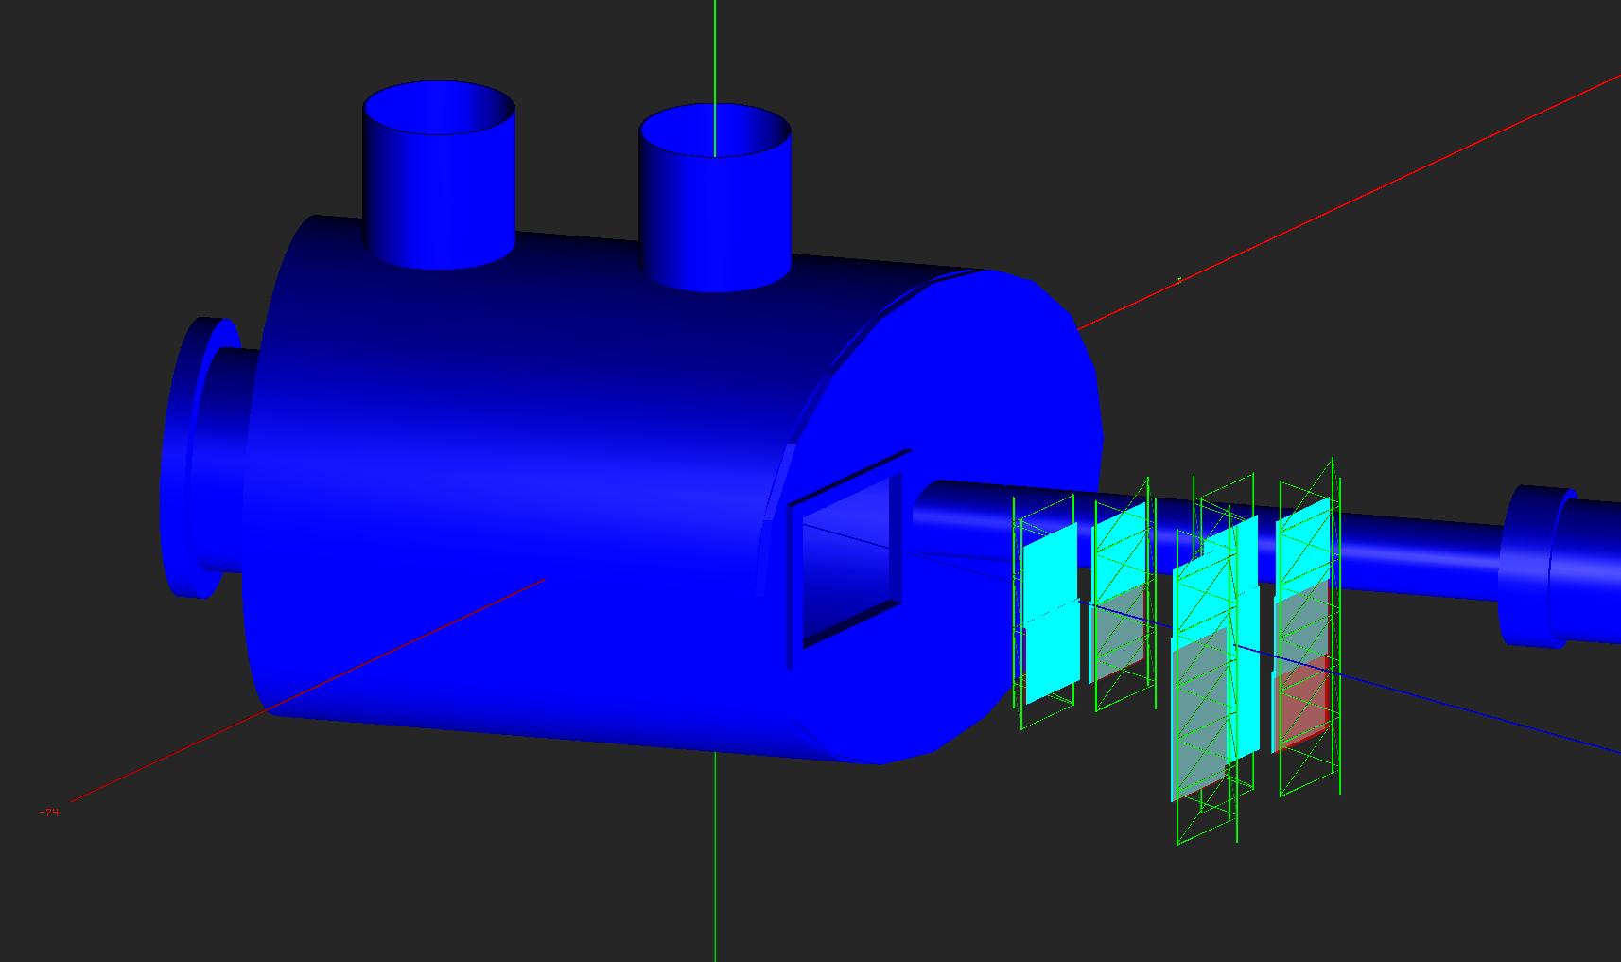
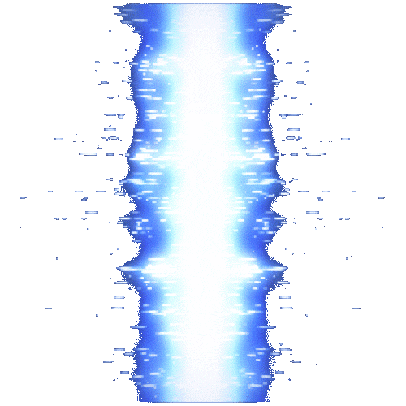
mSTS Vertex Reconstruction (beam spot) - Setup: Top view
2 stations
2 detection layers
(Ni) Target
Setup is rotated 25⁰ respect to the beam-line
Notes:
first, let me put you in a better geometrical perspective of our setup
As I mentioned before, we have 2 tracking stations, which translates in 2 detection layer

Slide 13
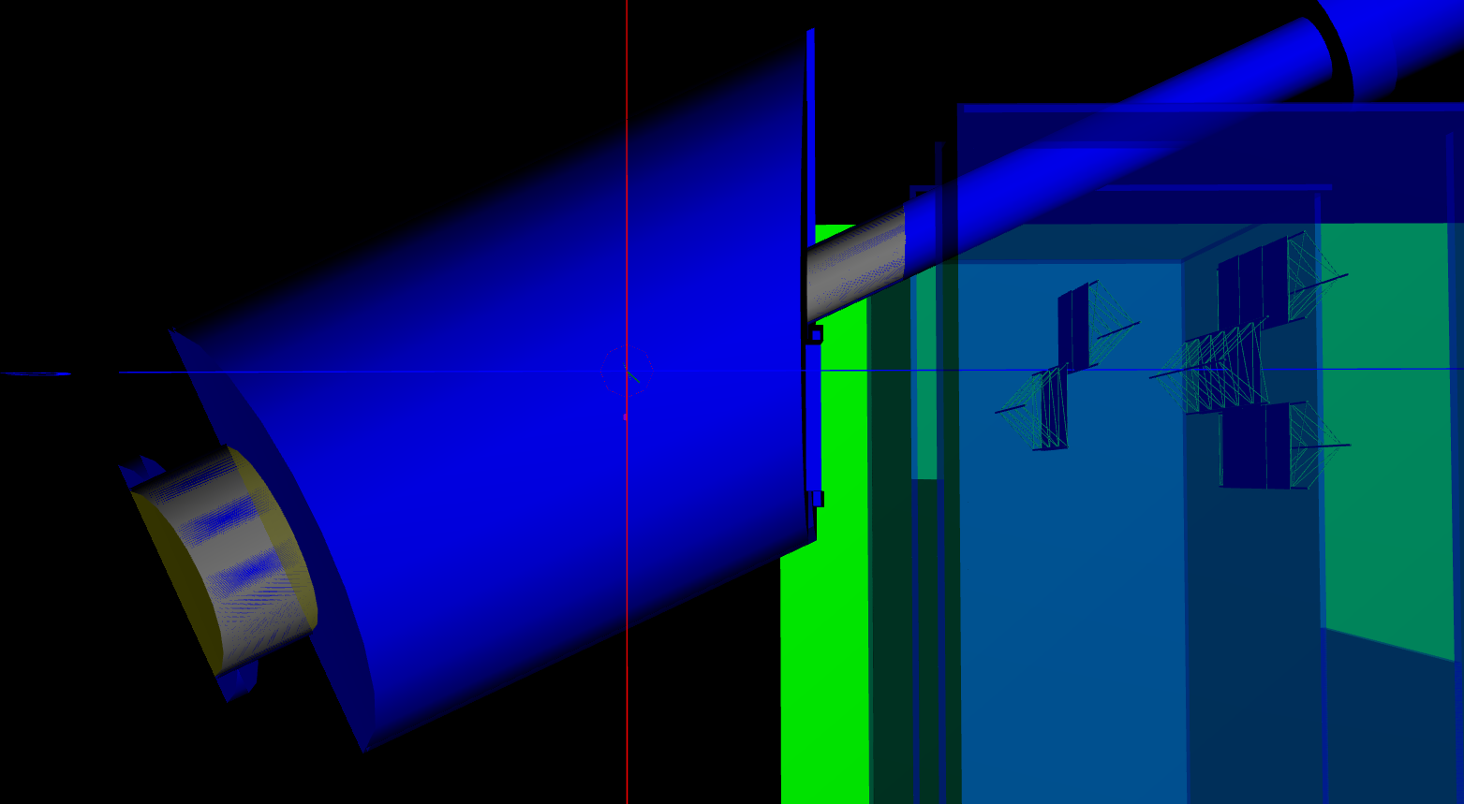
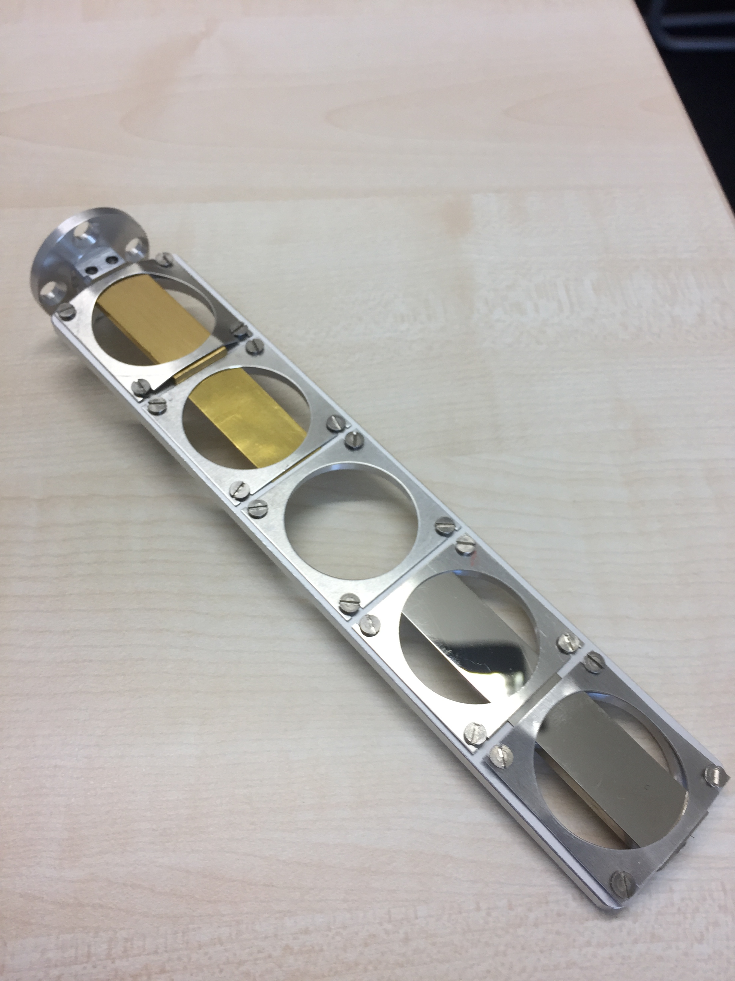

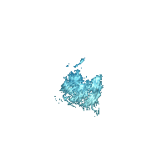
mSTS Vertex Reconstruction (beam spot) - Setup: Top view
(Ni) Target plane
Target ladder
Notes:
with the beam coming from “this”direction, particles created from the collision, will deposited energy in our sensors

Slide 14
mSTS Vertex Reconstruction (beam spot) - Setup: Top view
(Ni) Target plane
Reconstructed hits
Notes:
these energy deposition will be reconstructed

Slide 15
mSTS Vertex Reconstruction (beam spot) - Setup: Top view
Combinatorial background
Real tracks
Reconstructed hits
Straight lines defined by two STS hits
Notes:
and as we do not have magnetic field, trajectories will be defined by straight lines
- we can build all possible track-lets
- some will be combinatorial background
-other, will be real particle tracks
By extrapolating these track-lets, and intercepting with the target plane,

Slide 16
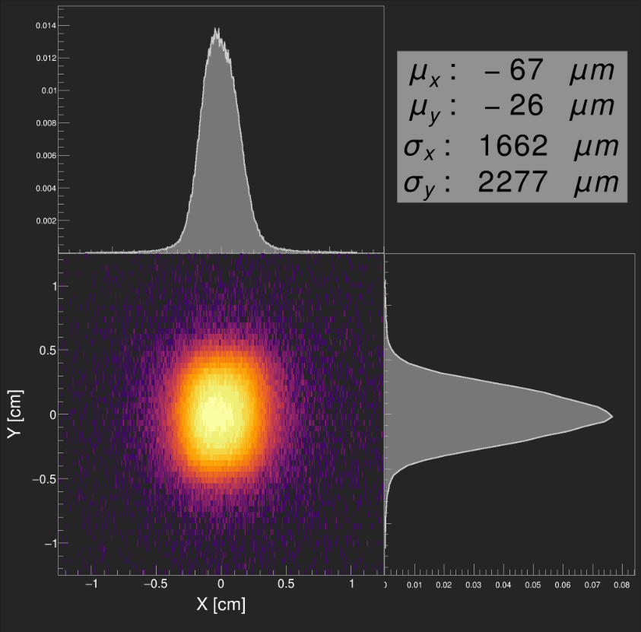
mSTS Vertex Reconstruction : beam spot at target plane
Notes:
we can reconstruct some vertexes, dominated by the beam spot

Slide 17
mSTS Vertex Reconstruction : secondary targets
(Ni) Target plane
T0 detector
(diamond counter)
Pipe flanges
Notes:
Now, the beam does not distinguish between our intended target and any other structure in it paths
Therefore we have secondary targets in our setup
corresponding to
- Diamond counter place 20 cm behind the Ni target
- the entrance of the target chamber
- and the pipe flange right before

Slide 18
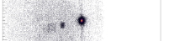
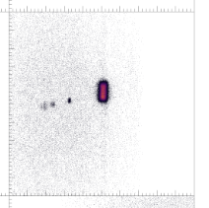
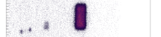
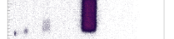
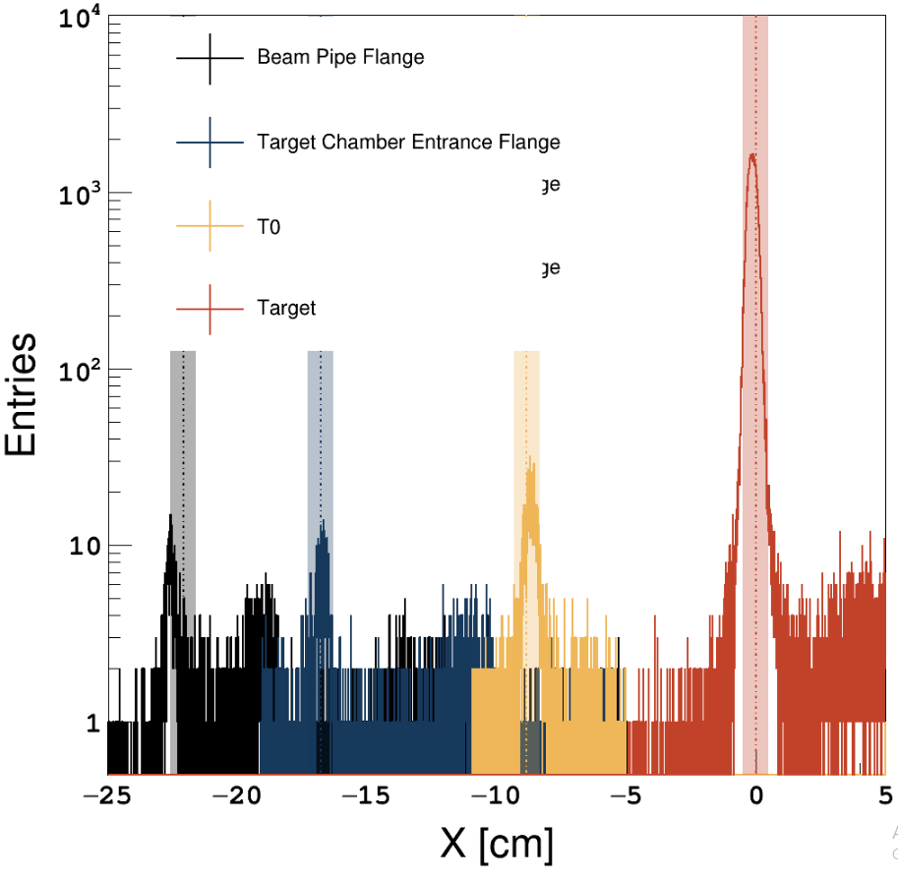
mSTS Secondary targets - Cave “tomography”
(Ni) Target plane
T0 detector
(diamond counter)
Pipe flanges
Notes:
Running the same analysis, and extrapolating to different planes, we in fact can observe those structures
By design, we know the extract position of such element

Slide 19

mSTS Secondary targets - Cave “tomography”
Notes:
Projecting to the X coordinate the 2D histograms, when obtain the peaks, corresponding to each structure, and with a dashed line and a shadow, and have place for you, the expected position of these peaks
resulting in a remarkable agreement

Slide 20
... hit reconstruction efficiency ...
Notes:
Now, lets make use of our tracking algorithm and explore our hits reconstruction efficiency

Slide 21
mSTS - Hit Reconstruction Efficiency
Global Track: Sts(1) - TRD(3) - TOF(>2)
Notes:
for this purpose, we require long track, with a single layer hit at STS

Slide 22
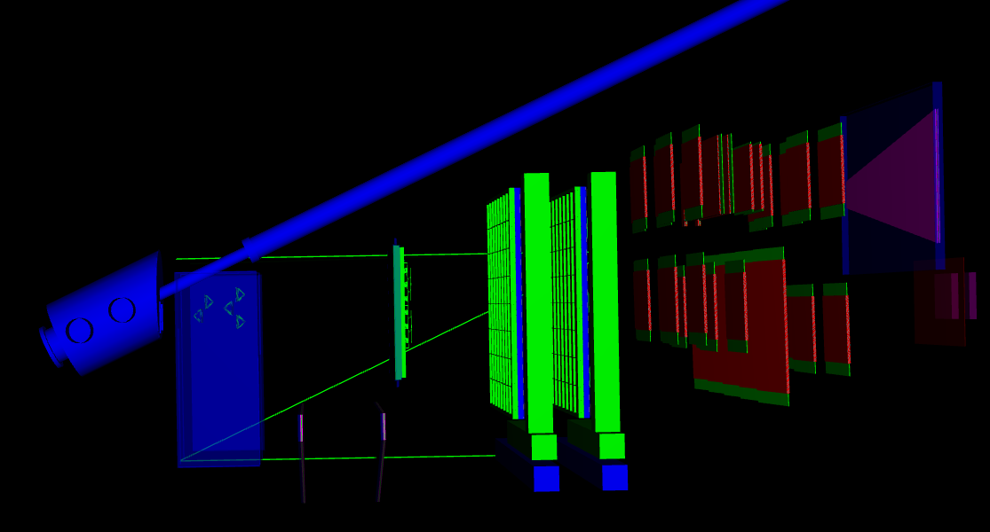
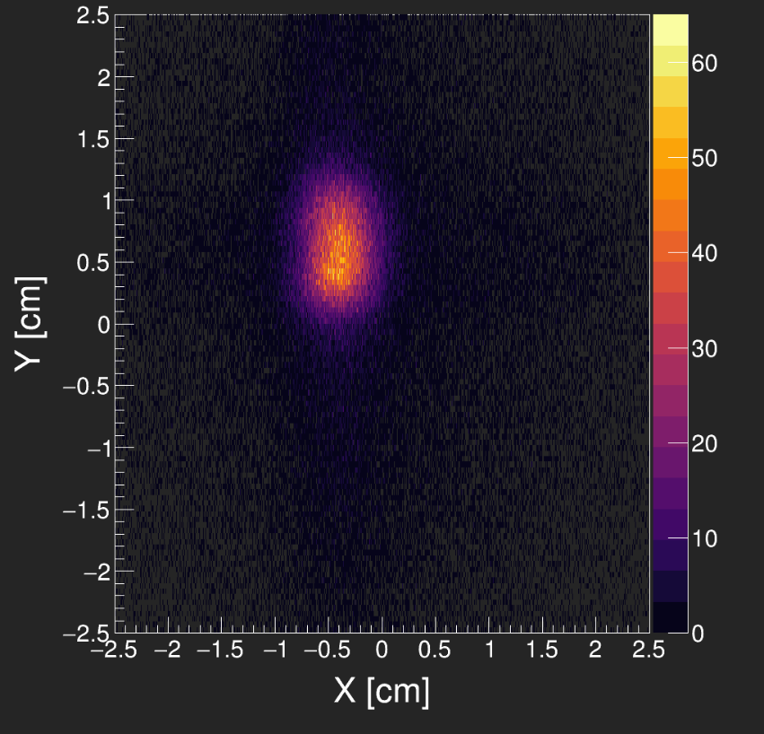
mSTS - Hit Reconstruction Efficiency
GlobalTrack: Sts(1) - TRD(3) - TOF(>2)
Notes:
Moreover, from the reconstructed beam stop, in order to reduced some combinatorial background

Slide 23
mSTS - Hit Reconstruction Efficiency
GlobalTrack: Sts(1) - TRD(3) - TOF(>2)
Notes:
we will use only those GTrks coming from the very center of such distribution

Slide 24
mSTS - Hit Reconstruction Efficiency
Is there a reconstructed hit, attachable to the track at the unused layer?
Unit 0
Unit 1
Notes:
Now the question that stands:
is there a reconstructed hit, attachable to the track at the unused layer?

Slide 25
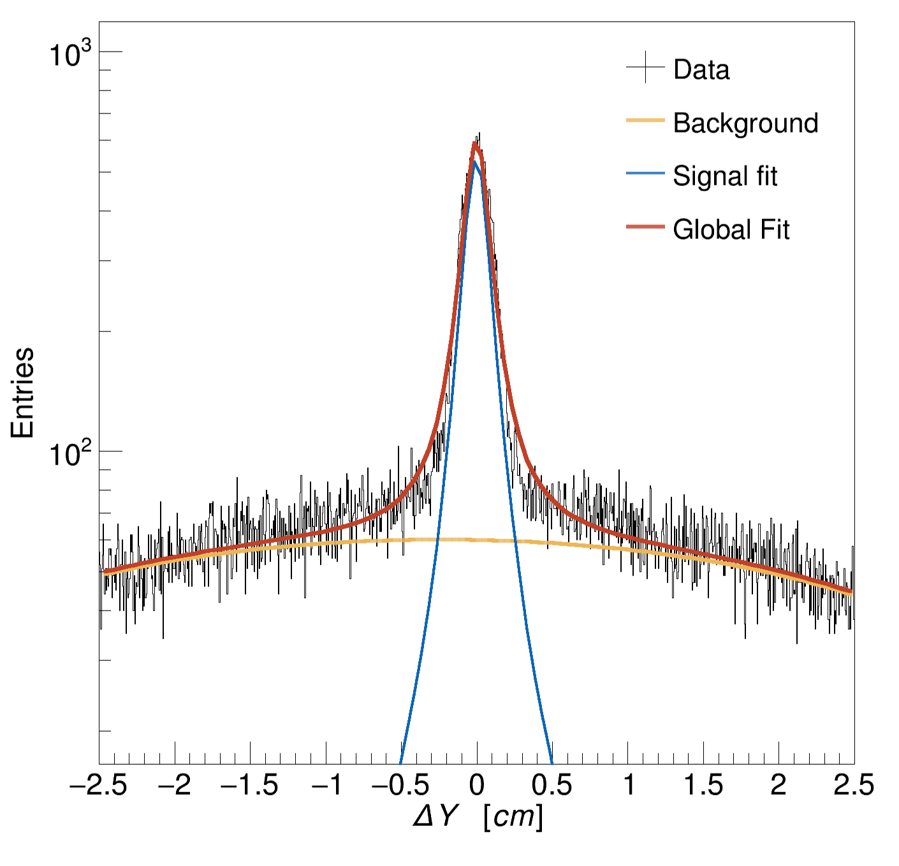
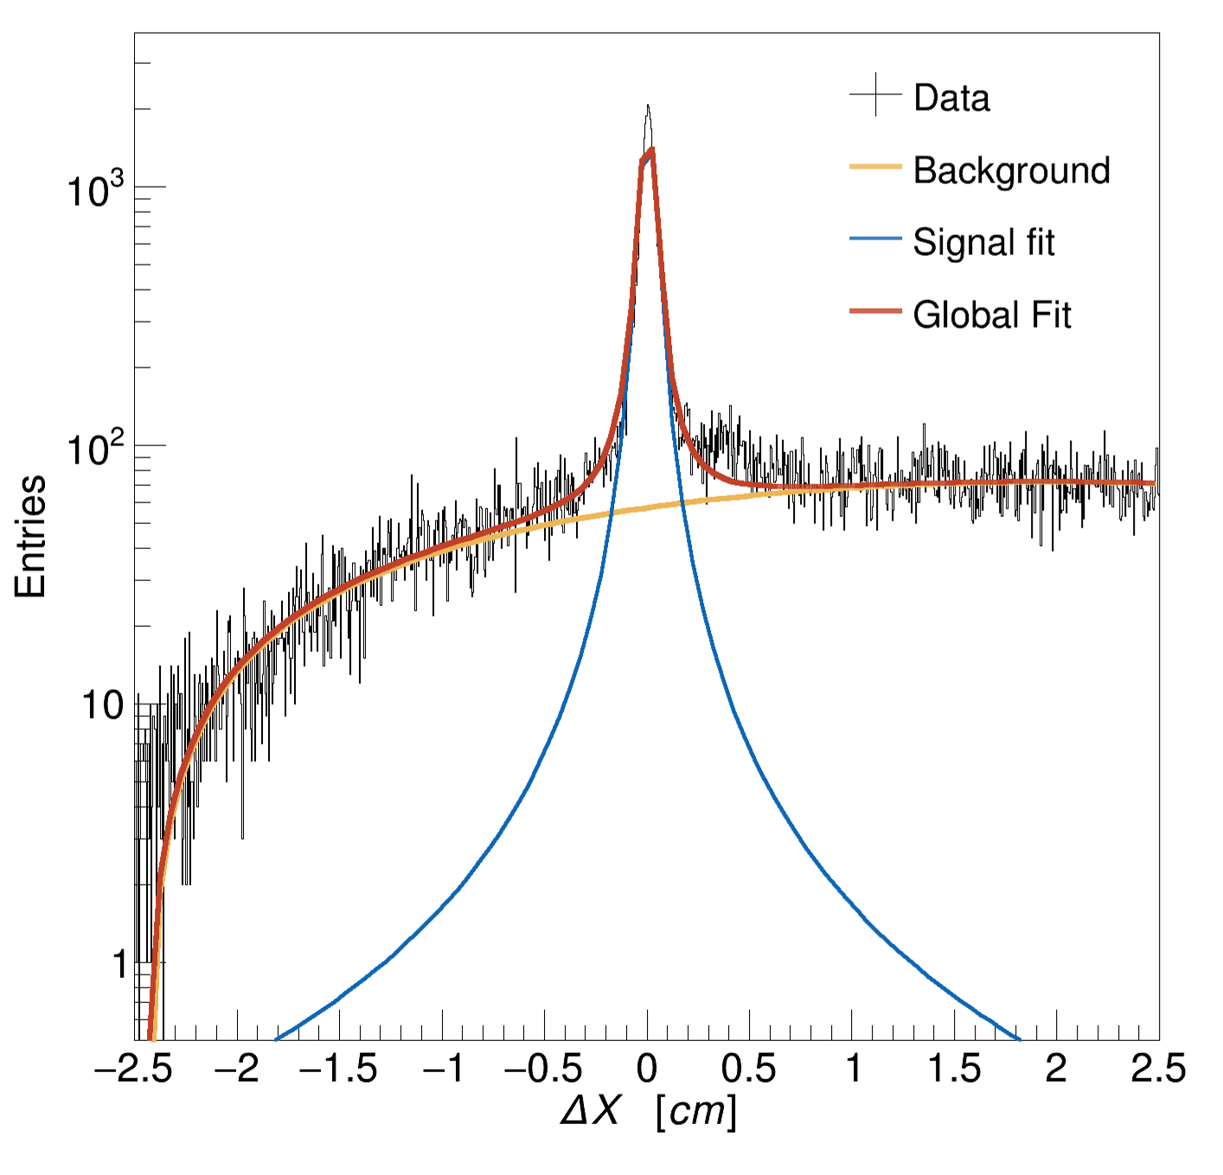
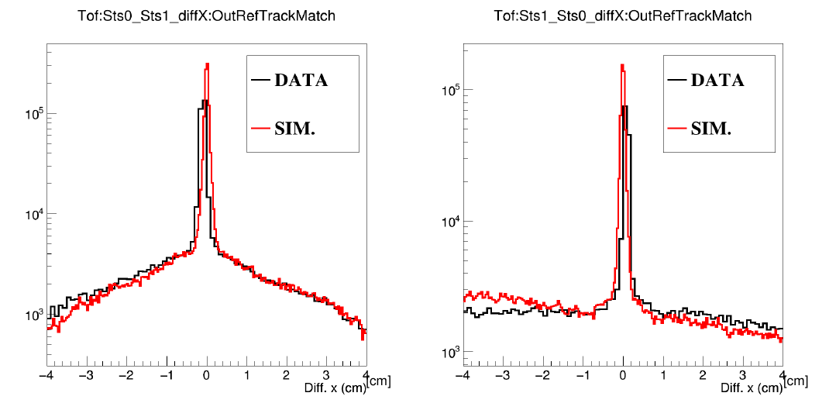
mSTS - Hit Reconstruction Efficiency
Is there a reconstructed hit, attachable to the track at the unused layer?
mCBM2021
Track-lets: Sts(1) - TOF(1)
mCBM2022
Global Tracks: Sts(1) - Trd(3)
Notes:
to answer such questions, a residual analysis must be done first.
To the left you see a comparison with MC, with the minimum requirement of 1STS hit and 1TOF hit
but four our ultimate purpose, we selected those with 3 TRD hits and 1 STS hit

Slide 26
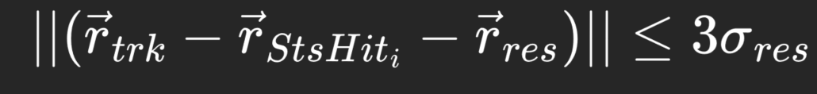
mSTS - Hit Reconstruction Efficiency
Is there a reconstructed hit, attachable to the track at the unused layer?
mCBM2021
Track-lets: Sts(1) - TOF(1)
mCBM2022
Global Tracks: Sts(1) - Trd(3)
Good agreement with Monte Carlo expectations
First tests of 4D tracking capabilities with data
Notes:
The residual analysis comes to our aid
the mathematical expression represent the condition to consider a reconstructed hits, attachable or not to a given track.
having 2 parameters
1 - the mean value of the residual, accounting for remaining miss-alignment
2 - the sigma of the peak which account for uncertainties

Slide 27
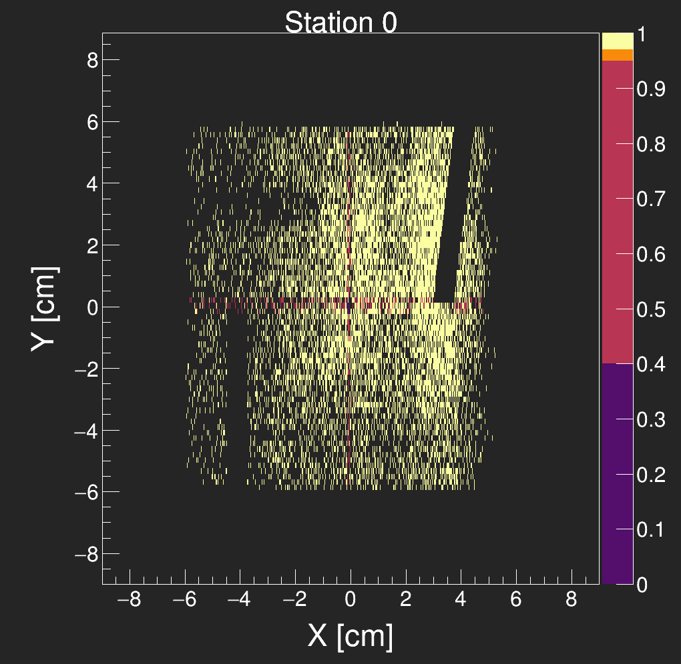
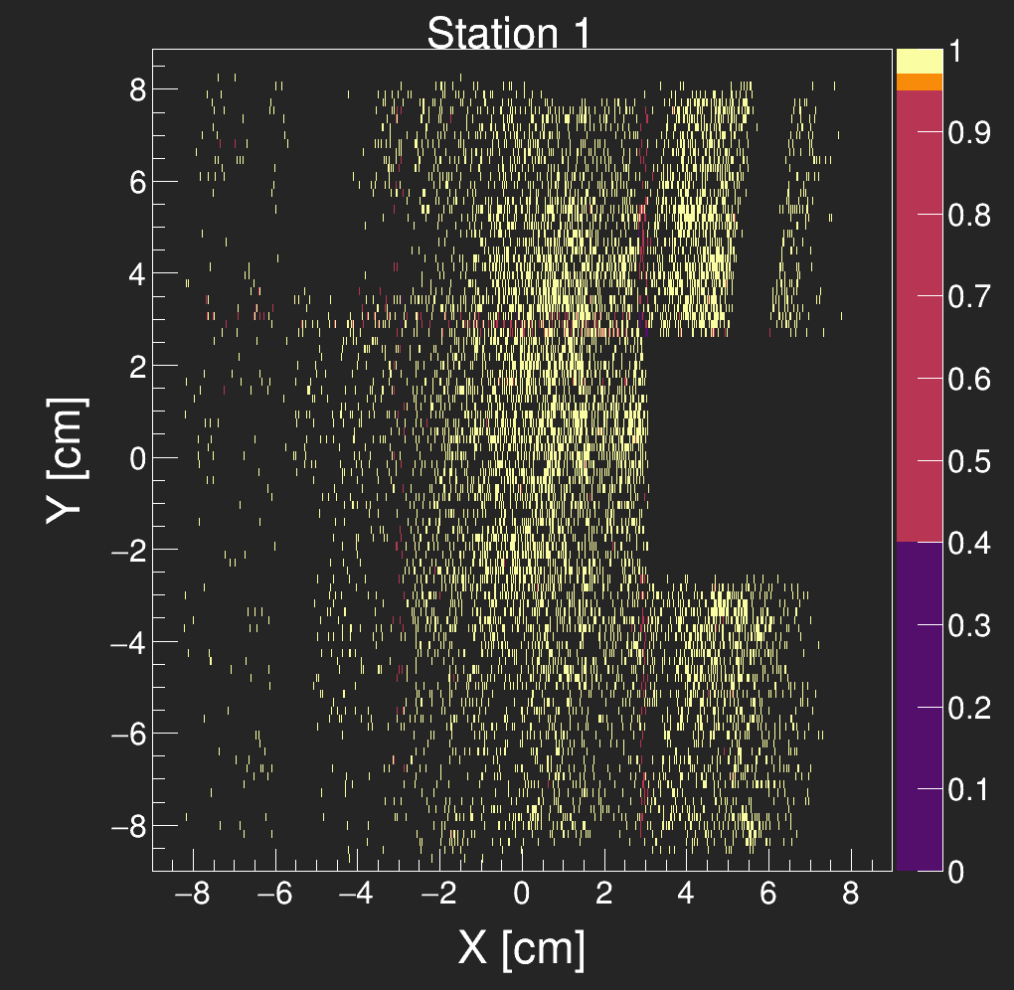

mSTS - Hit Reconstruction Efficiency
HRE > 97%
Excluding inactive areas
HRE > 97%
Excluding inactive areas and sensor edges
PRELIMINARY
PRELIMINARY
PRELIMINARY
Notes:
Now I show to you this plots
to the left a threshold dependency study
and to the right a differential hit reconstruction efficiency in the transversal plane.
these are preliminary results, but good enough to show, with a reconstruction efficiency above 97%, excluding

Slide 28
Summary
Robust time resolution procedure:
4.8 - 9.2 ns
(6k-67k e)
Position measurement inline with MC expectations
9 um
Hit reconstruction efficiency above 97%
Self-alignment capabilities
Consistent secondary targets reconstruction
Benchmark Lambda reconstruction
Good performance for vertexing and tracking
[cm]
PRELIMINARY
[cm]
PRELIMINARY
PRELIMINARY
Notes:
this brings me to my summary
remark benchmark Lambda reconstruction, reflecting the good performance for vertexing and tracking

Slide 29
Deep dive
M.Teklishyn From 3D to 5D tracking: SMX ASIC-based Double-Sided Micro-Strip detectors for comprehensive space, time, and energy measurements
TWEPP 2023 https://indico.cern.ch/event/1255624/contributions/5444008/attachments/2728888/4743371/smx_5d_tracking_teklishyn_06OCT2023.pdf
A. Rodriguez Rodriguez et al., Functional characterization of modules for the Silicon Tracking System of the CBM experiment
accepted by NIM
K. Agarwal, Thermal Management of the CBM-FAIR’s Silicon Tracking System (STS) – Concept and Demonstrators
Forum on Tracking Detector Mechanics 2023
https://indico.cern.ch/event/1228295/contributions/5390887/attachments/2656554/4600811/20230531_Agarwal_FTDMT%C3%BCbingen.pdf
S. Mehta, Impact of air cooling on mechanical stability of silicon sensors in CBM-STS
Forum on Tracking Detector Mechanics 2023
https://indico.cern.ch/event/1228295/contributions/5390888/attachments/2656536/4600775/Vib_Tracking_forum_Mehta_1.pdf
I. Elizarov, Sustainable cooling supply for the STS detector electronics
Forum on Tracking Detector Mechanics 2023
https://indico.cern.ch/event/1228295/contributions/5401384/attachments/2656351/4600422/Elizarov-Pilot%20Cooling%20Supply%20for%20the%20CBM%20Silicon%20Tracking%20System%20Detector%20Electronics.pdf
L.M. Collazo, Temperature calibration and thermal stress tests of the Front-End Electronics of the CBM Silicon Tracking System
Forum on Tracking Detector Mechanics 2023
https://indico.cern.ch/event/1228295/contributions/5394879/attachments/2656948/4601561/FTDM2023_Poster_Lady_Maryann.pdf
M. Teklishyn Detectors and Electronics for the CBM experiment at FAIR
ICPADGP 2023 https://events.vecc.gov.in/event/19/contributions/1009/attachments/198/411/teklishyn_cbm_detectorselectronics_07feb2023.pdf
Notes:
from previous studies, we know the residuals between STS-TOF track-lets are consistent
- a threshold dependency HRE shows

Slide 30
... additional material ...

Slide 31

mCBM Benchmark Lambda reconstruction
Rare signal reconstructed: Λ → p π⁻
Ni+Ni 1.93 AGeV
run 2391 (May '22):
10⁹ collisions, 1:57h
400 kHz av. coll. rate
preliminary
all detector systems involved
secondary vertex
velocity windows for p and π⁻ candidate

Slide 32








mSTS Signal Analysis - Charge vs Channel
Station 1
Station 2
ladder 0
ladder 1
ladder 1
2 non functional ASICs
few dead channels
module 0
STATION 1
STATION 2
UNIT 3
UNIT 0
UNIT 1
UNIT 2
Mod 0
Ladder 1
Mod 0
Mod 0
Mod 0
Mod 1
Mod 1
Mod 0
Mod 1
Mod 1
Ladder 0
Ladder 0
Mod 1
Mod 2
module 1
Ladder 1
Ladder 0

Slide 33





mSTS Signal Analysis - Charge vs Channel
module 0
module 1
module 2
1 non functional FEB
8 non functional ASICs
Calibration issues
ladder 0
STATION 1
STATION 2
UNIT 3
UNIT 0
UNIT 1
UNIT 2
Station 2
Mod 0
Ladder 1
Mod 0
Mod 0
Mod 0
ladder 2
Mod 1
Mod 1
Mod 0
Mod 1
Mod 1
Ladder 0
Ladder 0
Mod 1
Mod 2
Ladder 1
Ladder 0

Slide 34


STS Noise

Slide 35
... from hardware to software ...

Slide 36

STS sensors strips
p-side strips tilted by 7.5⁰
n-side strips
p-side strips
Front view
Cross-section view
Sensor on carbon fiber ladder

Slide 37
STS sensors strips
n-side strips
p-side strips

Slide 38
STS sensors fired strips
n-side fired strips
p-side fired strips

Slide 39
STS sensors strips
1 channel per strip
128 channels per ASIC
8 ASIC per side
n-side fired strips
p-side fired strips
Micro cables. Front-End Board (FEB)

Slide 40
Software objects: STS
n-side fired strips
StsDigi
Address (position of the sensor)
Channel (position relative to the sensor)
Time
Charge (1-31 ADC)
StsCluster
StsHit
p-side fired strips

Slide 41
Software objects: STS
n-side fired strips
StsDigi
StsCluster
Charge (1 - cluster size * 31)
Position
StsHit
p-side fired strips

Slide 42
Software objects: STS
n-side fired strips
StsDigi
StsCluster
StsHit
X, Y - cluster position
Z - sensor position
Time
Charge
p-side fired strips
Y
X

Slide 43
... time distributions ...

Slide 44

STS Time Calibration (Time Walk correction)
https://www-physics.lbl.gov/seminars/old/Cartiglia.pdf
Signal of different amplitudes are timed differently

Slide 45
STS Time Calibration (Time Walk correction)
Correction is ASIC dependent
Before
After

Slide 46


mSTS Time Resolution
Consistent
time calibration across
ASICs,
Modules &
Stations
Removal of combinatorial
- Hits
- Digis
- Clusters

Slide 47
... cluster distributions...

Slide 48






mSTS Signal Analysis - Cluster charge distribution
UNIT 0
UNIT 1
UNIT 2
Charge distribution is consistent along different cluster size
MODULE 0
MODULE 1

Slide 49
... preliminary alignment ...

Slide 50

mSTS Vertex Reconstruction - Setup: Top view

Slide 51

mSTS Vertex Reconstruction - Setup: Top view

Slide 52



mSTS Vertex Reconstruction - Splitting contributions

Slide 53





mSTS Self alignment
Run minimization: Vertex Spread
v_{ij} : vertex position for sensor_i, sensor_j
(currently, only translations - easily extended)
Minimization:
Gradient decedent

Slide 54

mSTS Vertex Reconstruction - Splitting contributions

Slide 55


mSTS Vertex Reconstruction
Aligned vertex
Sensor alignment parameters

Slide 56

mSTS Vertex Reconstruction
Different sensor pairs reconstruct beam spot at the same position

Slide 57
mSTS Vertex Reconstruction
Consistent vertex shape for different sensor pairs!

Slide 58

mSTS Vertex Reconstruction
Sensor in the same mechanical structure move on the same direction
Unit 3
Unit 2
Unit 1
Rotations still need to be considered
Unit 3
Unit 0
Unit 2
Unit 1
Unit 0

Slide 59
mSTS Vertex Reconstruction
Sensor alignment translations are consistent with the mechanical assembly!
Unit 3
Unit 2
Unit 1
Unit 0

Slide 60
... zoom in the beam spot ...

Slide 61


mSTS Vertex Reconstruction - Zooming the vertex
Extrapolating to large distance, detector structure shows up
y [cm]
x [cm]

Slide 62


mSTS Vertex Reconstruction - Vertex structures
y [cm]
x [cm]

Slide 63
mSTS Vertex Reconstruction - Vertex structures
y [cm]
x [cm]

Slide 64
... Monte Carlo studies ...

Slide 65


mSTS Acceptance - MCTrack
2 Reconstructed layers
All tracks
Hitting 2 Sts layers
6.15M
4.31k
2.70k
6.15M
4.31k
2.70k
6.15M primary tracks

Slide 66
mSTS Acceptance - MCTrack
2 Reconstructed layers
All tracks
Hitting 2 Sts layers
6.15M
4.31k
2.70k
6.15M
4.31k
2.70k
ACCEPTED / ALL: 7.00 %
RECO / ALL : 4.39 %
RECO / ACCEPTED: 62.64 %

Slide 67
mSTS Acceptance - MCTrack
2 Reconstructed layers
All tracks
Hitting 2 Sts layers
6.15M
4.31k
2.70k
6.15M
4.31k
2.70k
ACCEPTED / ALL: 7.00 %
RECO / ALL : 4.39 %
RECO / ACCEPTED: 62.64 %

Slide 68
mSTS Acceptance - MCTrack
2 Reconstructed layers
All tracks
Hitting 2 Sts layers
6.15M
4.31k
2.70k
6.15M
4.31k
2.70k
ACCEPTED / ALL: 7.00 %
RECO / ALL : 4.39 %
RECO / ACCEPTED: 62.64 %

Slide 69


mSTS Acceptance - MCTrack
2 Reconstructed layers
All tracks
Hitting 2 Sts layers
6.15M
4.31k
2.70k
6.15M
4.31k
2.70k

Slide 70



mSTS Acceptance - MC - Hit Reconstruction Efficiency
MC HRE >99.98%
Excluding inactive areas

Slide 71
mSTS Rates

Slide 72


Expected rates STS - Worst Scenario - Monte Carlo
Au+Au - 12AGeV/c - 10MHz
Au-beam target interaction at 10⁹ ions/s -> delta e
UrQMD Au+Au at 10⁷ collisions/s
Delta e - low pT - B-field (1T): bent out or absorbed
The two first STS stations suffer the most
Digitization:
ENC = 1000 e,
Threshold: 4000 e
Max rate per channel: 150·10³ digis /ch / s
few exceptions: 250 - 300·10³ digis /ch / s
Notes:
From MC studies done by Mehul
of Gold-Gold col at 12AGeV/c
where the interaction rate of 10 MHz have been split into
- 10 to the power of 9 ions/s from delta electrons
and 10 to the power of 7 collisions/s from the Gold-Gold by UrQMD
we can see that due to the 1T Mag Field and low pT delta electrons, there are hot spots in the 1st two stations
from this we conclude that the rate per channel which is shown in the bottom plots, reach a maximum of XXX

Slide 73



Observed rates mSTS
- Beam Intensity scan: U+Au
- micro-spill structures up to 1:10
STS can sustain rates up to:
27x10³ digi/channel/sec
Notes:
on the other hand, on with the mSTS setup, and beam intensity scan was perform
and was observe that mSTS can can hold rate of 28 times 10 to the power of 3 digis per channel per sec

Slide 74
Observed rates mSTS
- Beam Intensity scan: U+Au
- micro-spill structures up to 1:10
STS can sustain rates up to:
28x10³ digi/channel/sec
In mCBM saturation is reached
~ 5·10⁸ ions/spill
Saturated mSTS
Notes:
above that limit, a just have a saturated mSTS
this is not a surprise so FEBs with single uplink are the ones to used during assembling

Slide 75

Observed rates mSTS
Scaling bandwidth (to be tested!!!)
x5 FEB8_1 → FEB8_5:
140·10³ digi/ch/s
mSTS hardware update is coming to proof the linear scaling!
New module!!!
FEB8_5
Notes:
therefore, if we consider a linear scaling of the bandwidth, the expected rate per channels STS should withstand rates around 140 k digis per channels per seconds
and one of the purpose of testing such linear scaling is the upcoming upgrade of mSTS
by the addition of a new modules using FEB8 5 (5 uplink)

