Slide 1

ATLAS ITk BCM'
VERTEX 16-20 October 2023
Ignacio Asensi, CERN
on behalf of all BCM' Community

Slide 2
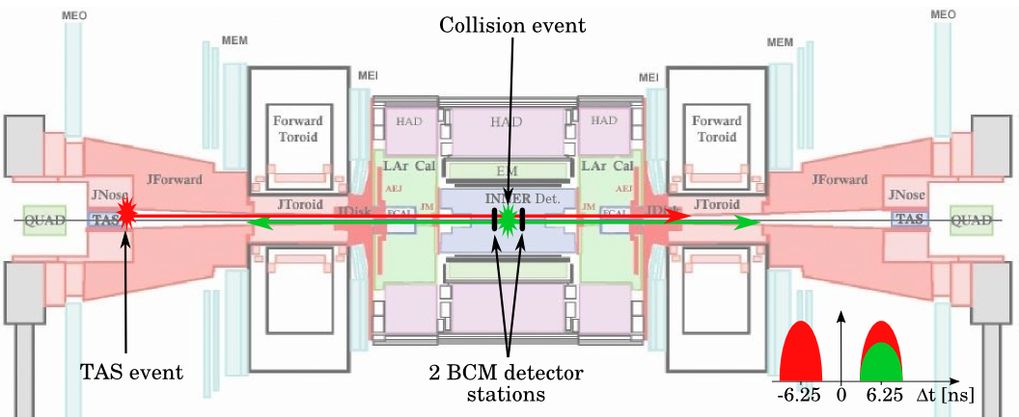
BCM' – Beam and Lumi protection
BCM – Beam Conditions Monitoring
Provides bunch-by-bunch for asynchronous detection
  Fast safety system for ATLAS
  (>105 MIP)
  Luminosity measurement (MIP)
  Background monitoring (MIP)
2 BCM detector
stations
BCM' TOF concept
Collisions: in-time
Background: out-of-time
Part of the new ATLAS ITk, BCM’ is the upgrade similar in operating principle to BCM
Two detector rings mounted symmetrically at z~1875 mm (6.25 ns)
  Four detector stations on each ring
Background events selected based on Time-of-Flight measurement
phi = 0°, 90°, 180°, 270° for lumi
Out-of-time events indicate possible beam instabilities. Abort conditions are met if 3 out of
4 detector stations on each ring trigger in two consecutive beam orbits
BCM' R1 ring position

Slide 3
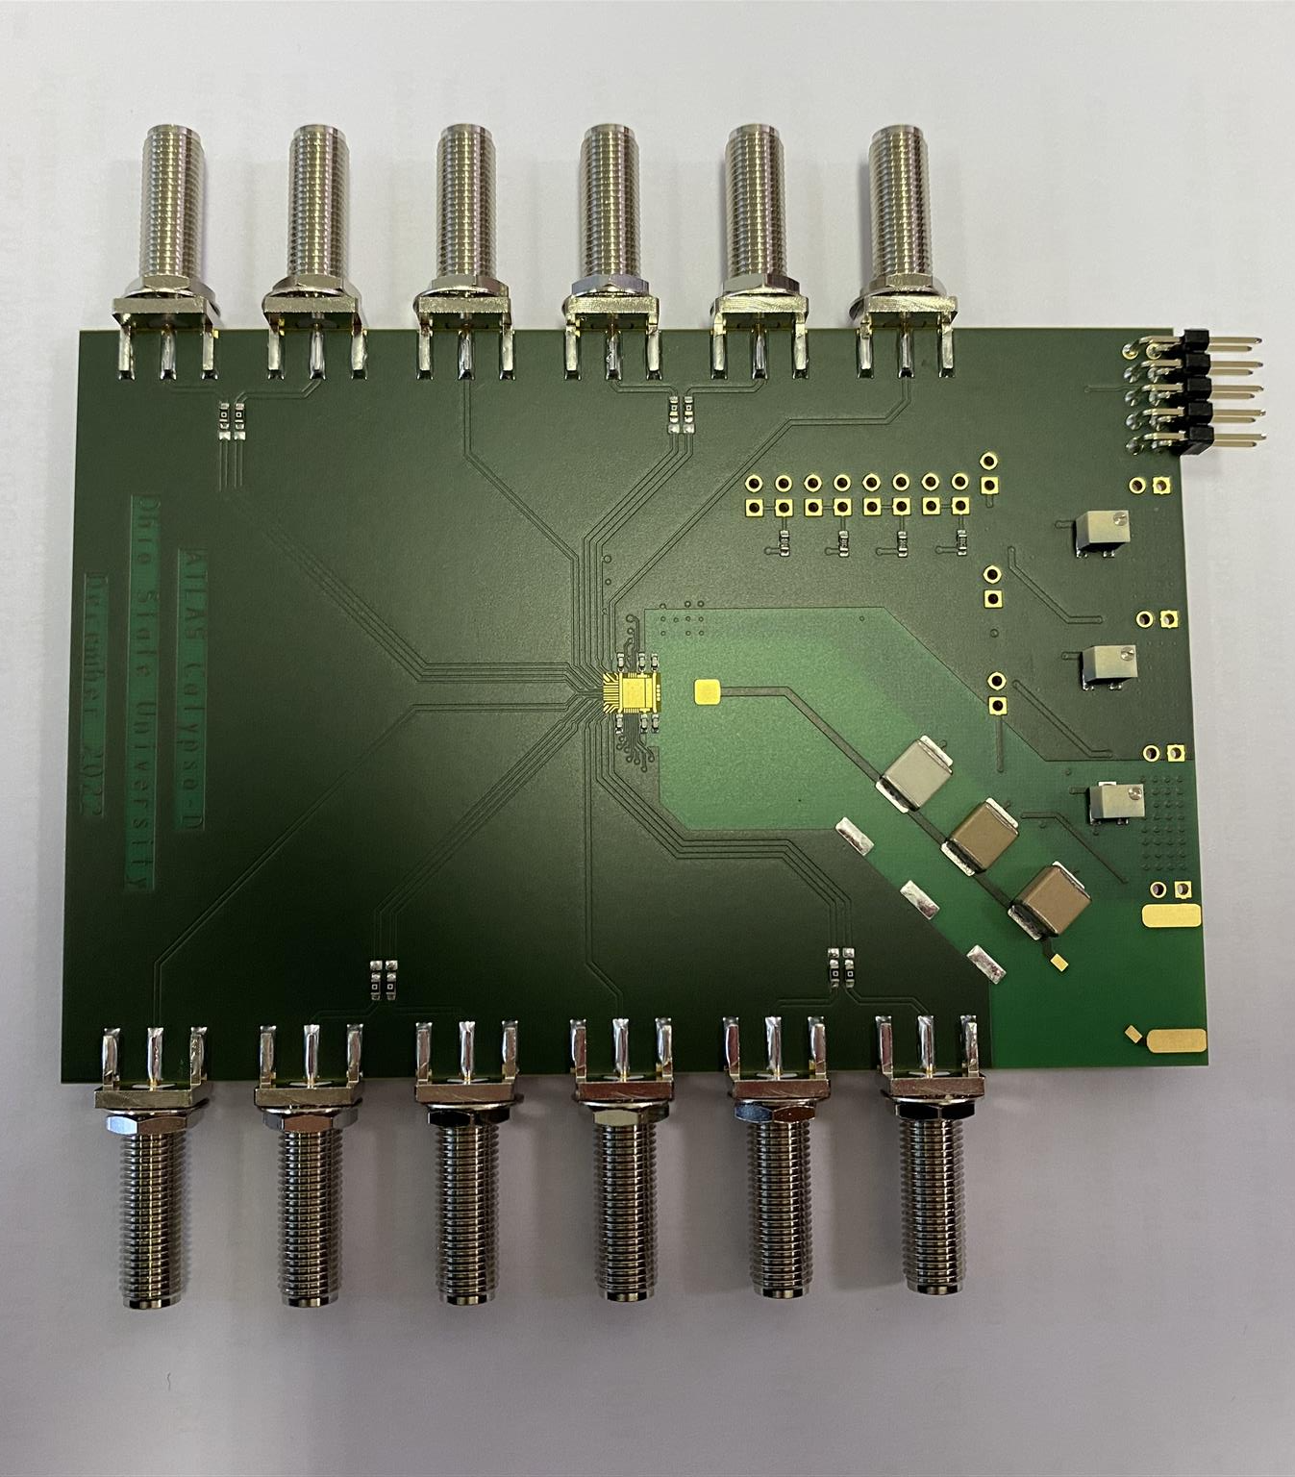
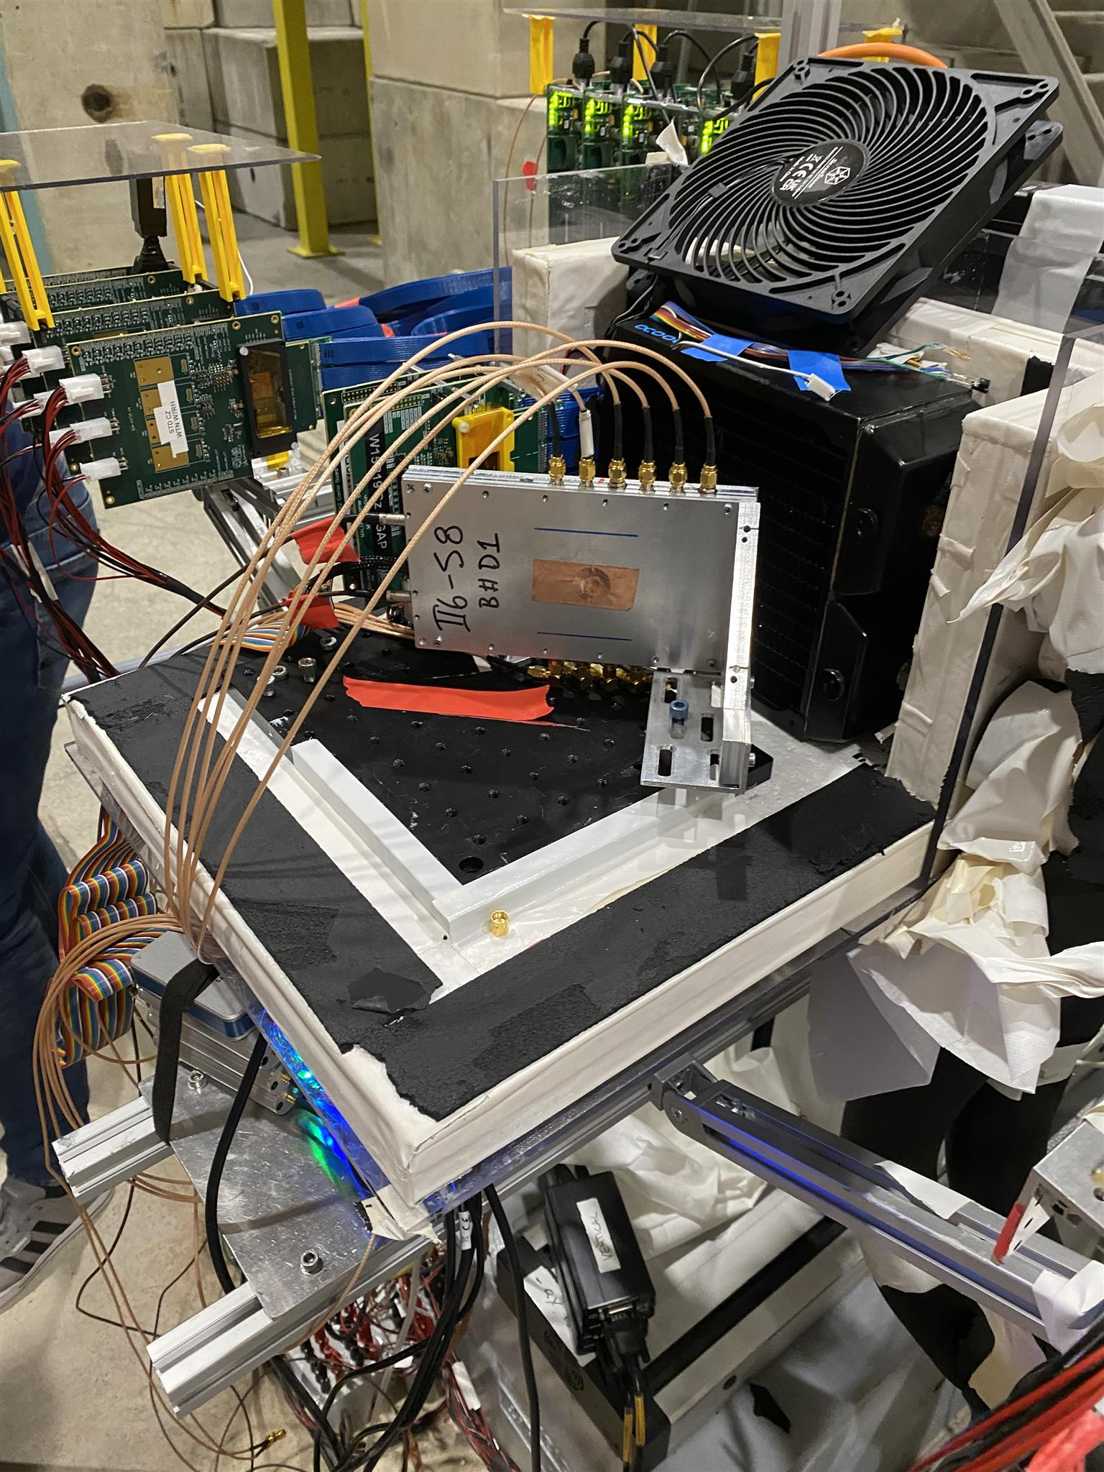
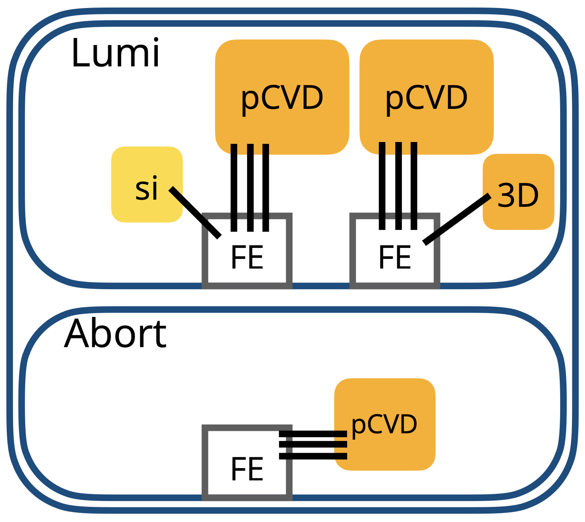
BCM' – Front-end Calypso
pCVD* diamonds selected for main detector material
Insulator at room temperature, no cooling required
  High electric field of up to 2V/ μm produces fast signals
Suitable for high radiation environments
Four channels, each FE amplifier and CFD configurable separately
Abort (8.2μ V/fC FE gain) or Lumi (60m V/fC FE gain) functionality
1 ns rise-time, 100 ps jitter, 200 e- noise for 2 pF detector capacitance
Outputs LVDS signal with ToA and ToT information foreach channel
Full feature design: 256 step of CFD threshold range, internal pulser, I2C addressing, and bandgap voltage reference
Single-chip board
2 planar pCVD diamond detectors
1 3D pCVD diamond detector
1 silicon detector for luminosity measurements per station
1 planar pCVD diamond detector for abort functionality
* polycrystalline Chemical Vapor Deposition
TB telescope and DUT

Slide 4
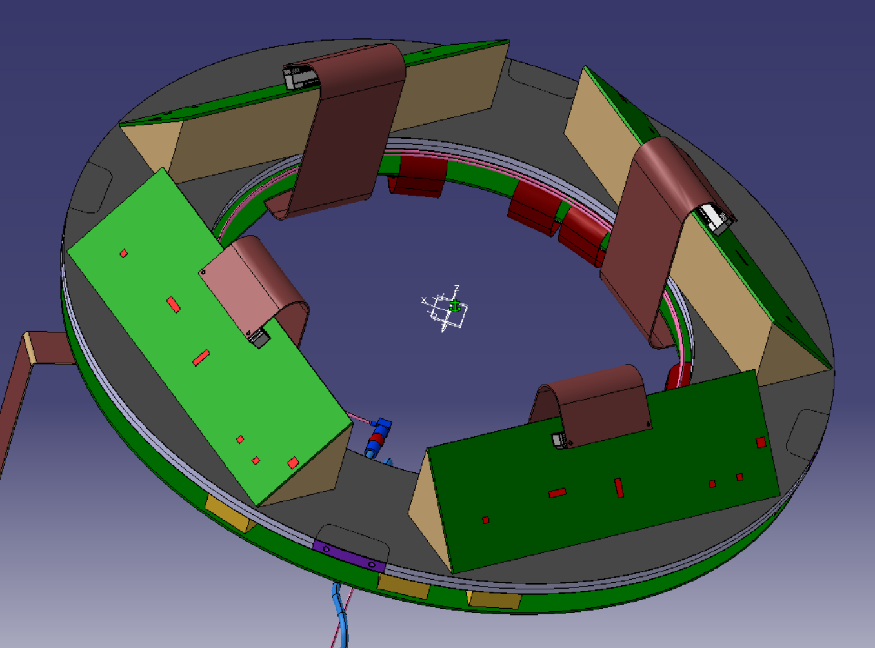
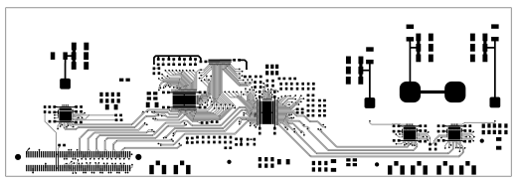
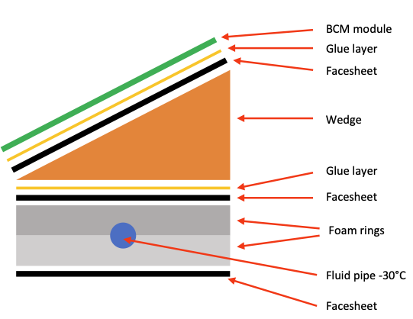
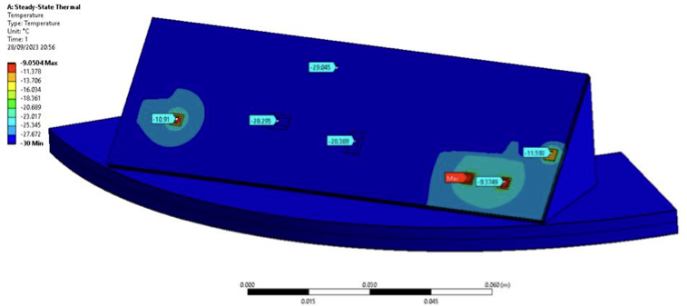
BCM' - Module
Mounting of pCVD’s at 45° angle difficult
  Avoid degrading Calypso performance
Opted for large (120x40 mm) 4-layer board, square design, sensors mounted flat on board
  Boards produced and stuffed
Engineering implications of the inclined flat module
  Envelopes check with Pixel IS
  Thermal simulation
  Carbon foam wedges
BCM' modules
25 cm
2 LAPAs
Temperature distribution obtained after simulation
Cut view of the model (normal to module’s length)

Slide 5
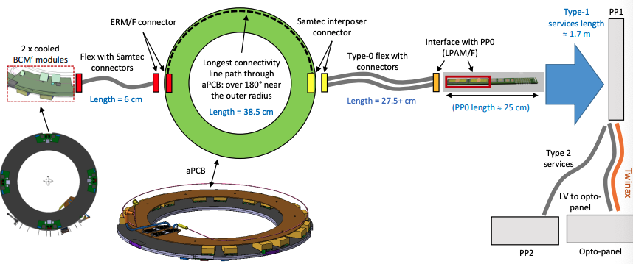
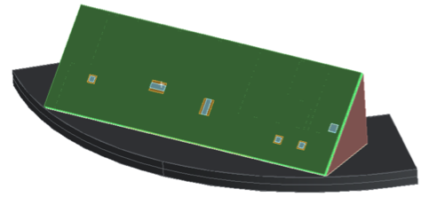
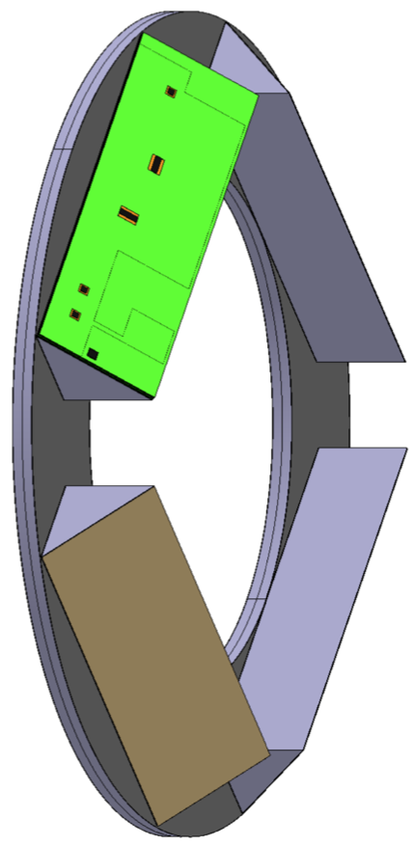
BCM' – Services
BCM services baseline follows ITK Pixel Inner System with some differences
aPCB being designed
Data transmission: 12 ribbons with 2x(10+8+10) Twinax per side feeding 2 slim + 2 L-shaped opto-boards, 56 total (48 up-, 8 down-links)
LV system uses DC-DC converters (bPOL), HV operates at 1000 V as opposed to 750 V in the Pixel IS
  Two floating BCM' power sections with single bPOL12V
Final G&S schematic reviewed
In-
detector
Off-
detector
BCM' connectivity
Readout

Slide 6
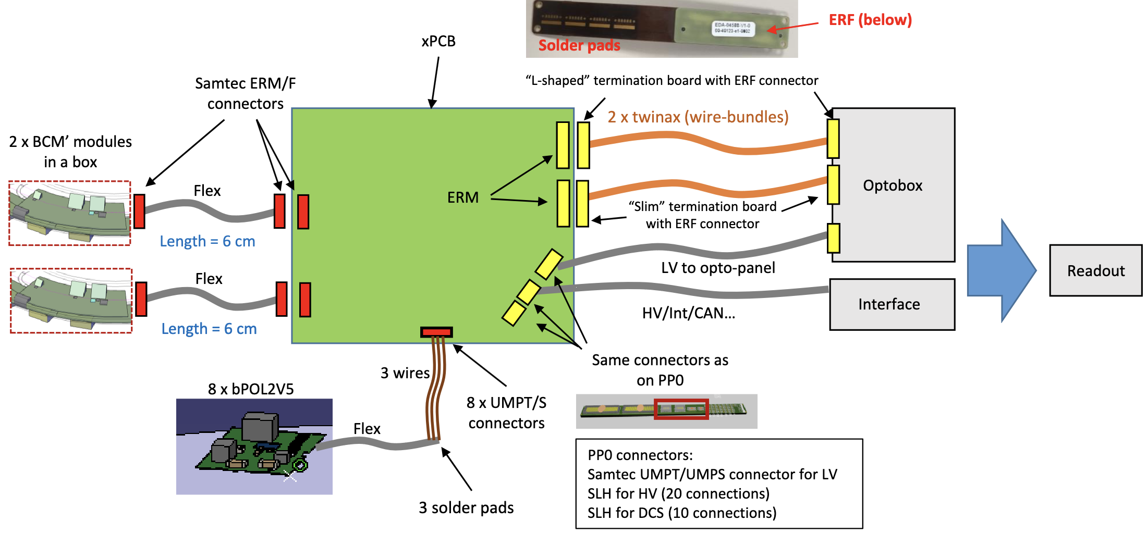
BCM' – System tests
Preparations for future tests ongoing
Use many components from Pixel IS (OptoBox, bPOL2V5, Twinax, cables…)
  Acquiring missing components (PP0, PP0_flex, PP1)
  Still need to demonstrate system aspects (power, control, read-out) up to opto-box
xPCB to incorporate aPCB + PP0 functionality – interface BCM' modules to opto-box

Slide 7
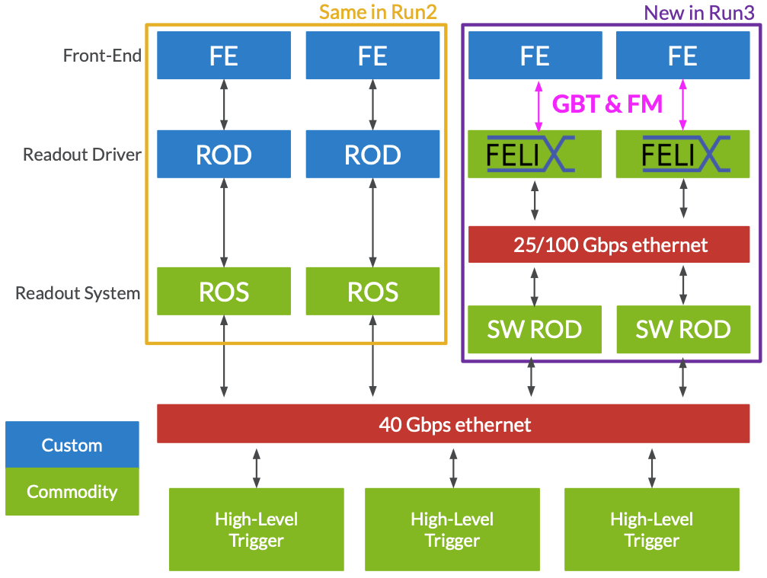
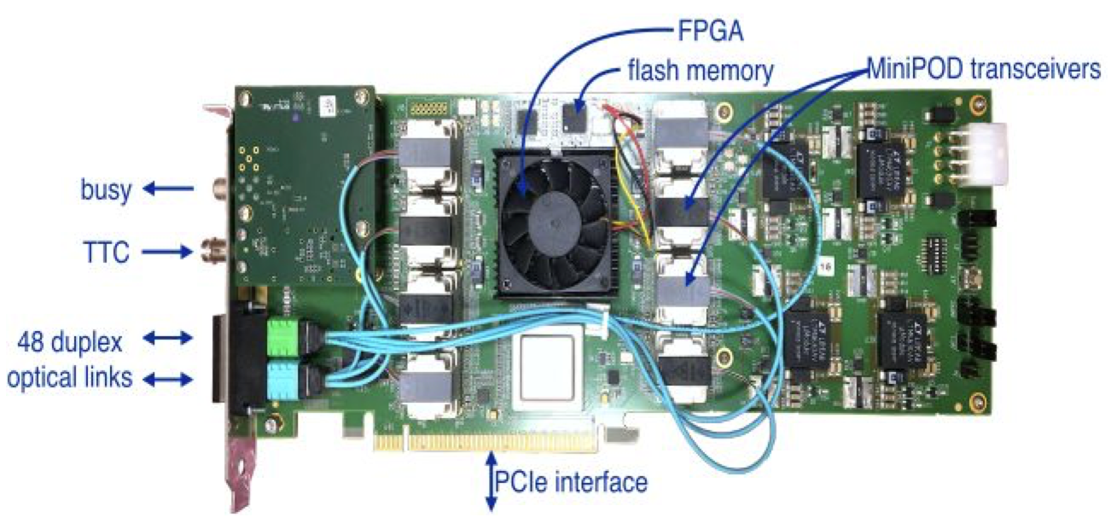
BCM’ – FELIX read-out
BCM’ read-out will be based on FELIX
Front-End LInk eXchange
https://atlas-project-felix.web.cern.ch
Legacy ROD and ROS architecture is being replaced with FELIX and SW ROD
Designed to reduce costs and custom electronics
FELIX is a data router that works as an interface between on-detector systems and commodity computing
  The data being routed includes readout, configuration, trigger, clock distribution, monitoring
  FELIX system consists of commodity servers with PCIe cards. Used for data routing only
  SWROD oversees data processing, aggregation, and monitoring. Hosted by commodity computers
8 MiniPODs to support up to 48 bidirectional optical links (most commonly: 4 MiniPODs/24 links)
Interface to Timing, Trigger and Control (TTC) systems. BUSY output.
Flash memory to store firmware
FPGA Xilinx Kintex UltraScale XCKU115, 16-lane PCIe Gen3

Slide 8
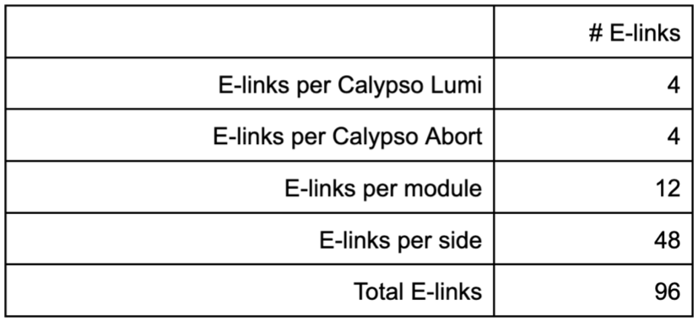
BCM' - Readout
When FELIX receives a L0A, the firmware sends out a chunk of data (TBD) around that L0A, it might contain raw data or else, to be defined later
FELIX is processing the data constantly
  If there is too much energy in the BCM', it should trigger beam abort
We have a prototype of the FW for decoding the raw data. We can process it. Could be integrated to ATLAS
  Abort to be implemented
4 modules per side
with LAPA driver
1.28 Gbps
5 m twinax
Optobox
10 Gbps
fiber
LHC abort
FELIX
40 MHz constant data processing
analog
(Differential pairs)
L0A
1MHz
Data
Per BC (25 ns)
TDAQ
Read-out channels

Slide 9
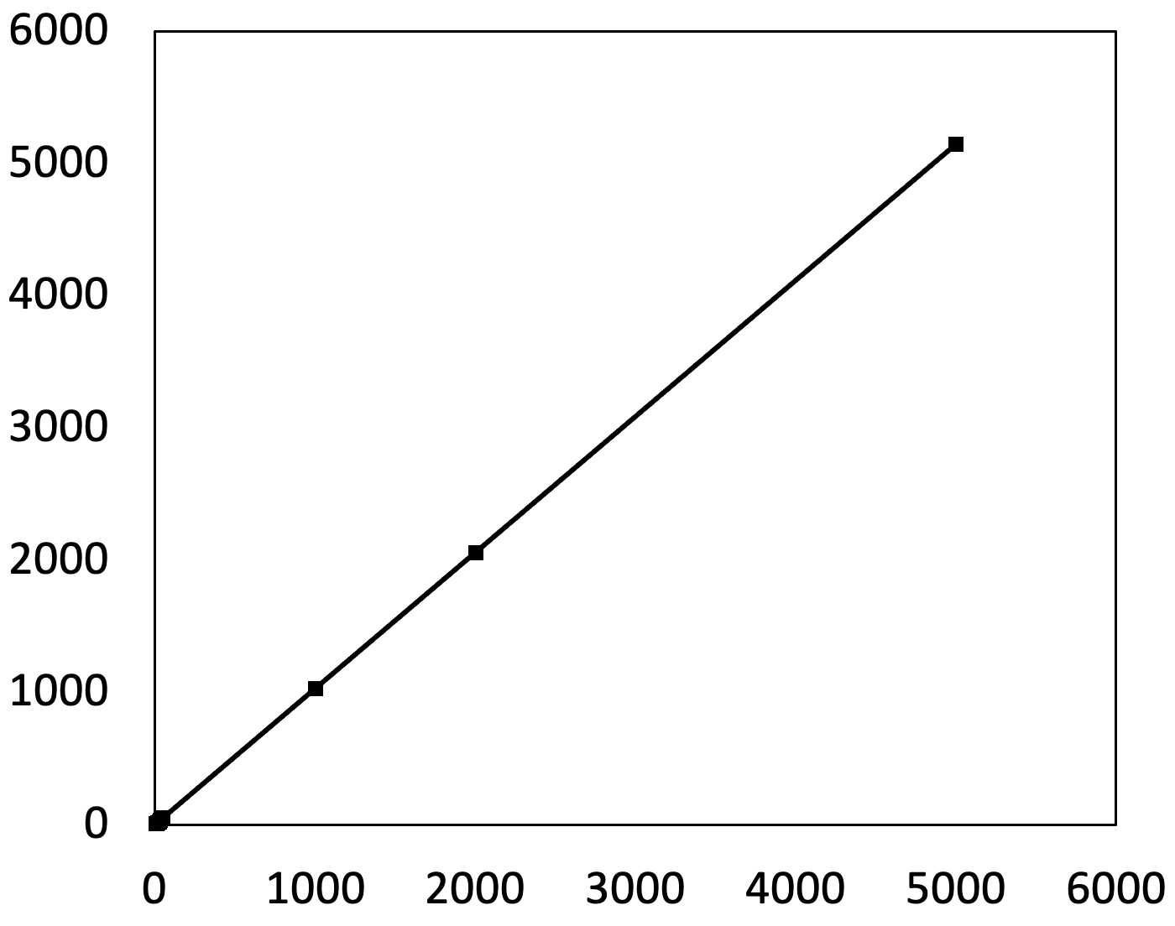

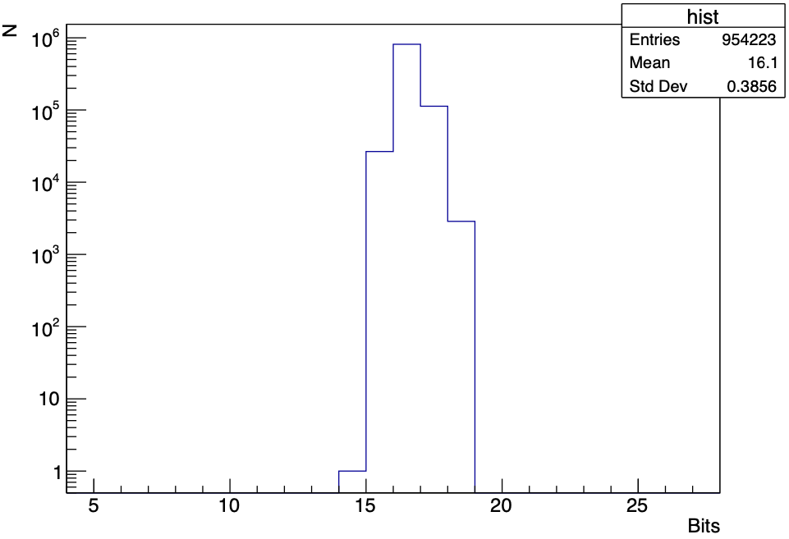
BCM' – FELIX FW
FELIX based BCM' readout
  Measurement of ToT and ToA
  Beam abort and data-taking
  Final design of the readout structure to be decided: One or two FELIX cards
Firmware
  Data-decoder of BCM' semi-digital signals as data-packets
  I2C commands to configure Calypso
  Beam abort implementation in progress
First version of the BCM' FW has presented to FELIX community
First working prototype completed
  Official FELIX software libraries in parallel with custom software ROD
Output word format might change
Measured pulse period [ns]
Injected pulse period [ns]
Output data format
Measured ToA at 80 MHz

Slide 10
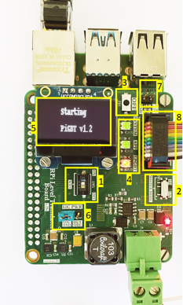
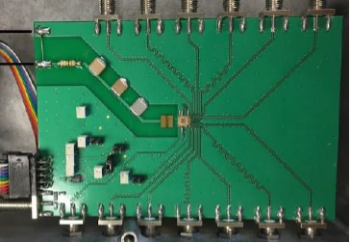
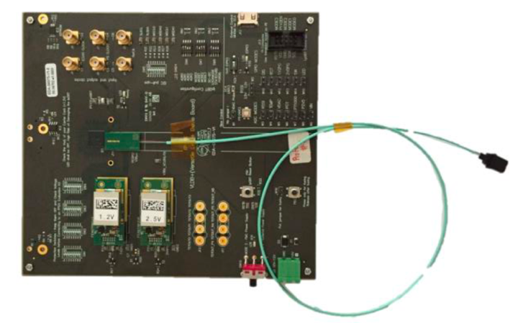
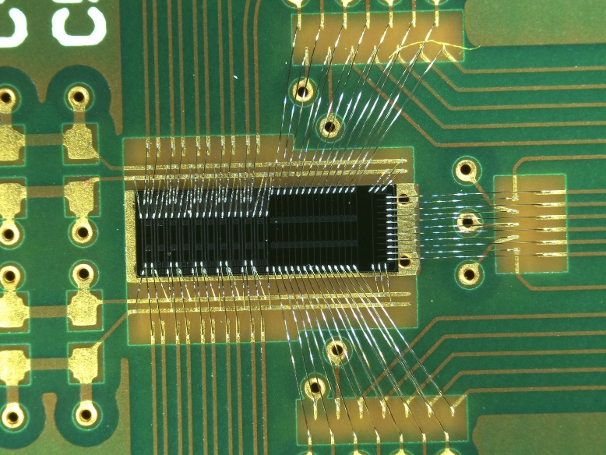
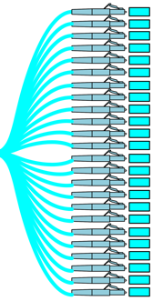

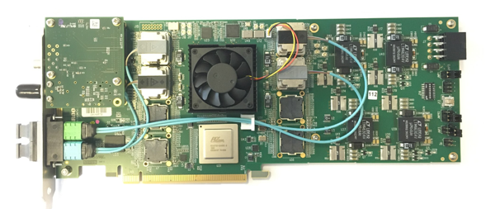
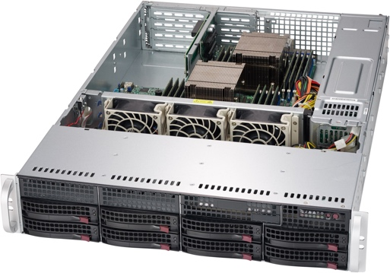
BCM' – Basic readout tests
Calypso
LAPA
driver
LPGBT
Sampling 1.28 Gpbs
(781 ps/sample)
FELIX
Phase-I (FLX-712)
Phase-I server
I2C config
PIGBT
5 m
twinax
cable
MPO12 to 12xLC
Optical CMD & Data
LAPA driver is used to improve the semi-digital signals over TwinAx cable
Calypso pulses (not synced to any clock) are recorded by FELIX
Data
Calypso
semi-digital
LAPA
driver
5 m
LPGBT
1.28 Gpbs sampling
(781 ps/sample)
VTRX
(VLDB+)
10 Gbps
FELIX
coaxial
TwinAx
electrical
optical
Command
Calypso
Up to 400 kHz
OptoBoard v0
VTRX
(VLDB+)
2.56 Gbps
FELIX
TwinAx
electrical
optical

Slide 11
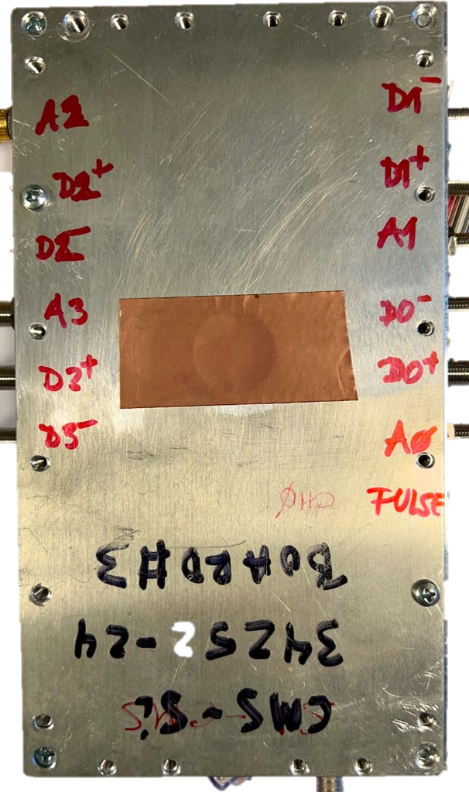
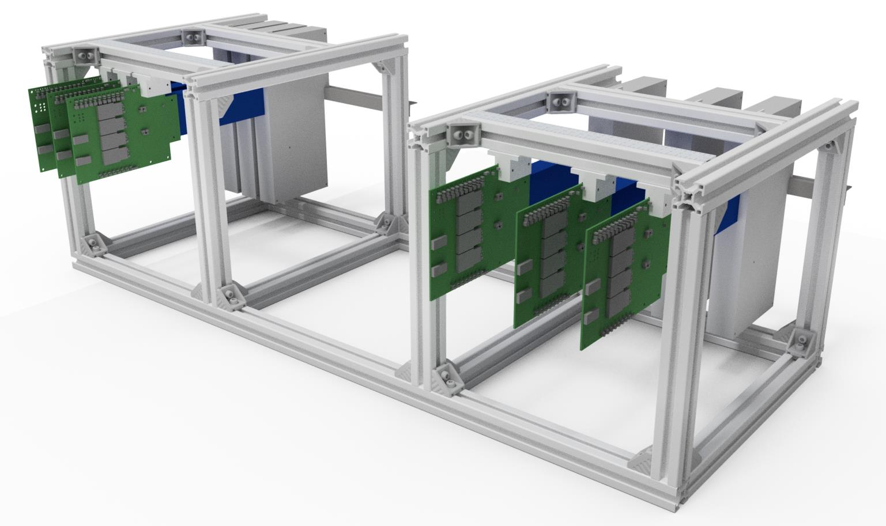
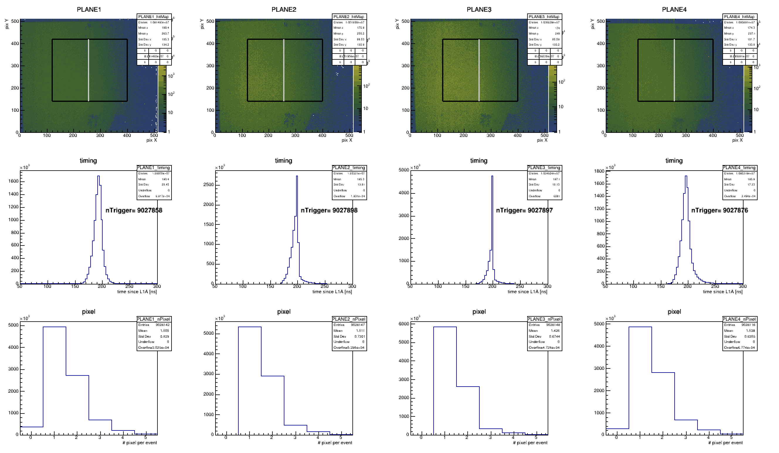
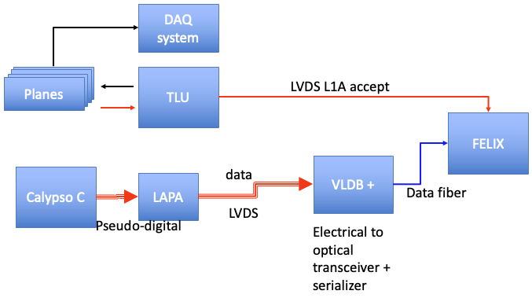
BCM' – Readout test
SPS beam test at CERN with 120 GeV pions used to simulate minimum ionising particles
MALTA Telescope* - Monolithic pixel sensors FPGA based Telescope
  Low material content - down to 50um Si
DUT
on x-y stage
Scintillator
MALTA telescope uses 6 tracking planes + scintillator which give the reconstructed track spatial resolution of 4.1 µm and reconstructed track timing resolution of 2.1 ns
Positron beam
(z-axis)
MALTA planes
MALTA planes
Data acquisition chain
Calypso testbeam measurement testing readout with FELIX using external triggering at high rate (realistic conditions)
* Dedicated slide in Giuliano Gustavino talk

Slide 12
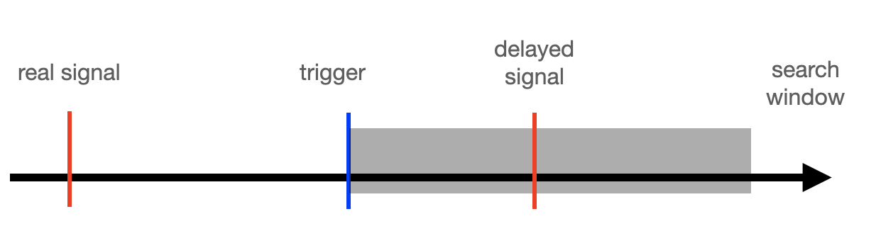
BCM' – FELIX readout
Preliminary results
ToT within expected values
Time between the L1A trigger and the processed signal
Time
Predictable timing between arrival of data signal and trigger
ToT depends on energy depositon

Slide 13
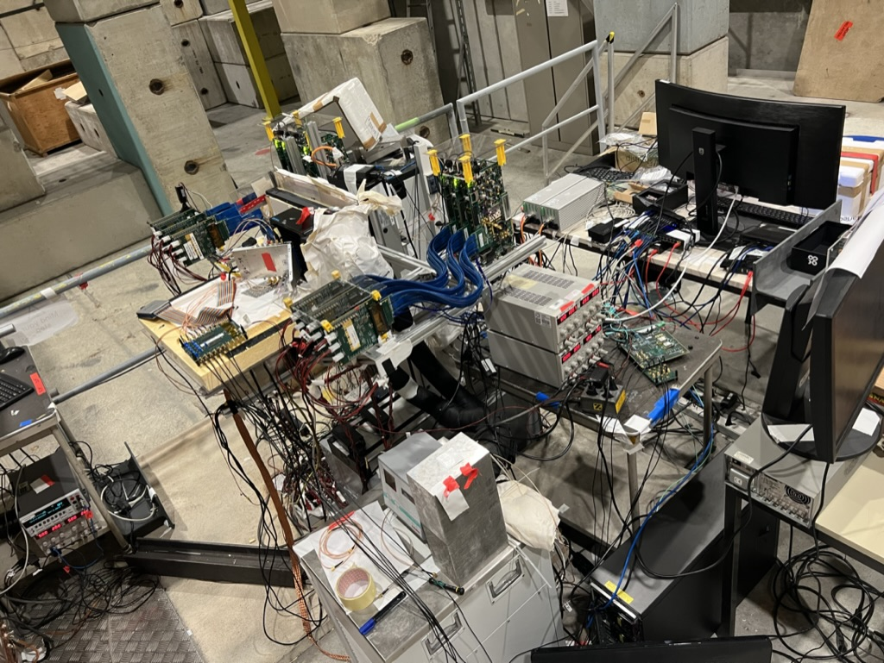
BCM' – Beam test at SPS (CERN)
TLU
Calypso
VLDB
LAPA
FELIX PC

Slide 14
Conclusions
The BCM' detector is currently being developed for the upcoming ATLAS High-Luminosity upgrade
  It will measure luminosity and protect the inner parts of the experiment
The design proposal and status have been presented
Results of Calypso are satisfactory and are within the requirements
BCM’ first ITK FELIX in beam line
The FELIX read-out full chain has been presented and tested in a beam line with realistic conditions
Initial results are satisfactory and withing requirements
  Read-out chain is able to transmit and process without loss of data
Missing funcionalitites in the FW will be implemented soon
Testing of the final modules with the full services will start in 2024

Slide 15
ATLAS ITk BCM'
VERTEX 16-20 October 2023
Ignacio Asensi, CERN
on behalf of all BCM' Community

Slide 16
Backup

Slide 17
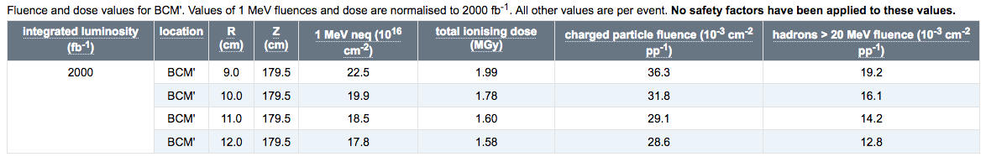
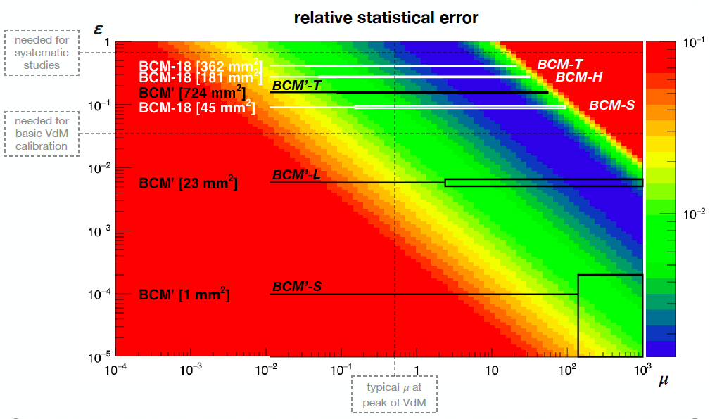
BCM'
Environment

Slide 18
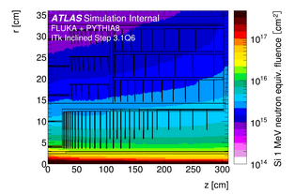
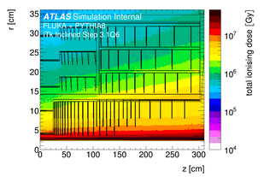
BCM' – Radiation environment
ATLAS radiation simulation, r=9-12 cm, z=1.8 m
NIEL&TID for 2/ab, nominal -> x1.5 safety factor
  TID ≲ 200 Mrad -> 300 Mrad
    Services: max. at PP1(Type1/2) – 300(450) Mrad
  NIEL ~2x10¹⁵ n_{eq}/cm² -> 3x10¹⁵ n_{eq}/cm²
    low neutron fraction
    n_{eq} for diamond ? -> take 3x10¹⁵ 800 MeV p/cm² for sensor benchmark
  Charged particle flux/BX @10 cm
    ~0.032/cm² x μ (50% e⁺e⁻)
    ~4.5(6.4)/cm² for μ = 140(200)
    hadron flux (SEE) ~2.3(3.2)/cm²
Flux ~140(200) MHz/cm² -> 70(100) MHz/cm2 SEE flux
  May 2022: Test @ CERN HiRadMat facility to verify high-rate response for lumi and abort – talk by Andrej

Slide 19
BCM' - Functionality
Beam protection - Abort
  out-of-time signals (~6 ns before collision) mean upstream non-collision background (NCB)
  abort on out-of-time activity above (large) threshold signifying beam background at ITk danger level
    danger thresholds can be high (now SCT 25k/cm²/BC i.e. 4000x the lumi induced signal)
  need to keep flexibility for threshold settings
  include machine-style (slow, 40 μs integrating) Beam Loss Monitor (BLM)
Luminosity measurement and NCB - Lumi
  lumi main algo: (absence of) in-time (~6ns after collision) signals (r - zero counting) -> single MIP sensitivity
  ideally have to cover μ-range from VdM (0.01 in tails) to μ=200 (ultimate HL-LHC lumi) in a lumi block
  1% limits in 60 LHC seconds vs. μ shown for sensor sizes at foreseen location, all sensors cover ~10 cm²
  comparison to current BCM': factor ~7 less sensitive per unit surface
    ~2 for larger radius
    ~3.5 for less conversions (less material !)
  NCB: out-of-time signals at (multi)-MIP level

Slide 20
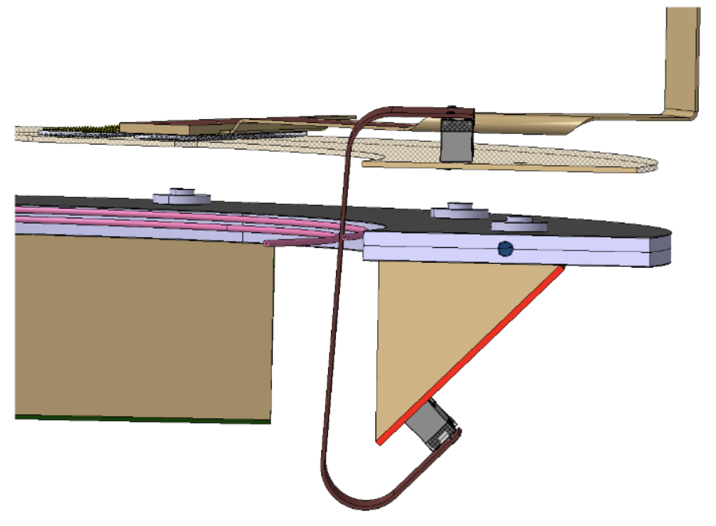
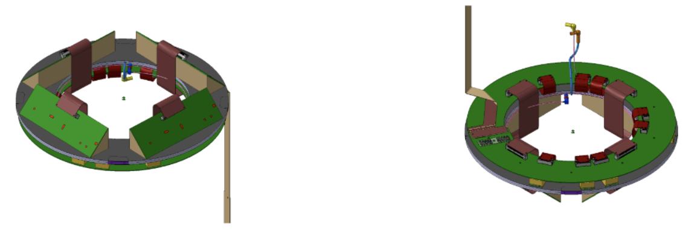
BCM’ – Module
The enclosure of the whole package of the BCMp station, including the aPCB
Evaluated together with the rest of the ITk CAD
The current design fits in the allocated space between the rings.
Detail of the aPCB (top) and the BCMp station (bottom)
Bottom (left) and top (right) 3D models of the BCMp station including the aPCB ring

Slide 21
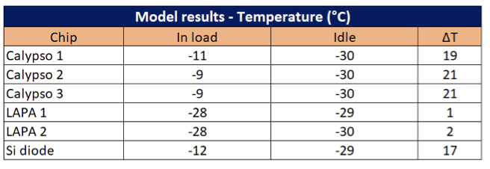
BCM' – Thermal
Temperatures obtained, in load and idle
Temperature distribution obtained after simulation
PCB’s composition/thermal conductivity is by far the most important parameter of the simulation, we observe a temperature gradient of less than 2°C between the cooling fluid and the top surface of the wedge
Critic components of the module are the Calypso chips, in terms of thermal performances/risks
Convection has a minor effect on cooling with respect to the cooling fluid, in this range of temperature
The model is probably too conservative, as the current PCB model does not include the thermal vias that are present on the real module yet

Slide 22
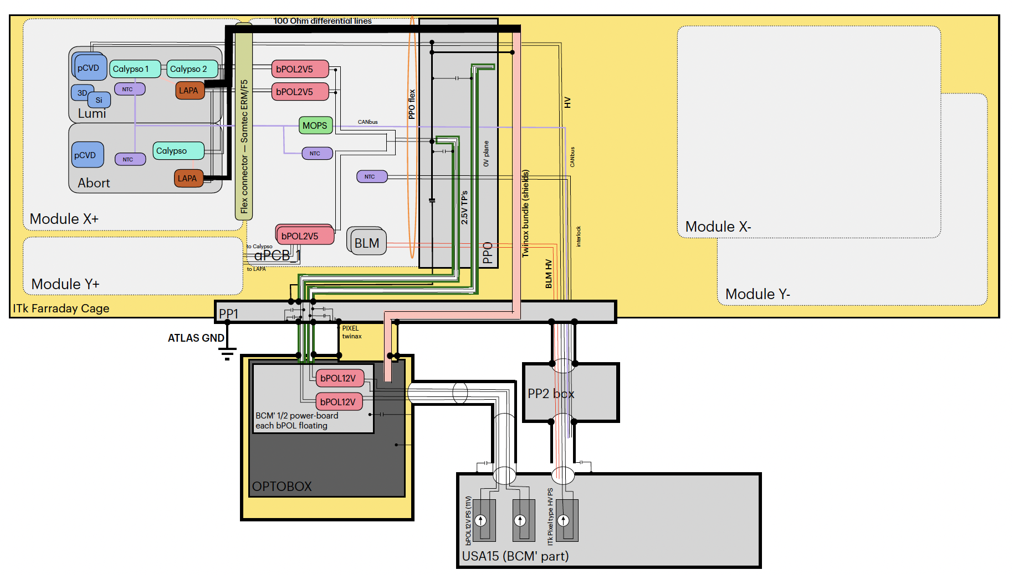
BCM' – Grounding and shielding
G&S schematic

Slide 23
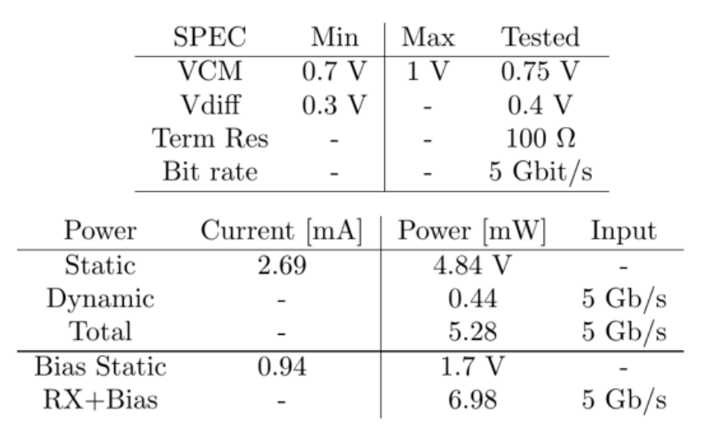
LAPA
LAPA, a 5 Gb/s modular pseudo-LVDS driver in 180 nm CMOS with capacitively coupled pre-emphasis
In the nominal condition with a steering current of 4 mA over a 100 Ω termination resistor, it consumes 30 mW from a 1.8 V supply
LAPA can drive up to 6 mA, in the nominal condition with a steering current of 4 mA over a 100 Ω termination resistor, it consumes 30 mW from a 1.8 V supply with an input clock of 2.5 GHz
10 In/Out CMOS/LVDS channels
CHIP input configurable CMOS/LVDS
Channel output configurable CMOS/LVDS
Power Supply 1.8V
Internal Input termination resistor 100Ω
Tuneable LVDS pre-emphasis
Configuration pads with internal pull-up, all active high
LVDS OUTPUT with selectable VCM internal feedback
Documentation - https://cds.cern.ch/record/2312590?ln=en
TWEPP - https://pos.sissa.it/313/038/pdf
TID measurements - https://twiki.cern.ch/twiki/bin/view/Atlas/Malta2PublicPlots#MALTA2_vs_TID

Slide 24
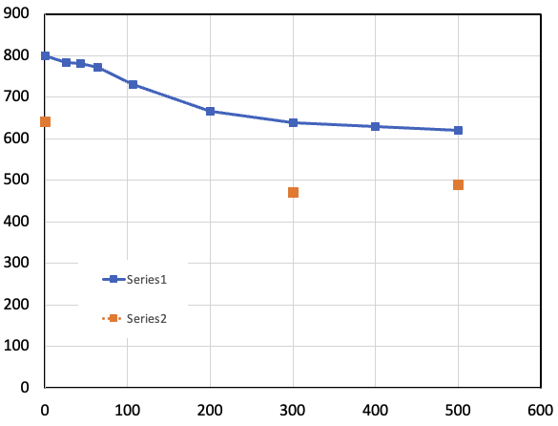
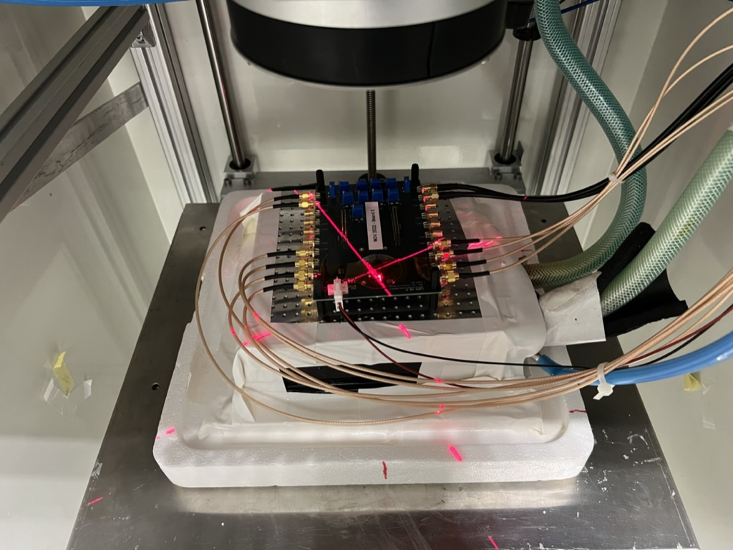
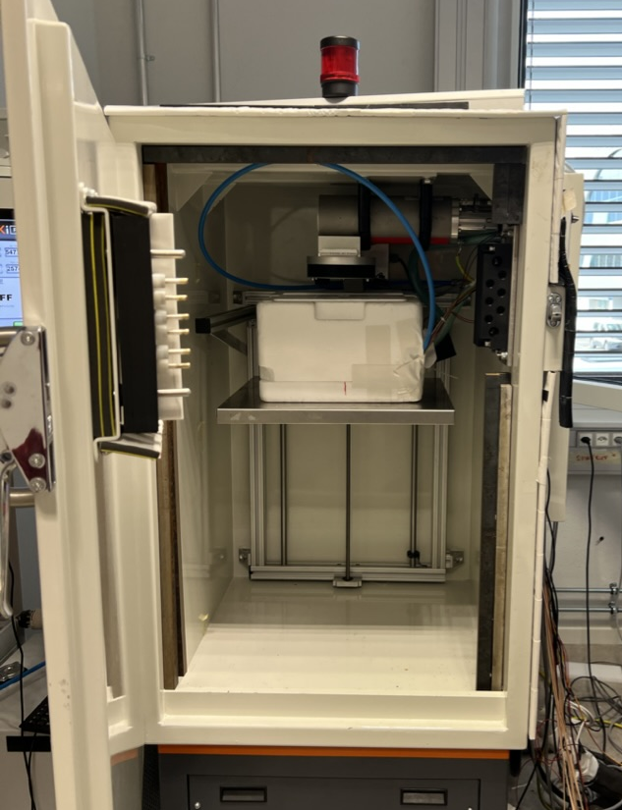
LAPA driver irradiation at CERN
LAPA, a 5 Gb/s modular pseudo-LVDS driver in 180 nm CMOS
LAPA irradiated to 500 Mrad.
Cooled at -10℃
Signal amplitude and rise time are affected by radiation but digital readout still 100 % operative
  Well within required range for differential signal
Measured ToT and ToA values remained constant
Performance with Twinax is the same
Small change in power consumption, from 37.7 mV to 35.6 mV
Signal amp. [mV]
Hardware accepted range
No twinax
Twinax
TID [Mrad]
24

Slide 25
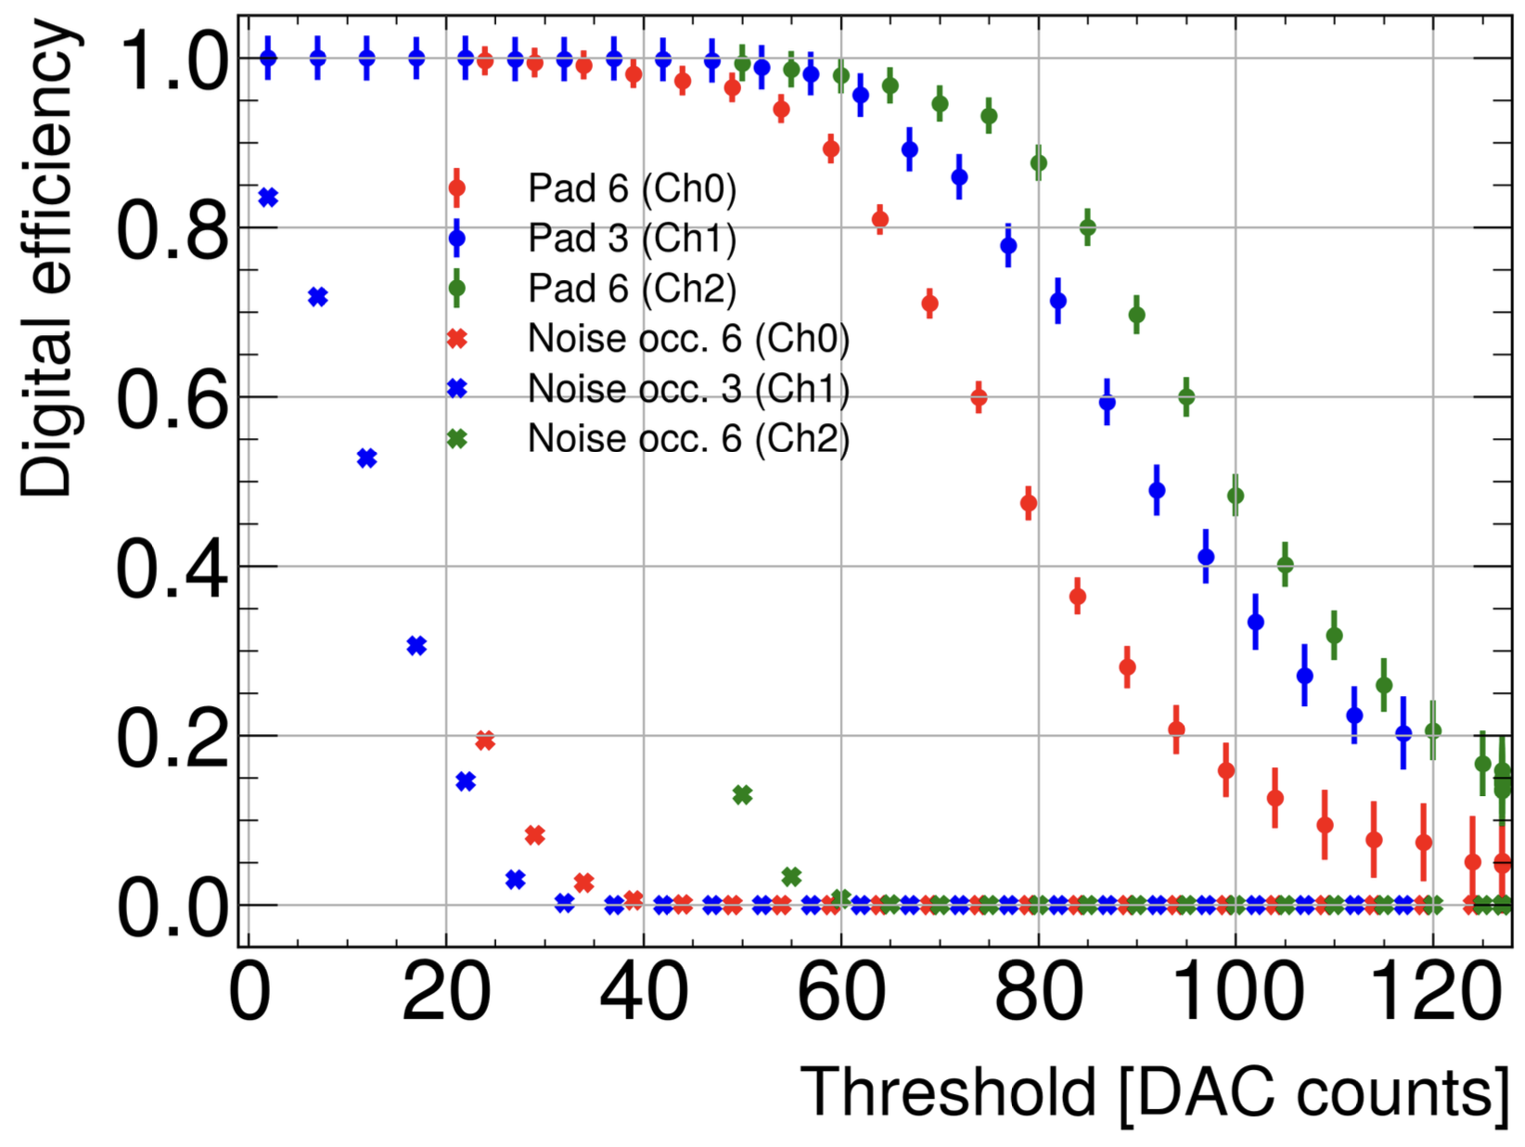
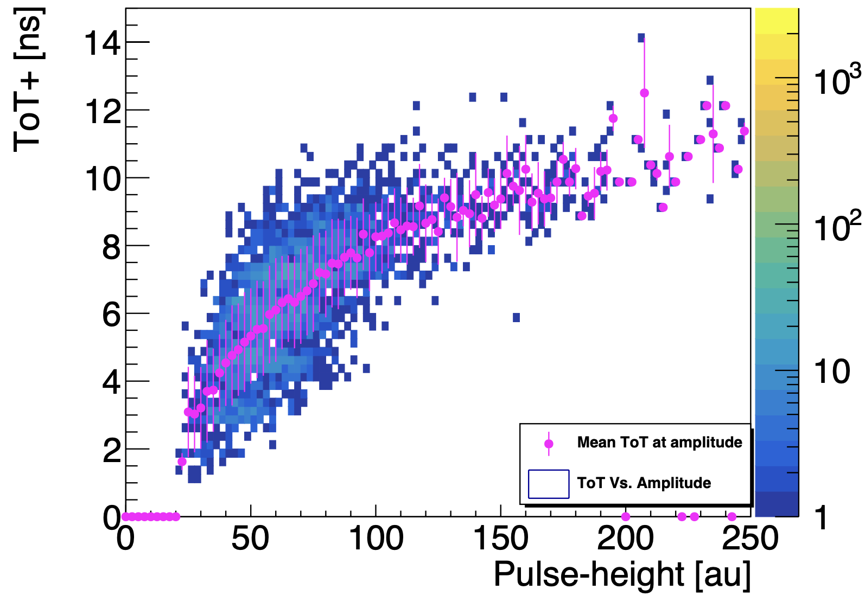
BCM' – Calypso efficiency
Calypso ver. C, S8 pCVD diamond, Pad 3, Cr/Au met., -1000 V, CFD threshold 52 DAC
Calypso ver. C, S8 pCVD diamond, Cr/Au met., -1000 V
Threshold scan shows Calypso ASIC can be run at variable efficiency and low noise occupancy for all three tested detector channels. The Calypso ASIC ver. C tested here featured a smaller range of 128 CFD threshold steps of ~100 - per step. For each individual threshold setting we measured the expected distribution of ToT vs. pulse-height for events triggered by the CFD.

Slide 26
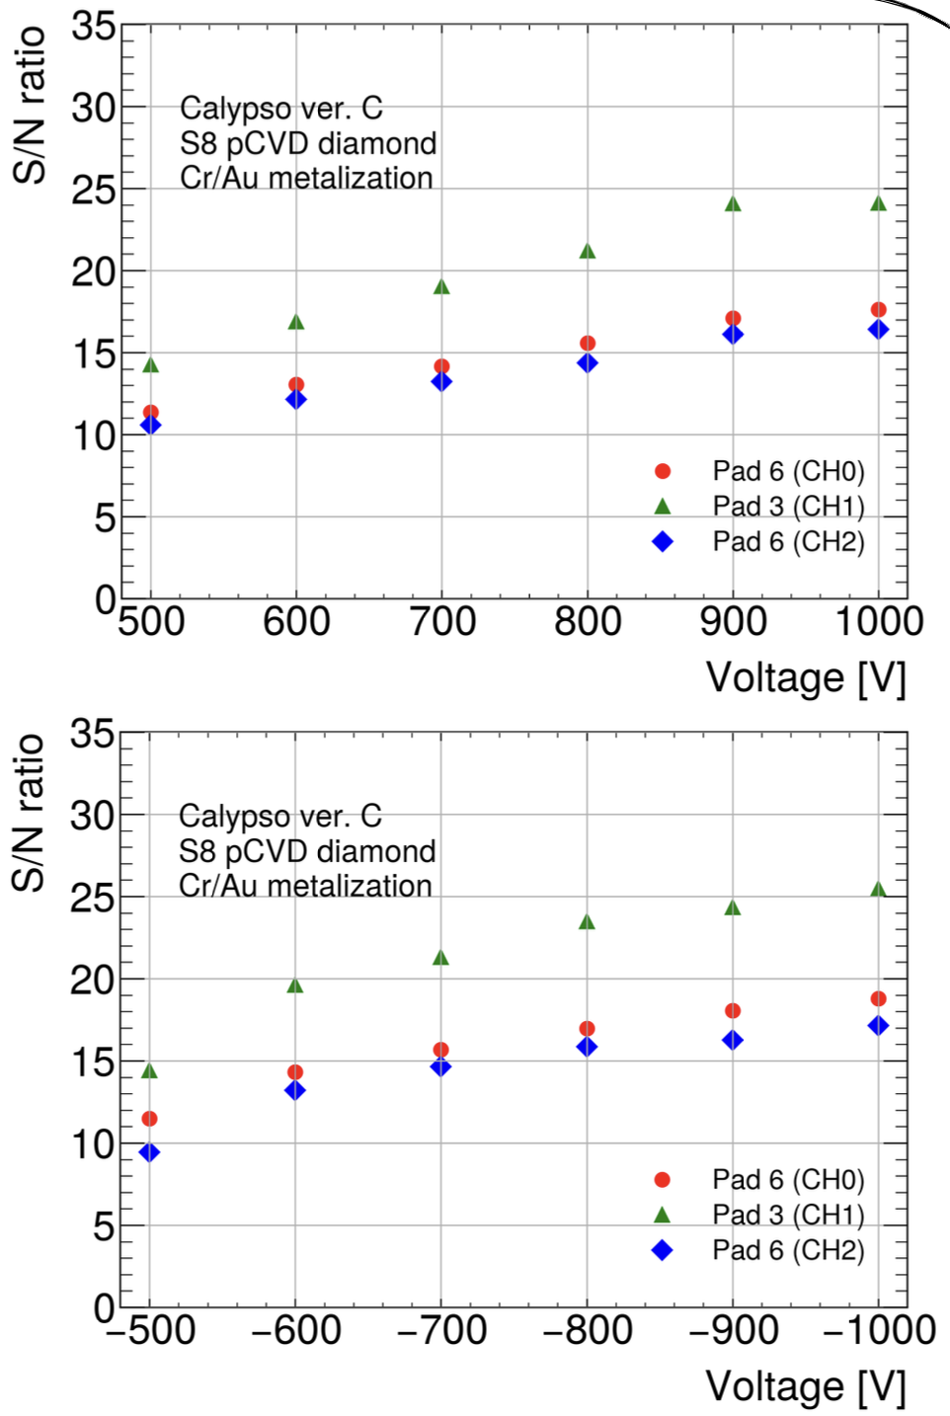
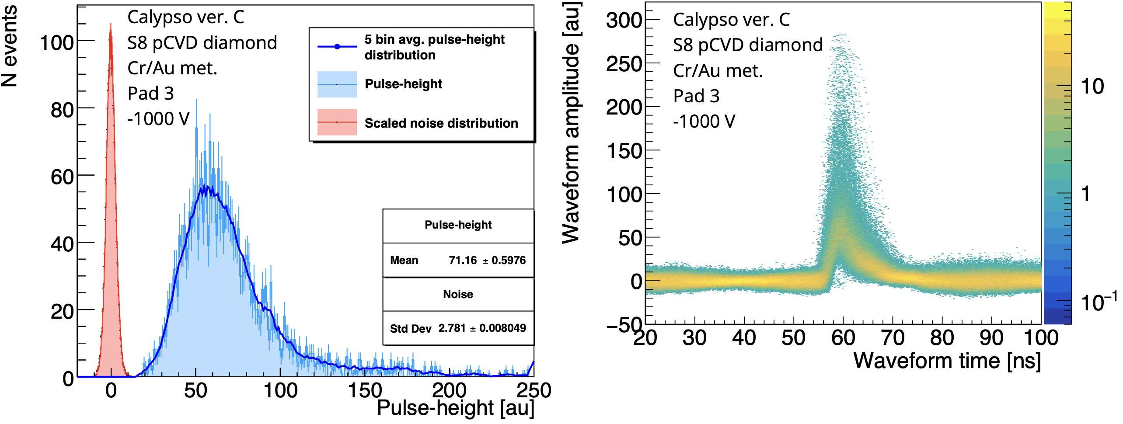
BCM' - Signal to noise
Analog output signal to noise ratio of 25 measured for Pad 3 at bias voltage of ±1000 V.
The system can reliably achieve S/N ratio >20 at ±800 V bias voltages.

Slide 27
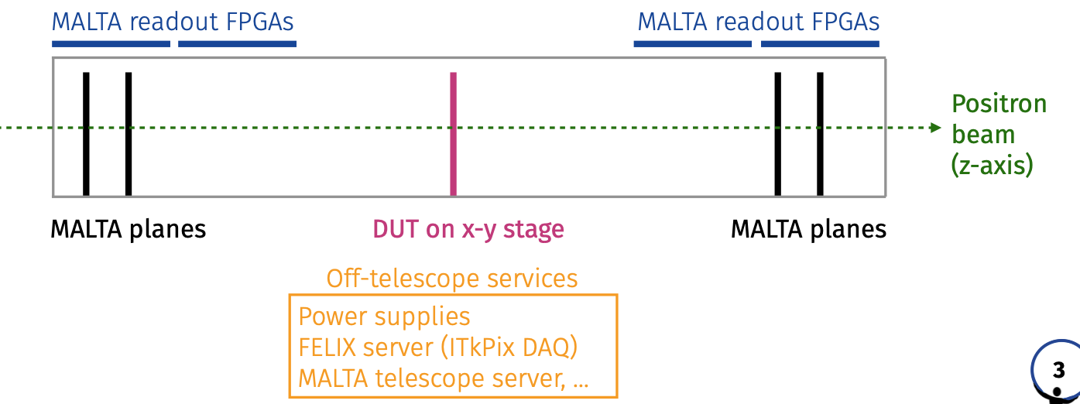
BCM' – Readout test
DAQ system
Planes
TLU
Planes
Planes
LVDS L1A accept
Planes
FELIX
data
VLDB +
Calypso C
LAPA
Data fiber
LVDS
Pseudo-digital
Electrical to optical transceiver + serializer

Slide 28
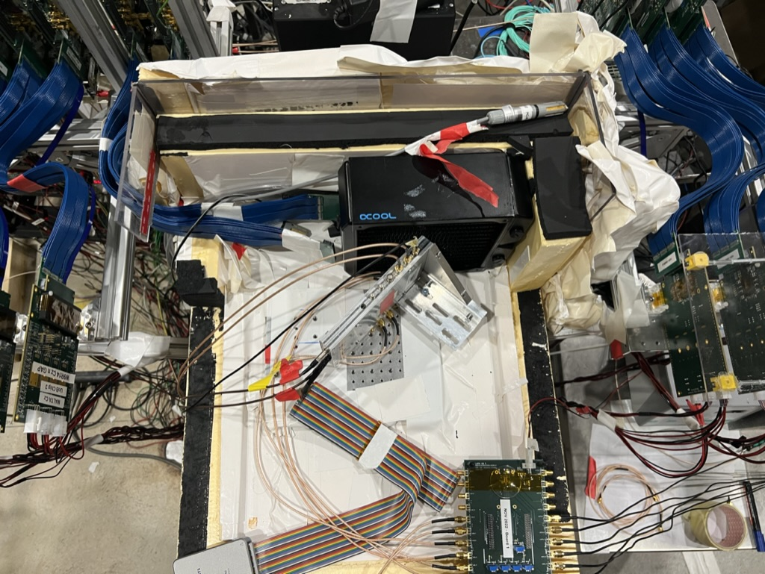
BCM' – Beam test at H6 line SPS (CERN)

