Slide 1
Recent results on micro-electronics developments for future trackers in
Hi-Lumi upgrades

Slide 2
Challenges in next Hi-Lumi upgrades (and 4D tracking)
Future colliders (LHCb Upgrade II, HIKE (NA62 upgrade), CMS-PPS, ATLAS AFP, FCC-hh) will have to cope with extremely high instantaneous luminosity:
REQUIREMENTS FOR SENSORS:
Radiation hardness against fluences from ${10}^{16}$ to ${10}^{17} 1MeV\frac{n_{eq}}{cm^{2}}$
Spatial resolution $σ_{s}≈10 μm$
Time resolution $σ_{t}≤50 ps$per hit
Detection efficiency $ε>99\%$ per layer
REQUIREMENTS FOR READ-OUT ELECTRONICS:
Pixel pitch $≈50 μm$
Time resolution $σ_{t}≤50 ps$on the full chain $→ σ_{t}^{2} \sim σ_{sensor}^{2}+σ_{AFE}^{2}+σ_{TDC}^{2}$
Radiation hardness $TID>1 Grad$
Power budget per pixel $P≈25 μW$ (referred to $55 μm$ pitch, $1.5 W/cm^{2}$)
DATA BANDWIDTH $≈100 Gbps/ASIC$
16-20 Oct 2023

Slide 3
Challenges in next Hi-Lumi upgrades (and 4D tracking)
Future colliders (LHCb Upgrade II, HIKE (NA62 upgrade), CMS-PPS, ATLAS AFP, FCC-hh) will have to cope with extremely high instantaneous luminosity:
REQUIREMENTS FOR SENSORS:
Radiation hardness against fluences from ${10}^{16}$ to ${10}^{17} 1MeV\frac{n_{eq}}{cm^{2}}$
Spatial resolution $σ_{s}≈10 μm$
Time resolution $σ_{t}≤50 ps$per hit
Detection efficiency $ε>99\%$ per layer
FAST
and
RAD-HARD SENSORS
REQUIREMENTS FOR READ-OUT ELECTRONICS:
Pixel pitch $≈50 μm$
Time resolution $σ_{t}≤50 ps$on the full chain $→ σ_{t}^{2} \sim σ_{sensor}^{2}+σ_{AFE}^{2}+σ_{TDC}^{2}$
Radiation hardness $TID>1 Grad$
Power budget per pixel $P≈25 μW$ (referred to $55 μm$ pitch, $1.5 W/cm^{2}$)
DATA BANDWIDTH $≈100 Gbps/ASIC$
16-20 Oct 2023

Slide 4
Challenges in next Hi-Lumi upgrades (and 4D tracking)
Future colliders (LHCb Upgrade II, HIKE (NA62 upgrade), CMS-PPS, ATLAS AFP, FCC-hh) will have to cope with extremely high instantaneous luminosity:
REQUIREMENTS FOR SENSORS:
Radiation hardness against fluences from ${10}^{16}$ to ${10}^{17} 1MeV\frac{n_{eq}}{cm^{2}}$
Spatial resolution $σ_{s}≈10 μm$
Time resolution $σ_{t}≤50 ps$per hit
Detection efficiency $ε>99\%$ per layer
FAST
and
RAD-HARD SENSORS
REQUIREMENTS FOR READ-OUT ELECTRONICS:
Pixel pitch $≈50 μm$
Time resolution $σ_{t}≤50 ps$on the full chain $→ σ_{t}^{2} \sim σ_{sensor}^{2}+σ_{AFE}^{2}+σ_{TDC}^{2}$
Radiation hardness $TID>1 Grad$
Power budget per pixel $P≈25 μW$ (referred to $55 μm$ pitch, $1.5 W/cm^{2}$)
DATA BANDWIDTH $≈100 Gbps/ASIC$
CMOS 28-nm
ELECTRONICS
16-20 Oct 2023

Slide 5
Challenges in next Hi-Lumi upgrades (and 4D tracking)
Future colliders (LHCb Upgrade II, HIKE (NA62 upgrade), CMS-PPS, ATLAS AFP, FCC-hh) will have to cope with extremely high instantaneous luminosity:
REQUIREMENTS FOR SENSORS:
Radiation hardness against fluences from ${10}^{16}$ to ${10}^{17} 1MeV\frac{n_{eq}}{cm^{2}}$
Spatial resolution $σ_{s}≈10 μm$
Time resolution $σ_{t}≤50 ps$per hit
Detection efficiency $ε>99\%$ per layer
FAST
and
RAD-HARD SENSORS
REQUIREMENTS FOR READ-OUT ELECTRONICS:
Pixel pitch $≈50 μm$
Time resolution $σ_{t}≤50 ps$on the full chain $→ σ_{t}^{2} \sim σ_{sensor}^{2}+σ_{AFE}^{2}+σ_{TDC}^{2}$
Radiation hardness $TID>1 Grad$
Power budget per pixel $P≈25 μW$ (referred to $55 μm$ pitch, $1.5 W/cm^{2}$)
DATA BANDWIDTH $≈100 Gbps/ASIC$
CMOS 28-nm
ELECTRONICS
SILICON PHOTONICS
16-20 Oct 2023

Slide 6
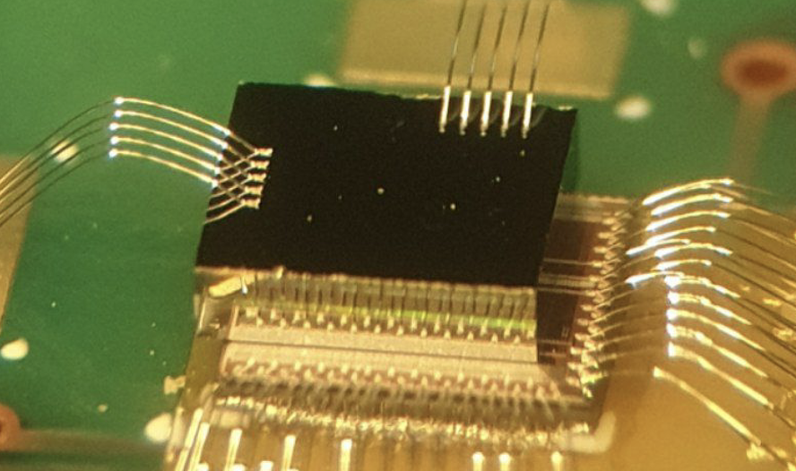
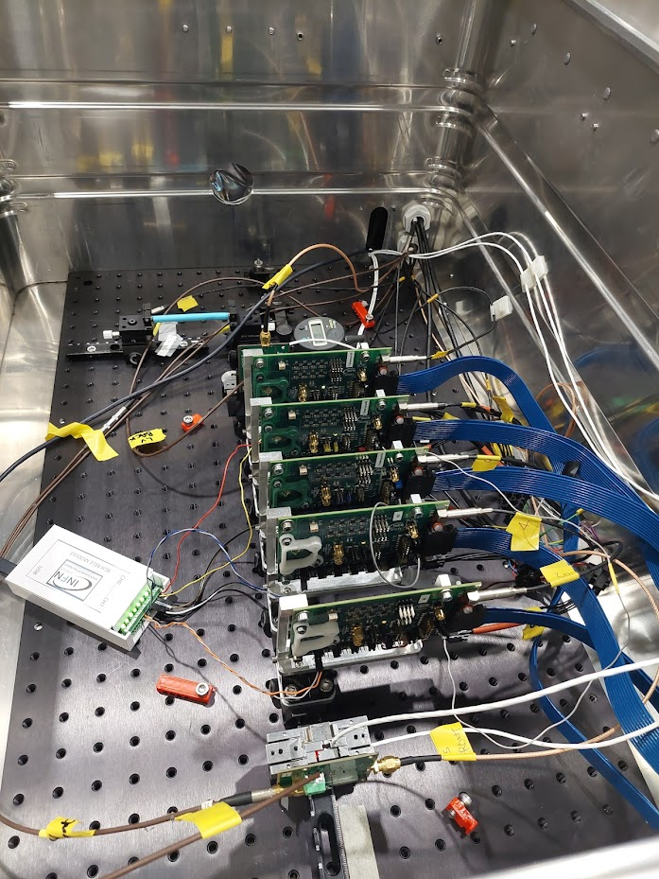
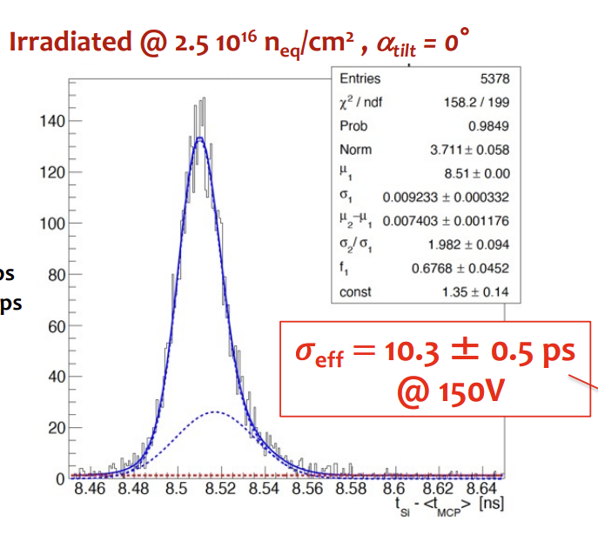
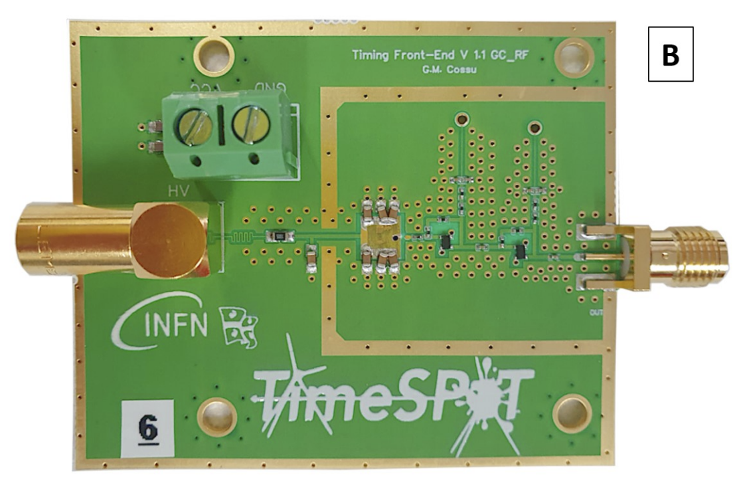
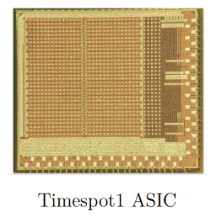
Sensor matrix
integrated electronics
INFN R&D on 4D tracking
Beam axis (180 GeV/c π⁺)
P. I. Adriano Lai
Timespot 3D Silicon Hybrids
10ps time resolution with 3D trench sensors and custom discrete electronics measured at test beam facility also on irradiated sensor up to fluence $2.5 {10}^{16} 1 MeV n_{eq}/cm^{2}$ see A. Lai presentation Vertex 2022
And Gian-Franco Dalla Betta’s Talk Timing performance of 3D silicon sensor
Timespot 3D Diamond Hybrids
See POSTER: Intrinsic timing properties of simulated ideal 3D-trench silicon sensor with fast front-end electronics GM Cossu, D Brundu, A Lai
Test beam with final demonstrator with 5 station with the TIMESPOT1 ASIC (May 2023)
16-20 Oct 2023

Slide 7
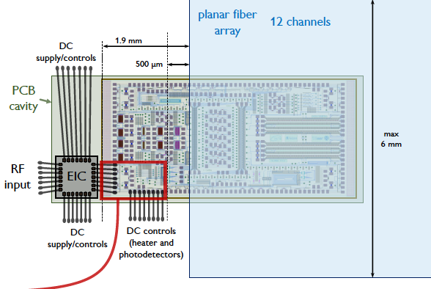
R&D on Silicon Photonics and High-speed Interconnect
FAST LINK AND RAD-HARD FRONT-END WITH INTEGRATED PHOTONICS AND ELECTRONICS FOR PHYSICS
P. I. Fabrizio Palla
10ps time resolution with 3D trench sensors and custom discrete electronics measured at test beam facility also on irradiated sensor up to fluence $2.5 {10}^{16} 1 MeV n_{eq}/cm^{2}$ see A. Lai presentation Vertex 2022
Compact Silicon Photonic Mach-Zehnder Modulators for High-Energy Physics
See Simone Cammarata’s talk given at TWEEP 2023
25 Gb/s NRZ transmission validated using standard Folded Mach Zehnder Modulator (FMZM)and RAD HARD FMZM up to 1.25 Grad!
Test beam with final demostrator with 5 station with the TIMESPOT1 ASIC
See POSTER: Intrinsic timing properties of simulated ideal 3D-trench silicon sensor with fast front-end electronics GM Cossu, D Brundu, A Lai
Also developing:
28-nm CMOS Serializer (target data rate 25 Gbps)
28-nm CMOS Driver/Receiver (target data rate 25 Gbps)
16-20 Oct 2023
7

Slide 8
The INFN - IGNITE initiative
GOAL: DEVELOP A TRACKING SYSTEM SUITABLE FOR HIGH LUMINOSITY CONDITIONS
Integrated system composed by a hybrid 28nm CMOS ASIC and pixel Sensor MATRIX
Readout ASIC for HIGH-BANDWIDTH optical data transmission
Take advantage of the experience obtained from the previous R&D projects (Timespot, Falaphel etc..)
considering all the challenges in realizing such a device
Obtain uniform timing performance over a large area
Minimize power consumption
Distribute data to the read out
Etc.
Explore innovative 3D technologies and vertical connections (TSVs, Face2Face or Face2Back bonding)
National initiative fundend by INFN
14 INFN institutes
70 people involved (physicist and engineers)
P.I. Adriano Lai (INFN Cagliari)
16-20 Oct 2023

Slide 9
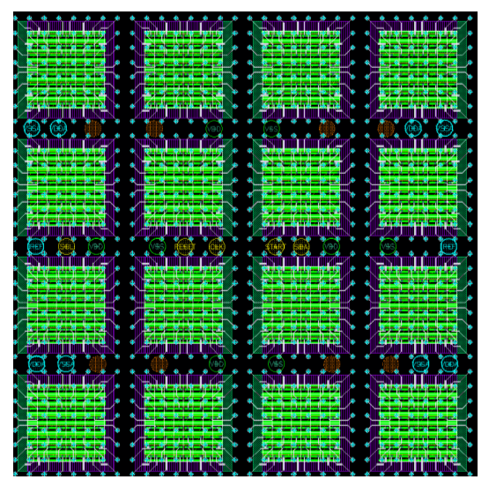
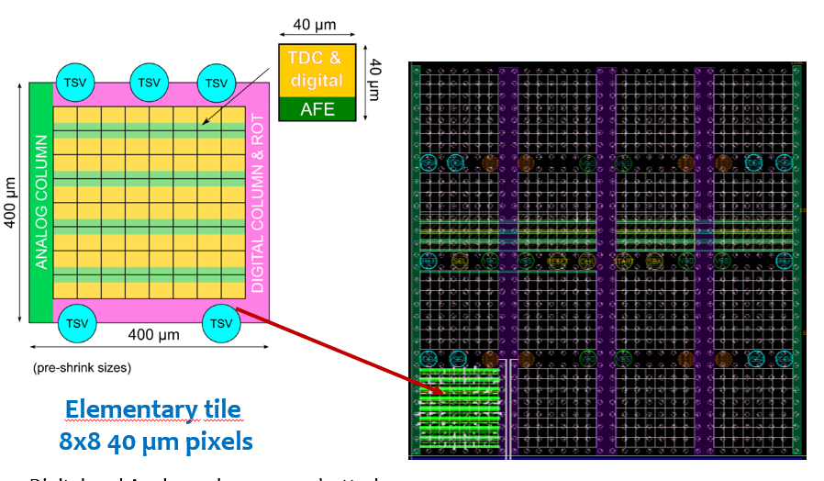
The IGNITE ASIC concept
ELEMENTARY
REPETITION UNIT
8X8 PIXEL
Each pixel has 36um pitch and AFE + TDC
Make space for the TSV
Plls for clock distribution in the digital space between tiles
Example of 32x32 ASIC for 45 um pitch Sensor
Example of 32x32 ASIC for 55 um pitch Sensor
Same repetition unit with different redistribution layer
Higher pitch (110um, 165um etc.) can be obtained by channel masking
16-20 Oct 2023

Slide 10
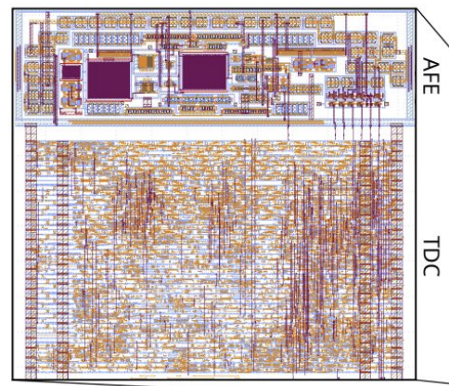
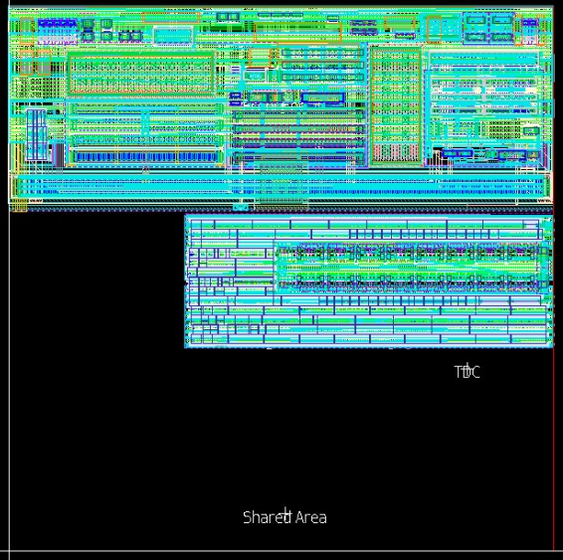
RESULTS: IGNITE ASIC PIXEL
TIMESPOT1 PIXEL
The pixel Fundament cells (AFE and TDC) have been completely redesigned using the new 28nm technology (HPC → HPC+)
The experience gained with the TIMESPOT1 ASIC was fundamental to speedup the process
Several improvements in area, power consumption and performance
IGNITE PIXEL
40 um
50 um
40 um
50 um
* PRE-SHRINK SIZES
16-20 Oct 2023

Slide 11
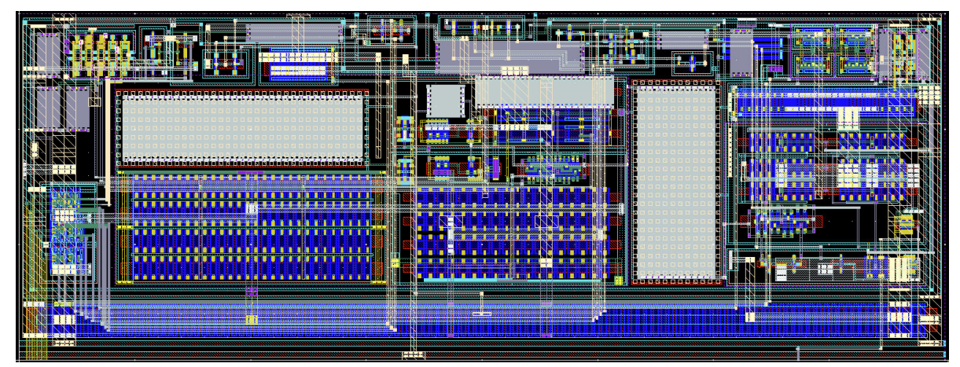
RESULTS: PIXEL AFE
IGNITE Analog Front-Ends
Several topologies investigated ( CSA, Common Gate TIA, Cascode TIA..etc)
4 different flavors simulated and with finalized design (Layout + Post Layout Simulations)
Cascoded Inverter with Fine DAC threshold tuning (FT-CAS )
Cascoded Inverter with enhanced Offset Compensation (OC-CAS)
No-Cascode Inverter with Fine DAC threshold tuning (FT-noCAS )
No-Cascode Inverter with enhanced Offset Compensation (OC-noCAS)
Specifics:
LAYOUT AREA = 40um x 15um
Local Charge injection circuit
Programmable Power : 4uW → 21 uW
Programmable TOT: e.g., 10ns → 160ns
TIMESPOT1 AFE
CSA inverted based with double Krummenacher feedback + dual Stage Discriminator
Discrete time DC Offset compensation (global threshold and baseline)
Issue with the Offset compensation but average performance around 60ps for 2fC charge injection with 100fF Sensor Capacitance
16-20 Oct 2023

Slide 12
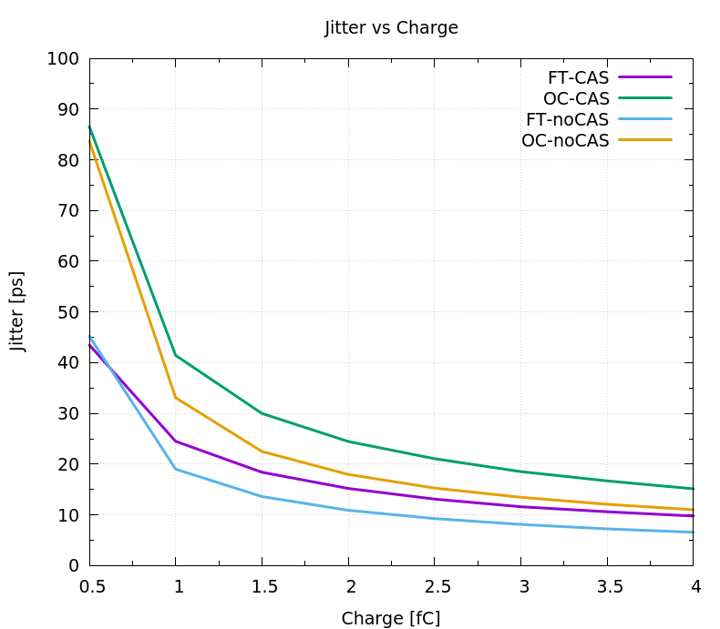
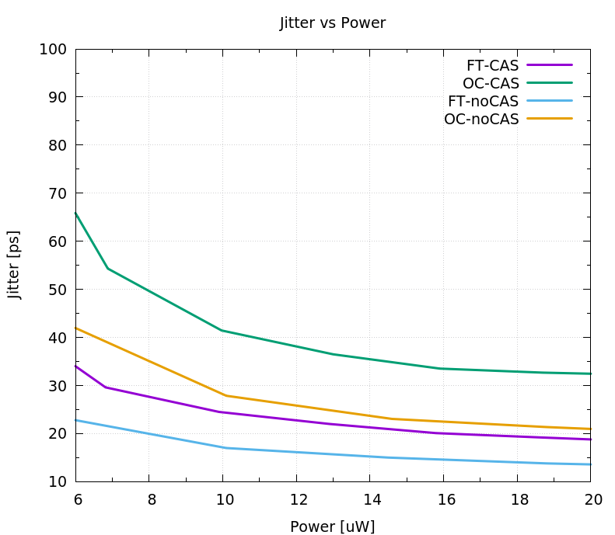
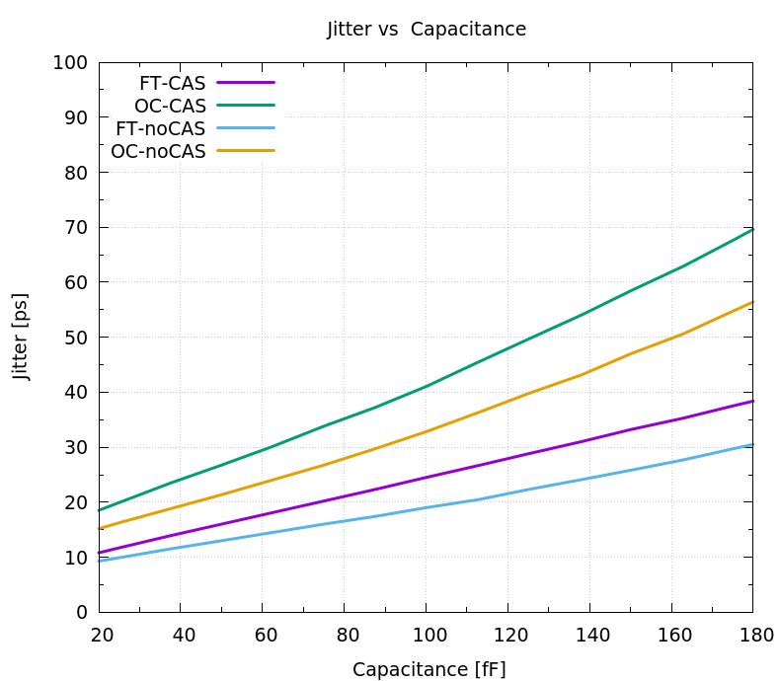
RESULTS: PIXEL AFE (post layout simulations)
Timespot
3D Trench
Sensor MIP
Timespot
3D Trench
Sensor Cd
Jitter Vs Charge
evaluated with:
Cd =100fF
Power = 10.8 uW
Discharge Current = 100nA
Vth ~ 30mV
Jitter Vs Power
evaluated with:
Cd =100fF
Discharge Current = 100nA
Vth ~ 30mV
Qin = 1fC
Jitter Vs Capacitance
evaluated with:
Qin= 1fC
Power= 10.8uW
Discharge Current = 100nA
Vth ~ 30mV
16-20 Oct 2023

Slide 13
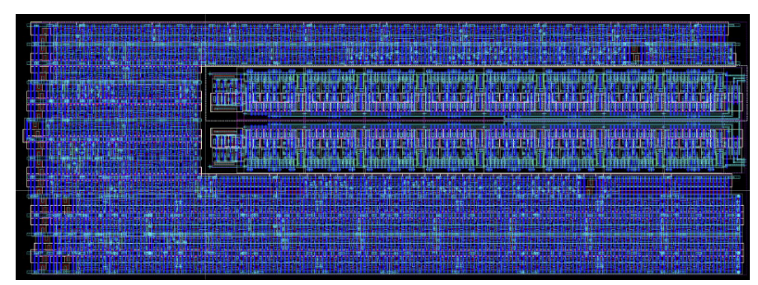
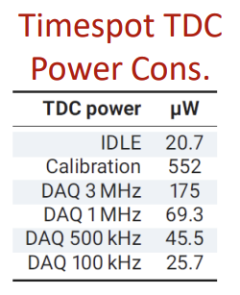
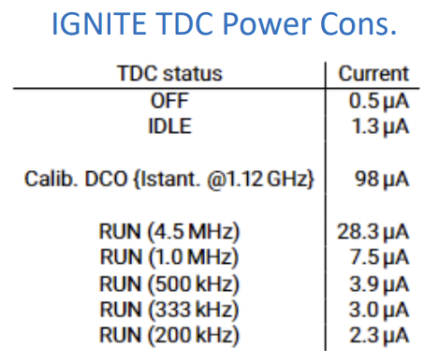
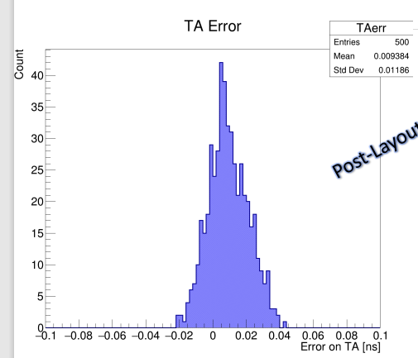
RESULTS: PIXEL TDC
IGNITE TDC
SAME VERNIER ARCHITECTURE DESIGNED COMPLETELY FULL CUSTOM (Area 27um x 10um)
DCO WITH 16 DELAY UNITS
Period range: 780ps → 900ps
Period tuning: Coarse (~50ps), Fine (3ps)
DCO jitter ~ 1ps
MEASURE OF TA with resolution ~ 12ps rms (POST LAYOUT SIMULATION)
TIMESPOT1 TDC
VERNIER ARCHITECTURE
2 DCO with frequency ~ 1GHz
DCO switched off after measure
Time resolution the depends on the difference in period of the 2 DCO
TA (~ 20ps), TOT (~ 1ns)
TIMESPOT1 RTL DESIGN
16-20 Oct 2023

Slide 14
RESULTS: IGNITE PLL
PLL (Phased Locked Loop) designed in order to provide an internal reference clock with a static phase with respect to an external clock
Based on a starved DCO with 3 different starving schemes (static, DAC and external)
Core Area: 30um x 6um
Area with Filter : 433um x 15.6 um
Lock frequency : 40 MHz
POST SIMULATION: power consumption 50uW, jitter filtering from 14ps (input) to 1.9ps (output)
16-20 Oct 2023

Slide 15
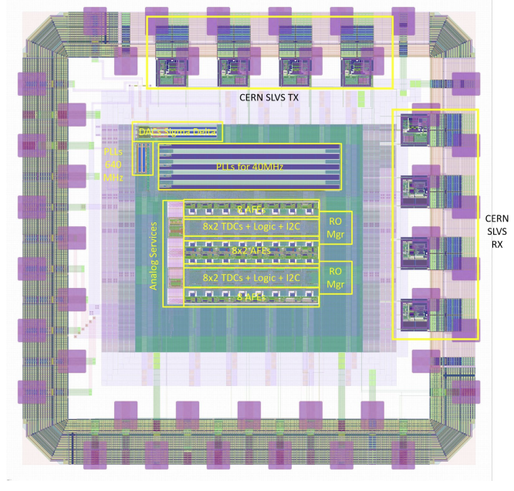
RESULTS: IGNITE0 TEST CHIP
IGNITE0 mini@SIC
Submitted in July ‘23
Expected in November ‘23
Contains:
Half Tile 8x4 ( Half repetition unit)
32 AFE channels (All different flavours)
32 TDCs
PLLs for clock generation/filtering (40MHz and 640MHz)
DACs
Readout Managers
I2C interfaces for controls and configuration
16-20 Oct 2023

Slide 16
RESULTS: IGNITE0 TEST CHIP
IGNITE0 mini@SIC
Some of the test we will be able to do:
Each pixel AFE can be pulsed individually using the Charge injection cell (measure jitter vs Charge), (measure jitter vs power)
Each AFE is connected to a “Sensor Cell” that allow to change the capacitance load (from 12.5fF to 187fF) at the input of the amplifier (measure jitter vs capacitance)
TDCs can be pulsed through the AFE but also from outside using a FAST-IN LVDS input (TDC performance scanning the phase with high accuracy)
Evaluate PLLs performance using loopback connection
16-20 Oct 2023

Slide 17
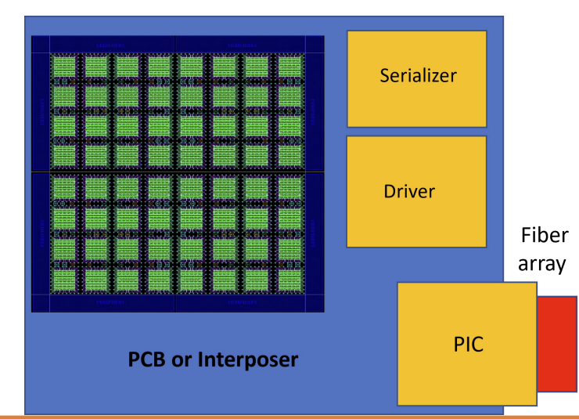
IGNITE Conclusions and Perspectives:
The IGNITE initiative is currently working for develop a tracking system for High luminosity environments
We have submitted a first prototype (IGNITE0) that contains half of the repetition unit that we want to use as a building block for a larger chip
We are currently working on the test PCB that will allow us to test IGNITE0
Next step development of ASIC “Fractal_IC_64”
64x64 pixels matrix
Periphery for test with conventional wire bonding integration
16-20 Oct 2023

Slide 18
THANK YOU

Slide 19
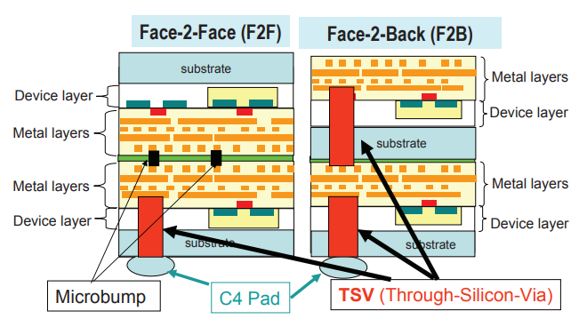
IGNITE: 3D/Vertical integration techniques
3D INTEGRATION: vertical interconnection of different active layers (different ASICs for example) using TSV (Through Silicon Vias)
Possibility of eliminate the inactive areas due to wire-bondings and enable “abutting”
Each layer can be assigned to a particular function, e.g. ( Front-end, Clock distribution, data merging)
16-20 Oct 2023

Slide 20
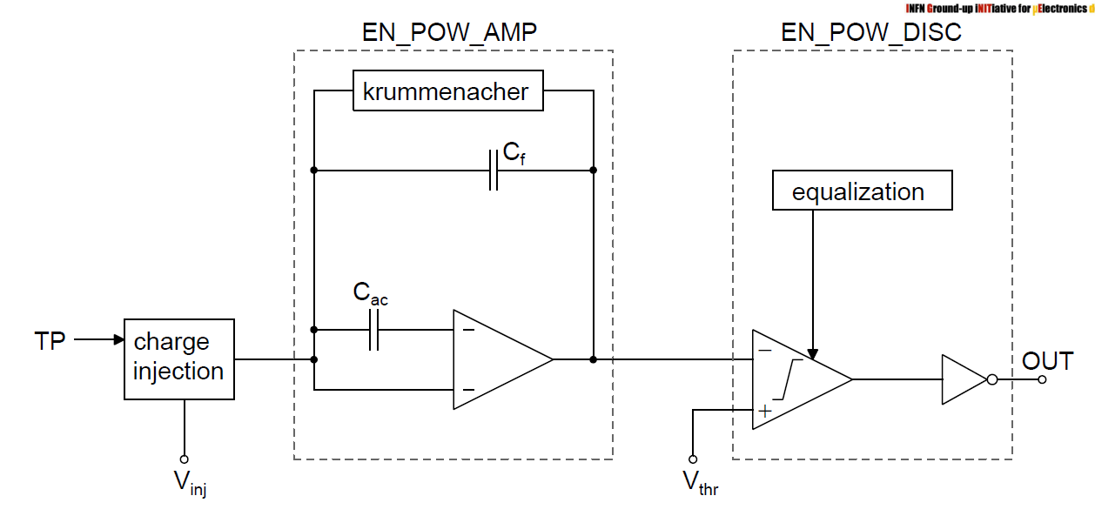
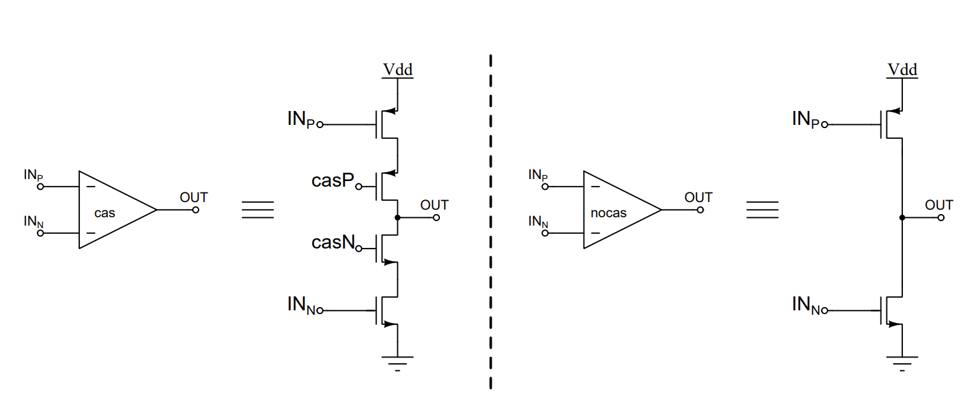
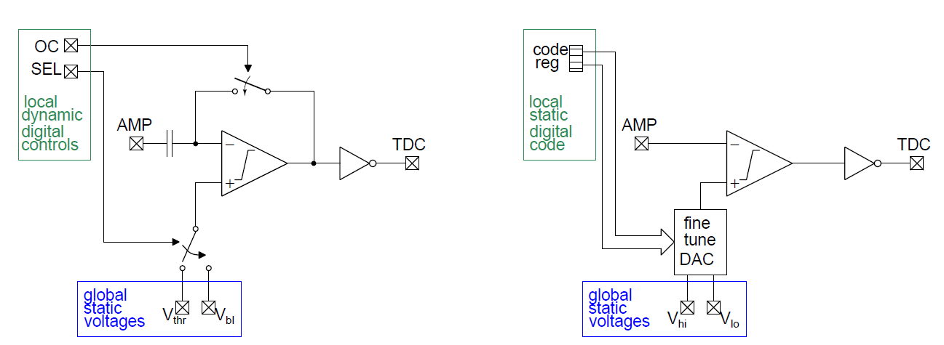
IGNITE AFE schematic:
Two Core Amplifier solution:
Cascoded Inverter
No-Cascode inverter
General architecture of the Analog Front-End
Single Krummenacher Feedback
AC coupling
Dual Stage Discriminator
Two channel equalization solution: Offset Compensation, Finetune DAC
16-20 Oct 2023

Slide 21
RESULTS: IGNITE0 TEST CHIP
IGNITE0 mini@SIC
READOUT SYSTEM:
One 16-word depth FIFO for each 8x2 block
Each event is a 49-bit word that includes all the info (Vernier counters, TOT, Coarse Timestamp/Bxid, Event type, pixel Address, FIFO Status)
Data not optimized for bandwidth (testing purposes)
Data out on two differential lines @ 640 Mb/s
Max event rate per output line/FIFO => ~ 12.5 MHz
Max event rate per pixel ~ 780 KHz
16-20 Oct 2023

Slide 22
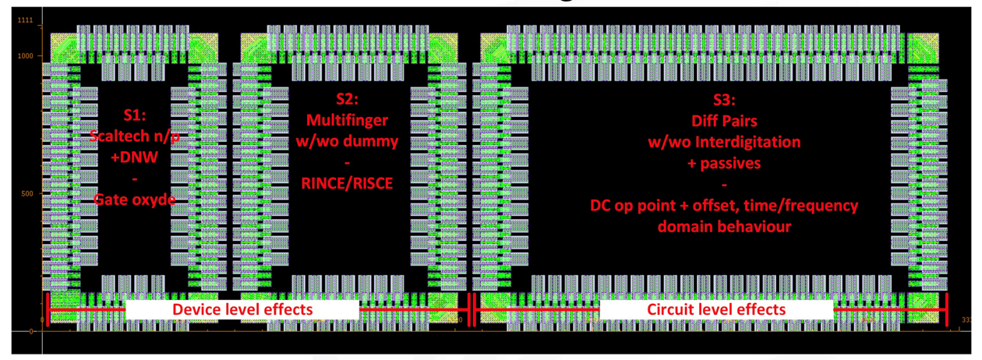
IGNITE radiation hardness of 28nm HPC+:
IGNITE RAD-CHIP
Submitted in April, samples arriving
PCB for testing under preparation
Irradiation test scheduled in Padua
16-20 Oct 2023

