Slide 1
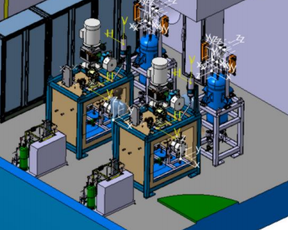
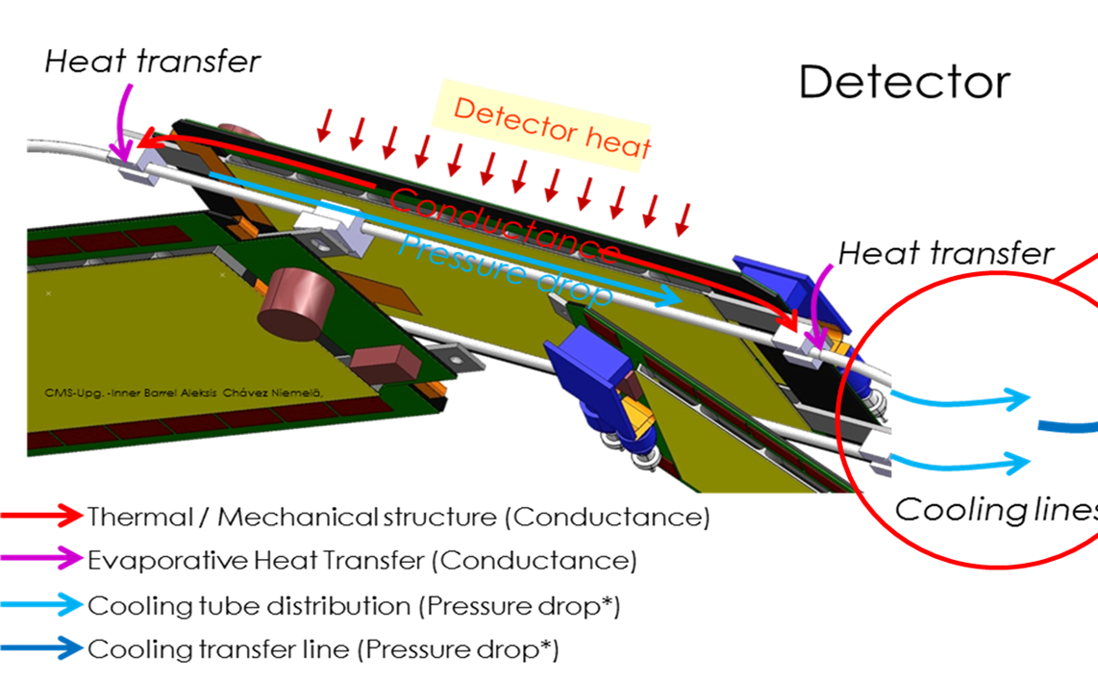
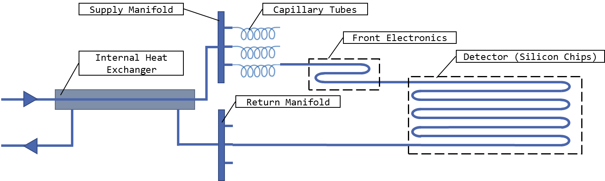
Overview on challenges on cooling
Paolo Petagna (CERN EP-DT)

Slide 2
Overview on challenges on cooling
Paolo Petagna (CERN EP-DT)
Selecting the best suited thermal management approach
Selected challenges for “warm” detectors
Selected challenges for “cold” detectors
Few words on the generic additional (…or main?) challenges
(some sort of) Conclusions

Slide 3
Electronics thermal management
Last general talk on cooling issues at VERTEX:
P. Petagna: Advanced cooling techniques, VERTEX 2017 (Las Caldas)
https://indico.cern.ch/event/627245/contributions/2676709/
Let’s quickly recap from there:
Electronics produces heat during operation: whatever you do (or not) to reduce power consumption, a detector is a quite confined volume, and you need to remove from that volume the heat dissipated
So, the problem of detector thermal management stays the same as in any “electronics cooling” application:
Heat Source
Engineer questions: Amount of heat produced by the Source?
Max temperature of the Heat Source?
Type of Heat Sink?
Temperature of the Heat Sink?
Position of the Heat Source?
Heat Source / Heat Sink interface?
Space available?
Material issues?
Environmental issues?
Cost issues?
Reliability?
Lifespan?
Thermal path
Heat Sink
Notes:
In the end – from a thermal management point of view – the problem is simply to remove from the volume the power dissipated, while keeping the sensitive part at an optimal operational temperature.
So we have a local heat source (the on-board electronics of the sensing modules) and a local heat sink (in our case the evaporator)- connected by a specific thermal path, and the optimal design is the result of the answers to a series of typical “thermal engineer questions”

Slide 4
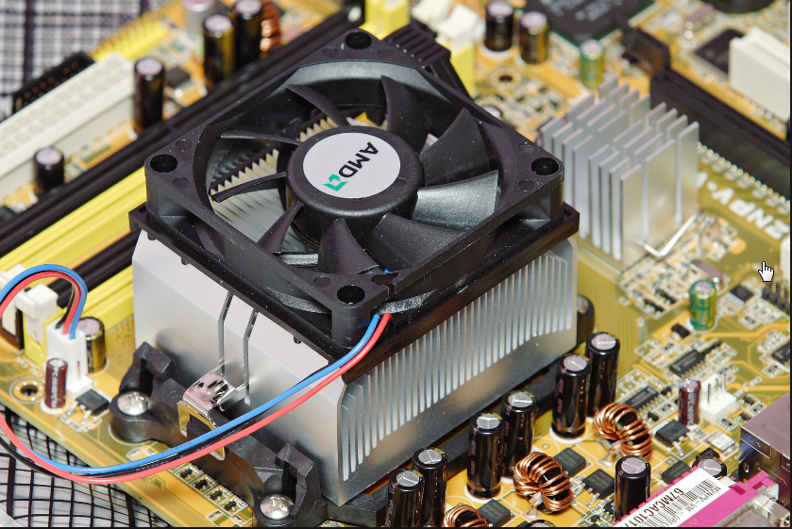
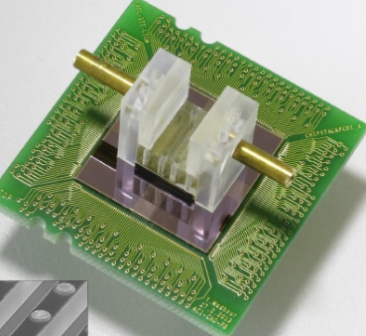
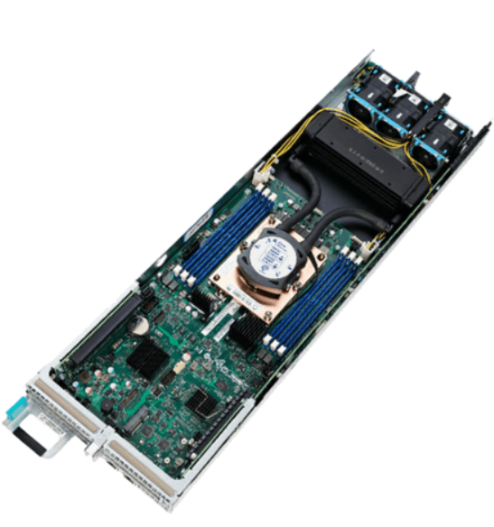
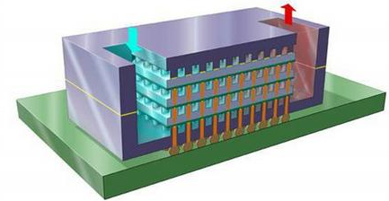
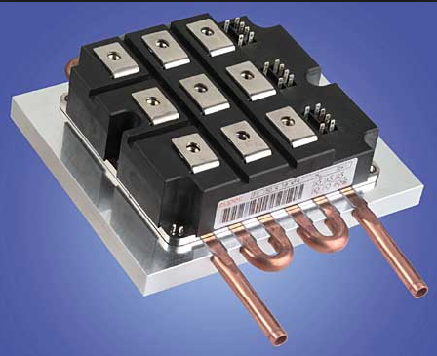
Electronics thermal management
Based on the answers to the above questions, you can basically find few big classes of approach to the thermal management of electronics (examples shown for high power computing chips, probably the most demanding application in commercial electronics):
Direct air cooling
(forced convection)
Heat Source
Thermal path
Heat Sink
Micro-channel cooling
(1- or 2-phase)
Or other innovative techniques, e.g. direct spray, pool boiling, etc…
Liquid-assisted air cooling
(with or without active pumping)
Pipe-flow cooling
(1- or 2-phase)
Notes:
READ THE SLIDE TEXT

Slide 5
Already a first challenge: divergence of requirements
Can operate at warm temperature
Seeks for ultimate precision
Allows for ultra-low power
Target absolute minimum X/X₀
=> Natural push to air cooling
Lightly irradiated silicon
Vs.
Heavily irradiated silicon
Requires cold (colder) temperature
Deals with enormous occupancy
Dreams of including timing
Available to compromise on X/X₀
=> Natural push to aggressive liquid cooling

Slide 6
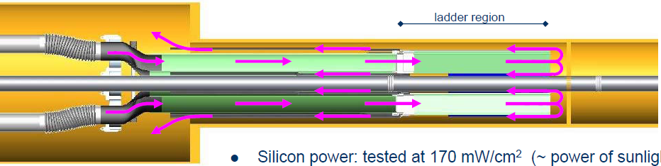

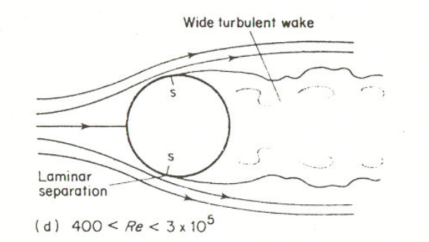
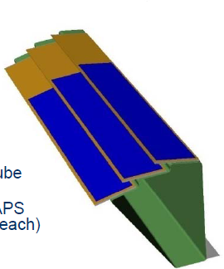
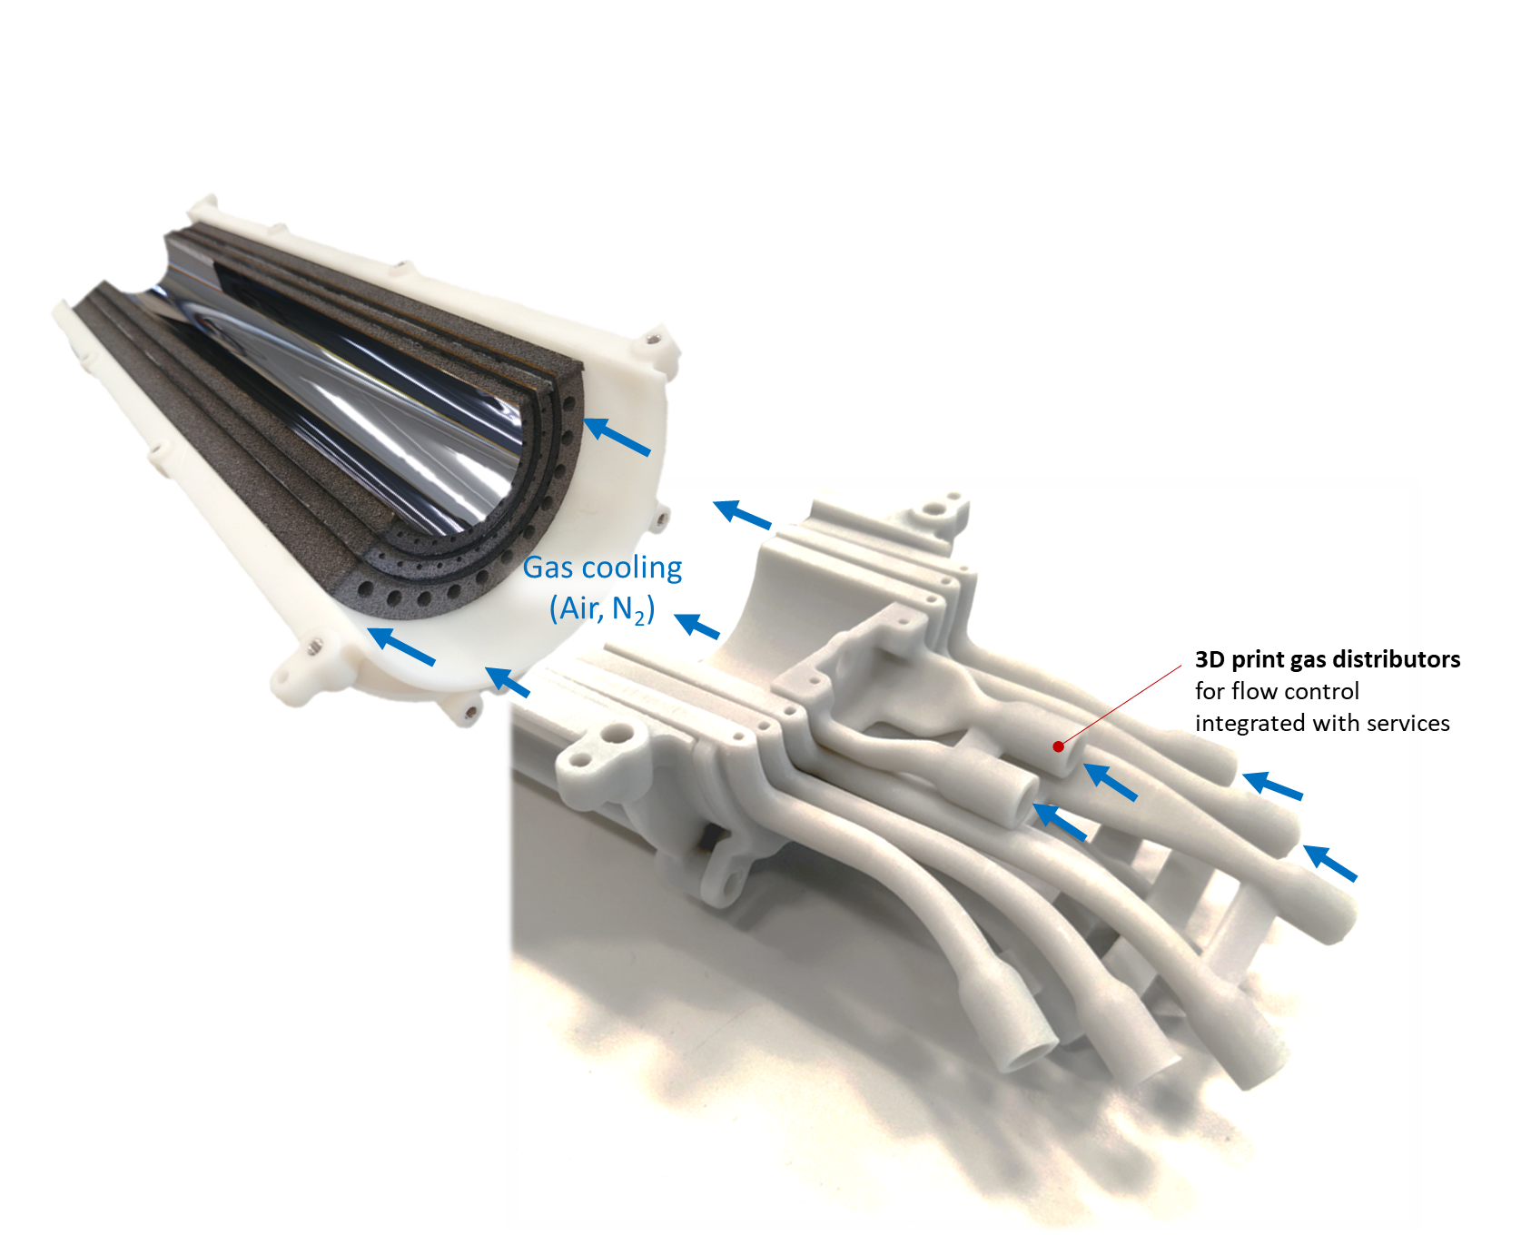
Warm detectors: air cooling
The “dangerous” way: STAR PXL @ BNL RHIC (but it worked)
Air flow-structure interactions are extremely configuration dependent and very difficult to keep under control
“Wind-tunnel-like” detector structure
The “smart” way: ALICE ITS3 @ CERN HL-LHC
Carbon foam used as support acts as a radiator expanding the surface available for heat exchange and forcing the air flow in contact (drawback: higher thermal resistance due to the intermediate structure)
SEE (in this workshop):
Filip Krizek - ITS3: next ALICE upgrade of the Inner Tracking System for LHC Run 4
Corrado Gargiulo - Overview on challenges on mechanics

Slide 7
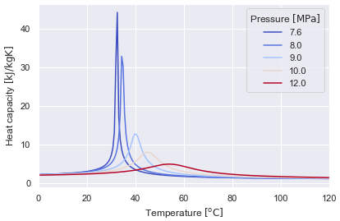
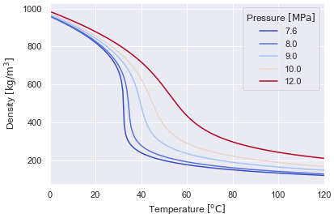
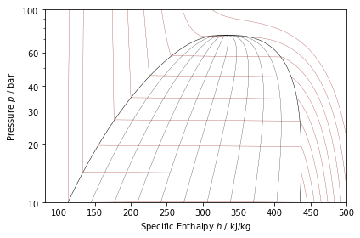
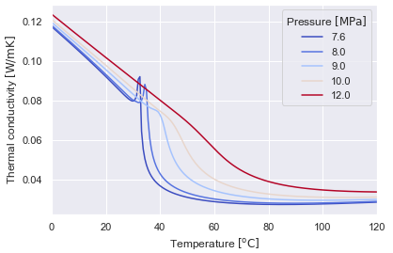
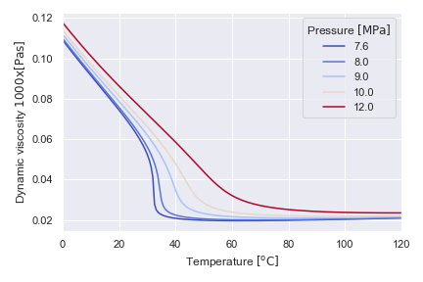
Innovative warm liquid cooling: supercritical CO₂
Heavier detectors like calorimeters or large external tracking layers may benefit from the “magical” thermal-physical properties of CO₂ above its critical point in the range 31-45 ºC
At subcritical: discontinuities
Above critical value: change is continuous
  T<Tc liquid-like fluid
  T>Tc vapor-like fluid
Critical point of carbon dioxide: 74 bar, 31 °C

Slide 8
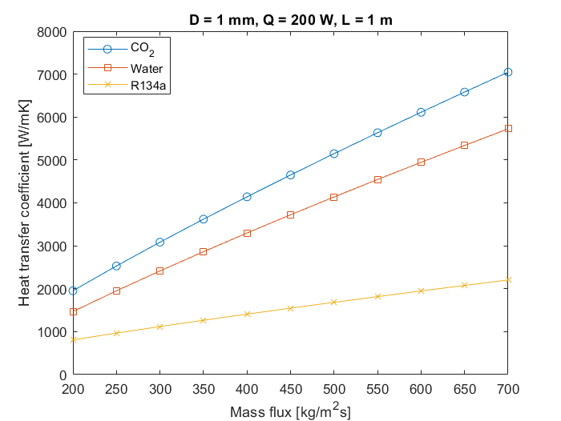
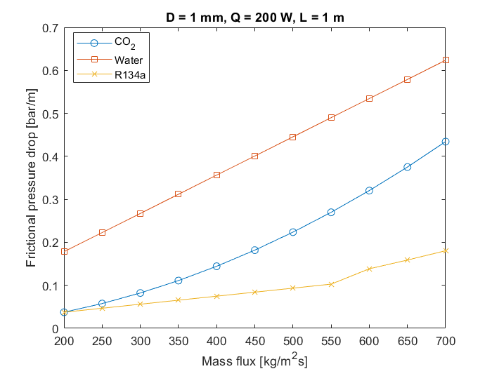
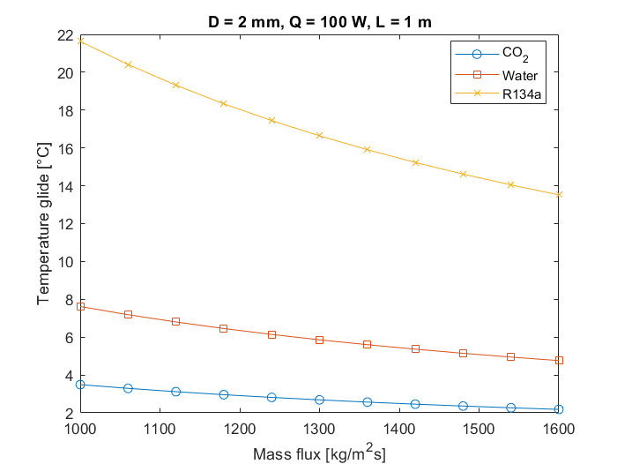
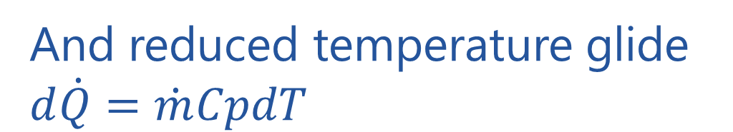
Innovative warm liquid cooling: supercritical CO₂
Much better singe-phase refrigerant than water (and CO₂ is not electrically conductive)
Heat transfer coefficient higher than that of water
With significantly lower pressure drops
And reduced temperature glide $d\dot{Q}=\dot{m}CpdT$
On-going PhD (CERN-Offenburg-KIT): Camila Medina Pedano

Slide 9
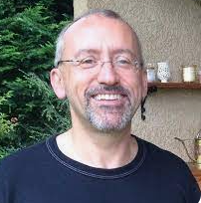
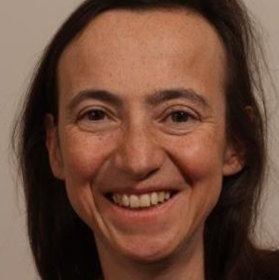

Cold detectors: which approach?
Let’s play safe
I want it all!!
Reduce the fluid-sensor Temperature difference
(i.e. reduce the global thermal resistance)*
Heavily irradiated silicon
(Cold operation)
Reduce the refrigerant Temperature
(i.e. find a new refrigerant)
*This boils down to minimise the

Slide 10
Need for an integral approach in cold cooling
This is a whole integrated system, interlaced with the detector design
(which also require complex professional figures)
site integration
experiment integration
detector design
electronics and module design
cooling plant
transfer lines
distribution
heat sink
We manage quite well (now…) during engineering but we still completely fail during R&D
Notes:
All of this requires an integral approach to cooling, where the whole system, from the cooling plant in the service cavern down to the local heat sing buried in the core of the innermost detector, is conceived as an integrated system, where every components somehow interact with all the other ones

Slide 11
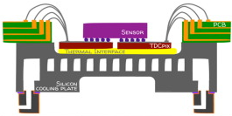
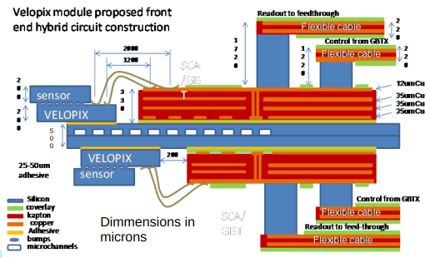
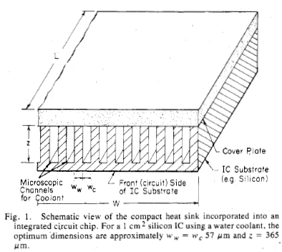
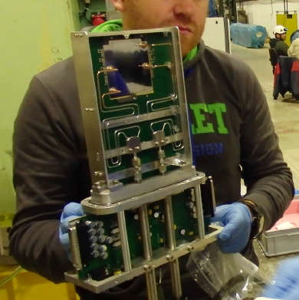
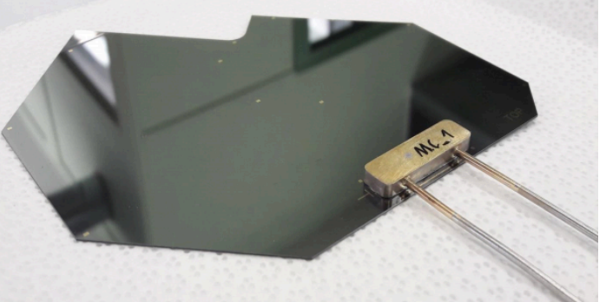
The ultimate reduction of the TFM: microchannel devices
NA62-GTK (liquid FC72)
LHCb-Velo (Boiling CO₂)
Original idea (liquid H₂O)
silicon cold plate circulating boiling CO₂: typical TFM ~3 K cm²/W
e.g. for a power dissipation of 1 W/cm² if you look for T_{MAX} <-30 °C on your sensor, the saturation temperature in the evaporator must just be T_{Sat} <-33 °C
D.B.Tuckerman, R.F.W.Pease: High-performance heat sinking for VLSI,
IEEE Electron Device Letters Vol.2, Issue 5, pages 126–129, 1981
O. Augusto: Microchannel cooling techniques for the LHCb VELO Upgrade, 26th International Workshop on Vertex Detectors, Las Caldas, Spain, 2017
C. Bertella: Micro-channels cooling for the LHCb VELO pixel upgrade, 28th International Workshop on Vertex Detectors, Lopud Island, Croatia, 2019
G.Romagnoli et al: Silicon micro-fluidic cooling for NA62 GTK pixel detectors,
Microelectronic Engineering, Vol.145, pages 133-137, 2015

Slide 12
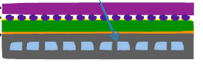

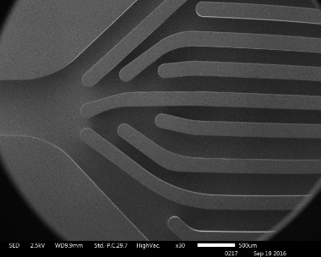
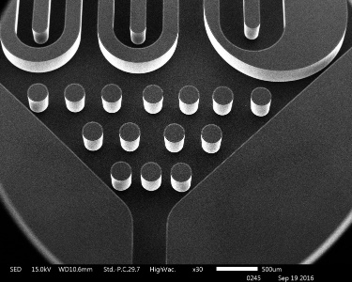
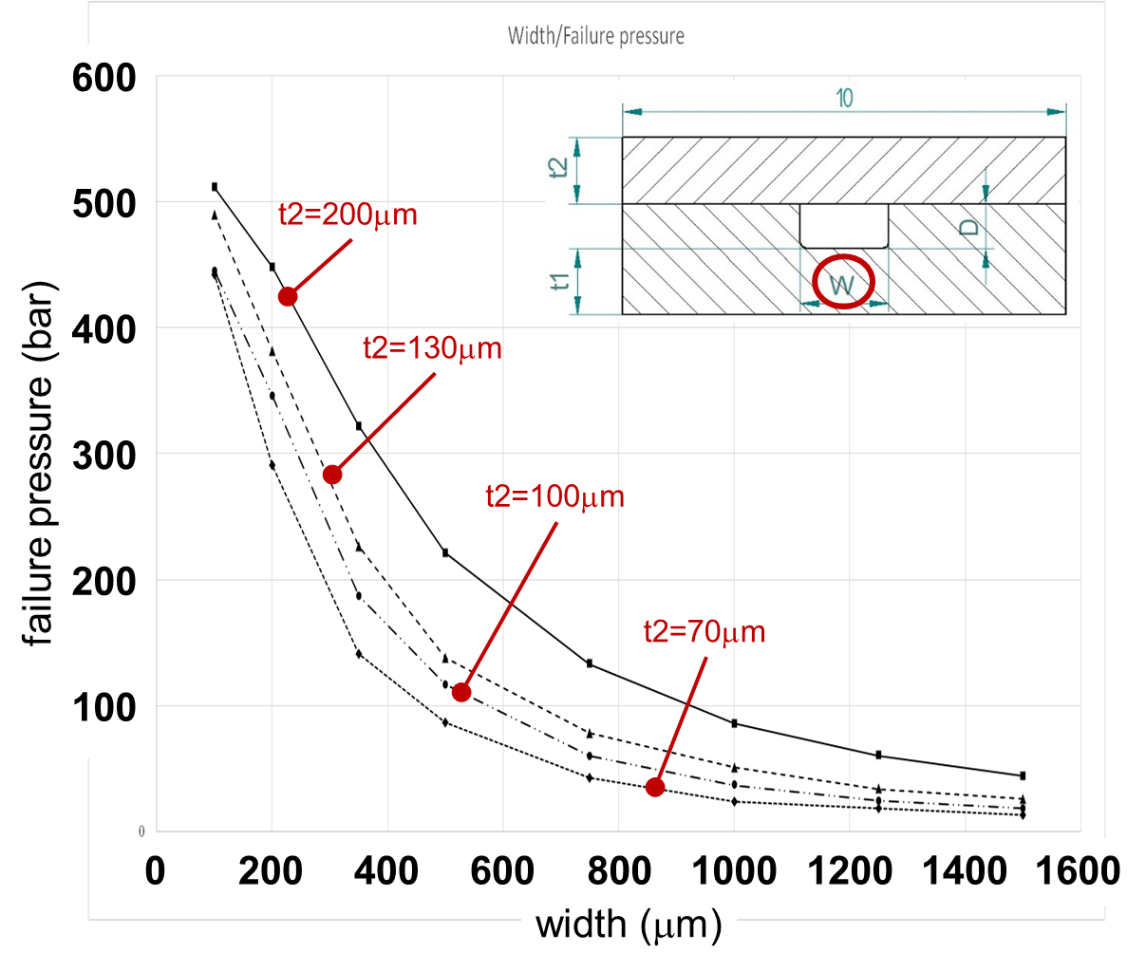

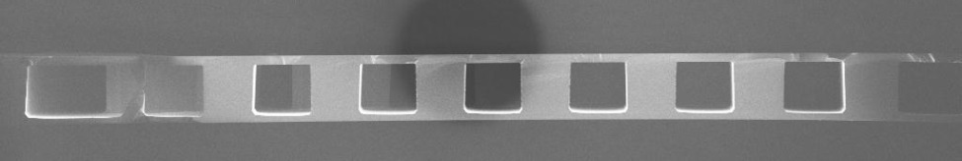
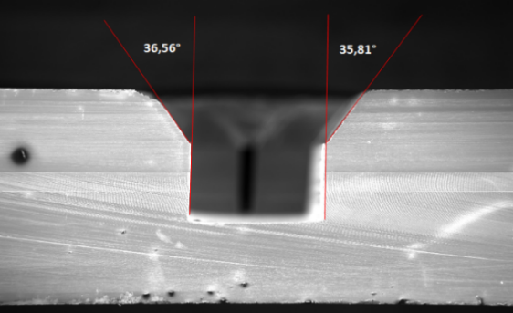
Microfabricated Silicon cold plates
Good thermal conductivity (>150 W/mK)
Same CTE of chip and sensor
Wafer-level etching + fusion bonding:
Si-Si (hydrophobic bonding)
Si-O-Si (hydrophilic bonding)
Well established MEMS technology
Extreme geometrical accuracy
Complex shapes
High mechanical resistance
Pure elastic material (no fatigue)
Very thin cold plates possible
Drawbacks:
expensive process
Very poor yield (direct bonding)
size limitation

Slide 13
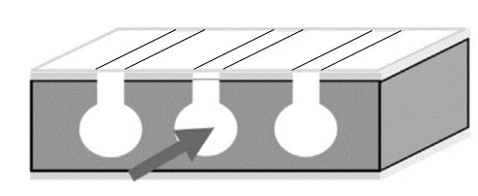
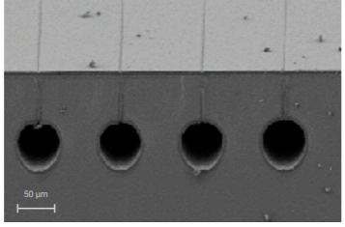
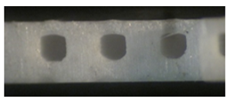
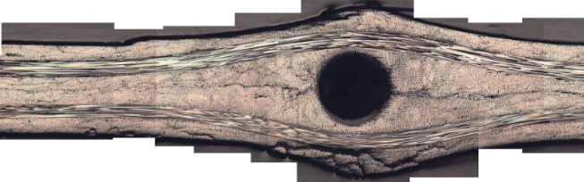
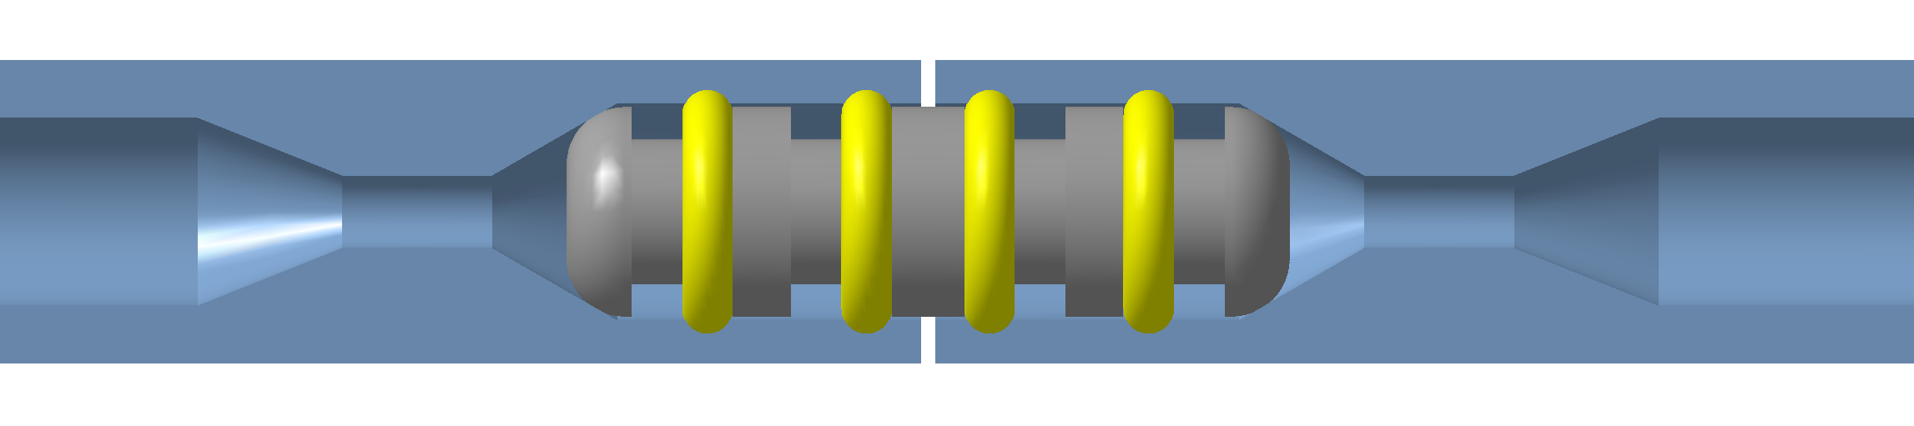
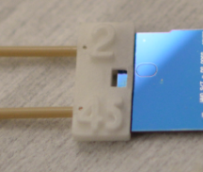
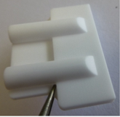
Challenges in microchannel development
Alternative Si-Si bonding techniques (Eutectic? Thermocompression?):
Tested initially around 2013-2014 then set aside: difficult to find volunteers to restart (IFIC/CMM?)
Embedded channels in Silicon wafers (CMOS-compatible) :
Launched around 2010 by FBK/INFN. Stopped. Revamped in 2016-2019 by CERN/EPFL. Stopped…
3D printed devices in ceramic:
Some progress in AIDA2020 and in CERN EP-RDET WP4, but requires first basic step (AIDAinnova)
Carbon cold plate with microvascular network:
Some progress in CERN EP-RDET WP4, but still in early stages
Micro-connections and Interconnections:
Some nice progress in AIDA2020, then stasis, now interesting advances in CERN EP-RDET WP4
Housing channel (Ø = 1.5 mm ; A_{CS}=1.77mm²)
Restriction
(Ø = 0.5)
60°
Groove
O-ring
0.2
2.2
5mm

Slide 14
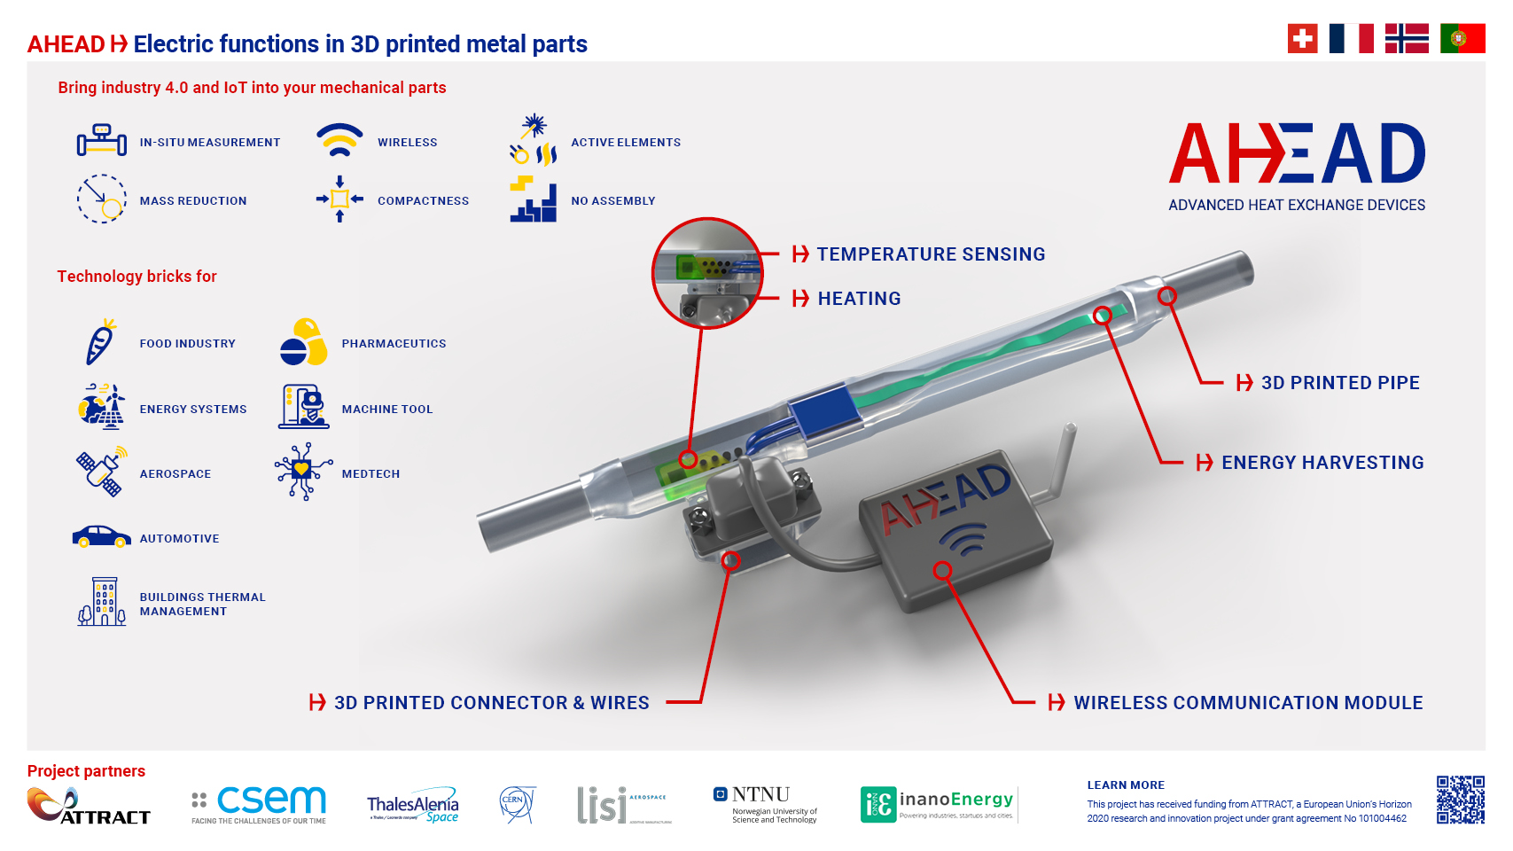
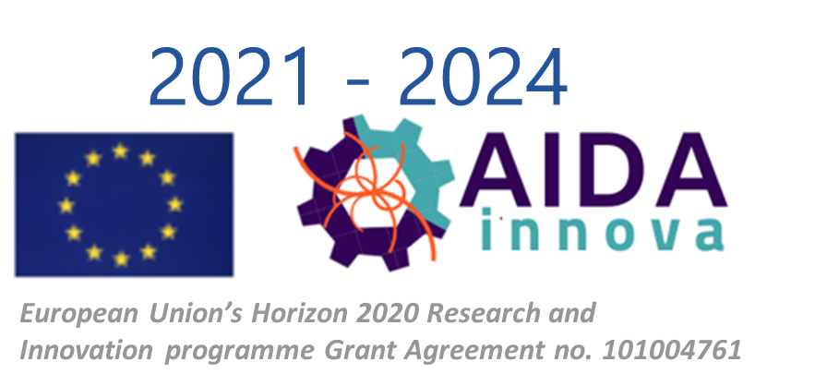
The promises of Additive Manufacturing (3D printing)
Additive Manufacturing brings countless potentialities also in the world of detector cooling.
This is not only limited to complex shapes, but also allowing for new concepts like pipe segments integrating self-powered instrumentation
But there are still a lot of technical limitations to be understood and overcome. Examples:
- minimum wall thickness for leak-tight pipes in metal (including in light alloys)
- devices in alternative metals (e.g. Kovar)
- planarity of sintered ceramic devices (including highly thermally conductive ceramics)
- direct use of non-sintered devices (“green parts”)
- thin-wall leak-tight devices in PEEK
CERN EP-RDET
VERY SLOW PROGRESS!

Slide 15
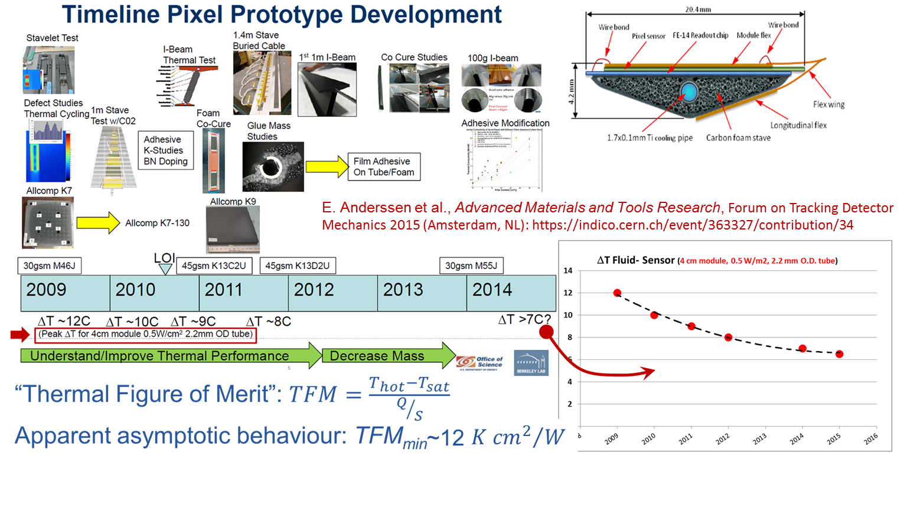
What if I cannot reduce the TFM? Optimise the refrigerant!
e.g. for a power dissipation of 1 W/cm² if you look for T_{MAX} <-30 °C on your sensor, the saturation temperature in the evaporator must be T_{Sat} <-42 °C (maybe -40 if an optimal design for CO₂ allows for higher HTC)

Slide 16
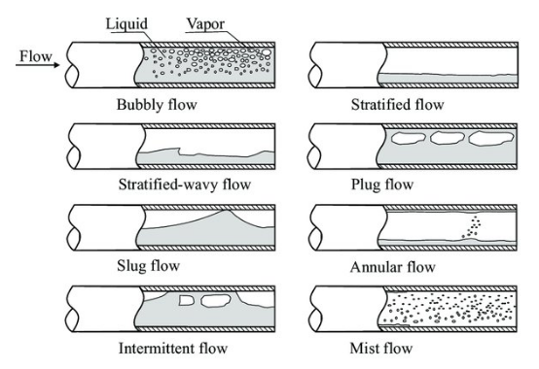

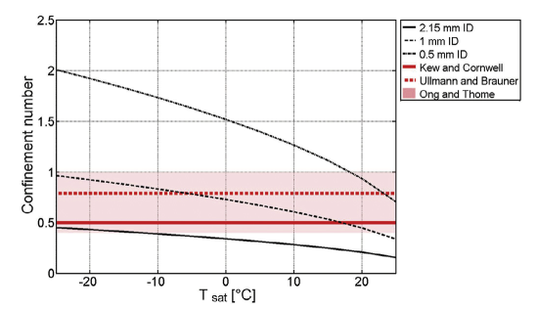
There is still some space to optimise boiling in SMALL ID pipes
Large ID
Small ID
When the size of the bubbles quickly reaches dimensions comparable to the pipe ID, they cannot evolve freely and the possible boiling patterns are different: “confined flow”
Bond number
Confinement number
0.5 mm
1.0 mm
2.15 mm
Growing effect of “confinement” in CO₂ boiling flows reducing T and ID
Notes:
The plot shows the trend of the Confinement Number for CO2 boiling in small pipes of different inner diameters, WHILE VARYING THE SATURATION TEMPERATURE and compares these trends with some of the most cited criteria to define “confined flows”: Kew & Cornwell; Ullmann & Baruner; Ong and Thome
ID 0.5mm pipes clearly always provide confined flows in the whole observed range
ID 2.15mm should be typically unconfined at least down to Tsat below -30 (possibly starting confinement effect below that limit)
ID 1.0mm is a particularly interesting case, since it since to cross all the criteria, however without ever being exceedingly on one side or on the other

Slide 17
Investigations at CERN on CO₂ boiling
D. Hellenschmidt et al., New insights on boiling carbon dioxide flow in mini- and micro-channels for optimal silicon detector cooling, Nuclear Inst. and Methods in Physics Research, A 958 (2020) 162535
D. Hellenschmidt, P. Petagna, Effects of saturation temperature on the boiling properties of carbon dioxide in small diameter pipes at low vapour quality: Pressure drop, Int. Journal of Heat and Mass Transfer 163 (2020) 120209
D. Hellenschmidt, P. Petagna, Effects of saturation temperature on the boiling properties of carbon dioxide in small diameter pipes at low vapour quality: Heat transfer coeﬃcient, Int. Journal of Heat and Mass Transfer 172 (2021) 121094
D. Schmid et al., Flow pattern observations and flow pattern map for adiabatic two-phase flow of carbon dioxide in vertical upward and downward direction, Experimental Thermal and Fluid Science 131 (2022) 110526
D. Schmid et al., Adiabatic two-phase pressure drop of carbon dioxide in different channel orientations, Int. Journal of Heat and Fluid Flow 95 (2022) 108966
D. Schmid et al., Heat transfer of ﬂow boiling carbon dioxide in vertical upward direction, Int. Journal of Heat and Mass Transfer 196 (2022) 123246
Evaporation in mini- and micro-channels
Two-phase boiling flows in large VERTICAL pipes
For large pipes (i.e. NON confined flows) “good” correlations developed involving CO₂ data work relatively well in horizontal flow and can be re-adapted to vertical flow based on additional data^{(*)}
For small pipes (i.e. potentially confined flows) almost no existing model really works as they seem to be unable to catch the dependence from the saturation temperature
Activity idle due to limited resources. Actively looking for collaborations (including external)

Slide 18
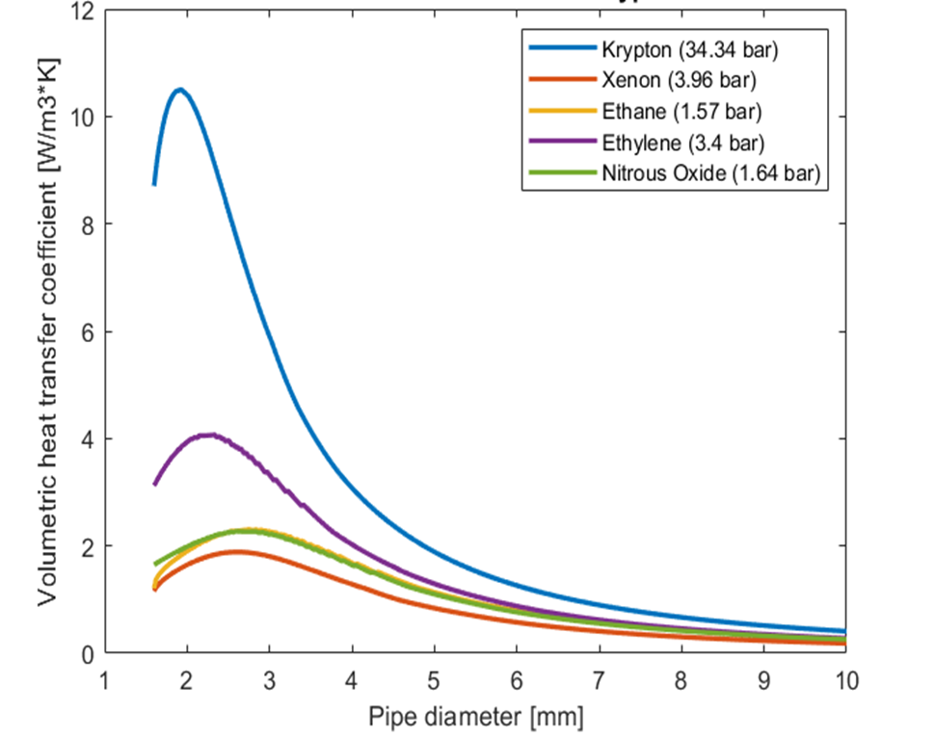
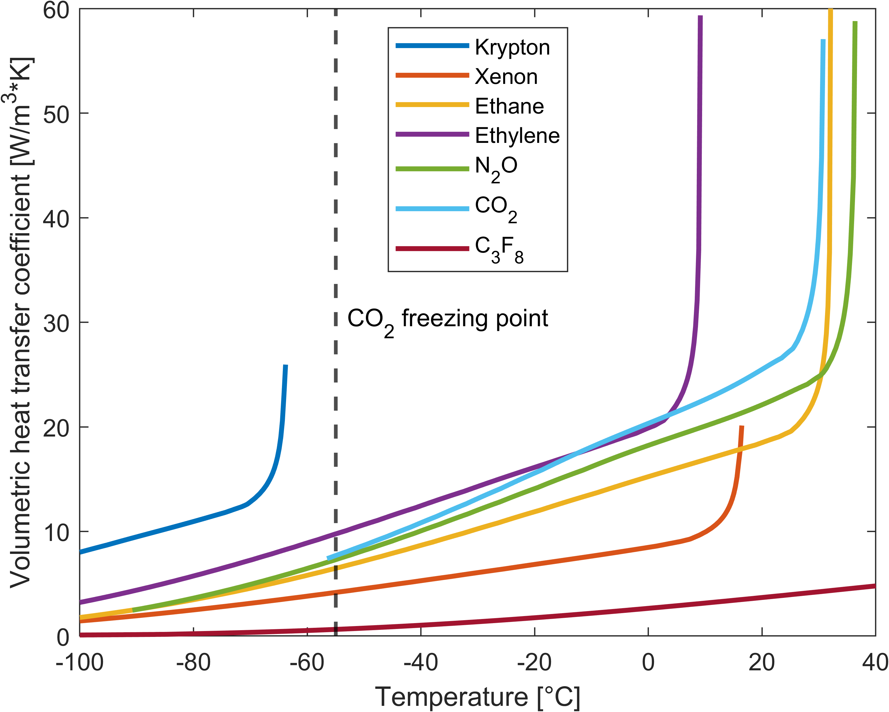
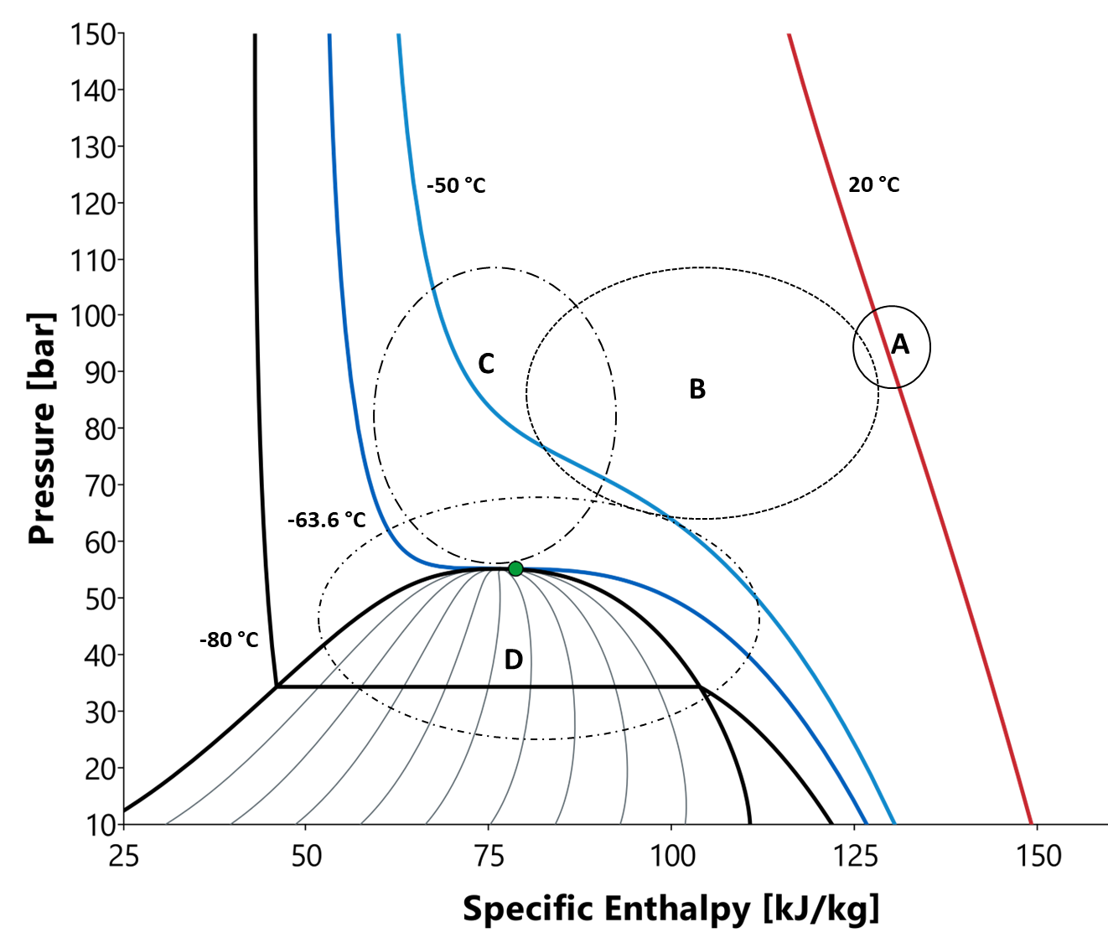
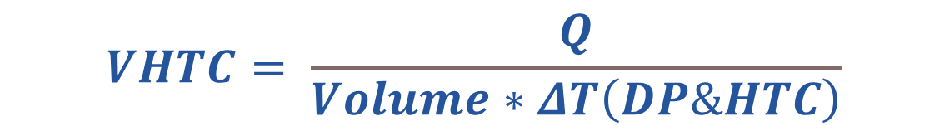
Yes, but to REALLY go colder? Supercritical Kr!
Today the only refrigerants in use for T < -45 ºC are R23 (CHF₃ very high GWP but still allowed since no viable alternative below -50 ºC on the market) or CO₂/N₂O mixtures (natural but difficult to use and with limited thermal-fluidic performances: very limited use)
Krypton is a natural fluid with Critical Point at [−63.8 ºC / 54.3 bars] with fantastic thermal-physical properties close to it (above AND below)
$$VHTC= \frac{Q}{Volume∗ΔT\left(DP\&HTC\right)}$$

Slide 19


An innovative trans-critical Kr refrigeration cycle
An innovative refrigeration cycle is being studied to use with full continuity Krypton from room temperature to −63.8 ºC in supercritical (single phase) conditions and down to -80 ºC in subcritical (two-phase boiling) conditions
On-going PhD (CERN-NTNU): Luca Contiero

Slide 20
The really tough challenges (my personal opinion)
The community of people/institutes active in the field is quite small and the impression is that there is tendency to shrinkage (“I guess THEY will take care of this”)
Frame programmes – like large EC-funded projects or the CERN EP-RDET – help but all experienced people have extremely limited time to get really involved (even just in effective supervision) and at best can live this as exciting hobby
Engineering and physics resources are often “out of phase”; towards the end of a large project, when physicists start to free resources to go back to R&D, engineers enter their peak of activity and are in “R&D black-out”
Experience shows that the progress “from small to large” is extremely effective (e.g. microchannel cooling from NA62 to LHCb; CO₂ cooling from LHCb to ATLAS & CMS). But it is more often a question of good chances aligning than the product of a global vision
The lack of a global vision – if not of some sort of coordination – makes all evolution processes extremely inefficient

Slide 21
The Forum on Tracking Detector Mechanics
Since 2012 the small community of people active in Tracking Detector Mechanics started to meet once per year to exchange ideas, issues and innovations
It’s a very interesting window on what’s going on: you are all invited at least to have a look at what has been presented in the years
However, this is not a federative and/or coordination event, which we still miss badly
2012 (CERN - Geneva): https://indico.cern.ch/event/192033/
2013 (Oxford Uni): https://indico.cern.ch/event/233332/
2014 (DESY - Hamburg): https://indico.cern.ch/event/287285/
2015 (Nikhef - Amsterdam): https://indico.cern.ch/event/363327/
2016 (Bonn Uni): https://indico.cern.ch/event/469996/overview
2017 (CPPM - Marseille): https://indico.cern.ch/event/590227/
2018 (IFIC – Valencia): https://indico.cern.ch/event/695767/
2019 (Cornell Uni – Ithaca, NY): https://indico.cern.ch/event/775863/
2021 (videoconference): https://indico.cern.ch/event/1017981/
2022 (LNFN – Frascati): https://indico.cern.ch/event/853861/
2023 (Tübingen Uni): https://indico.cern.ch/event/1228295/
2024 (Purdue Uni – Purdue, IN): website in preparation

Slide 22
CONCLUSIONS
Since the start of LHC Run1 there has been tremendous progress in the approach to detector cooling
The lines of development for future projects (medium-, long- and very long-term) are sparse and present many technical challenges
There are quantities of new ideas and new technologies arriving in the field
But it is also worrisome to see very important lines of R&D left completely idle because nobody has time and/or resource to pick them up
Some move towards a better coordination would be beneficial (discussion on ideas are presently ongoing)

