Slide 1


Development of HPK Capacitive-Coupled LGAD (AC-LGAD) detectors
Tomoka IMAMURA, Sayuka KITA, Junya NISHINO,
Yua MURAYAMA, Issei HORIKOSHI,
Koji NAKAMURA^{A}, Kazuhiko HARA
University of Tsukuba, KEK^{A}
32nd International Workshop on Vertex Detector
17/Oct/2023

Slide 2
Detectors with high timing resolution
Future high energy physics experiments
Higher Energy
Higher luminosity
Event pile-up will be an issue
140pileup@HL-LHC
1500pileup@FCC-hh
Solution
Detector with…
Good spatial resolution
Good timing resolution
Timing information
More robust reconstruction!

Slide 3
LGAD technology
Low-Gain-Avalanche-Diode
p+ implantation below the n+ implantation to make gain layer
Al electrode
Oxide film
Elec Field
Local high electric field in p+ layer develops avalanche
n+
Gain layer
p+
e
Large amount of e/h pairs are created per initial electron
h
p-
Creation of large signal in the vicinity
Operation principle of LGAD
Good timing resolution

Slide 4
AC-LGAD detector
DC-LGAD
Each electrode has individual gain layer
With Junction Termination Extension and p-stop
Al electrode
Oxide
n++
n+
n+
n+
n+
n++
p++
p++
p++
p++
Low fill factor
p+
AC-LGAD
Al electrode
Oxide
n++
n+
n++
p+
Uniform gain layer under segmented electrodes
e
h
p-
AC-LGAD detector has been successfully developed down to 100um pitch pixel detector with 100% fill factor
arxiv:2305.12355

Slide 5
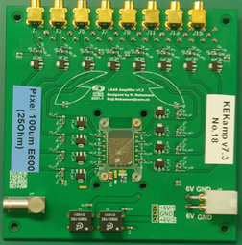
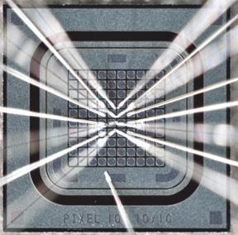
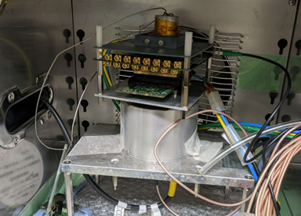
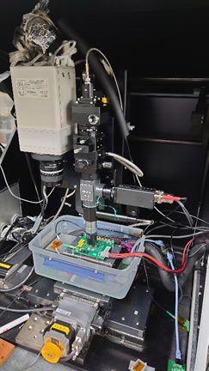
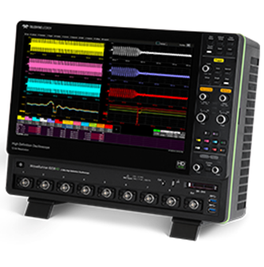
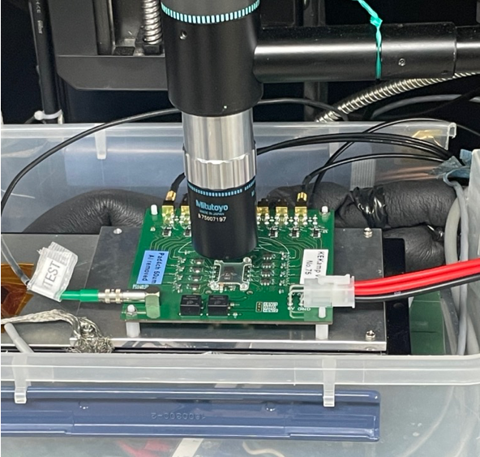

Measurement setup
Sensors on amplifier board
Wire bonding
Wire-bonded sensor electrodes to amp inputs
Each amp channel employs two-stage fast charge sensitive amp IC
16 channels available for one board
Beta-ray
LGAD Sensor
⁹⁰Sr
IR laser
DAQ system
MCX cable
MCX cable
LeCroy Waverunner 8000
350MHz – 2GHz
10GS/s
8ch
MCP-PMT 240
as timing reference
Infra red laser (1065nm)
Laser size σ~1um
Inject through slit made in the sensor
Electron from ⁹⁰Sr beta decay
In the bath to keep the temperature

Slide 6
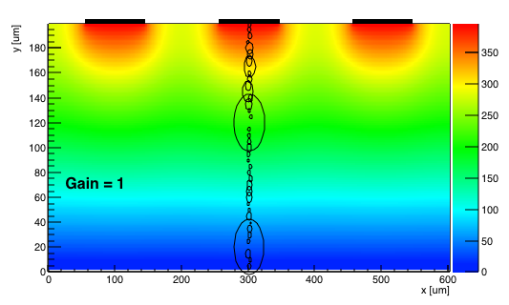
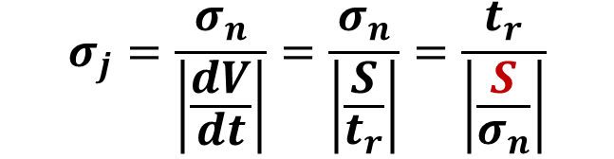
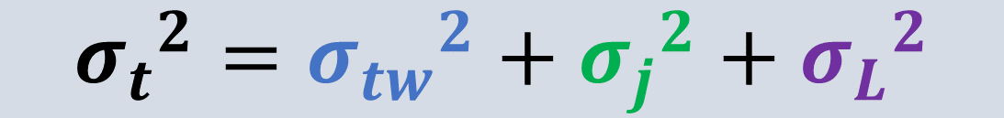
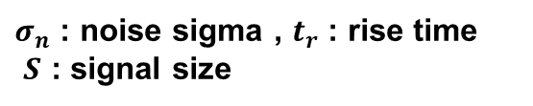
Timing resolution
$${σ_{t}}^{2}={σ_{tw}}^{2}+{σ_{j}}^{2}+{σ_{L}}^{2}$$
Time walk
Minimize contribution
by adopting constant
fraction
Jitter
Landau noise
$$σ_{j}=\frac{σ_{n}}{\left|\frac{dV}{dt}\right|}=\frac{σ_{n}}{\left|\frac{S}{t_{r}}\right|}=\frac{t_{r}}{\left|\frac{S}{σ_{n}}\right|}$$
Non uniform energy deposition of MIP
Laser measurement results do not include this effect
Thinner sensors should reduce this effect
Use a fraction of pulse height max instead of a fixed threshold
$σ_{n}$ : noise sigma , $t_{r}$ : rise time
$S$ : signal size
Big signal size is important to reduce jitter effect
50% of
Max pulse height
+ the smaller noise as well
Determine the best bias voltage

Slide 7
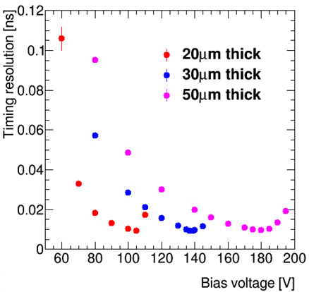
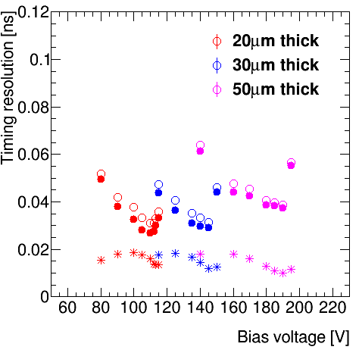


Timing resolution results
Laboratory measurement
Lab meas | 50um | 30um | 20um
Timing resolution | 38.8ps | 31.5ps | 31.2ps
Jitter | 9.8ps | 11.8ps | 15.9ps
Landau noise | 37.5ps | 29.2ps | 26.8ps
IR laser
${ σ}_{t}^{2}={ σ}_{tw}^{2}$+ $σ_{j}^{2}$+${ σ}_{L}^{2}$
Beta
${ σ}_{t}^{2}={ σ}_{tw}^{2}$+ $σ_{j}^{2}$+${ σ}_{L}^{2}$
●landau
＊jitter
○Time reso.
Thinner samples have better timing resolution due to landau noise
Beam test measurement
2x2 pad with 500um square electrodes
Injected 120GeV Proton beam at FTBF
TB meas
~20ps
Uniform timing resolution over the detector has been observed

Slide 8
Radiation damage on LGAD
Future high energy physics experiments
Higher Energy
Higher luminosity
Detectors will be exposed to large amount of radiation
e.g. Inner trackers in HL-LHC ATLAS at 4000fb⁻¹
2×10¹⁶ n_{eq}/cm²
10MGy
Acceptor removal
  One of the major effects of radiation damage of LGAD
  Acceptor doping concentration in gain layer is reduced by radiation damage
n+
p+
Shallow dope
Radiation damage
e
Defect complexities
p-
h
need to apply higher bias voltage
Single Event Burnout
For bias voltage with average E-field of >12V/um, a large energy deposit happens to create a crater
Our sensors are 50um upper limit is 600V

Slide 9
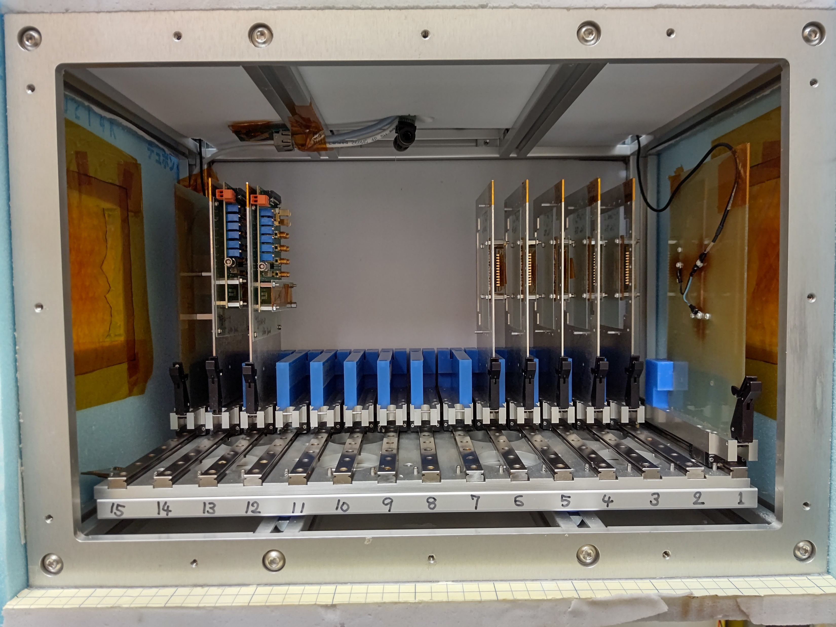
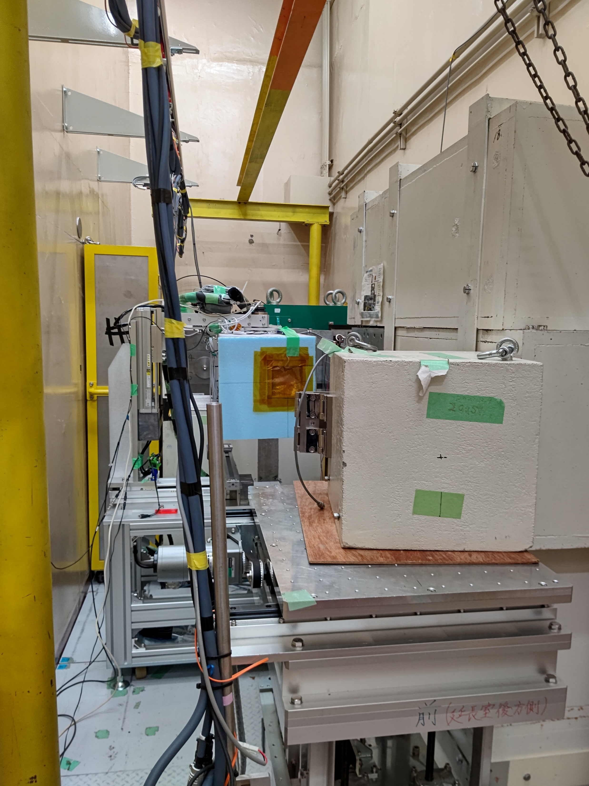
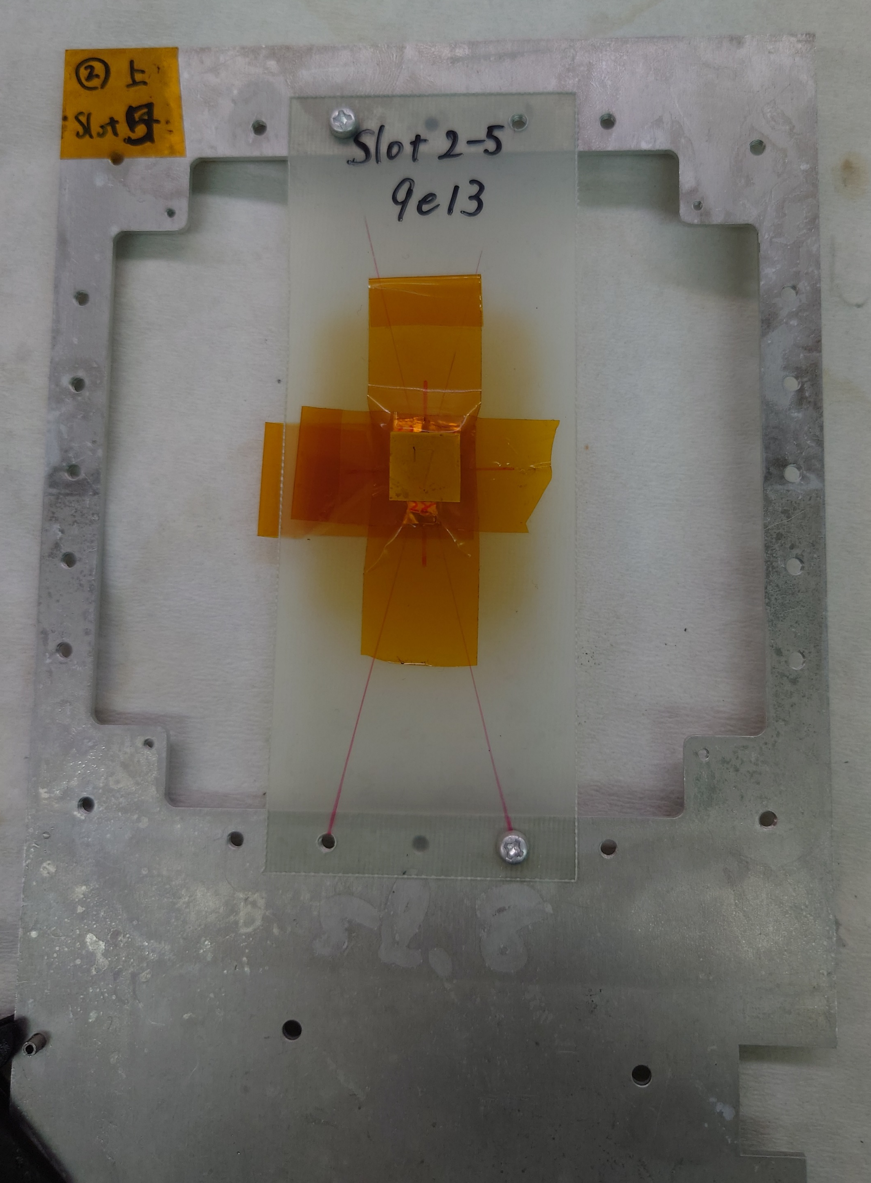
Ideas to improve radiation hardness
Need to reduce the bias voltage after the irradiation
need to reduce the effect of acceptor removal
Compensation
Partially-Activated-Boron
Made samples Irradiation test IV & Signal measurement
Irradiation test
  CYRIC at Tohoku University
  70MeV proton beam at 7nA~1600nA
  Temperature was set to -15℃
  Uniform scanning over the sensors
  7×10¹⁵, 3×10¹⁵, 6×10¹⁴,
  8×10¹³ n_{eq}/cm²
Samples

Slide 10
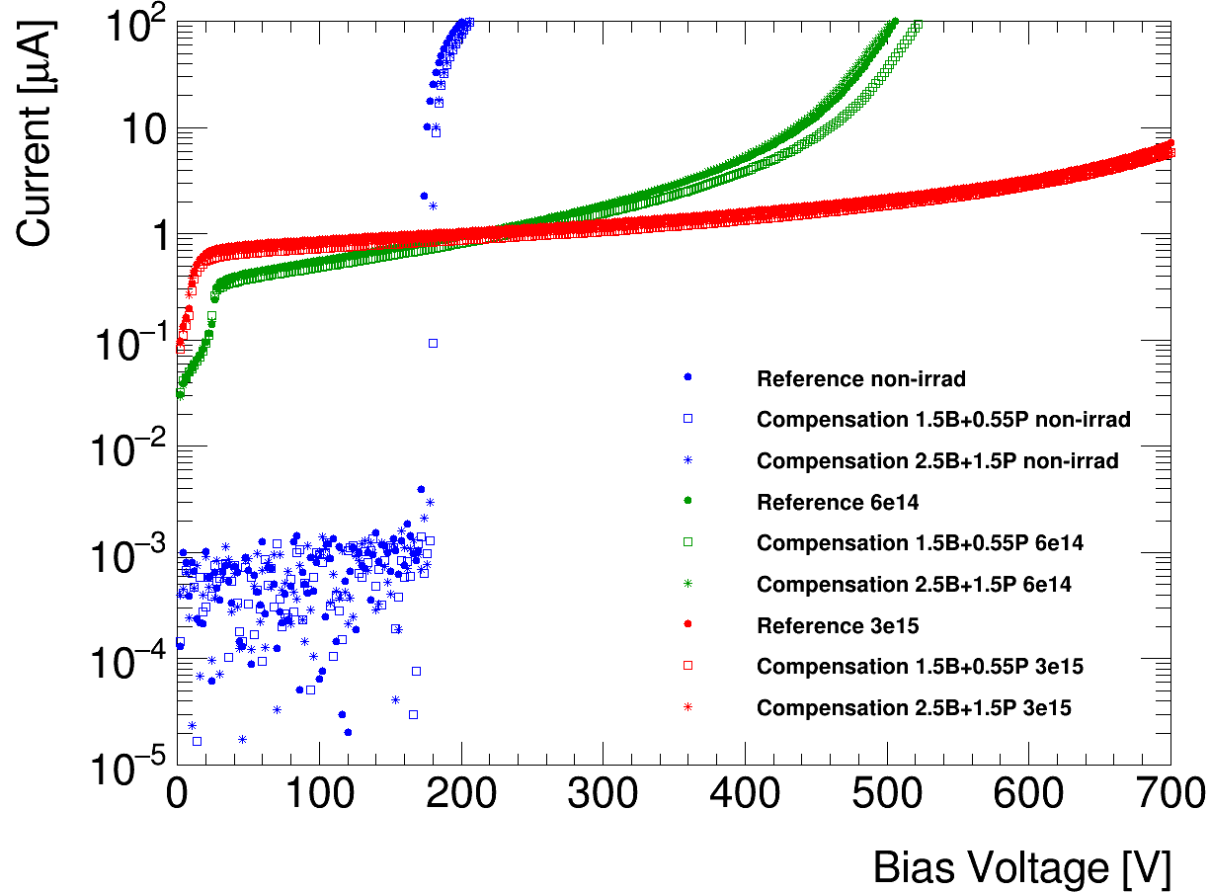
Compensation(I)
Dope quantity
Radiation damage
Dope quantity
n+
p+
Donor removal
Acceptor removal
depth
e
depth
p-
h
Both p and n are reduced
Amount of effective p+ may not reduce if donor removal is fast enough
Result of first samples
6×10¹⁴
Tested samples
Non-irrad
3×10¹⁵
 | p+ Boron | n+ Phosphorous | effective p+
2.5B+1.5P | 2.5a | 1.5a | a
1.5B+0.55P | 1.5a | 0.55a | 0.95a
Reference | a | 0 | a
IV curves are overlapped with reference sample
No significant improvement has been observed

Slide 11
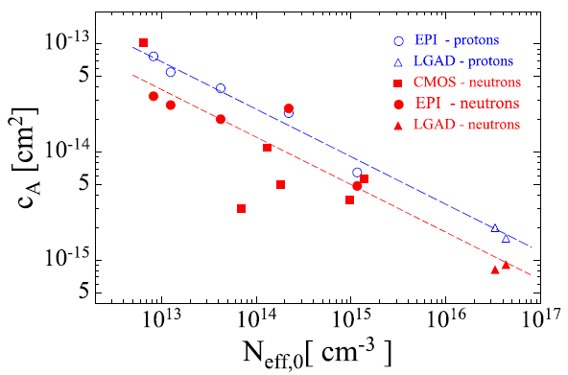
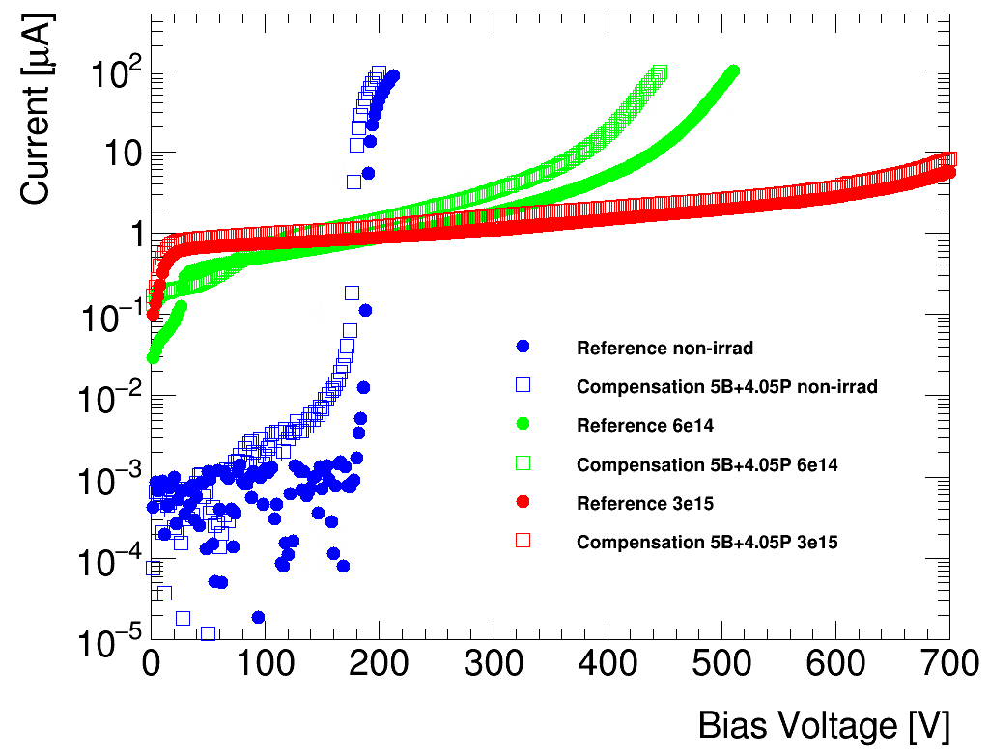
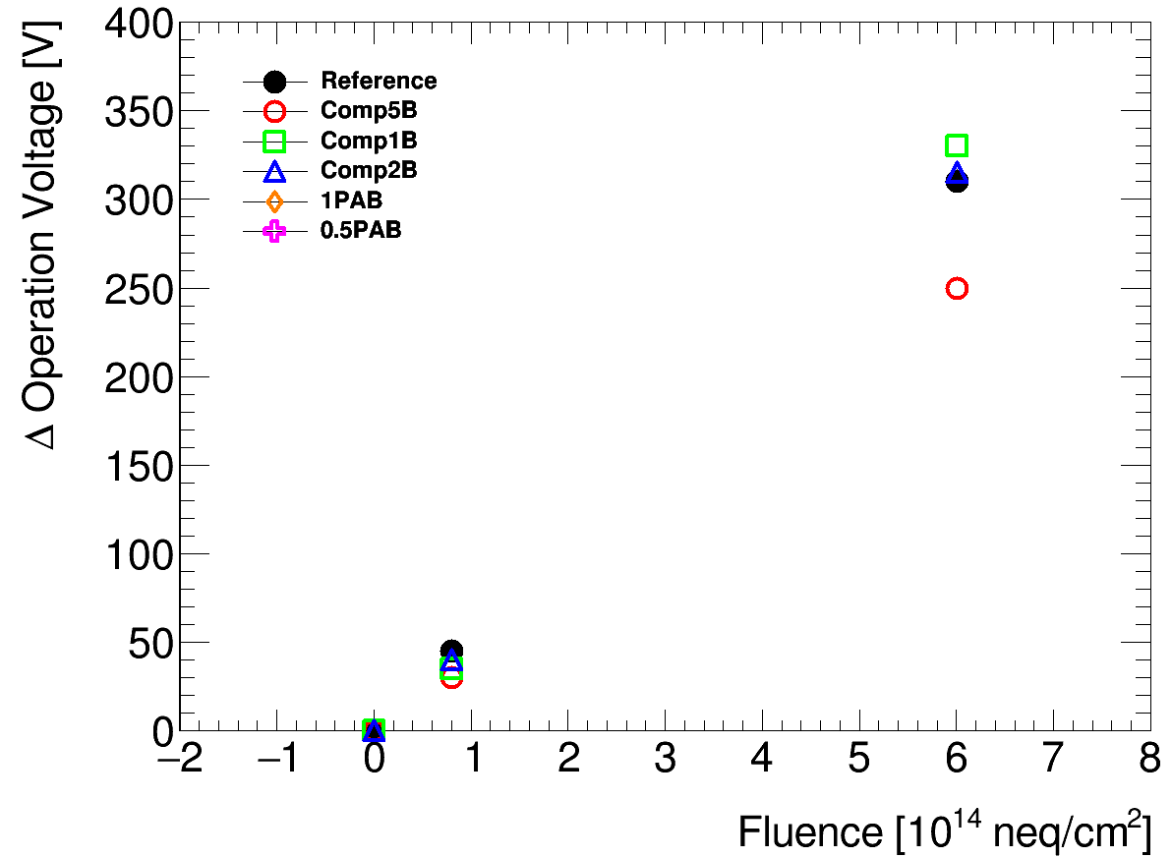

Compensation(II)
Higher dope concentration will help suppressing acceptor removal effect
  Reduce the reduction factor of acceptor
Reduction factor of acceptor
$$N_{A}(∅)=N_{A}(0)∙e^{{−C}_{A}∅}$$
Result of higher dope concentration samples
IEEE Transactions on Nuclear Science , 65, Issue: 8, 2018
 | p+ Boron | n+ Phosphorous | effective p+
10B+9.2P | 10a | 9.2a | 0.8a
5B+4.05P | 5a | 4.05a | 0.95a
Reference | a | 0 | a
➡No signal have been observed
Dope concentration
Non-irrad
6×10¹⁴
Signal measured using ⁹⁰Sr β
Operation voltage is defined as the voltage with the largest S/N
Fluence dependence of increment of operation voltage
3×10¹⁵
Compensation with high dope concentration reduces acceptor removal effect
IV measurement

Slide 12
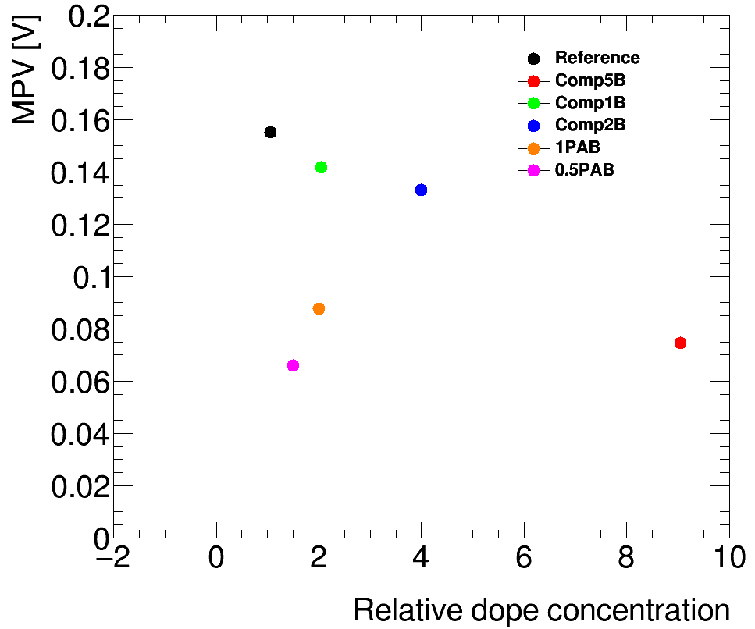
Compensation – MPV of non-irradiated samples
Higher dope concentration seems reduce acceptor removal more
No signal has been observed with 10B+9.2P sample…
Signal MPV dependence on dope concentration
Only for non-irradiated samples
Signal size is reduced by total dope concentration of gain layer implantation
Difficult to improve by simply increasing dope concentration
Compensation method will be developed with carbon dope as the next step…
Relative dope concentration is the dope concentration normalized by reference one

Slide 13
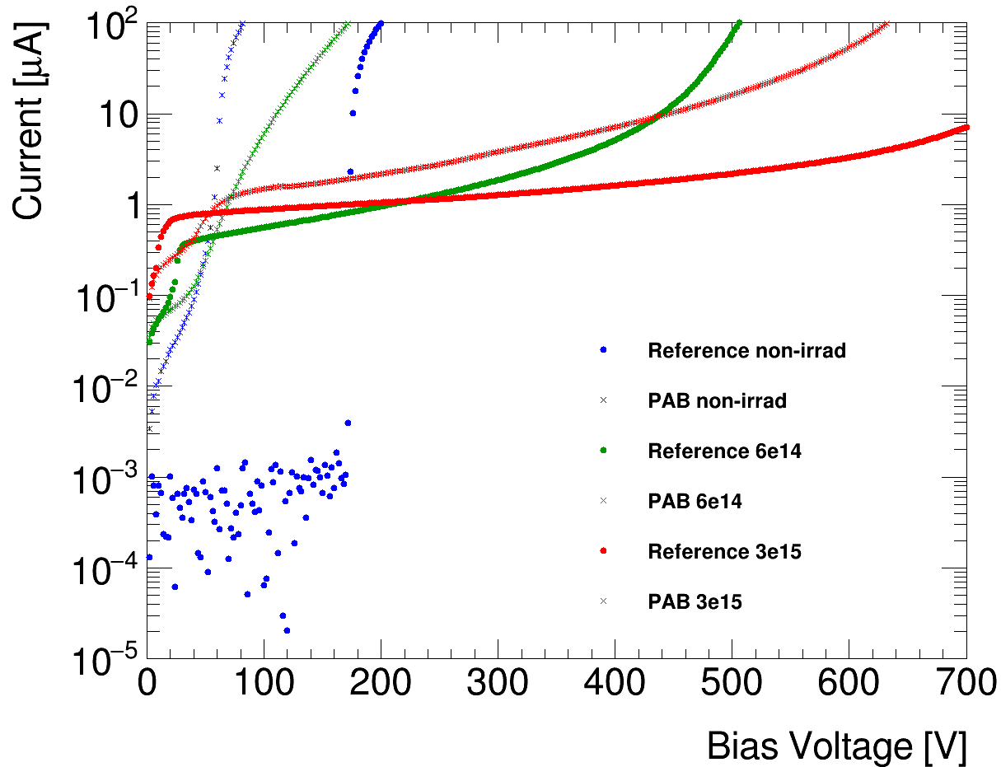
Partially-Activated-Boron(I)
B_{S} substitutional Boron
B_{i} interstitial Boron
Conduction Band
Conduction Band
Clean up the oxygen before irradiation to prevent B_{i} from becoming B_{i}O - new donor
B_{i} deliberately left in p+ layer takes oxygen with it
B_{s} ➡ B_{i}
B_{i}O
B_{s}
Boron inactivation
donor
acceptor
Valence Band
Valence Band
B_{i} + O ➡B_{i}O
Inactivated Boron combine with Oxygen
Result of first samples
6×10¹⁴
Break down voltage was ~50V
Not enough to observe signal
Break down voltage of irradiated samples seem less than reference sample …?
3×10¹⁵
Non-irrad
Break down voltage tuned samples have been tested as second samples

Slide 14
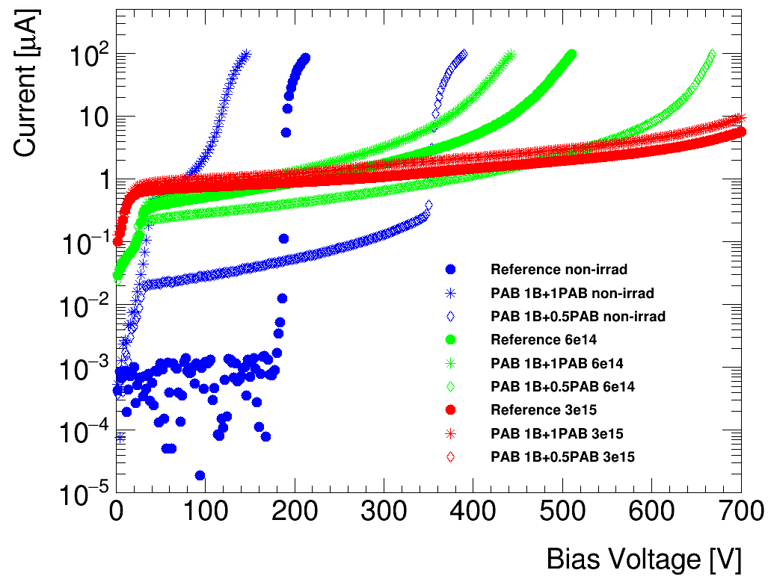
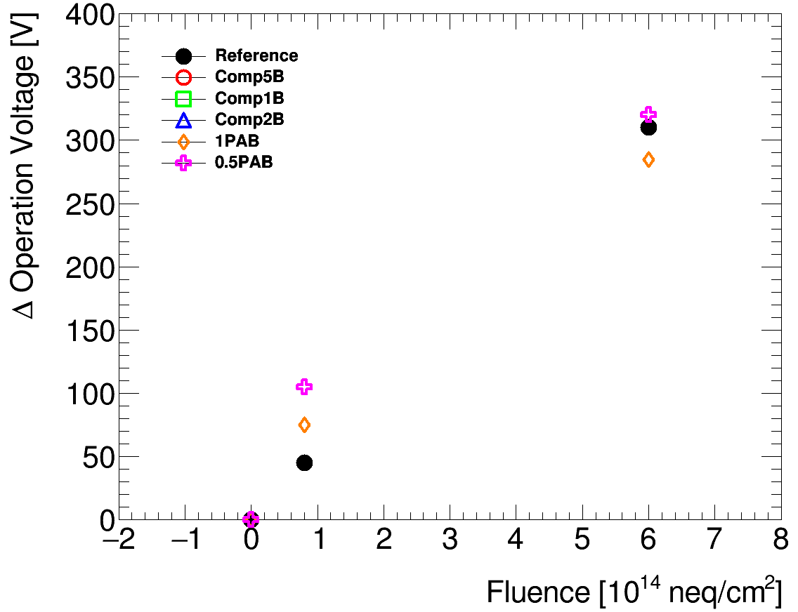
Partially-Activated-Boron(II)
B_{S} substitutional Boron
B_{i} interstitial Boron
Second samples … Inject additional boron over fully activated boron
1PAB
0.5PAB
Fully activated
B_{i}
Fully activated
B_{i}
Injected B_{i} the same amount as activated B_{s}
Injected B_{i} the half amount as activated B_{s}
B_{s}
B_{s}
B_{s}
B_{s}
Result of break down voltage tuned samples
Signal measured using ⁹⁰Sr β
Operation voltage is defined as the voltage with the largest S/N
Fluence dependence of increment of operation voltage
No significant improvement has been observed
IV measurement results

Slide 15
Conclusion
Detector with high timing resolution is needed
  LGAD detector is being investigated as a detector with superior timing resolution
AC-LGAD detector is successfully developed
  Finely segmented pixel sensor solving fill factor problem
  ~30ps timing resolution with laboratory measurement setup
  ~20ps timing resolution with 120GeV proton beam
  Uniformed timing resolution
Two novel ideas to improve radiation hardness have been tested
  Compensation method
  higher dope concentration seems effective in reducing acceptor removal
  effect, but shows smaller pulse
  Partially-Activated-Boron method
  No significant improvement has been observed so far

Slide 16
Back up

Slide 17
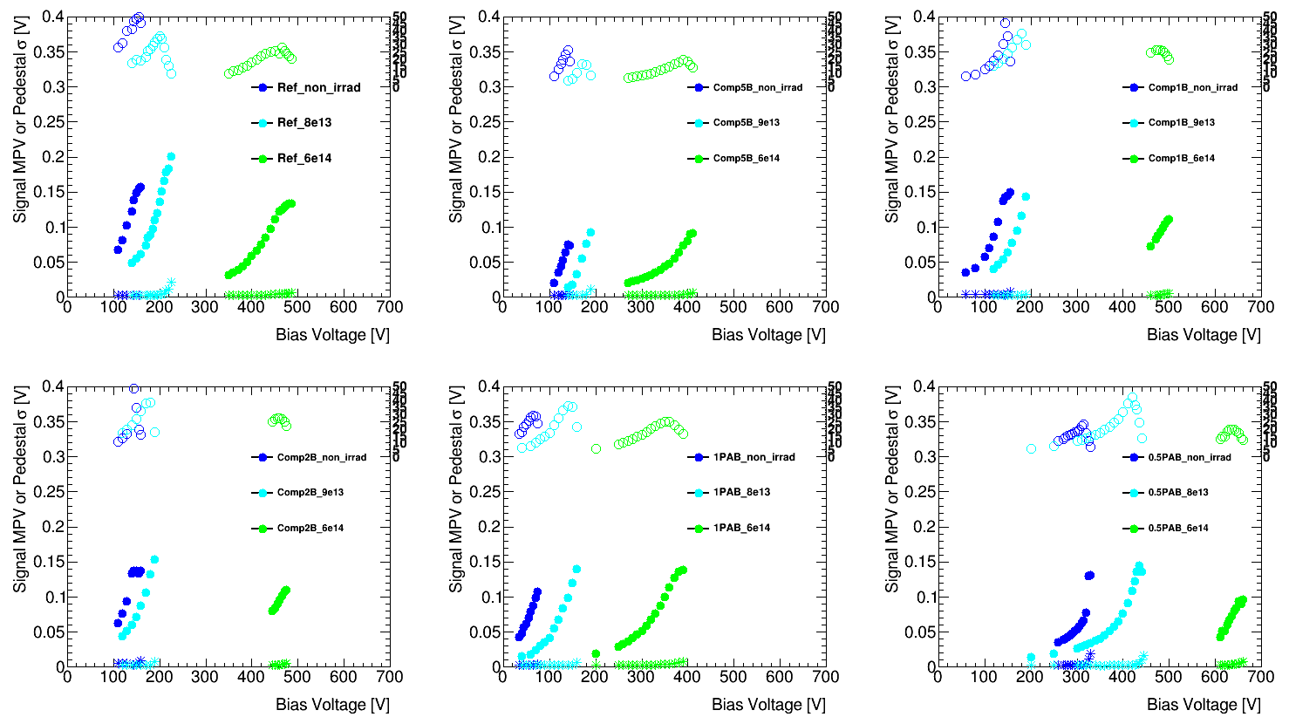
Bias voltage dependence of signal and noise

Slide 18
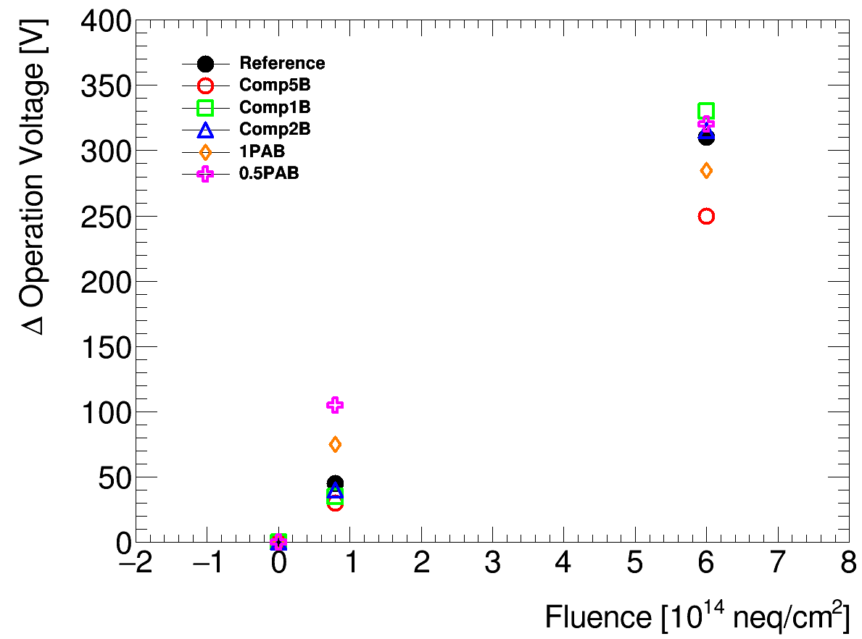
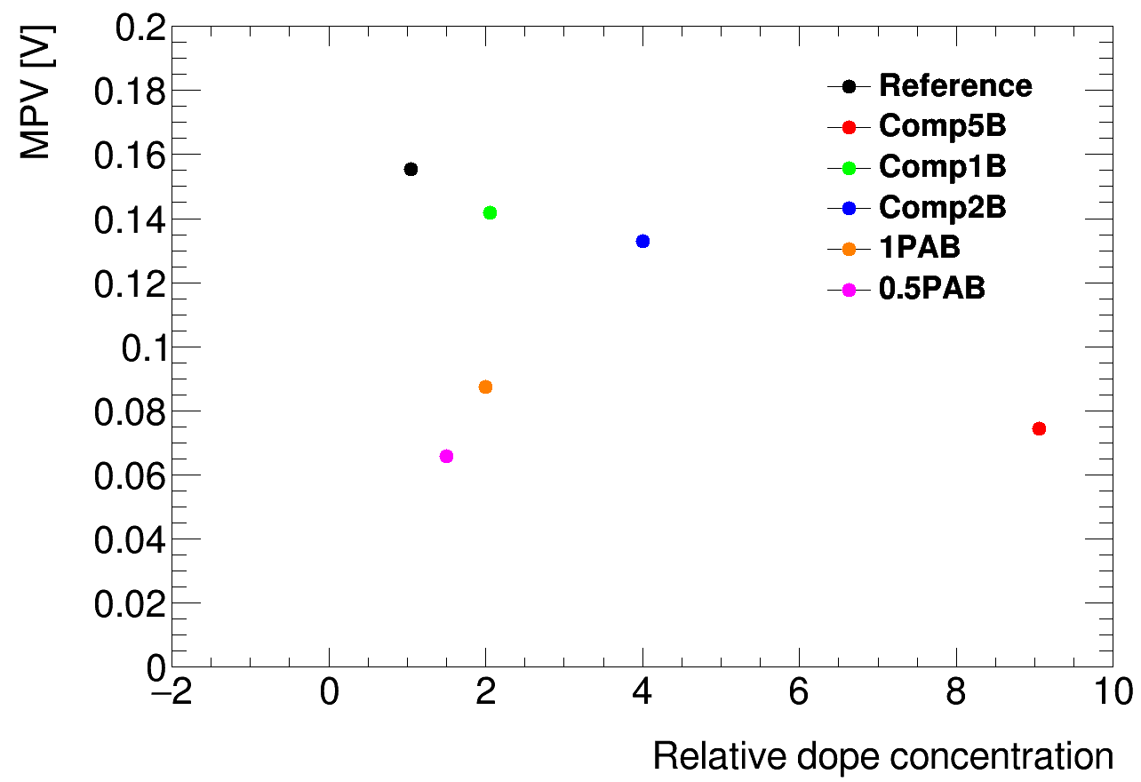
Tested samples and results
Compensation
Partially-Activated-Boron
 | p+ Boron | n+ Phosphorous | effective p+
10B+9.2P | 10a | 9.2a | 0.8a
5B+4.05P | 5a | 4.05a | 0.95a
2.5B+1.5P | 2.5a | 1.5a | a
1.5B+0.55P | 1.5a | 0.55a | 0.95a
Reference | a | 0 | a
1PAB
  Once the activation is complete, inject an equal amount of Boron and left inactivated
0.5PAB
  Once the activation is complete, inject a half amount of Boron and left inactivated
Fluence dependence of increment of operation voltage
Dope concentration dependence of MPV

Slide 19
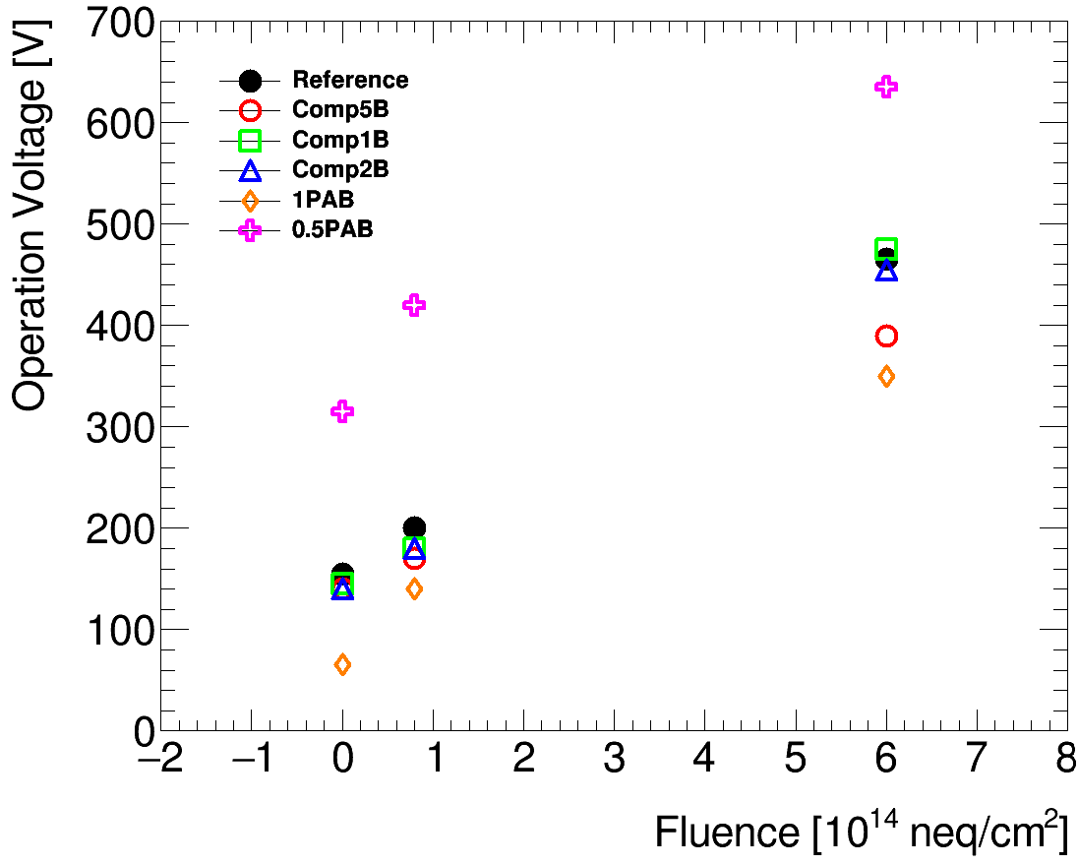
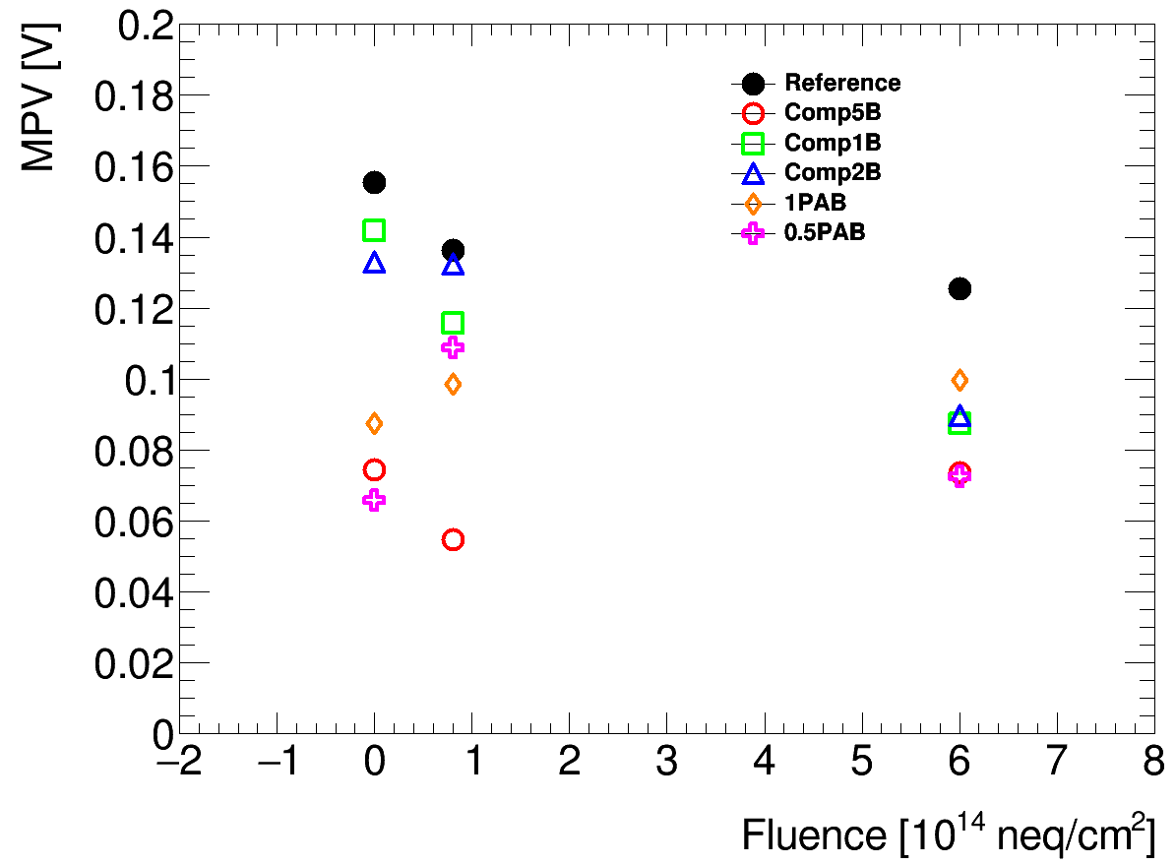
Degradation due to radiation damage
Increase in operation voltage – non-linear function of fluence
Reduction of signal size

Slide 20
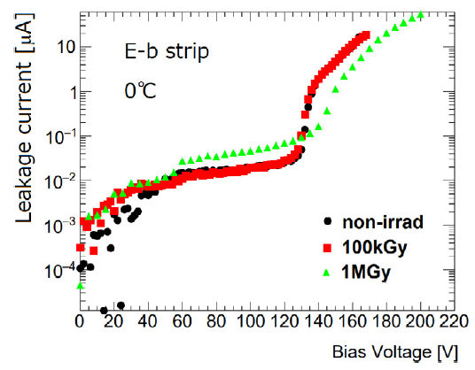
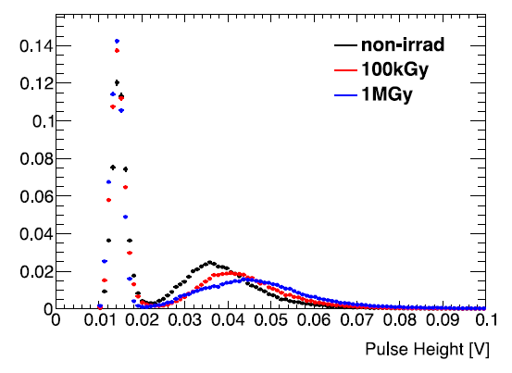
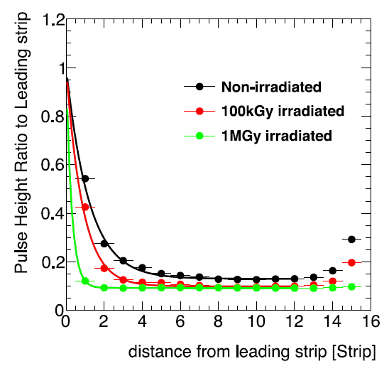
TID damage
Already studied
  Gamma ray irradiation with ⁶⁰Co
IV measurement
Pulse height distribution
Cross talk
The effect of TID damage is small*
*Compare with proton irradiation

Slide 21
Dosimetry
Method
Calibration
Proton irradiation to Al
Al
P
^{２４}Na are produced
Decay with half-lifetime 15hrs
Sensor
1.37MeV&2.75MeV γ-ray
Ge detector
Efficiency due to solid angle
  Depending on the distance
    10mm
    30mm
    60mm
Energy efficiency
  - γ→ photoelectric absorption + Compton scattering
Ge detector
*with ⁶⁰Co，¹³⁷Cs
→extrapolation

Slide 22



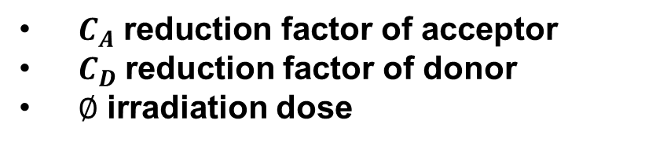
C_{A} and C_{D} relations
Assuming an exponential reduction in irradiation dose^{[2]}
Using the relation from the IV measurement results
  Overlap among all three conditions
p+
$$N_{A}(∅)=N_{A}(0)∙e^{{−C}_{A}∅}$$
$C_{A} \text{reduction} \text{factor} \text{of} \text{acceptor}$
$C_{D}$reduction factor of donor
$∅$ irradiation dose
n+
$$N_{D}(∅)=N_{D}(0)∙e^{{−C}_{D}∅}$$
effective p+
$$N_{A} \left(∅\right)−N_{D}\left(∅\right)=N_{A}\left(0\right)∙e^{{−C}_{A}∅}−N_{D}(0)∙e^{{−C}_{D}∅}$$
Reference
Compensation
p+
=
effective p+
$$N_{A}(0)∙e^{{−C}_{A}∅}=N_{A}\left(0\right)∙e^{{−C}_{A}∅}−N_{D}(0)∙e^{{−C}_{D}∅}$$
$$C_{A}=C_{D}$$

Slide 23
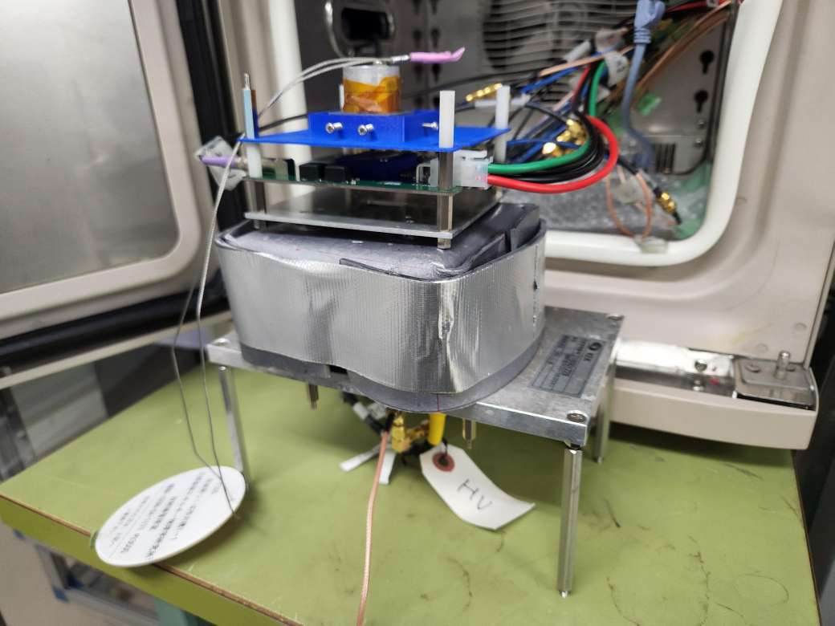
Signal measurement setup
Signal measurement with Sr90
HV
Sr
sensor
Oscillo
scope
PC
LV
Amplifier board
HV
PMT
trigger
Lead shield
bath
Non-irradiated samples : 20℃
Irradiated samples : -20℃

Slide 24
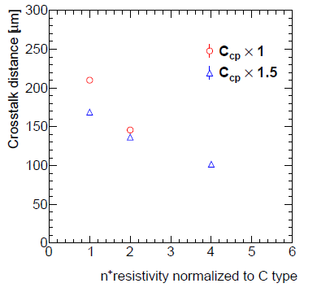
Cross talk of AC-LGAD
JFY2019
sample
JFY2020
sample
C2
C2-b
D-a
D-b
E-b
Larger n+ resistivity
→smaller cross talk
NIMA 1048(2023) 168009

Slide 25
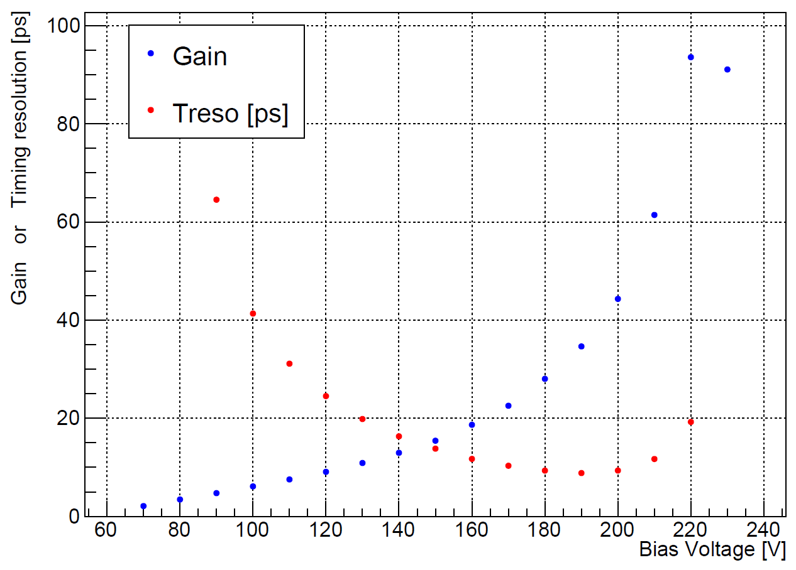
Gain of LGAD detector

Slide 26
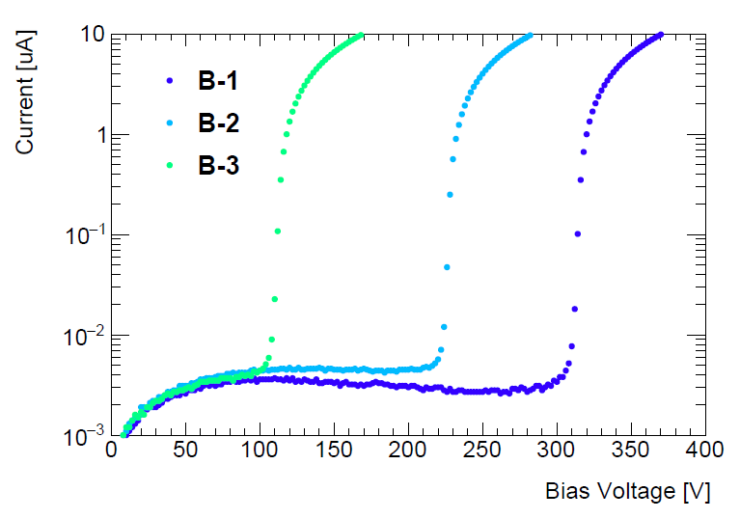
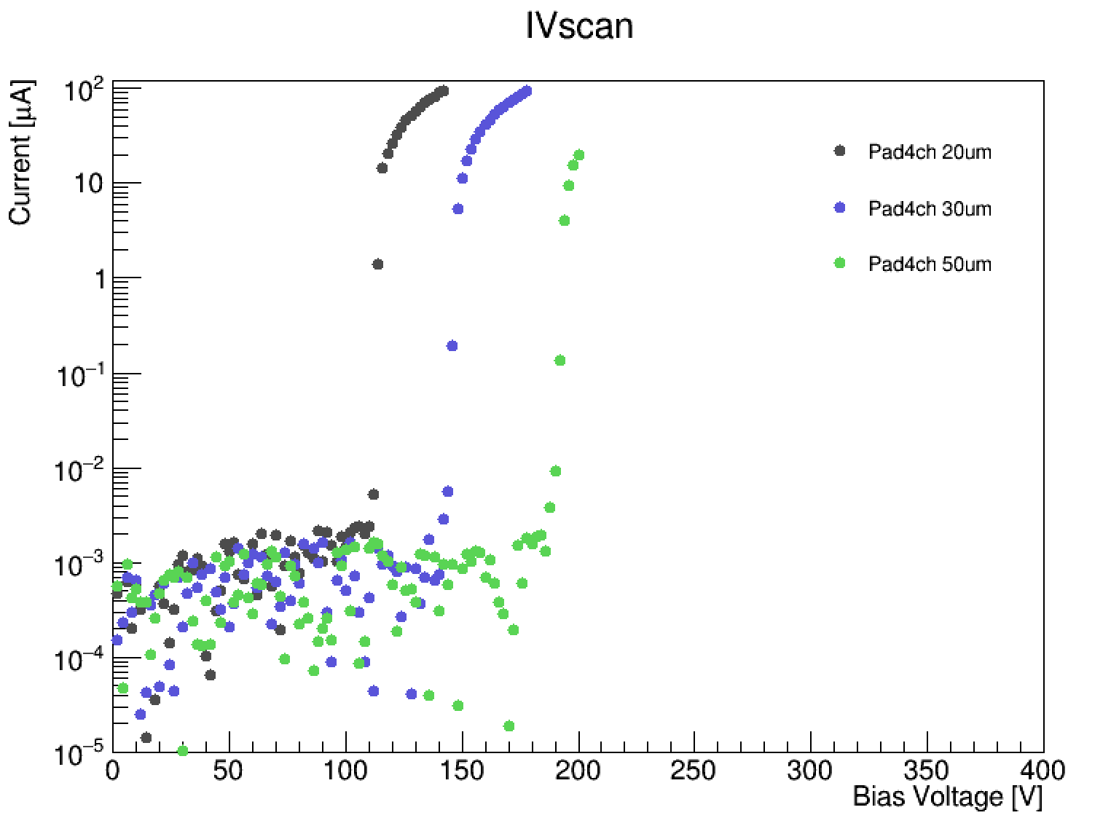
Some dependence of break down voltage
low
mid
high
Dope concentration dependence
Thickness dependence

