Slide 1
Resistive read-out Silicon Detectors with internal gain
Luca Menzio
VERTEX 2023 - 32nd International Workshop on Vertex Detectors
Sestri Levante, 16-20th October

Slide 2
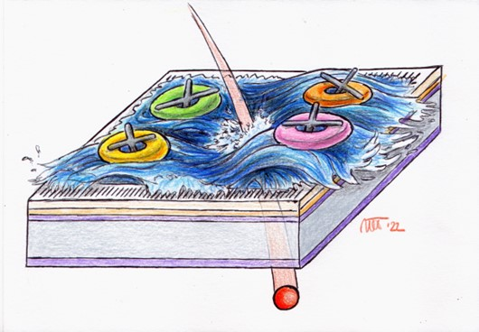
Introduction

Slide 3
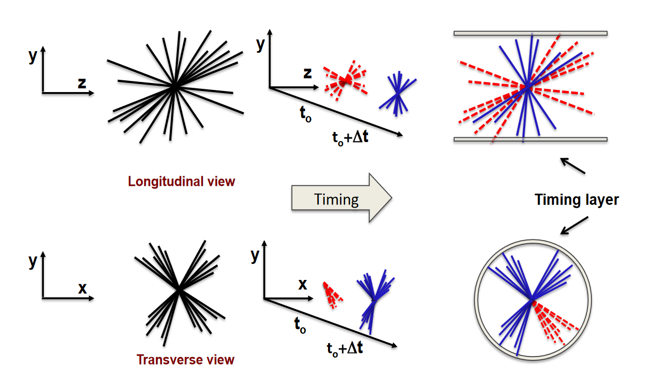
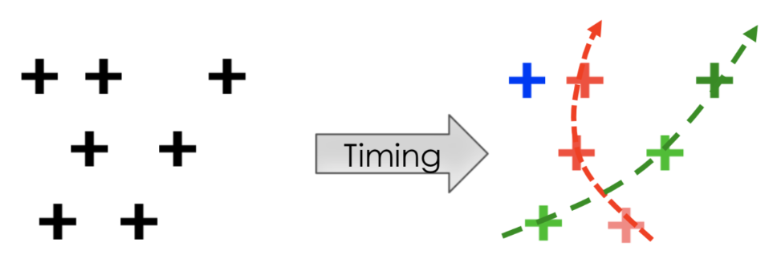
4D Tracking
Adding the time information allows resolving events overlapping in space
If the timing information is present on each point along the tracks, the reconstruction can be performed employing only the compatible times
Non-compatible tracks are discarded at the trigger level – online rejection allows for reducing the amount of saved data
This work aims to describe the development of an option of silicon detector for 4D tracking
Luca Menzio – INFN Toino
17th October 2023
VERTEX 2023
Notes:
Resistive read-out devices are capable of measuring both time and space

Slide 4
4D Tracking Silicon Detectors - Overview
Hybrid
Monolithic
ASIC
Sensor
Sensor
ASIC
Low-gain (LGADs)
No gain
Low-gain (LGADs)
No gain
Luca Menzio – INFN Toino
Standard read-out
Resistive read-out
Planar
3D
Si/Diamond
BiCMOS
(SiGe)
CMOS
BiCMOS
(SiGe)
CMOS
17th October 2023
VERTEX 2023

Slide 5
Resistive read-out in LGADs

Slide 6
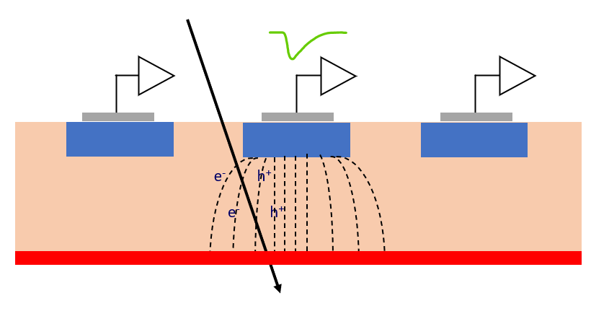
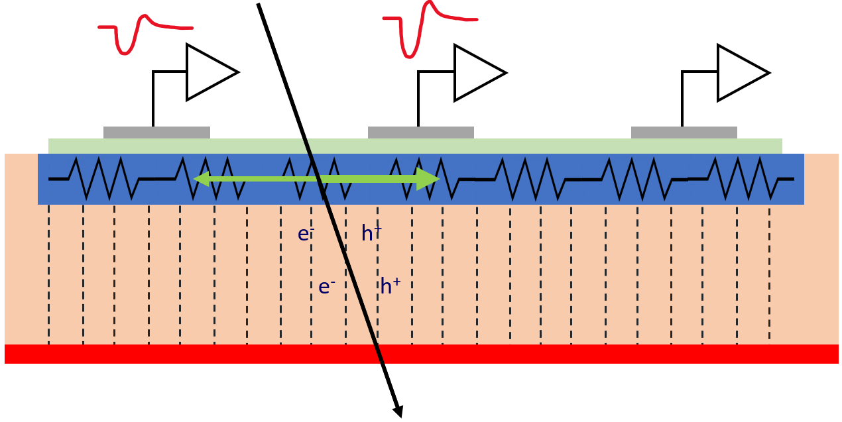
Resistive Read-out
Luca Menzio – INFN Toino
In resistive read-out, instead of many p-n diodes, there is a single diode.
The n-doped implant is resistive and acts as a signal divider
Very uniform electric and weighing fields, perfect geometry for timing
17th October 2023
VERTEX 2023

Slide 7
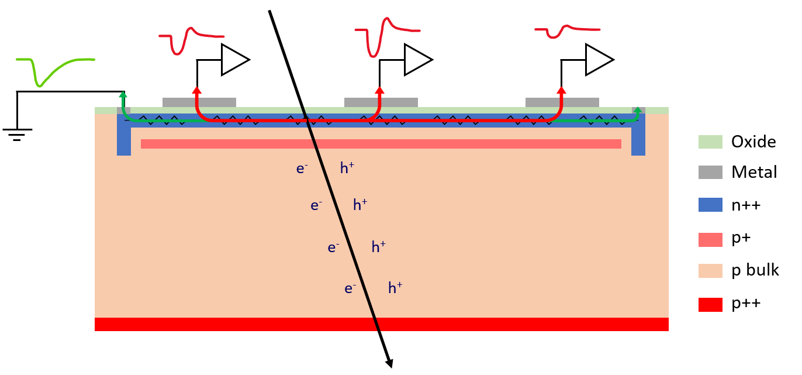
Resistive Read-out Principles of Operation
e-h pairs are produced by the impinging particle in the sensor volume
AC-coupled signals
Electrons are multiplied (LGAD)
Charge is induced in the n+ layer (resistive layer)
Nearby electrodes see a fast signal
Charges in the n+ flow to ground
AC-coupled electrodes
50 μm
Signal sharing
Luca Menzio – INFN Toino
In normal pixel detectors ${\text{σ}}_{x}=k\frac{ pitch}{\sqrt{12}}$ with $k\sim 0.5−1$
Resistive read-out sensors have
${\text{σ}}_{x}≪pitch$
Time resolution typical of thin LGADs
17th October 2023
VERTEX 2023

Slide 8
Resistive Read-out
Charge sharing over silicon surface
Excellent position resolution with large pads
Internal gain (LGAD)
Excellent Timing
Luca Menzio – INFN Toino
Pros
Low channel density
Thin sensors
Low power consumption
Low material budget
+ 100 % intrinsic fill factor!
17th October 2023
VERTEX 2023

Slide 9
Standard Silicon Detector vs RSD
Pixel size
~ 25 x 25 μm²
Electronics
Pixel size
~ 250 x 250 μm²
~ 150 μm
Contacts
~ 50 μm
Luca Menzio – INFN Toino
--
---
- --
+
++
+++
---
- --
++
+++
Resistive implant
Silicon bulk
Gain implant
Standard Silicon Detector
Resistive Read-out Detector
17th October 2023
VERTEX 2023
Notes:
Parametrizzazioni prossima

Slide 10
Active Foundries
The first AC-Coupled Resistive read-out LGAD sensor has been developed by Fondazione Bruno Kessler (FBK)
RSD1 prototype production [2]
Shortly after, other foundries manufacturing LGAD started producing LGADs based on resistive read-out:
Hamamatsu Photonics K.K. (HPK)
Brookhaven National Laboratories (BNL)
Institute of High Energy Physics (IHEP-IME)
Centro Nacional de Microelectrónica (IMB-CNM), the first batch production was just delivered
Relevant expertise is being gained!
Luca Menzio – INFN Toino
17th October 2023
VERTEX 2023
Notes:
“info about HPK sensors will be brought in the next talk”

Slide 11
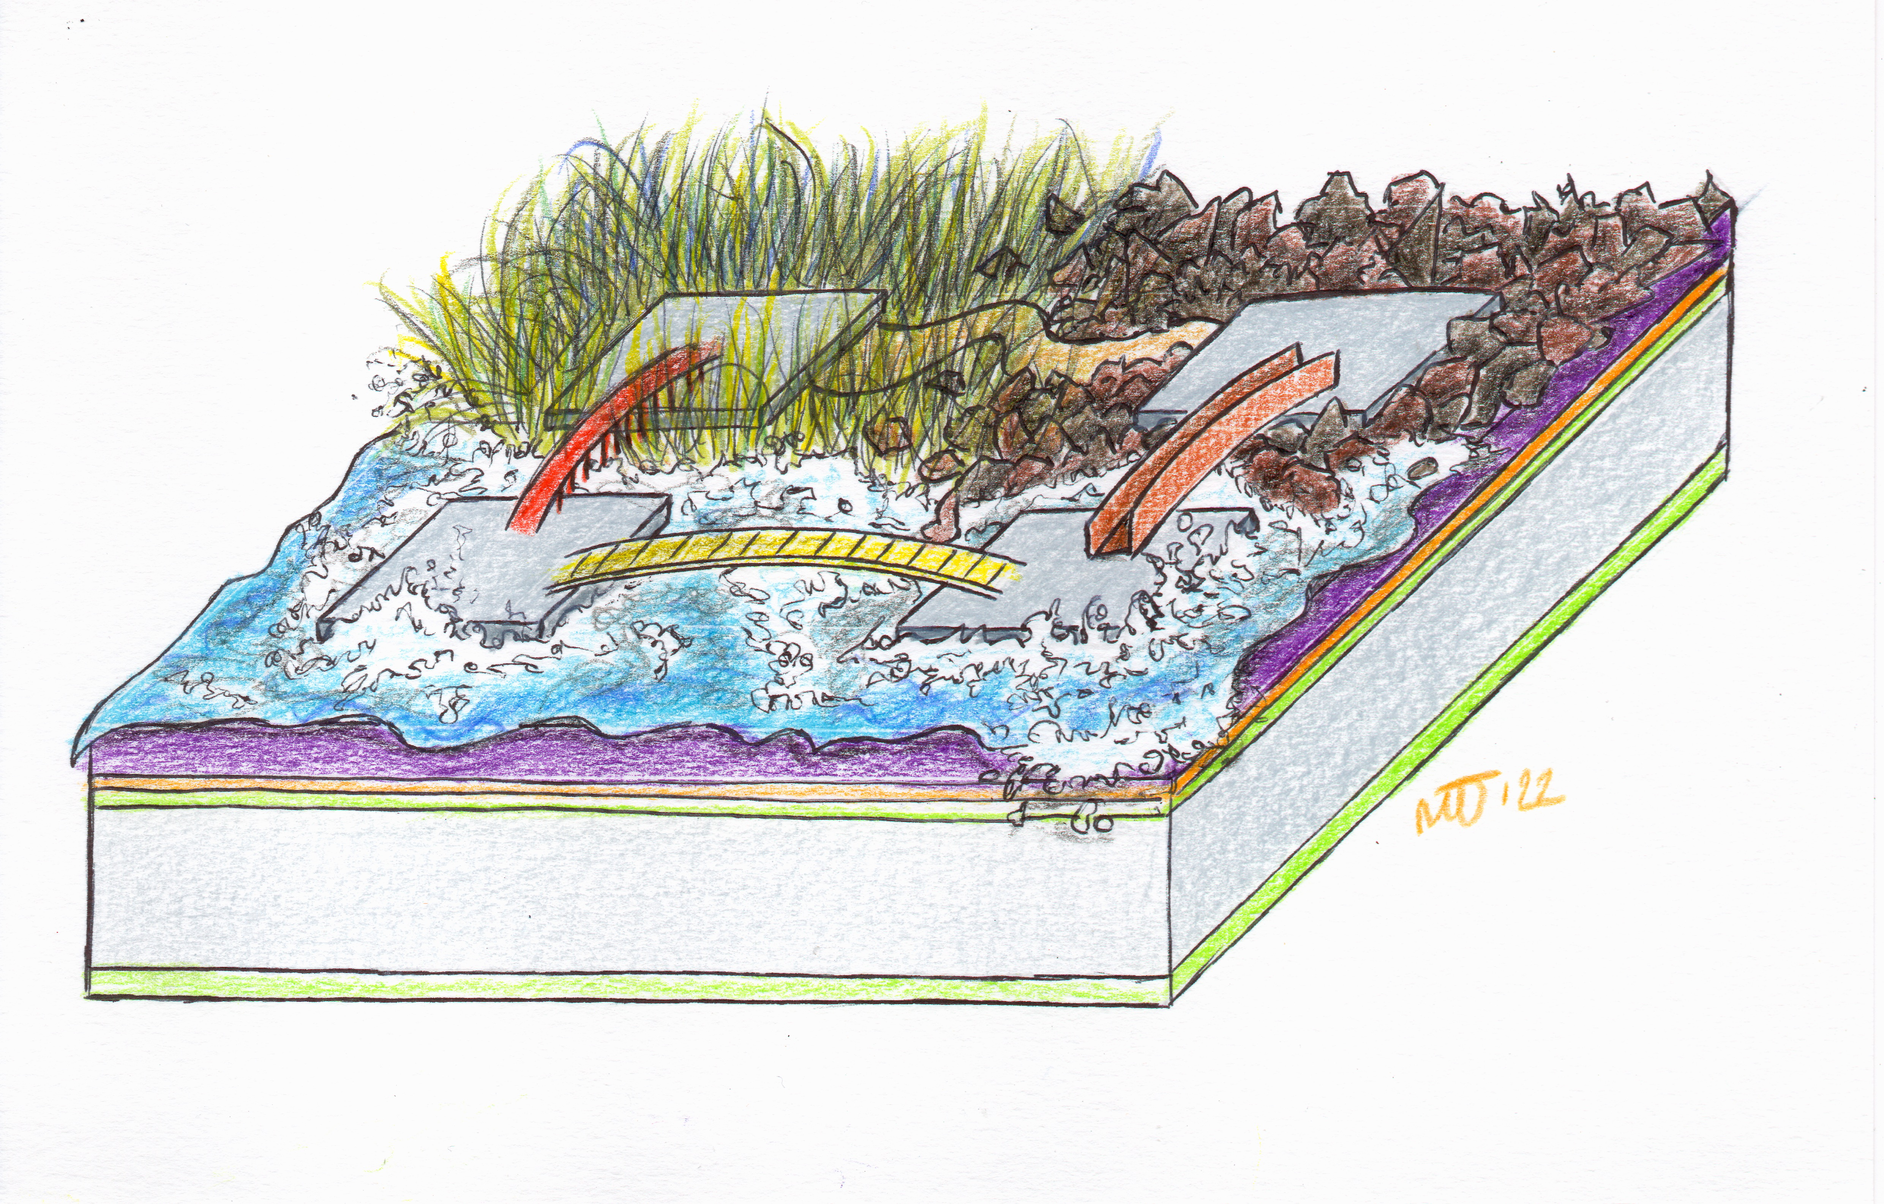
Performance

Slide 12
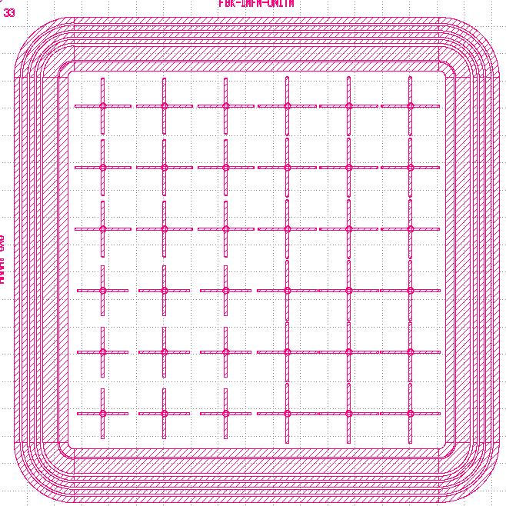
FBK Pixels Results
Two prototype runs of Resistive Silicon Detectors have been characterized:
RSD1 – proof of concept
RSD2 – aimed at improving the spatial resolution among the whole sensor area
Optimized metal layouts to achieve more efficient signal sharing
1.3 mm pitch
450 µm pitch
Luca Menzio – INFN Toino
gain = 30
Tested with laser setup
17th October 2023
VERTEX 2023

Slide 13
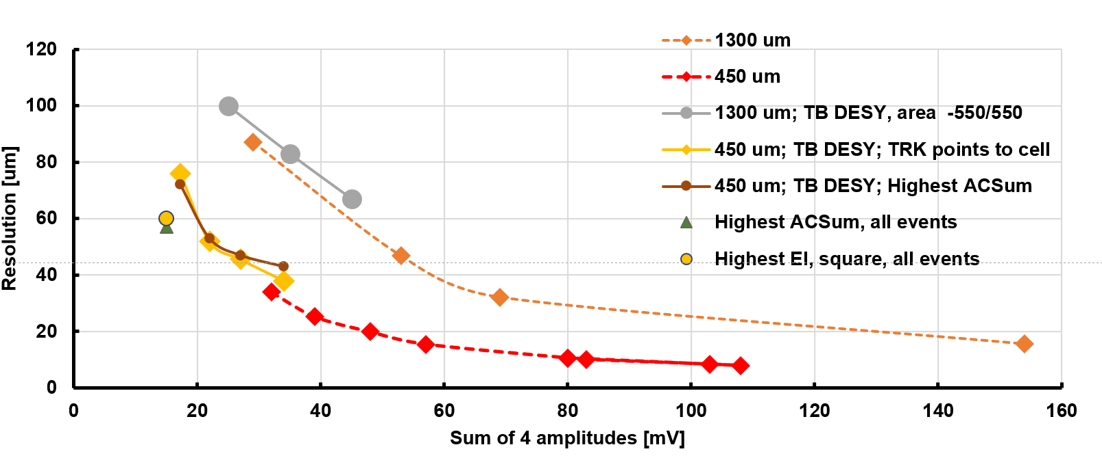
FBK Pixels Results
Two prototype runs of Resistive Silicon Detectors have been characterized:
RSD1 – proof of concept
RSD2 – aimed at improving the spatial resolution among the whole sensor area
Optimized metal layouts to achieve more efficient signal sharing
1.3 mm pitch
450 µm pitch
Luca Menzio – INFN Toino
Spatial resolution ~5-10% of the pixel pitch
Time resolution typical of traditional LGADs
Test beam results
17th October 2023
VERTEX 2023

Slide 14
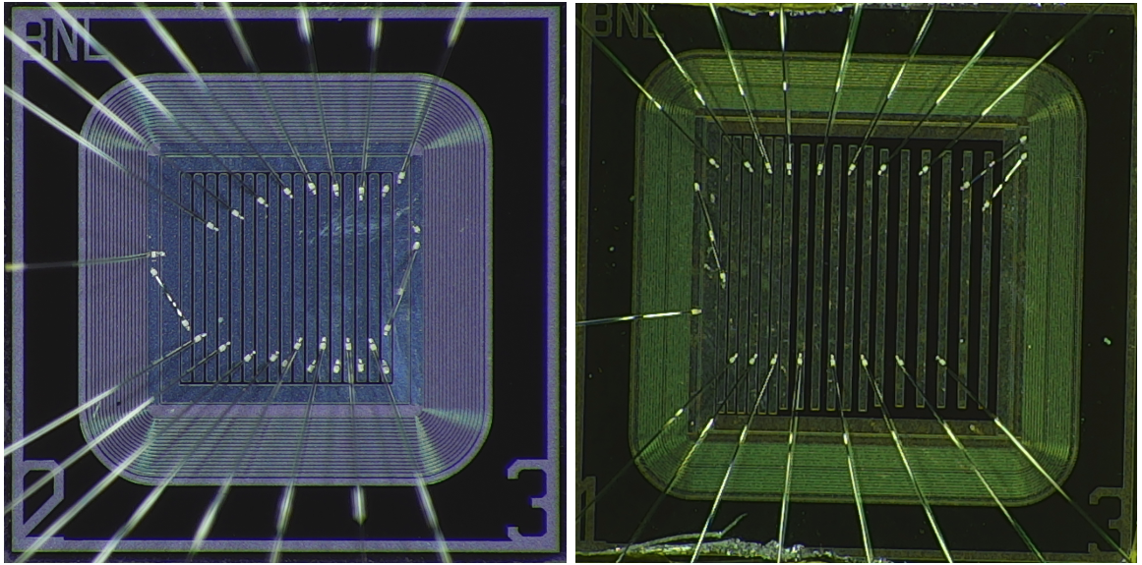
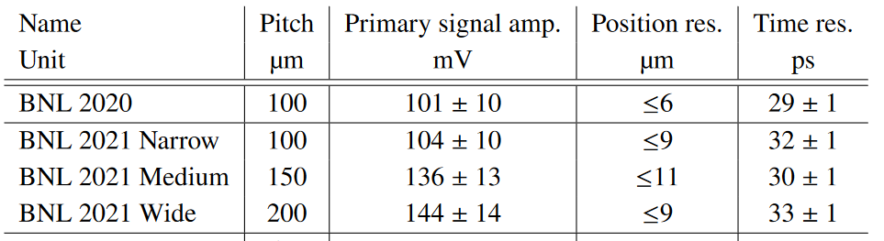
BNL Strips Results
Devices produced by BNL with best results consist in resistive strip layout devices with different pitches.
Following laser and test beam campaigns, these devices demonstrated to be able to reach great spatial and temporal resolutions.
Luca Menzio – INFN Toino
Future studies are concentrated to improve the spatial resolution uniformity among the whole device surface (e.g. narrower metal pads).
Test beam results [4]
17th October 2023
VERTEX 2023

Slide 15
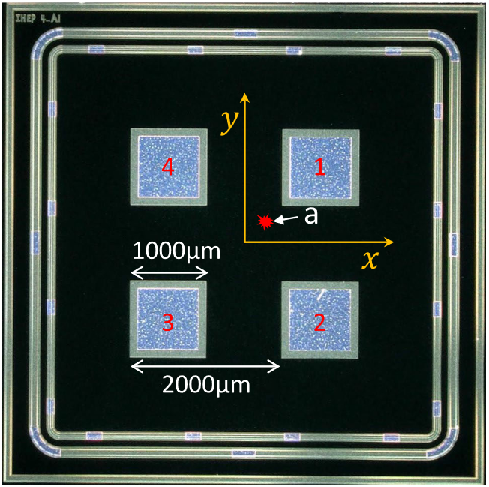
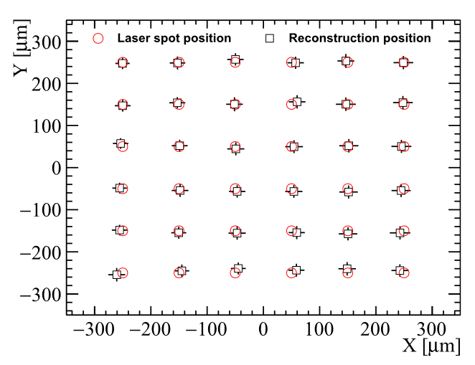
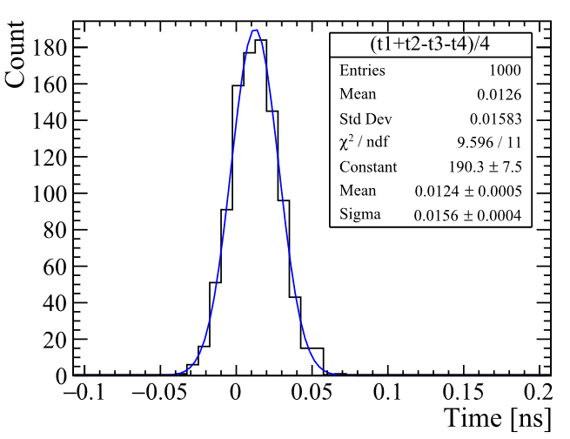
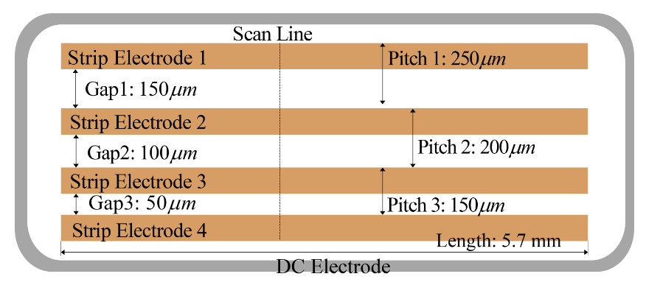
IHEP-IME Results
The IHEP-IME foundry produced AC-coupled resistive detectors with different shapes and implant doses.
These devices have been tested employing a laser and beta setup [5], indicating the ability to achieve results comparable with the other producers.
Luca Menzio – INFN Toino
17th October 2023
VERTEX 2023

Slide 16
Future Developments

Slide 17
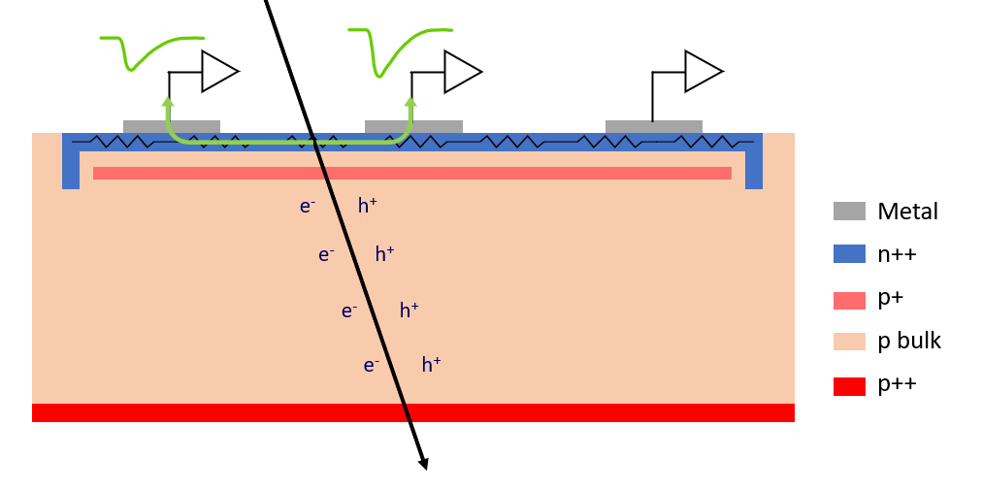
Future Developments
DC-RSD
Buried layer LGAd
Improvement of the RSD sensors aiming at addressing drawbacks of the AC-LGAD (see yesterday’s poster and [3]).
Sensors based on a continuous gain layer positioned deeper into the bulk to improve radiation resistance.
One batch was already produced but suffered from poor epitaxial deposition [7].
Luca Menzio – INFN Toino
Signal confinement in DC-coupled devices brings:
Fewer electrodes involved in the reconstruction – better S/N
Smaller area covered by the signal – better performance in high-occupancy environments
DC-RSD
17th October 2023
VERTEX 2023
Notes:
Signal confinement parlare di piu’

Slide 18
Conclusions
Resistive read-out prototypes have already demonstrated to be able to reach exceptional performance with low channel density
Provided by multiple producers – multiple R&D paths
Excellent performance in terms of spatial and temporal resolution
Margins for improvements:
Signals confinement – DC-RSD
Resistive read-out in LGADs looks like a very promising technology for 4D Tracking

Slide 19
Thank you!

Slide 20
Special Thanks to
We kindly acknowledge the following funding agencies and collaborations:
INFN - Gruppo V, UFSD and RSD projects
INFN – FBK agreement on sensor production (convenzione INFN-FBK)
Horizon 2020, grant UFSD669529
Dipartimenti di Eccellenza, Univ. of Torino (ex L. 232/2016, art. 1, cc. 314, 337)
Ministero della Ricerca, Italia , PRIN 2017, progetto 2017L2XKTJ – 4DinSiDe
Ministero della Ricerca, Italia, FARE, R165xr8frt_fare
Marta Tornago for all the nice drawings
Luca Menzio – INFN Toino
17th October 2023
VERTEX 2023

Slide 21
References
Resistive Read-out in Thin Silicon Sensors with Internal Gain, N. Cartiglia (2023) https://arxiv.org/abs/2301.02968
Resistive AC-Coupled Silicon Detectors: Principles of operation and first results from a combined analysis of beam test and laser data, M. Tornago et al., NIM A (2021)
Development of Resistive Silicon Detectors for 4D tracking, L. Menzio, PhD Thesis (2023)
Characterization of BNL and HPK AC-LGAD sensors with a 120 GeV proton beam, R. Heller, JINST (2022)
Timing and spatial performance of IHEP AC-LGADs, X. Zhang et al., JINST (2022)
4-Dimensional Trackers, V. Cairo, R. Heller, S. Mazza A. Schwarzman et al, Showmass 2021 (2022)
Buried Layer Low Gain Avalanche Diodes, Ronald Lipton, TIPP 2021 https://indico.cern.ch/event/981823/contributions/4293564/attachments/2251204/3818882/BL-LGAD-TIPP.pdf
17th October 2023
VERTEX 2023

Slide 22
Requirements
The requirements for future facilities are
Plus the usability of the detectors up to 10¹⁷ n_{eq}cm⁻²
Nowadays sensors have $σ_{pos}\sim \frac{1}{\sqrt{12}}pitch$
5 µm obtainable with 25x25 µm², but the number of channels is too high
Better spatial resolutions are possible with charge sharing due to external magnetic field, but sensors become too thick
And they lack the desired temporal resolution (now $σ_{t}\sim 100−150 ps$)
A new solution is needed → 4D Tracking = Different sensor design
Luca Menzio – INFN Toino
17th October 2023
VERTEX 2023

Slide 23
Timing in Silicon Devices
Until ten years ago, silicon devices were not employed for particles timing measurements
With the advent of the Low Gain Avalanche Diodes (LGAD) technology it became possible to achieve tens of picoseconds time resolution in silicon detectors
The addition of a p⁺-doped region allows achieving electron multiplication leading to moderate gain (10-30) - large signals with low noise
Thin (~50 μm) active thickness yields to fast signal rising edge
“recipe” of the Ultra Fast Silicon Detectors
Luca Menzio – INFN Toino
Electric Field
Electric Field
PiN
LGAD
17th October 2023
VERTEX 2023

Slide 24
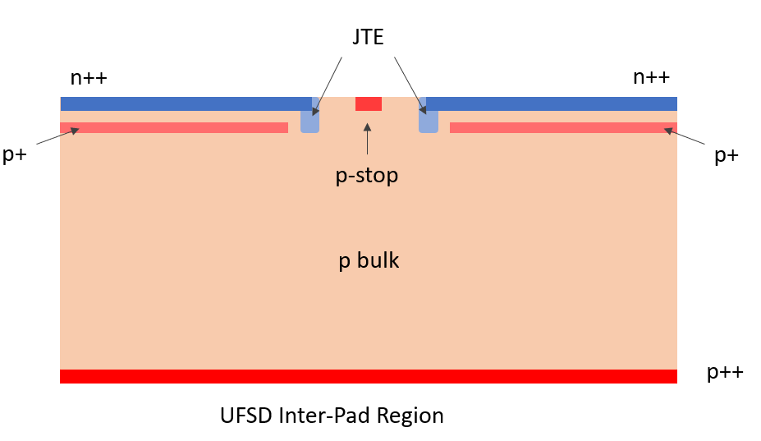
Low-Gain Avalanche Diode(s)
The LGAD technology has been optimized for timing in HEP.
They can achieve $σ_{t}\sim 30 ps$ when new
Can withstand radiation damage up to fluences of $Φ\sim {1.5∙10}^{15}{n_{eq}}/{{cm}^{2}}$
Provide large signals, easily processable by electronics
Are thin ($\sim$ 50 µm) - low material budget
But
Have no-gain area $\sim$70 µm → they cannot reach good enough spatial resolution with high fill factor
Luca Menzio – INFN Toino
17th October 2023
VERTEX 2023

Slide 25
RSD1 Radiation Hardness
Similar to traditional LGADs
The space and time resolutions decrease due to the signal being smaller
No “RSD specific” effects have been found, resistive read-out is not sensitive to radiation damage up to 1E15 n/cm2
Luca Menzio – INFN Toino
17th October 2023
VERTEX 2023
25

Slide 26
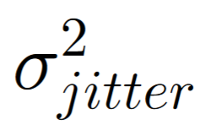
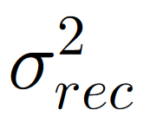
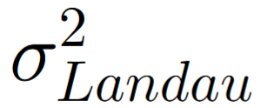
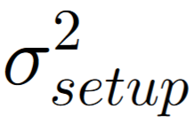
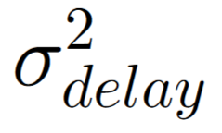
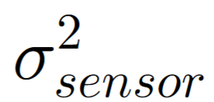
Resolutions parametrization
Space
Time
due to the variation in the signal amplitude caused by the electronic noise ~ noise/(dV/dx)
accuracy of the reconstruction method
related to eventual variations in the signal sharing due to the experimental setup (i.e. amplifiers)
all sensor imperfections that could contribute to differences in signal sharing
similar as before, ~ noise/(dV/dt)
non-uniform ionization contributes with ~30 ps in 50 μm thick sensors
propagation time from the impact point to the read-out pad. It is correlated to the precision of the hit position reconstruction
Luca Menzio – INFN Toino
17th October 2023
VERTEX 2023
Notes:
To produce the best possible sensor, one should keep in mind the physics behind

Slide 27
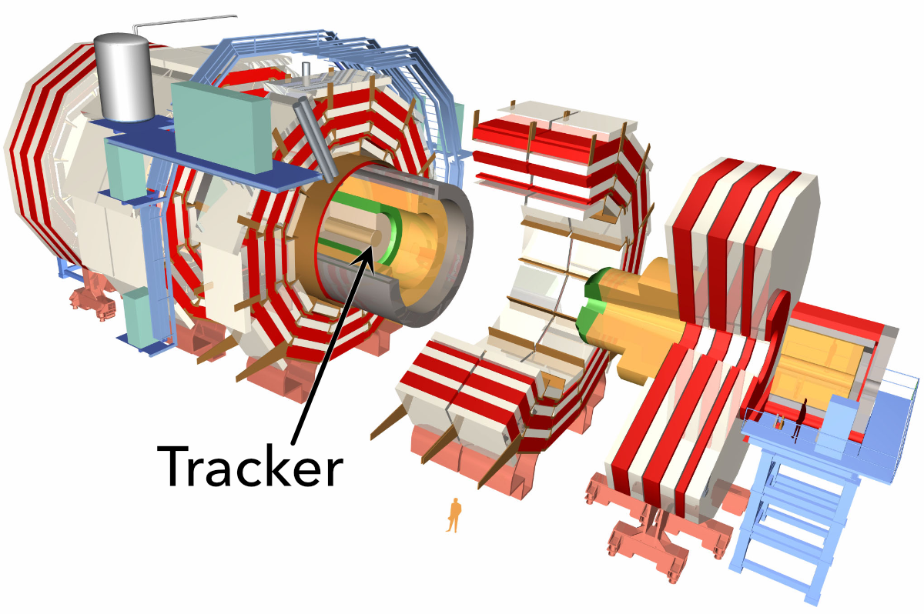
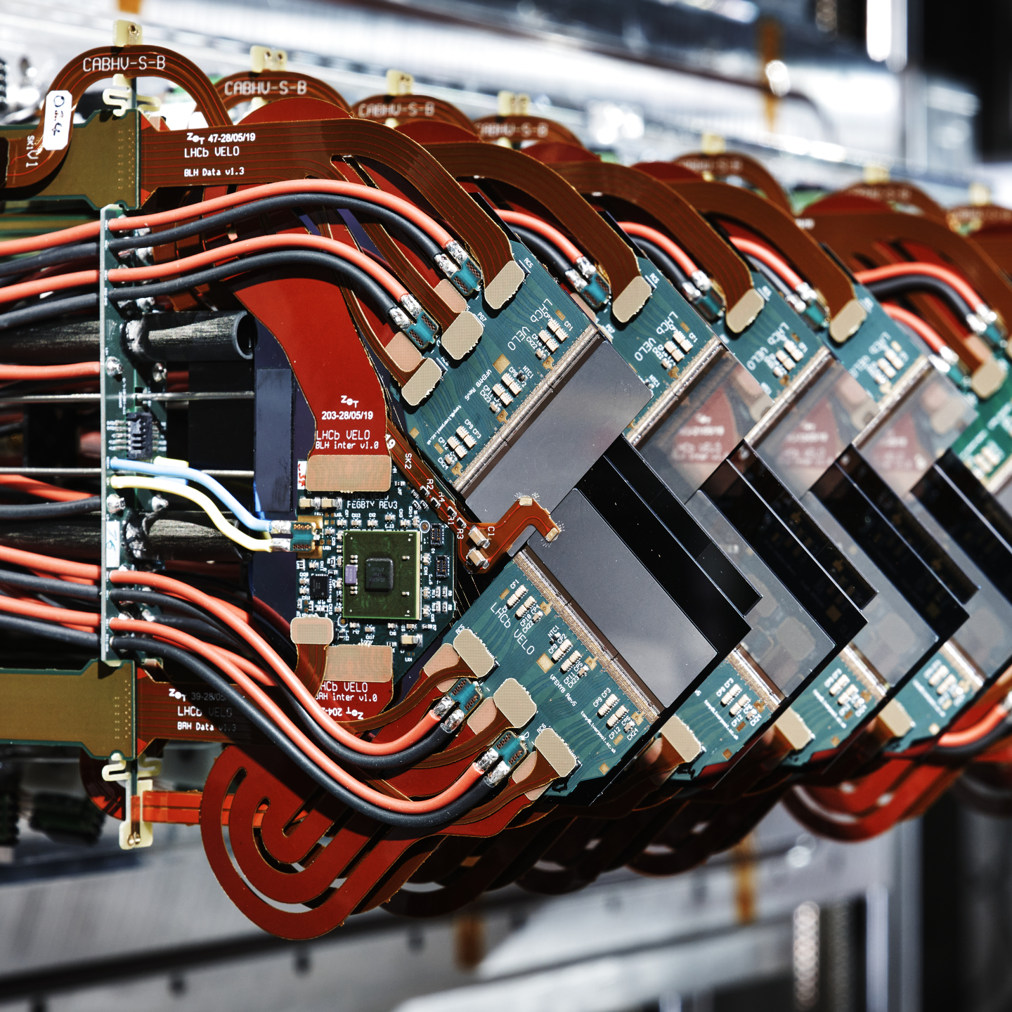
“Traditional” Tracking in HEP
Tracking systems are a fundamental part of HEP experiments
Nowadays are composed by mainly silicon pixel or strips detectors positioned close to the collision point
Can measure primary and secondary interaction point(s)
Right now, at LHC vertexes do not overlap in space (pileup $\sim$50) and tracking resolves all vertexes
In future facilities such HL-LHC (pileup $\sim$150-200) standard trackers will not suffice
CMS tracker
Thanks to the precise measurement of hit position on a surface, charged particle tracks are reconstructed
Measurement of charged particle momentum by curvature in magnetic field
Luca Menzio – INFN Toino
LHCb VELO modules
17th October 2023
VERTEX 2023

