Slide 1
Operational experience of the Upstream Tracker of LHCb
Giorgia Tonani
on behalf of the LHCb collaboration
VERTEX 2023 - 32nd International Workshop on Vertex Detectors

Slide 2
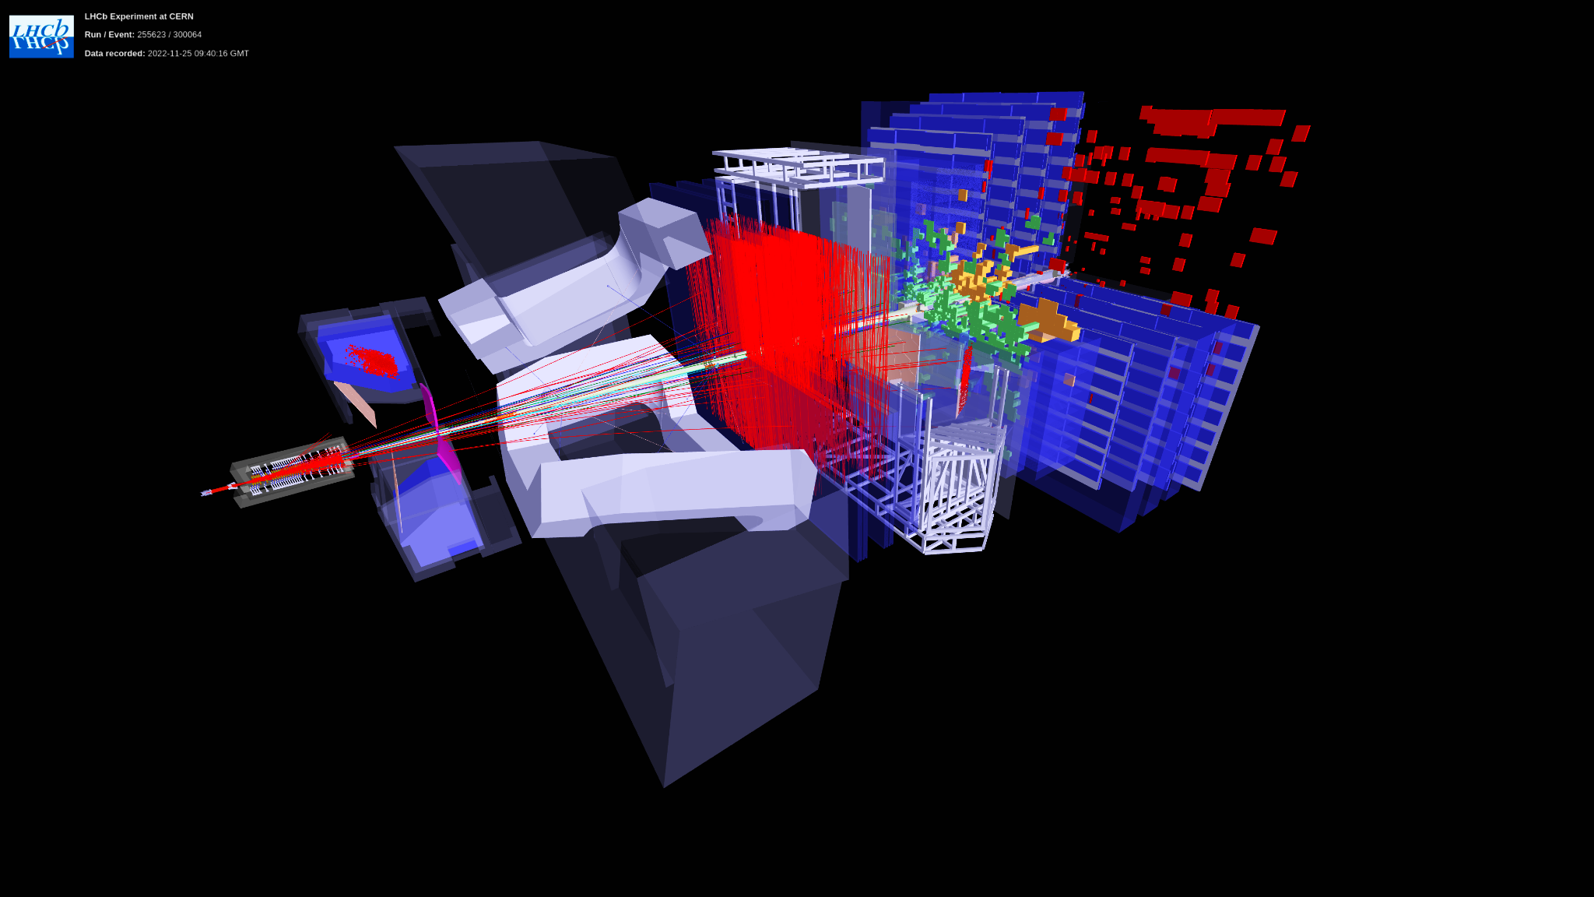
LHCb experiment
LHCb experiment
Run 3 goal: collect more data to improve the physics results → L = 2 10³³ cm⁻² s⁻¹
Not efficient with Run 1-2 detector, main limitation: L0 hardware trigger
→ BRAND NEW LHCB: software trigger, detector upgrade, change of readout electronics
90% of the detector channels upgraded
100% replacement of readout electronics
100% new DAQ & online system @ collision rate
Giorgia Tonani VERTEX 2023 1

Slide 3
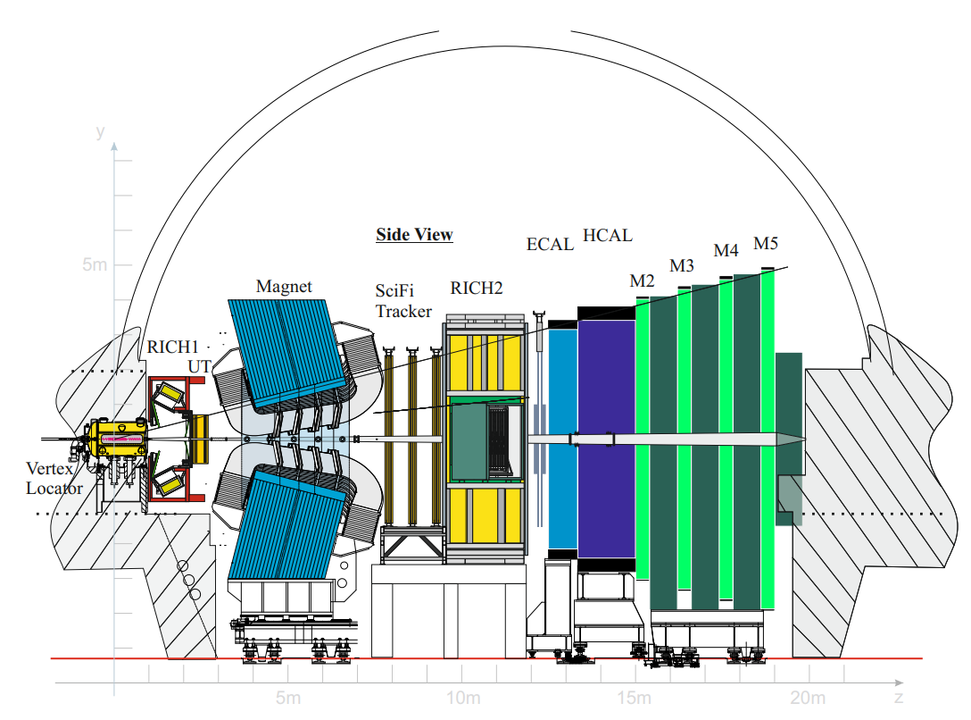
LHCb detector
Single-arm forward spectrometer
Pseudorapidity range: 2 < 𝜂 < 5
Tracking system
Particle identification system
Giorgia Tonani VERTEX 2023 2

Slide 4
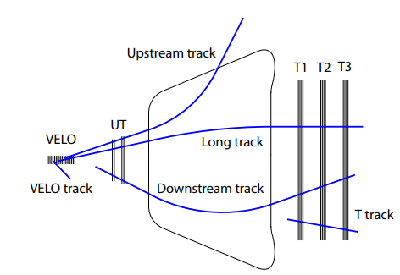
Upstream Tracker (UT): importance in LHCb
Track reconstruction: UT fundamental to improve the momentum resolution of Long tracks
Ghost rate reduction: factor 2 improvements,
essential for the software trigger
Long lived particles reconstruction decaying after the VELO (e.g. Λ, K⁰_{S})
Giorgia Tonani VERTEX 2023 3

Slide 5
Upstream Tracker (UT): importance in LHCb
Track reconstruction: UT fundamental to improve the momentum resolution of Long tracks
Ghost rate reduction: factor 2 improvements,
essential for the software trigger
Long lived particles reconstruction decaying after the VELO (e.g. Λ, K⁰_{S})
Giorgia Tonani VERTEX 2023 3

Slide 6
Upstream Tracker (UT): importance in LHCb
Track reconstruction: UT fundamental to improve the momentum resolution of Long tracks
Ghost rate reduction: factor 2 improvements,
essential for the software trigger
Long lived particles reconstruction decaying after the VELO (e.g. Λ, K⁰_{S})
Giorgia Tonani VERTEX 2023 3

Slide 7
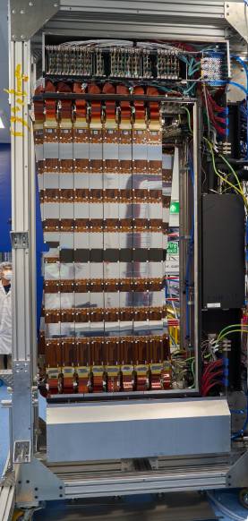
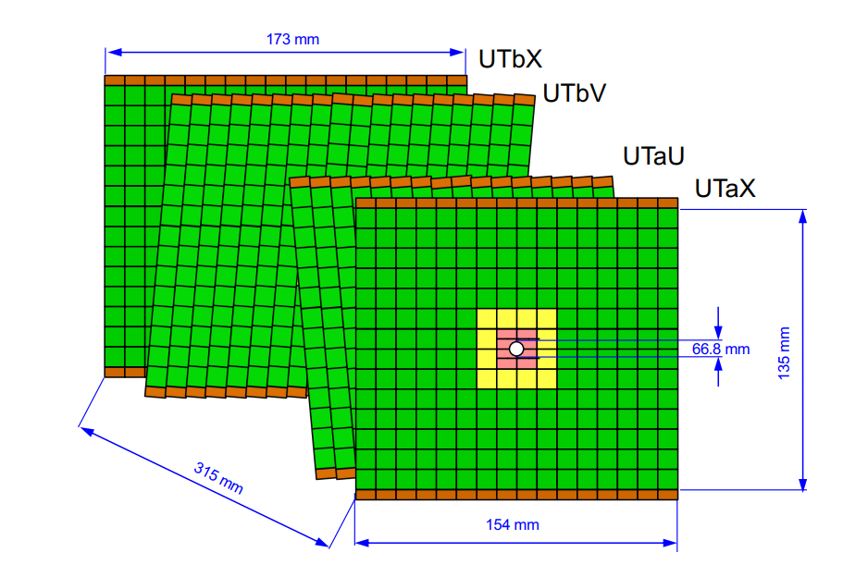
Upstream Tracker (UT)
Peripheral electronics
Silicon strip detector
4 layers with vertical and stereo (+/- 5 deg) orientation
divided in 2 sides: A-side and C-side
organized in 68 staves
stave
The LHCb Upgrade (arxiv.org)
Giorgia Tonani VERTEX 2023 4

Slide 8
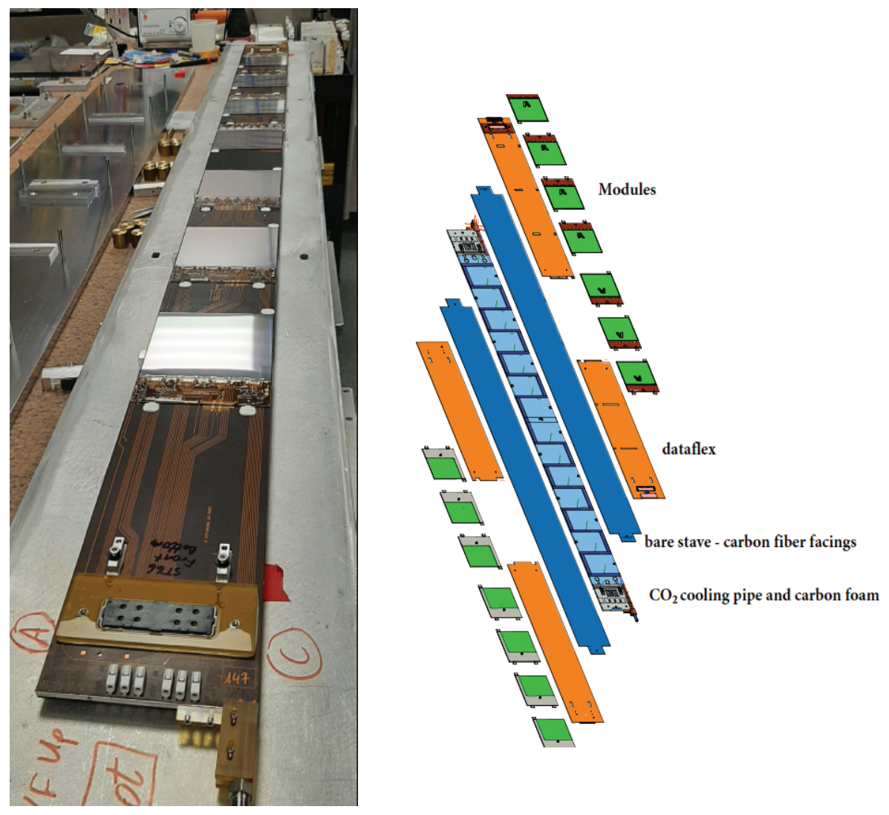
Upstream Tracker (UT)
Stave:
99.5mm x 1640mm (width x length)
carbon fiber structure with
thermal and structural foam in between
S-shaped titanium cooling pipe
4 Flex Cu- Kapton cables, power and
data distribution
Single stave can host 14 or 16 modules,
on both sides
Giorgia Tonani VERTEX 2023 5

Slide 9
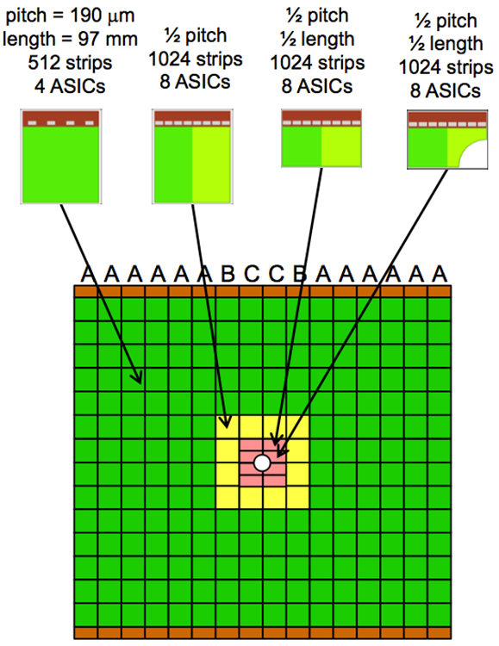
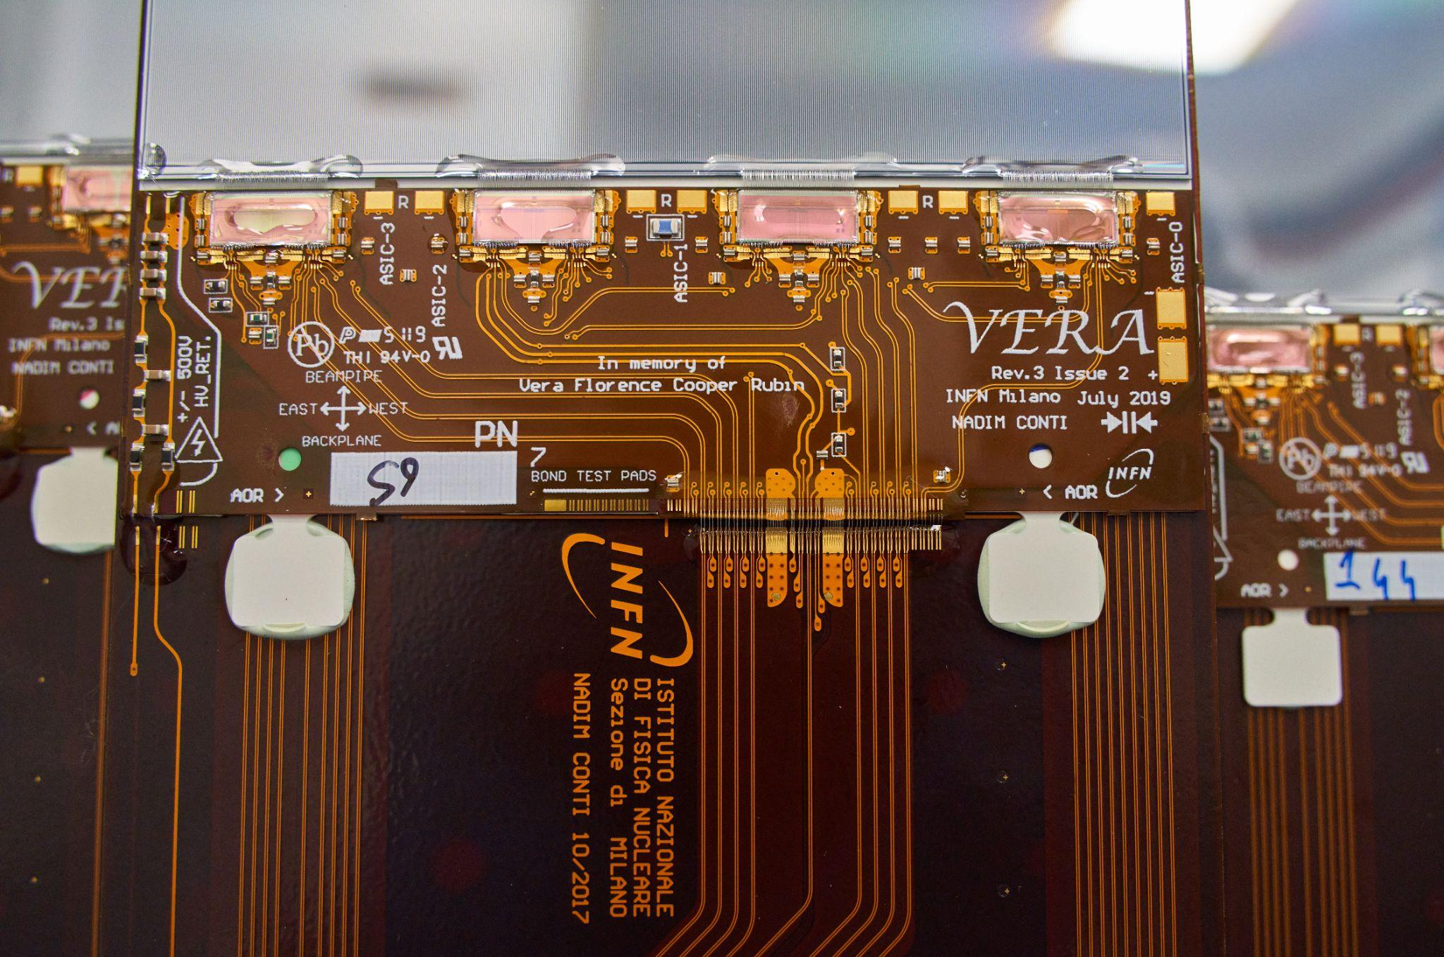
Upstream Tracker (UT)
Modules
silicon micro strip sensors (A-Type: p-in-n; B-, C-, D-type: n-in-p)
Hybrids: VERA (4 ASICs), SUSI (8 ASICs)
Front-end ASIC (SALT) glued and bonded to hybrid flex
Ceramic stiffener (PBN): good thermal conductivity and electrical insulation
Giorgia Tonani VERTEX 2023 6
Notes:
thermal interface ?, capacita’ sensori 10pF (/ cm ?)

Slide 10
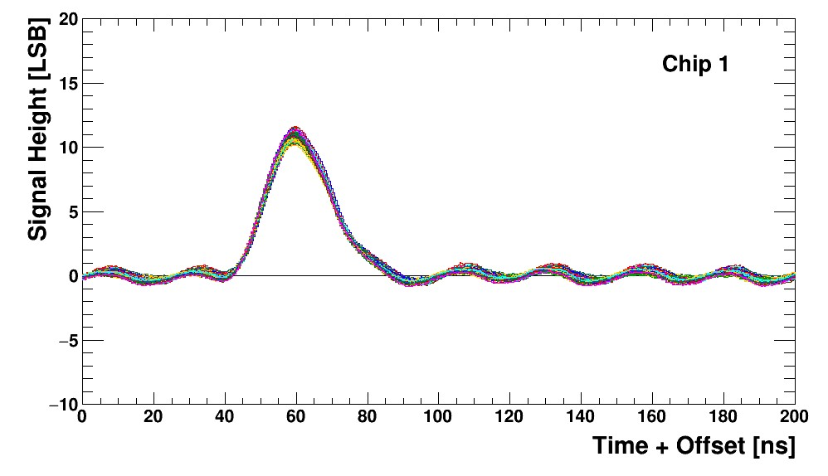
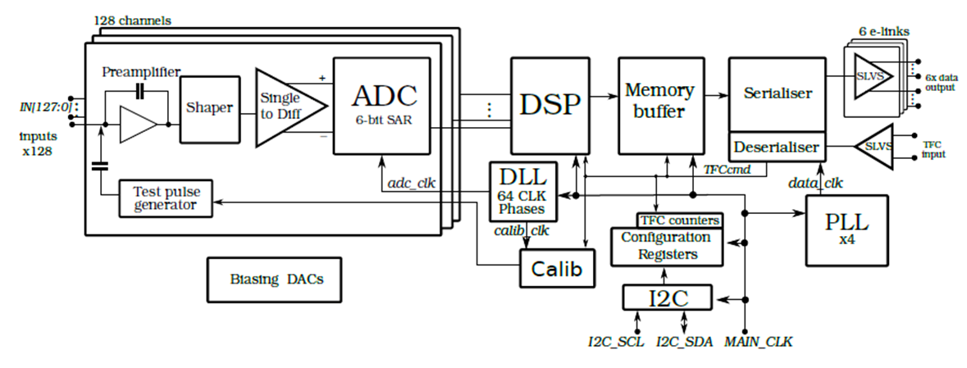
Upstream Tracker (UT)
Silicon ASIC for LHCb Tracking
(SALT):
CMOS 130 nm
technology
128 channels / ASIC
6 bit ADC / channel
Digital Signal Processing (DSP): pedestal and common mode noise subtraction, zero-suppression, data formatting, spillover correction
peaking time ̴ 25 ns, S/N ̴ 20, input C=12 pF, power dissipation/channel < 6mW
Giorgia Tonani VERTEX 2023 7

Slide 11
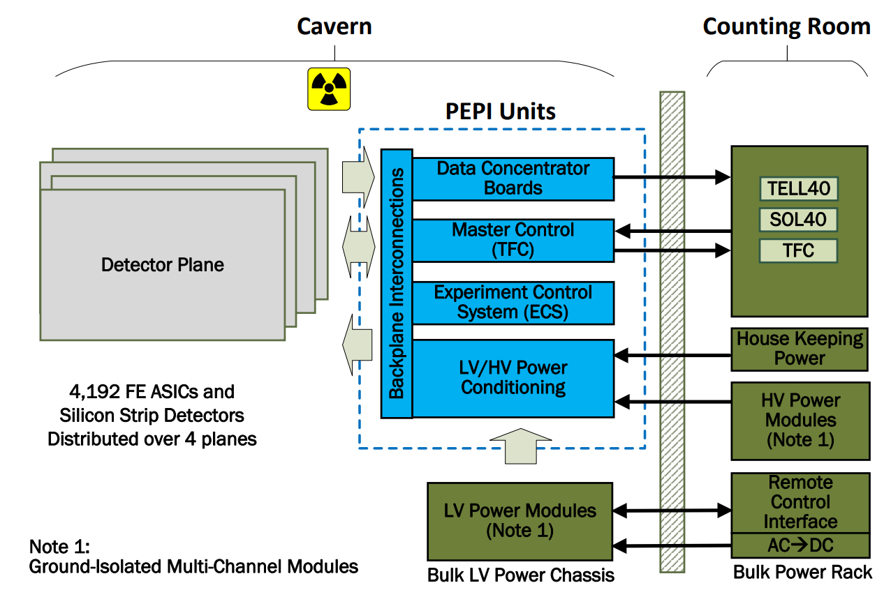
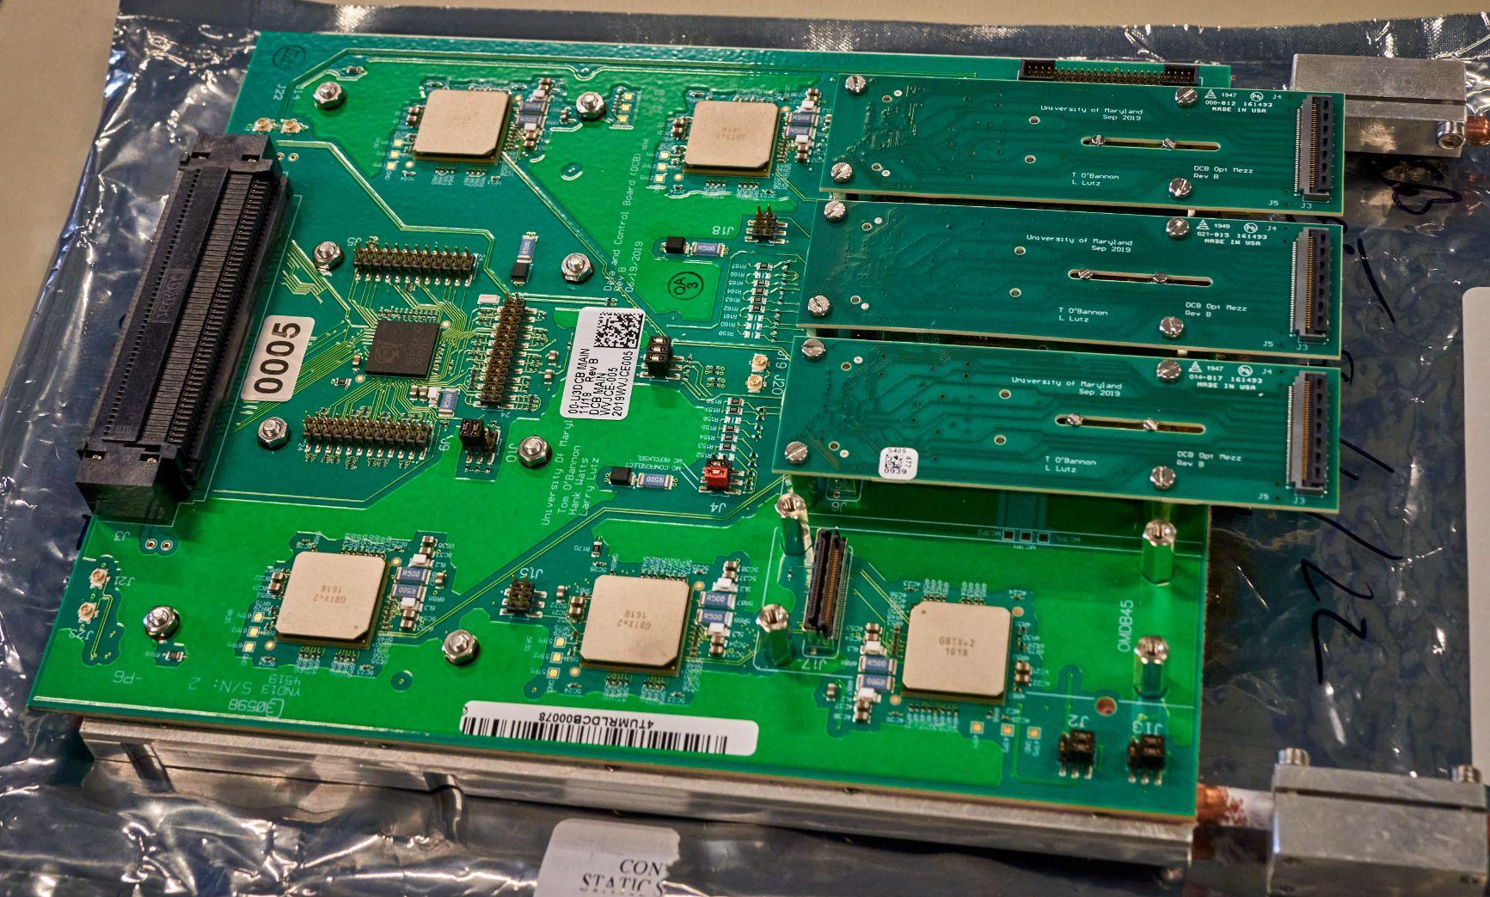
Peripheral electronics
Periphery electronics processing interface (PEPI) to read out and control the detector:
24 backplanes
24 pigtail power breakout boards (P2B2s)
248 data and control boards (DCBs)
The GBTx, mounted on the DCBs, implements bidirectional links between the detector and the counting room
Giorgia Tonani VERTEX 2023 8

Slide 12
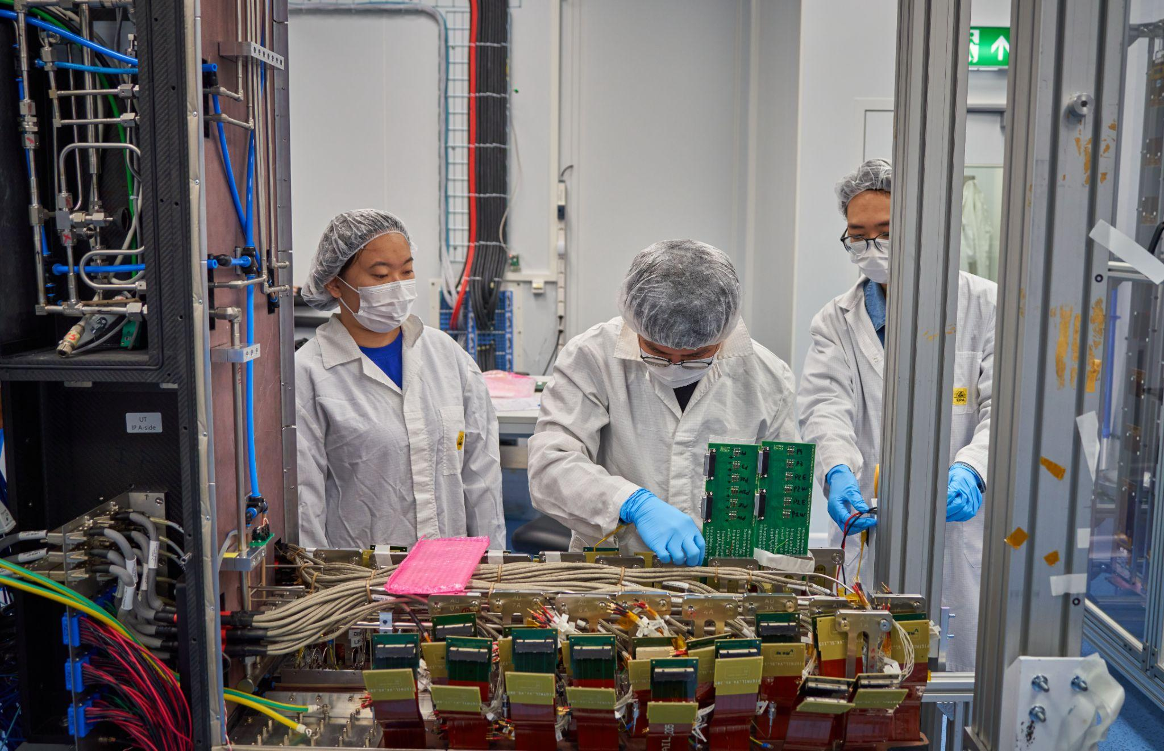
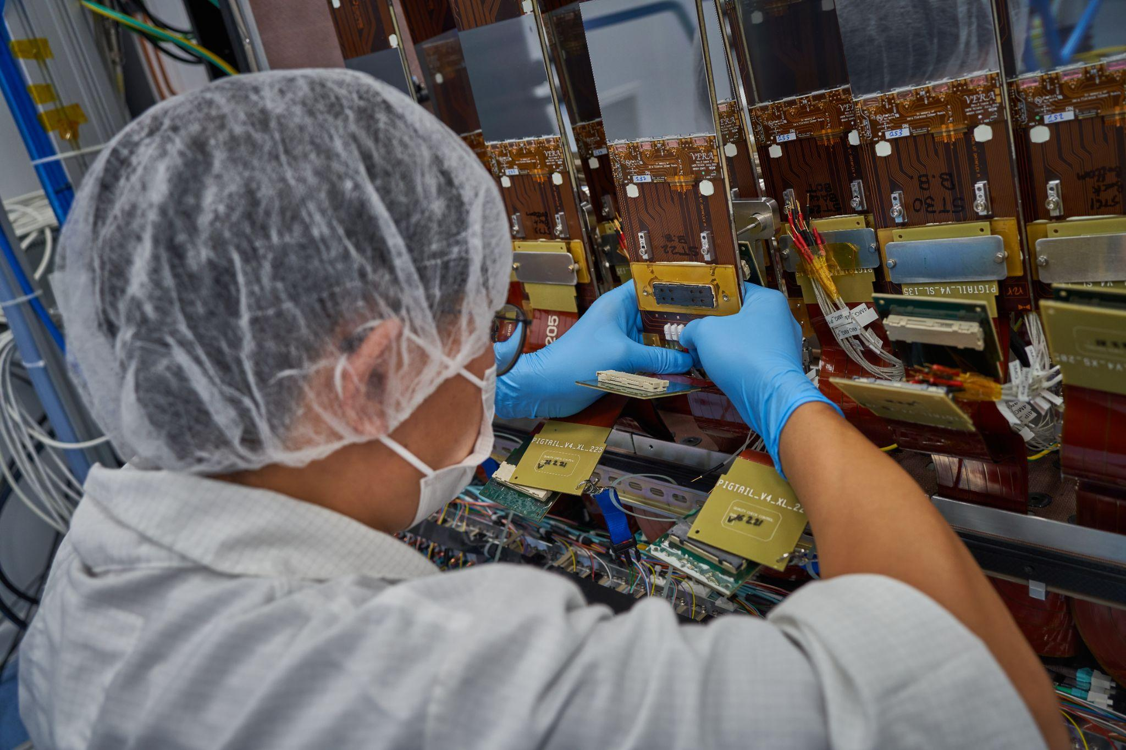
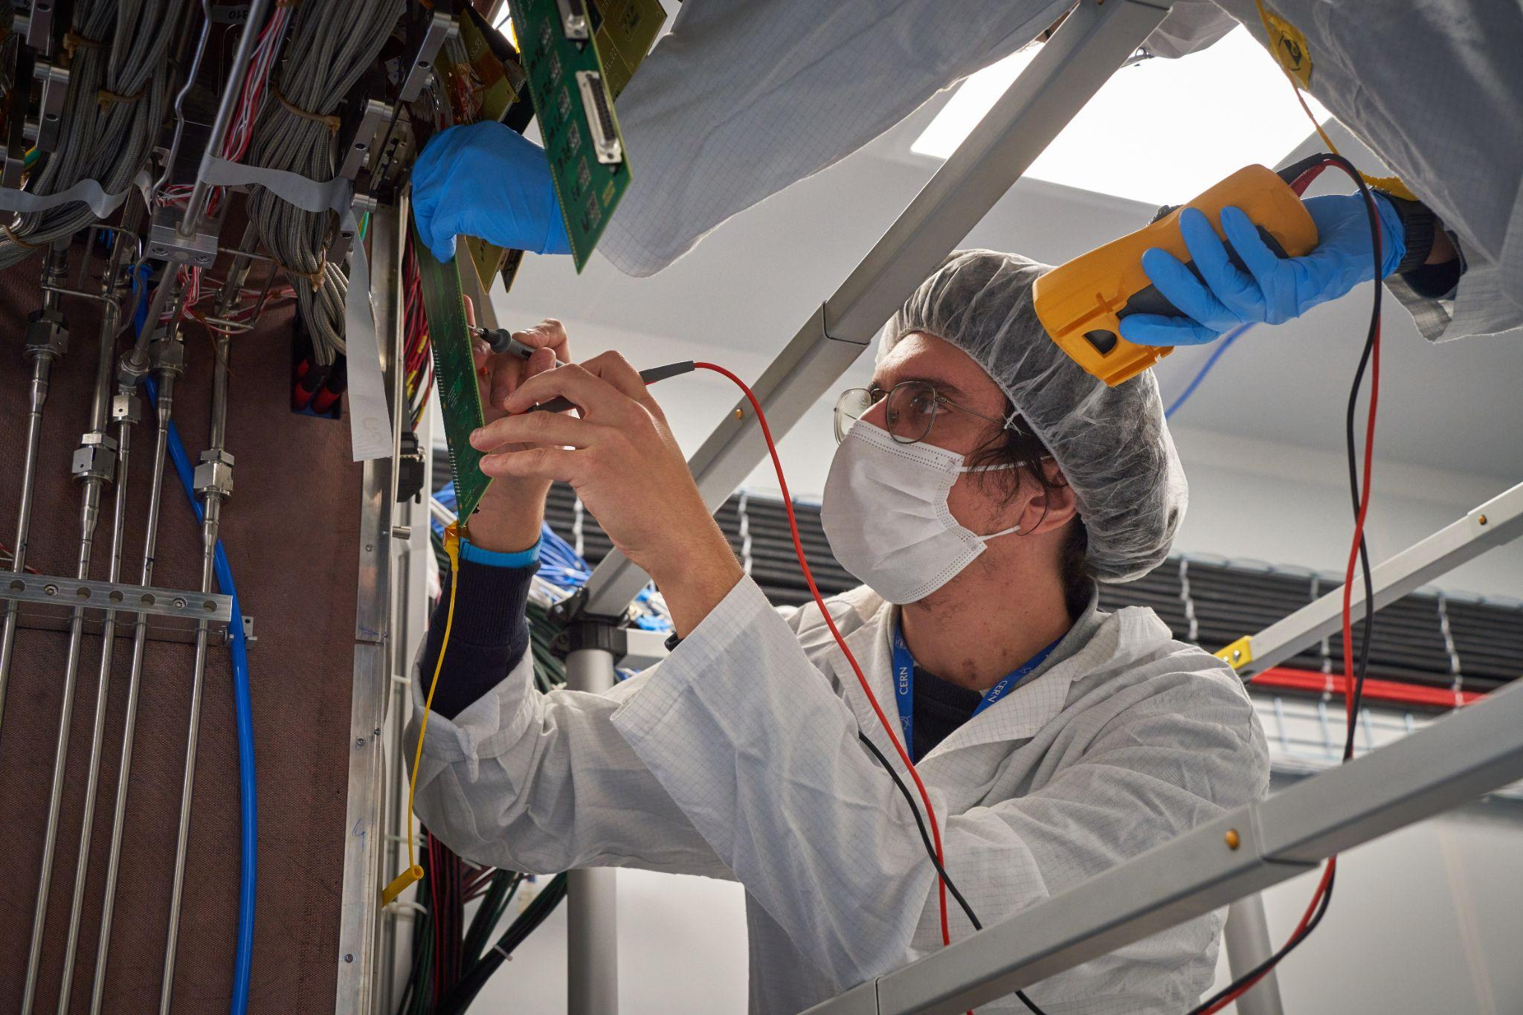
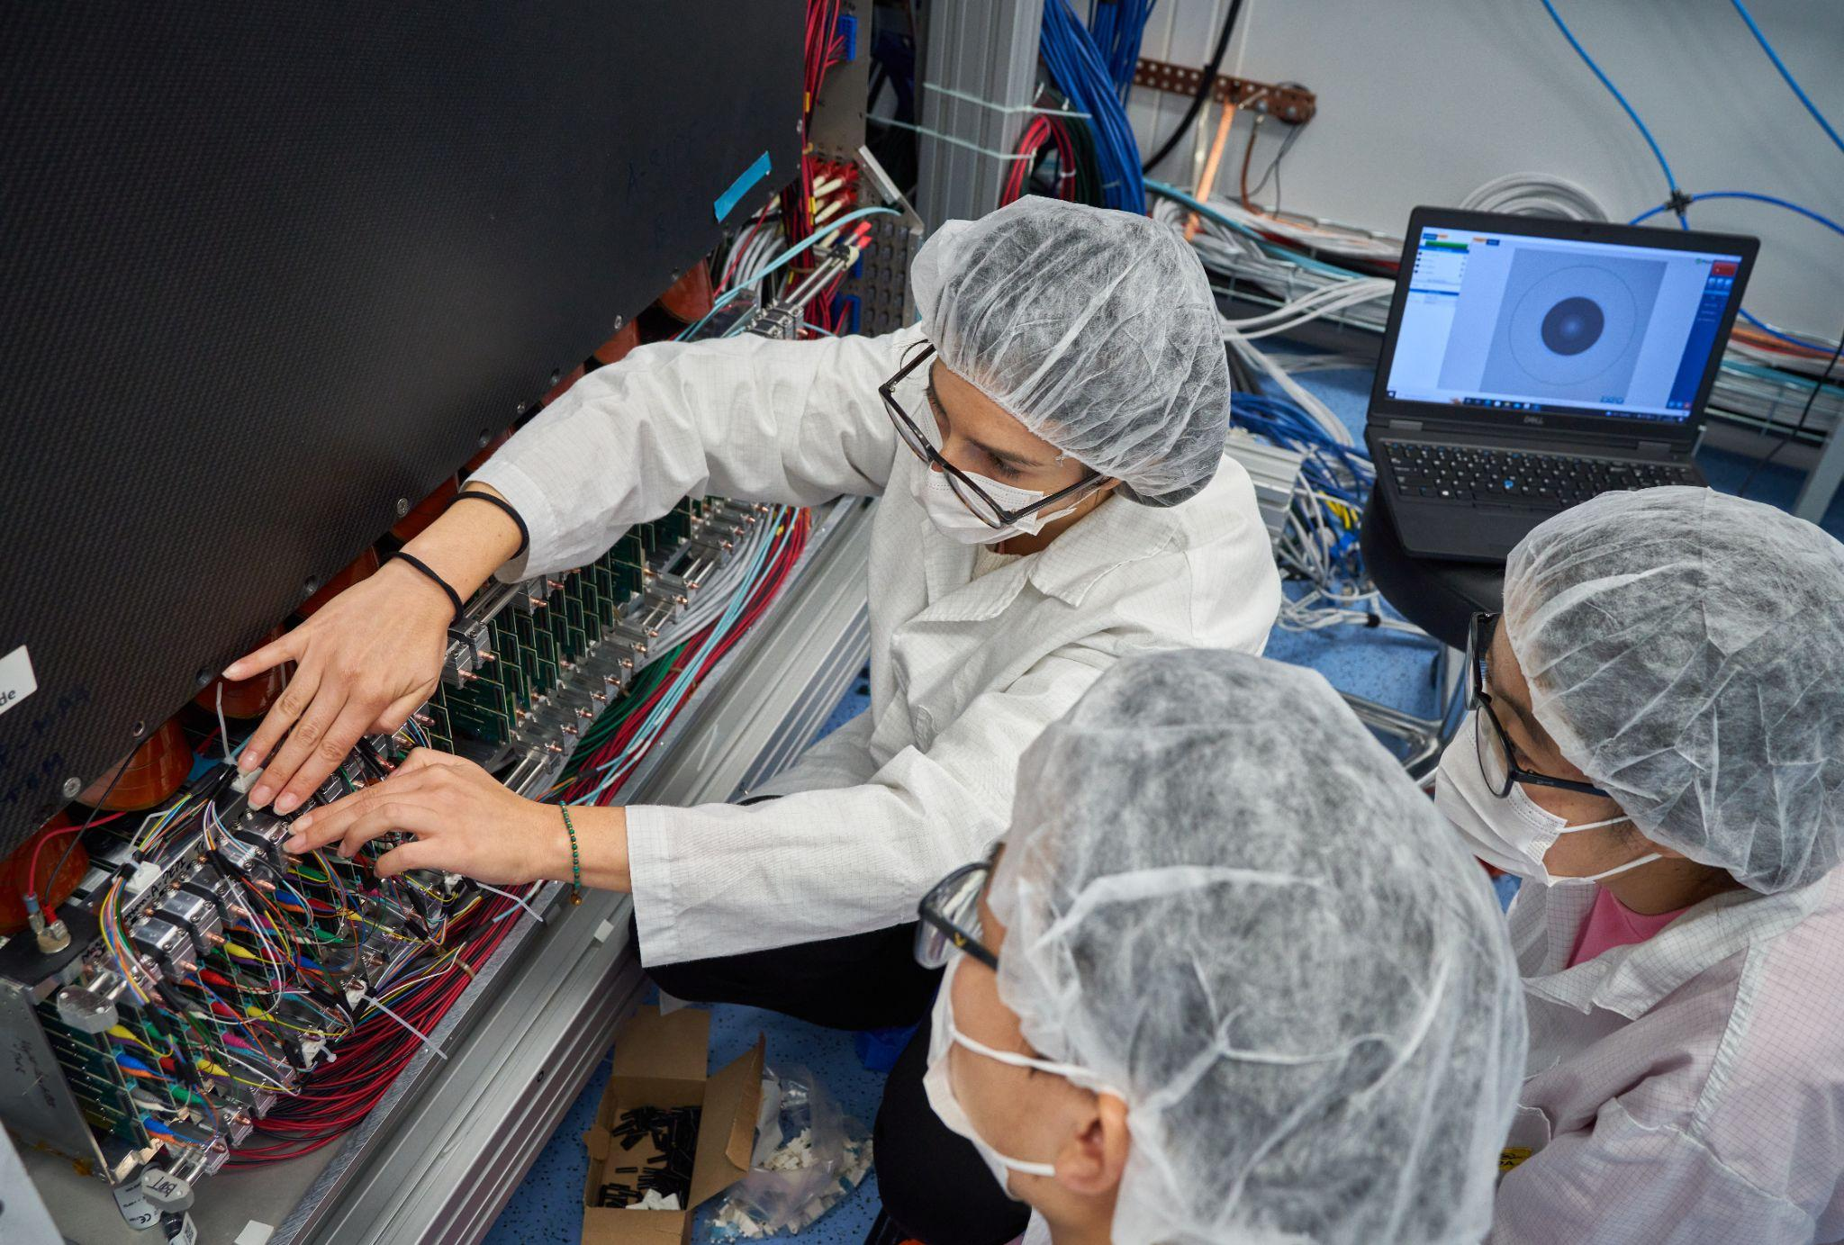
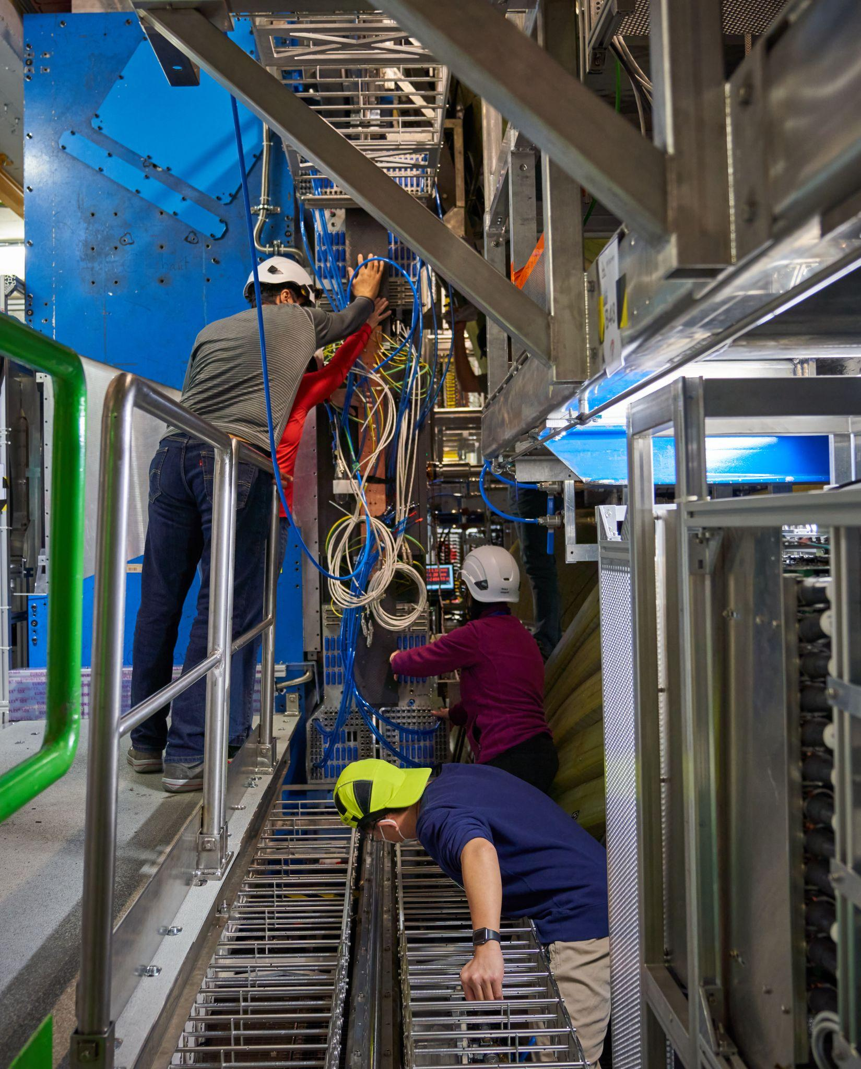
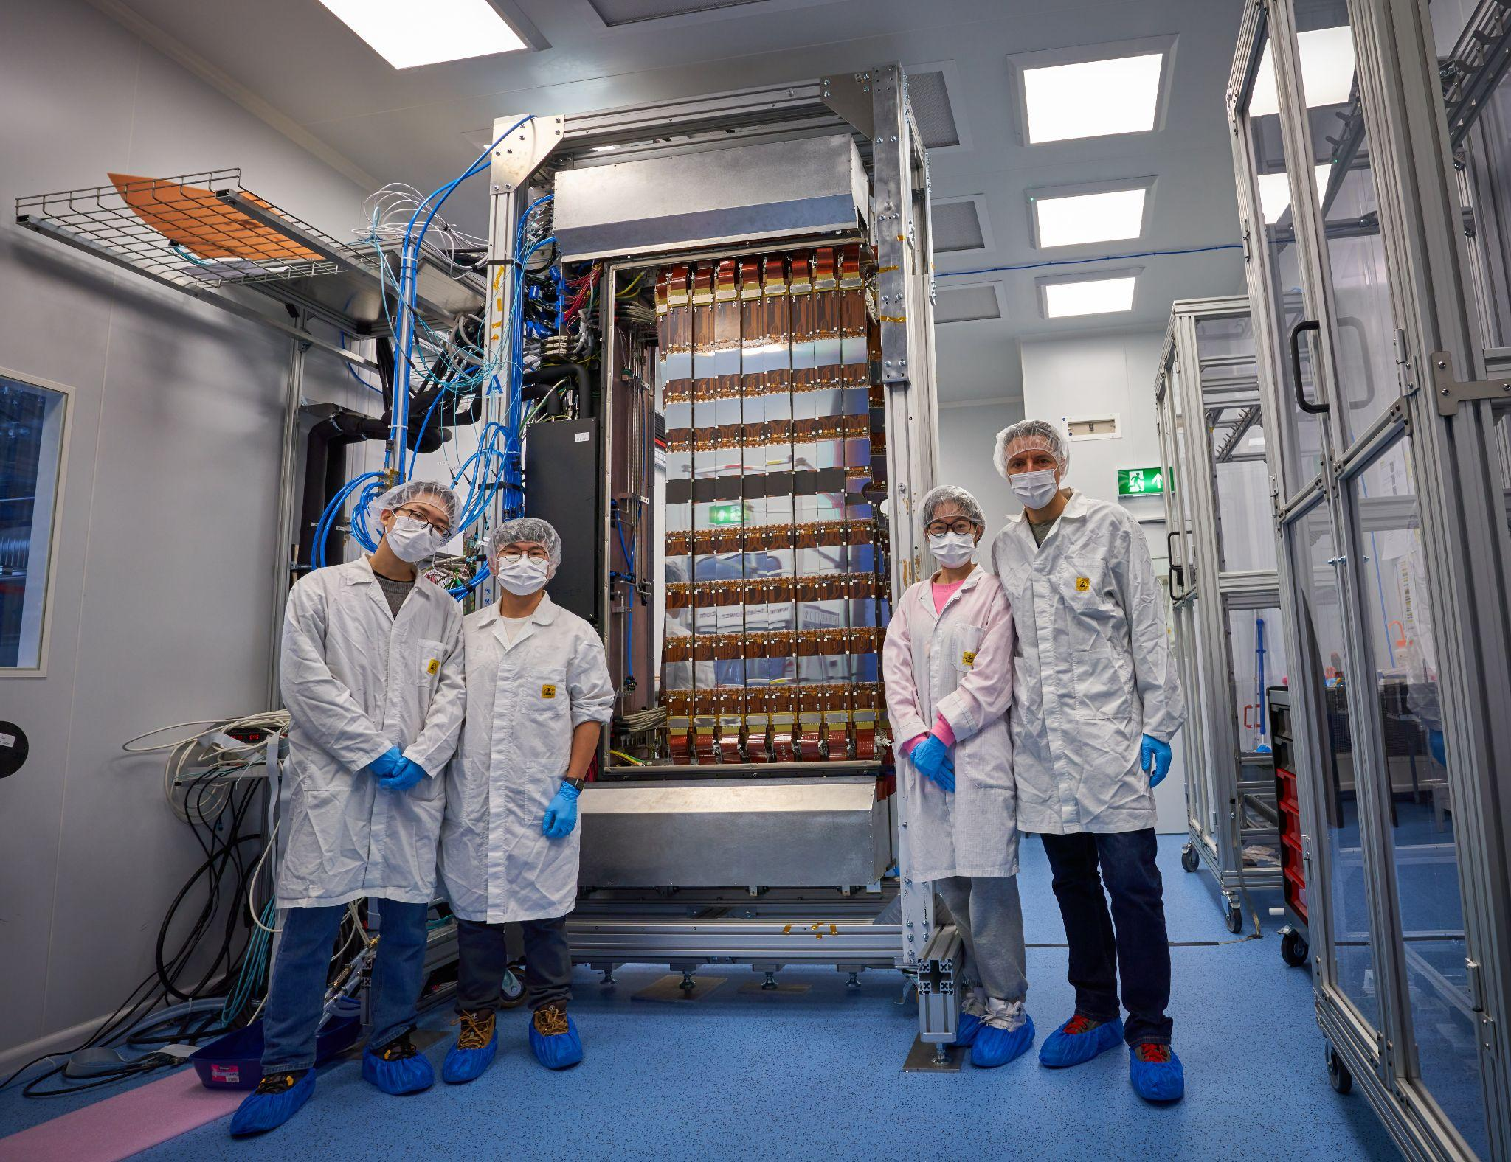
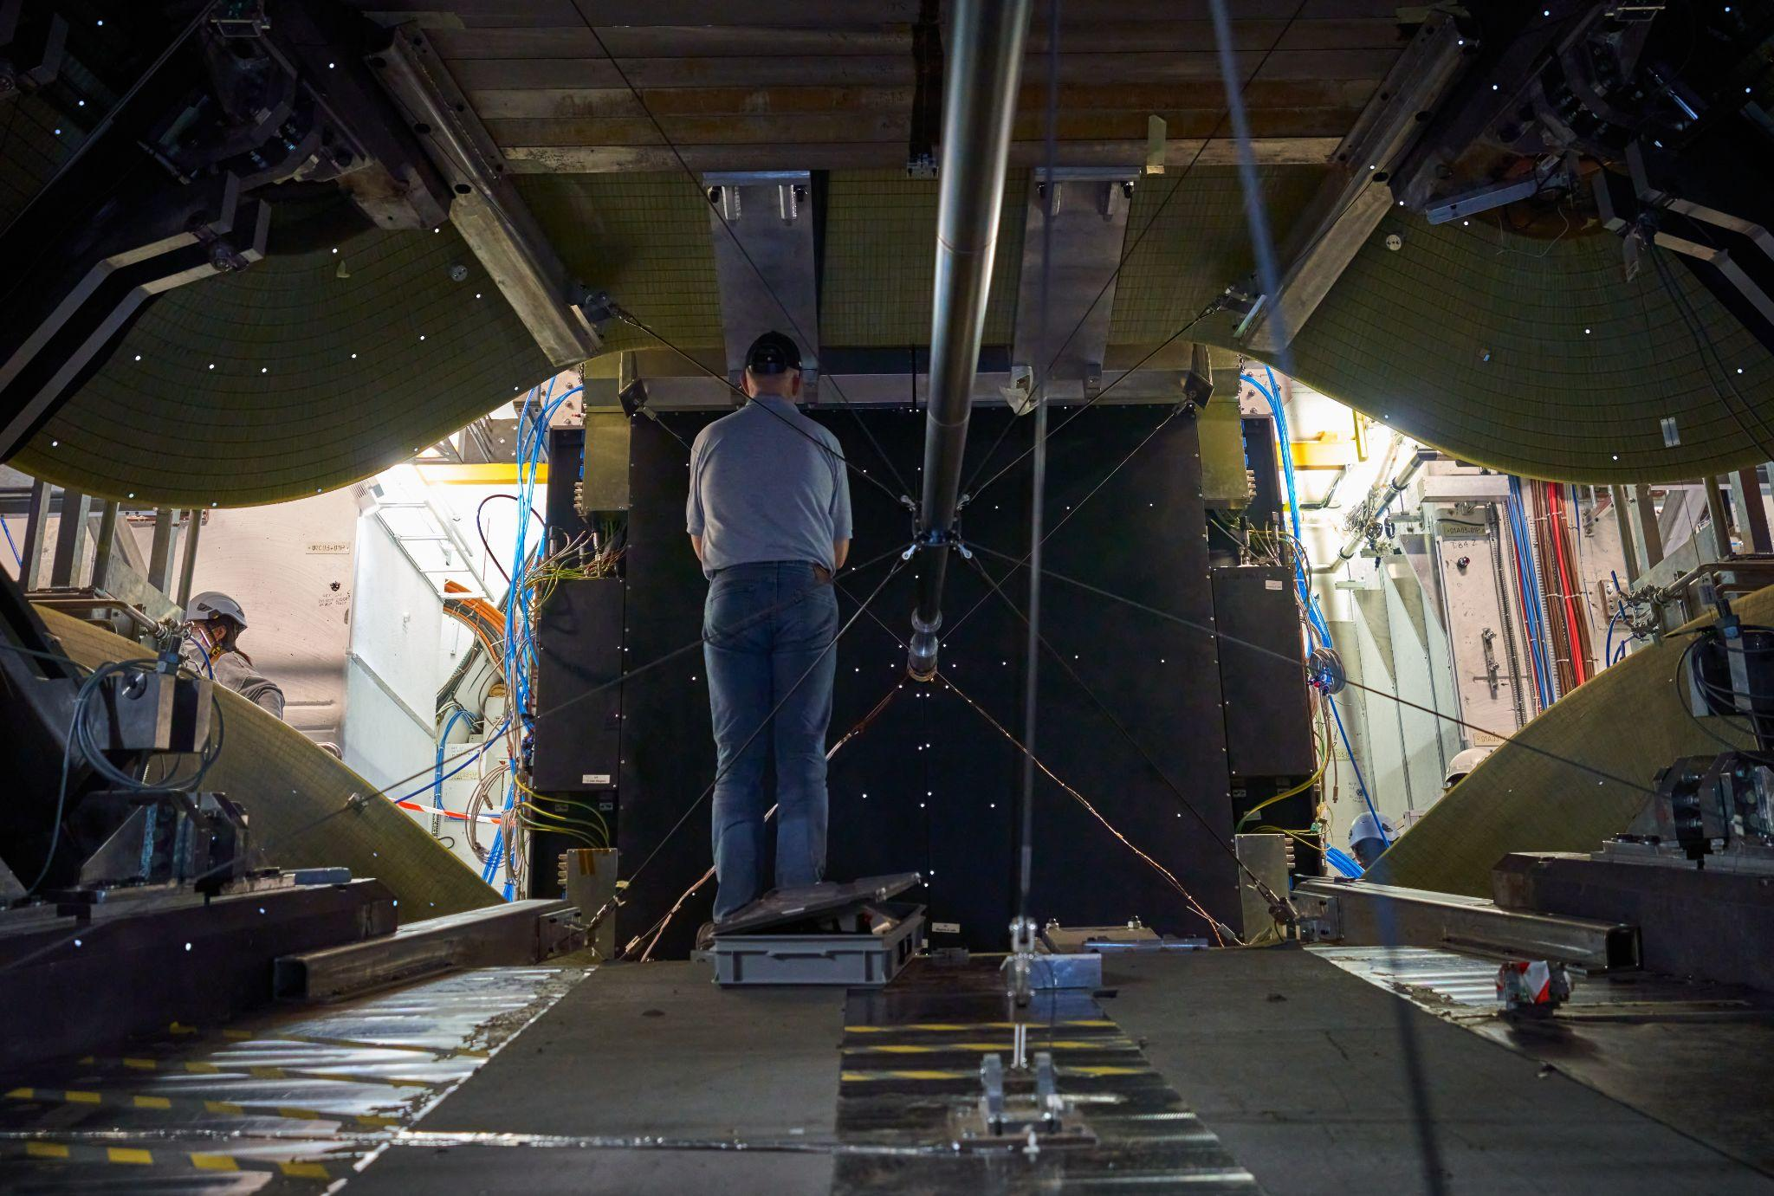
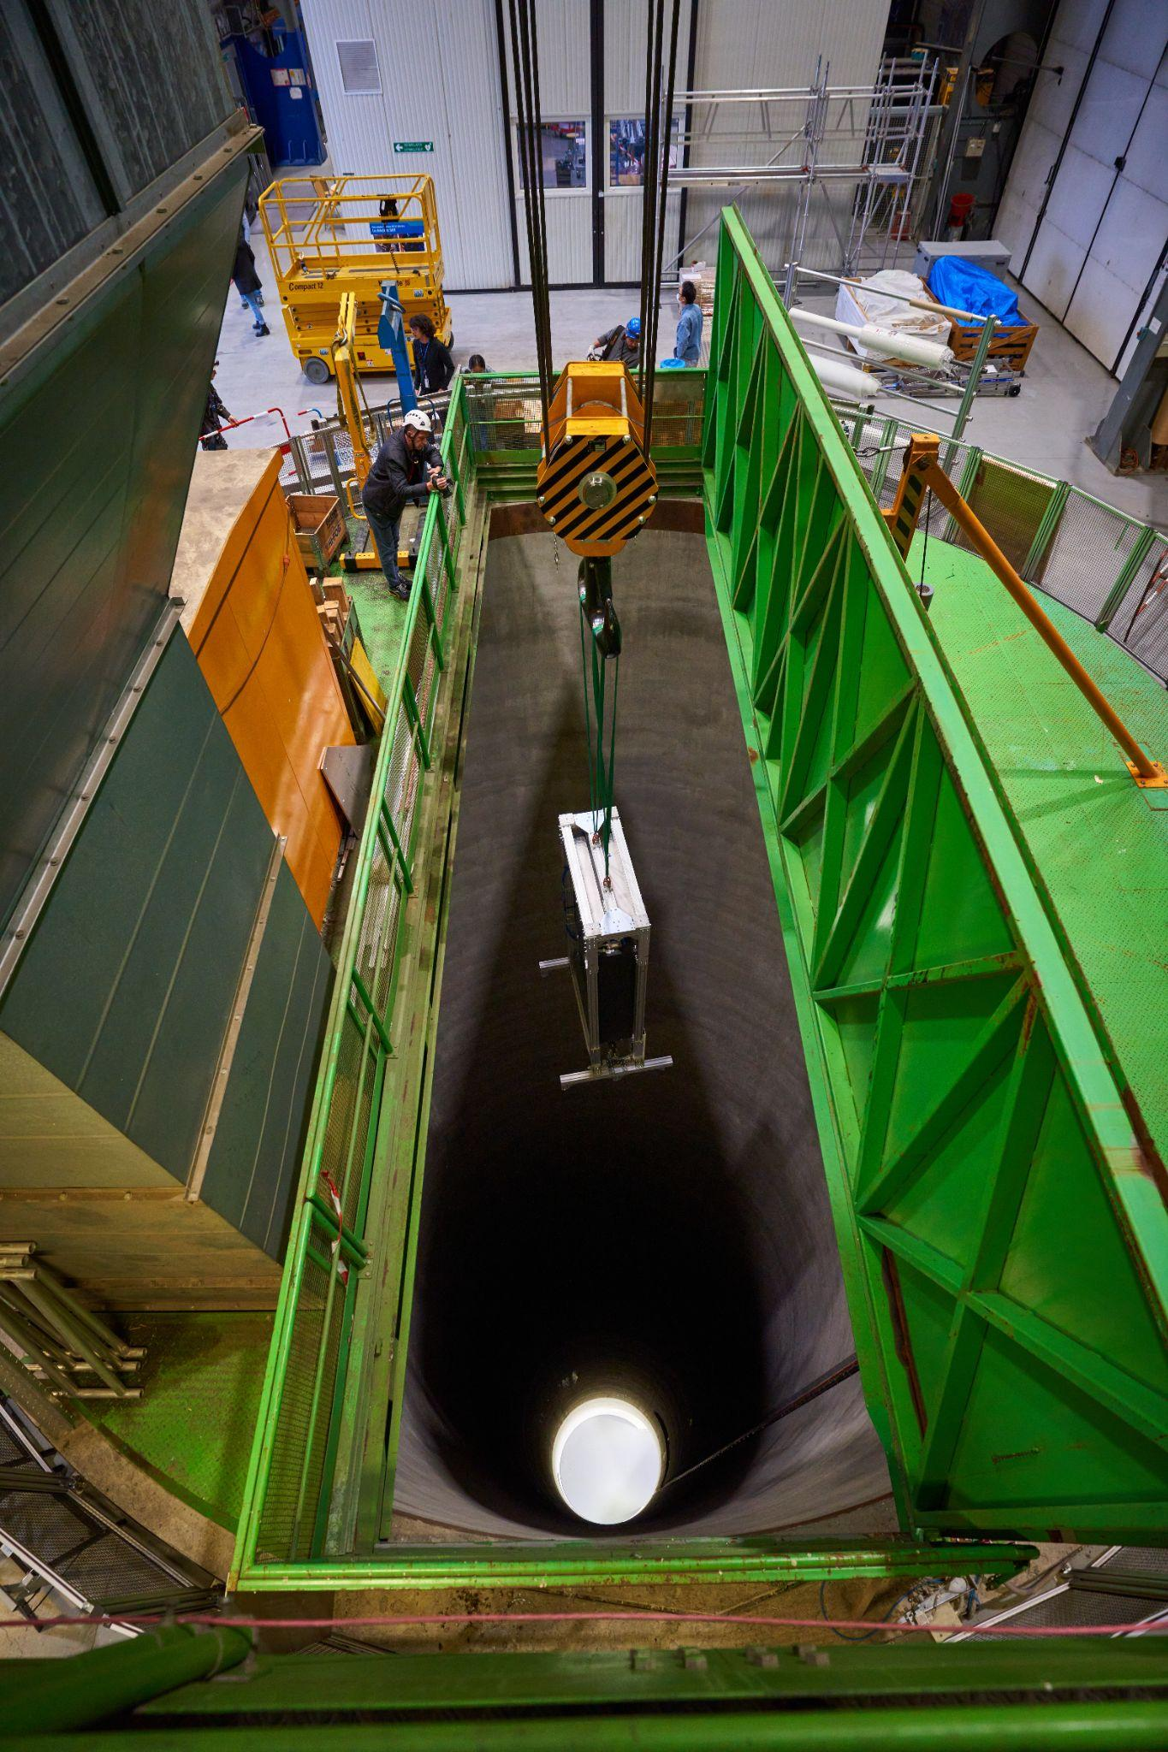
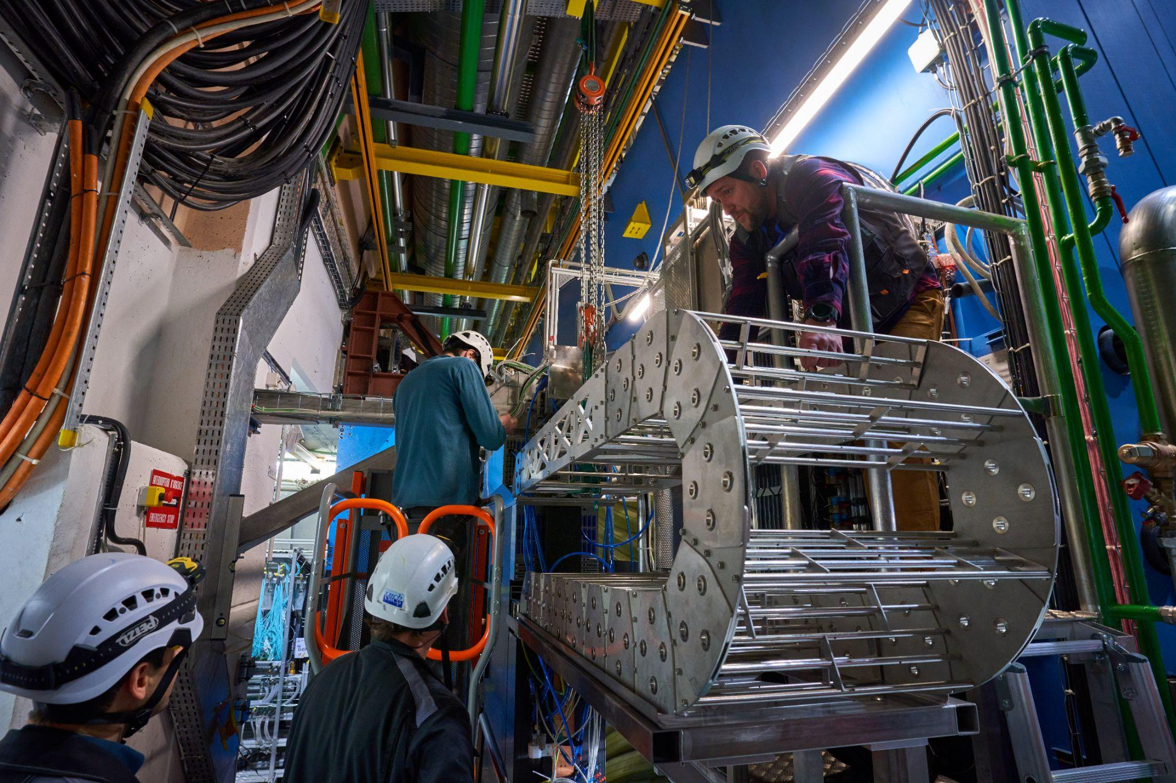
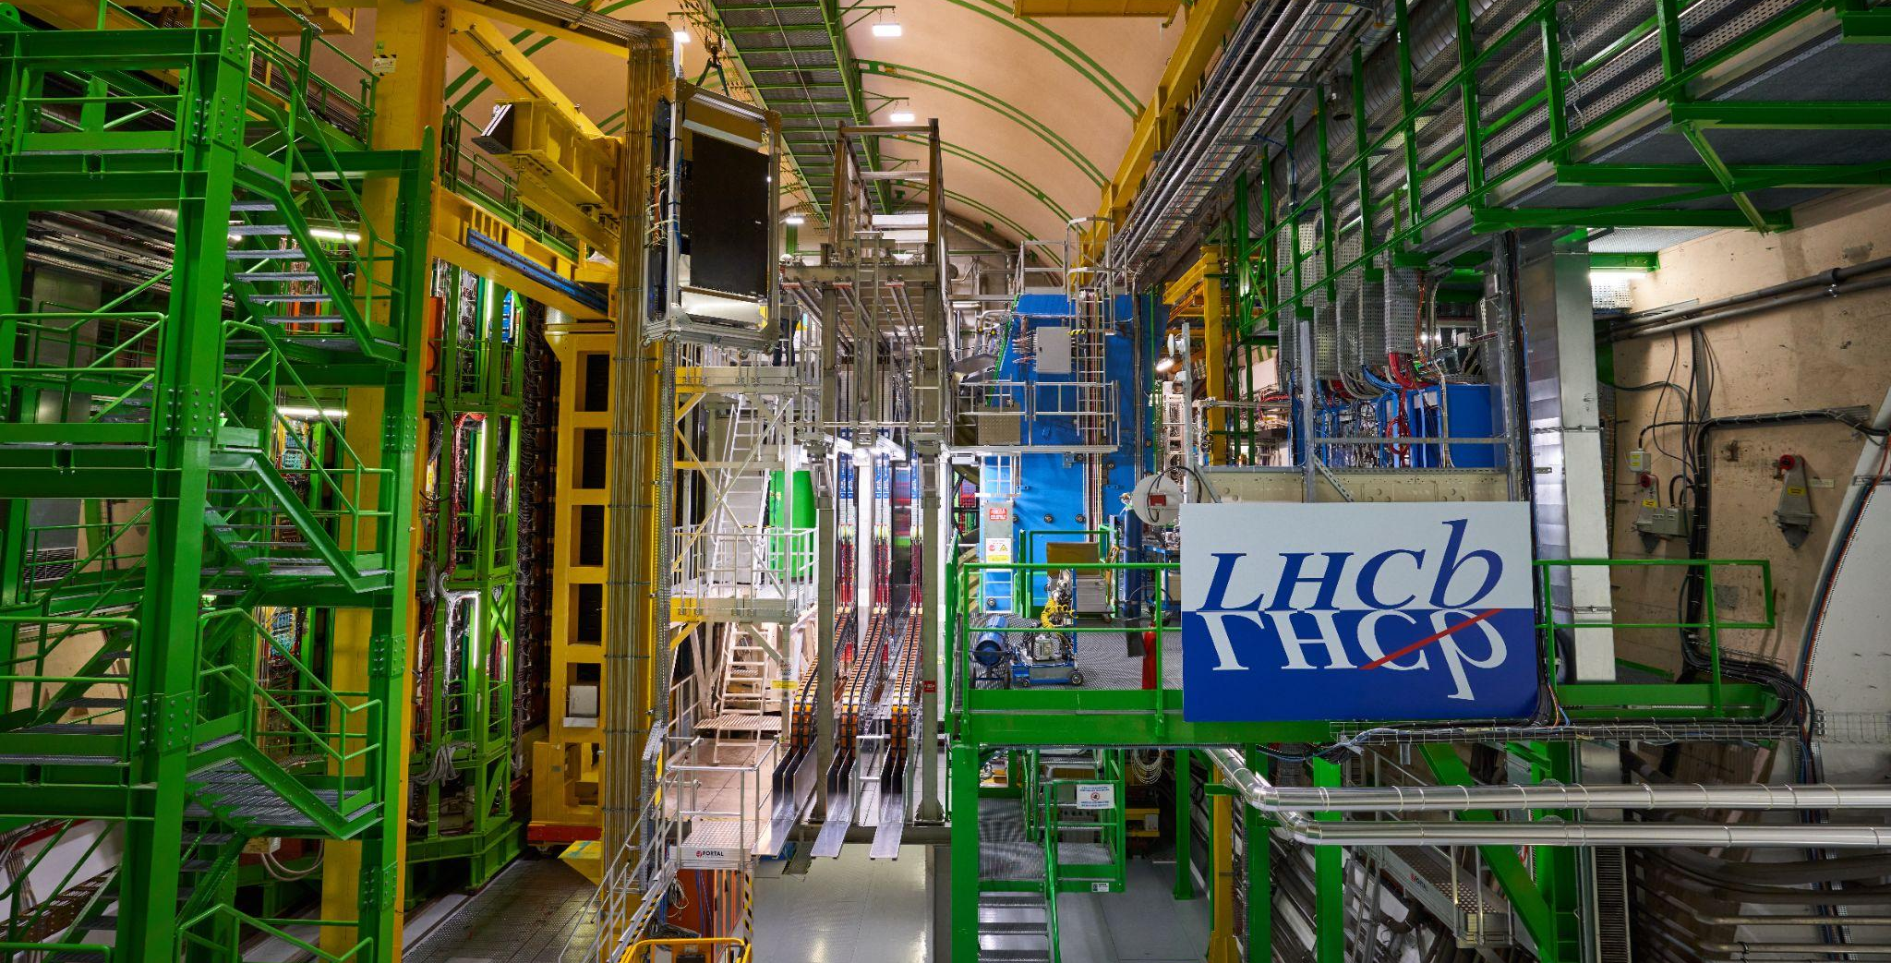
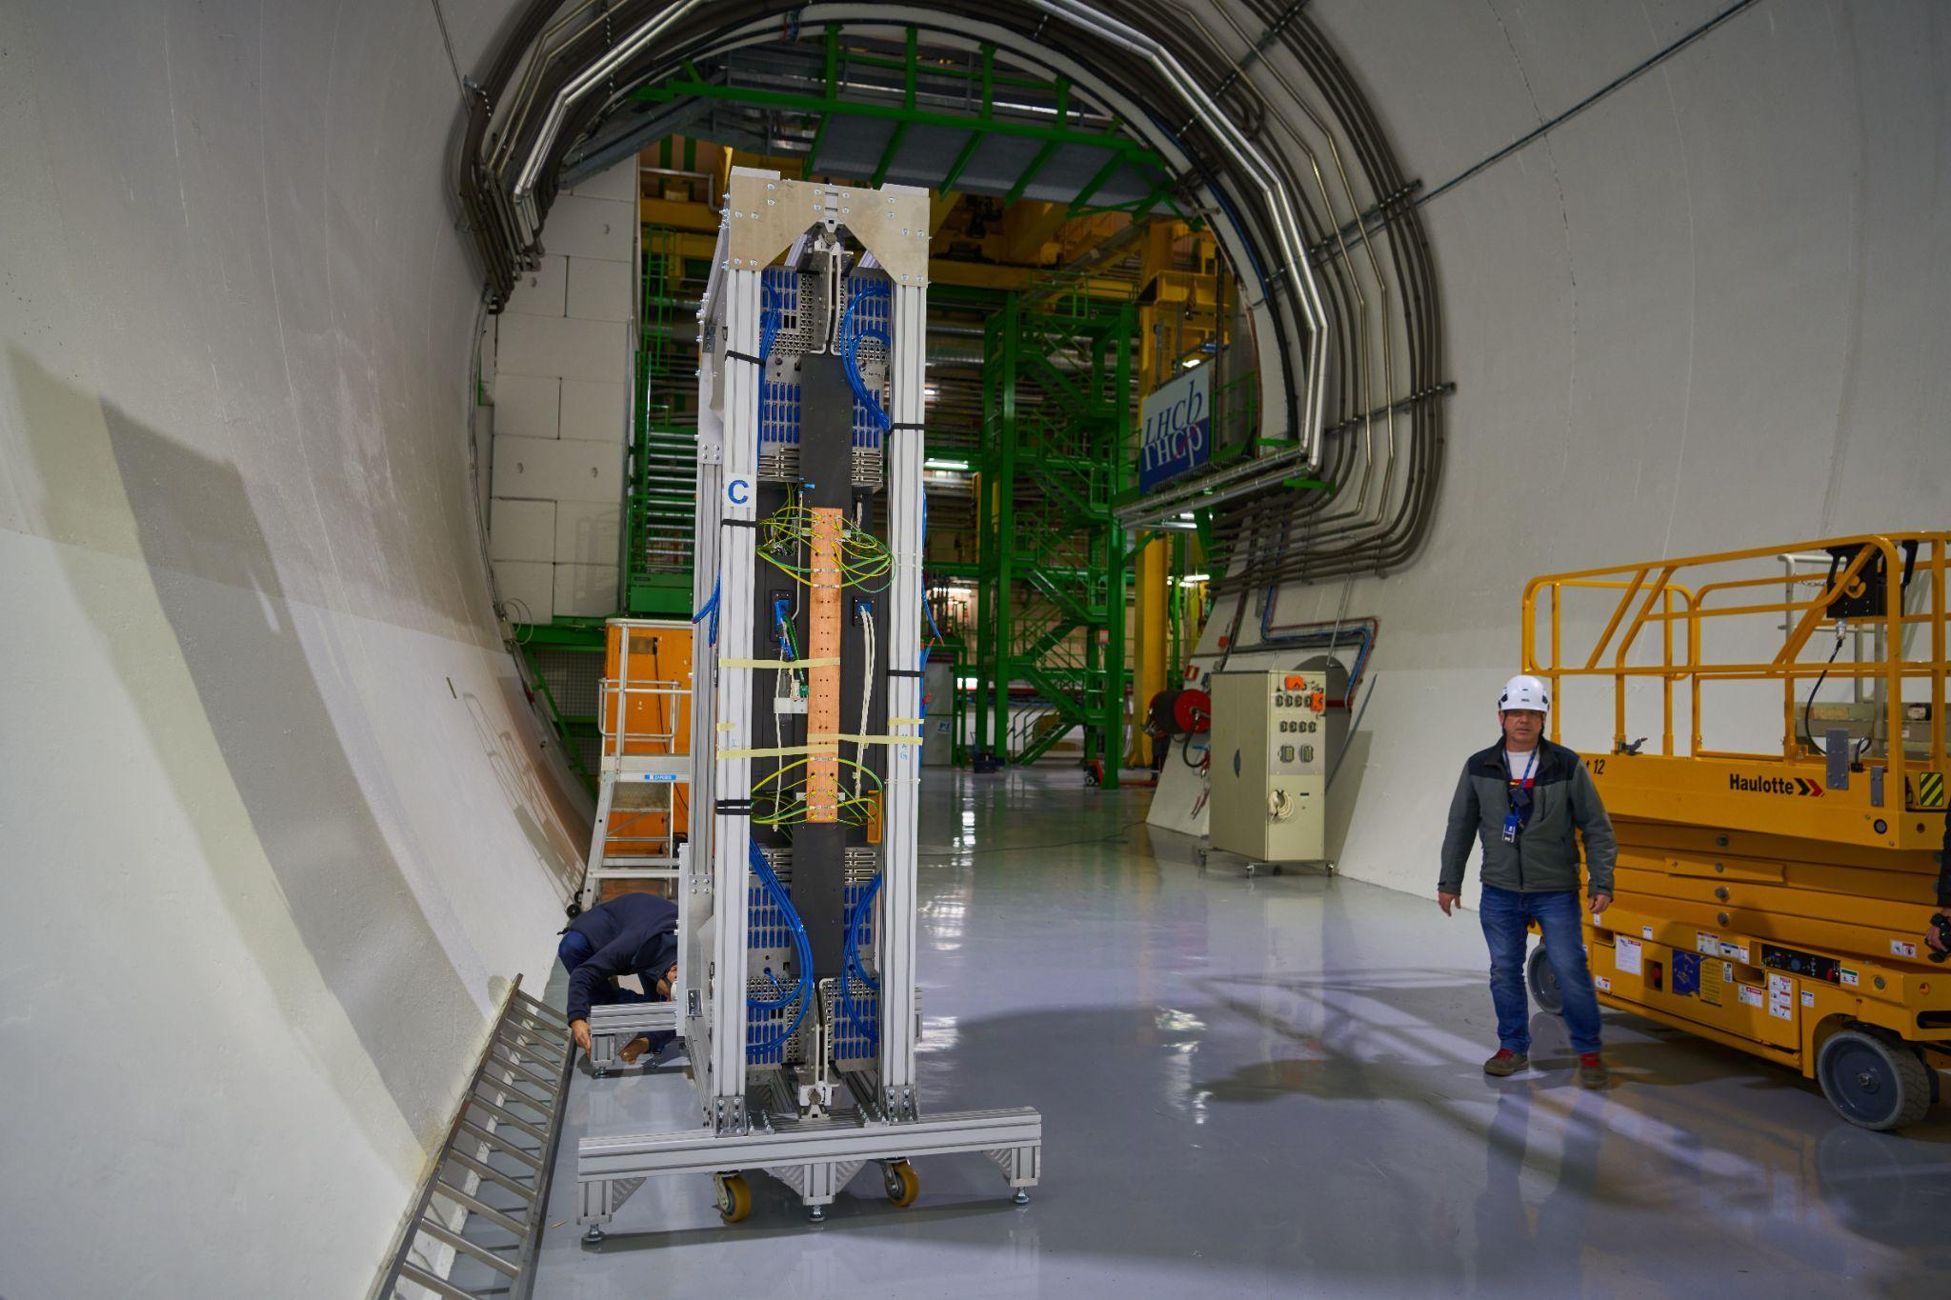
UT timeline
Installation
completed in March 2023
Giorgia Tonani VERTEX 2023 9

Slide 13
UT timeline
Installation
completed in March 2023
Commissioning
NOW
Giorgia Tonani VERTEX 2023 9

Slide 14
UT path to collect physics data…
to make UT work..
to take data..
DETECTOR SAFETY
UT
FIRMWARE
DETECTOR
MONITORING
ECS
Software
to take good quality data for physics..
Data quality monitoring
Time alignment
Space alignment
Calibration
Giorgia Tonani VERTEX 2023 10

Slide 15
UT path to collect physics data…
to make UT work..
to take data..
DETECTOR SAFETY
UT
FIRMWARE
DETECTOR
MONITORING
ECS
Software
to take good quality data for physics..
Data quality monitoring
Time alignment
Space alignment
Calibration
Giorgia Tonani VERTEX 2023 10

Slide 16
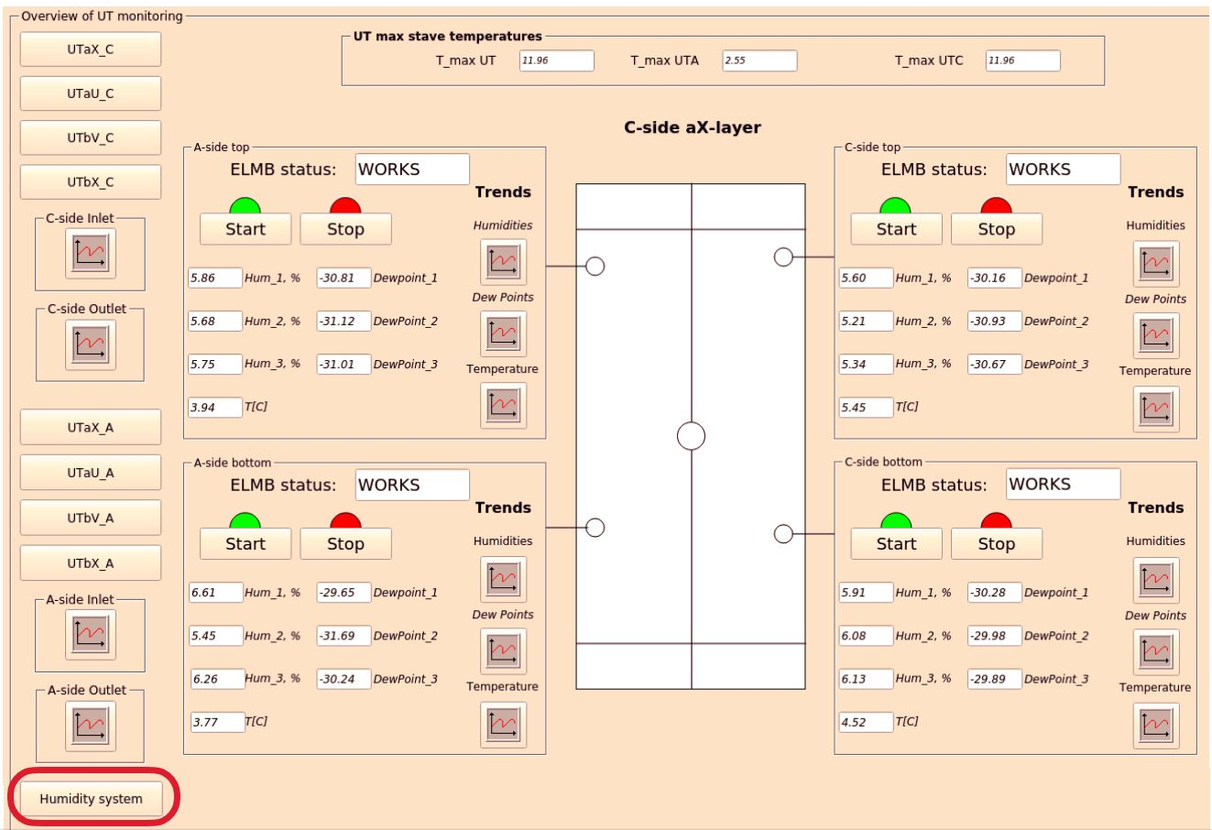
Detector safety:
Humidity inside the box
Temperature of the electronics
Stave temperature
Current and Voltage
(high and low voltage)
Alarms
exploiting sensors
monitoring, warning the shifter
action taken by expertes
DSS
thermal switches + sensors
regulated to operate in a range
action taken by DSS
All the switches and sensors installed and active, DSS panel working
Giorgia Tonani VERTEX 2023 11
Notes:
switch off the system in case of exceeded threshold

Slide 17
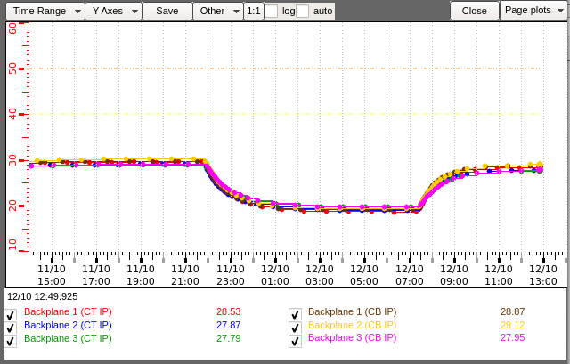
Cooling system
PLOT: stable operations
module cooling: bi-phase CO₂
manifolds connect to the cooling tube of the stave
single tube for each stave
sensor design temperature: -5℃
→ current setpoint temperature 0℃ , need to optimized the box sealing to reach design temperature (during YETS)
peripheral electronics cooling: demineralized/mixed water
Giorgia Tonani VERTEX 2023 12

Slide 18
High voltage
Only part of the detector considered
Prediction
High voltage for sensors depletion
Monitoring panel in place: scan of the current over time
Δ I = α * Φ * V
Total Fluence Φ
Damage rate α
Sensor volume V
Data
Giorgia Tonani VERTEX 2023 13

Slide 19
High voltage
Only part of the detector considered
Prediction
Good agreement between data and prediction:
no additional current in the detector -> monitoring for the UT wellbeing
extend to higher luminosity to predict annealing
Data
Giorgia Tonani VERTEX 2023 13

Slide 20
UT path to collect physics data…
to make UT work..
to take data..
DETECTOR SAFETY
UT
FIRMWARE
DETECTOR
MONITORING
ECS
Software
to take good quality data for physics..
Data quality monitoring
Time alignment
Space alignment
Calibration
Giorgia Tonani VERTEX 2023

Slide 21
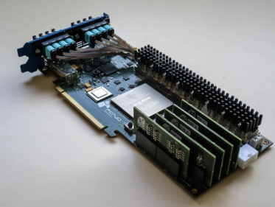
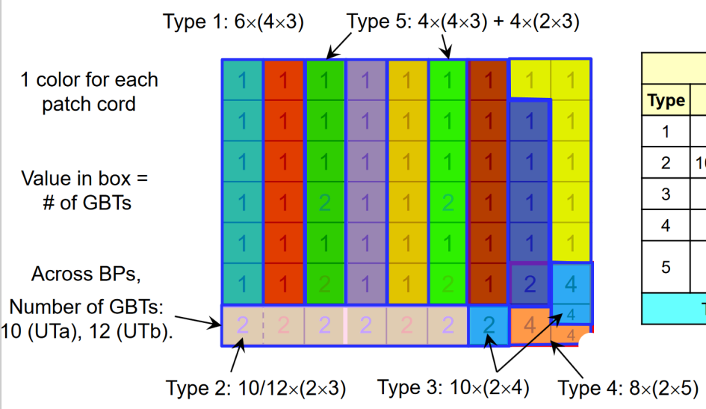
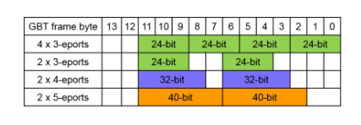
Firmware
Readout of the detector possible with PCIe40 cards hosting
Intel Arria 10 FPGA: transforms the data from ASIC to PCIe format
5 flavours, design to cope with different occupancies and to minimize the cost
flavour= (#ASICs x #e-links)
Implemented to work in Non-zero-suppressed (NZS) and in Zero-suppressed (ZS) mode
Giorgia Tonani VERTEX 2023 14

Slide 22
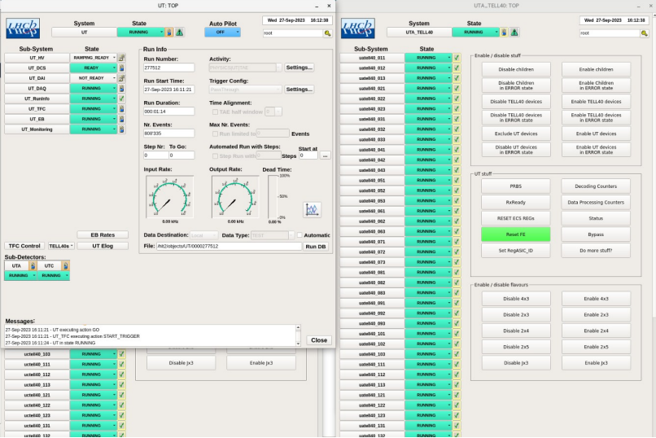
ECS
Developed a complete Experiment Control System: configure and control the back-end and front-end electronics
One panel for each part of the detector, organized in a tree structure
Can be used as debugging tool for synchronization checks
Operating the detector with 92% of the ASICs enabled due to known power issues (to be recovered during YETS to run with 99% of the ASICs)
Giorgia Tonani VERTEX 2023 15
Notes:
Come si configura, parla con asic attraverso

Slide 23
UT path to collect physics data…
to make UT work..
to take data..
DETECTOR SAFETY
UT
FIRMWARE
DETECTOR
MONITORING
ECS
Software
to take good quality data for physics..
Data quality monitoring
Time alignment
Space alignment
Calibration
Giorgia Tonani VERTEX 2023

Slide 24
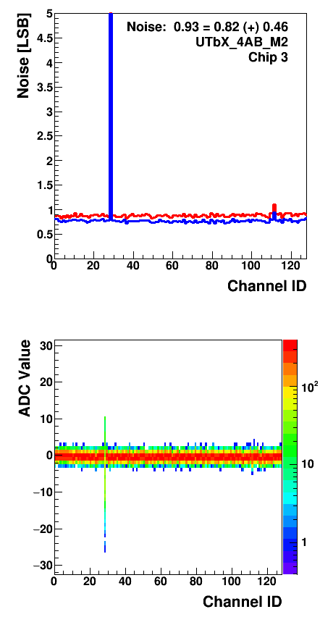
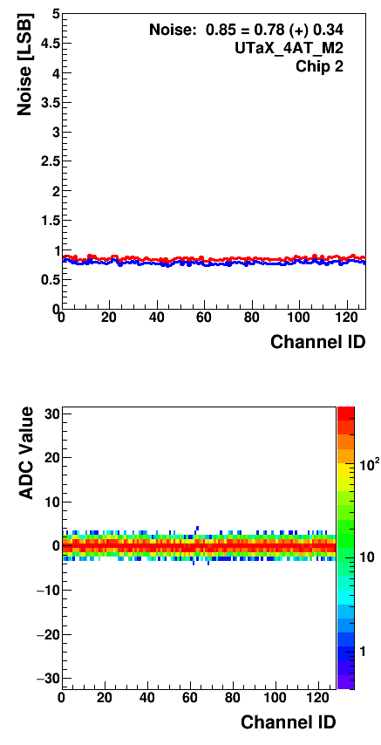
Performance studies
Characterization of the hybrids in the early stage of the commissioning to illustrate the behaviour of the detector
Data collected in bypass mode (data not serialized by TELL40)
Tests performed before and after the installation: good agreement of noise and bad channels
Constant values of noise and pedestals during the installation time
0.16% of all the channels analysed are tagged as bad channels (0.07% pedestal shift, 0.09% high noise)
Channel 28 tagged as noisy
Giorgia Tonani VERTEX 2023 16

Slide 25
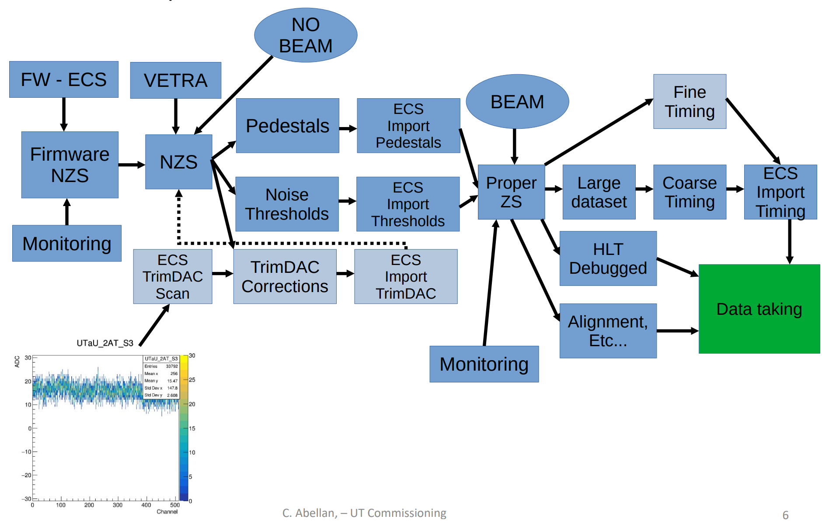
Path to the data taking
Calibration
Development of software to run automated detector calibrations
Pedestals and thresholds computed exploiting End of Fill calibration runs (no LHC beam, only NZS data)
Detector parameters updated automatically (ECS)
Precise knowledge of the noise needed to run in ZS mode
Trigger
Giorgia Tonani VERTEX 2023 17

Slide 26
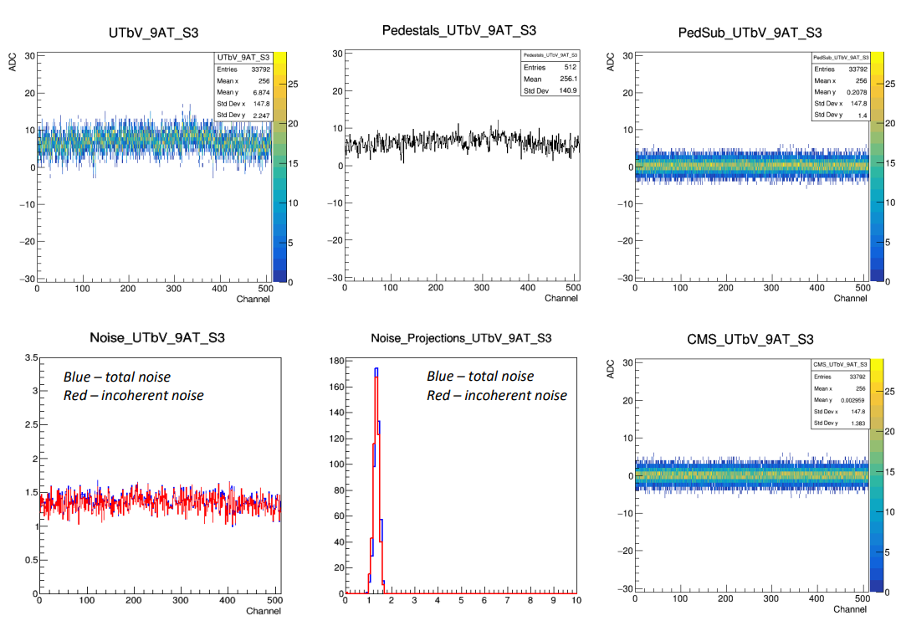
Offline calibration
USEFUL FOR THE COMMISSIONING!
Dedicated software package (VETRA), part of the LHCb software project
Analysis of the decoded readout and compute sensors parameters:
Pedestal
Total noise
Coherent noise
Incoherent noise
CMS data monitoring
Preliminary results:
observed the variation of pedestals across the layer
uniform incoherent noise in the detector
noise check after pedestal subtraction
agreement with the early performance studies
Giorgia Tonani VERTEX 2023 18

Slide 27
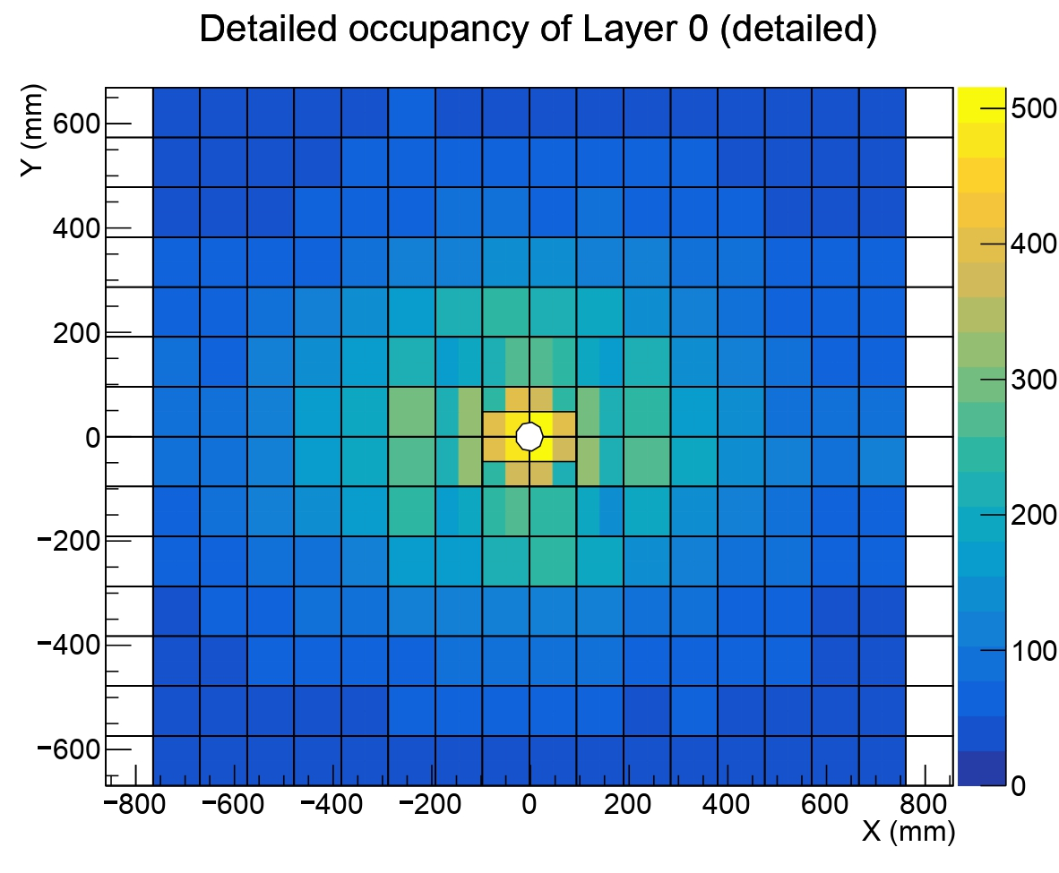
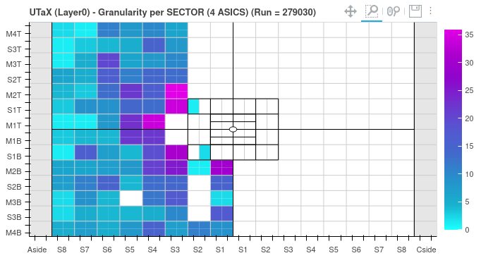
Online monitoring
Monitoring in place: small sample of the captured data sent to computer farm to monitor in real time
Crucial for the commissioning phase: basic information e.g. hits per sensor, errors information, analogue response. More plots to be added at the need
Simulation, LHCb Unofficial
Data
Operating with half of the detector for different commissioning purposes
Giorgia Tonani VERTEX 2023 19

Slide 28
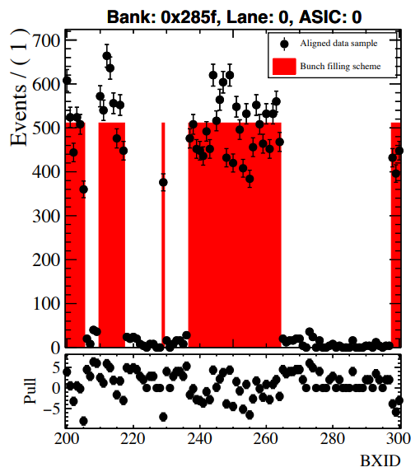
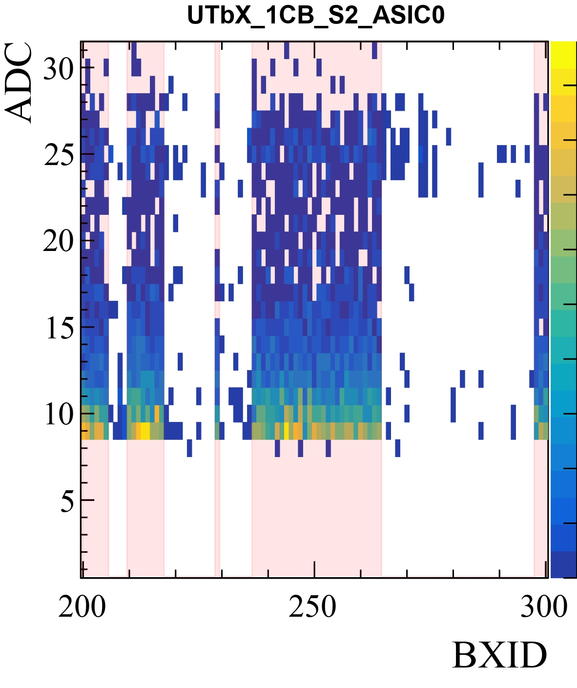
Time alignment
Aligned
Goal: match the UT hits with the
bunch filling scheme of the LHC
Fit a linear regression model: minimization of Residual Sum of Squares
The ZS bank decoder has to provide“Number of hits” vs. “BXID” histograms for each ASIC using the
First a global alignment, then performed for every ASIC
No need for dedicated TAE runs
Ongoing studies on data with ion run, waiting for calibration to perform coarse time alignment
Giorgia Tonani VERTEX 2023 20
Notes:
ZS data??

Slide 29
Current status
Commissioning phase started in March 2023
Detector alignment developed for one degree of freedom on MC
Decoder ready to be used in the trigger
Many surveys performed to check the status of the detector
Data taking ongoing in local during the ions runs
Faced issues in the integration of UT in the rest of the infrastructure: desynchronization with experiment clock → commissioning slowed down→ affected the data taking stability → made significant progresses, learnt how to operate
Working to guarantee continuity in the data taking
Giorgia Tonani VERTEX 2023 21

Slide 30
UT timeline
Repairs and adjustments of the electronics, fibers
Mechanics: surveys, improved beam pipe seal, improved approach mechanism
Installation
completed in March 2023
Commissioning
NOW
YETS
November 2023
Categories:
recover loss of efficiency in data taking
guarantee detector safety
operation
Giorgia Tonani VERTEX 2023 22

Slide 31
UT timeline
Installation
completed in March 2023
Commissioning
NOW
YETS
November 2023
Global commissioning + data taking
March 2024
Giorgia Tonani VERTEX 2023 22

Slide 32
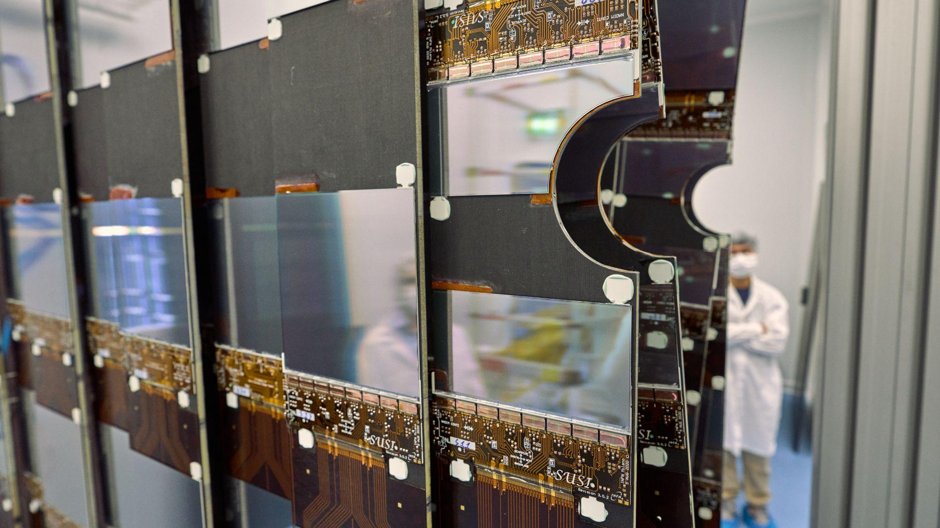
Summary
Installation completed successfully in March
Detector performance matches specifications
Analysing the first commissioning data
Working to ensure stability in the data taking (5 flavour firmware)
YETS plan to recover 99% of the detector efficiency
Work in progress to have UT in the global LHCb data taking
Giorgia Tonani VERTEX 2023 23

Slide 33
Thank you

Slide 34
Backup

Slide 35
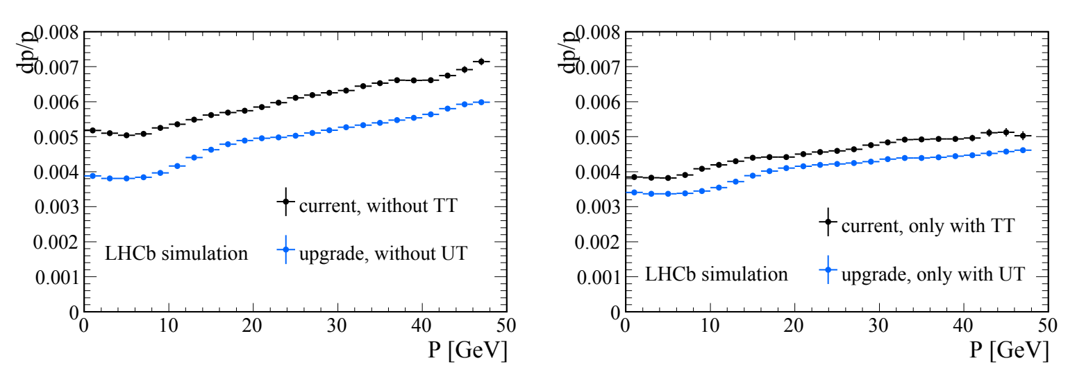
Upstream Tracker: importance in LHCb
Track reconstruction: UT fundamental to improve the momentum resolution of long tracks
Giorgia Tonani VERTEX 2023 1

Slide 36
Upstream Tracker: importance in LHCb
Track reconstruction
Ghost rate reduction: factor 2 improvements with only less than 1% drop in efficiency
Giorgia Tonani VERTEX 2023 2

Slide 37
Upstream Tracker: importance in LHCb
Track reconstruction
Ghost rate reduction
Long lived particle reconstruction decaying after the VELO
Giorgia Tonani VERTEX 2023 3

Slide 38
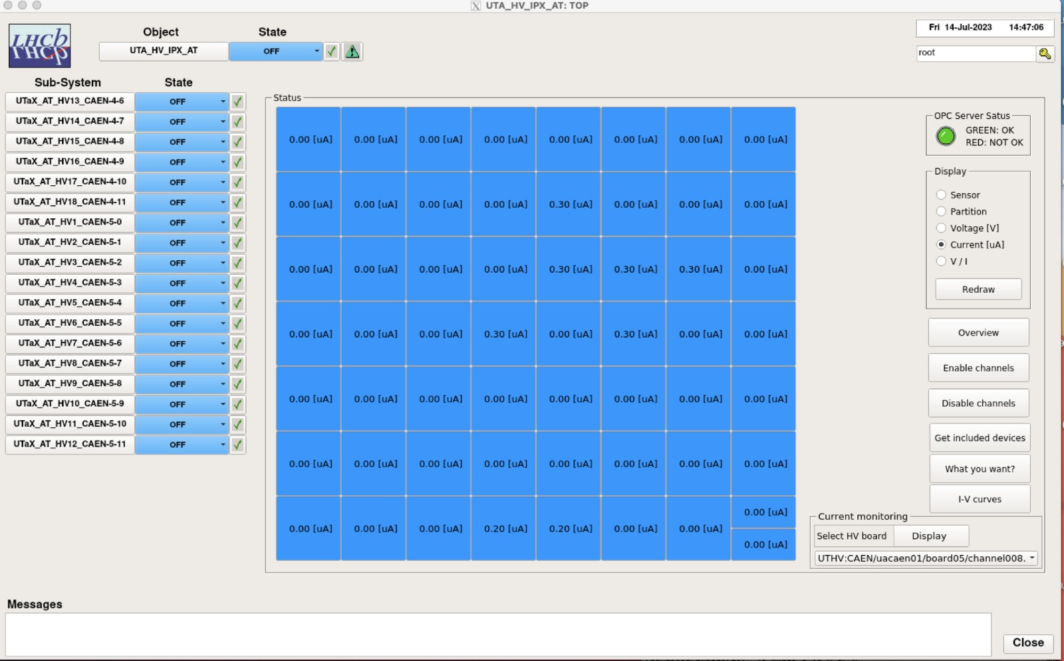
High voltage
High voltage cables for sensors depletion
Monitoring panel in place:
access to each channel
sensor name
voltage per sensor
current per sensor
V/I per sensor
Giorgia Tonani VERTEX 2023 4
Notes:
fai apparire ogni punto alla volta cerchiando sul pannello

Slide 39
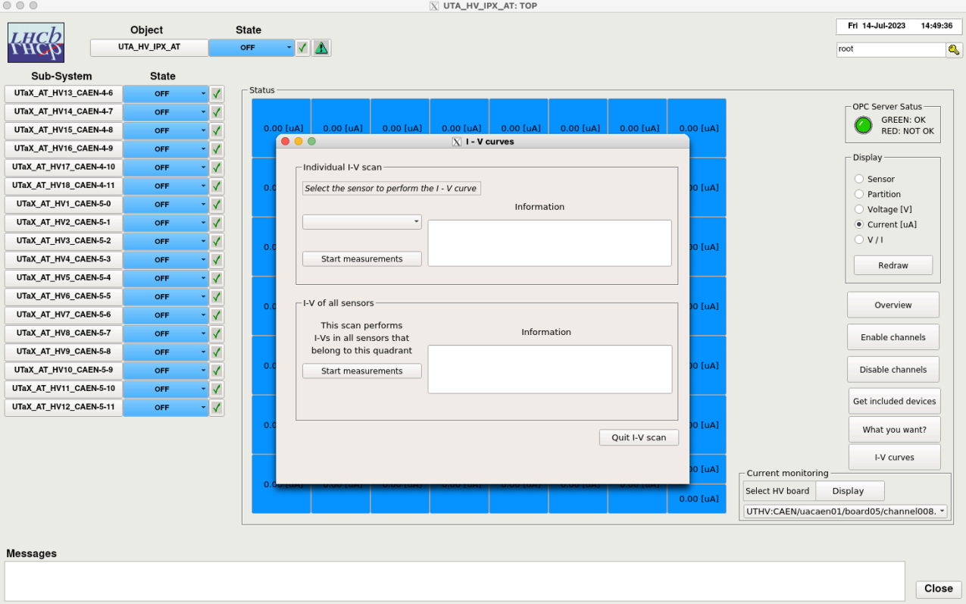
High voltage
I - V curves
Single sensor scan
List of sensors scan
Scan all sensors that belong to a subsystem
Scan of the current over time
Giorgia Tonani VERTEX 2023 5

Slide 40
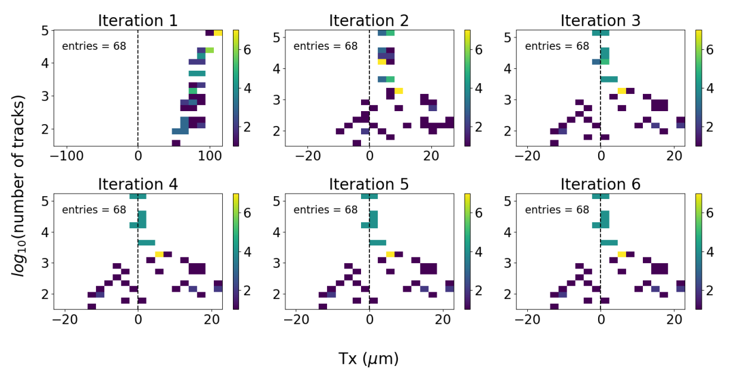
Space alignment
Implementation in DD4hep:
after simulation and
digitisation, with
sub-detectors at the
design position: no
misalignment
Run Alignment software with some initial misalignment in UT
Expect Alignment to correct the misalignment after a few iterations using pure tracking (no constraints applied) : obtained after 4 iterations
10⁴ tracks needed to reach good results
Single degree of freedom (DOF), multiple DOFs studies ongoing
Giorgia Tonani VERTEX 2023 6

Slide 41
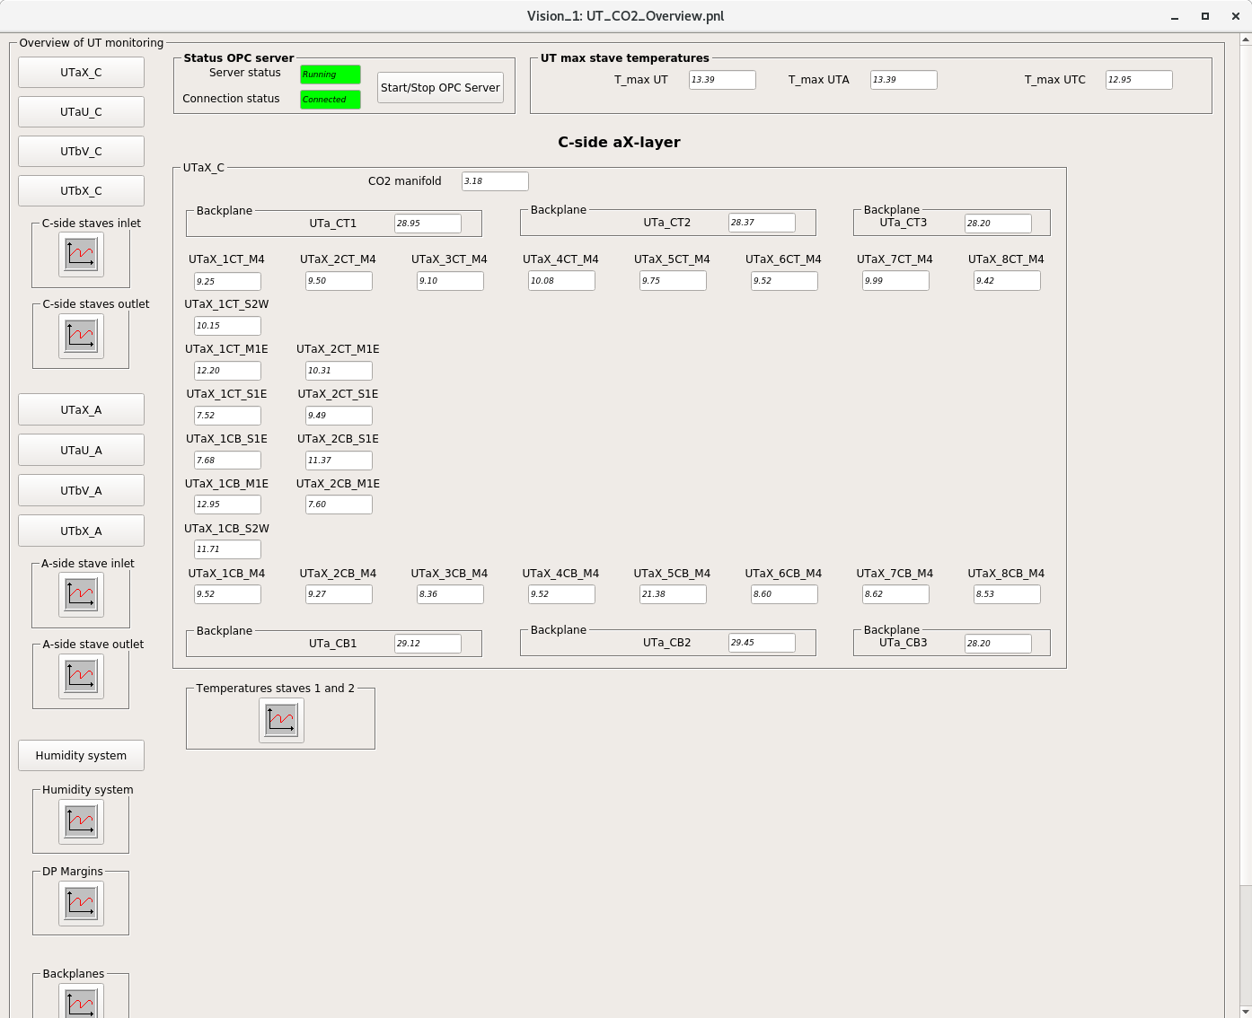
Cooling system monitoring
Online temperature monitoring of manifold, backplanes and modules
Monitoring of temperature and humidity trend in time (useful during commissioning)
Giorgia Tonani VERTEX 2023 7

Slide 42
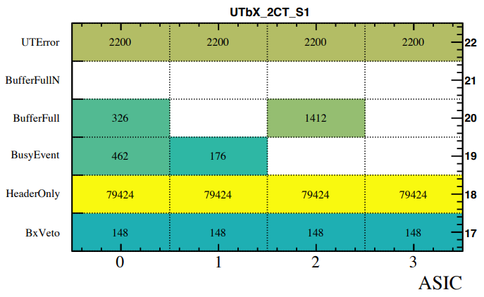
Online monitoring
Monitoring in place: small sample of the captured data sent to computer farm to monitor in real time
Adding plots to help the commissioning phase: basic information i.g. errors information
UT errors
UT specials
work in progress to add more errors
Giorgia Tonani VERTEX 2023 8
Notes:
MC ?

Slide 43
Firmware data format
Input data:
Output data:
Giorgia Tonani VERTEX 2023 9

Slide 44
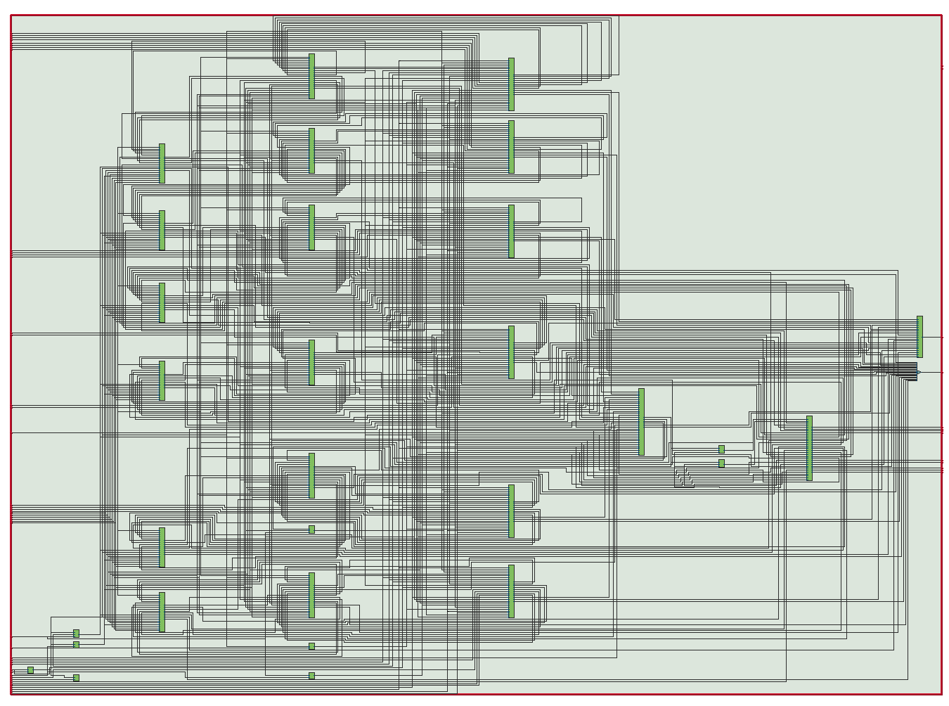
Firmware
spillover
output
200 MHz
FPGA
Functionalities
flavour independence output data format
spillover correction application
merging the information all asics in a flow (one output)
tag different data type received
250 MHz
input
lane builder
Status: implemented to work in Non-zero-suppressed (NZS) and in Zero-suppressed (ZS) mode
Giorgia Tonani VERTEX 2023 10

Slide 45
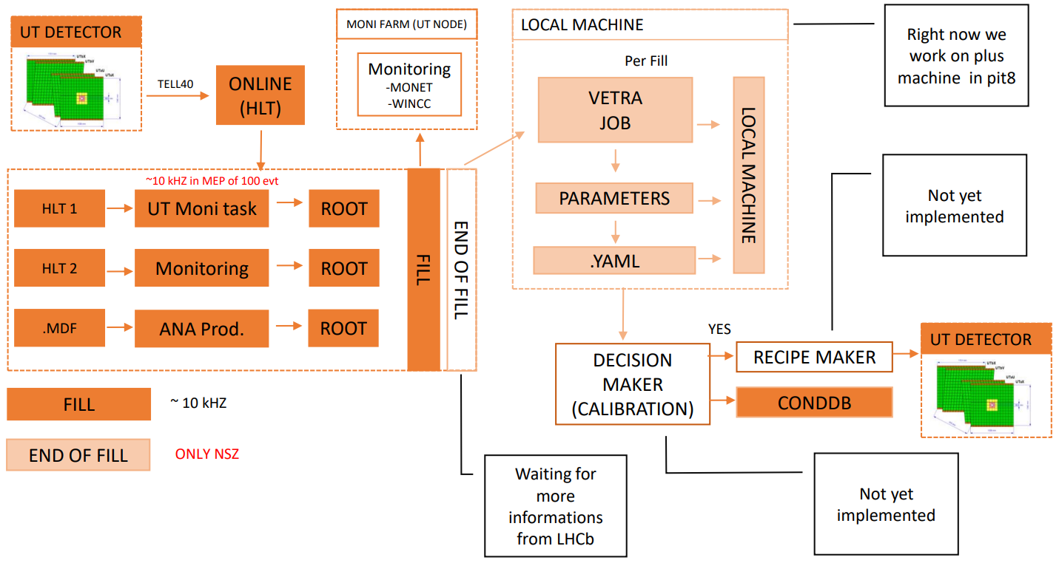
Calibration
Development of software to run automated detector calibrations
Pedestals and thresholds computed exploiting End of Fill calibration runs (no LHC beam, only NZS data)
Detector parameters updated automatically (ECS)
Giorgia Tonani VERTEX 2023 11
Notes:
togli schema, aggiungi plot

Slide 46
Desynchronization issue
Biggest problem during commissioning: random lost of ASICs configuration
Unstable clock signal received from the ASICs, related to the TFC sequence
TFC sequence quiet for a relatively long time + a single command bit activated → GBT loses synchronization with the SOL40 board which sent the clock
GBT not able to send a valid signal back to the SOL40 card → both the FEC in the GBT and in the SOL40 are activated → clock signal GBTs deliver to the ASICs is disturbed → confuse the ASICs and put them in a state of which they can not recover on their own
Giorgia Tonani VERTEX 2023 12

Slide 47
Desynchronization issue
UT not the only detector seeing this effect on the GBT chip, other detectors using it have reported similar problems.
Palliation strategy was found: if at least 1 of the 8 bits of the TFC command is asserted at all times, then the GBT suffers many less losses of synchronization
In the UT the SNAPSHOT bit has been sacrificed for this purpose: by activating it in every event, the command becomes useless, but the situation improves enough that it allows us to take some data for commissioning.
The reason why this works is theorized to be related to signal DC balance, but it is not fully understood or proven. It is not a complete cure either, as errors become much less frequent but still happen. Several improvements are currently being studied. We hope the situation will be enhanced in the future.
Giorgia Tonani VERTEX 2023 13

Slide 48
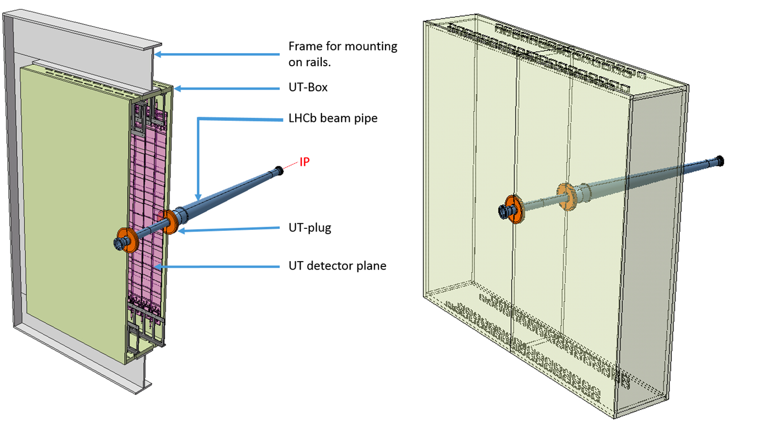
UT box deformation
UT box deformation → not properly closed → higher temperature
→ decreased humidity, nitrogen leakage
Surveys and monitoring of the sensors behaviour:
possible to run at 0℃
YETS: stop the Nitrogen leakage with a beam pipe seal + surveys
Giorgia Tonani VERTEX 2023 14

Slide 49
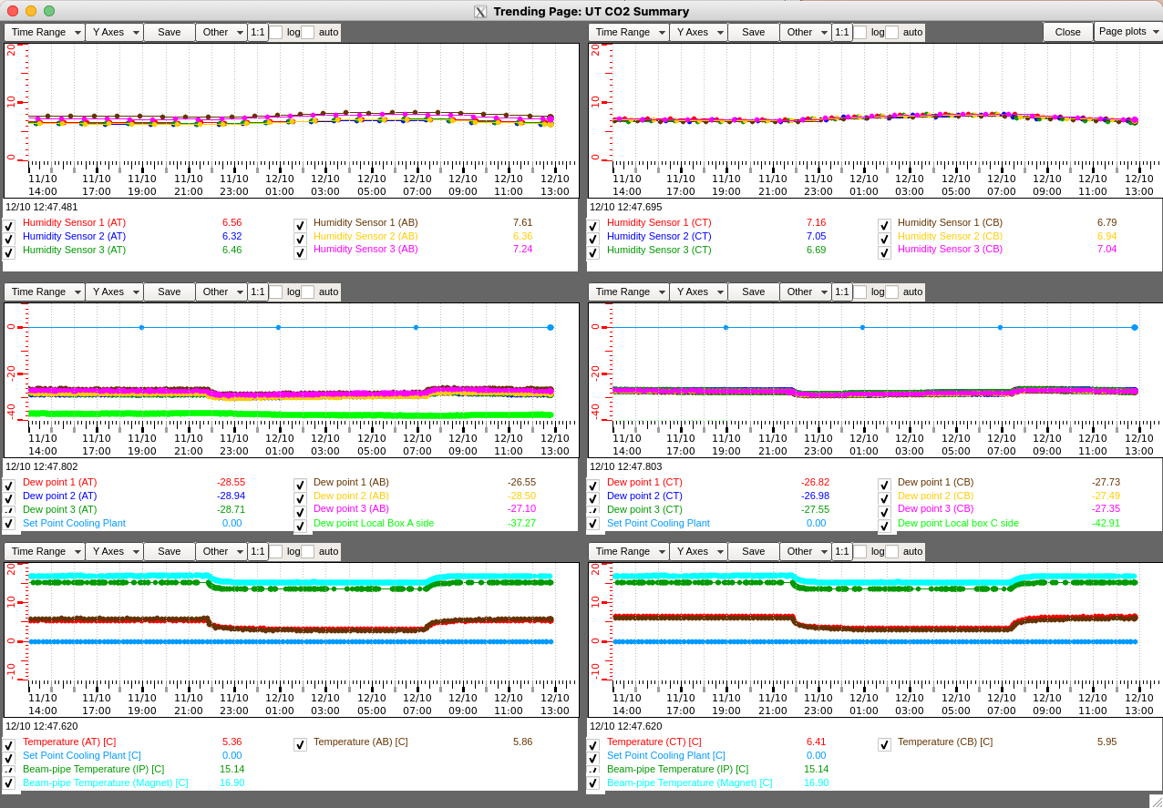
Giorgia Tonani VERTEX 2023 15

