Slide 1

Reconstruction techniques and physics case for displaced tracks and vertices at LHC
Agnieszka Obłąkowska-Mucha
on behalf of LHCb Collaboration
This work is partially supported by the NCN grant UMO-2019/35/O/ST2/00546

Slide 2
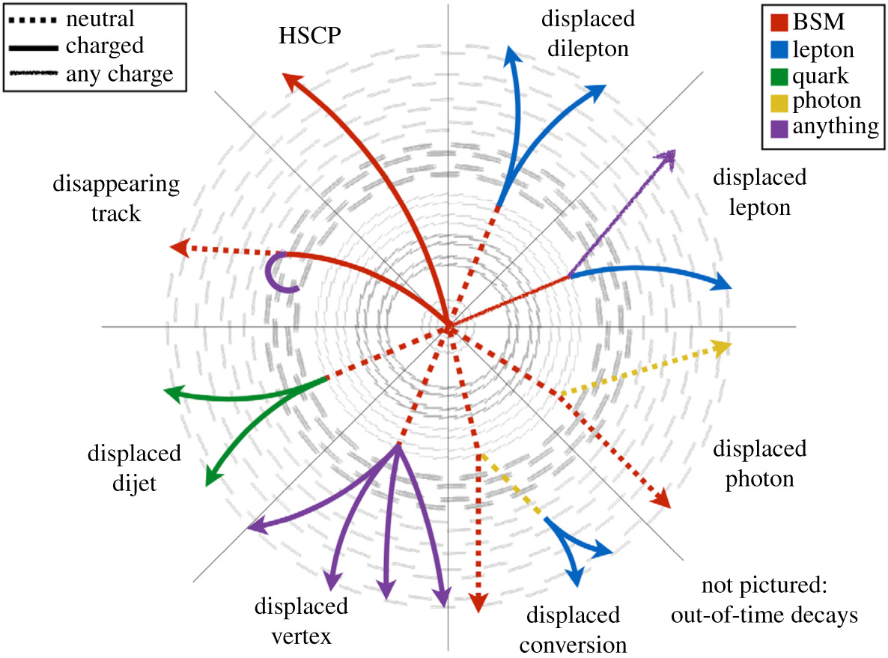



Motivation and outline
New Physics @ LHC experiments
LHCb Upgrade 1:
  SM particles
  real-time trigger
  novel algorithms in HLT1
ATLAS new trigger
CMS displaced muons and jets
Standard Model particles
Albert De Roeck
$$m_{NP}$$
New Physics
New Physics searches take displaced vertices as the first criterium of selection
$$ℴ(mm)$$
$${cτ}_{NP}$$

Slide 3
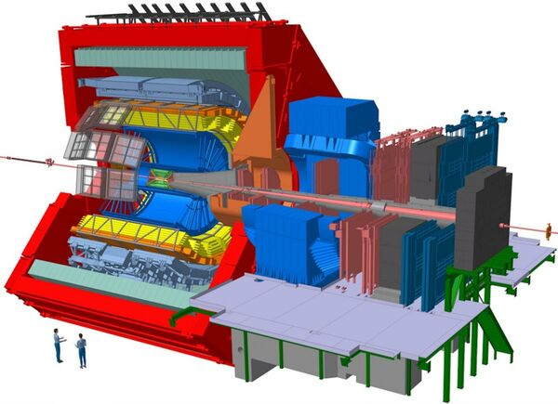
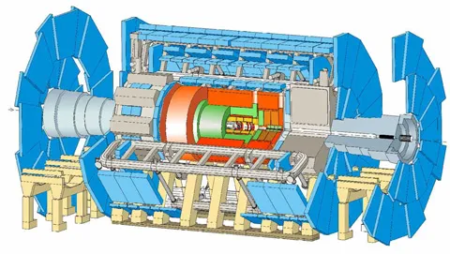
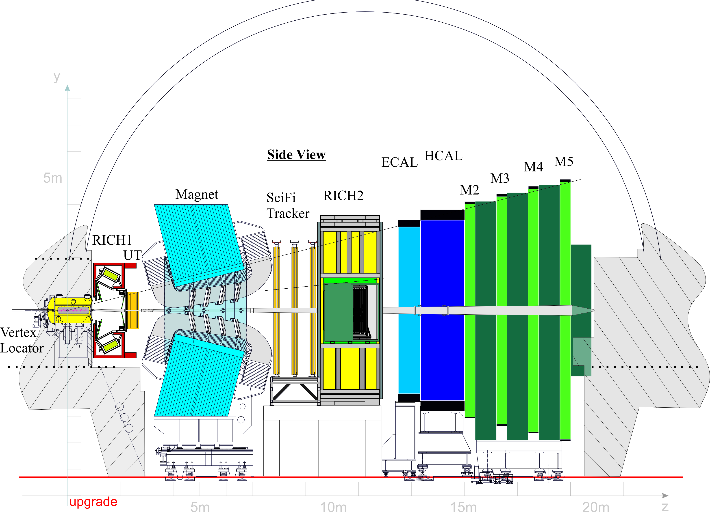
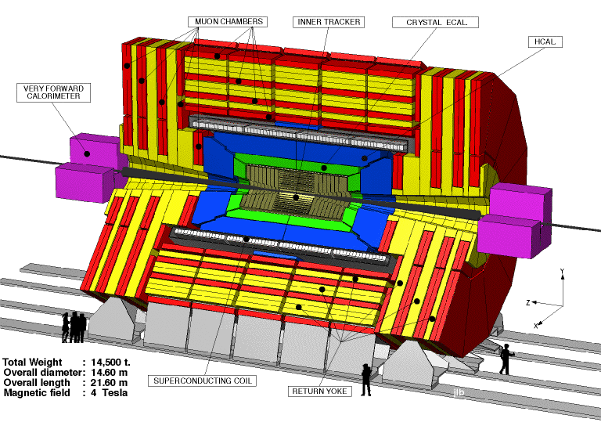
LHC experiments
ATLAS
ALICE
LHCb
CMS

Slide 4
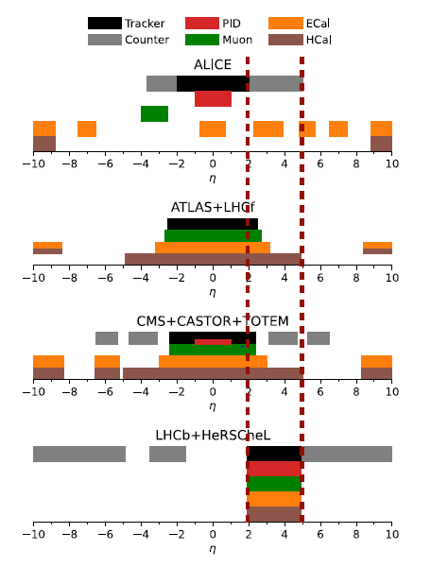
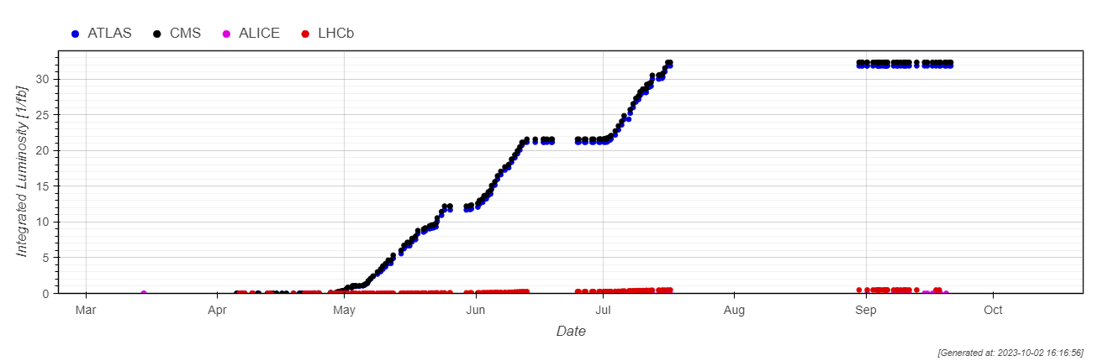
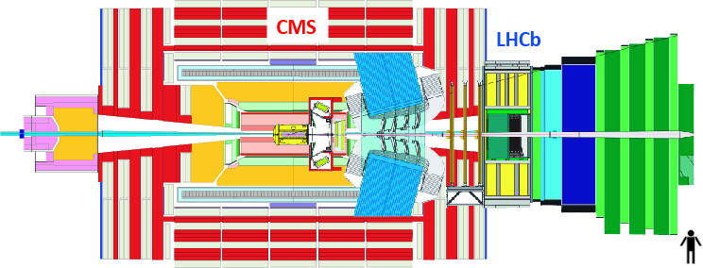

LHCb vs ATLAS/CMS
LHCb collects less data than ATLAS/CMS (factor ~10) and has a limited acceptance.
web.cern.ch/lhc/statistics/
LHCb has softer triggers (low pT), good vertexing, PID, momentum resolution.
In LHCb we look into complementary phase space regions.
$$\sim 8 m$$

Slide 5
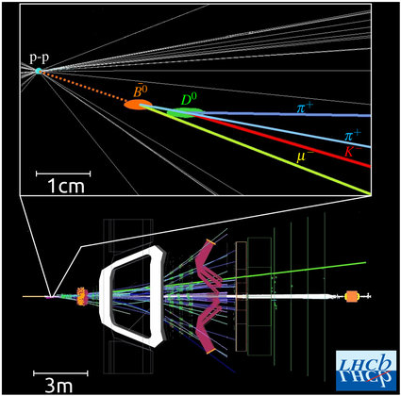
LHCb case study:
heavy flavour decays

Slide 6

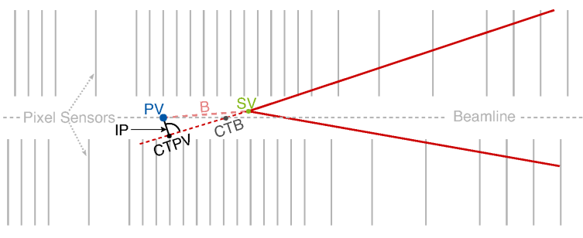
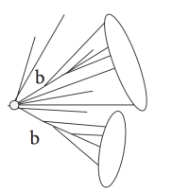


Long-lived particles in LHCb
Secondary vertices
Displaced vertices
Standard Model:
  Strange hadrons.
  Searches for exotic resonances in B/D decays.
Beyond Standard Model:
  Direct production of new particles
  Dark Matter with LL Higgs coupling,
  Dark Photon, etc
VELO sensors
$$X$$
$${cτ}_{X}$$
Decays reconstructed in VELO sensors.
Decays outside VELO

Slide 7
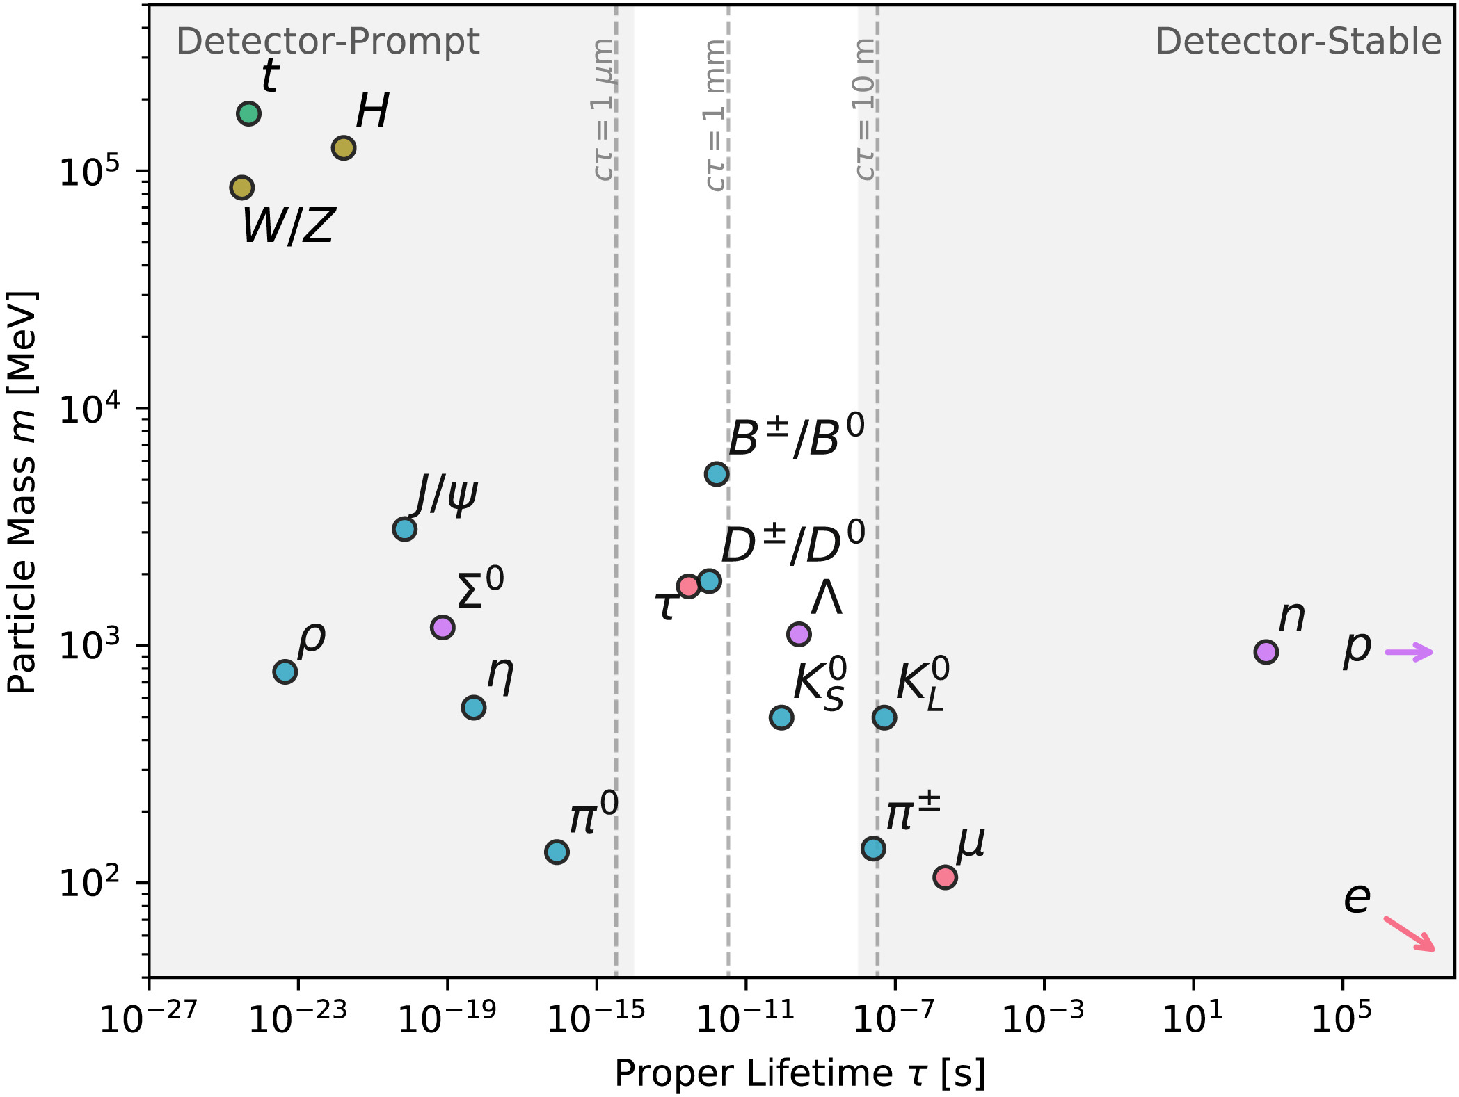
Heavy flavours – secondary vertices
Standard Model beauty and charm hadrons fly mm-cm distances and decay into low-momentum particles.
Tracking system (VELO, UT, SciFi) reconstructs tracks geometrically and provides momentum.
Main track types for physics analysis:
  Long (VELO+SciFi+UT),
  Downsteam (SciFi+UT),
  T tracks (SciFi).
Identification system gives the mass and energy of final states
so the decay tree is reconstructed.
Tracking + PID = decay chain
LLP
Displacement from primary vertex – first selection (trigger)

Slide 8
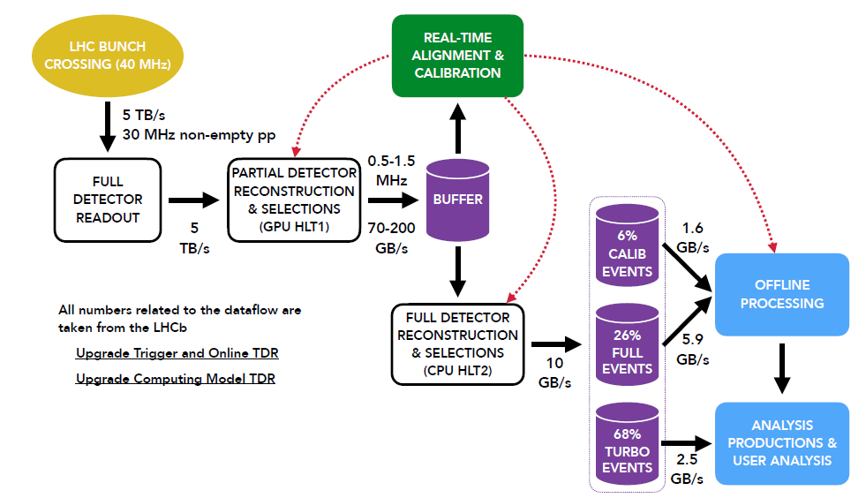
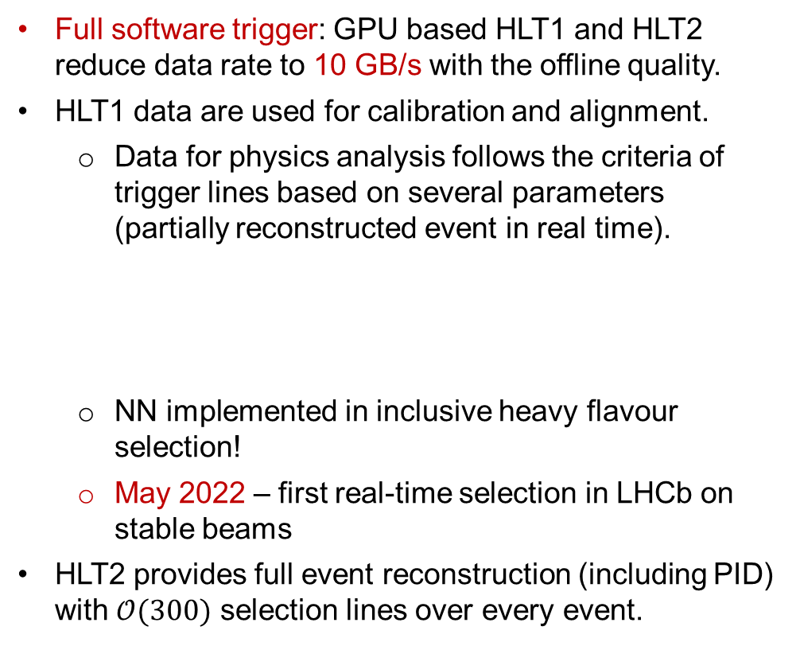
Real-Time Analysis Trigger
LHCb data are read out at 30 MHz (trigger-less system).
Full software trigger: GPU based HLT1 and HLT2 reduce data rate to 10 GB/s with the offline quality.
HLT1 data are used for calibration and alignment.
  Data for physics analysis follows the criteria of trigger lines based on several parameters (partially reconstructed event in real time).
  NN implemented in inclusive heavy flavour selection!
  May 2022 – first real-time selection in LHCb on stable beams
HLT2 provides full event reconstruction (including PID) with $𝒪(300)$ selection lines over every event.
LHC data rate: 4 TB/s
HLT1TwoTracks, HLT1FourTracks, etc.
tracks are required to be displaced with respect to the PV
LHCb disk storage: 2-10 GB/s
LHCb-FIGURE-2020-016

Slide 9
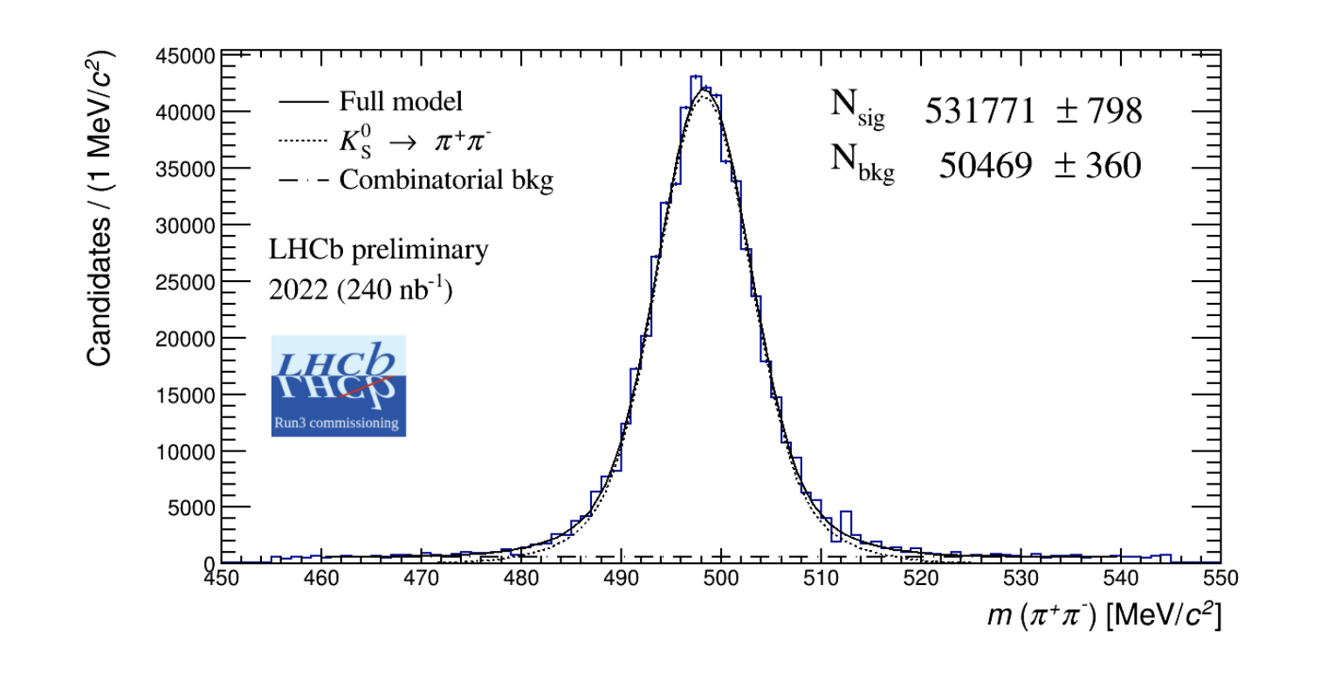
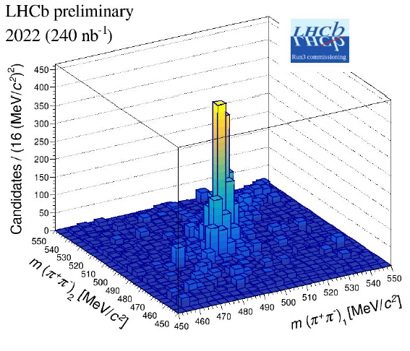

Long-lived SM particles in LHCb Run 3
  Strange hadrons reconstruction in Run 3:
    first LLP early triggering – HLT1 selections: TwoTrackKs, TwoKs
  Simulation studies:
    selection optimised with TMVA (criteria as in Run 2, typical for secondary vertices) – general-purpose TwoTrackMVA selection,
    negligible impact on HLT1 timing- ~%GPU, keeps 30 MHz read-out.
  Small Run 3 2022 data sample shows $K_{s}^{0}$ with good purity of collected candidates.

Slide 10
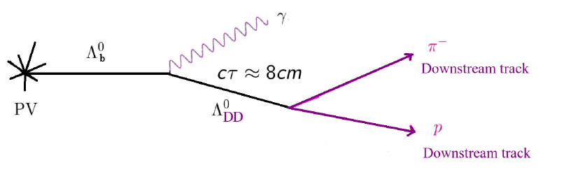

Long-lived SM particles in LHCb Run 3
Decays outside VELO
Ongoing LHCb effort toward HLT1 Downstream triggering (10.3389/fdata.2022.1008737)
- extremely computationally expensive (see the next slides).
- Long and Downstream Tracks were used for physics analysis for max decay length ~2m.
Displaced vertices
FPGA-based device for so-called Downstream Tracker (from Run 4) 1525 (2020) 012101 (ACAT 2019)
  solve heavy pattern recognition right after readout

Slide 11
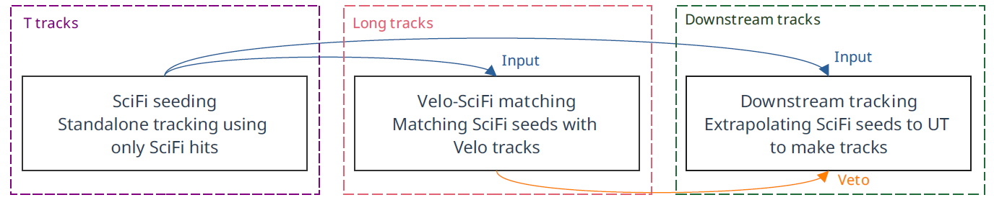

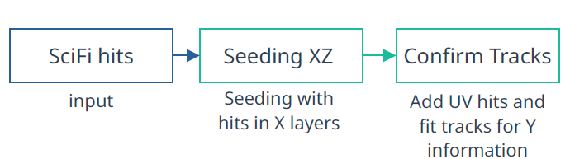
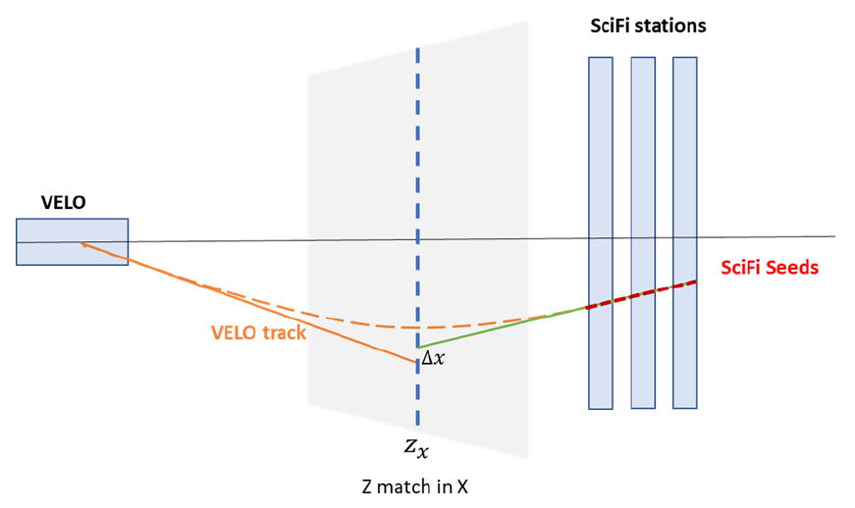
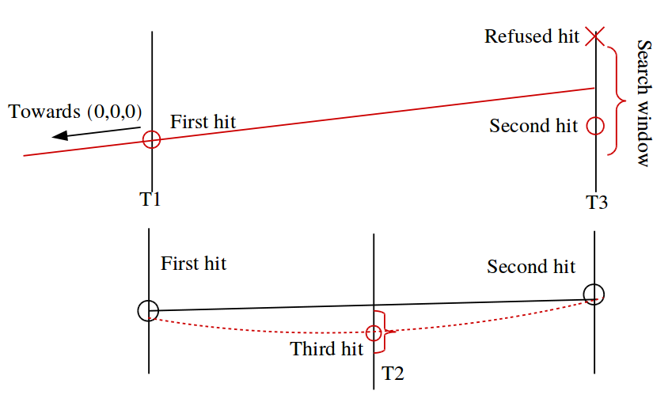
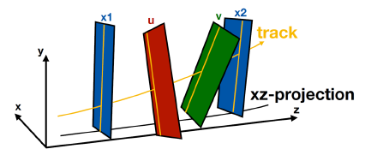
High Level Trigger in LHCb Upgrade
Long living particles (LLPs) are likely to decay after VELO (Downstream or T tracks).
Current HLT1 triggers long tracks only – less sensitive to LLPs searches.
Let’s implement the Hybrid seeding and add LLP reconstruction to HLT1: arxiv:2007.02591
B.K. Jashal Connecting the Dots Workshop 2022

Slide 12

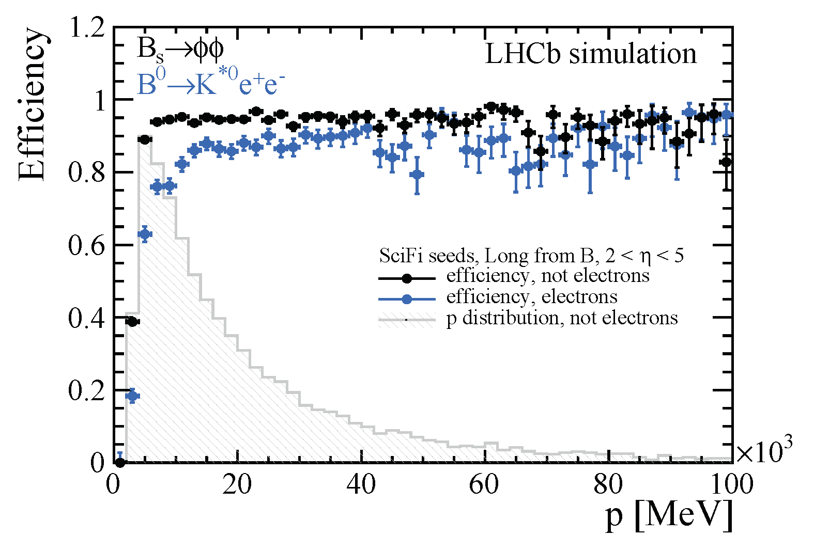
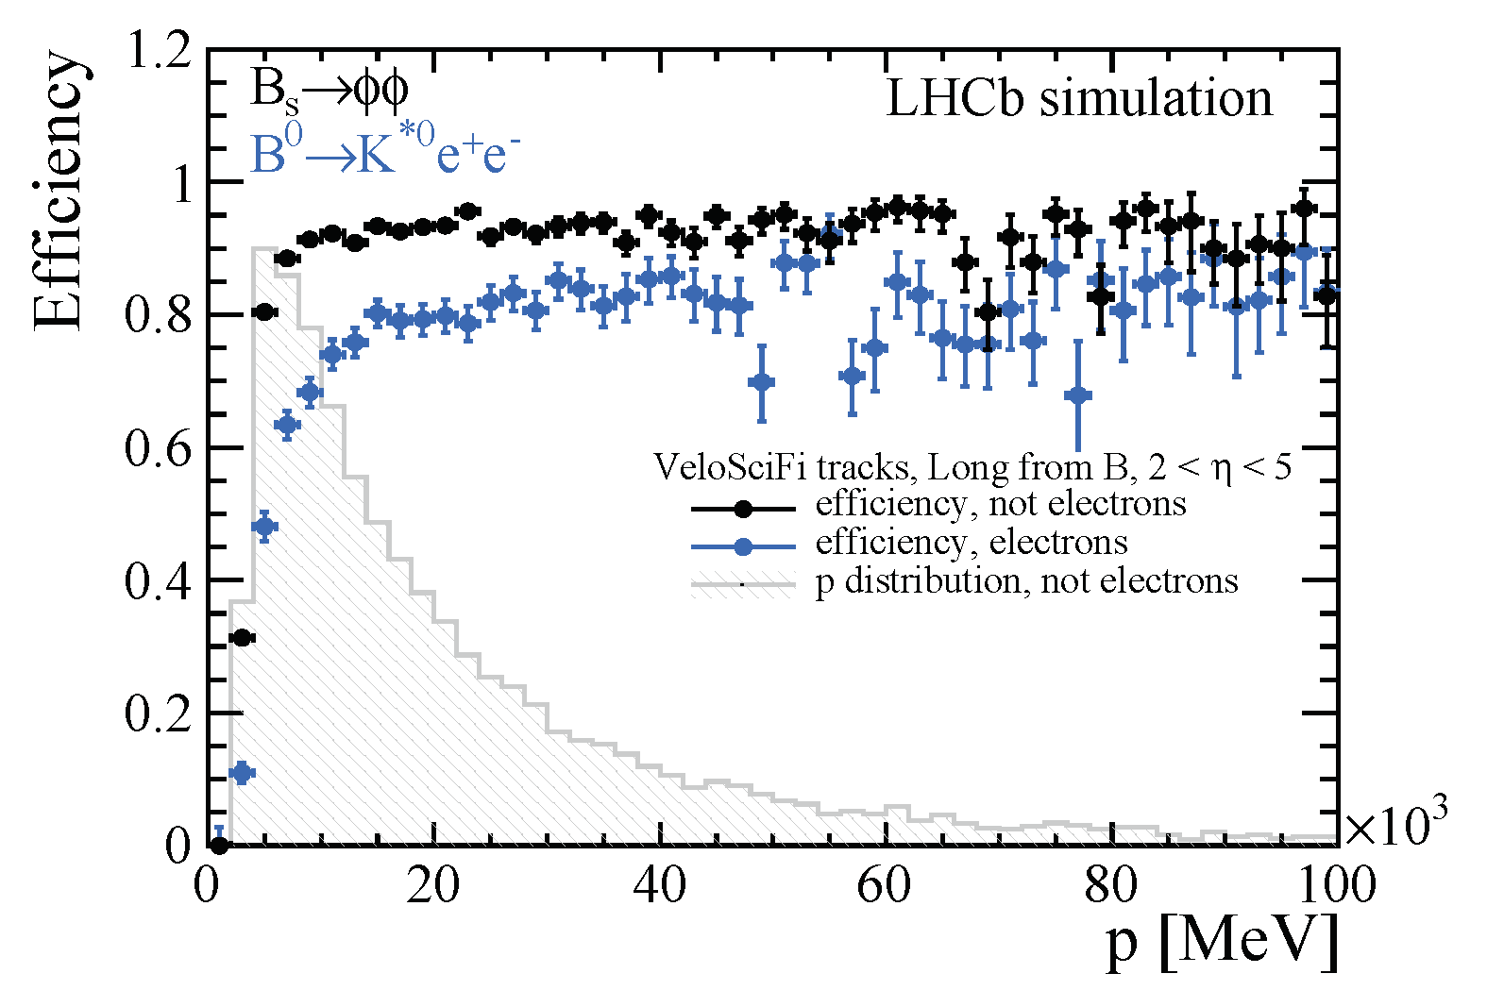
High Level Trigger in LHCb Upgrade
Long living particles (LLPs) are likely to decay after VELO (Downstream or T tracks.
Current HLT1 triggers long tracks only – less sensitive to LLPs searches.
Let’s implement the Hybrid seeding and add LLP reconstruction to HLT1: arxiv:2007.02591
see Jiahui Zhuo’s poster on Downstream Tracking
UT hits to be added after the commissioning
Now:
SciFi seeds in HLT1 (GPU) which are basic building blocks for downstream tracking.
LHCB-FIGURE-2022-010
B.K. Jashal Connecting the Dots Workshop 2022
To zdjęcie, autor: Nieznany autor, licencja: CC BY-SA

Slide 13

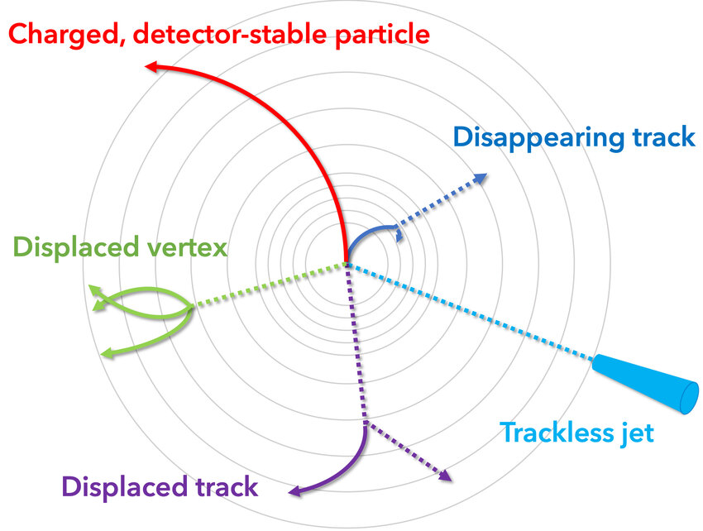
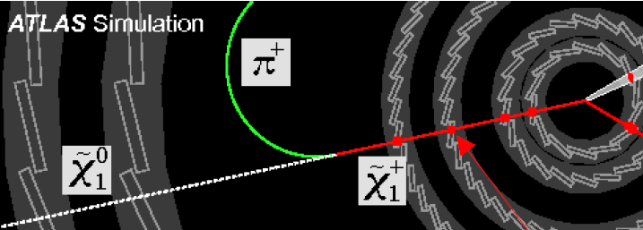
ATLAS
RUN 2:
A plethora of LLPs searches based on dedicated track and vertex reconstruction.
Limited efficiencies due to:
  large flight distances, escaping from the most precise detectors,
  displaced tracks and vertices,
  low transverse momentum.
RUN 3:
Dedicated trigger is necessarily
Disappearing Track Trigger:
  categorise tracks based on number of Pixel and SCT hits (tracklets)
  Train BDT on various track-related quantities to remove fake tracks,
  lower missing momentum threshold and increase in acceptance.
2019 JINST 14 P11099

Slide 14
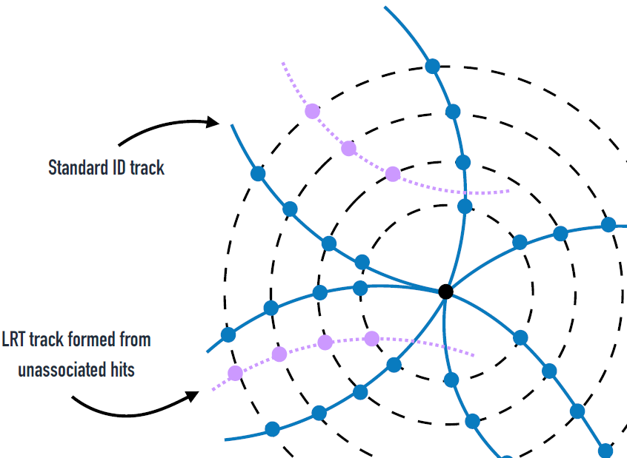
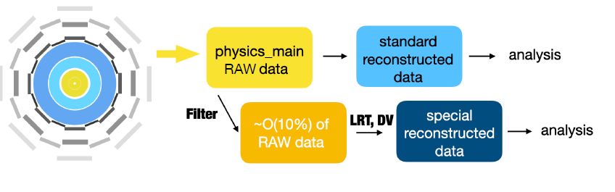
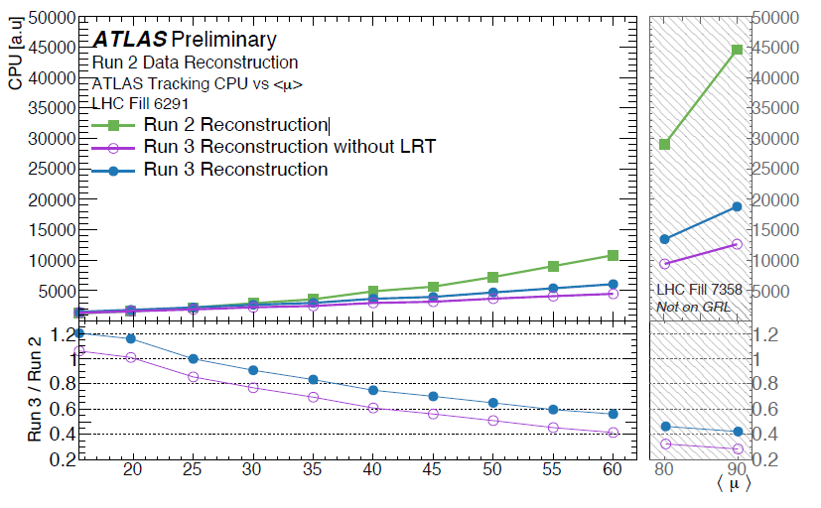
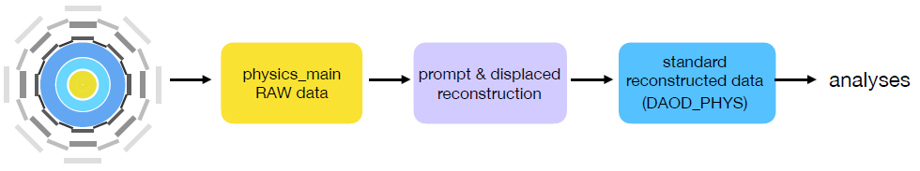
ATLAS LLP tracking (displaced leptons)
LLPs decays should occur in ID
Large Radius Tracking (Run 2):
  modification of standard ATLAS reconstruction (increased distances from IP)
In Run 3 reoptimised for fake reduction and CPU time.
Trigger runs LRT like offline tracking and standard reconstruction over
entire detector,
Displaced electrons and muons up to 30 cm.
J.Burzynski CTD Workshop 2022

Slide 15

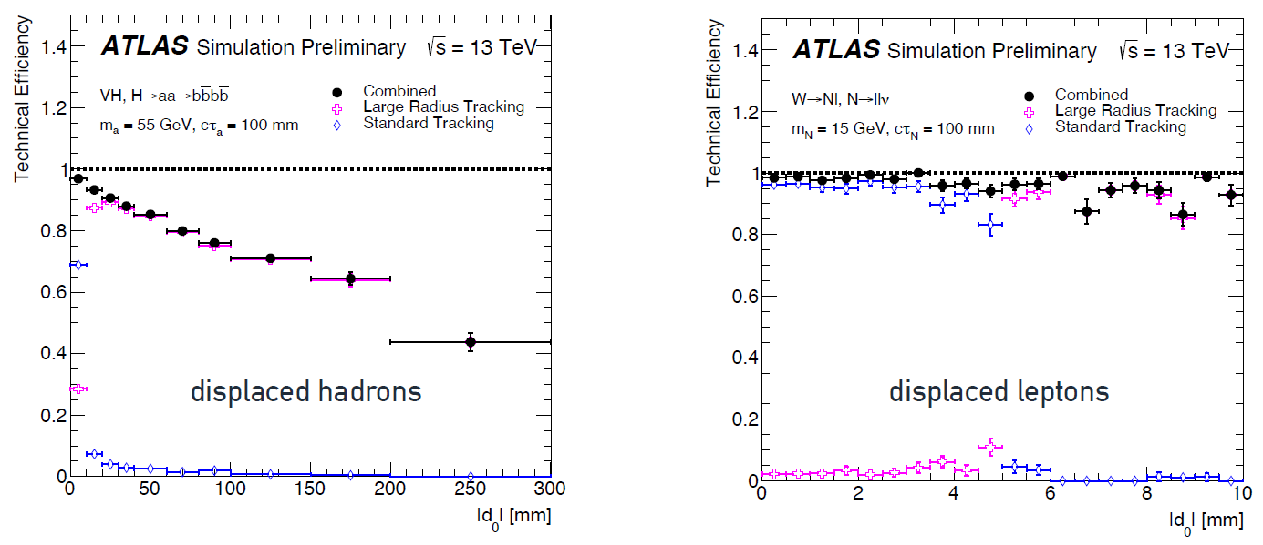
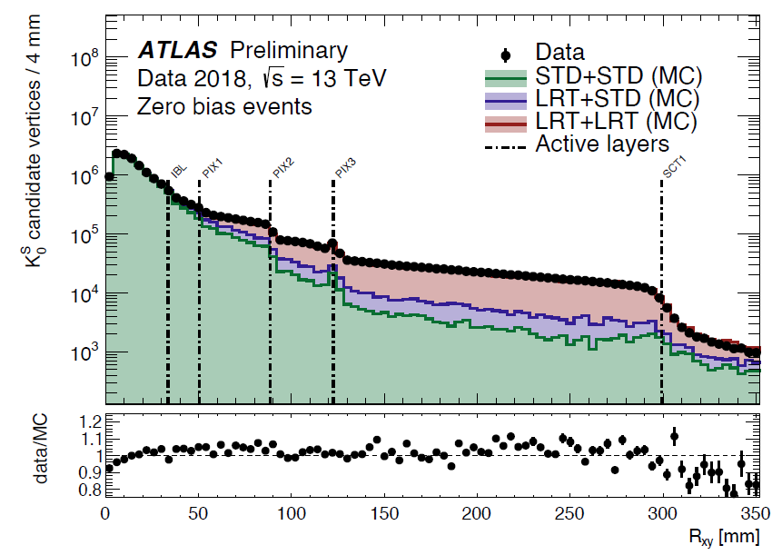
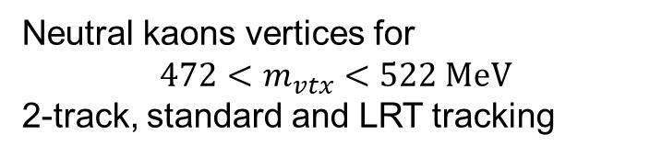
Performance of Large Radius Tracker
Neutral kaons vertices for
$$472<m_{vtx}<522 MeV$$
2-track, standard and LRT tracking
Efficiency with simulated samples:
Data!
HL-LHC, new Inner Tracker: ML applied to tracking (Graph Neural Network)
J.Burzynski CTD Workshop 2022

Slide 16

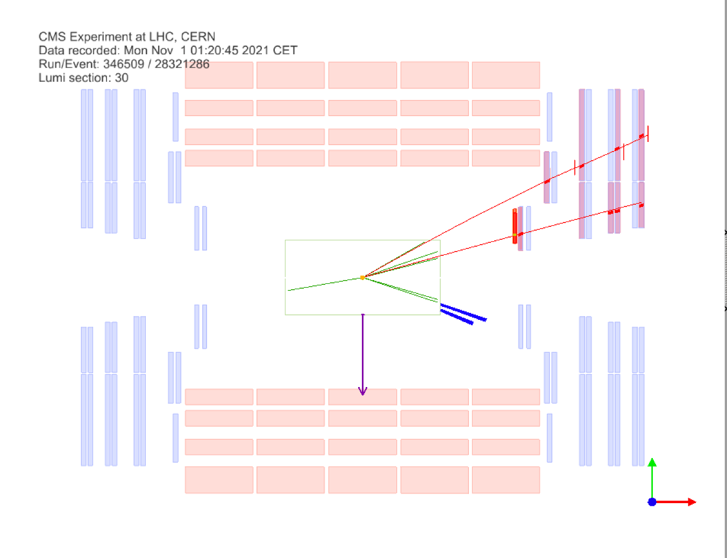
CMS Trigger in Run 3
JHEP 05 (2023) 228
Run 3 trigger: new tracking in HLT based on optimised pixel track.
Software based trigger online trigger running on CPU+GPU farm.
GPU reconstruction implemented and fully commissioned
  calorimeter and pixel local reconstruction + pixel tracking + vertex reconstruction
  The execution time per event of was reduced by ~40%
    CMS DP2023-024
Displaced muons:
Muons originating from a common secondary vertex separated from pp interaction by distance ~µm to several meters (dimuon trigger) Phys. Rev. Lett. 127(2021) 261804
Search for LLP with high missing energy in 4 endcap muon detectors (7-10.5 m away from IP).
EXO-21-006
CMS-PHO-EVENTS-2021-031

Slide 17
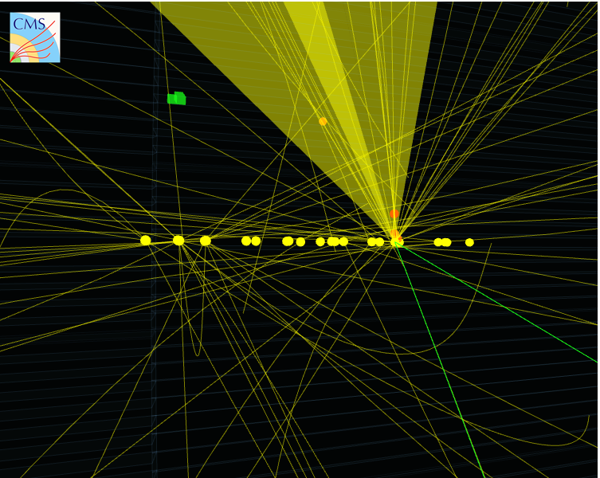



Displaced jets: CMS
Goal: model-independent search for displaced jets.
LLP should decay inside the tracker, decay vertex displaced from production vertex no more than 55 cm in transverse plane.
jets with
displaced tracks
New dedicated trigger tested in Run 2 and applied in Run 3.
Identification of PVs.
Jets reconstructed by energy deposits in calorimeter, with tracks associated with PV and missing momentum.
Full event reconstruction offline with BDT to estimate background etc.
Reconstruction of secondary vertex.
SV
PVs
$$e^{−}$$
Displaced trigger
more efficient for low-mass LLP
Inclusive trigger
high-mass LLP with decay length <3 mm or >300 mm
$$e^{+}$$
https://cms3d.web.cern.ch/EXO-20-003/

Slide 18


Summary
Progress in LLP reconstruction was done mainly due to better reconstruction algorithms, run on GPU and usage of ML techniques.
LHCb:
  software trigger on CPU+GPU successfully selects secondary vertices,
  hybrid seeding implemented for displaced tracks,
  Run 4 and beyond, FPGA-based trigger: pattern recognition for tracking with RETINA algorithm,
ATLAS: Improved efficiency in L1 trigger and HLT with new Large Radius Trigger
CMS: new tracking with fully implemented GPU reconstruction and displaced muon and jets searches.
ALICE: new detector readout, continuous for ion events.
2024 data taking

