Slide 1
The Future of Solid-State Detectors (from the DRD3 point of view)
Disclaimer:
Solid-state detectors are much more diverse than the small ensemble we use for particle tracking.
The future of solid-state detectors for tracking is not contained solely in the DRD3 activities.
Other collaborations are developing solid-state detectors.
Single groups not active in DRD3 are doing excellent R&D.
In this presentation, I will summarize the draft plan proposed as the starting point of the soon-to-be DRD3 collaboration.
The real plan will be decided by the DRD3 collaboration
Nicolò Cartiglia
INFN, Torino.

Slide 2
The definition of future
What is needed by future experiments
What technologies will be used
Future
What blue-sky R&D will make possible
What people want to do

Slide 3
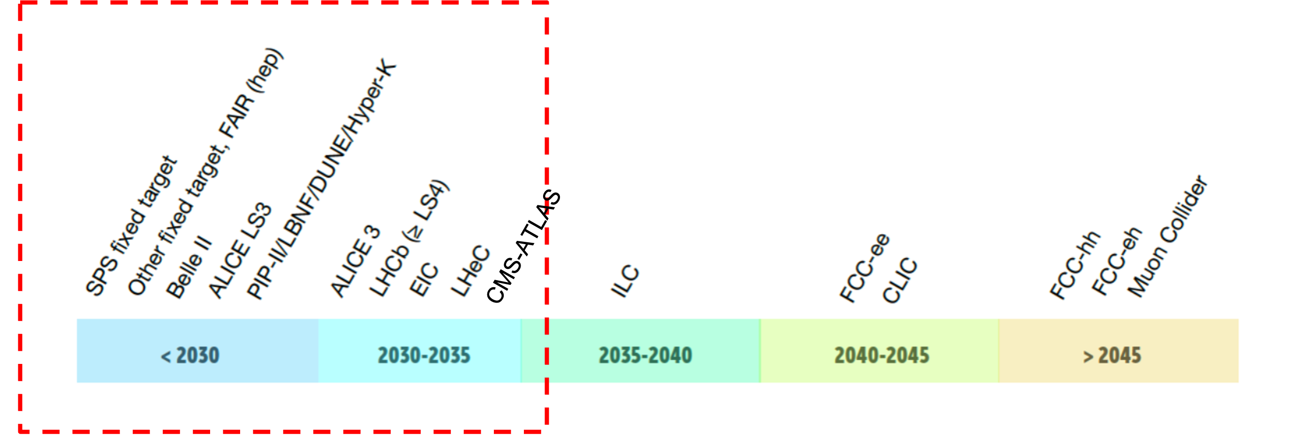
What is needed by future experiments
Broadly speaking, there are two large families of experiments that cover the needs of all other applications:
Lepton colliders:
4D tracking
Very low mass
Low power
Air cooling
Hadron colliders:
4D tracking
High occupancy
High radiation environment
Large area coverage

Slide 4
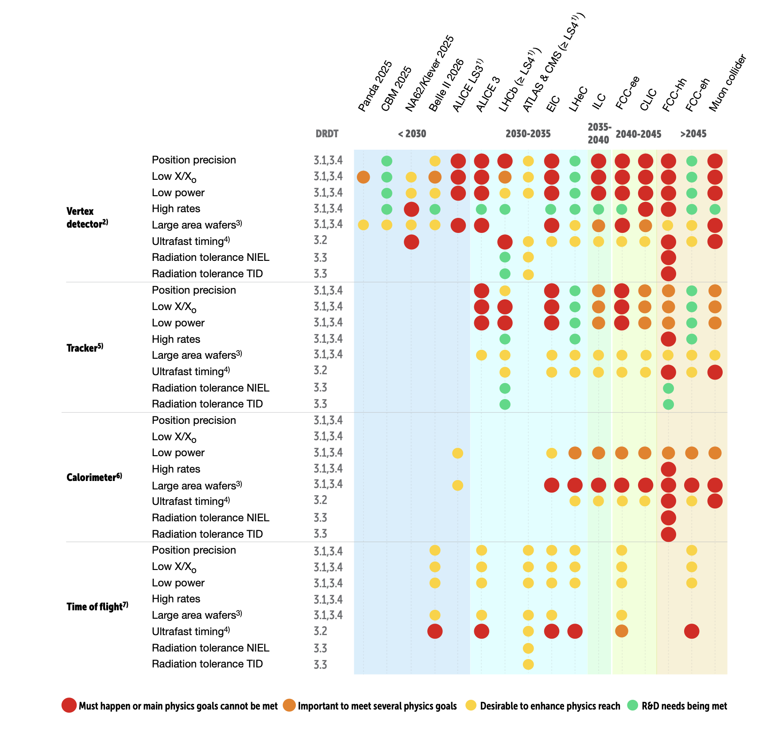
Future experiments needs - I
This table details the need of the experiments in terms of
Spatial precision
Low mass
Low power
Large area
Temporal precision
Radiation levels
considering the division among detectors:
Vertex
Tracker
Calorimeter
Time-of-Flight

Slide 5
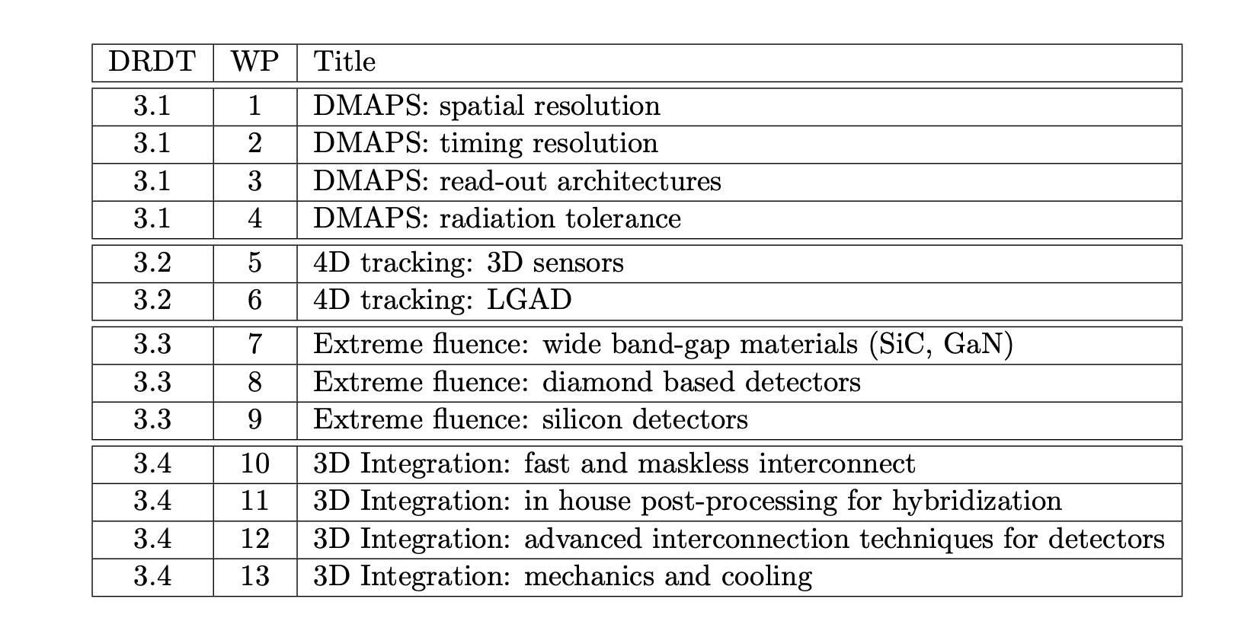
Future experiments needs - II
The needs have been summarized into 4 large groups in the ECFA road-map
with a finer-grain definition in the DRD3 proposal

Slide 6
Future experiments needs - examples
Example 1)
5-10 micron position resolution
10-20 ps temporal resolution
50 microns of silicon equivalent material budget
<1 W/cm² power consumption (upper limit for air cooling)
Example 2)
~ 10 ¹⁷ n_{eq}/cm² radiation levels
Example 3)
12” wafer capability
1000 m² detector

Slide 7
What technologies will be used
Hybrid
Monolithic
ASIC
Sensor
Sensor
ASIC
Low-gain (LGADs)
No gain
Low-gain (LGADs)
No gain
Standard read-out
Resistive read-out
Planar
3D
Si/Diamond
BiCMOS
(SiGe)
CMOS
BiCMOS
(SiGe)
CMOS

Slide 8
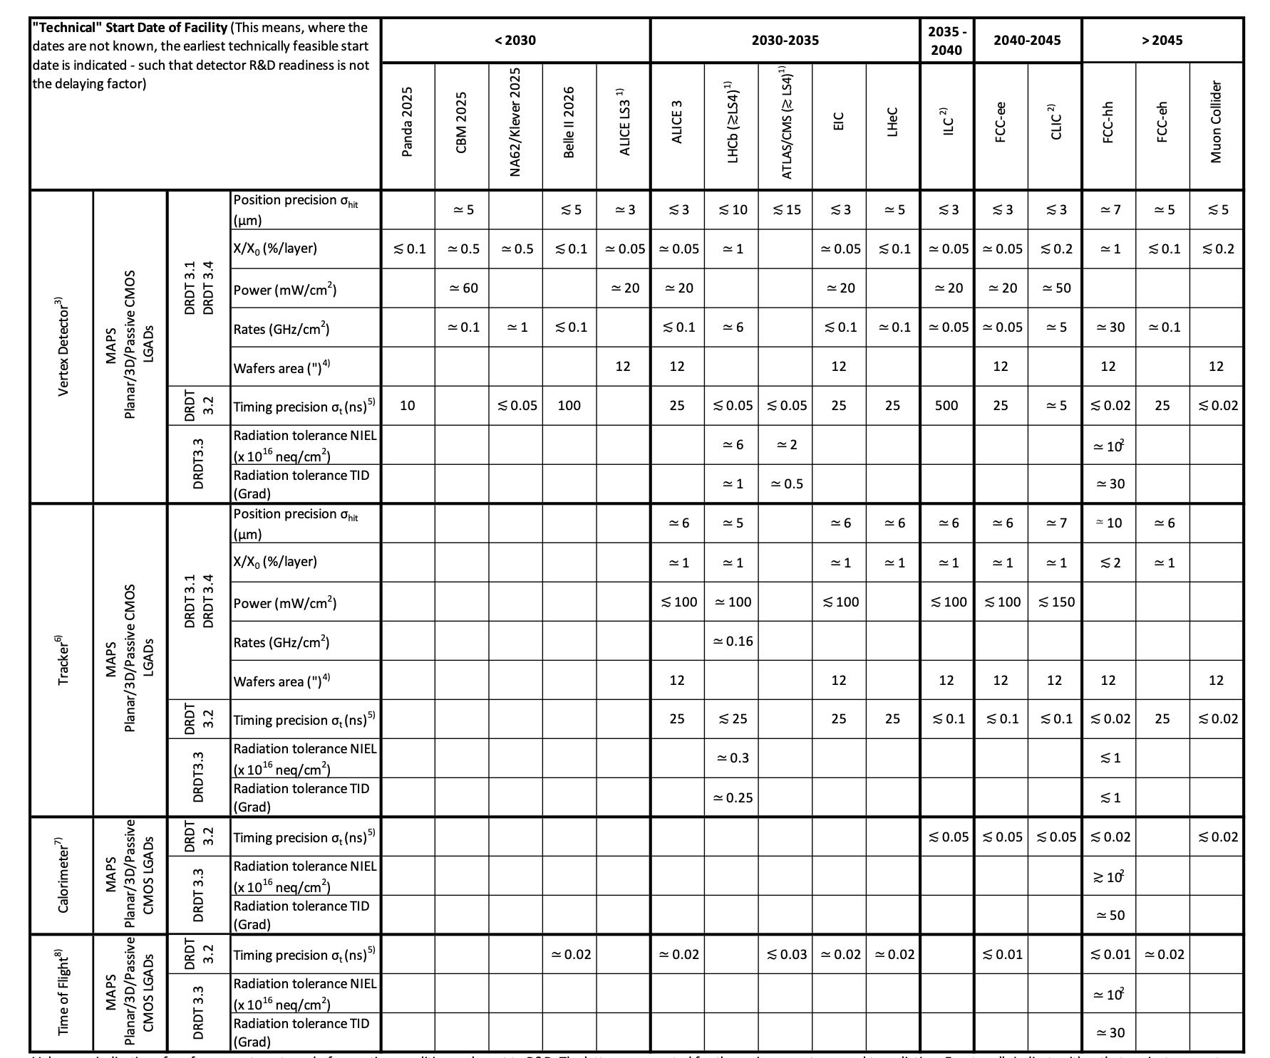
Technologies - I
This very nice and very difficult-to-read table links together the previous pieces:
The needs of the experiments
Applications,
Technologies
DRDT
and provide quantitative targets for the R&D.

Slide 9
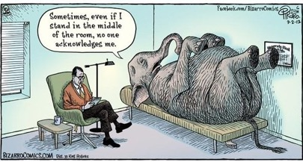
Technologies – Example
4D tracking: Interplay of power, pixel size, and electronics
The sensor design, based on the LGAD concept, is well-developed
The electronic design of accurate amplifiers for timing is well-known
However: the power requirement for a large system with very good position resolution is presently too high.
Power will determine:
The architecture of 4D tracking detectors
how many layers will be 4D and how many will be 3D
The pixel size and the temporal precisions.
Power

Slide 10
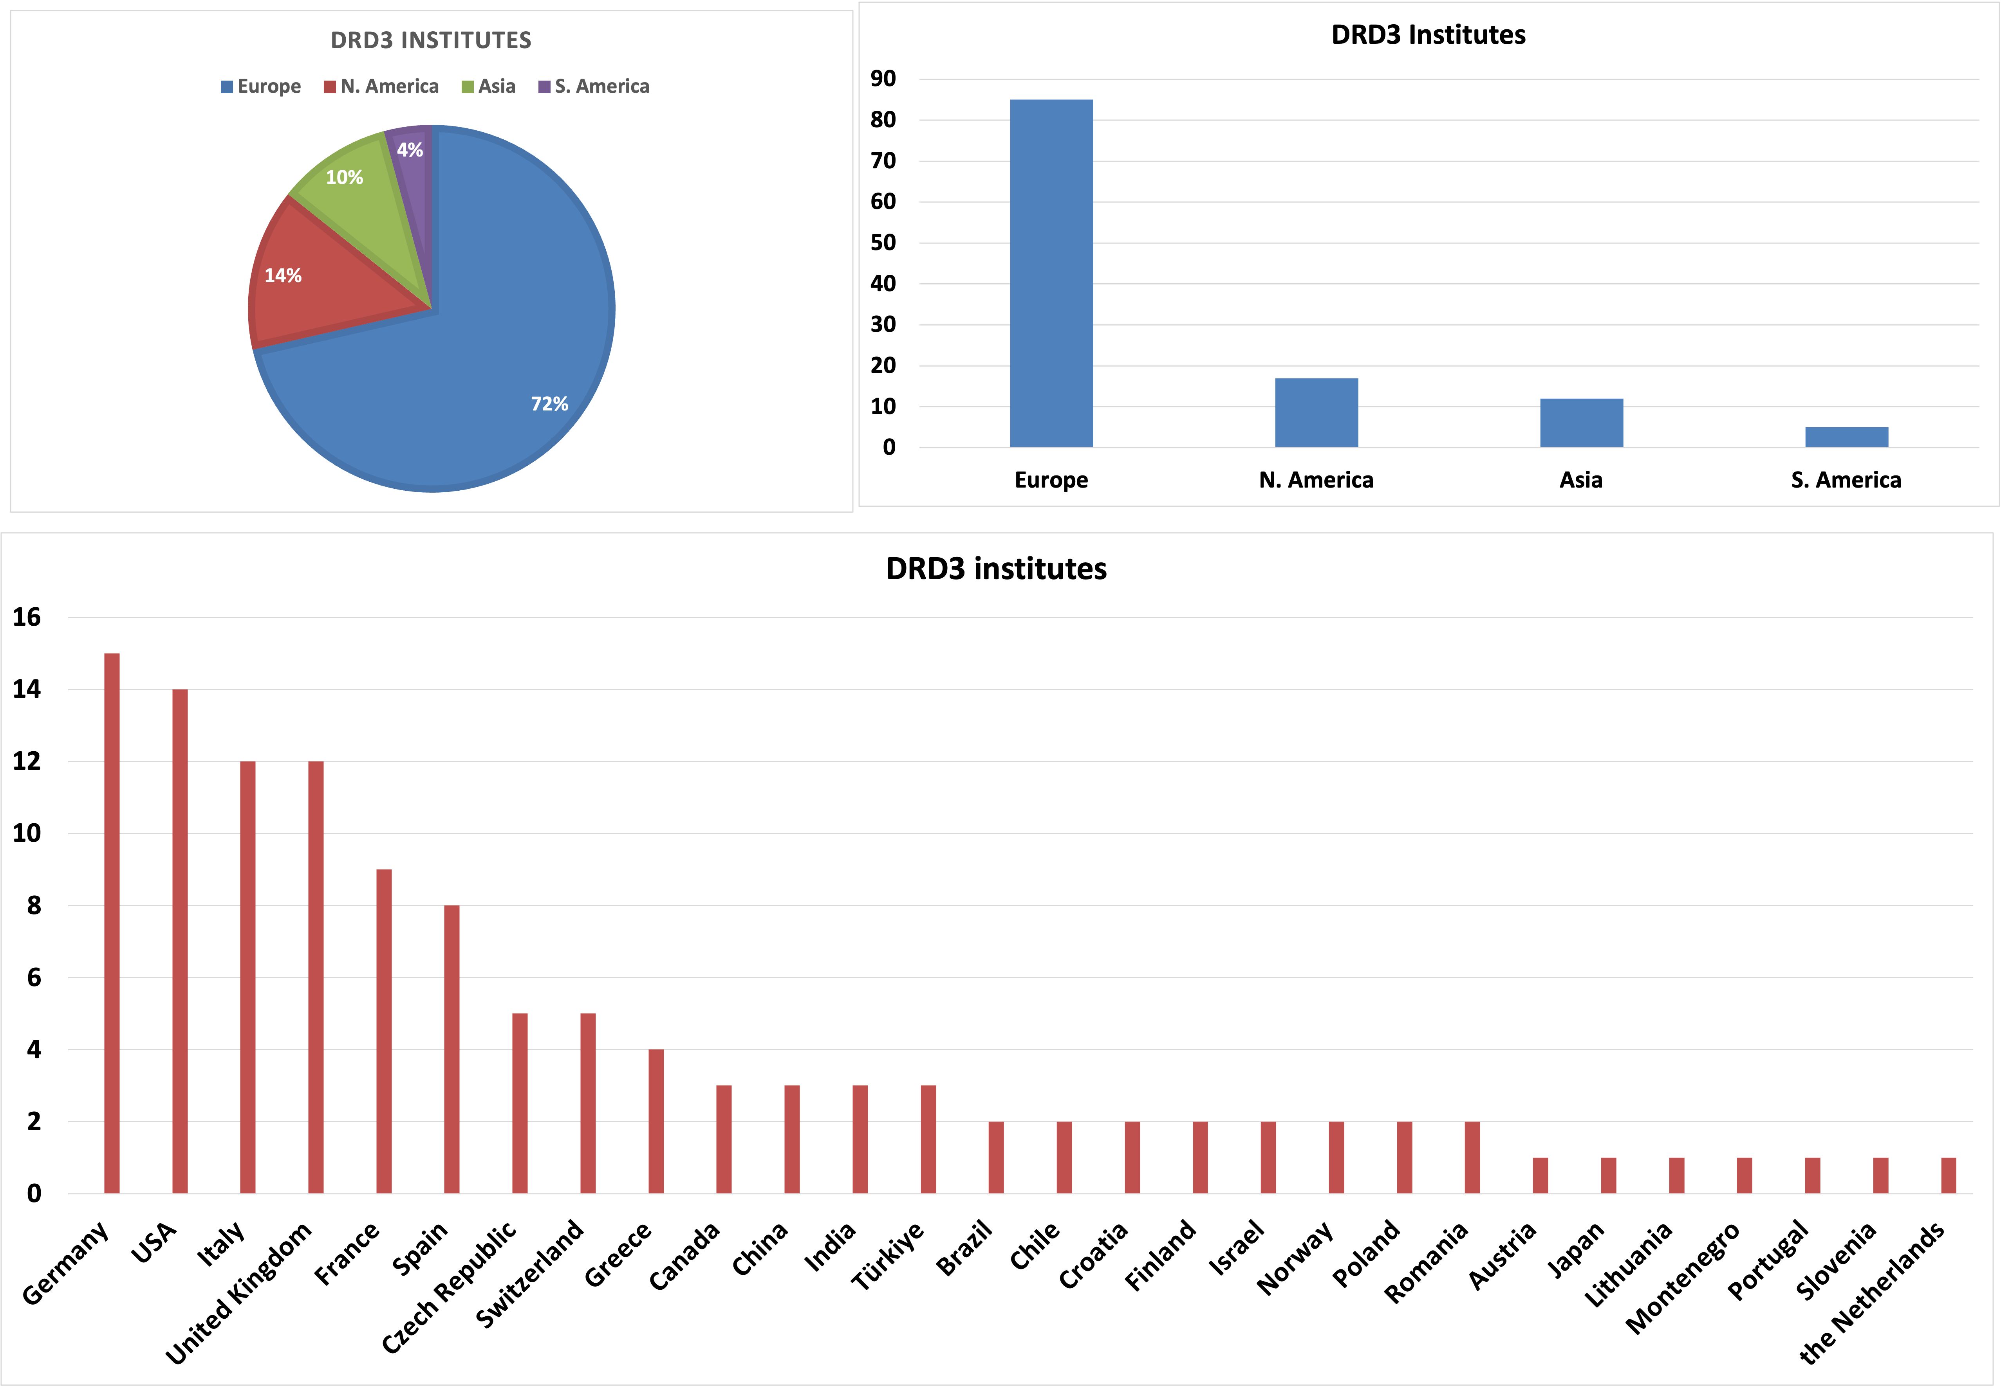
What people want to do – DRD3 composition
Presently, the DRD3 proto-collaboration comprises 119 groups from 28 countries, for about 900 interested people.
The more, the merrier…

Slide 11
What people want to do – DRD3 working groups
The DRD3 activity is divided in 8 working groups.
WG 1
Monolithic
CMOS sensors
WG 2
Sensors for tracking
and Calorimetry with
space/time and/or
energy resolution
WG 3 Radiation damage
and extreme
fluence
operation
WG 4
Simulations
WG 5
Techniques,
Infrastructures, and
facilities for sensors
characterization
WG 6
Wide bandgap and
Innovative sensor
material
WG 7
Sensor
Interconnection
techniques
WG 8
Dissemination
and
outreach

Slide 12
What people want to do - I
Number of institutes interested in each working group
Interestingly, the number of institutes is evenly distributed among the working groups

Slide 13
What people want to do – finer grain

Slide 14
What blue-sky R&D will make possible
R&D aimed at increasing our understanding of solid-state detectors is a key ingredient of DRD3
Blue-sky R&D will be financed by the “blue-sky fund”, created by asking for an annual fee to each institute (about 2k CHF)
The blue-sky fund will finance projects proposed by DRD3 members (typically contributing about 50% of the total cost while the other 50% is shared among the proponents).

Slide 15
Putting everything together: the DRD3 structure
WG1
RG #1
RG #2
….
WG2
RG #1
RG #2
….
….
WG8
RG #1
RG #2
….
DRDT 3.1
DRDT 3.2
DRDT 3.3
DRDT 3.3
DRD3 approval
WP1
Deliverable #1
Deliverable #2
……
WP2
Deliverable #1
Deliverable #2
…..
WPn
Deliverable #1
Deliverable #2
…..
CP1
…
CPn
…..
Blue Sky R&D
Strategic R&D
WG: Working group RG: Research goal WP: Work package CP: Common project

Slide 16
The path to the DRD3 collaboration
The DRDC gives the green light to form the DRD3 collaboration.
The representatives from each of the intestested institutes (119 so far) form the collaboration board.
The collaboration board elects the chair.
The first DRD3 collaboration meeting is organized (Q1/2024).
The spokespersons are elected
The mandate of the DRD3 “facilitators” ends
The DRD3 MoU is signed

Slide 17
Outlook
If your dreams do not scare you, they are not big enough
In the past 30 years, solid-state sensors have consistently exceeded expectations in terms of performance.
DRD3 is a new collaboration that aims to continue this tradition.
If you have not done it yet, please consider joining DRD3. We are now entering an important organizational phase that needs the broadest possible inputs.

