Slide 1



Control of synthetic genetic circuits to program bacterial gene expression and behavior
Clock synchronization and therapeutics delivery
April 26th , 2023
INFN@Young Seminar
Filippo Liguori
Ciclo XXXVII

Slide 2
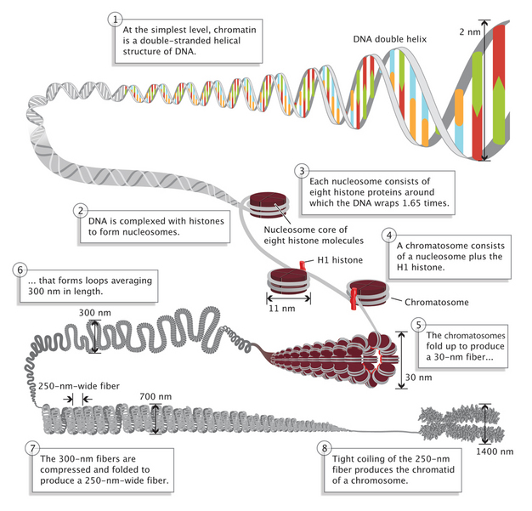
Synthetic genetic circuits
A
T
Genes interact via proteins that can bind DNA and activate or repress gene expression.
R
T
R1
Bacterial genetic circuits are synthetic networks of interacting genes designed to program the time dynamics of protein production in bacteria.
R2
A

Slide 3

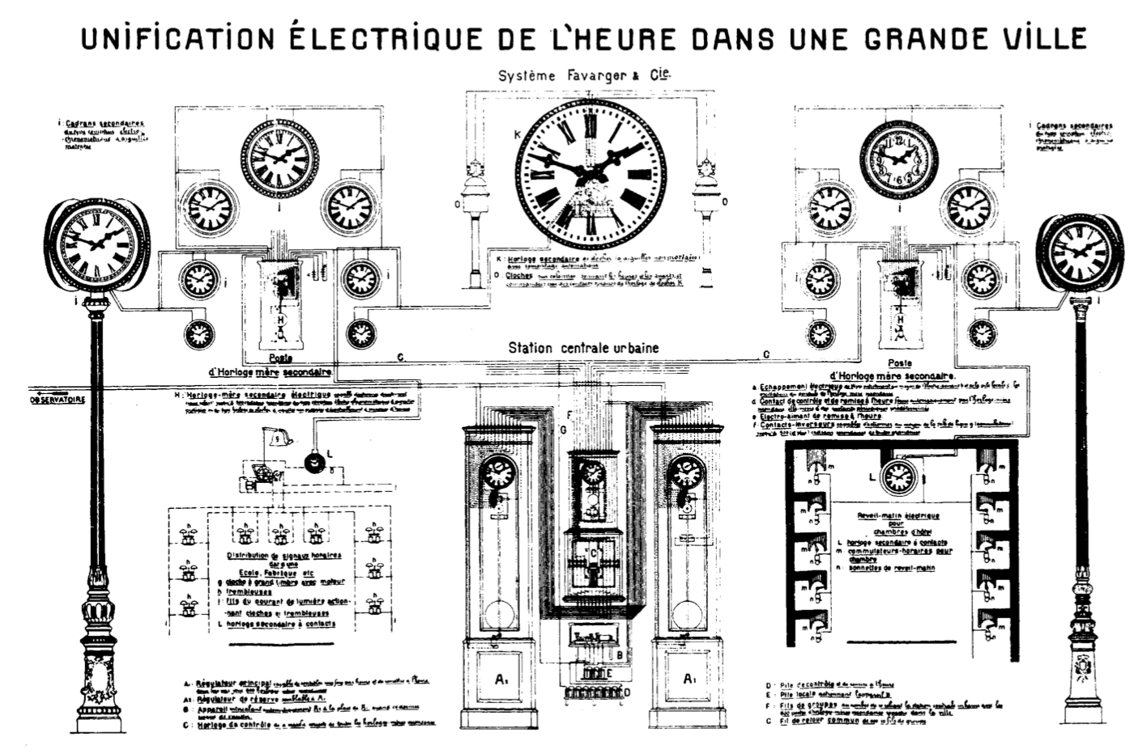
Synchronizing clocks
Complex synchronous rhythms in nature arise from stochastic, nonlinear biological mechanisms.
The ‘clock coordination’ problem has widely impacted Europe in the 19th and early 20th century.
Fireflies getting in sync
MEYER & GWERDER, SYNCHRONICITY (THAILAND), 2015

Slide 4
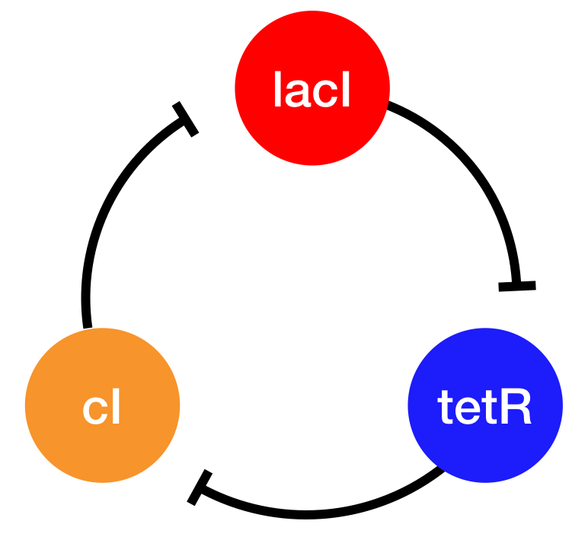
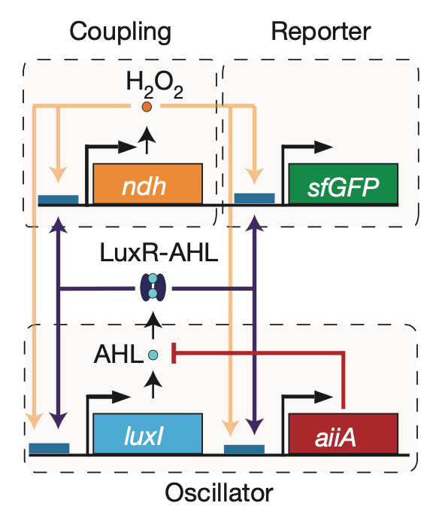
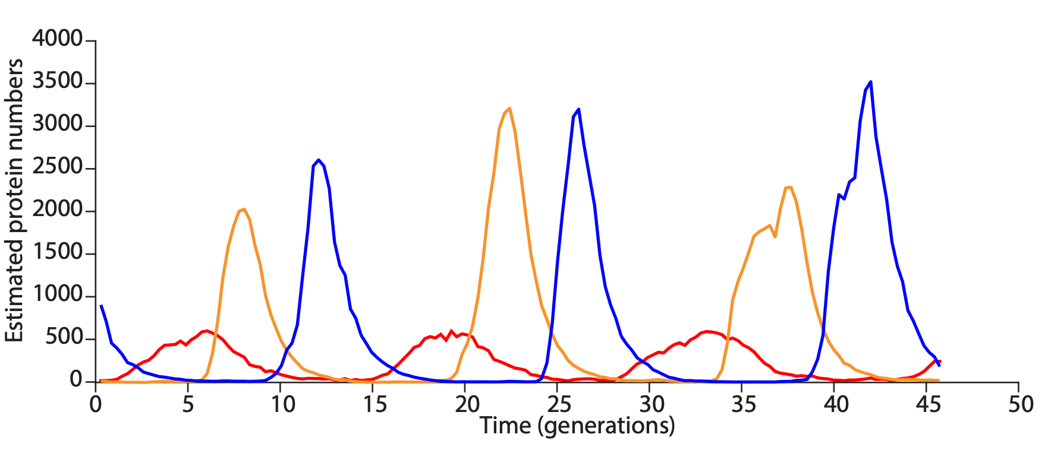
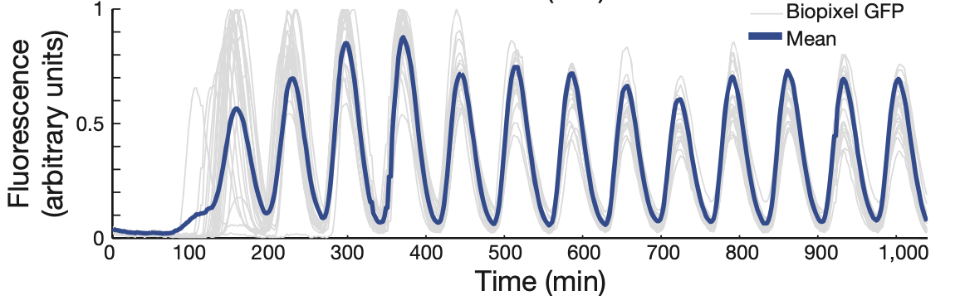

Synthetic genetic oscillators
Repressilator
Quorum oscillator
ELOWITZ & LEIBLER, NATURE, 2001
PRINDLE ET AL., NATURE, 2011
POTVIN-TROTTIER ET AL., NATURE, 2016
PRINDLE ET AL., NATURE, 2011

Slide 5
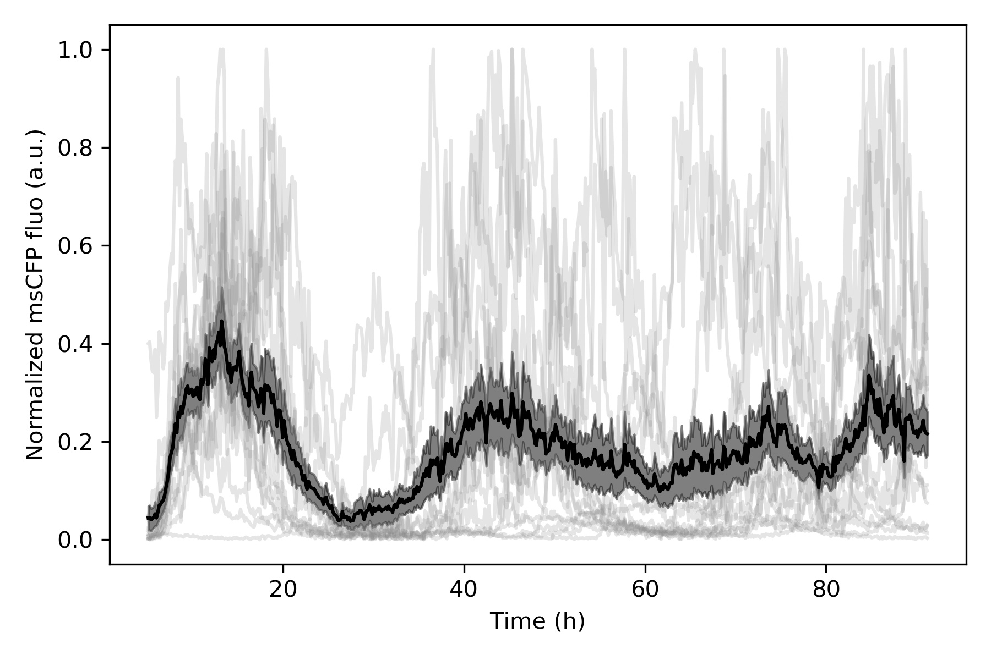
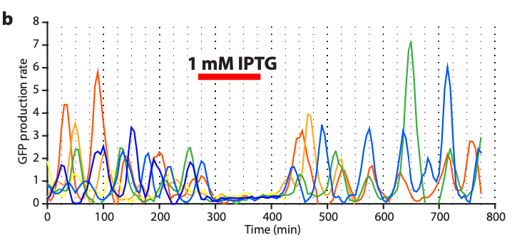
Loss of sync in the repressilator
IPTG
Biological noise poses fundamental limits on the phase drift of independent repressilators. An external cue is the optimal strategy to prevent it.
POTVIN-TROTTIER ET AL., NATURE, 2016

Slide 6
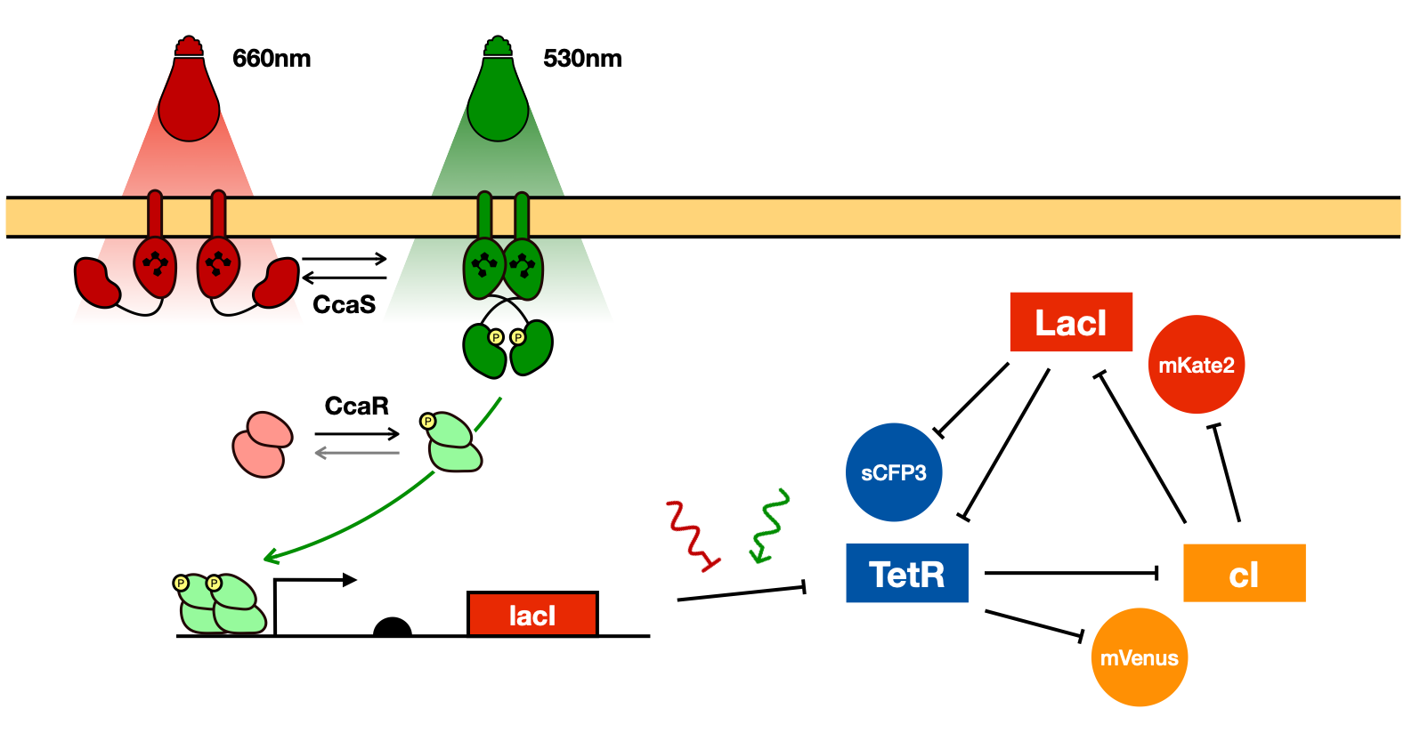
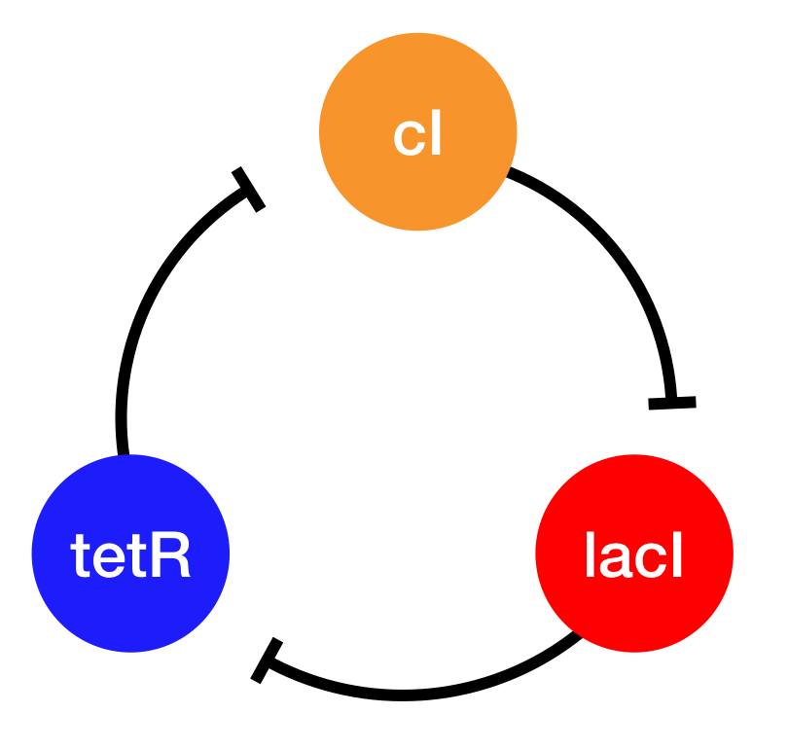
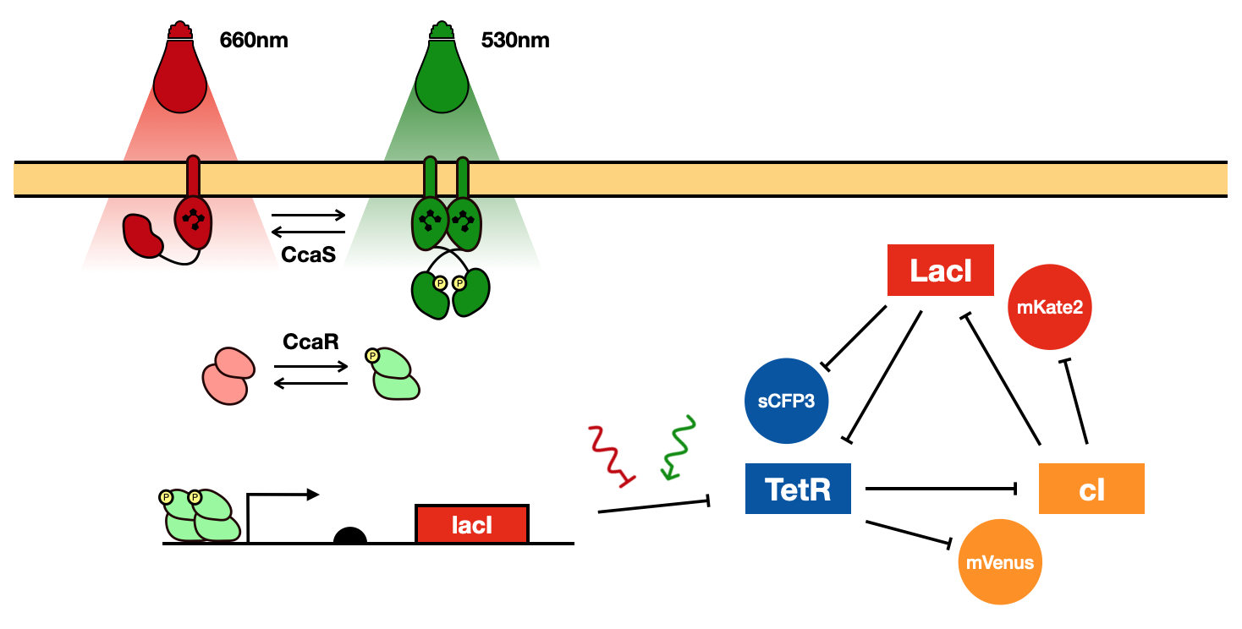
Cueing the clocks with optogenetics
TABOR ET AL., J. MOL. BIO., 2011

Slide 7

Methods: plate reader
samples start with chemical synchronization
96-well plate for population measurement
with light input
2h growth
OD and fluorescence measurement
refresh with new medium in new wells
repeat for population measurements of exponential phase bacteria
well controllable with RGB LEDs
well for growing without light input

Slide 8
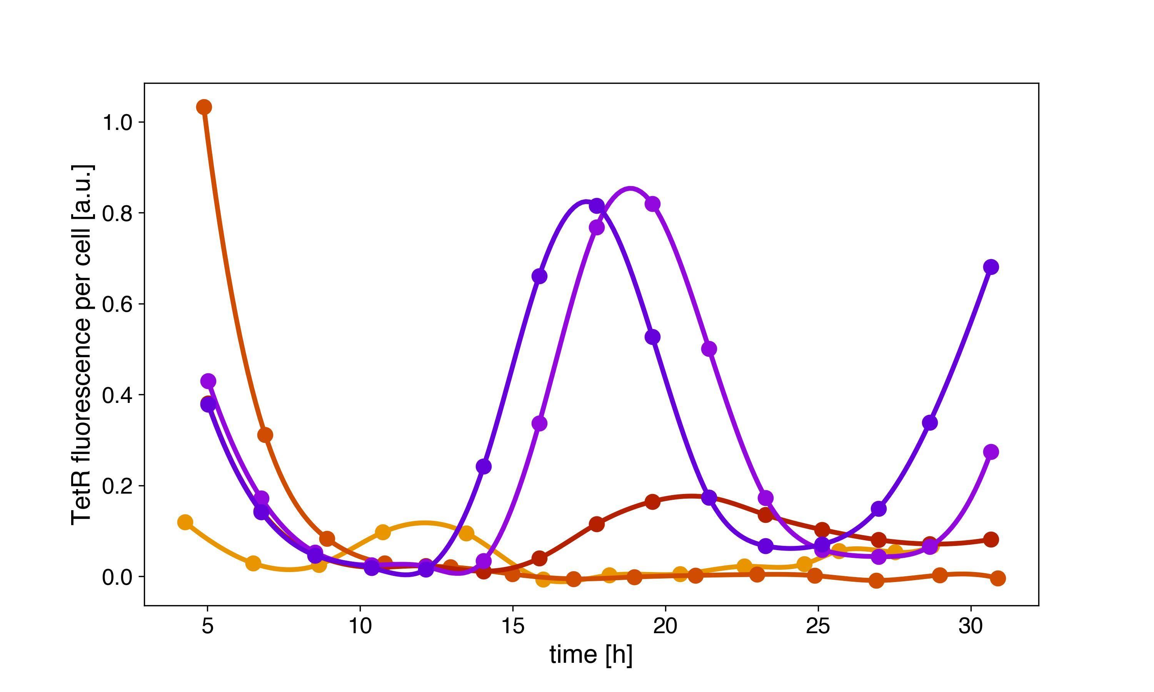
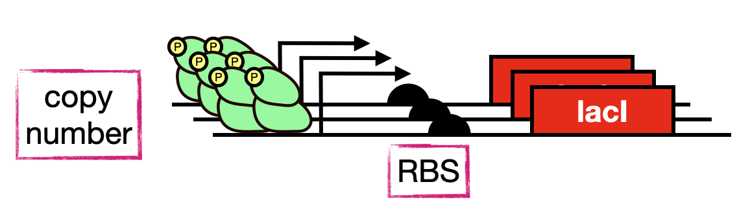
Testing the system
Under saturating red light, our system should behave exactly like the repressilator.
lacI
repressilator
optorepressilator

Slide 9
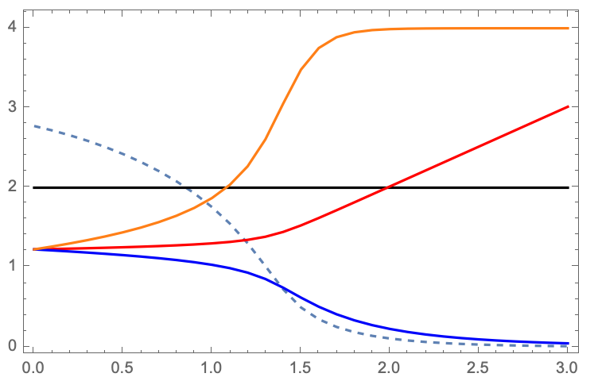
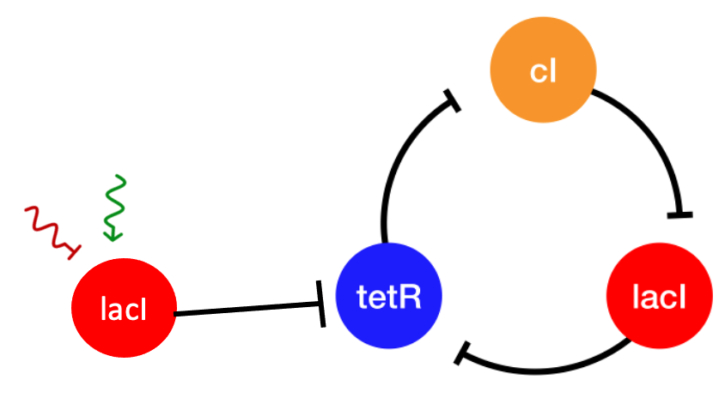
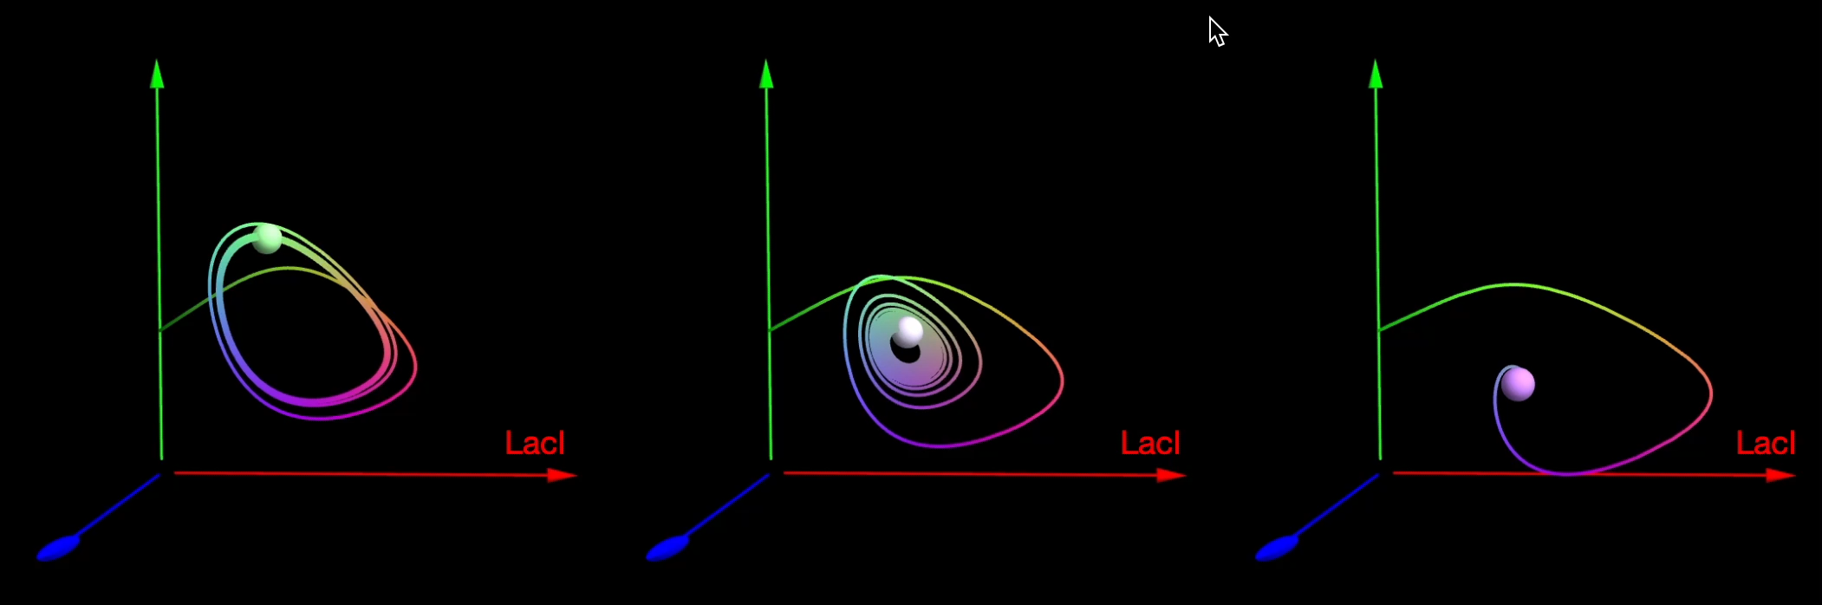
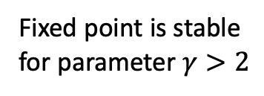


$$γ$$
Light disrupts oscillations
fixed point (a.u.)
$$b$$
perturbation (b)
fixed point is unstable (oscillations)
fixed point is stable
(no oscillations)
Linear stability analysis
Fixed point is stable
for parameter $γ>2$
increasing light-controlled transcription b

Slide 10
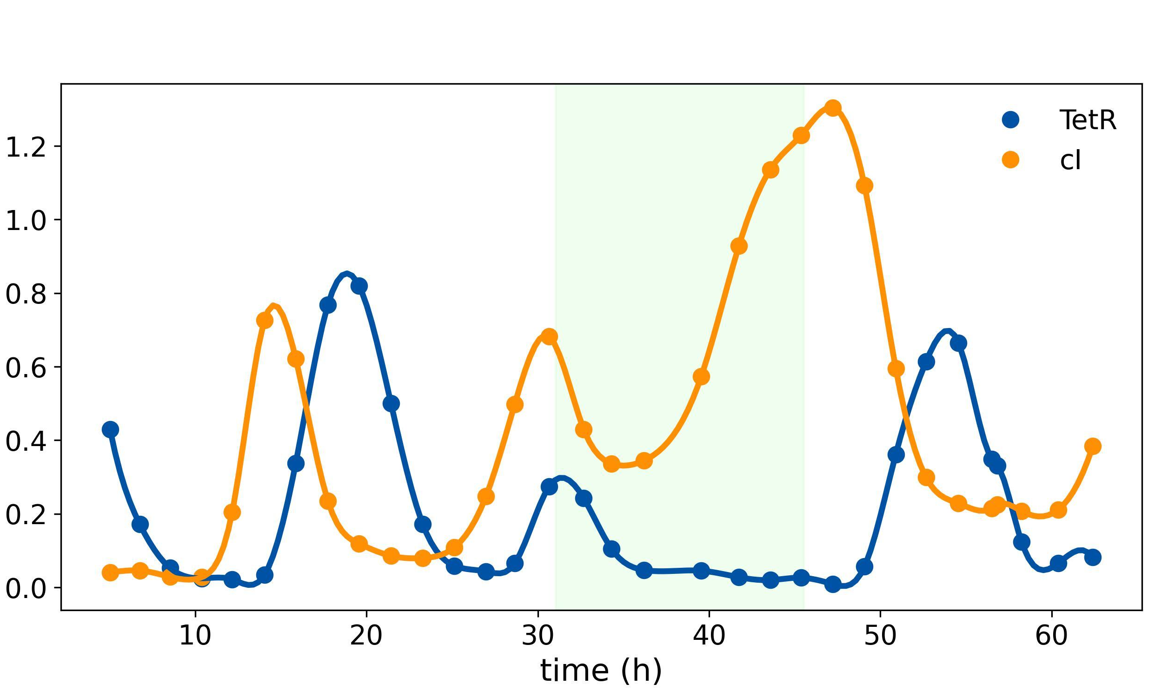
Green light disrupts oscillations on-demand

Slide 11
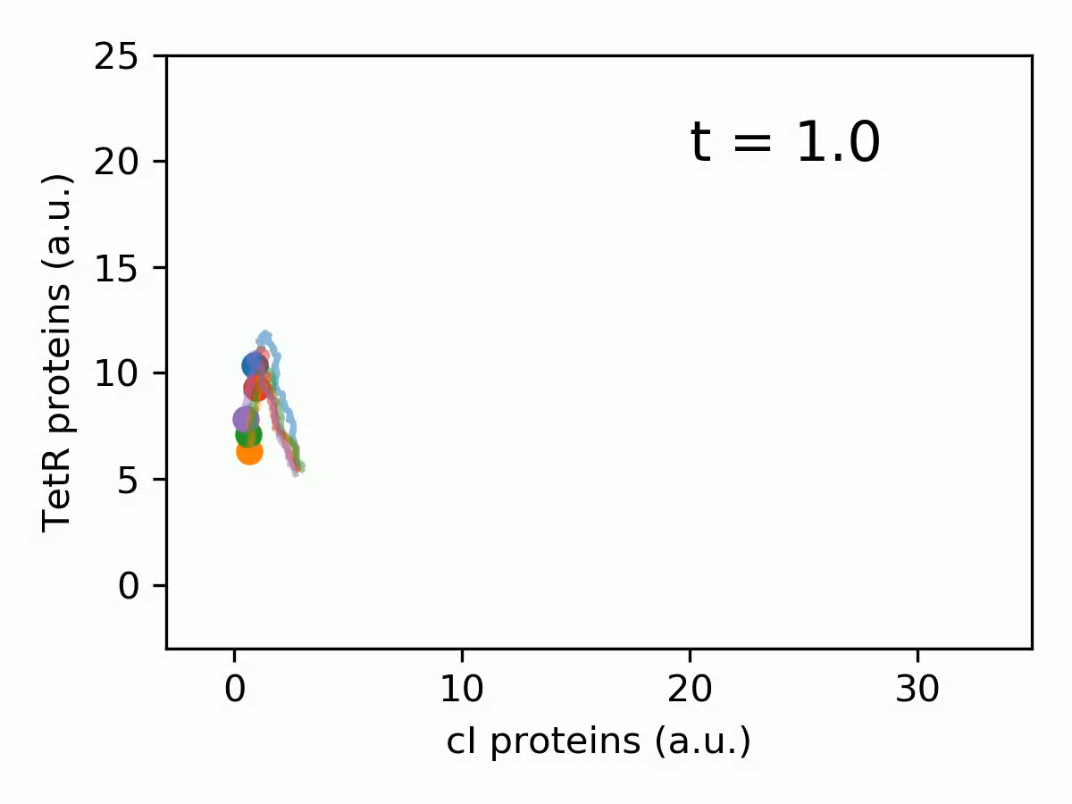


Synchronizing with light
Optorepressilators can be synchronized optically.
gaussian noise $η$
$$b$$

Slide 12
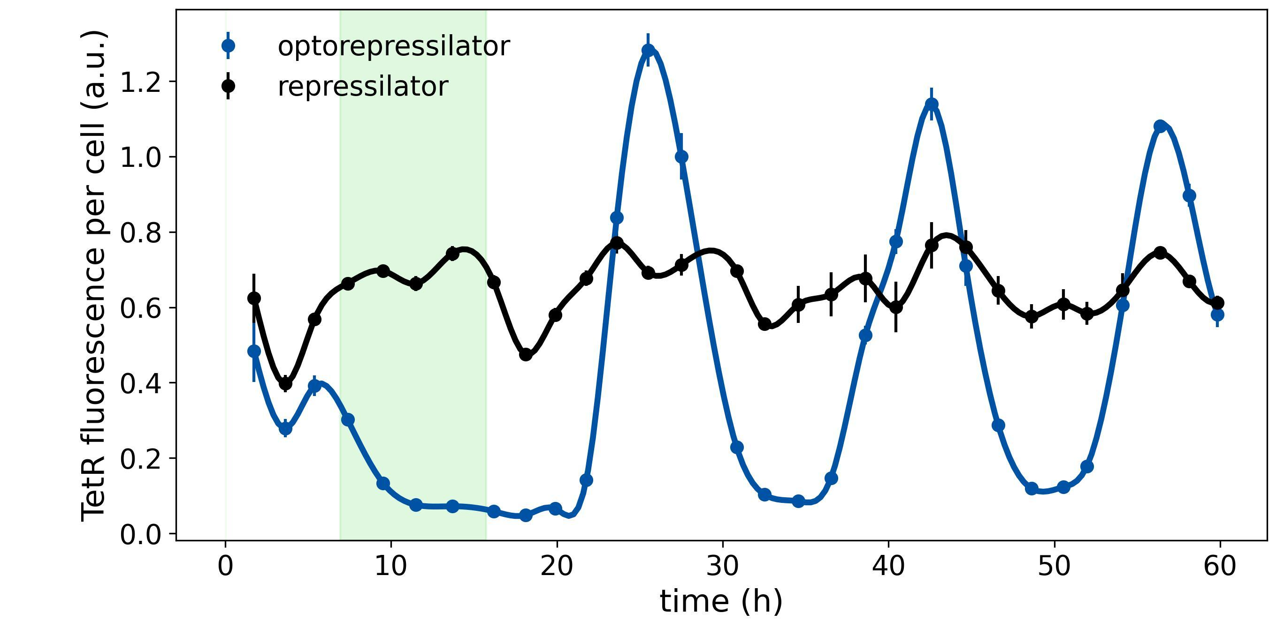
Synchronizing with light

Slide 13
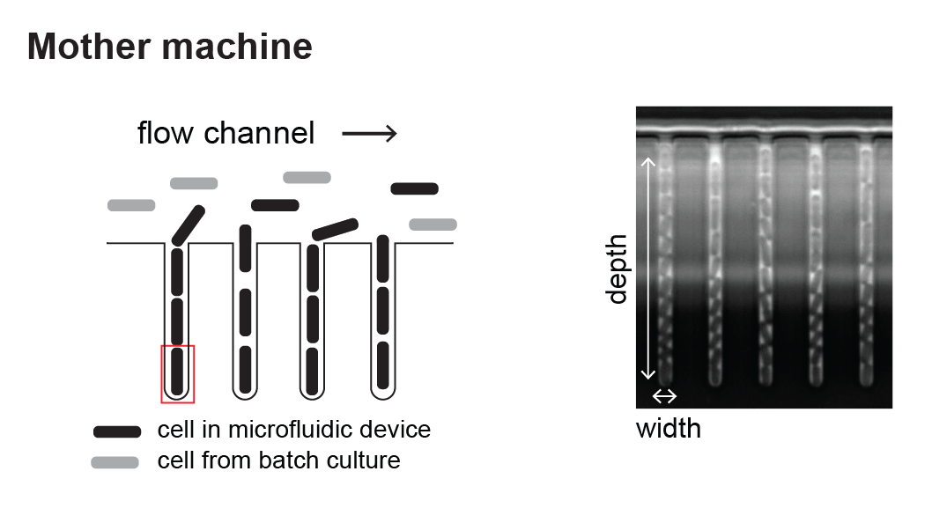
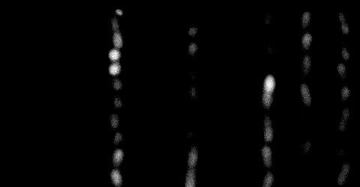




Methods: mother machine
Growth
channels
Flow channel
1 $μm$
Image
segmentation
Single-cell fluorescence

Slide 14
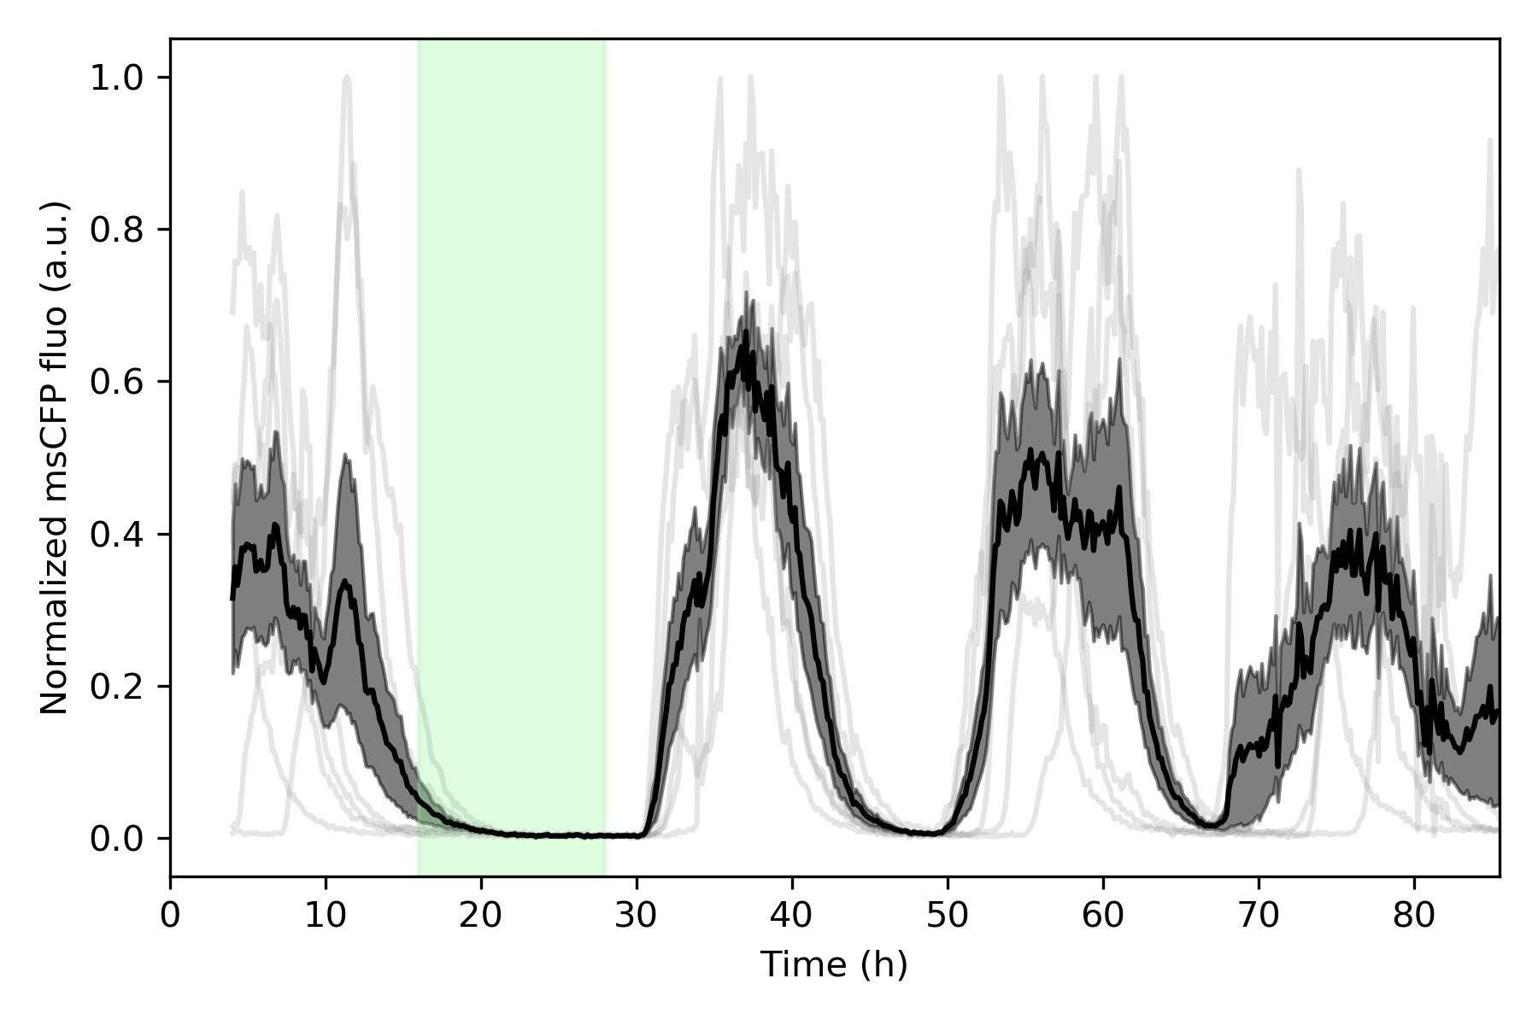
Methods: mother machine
Flow channel
Growth
channels
1 $μm$
Image
segmentation
Single-cell fluorescence

Slide 15
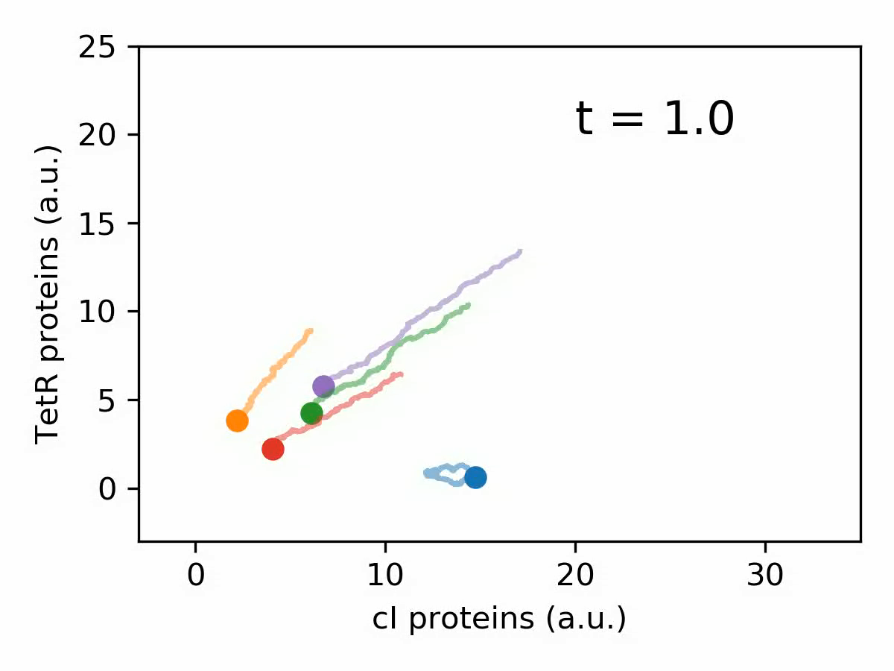
Entraining a population to synchronization
SIMULATION

Slide 16
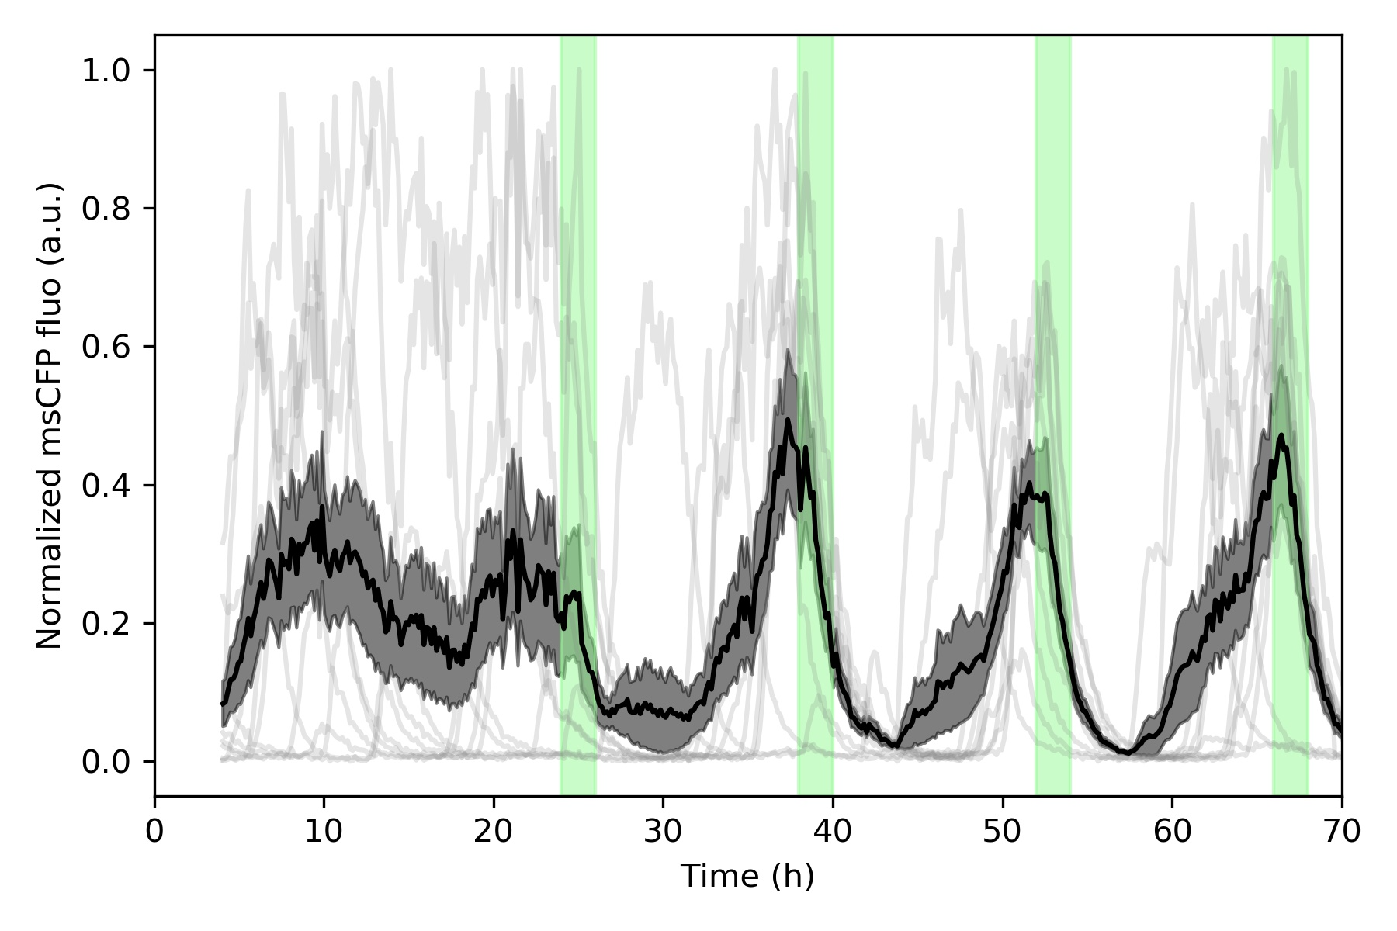
Entraining a population to synchronization
EXPERIMENT

Slide 17
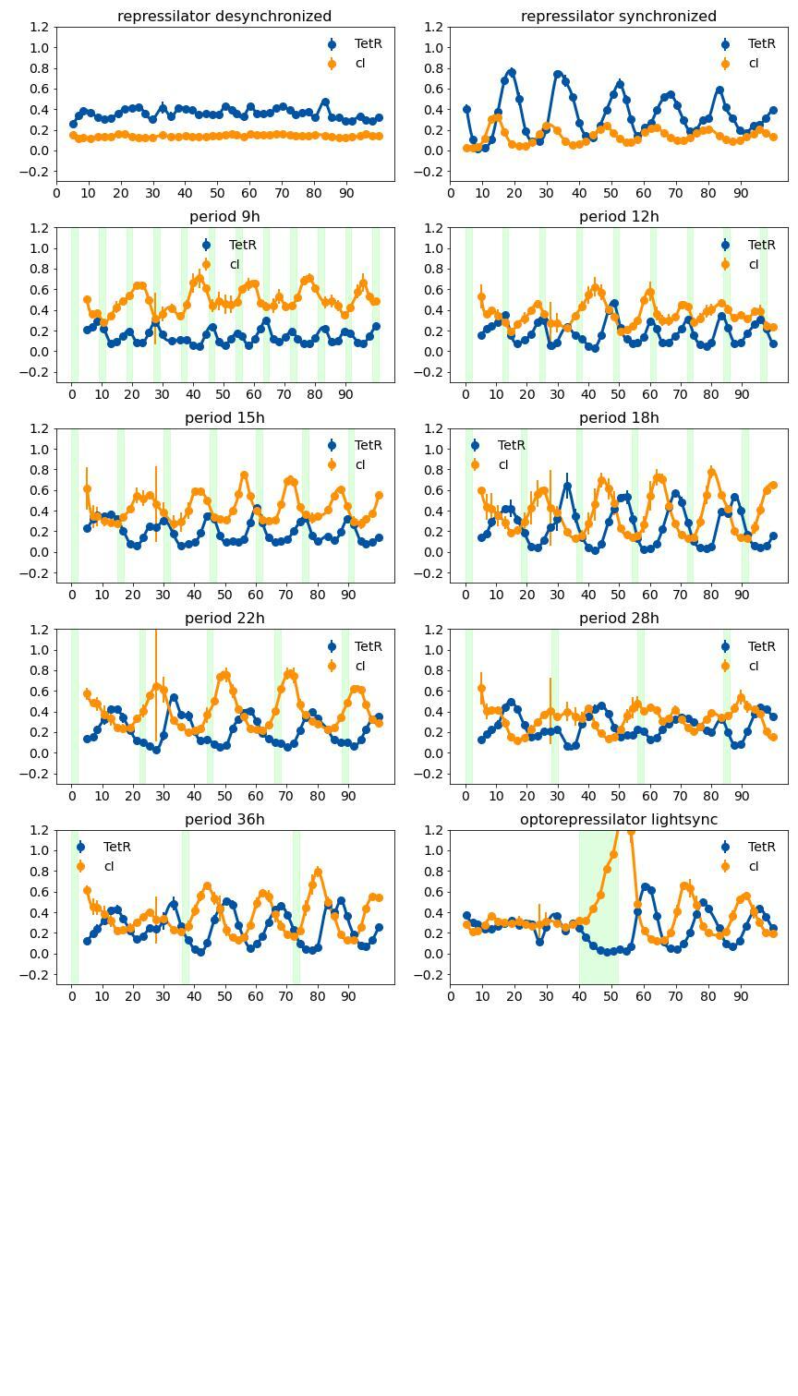
Entraining a population to synchronization

Slide 18
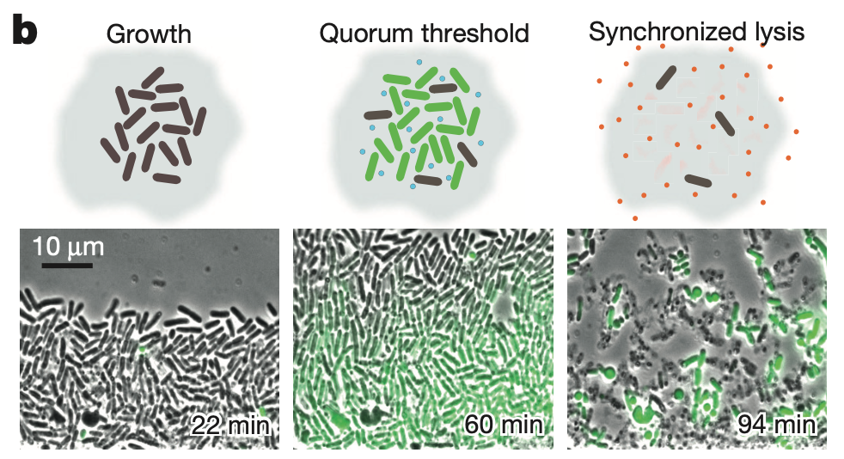
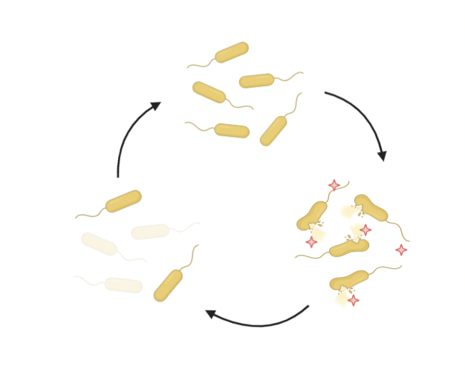
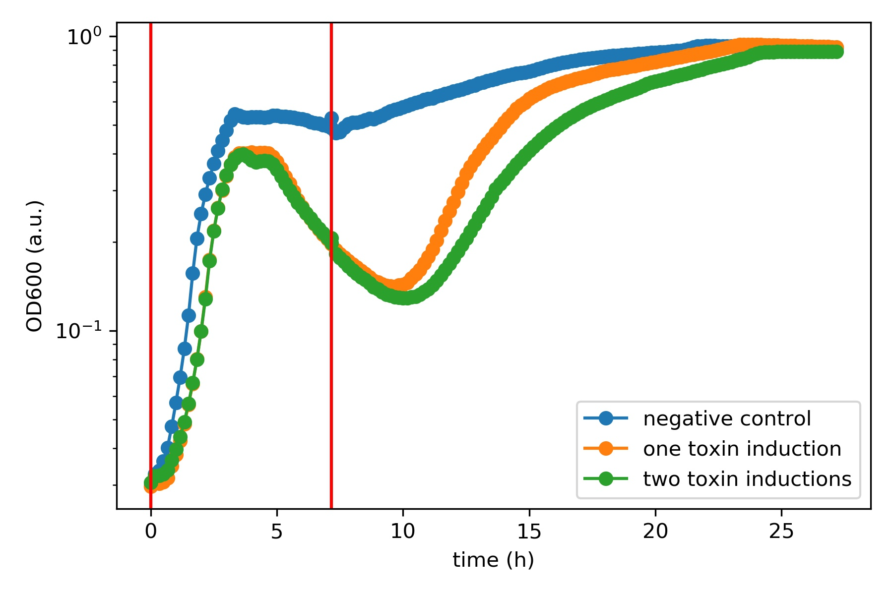
Synchronized lysis for therapeutic delivery
AHL diffuses rapidly out of the cell, so this circuit is a sensor of bacteria density
AHL
GFP
luxR
toxin
No control mechanism to switch the lysis cycle off, resulting in reduced predictability of the circuit

Slide 19
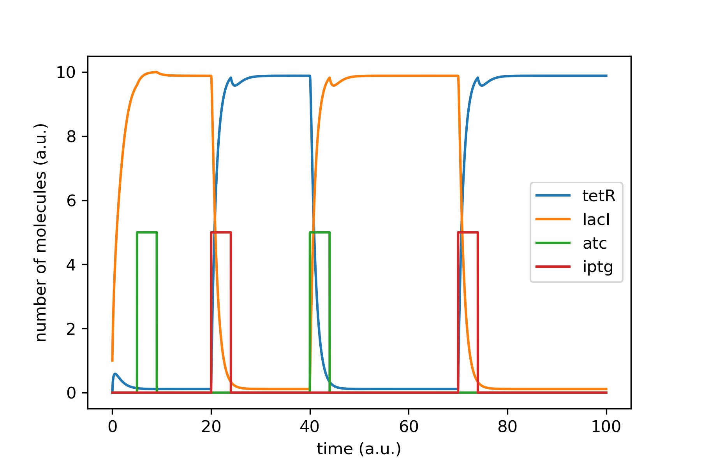
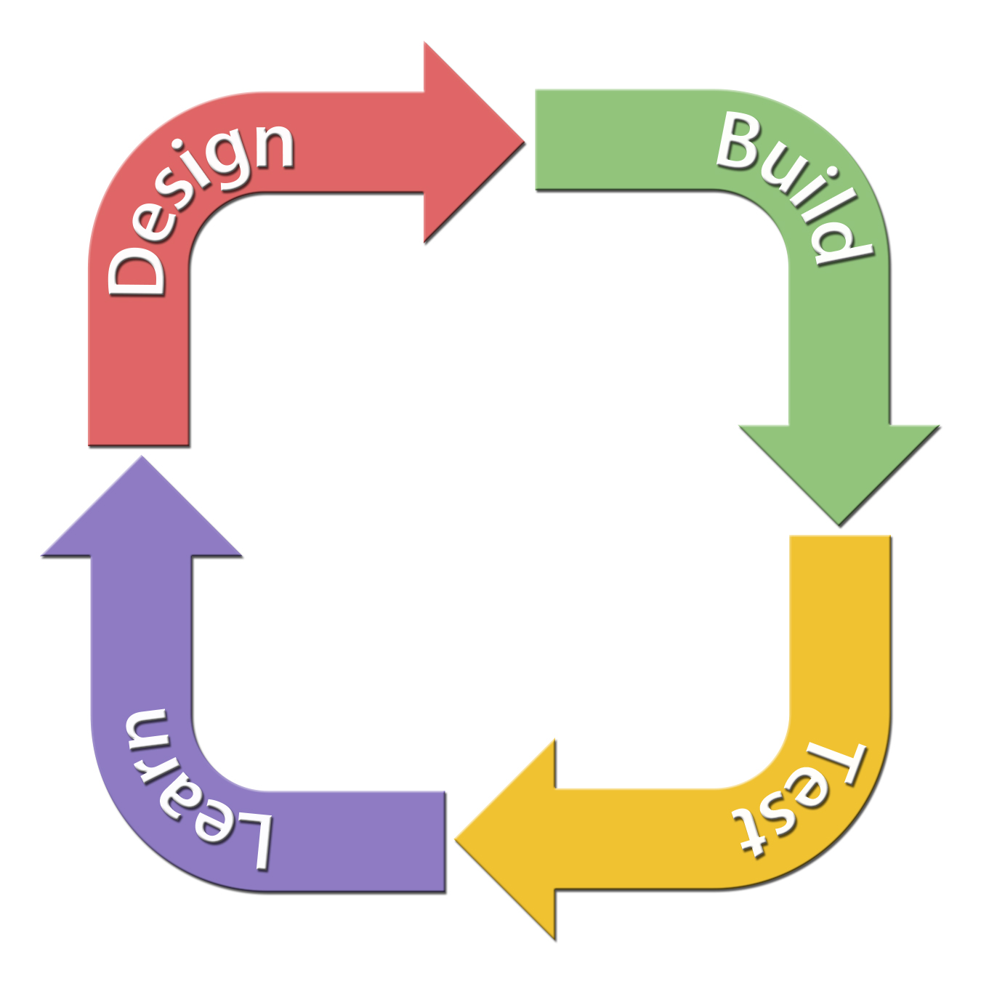
Switching synchronized lysis on and off
atc
IPTG
AHL
toxin
luxR
IPTG
lacI
tetR
atc

Slide 20

Conclusions
Revisited the repressilator and coupled it to an external light signal.
Demonstrated experimentally robust optical synchronization of a population.
Showed that short periodic optical impulses achieve long-term population-synchronization.
Testing a toggle switch control for a synchronized lysis circuit to prevent mutations and switch therapeutic delivery on-demand.
Control systems can be integrated into synthetic gene networks to achieve greater precision.

Slide 21
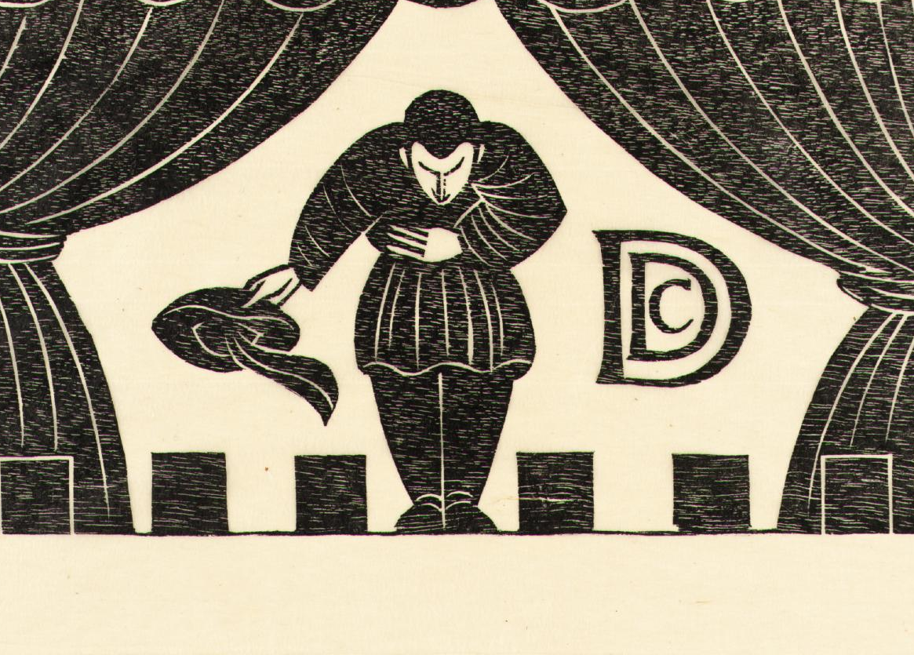

Thank you for your attention
Acknowledgements:

Slide 22
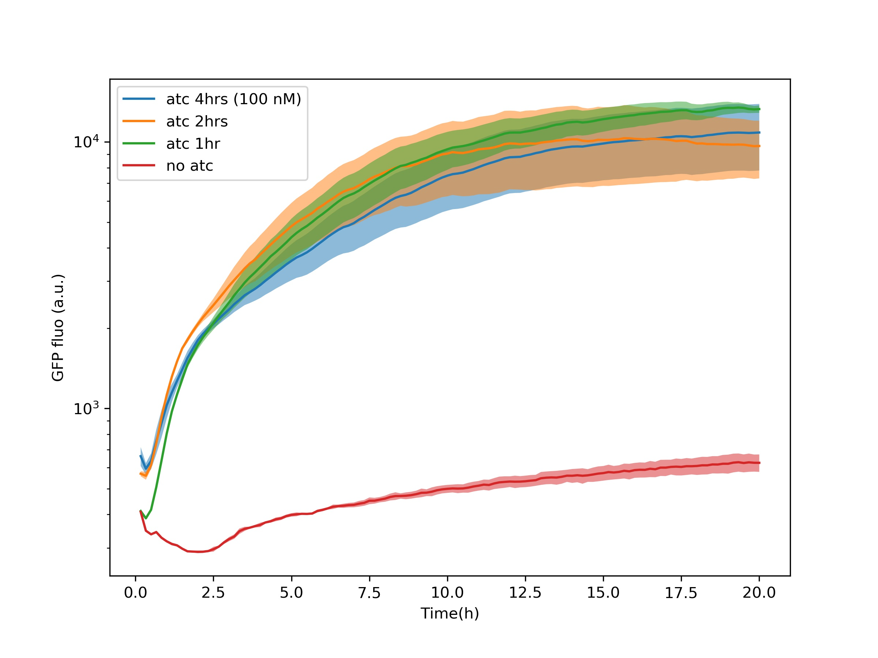
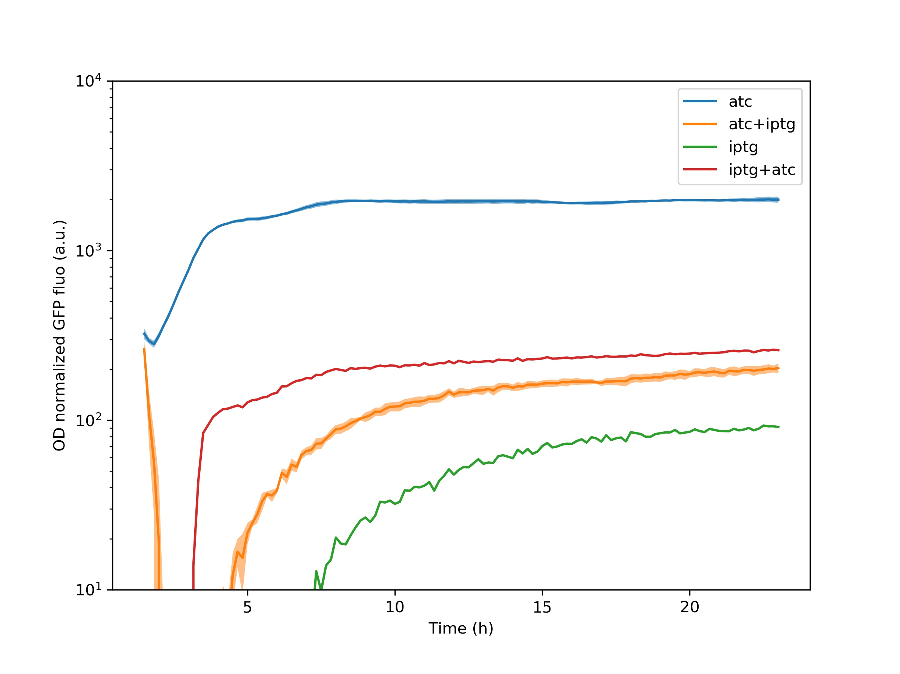
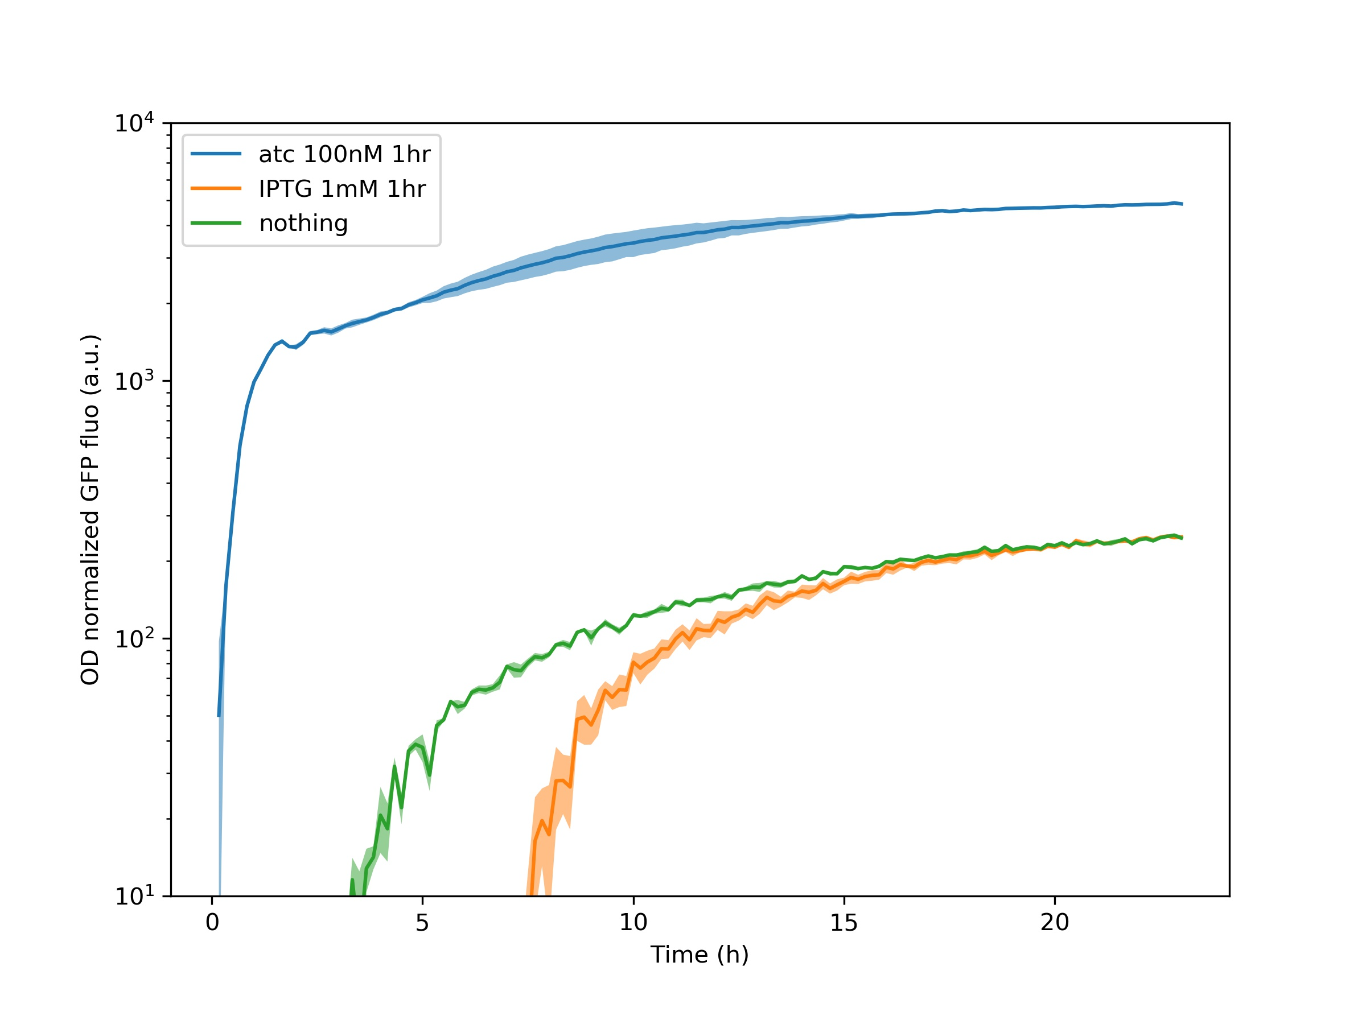
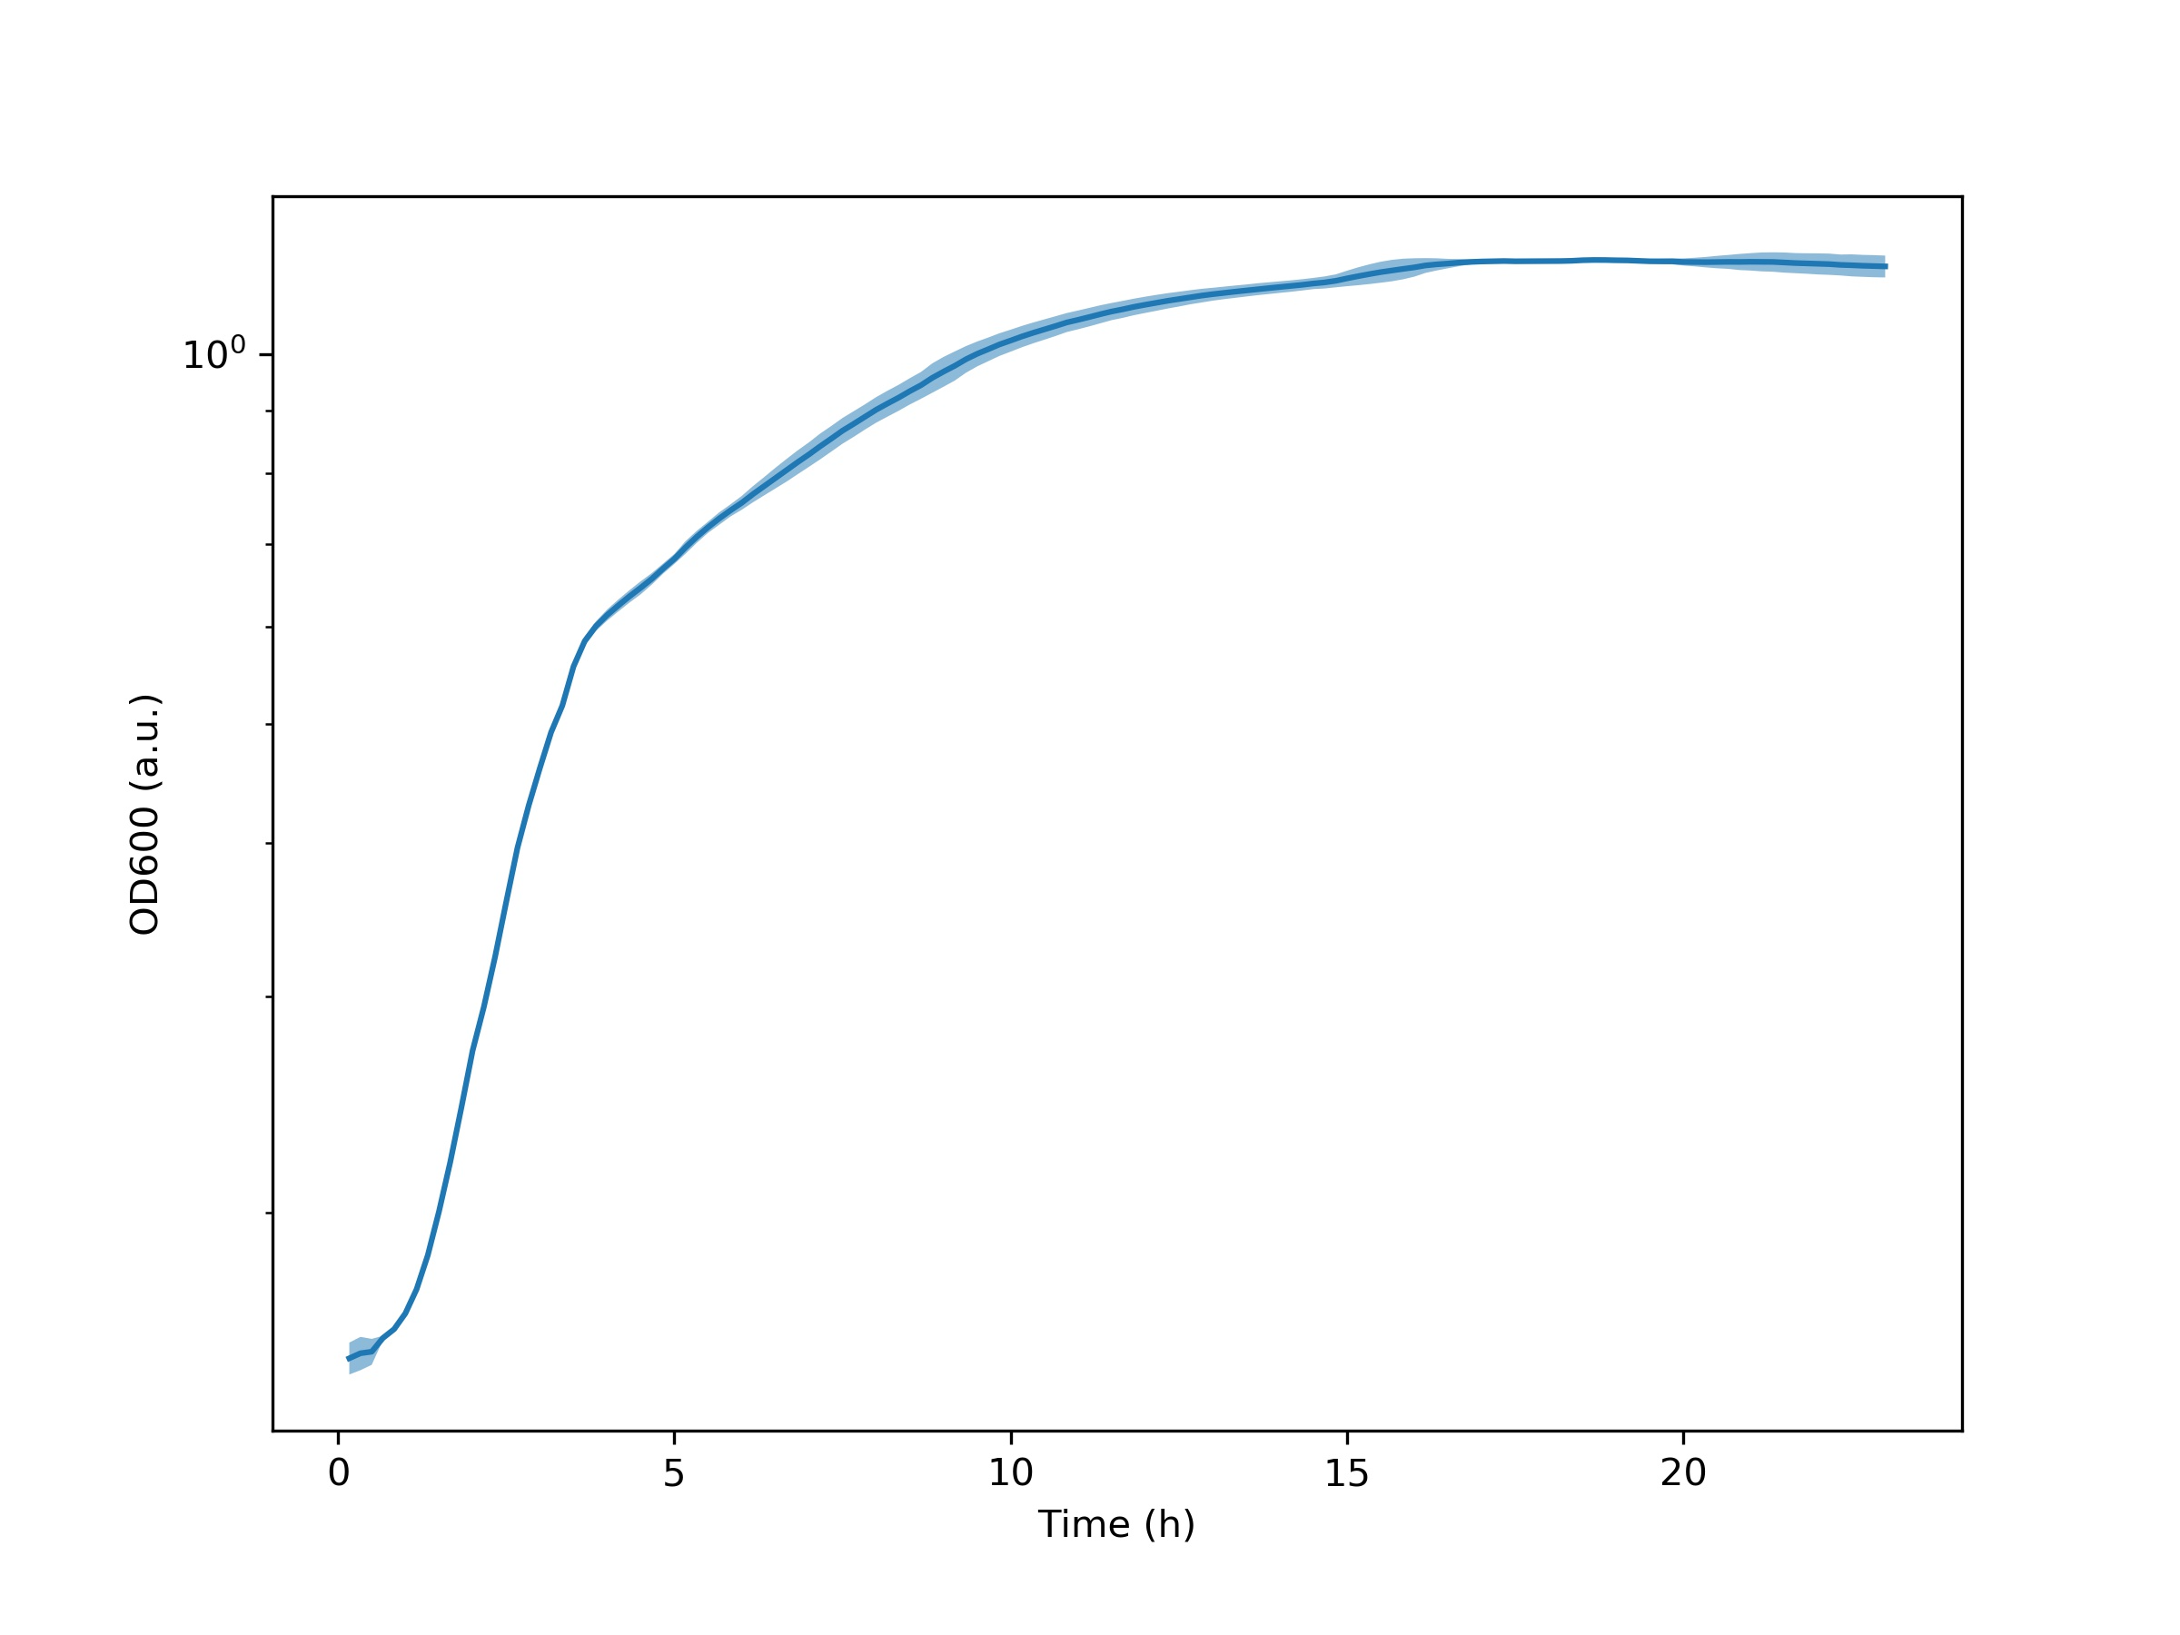
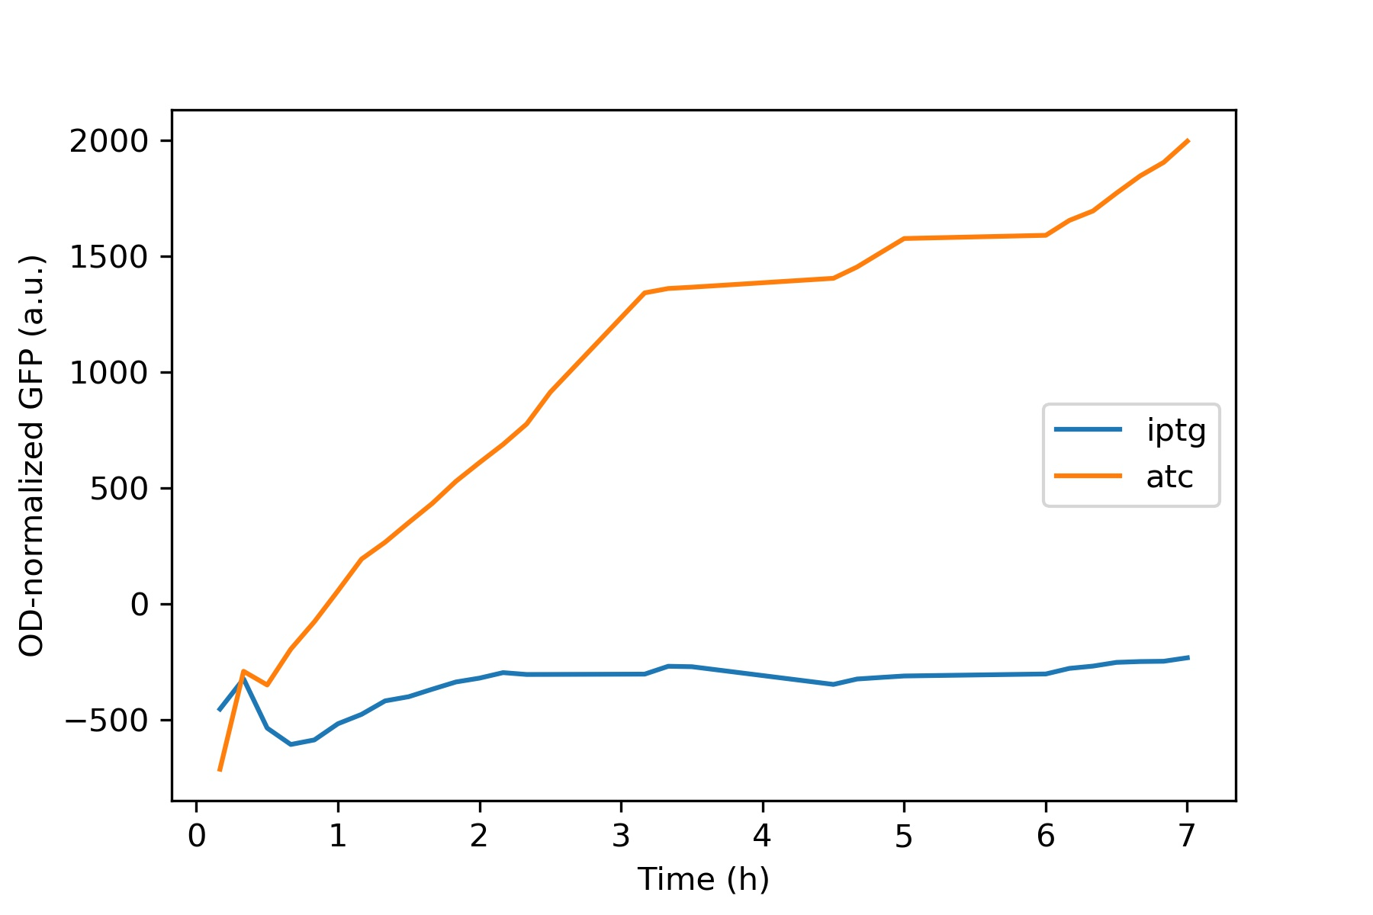
Testing the circuit
AHL
GFP
toxin
luxR
IPTG
lacI
tetR
atc

