Slide 1
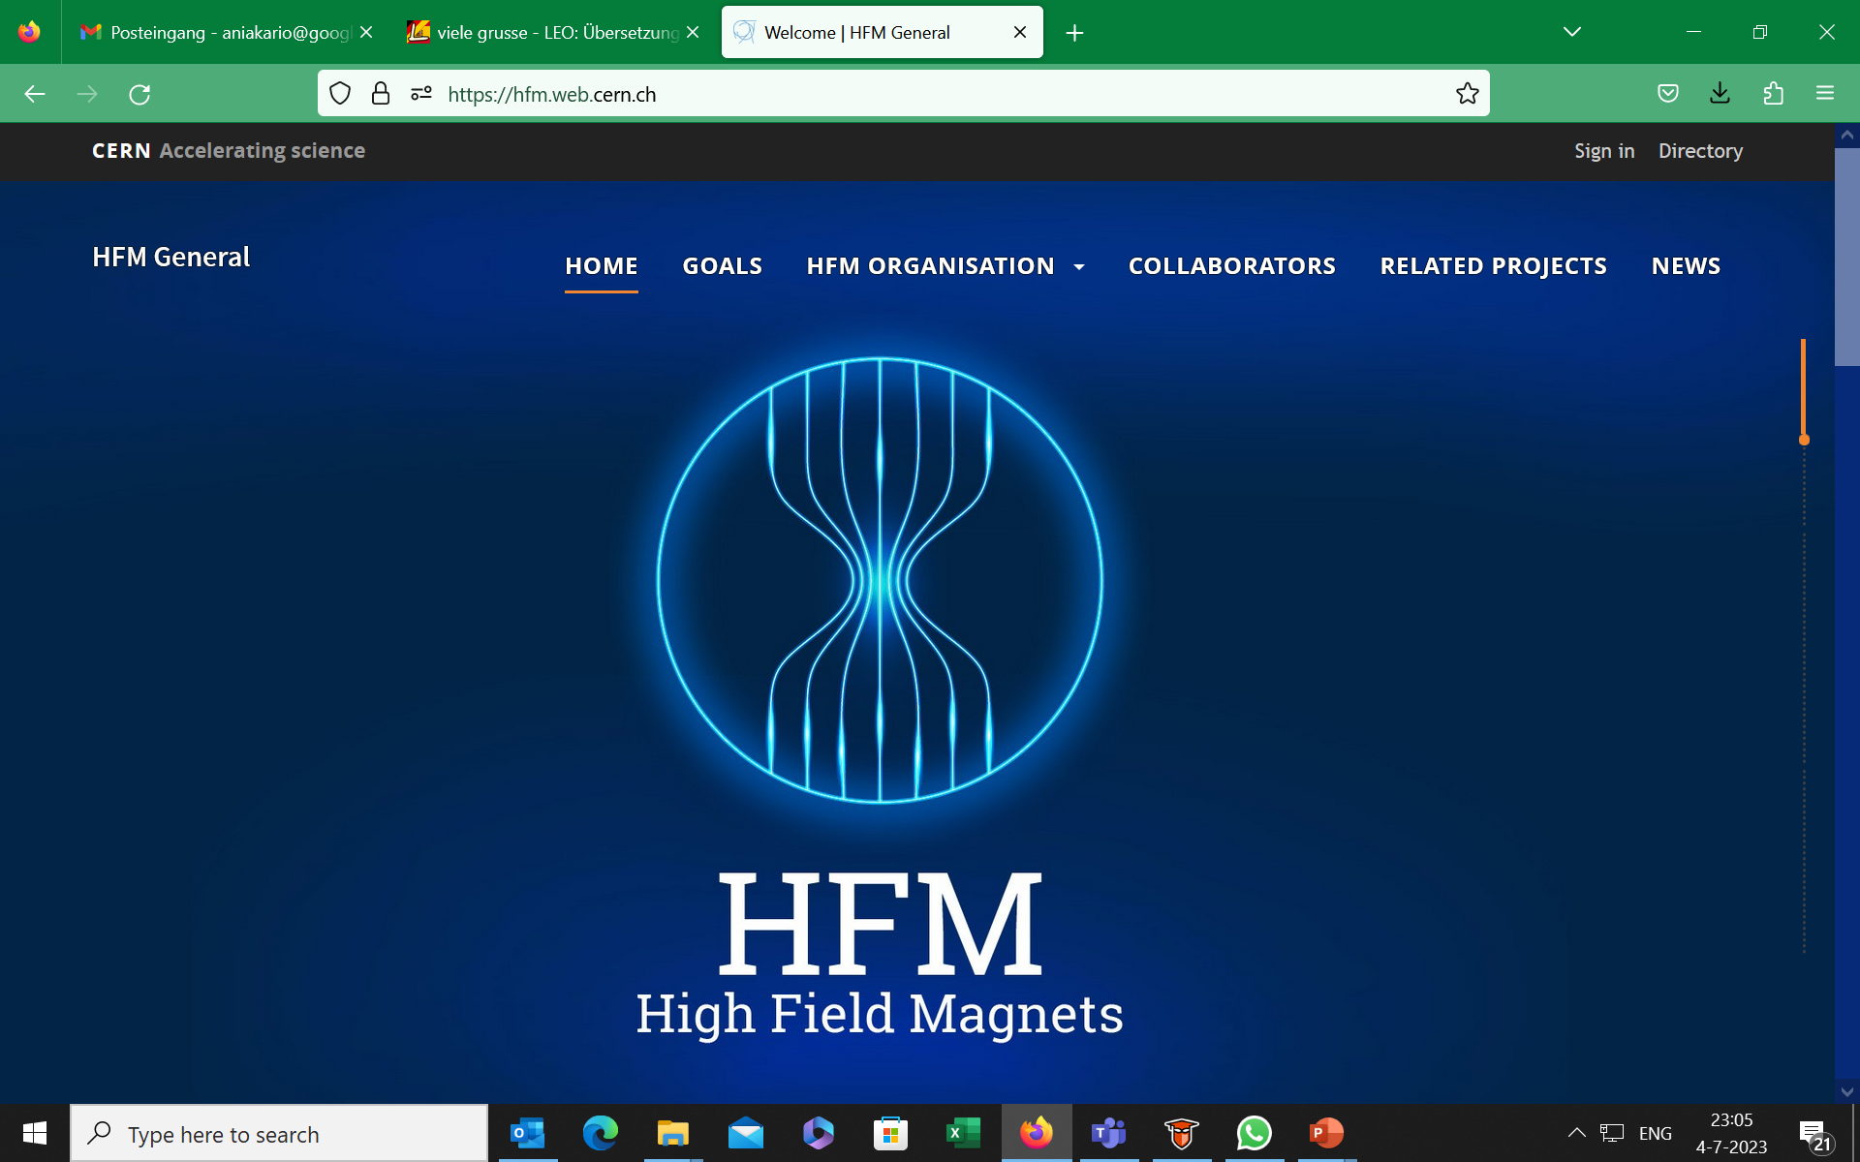
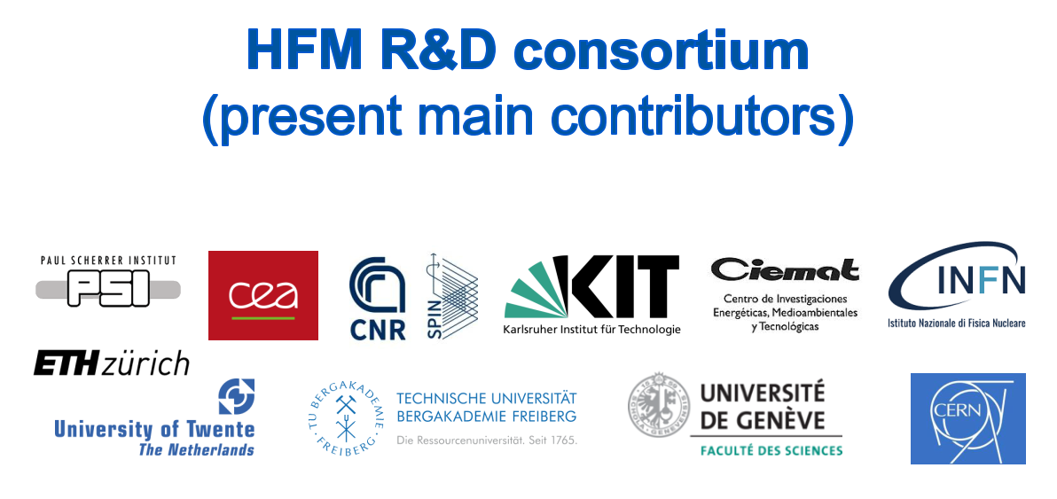

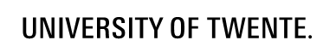
Prospects of High Temperature Superconductors
Community Report on Accelerators Roadmap
Anna Kario, Simon Otten, Amalia Ballerino, Christian Barth, Carmine Senatore, Bernhard Holzapfel,
Bernhard Auchmann, Jaap Kosse, Yifeng Yang, Andrea Malagoli, Thibault Lecrevisse, Andrzej Siemko

Slide 2
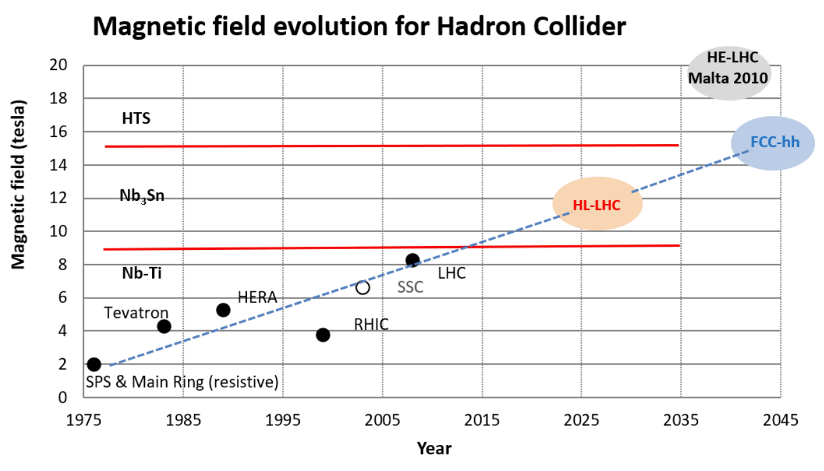
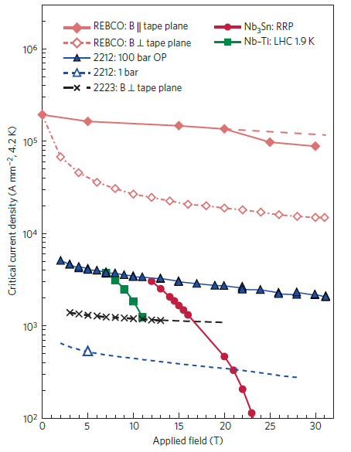
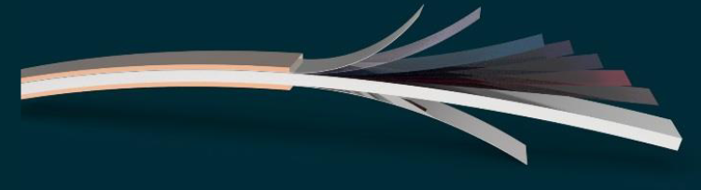
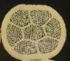
High temperature superconductors – future for 20 T +
(accelerator) magnets
L. Rossi, C. Senatore, https://doi.org/10.3390/ instruments5010008
Mechanical stress limitation of superconductors
Coils structural materials constrains
Material tailored magnet designs
D. Larbalestier, et al. Nat. Mater. (2014)
High Field Magnets
2

Slide 3
The physics landscape
 | Dipoles | Quadrupoles | Undulators/Wigglers | Detectors | Field (T)
FCC-ee |  | IR Quad |  | × | < 3 T
CEPC |  | IR Quad |  | × | < 5 T
ILC | × | × | × | × | < 2 T
CLIC |  |  | × | × | < 2.5 T
FCC-pp | × | × |  |  | 16 T -20 T
SppC | × | × |  |  | 12 T- 24 T
Muon Collider | × | × |  |  | Solenoids 20 T, 55 T
Higgs Factories
HTS Enabling Technology
Energy Frontier
High Field Magnets
3
Notes:
Future circular collider
Circular Electron Positron Collider
International Linear Collider
Compact Linear Collider
Super Proton-Proton Collider

Slide 4
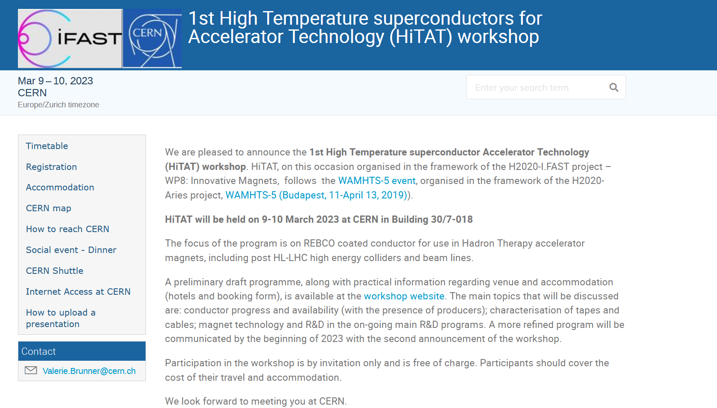
The High Temperature Superconductors workshop at CERN in 2023
https://indico.cern.ch/event/1220254/
High Field Magnets
4
Notes:
Future circular collider
Circular Electron Positron Collider
International Linear Collider
Compact Linear Collider
Super Proton-Proton Collider

Slide 5
Where do we stand with the ReBCO conductor for accelerator magnet application?
Current homogeneity as function of length, temperature and field
- measurements (l,α, T, B)
- modelling
Quench protection
- mitigation of Normal Zone Propagation velocity
- novel protection methods
- partial insulation, cable, coil
Shear stress sensitivity
- conductor architecture
- delamination
Magnetization and the other AC loss components
- conductor, cable, coil architectures
High current capability
Long lengths of ReBCO > 300m from several companies worldwide for demonstrator usage
High temperature margin (T_{c}~90 K)
React and wind technology
Mechanical properties: tensile stress ~600 MPa, transverse stress >300 MPa
High Field Magnets
5

Slide 6

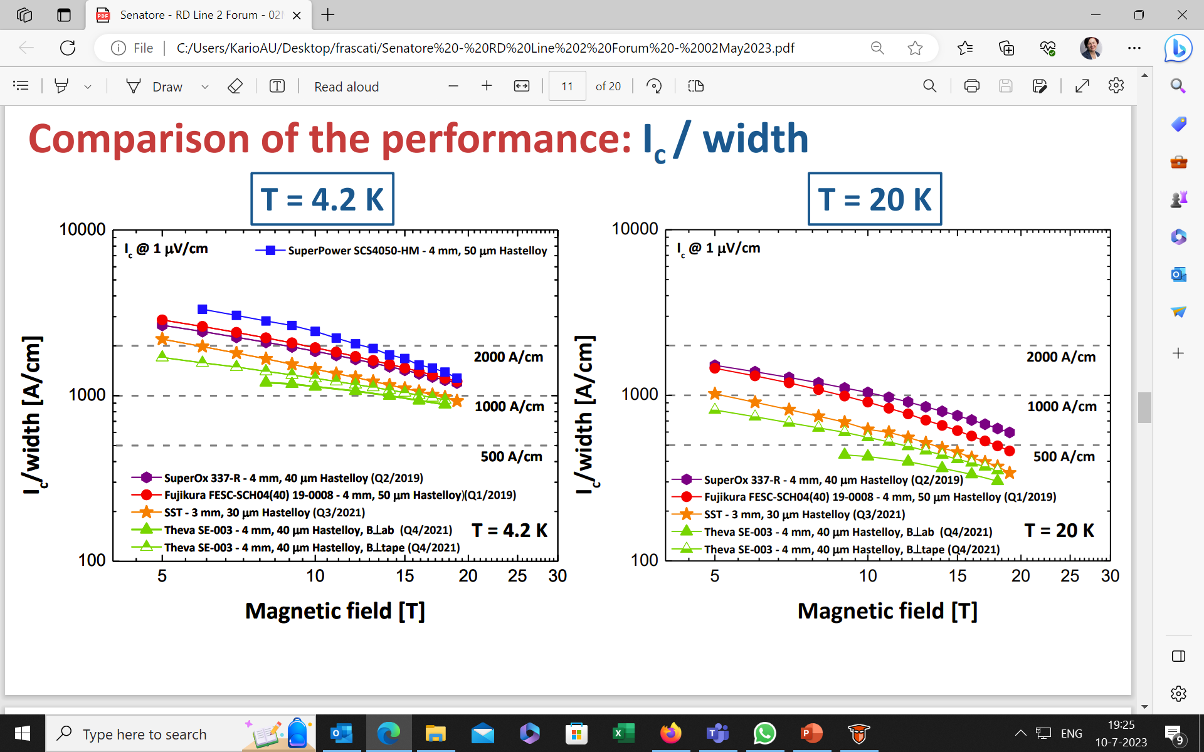
ReBCO transport critical current measurements
Comparison of Ic / width – high performance tapes
T = 4.2 K
T = 20 K
Various orientations in magnetic fields up to 19 T/21 T and variable temperatures
Characterisation of samples from different manufacturers, batches
High Field Magnets
6

Slide 7
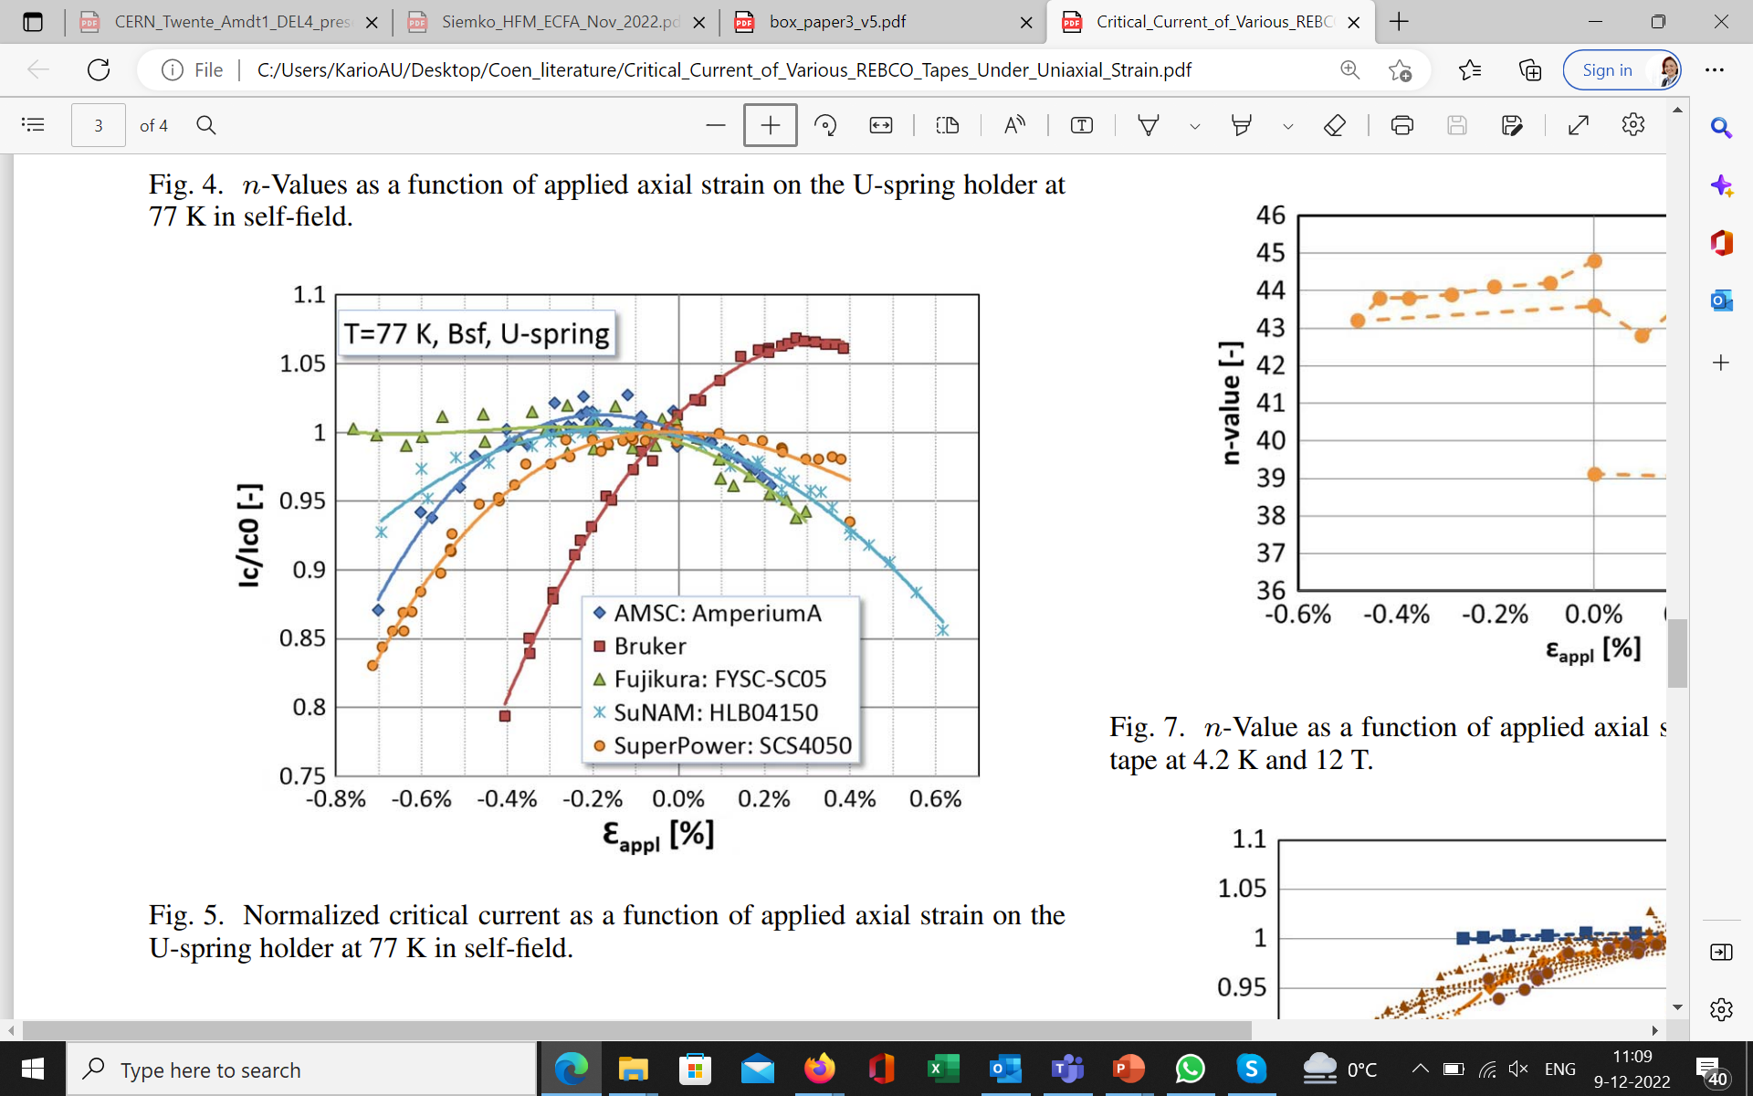
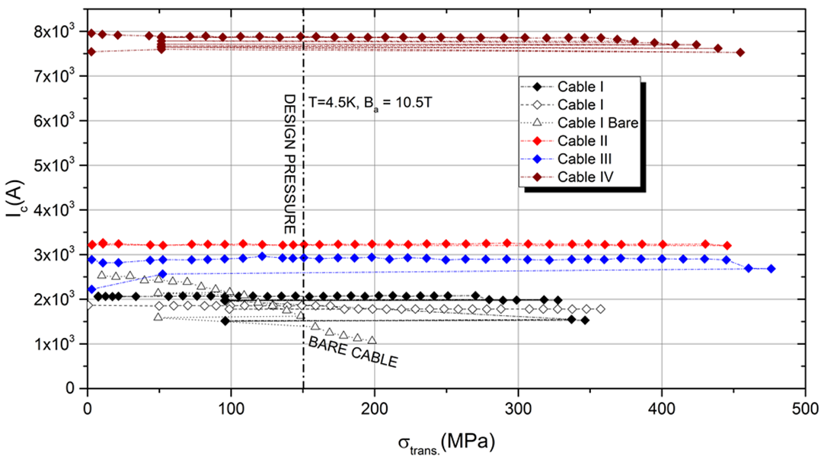
ReBCO tapes and cables mechanical properties
Bruker
SuperPower
C. Zhou et al., IEEE TAS, Vol. 26, No. 4, June 2016.
P. Gao et al 2019 Supercond. Sci. Technol. 32 055006.
Importance of study ReBCO tape mechanical properties, together with simulations, for understanding limits for future high-current cables and further high-field magnets.
Important study ReBCO cables under transverse stress to understand the limits in high-field magnets
High Field Magnets
7

Slide 8
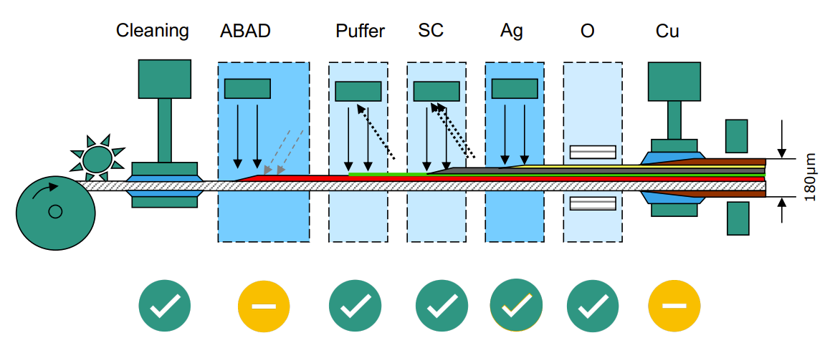
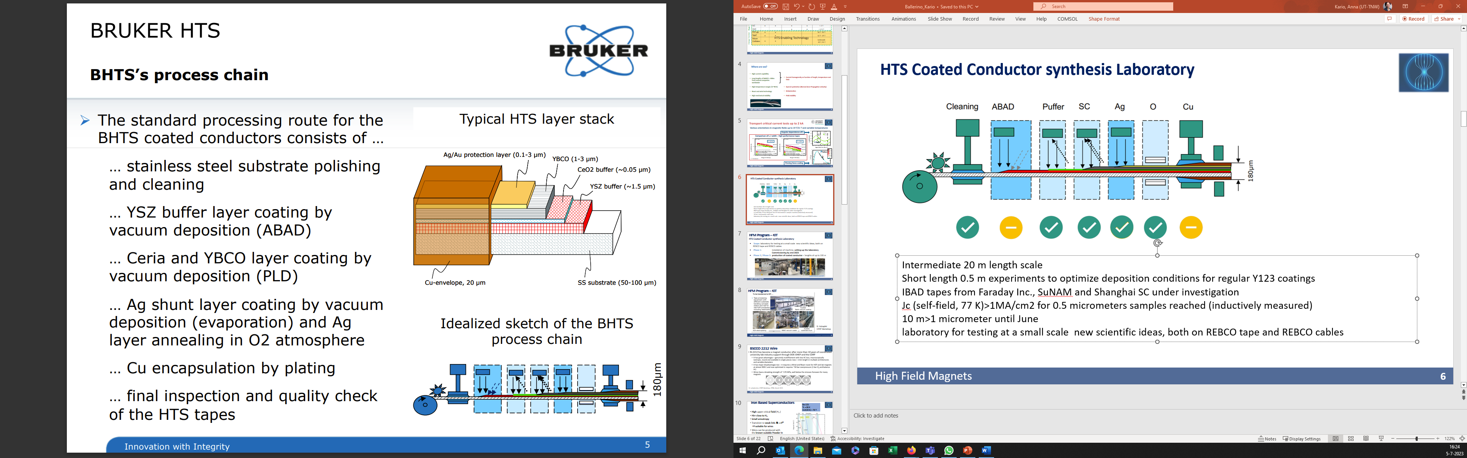
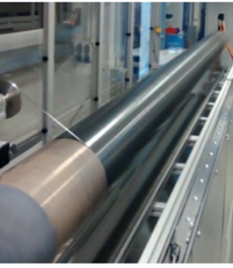
“New architectures” ReBCO synthesis laboratory
Intermediate 20 m length scale
Short length 0.5 m experiments to optimize deposition conditions for regular Y123 coatings
IBAD tapes from Faraday Inc., SuNAM and Shanghai SC under investigation
J_{c} (self-field, 77 K)>1MA/cm² for 0.5 micrometers samples reached (inductively measured)
10 m>1 micrometer until June
Laboratory for testing at a small scale new scientific ideas, both on ReBCO tape and cables
PLD600
Substrate drum
High Field Magnets
8

Slide 9
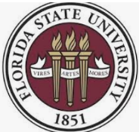
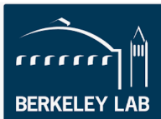
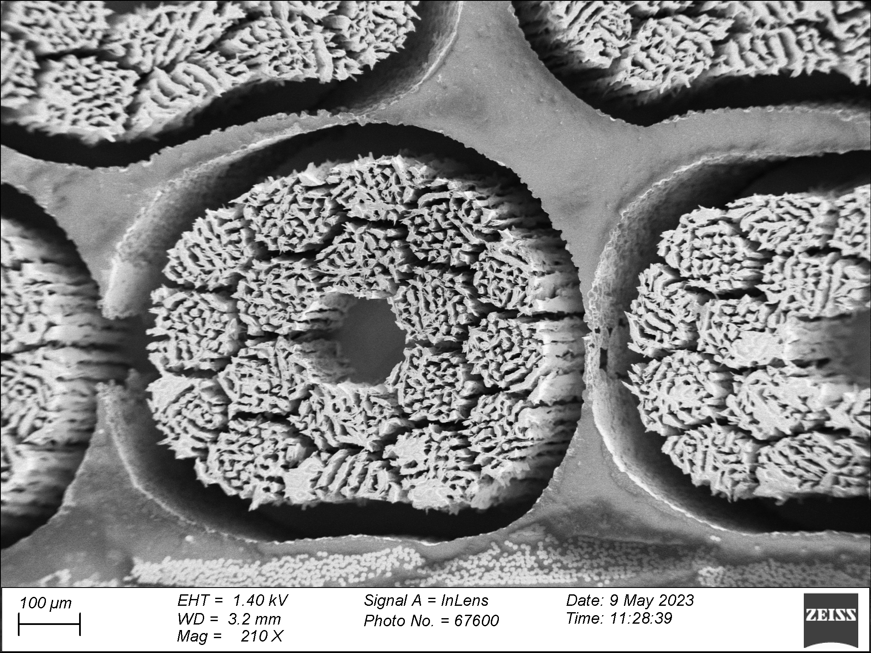
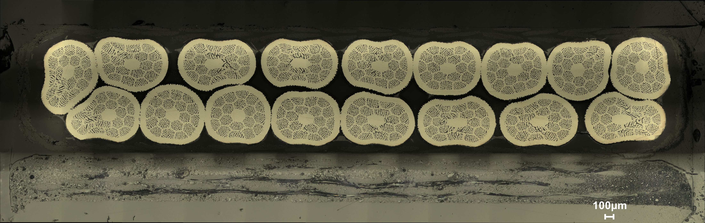
BSCCO-2212 wire potential - USA effort
Bi-2212 has become a magnet conductor after more than 10 years of coordinated university-lab-industry support through DOE-OHEP and the CDRP
It has great advantages – genuinely multifilament with low AC loss, macroscopically isotropic, round and available in single pieces now > 1 km length in multiple architectures and variable diameters
It has major too –it requires Wind and React route for HEP and lab magnets at almost 900°C and now optimized J_{c} requires ~50 bar overpressure (1 bar O₂ and balance Ar)
Wires have a breaking strength of ~170 MPa, well below the stresses foreseen for many magnets
D. Larbalestrier, HiTAT Workshop, CERN, March 2023
High Field Magnets
9

Slide 10
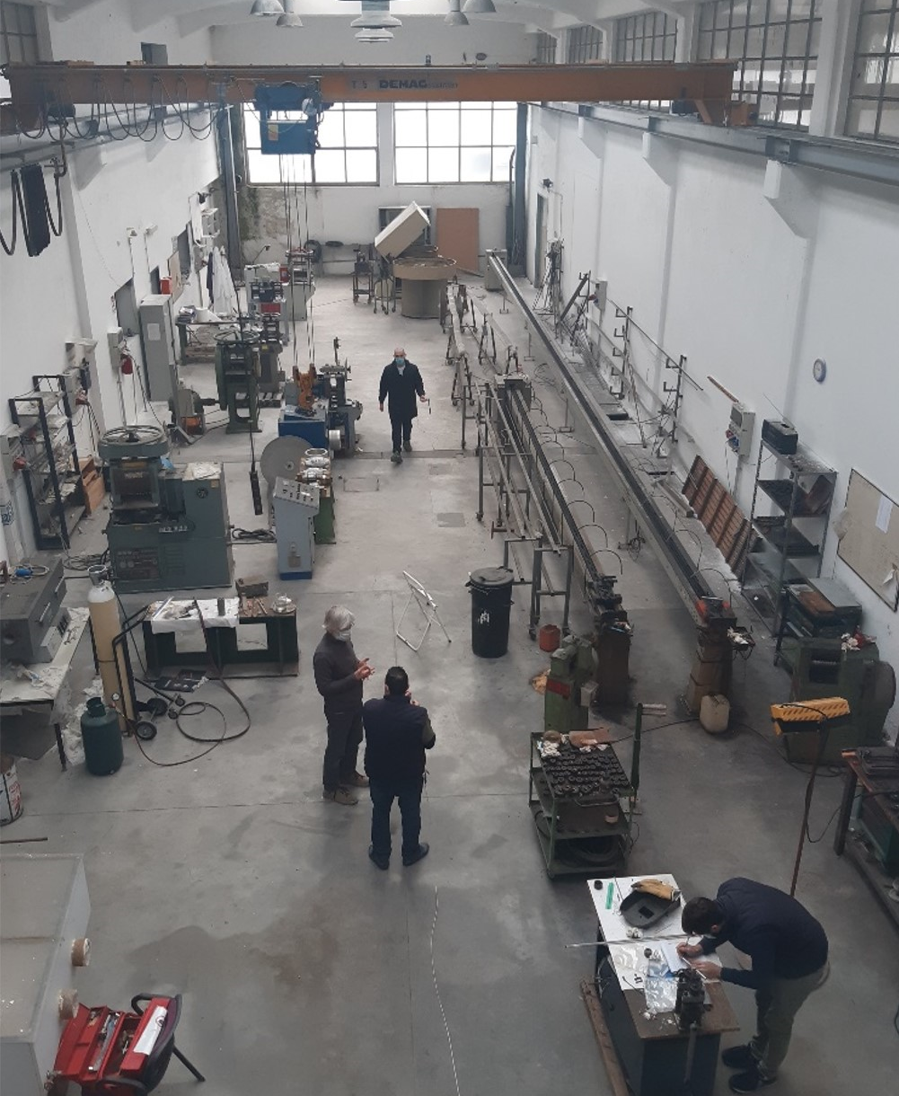
Iron Based Superconductors (IBS) Laboratory
Drawing machines
Groove rolling machines
Flat rolling machine
Ba-122:
T_{c} ∼ 38 K
H_{c2}(20 K) > 70 T
A Gurevich, Ann. Rev. Cond. Matt. Phys 5 (2014) 35
C Yao and Y Ma, iScience 24 (2021) 102541
R&D on Iron Based 122 PIT wires
Critical current density (J_{c}) through reliable, simple and scalable techniques that could enable industrialization
Target Jc ≥ 10³ A/mm² at 16 T
From mono to multi-filamentary wire
Target unit length ∼ 100 m
High Field Magnets
10

Slide 11
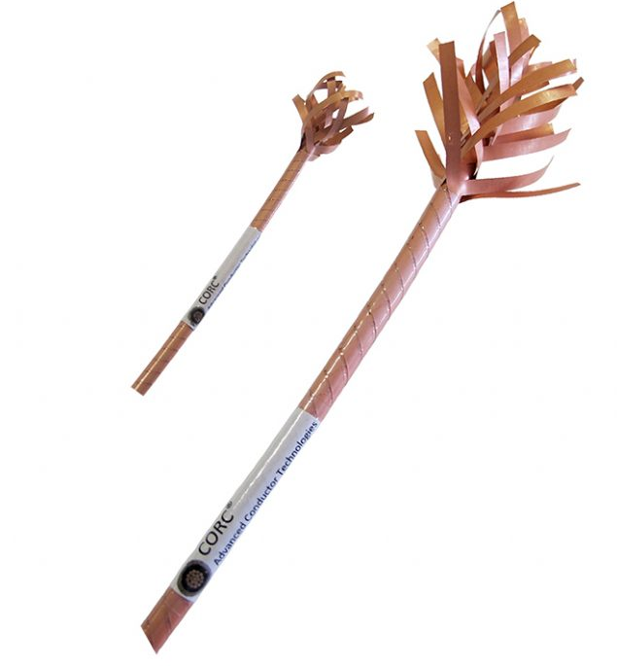
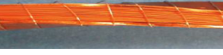
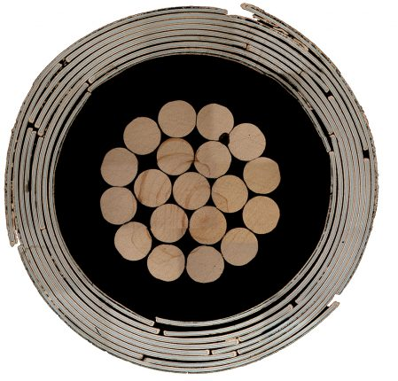
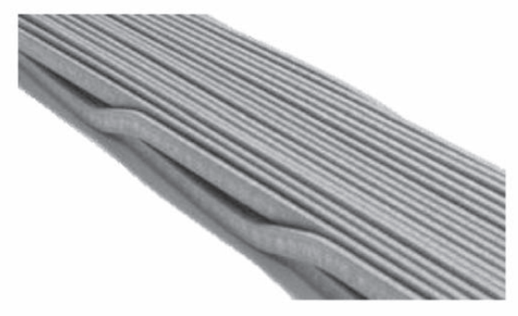
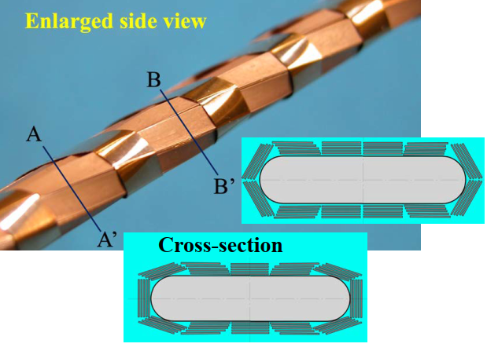
ReBCO – different cables architectures
Stack of tapes
CORC® round cables
ReBCO Roebel flat cables
for EU Eucard 2
MIT, CEA (I-FAST), ENEA, SPC, KIT, North China Electric Power University
Advanced Conductor
Technologies
STAR® REBCO Wire
(Φ∼0.8 mm)
Roebel bar, Martin Wilson
Bi-2223 tapes, Sumitomo
ReBCO: KIT, Robinson Research Institute, SuperOx
MIT
University of Houston
High Field Magnets
11

Slide 12
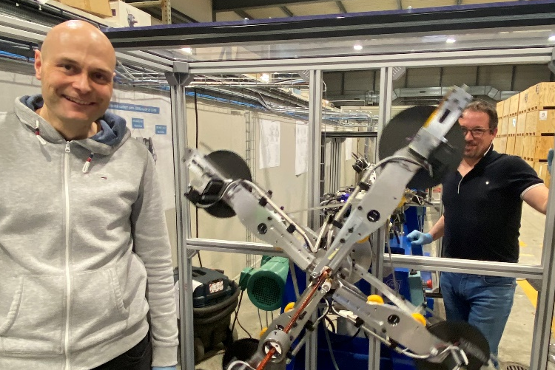
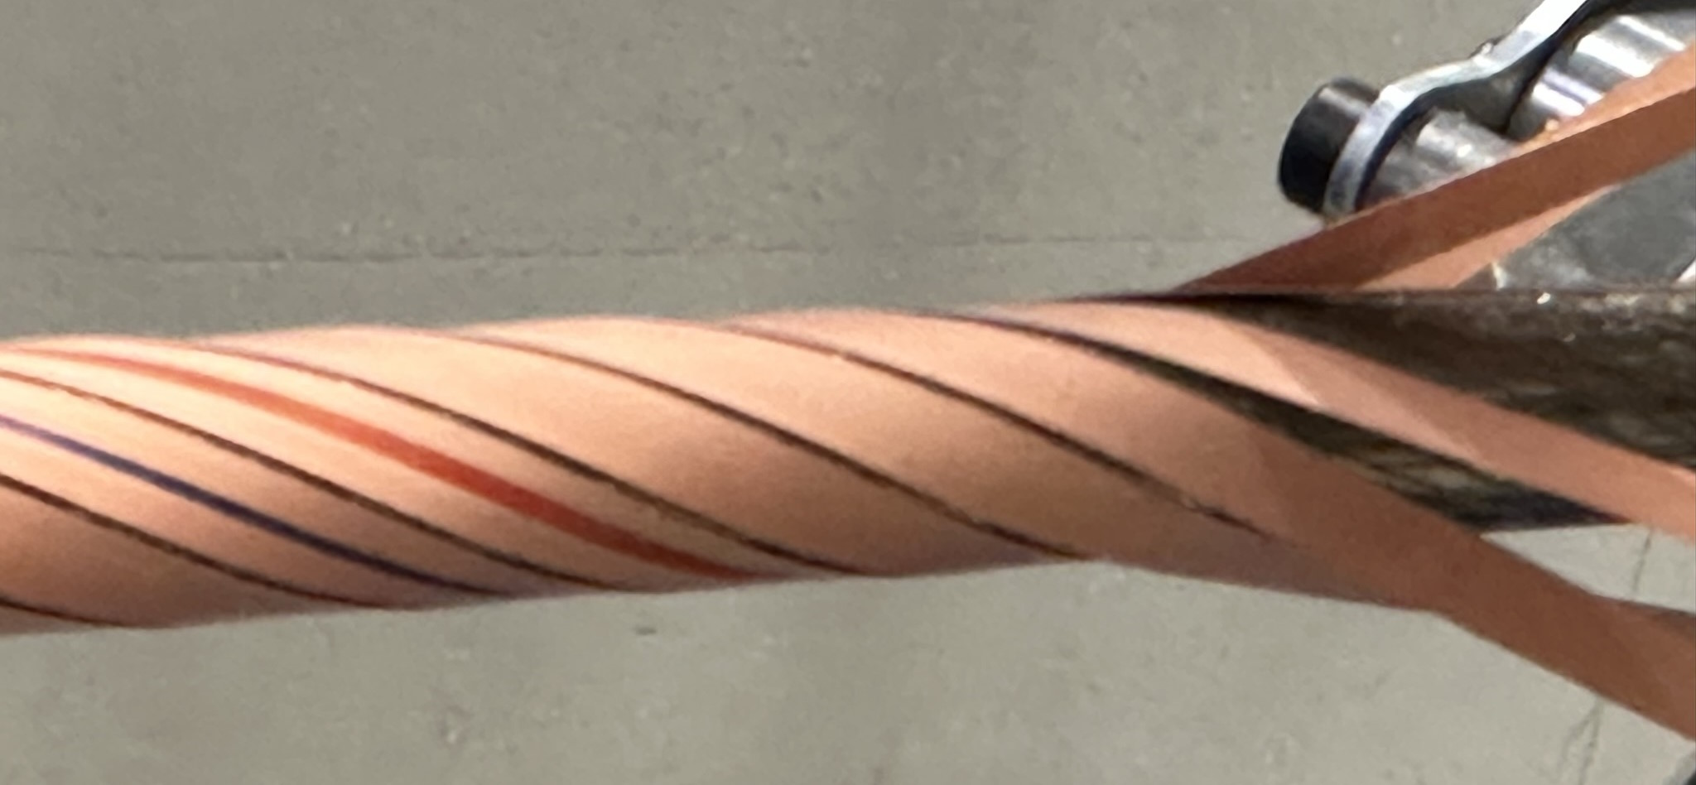
…and ReBCO round Cables for HL-LHC
Round, flexible, electrically insulated REBCO cables
No measurable critical current degradation of tapes after cabling
Current rating of ReBCO cables: 600 A, 3000 A, 7000 A and 18000 A @ 60 K (∼ 0.7 T)
Cabling machine designed and constructed at CERN
Two layers of tape
On-line Polyimide insulation
3 kA @ 60 K (B = 0.7 T)
High Field Magnets
12

Slide 13
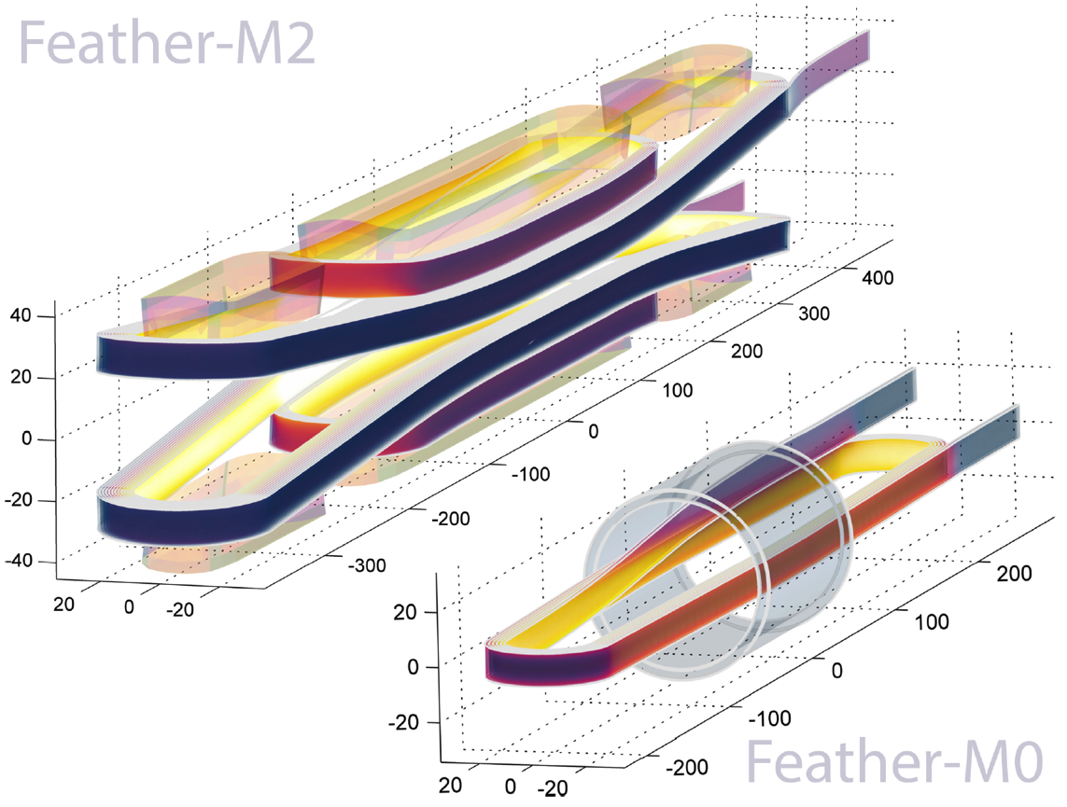
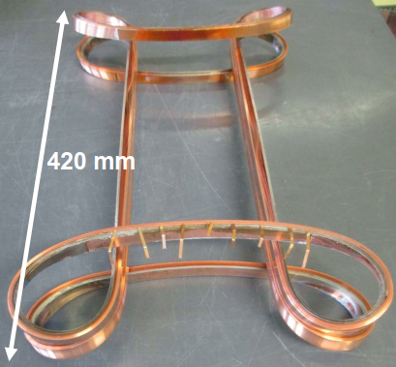
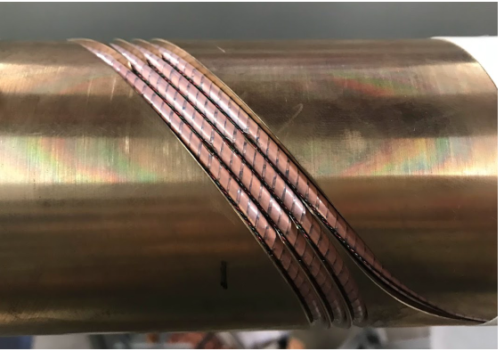
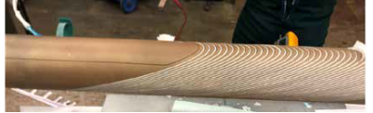
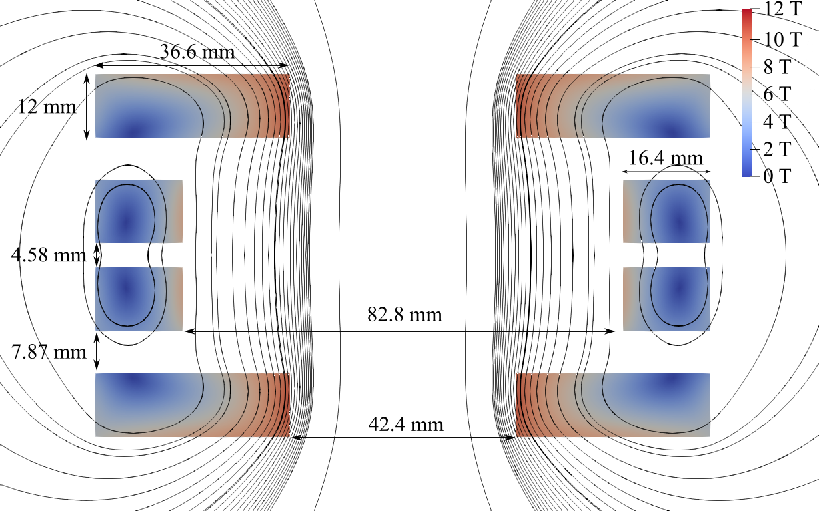
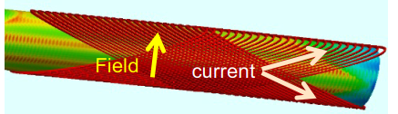
Recent accelerator type HTS magnet developments
Feather-M2
Superconducting coil, ReBCO
Dummy coil
REBCO CORC® CCT, LBNL
Feather-M0
ReBCO Cloverleaf, CERN and UTwente
PhD Thesis of Th. Nes
BSCCO-2212 CCT, LBNL and ASC
Rutherford cable
ReBCO Conductor On Molded Barrel (COMB)
Fermilab, STAR Wires
ReBCO Cloverleaf demonstrator CERN
High Field Magnets
13

Slide 14
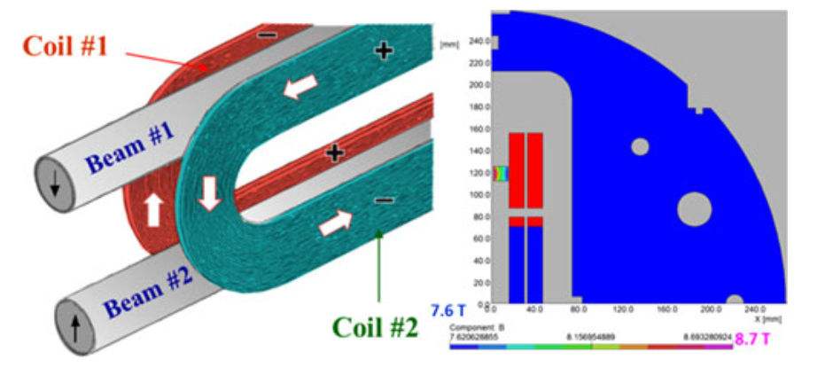
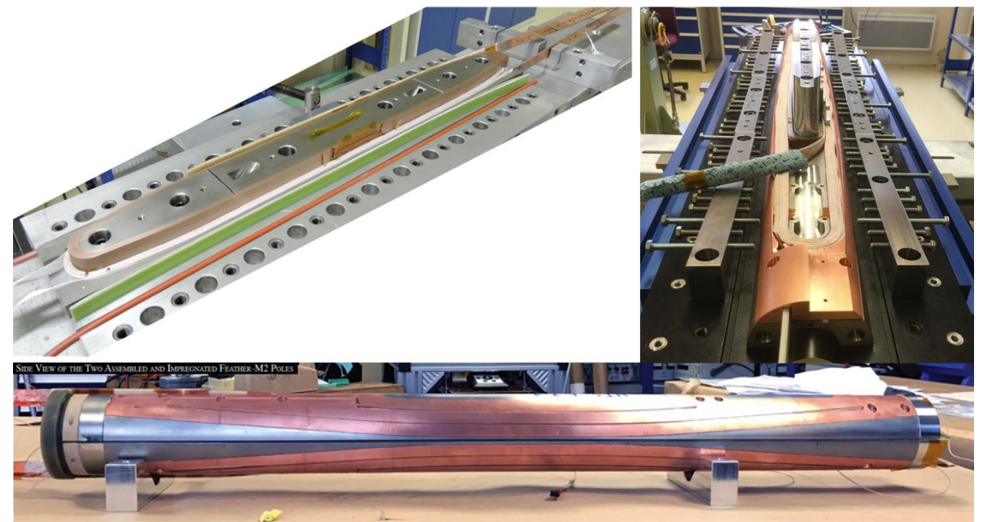
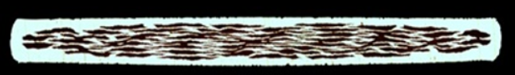
Recent accelerator type HTS magnet developments
R. Gupta et al., IEEE TAS, Vol. 28, No. 3, April 2018
L. Rossi, C. Senatore, https://doi.org/10.3390/ instruments5010008
High Field Magnets
14

Slide 15
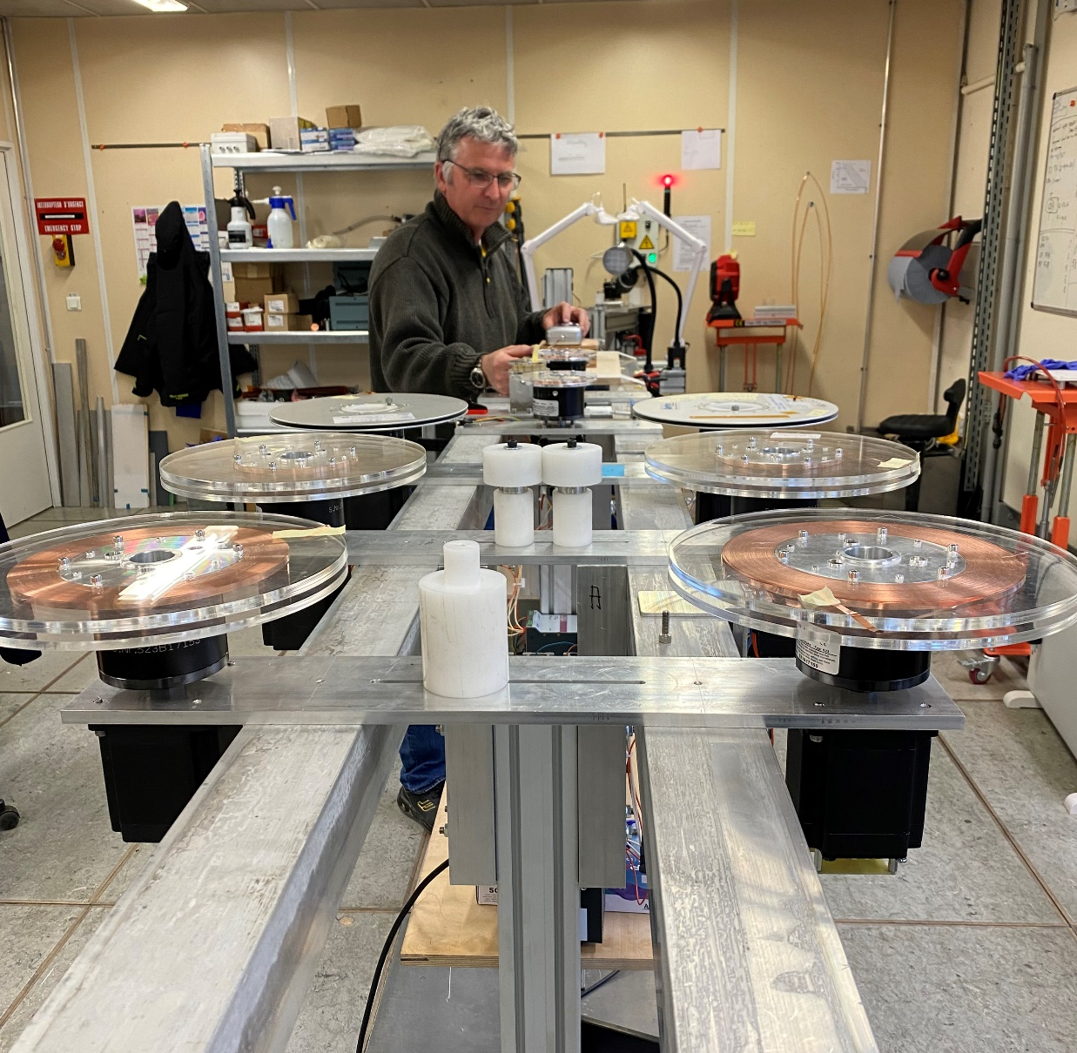
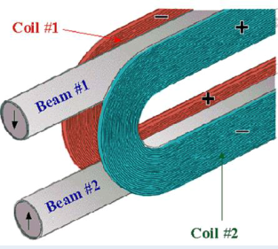
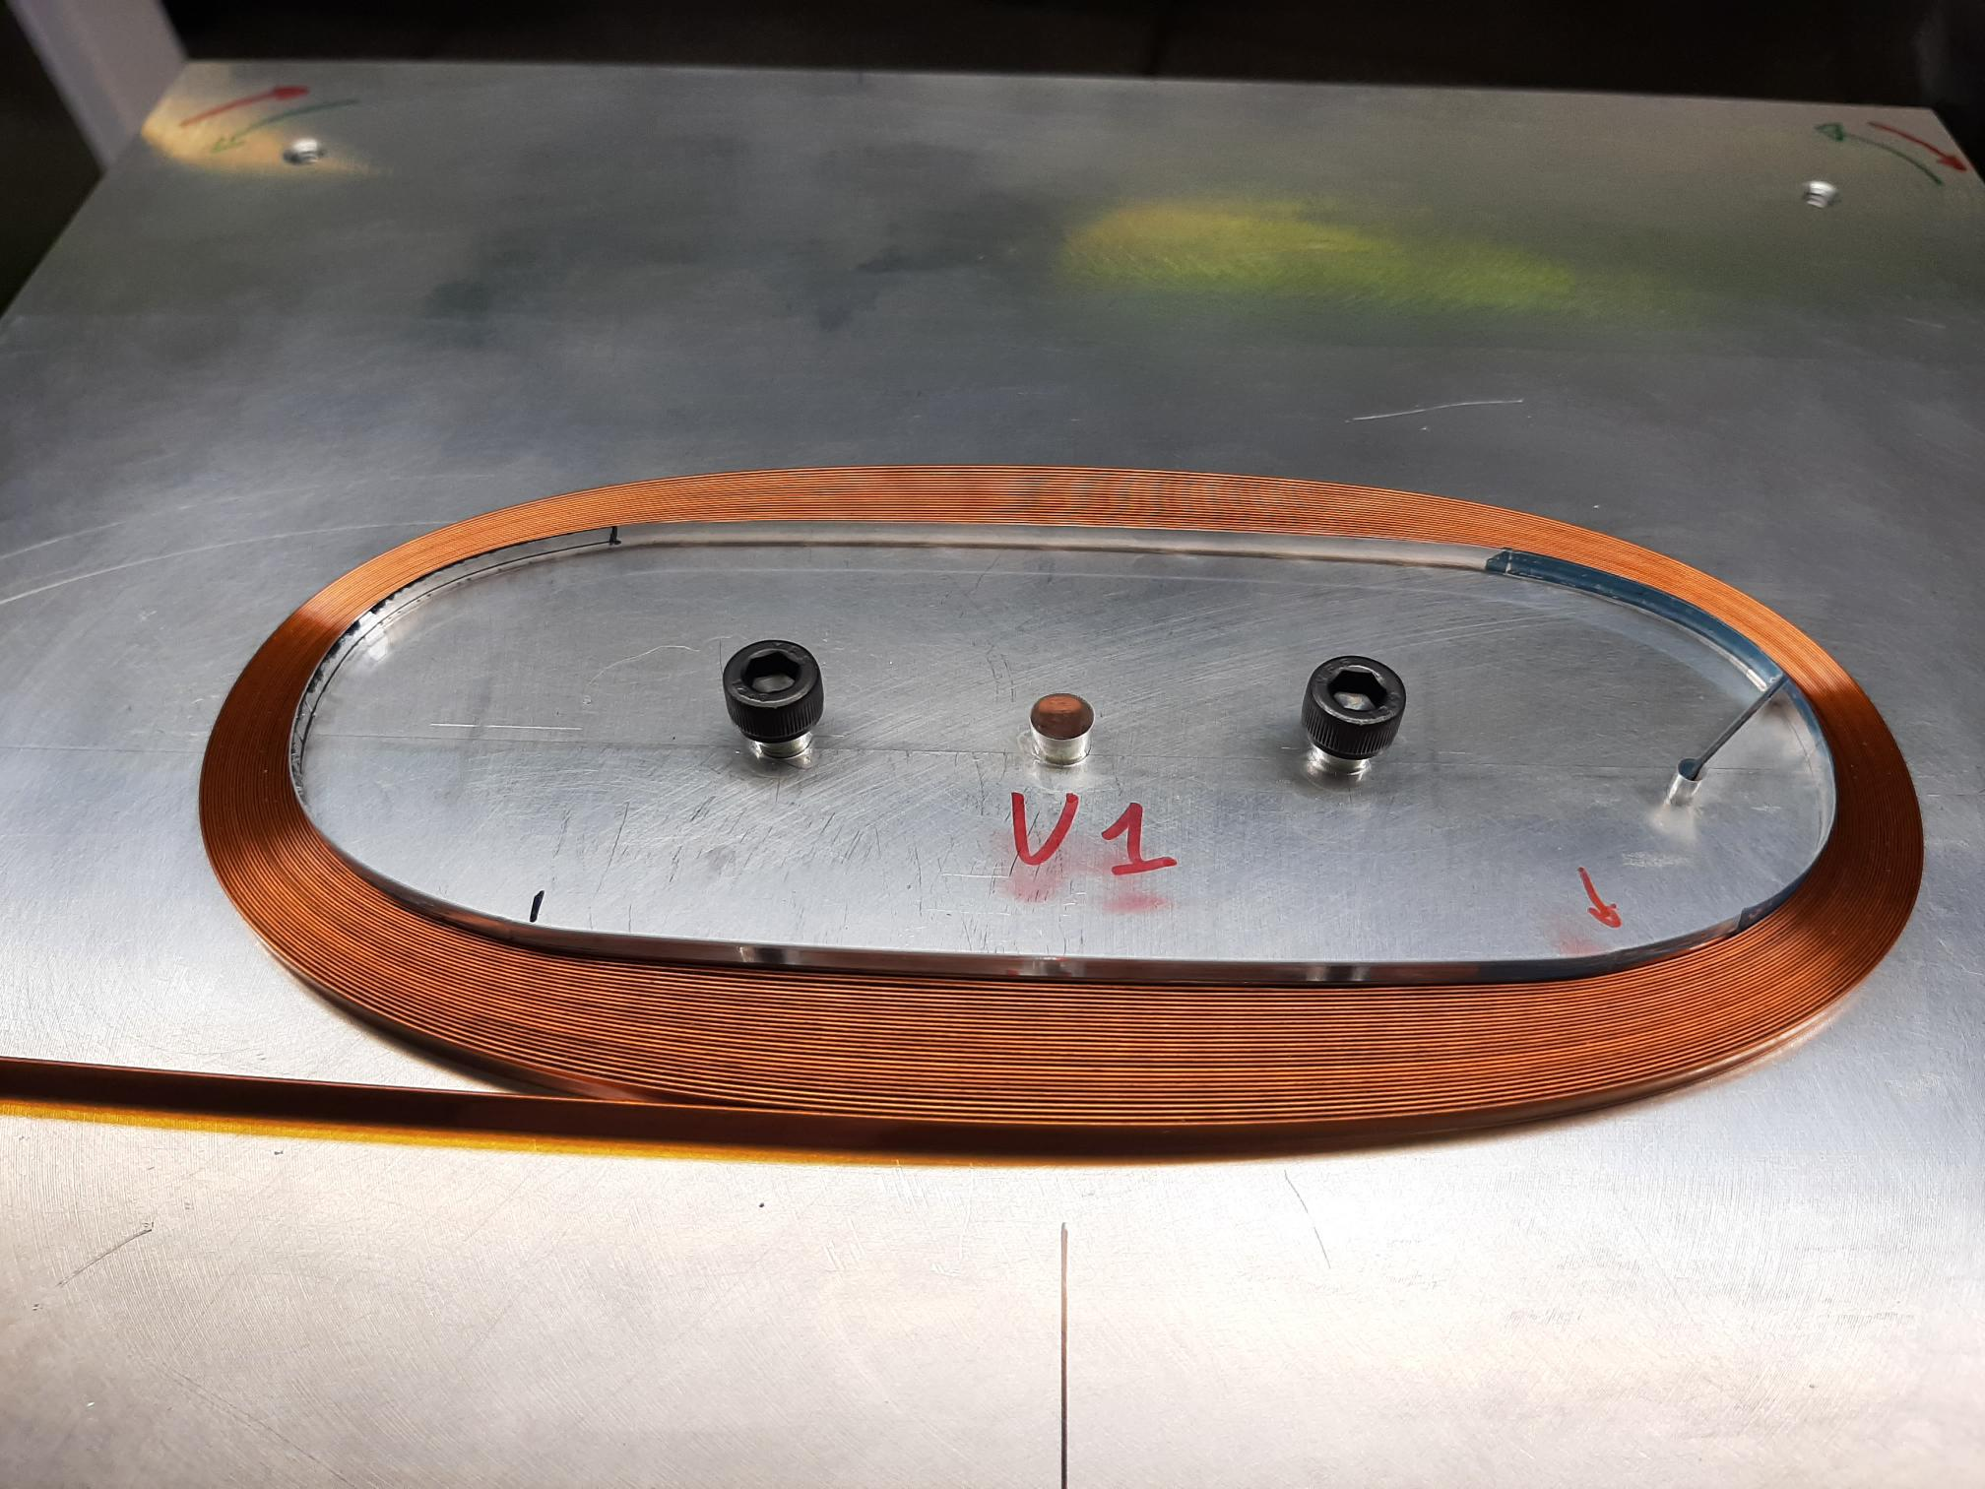
Prototype ReBCO coils at CERN
Objective: demonstrator of 5 T in a background field of 15 T
Development of electrically insulated cables. Target: 10 kA @ 20 T, 5 kV
Model racetrack coils
Common coil design
Winding machine - up to 14 tapes
Common-coil design, R. Gupta
Electrically insulated stacks
of REBCO tapes
Ø int 37 mm
Ø ext 57 mm
160
High Field Magnets
15

Slide 16
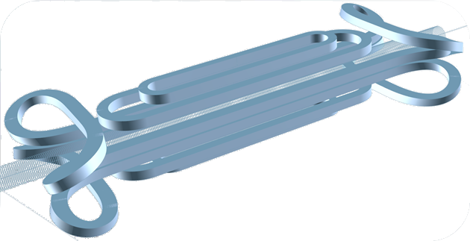
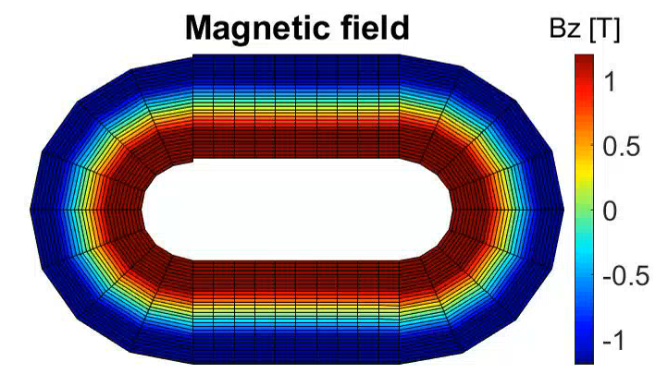
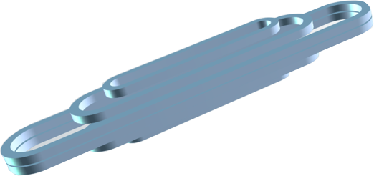
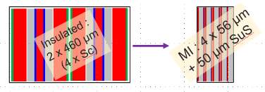
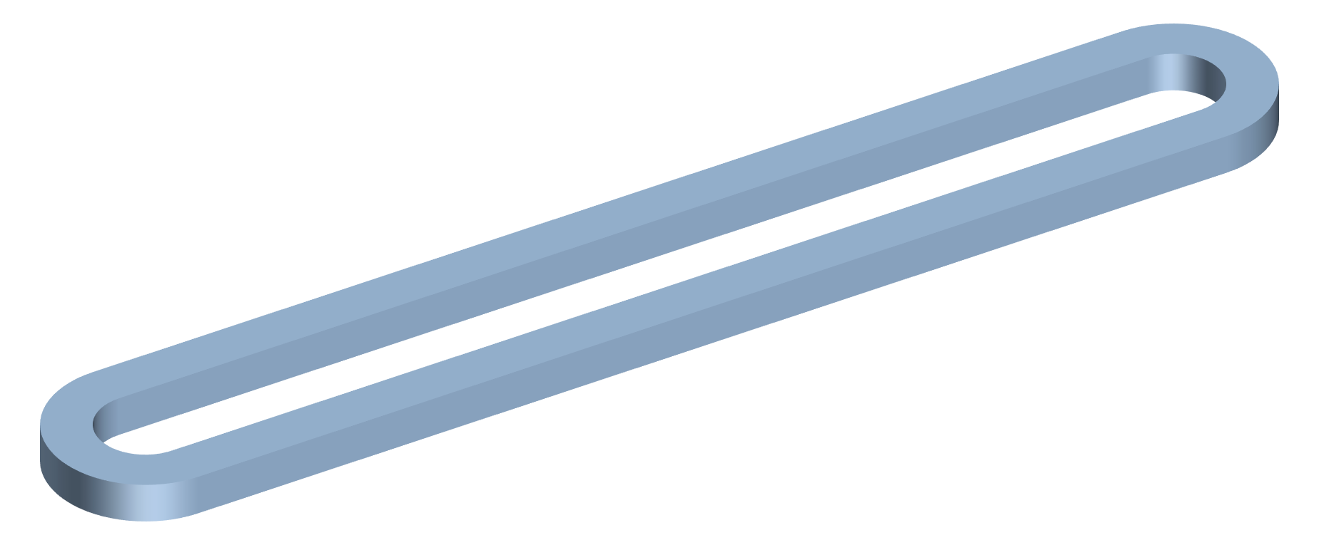
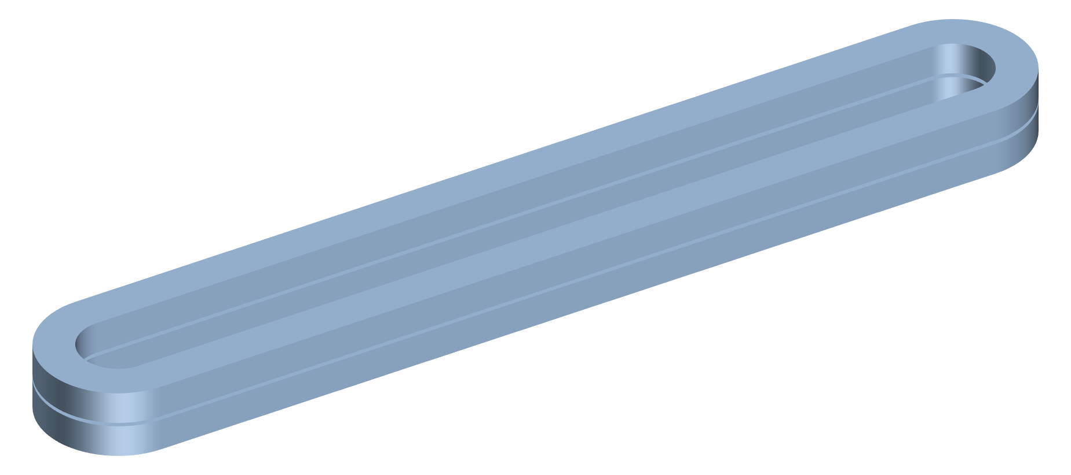
Prototype ReBCO coils at CEA
Technology
Global roadmap phases
CEA PEEC model
Aperture +
Field quality measurements
Phase 3 :
« EuCARD V3 »
MI cold bore 16 T+
magnet
Phase 2 :
magnet MI 16 T+
« EuCARD V2 »
Mechanics + high field +
Quench + assembly
Phase 1 (KE5647) 2023-2025:
Simple or double Racetrack MI
Models + techno
High Field Magnets
16
Notes:
Use «Metal-insulated (MI)» winding:
No need for insulation nor Cu stabilizer
Considerable increase of the current density in the coil to reach very high fields

Slide 17
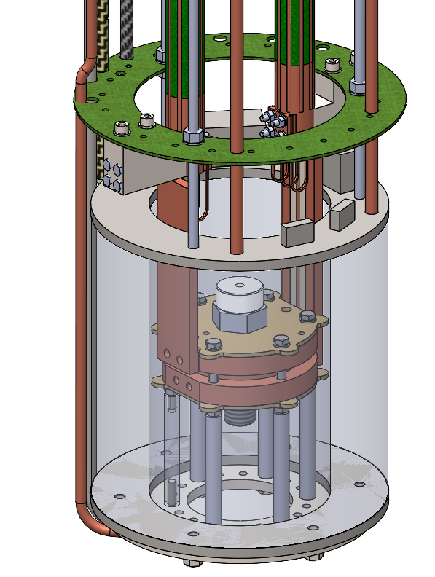
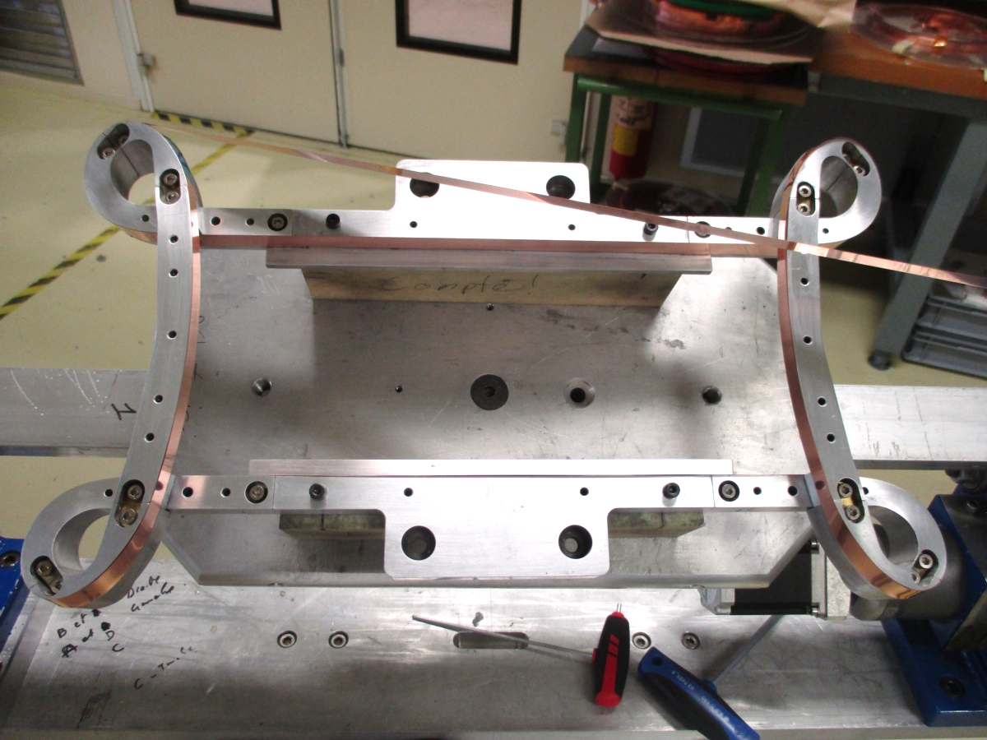
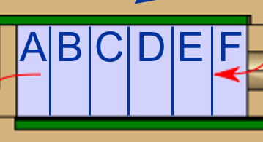
Prototype ReBCO coils at University of Twente
Non-insulated ReBCO coil at 4.2 K in background field
ReBCO Clovearleaf demonstrator test at 77 K
HTS/vapor cooled current leads
Solenoid magnet 7 T
NI dry wound double ReBCO pancake coil
146 mm
ReBCO coil mechanical support
High Field Magnets
17

Slide 18
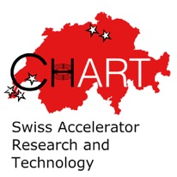
Prototype ReBCO coils at PSI
NI coil technology license agreement with Tokamak Energy
MagDev Laboratory
REBCO, 2 tapes
18.2 T in the center,
20.3 T on the conductor
2 kA and 12 K
Aperture: 50 mm
High Field Magnets
18

Slide 19

Summary
Current homogeneity as function of length, temperature and field
- measurements (l,α, T, B)
- modelling
Quench protection
- mitigation of Normal Zone Propagation velocity
- novel protection methods
- partial insulation, cable, coil
Shear stress sensitivity
- conductor architecture
- delamination
Magnetization and the other AC loss components
- conductor, cable, coil architectures
Quantification of the current homogeneity, setting the requirements
Improvements of the conductor architecture and realization of the protection
Enhance shear stress trough conductor architecture and prototype design
Advance conductor and cables architectures lowering magnetization and other AC losses
High Field Magnets
19

