Slide 1
High Field Magnet R&D Programme
Status of HFM within the Accelerators Roadmap
Andrzej Siemko on behalf of HFM R&D Programme Team

Slide 2
Outline
Current Consortium and main objectives of the HFM R&D Programme
Strategy and focus areas for the LTS high-field magnets
  State-of-the-art LTS superconductors and magnet technology
  Development of 12 T Nb₃Sn “robust dipole”
  R&D strategy and main focus areas
Strategy and focus areas for the HTS high-field magnets
  State-of-the-art HTS superconductors and magnet technology
  R&D strategy and main focus areas
Focus areas for other domains of interest
Key mid-term deliverables until the next update of European Strategy for Particle Physics
Final remarks

Slide 3













HFM R&D Consortium
(present main contributors)
Magnets
Conductors
Enabling
Technologies

Slide 4
HFM Programme – broad goals
The EU Accelerator R&D Roadmap identifies main objectives for the High Field Magnet Programme:
  OBJECTIVE 1:
    Design and demonstrate a full-size Nb3Sn accelerator magnet to proof the maturity of the most advanced technologies today, based on the HL-LHC design, i.e., 12 T magnets, and applying all the lessons learned from the US LHC Accelerator Research programme (LARP), the US High-Luminosity LHC Accelerator Upgrade project (AUP) and the HL-LHC project
  OBJECTIVE 2:
    Explore the limitations of the LTS state-of-the-art technology and push Nb3Sn magnet technology to its practical limits in terms of ultimate performance, towards the 16 T target targeted by the FCC-hh
  OBJECTIVE 3:
    Explore the capabilities and limitations of state-of-the-art HTS and magnet technology based on these superconductors. Demonstrate the suitability of HTS
  Create a European Research Network involving CERN and National Labs

Slide 5
HFM Programme Executive Structure
Governance
Executive Structure

Slide 6
Outline
Current Consortium and main objectives of the HFM R&D Programme
Strategy and focus areas for the LTS high-field magnets
  Development of 12 T Nb₃Sn “robust dipole”
  State-of-the-art LTS superconductors and magnet technology
  R&D strategy and main focus areas
Strategy and focus areas for the HTS high-field magnets
  State-of-the-art HTS superconductors and magnet technology
  R&D strategy and main focus areas
Focus areas for other domains of interest
Key mid-term deliverables until the next update of European Strategy for Particle Physics
Final remarks

Slide 7
Focus areas for the LTS magnet technology
Demonstrator of the maturity of state-of-the-art Nb₃Sn technology
“12 Tesla Robust Dipole”
So far, no full-size dipole magnet using Nb₃Sn technology has been built
As stipulated by the Accelerator R&D Roadmap, in order to demonstrate the maturity of the most advanced technologies today applying all the lessons learnt so far, and to investigate the physical and technological effects related to the length of the magnets, an accelerator-size magnet demonstrator will be built, taking HL-LHC as a benchmark, i.e., 12 T
12 Tesla
Robust
Accelerator-size demonstrator of maturity of Nb₃Sn technologies, including improved manufacturability through collaboration with industrial partners
Reaching 14+T with this 12 T robust technology will be aided by increased J_{c} and enhanced mechanical properties of Nb₃Sn conductor

Slide 8


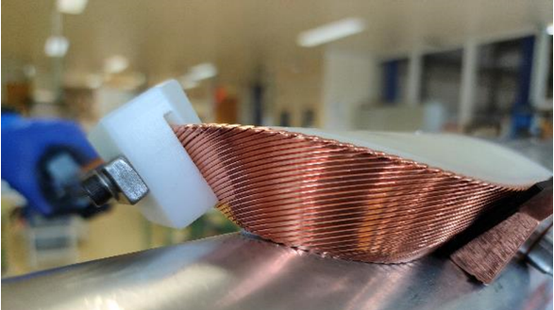
Ongoing work examples:
12 T robust dipole development
Development of a single aperture 12 T “robust dipole” in INFN, Genova
Courtesy of S. Farinon
Development of twin 12 T “robust dipole” at CERN
Winding tests are ongoing in INFN Genova
Both the INFN and CERN 12 T short robust dipole models are expected to be ready in 2025
Courtesy of D. Perini

Slide 9
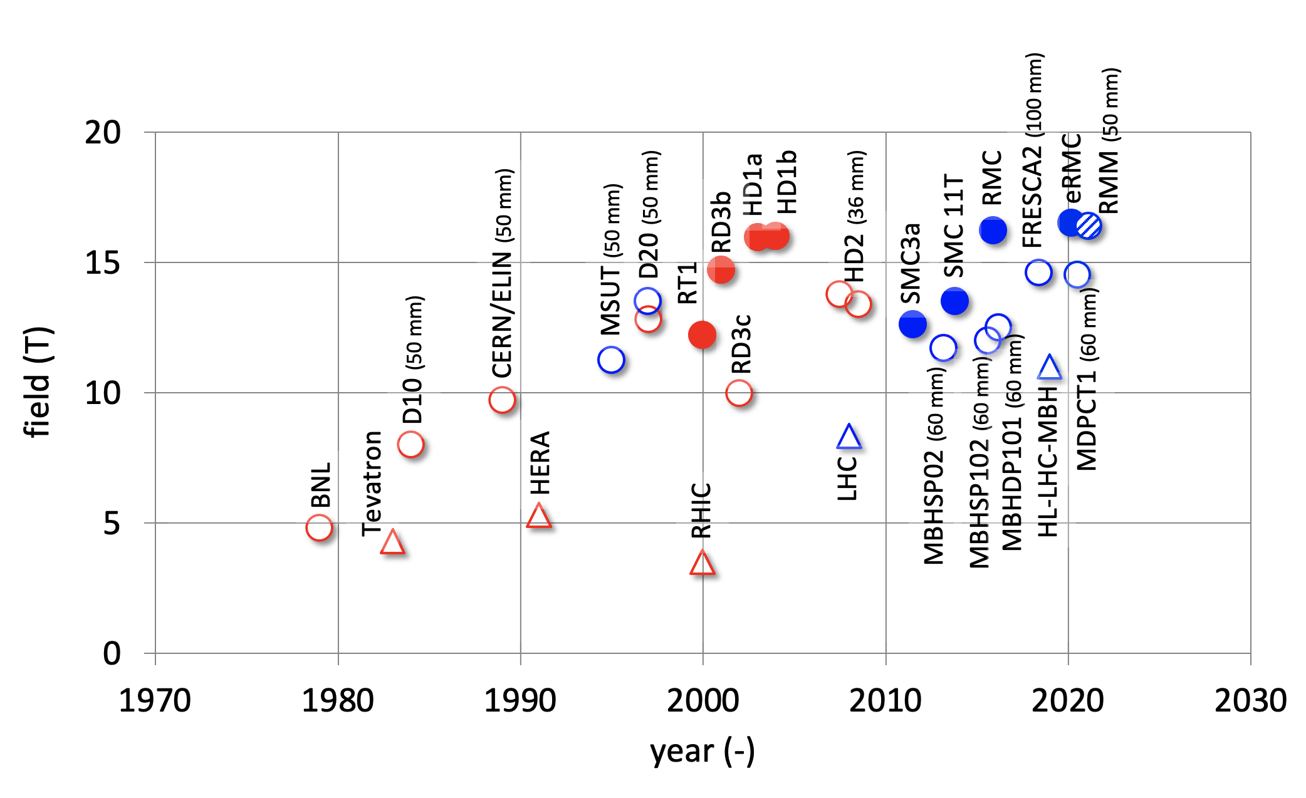
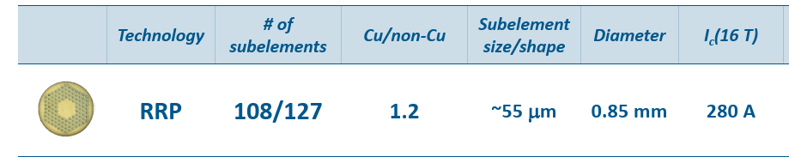
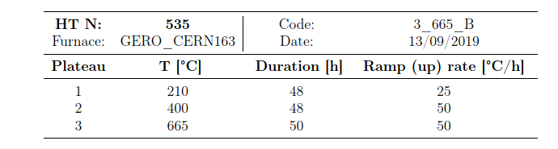
State-of-the-art LTS superconductors and magnet technology
State-of-the-art of Nb₃Sn magnet performance
Upper limit of Nb₃Sn
technology (~16 T)
Present state-of-the-art
(short models ~13-14 T)
Courtesy of L. Bottura
State-of-the-art Nb₃Sn conductor (HL-LHC)
Heat treatment
Courtesy of S. Hopkins

Slide 10
Main challenges facing the development of future 14+ Tesla LTS high-field magnets
Nb₃Sn Conductors
Present limitations of Nb₃Sn technology are linked to:
  conductor stress/strain sensitivity and degradation
  thermomechanical behaviour and degradation of magnet performance
σ_{irr} = 145–175 MPa
I_{c}/I_{c0} @ 150 MPa
→ 16 % - 28 %

Slide 11
R&D Strategy and Focus Areas for the LTS high-field 14+ T magnets
Nb₃Sn Conductors and magnets: pushing towards ultimate performance
Stress/strain sensitivity and degradation of Nb₃Sn conductors to be overcome by one of the two development paths:
Direct path to overcome conductor stress/strain limitations
Indirect path to overcome conductor stress/strain limitations
Nb₃Sn Conductor
R&D
New Nb₃Sn wire structures with enhanced mechanical strength
Higher Jc (increased margins)
Industrialization of improved superconductors
Novel Magnet Structures
Magnet structures need to be adapted via stress management to cope with performance limitations due to Nb₃Sn stress/strain sensitivity and thermomechanical behaviour

Slide 12

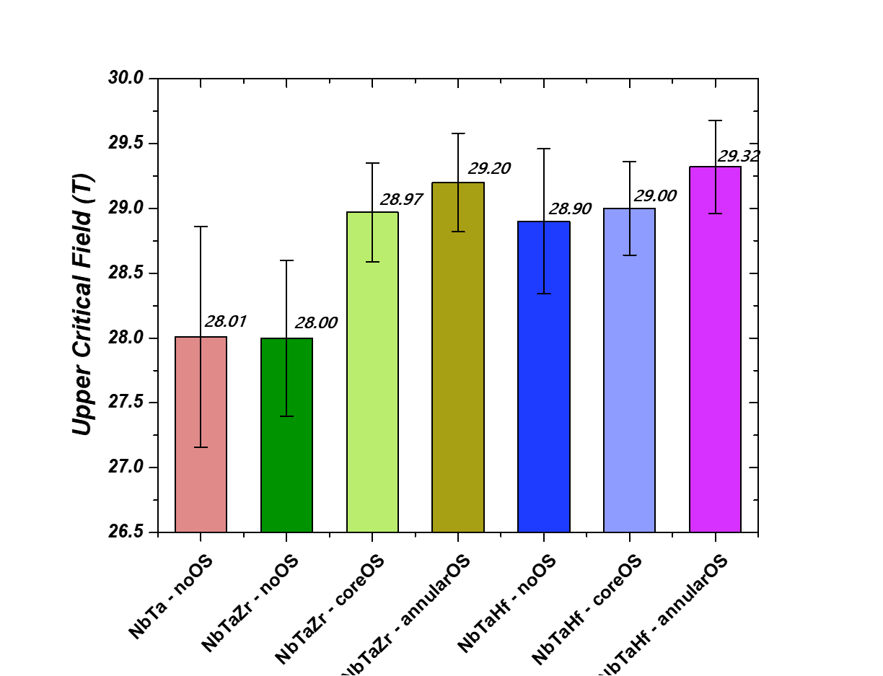
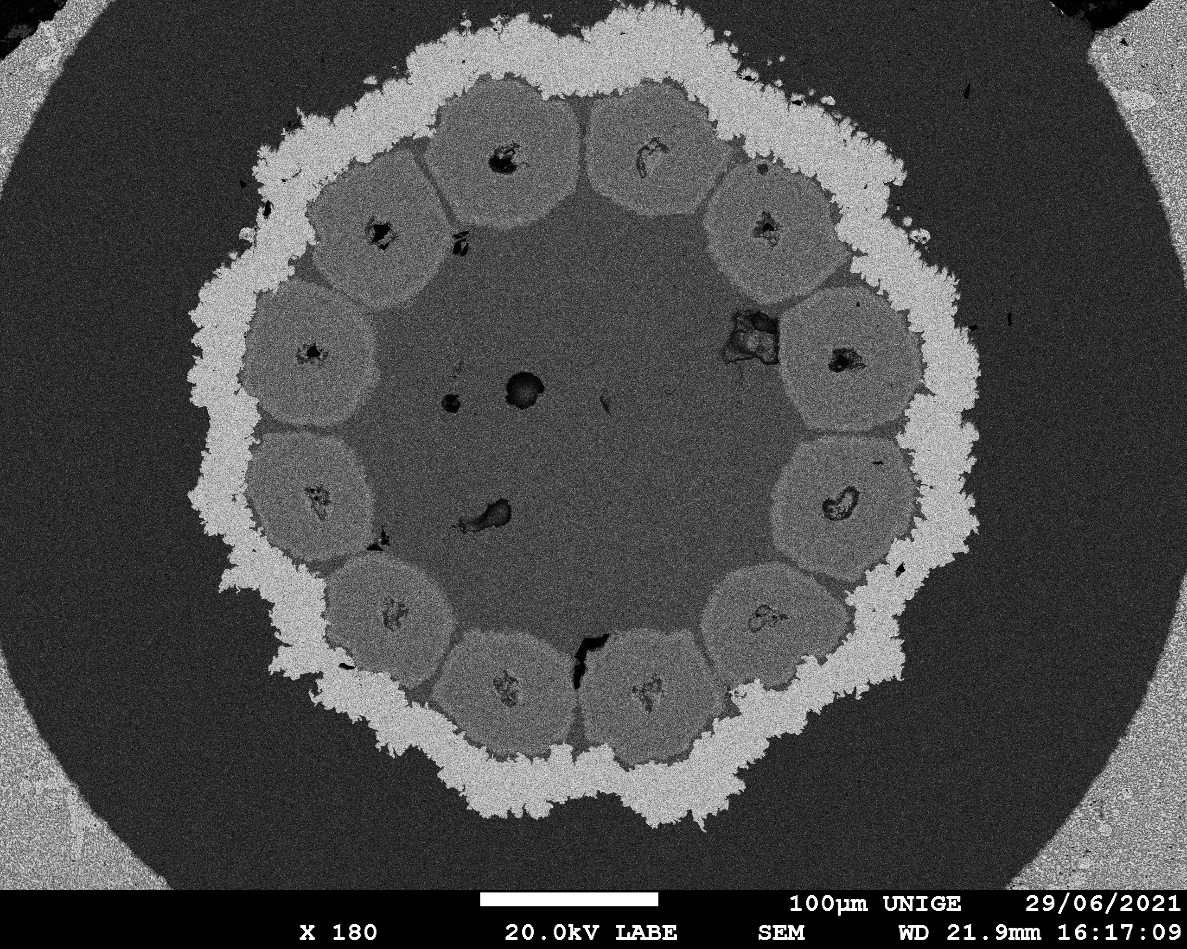
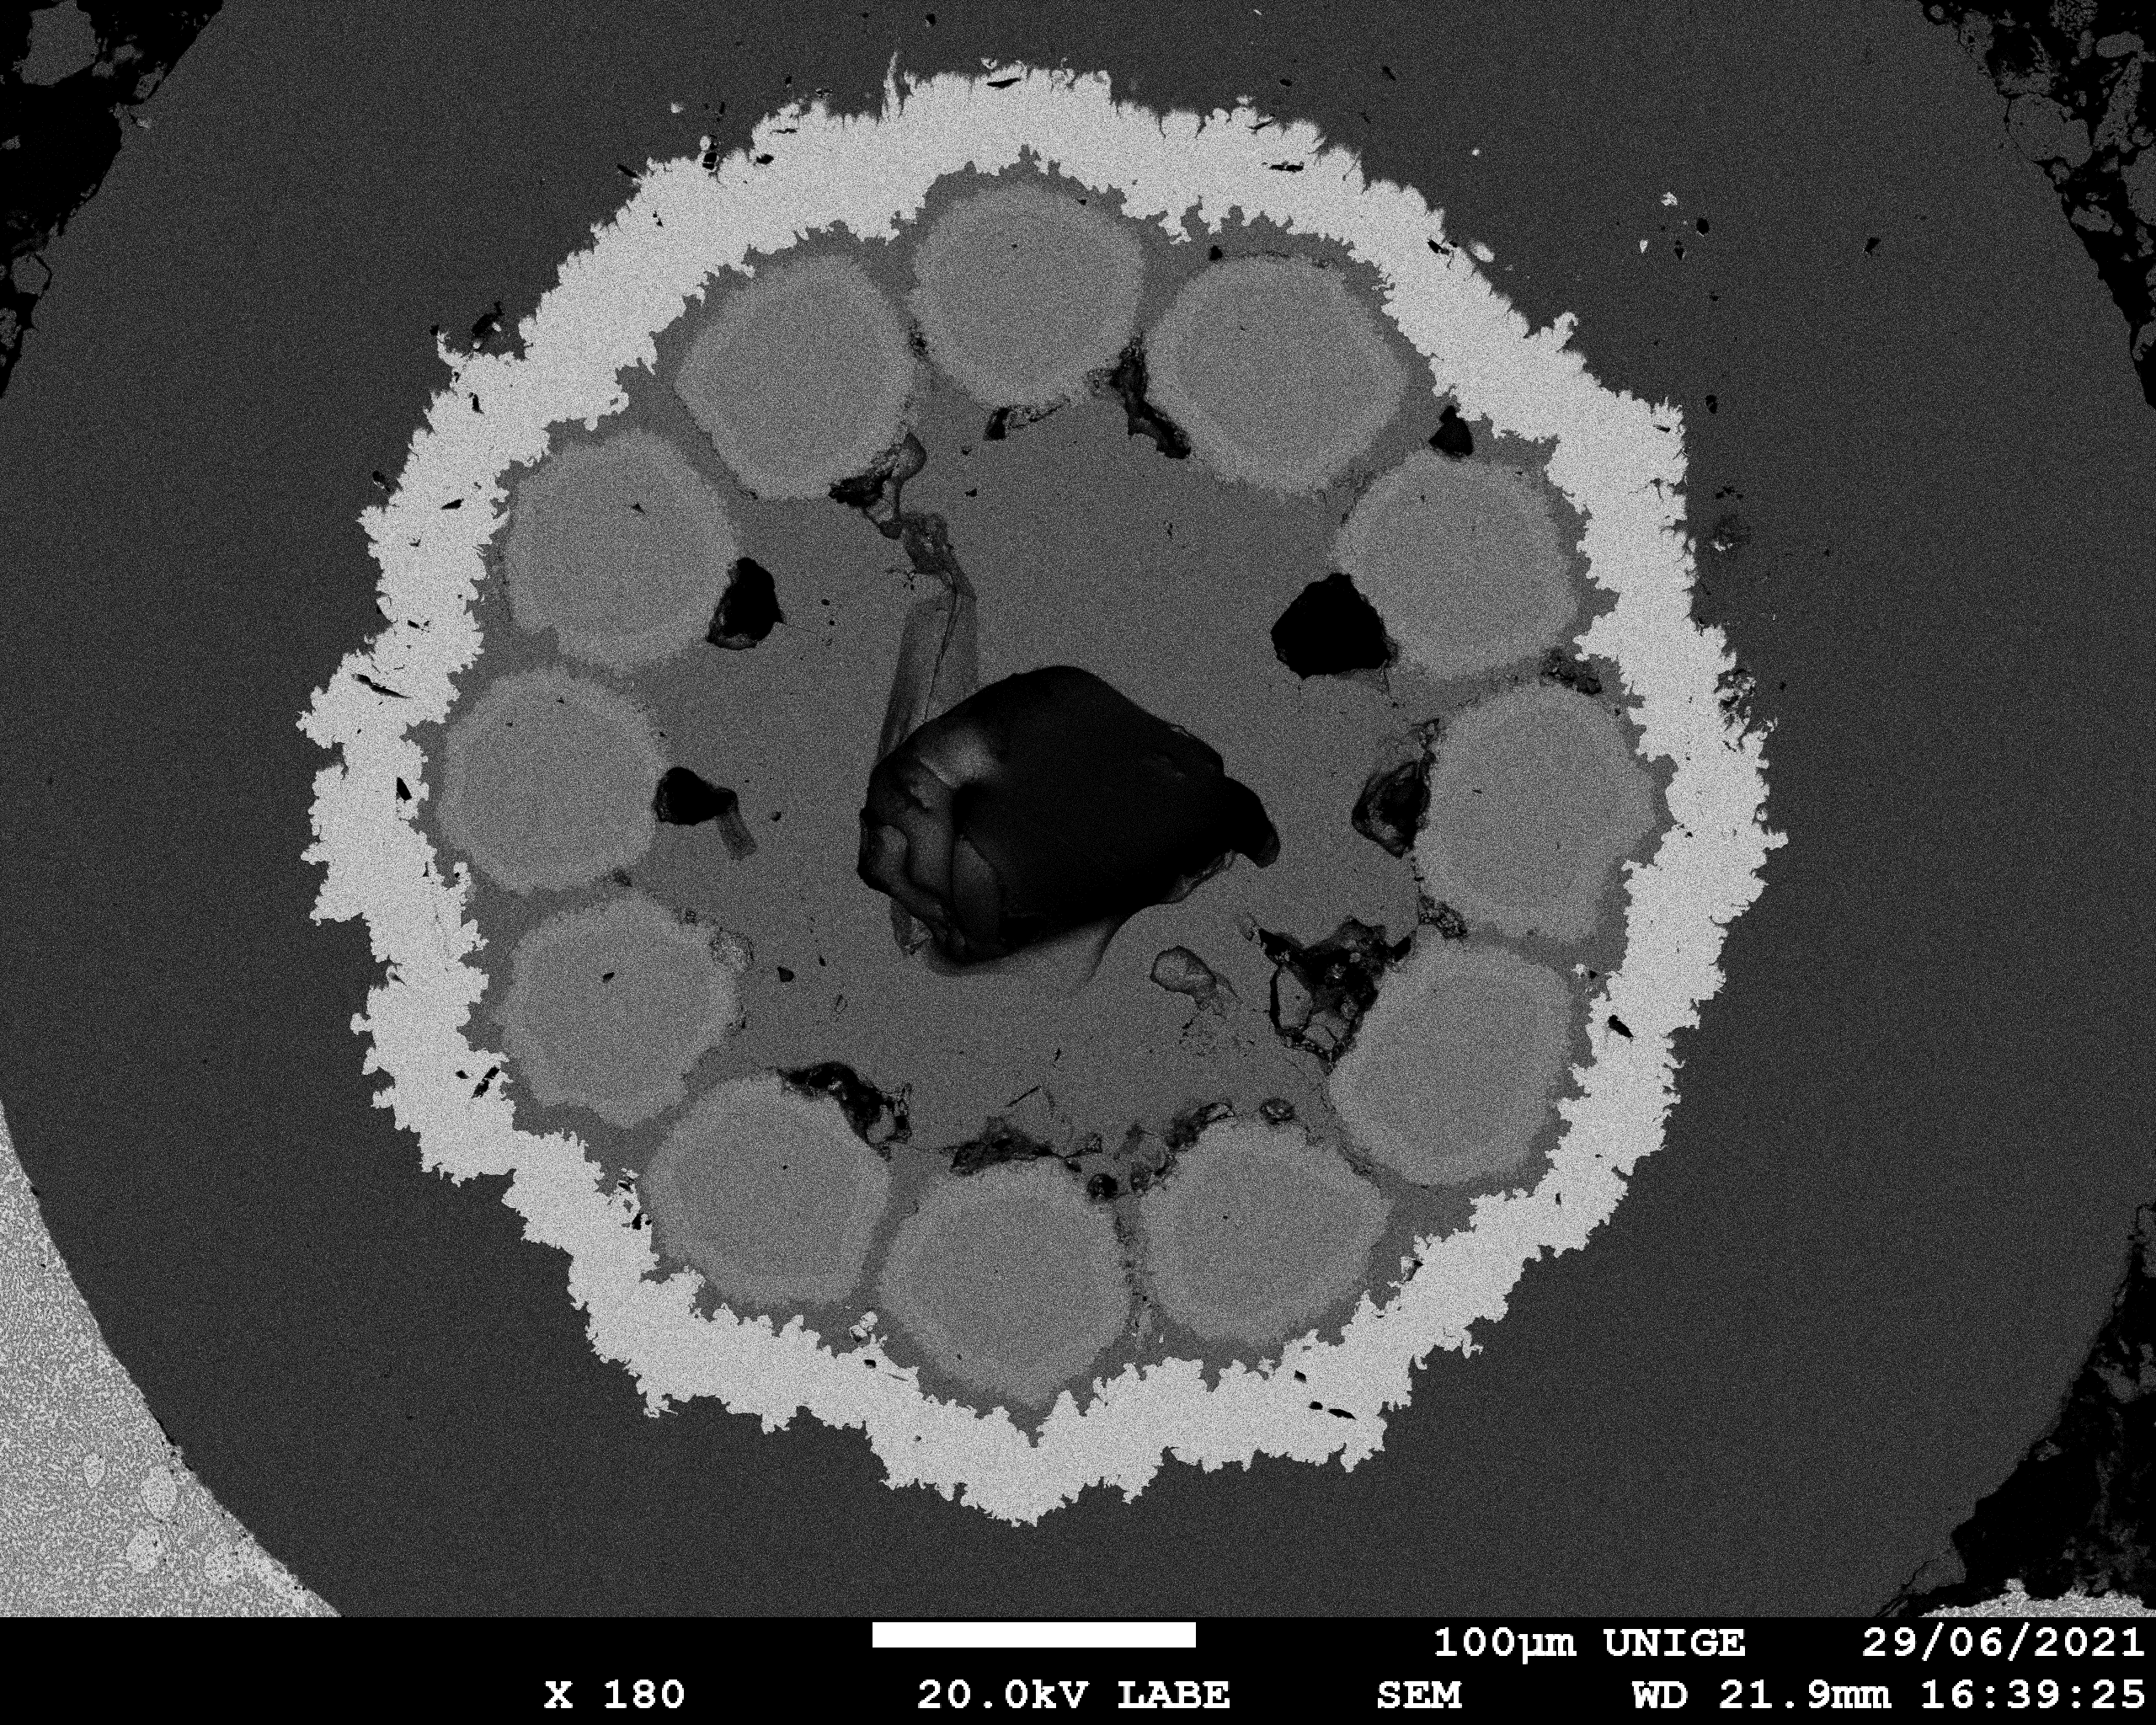
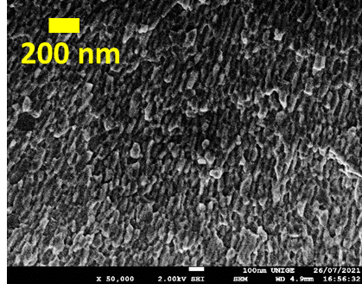
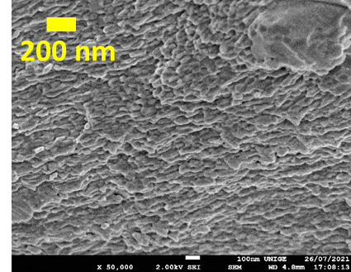
Ongoing work examples: Prototype
Nb₃Sn Wire Development at UniGE
Pushing Nb₃Sn towards its ultimate performance
Internal Oxidation in prototype multifilamentary wires
1
Refinement of the grain size: 100 nm → 50 nm
2
Large increase of the layer J_{c} → exceeding the FCC target
3
Enhancement of B_{c2} by > 1 T → improved in-field performance
1
2
3
Average grain size
∼ 47 nm
Average grain size
∼ 45 nm
Reference
Courtesy of C. Senatore
Notes:
Another peculiarity of the laboratories at UNIGE is the capability of manufacturing superconducting wires with the same processes as at industry. The goal of the running activity is the development of methods scalable at industrial level to implement internal oxidation (to refine the grain size and increase Jc) in wires produced by the internal Sn method.
Prototype wires with reduced number of filaments exhibit a significant grain refinement. But this is not the most surprising result. These wires with a combined presence of Ta (to enhance Bc2) and Zr (needed for the internal oxidation) exhibit record high upper critical fields. The highest measured value is 29 T at 4.2 K, which is about 1 T higher compared to industrial wires. The mechanism is still under investigation, but it is showing that it is possible to further improve the field performance of Nb3Sn.

Slide 13

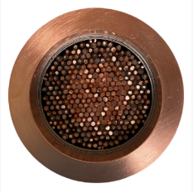

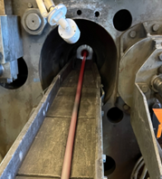
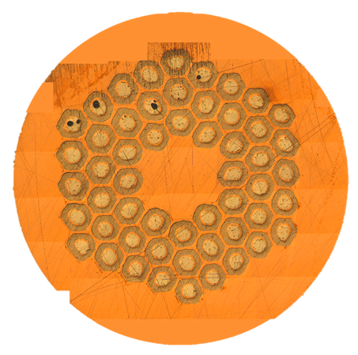
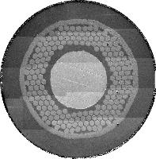
Ongoing work examples: Development of Prototype Nb₃Sn Billets at UniGE
Cu and Cu/Nb filaments produced and assembled at UNIGE
Billet e-Beam weld at CERN
Hot Isostatic Extrusion to remove voids
Cold-deformation,
gun-drilling of the subelement Cu core to insert the Sn rod
∅ = 18 mm
∅ = 71 mm
Cold-deformation to reach restack size
54/61 wire
1.5 – 1.0 mm
Restack of the sub-element in a Cu tube, and cold-deformation to final wire size (1 – 0.7 mm)
∅ = 6.05 mm
∅ = 15 mm
Courtesy of C. Senatore
Notes:
Another peculiarity of the laboratories at UNIGE is the capability of manufacturing superconducting wires with the same processes as at industry. The goal of the running activity is the development of methods scalable at industrial level to implement internal oxidation (to refine the grain size and increase Jc) in wires produced by the internal Sn method.
Prototype wires with reduced number of filaments exhibit a significant grain refinement. But this is not the most surprising result. These wires with a combined presence of Ta (to enhance Bc2) and Zr (needed for the internal oxidation) exhibit record high upper critical fields. The highest measured value is 29 T at 4.2 K, which is about 1 T higher compared to industrial wires. The mechanism is still under investigation, but it is showing that it is possible to further improve the field performance of Nb3Sn.

Slide 14

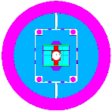
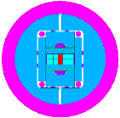
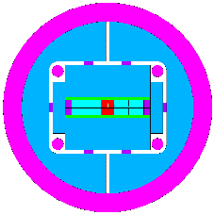
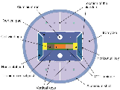
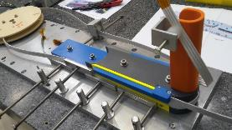
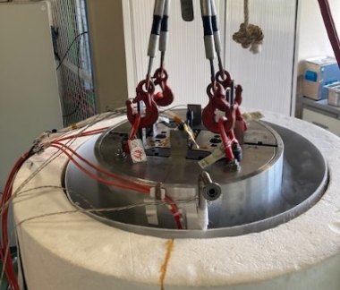
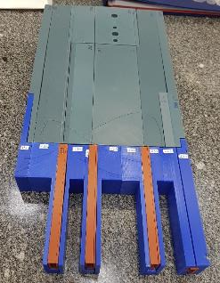
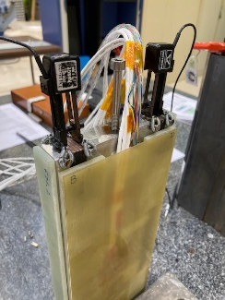
Ongoing work examples: Development Plan at CEA towards 16 T Nb₃Sn dipoles with block coil structure
14 T
Demo
Subscale Demonstrators
Powered samples
Non-powered samples
16 T
Demo
F2D2 Short model
Grading + Flared-ends + Aperture, 16 T
1.5 m, 50 mm bore
→ Planned
with aperture
FD Demonstrator
Grading + flared-ends, 14 T
1.5 m, No bore
→ Planned
with flared ends
CEA-CERN R2D2
Demonstrate grading ≥ 12 T
1.5 m, No bore
→ Ongoing
with grading
CEA-CERN SMC-11T coil
Demonstrate Nb₃Sn tech. ≥ 12 T
Done

Slide 15
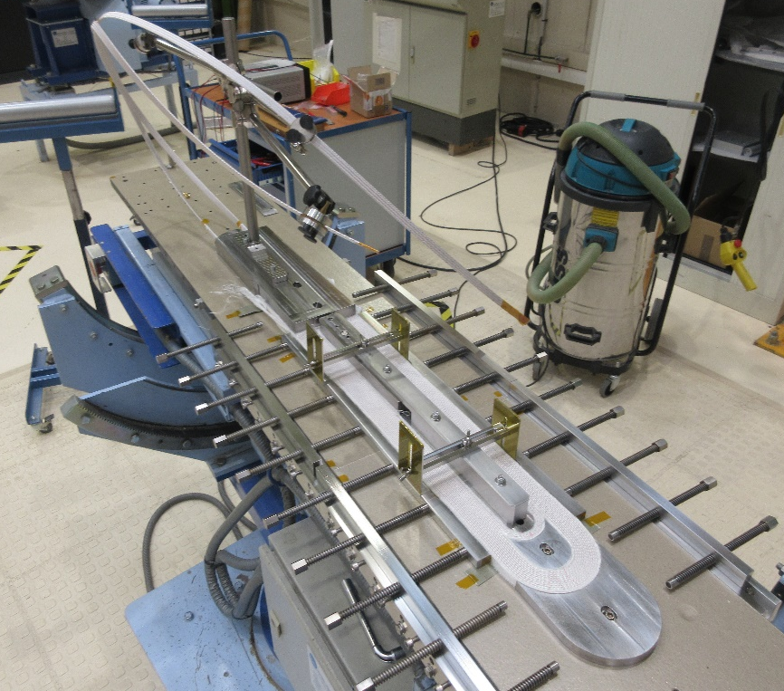
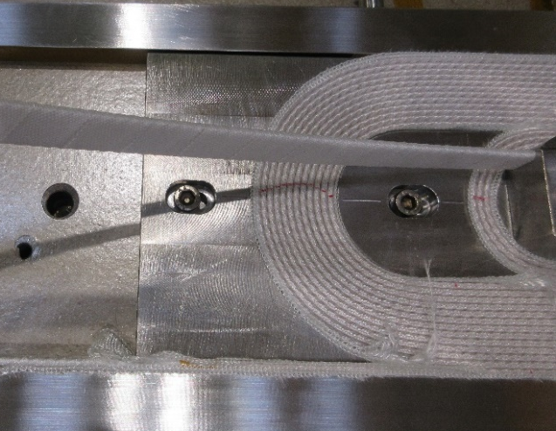
Status of R2D2 subscale demonstrator of graded Nb₃Sn block coil technology
Conceptual design done and reviewed
External joint procedure validated at CEA
Nb₃Sn prototype cables validated at CERN
Coil components and tooling received and qualified at Saclay
Fabrication started at CEA
Courtesy of E. Rochepault

Slide 16
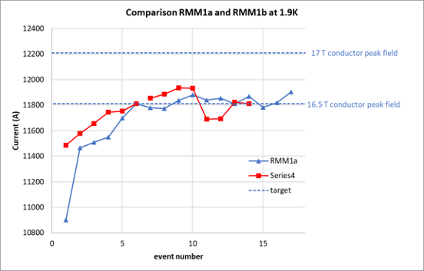
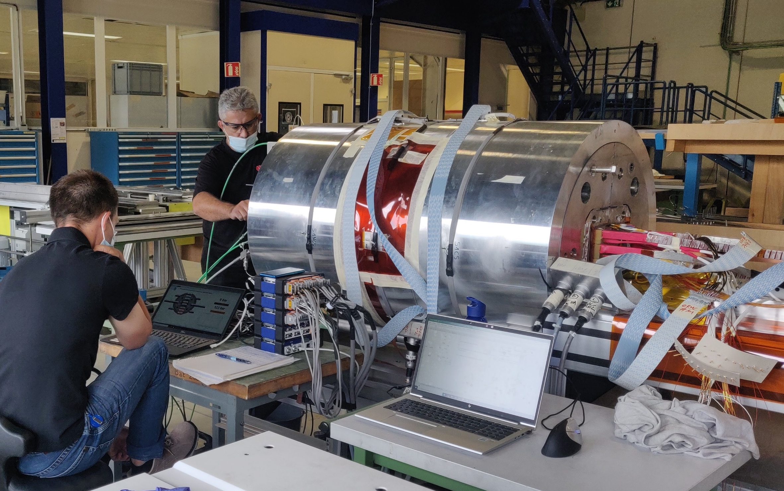
Ongoing work examples:
RMM1b demonstrator tests at CERN
RMM1b test performed at CERN Aug/Sept 2022
Maximum current reached in Q #9 & Q #10 of 11.94 kA corresponding to conductor peak field Bp of 16.7T and 16.5 T in aperture cavity
Small detraining is attributed to insufficient prestress in the coils
Magnet was warmed up and will be assembled with higher prestress in the coils
Courtesy of J. C. Perez

Slide 17

State of development of other magnet structures within the LTS exploratory phase
Collaboration agreement for the development of technological steps towards 16 T Nb₃Sn magnets with common coil structure: preparation of workshops for the implementation phase
Collaboration agreement for the development of technological steps towards 16 T common coil Nb₃Sn magnets with stress management: collaboration agreement is finalised
Development of technological steps towards 16 T block coil Nb₃Sn magnets with stress management: conceptual design has started

Slide 18
Outline
Current Consortium and main objectives of the HFM R&D Programme
Strategy and focus areas for the LTS high-field magnets
  Development of 12 T Nb₃Sn “robust dipole”
  State-of-the-art LTS superconductors and magnet technology
  R&D strategy and main focus areas
Strategy and focus areas for the HTS high-field magnets
  State-of-the-art HTS superconductors and magnet technology
  R&D strategy and main focus areas
Focus areas for other domains of interest
Key mid-term deliverables until the next update of European Strategy for Particle Physics
Final remarks

Slide 19
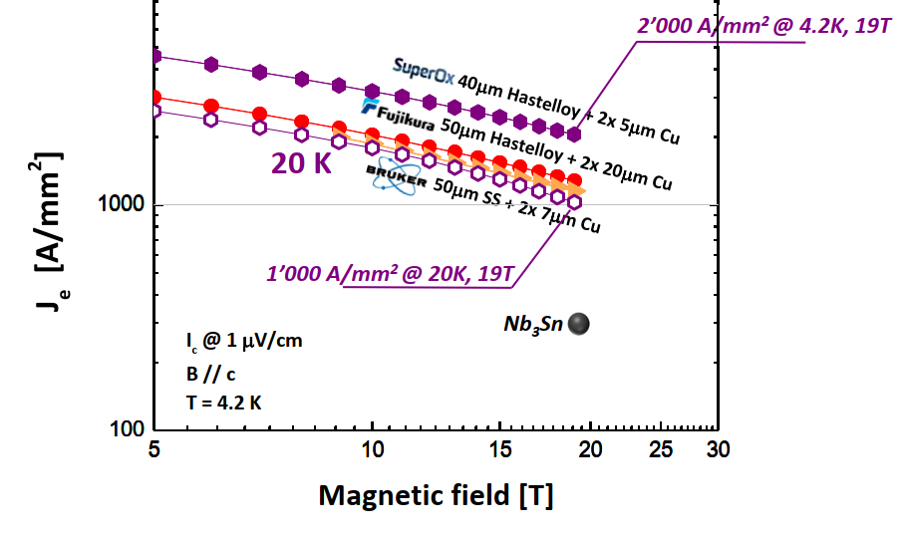
HTS REBCO and BSCCO: State of the Art
ReBCO (ReBa₂Cu₃O_{7-x},) coated conductor is a potential enabling technology for magnets beyond 16 T
  J_{c} is sufficient for most application requirements, J_{e} (4.2 K, 20 T) > 1000 A/mm²
HTS ReBCO and BSCCO materials outperform LTS Nb₃Sn at higher field, but under-perform at low field
  Hybrid LTS/HTS magnets are most efficient
Comparisons of critical current densities in available ReBCO tapes
Engineering current density (J_{e}) in magnetic field perpendicular to substrate for selected conductors (C. Senatore, UNIGE)
Notes:
Also this slide is very well known to the US-MDP community.

Slide 20
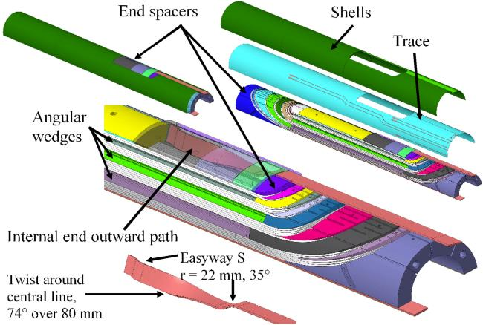
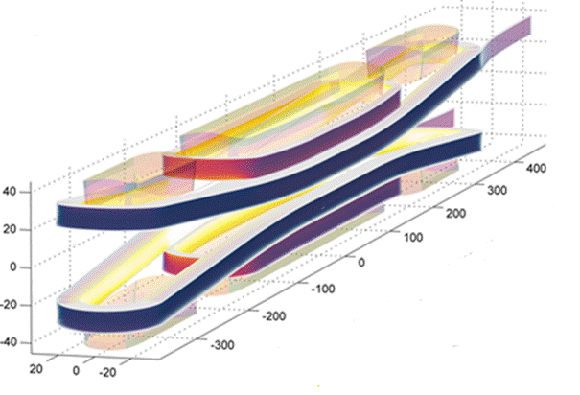

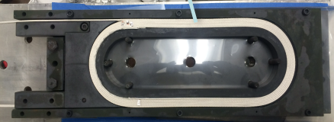
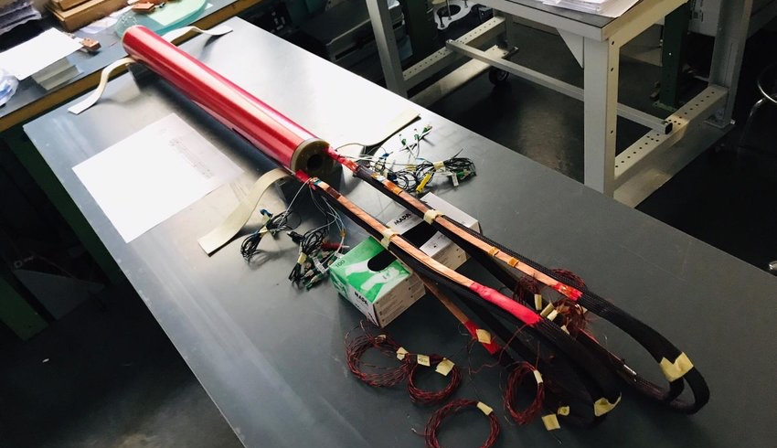
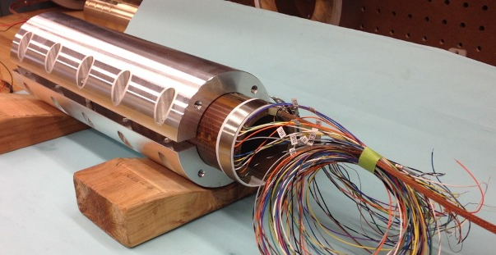
State-of-the-art of HTS magnet technology
So far, many small experimental solenoid magnets have been built, but only a few coils for accelerator dipole magnets made either of ReBCO tapes or Bi-2212 cables, and only the first HTS inserts for hybrid dipole demonstrators, such as 5 T inserts at CERN and CEA and 3 T at BNL
In practice, all insert coils built for hybrid LTS/HTS magnets had significant performance limitations
CERN design of HTS 5 T
insert magnet
CEA design of Cos-theta HTS
5 T insert magnet
CERN Feather-M2 HTS 5 T insert magnet
LBNL
Bi-2212 coils
Courtesy of G. Kirby, J. Van Nugteren
Courtesy of L. Garcia Fajardo, T. Shen
Notes:
All examples here are ReBCO. Why mention Bi-2212?
Second bullet not a full sentence.

Slide 21
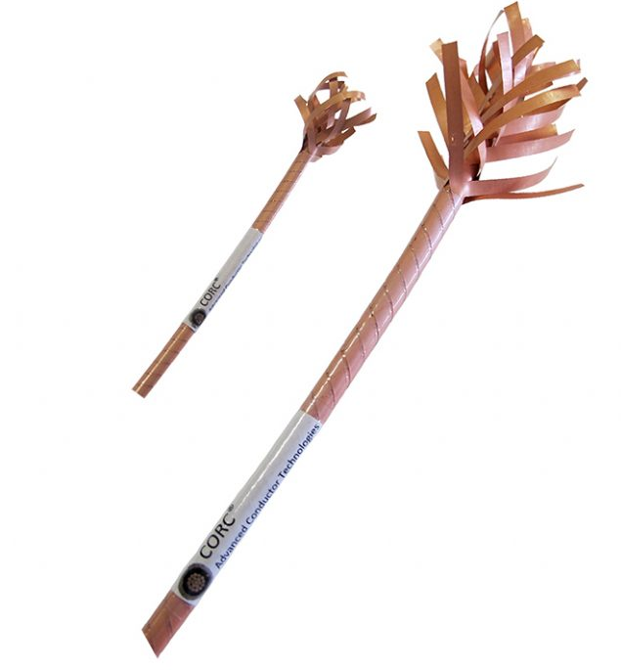
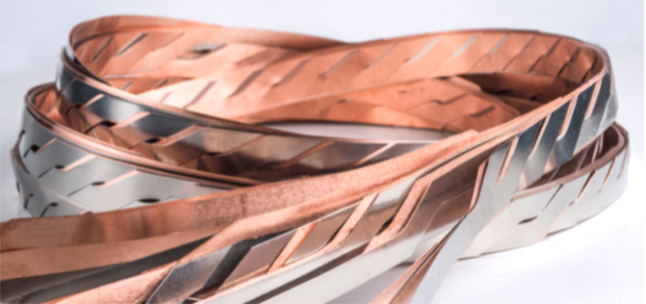
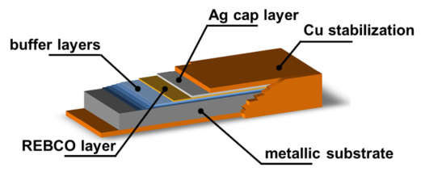

Main challenges facing the development of future HTS high-field magnets
Roebel flat cables
HTS Conductors
CORC® round cables
Current main limitations of HTS conductors specific to accelerator magnets:
  ReBCO conductor shear stress sensitivity and degradation caused by delamination
  Large magnetisation of ReBCO conductors (due to the tape shape) and resulting field errors
  AC losses (magnetic hysteresis, coupling and eddy currents) are major drawbacks of ReBCO. With significant “filamentation” the ReBCO losses compare to Nb₃Sn (at > 10 T)
  Limited ability to bend at small radii of ReBCO tapes is forcing specific designs of coil ends
  Quench protection of accelerator size magnets due to low quench propagation velocity and high stored energy density in coils made of ReBCO as well as Bi-2212
  Anisotropy of ReBCO tapes properties, including mechanical properties. Uniformity of tapes and cables along the length and lot to lot, impacting on magnet protection
  Bi-2212 conductor stress/strain sensitivity and degradation
  Very complex Reaction Heat Treatment for Bi-2212
  …

Slide 22
R&D Strategy and Focus Areas for the HTS high-field magnets
  The broader HTS magnet technology, including cable design, coil design, joints, quench detection and magnet protection remains at an early stage of development
  The main focus area is demonstration of the suitability of state-of-the-art HTS conductors for accelerator magnets, providing a proof of principle of HTS magnet technology beyond the capability of LTS Nb₃Sn technology
HTS Conductors
Improvement of ReBCO conductors for low magnetisation demand and mechanical robustness
Development of alternative HTS superconductors such as IBS
Development of practical HTS cables
HTS Magnets
Development of stand-alone all-HTS demonstrator magnets
Development of subscale HTS insert coils for background field and development of hybrid LTS/HTS magnets

Slide 23
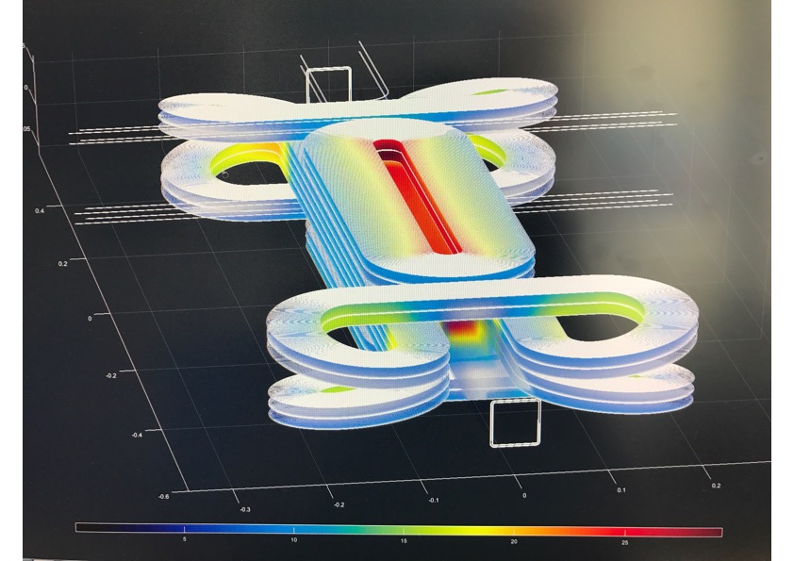
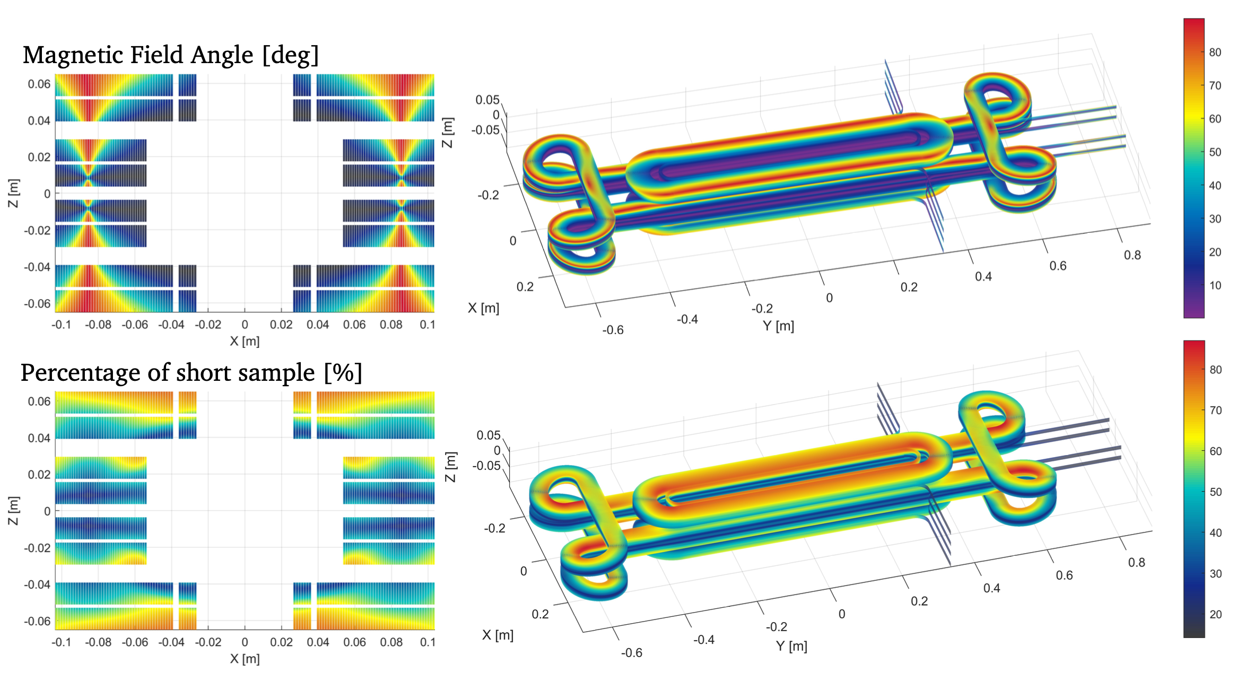
HTS is the only path beyond 16 Tesla
Are we ready for the HTS revolution in accelerator magnets now?
  It seems that we still have a long way to go before all-HTS magnets replace LTS magnets
  Hybrid LTS/HTS magnets seem to be the most promising to break the 16 T barrier by the end of this decade
  Development of novel, practical HTS conductors/cables will be the most important
  As part of the HFM Programme, work is underway on the conceptual designs of HTS magnets using existing conductors and developing the magnet structures not as we would like, but as allowed by conductors
Courtesy of G. Kirby
Notes:
What does ‘better’ mean? Do we have a choice? We must start with what we have. Maybe mention which labs are starting to work on the topic (CERN, CEA, PSI, INFN)

Slide 24
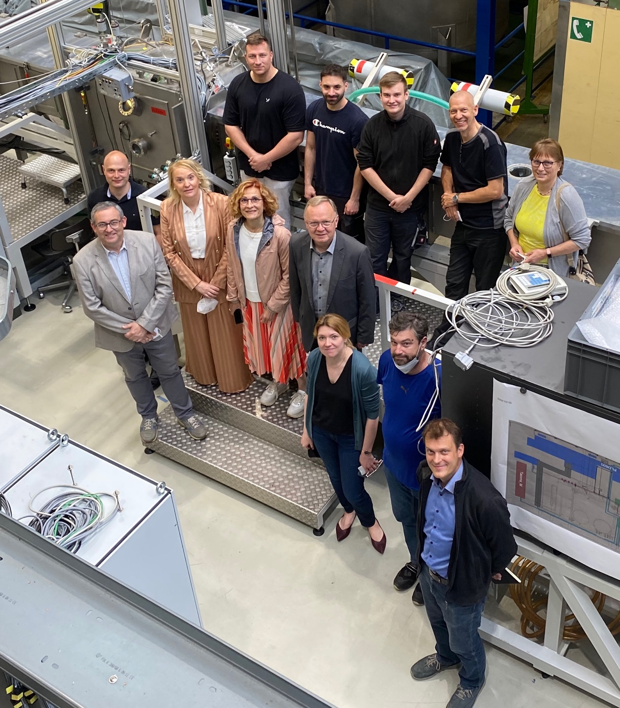
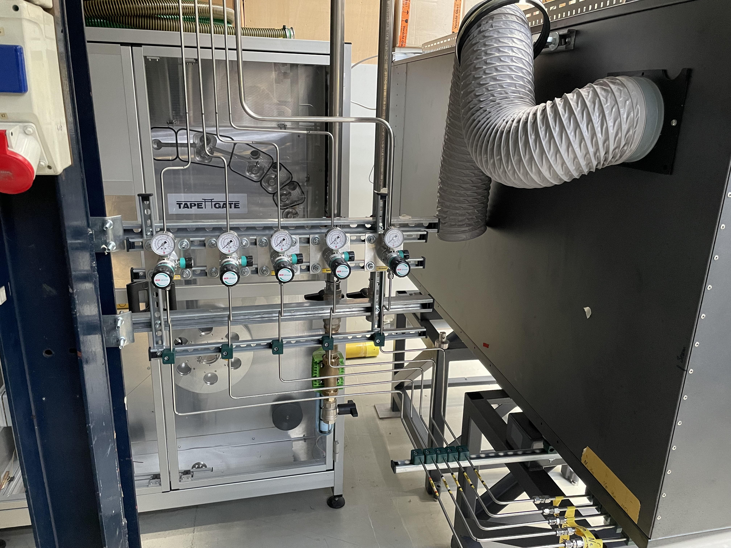
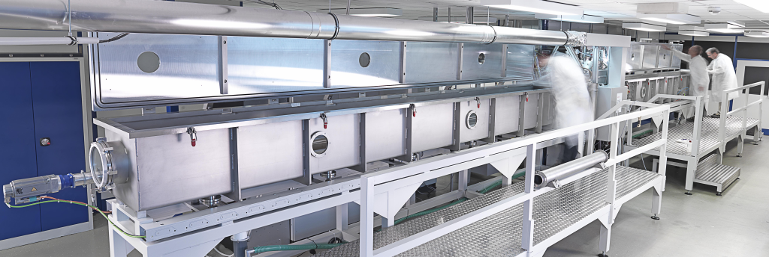

Ongoing work examples: KIT-CERN Collaboration on Coated Conductors
KC⁴ mission
Development of tailored HTS-tapes for magnet and energy applications
  Company independent
  Special tape architectures for R&D
  Tape length up to 100m to meet
  demonstrator needs
Commissioning of CC deposition equipment
  PLD setup adapted to local lab requirements
  Short sample (10m batches)
  synthesis just started
Courtesy of B. Holzapfel
Notes:
Mention that US has such independent tape R&D, producing, e.g., tape for STAR conductor.

Slide 25
Outline
Current Consortium and main objectives of the HFM R&D Programme
Strategy and focus areas for the LTS high-field magnets
  Development of 12 T Nb₃Sn “robust dipole”
  State-of-the-art LTS superconductors and magnet technology
  R&D strategy and main focus areas
Strategy and focus areas for the HTS high-field magnets
  State-of-the-art HTS superconductors and magnet technology
  R&D strategy and main focus areas
Focus areas for other domains of interest
Key mid-term deliverables until the next update of European Strategy for Particle Physics
Final remarks

Slide 26
R&D strategy in other areas of interest
Enabling Technologies R&D
Present limitations of state-of-the-art HFM are often linked to enabling technologies that need to be further developed and advanced
Enabling Technologies
Enhanced impregnation materials for HFM magnet coils
Enhanced insulation materials for HFM conductors and coils
Common modelling and simulation tools for HFM magnets
Cryogenic and thermal management studies for HFM magnets
Novel quench detection and protection methods for both Nb3Sn and HTS high-field magnets
New structural materials for HFM magnets with enhanced functionality through additive manufacturing

Slide 27
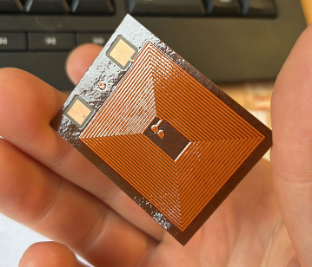
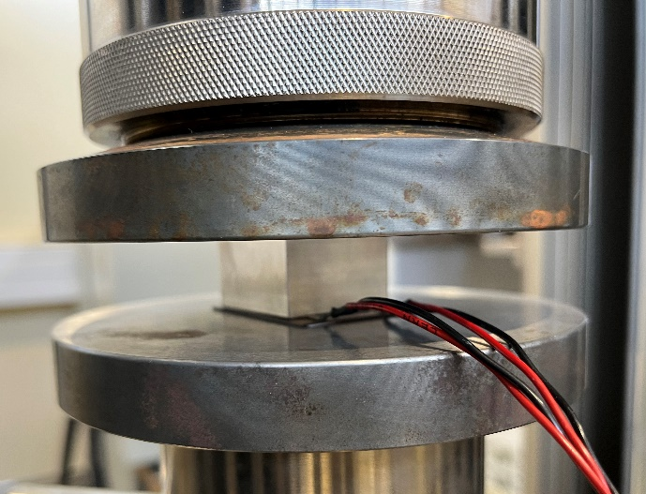

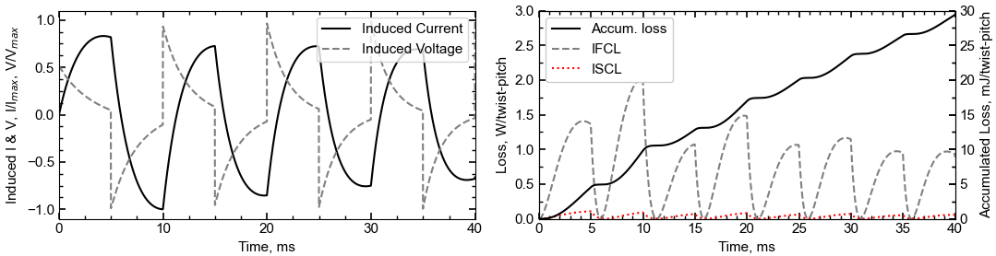
Ongoing work examples:
Novel Magnet Protection Method
E-CLIQ: External Coil Coupled Loss Induced Quench
A set of very compact copper coils strategically positioned close to the primary coils, similar to resistive quench heaters, see Mulder et al. 2023
PCB E-CLIQ in development for integration with an SMC
  Optimized for use with low-current amplifier
  Able to generate local dB/dt of > 100 T/s
  Compact envelope, width of a Nb₃Sn cable
The design is experimentally verified to withstand mechanical loads of over 200 MPa ✓
Thanks to I. Santillana and A. Terricabras (EN/MME) for effort during the mechanical tests
Modeling tools further matured

Slide 28
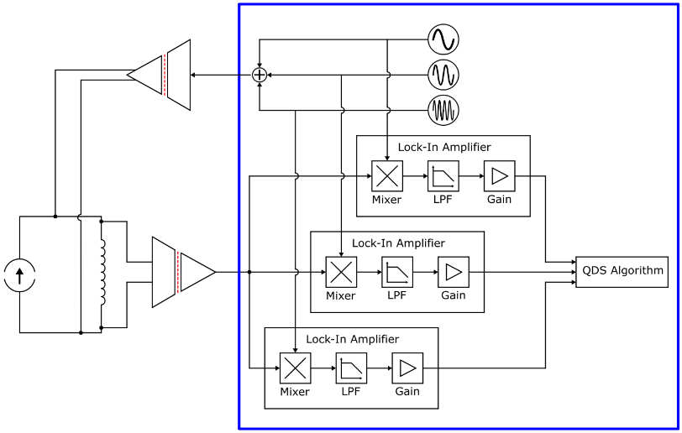
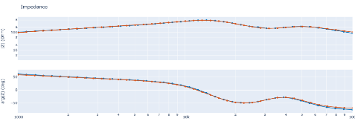
Ongoing work examples:
Novel Quench Detection Method
Impedance Measurement for Continuous Condition Monitoring
Current Status:
Built hardware required to inject and measure the response of stimuli signals, like:
  DAC (inject) & ADC (measure) cards
  FPGA to supervise the cards and relay the collected samples
Quantified performance when measuring LTS magnets in non-powered state
Upcoming Tasks:
Quantify the performance when measuring HTS magnet (non-powered)
Quantify the performance when powering magnets for LTS and HTS
Evaluate the systems operational impact on auxiliary systems.
Conceptual illustration of future quench detection.
Stimuli inject.
FPGA
SC circuit
Impedance of warm D2 magnet, all coils in series.
Orange – ELQA team with ‘commercial hardware’,
Blue - Newly Developed hardware, tot. aquisition time 1.2s
Courtesy of Magnus Christensen and SM18 colleagues
Notes:
Concept advantages:
-Allows for enhanced noise rejection compared to contemporary methods.
-Can provide insight into magnet’s instantaneous impedance – this could aid in quench detection.
To minimize the operational impact on auxiliary equipment, such as power converters and existing quench detection systems, the injection hardware is designed to inject low amplitude signals (1-100mV).

Slide 29

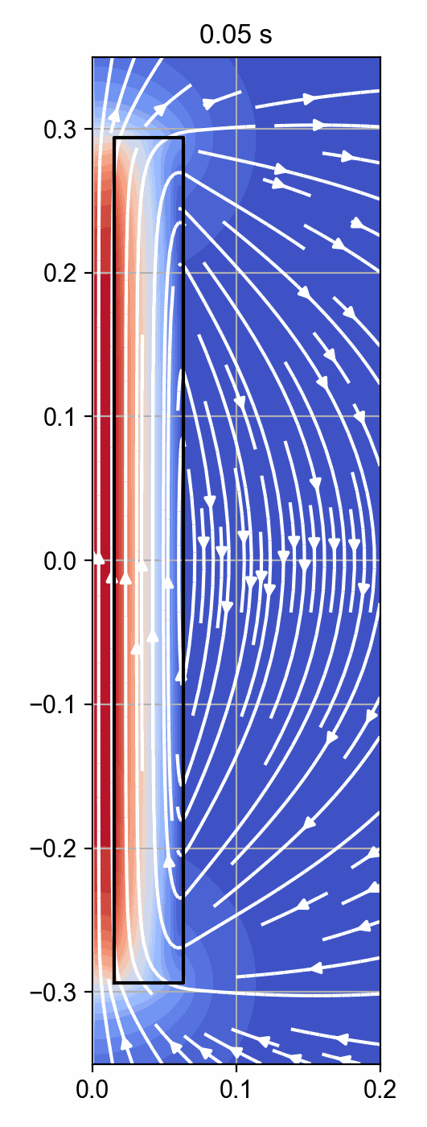
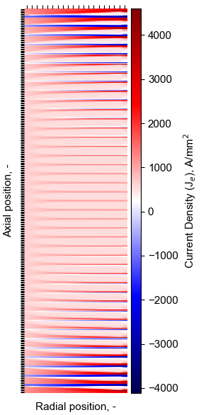
HTS Quench Tools Development
Selected Finite Difference Results
NICQS
NICQS : No-Insulation HTS Coil Quench Simulator
Modeling tools are in development to describe the thermo-electromagnetic behavior of NI/Controlled-Resistance HTS coils
New: persistent currents within the tapes.
  Required for mechanical evaluation.
  Magnetization and its loss during operation.
New: Eddy currents in structural elements.
  Important for quench protection studies.
  AC-loss generated during operation.
Fast, example:
40 T cooling solenoid: 42 pancake coils, 600 turns each -> simulation time of a few minutes to an hour*.
* Depending on the scenario and solver settings.
Courtesy of Tim Mulder

Slide 30
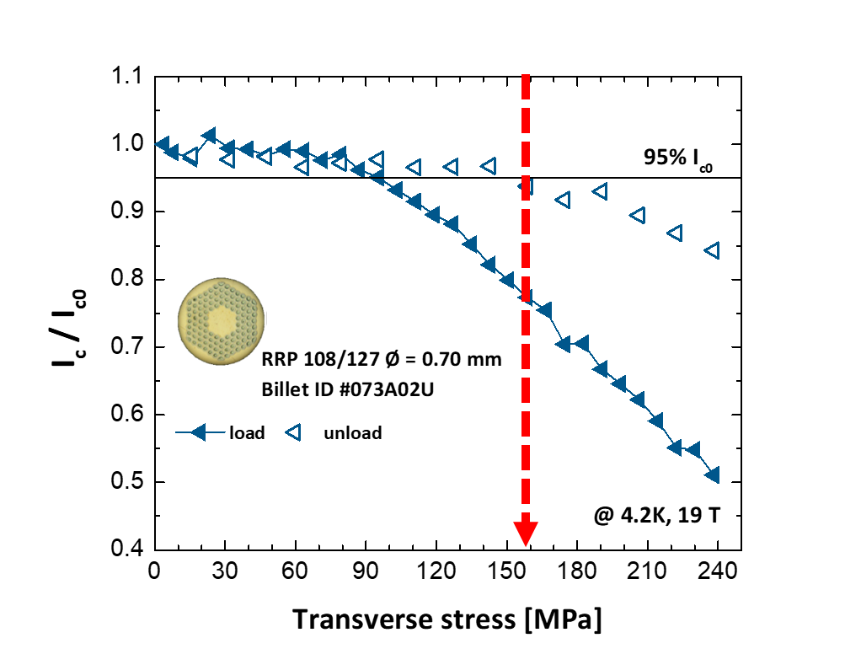
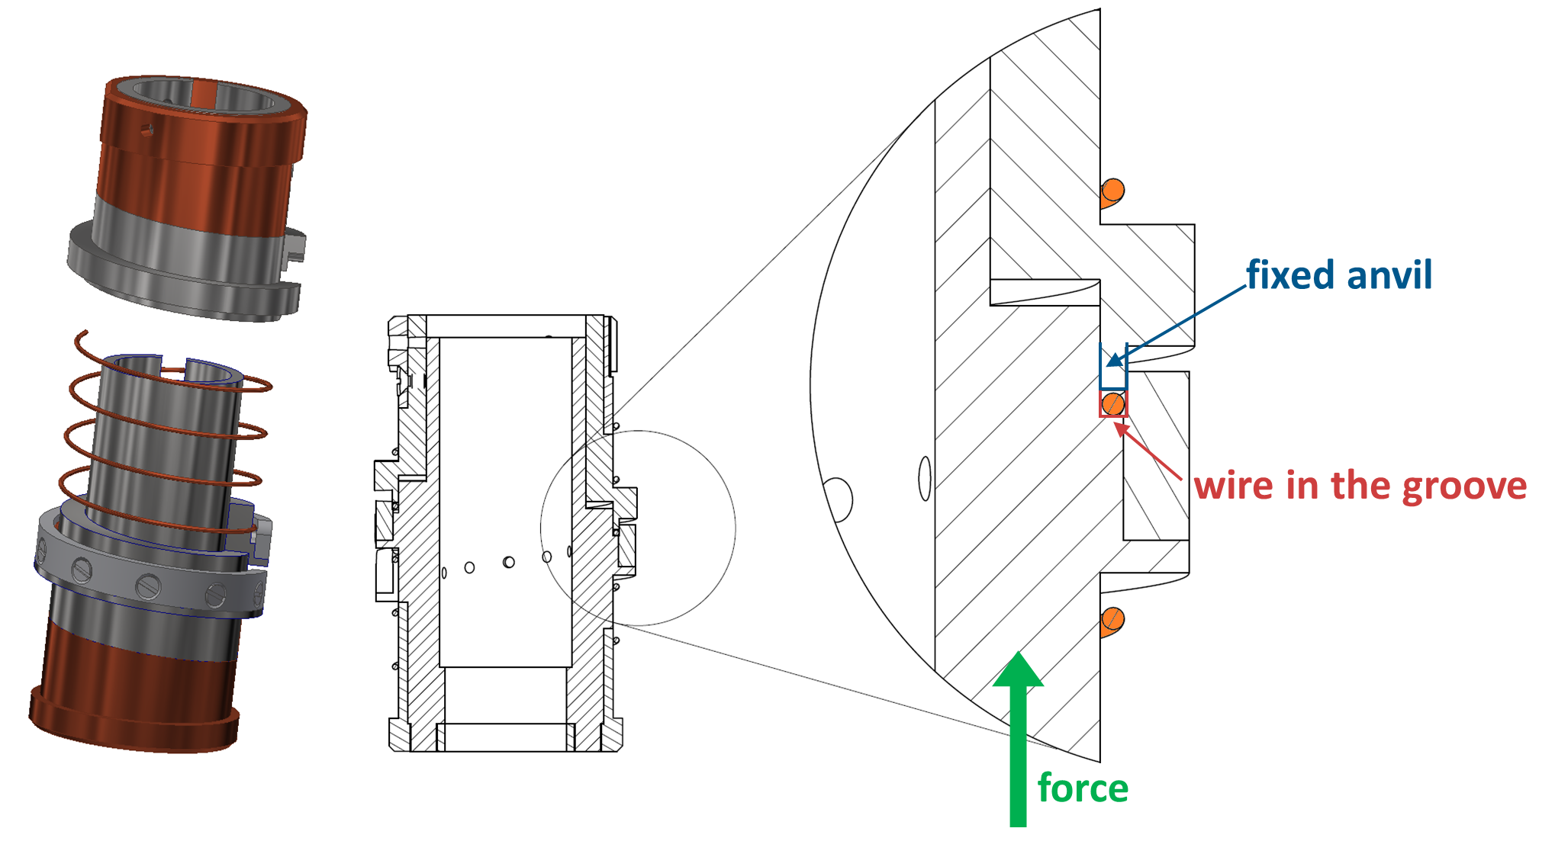
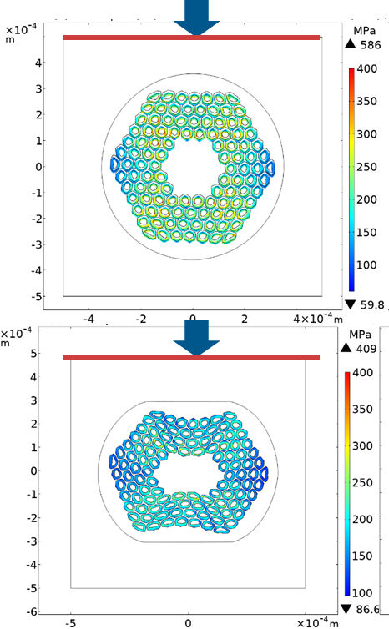
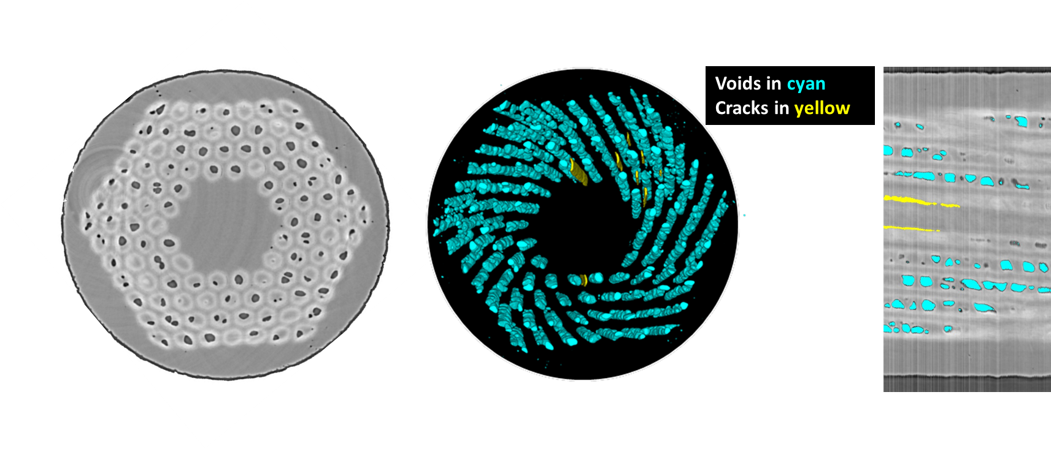
Ongoing work examples: Advanced Characterizations of Superconductors
Assessing the mechanisms behind the permanent reduction of I_{c}
FE simulations to investigate the role of plastic deformation and residual stresses in the irreversible loss of critical current under transverse load, in collaboration with PSI
A comprehensive campaign of electromechanical tests on different wire types to gain knowledge on several practical aspects for magnet operations
Machine learning applied to X-ray tomography as a new tool to analyze crack formation and propagation in Nb₃Sn wires, in collaboration with ESRF
Courtesy of C. Senatore
Notes:
UNIGE is one of the few laboratories specialized in testing the electromechanical properties of technical superconductors under conditions relevant for magnet design. Recently, they developed a new tool to investigate the internal features of Nb3Sn superconducting wires, combining X-ray tomographic data with an unsupervised machine-learning algorithm, with a view to providing new insights to enhance the electro-mechanical performance of the wires. The tool is ideal for characterizing quantitatively the distribution and morphology of the components of superconducting wires, with a particular focus on the voids that are generated during the heat treatment necessary to form the Nb3Sn superconducting phase. Voids can be detrimental for the electro-mechanical performance as they act as stress concentrators. This tool paves the way for novel wire design, assisted by detailed Finite Element Models (FEM) at sub-element level, with the final goal being further optimization of wire properties relevant for use in future accelerator magnets.

Slide 31
HFM - Challenges and Plans for Test Infrastructures
Main HFM Programme needs
HFM R&D programme will require the development of new infrastructures related to both superconducting cables and magnets
Infrastructures
Magnet test infrastructures for the HFM programme
Infrastructures for conductors and characterisation
Infrastructures for building demonstrators, short magnet models and full-scale prototypes
Novel instrumentation, diagnostics and measurement equipment

Slide 32
Outline
Current Consortium and main objectives of the HFM R&D Programme
Strategy and focus areas for the LTS high-field magnets
  Development of 12 T Nb₃Sn “robust dipole”
  State-of-the-art LTS superconductors and magnet technology
  R&D strategy and main focus areas
Strategy and focus areas for the HTS high-field magnets
  State-of-the-art HTS superconductors and magnet technology
  R&D strategy and main focus areas
Focus areas for other domains of interest
Key mid-term deliverables until the next update of European Strategy for Particle Physics
Final remarks

Slide 33
Summary of main deliverables during 2023-2026 as an input to the next update of ESPP (LTS)
Development of new HFM grade Nb₃Sn conductor with target Jc of 1500 A/mm2 @ 16 T and enhanced mechanical properties
Demonstration of the maturity of Nb₃Sn technology for collider-scale production through 12 T robust dipole magnet design, including industrial processes and cost reduction:
  INFN – 12 T FalconD single aperture short dipole model
  CERN – 12 T Robust twin aperture short dipole model (either collared coils or bladder and key)
Demonstrators of the Nb₃Sn potential above 14 T:
  CEA – FD single aperture 14 T graded conductor block coil demonstrator (no aperture)
  CERN – 14+T block coil demonstrator with coil stress management (targeting 16 T)
  CIEMAT – 14 T common coil demonstrator
  PSI – 14+ T common coil demonstrator with coil stress management (targeting 16 T)

Slide 34
Summary of main deliverables during 2023-2026 as an input to the next update of ESPP (HTS)
Exploration and demonstration of suitability of state-of-the-art HTS conductors for building accelerator magnets
  KIT – accelerator magnet grade REBCO prototype tapes with optimized magnetization and mechanical properties
  CERN – development of practical HTS cables
  CEA – development of MI racetrack coil demonstrator
  PSI – development of insulated soldered tape-stack racetrack demonstrator with stress management.
  CERN – development of dielectric-insulated racetrack coil demonstrator
The target objectives are defined and challenges to reach them are shared with EU national labs

Slide 35
Final Remarks
The High-Field Magnet Programme, hosted at CERN, has begun to implement a strategic roadmap for High-Field Magnet R&D in Europe with the aim to provide timely feedback to the ESPP update(s) via technology demonstrators and credible milestones
  Substantial progress and first promising results were obtained over the past 12 month and the main projects are advancing well
To accelerate further the progress, we must:
  introduce new fast-turnaround R&D vehicles to reduce the feedback time on technology choices and encourage creative risk taking
  foster communication, coordination, and exchange of know-how among all actors
The LTS and HTS magnet technology challenges faced by the HFM Programme are many and significant, in particular requiring a decisive advancement beyond the state of the art in the development of required practical LTS and HTS superconductors and superconducting cable designs

Slide 36
Thank you for your attention!

