Slide 1
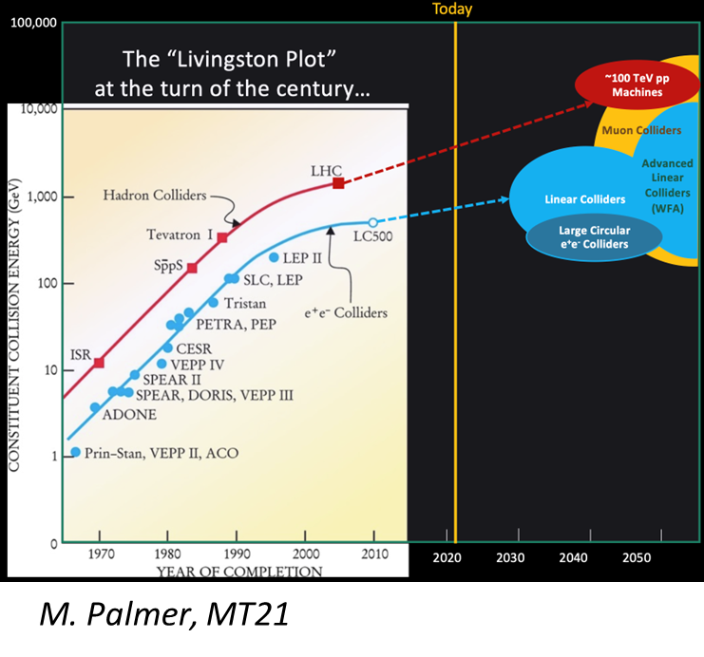

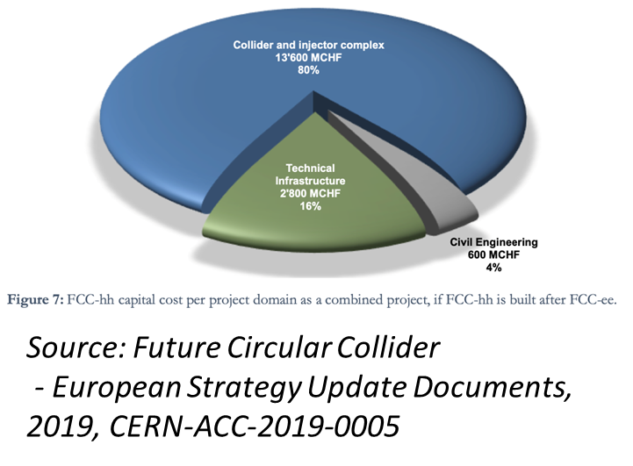
Magnet developments for future physics programmes
1

Slide 2
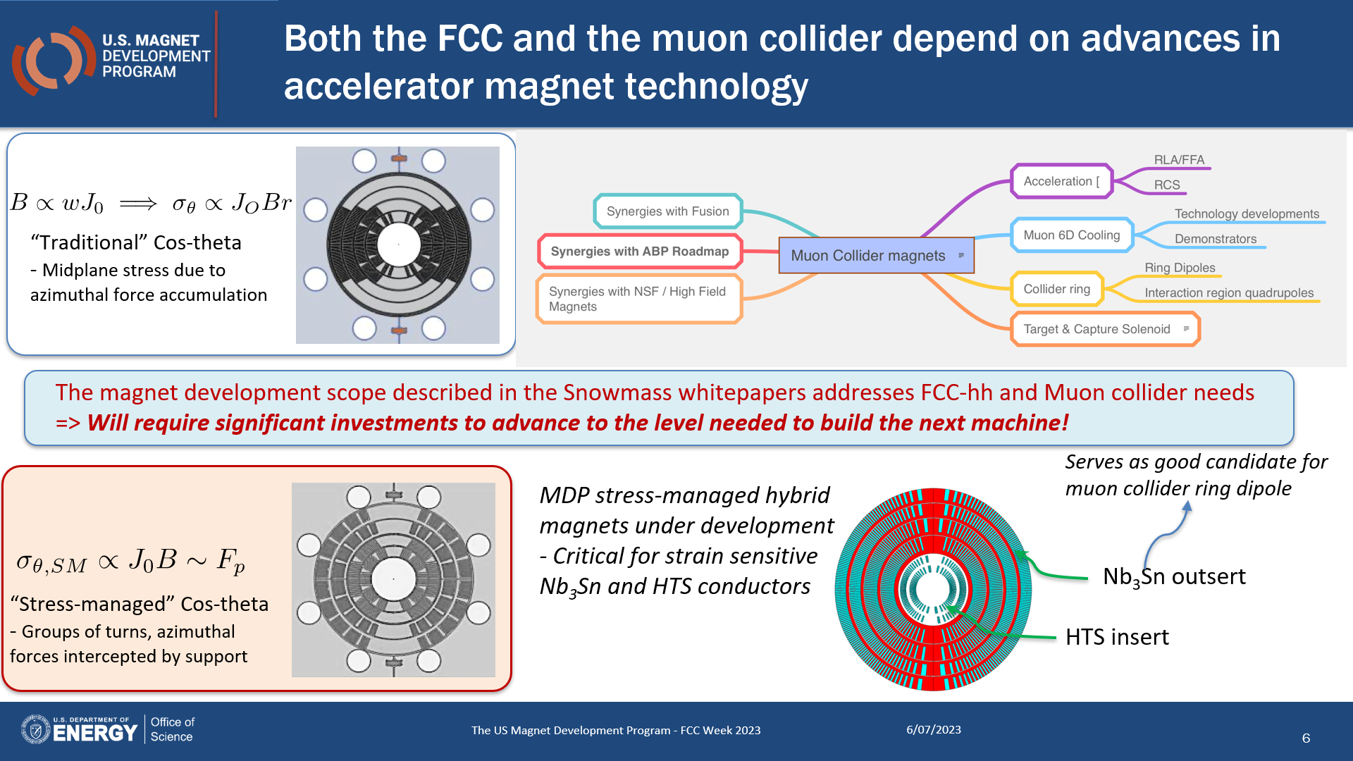
Courtesy of Soren Prestemon

Slide 3
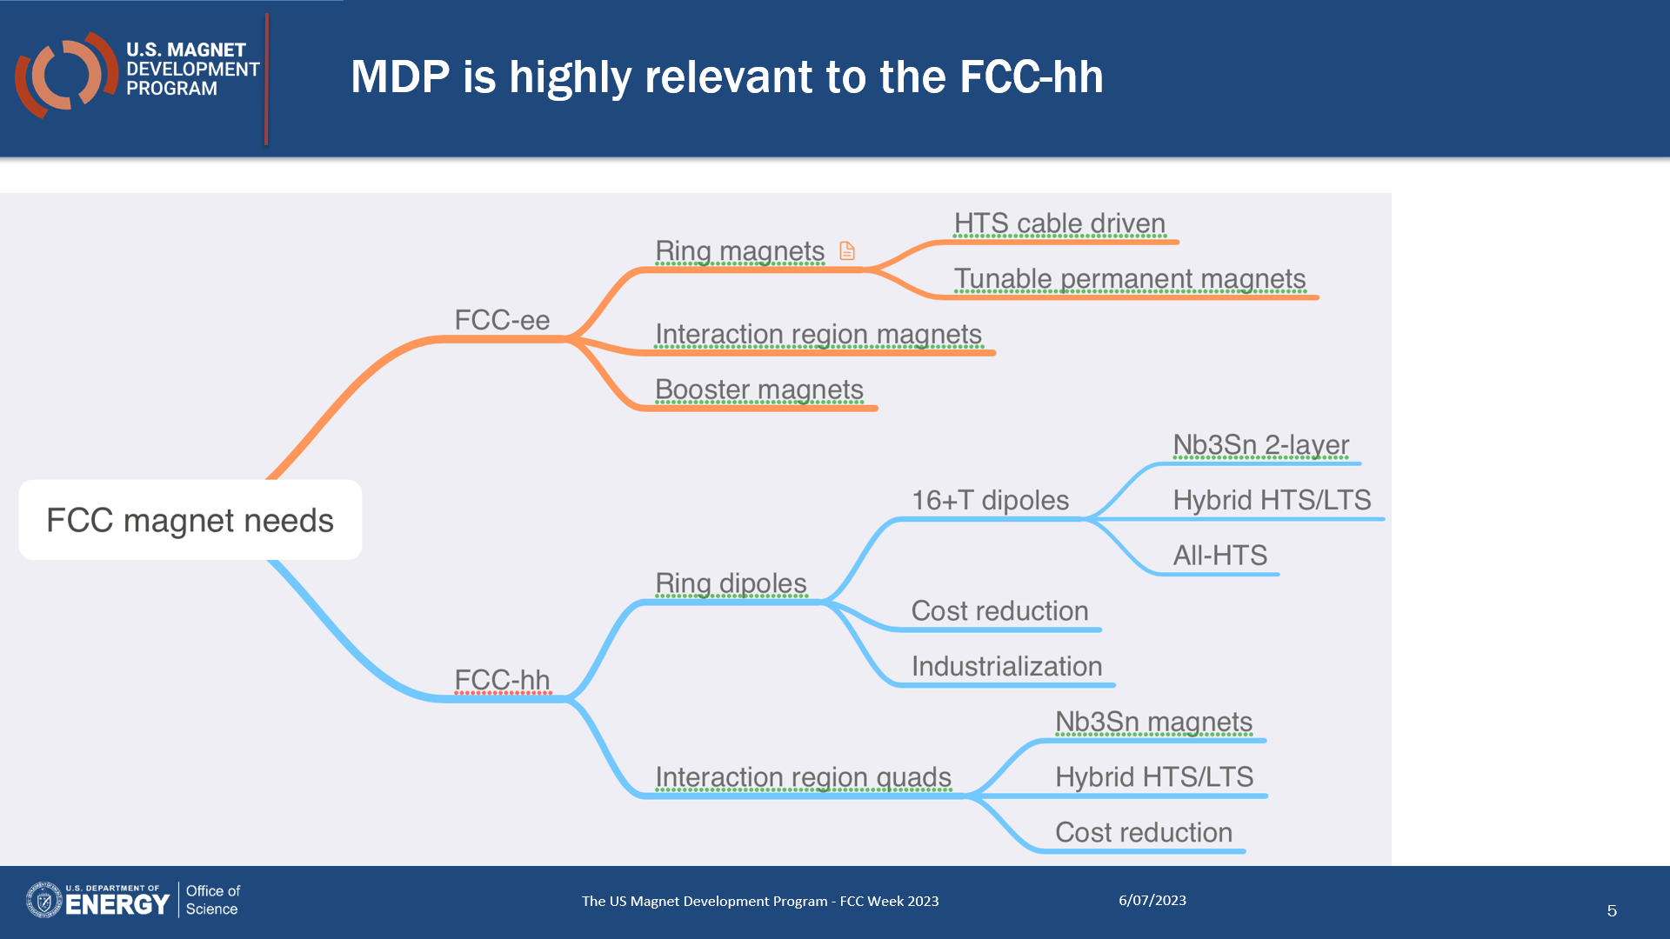
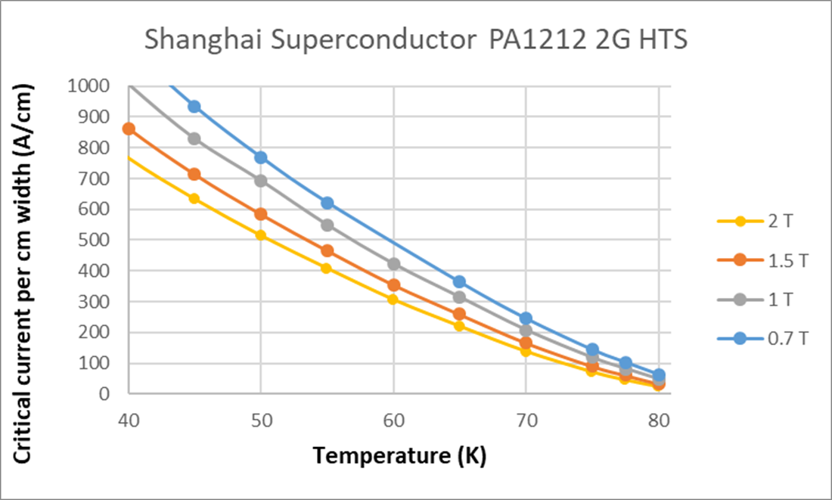
But ultimate field will no longer be the driving factor…
Ideal path… but longest lead-time
HTS versus LTS
having the right perspective
HTS performance @ 40K compared to 77K differs by a factor ~10 while the cost of cryo cooling, only increases by a factor ~2
Real path… what may happens…
Courtesy of Soren Prestemon
3

Slide 4
and beyond FCC and Muon Collider accelerators…
 | Dipoles | Quadrupoles | Undulators/Wigglers | Detectors | Field (T)
FCC-ee |  | IR Quad |  | × | < 3 T
CEPC |  | IR Quad |  | × | < 5 T
ILC | × | × | × | × | < 2 T
CLIC |  |  | × | × | < 2.5 T
FCC-pp | × | × |  | × | 16 T -20 T
SppC | × | × |  | × | 12 T- 24 T
Muon Colliders | × | × |  | × | Solenoids > 10 T-20 T
Beneficial Technology
Higgs Factories
HTS Enabling Technology
Energy Frontier
HTS for Sustainability: operation at higher temperatures (> LHe)
to minimize power consumption
Courtesy of Amalia Ballarino

Slide 5
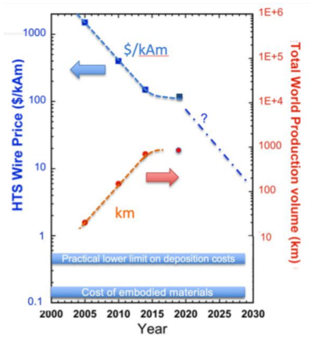
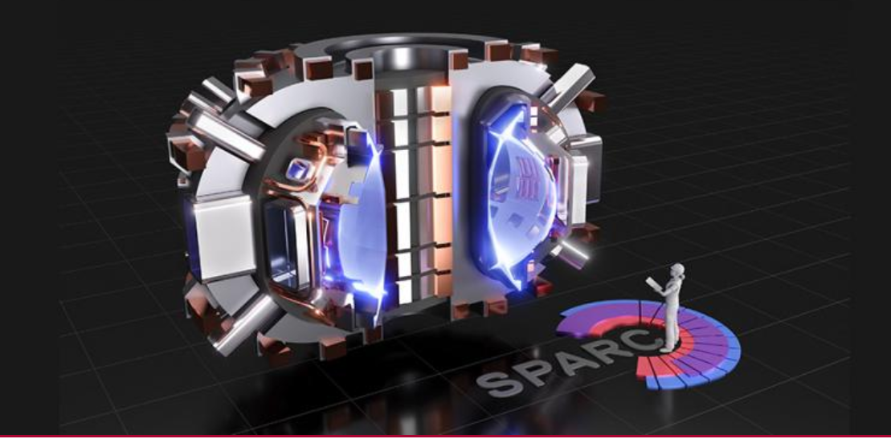
and not only HEP accelerators…
https://www.snowmass21.org/docs/files/summaries/AF/SNOWMASS21-AF7_AF0_Vladimir_Matias-251.pdf
Synergies with Fusion projects
Cf: SPARK fusion project needs 10,000 kms of HTS cable ~today
Nature, Scientific Reports | (2021) 11:2084 | https://doi.org/10.1038/s41598-021-81559-z
Courtesy of Mike Koratzinos

Slide 6
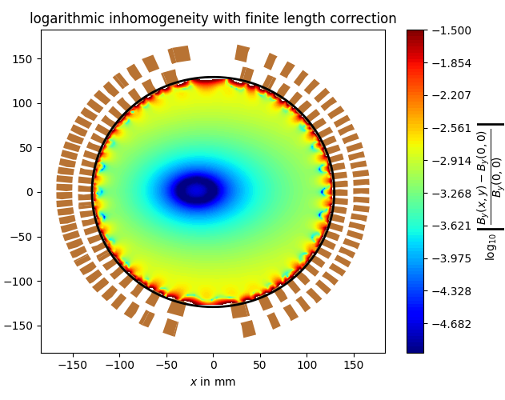
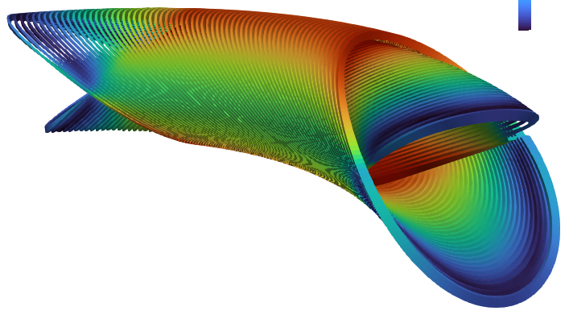
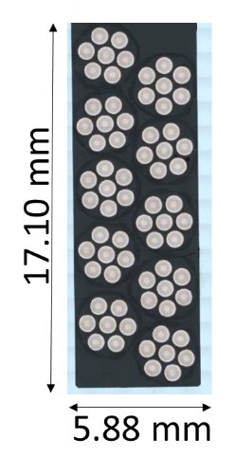
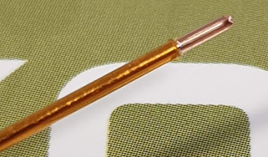
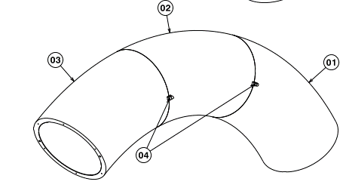
Also Experiments/Medical applications: Strongly-Curved Nb‒Ti Dipole Magnet Demonstrator
Design is nearly completed.
The electromagnetic design was carried out using the CERN-based Roxie software; the optimization includes
  field harmonic correction to account for curvature;
  fading winding pitch to reduce peak field over coil ends;
  A field homogeneity of 0.1% in 2/3rd of the aperture.
Coil winding relies on a rope-type cable, with a polyimide insulation and a compact arrangement.
Main manufacturing challenge is the production and assembly of the formers supporting the two coil layers and assuming the 90° shape.
Field Maps of Full-Scale Fusillo Demonstrator (generated by Roxie)
X-Sectional View
of Fusillo
Winding
Insulated Fusillo conductor
Courtesy of A. Haziot (CERN/TE-MSC)
Conceptual Design of
Fusillo Formers

Slide 7
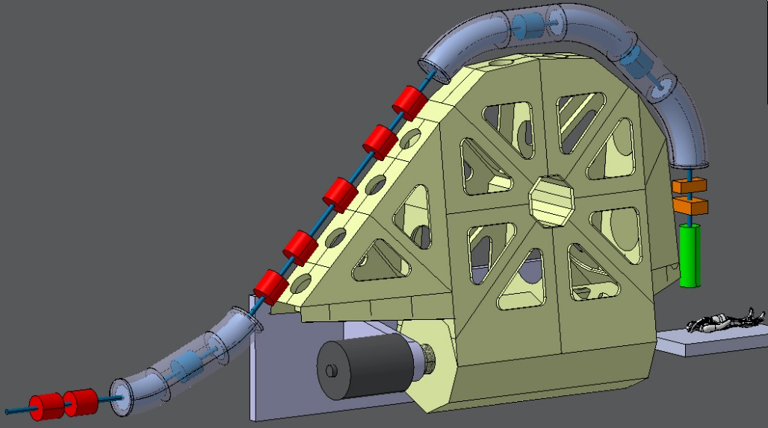
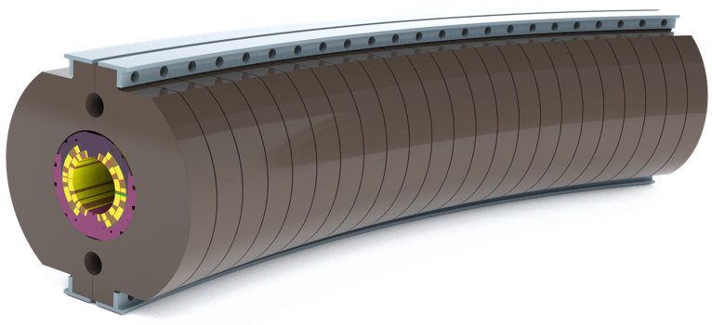
Also Experiments/Medical applications: Conduction-Cooled Dipole Magnet
Main objective is the development of a straight, conduction-cooled, Nb‒Ti, cosθ dipole magnet demonstrator, with a bore field of 4 T in a 80-mm aperture and a field ramp rate of up to 0.4 T/s.
The project scope includes a 1-m-long demonstrator, with coils wound from a 36-strand, cored cable and using a ∅ 0.48 mm LHC05 strand (not optimized for low loss).
A preliminary design study was carried out by M. Karppinen and relies on a collared-coil structure with clamped yoke laminations.
Possible applications include bending magnets of rotating gantry systems for compact ion therapy, such as SIGRUM, a project developed by a collaboration initiated in 2019 between CERN, INFN, CNAO and MedAUSTRON.
The cooling features shall be later transposable to a curved, cosθ dipole magnet design.
As part of SIGRUM, INFN is presently developing a curved, Nb‒Ti, cosθ demonstrator to be tested in LHe.
Goal < 50 tons
Conceptual design of rotating gantry system
for compact ion therapy
Conceptual design of bending magnet for compact ion therapy gantry, including some conduction-cooling features
Courtesy of M. Karppinen (CERN TE-MSC)

Slide 8
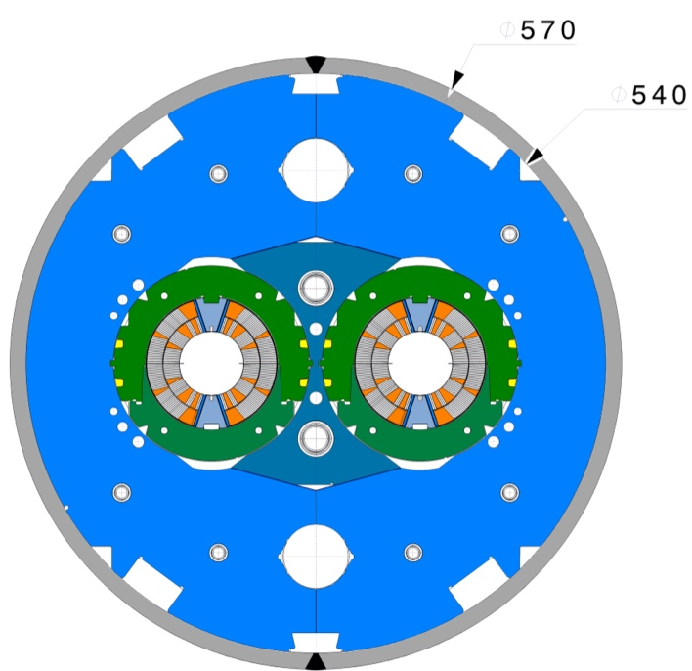
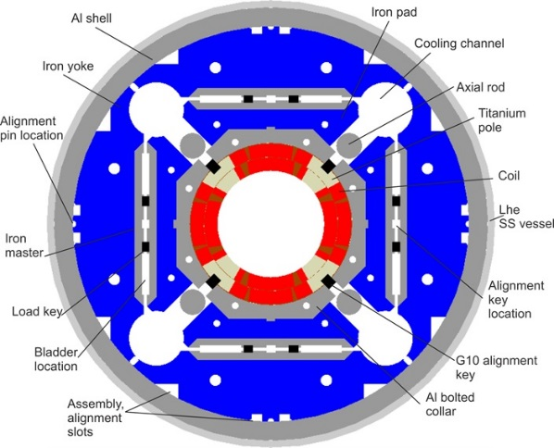
HL-LHC Nb₃Sn Magnets
HL-LHC initially envisioned relying on two types of Nb₃Sn magnets
  pairs of 5.3-m-long, 60-mm-twin-aperture dipole magnets (referred to as “11 T”) for installation in two dispersion suppressor areas, to replace existing 15-m-long LHC dipole magnets and make room for additional collimators;
  sets of large, 150-mm-single-aperture quadrupole magnets (referred to as MQXF) for installation in the interaction regions of the 2 high-luminosity LHC experiments (ATLAS and CMS).
The four (plus 2 spares) 11 T dipole magnets are based on a design initially developed at Fermilab circa 2010 and were supposed to be produced at CERN;
The quadrupole magnets are based on a design developed within the framework of the U.S. LHC Accelerator Research Program (LARP), initiated in 2003, and come in 2 lengths:
  ‒ 16 (plus 4 spares) 4.2-m-long MQXFA magnets under production by the U.S. HL-LHC Accelerator Upgrade Project (AUP; started in 2018);
  ‒ 8 (plus 2 spares) 7.2-m-long MQXFB magnets under production at CERN.
11 T Dipole Magnet X-Section
Courtesy of F. Savary (CERN TE-MSC)
MQXF Quadrupole Magnet X-Section
Courtesy of E. Todesco (CERN TE-MSC)

Slide 9
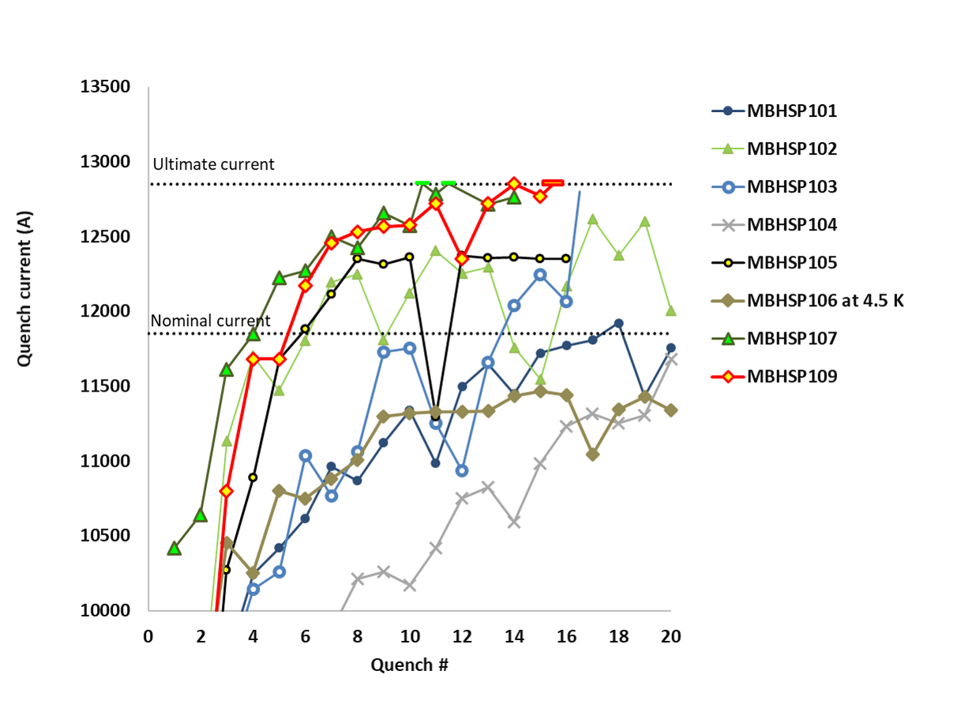
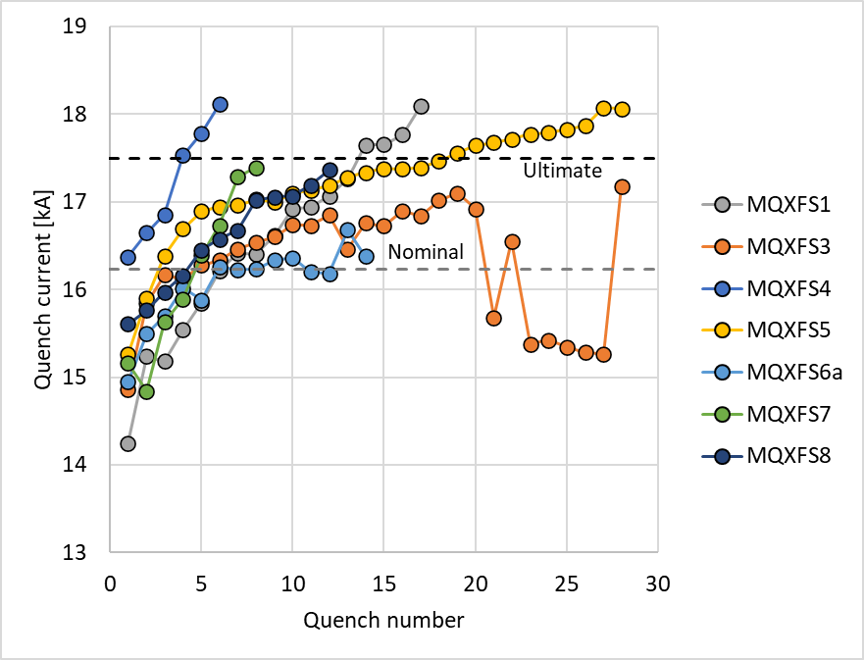
SP107
Short HL-LHC Nb₃Sn Model Magnets
SP109
HL-LHC has two levels of performance requirements
  nominal level, corresponding to 7.0 TeV operation;
  ultimate level, corresponding to 7.5 TeV operation.
Both HL-LHC Nb₃Sn dipole and quadrupole magnet programs have produced successful short model magnets that demonstrate feasibility, achieving nominal and ultimate currents with a limited number of quenches at 1.9 K.
For 11 T, nominal current is 11.85 kA and bore/peak fields are 11.23/11.77 T; ultimate current is 12.85 kA and bore field is 12.15 T (at 1.9 K).
For MQXF, nominal current is 16.23 kA and gradient/peak fields are 132.6 T/m/11.4 T; ultimate current is 17.5 kA and gradient/peak field are 141.4 T/m/12.1 T (at 1.9 K).
Initial Training of short 11 T dipole model magnets
Courtesy of G. Willering (CERN TE-MSC)
S4
S1
S5
Initial Training of short MQXFS quadrupole model magnets
Courtesy of
F. Mangiarotti
(CERN TE-MSC)

Slide 10
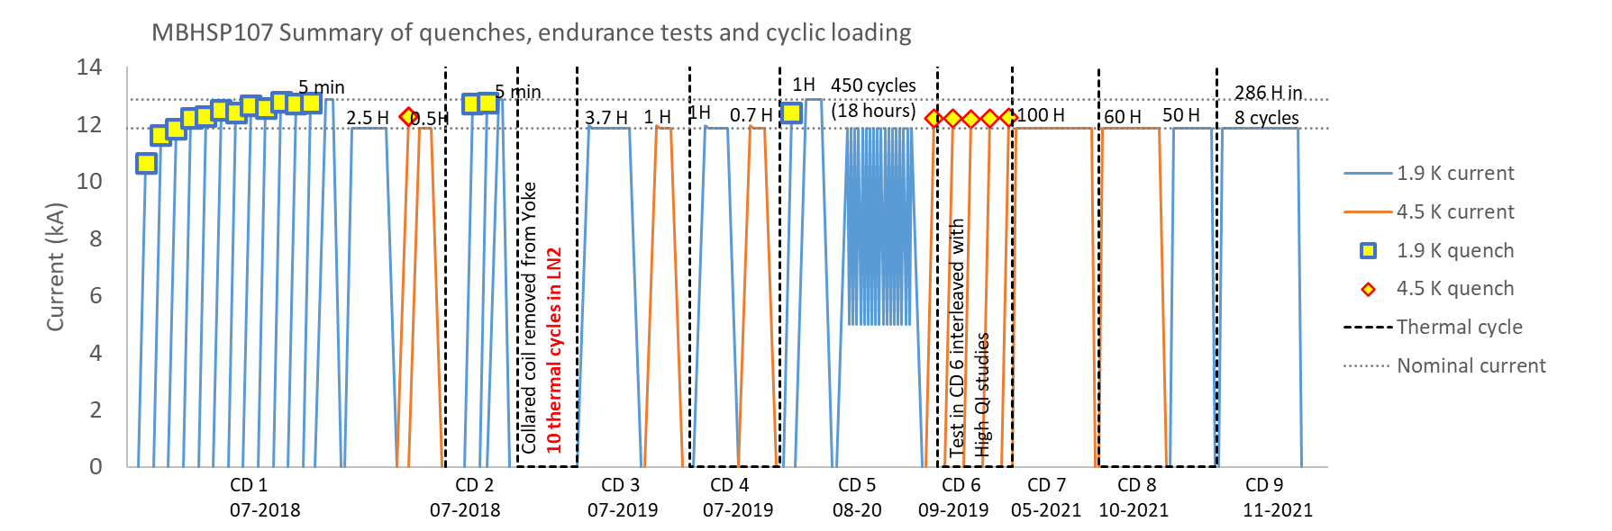
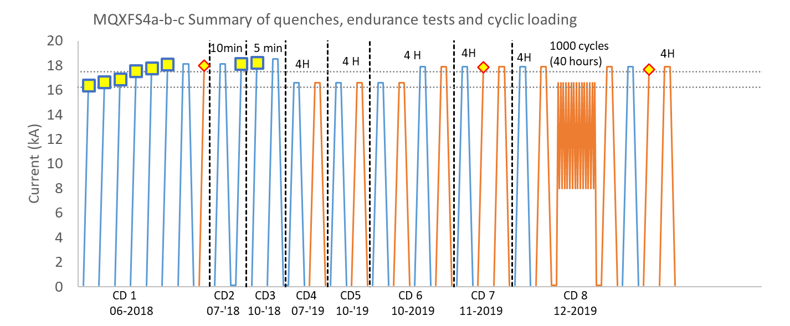
Endurance Tests of Short HL-LHC Nb₃Sn Model Magnets
Short model magnets for both 11 T (SP107 ─issued from 1st 11 T Task Force) and MQXFB (MQXFBS4) programs have been successfully submitted to endurance testing (8-9 cooldowns, 500-1000 EM cycles), thereby demonstrating robustness of Nb₃Sn technology on short magnets.
SP107 was even used for several months in SM18 facility at CERN to provide background field for the RADES experiment.
One specific feature of Nb₃Sn accelerator magnets is that, once trained up to a current level, they exhibit little or no retraining up to this level upon subsequent warm up/cool down cycles.
Endurance Testing of Short HL-LHC 11 T Dipole Model Magnet SP107
Courtesy of G. Willering (CERN TE-MSC)
Endurance Testing of Short HL-LHC Quadrupole Magnet Model MQXFS4

Slide 11
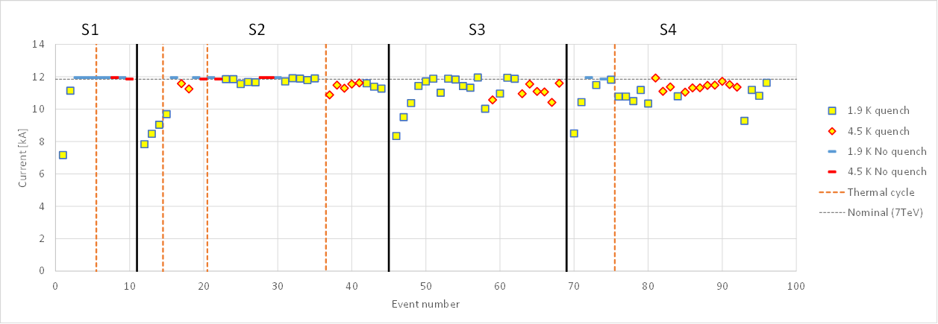
Long (> 5 m) HL-LHC Nb₃Sn Prototype Magnets @CERN
Problems arose in 2020/2021 with the power testing of full-length (> 5 m) HL-LHC Nb₃Sn magnets at CERN.
First 11 T dipole series magnet (S1) reached nominal current after a 2 training quenches and exhibited no re-training after warm-up/cooldown cycle, but subsequent series magnets (S2-S4) exhibited performance degradation, either upon first cooldown (S3), or after two or more cooldowns (S2 and S4).
First and second MQXFB quadrupole prototype magnets (P1 and P2) exhibited performance limitation below nominal current.
These results triggered the decision in Q4 2020 not to install 11 T dipole magnets in the LHC machine and to put MQXFB production activities on hold in Q2 2021.
Quench Performance of 5.3-m-long, 60-mm-twin-aperture 11 T Dipole Series Magnets
Courtesy of G. Willering
(CERN TE-MSC)
I_{nom} + 300 A
I_{nom} + 300 A
I_{nom}
I_{nom}
Courtesy of F. Mangiarotti
(CERN TE-MSC)
MQXFBP1 (~70% of short sample @1.9 & 4.5 K)
MQXFBP2 (~74% of short sample @1.9 & 4.5 K)
Quench Performance of 7.2-m-long, 150-mm-single-aperture MQXFB Quadrupole Prototypes Magnets

Slide 12
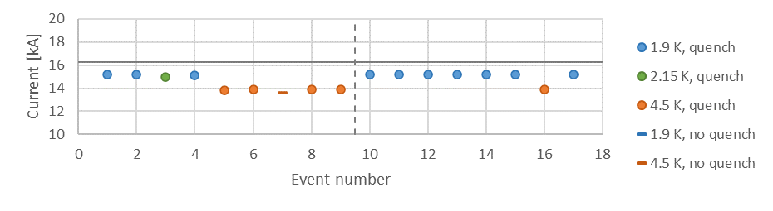
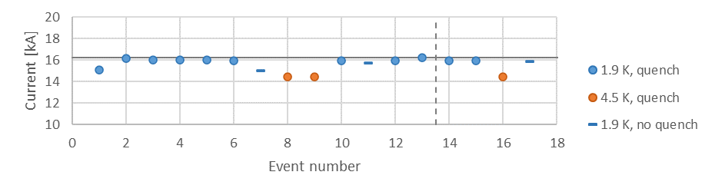
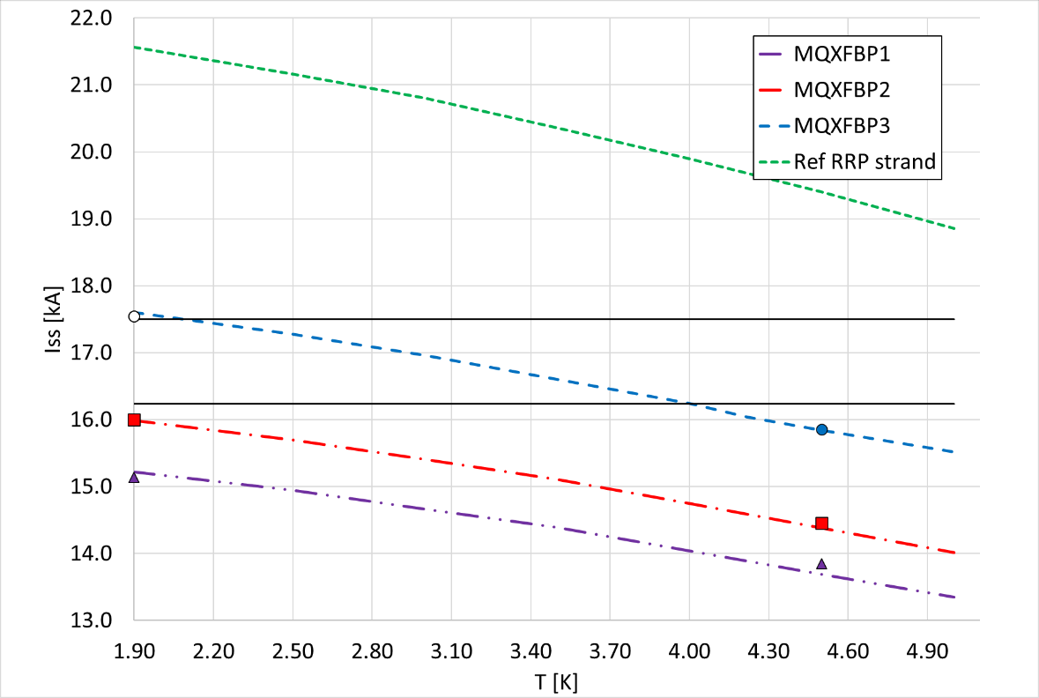
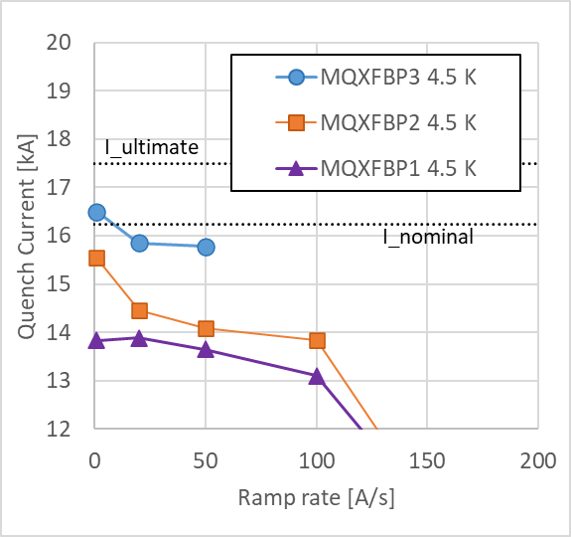
Performance Limitation
Magnet reaches a performance plateau after first cooldown below target current.
Reproducible quench location (mostly towards magnet mechanical center for MQXFB quadrupole magnets).
Proper scaling between 1.9 K and 4.5 K and regular ramp rate behaviour.
Reproducible behaviour after WUCD cycle.
MQXFBP1
MQXFBP2
Quench Performance of MQXFBP1&2 (7.2-m-long, 150-single-aperture, HL-LHC quadrupole magnet prototypes)
Courtesy of F. Mangiarotti (CERN/TE-MSC)

Slide 13
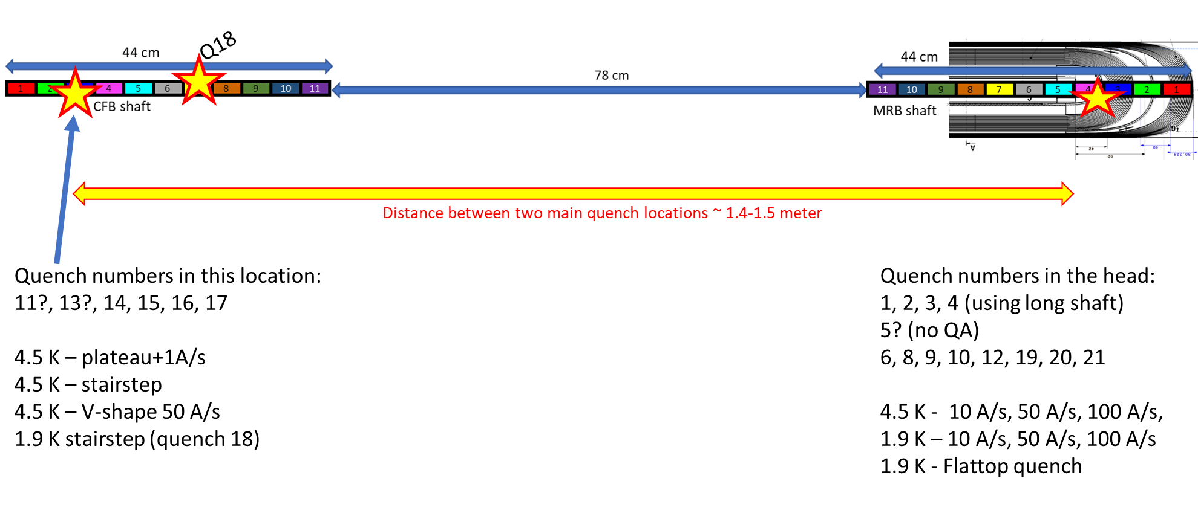
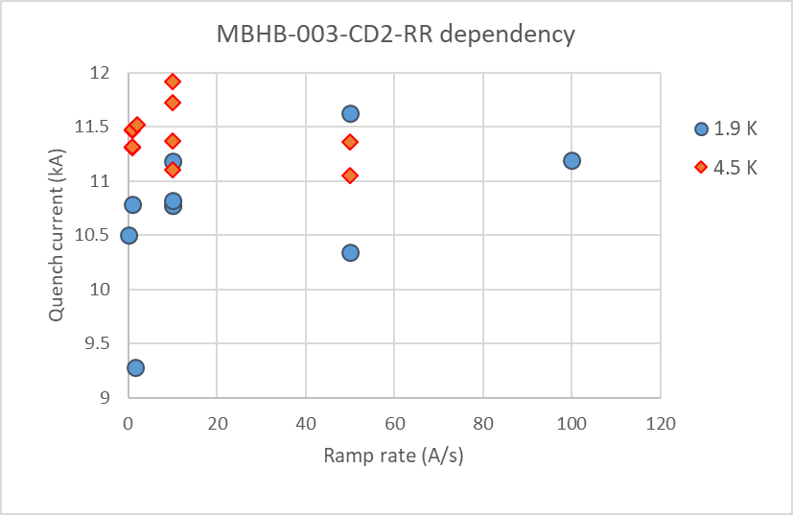
Performance Degradation
Courtesy of G. Willering (CERN/TE-MSC)
Magnet exhibits a performance degradation after a sequence of EM and WUCD cycles.
Quench location mostly in coil head (for 11 T dipole magnets) but affected by type of current ramp.
Performance does not scale with temperature and can exhibit irregular ramp rate behavior.
Impacted by WUCD.
Quench start localization in S4 series magnet
Ramp-rate sensitivity of S4 series magnet
Quench Performance of 11 T S1 to S4 series magnets (5.3-m-long, 60-mm-twin-aperture HL-LHC dipole magnets)

Slide 14
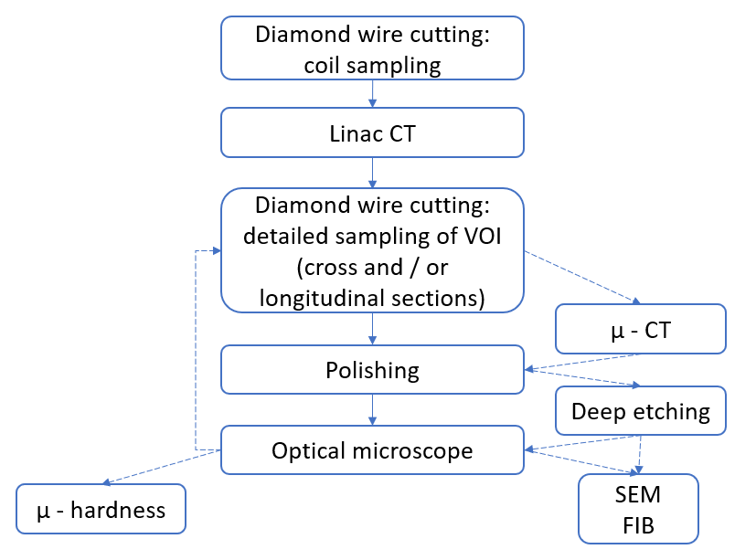
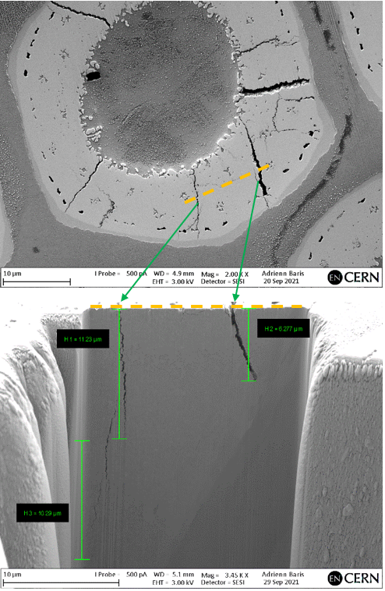
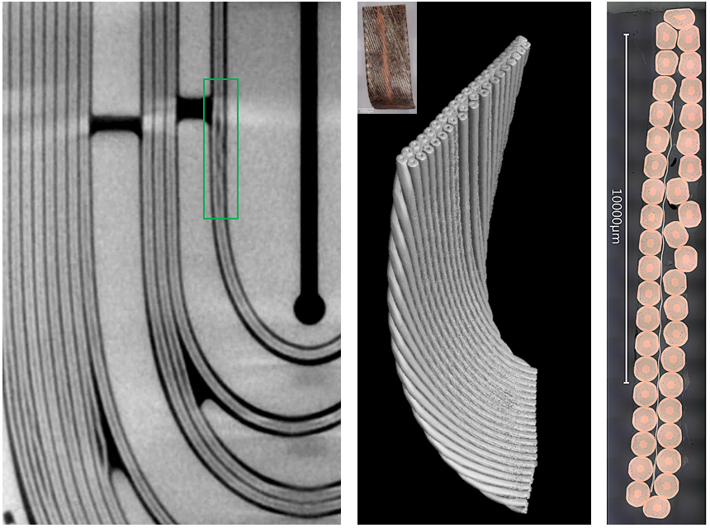
Overview
Starting from June 2019, the team of S. Sgobba in CERN/EN-MME has developed a methodology to carry out post-mortem examinations of sections of HL-LHC dipole and quadrupole magnet coils that exhibited performance limitation and/or degradation.
Examination starts from mesoscale observation of a whole coil volume (typically, the volumes where the quench origins have been localized).
Different techniques are gradually applied to get more detailed insights into internal events, geometrical distortions, and possible flaws, down to the microscopic scale.
Courtesy of I. Aviles Santillana (CERN/EN-MME)

Slide 15
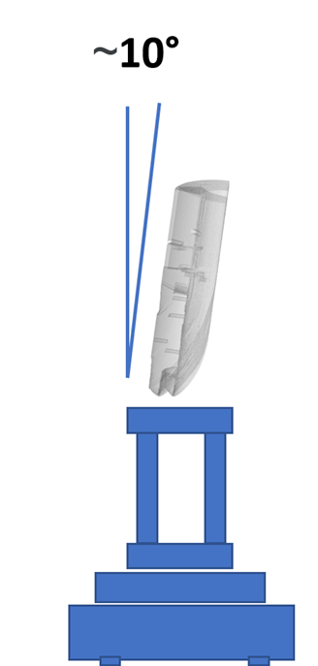
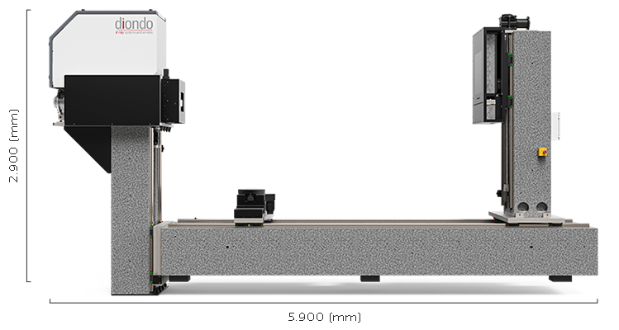
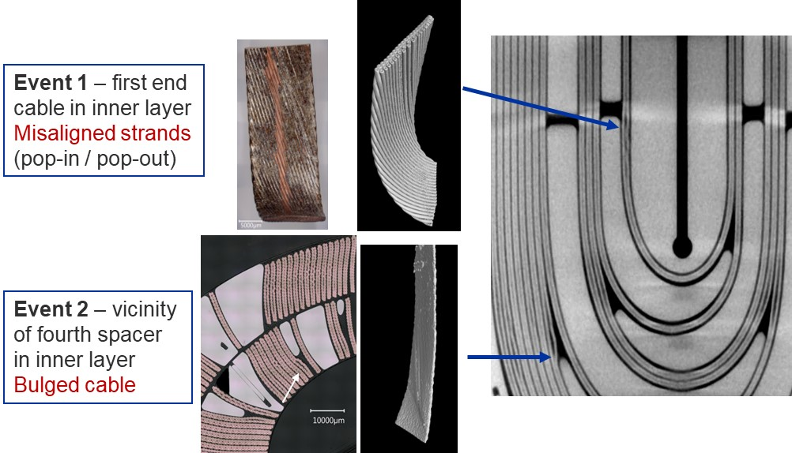
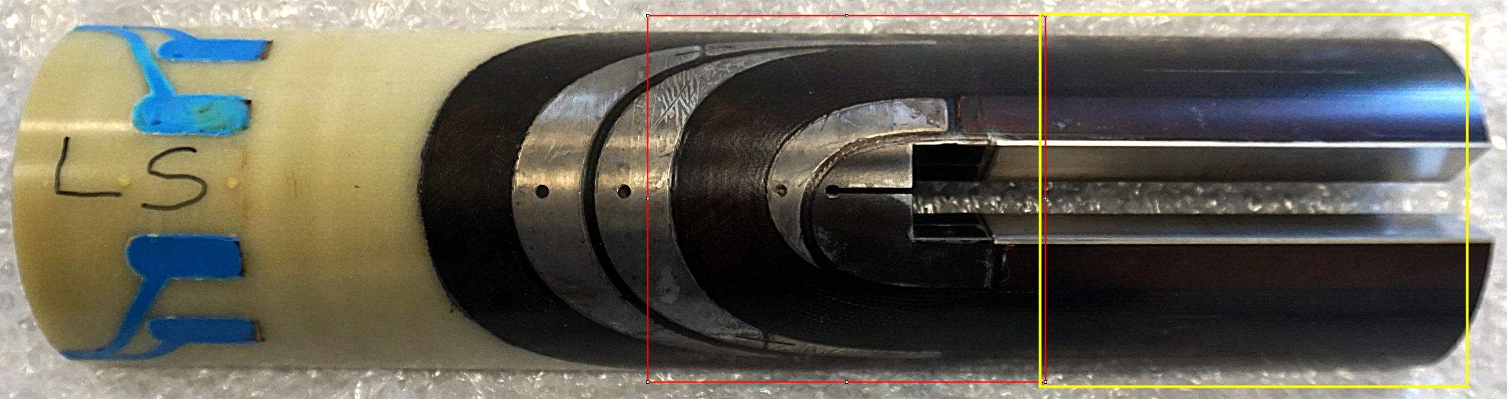
High-Energy X-Ray Tomography
Courtesy of S. Sgobba (CERN/EN-MME)
High-energy X-ray computed tomography has proven to be an efficient tool for inspecting 20-30 cm coil samples (including full coil ends).
The system relies on a 6 MeV LINAC, it has a spot size of 2 mm and a resolution of ~120 μm.
Examples of X-ray tomograph analyses of the end of a 5.3-m-long, 11 T dipole magnet coil (GE2) where most limiting quenches had been localized

Slide 16
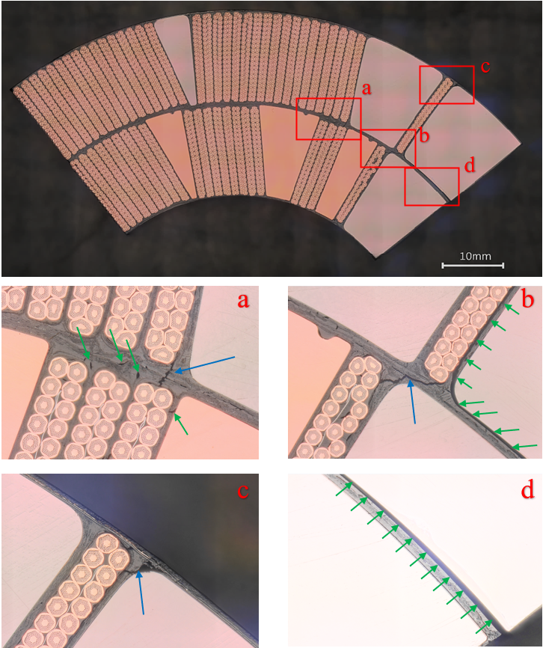
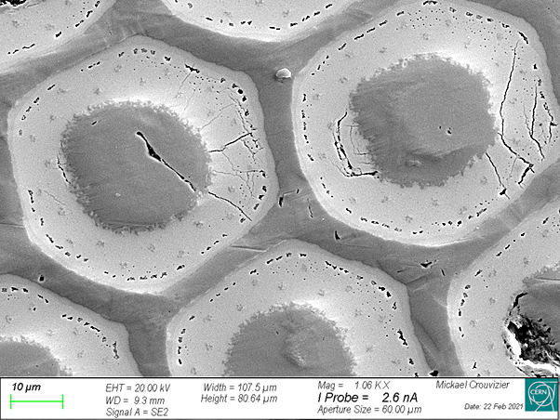
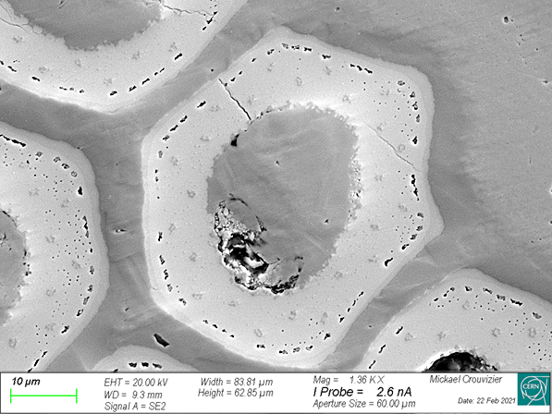
Metallographic Analyses
Next step is to carry out metallographic analyses in the zones of interest identified by tomography.
Direct visualization of internal defects: strand displacement, cracks in Nb₃Sn sub-elements and in epoxy resin.
Courtesy of M. Crouvizier (CERN/EN-MME)
a
a
b
b
Analyses of 5.3-m-lonh, 11 T dipole magnet coil GE13 (used in series magnet S2): a) Shrinkage cavities (green arrows) and metal-to-metal crack across the coil interlayer (blue arrow); b) Metal-to-metal crack (blue arrow) and a large decohesion (green arrows); c) Conductor–to–pole crack (blue arrow); d) Large decohesion between resin and pole piece
Analyses of a zone of interest in of the end of 5.3-m-long, 11 T dipole magnet coil GE2 (see previous slide)

Slide 17
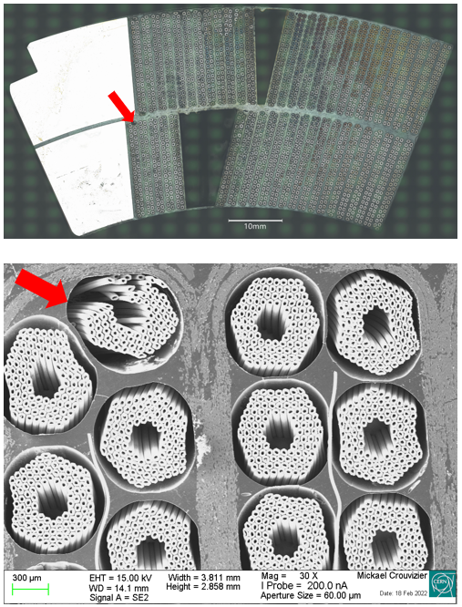
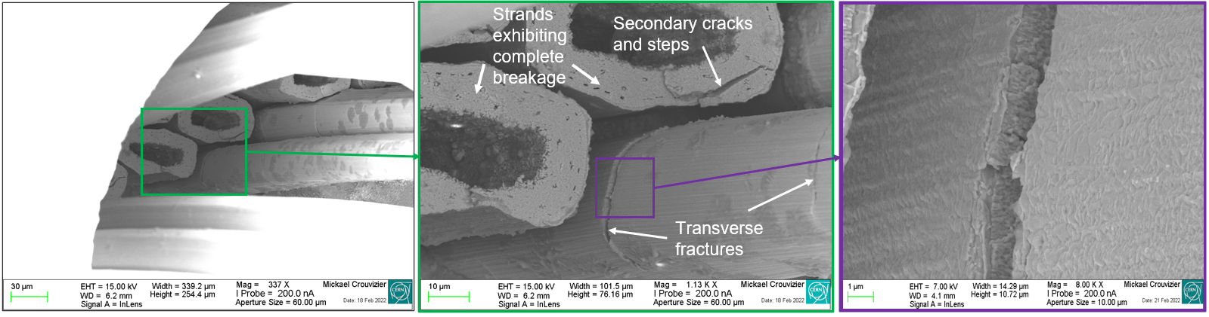
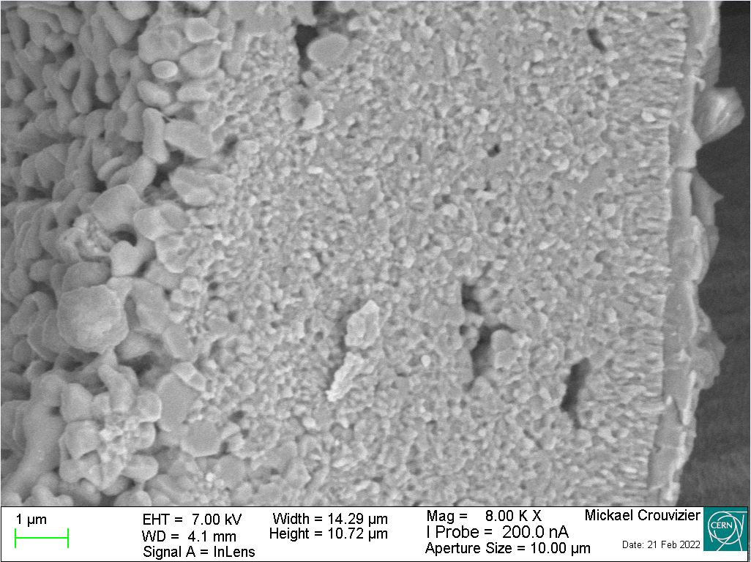
Analyses After Deep Cu Etching
Courtesy of M. Crouvizier (CERN/EN-MME)
Next is to apply deep Cu etching and microscopy to assess the extent of Nb₃Sn sub-elements damages.
In limiting, long MQXFB coils, the area of quench start localization (towards the magnet center) appears correlated with sub-element damages observed in one specific cable strand (out of 2000), at the top of the inner=layer pole turn, underneath a corner of the outer layer Ti-pole.
The grain morphology at the fracture surface of the ruptured sub-elements seems to indicate that the damage occurred after completion of the-high temperature plateau of the heat treatment.
Fracture surfaces of Nb₃Sn sub-elements observed in damaged strand in MQXFBP1 quadrupole magnet coil CR 108

Slide 18
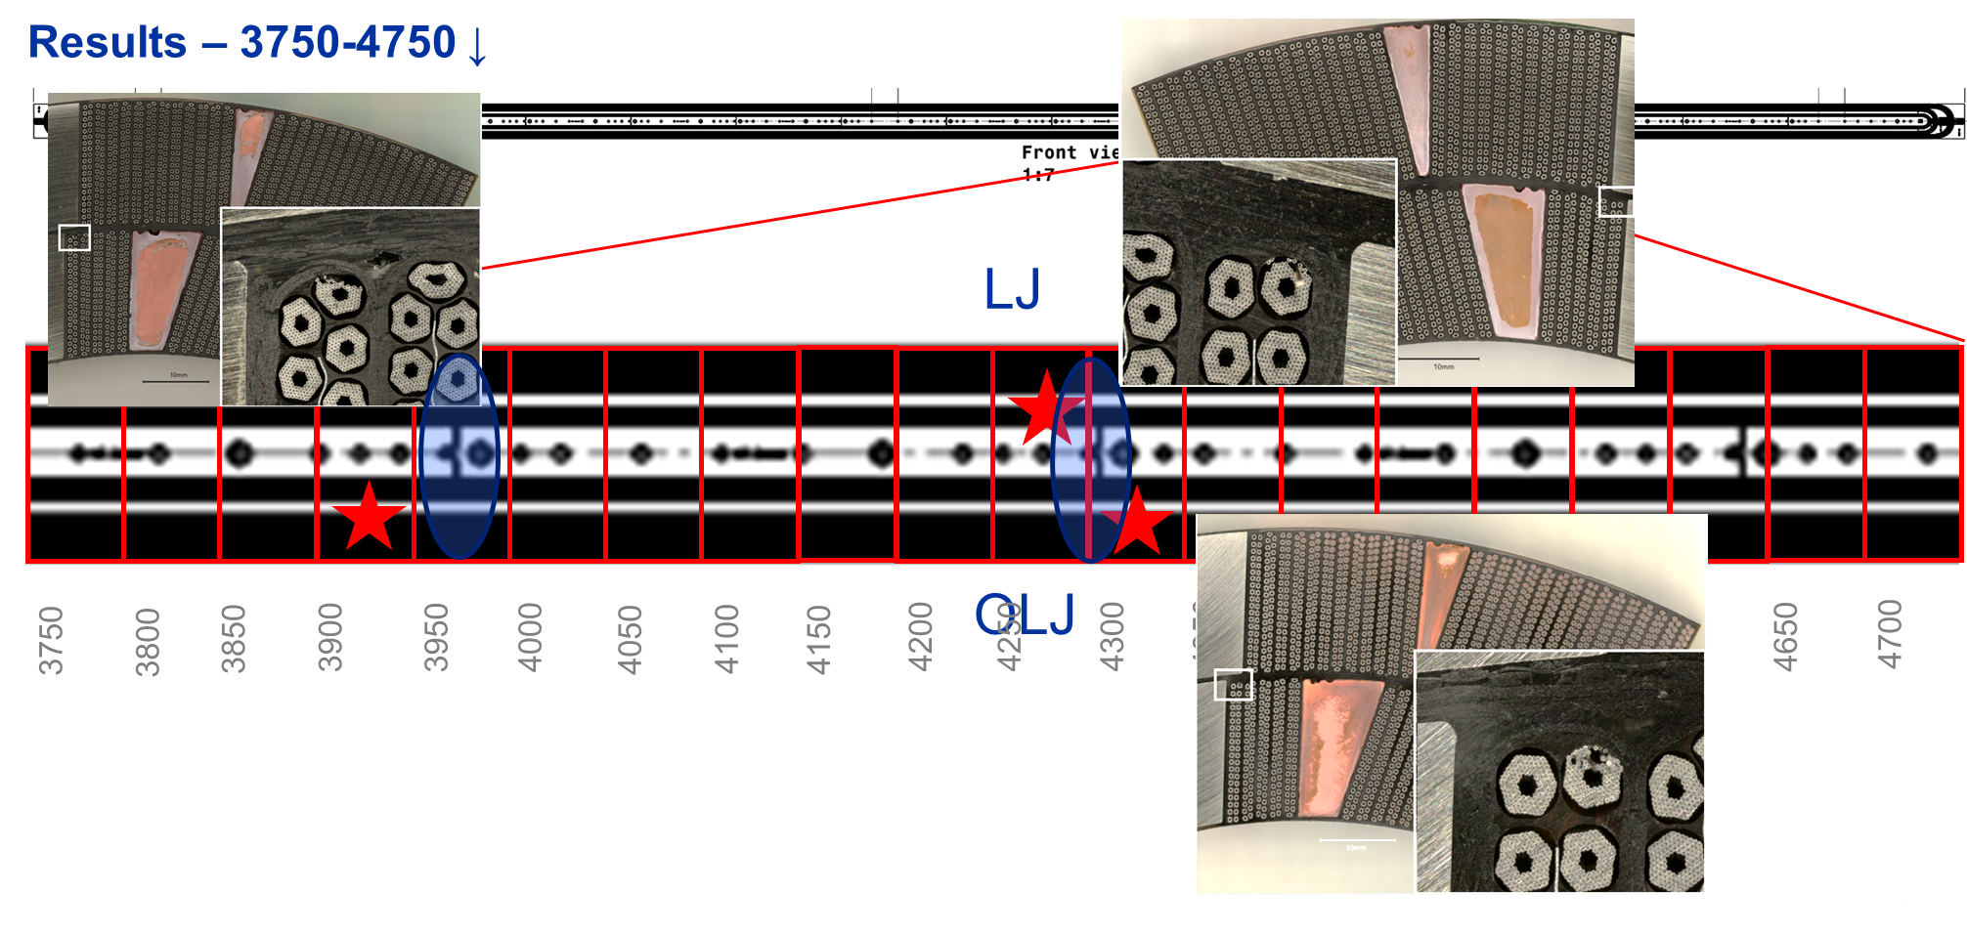
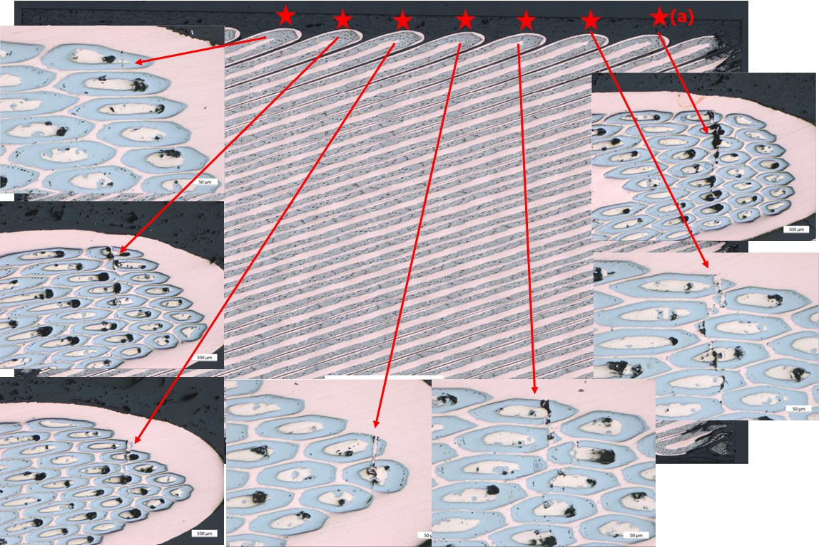
Examples of Additional Analyses (1/2)
Courtesy of M. Crouvizier A. Moros (CERN/EN-MME) and S. Izquierdo Bermudes (CERN/TE-MSC)
● From the extensive analyses carried out on the limiting coil of HL-LHC quadrupole magnet prototype MQXFBP1 (CR108), the longitudinal positions where damages are observed on the strand at the top of the inner-layer pole turn are always in the vicinity of a Ti-pole transition (possible “hinge” effect when opening/closing molds).
● Metallographic analyses carried out on a longitudinal cut near the center of the layer-jump side of the limiting coil of HL-LHC quadrupole magnet prototype MQXFBP1 (CR108) show a typical V-shape fracture.

Slide 19
Examples of Additional Analyses (2/2)
Courtesy of A. Baris (CERN/EN-MME)
Example of crack propagation within a fractured sub–element in the connection-side head of 11 T dipole magnet coil C122 (not used in a magnet).
Top: top view of a sub–element showing superficial radial cracks in the aggregate of reacted filaments; the orange dashed line represents the removal plane of the FIB.
Bottom: crack propagation along the sub–element axis; green arrows point to the corresponding superficial cracks, while the orange dashed line corresponds to the one of the top image (note that a third sub–superficial crack is also observed).

Slide 20
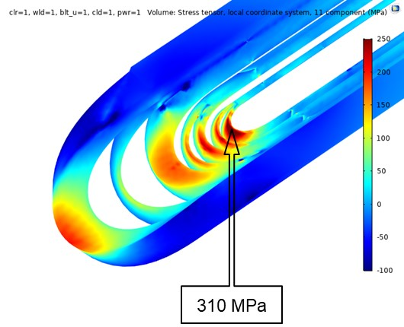
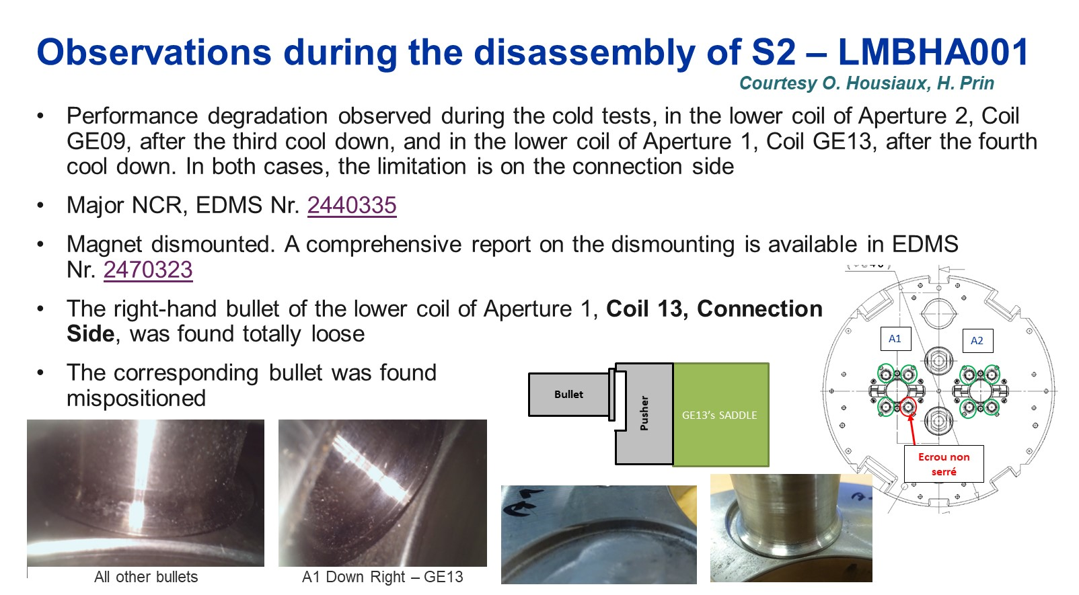
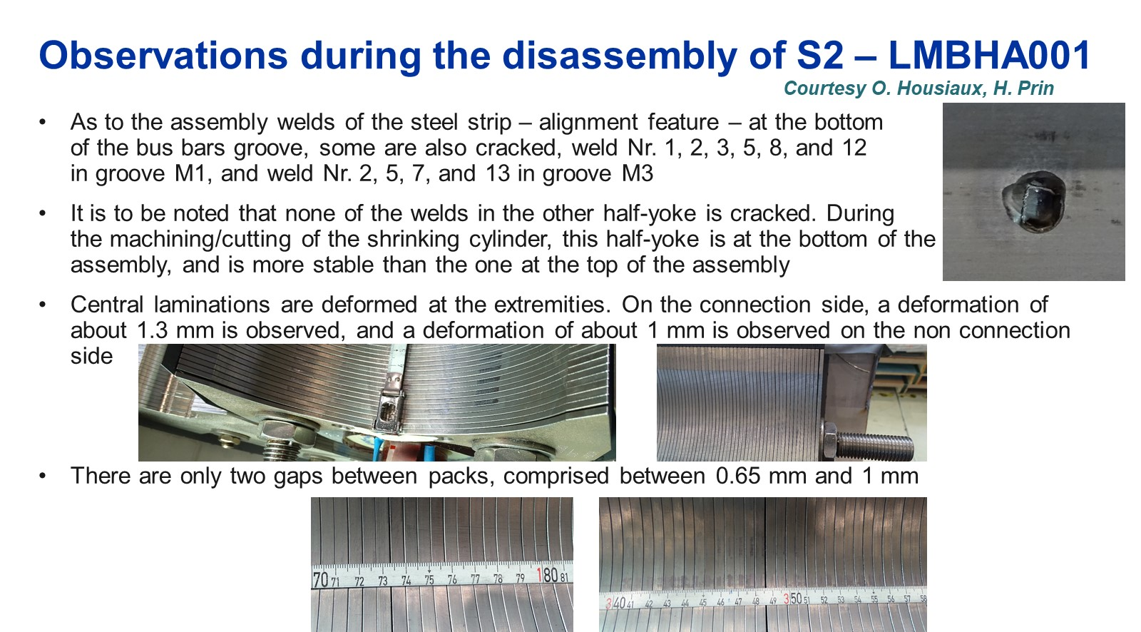
Root-Cause Analysis for 11 T
Two groups of issues have been identified: (1) internal to the coils and (2) external to the coils.
Regarding (1), tomographic analyses have shown that strand pop-outs and cable bulging are likely to arise at the time of winding; such issues cannot be addressed without manufacturing new coils, which has been considered as impractical for the time being.
Regarding (2), three possible root causes have been identified
  high peak stresses in coil ends;
  non-optimum coil end support and axial loading;
  non-optimum support of surrounding laminated structure in magnet ends.
It has been concluded that a combination of the above causes may result in the kind of degradation phenomenon observed after a sequence of electromagnetic and thermal cycling.
Nominal case –series production,
powering at nominal current
(axial stress)
Courtesy of C. Garion and M. Morrone (CERN/TE-VSC)
Courtesy of H. Prin, R. Principe, F. Savary, et al. (CERN/TE-MSC)

Slide 21
Recovery Plan for 11 T
Although the internal coil problems cannot be fixed without producing new units, it has been decided that sufficient improvements could be be made to the coil and magnet/cold mass assemblies to justify the assembly of a new, full-length, twin-aperture prototype, aiming at
  reduced peak stresses in coil ends;
  improved coil end support and axial loading;
  improved support of surrounding laminated structure in magnet ends,
  improved instrumentation, in particular, for the coil/magnet ends, to validate design and analyses.
A short model magnet, made from recovered coils from already tested magnets, has been assembled and will be power tested in early June 2023, to validate the new mechanical features and assembly procedures (including an “end-cage type” support structure in one aperture; low expectations regarding quench performance due to coil history).
The plan is to proceed thereafter with the assembly of the full-length prototype, with already manufactured but “virgin” coils (never loaded in a magnet assembly and never tested at cryogenics temperate), aiming at a completion by end of 2023 and a power test in early 2024.

Slide 22
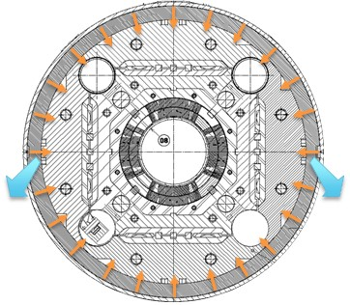
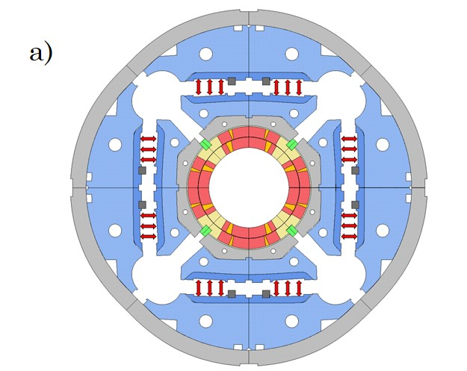
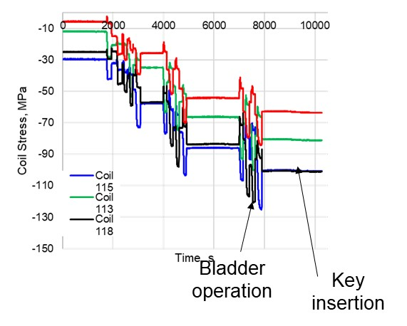
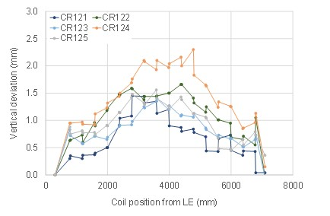
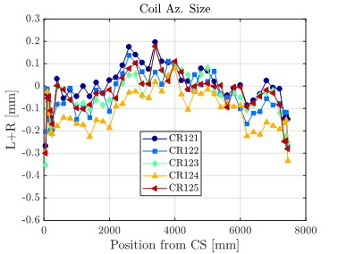

Root-Cause Analysis for MQXFB
Initial MQXFB cold mass design with tight mechanical coupling between outer shell and magnet
Three possible root causes have been identified for the performance limitation of prototypes MQXFBP1 and MQXFBP2 at CERN
  (1) cold mass assembly: non-optimum mechanical coupling between welded outer stainless steel and magnet structure (aluminum rings).
  (2) magnet loading: non-optimum magnet assembly parameters and processes (e.g., keying and bladdering) leading to unbalanced and/or excessive peak stresses on coils;
  (3) coil manufacturing: Issues during coil manufacturing and/or handling leading to coil non-uniformities and/or deformation.
Of course, it can be a combination of the three, or there can be one predominant cause, and the other may exacerbate the problem.
Courtesy of H. Prin (CERN/TE-MSC)
Initial MQXFB loading procedure with significant coil stress overshoot at time of bladdering
Courtesy of J. Ferradas Troitino and S. Izquierdo Bermudez (CERN/TE-MSC)
Fuji Paper Test on CR126
Observations of coil hump after HT, stress concentration at Ti-pole junctions upon closure closing of VPI mold, and of coil belly after VPI
Courtesy of N. Lusa and A. Milanese (CERN/TE-MSC)

Slide 23




Recovery Plan for MQXFB (1/2)
- New coldmass
- Old loading
- Old coils
Due to manufacturing lead times, the three root causes can only be addressed in “reverse order” (shell welding, then magnet assembly, then coil manufacturing), but the results of each step can be fed back into the next one
  (1) cold mass assembly: already assembled cold mass MQXFB01 dismounted and reassembled into MQXFBP3 with optimized shell welding parameters, using already assembled magnet with already manufactured coils; tested in Q2/Q3 2022.
  (2) magnet loading:
    Full-length mechanical model MQXFBMT3 assembled for optimization of keying/bladdering processes and check of coil peak stresses at full force with Fuji paper in Q1 2022; stress overshoot during magnet loading has been eliminated.
    MQXFB02 assembled with optimized keying/bladdering parameters, using already manufactured (virgin) coils and optimized shell welding qualified on MQXFBP3; first tested n in Q4 2022 and endurance-tested in Q1 2023.
Optimized MQXFB loading procedure with no coil stress overshoot
Courtesy of J. Ferradas Troitino and S. Izquierdo Bermudez (CERN/TE-MSC)
- New coldmass
- New loading
- Old coils

Slide 24



Recovery Plan for MQXFB (2/2)
MQXFBP3 and MQXFB02 reached and held nominal current + 300 A at 1.9 K for several hours, but still exhibit a performance limitation at 4.5 K, similar to the one of first 2 prototypes, albeit at a progressively higher level.
The first two recovery actions have been beneficial, but the root cause has not yet been fully eradicated; decision has been taken to proceed with 3rd recovery action.
  (3) coil manufacturing:
  3 transition coils have been manufactured (127, 128, 129) aiming at reducing/eliminating hump and belly at coil centers, and the hinge effect that may occur on pole turn conductors in the vicinity of the Ti-pole junctions at the time of HT mold opening and VPI mold closure.
  Goal was achieved on coils 128 & 129, thanks to changes in assembly/process parameters (e.g., removal of ceramic binder on coil outer layer); decision was taken to manufacture coils of next magnet (MQXFB03) with such processes; test in Q3 2023.
Quench current vs. temperature for full-length MQXFB magnets
Elimination of coil hump & belly starting from coil 128
Significant reduction of hinge effect at Ti pole junctions
Courtesy of S. Izquierdo Bermudez, N. Lusa and A. Milanese (CERN/TE-MSC)

Slide 25
Nb₃Sn Conductor Development (1/5)
Performance targets for Nb₃Sn conductor development for future accelerator magnets were initially defined in 2015 as
  non-Cu J_{c} ≥ 1500 A/mm² (16 T, 4.2 K);
  µ₀ΔM ≤ 150 mT (1 T, 4.2 K);
  d_{eff} ≤ 20 µm;
  RRR ≥ 150.
FCC conductor development sought to work towards these for
  wire diameter ~ 1 mm;
  Cu/non-Cu ~ 1.
Considering the disparity in manufacturers’ capabilities at the start of the programme, it was decided (circa 2018) to
  prioritise J_{c} increase over d_{eff} decrease;
  set interim “stage 1’ objectives” comparable to the specification used for HL-LHC procurement
    Non-Cu J_{c} ≥ 1000 A/mm² (16 T, 4.2 K); target: 1200 A/cm²;
    d_{eff} ≤ 60 µm.
Prepared by S. Hopkins (CERN/TE-MSC)

Slide 26


Nb₃Sn Conductor Development (2/5)
Collaboration agreements (now completed) were initiated with KEK in Japan, KAT in Korea, TVEL in Russia, and Bruker EAS in Germany.
KEK promoted alternative internal tin wire design developments with 2 Japanese manufacturers towards the interim J_{c} target
  JASTEC: distributed tin wire;
  Furukawa: tube-type wire.
KAT developed distributed tin wire towards the interim J_{c} target.
TVEL primarily developed distributed barrier wires, in two phases
  evaluation of common and distributed barrier designs, including with sub-element dividers;
  further development of distributed barrier wire designs towards the interim J_{c} target;
Bruker EAS, as an established producer of wires exceeding the interim J_{c} target, aimed to further develop wire designs leveraging its PIT experience towards the ultimate targets
    internal oxidation for increased J_{c};
    processing developments for lower cost, improved uniformity and increased RRR.
Distributed Tin
(JASTEC)
Distributed Tin
(KAT)
Distributed Barrier
(TVEL)
Courtesy of S. Hopkins (CERN/TE-MSC)

Slide 27

Nb₃Sn Conductor Development (3/5)
KAT, JASTEC and TVEL have all achieved interim J_{c} target for at least one trial design.
KAT
  pilot production delivered with good piece lengths at 1.0 mm;
  successful cabling at CERN: good RRR, low cabling degradation;
  poor stability inhibits testing and requires improvement.
JASTEC
  pilot production delivered at 1.1 and 1.2 mm after many breakages: production workability and yield require improvement;
  0.8 mm wire showed good I_{c} and RRR retention on rolling;
  1.1 mm wire successfully cabled at CERN; currently in test.
TVEL
  Pilot production delivered with good piece lengths at 1.0 mm;
  Successfully cabled at CERN; good I_{c} retention on rolling; cabling degradation ~ 5%, but RRR close to minimum acceptable (100);
  Rather large and non-uniform sub-elements (~75 µm), limiting J_{c} and RRR; processing improvements required.
HFM collaborations
(lines: scaled to 4.22 K)
HL-LHC reference
(lines: mean, bands: ± SD)
Summary of J_{c} vs. B performance of trial FCC wires in comparison to HL-LHC wires
Cross-section of trial KAT cable (40 strands, 20.95×1.80 mm, 0.5° keystone)
Courtesy of S. Hopkins (CERN/TE-MSC)

Slide 28


Nb₃Sn Conductor Development (4/5)
Bruker EAS
  Implemented internal oxidation in modified PIT routes, achieving precipitate formation (APCs) and/or grain refinement depending on design; workability and processing improvements required to achieve wires with significant J_{c} increase towards ultimate target;
  Nb-Ta-Hf alloy trialled in PIT and RRP® wires; RRP sub-element production failed due to workability issues;
  Improved metal forming significantly improved PIT filament geometry and enables drawing to small filament diameters maintaining J_{c}: potential for low d_{eff} wires, and for better J_{c} and RRR optimization, but cabling degradation not yet assessed.
Nanoparticle precipitate formation, but no grain refinement, observed in internal oxidation PIT wires with a central Sn and O source
Courtesy of S. Hopkins (CERN/TE-MSC)
intOx-core

Slide 29
Nb₃Sn Conductor Development (5/5)
New collaboration agreements with KEK and KAT proposed, and further development of internal oxidation routes under consideration.
Industrialisation of new wire designs at 0.85 mm diameter and with presently achieved J_{c} performance
  aim to qualify alternative wire technologies/sources in the MQXF conductor selected for the 12 T, value-engineered dipole magnet programme;
  JASTEC (KEK collaboration): R&D to improve workability and piece length, to be qualified in pilot production (~25 kg/5 km);
  KAT: R&D to improve magnetothermal stability, to be qualified in pilot production.
R&D to further develop wire towards ultimate requirements for 14+ T dipole magnet programme
  increase J_{c} towards 1500 A/mm² (16 T, 4.2 K) at JASTEC and KAT;
  in KEK collaboration, develop and trial reinforcement methods to increase mechanical strength and tolerance of transverse stress,
Courtesy of T. Boutboul & S. Hopkins (CERN/TE-MSC)

Slide 30

Endurance Test of MQXFA05
AUP 4.2-m-long series magnet MQXFA05 was subjected to an endurance test at BNL (in vertical position, without outer welded shell).
In total
  ─ 5 Thermal cycles
  ─ 52 quenches (10 spontaneous + 42 induced)
  ─ 79 power cycles (52 quenches + 27 cycles w/o quench) above 10 kA.
Successfully Completed on 27 May 2022 with no evidence of degradation.
  (Completion of test made possible by delivery of GHe from FNAL to BNL.)
(Courtesy G. Apollinari, US AUP), and Y. Ben Yahia, BNL)
30

Slide 31





Retesting of MSUT (after 24 years)
Further demonstration of robustness of short Nb₃Sn magnets was provided by the retest, after 24 years, of MSUT.
MSUT is a 1-m-long, 50-mm, single-aperture dipole magnet designed to achieve a minimum field of 10 T at 4.4 K, using Nb₃Sn PIT wire technology.
It was built in the early 1990s by a collaboration between Twente University, NIKHEF, ECN, CERN and 2 Dutch suppliers (HOLEC and SMI Wire);
it did not exhibit any retraining and reached 11.8 T (power supply limitation).
(Courtesy A. den Ouden and H. ten Kate, formerly Twente University & G. Willering, CERN/TE-MSC)
31

Slide 32


12-T, Value-Engineered Dipole Magnet Development (1/3)
Minimize coil compression at all stages of magnet lifecycle;
Minimize retaining structure deformations as these can generate extra coil deformations in the horizontal midplane;
Protect the coils against risk of overstress due to accidental loads;
Decrease the degree of redundancy in the structure to enable better control of contact force distribution between parts;
Increase the reproducibility of coil fabrication procedures;
Decrease influence of manufacturing tolerances on magnet performances.
The closed cavity concept
Reduced number of pieces in magnet cross section
Less pieces ⇒ less tolerances
The aluminium stoppers at room temperature and the closed iron gap at cold protect the coils from extra or accidental stresses; coils are kept in a closed cavity.
Conceptual Design Review at CERN on 5 July 2023.
Conceptual design of 12-T Value-Engineered Dipole Magnet Design at CERN
Courtesy of D. Perini (CERN/TE-MSC)
32

Slide 33



Ongoing projects:
12 T Robust Dipoles
Development of a single aperture “12 T Robust Dipole” in INFN, Genova
Courtesy of S. Farinon
Development of twin “12 T Robust Dipole” at CERN
Winding tests are ongoing in INFN Genova
Both the INFN and CERN 12 T short robust dipole models are expected to be ready in 2025.
Courtesy of D. Perini (CERN/TE-MSC)
33

Slide 34


12-T, Value-Engineered Dipole Magnet Development (2/3)
Advantages of a horizontal iron yoke gap structure
collaring at relatively low prestress at room temperature;
structure kinematics can be designed to enable coil pre-compression increase during cool down as in MQXFB (while a vertical gap necessarily results in pre-compression decreases due to thermal shrinkage differentials);
Peaks of coil compression can be contained to values lower than 110 MPa at room temperature and 120 MPa at cold during powering.
Average coil prestress at the contact with the collar pole during the assembly and energization.
Development program
Collaring mock-up tests (using 11 T dipole coil sections): Q3 2023;
Mirror coil test to validate first coil production: Q1 2024;
Single-aperture dipole magnet model in previous structure: Q3 2024;
Twin-aperture dipole magnet model: 2025.
Cross section of coil test structure
in a mirror configuration
Courtesy of D. Perini (CERN/TE-MSC)
34

Slide 35


12-T, Value-Engineered Dipole Magnet Development (3/3)
Technology Development for Coil Manufacturing
Extensive winding tests to optimize the shape of the end spacers and the winding parameters.
Minimization of coil handling during fabrication: the winding mandrel becomes part of heat treatment mould; no need to move the stand-alone coil from the winding machine to the oven.
Separation of inner and outer layer coils to have them less statically indeterminate; the coils can slightly move with respect to each other and peaks of stresses (possibly leading to cracks) are reduced; in addition it enables inspection of outer layer of inner layer coil at each manufacturing step.
Winding mandrel (in yellow) integrated into heat treatment mould
This requires the design of an internal splice and the development of new procedures and tools.
Implementation of internal splice
Courtesy of D. Perini (CERN/TE-MSC)
35

Slide 36


Exploring the Limits of Nb₃Sn Technology: RMM Demonstrator (1/3)
The Racetrack Magnet Model is a technology demonstrator aimed at assessing the in-coil performances of Nb₃Sn conductors in fields up to 18 T.
It relies on three double-pancake, racetrack-type coils stacked on top of each other with a 50-mm closed cavity inside at the middle coil centre.
The block-coil design features a straight section with an accelerator magnet equivalent aperture and no layer jump over about 431 mm.
It is also designed as a tool to study the impact of mechanical pre-load and fittings in the assembly; it relies on an aluminium shrinking cylinder for transversal pre-load and end plates with tie rods to provide adequate longitudinal support to the coil ends; coil loading is provided by a key-and-bladder process.
Coils are wound from a Rutherford-type cable, composed of 40 strands of 1 mm diameter and a Cu/non-Cu ratio of ~1.
Electromagnetic design has been optimized in ROXIE and OPERA to have a proper assessment of the peak field in the straight section.
2D Electromagnetic Design of RMM Demonstrator at CERN
3D Mechanical Design of RMM Demonstrator at CERN
Courtesy of D. Tommasini and J.-C. Perez (CERN/TE-MSC)
36

Slide 37



Exploring the Limits of Nb₃Sn Technology: RMM Demonstrator (2/3)
Coil preload targets are set to reach bore/peak fields of 16.3/16.5 T.
Assembly is driven by the strain measured on the shell; keys’ thicknesses are increased until reaching the calculated strain corresponding to the preload target.
At room temperature, coils are preloaded to a level of about 50 MPa in average, while after cool-down, the coils undergo a prestress increase of about 100 MPa in average; as expected by design, the coil preload comes for ~50% from assembly and for ~50% from thermal shrinkage differentials during cooldown.
To validate the force contact distribution during assembly, pressure-sensitive film layers were added inside the coil pack; coil shimming was optimized accordingly.
Two magnets assemblies were performed and tested (1) RMM1a and (2) RMM1b after curing an undesirable mechanical radial interference between tie rods & yoke.
1.2 m
RMM Demonstrator Assembly at CERN
Bladders
Keys
Coil Pre-Loading Concept (left) and Pressure Sensitive Films Results (right)
Courtesy of E. Gautheron and J.-C. Perez (CERN/TE-MSC)
37

Slide 38




Exploring the Limits of Nb₃Sn Technology: RMM Demonstrator (3/3)
RMM1a reached the 16.5 T conductor peak field target at 1.9 K after 5 quenches and RMM1b after 6 quenches.
A record conductor peak field of 16.7 T was reached on RMM1b, corresponding to a calculated and measured field of 16.5 T in the closed bore.
Above target, the performance appers rather erratic, likely due to mechanical limitations
  precursors are observed in the quench signals;
  no sign of degradation in the V-I measurements.
About 68% of the quenches occur in the lower layer of one side coil (eRMC #102), in the high-field region and in the straight section.
Only 4 quenches occurred in the middle RMM coil which was the only virgin coil.
Next step: RMM1c has been assembled with increased shimming on top and bottom eRMC coils; powering tests to start at the end of June 2023.
Quench Performance of RMM Demonstrator at CERN
Courtesy of G. Willering (CERN/TE-MSC)
Hall Probe Sensor & Measurements Mounted in Closed Cavity of RMM Demonstrator at CERN
Courtesy of C. Petrone
(CERN/TE-MSC)
38

Slide 39

14+ T Dipole Manet Development
Ongoing work
Review of past block-coil magnet programmes (design and performances);
preliminary studies to assess influence of different magnetic and mechanical parameters on dipole magnet performances;
assessment of available strands and cables characteristics and of the possibility of future developments;
It should be noted that a twin-aperture dipole magnet, with Nb₃Sn block coils has never been built; it is a very challenging configuration.
Conceptual Design of 14+ T Block Coil Design
at CERN
Courtesy of J.-C. Perez (CERN/TE-MSC)
Step-by-step approach
Produce and validate block coils with flared ends: 2024;
Design and manufacture of a single aperture, 2-m long dipole magnet model: 2025-2026;
Design and manufacture a twin aperture, 2-m long dipole magnet model: 2026-2027.
39

Slide 40


HTS vs LTS superconductors & magnets – some key distinctions
HTS materials outperform LTS at higher field, but under-perform at low field
=> hybrid magnets are most efficient
104
M
ax
i
m
al
Je
at
1.
9
K
fo
r
entir
e
LHC
Nb
T
N
b
4.
2
K
LHC
inser
tion
i
-
T
i
R
E
B
CO
BI
|
T
ap
e
P
l
an
s
e
t
r
an
d
p
r
o
d
u
ct
i
o
n
(
CE
R
N
-
T
.
Bo
u
tb
o
u
l
q
u
ad
'0
7).
r
u
p
o
l
e
s
t
r
an
d
R
e
d
u
ci
n
g
the
t
e
m
p
e
r
at
u
r
e
Bo
fr
om
4.
2
K
u
tb
o
u
l
et
al
.
)
20
0
6
SuperP
o
wer
t
ap
e
,
p
50
um
r
o
d
u
ce
s
a
~3
T
shif
t
in
Je
fo
r
Nb
-
T
K
i
s
u
b
s
t
r
at
e
,
50
um
Cu
,
7
.
5%
Zr
m
e
as
,
u
r
2
e
d
at
NHMFL
.
4
,
?
m
m
221
2
55
?
18
f
i
l
am
e
n
t
B-
OS
T
s
t
r
an
/
50
b
ar
Ov
er
d
with
NHMFL
-
P
r
essu
r
e
HT
.
J.
J
i
an
g
et
al
A
.
(
Nb
-
T
y
03
i
t
1.
i
9
K
s
2223:
B
I|
T
ap
e
P
l
an
n
e
R
E
B
CO
B1
T
ap
e
P
l
an
MDP seeks to address questions such as:
What is the nature of accelerator magnet training?
Can we reduce or eliminate it?
What are the drivers and required operation margin for Nb₃Sn and HTS accelerator magnets?
What are the mechanical limits and possible stress management approaches for Nb₃Sn and 20 T LTS/HTS magnets?
What are the limitations on means to safely protect Nb₃Sn and HTS magnets?
e
Sumit
e
o
mo
E
l
e
ct
r
i
D
c
(NHMF
L)
t
n
e
r
r
2223
"
Car
r
i
e
u
2223:
B1
d
r
l
"
l
t
e
r
C
C
o
n
o
l
-
R
E
B
CO
:
B
I|
T
ap
e
p
l
an
T
e
ap
e
P
l
an
a
e
MEM'13
2223:
B1
T
Sumit
ap
e
c
o
mo
•
R
E
B
CO
:
B
1
T
ap
e
P
l
an
Nb
e
-
T
i
i
P
l
an
e
Sumit
E
o
mo
l
e
ct
r
i
t
c
(20
12
D
«
Ж
=
«
Bi-
2
2
12
:
i
4.
2
2
K
High
Field
pr
o
d
50
b
ar
OP
.
r
)
E
l
e
ct
r
i
10
2
MRI
c
(NHMF
L)
s
t
r
an
C
d
a
"
W
.
•
Bi-
2
2
2
3
:
B
II
T
ap
e
P
l
an
(
e
e
L
u
v
at
a)
E=
Bi-
2
2
2
3
:
B
1
T
ap
e
P
l
r
ace
i
Nb
Sn:
High
J.
O
Bi-
2
2
2
3
:
B
1
T
ap
e
p
l
an
e
(
car
r
.
co
n
t
.
W
O
)
Bi-
2
2
2
3
:
B
1
T
ap
e
p
l
an
e
(pr
o
d
.
e
Nb
,Sn:
)
l
o
Br
o
n
z
e
P
r
o
ce
s
s
O
Nb
:Sn:
I
n
t
e
r
n
al
Sn
RRP
h
MgB,:
2nd
Ge
n.
AI
MI
18
+
1
®
-+
Nb
3Sn:
High
Sn
Br
o
n
F
z
e
i
l
am
e
n
t
s
,
The
OSU
/
HTRI
W
,
Co
m
p
i
l
20
1
e
d
fr
om
3
-
Nb
-
T
i:
LHC
1.
A
S
CO
2
an
9
K
d
-X
-
Nb
-
T
1
i:
LHC
4.
2
K
CM
C'
0
3
p
ap
e
r
4
54
3
s
f
i
l
am
e
n
t
High
Sn
•
•X•
•
Nb
-
T
i:
High
Field
MRI
(I
4.
2
2
K
.
P
ar
r
e
l
l
OL
Br
-
S
T)
o
n
z
e-
16wt.
%Sn-0
.
3wt%T
i
-
MgBz:
18
+
1
(
Fil.
13
%
Fill
M
i
y
a
z
ak
i
-
M
T
1
8
-
I
E
E
E
'
0
4
10
)
-
5
10
15
20
25
30
35
40
45
Applied
M
ag
MA
G
LAB
n
e
t
i
A
p
c
Field
(T)
r
i
l
2
0
1
8

Slide 41



A priority now is to build the Nb₃Sn outserts
Canted Cosine theta:
  4 layers
    Bore field of 12 T / 13 T for standalone operation
    Bore diameter: 120 mm
Stress-managed Cosine Theta:
  2 layers
    Bore field of 11 T
    Bore diameter: 120mm
SMCT
CCT
30+ % current margin at target fields of 12 T, 4.2 K and 13 T, 1.9 K
These are two variants on stress-management
CCT is a “limiting case” of maximal SM
SMCT is a more efficient design

Slide 42





Design efforts now leading to hardware and first testing
FNAL mirror test of SMCT imminent
Practice winding of CCT6 underway

Slide 43


Slide 44


Slide 45
Advantages of HTS
Very high in-field current density at low temperature
  Enabling technology for magnets with fields > 16 T
  No magneto thermal-thermal instability, e.g. no flux jump (an issue to be treated for future high-field Nb₃Sn accelerator magnets);
  Higher temperature margin, e.g. capability of tolerating a rise of temperature due, for instance, to decay particles
  Operation at higher temperature
    Low(er) field magnets operated at temperatures higher than liquid helium (dry-cooling, He gas cooling, LH₂, LN₂): operational energy saving
    High specific heat, i.e. high thermal stability (MQE) – the issue comes once the quench has generated (detection and protection)
    Higher temperature margin to the benefit of an easier cryogenic control
A. Ballarino, et al. | Superconducting Magnets & Devices @CERN
26 June 2023
45

Slide 46
The present HTS landscape
A. Ballarino, et al. | Superconducting Magnets & Devices @CERN
26 June 2023
46

Slide 47

REBCO
Development on magnets requires having solved all issues on superconductors !
Very high current capability
React & Wind technology
Several manufacturers word-wide (unit lengths ∼ 300 m)
Development to be done on:
QA of conductor
Longer (> 1 km) conductor unit lengths
Field quality issues (effect of persistent currents in wide tapes)
Effect of screening currents on stress/strain distribution
High current cables (twisted and transposed ?)
Modelling
Quench detection, quench protection
Impregnation and insulation techniques (no insulation, metal insulation, high voltage insulation)
High current splices
Magnet geometry/design – taking into account also tape anisotropy
….
A. Ballarino, et al. | Superconducting Magnets & Devices @CERN
26 June 2023
47
Notes:
Homogeneity, absence of defects

Slide 48




REBCO – Tape
High current capability
4.2 K
4.2 K, 10 K and 20 K
Data presented by tape manufacturers at the HiTAT Workshop, CERN, March 2023
A. Ballarino, et al. | Superconducting Magnets & Devices @CERN
26 June 2023
48

Slide 49

REBCO – Cables (1/2)
A. Ballarino, et al. | Superconducting Magnets & Devices @CERN
26 June 2023
49

Slide 50



REBCO Cables for HL-LHC (2/2)
Round, flexible, electrically insulated REBCO cables
No measurable critical current degradation of tapes after cabling
Current rating of REBCO cables: 600 A, 3000 A, 7000 A and 18000 A @ 60 K (∼ 0.7 T)
Cabling machine designed and constructed at CERN
Two layers of tape
On-line Polyimide insulation
3 kA @ 60 K (B = 0.7 T)
A. Ballarino, et al. | Superconducting Magnets & Devices @CERN
26 June 2023
50

Slide 51
Iron Based Superconductors
Ba-122:
Tc ∼ 38 K
Hc2(20 K) > 70 T
High upper critical field (H_{c2})
Hirr close to H_{c2}
Small anisotropy
Transition to weak link: θc ∼ 9°
→ suitable for wires
Wires can be produced with the known scalable Powder In Tube process at potentially low cost
A Gurevich, Ann. Rev. Cond. Matt. Phys 5 (2014) 35
C Yao and Y Ma, iScience 24 (2021) 102541
A. Ballarino, et al. | Superconducting Magnets & Devices @CERN
26 June 2023
51

Slide 52




Iron Based Superconductors in China
D. Wang and Y. Ma, HiTAT Workshop, March 2023, CERN
A. Ballarino, et al. | Superconducting Magnets & Devices @CERN
26 June 2023
52

Slide 53

D. Wang and Y. Ma, HiTAT Workshop, March 2023, CERN
A. Ballarino, et al. | Superconducting Magnets & Devices @CERN
26 June 2023
53

Slide 54

HFM Program - CERN/SPIN collaboration agreement
Drawing machines
Groove rolling machines
Flat rolling machine
Iron Based Superconductors Laboratory
R&D on Iron Based 122 PIT wires
Critical current density (J_{c}) through reliable, simple and scalable techniques that could enable industrialization
Target Jc ≥ 10³ A/mm² at 16 T
From mono to multi-filamentary wire
Target unit length ∼ 100 m
Courtesy A. Malagoli
CNR- SPIN, Genova
A. Ballarino, et al. | Superconducting Magnets & Devices @CERN
26 June 2023
54

Slide 55


BSCCO 2212 Wire
D. Larbalestrier, HiTAT Workshop, CERN, March 2023
A. Ballarino, et al. | Superconducting Magnets & Devices @CERN
26 June 2023
55

Slide 56
HTS Conductor
Measurements required:
  Critical current (Ic) at 4.2 K and at higher temperatures in external fields
  (B up to 20 T). Because of the anisotropy of these materials, the angular dependence Ic(T,B_{θ}) has to be measured as well;
  Magnetization measurements;
  Mechanical properties;
  Effect of thermal cycles on Ic and Tc;
  Delamination effects (inside the multi-layer structure);
  Sensitivity to impregnation processes;
  Homogeneity of properties along long lengths;
  QC for identification of defects (on the tape, before use in cables/coils);
  Thermal properties;
  Quench characteristics and protection aspects
This information is an input for development of cables and coils
A. Ballarino, et al. | Superconducting Magnets & Devices @CERN
26 June 2023
56

Slide 57
Develop and qualify HTS cables
Conceive and qualify novel cable layouts. Start with stacks of tapes, understand limitations and evolve toward different geometries (need for twisting, transposition,…). Move from concepts (few meters) to prototypes (up to ∼ 30 m) first and then to long (> 100 m) lengths
Tackle electrical insulation vs protection aspects and prove feasibility of electrically insulated cables
Address quench detection and quench protection aspects
Address field quality aspects
Address mechanical aspects
Address robustness/windability for use in coils
Target performance at 20 T, 4.2 K and ∼ 10 K: 10 kA
Required a qualification test campaign – and purpose-built experimental set-ups
A. Ballarino, et al. | Superconducting Magnets & Devices @CERN
26 June 2023
57

Slide 58

Fresca 2 at CERN – The superconductors laboratory
Background field: 13 T nominal (15 T ultimate)
CERN/CEA Nb₃Sn block-coil dipole (EU EUCARD project)
Aperture: 100 mm
1.9 K, 4.2 K and variable temperature
A. Ballarino, et al. | Superconducting Magnets & Devices @CERN
26 June 2023
58

Slide 59
Good Engineering Practices
HFM magnet technology implies the critical need of a rigorous and systematic methodology and the importance of following good engineering practices at all stages of the process
  Design should be done consistently integrating from the start all requirements/constraints imposed by the manufacture and operation of the final product; it is always better to decouple the functions;
  Design and assembly processes should be done to maximize contingency and avoid eating margins;
  There should be a rigorous and systematic program to qualify and validate key material and design/assembly features through mock-ups, short models and full-size prototypes; such program costs much less than recovery or crash programs; post-mortem analyses can prove invaluable.
  Qualification and validation call for suitable instrumentation and procedures; the instrumentation should be adapted to what one needs to measure and not the other way around;
  It is critical to have available FE models and to keep updating them at all stages; these models are not only meant to justify design choices but also to identify/analyze issues;
  if size is a potential issue, scalability should be assessed in a proper manner early enough in the project;
  Test of individual coils (e.g., in mirror configuration) can enable fast turnaround;
  Do not procrastinate when confronted with discrepancies or unexpected results: they rarely heal themselves naturally and are likely to come back and turn into more severe issues later on.

Slide 60

Recent magnet developments
A. Ballarino, et al. | Superconducting Magnets & Devices @CERN
26 June 2023

Slide 61


CAD design of sextupole demonstrator
Specifications:
Aperture: 90mm
Current: 260A
Temperature: 40K
Field gradient: 1000T/m2
Max. field @conductor:1.5T
Crit. Current fraction: 49%
Temp. margin: 14K
A. Ballarino, et al. | Superconducting Magnets & Devices @CERN
26 June 2023

Slide 62



Tapered Double-Helix Magnet
Tapered coils used for some low-β quads closest to IP (Q1APR/Q1ER).
Use Double Helical coils produced via the BNL Direct Wind process (see below).
R&D Test Coil: 4 layers, aperture varies from 60 to 80mm over 0.4 m length, gradient 43 T/m, 30-40 mm inner radius
Although the aperture varies, the gradient is maintained constant.
Field Measurements
Tapered Quadrupole – no training, reached
short sample at 960 A
Calculated Coil Field
H. Witte et.al. http://dx.doi.org/10.1109/TASC.2019.2902982.
A. Ballarino, et al. | Superconducting Magnets & Devices @CERN
26 June 2023

Slide 63





Cross-Cutting Activities
Numerical models, materials, protection techniques, cryogenics, diagnostics, magnetic measurements, etc. are all challenging applications of their respective engineering sciences.
[A]
[C]
[D]
1973: Asner, Holsinger, Iselin, MAGNET code.
1983: Holsinger, Iselin, POISSON FEM code– still in use.
1999: Kurs, Russenschuck, BEM-FEM in ROXIE, state of the art.
Today: Schaubelt, Vitrano, Verweij, Wozniak, FiQuS magnetic and thermal
thin-film approximations for ReBCO, parallel in space and time FEA,
under development
A. Ballarino, et al. | Superconducting Magnets & Devices @CERN
26 June 2023

Slide 64



Cross-Cutting Activities
Numerical models, materials, protection techniques, cryogenics, diagnostics, magnetic measurements, etc. are all challenging applications of their respective engineering sciences.
[A]
[B]
P. Studer, T. Tervoort: Best-in-class cryogenic fracture toughness in resins; ongoing.
G. Vallone et al.: Coil composite mechanical modeling, reference-volume technique; new state-of-the-art.
A. Ballarino, et al. | Superconducting Magnets & Devices @CERN
26 June 2023

Slide 65
Test, Measurement & Analyses: Roadmap ‒ 1/2
Software tools:
  (1.1) update ROXIE software to cater to the electromagnetic design needs of HFM collaborators, for both LTS and HTS and for all design types (cos(θ), block coils, common coils, CCT, straight and curved).
  (1.2) Create software environment (pyMBSE) for soft-coupling of finite element (FE) tools for mechanics (Ansys), thermal (Comsol) and electrical design (P-Spice, LEDET) in collaboration with TE-MPE.
Materials and FEA models databases: contribute to the establishment of databases for materials and FE models (magnets as built) within the TE-MSC Group and with external collaborators, in collaboration with TE-VSC and EN-MME.
Diagnostics: develop a comprehensive set of novel DAQ and diagnostics tools, magnetometers and sensors for performance assessment of HFM demonstrators and model magnets to be tested in SM18, including
  (3.1) mechanical analysis;
  (3.2) quench detection and localization (in particular, quench antenna systems);
  (3.3) magnetic measurements and generalized field descriptions;
  (3.4) others (e.g., acoustic emission and field sensors, optical fibers, …).

Slide 66
Test, Measurement & Analyses: Roadmap ‒ 2/2
(4) Infrastructure: update SM18 infrastructures to enable the test and measurements of HFM demonstrators and magnet models, including
  (4.1) mirror-type coil test setups in vertical and horizontal configurations (up to 15 m);
  (4.2) D1 magnet model integration as background magnet for insert test;
  (4.3) anti-cryostats and magnetic measurement equipment for Cluster G vertical test facilities;
  (4.4) high frequency, high resolution DAQs as required by diagnostics in (3);
  (4.6) consolidation of liquid nitrogen test station in collaboration with TE-CRG for HTS coil/magnet test;
  (4.7) consolidation of cryo-cooler for testing and calibration of instrumentation at cryogenic temperatures, in collaboration with TE-CRG;
  (4.8) assess need for power converter upgrade beyond existing capability (30 kA in both Clusters D and G) as required by magnet test program; if need is confirmed, proceed with upgrade in collaboration with SY-EPC.

Slide 67


V-I Measurements (1/2)
MQXFBP2 V-I Measurements (7.2-m-long HL-LHC quadrupole magnet prototype)
Sensitive voltage measurements can be carried during magnet testing, enabling early detection of resistive transitions and monitoring of their evolutions after EM and thermal cycling.
Was successfully developed in later part of 11 T short models and series magnets (circa 2018) and can be applied to full coil voltages.
Courtesy of G. Willering (CERN/TE-MSC)
Voltage build-up up to 6.5 µV in quenching Pole 1 (P1) of MQXFBP2 at 4.5 K & 15.4 kA.
Voltage build-up in 2 other poles (P2 and P3) that did not show a quench limit at that current level but appeared limited at higher current levels during trim powering (see next slides).
11 T Series #2 V-I Measurements (5.3-m-long HL-LHC Dipole Magnet): Change in full coil voltage after cool down 3 and cool down 4; the method can show degradation and changes in degradation, even before the quench happens

Slide 68




V-I Measurements (2/2): midplane coil segment of SP107 & SP109 @4.5 K (short HL-LHC 11 T dipole magnet models)
SP107
SP109
Stable Behavior
Degrading Behavior
Courtesy of G. Willering (CERN/TE-MSC)

Slide 69

Trim Powering (1/2)
In case the performance of a magnet is limited by one coil, the trim powering procedure enables injection of additional current in the other coils to assess their performances (concept initially proposed by A. Milanese, CERN/TE-MSC).
Main current leads (20 kA)
Auxiliary current leads (600 A) used for CLIQ in the temporary cold mass configuration
Superconducting CLIQ leads
Coil to trim down
~0.3 V
10x 300 A
~0.6 V, 13 kA
Next step: double the leads to allow up to 2 kA trim powering
Trim PC protection diode
Notes:
600 A leads can accommodate up to 1.6 kA peak (quench or control cryogenics) and 1.5 kA steady state.

Slide 70







Trim Powering (2/2): MQXFBP2 Test Results (7.2-m-long HL-LHC quadrupole magnet prototype)
Ultimate current
Test-plan limit
Nominal current
Courtesy of F. Mangiarotti (CERN/TE-MSC)

Slide 71




3-D Quench Antenna (1/3)
Quench antenna configuration relying on “Morgan coils” sensitive to multipole components (e.g., B₃, A₃, B₄, A₄ for a quadrupole magnet) and enabling accurate quench start localization, both longitudinally and azimuthally (concept initially proposed by T. Ogitsu, circa 1992).
Present design relies on flexible Printed Circuit Boards (PCB).
Courtesy of L. Fiscarelli (CERN/TE-MSC)

Slide 72



3-D Quench Antenna (2/3): MQXFBP3 Test Results (7.2-m-long HL-LHC quadrupole magnet prototype)
Limiting quenches of MQXFB magnets are very reproducible and originate in pole turn of coil inner layer towards mechanical center of magnet.
Limiting Quenches at 20 and 50 A/s at 4.5 K
Courtesy of L. Fiscarelli and P. Rogacki (CERN/TE-MSC)

Slide 73

3-D Quench Antenna (3/3): flux jump signals in MQXFB02
(7.2-m-long HL-LHC quadrupole magnet)
Propagation speed from ~700 to ~350 m/s at 1.9 K, and from ~900 to ~500 m/s at 4.5 K.
Courtesy of L. Fiscarelli and P. Rogacki (CERN/TE-MSC)
73

Slide 74


Extremely demanding in Quality & Processes: Nb3Sn & HTS
19 T all superconducting magnet
Analysis of quenching reason:
The small notch
A small notch appeared in the innermost REBCO tape of DP1 due to improper winding procedures, and the superconducting layer may have been damaged
The transport current behavior of DP 1 was normal in the test at 77 K
The large electromagnetic force caused the notch or cracks to grow or even break

Slide 75

Engineering of interconnexions & instrumentation/protection ports
“Don't lose with the interconnect what you struggled to achieve with the magnets”.
Quality, reliability, contingencies
LTS “block coils” and HTS will have very challenging interconnections.
Longer length implies less T/m for the accelerator…

Slide 76
Closing remarks (1/2)
HL-LHC will see the first large-scale application of MgB₂ superconducting links and Nb₃Sn accelerator magnets; both systems are in an advanced prototyping phase and are expected to be fully validated by early fall 2023; they will subsequently be installed in an integrated system test, pending demonstrating reliabilities equivalent of the NbTi technology.
Nb₃Sn is a viable and robust technology for fusion and accelerator magnet applications, which is now reaching maturity, thanks to ITER and HL-LHC; there is no inherent issues with the technology, but it requires reliance on good engineering practices. More,
  Nb₃Sn is the only reliable option:
    For long magnets >10 m in the range of 12-14 T within 2030.
    Together with NbTi, for the hybrid HTS/LTS outserts for magnets in the range of 14-20 T within 2030.
Nb₃Sn should preserve its momentum until full exploitation of its potential, more specifically:
  Its potential beyond 14+ T.
  The feasibility of long twin-aperture magnets up to 15 m using a mirror configuration for cost optimisation.

Slide 77
Closing remarks (2/2)
  HTS technology is still (36 years after its discovery) in its infancy; it is well worth exploring its potentials, but it is not, and will not be matured for large applications before several decades. HTS has clear potential for high field magnets >16 T, however:
  HTS magnet protection and ramping rates are till concerns.
  Some keys projections need to be reiterated such are costs reduction of conductors, operating temperature vs power/energy/operation costs and other environmental issues, delays for feedback processes on conductor production, etc.
  Development/study on low-field HTS magnets shall be launched in parallel to combine both sustainability studies for future accelerators and market for producers, meanwhile HFM gets in speed.
Beyond high-field magnet applications, there are emerging needs for strongly-curved, multipolar magnets, compact superconducting links and conduction-cooled superconducting magnets.
Thanks to its large and unique facilities, its long experience and the preservation of its competency poles, CERN remains a premier laboratory in normal-conducting and superconducting magnet technology.
It is important to concentrate efforts and train the new generation of scientists/Engineers.

Slide 78
with support from:
A. Devred¹, C. Abad Cabrera¹, I. Aviles Santillana², A. Ballarino^{1,} A. Baris², C. Barth¹, T. Boutboul¹ , M. Crouvizier², D. Duarte Ramos¹, J. Ferradas-Troitino¹, L. Fiscarelli¹, J. Fleiter¹, C. Garion³,
E. Gautheron¹, A. Haziot¹, S. Hopkins¹, S. Izquierdo-Bermudez¹, A. Moros², N. Lusa¹,
F. Mangiarotti¹, A. Milanese¹, A. Moros², M. Morrone³, J.-C. Perez¹, D. Perini¹, C. Petrone¹,
R. Piccin¹ , H. Prin¹, K. Puthran¹, P. Rogacki¹, S. Russenschuck¹, F. Savary¹, C. Scheuerlein¹,
S. Sgobba², E. Todesco¹, G. Vernassa¹ and G. Willering¹
¹CERN/TE-MSC, ²CERN/EN-MME and ³CERN/TE-VSC
And all contributors to the HL-LHC and HFM programs

Slide 79

«Being a leader is
having vision»
17th May 1954
CERN worksite
Questions?

Slide 80

FCC-hh: highest collision energies
Order of magnitude performance increase in energy & luminosity
100 TeV cm collision energy (vs 14 TeV for LHC)
20 ab⁻¹ per experiment collected over 25 years of operation (vs 3 ab⁻¹ for LHC)
similar performance increase as from Tevatron to LHC
Key technology: high-field magnets
Detailed documentation from the ESPP: http://fcc-cdr.web.cern.ch, and more recent talk in the 2022 FCC week: LINK (Giovannozzi)

Slide 81



SPPC
Recent focus on:
Compatibility with CEPC
Lattice design
HFM developments

