Slide 1



Implications for the Future Physics Programme
Community Report on Accelerators Roadmap
Brian Foster (Oxford/DESY/Hamburg)
12/7/23

Slide 2
Outline of Talk
Introduction
Injectors
Fixed-target, ep & “other” physics (AWAKE)
Stand-alone colliders (HALHF)
Summary

Slide 3
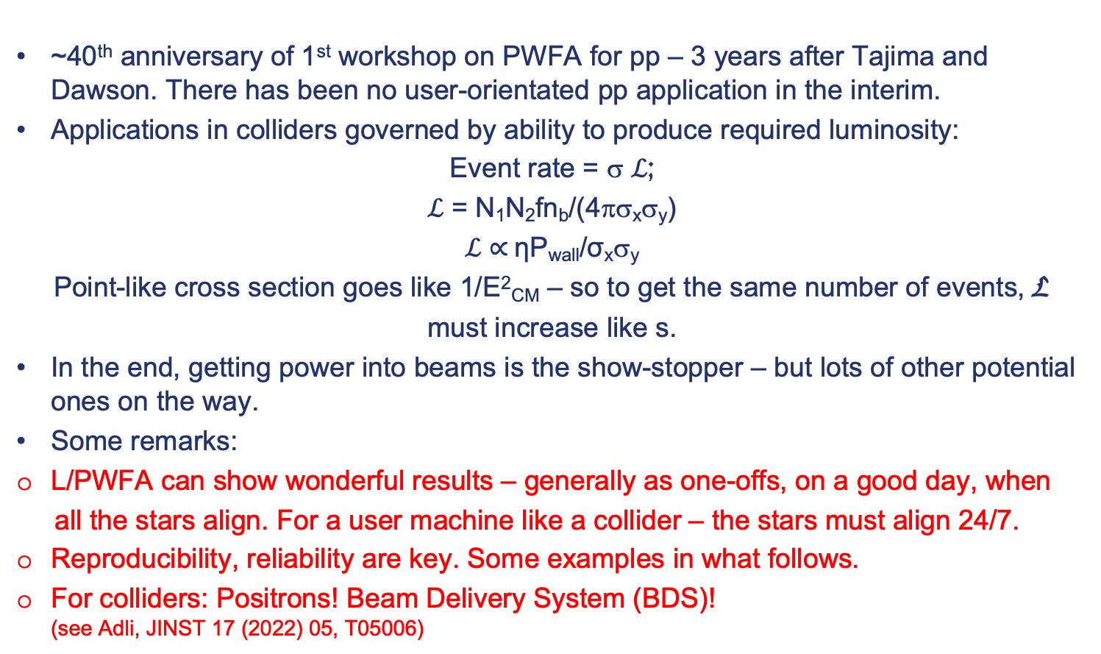
Introduction
~40th anniversary of 1st workshop on PWFA for pp – 3 years after Tajima and Dawson. There has been no user-orientated pp application in the interim.
Applications in colliders governed by ability to produce required luminosity:
Event rate = σ ℒ;
ℒ = N₁N₂fn_{b}/(4πσ_{x}σ_{y})
ℒ $∝$ηP_{wall}/σ_{x}σ_{y}
Point-like cross section goes like 1/E²_{CM} – so to get the same number of events, L
must increase like s.
In the end, getting power into beams is the show-stopper – but lots of other potential ones on the way.
Some remarks:
L/PWFA can show wonderful results – generally as one-offs, on a good day, when
all the stars align. For a user machine like a collider – the stars must align 24/7.
Reproducibility, reliability are key. Some examples in what follows.
For colliders: Positrons! Beam Delivery System (BDS)!
(see Adli, JINST 17 (2022) 05, T05006)

Slide 4
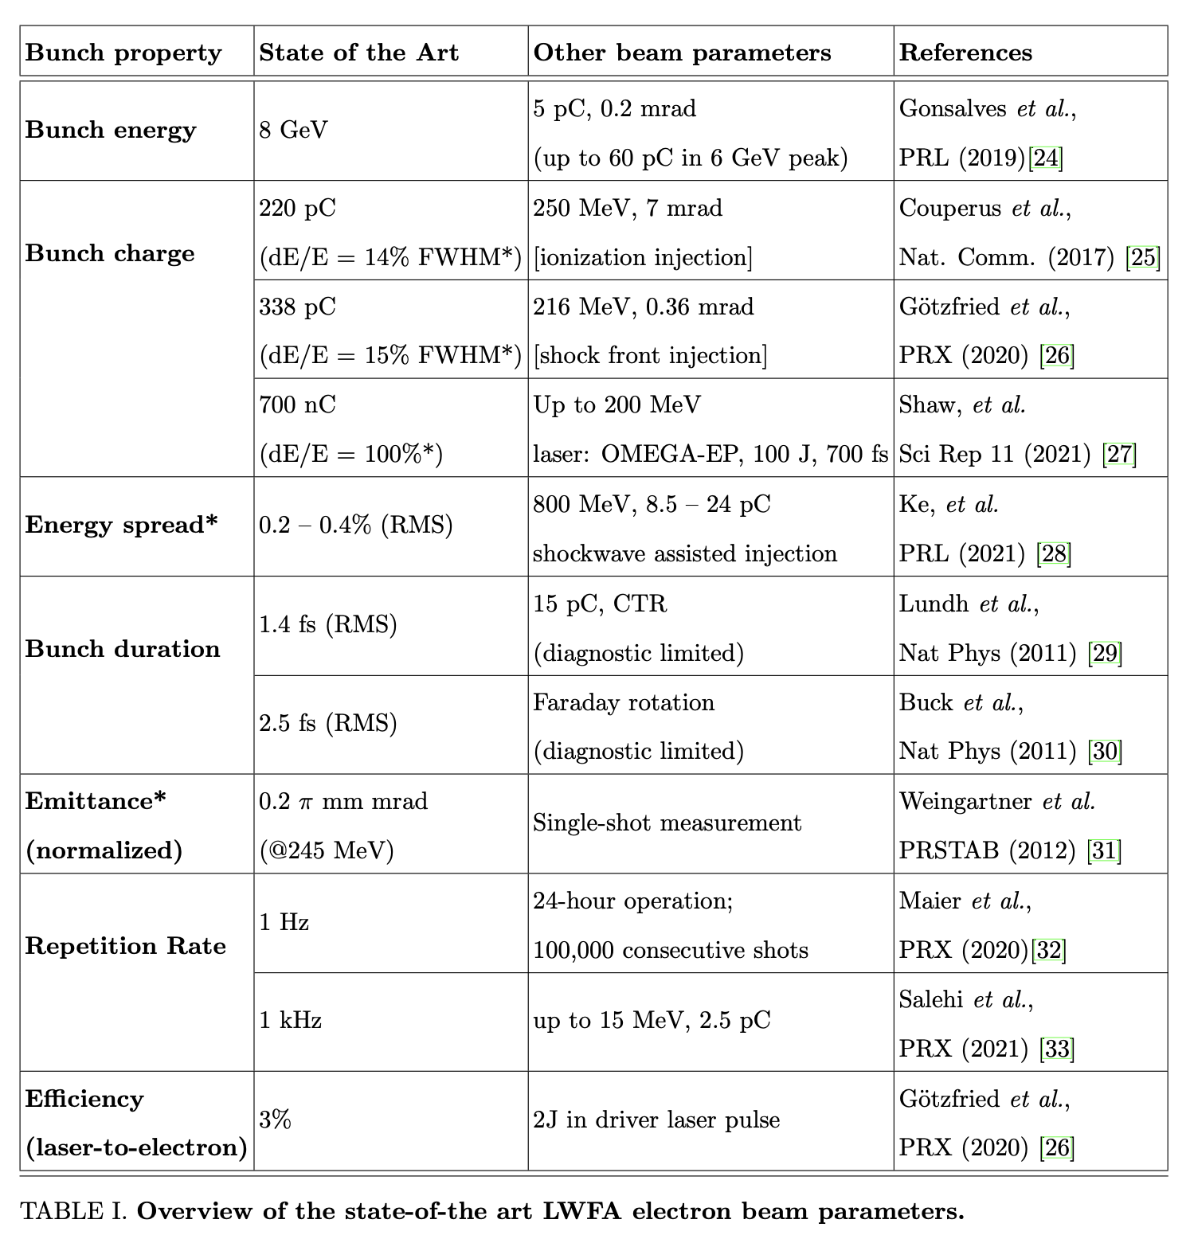
Injectors
An obvious use of L/PWFA – intrinsically tiny “feature-size” promises intrinsically excellent 6D emittance – low energy, no staging required. But archetypically the area where reliability crucial. Some applications need low rep. rate.
What is state of art?
1 nC @ 1Hz
@ 300 TW
Plasma-Based Particle Sources,
Fuchs et al., Snowmass2021,
arXiv:2203.08379
Notes:
Andi’s results at LUX

Slide 5
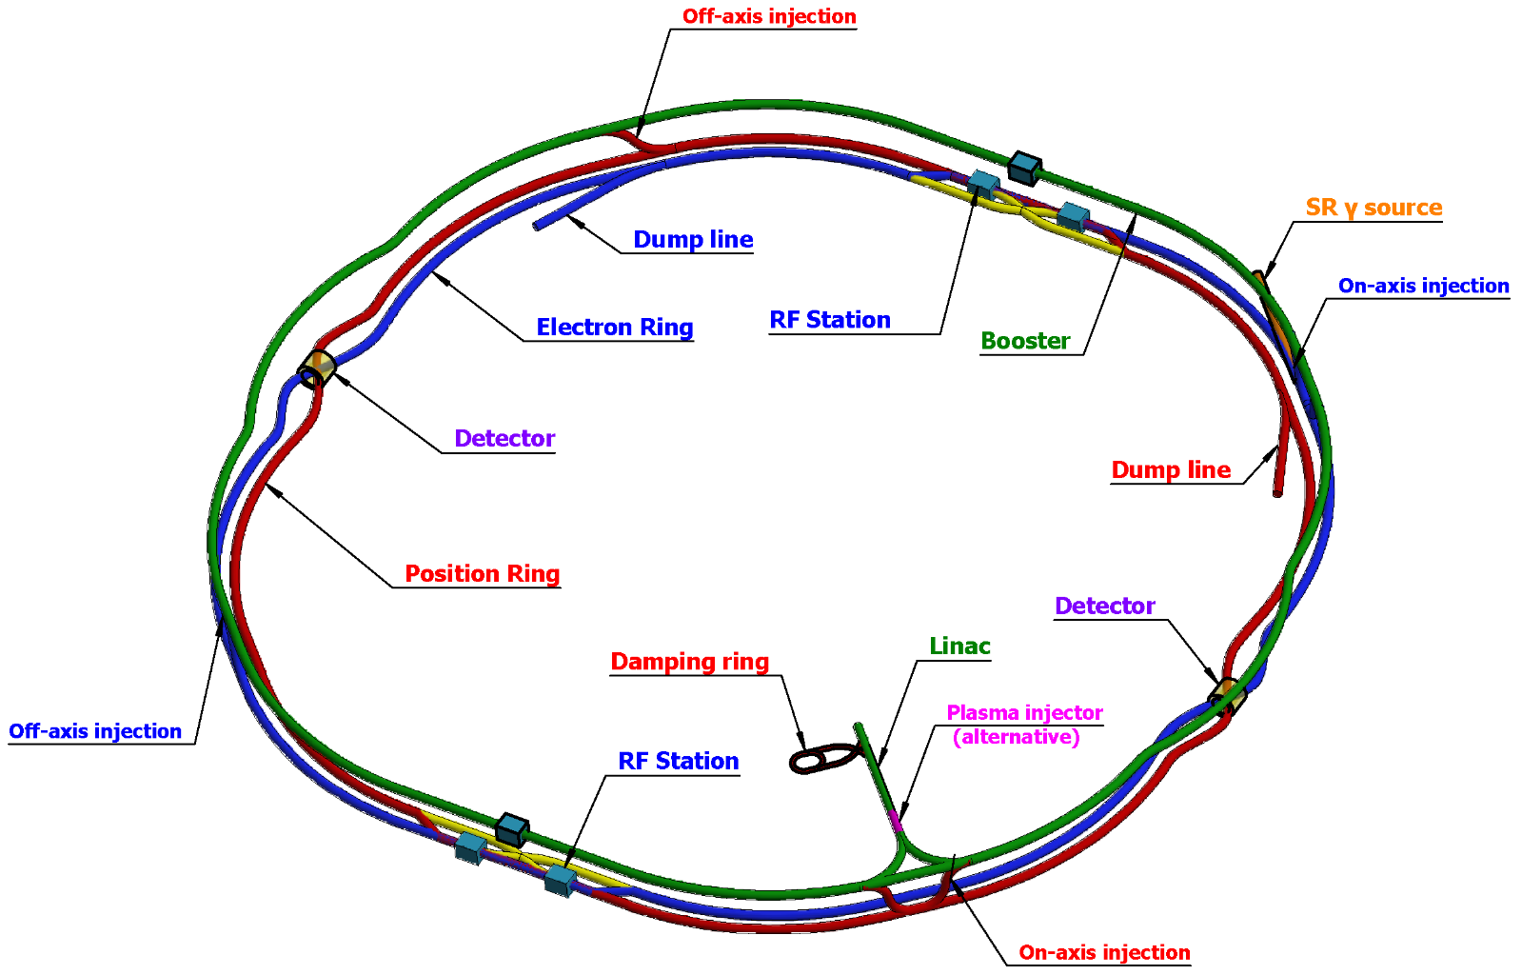
CEPC Accelerator
CEPC as a Higgs (ttbar,H, W, Z) Factory
  Linac, 30GeV, 1.8km
  Full-energy Booster & Collider Rings, 100km each
Notes:
Convergence with FCCee due to Katsunobu Oide

Slide 6
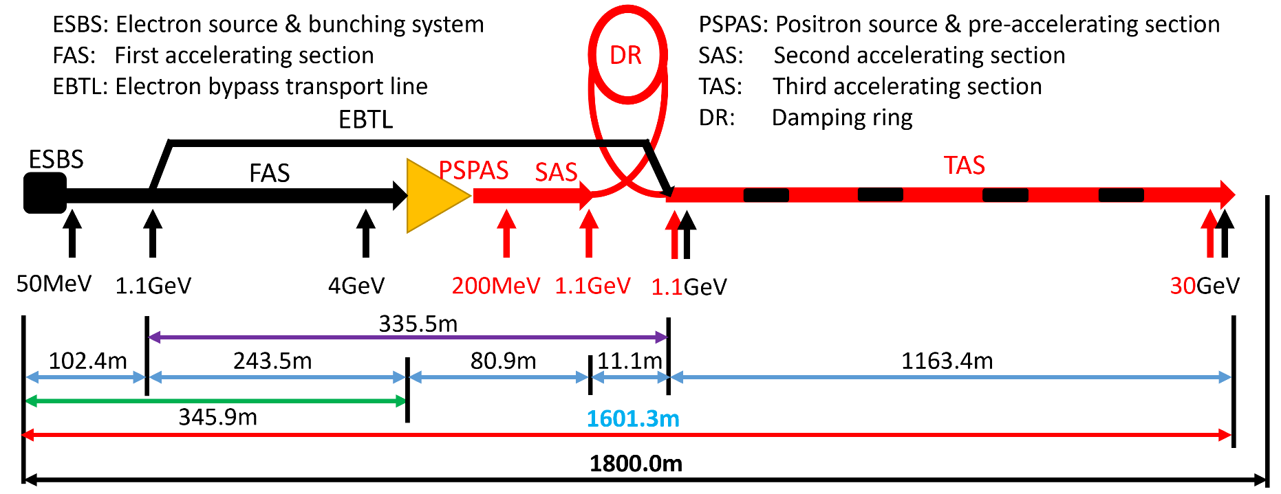
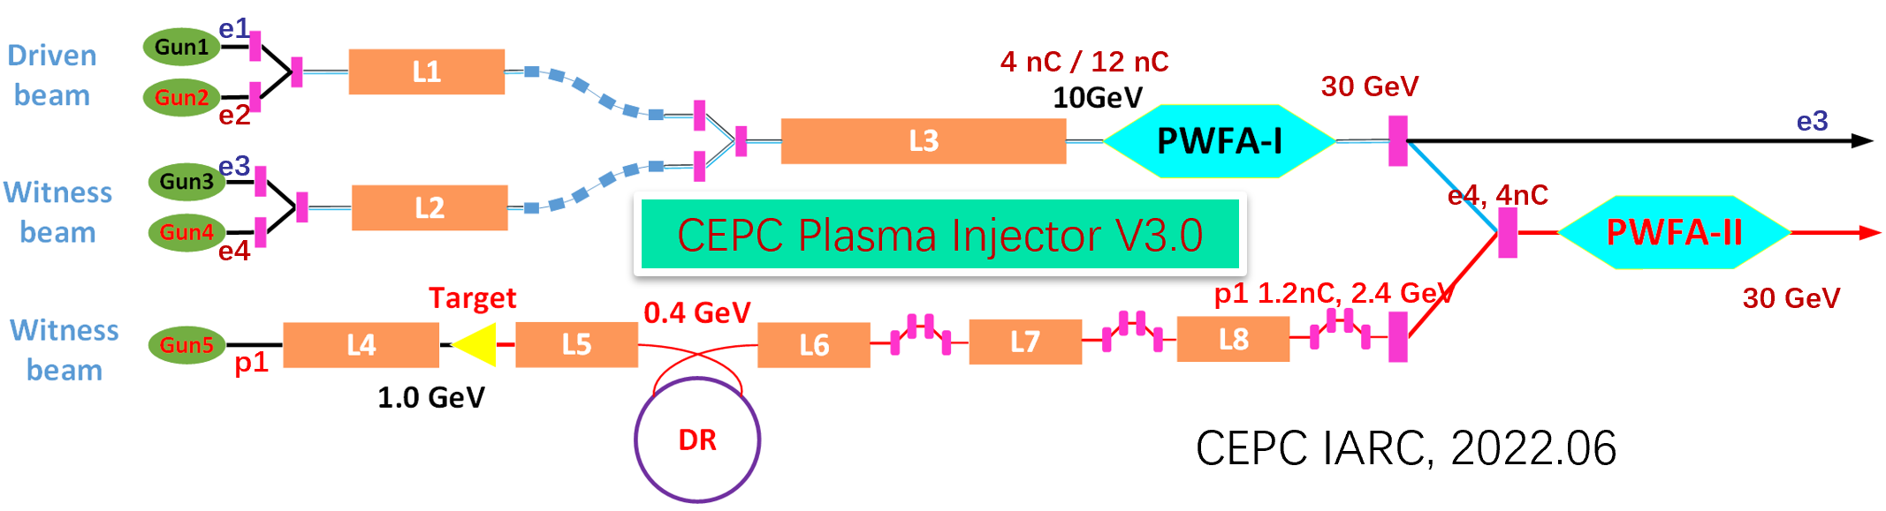
CEPC PWFA Linac
S-band
C-band
Uniquely useful for green-field site – FCCee? No.
But e⁺? Ideas – hollow channels, truncated plasmas etc exist – but currently nowhere to test them.
Not on right time-scale for current CEPC plans
Notes:
Carl recovery

Slide 7
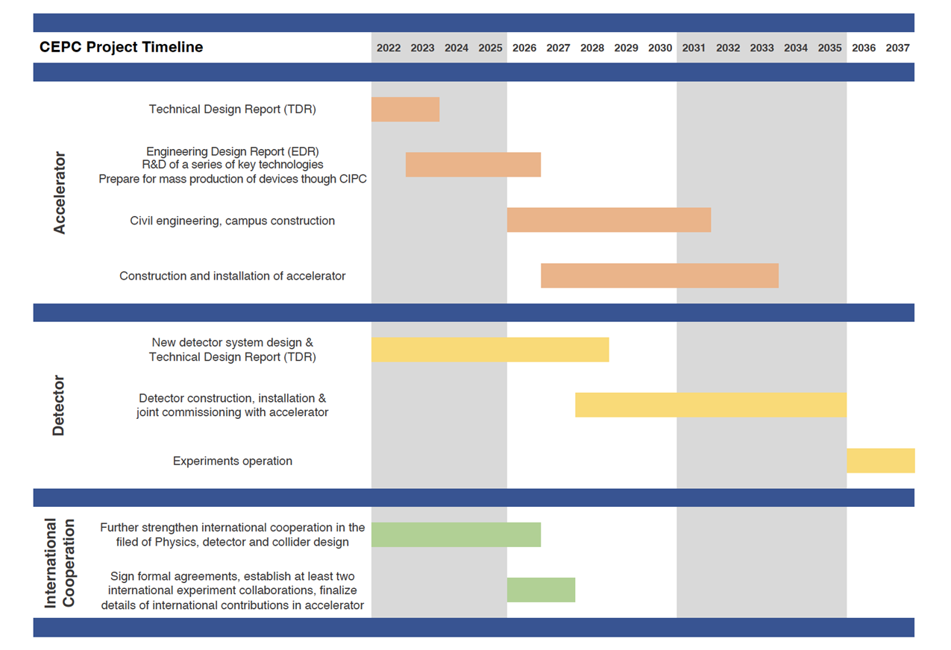
CEPC Timeline
TDR (2023), EDR(2026), start of construction (2027-8)
15th FY
16th FY
Notes:
Carl recovery

Slide 8
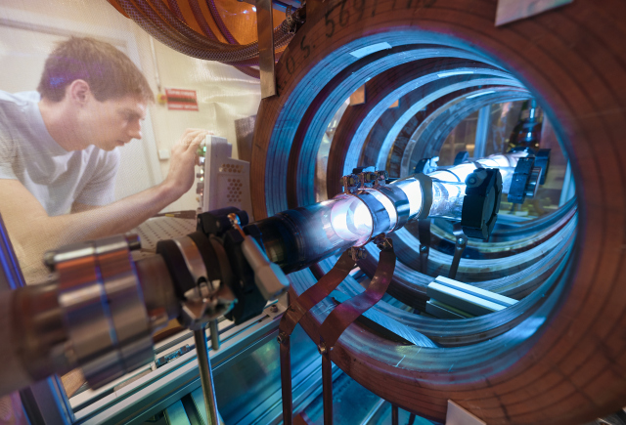
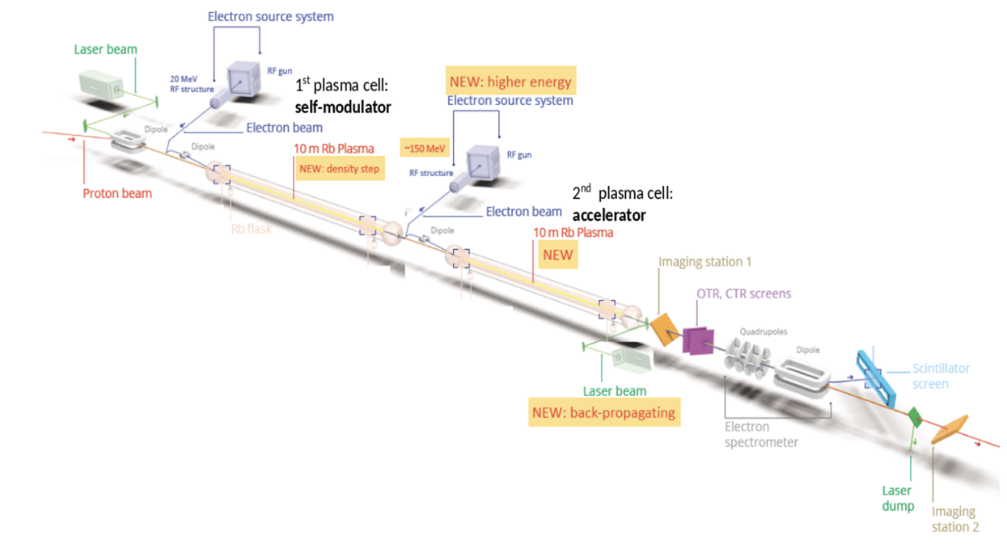
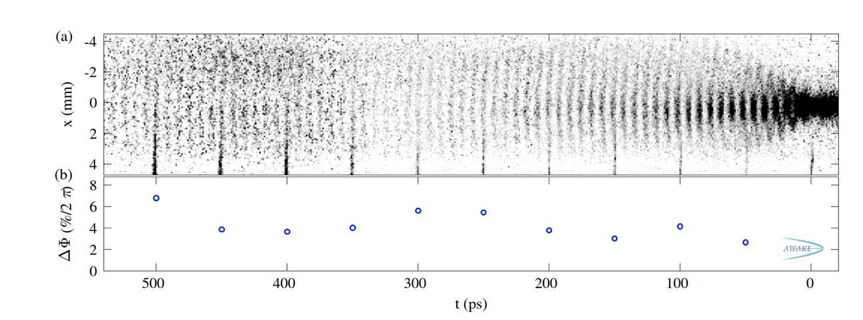
AWAKE
Proton-beam-driven facilitates long plasma cells and reduces/removes need for staging.
Plasma source 10m long, 4cm diameter, density 10¹⁴ – 10¹⁵cm⁻³

Slide 9
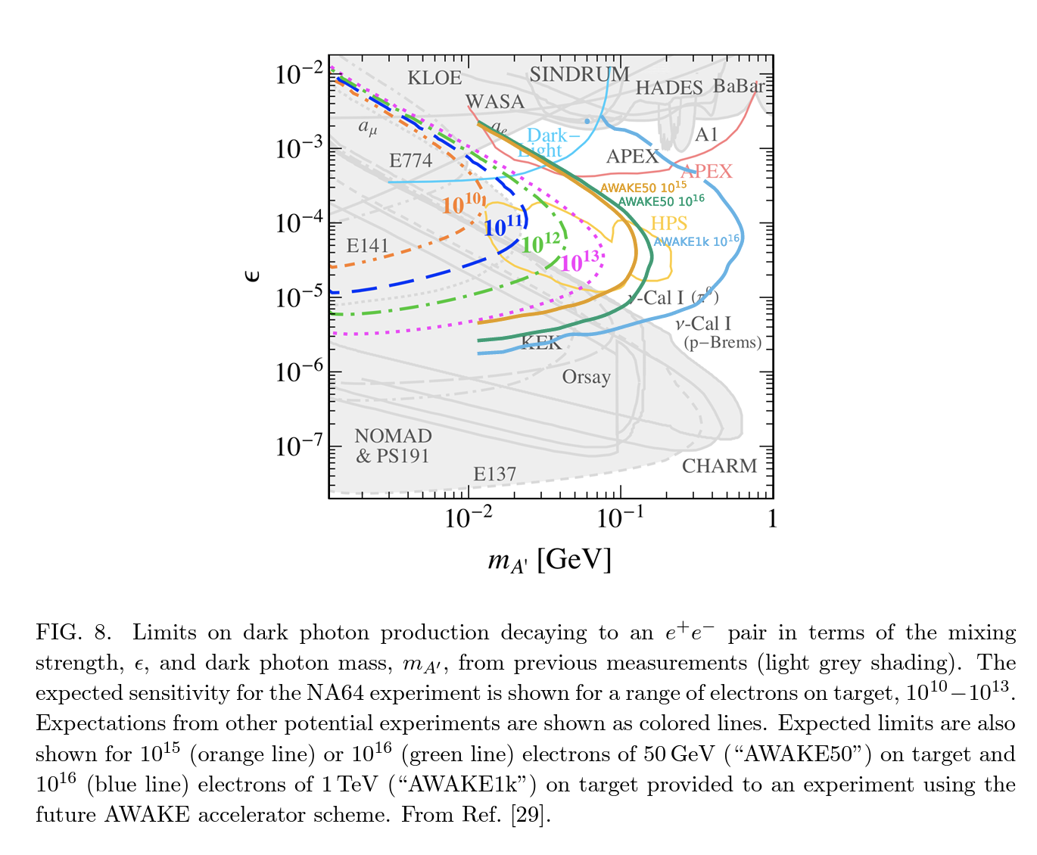
AWAKE Physics
ℒ Limited by p accelerator repetition rate – look for high-cross-section processes to compensate.

Slide 10
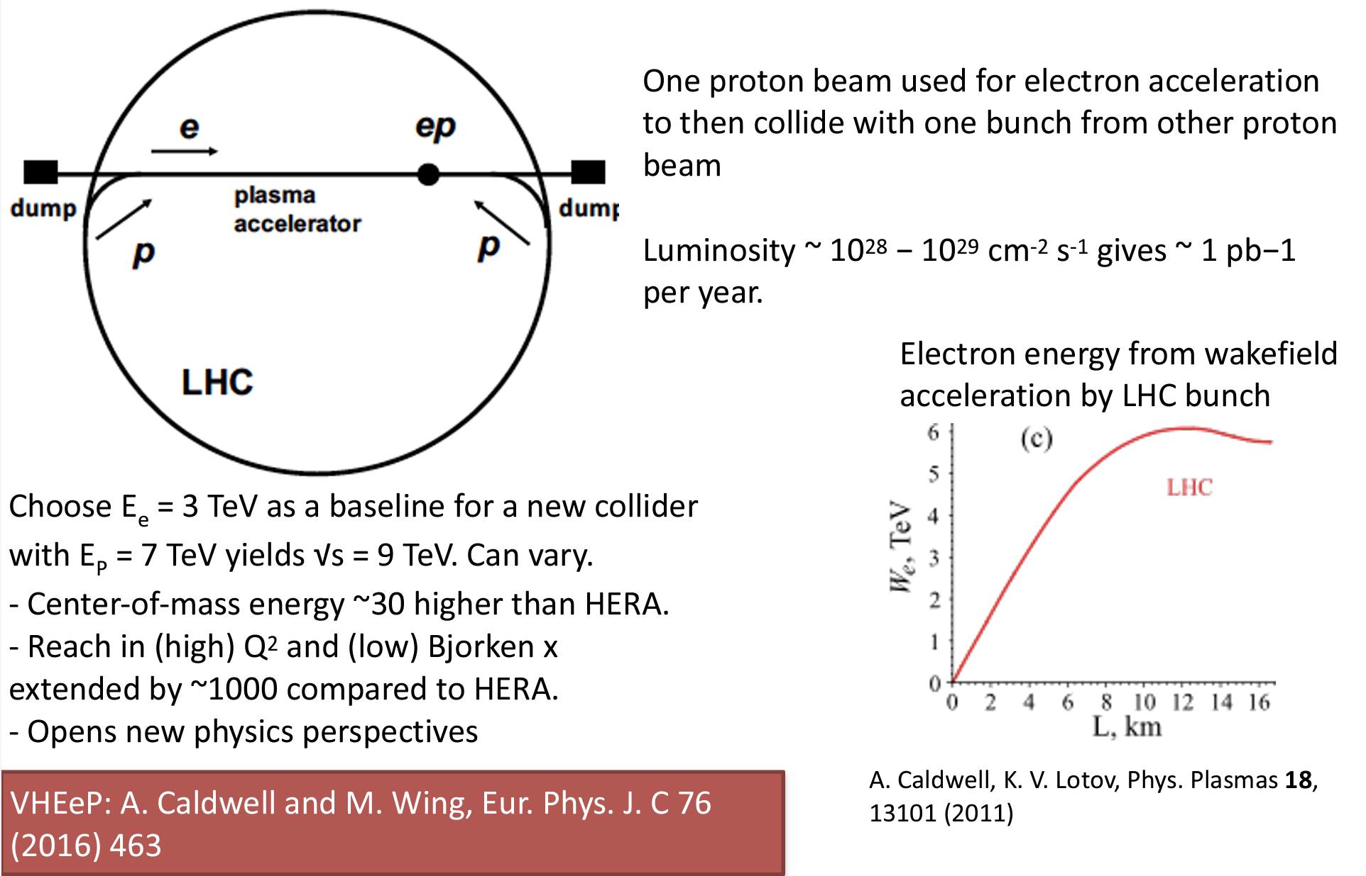
AWAKE Physics -VHEeP

Slide 11
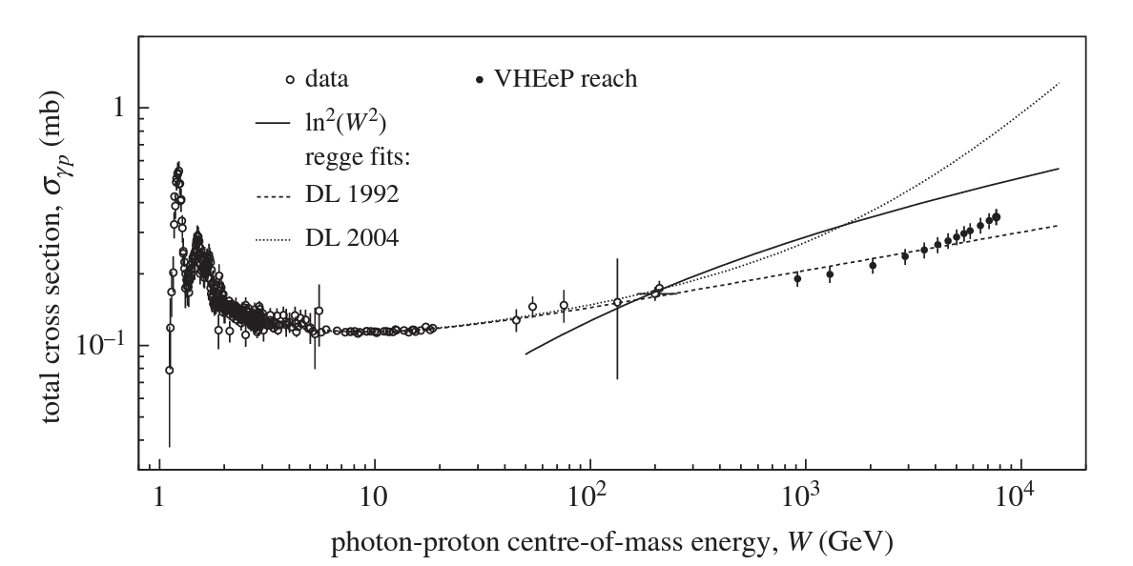
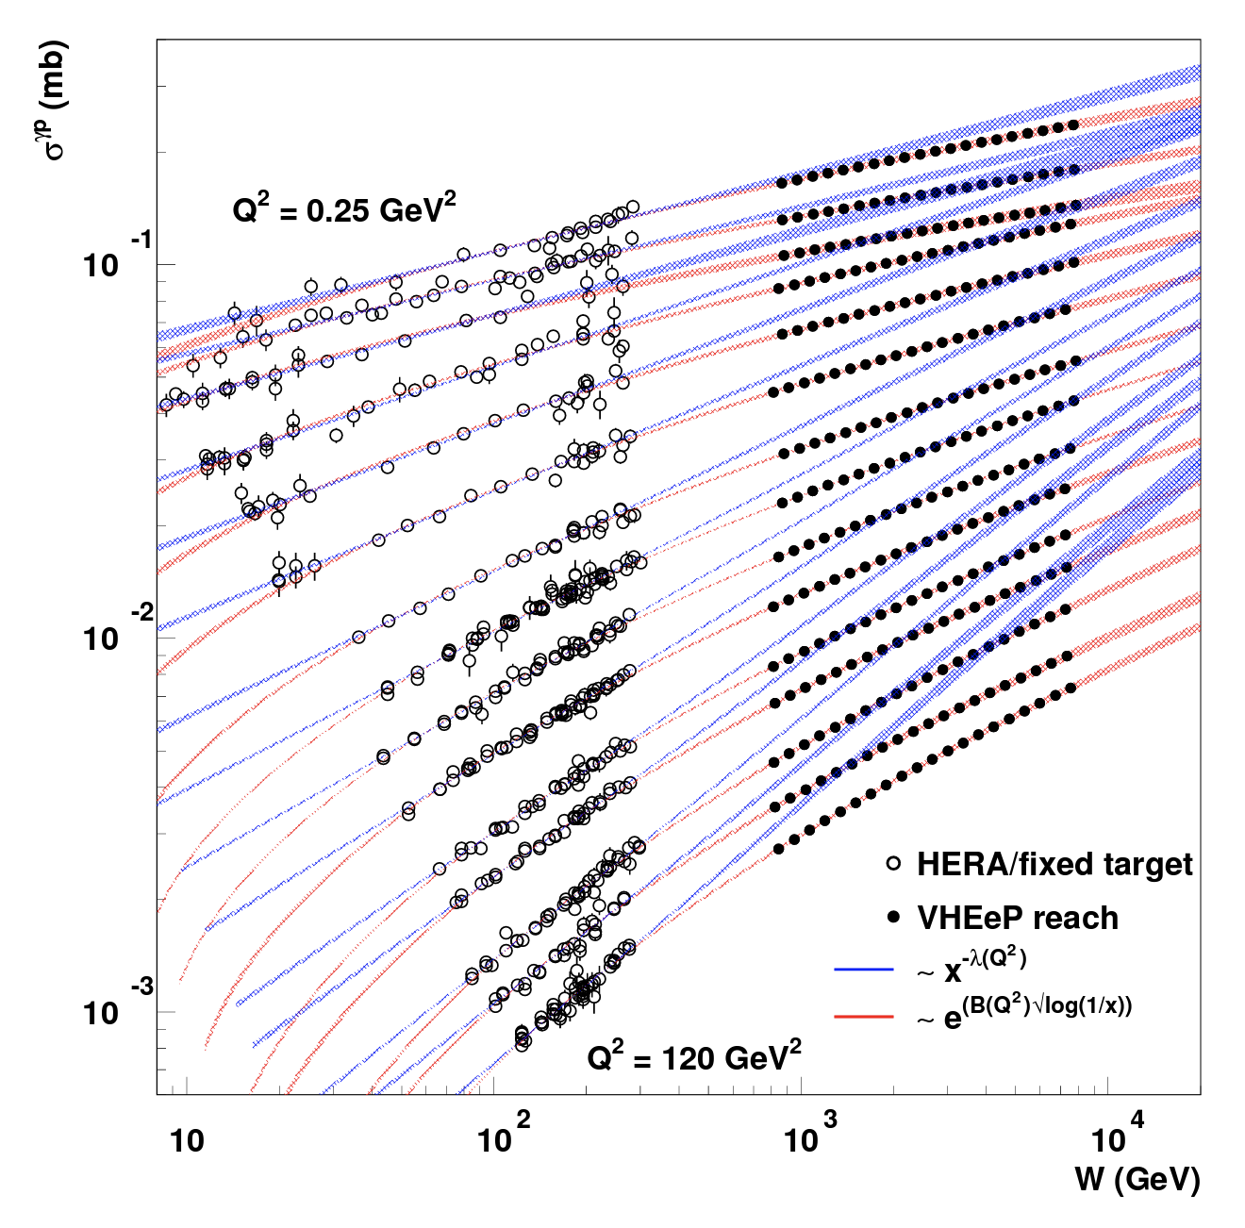
AWAKE Physics

Slide 12
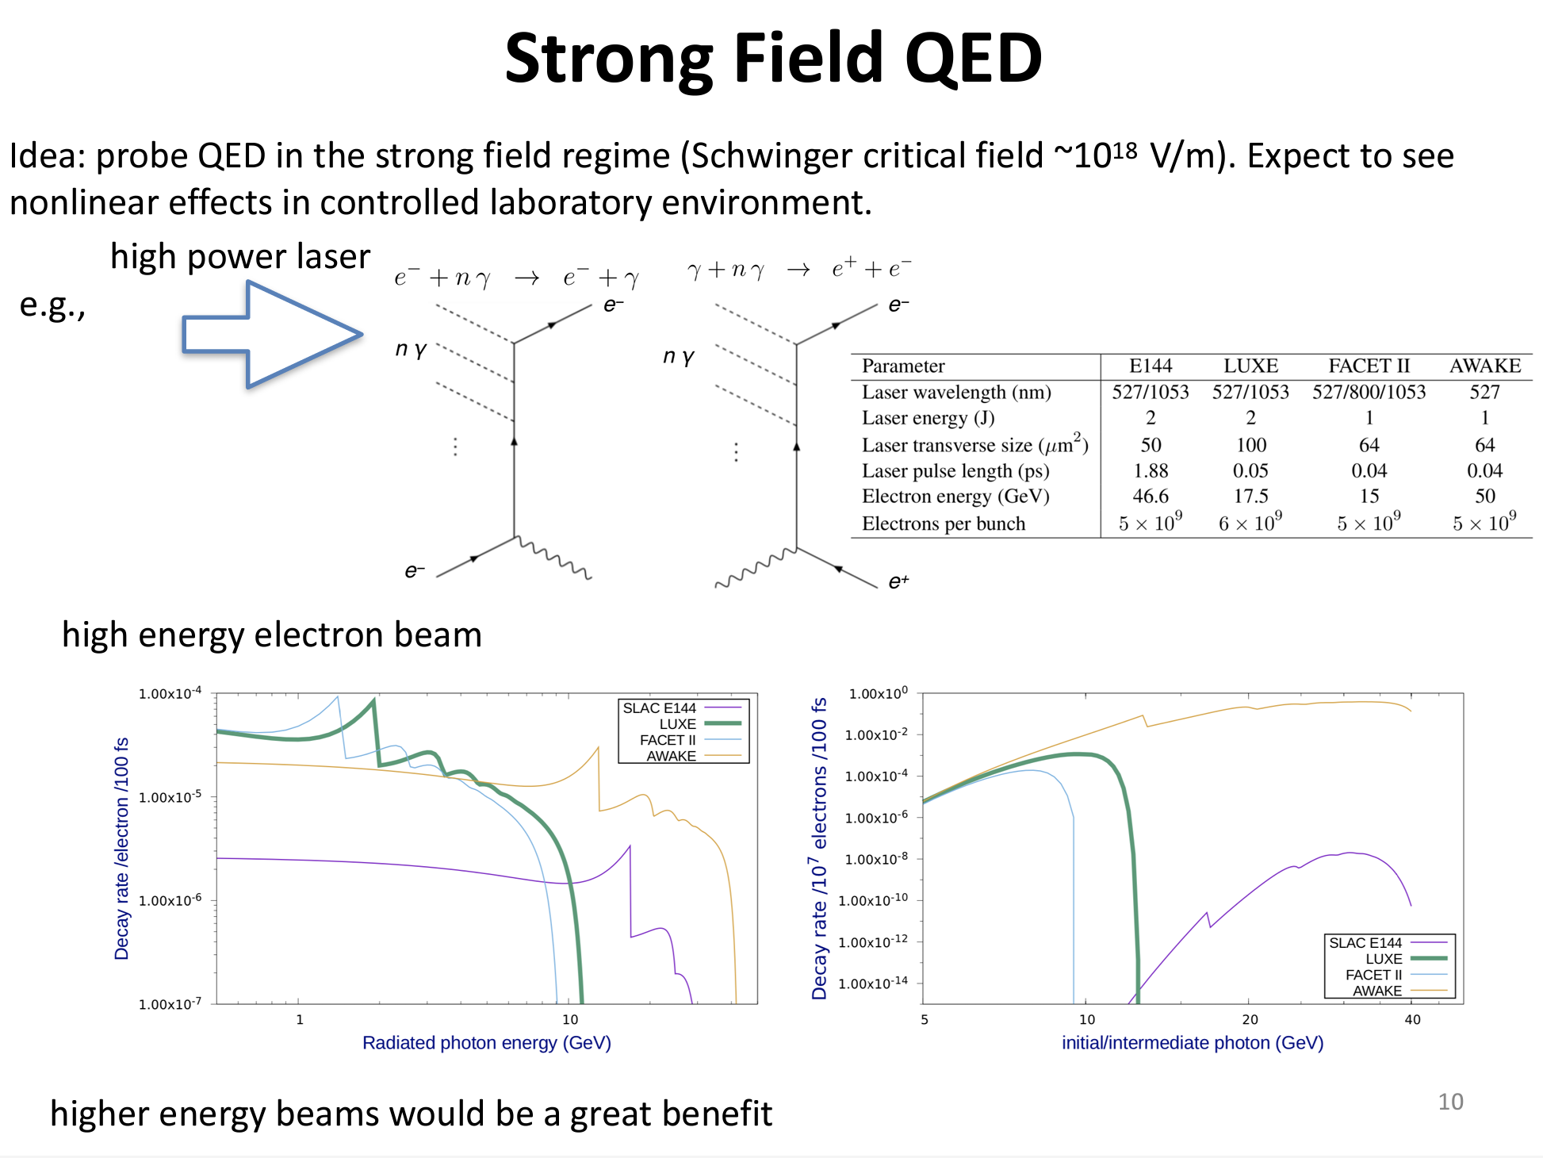
AWAKE Physics –
Strong-Field QED

Slide 13
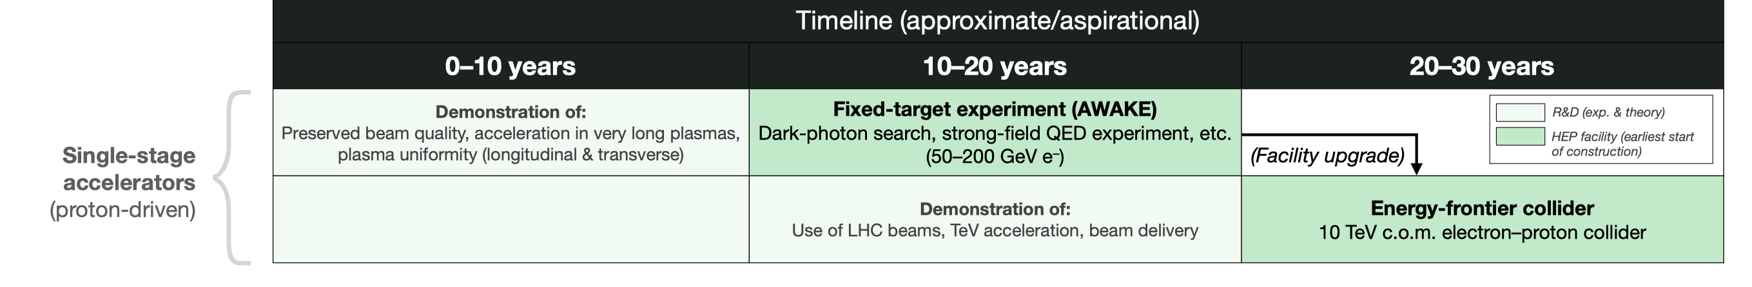
AWAKE Timeline

Slide 14
Strong-Field QED
Critical requirement is high-energy (<~ 100 GeV) e⁻ beam which is a crucial “early” deliverable of any sort of L/PWFA facility.
Also highly useful for pp test beam purposes.
αχ^{2/3}>0.1
QED Cascades
and pair plasmas

Slide 15
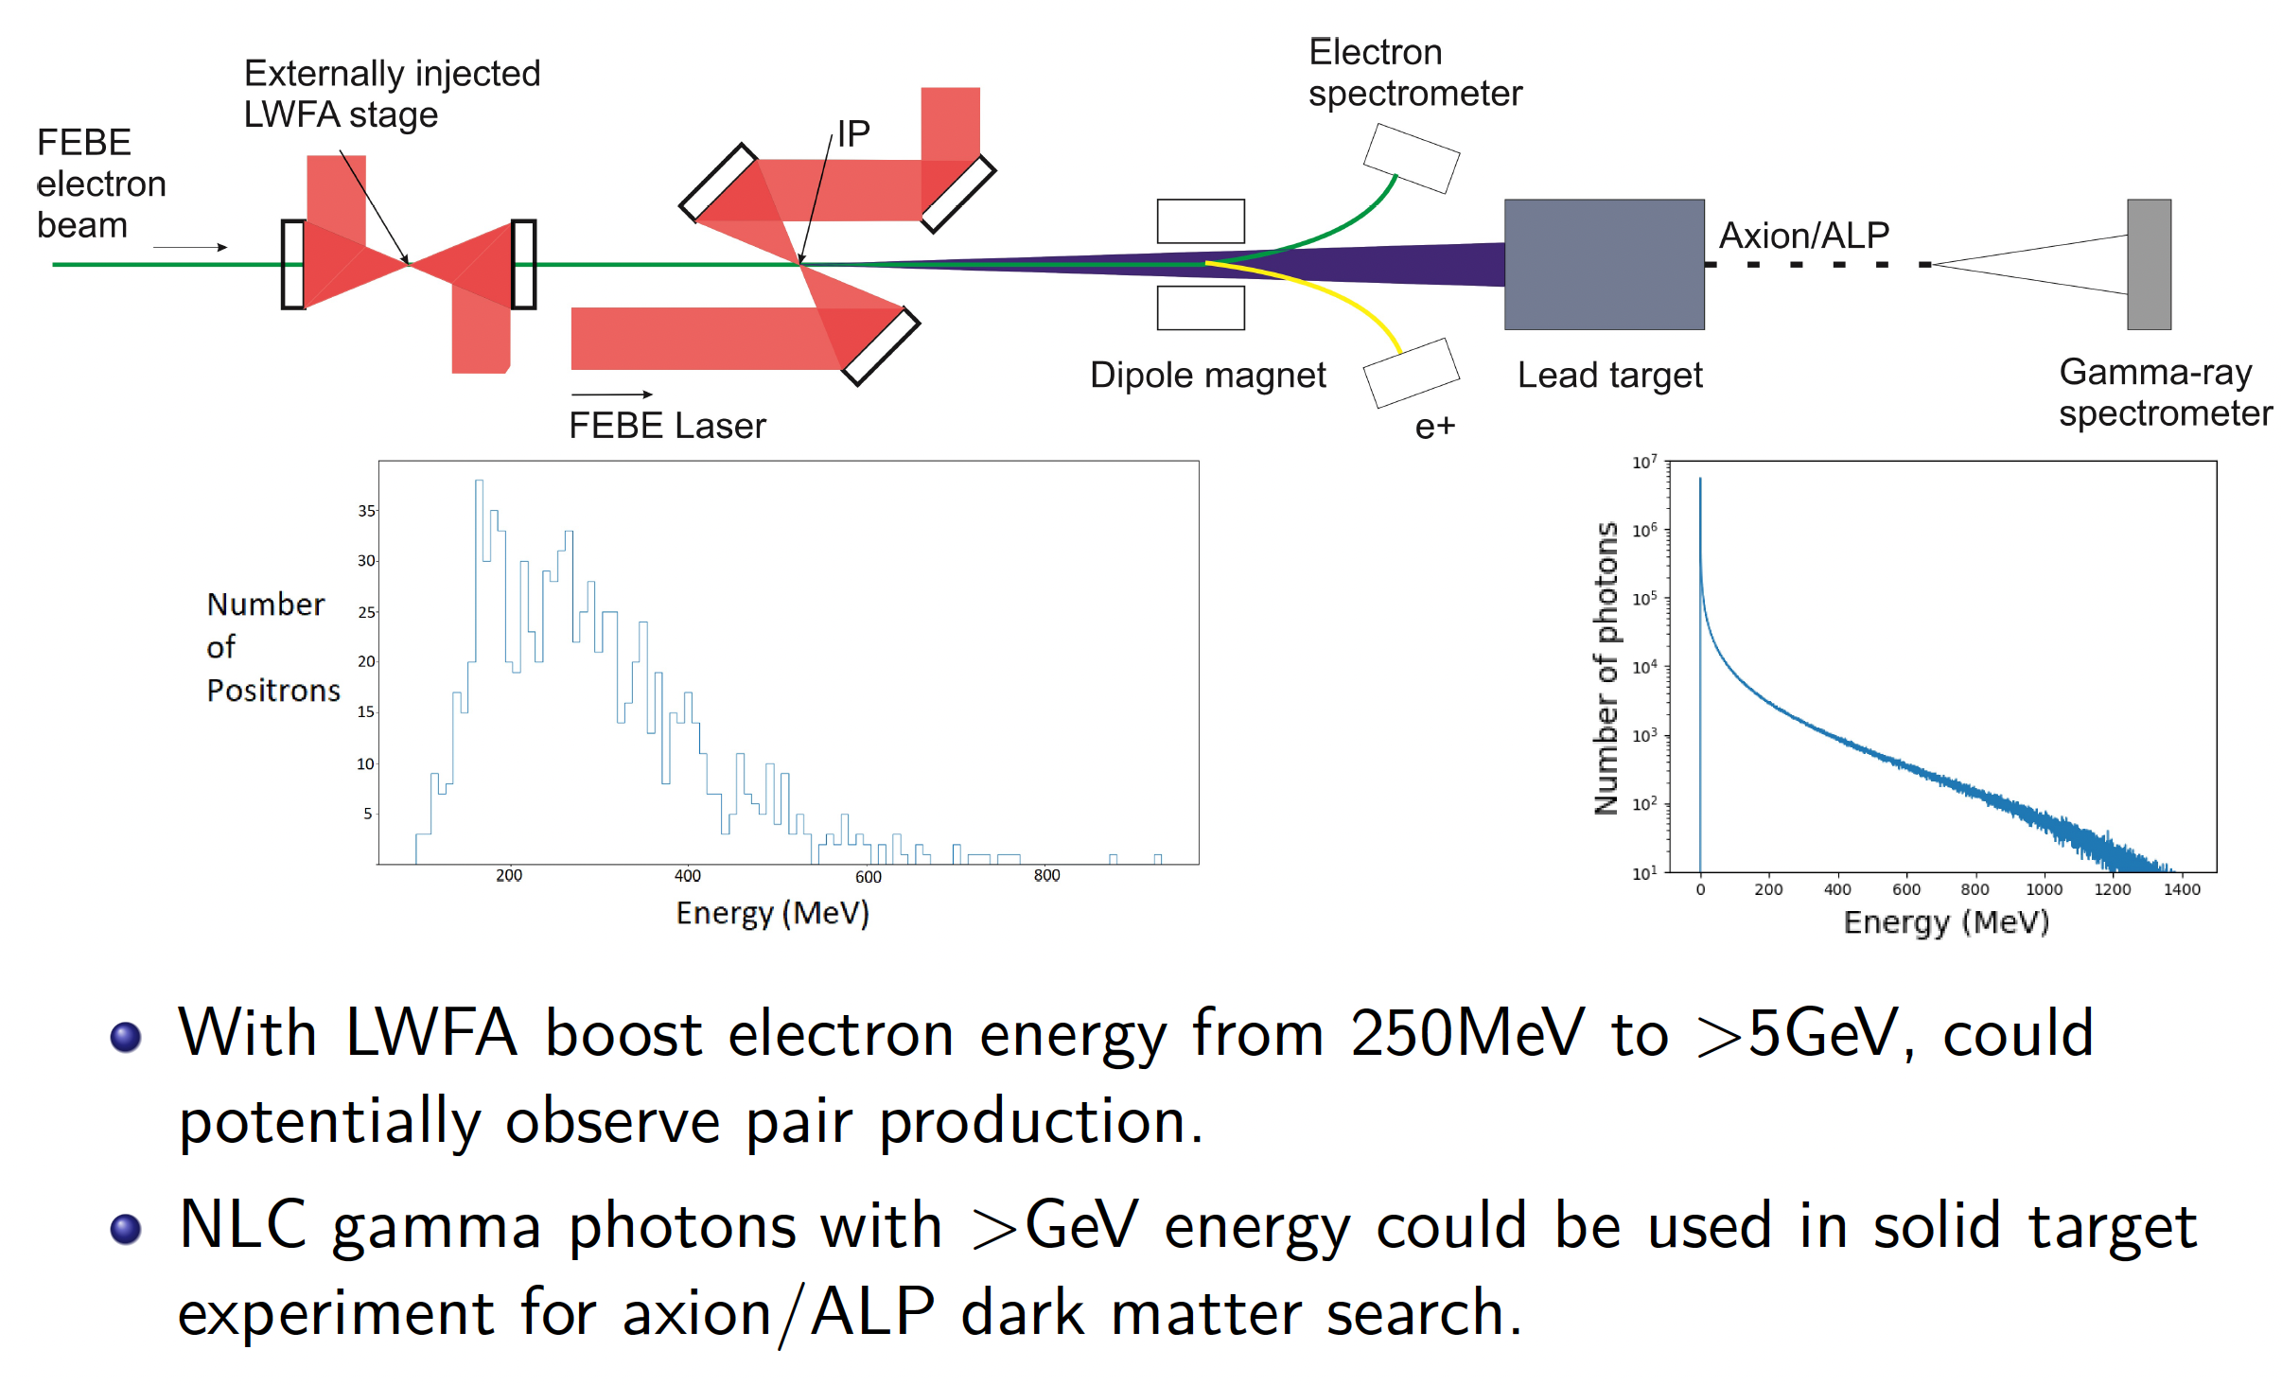
Strong-Field QED
Work at CLARA at Daresbury on LPWA-driven electron booster for SFQED.
(thanks to M. Radford (Liverpool))

Slide 16
Strong-Field QED
C. Lindstrøm ERC proposal – highly relevant for HALHF R&D – Multistage plasma-accelerator facility for strong-field QED experiments.

Slide 17
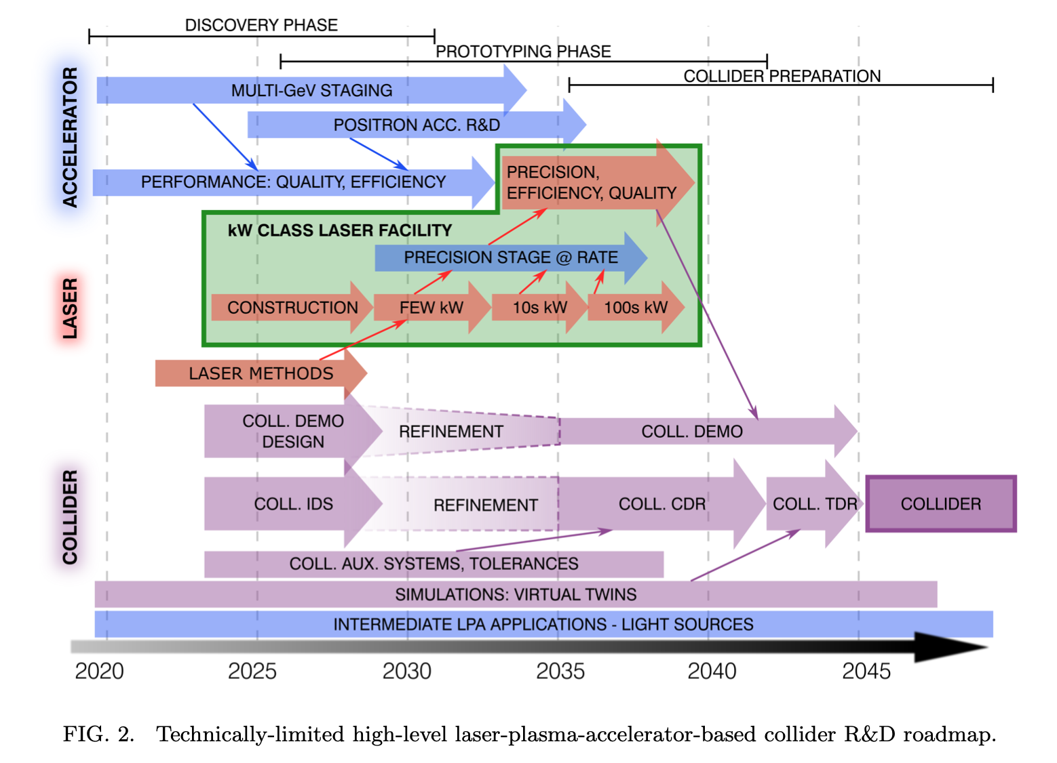
LWFA Colliders
Benedetti et al.,
arXiv:2203.08366 –
Snowmass21 contribution

Slide 18
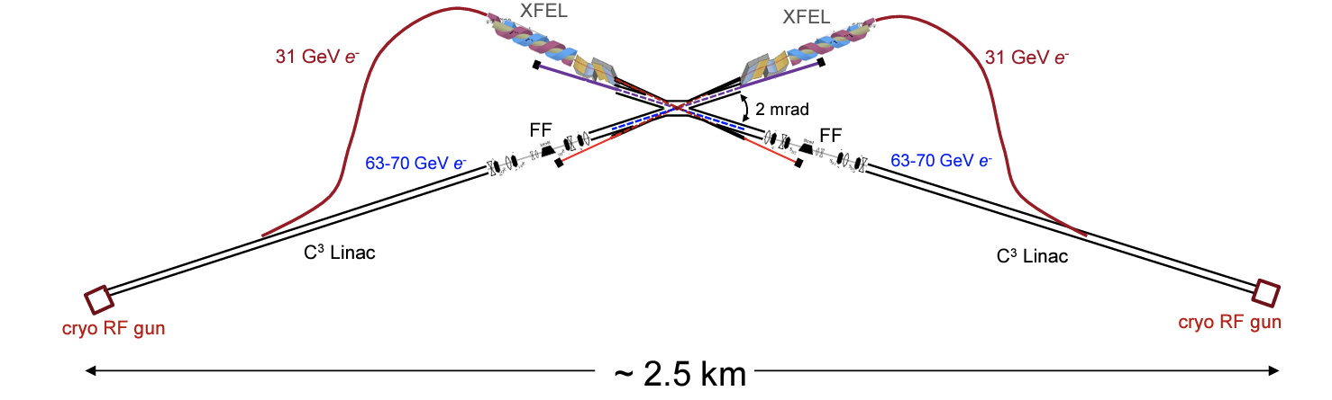
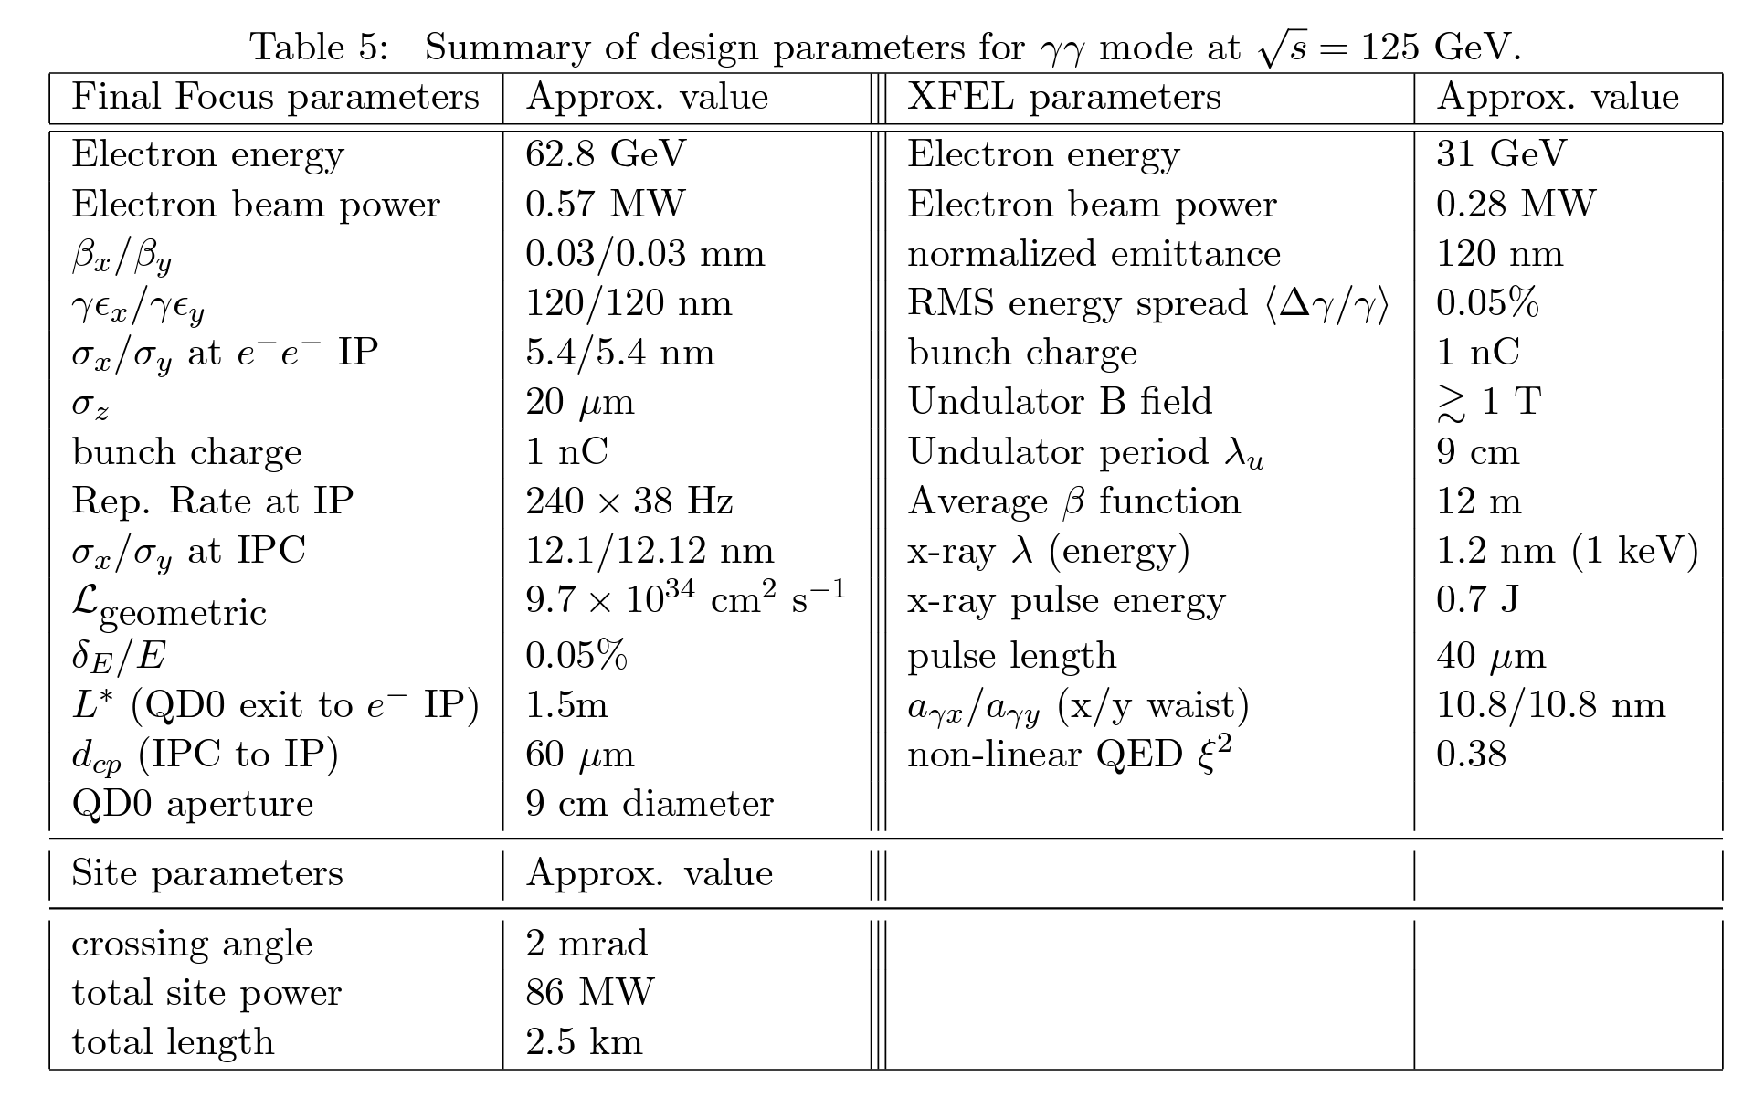
X-ray FEL-based γγ Collider
Higgs Factory
Technology is C³ @ 70 MV/m
Barklow et al,
arXiv:2203.08484
Snowmass21
See also
Barzi et al,
arXiv:2203.08353
Snowmass21;
Adli, JINST 17 (2022) 05,
T05006
Round beams may increase experimental backgrounds;
Beta functions highly challenging –
- tolerances!
But “easy” to imagine replacing
with PWFA –
Notes:
One way to avoid the positron problem is gamma-gamma – and cross section goes up like log s – also different sensitivity to various SM processes.

Slide 19
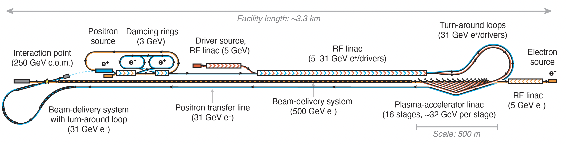
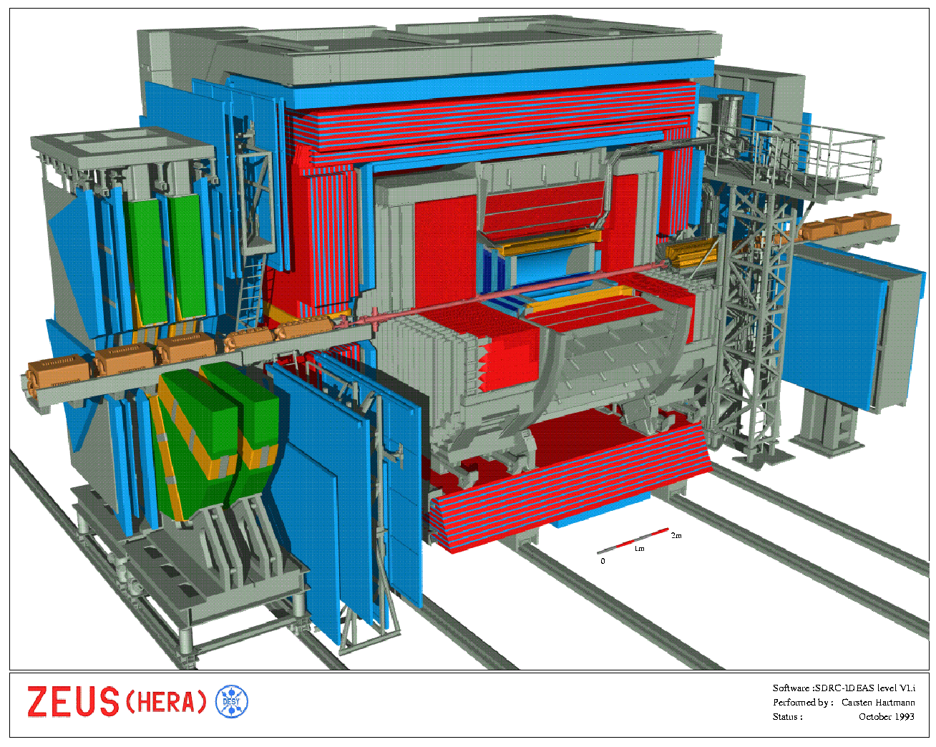
Experimentation at HALHF
Boost is smaller than
HERA - HERA detectors
very similar to those at
symmetric machines.
Also H & Z heavy, so
anyway more
homogeneous.
Measurement of L via
Bhabha (e⁺e⁻ -> e⁺e⁻)
- rate reduced by
1/(θγ)² & e⁺ scattered
into barrel – but not a
problem. Singles rate
good for machine
optimisation

Slide 20
HALHF Concept
Some preliminary physics studies from Mikael
Berggren (DESY)
with ILD detector for Higgs production
Higgs mass from e⁺e⁻ HZ
ILC (symmetric)
HALHF
HALHF (long barrel)

Slide 21
Project Staging
Any project of this size and scope needs a ~10% prototype. A few cells producing useful currents of e⁻ at few 100 GeV would be very interesting for SFQED.
Once satisfactory performance demonstrated, remaining elements can be constructed and then running at Z can be used to tune up machine and detector.

Slide 22
Upgrades (1)
HALHF not competitive in L with circular machines at Z and gets more expensive and complicated at high E. Keep e⁺ energy same increases γ as E increases – experiments more and more difficult; increasing e⁺ energy to keep γ ~ constant gives expensive linac.
However, getting to ttbar threshold with same e⁺ energy => E(e-) ~ 1 TeV and γ ~ 2.9, still less than at HERA.
Alternatively, keeping γ constant by lengthening conventional linac (space allocated and tunnel built already in anticipation) needs E(e⁺) ~ 44 GeV and E(e⁻) ~ 700 GeV.

Slide 23
Upgrades (2)
γ − γ collider also avoids e⁺ PWFA acceleration. Switch out e⁺ source and construct another PWFA linac.
Produce e⁺ polarization via ILC-like scheme. Needs design work but experts say that this should be possible.

Slide 24
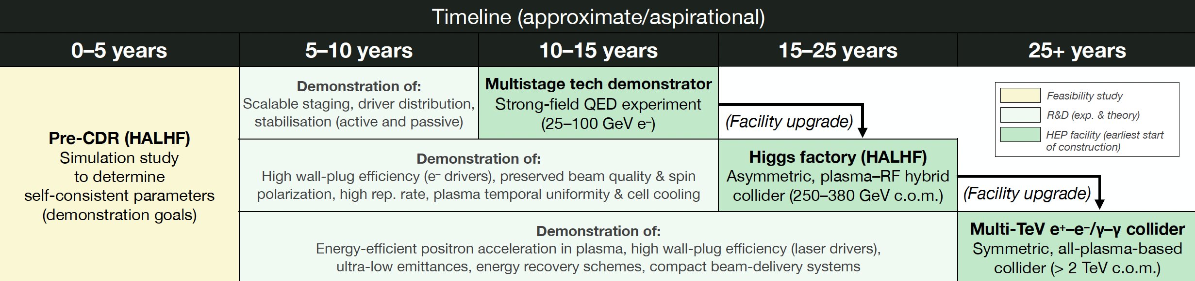
HALHF Timeline

Slide 25
Summary
Progress on application of L/PWFA to pp, but so far no application in the real world.
Afterburners etc. have to accept beam parameters from conventional machines.
3T & 7.6m
24/7 reliability! Long periods – weeks - of stable operation.
High power/repetition rate/efficiency. Shorten BDS – plasma lenses?
Positrons! Some distance from solution applicable to a real machine. R&D needs FACET-II. Bejing IHEP facility?
Near-term physics applications from AWAKE.
HALHF promises for first time a credible PWFA Higgs factory – requires ~ 10-year R&D both conventional and L/PWFA.
If R&D successful after decade, multistage demonstrator leads to HALHF - could be operating before many other HF proposals.

