Slide 1
RF Achievements and Plans
Giovanni Bisoffi-INFN, Peter McIntosh-STFC and the RF Implementation Panel
Community Report on Accelerators Roadmap
12–13 Jul 2023
INFN Frascati National Laboratories

Slide 2
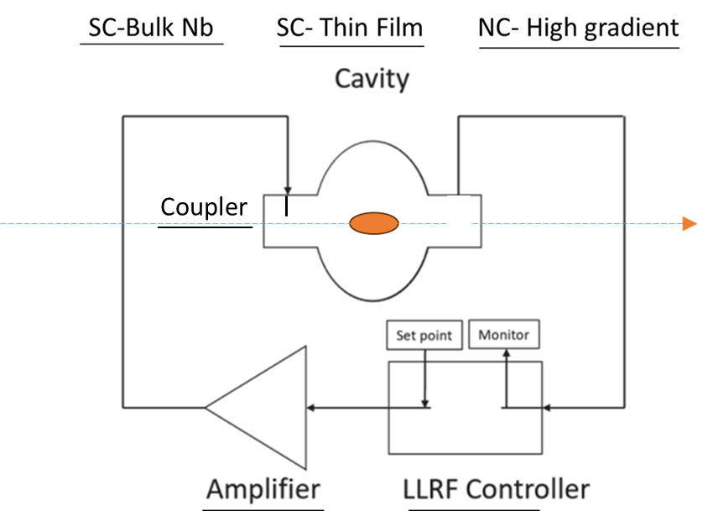
RF = increase beam energy efficiently and reliably
Per year: 10 M€, 90 FTE (nominal, ~30% higher than actual - ref. Accelerator R&D strategy)
Notes:
Including: 3 M€ and 18 FTE in 5 years for MC test stand (obsolete)

Slide 3
Progress/plan of the LDG RF Implementation Panel
From the RF Roadmap (Nov22 – Mar23):
update future accelerator needs and RF goals, special attention to sustainability (Nov22 – Mar23)
Consult national teams (Apr23 – Oct23):
through ad-hoc surveys, at workshops, town meetings etc
Follow-up technical progress
Pinpoint weak areas, duplications, needed infrastructures, funds, personnel
Demonstrate RF improvements and impact on regular basis (from Apr23):
to LDG and accelerator community
at conferences, workshops, reviews;
at forums, town meetings; to CERN SPC and Council
on websites, social media, brochure, through impact studies, through slide decks.
Strengthen or develop existing, new communities (from Nov23):
to address specific performance requirements
Explore funding routes:
National, EU (e.g follow-up of I.FAST); project-related, R&D-activities
Coordinate with ERL and MC panel and international efforts (from Apr23):
ERL - Integrated into the Horizon Europe - Innovative Sustainable Accelerator Systems (iSAS) proposal.
MC - Focus on infrastructure for RF breakdown studies under strong magnetic field (WG4, WG5)
Snowmass-P5, EIC
Notes:
MC: this infrastructure (Graeme is comparing the test stands, as an exercise with proponents), plus related cavity design and RF Power Source items

Slide 4
Outline
Review of the R&D effort from each working group
WG1
WG2
WG4
Blue board
Needs of future colliders in terms of RF performance
White
Status and technical progress
WG3
Yellow board
Hints for the funding agencies – what to invest on...
the take-home message
WG5
WG6

Slide 5
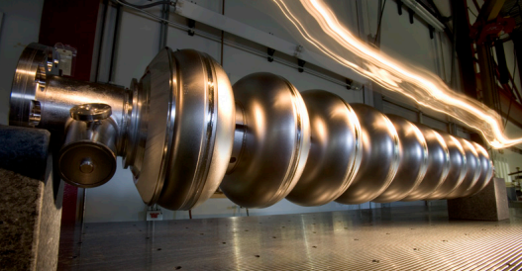
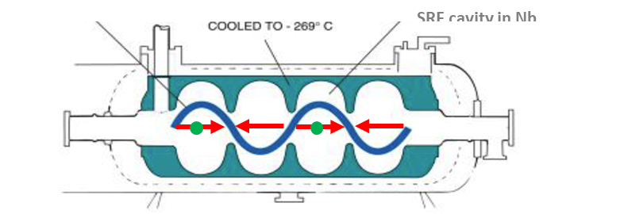
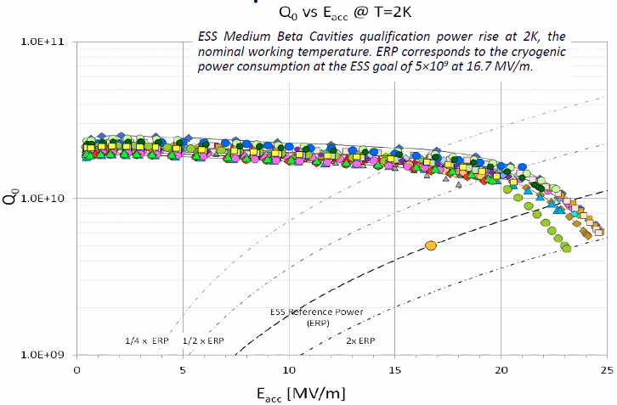
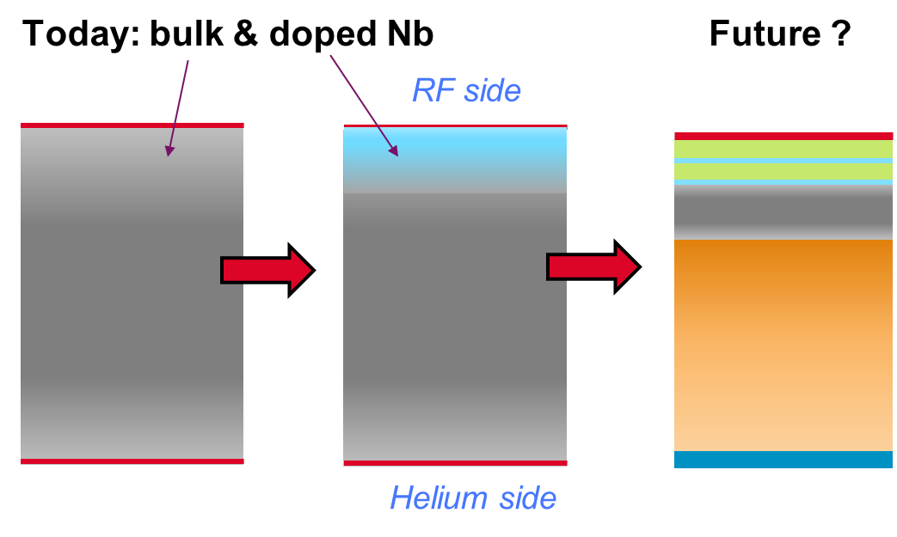

WG1-2: RF Cavities: reduce operational cost (Q₀ ↑) and capital cost (E_{acc} ↑)
Cavity types – mostly elliptical: 1.3 GHz (3.9 GHz), 802 MHz (401 MHz), 704 MHz (352 MHz), 650 MHz (325 MHz).
(mature)
Niobium (T_{c}=9.2K, T_{cryo}= 2K is mandatory)
E_{acc} > 40 MV/m, Q₀ > 10¹⁰ - 35% saving in P_{ele,cryo};
Theoretical limits close? ≤ 57 MV/m s.h. ….
Thin films (higher-T_{C} materials)
E_{acc} x 2 higher than Nb (≤100 MV/m); Q₀>10¹⁰ at T_{cryo}=4.2K (66% saving in P_{ele,cryo}) – 40% cryo-plant cost saving (cryocoolers?))
P_{diss, ref}
$Q_{0}=\frac{2πf_{0}U}{P_{diss}}$ vs. E_{acc}
NEEDS:
Higher E_{acc}
ILC – higher E_{acc} ⇒ smaller linac (= lower capital cost)
MC – quick acceleration (vs μ-lifetime)
FCC – fewer cavities ⇒ smaller RF installation
Higher Q₀
FCC, ERL, ILC – lower RF losses, cryogenic power minimised.
Others: Reproducibility, cost, industrial manufacturing
(R&D goal)
Notes:
cryogenic power reduced by factor > 2 with high measured Q₀
Grassellino: we discover that the addition during the mild bake of a step at 75deg for few hours, before the 120deg, increases systematically the quench fields up to unprecedented values of 49 MV/m.

Slide 6
WG1: Niobium cavity R&D progress
R&D DIRECTIONS:
1.`Further increase Q and E_{acc}: in the last years surface polishing (HPR, BCP, EP), surface treatment (N doping), heat treatments (low/mid/2-step baking, H degas).
2. Improve reproducibility of high-E_{acc} fields: Reduce contamination during assembly (E_{acc} , field emission-FE) via robots in clean room, in-situ plasma processing.
3. Reduce the cost
From-Fine-to-Medium Grain: material 35% cheaper, full cavity 5% cheaper.
4. Risk of losing manufacturing capability?
Few Nb suppliers (1 in China, perhaps 2 in Japan/USA).
Few cavity suppliers (2 in Europe, 2-3 in China, 1 in Japan) – for future machines, must maintain SRF technology skills in both labs & industry.
Need to invest in industrial processes (Eu-XFEL - 800 cavities ➔ FCC – ~1000 cavities, ILC - 8000 cavities).
Labs involved - CERN (CH), CEA and IJCLab (F), DESY, HZB, Hamburg-Uni (D), INFN (LASA, LNF, LNL), STFC (UK)
Notes:
medium grain : grain size < 1 mm; large grain : grain size >> 1 cm

Slide 7
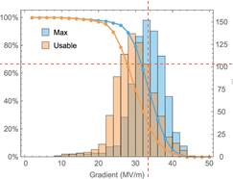
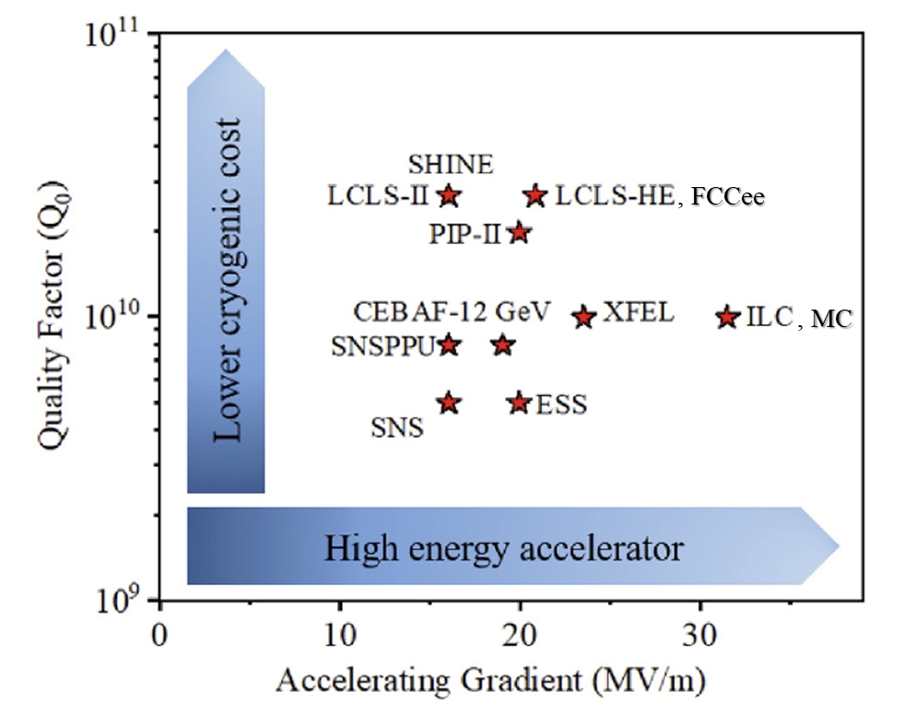
WG1: Niobium cavity R&D goals & direction
Most R&D benefits several future PP
colliders (FCC, MC, ILC, ERLC)
HINTS FOR THE FUNDING AGENCIES
  1. More funding & HR for treatments:
  FE studies, cost optimisation, industrial manufacture.
  2. Contributions from other disciplines:
  Robotics - cavity prep. in cleanrooms.
  Chemistry - Plasma proc. for FE recovery.
  3. Maintain/improve infrastructures:
    ISO4 cleanrooms for preparation & assembly.
    Vertical low power test stand
Notes:
Cost of a single SRF cavity test : 20 k€ (w/fluids, manpower …)
Cost to implement a new, reproducible, industrialised R&D recipe: 2.5 M€, 4 years, 3 FTE (+ technical support)

Slide 8
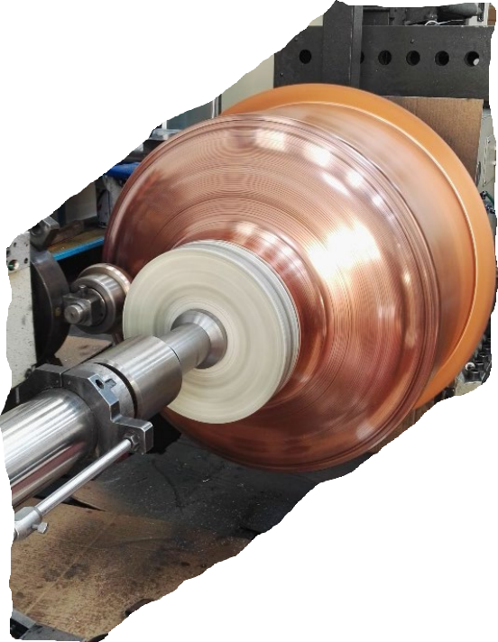
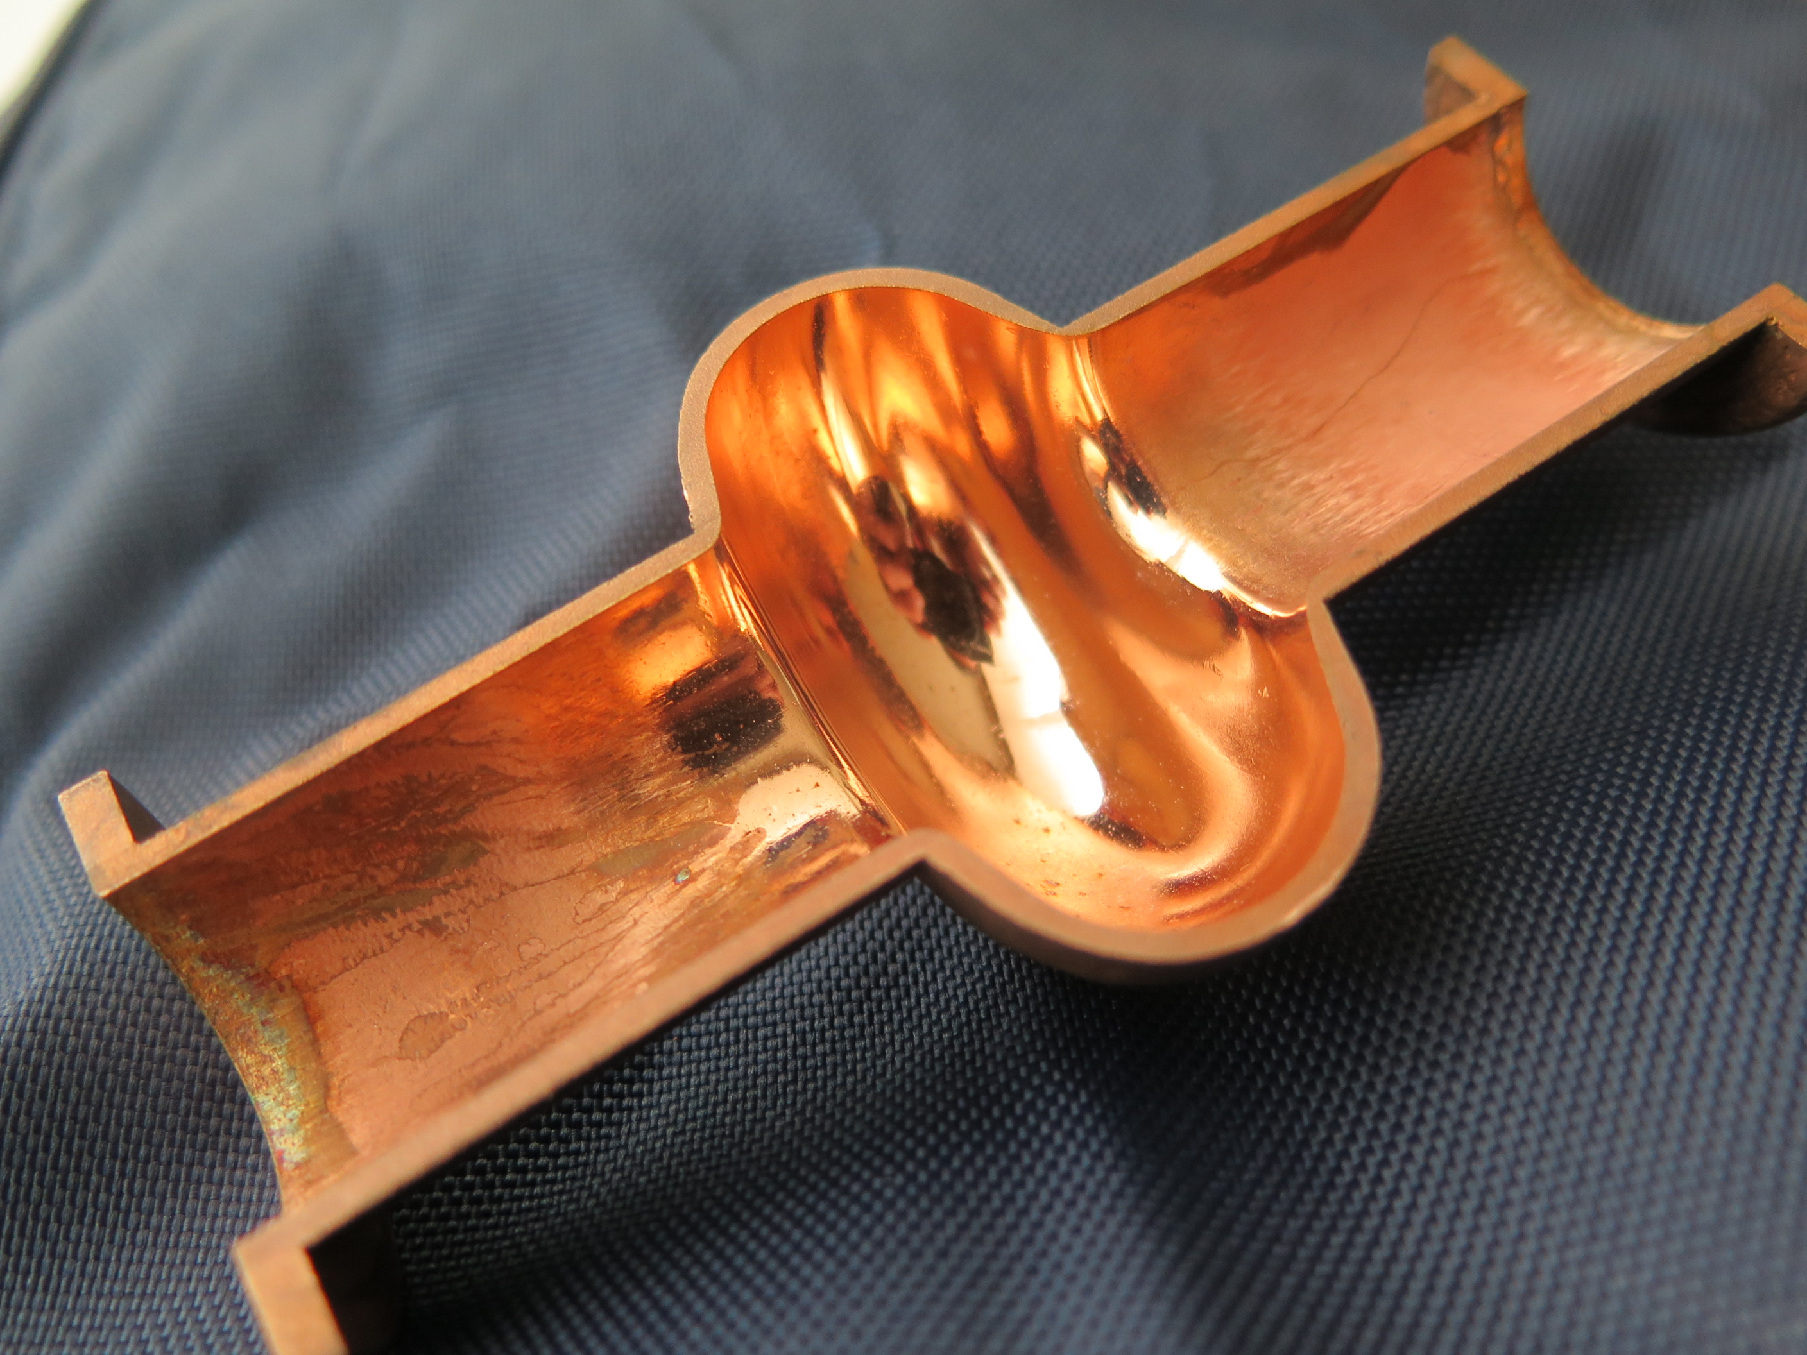
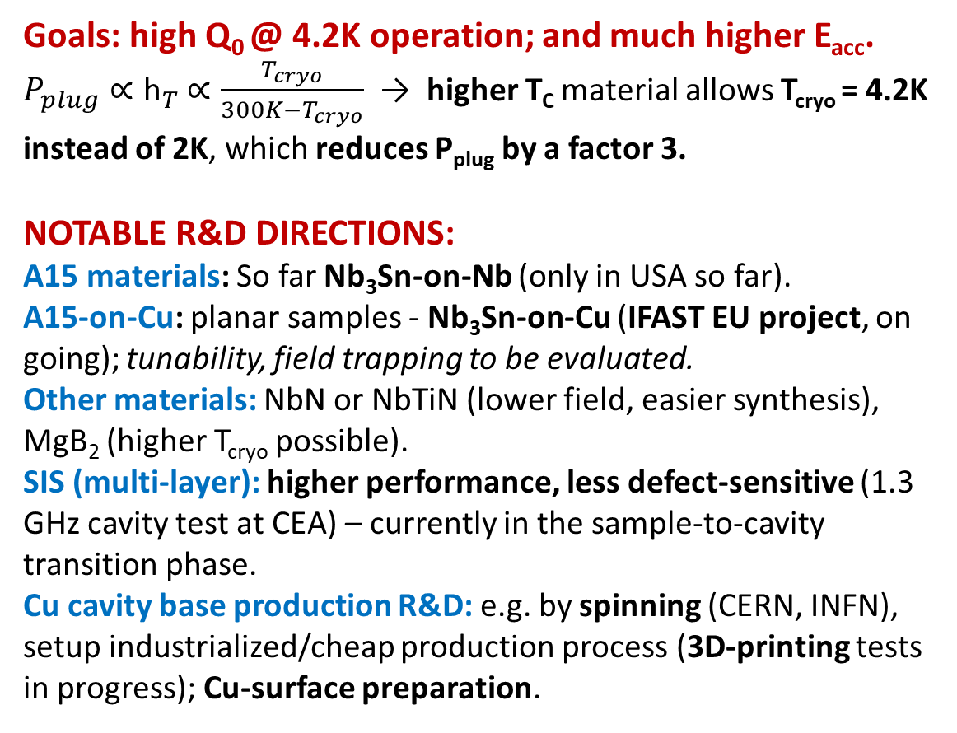
WG2: Thin-film cavities
  Goals: high Q₀ @ 4.2K operation; and much higher E_{acc}.
  $P_{plug}∝{\text{h}}_{T}$ $∝\frac{T_{cryo}}{300K−T_{cryo}}$ → higher T_{C} material allows T_{cryo} = 4.2K instead of 2K, which reduces P_{plug} by a factor 3.
  NOTABLE R&D DIRECTIONS:
  A15 materials: So far Nb₃Sn-on-Nb (only in USA so far).
    A15-on-Cu: planar samples - Nb₃Sn-on-Cu (IFAST EU project, on going); tunability, field trapping to be evaluated.
    Other materials: NbN or NbTiN (lower field, easier synthesis), MgB₂ (higher T_{cryo} possible).
  SIS (multi-layer): higher performance, less defect-sensitive (1.3 GHz cavity test at CEA) – currently in the sample-to-cavity transition phase.
  Cu cavity base production R&D: e.g. by spinning (CERN, INFN), setup industrialized/cheap production process (3D-printing tests in progress); Cu-surface preparation.
Nb₃Sn/Nb
Q₀ (Nb₃Sn) @ 4.2 K ~ Q₀ (full-Nb) @ 2 K; E_{acc} ~25 MV/m; more sensitive to trapped flux; brittle (f₀ tuning by mechanical deformation possible?)
Notes:
Nb3Sn/Cu, Uni-Hamburg, CERN, INFN, ... On top of I-FAST

Slide 9
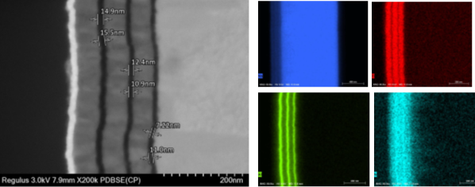
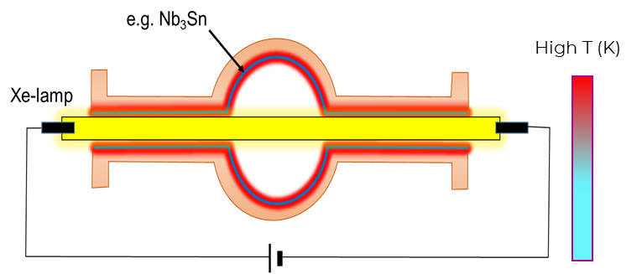
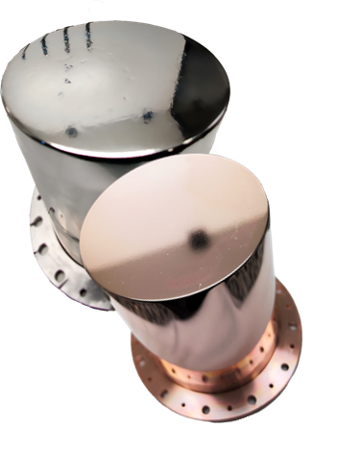

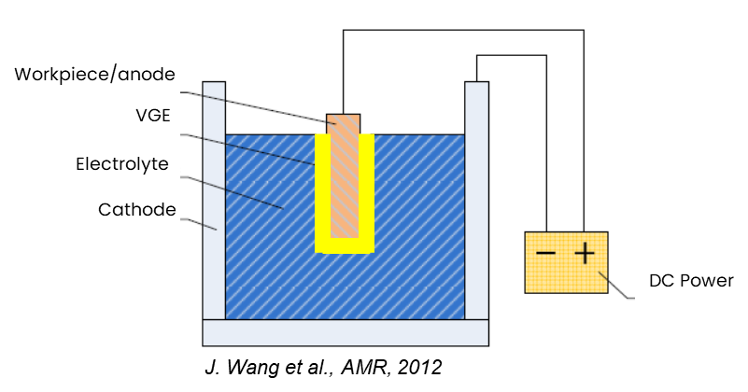
WG2: Thin-film cavities
HINTS FOR THE FUNDING AGENCIES
To facilitate expedited multi-cell coated cavity verification, 1.3 GHz and lower
Intensify R&D:
more SC materials to explore, various techniques, targets
surface/material characterization and SC property measurements.
Cu-cavity production and their polishing.
laser and flash-lamp annealing on Cu samples/cavities.
More funds-people/higher priority for:
facilities (people, liq-He, electricity, …); for many cells, various frequencies
furnace + new ALD coating set-up.
access to clean rooms.
Have more test installations available (so far some at CERN, HZB and DESY, INFN; in preparation at STFC).
Have more sample characterization stations available.
SIS multilayer coating (Nb/AlN/Nb3Sn) on Ta
Flash Lamp Annealing
Same EP set-up
Different regime
Plasma Electrlytic Polishing
Labs: CEA-Saclay, CERN, HZB, HZDR, INFN, STFC, USI, Hamburg U. (DESY), (I.FAST-WP) JLAB, KeK and FNAL
Tightly-knit network, very well connected worldwide.
Small teams, limited budgets, technical support and access to RF tests.
Notes:
https://www.hzdr.de/db/Cms?pOid=56060&pNid=3240 on laser and flash lamp annealing

Slide 10
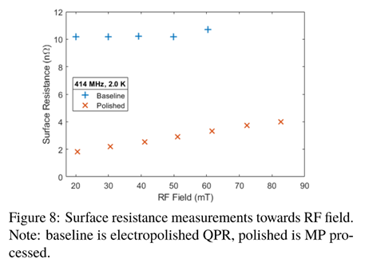
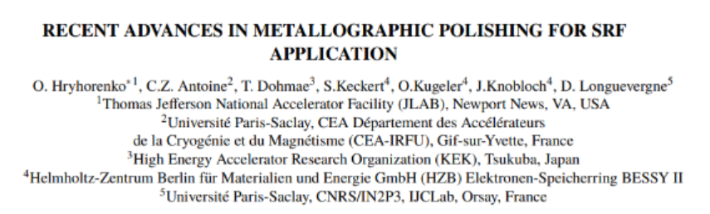
Progress is constant, from multi-faceted R&D programmes
Latest news!
Metallographic polishing, reducing Nb surface resistance by a factor 5
(collaboration between the Nb and thin film communities)

Slide 11
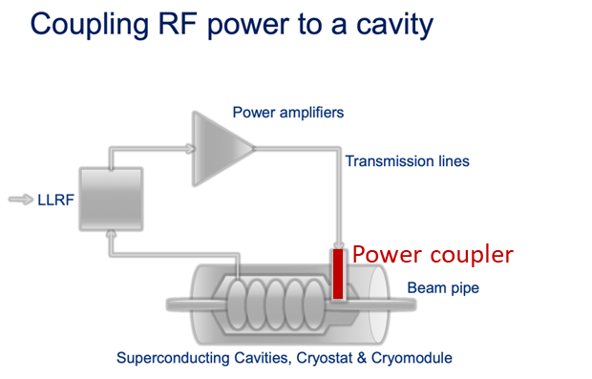
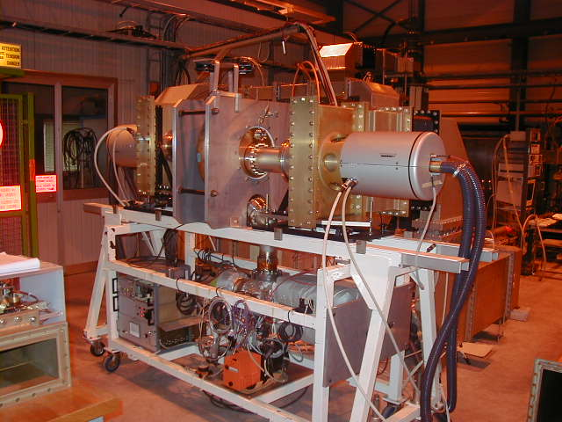
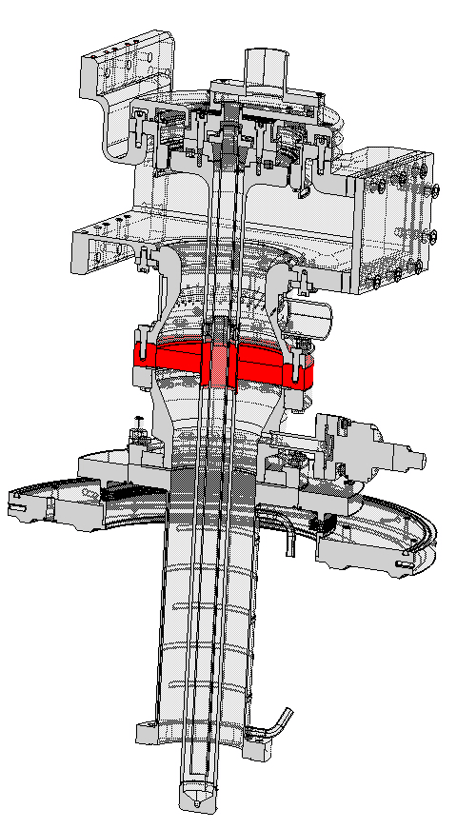
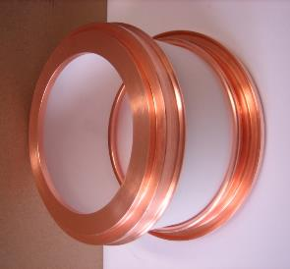
WG3: Fundamental power couplers (FPC)
Test box for LHC couplers (400 MHz)
The ceramic window!
Ensures vacuum tightness of FPC vs. the cavity and the entire machine - no leaks allowed!
Mostly Al₂O₃, metal-brazed, should:
have low losses at operating f and T.
be brazed, with low RF losses (→ high purity).
have a low T-gradient (ensures a known thermal conductivity).
Top-priority R&D topic for high power couplers.
NEEDS:
Transmitting hundreds of kW (W’s in the cold mass) reliably through thin ceramic windows (diameter ~ 5÷ 50 cm) into SRF cavities.
Risk: window breach can spoil a complete cryostat with multiple cavities within seconds.
FCCee (Z→W,H → ttb modes): 112→864 couplers, CW, 400-800 MHz, P = 165 - 900 kW
MC (SC driver, NC RF, SC RCS): 250, 7000, 4500 couplers, dc 0.05% → 4%, 325-1300 MHz, P = 100 - 4000 kW
400MHz, LHC,
500 kW CW
(for ILC and CLIC: FP
specs achieved)
HOMs couplers (see iSAS proposal): R&D on 800, 1300 MHz multicell; ~ kW RF power out of the cold mass
Notes:
(usually, high purity difficult to braze, but low
losses, low purity vice-versa)
MC 4 MW is an engineering issue which is not for now…

Slide 12
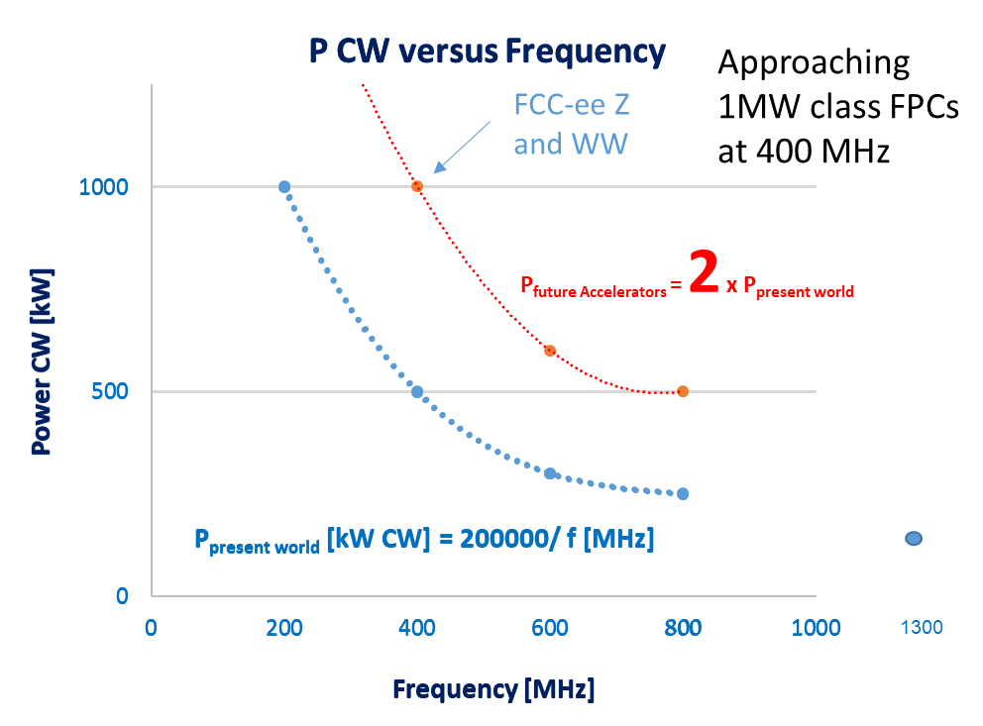
WG3: Present evolution, labs involved
Development done for specific machines:
Generic R&D on couplers does not exist (except some at EIC, USA)
Coupler modelling capacity is reasonably wide (e.g. Uni-Rostock)
EXPERIMENTAL-FABRICATION CAPABILITIES
CERN: developments for future colliders, can guarantee long-term expertise; couplers for Soleil, ESRF, PERLE, …; has test stands.
CEA: couplers on request for XFEL, ESS - has test stands.
DESY: 1.3 GHz CW couplers – has test capabilities.
RI company: fabricates (and tests) couplers on specs.
EIC (USA): couplers with challenging specs, developments will benefit next colliders.
The coordination event for international experts: (almost) yearly world-wide FPC workshop (WWFPC) brings together international experts.

Slide 13
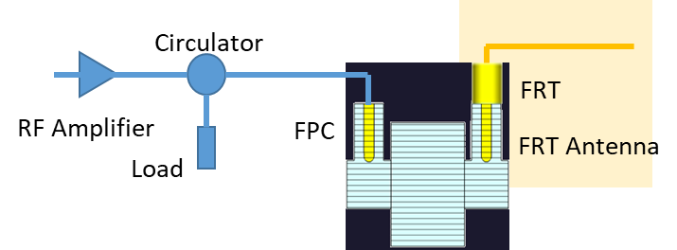
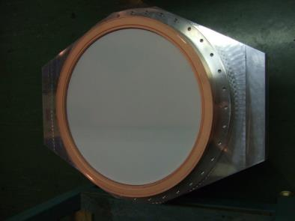
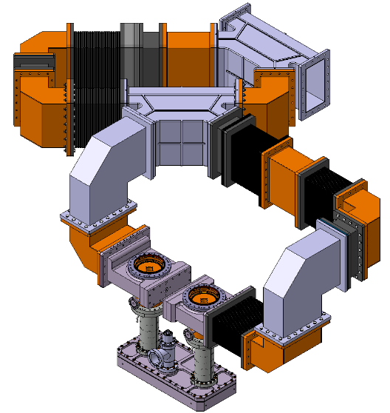
WG3: Couplers: what to work on
HINTS FOR THE FUNDING AGENCIES
Fast Reactive Tuners
Suggested directions to improve or speed up R&D:
(mostly at CERN, FCC-driven):
  Water cooled ceramics.
  Highly adjustable couplers using 2 windows.
  New methods of mounting couplers with high cleanliness.
  Resonant ring for efficient testing & conditioning (5 ÷ 10 smaller power sources) .
  Enable smaller labs to build-up test capacity at a moderate cost (~ 300-400 k€).
  Develop Fast Reactive Tuners (a broad-scope promise for colliders and many other applications)
Tuning at room-T (outside the cryomodule), without mechanical deformation. Proof-of-principle at CERN.
Tuning speed > 600 ns (limited by the HV circuit), delivers power savings and improved stability.
Huge potential for all SRF accelerators, not only colliders.
Short coaxial structure, with FE element: RF power goes in and reflected back. FE permittivity changed by an applied voltage → change of P_{refl} → change of f₀.
Applicable to transient detuning: R&D CERN + Lancaster U
Interest shown by: HZB, PERLE, JLAB (also engaged)
Collaboration - bridge gap between R&D & operation.
FE material studies desired.
Potential game changer:
tuning; transient beam loading; microphonics
Good for small labs!
400MHz, LHC 2
1 MW CW expected
CERN SPS resonant ring proposal:
(~ 20 dB amplification at device under test)
Notes:
Jlab is Jefferson?
PolFEL, NVBJ, Poland may be interested
Industrial capabilities not needed now, for a machine starting operation in 2040 and construction in 2028, at the earliest
A resonant ring is a closed loop of a waveguide system that can amplify power, and it is widely used for the breakdown test of the RF components under high power

Slide 14
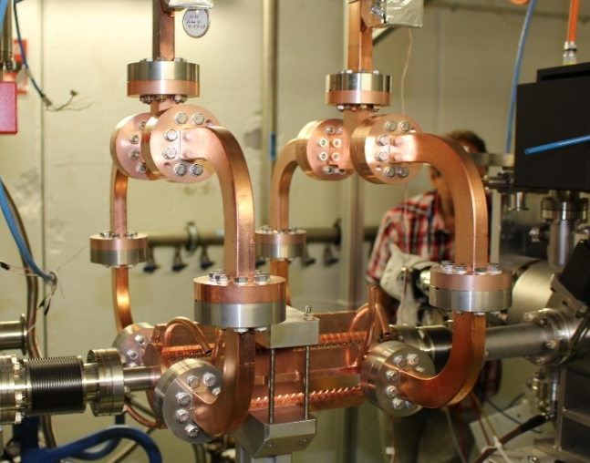
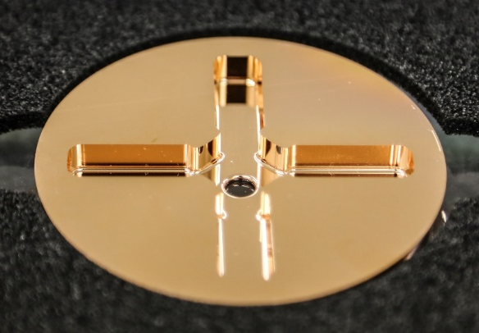
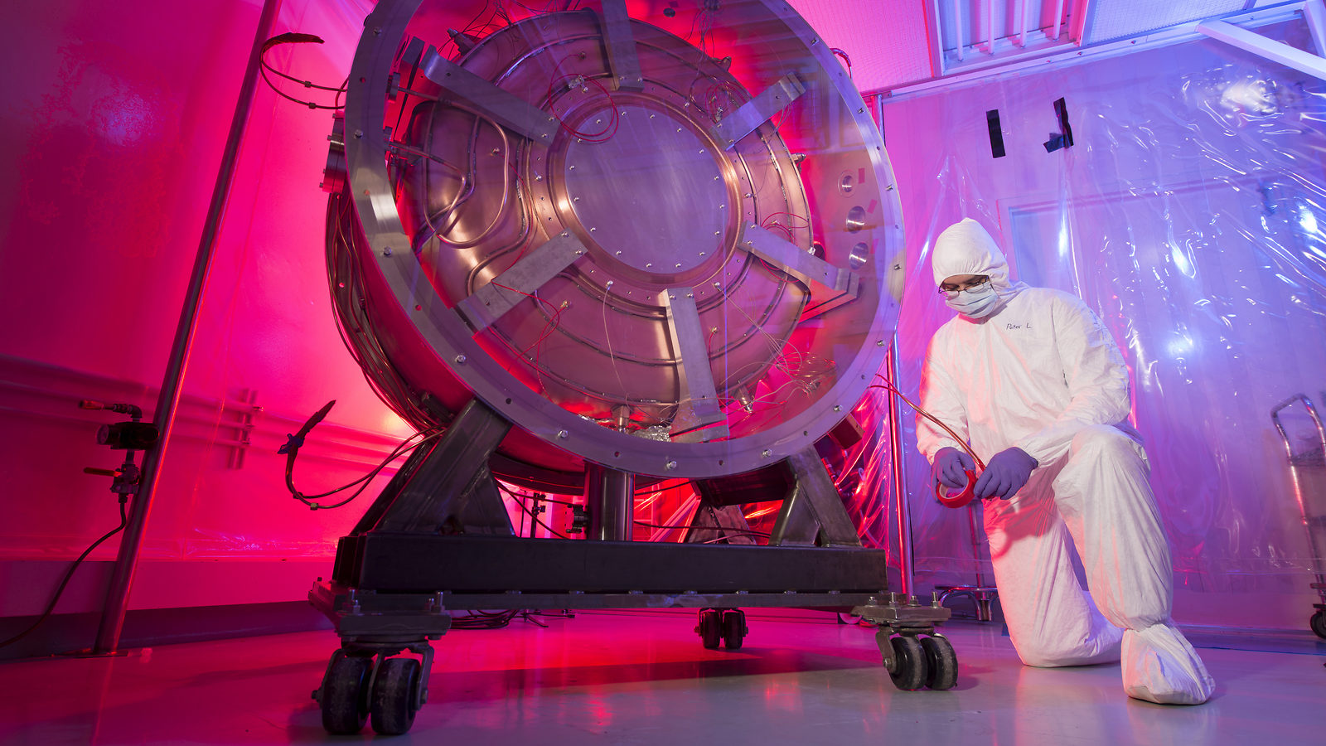
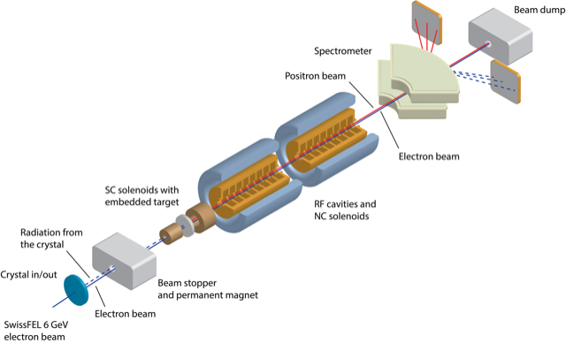
WG4: High-Gradient (HG) Normal-Conducting (NC) RF
NEEDS/GOALS:
CLIC
CLIC
HG (70 to 100 MV/m), X-Band with very low breakdown rate, key performance parameters for cost (linac length) and efficiency (optimized beam dynamics).
Very strong interplay between HG and beam dynamics for wakefields – precision alignment mitigates.
Muon Collider
HG important for muon capture, fundamentally with high external magnetic field.
FCC
For 20 GeV NC injector in FCC-ee and electrostatic separators in FCC-hh in S and C-Band.
Applications outside HEP require gradients up to 60 - 70 MV/m (synergies)
MC
FCC Injector
Notes:
Funding for CLIC from 4 to 2 nowadays

Slide 15
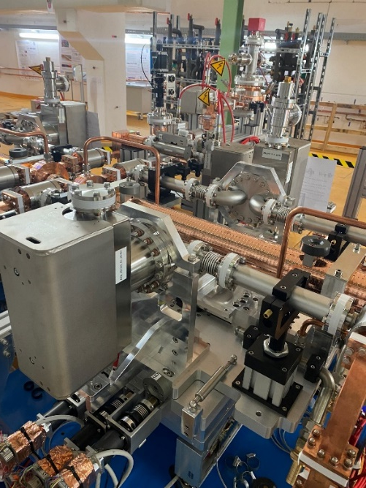
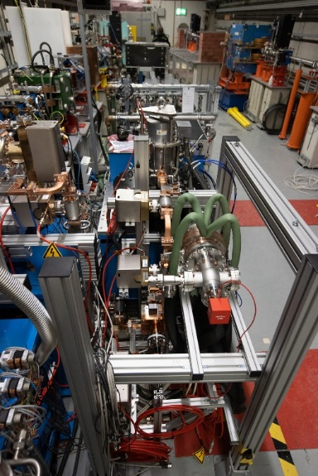
WG4: Current R&D activities to achieve these goals
CLIC
Achieved: Gradient specs attained & deep understanding of fundamental physics (with multi-decade HG development and funding); great stimulus for industrial supply of NC RF components/systems; synergies with applications (XFEL, Eupraxia, ICS, medical, plasma accelerator, RFQ, …)
Generated: new directions - dielectric structures, short pulse acceleration and HT superconductors.
Required: systems engineering and integration, dedicated manufacturing R&D & mech. design with μm-level alignment required (applications can bring these aspects further).
Muon Collider
To be urgently planned: HG required in high magnetic fields, with significant need for dedicated test infrastructure.
Fundamental mechanisms of breakdown
Electrodynamics and material science, plasma physics, surface physics (often at University scale), with wide applicability.
POLARIX
deflector, DESY
Notes:
FCChh design: «The injected beam will be captured, accelerated and stored using a 400 MHz superconducting cavity system, which is also used to damp the longitudinal injection errors. A system of electrostatic deflectors will be used to damp the transverse injection instabilities/errors and thus ensure transverse stability. “
HG for FCC is S-band, some L-band, some positron capture
CLIC nest step? CLIC-0 , a larger scale development facility, nonsense if CLIC is NOT approved

Slide 16
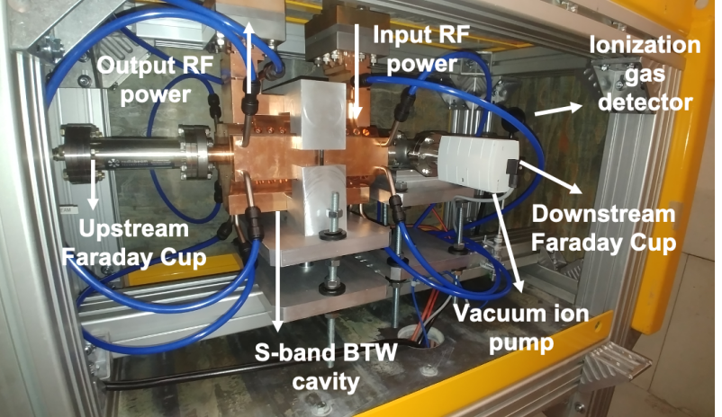
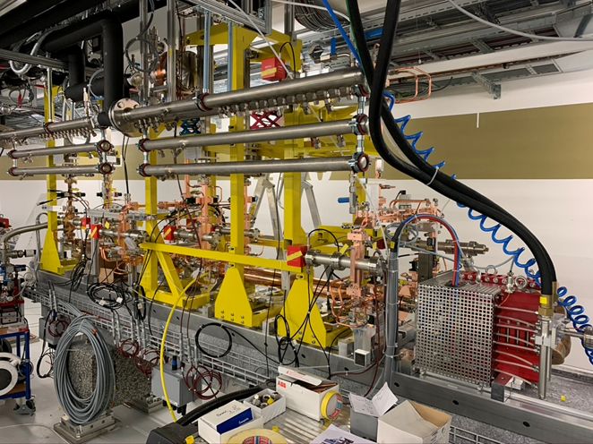
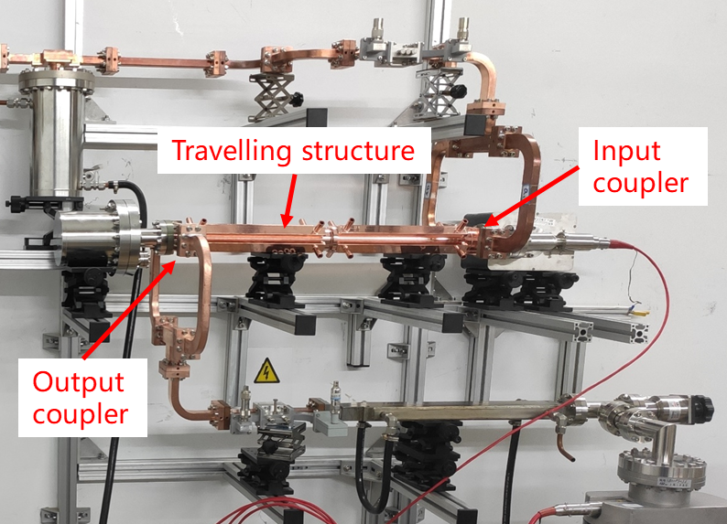
WG4: HG NC: priority R&D and investments
Operational HG test infrastructures in Europe (crucial!): CERN (n.3, 50 MW, 12 GHz), Trieste (45 MW, 3 GHz), Valencia (7.5 MW, 3 GHz), Frascati (50 MW, 12 GHz), Uppsala (cryo pulsed DC sys)
Active on X-band linearizers and deflectors: PSI, DESY, STFC-Daresbury Lab
High performance linacs (design÷operation): INFN-Roma, STFC-Daresbury Lab, CERN, PSI, Eindhoven, INFN-LNF, Elettra, Medical (VHEE FLASH)
HINTS FOR THE FUNDING AGENCIES
Top priority: to maintain multiple EU RF test stations (and staff).
Explore HG designs - precision mechanics.
New materials, procedures, care to minimise costs.
Test NC structures in high magnetic fields: paramount for Muon Collider R&D (major requirement):
Fund new and upgrades of existing infrastructures (test stands will open important new areas in HG studies and will stimulate important scientific understanding).
S-band testing, IFIC Valencia
POLARIX deflector, DESY
X-band testing, Tsinghua University, Beijing
Notes:
For the MC:
Small scale tests: 5 M€
Full test stand: 100 M€
ANL developments, MICE developmens

Slide 17
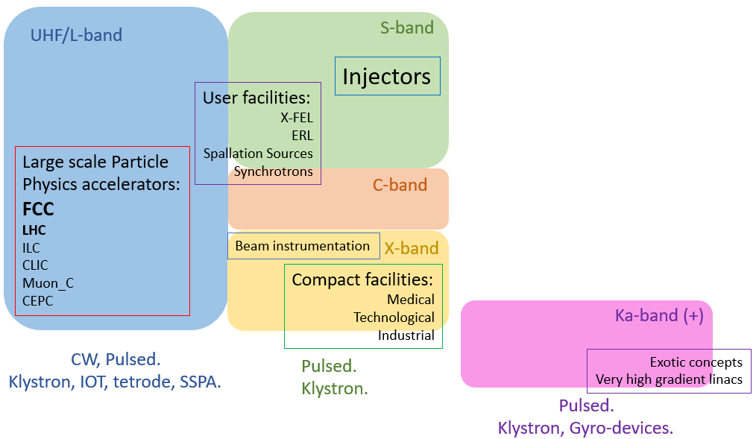
WG5: High Efficiency Amplifiers
Facilities driven by a vast diversity of RF power sources.
NEEDS/GOALS:
Support/promote development of high efficiency RF power sources for future large-scale particle accelerators.
Intensify collaboration with industry to ensure long-term industrial support for decades to come.
LHC and FCC_{ee} are first/primary objectives for such development.
DEVELOPMENT SYNERGY:
Support various community needs for high efficiency RF sources (either/or):
development synergy
specialised activity
(for novel/customized requirements).
Choice driven by: tunnel integration, spatial power density, cost/W, efficiency.
Notes:
Efficiency imply reducing klystron current, say by 15%
Higher efficiency means having 15% fewer klystrons, with impact on capital and maintenance costs

Slide 18
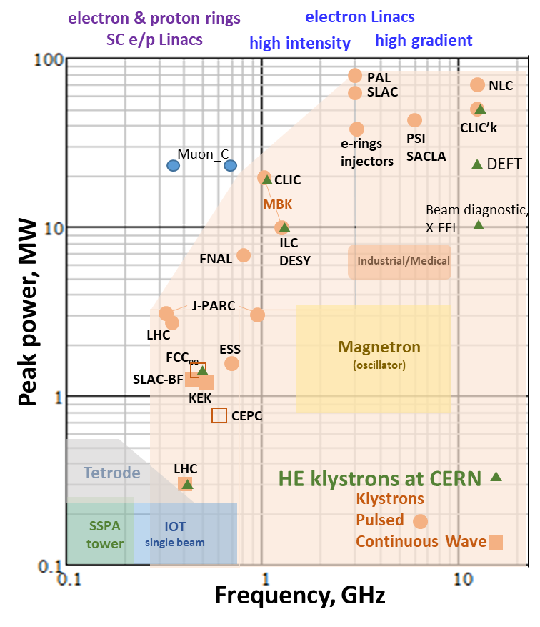
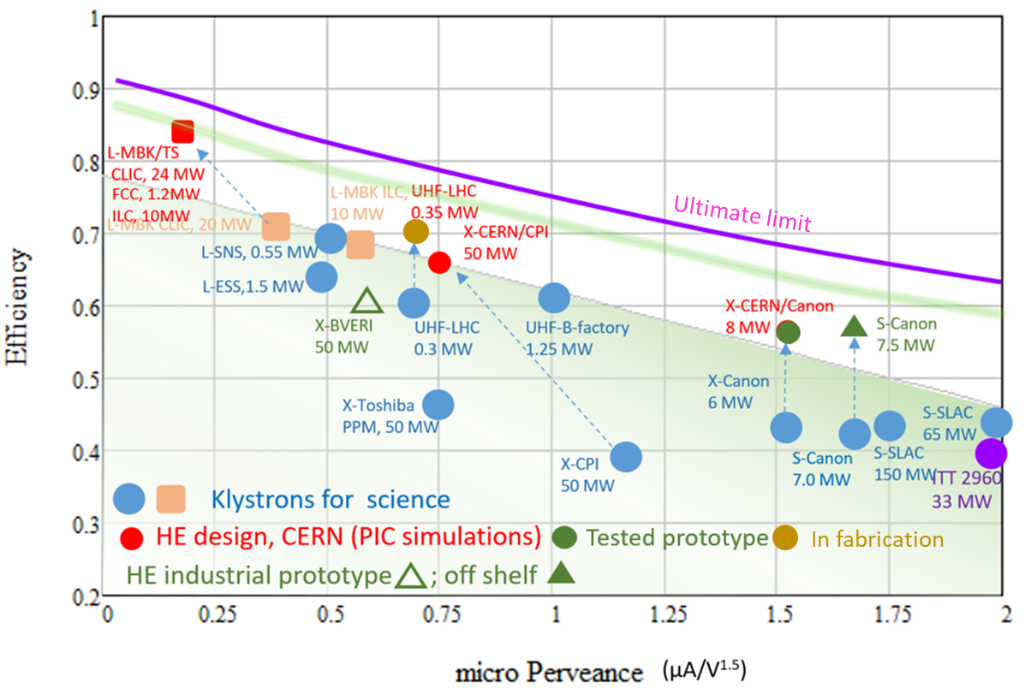
WG5: Power amplifier developments
High Efficiency klystrons project at CERN: targeted to improve efficiency and performance for various applications.
FCC klystron efficiency gain from 65% to 80% can save > 1 TWh in 10-years (~ 84 MCHF)
Notes:
Klystrons still dominating the scene, in the P vs f plot
M. Jen

Slide 19
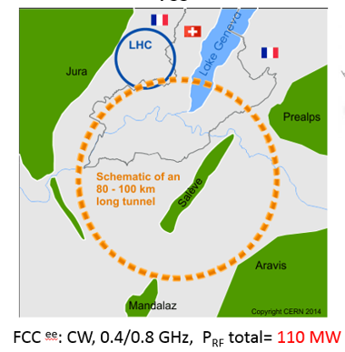
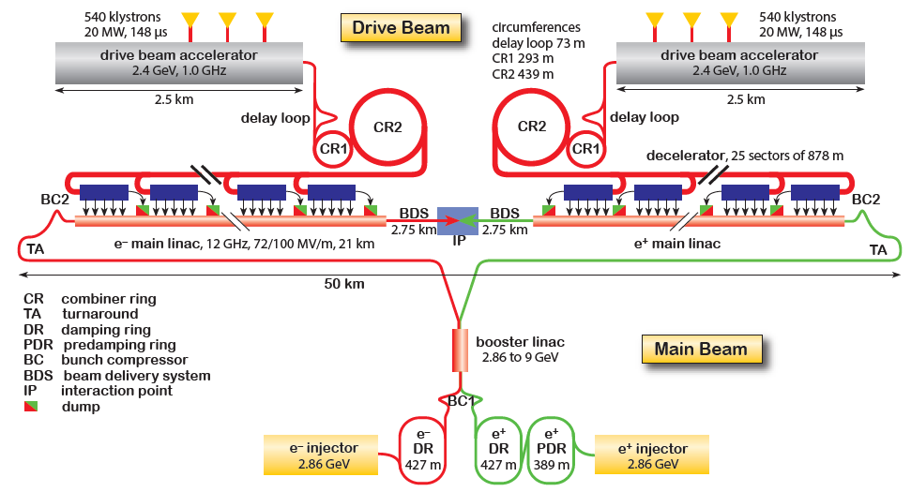
WG5: RF Amplifier R&D status and directions
Klystrons: R&D is (i) costly and (ii) only done with industry, unless significant investment in klystron production infrastructure at Lab level (i.e as done at SLAC). Only 3 qualified vendors worldwide. Large cost increase, 50-100% over ~5 yrs. (CERN, Uni-Lancaster and ESS, CEA)
SSPA: progress (incl. η-increase) rely on industry transistor development; labs contribute with combination/matching techniques (CERN, Uppsala, CEA Saclay, INFN-Legnaro, NCBJ (Swierk), CIEMAT)
Only large projects can afford R&D costs and risks, which benefit many applications; for small labs energy savings are not worth the investment.
105 MW
from 380 klystrons and 600 SSPAs
HINTS FOR THE FUNDING AGENCIES
Klystrons: labs taking partial responsibility in the fabrication process would help reduce cost, risks & delivery time.
SSPA: a coordinated lab effort is mandatory. Most promising technology must be selected (e.g. GaN), which should last for decades, and most efficient power combiner (cavity/distributed, considering cost & size). η=70% goal. FCC aims at a prototype SSPA tower in 2026.
3.0 TeV CLIC^{e+e-} ; pulsed, 1.0 GHz, P_{RF} total = 180 MW
Notes:
Efficiency of interest for small labs only if it reduces the size of the modulator.
Efficiency is a 3-4 years investment of industry, not interesting for few klystrons!
Klystrons like diamnds are for ever (for 20 years...!)

Slide 20
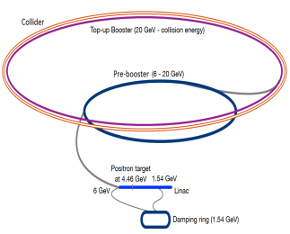
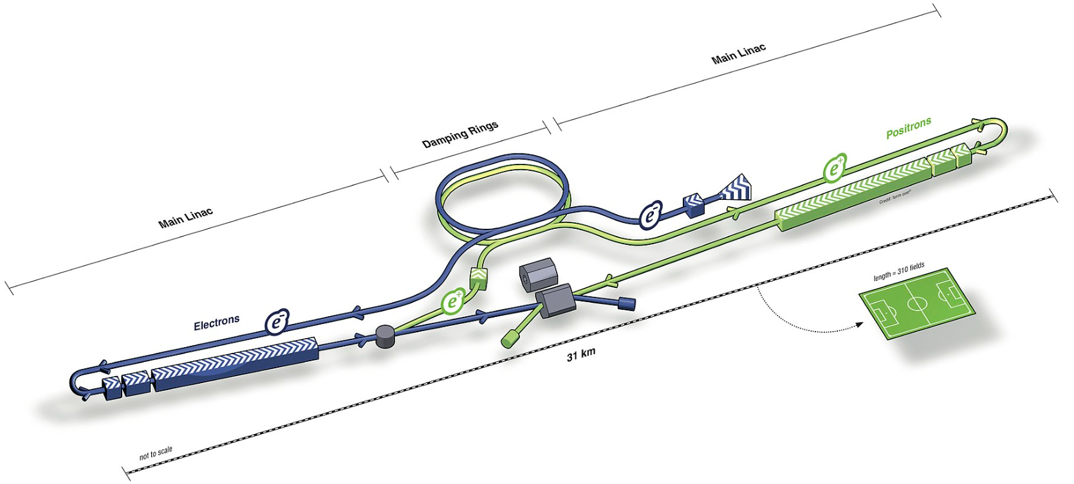
WG6: RF Control - LLRF and Artificial Intelligence
NEEDS:
Multiple accelerator sections with different beam patterns and RF frequencies → high-level intelligent automation and optimisation.
Reduction of electrical energy consumption → optimal RF control strategies and operational procedures.
Long construction and operation cycles → sustainable RF control systems, with long-term standardised HW/SW, optimal architecture and framework suited for system integration/upgrades.
ILC/FCC/MC superconducting RF cavities → RF field control vs. strong mechanical vibrations and heavy beam loading (with critical electrical/mechanical characteristics of the cavity).
A comprehensive, intelligent, highly automated, and standardised LLRF system is essential for the success of the RF systems of future colliders.
FCCee
ILC

Slide 21
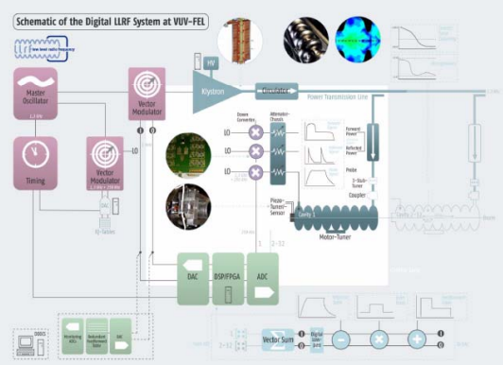

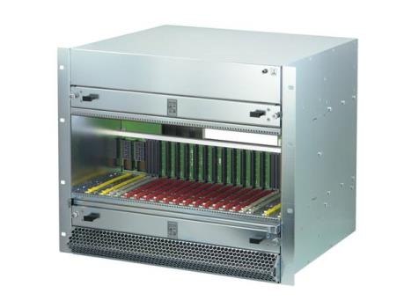
WG6: Current R&D effort
RF stability figures achieved! (0.01 % amplitude and 0.01° phase) of FEL machines is more demanding, sufficient for future colliders (e.g. ILC requires 0.07 % and 0.24°).
Real-time cavity field stabilisation, with advanced automation and optimisation algorithm: high-res fast ADCs and high-performance DSPs from telecom industry,.
Standardise LLRF system design: gain long-term industry support (HW/SW platforms like VME, ATCA to MicroTCA, System-on-Chip) and broaden scientific collaboration labs/industry, facilitating large scale projects with in-kind contributions (e.g. HL-LHC, ESS and PIP-II).
Improving availability, reliability and operability (FCC, ILC, MC, …) with many RF stations & cavities (e.g., ILC main Linac has > 560 RF stations and 14500 cavities), → automation and optimisation for RF system operation, e.g. ML algorithms will decrease operation/maintenance costs.
Notes:
- some applications of machine learning (e.g., SC cavity quench detection, RF faults classification) already demonstrated.
Chips get obsolete, but a good framework architecture, a modular design with interfaces is flexible to chip update. It should be as modular as possible, to exchange whatever is on the market at the appropriate moment. NO to customized solutions

Slide 22
WG6: Future priority investment
HINTS FOR THE FUNDING AGENCIES
Stabilising cavity field and minimizing electricity power consumption: optimization of RF system configurations, control strategies and operational procedures (especially for SRF cavities).
Standardise to streamline: to unify R&D activities on various subsystems, to avoid duplications, to attract active involvement from industry:
Simplify system integration, faster prototyping, modular design, promoting better integration with industrial R&D: standardised hardware/software architecture & platforms (e.g. the Eu-XFEL μTCA.4 as standard platform).
Standardised software/firmware libraries for sharing knowledge for worldwide LLRF community, avoid duplicated development, enabling fast prototyping and encourage collaboration.
Continuous development of automation & optimization algorithms (e.g. machine learning) to successfully operate RF systems of future colliders.
Most developments are also beneficial to accelerators beyond colliders; therefore a world-wide collaboration is encouraged.
Notes:
Standardisations among labs and with industry are opportunities coming from big machines, as XFEL was and a colldier will be
In-kind big projects impose a standardization
Companies in this field tend to cooperate in joint framewrks, good tradition

Slide 23
In summary
Priority routes in all areas of RF development are clearly identified, as presented here.
European R&D communities are being coordinated to make the R&D progress more effective.
The outcome shall be analysed and then translated into suggested strategic actions and deliverables (Fall 2023).
The process shall be updated at regular intervals and reported to LDG, up until the next ESPP update exercise.
Notes:
Per year 10 M€, 90 FTE. Nominal, which is 30% higher than present

