Slide 1


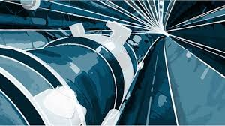
Muon Collider magnets and a future EU project
Presented by L. Bottura (CERN)
with many contributions from:
The Muons Magnets Working Group (https://indico.cern.ch/category/13958/)
M. Vretenar, D. Schulte, R. Losito (CERN), L. Rossi (INFN),
J.M. Perez, L. Garcia Tabares (CIEMAT), M. Calvi (PSI), P. Vedrine (CEA)
Community Report on Accelerators Roadmap 2023
Jul 12 – 13, 2023
INFN Frascati National Laboratories

Slide 2
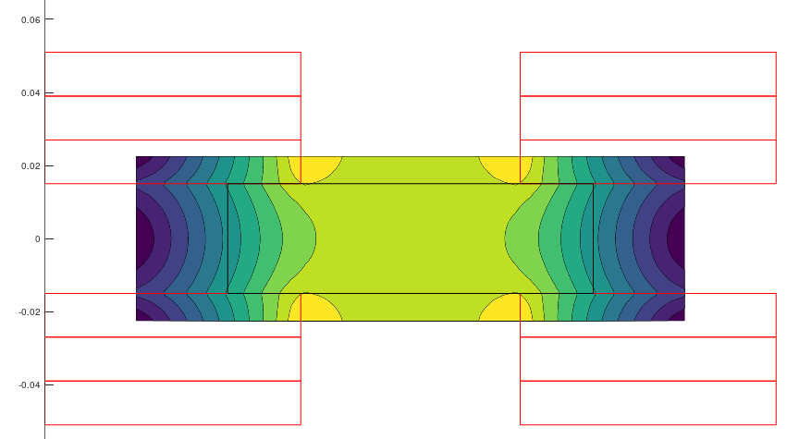
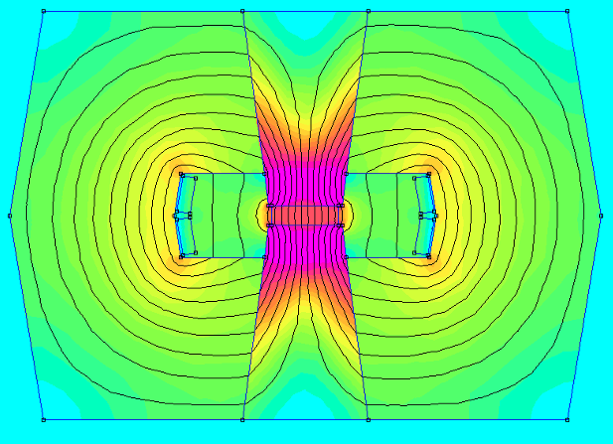
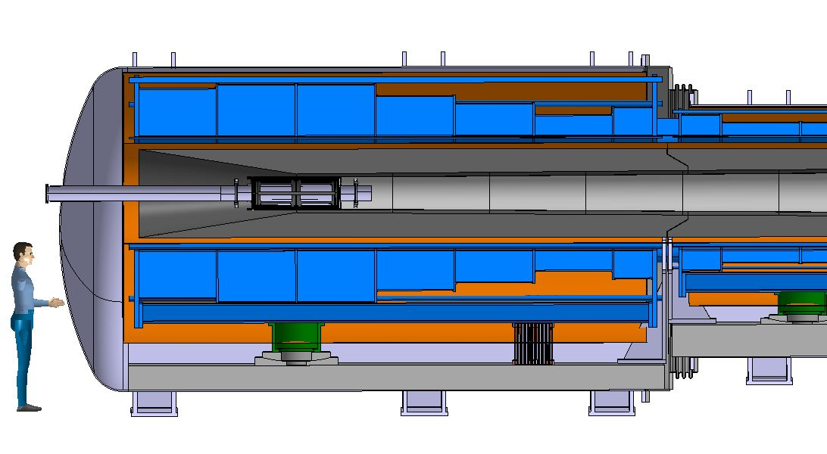
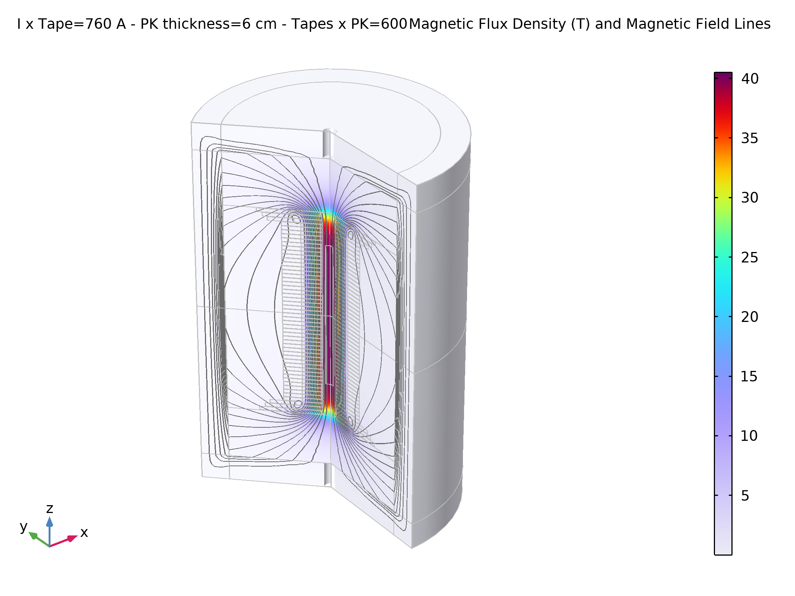
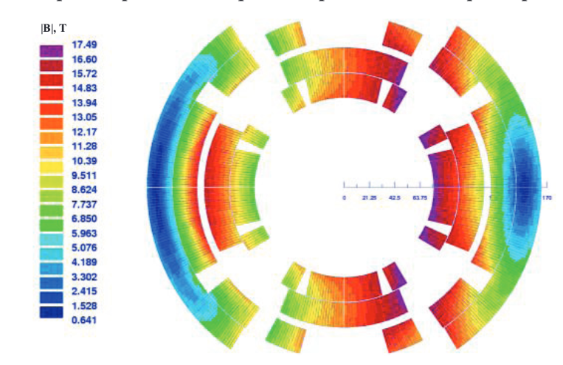
Muon Collider magnets
HTS !
NC ±1.8 T, 400 Hz 100 mm x 30 mm
SC < 10T
100 mm x 30 mm
20 T, 200 mm
Radiation heat load ≈ 5…10 kW
Radiation dose: 80 MGy
HTS ?
SC dipole
NC dipole
NC dipole
SC dipole
RCS
> 40 T, 60 mm
16 T peak, 150 mm
Radiation heat load ≈ 5 W/m
Radiation dose ≈ 20…40 MGy
HTS ?
HTS !

Slide 3
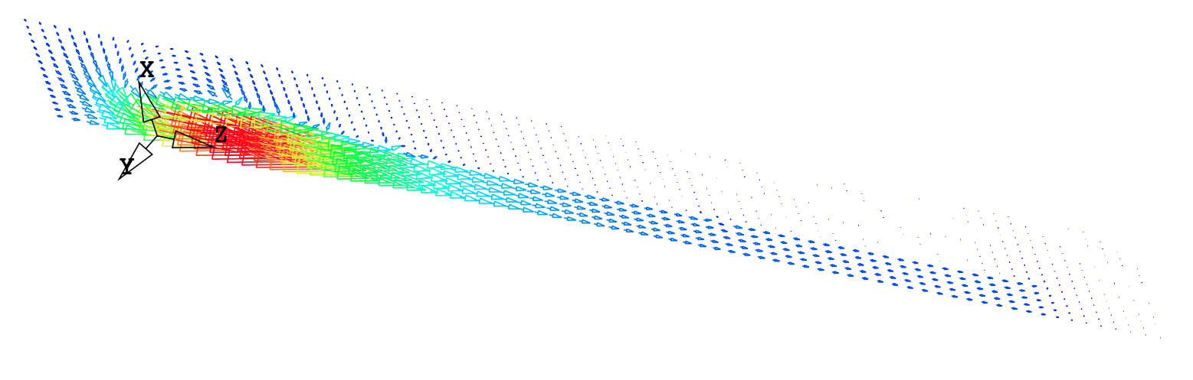
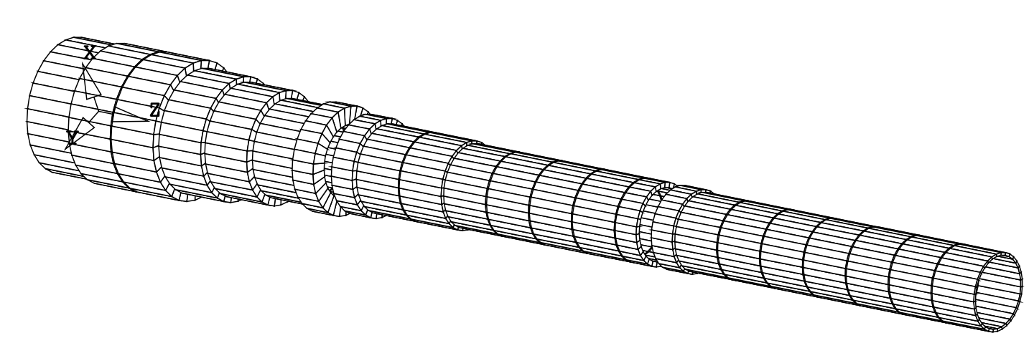
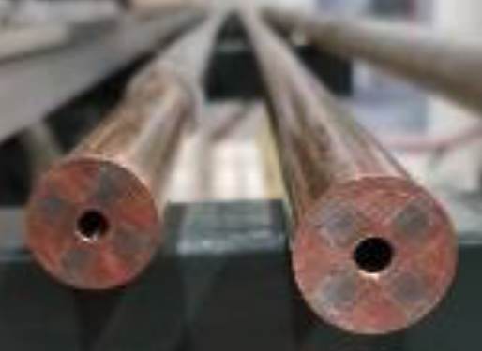
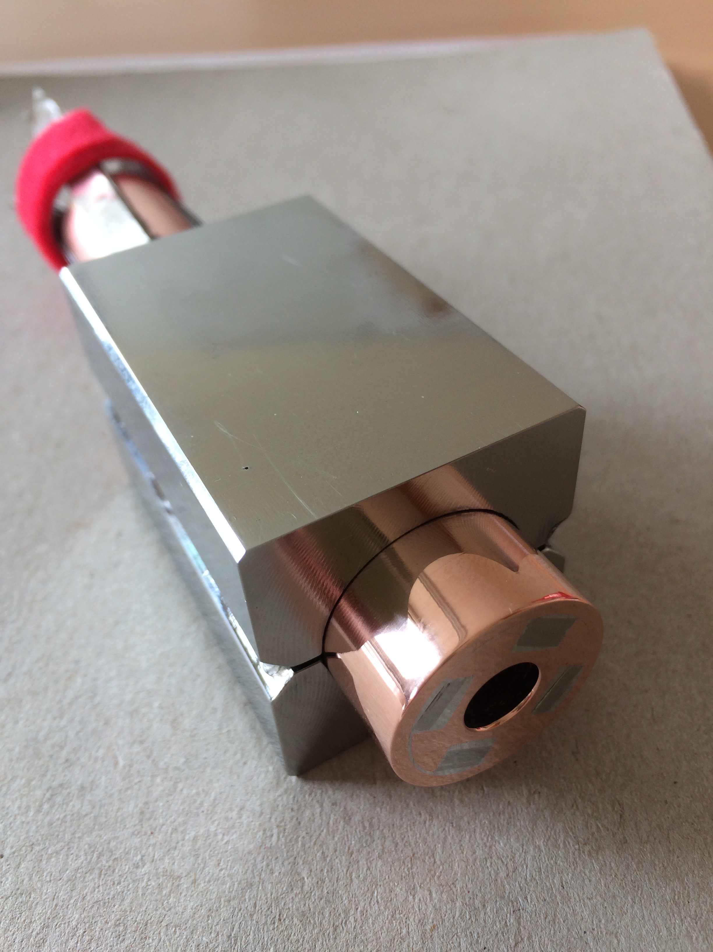
Target and capture solenoid (20 T)
A Portone, P. Testoni, J. Lorenzo Gomez, F4E
Operating current: 61 kA
Operating field: 20 T
Operating temperature: 20 K
SS JACKET
SS WRAP
MIT “VIPER” conductor
COPPER FORMER
SOLDERED HTS STACK
COOLING CHANNEL
8
23.5
M. Takayasu et al., IEEE TAS, 21 (2011) 2340
Z. S. Hartwig et al., SUST, 33 (2020) 11LT01
39.5
Strong connection to HTS magnets for fusion

Slide 4
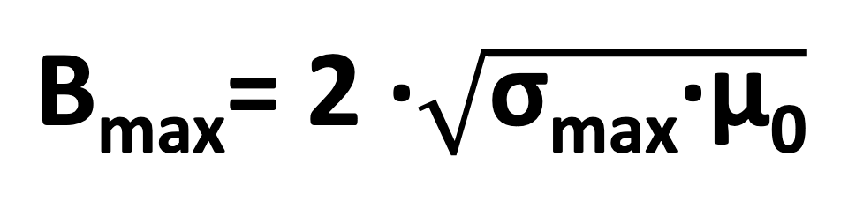
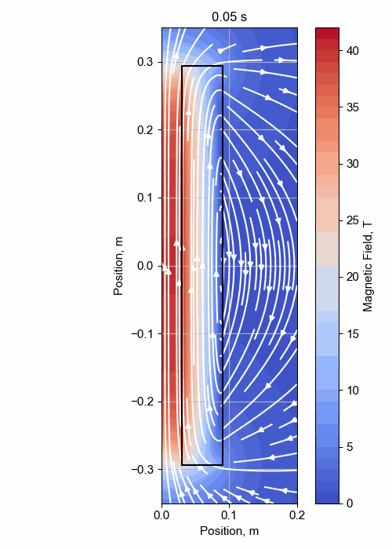
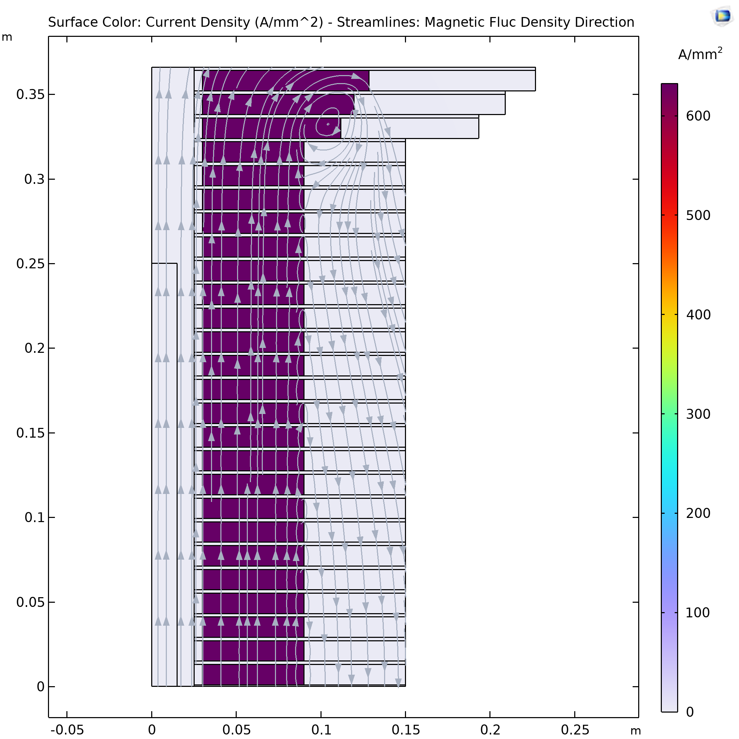
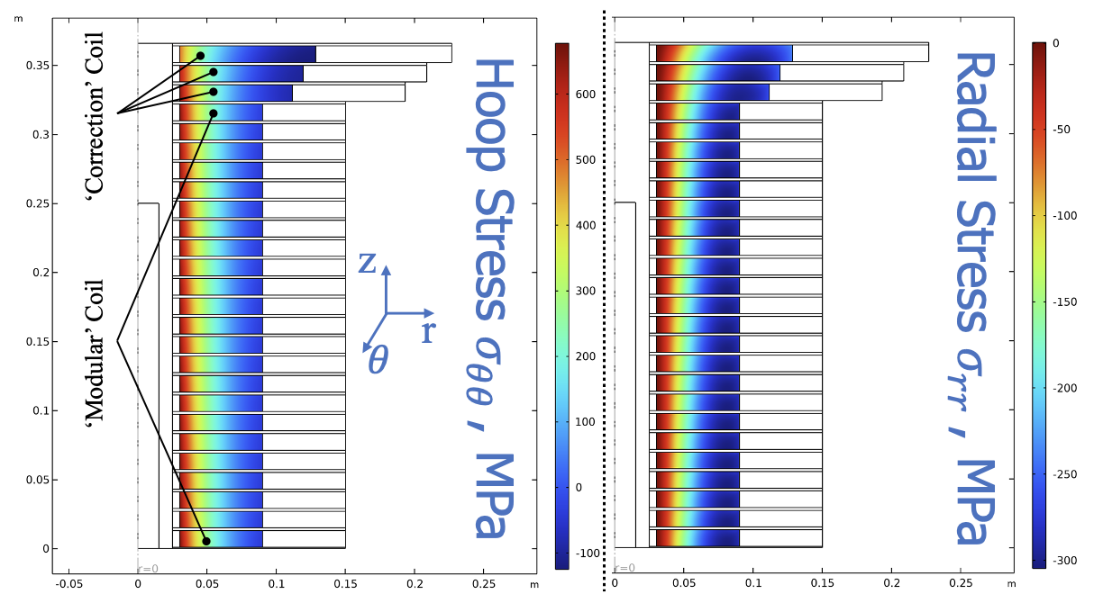
Final cooling (40 T)
σ_{max} = 600 MPa
B_{max} ≈ 55 T
Upper limit of mechancs
A. Dudarev, CERN
Inner Ring
‘Correction’ Coil
Outer Ring
Bore
40 T solenoid design
‘Modular’ Coil
1 % Field Homogeneity
Support Plate
B. Bordini, CERN
T. Mulder, CERN
B. Bordini, CERN
Strong connection to HTS magnets for science

Slide 5
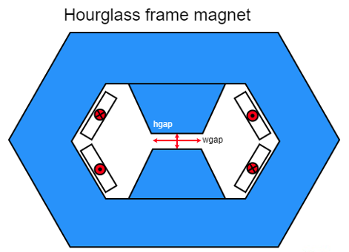
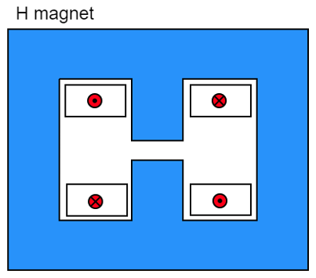
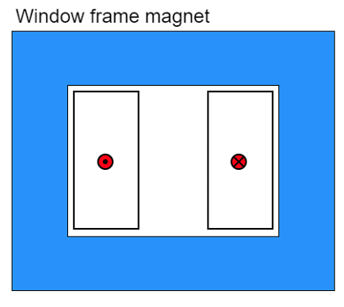
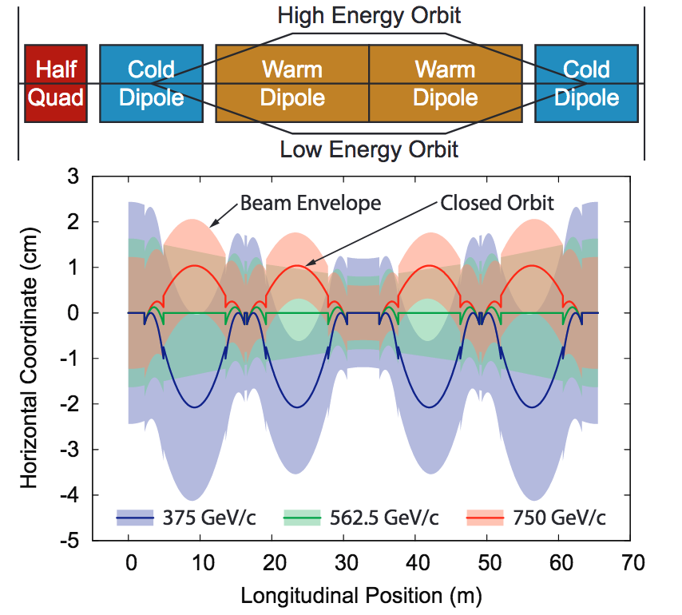
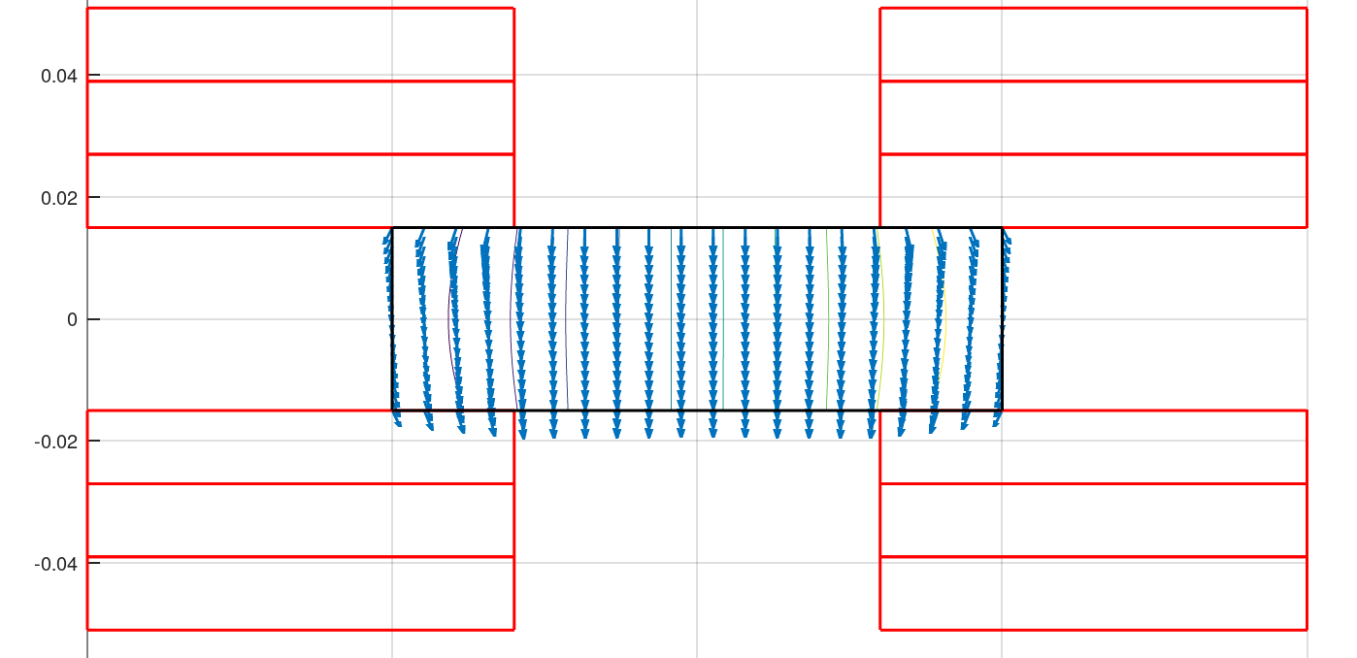
Accelerator magnets (±1.8 T)
Warm dipoles are pulsed from
-Bmax to +Bmax at high speed (0.35 to 6.37 ms) every 200 ms
5.07 kJ/m
5.65…7.14 kJ/m
5.89 kJ/m
The main challenge is the management of the power in the resistive dipoles (several tens of GW):
Minimum stored magnetic energy
Highly efficient energy storage and recovery
A simple HTS racetrack dipole could match the beam requirements and aperture
HTS flat racetracks
b3 = -7.2 units
b5 = -1.4 units
b7 = -0.03 units
peak field
10.4 T
Cold dipoles provide a steady baseline field of about 10 T
Rectangular magnet bore 100 mm x 30 mm
Possible connection to pulsed powering for fusion
F. Boattini, CERN

Slide 6
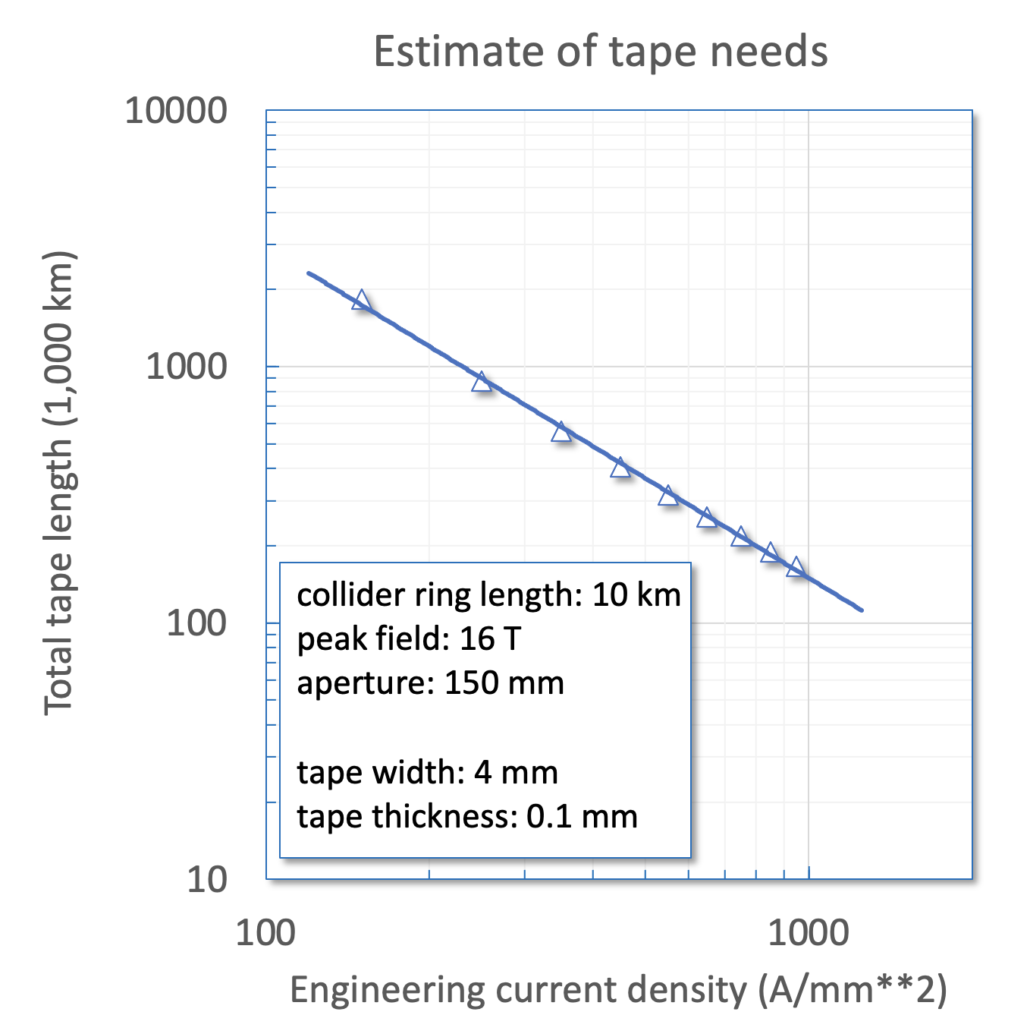
Compact collider magnet windings
Example of 16 T muon collider main dipole built with HTS
We need to increase the winding current density to fall in a reasonable range of conductor mass (applies both to LTS and HTS)
Unresolved issues:
  Winding geometry for tapes and stacks (ends, alignment, transposition possibly superfluous ?)
  Mechanics of coils under the exceptional electromagnetic loads (longitudinal stress in the range of 600 MPa, transverse stress in the range of 400 MPa)
  Quench management at high current and energy density (above 100 MJ/m³)
  Radiation hardness of materials and coils (40…80 MGy and 10²² n/m²)
350 A/mm²
500,000 km
950 A/mm²
150,000 km
Connection to HFM for FCC-hh

Slide 7
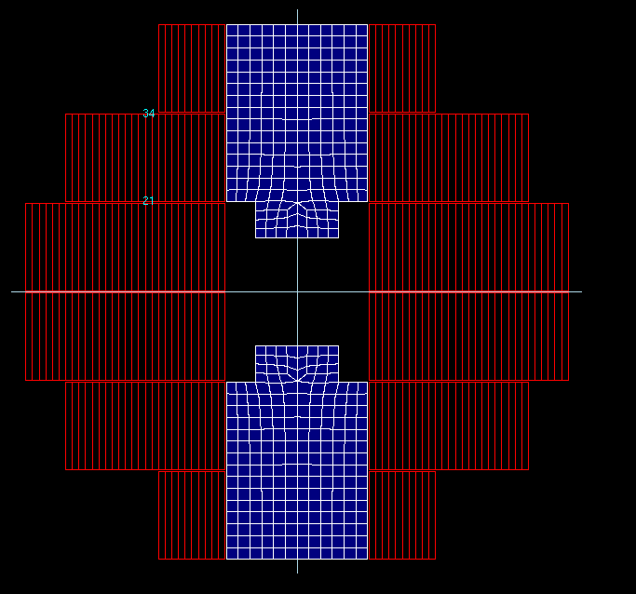
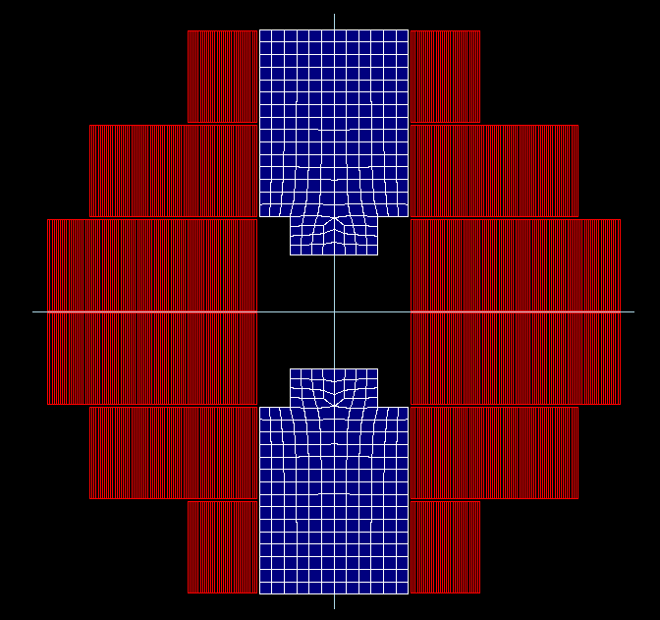
The HEP push towards HTS
Operate SC magnets at higher cryogenic temperature (gas)
Reduce energy consumption
(FCC-ee 350 MW, FCC-hh 580 MW)
Increase energy efficiency
(COP at 1.9 K is about 1000)
Avoid large liquid helium bath and operate with gas (lower density)
Risk with helium supply chain
(FCC-hh would require 900 tons of lHe)
Reduce SC cost per unit length and current
Infrastructure (magnet) cost
(FCC-hh quoted at 9 BCHF)
Increase coil current density to decrease conductor inventory
Calculation example
(T. Lecrevisse, CEA)
Compact HTS windings
Target J_{E} 1000 A/mm²
Operation in gaseous He
Range of 15…25 K
5 T at 2800 A
J_{E} = 250 A/mm²
16 T at 2800 A
J_{E} = 850 A/mm²

Slide 8
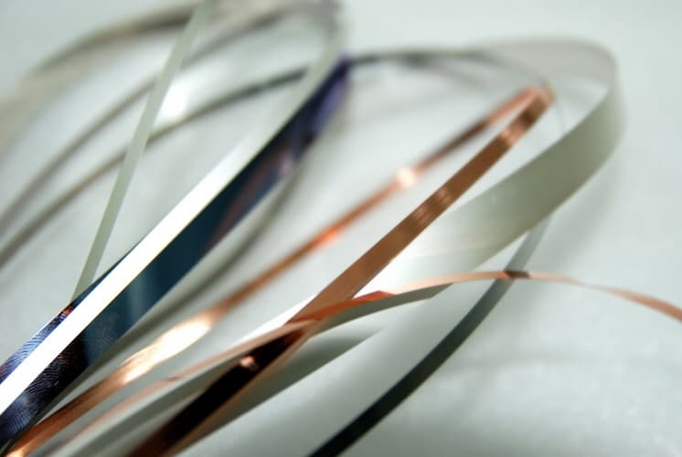
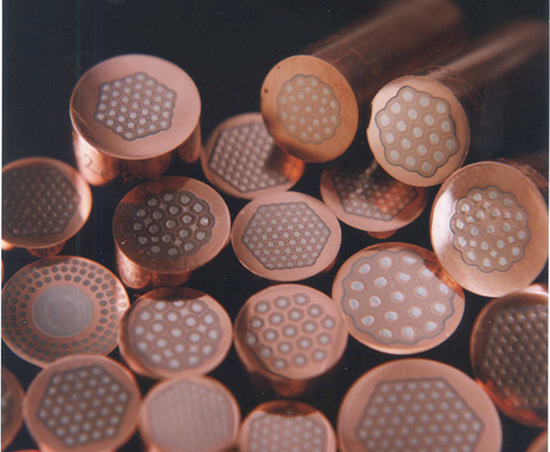
Not only HTS
The path towards a future muon collider implies finding the most effective and quickest means to produce new physics
HTS can lead to premium collider performance in many ways (field, margin, energy efficiency, sustainability)
Present TRL is low, typically 3 to 5
Other solutions are possible, using LTS and resistive magnets, at sub-optimal performance
Present TRL is high, typically 5 to 7
Priority R&D, deserving focussed effort to explore feasibility and limits
LTS and resistive magnet designs will be “sketched” as part of the study
The final choice will depend on the physics opportunity

Slide 9















The team
Task 1
Technical Coordination and Integration
Task 2
Target, Capture and Cooling Magnets
Magnet Systems
Task 3
Fast Cycled Accelerator Magnets
Task 4
Collider Ring Magnets

Slide 10
The plan (MuCol)
Deliverables
  D7.1 – January 2026: Preliminary report on muon collider magnets
  D7.2 – January 2027: Consolidated report on muon collider complex magnets
Milestones
  June 2023: Technology options review
  Spring 2024: Workshop on radiation effects in HTS
  M7.1 – March 2024: Report on solenoids and TPL experiments
  M7.2 – March 2025: Report on RCS and HCS configurations
  M7.3 – October 2025: Workshop on ultra-high-field solenoids
  M7.4 – December 2025: Report on HTS fast-cycled magnets
  M7.5 – January 2026: Report on high-field collider magnet design
  M7.6 – February 2026: Report on solenoid conceptual design
  M7.7 – September 2026: Workshop on high-field collider magnets
  M7.8 – November 2026: Report on footprint, power and cost model
  M7.9– November 2026: Report on R&D and impact

Slide 11
Four HTS magnets challenges
Ultra-high field solenoids (from 40 T up to 60 T)
  Material science in high field
  NMR and life sciences
  Muon collider (muon beam cooling)
High field/large bore solenoids (up to 20 T, 1 m bore)
  Fusion
  Muon collider (muon beam production)
  Hybrid (SC/NC) high field magnets
High field/low consumption accelerator magnets (up to 20 T, up to 150 mm bore, up to 20 K)
  FCC-hh: 16 T…20 T
  Muon collider (collider ring): 16 T…20 T, 5 W/m
  Low consumption beam line magnets, also medical applications: 1 T…4 T
  Low consumption light source main ring magnets: ≈ 1 T
  Light source super-bends: ≈ 10 T peak, ≈ 1 Tm integral
High field undulators (up to 3 T gap field, 5 mm gap, short period)
  Synchrotron light sources
  Free Electron Lasers

Slide 12
Four HTS magnets challenges
INFRA-2024-TECH
Ultra-high field solenoids (from 40 T up to 60 T)
  Material science in high field
  NMR and life sciences
  Muon collider (muon beam cooling)
High field/large bore solenoids (up to 20 T, 1 m bore)
  Fusion
  Muon collider (muon beam production)
  Hybrid (SC/NC) high field magnets
High field/low consumption accelerator magnets (up to 20 T, up to 150 mm bore, up to 20 K)
  FCC-hh: 16 T…20 T
  Muon collider (collider ring): 16 T…20 T, 5 W/m
  Low consumption beam line magnets, also medical applications: 1 T…4 T
  Low consumption light source main ring magnets: ≈ 1 T
  Light source super-bends: ≈ 10 T peak, ≈ 1 Tm integral
High field undulators (up to 3 T gap field, 5 mm gap, short period)
  Synchrotron light sources
  Free Electron Lasers

Slide 13
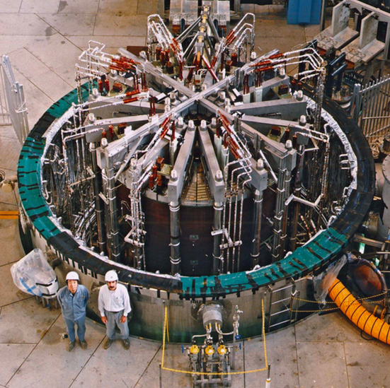
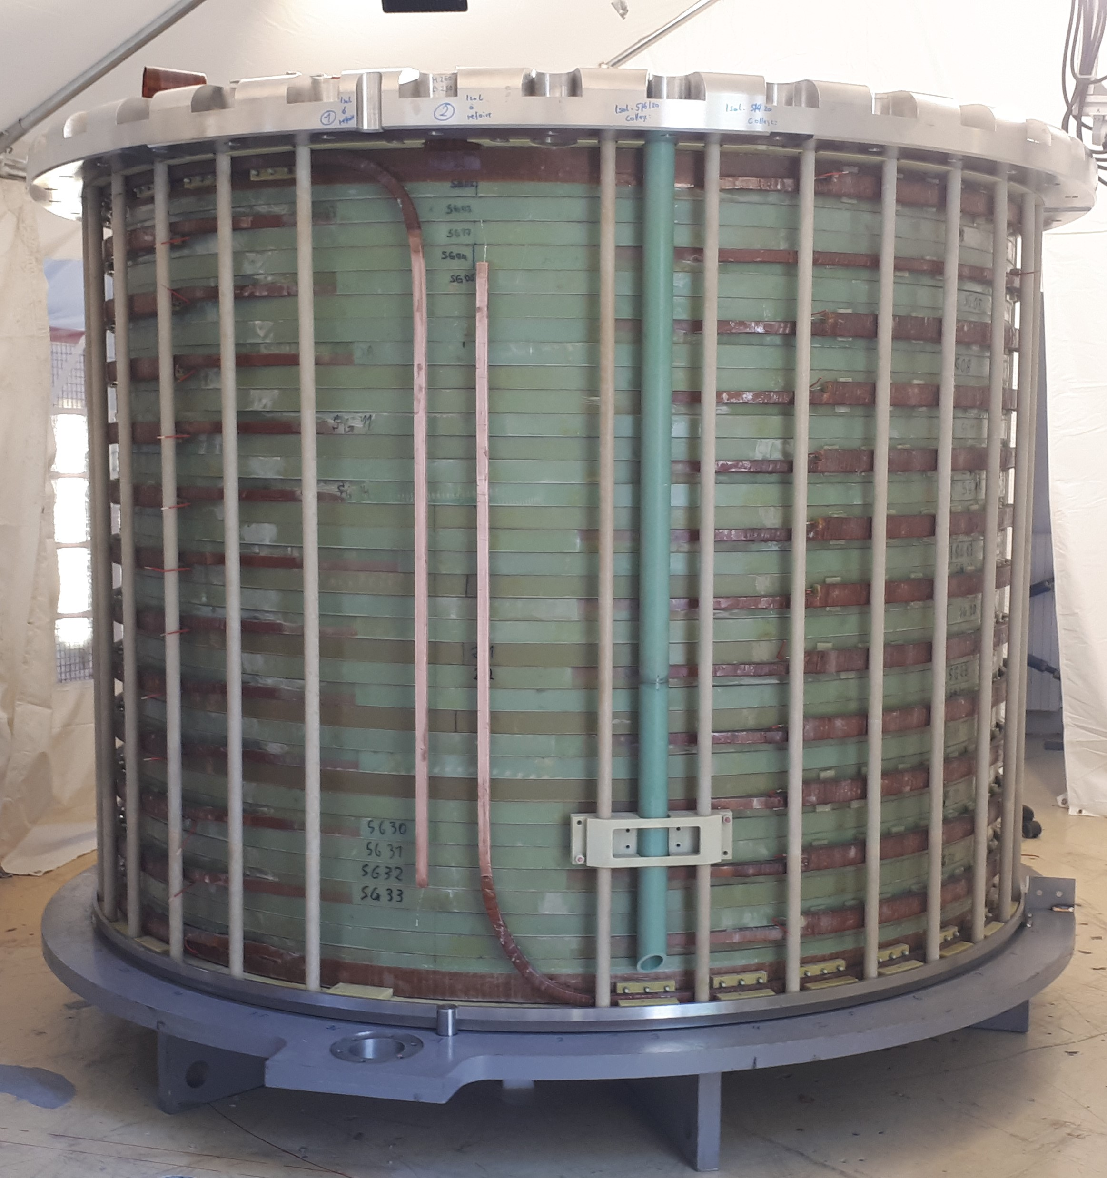
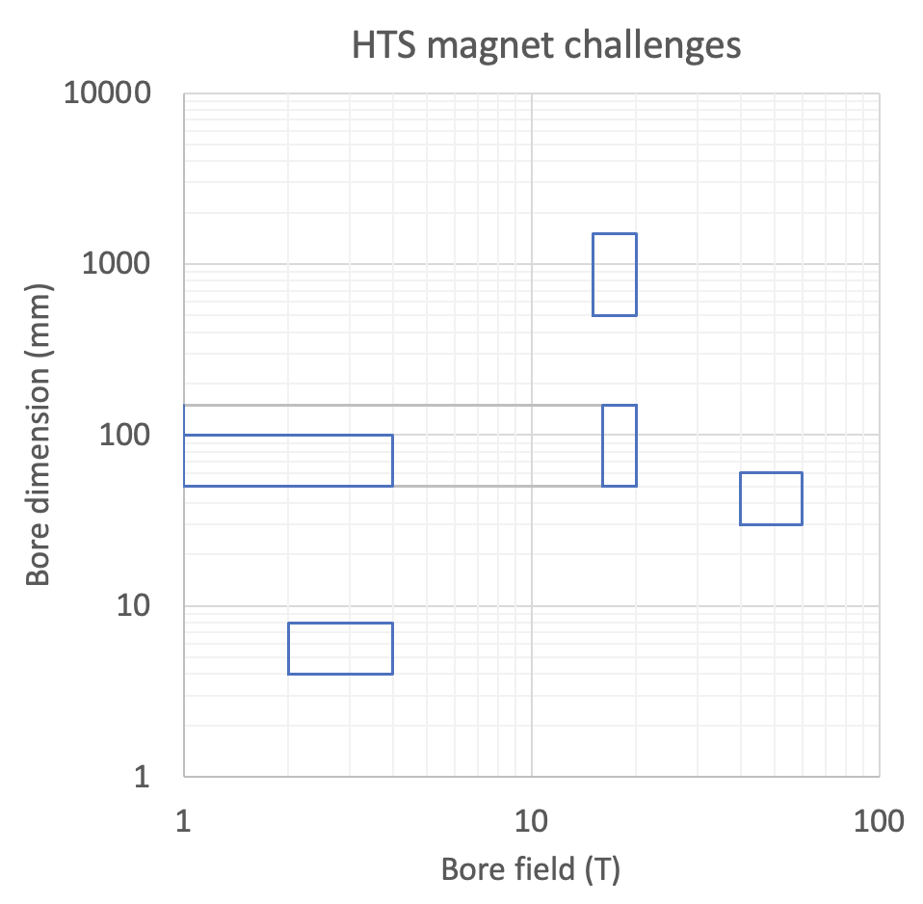
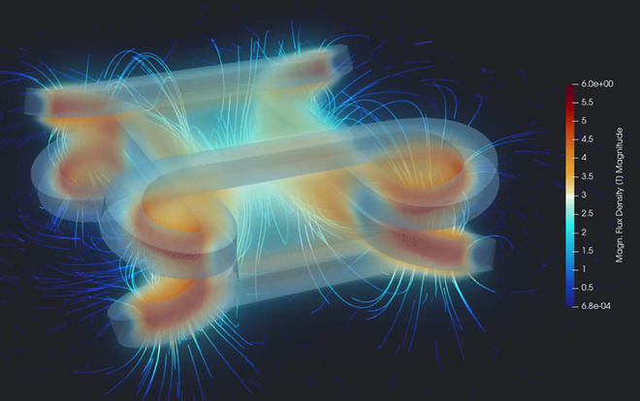
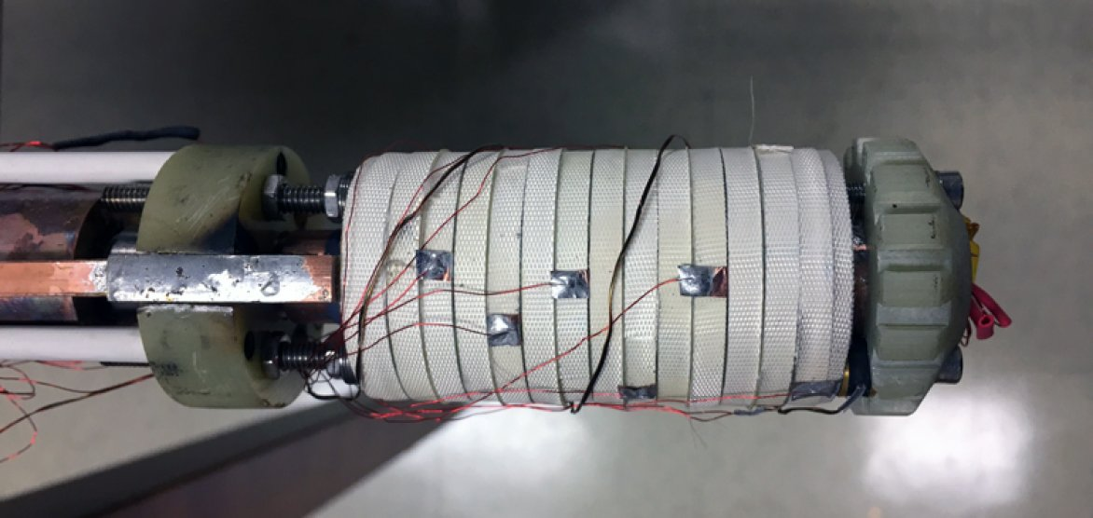
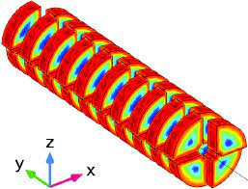
Four HTS magnets challenges
High field and large bore solenoids
Accelerator magnets
UHF solenoids
Wigglers and undulators

Slide 14
Technologies crucial to HTS
Energy efficient and sustainable cryogenic technology
  Cryogenic fluids and cycles for high temperature (20 K)
  Heat management (dry, indirectly cooled, gas cooled,…)
  Minimal cryogen (reduced fluid inventory)
HTS cables and conductors technology
  High current cables and conductors (10…50 kA)
  Cables for DC and ramped (AC) magnets
HTS winding technology,
  3D shapes (non-planar coils)
  Interturn insulation/resistance control
  Joints and terminations
Diagnostics, sensors and control technology
  Quench detection and quench protection (voltage, other techniques…)
  Field control (field shaking, field feedback)
Radiation properties and radiation hardness
  HTS superconductors
  Insulators

Slide 15
Energy Efficient Cryogenics
HTS Winding
Diagnostics and Controls
HTS Cables and Conductors
Radiation Hardness
Ultra-High Field Solenoids
Large Bore High Field Solenoids
Accelerator Magnets
Undulators and Wigglers

Slide 16
Demonstrators (ideas)
Application specific engineering design, construction and test of demonstrators. Options:
  Demonstration towards an all-superconducting user facility for ultra-high field: 40 T, 50 mm bore HTS solenoid insert for test at EMFL (LNCMI) [exploit synergy with SuperEMFL]
  Standalone background field for laboratory testing or as instrument in a beam line: 20 T, 50 mm bore, possibly split (?) all-HTS compact solenoid
  Demonstration of large-scale magnet technology: 20 T, 1 m bore, gas-cooled HTS solenoid model coil (or insert)
  New EU test station, beyond FRESCA, SULTAN and EDIPO: 20 T, 100 mm x 150 mm bore, 1 m long background field dipole operating with minimal cryogen and/or at temperature higher than liquid helium
  Small period undulator beyond the state of the art: 3 T gap field, 8 mm period, 5 mm gap HTS demonstrator for next generation synchrotron light sources and FEL

Slide 17
UHF HTS solenoids – now !
Progression of technology demonstrations
  Tape tests in “standard” and “reverse” force situation to test delamination strength (B_{max} ≈ 20 T, JBR ≈ 500 MPa)
  Sub-size and full-size pancakes, tested as single pancakes and stacked pancakes (B_{max} ≈ 25 T, JBR ≈ 700 MPa)
  Test of selected winding variants in 20 T/120 mm background field at LNCMI, targeting field levels of B_{max} 40 T
First order of HTS tape is in prepation (6 to 9 km of 4 mm REBCO tape) in synergy with HFM
4-20-1-1
Sub-size
12-20-1-1
4-60-1-1
Full-size
12-60-1-1

Slide 18
20 T HTS model coil – idea
A 20 T, 1m bore solenoid is of interest to fusion, i.e. the central solenoid of a current driven tokamak
A possible plan towards a 20 T model coil would require
  Conductor development and testing in background field
  Insert coil manufacturing and testing in a large bore background field
  Model coil manufacturing and testing as standalone magnet. This could become a new test facility for fusion magnet R&D and qualification
CSMC at JAEA, Naka(J)
Some 500…1000 km of tape would be required for such a program. This represents the present production capacity of a single manufacturer
The evolution of HTS cost is favorable, present cost of HTS is about twice that of HEP-grade Nb₃Sn

Slide 19
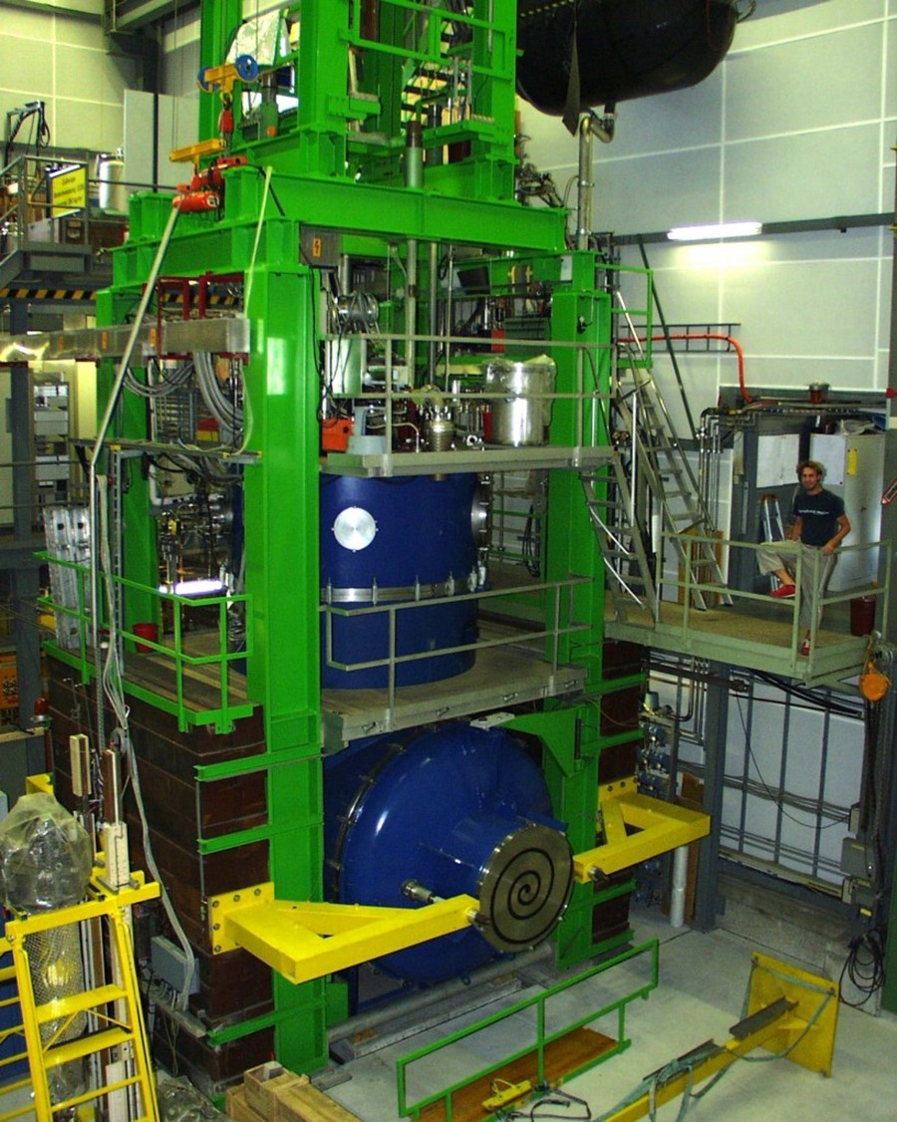
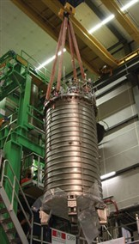
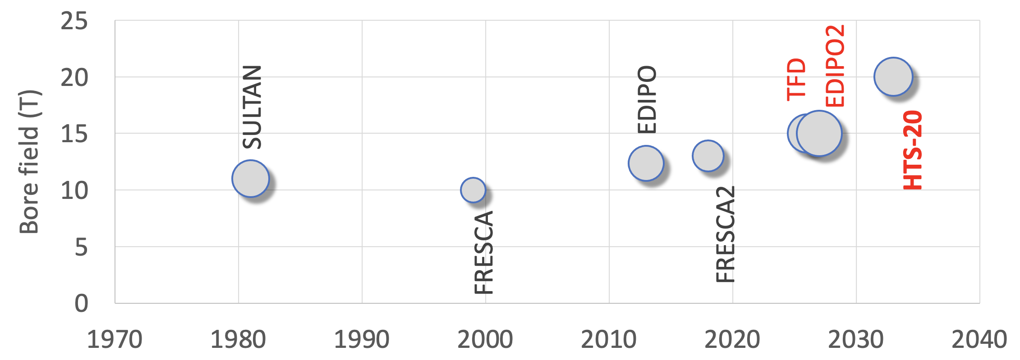
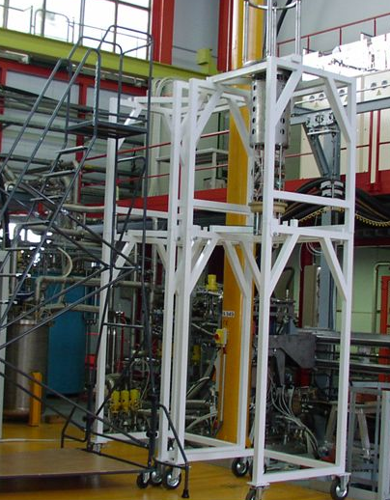
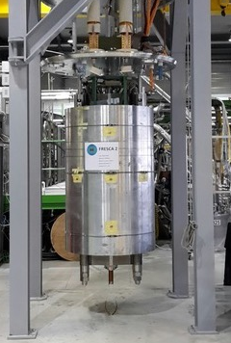
HTS-20 dipole test facility - idea
A 20 T dipole with ≈ 100mm x 150mm bore built with HTS would be the natural next step for cable testing for the future of both HEP and fusion

Slide 20
Potential partners
ESFRI - CERN and associated laboratories (INFN, CEA, CIEMAT)
ESFRI - EMFL laboratories (LNCMI, HLD, HFML)
ESFRI - Synchrotron light sources ESRF and FEL facilities EUXFEL and associated laboratories (PSI)
ESFRI - GSI/FAIR for low consumption super-ferric magnets (TBC)
ESFRI - ESS for neutron scattering experiments (TBC)
Fusion associated partners (TBC)
Industrial partners: discussion necessary to clarify the (mandatory !) participation mechanism

Slide 21
Packaging – 3
WP1 - Management, communication and strategy (roadmap)
WP2 - Materials
2.1 HTS cables and conductors
2.2 Radiation effects
WP3 - Technologies
3.1 Cryogenics
WP4 - Applications
3.2 Coils and winding
3.3 Diagnostics and controls
4.1 Energy, efficiency and sustainability
4.3 Medical applications
4.4 High field science and NMR
4.2 HEP applications
WP6 - Test infrastructures
4.5 High field/short period undulators
WP5 - Demonstrators
5.1 Technology demonstrator 1
5.2 Technology demonstrator 2

Slide 23
HTS for accelerators
 |  | Specification | Target
Minimum J_{non-Cu} (4.2 K, 20 T) | (A/mm²) | 1500 | 3000
Minimum J_{non-Cu} (20 K, 20 T) | (A/mm²) | 600 | 1250
σ(I_{C}) | (%) | 10 | 5
Minimum copper RRR | (-) |  | 20
Minimum Unit Length (UL) | (m) | 200 | 500
Minimum bending radius | (mm) | 15 | 10
Allowable σ_{longitudinal non-Cu} | (MPa) | 800 | 1000
Allowable compressive σ_{transverse} | (MPa) |  | 400
Allowable tensile σ_{transverse} | (MPa) |  | 25
Allowable shear τ_{transverse} | (MPa) |  | 20
Allowable peel σ_{peel} | (MPa) |  | TBD
Allowable cleavage σ_{cleavage} | (MPa) |  | TBD
Range of allowable ε_{longitudinal} | (%) | -0.1…0.4 | -0.1…+0.5
Internal specific resistance ρ_{transverse} | (nΩ/cm²) |  | 20
Width: 4…12 mm
Substrate (non-magnetic alloy): 40…60 μm
Copper stabilizer (total): 20…40 μm
Total tape thickness: 60…100 μm

Slide 24
Muon Collider magnet “specs”
Accelerator magnets
Field: ±1.8 T (NC), < 10 T (SC)
Rate: 400 Hz (NC), SS (SC)
Bore: 100 mm(H) x 30 mm(V)
Length: 3 m … 5 m (x 1500)
Radiation heat: ≈ 3 W/m
Radiation dose: TBD
Target solenoids
Field: 20 T… 2T
Bore: 1200 mm
Length: 18 m
Radiation heat: ≈ 4.1 kW
Radiation dose: 80 MGy
6D Cooling solenoids
Field: 4 T … 19 T
Bore: 90 mm … 600 mm
Length: 1 km (x 2)
Radiation heat: TBD
Radiation dose: TBD
RCS
Final Cooling solenoids
Field: > 40 T (ideally 60 T)
Bore: 50 mm
Length: ≈ 500 mm (x 17)
Radiation heat: TBD
Radiation dose: TBD
Collider ring magnets
Field: 16 T peak (IR 20 T)
Bore: 150 mm
Length: 10 m … 15 m (x 700)
Radiation heat load: ≈ 5 W/m
Radiation dose: ≈ 20…40 MGy

Slide 25
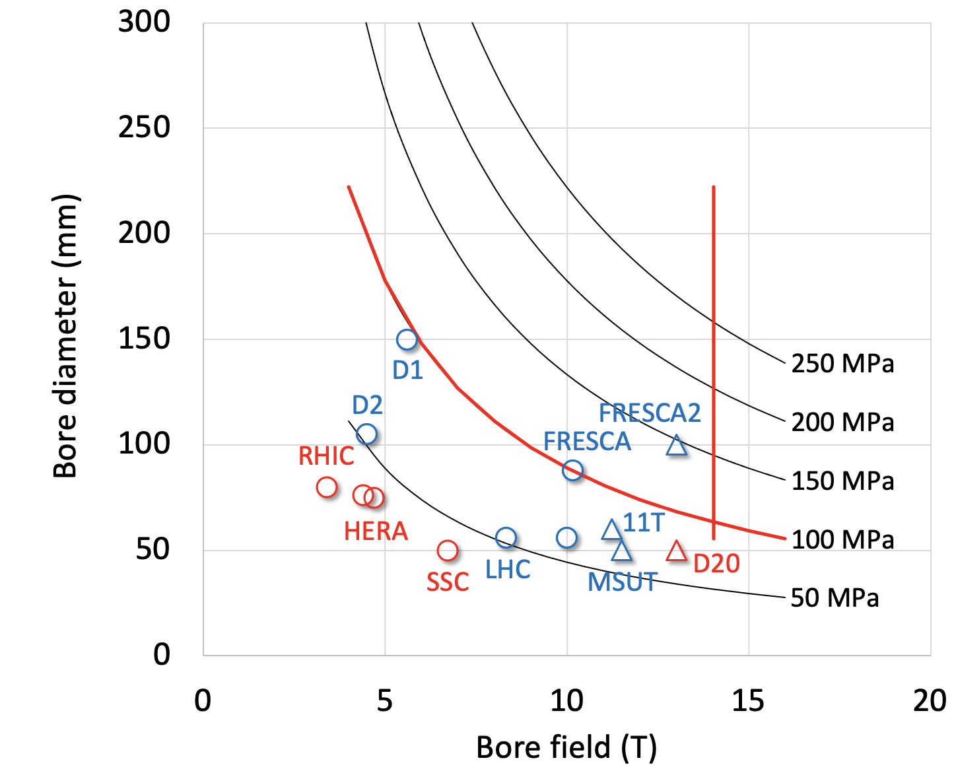
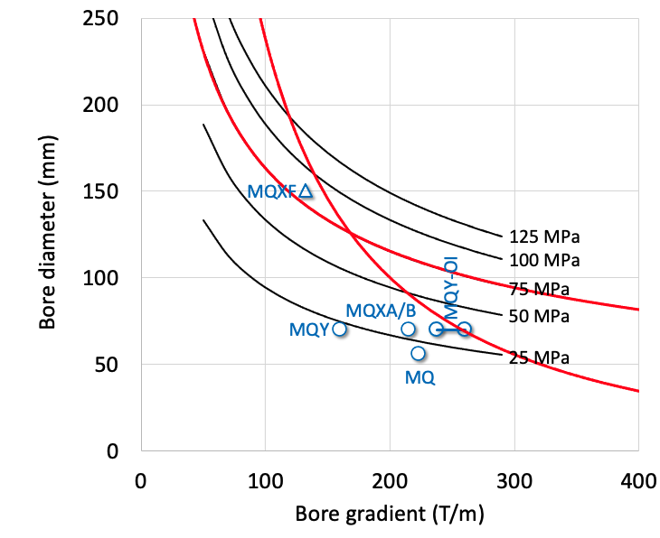
Collider magnets limits (Nb₃Sn)
Stress limit
Margin limit
Stress limit
Margin limit
Dipoles
Quadrupoles
Work in progress to provide analytical expression for the magnet design limits (including protection and cost)
  Maximum field and gradient vs. magnet aperture in LTS and HTS
  Combined function limits B+G and B/G
Proposal: take provisionally 9 T for NbTi and 14 T for Nb₃Sn

Slide 26
The call
Research and Innovation Action
Total budget estimate: 62 MEUR
EU contribution per proposal: 5…10 MEUR
Eligibility: Consortia must include at least 3 different research infrastructures, each of them being an ESFRI infrastructure, and/or a European Research Infrastructures Consortium (ERIC) or another research infrastructure of European interest

Slide 27
Expected outcome
Enhanced scientific competitiveness of European research infrastructures;
Enhanced RI capacities to address research challenges and EU policy priorities;
Foundations for the development of innovative companies;
Increased collaboration of research infrastructures with universities, research organisations and industry;
Increase of the technological level of industries through the co-development of advanced technologies for research infrastructures and creation of potential new markets;
Integration of research infrastructures into local, regional and global innovation systems and promotion of entrepreneurial culture.

Slide 28
Scope
The aim of this topic is to deliver innovative scientific instrumentation, tools, methods and solutions which advance the state-of-art of RIs in the EU and Associated Countries, and show transformative potential in RIs operation. The related developments, which underpin the provision of improved and advanced services, should lead research infrastructures to support new areas of research and/or a wider community of users, including industrial users.
Cutting-edge technologies will also enhance the potential of RIs to contribute addressing EU policy objectives and socio-economic challenges.
Proposals should ensure complementarity with actions funded under the previous 2022 call (topic HORIZON-INFRA-2022-TECH-01-01 in the 2021-2022 work programme), targeting different instrumentation, tools, methods and solutions.
Proposals should address the following aspects, as relevant:
  Research and development of new scientific instrumentation, tools and methods for research infrastructures taking into due account resource efficiency (e.g. energy consumption) and environmental (including climate-related) impacts. This could also include the development of new, more sustainable and efficient methods of collecting data and/or of providing access, including remote and digital, as well as digitalisation of instrumentation, services and results;
  their technology validation and prototyping;
  training of RI staff for the operation and use of these new solutions. When relevant,
  developing skills on technical validation to industrial standards;
  the innovative potential for industrial exploitation of the solutions and/or for the benefits of the society, including facilitating proof of concept for use by SMEs.

